Slide 1
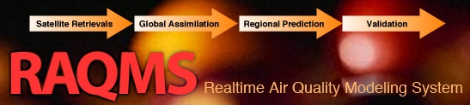
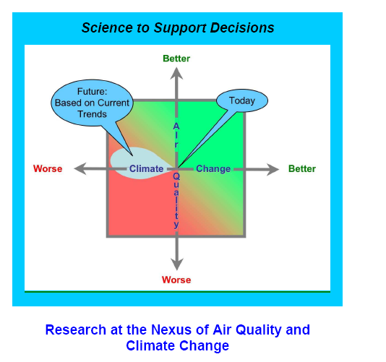
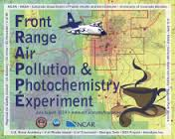

Development of National Air Quality Forecasting Capabilities:
Combining models, satellite, and insitu measurements during airborne field campaigns
Brad Pierce (NOAA/NESDIS)
UW-Madison Environmental Studies Introduction to Air Quality (ES401), October 20, 2015

Slide 2

Who I am
Work at the NOAA National Environmental Satellite, Data, and Information Service (NESDIS) as an atmospheric scientist to support the NOAA Air Quality Program
  Reside at the Cooperative Institute for Meteorological Satellite Studies (CIMSS) at UW-Madison, which hosts the NESDIS Advanced Satellite Products Branch (ASPB)
  Collaborate with NOAA, NASA, US EPA and State and local Air Quality Management (NOAA Air Quality Research Program, NASA Air Quality Applied Science Team, GOES-R Alogrithm Working Group, etc..)
  Use Real-time Air Quality Modeling System (RAQMS) to support Air Quality field missions and develop capabilities for air quality forecasting (TEXAQS, CalNex, ARCPAC, SENEX, FRAPPE/DISCOVER-AQ, SONGNEX)

Slide 3






How did I get here?
2015 – NOAA Scientist at CIMSS working with the EPA (and Wisconsin DNR, Texas TCEQ, Colorado CDPHE, California, CARB, Maryland DEQ, etc..)
1978 – Undergraduate at UW-River Falls wanted to work EPA

Slide 4
The NOAA Air Quality research program has traditionally focused on field experiments
Regional forecast model development and evaluation is driven by comparisons with in-situ composition measurements from airborne platforms and surface monitoring
Data collected during field missions is used to support State and Local Air Quality management
NOAA Air Quality Research Program (from Steve Fine, NOAA/OAR)

Slide 5
Recent NOAA Air Quality field experiments have focused understanding issues at the nexus of air quality and climate change
Assess the fidelity of global and regional air quality and climate model predictions
Provide scientific information regarding the tradeoffs faced by decision makers when addressing these two inter-related issues.

Slide 6
Online global chemical and aerosol assimilation/forecasting system
Modeling Framework:
UW-Madison hybrid θ−η coordinate model (UW-Hybrid) dynamical core
Unified stratosphere/troposphere chemical prediction scheme developed at NASA LaRC
Aerosol prediction scheme (GOCART) developed by Mian Chin (NASA GSFC).
Real-time assimilation:
Microwave Limb Sounder (MLS) stratospheric ozone profiles (above 50mb)
Ozone Monitoring Instrument (OMI) total ozone column (cloud cleared)
Moderate Resolution Imaging Spectroradiometer (MODIS) Aerosol Optical Depth (AOD)
Real-time fire detection:
Moderate Resolution Imaging Spectroradiometer (MODIS)
(http://raqms-ops.ssec.wisc.edu/)
Notes:
6

Slide 7
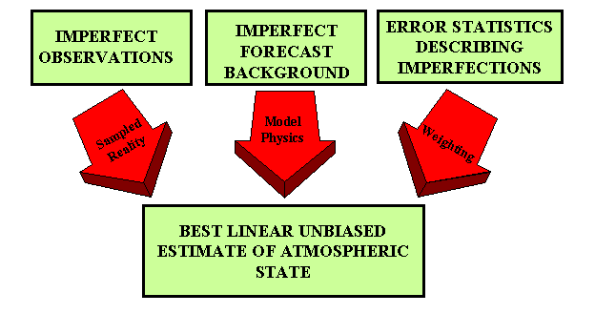

Analysis/Forecast Cycle
Current observations are combined with previous knowledge (first guess) to produce a forecast of the weather
Observations
Model
Forecast
Increment:
OBS-FX
Analysis
FX IC
Statistical
Blending

Slide 8
Two different Air Quality Field Missions
2010 NOAA California Research at the Nexus of Air Quality and Climate Change (CalNex, http://www.esrl.noaa.gov/csd/projects/calnex/)
2014 NSF Front Range Air Pollution and Photochemistry Éxperiment, and NASA Deriving Information on Surface Conditions from Column and Vertically Resolved Observations Relevant to Air Quality (FRAPPE/DISCOVER-AQ, https://www2.acd.ucar.edu/frappe)

Slide 9
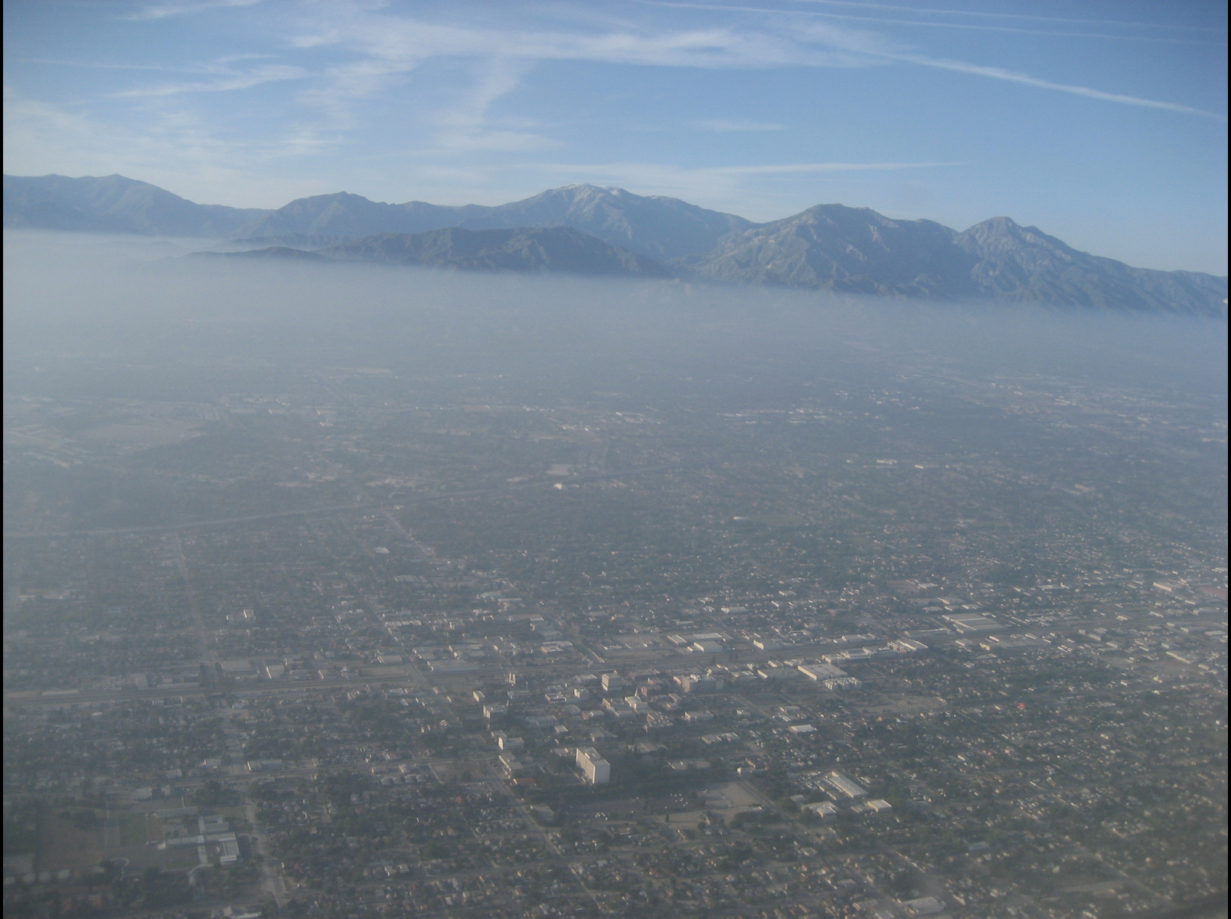
LA Basin as seen from the NOAA P3 during CalNex
CalNex Science Questions
What are the effects of long-range transport on California Air Quality during May-June 2010?
Does assimilation of satellite ozone and aerosol retrievals improve forecasts of intercontinental transport?

Slide 10
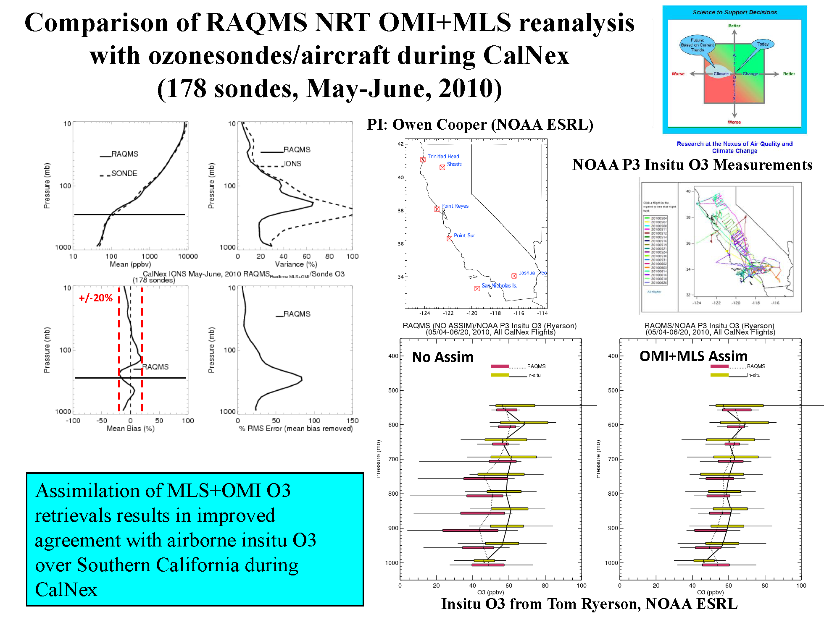

Slide 11
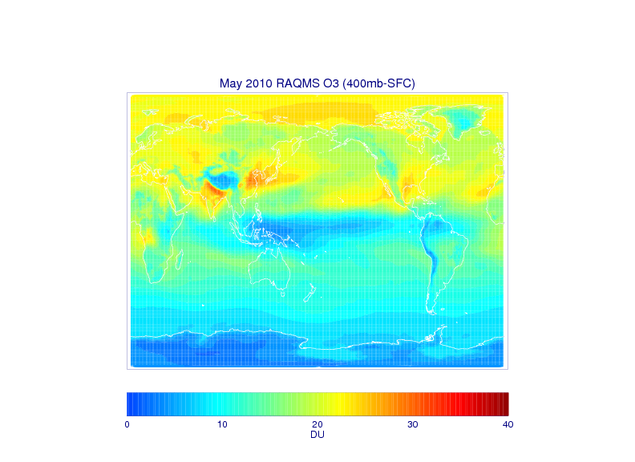
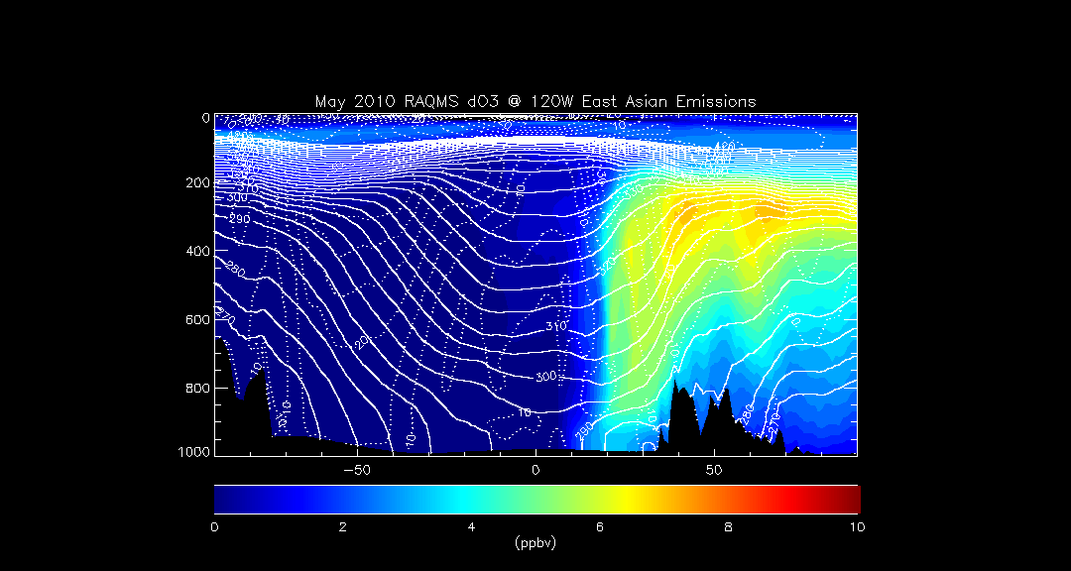
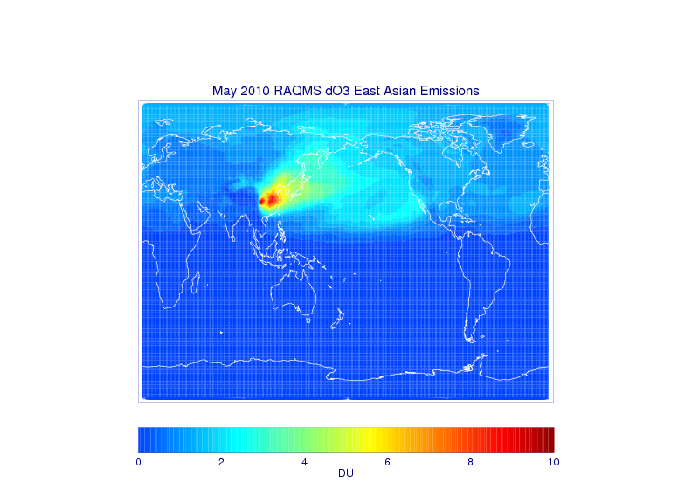
Impacts of East Asian Emissions – May 2010
120W
Impact of East Asian ozone production extends into North America with potential US Air Quality impacts
The Task Force on Hemispheric Transport of Air Pollution (TF HTAP) is an international scientific cooperative effort to improve the understanding of the intercontinental transport of air pollution across the Northern Hemisphere.
Notes:
11

Slide 12
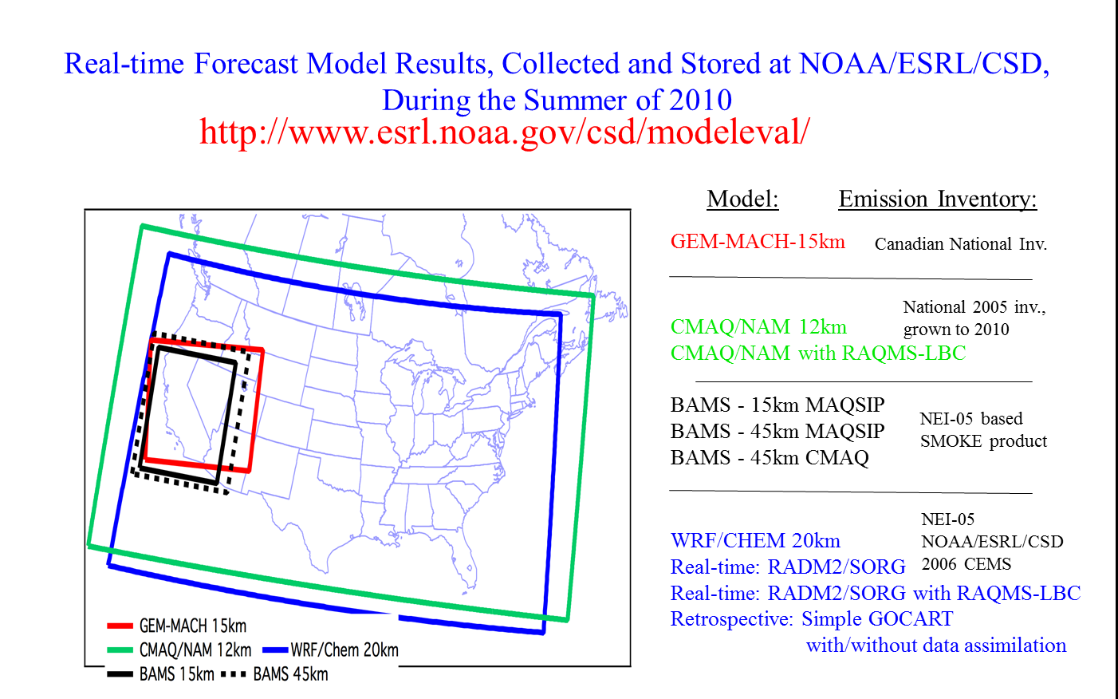
Evaluation of Real-time AQ Model Forecasts during CalNex
Lead by Stu McKeen (NOAA/ESRL)
Regional Air Quality Forecast models:
Georg Grell, Steven Peckham (NOAA/ESRL/GSD) -WRF/Chem
Wanmin Gong, Sylvain Ménard, Hugo Landry (Environment Canada) – GEM-MACH
Youhua Tang and Jeff McQueen (NOAA/NWS) - CMAQ/NAM (CB-05 - experimental in 2010)
John McHenry and Don Olerud (Baron AMS) – BAMS
RAQMS used for O3 and PM2.5 lateral boundary conditions (LBC) in NWS CMAQ/NAM and ESRL WRF/Chem
From Stu McKeen (NOAA/ESRL) AGU Annual Meeting, San Francisco CA, December, 2010

Slide 13
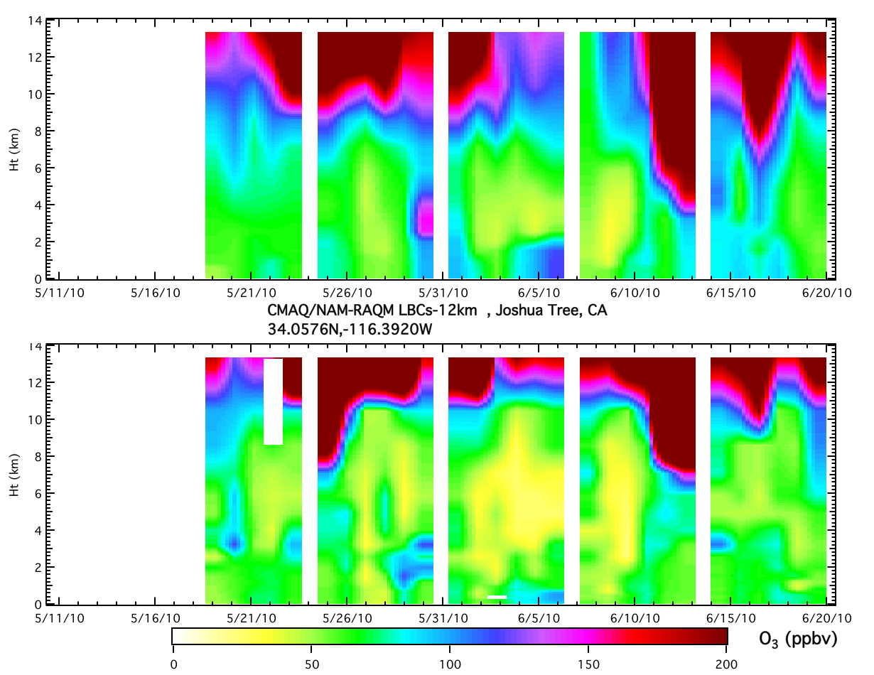
CMAQ/RAQM-LBCs at Joshua Tree
Model
NAM-CMAQ does not resolve sharp gradient in ozone at tropopause resulting in higher ozone in free troposphere
Obs.
From Stu McKeen (NOAA/ESRL) AGU Annual Meeting, San Francisco CA, December, 2010

Slide 14
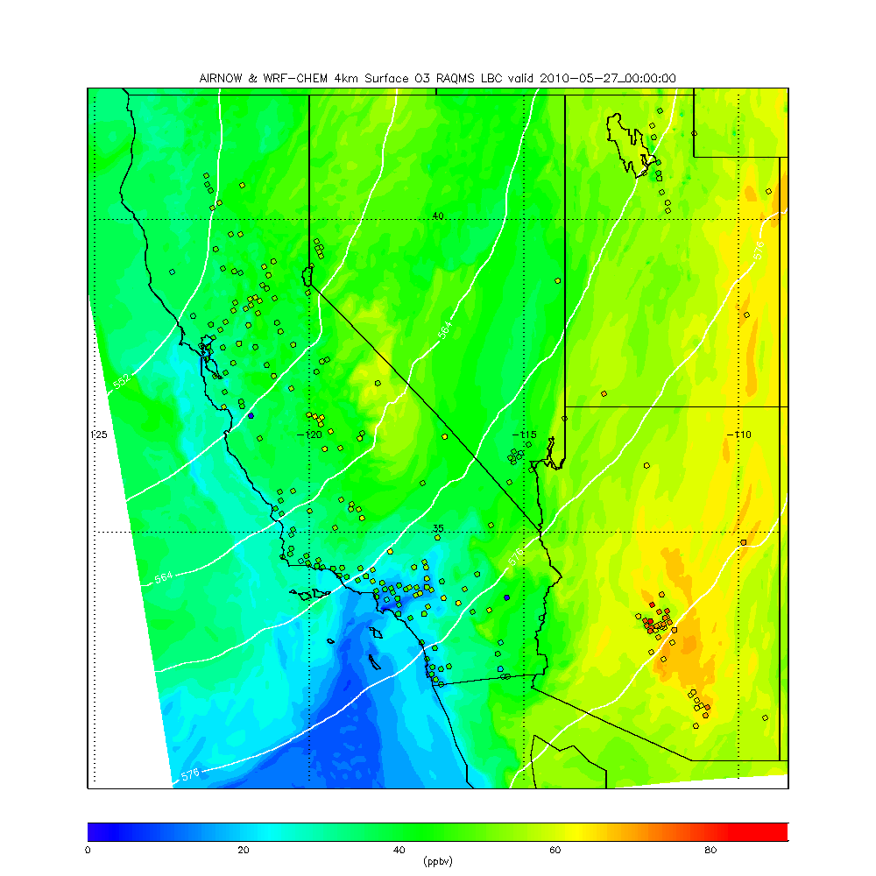
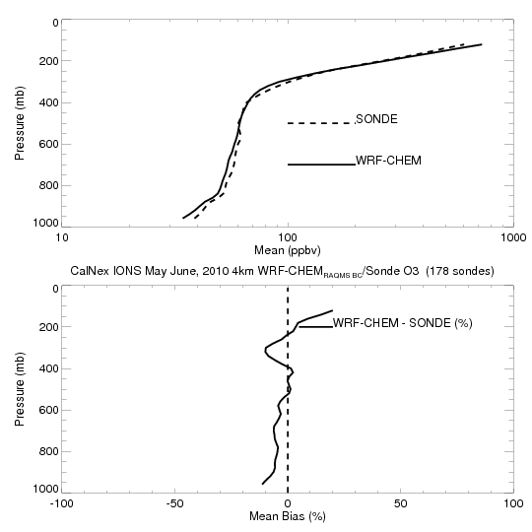
Retrospective 4km WRF-CHEM CalNex forecasts
(RAQMS 1x1 MLS+OMI ozone analyses)
WRF-CHEM does resolve sharp gradient in ozone at tropopause resulting in very small (<10%) biases in free tropospheric ozone

Slide 15
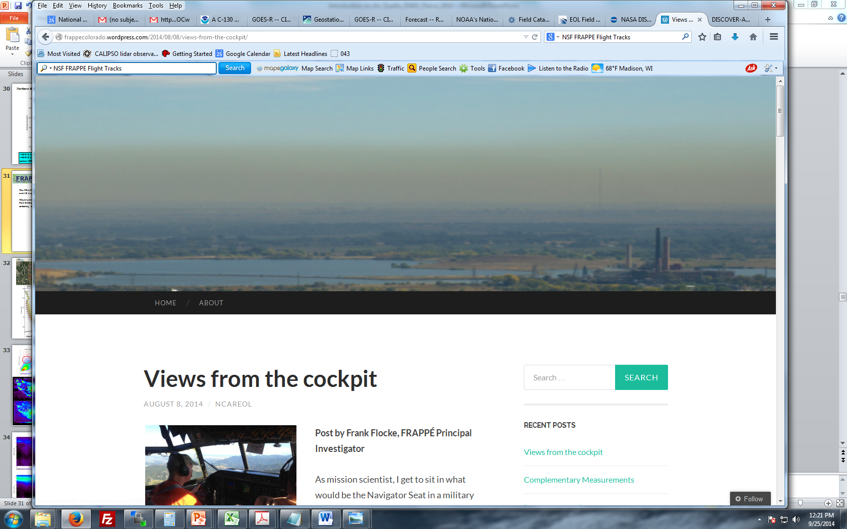
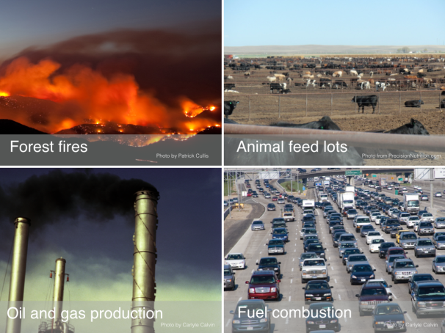
The FRAPPE and DISCOVER-AQ field campaigns took place between 16 July and 18 August 2014 over northern Colorado and were designed to investigate and quantify all factors contributing to air quality in the Colorado Front Range with a special focus on summertime ozone pollution.
Smoke layer over Colorado Front range as seen from the NCAR C130 during FRAPPE

Slide 16
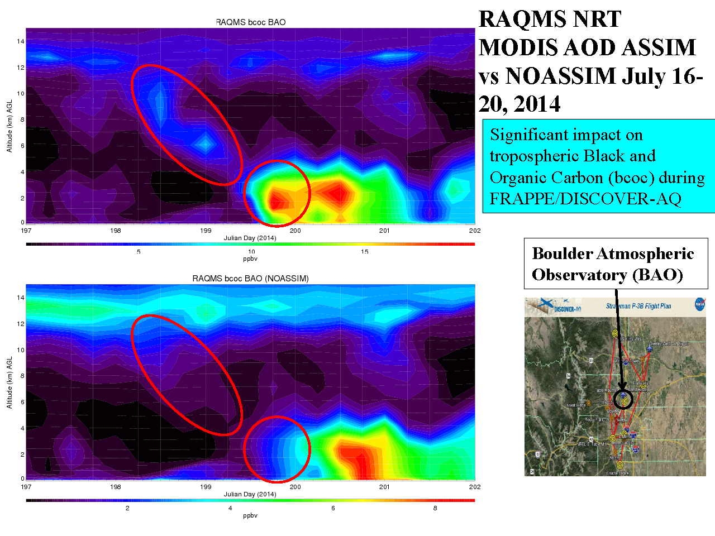
RAQMS Smoke prediction (with MODIS AOD Assimilation)
RAQMS Smoke prediction (no MODIS AOD Assimilation)

Slide 17
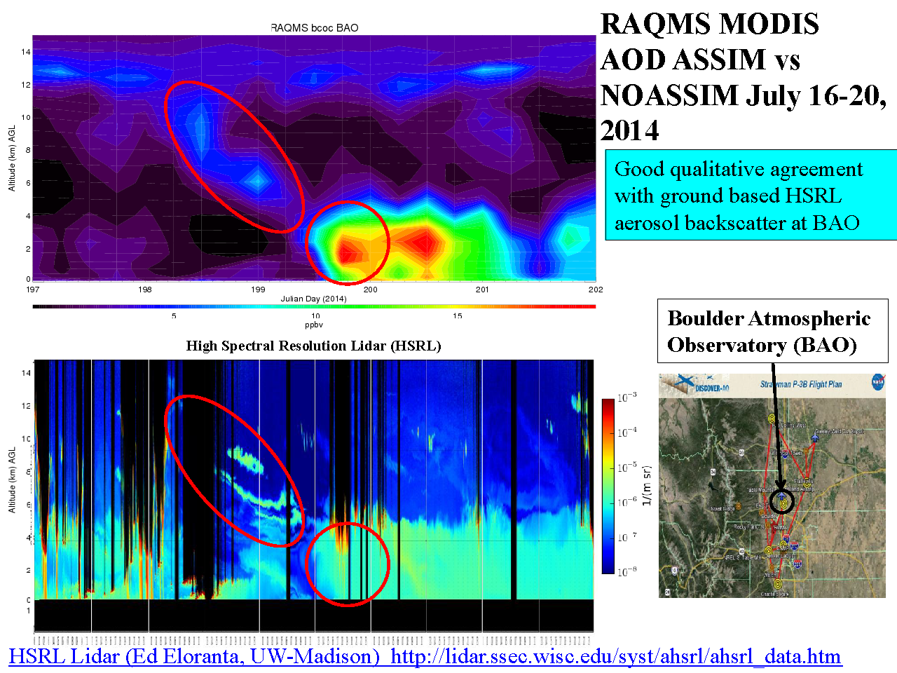
RAQMS Smoke prediction (with MODIS AOD Assimilation)

Slide 18
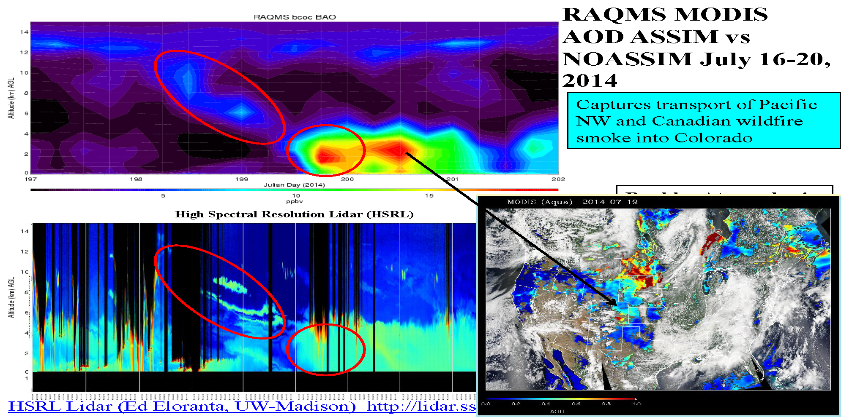
RAQMS Smoke prediction (with MODIS AOD Assimilation)

Slide 19
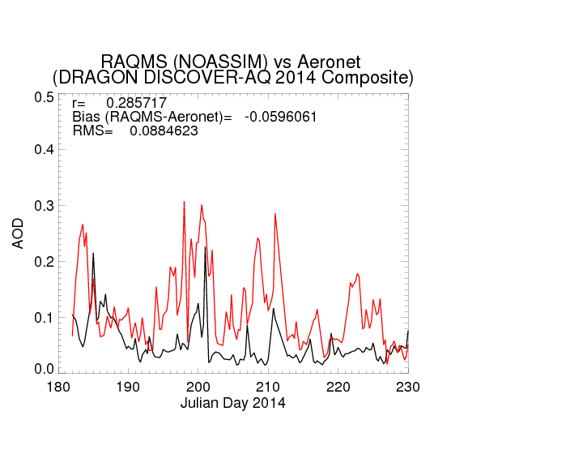
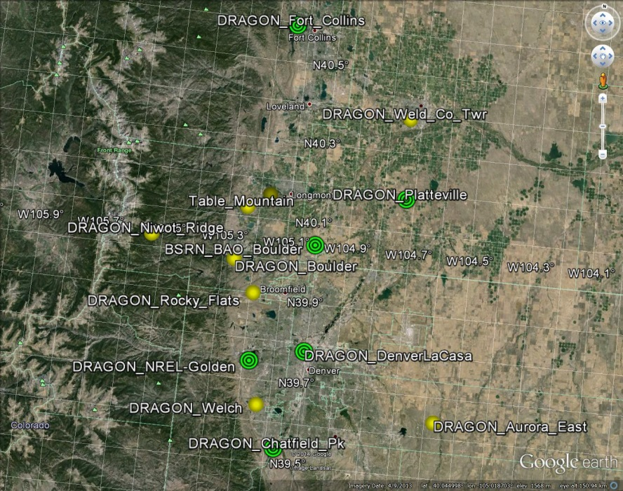
Distributed Regional Aerosol Gridded Observation Networks (DRAGON)-USA
2014 Colorado Front Range Urban Corridor
July 16-20
DRAGON
RAQMS
(DRAGON-USA, Brent Holben, NASA/GSFC)
http://aeronet.gsfc.nasa.gov/new_web/DRAGON-USA_2014_Colorado.html

Slide 20
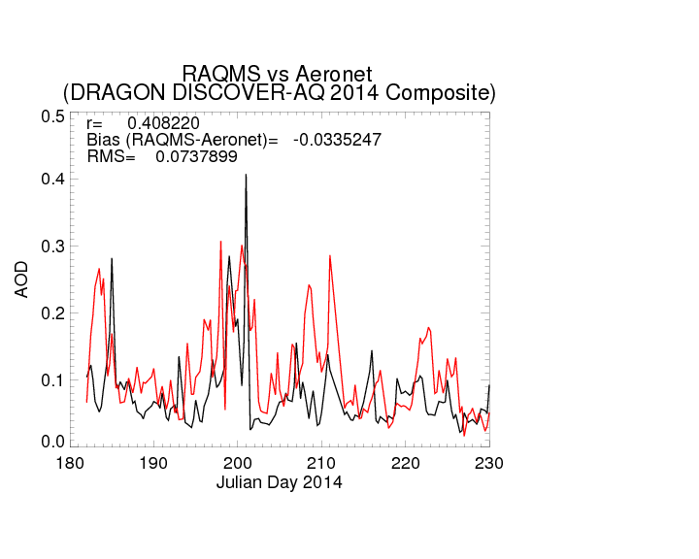
Distributed Regional Aerosol Gridded Observation Networks (DRAGON)-USA
2014 Colorado Front Range Urban Corridor
July 16-20
DRAGON
RAQMS
(DRAGON-USA, Brent Holben, NASA/GSFC)
http://aeronet.gsfc.nasa.gov/new_web/DRAGON-USA_2014_Colorado.html

Slide 21
NOAA Earth System Research Laboratory (ESRL)
Real-time Air Quality Forecasts
Rapid Refresh with Chemistry
Real time forecasts predicting weather and air quality
The forecast model based on the Weather Research and Forecasting (WRF) coupled with chemistry via the RACM chemical mechanism including MOSAIC/VBS for better prediction of secondary organic aerosols (SOA).
In addition, the forecasts include:
MEGAN biogenic emissions,
NEI and RETRO/EDGAR anthropogenic emissions,
Chemical deposition,
Convective and turbulent chemical transport,
Photolysis,
Advective chemical transport performed simultaneously with the meteorology ("online"),
Lateral chemical boundary conditions obtained from RAQMS model real time forecasts.
http://ruc.noaa.gov/wrf/WG11_RT/

Slide 22
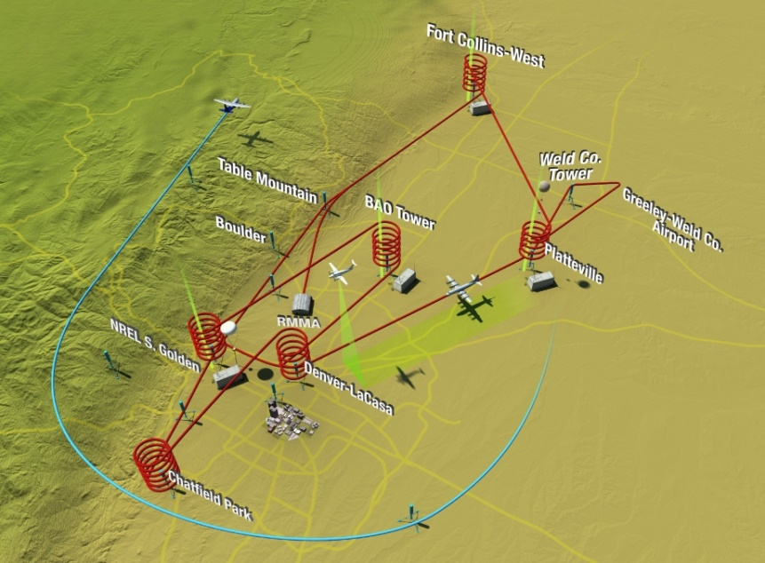
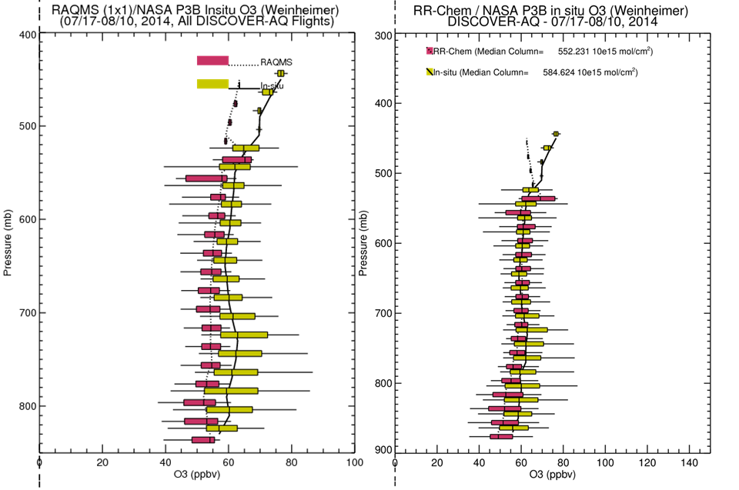
RAQMS/RR-Chem Real-time forecasts during the 2014 FRAPPE/DISCOVER-AQ mission
Nested RAQMS/RR-Chem forecasts show reduced biases and improved variability compared to airborne insitu measurements between 700-500mb.
However, biases are similar (15-20 ppbv) below 700mb and neither model captures the upper 90% of the observed ozone
Reduced bias

Slide 23
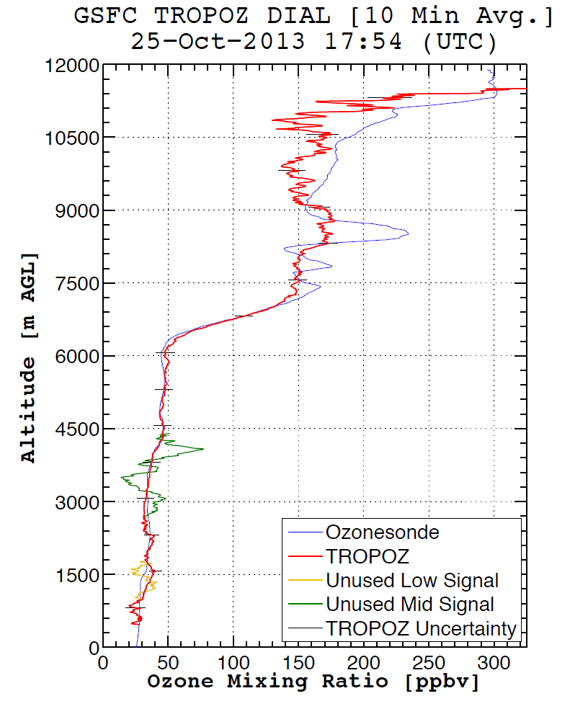
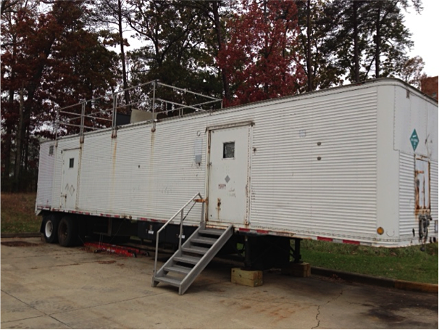
NASA Goddard Space Flight Center TROPospheric OZone DIfferential Absorption Lidar (GSFC TROPOZ DIAL)
(Thomas McGee, GSFC and John Sullivan UMBC)

Slide 24
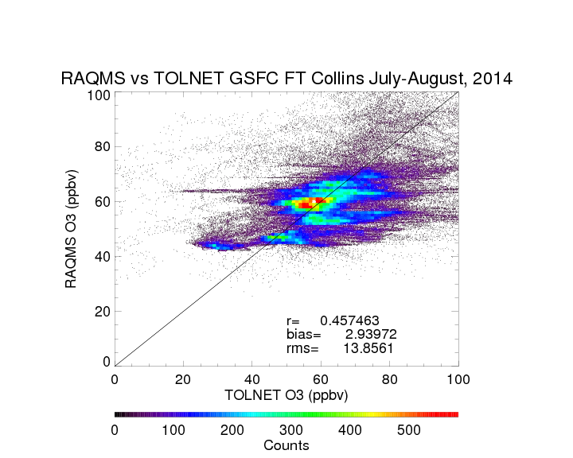

Slide 25
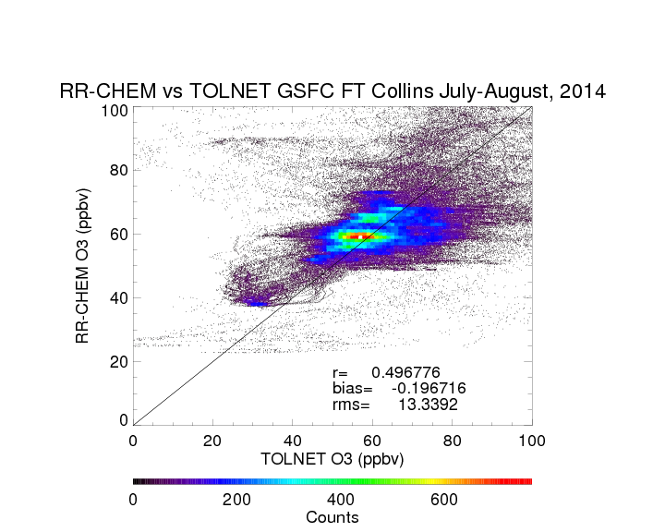
RR-CHEM shows improved correlation, reduced bias, and similar RMS errors compared to 1 degree RAQMS analysis

Slide 26
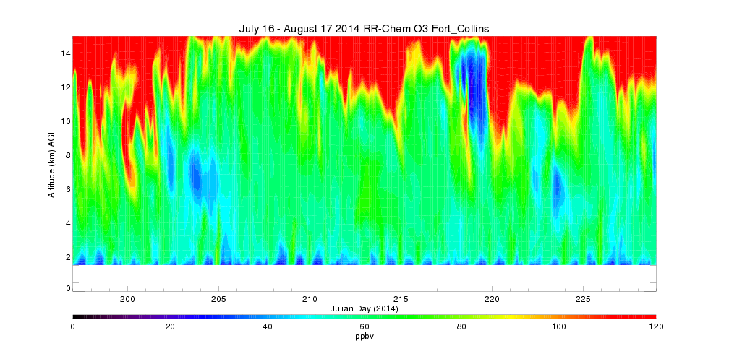
July 16 – August 17, 2014 RR-Chem Ozone timeseries
(Fort Collins, CO)

Slide 27
July 16 – August 17, 2014 RR-Chem Ozone timeseries
(Fort Collins, CO)
August 6: STE
John T. Sullivan et al., 2015, under review, JGR

Slide 28
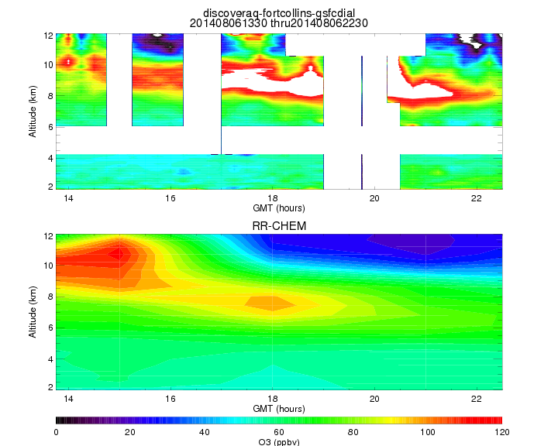
August 06, 2014 TROPOZ and RR-Chem Ozone timeseries
(Fort Collins, CO)
RR-CHEM captures altitude of STE and low ozone tropical air aloft but underestimates the ozone mixing ratio within the STE

Slide 29
July 16 – August 17, 2014 RR-Chem Ozone timeseries
(Fort Collins, CO)
August 9: CONUS PBL
August 6: STE

Slide 30
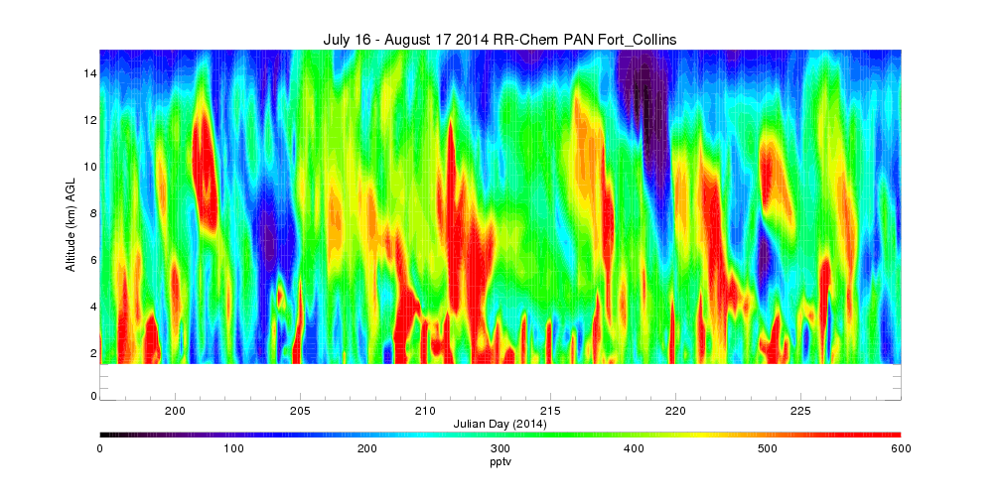
July 16 – August 17, 2014 RR-Chem PAN timeseries
(Fort Collins, CO)
August 9: CONUS PBL
August 6: STE
NOx, CO, CH4 and Volatile organic Compounds (VOC) are ozone precursors. Transport of longer lived NOx reservoirs such as Peroxyacetyl Nitrate (PAN) can play an important role in perturbing ozone photochemistry in regions remote from direct NOx emissions (Singh et al., 1992)

Slide 31
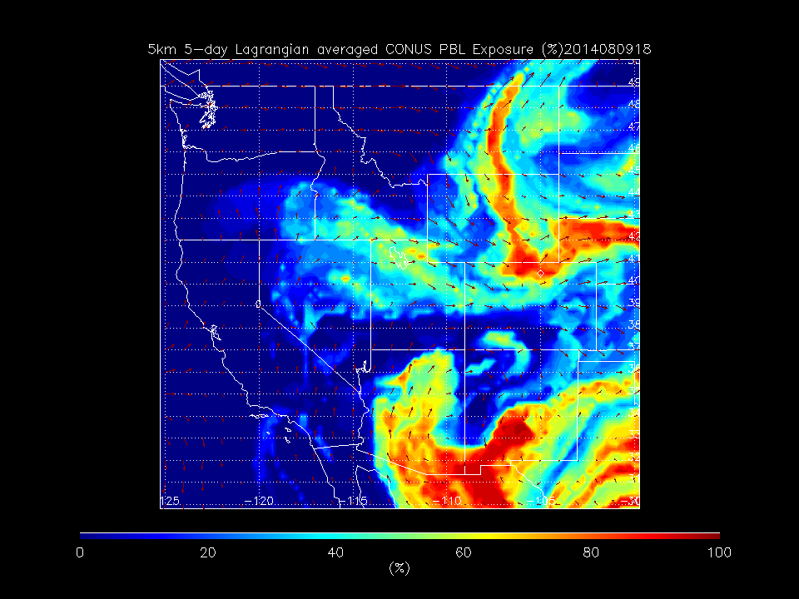
RAQMS Reverse Domain Filling (RDF) show that high PAN airmass over Fort Collins on 08/06 had it’s origins within the Continental US boundary layer
Pierce, R. B. 2008, J. Geophys. Res., 114, D00F09, doi:10.1029/2008JD011337

Slide 32
July 16 – August 17, 2014 RR-Chem PAN timeseries
(Fort Collins, CO)
August 11:East Asian Transport
August 9: CONUS PBL
August 6: STE

Slide 33
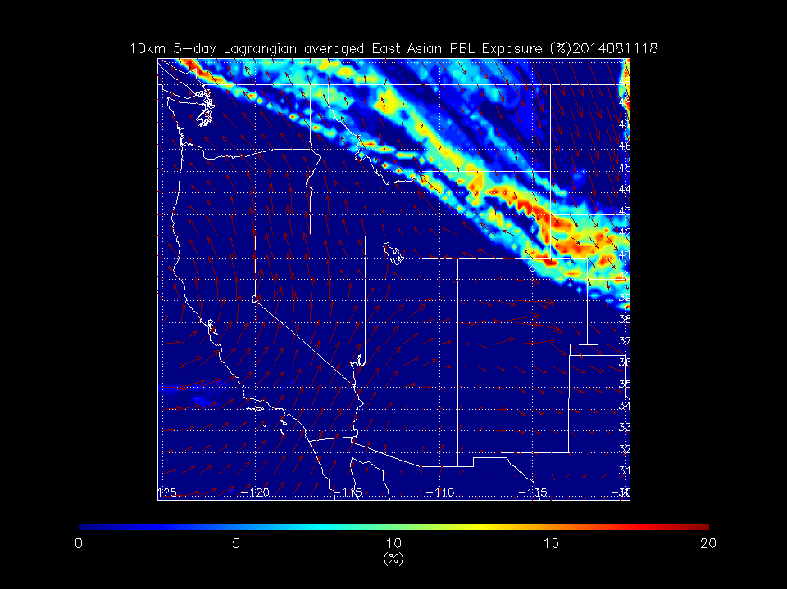
RAQMS RDF shows that high PAN air mass over Fort Collins on 08/11 had it’s origins within the East Asian boundary layer

Slide 34
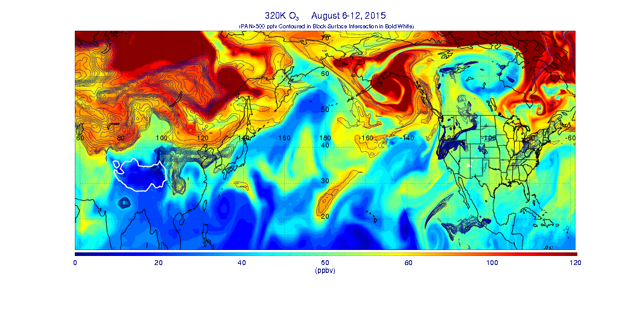
320K Nested RAQMS/RR-CHEM
O3 (colored), PAN (Black contours), Surface intersection, (White)
Discontinuity at LBC due to animation of RAQMS Analysis (forecast used in nesting)

Slide 35
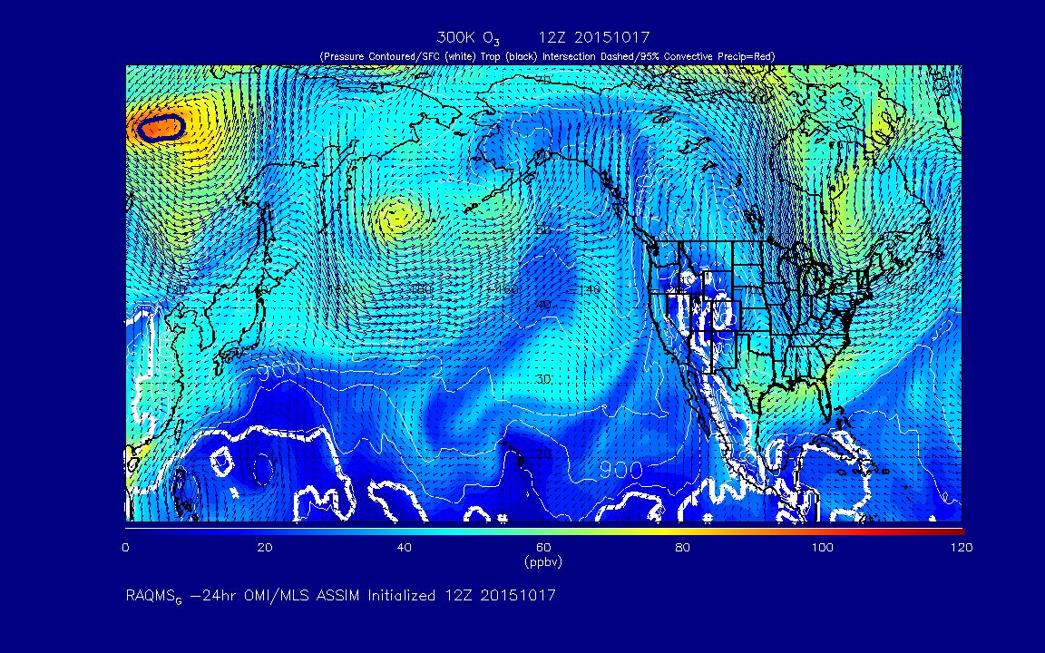
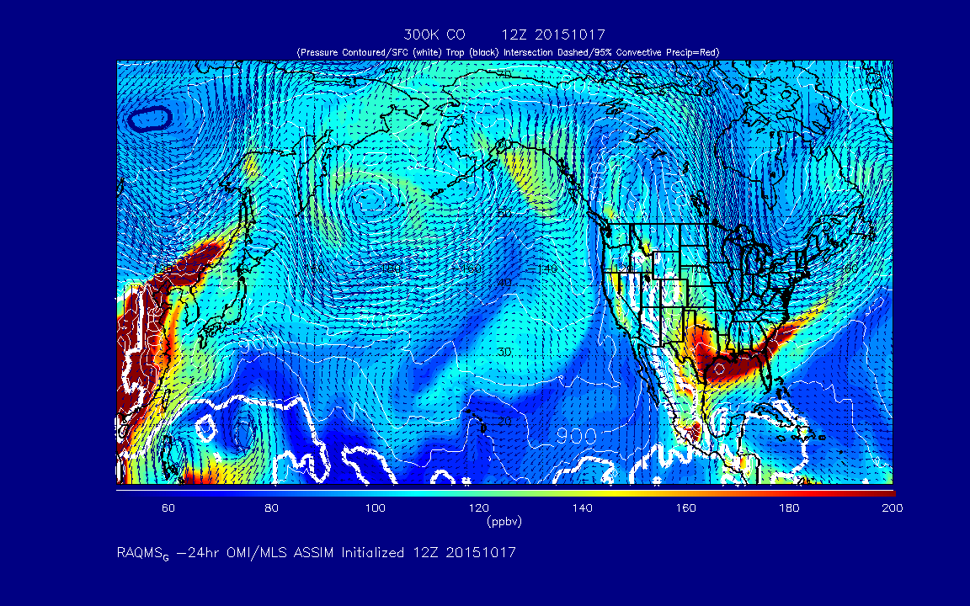
  A path forward towards NOAA operational global/regional real-time trace gas and aerosol assimilation/forecasting
A RAQMS chemical and aerosol re-analysis will be conducted using measurements from the NASA Aura, Aqua, and Terra satellites analysis system (under support from the NASA Applied Science Program)
This Aura analysis can serve as a “proof of concept” for future global operational trace gas and aerosol data assimilation/forecasting at NOAA (following EU GEMS/MACC path)
RAQMS 300K Ozone (O3) and Carbon Monoxide (CO) Forecast
(http://raqms-ops.ssec.wisc.edu/)
http://www.copernicus-atmosphere.eu/services/aqac/

Slide 36
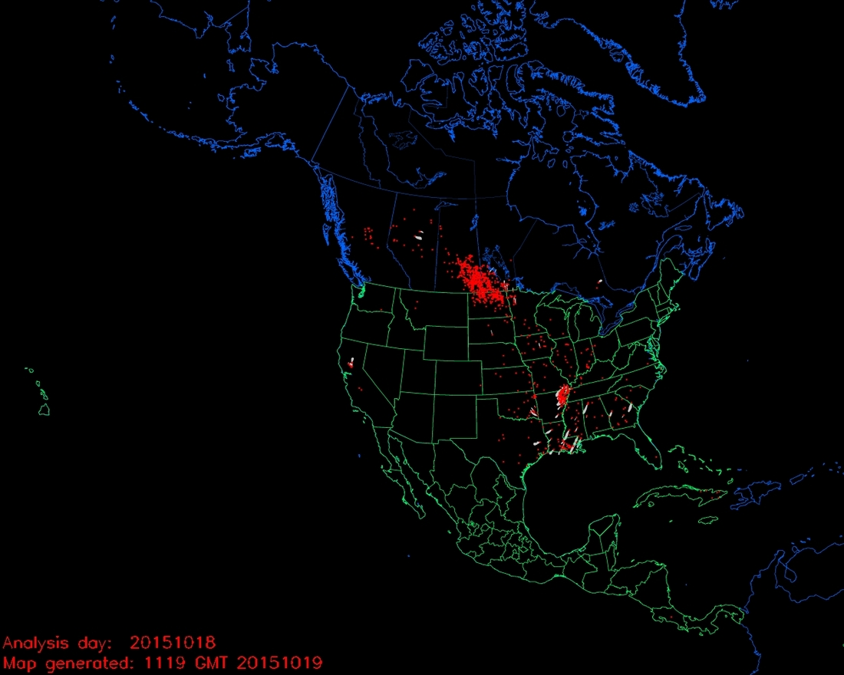
  A path forward towards NOAA operational global/regional real-time trace gas and aerosol assimilation/forecasting
A RAQMS chemical and aerosol re-analysis will be conducted using measurements from the NASA Aura, Aqua, and Terra satellites analysis system (under support from the NASA Applied Science Program)
This Aura analysis can serve as a “proof of concept” for future global operational trace gas and aerosol data assimilation/forecasting at NOAA (following EU GEMS/MACC path)
Hazard Mapping System Fire and Smoke Product
Agricultural Burning
(crop residue)
RAQMS 300K Ozone (O3) and Carbon Monoxide (CO) Forecast
(http://raqms-ops.ssec.wisc.edu/)
http://www.ospo.noaa.gov/Products/land/hms.html
http://www.copernicus-atmosphere.eu/services/aqac/

