Slide 1
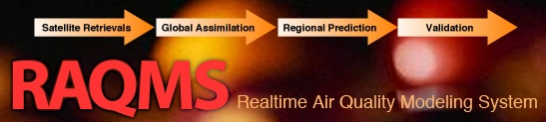
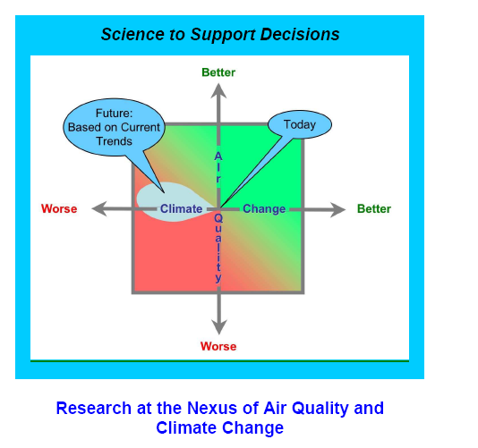
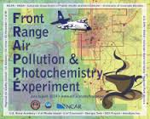


Development of National Air Quality Forecasting Capabilities:
Combining models, satellite, and insitu measurements during Airborne field missions
Brad Pierce (NOAA/NESDIS)
UW-Madison Environmental Studies Introduction to Air Quality (ES401), Sept 25, 2014

Slide 2

Who am I and what am I doing here?
Work at the NOAA National Environmental Satellite, Data, and Information Service (NESDIS) as an atmospheric scientist to support the NOAA Air Quality Program
  Reside at the Cooperative Institute for Meteorological Satellite Studies (CIMSS) at UW-Madison, which hosts the NESDIS Advanced Satellite Products Branch (ASPB)
  Collaborate with NOAA, NASA, US EPA and State and local Air Quality Management (NOAA Air Quality Research Program, NASA Air Quality Applied Science Team, GOES-R Alogrithm Working Group, etc..)
  Use Real-time Air Quality Modeling System (RAQMS) to support Air Quality field missions and develop capabilities for air quality forecasting (TEXAQS, CalNex, ARCPAC, SENEX, FRAPPE/DISCOVER-AQ, field missions are fun!!!)

Slide 3
How did I get here?
Hired at NASA Langley Research Center (1990) as an atmospheric scientist
  Inter Disciplinary Science (IDS) team for the Upper Atmspheric Research (UARS) Satellite program (first part of NASA Earth Observing System program, followed by Terra, Aqua, Aura, A-Train)
  Participation in stratospheric airborne chemistry campaigns focusing on Antarctic and Arctic ozone loss (ASHOE/MAESA, POLARIS, SOLVE, found out that airborne field missions is where all the fun is!!!)
  Transition to tropospheric chemistry and development of chemical data assimilation/forecasting within NASA Applied Sciences Program (support National Air Quality programs, TRACEP, INTEX-A, INTEX-B TEXAQS, more field missions, more fun!!!)
Transferred to NOAA (2007) to work on operational AQ forecasting capabilities
  Development and evaluation of global chemical satellite data assimilation systems for improved lateral boundary conditions for the regional AQ forecasts

Slide 4




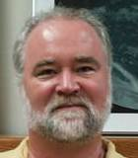

2014 – NOAA Scientist at CIMSS working with the EPA (and Wisconsin DNR, Texas TCEQ, Colorado CDPHE, California, CARB, Maryland DEQ, etc..)
1978 – Undergraduate at UW-River Falls wanted to work EPA

Slide 5
The NOAA Air Quality research program has traditionally focused on field experiments
Regional forecast model development and evaluation is driven by comparisons with in-situ composition measurements from airborne platforms and surface monitoring
Data collected during field missions is used to support State and Local Air Quality management
NOAA Air Quality Research Program (from Steve Fine, NOAA/OAR)

Slide 6
More recent NOAA Air Quality field experiments have focused understanding issues at the nexus of air quality and climate change
Assess the fidelity of global and regional air quality and climate model predictions
Provide scientific information regarding the tradeoffs faced by decision makers when addressing these two inter-related issues.

Slide 7
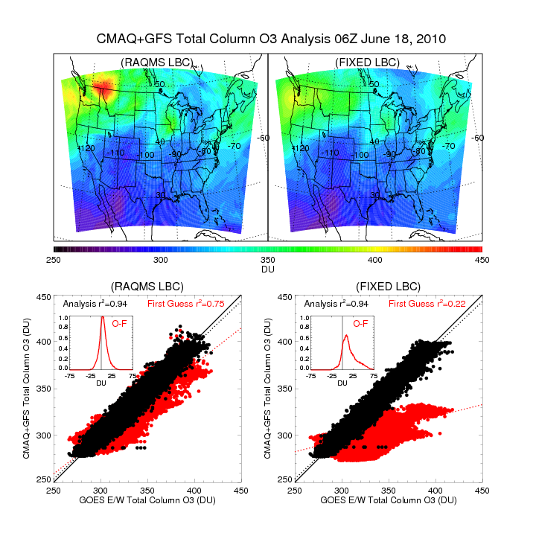
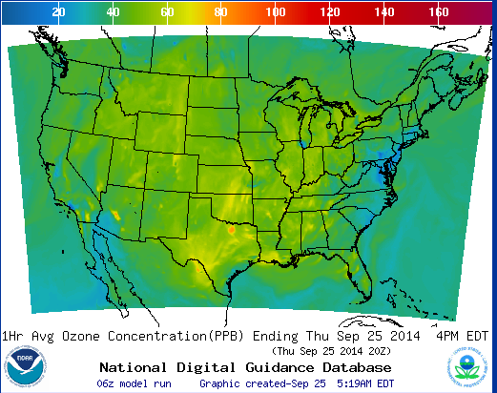
Air quality forecasting and data assimilation
National Weather Service
Air Quality forecast
Joint Center for Satellite Data Assimilation
GOES Total Column Ozone Assimilation
http://airquality.weather.gov/
http://www.jcsda.noaa.gov/

Slide 8
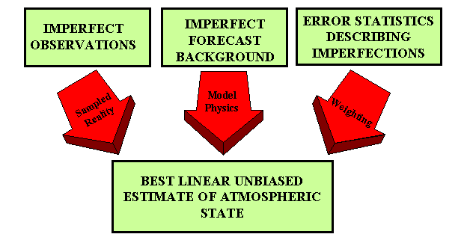

Analysis/Forecast Cycle
Current observations are combined with previous knowledge (first guess) to produce a forecast of the weather
Observations
Model
Forecast
Increment:
OBS-FX
Analysis
FX IC
Statistical
Blending

Slide 9
Online global chemical and aerosol assimilation/forecasting system
Modeling Framework:
UW-Madison hybrid θ−η coordinate model (UW-Hybrid) dynamical core
Unified stratosphere/troposphere chemical prediction scheme developed at NASA LaRC
Aerosol prediction scheme (GOCART) developed by Mian Chin (NASA GSFC).
Real-time assimilation:
Microwave Limb Sounder (MLS) stratospheric ozone profiles (above 50mb)
Ozone Monitoring Instrument (OMI) total ozone column (cloud cleared)
Moderate Resolution Imaging Spectroradiometer (MODIS) Aerosol Optical Depth (AOD)
Real-time fire detection:
Moderate Resolution Imaging Spectroradiometer (MODIS)
Notes:
9

Slide 10
Three different Air Quality Field Missions
2006 NOAA Texas Air Quality Study - Gulf of Mexico Atmospheric Composition and Climate Study (TEXAQS, http://www.esrl.noaa.gov/csd/projects/2006/)
2010 NOAA California Research at the Nexus of Air Quality and Climate Change (CalNex, http://www.esrl.noaa.gov/csd/projects/calnex/)
2014 NSF Front Range Air Pollution and Photochemistry Éxperiment, and NASA Deriving Information on Surface Conditions from Column and Vertically Resolved Observations Relevant to Air Quality (FRAPPE/DISCOVER-AQ, https://www2.acd.ucar.edu/frappe)

Slide 11
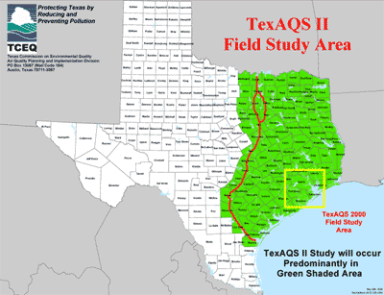
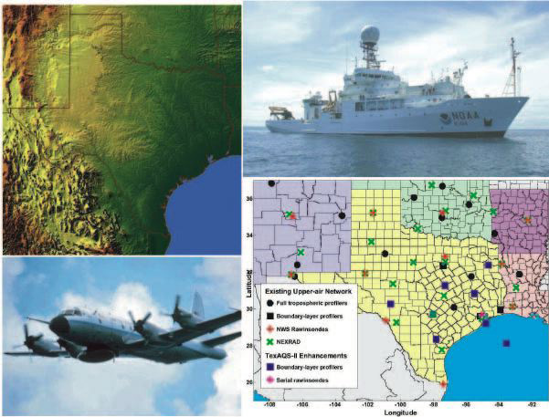
TexAQS / GoMACCS 2006
Texas Air Quality Study - Gulf of Mexico Atmospheric
Composition and Climate Study
Where: East Texas and the Gulf of Mexico
When: August - September 2006
The TexAQS II study provided support Texas Commission on Environmental Quality (TCEQ)
to develop strategies for the new federal eight-hour ozone standard and regional-haze requirements.

Slide 12
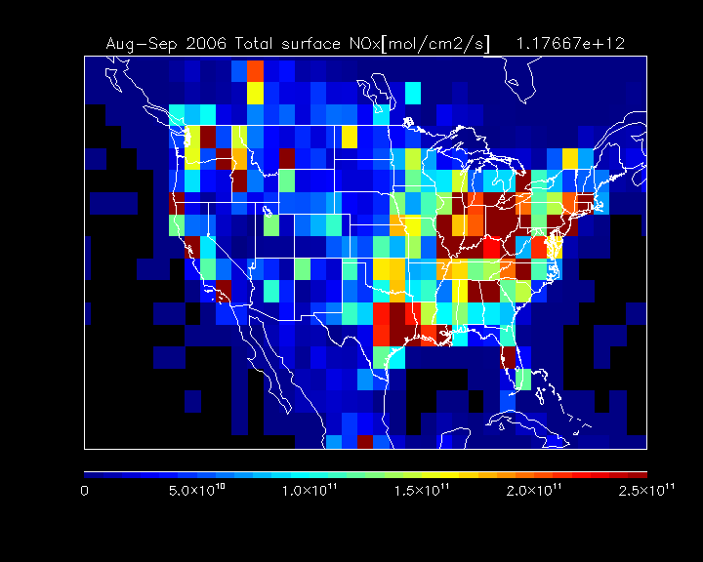
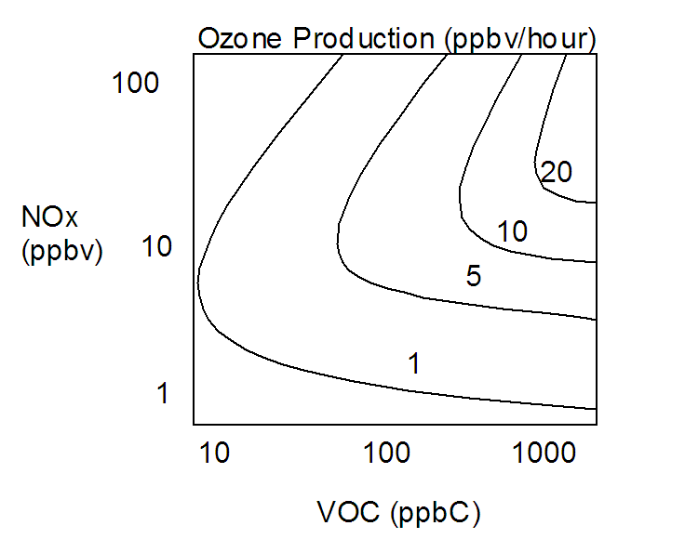
TEXAQS Science Questions
How do emissions from local and distant sources interact to determine the air quality in Texas, and which areas outside of Texas adversely affect the air quality of non-attainment areas within Texas?
RAQMS is used to investigate the impact of continental scale ozone production on Houston and Dallas air quality from July 15 through October 15, 2006.
Ensemble trajectory analysis is used to determine the source regions associated with enhanced regional ozone production for the Houston and Dallas receptor regions.
RAQMS NOx emissions during TEXAQS: Aug-Sep 2006

Slide 13
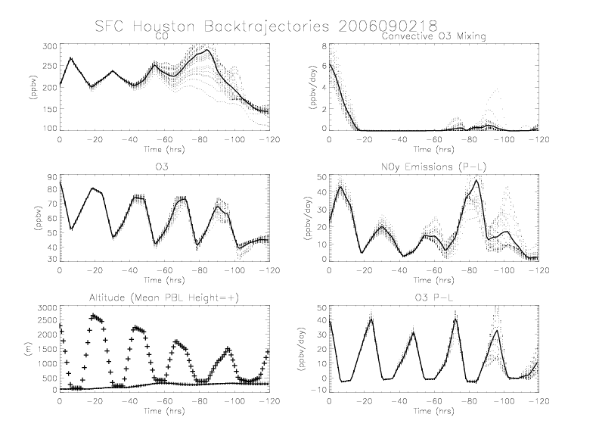
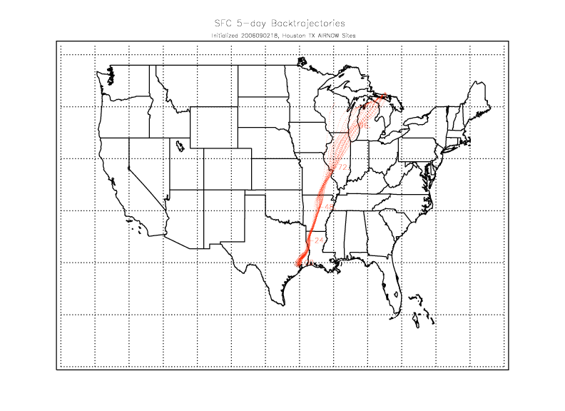
Impacts of background ozone production on Houston, TX
Average O3 Production – Loss (P-L) rates along the back trajectories are used as a metric to classify back trajectories from Houston, TX AIRNow Sites
Pierce, R. B., et al. (2009), Impacts of background ozone production on Houston and Dallas, Texas, air quality during the Second Texas Air Quality Study field mission, J. Geophys. Res., 114, D00F09, doi:10.1029/2008JD011337.

Slide 14
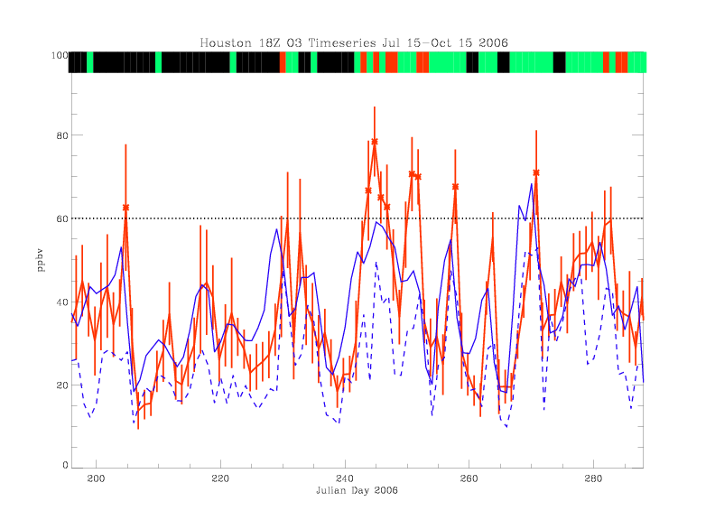
Impacts of background ozone production: Houston July 15-October 15, 2006
Red=AIRNow MSA mean+Std
Blue=RAQMS MSA (solid) Regional (dashed) bias corrected mean
Classifications:
RED=Class1: Enhanced back ground ozone production (ensemble mean 5-day Lagrangian averaged O3 P-L > 10 ppbv/day)
GREEN=Class 2: Moderate back ground ozone production (ensemble mean 5-day Lagrangian averaged O3 P-L > 0 ppbv/day and < 10 ppbv/day).
BLACK=Class 3: Back ground ozone destruction (ensemble mean 5-day Lagrangian averaged O3 P-L < 0 ppbv/day).

Slide 15
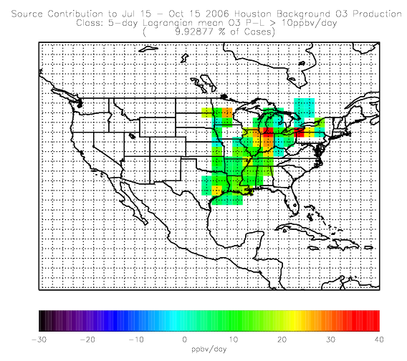
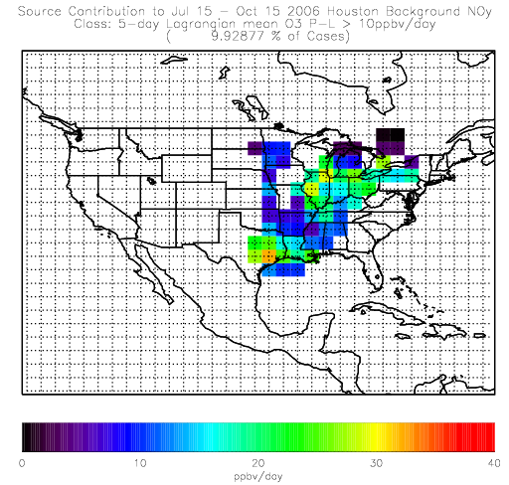
Houston Class 1 Source Contributions July 15-Oct 15, 2006
O3 P-L (ppbv/day)
NOy emissions (ppbv/day)
Class 1➔Midwest/Ohio River Valley source with significant O3 P-L (40ppbv/ day) due to NOx sources along the southern Great Lakes.

Slide 16
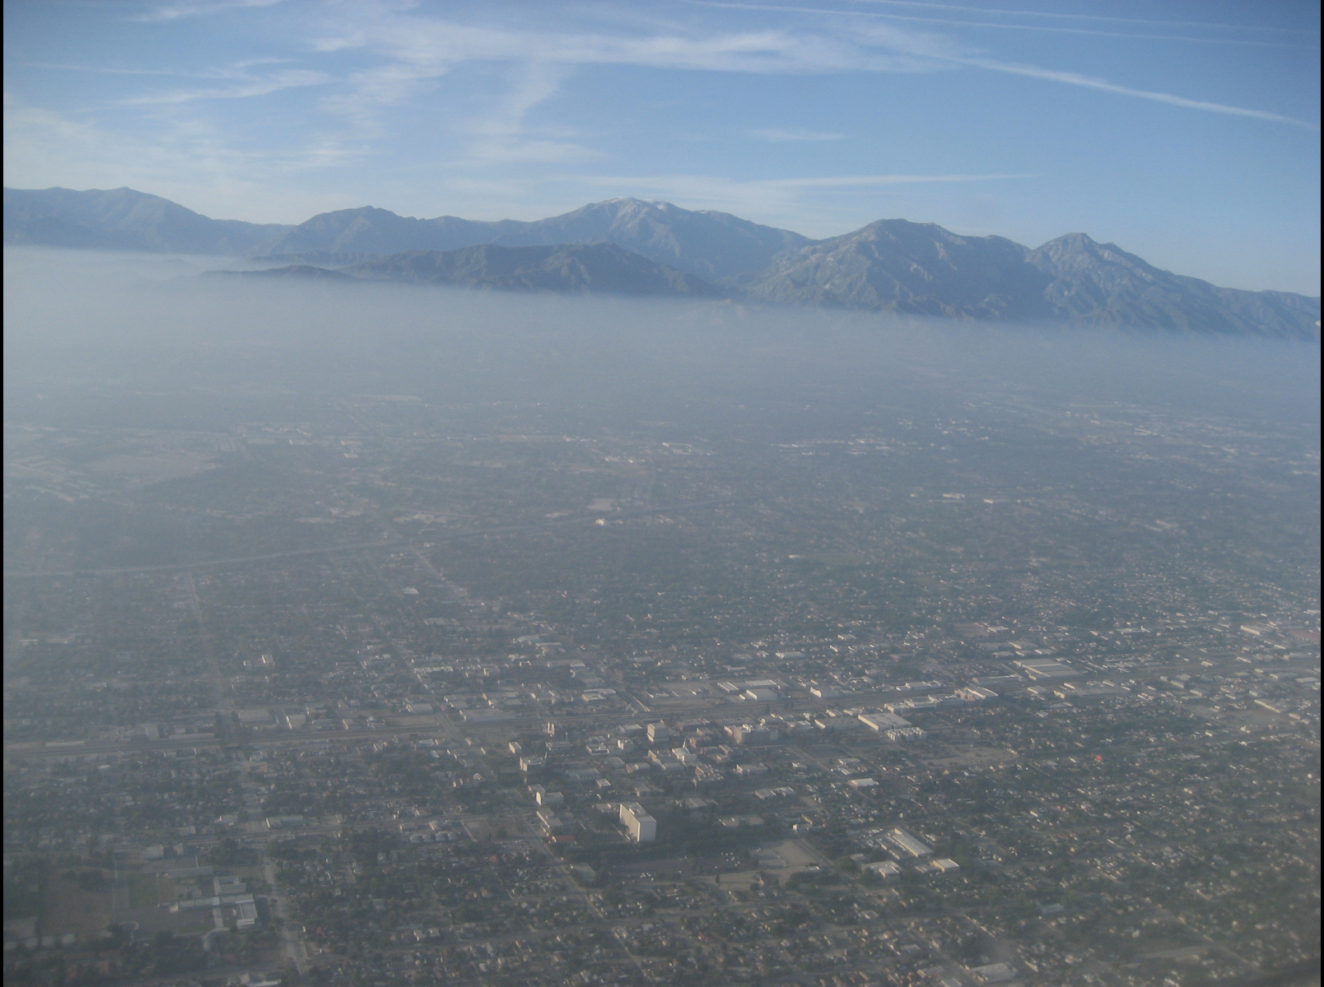
LA Basin as seen from the NOAA P3 during CalNex
CalNex Science Questions
What are the effects of long-range transport on California Air Quality during May-June 2010?
Does assimilation of satellite ozone and aerosol retrievals improve forecasts of intercontinental transport?

Slide 17
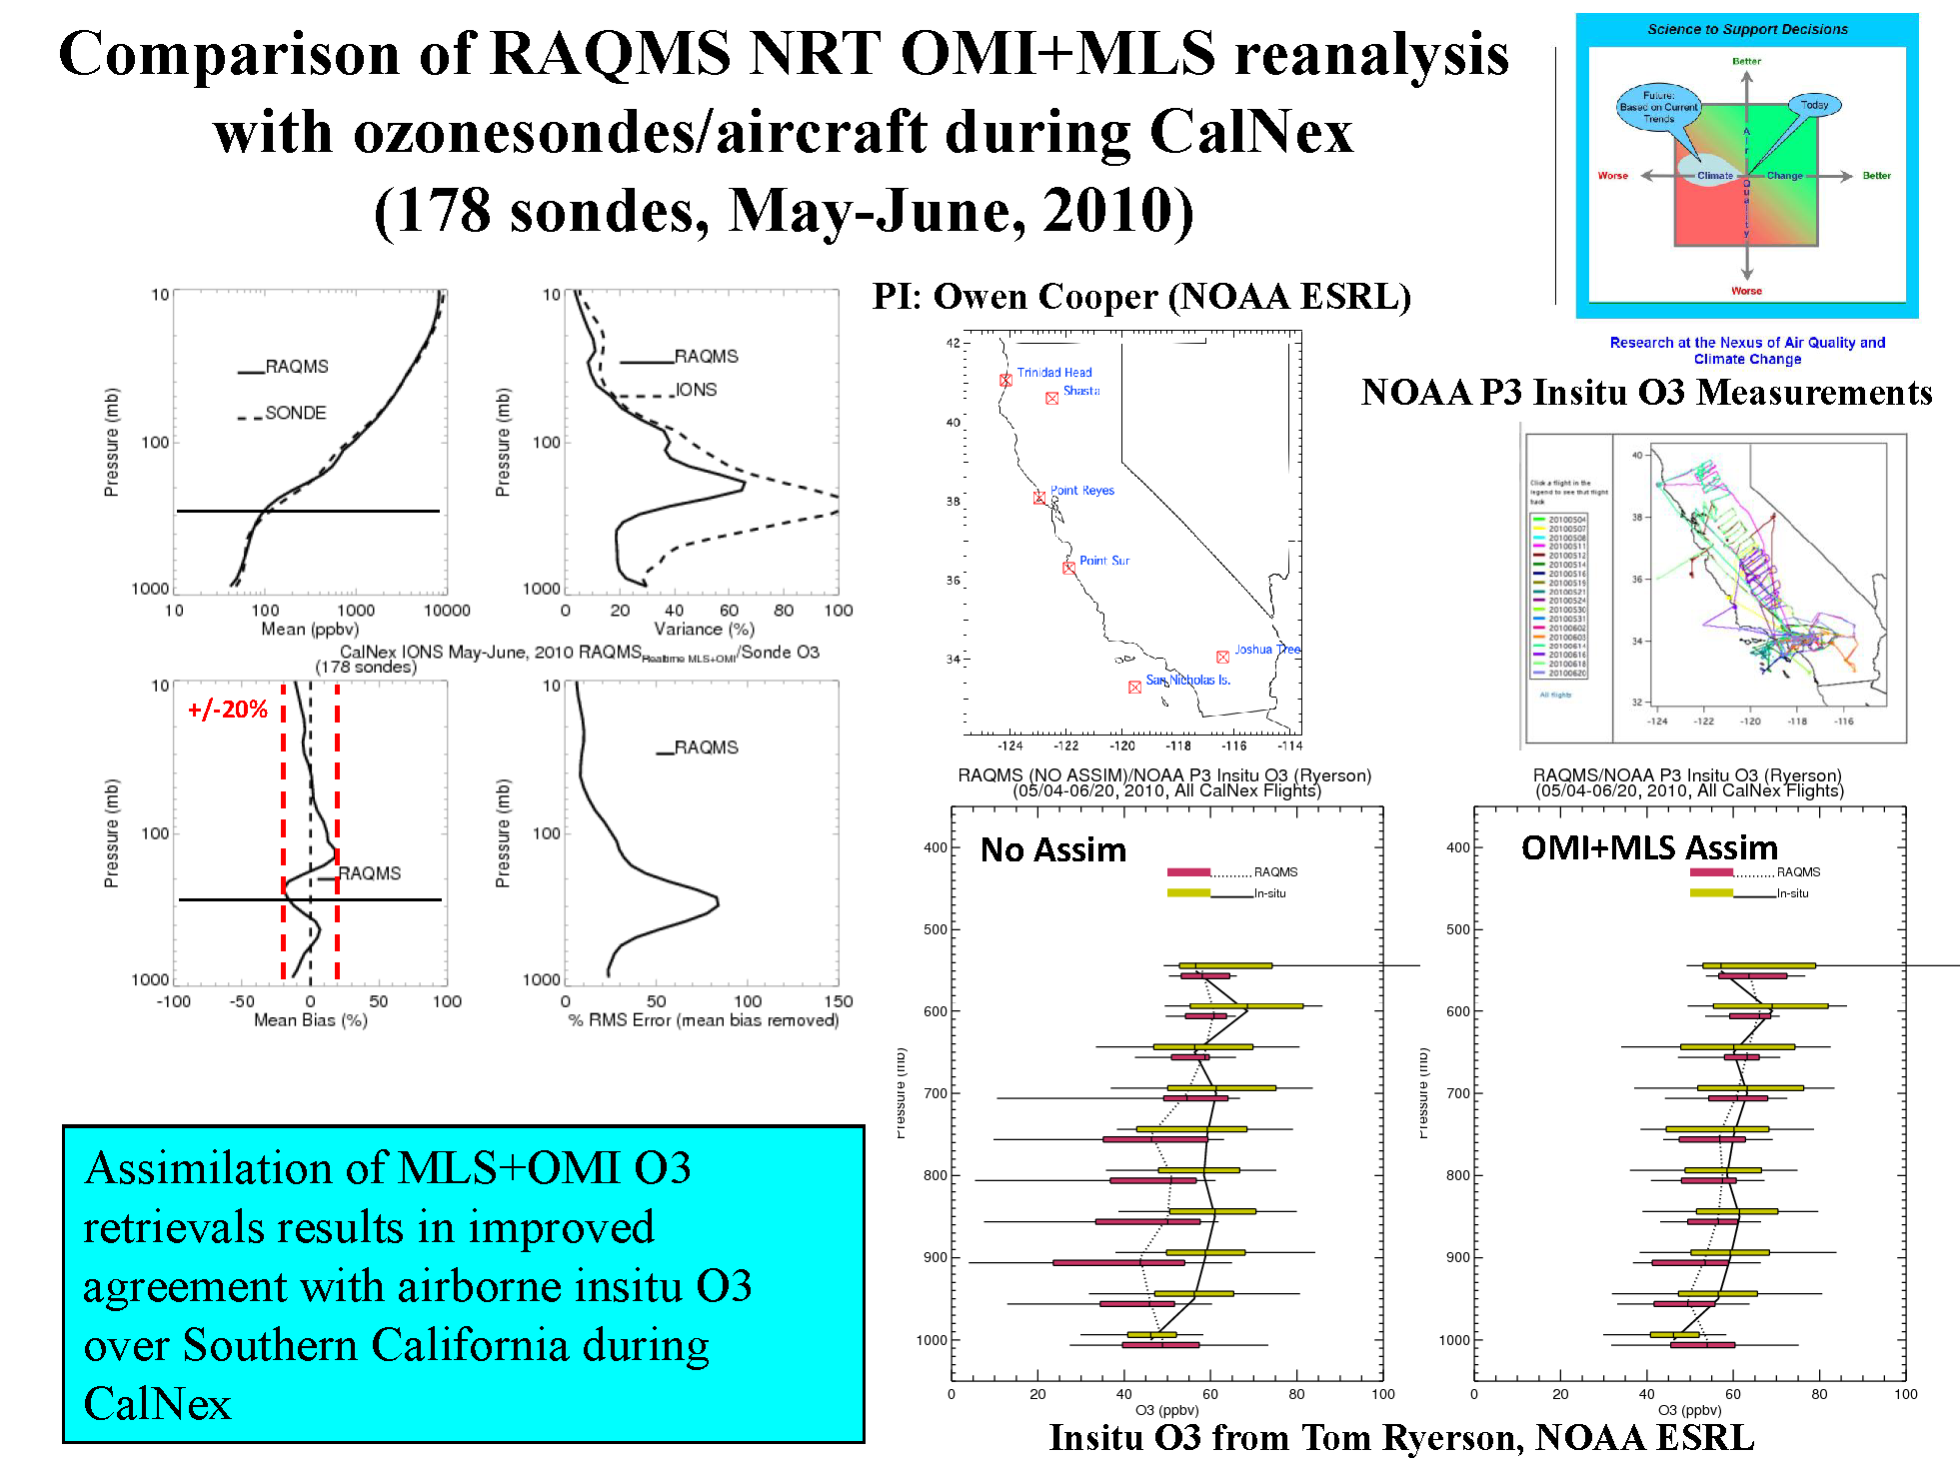

Slide 18
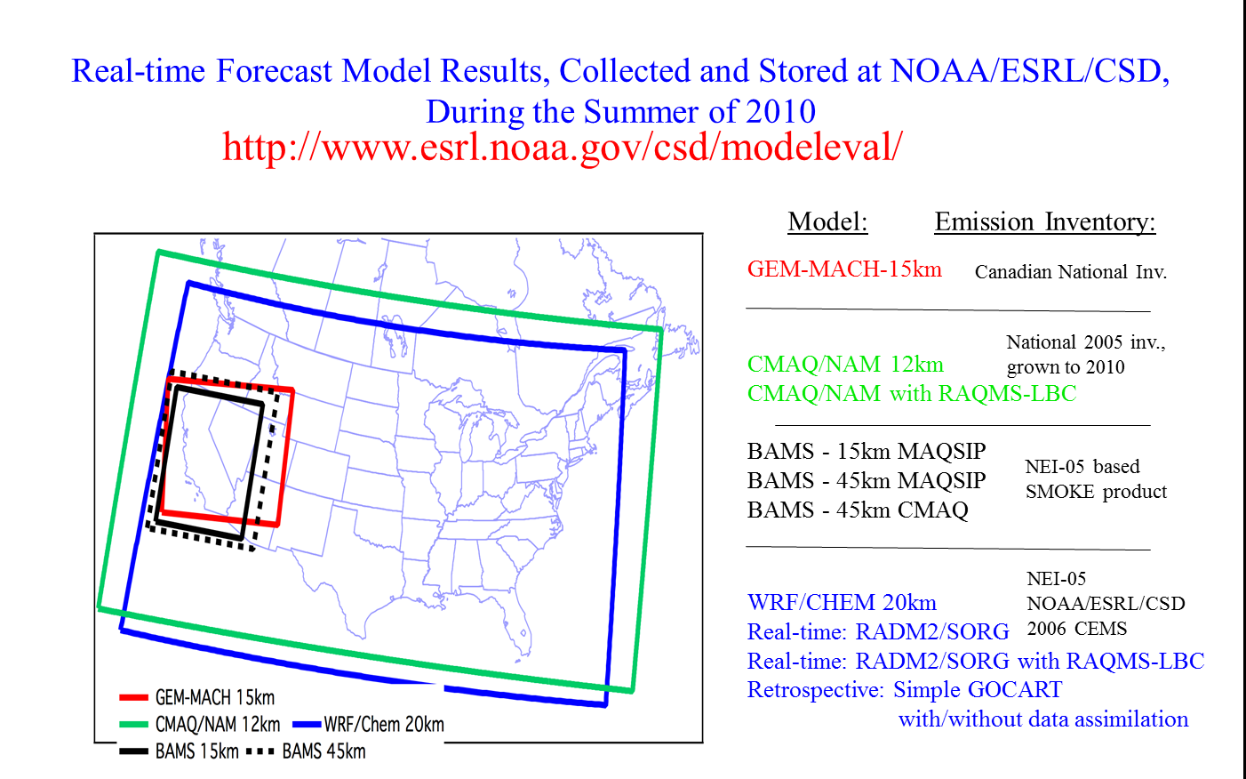
Evaluation of Real-time AQ Model Forecasts during CalNex
Lead by Stu McKeen (NOAA/ESRL)
Regional Air Quality Forecast models:
Georg Grell, Steven Peckham (NOAA/ESRL/GSD) -WRF/Chem
Wanmin Gong, Sylvain Ménard, Hugo Landry (Environment Canada) – GEM-MACH
Youhua Tang and Jeff McQueen (NOAA/NWS) - CMAQ/NAM (CB-05 - experimental in 2010)
John McHenry and Don Olerud (Baron AMS) – BAMS
RAQMS used for O3 and PM2.5 lateral boundary conditions (LBC) in NWS CMAQ/NAM and ESRL WRF/Chem
From Stu McKeen (NOAA/ESRL) AGU Annual Meeting, San Francisco CA, December, 2010

Slide 19
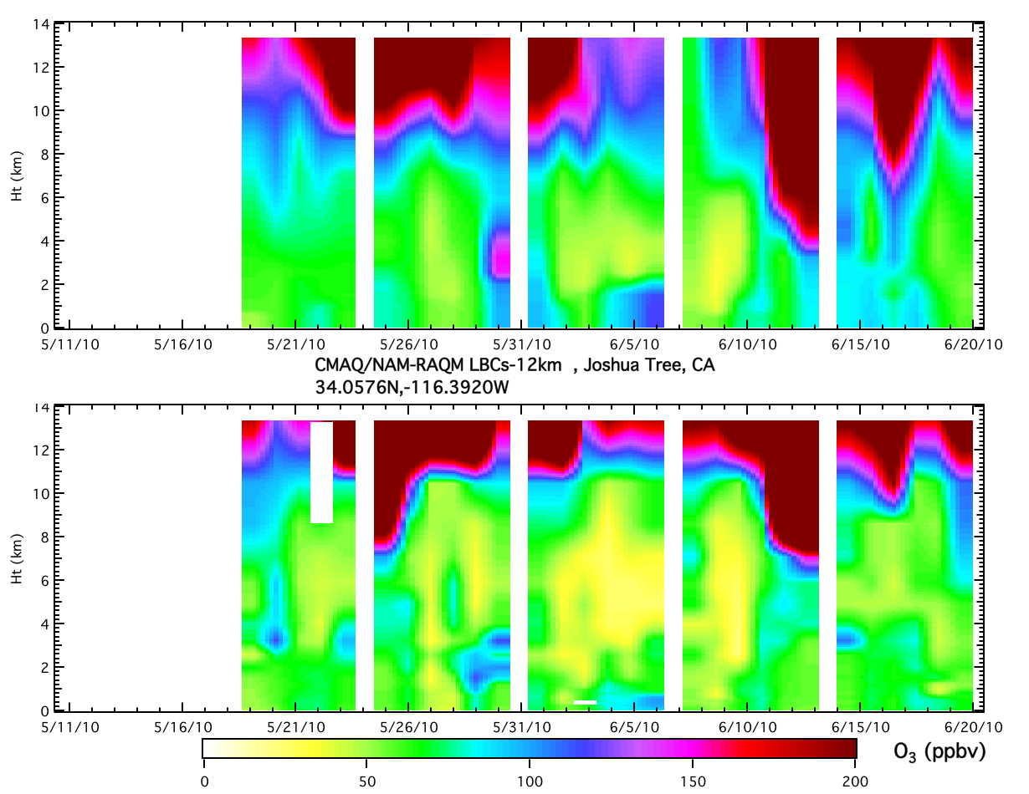
CMAQ/RAQM-LBCs at Joshua Tree
Model
NAM-CMAQ does not resolve sharp gradient in ozone at tropopause resulting in higher ozone in free troposphere
Obs.
From Stu McKeen (NOAA/ESRL) AGU Annual Meeting, San Francisco CA, December, 2010

Slide 20
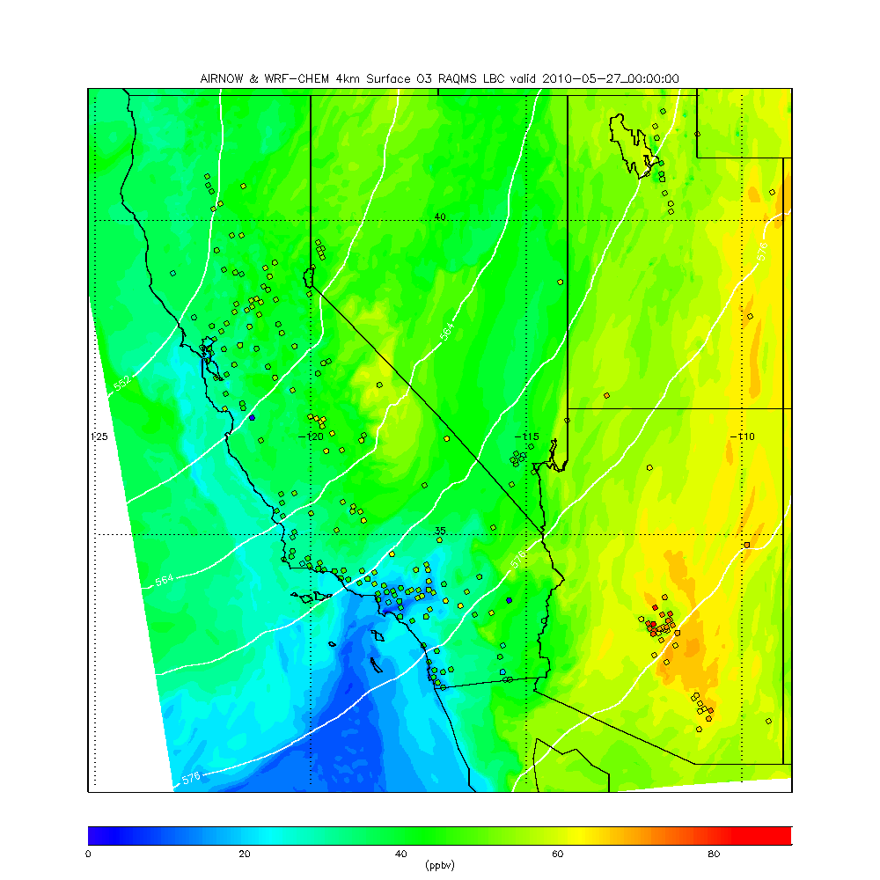
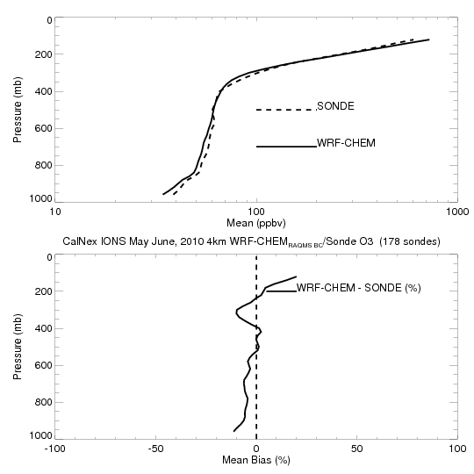
Retrospective 4km WRF-CHEM CalNex forecasts
(RAQMS 1x1 MLS+OMI ozone analyses)
WRF-CHEM does resolve sharp gradient in ozone at tropopause resulting in very small (<10%) biases in free tropospheric ozone

Slide 21
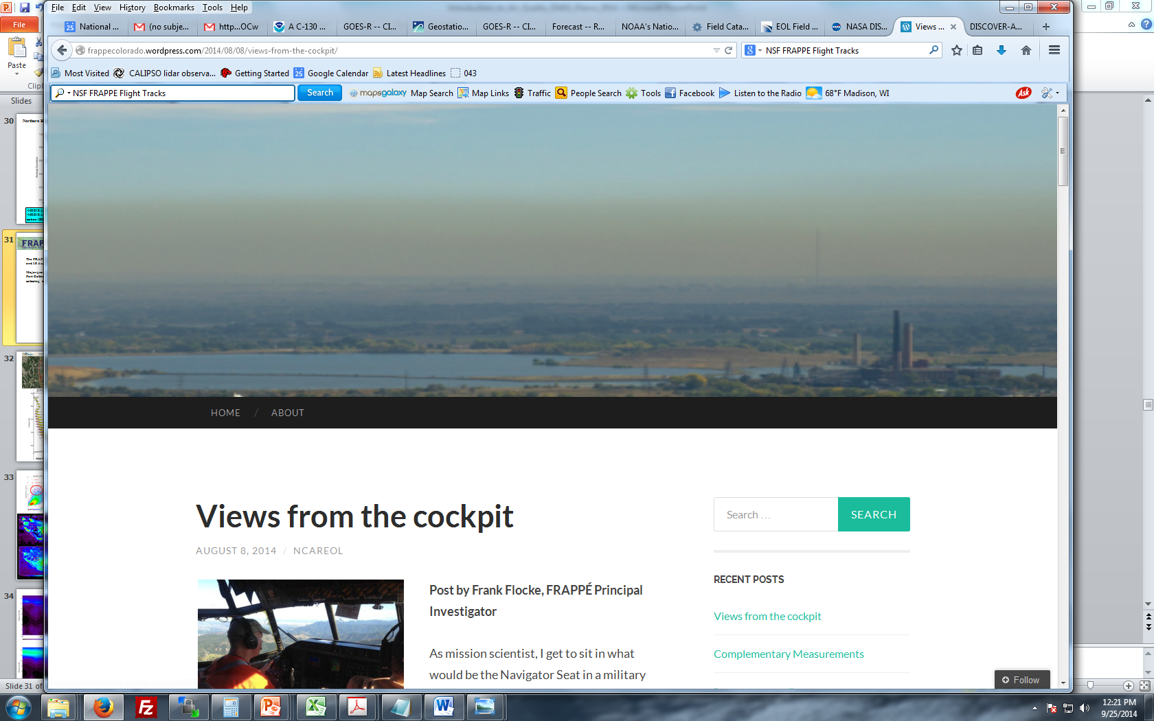
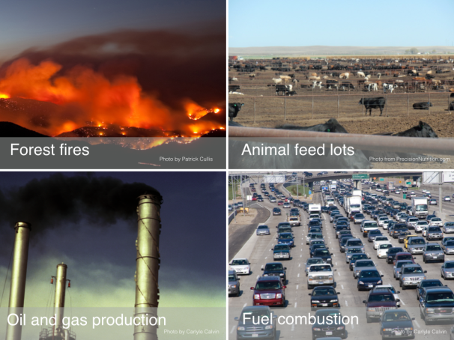
The FRAPPE and DISCOVER-AQ field campaigns took place between 16 July and 18 August 2014 over northern Colorado and were designed to investigate and quantify all factors contributing to air quality in the Colorado Front Range with a special focus on summertime ozone pollution.
Smoke layer over Colorado Front range as seen from the NCAR C130 during FRAPPE

Slide 22
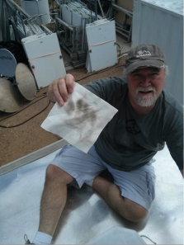
The FRAPPE and DISCOVER-AQ field campaigns took place between 16 July and 18 August 2014 over northern Colorado and were designed to investigate and quantify all factors contributing to air quality in the Colorado Front Range with a special focus on summertime ozone pollution.
Guess those theory guys are good for something other than forecasting where the pollution is! (Brad Pierce, FRAPPE Blog, http://frappecolorado.wordpress.com/)
Smoke layer over Colorado Front range as seen from the NCAR C130 during FRAPPE

Slide 23
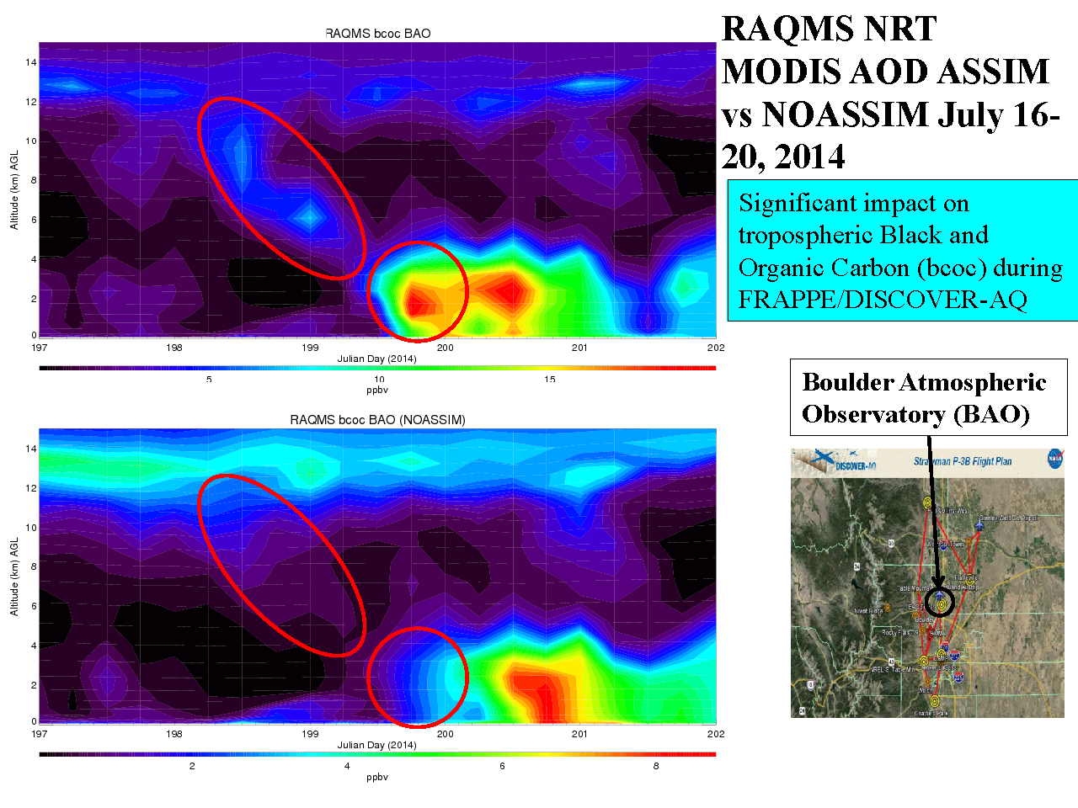
RAQMS Smoke prediction (with MODIS AOD Assimilation)
RAQMS Smoke prediction (no MODIS AOD Assimilation)

Slide 24
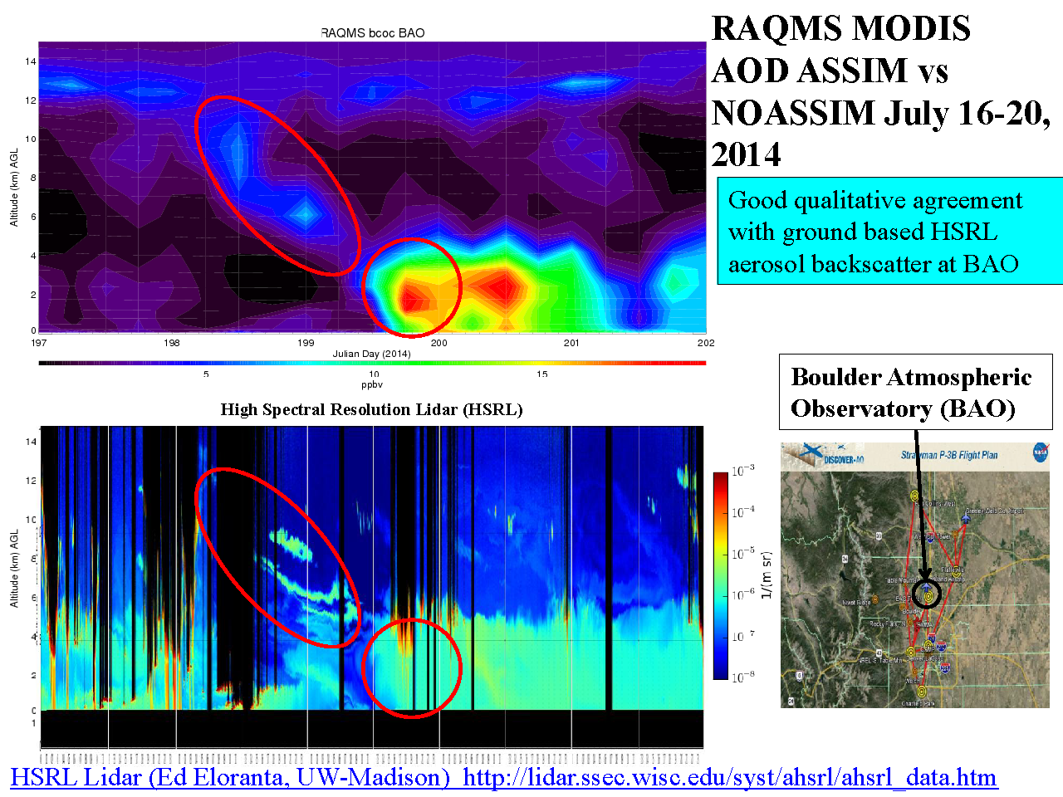
RAQMS Smoke prediction (with MODIS AOD Assimilation)

Slide 25
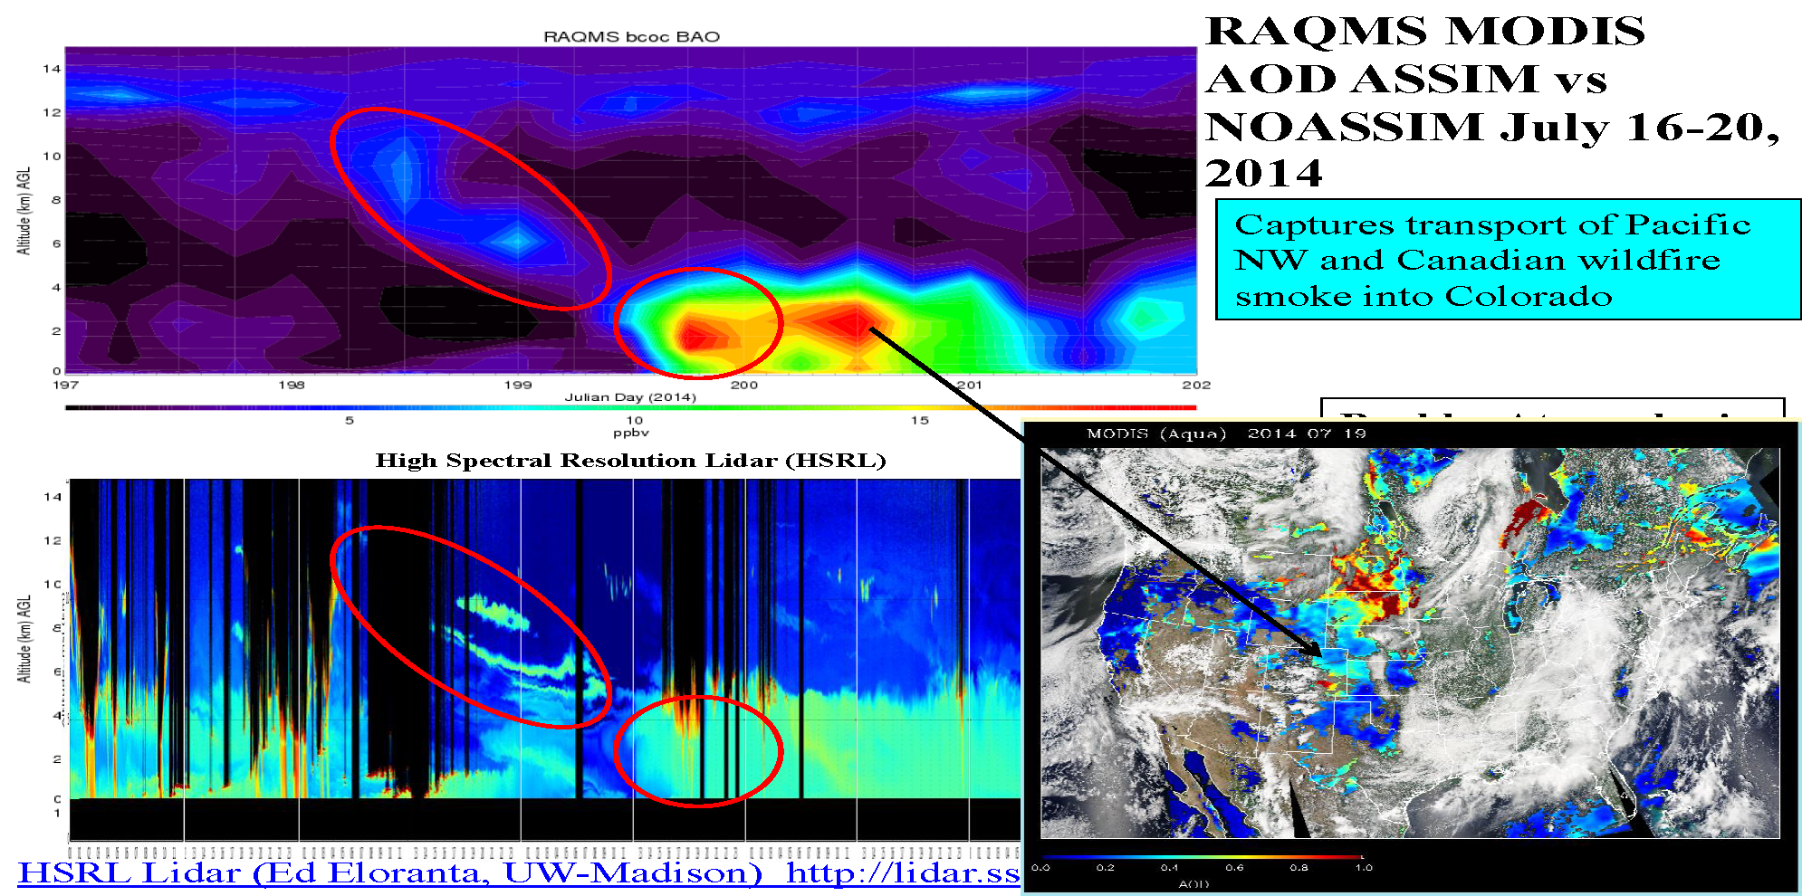
RAQMS Smoke prediction (with MODIS AOD Assimilation)

Slide 26
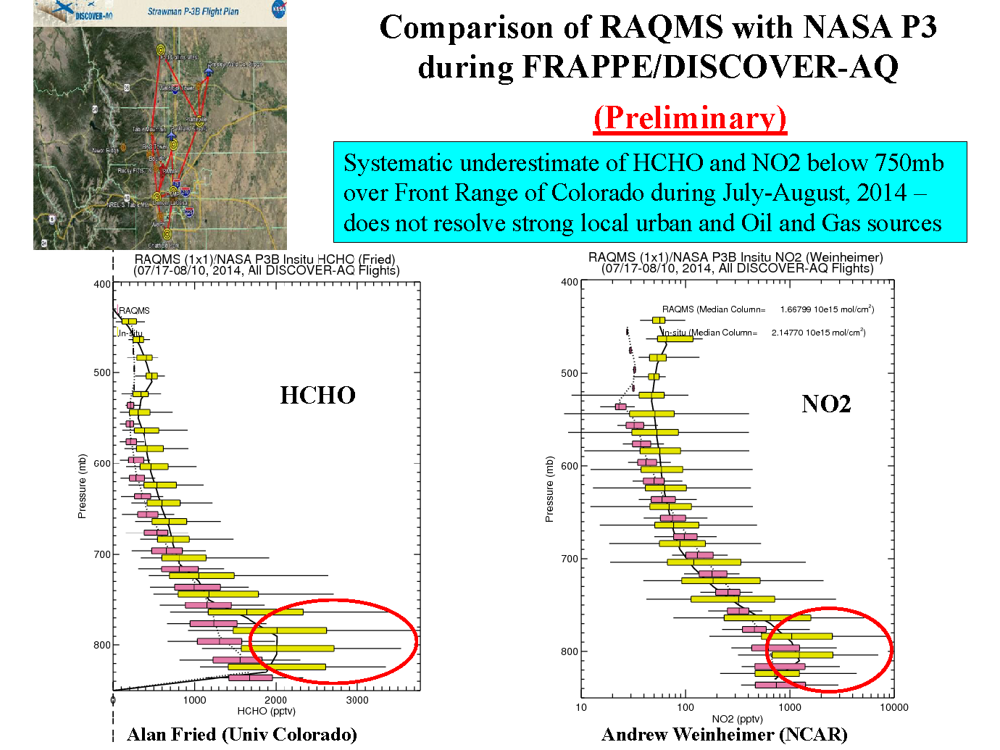
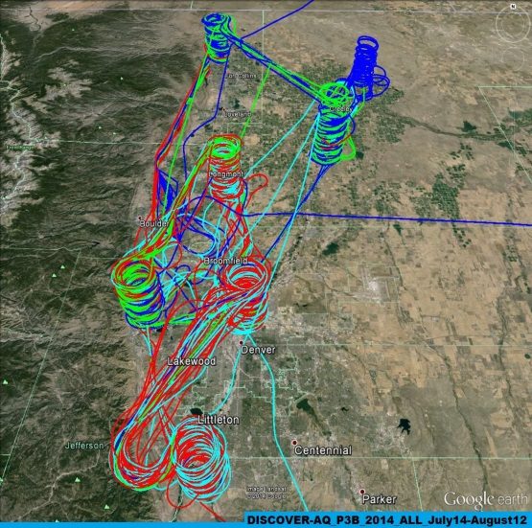

Slide 27
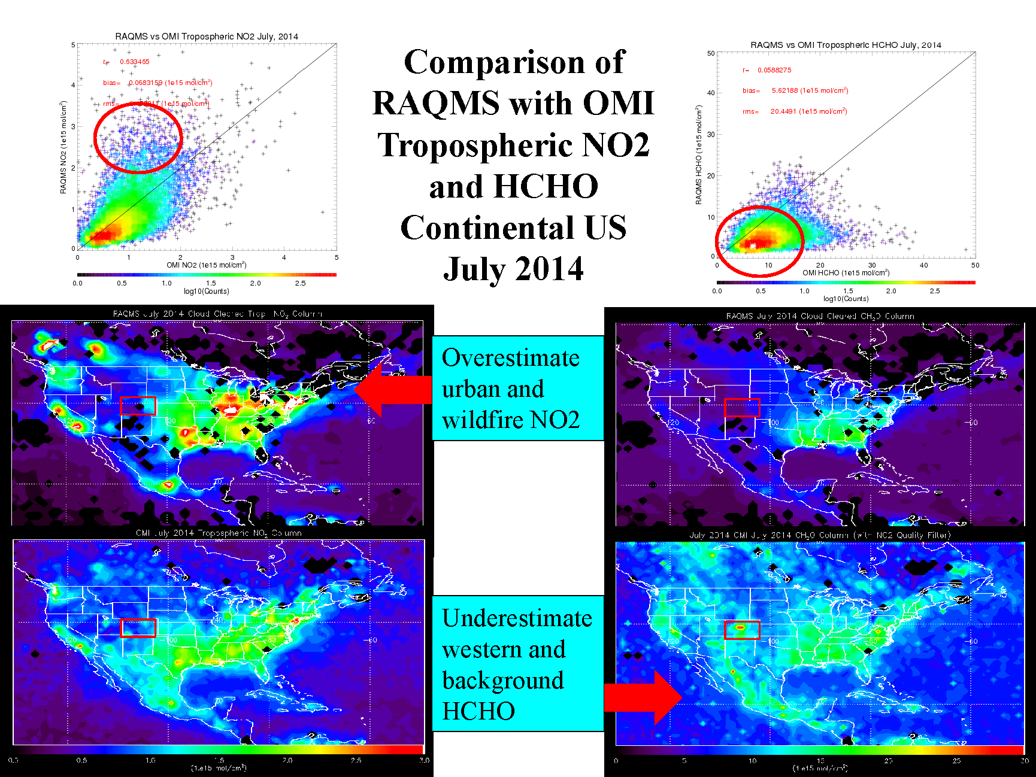

Slide 28
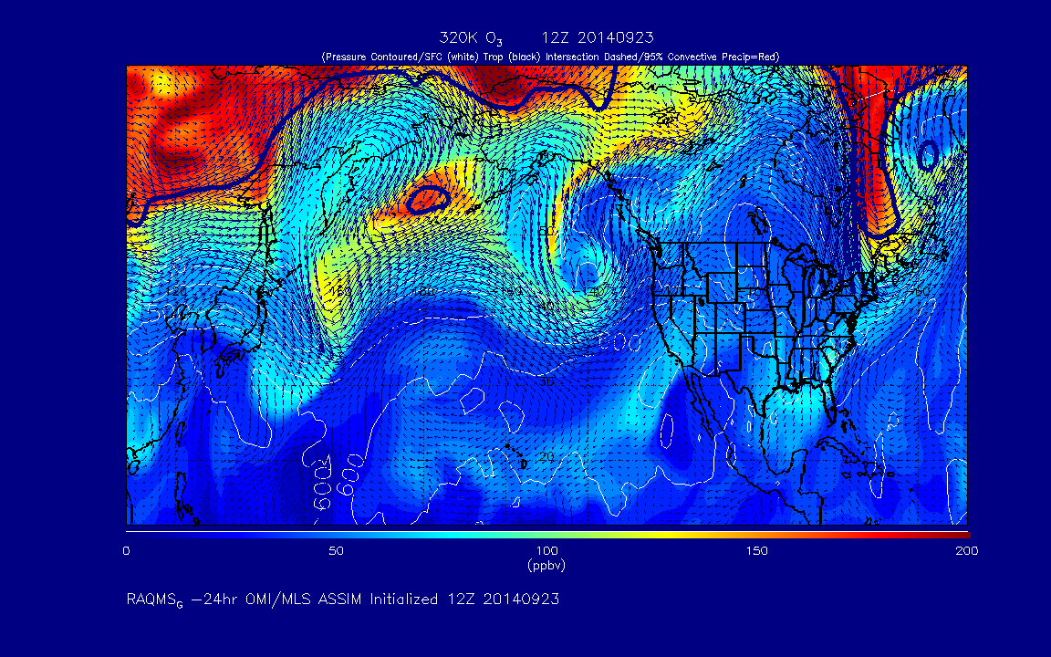
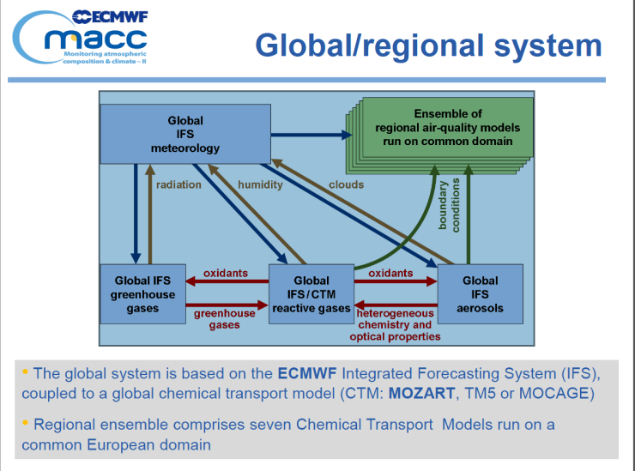
  A path forward towards NOAA operational global/regional real-time trace gas and aerosol assimilation/forecasting
A RAQMS chemical and aerosol re-analysis will be conducted using measurements from the NASA Aura, Aqua, and Terra satellites analysis system (under support from the NASA Applied Science Program)
This Aura analysis can serve as a “proof of concept” for future global operational trace gas and aerosol data assimilation/forecasting at NOAA (following EU GEMS/MACC path)
RAQMS 320K Ozone Forecast
(http://raqms-ops.ssec.wisc.edu/)
http://www.copernicus-atmosphere.eu/services/aqac/

