Slide 1
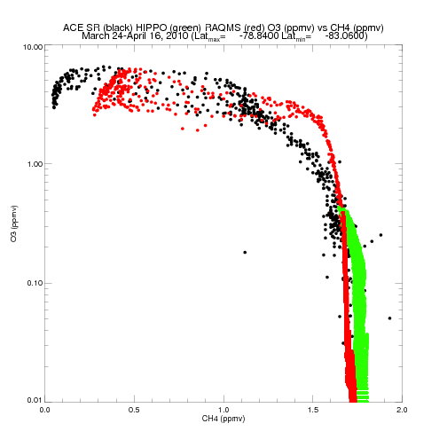
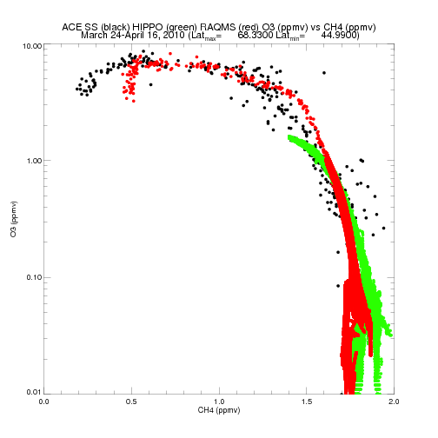
O3 vs CH4 Pacific Sector (120E to 120W)
RAQMS at coincident ACE and HIPPO points

Slide 2
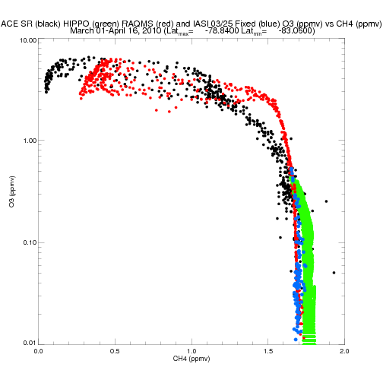
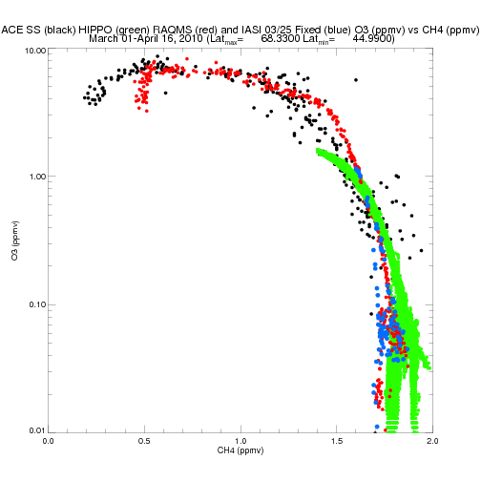
O3 vs CH4 Pacific Sector (120E to 120W)
RAQMS at coincident ACE and IASI points along HIPPO flight Track

Slide 3
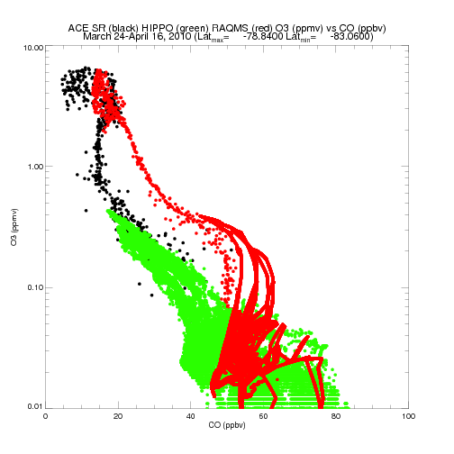
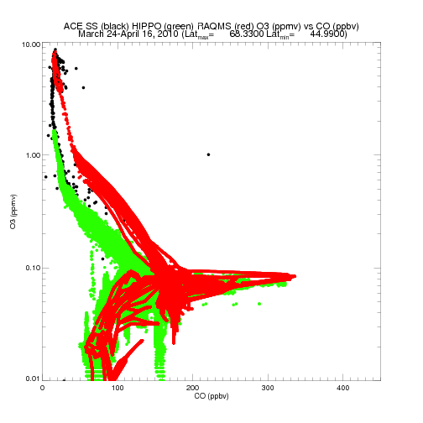
O3 vs CO Pacific Sector (120E to 120W)
RAQMS at coincident ACE and HIPPO points

Slide 4
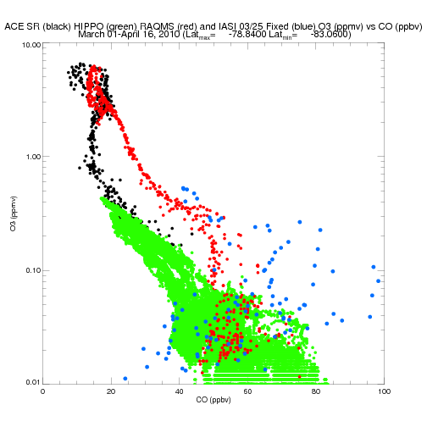
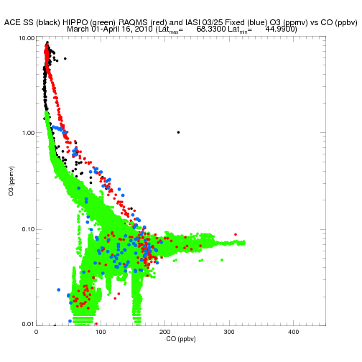
O3 vs CO Pacific Sector (120E to 120W)
RAQMS at coincident ACE and IASI points along HIPPO flight Track

Slide 5
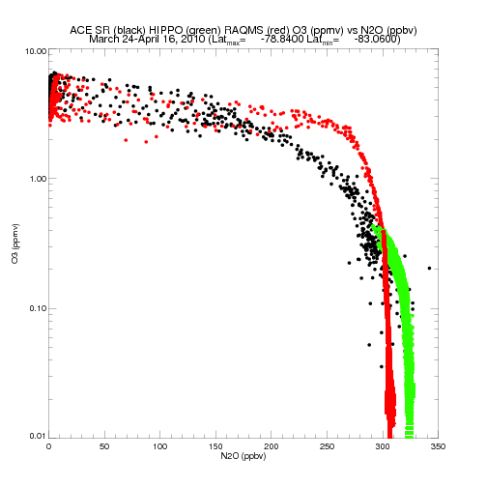
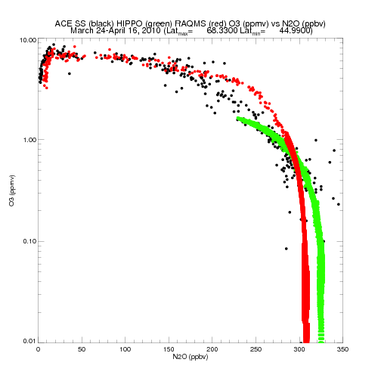
O3 vs N2O Pacific Sector (120E to 120W)
RAQMS at coincident ACE and HIPPO points

Slide 6
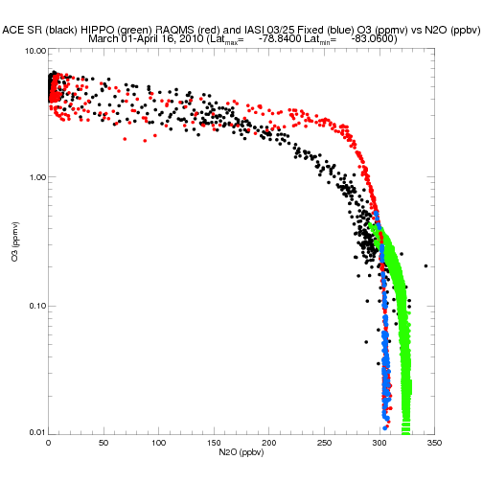
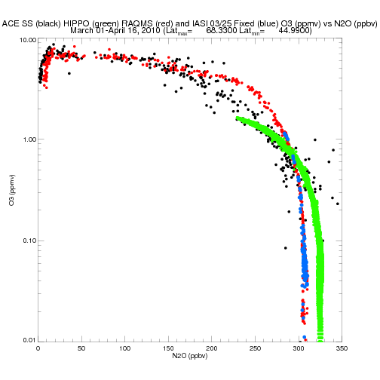
O3 vs N2O Pacific Sector (120E to 120W)
RAQMS at coincident ACE and IASI points along HIPPO flight Track

Slide 7
03/24 (retrievalc) Stats with respect to HIPPO insitu measurements
Retrieved O3 r= 0.952098, Median Bias= -0.00115306 (obs-ret ppmv)
RAQMS O3 r= 0.970269, Median Bias= -0.00311753 (obs-mod ppmv)
Retrieved CO r= 0.0540853, Median Bias= -23.8275 (obs-ret ppbv)
RAQMS CO r= 0.0139628, Median Bias= -24.4463 (obs-mod ppbv)
Retrieved CH4 r= 0.112098, Median Bias= 0.0528877 (obs-ret ppmv)
RAQMS CH4 r= 0.0887649, Median Bias= 0.0566000 (obs- mod ppmv)
Retrieved N2O r= 0.166736, Median Bias= 16.2955 (obs-ret ppbv)
RAQMS N2O r= 0.161796, Median Bias= 16.1100 (obs-mod ppbv)

Slide 8
03/24 Stats with respect to HIPPO insitu measurements
Retrieved O3 r= 0.949519, Median Bias= -0.00372642 (obs-ret ppmv)
RAQMS O3 r= 0.977643, Median Bias= -0.00275619 (obs-mod ppmv)
Retrieved CO r= 0.0561172 , Median Bias= -29.0780 (obs-ret ppbv)
RAQMS CO r= 0.0183729 , Median Bias= -23.7662 (obs-mod ppbv)
Retrieved CH4 r= 0.135881, Median Bias= 0.0513659 (obs-ret ppmv)
RAQMS CH4 r= 0.106477, Median Bias= 0.0542023 (obs- mod ppmv)
Retrieved N2O r= 0.170059 , Median Bias= 16.5746 (obs-ret ppbv)
RAQMS N2O r= 0.154148, Median Bias= 16.2986 (obs-mod ppbv)`

