Slide 1
CRTM V2.1 ABI Band 2 (0.64micron)
09/25: Default surface reflectivity
09/26: User defined surface reflectivity (MODIS BRDF)
10/01: Time-series of CRTM output over North Central WI

Slide 2
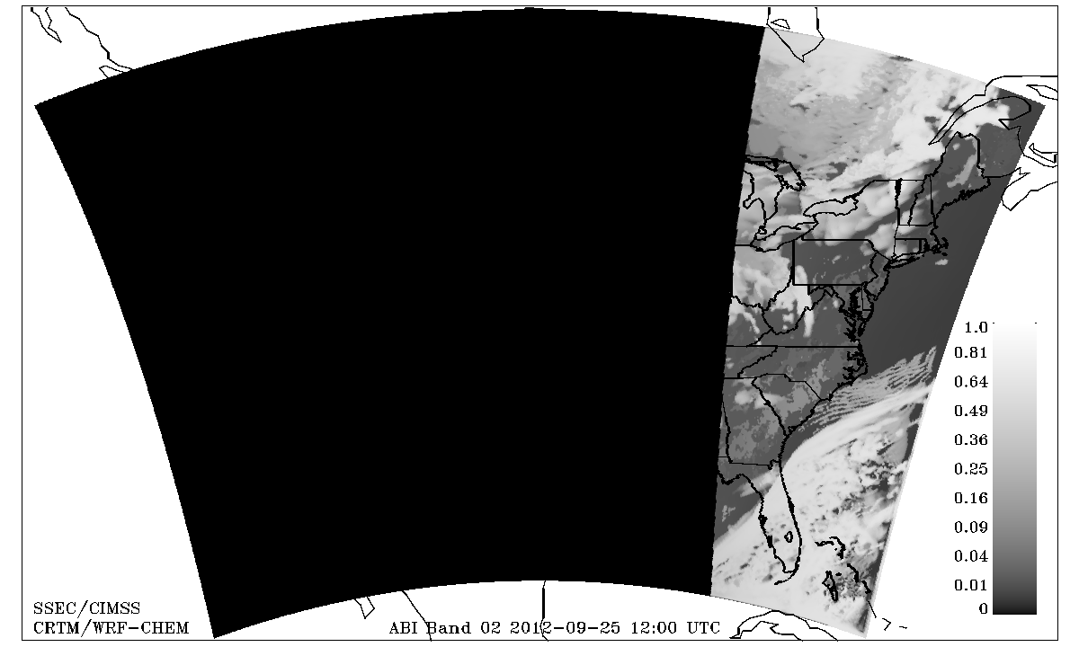
NESDIS/CIMSS Realtime WRF-CHEM/CRTM ABI Proxy
09/25 12Z to 09/26 12Z

Slide 3
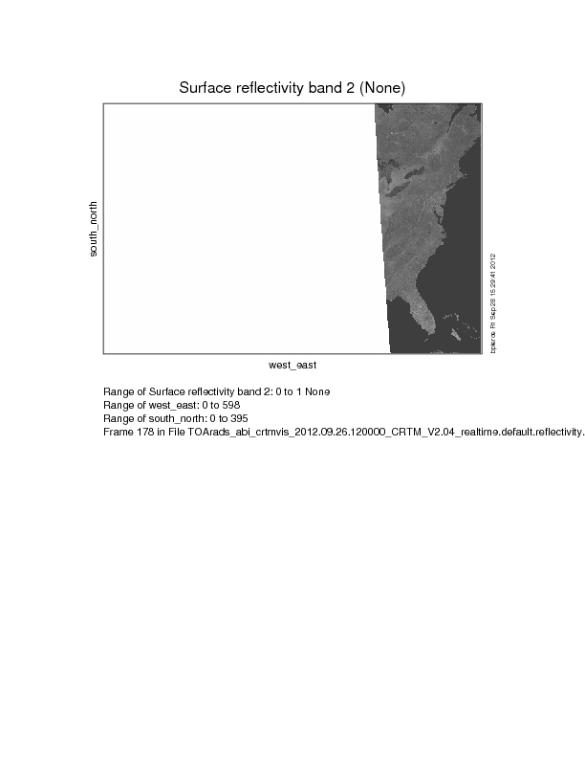
NESDIS/CIMSS Realtime WRF-CHEM/CRTM ABI Proxy
09/25 12Z to 09/26 12Z
User defined surface reflectance for ABI band02 (0.64micron) obtained from MODIS BRDF retrieval

Slide 4
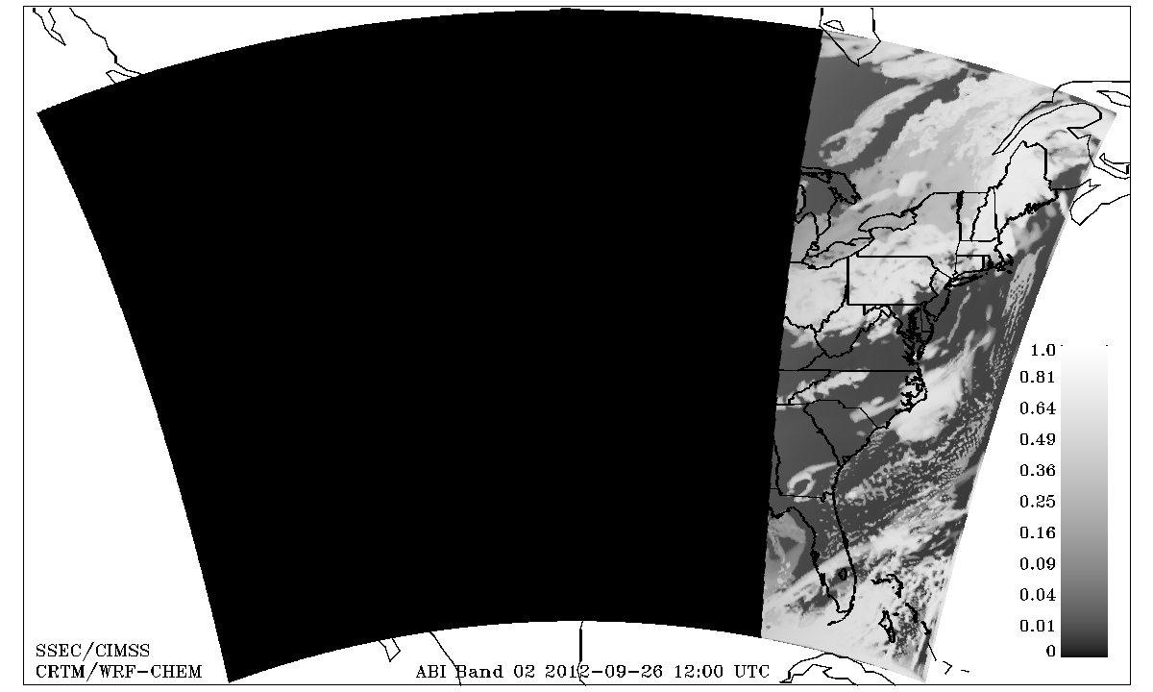
NESDIS/CIMSS Realtime WRF-CHEM/CRTM ABI Proxy
09/26 12Z to 09/27 12Z
(switch to user defined surface reflectance)

Slide 5
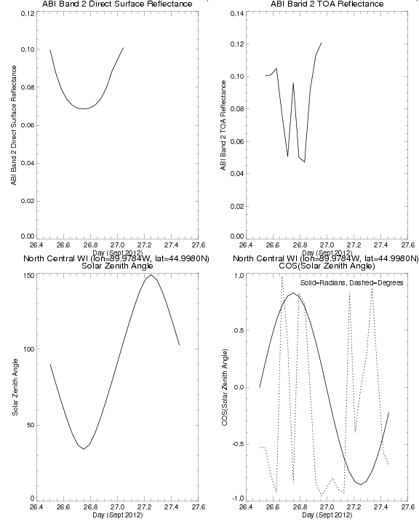
Time series
Over North Central
Wisconsin – user defined surface reflectance
Possible that solar zenith angle is not being converted to radians with user defined surface reflectance?

