Slide 1
Satellite Perspective
April 11, 2020 LaCrosse, WI PM2.5 Event
NESDIS Hazard Mapping System (HMS) Smoke Analysis
(https://www.ospo.noaa.gov/Products/land/hms.html)
Composite: NOAA GOES-16 AerosolWatch True Color Image/AOD/EPA AIRNOW PM2.5
(https://www.star.nesdis.noaa.gov/smcd/spb/aq/AerosolWatch/)
High-resolution VIIRS AOD Trajectories
(http://smoke.ssec.wisc.edu/idea-i-aerosolEntHR-live-j01/ )

Slide 2
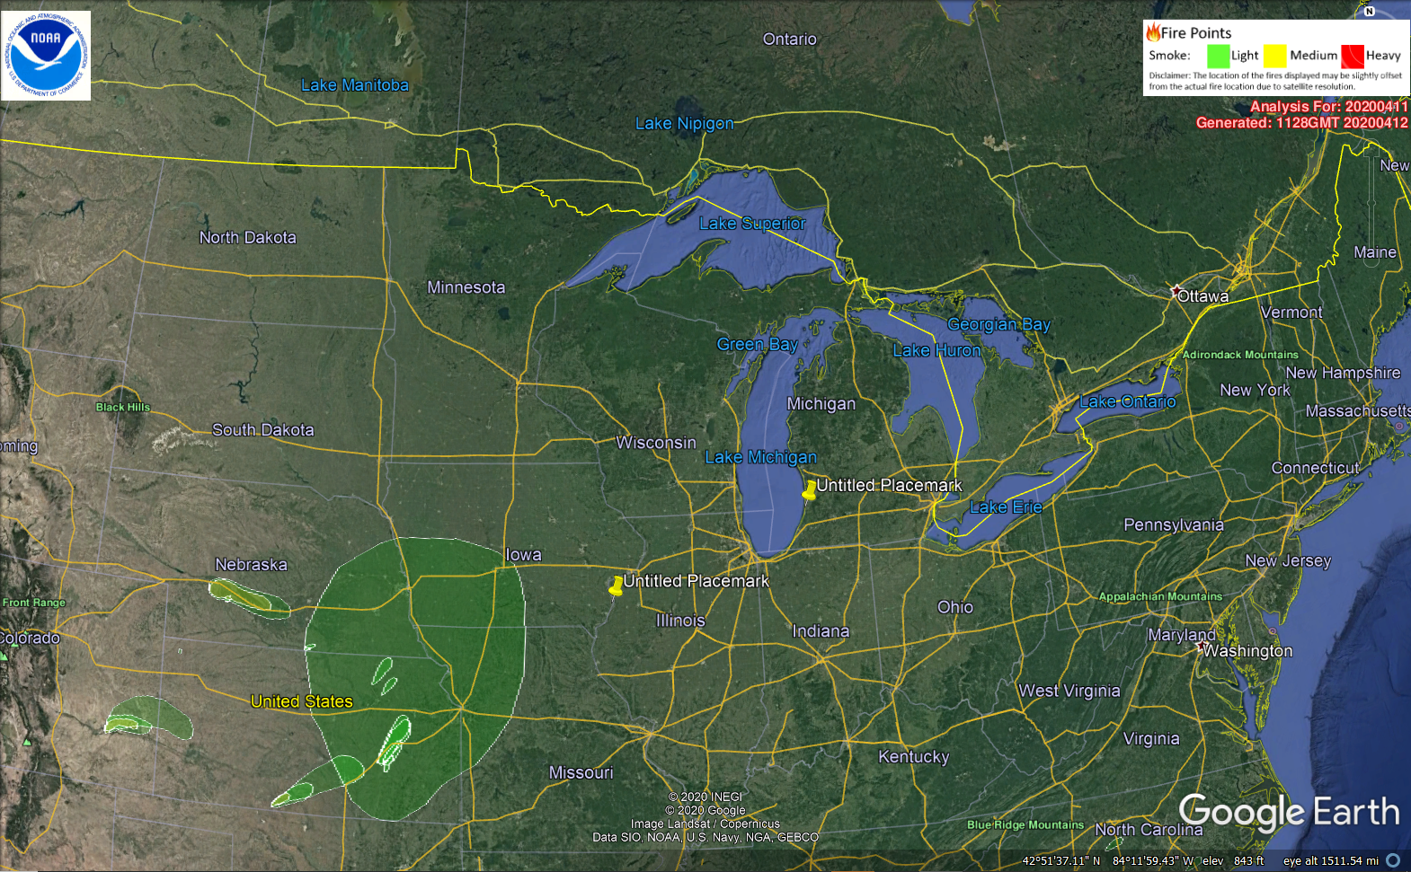
NESDIS Hazard Mapping System (HMS) Smoke Analysis 04/11/2020
Smoke plumes analyzed over KS, NE with light smoke extending into MO and IA

Slide 3
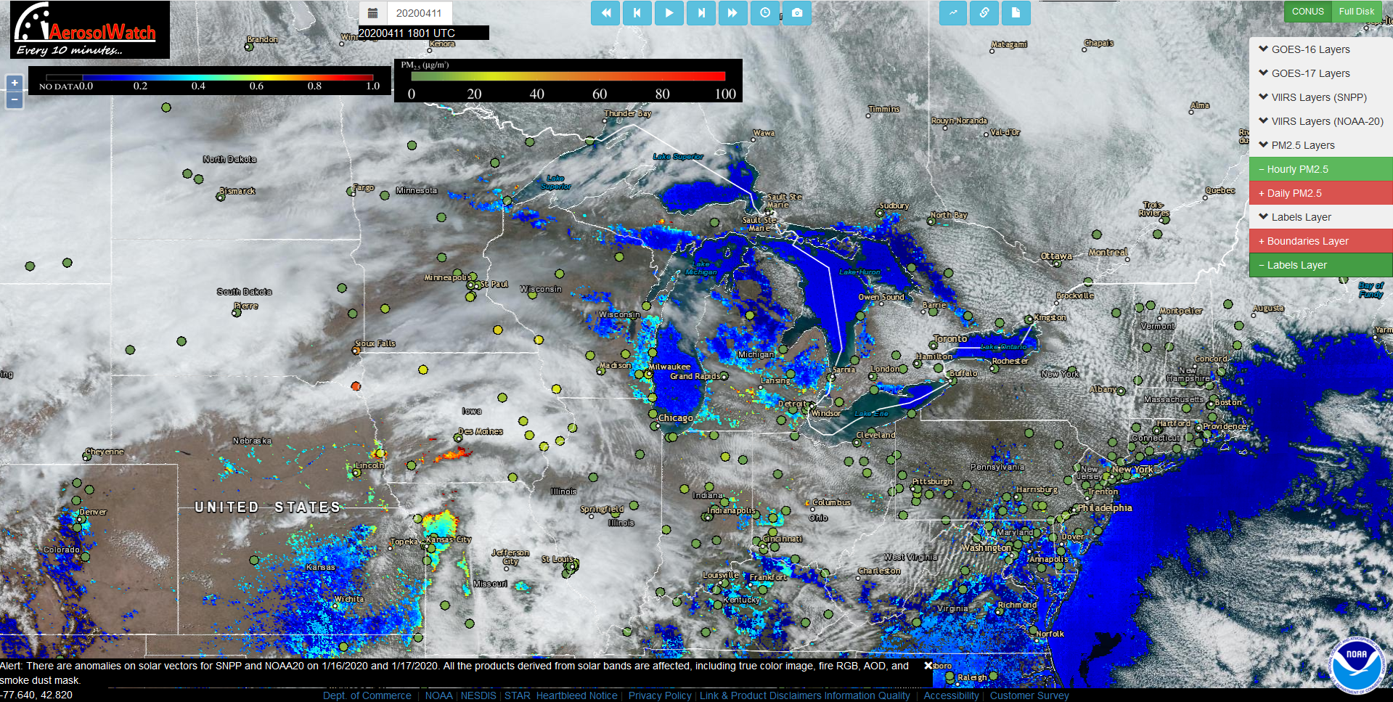
NOAA GOES-16 AerosolWatch True Color Image/AOD/EPA AIRNOW PM2.5
18Z 04/11/2020 (1pm CST)
High AOD evident in SW IA and NW MO
High (>60μg/m³) PM2.5 in SE SD

Slide 4
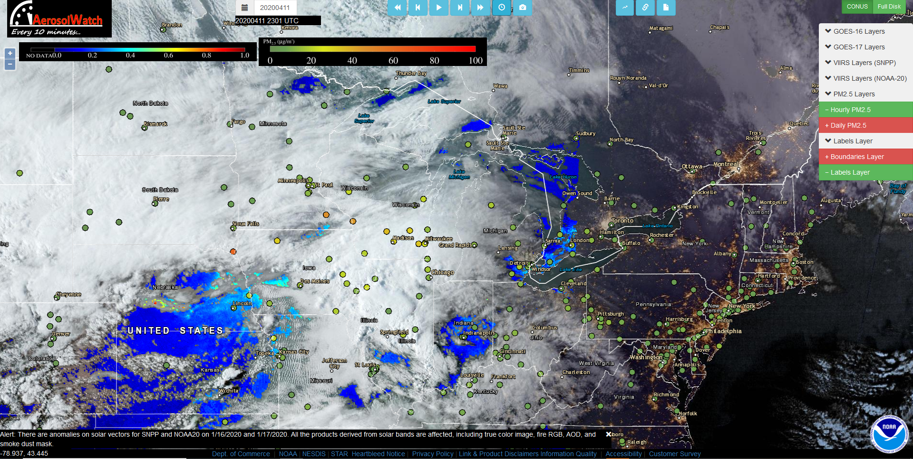
NOAA GOES-16 AerosolWatch True Color Image/AOD/EPA AIRNOW PM2.5
23Z 04/11/2020 (6pm CST)
Moderate AOD evident in SW IA
High (>60μg/m³) PM2.5 in SE SD and elevated (>40μg/m³) PM2.5 in SE MN and LaCrosse, WI

Slide 5
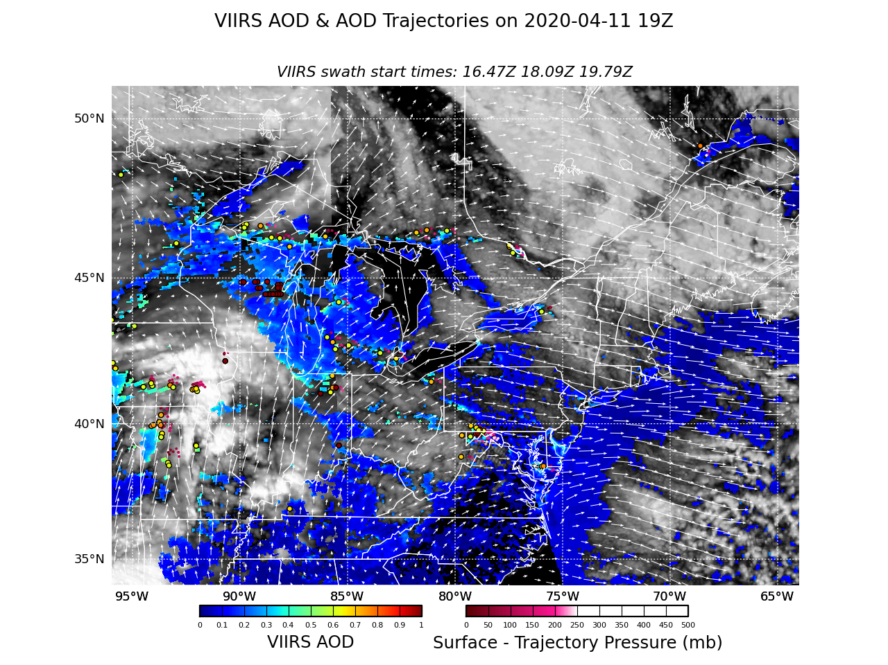
High-resolution VIIRS AOD Trajectories
19Z 04/11/2020 (2pm CST, 04/11/20)
Trajectories initialized within Elevated AOD over Southern IA

Slide 6
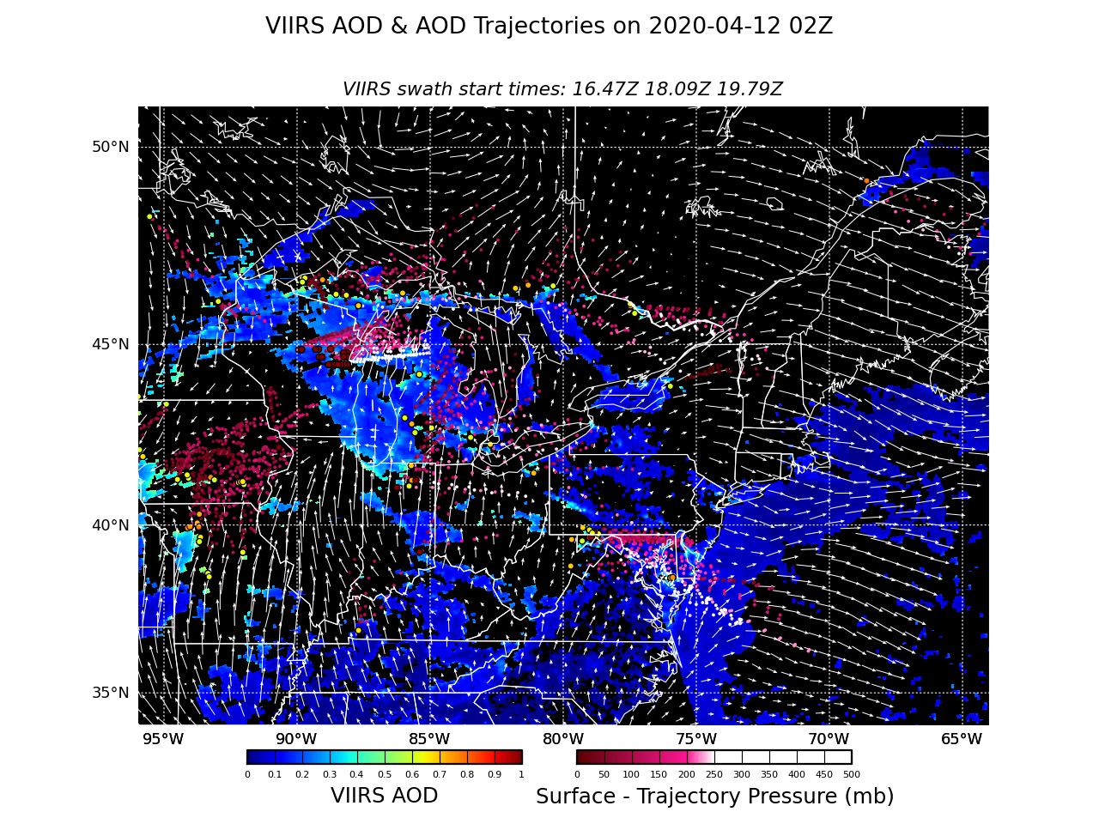
High-resolution VIIRS AOD Trajectories
02Z 04/12/2020 (9pm CST, 04/11/20)
Trajectories show low-level transport into SW WI

