Slide 1
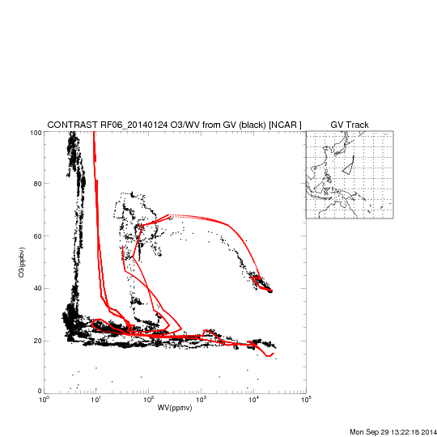
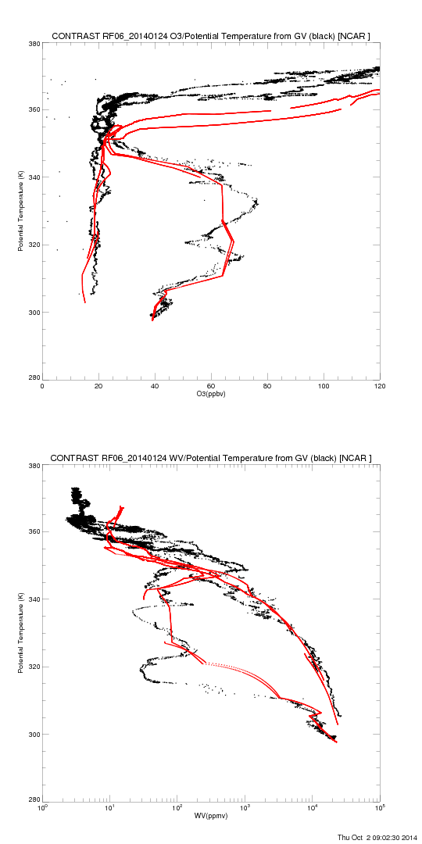
RAQMS (red) O3/WV vs GV (black) RF06 (20140124)

Slide 2
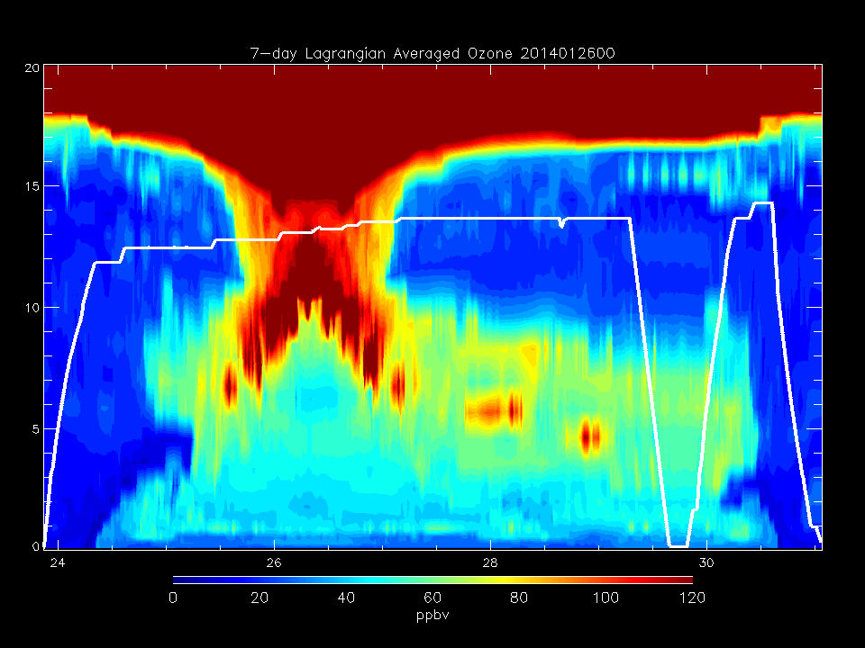
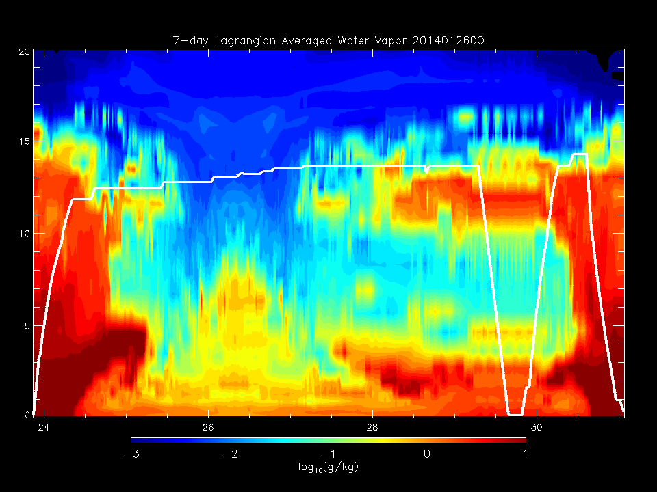
Determine origin of RDF back-trajectories with high O3/low WV for RF06 (20140124)
Select back-trajectories initialized at GMT=29:00-30:30Z, Altitude 5-10km

Slide 3
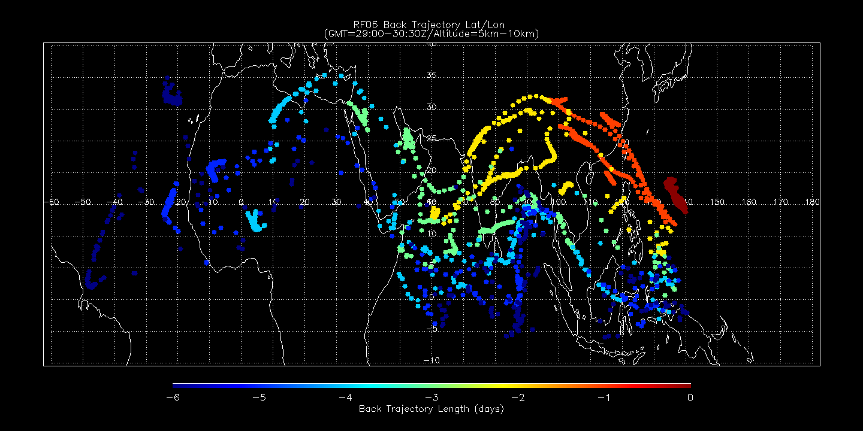
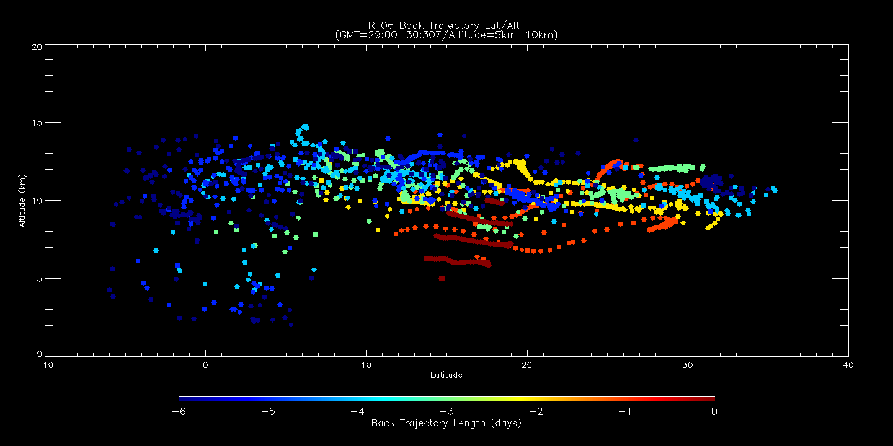
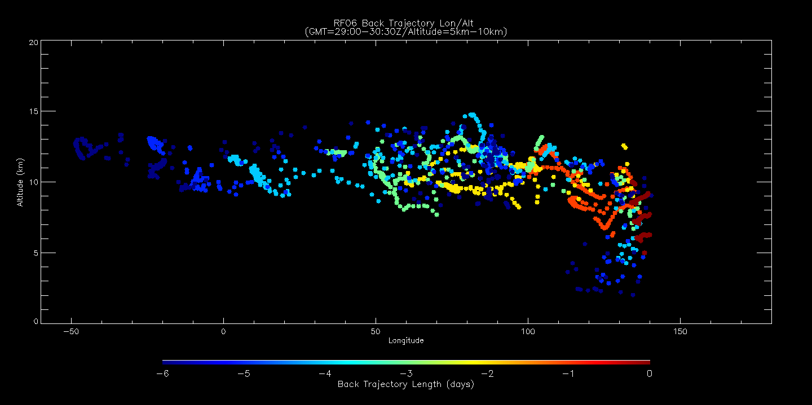
Lat/Lon
5 day
6 day
Back trajectory age shows 6 (5) day cluster with origin at ~10E/15N/12km (~10W/20N/10km)
Lat/Alt
Lon/Alt

Slide 4
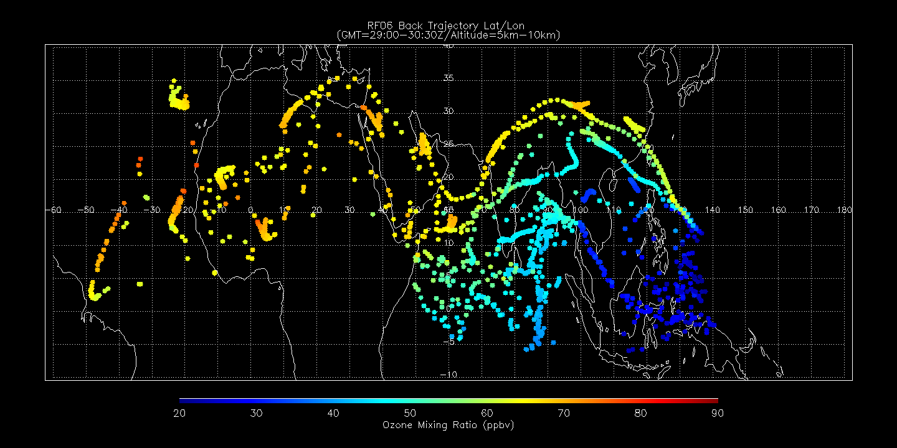
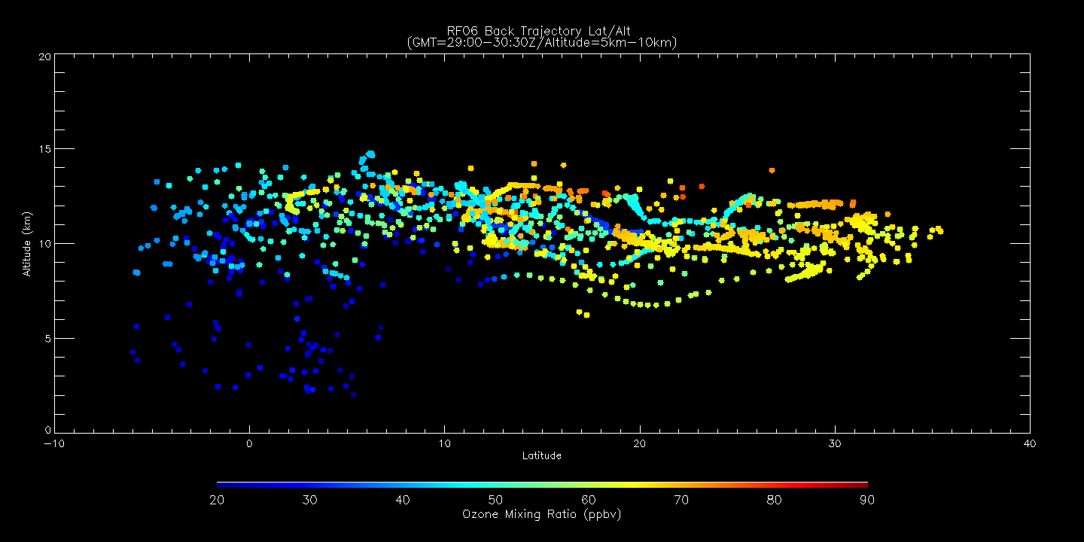
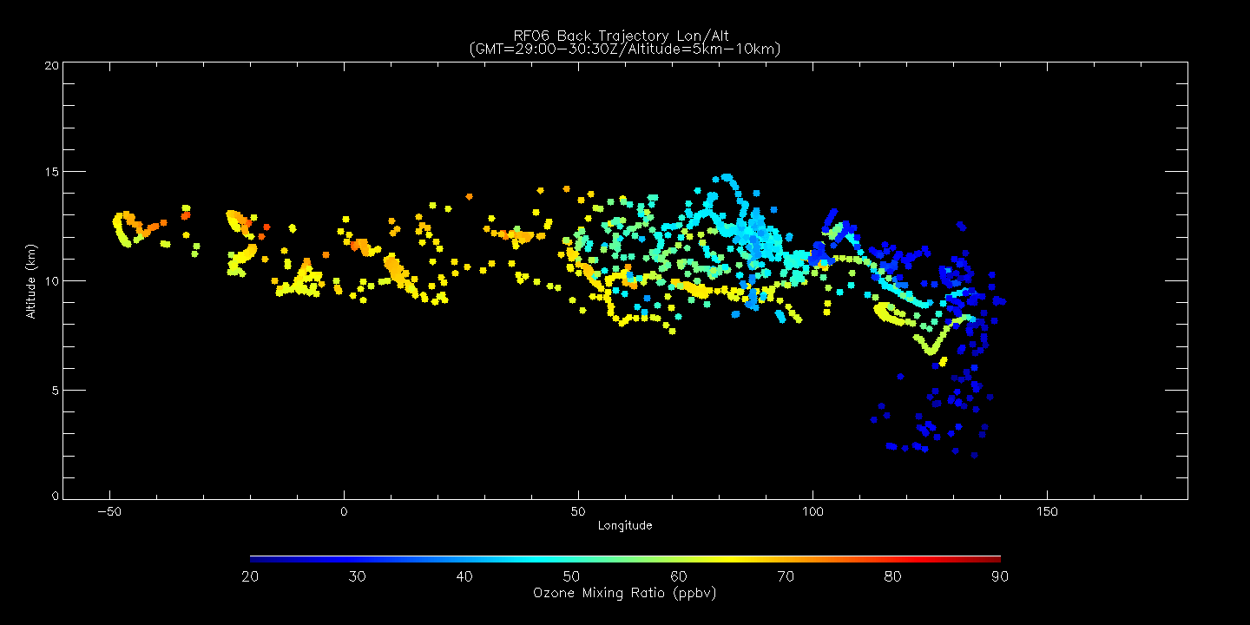
Lat/Lon
5 day
6 day
Back trajectory O3 shows high O3 in 6 (5) day cluster with origin at ~10E/15N/12km (~10W/20N/10km)
Lat/Alt
Lon/Alt

Slide 5
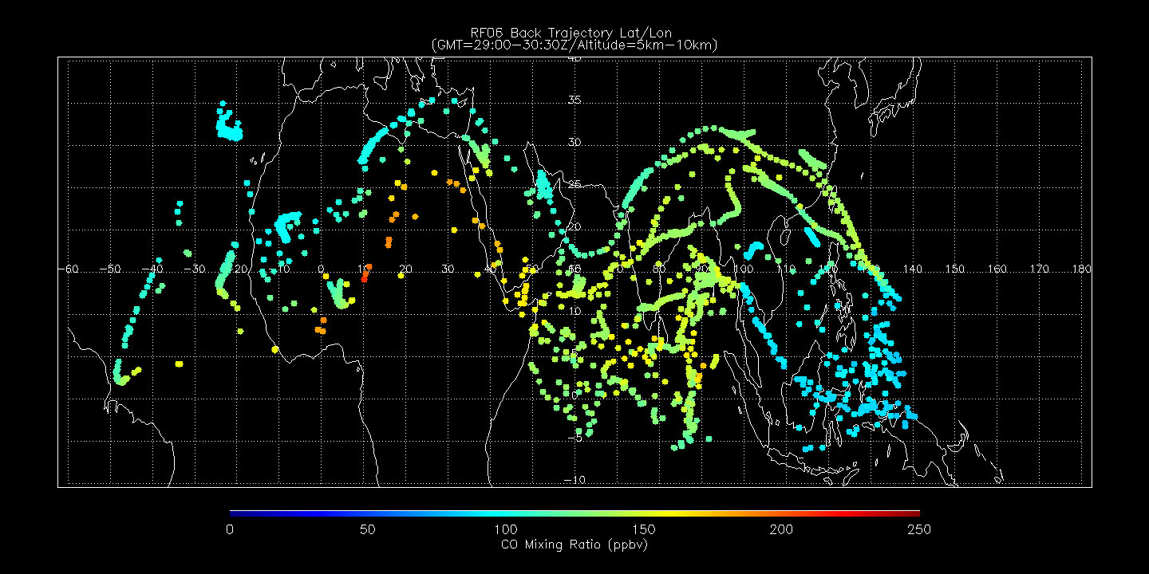
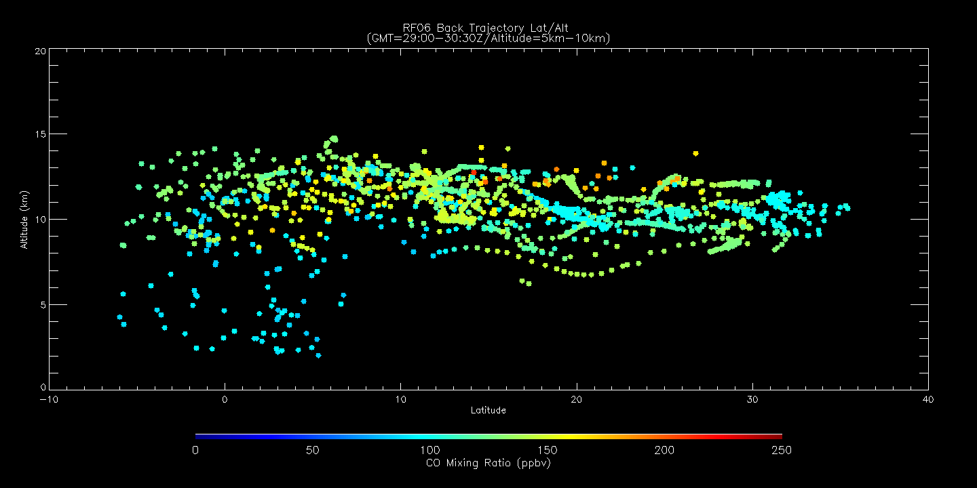
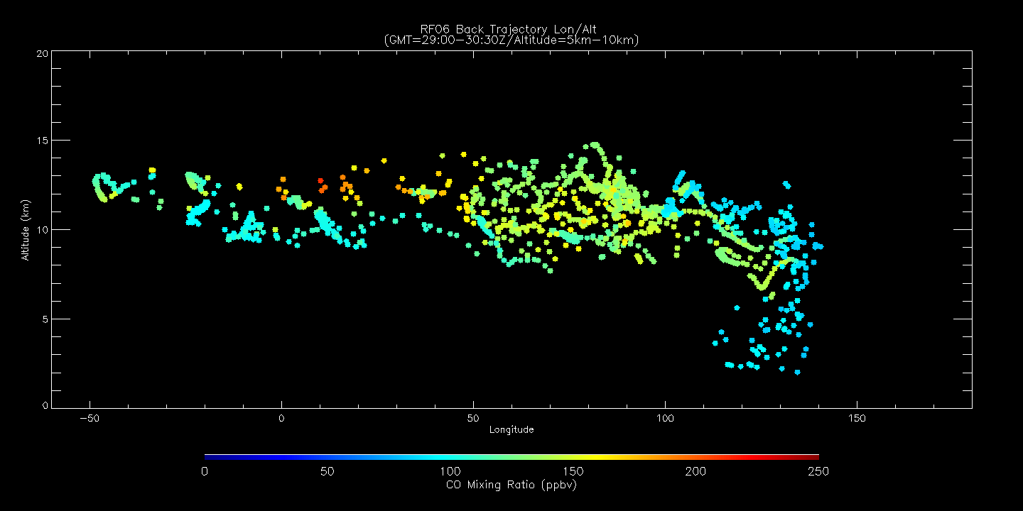
Lat/Lon
5 day
6 day
Back trajectory CO shows high (low) O3 in 6 (5) day cluster with origin at ~10E/15N/12km (~10W/20N/10km)
Lat/Alt
Lon/Alt

Slide 6
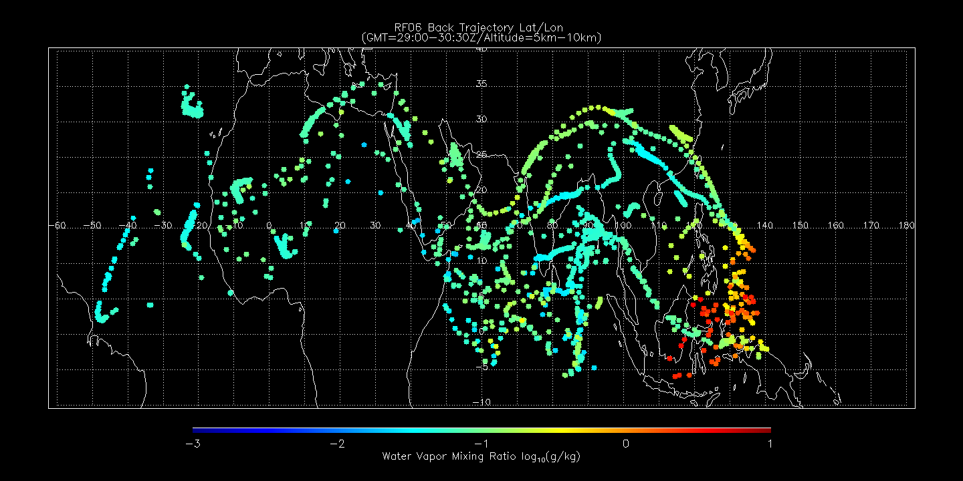
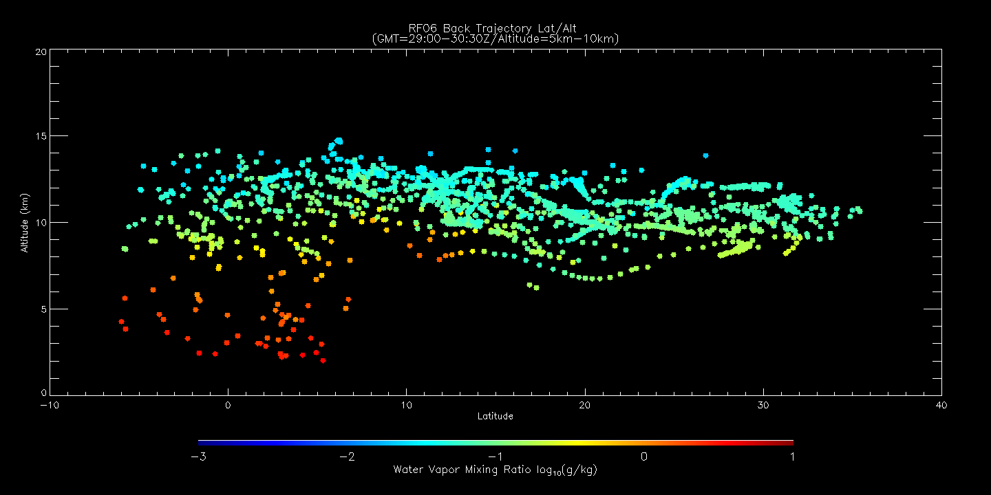
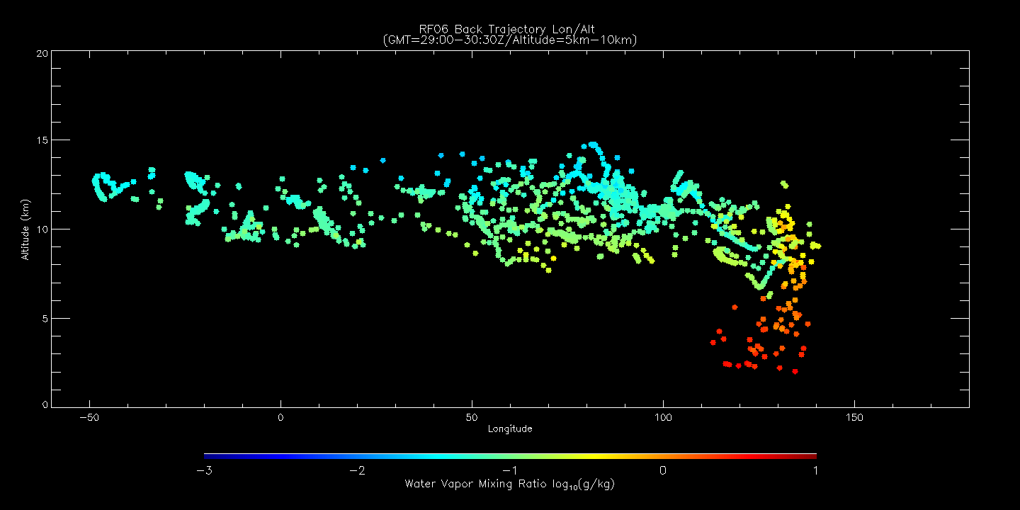
Lat/Lon
5 day
6 day
Back trajectory WV shows low WV in 6 (5) day cluster with origin at ~10E/15N/12km (~10W/20N/10km)
Lat/Alt
Lon/Alt

Slide 7
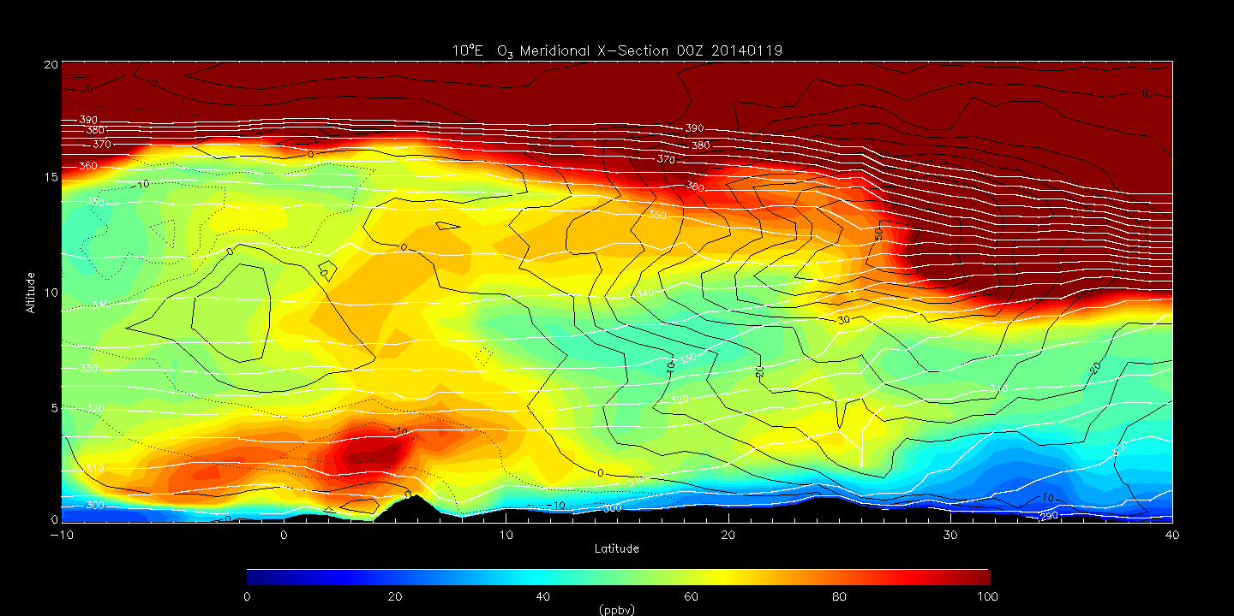
RAQMS analyzed O3 Meridional X-Section at 10E at 00Z on 20140119
(6 days prior to 00Z on 20140125)
350K isentrope intersects 6 day cluster with high O3

Slide 8
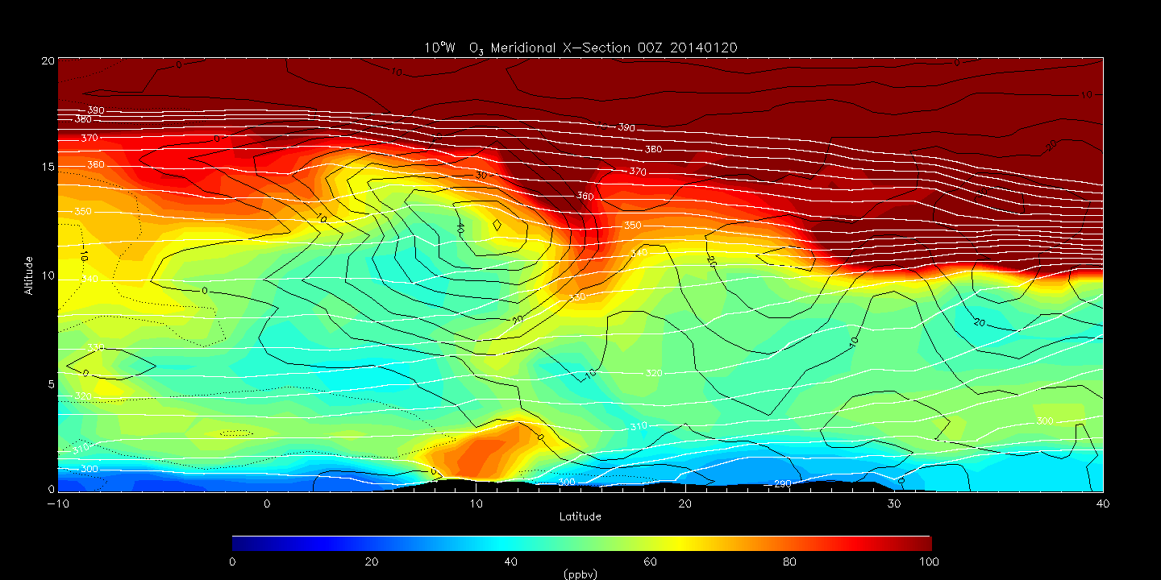
RAQMS analyzed O3 Meridional X-Section at 10W at 00Z on 20140120
(5 days prior to 00Z on 20140125)
340K isentrope intersects 5 day cluster with high O3

Slide 9
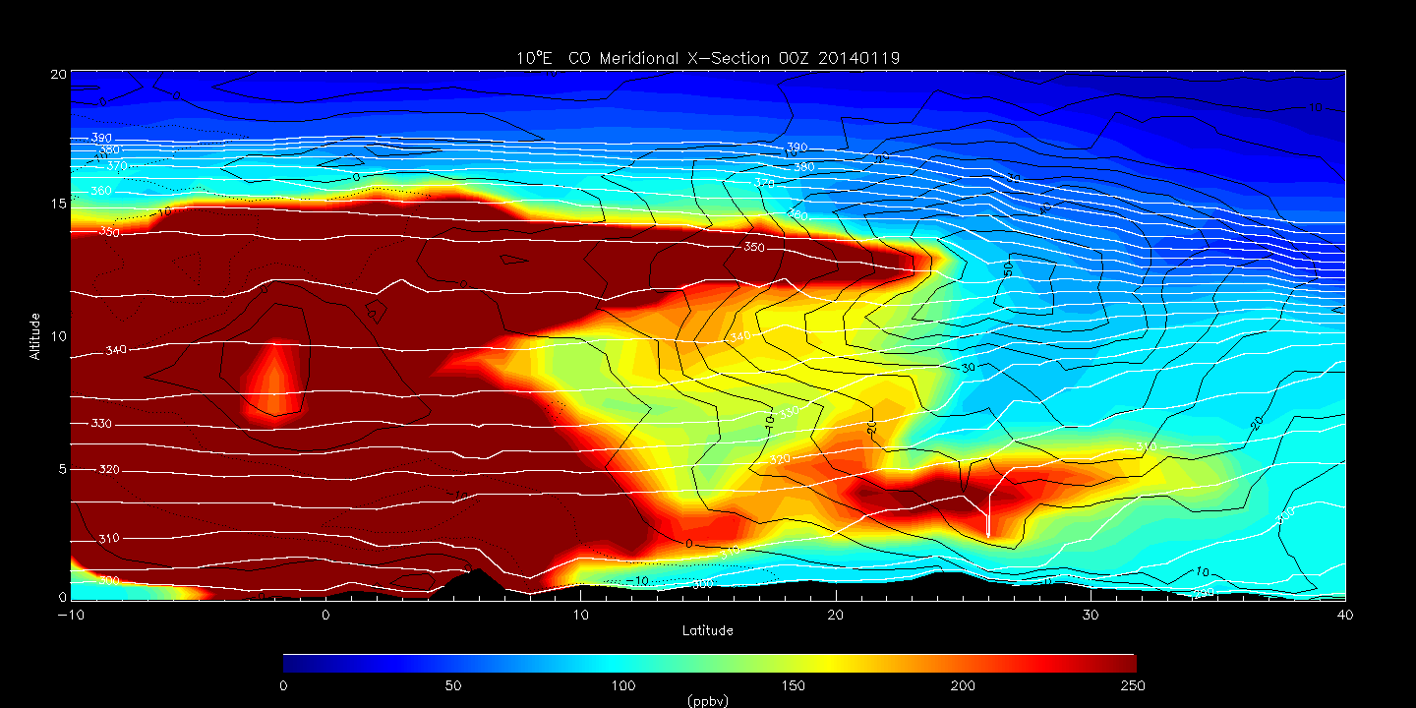
RAQMS analyzed CO Meridional X-Section at 10E at 00Z on 20140119
(6 days prior to 00Z on 20140125)
350K isentrope intersects 6 day cluster with high CO

Slide 10
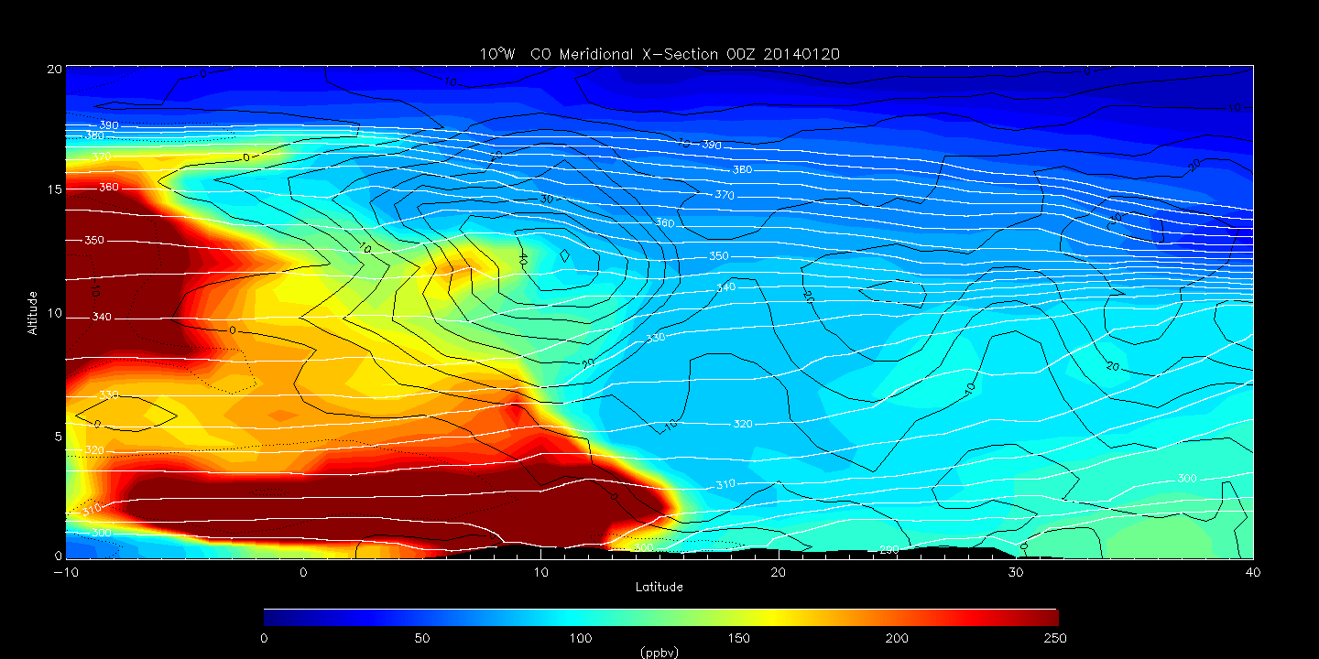
RAQMS analyzed CO Meridional X-Section at 10W at 00Z on 20140120
(5 days prior to 00Z on 20140125)
340K isentrope intersects 5 day cluster with low CO

Slide 11
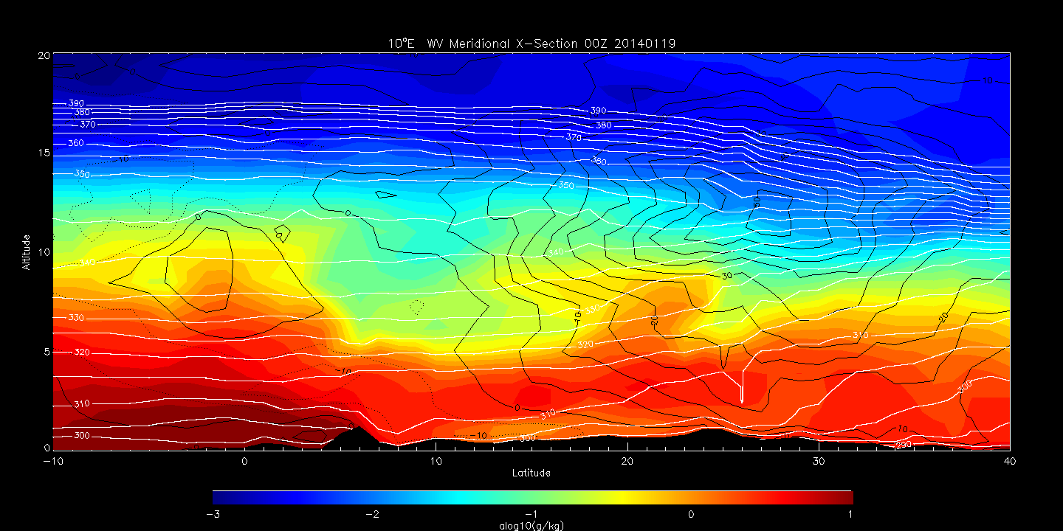
RAQMS analyzed WV Meridional X-Section at 10E at 00Z on 20140119
(6 days prior to 00Z on 20140125)
350K isentrope intersects 6 day cluster with low WV

Slide 12
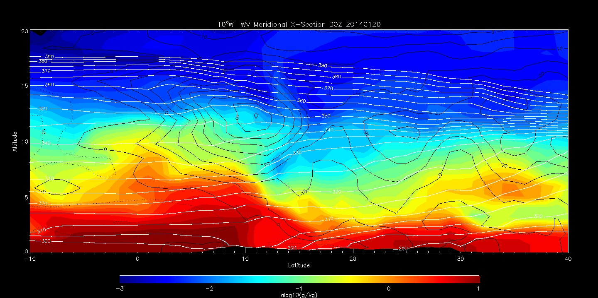
RAQMS analyzed WV Meridional X-Section at 10W at 00Z on 20140120
(5 days prior to 00Z on 20140125)
340K isentrope intersects 5 day cluster with low WV

Slide 13
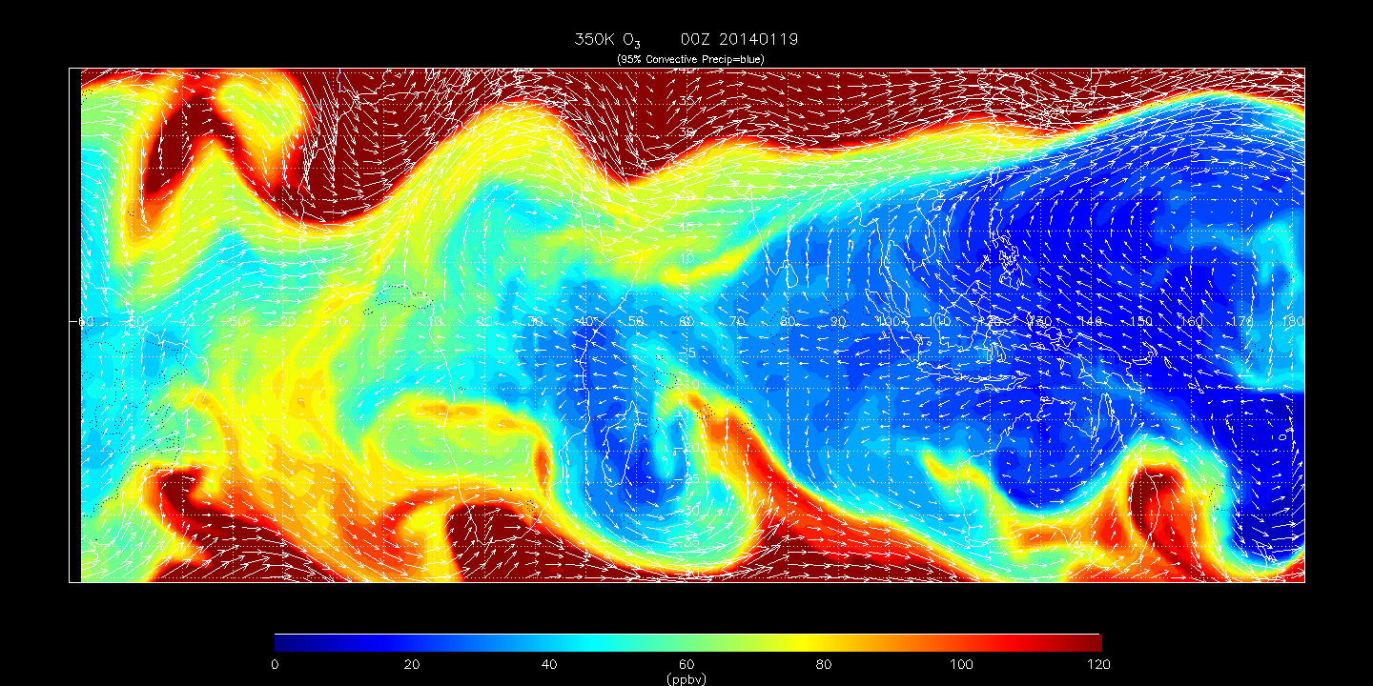
RAQMS analyzed 350K O3 at 00Z on 20140219 (6 days prior to 00Z on 20140125)
Location of RF06 6 day cluster with origin at ~10E/15N/12km

Slide 14
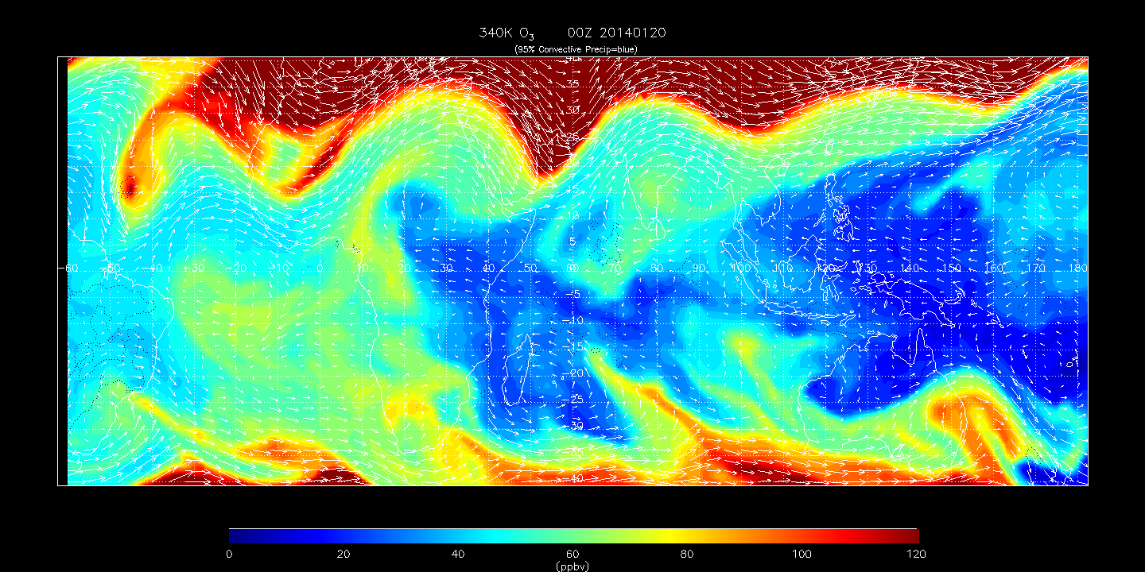
RAQMS analyzed 340K O3 at 00Z on 20140220 (5 days prior to 00Z on 20140125)
Location of RF06 5 day cluster with origin at ~10W/20N/10km

Slide 15
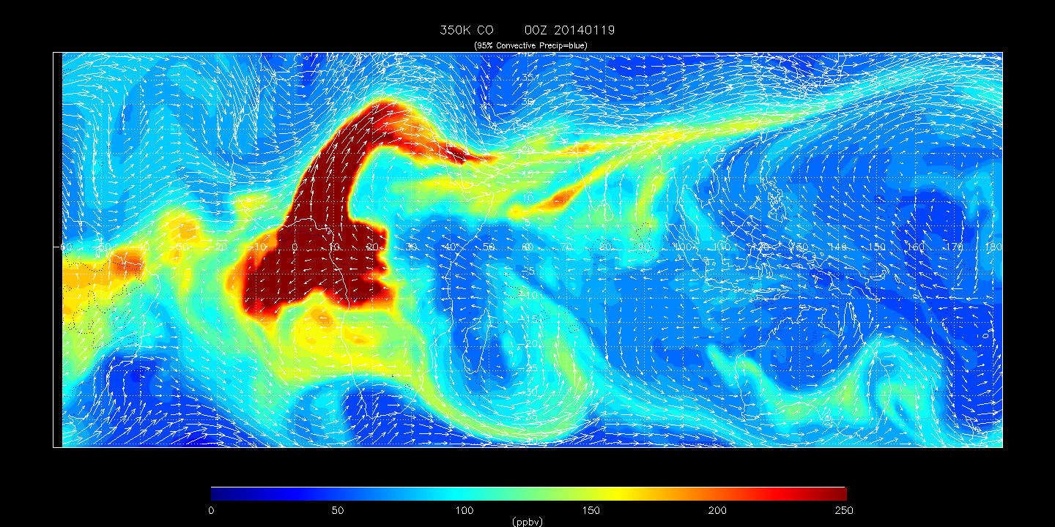
RAQMS analyzed 350K CO at 00Z on 20140219 (6 days prior to 00Z on 20140125)
Location of RF06 6 day cluster with origin at ~10E/15N/12km

Slide 16
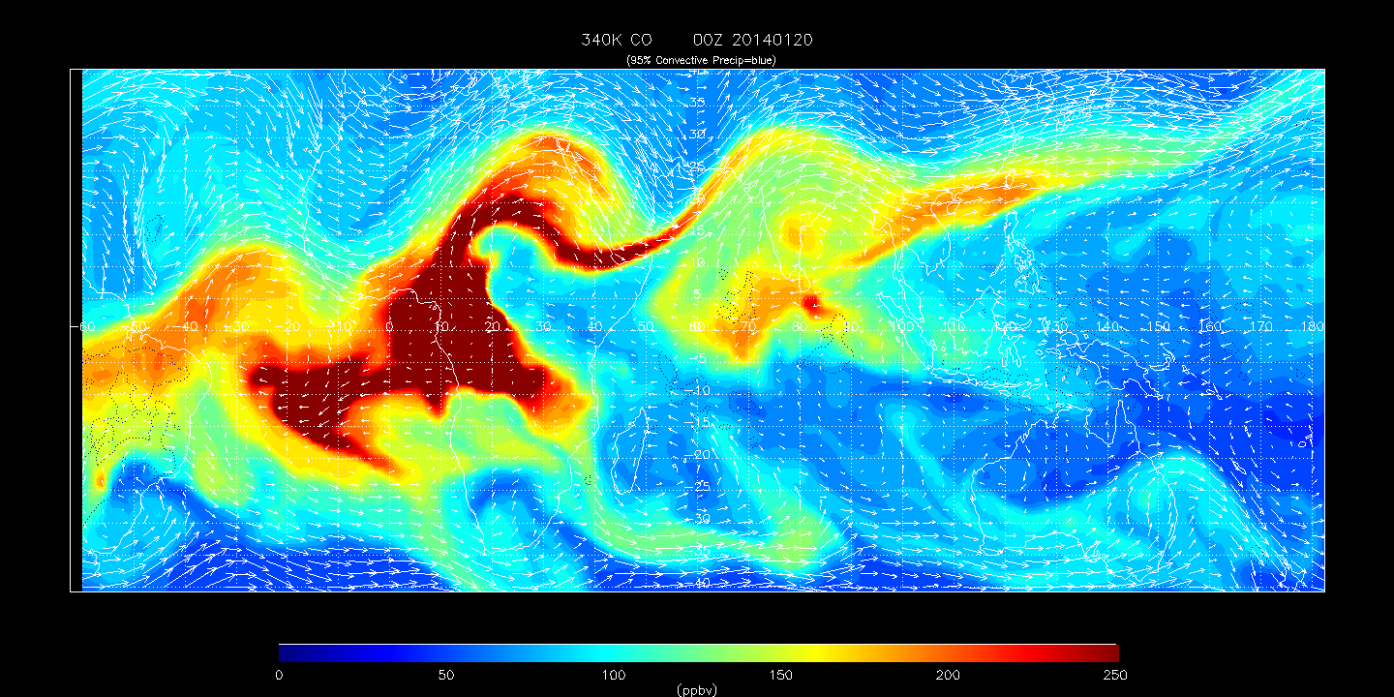
RAQMS analyzed 340K CO at 00Z on 20140220 (5 days prior to 00Z on 20140125)
Location of RF06 5 day cluster with origin at ~10W/20N/10km

Slide 17
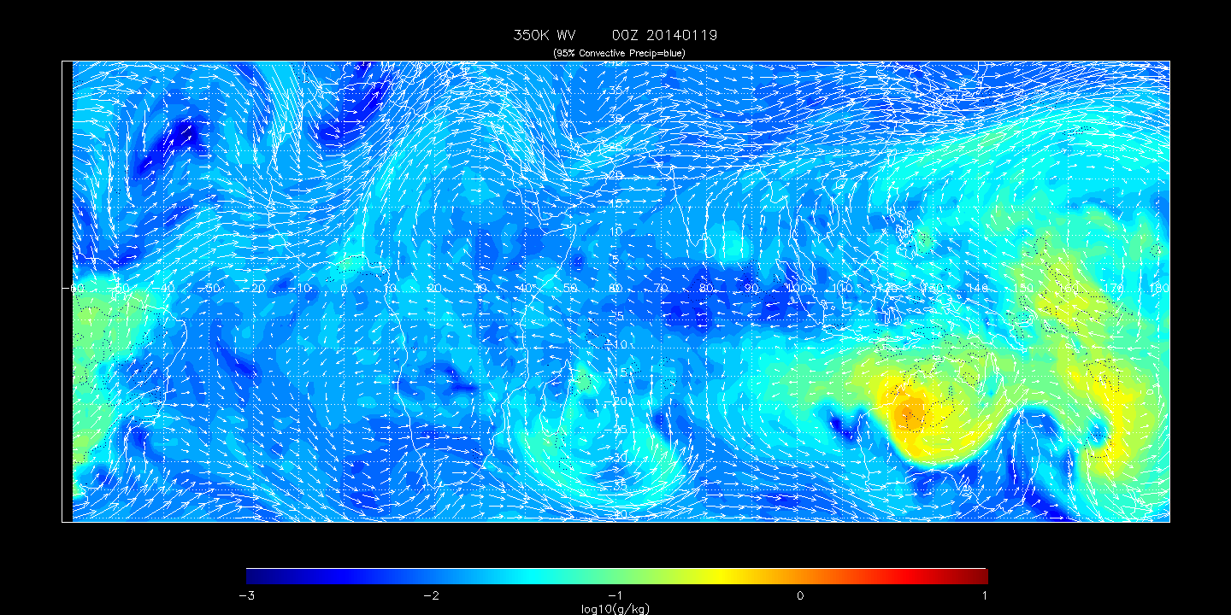
RAQMS analyzed 350K WV at 00Z on 20140219 (6 days prior to 00Z on 20140125)
Location of RF06 6 day cluster with origin at ~10E/15N/12km

Slide 18
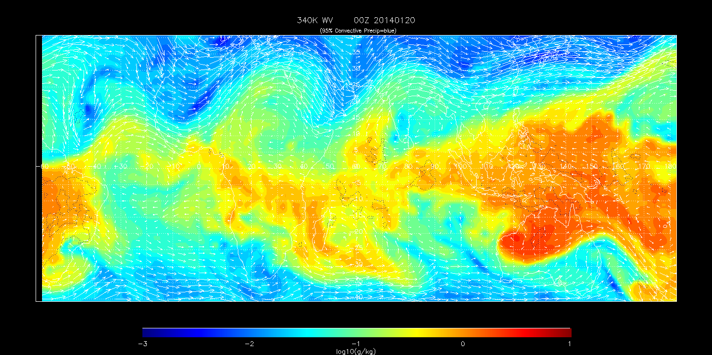
RAQMS analyzed 340K WV at 00Z on 20140220 (5 days prior to 00Z on 20140125)
Location of RF06 5 day cluster with origin at ~10W/20N/10km

Slide 19
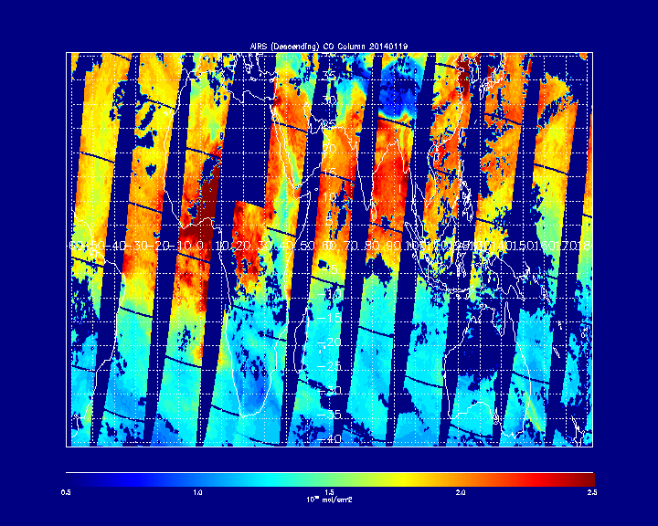
AIRS V6 Total Column CO on 20140219 (6 days prior to 00Z on 20140125)
Location of RF06 6 day cluster with origin at ~10E/15N/12km

Slide 20
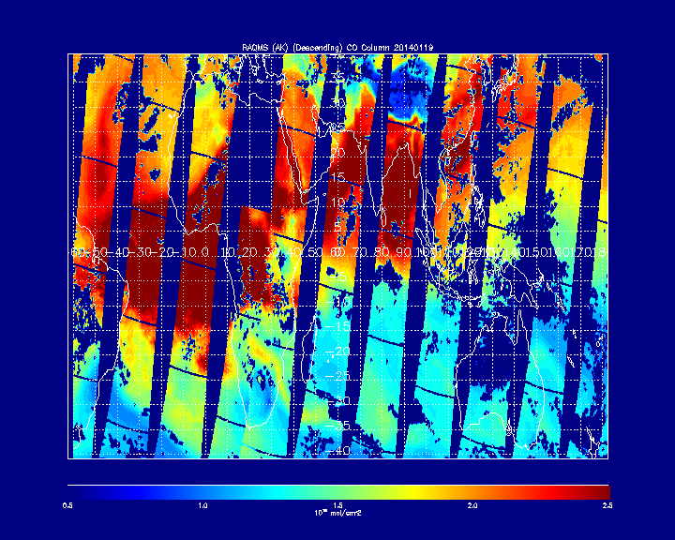
RAQMS (with AIRS V6 Averaging Kernel) Total Column CO on 20140219 (6 days prior to 00Z on 20140125) – RAQMS overestimates Column CO compared to AIRS
Location of RF06 6 day cluster with origin at ~10E/15N/12km

Slide 21
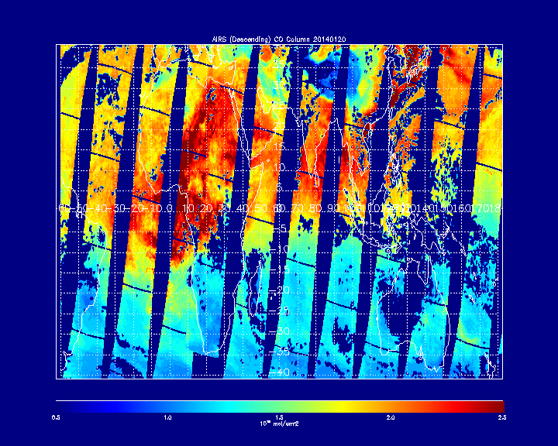
AIRS V6 Total Column CO on 20140220 (5 days prior to 00Z on 20140125)
Location of RF06 5 day cluster with origin at ~10W/20N/10km

Slide 22
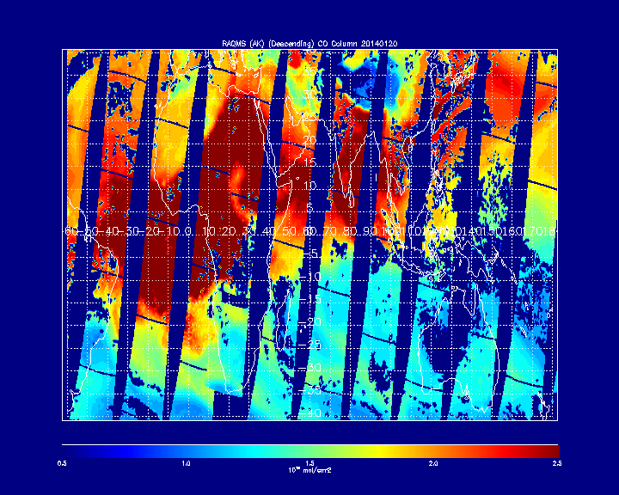
RAQMS (with AIRS V6 Averaging Kernel) Total Column CO on 20140220 (5 days prior to 00Z on 20140125) – RAQMS overestimates Column CO compared to AIRS
Location of RF06 5 day cluster with origin at ~10W/20N/10km

