Slide 1
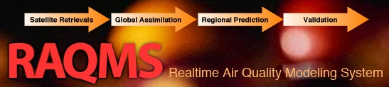

Online global chemical and aerosol assimilation/forecasting system
Brad Pierce
NOAA/NESDIS/CIMSS
Allen Lenzen, Todd Schaack, Donald Johnson, Tom Zapotocny
SSEC
Jassim Al-Saadi, Murali Natarajan, Jennifer Olson, Chieko Kittaka
NASA/LaRC
Matt Hitchman, Greg Tripoli
UW-Madison AOS
http://raqms-ops.ssec.wisc.edu/index.php (North America/Pacific Sector)
http://raqms.ssec.wisc.edu/index.php (CONUS)
Notes:
1

Slide 2
Online global chemical and aerosol assimilation/forecasting system
Modeling Framework (1x1 degree):
UW-Madison hybrid θ−η coordinate model (UW-Hybrid) dynamical core
Unified stratosphere/troposphere chemical prediction scheme developed at NASA LaRC
Aerosol prediction scheme (GOCART) developed by Mian Chin (NASA GSFC).
Statistical Digital Filter (SDF) aerosol and chemical data assimilation developed by Jim Stobie (NASA GSFC)
Real-time assimilation:
Microwave Limb Sounder (MLS) stratospheric ozone profiles (above 50mb)
Ozone Monitoring Instrument (OMI) total ozone column (cloud cleared)
Moderate Resolution Imaging Spectroradiometer (MODIS) Aerosol Optical Depth (AOD)
Real-time fire detection:
Moderate Resolution Imaging Spectroradiometer (MODIS)
Developed in partnership with NASA LaRC and maintained at UW-Madison
http://raqms-ops.ssec.wisc.edu/index.php (North America/Pacific Sector)
http://raqms.ssec.wisc.edu/index.php (CONUS)
Notes:
2

Slide 3
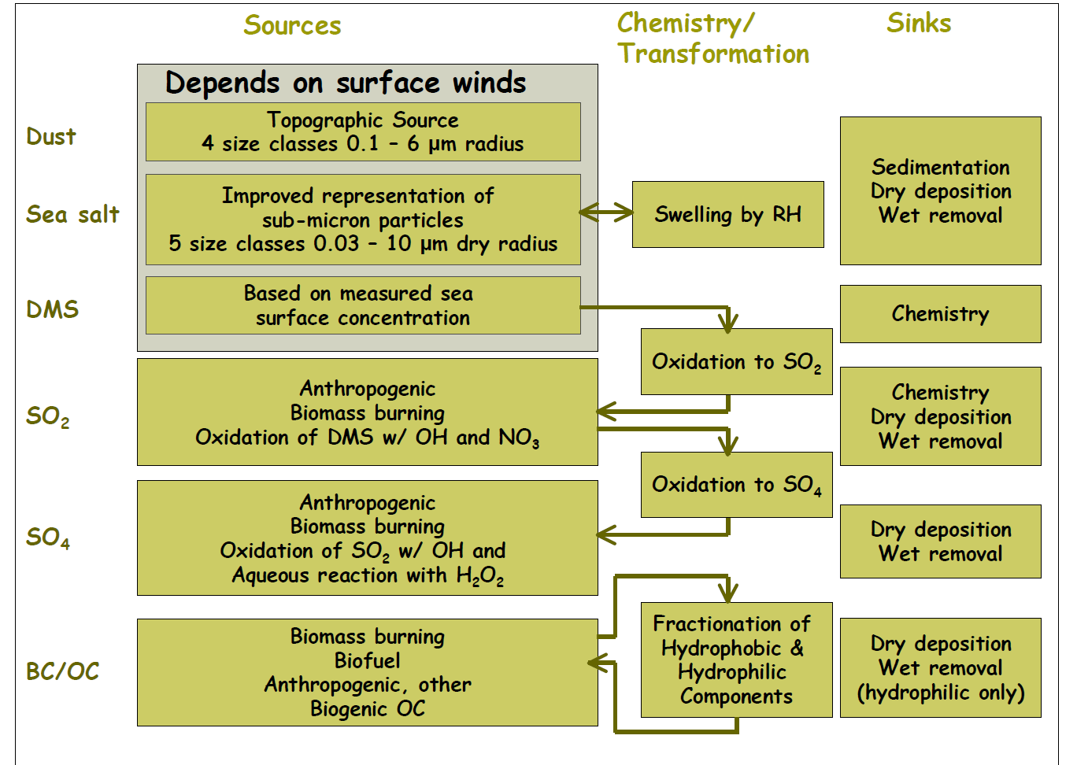
GOCART Aerosol Module

Slide 4


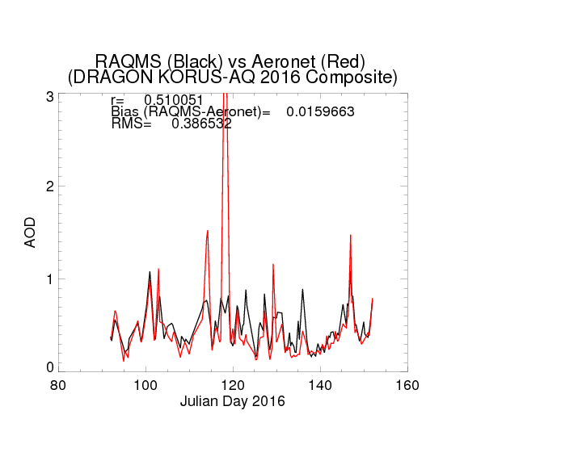
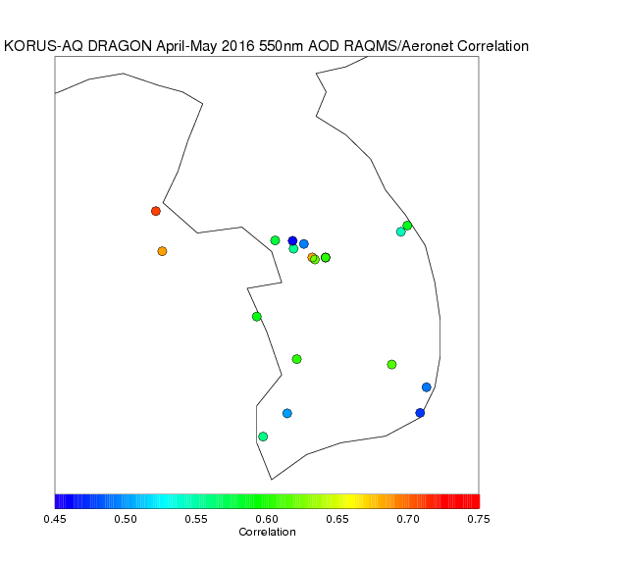
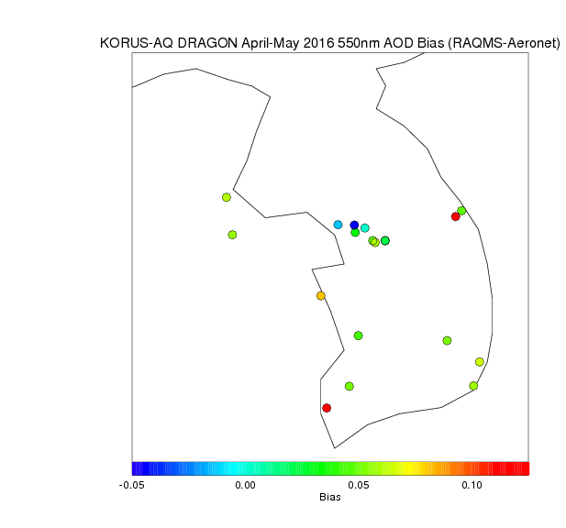
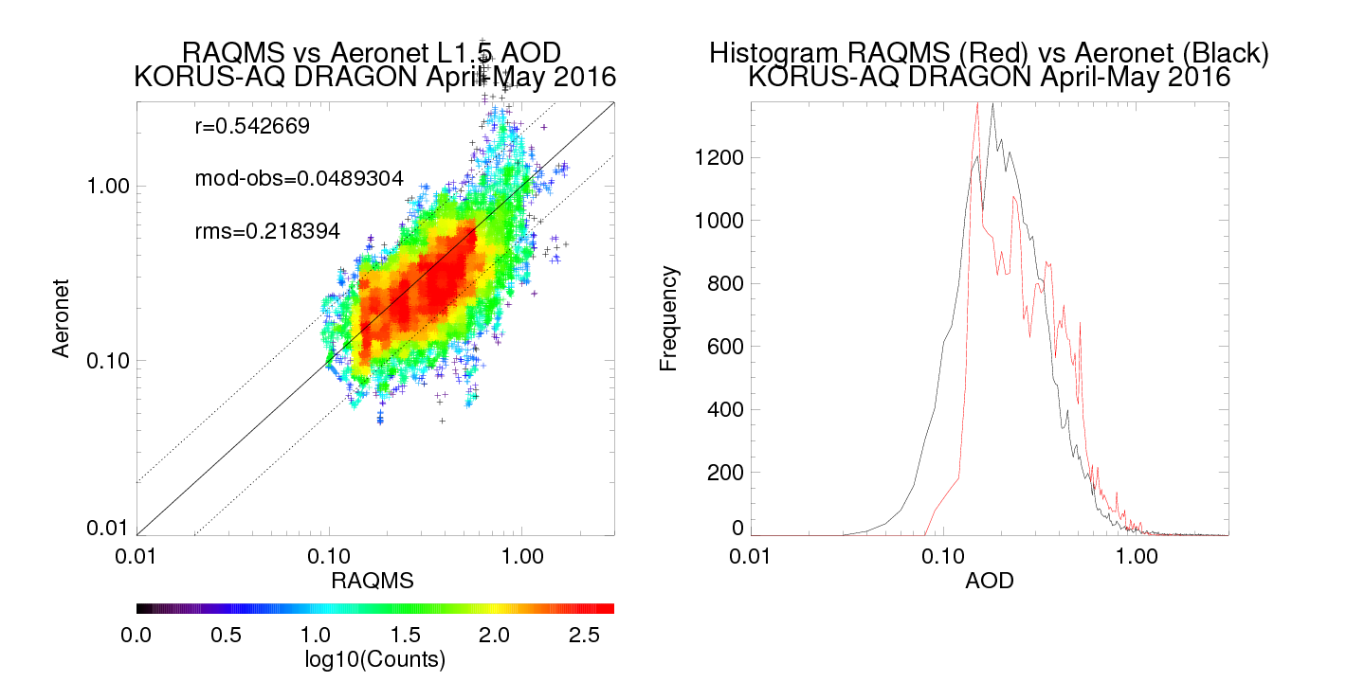
Cirrus?
Focus
Good quantitative agreement with aerosol optical depth observed by the Aeronet KORUS-AQ DRAGON Network during April 01-20, 2016 (Julian Day 92-111) focus period
https://aeronet.gsfc.nasa.gov/

Slide 5
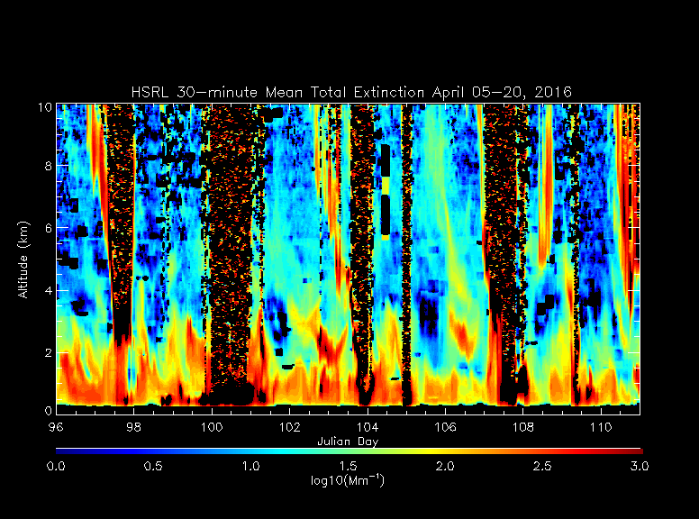
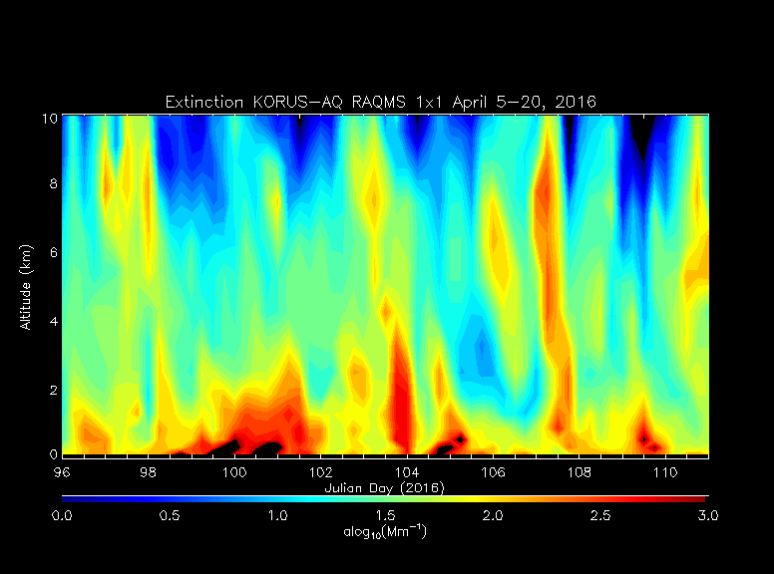
HSRL Observed Extinction Profile
University of Wisconsin Lidar Group
(Ed Eloranta)
Good qualitative agreement in vertical distribution of aerosol extinction with High Spectral Resolution Lidar (HSRL) deployed to Seoul, South Korea
RAQMS Analyzed Extinction Profile
Very high extinction (>3000Mm or <0.81mile/1.3km visual range) during April 09-11 (Julian Days 100-102)
http://lidar.ssec.wisc.edu/

Slide 6
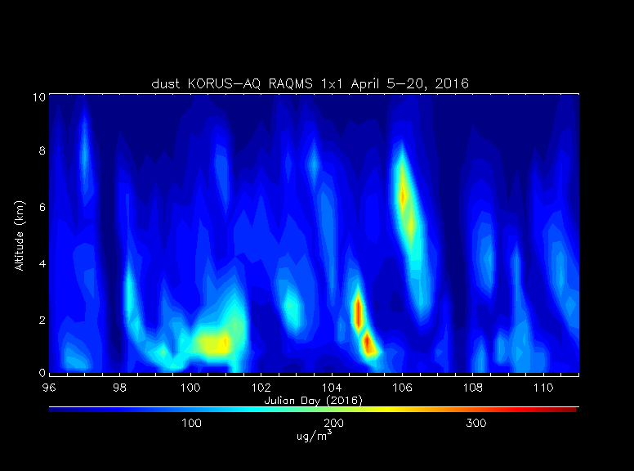
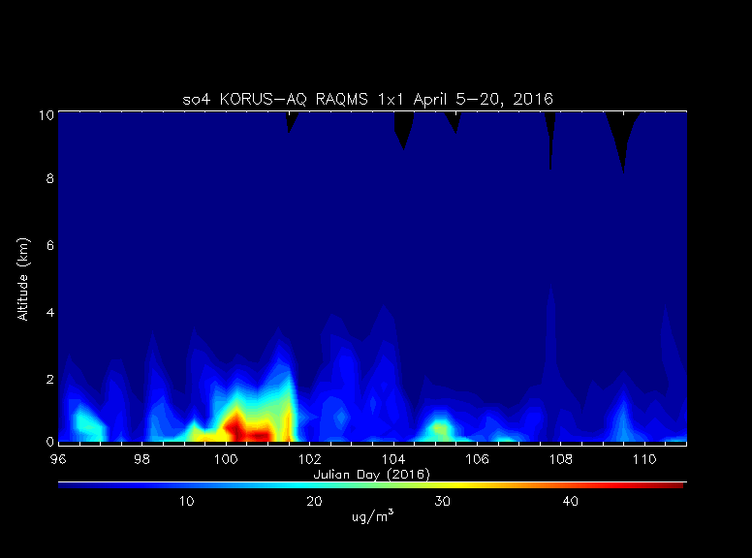
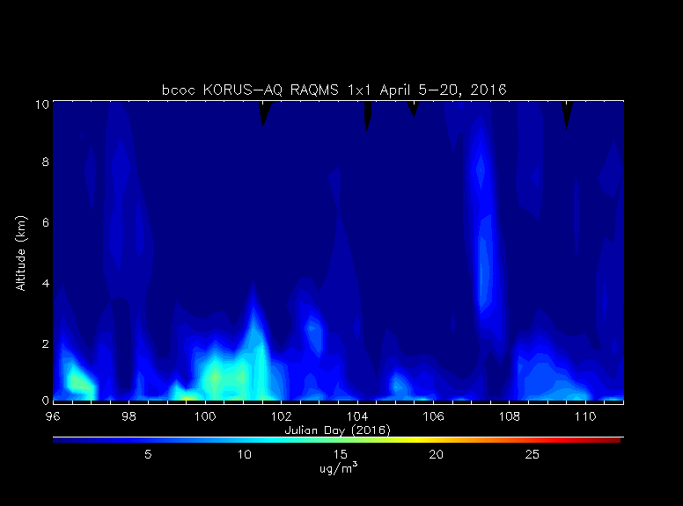
RAQMS Analyzed Dust concentration
RAQMS Analyzed Sulfate concentration
April 09-11. 2016 event includes Dust, Sulfate (so4), and black and organic carbon (bcoc) contributions
RAQMS Analyzed Extinction Profile
Black and Organic Carbon concentration

Slide 7
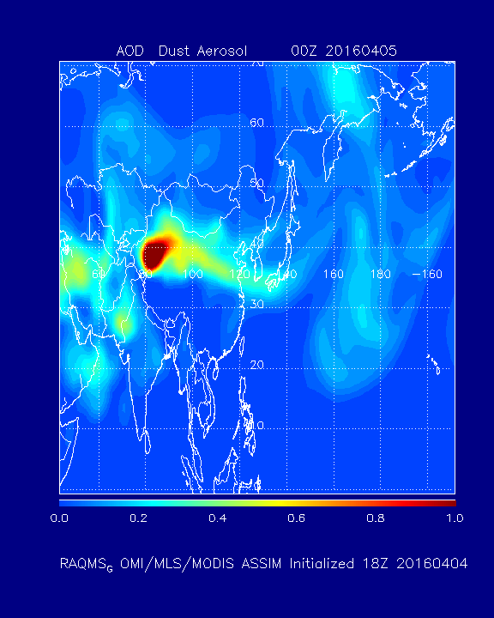
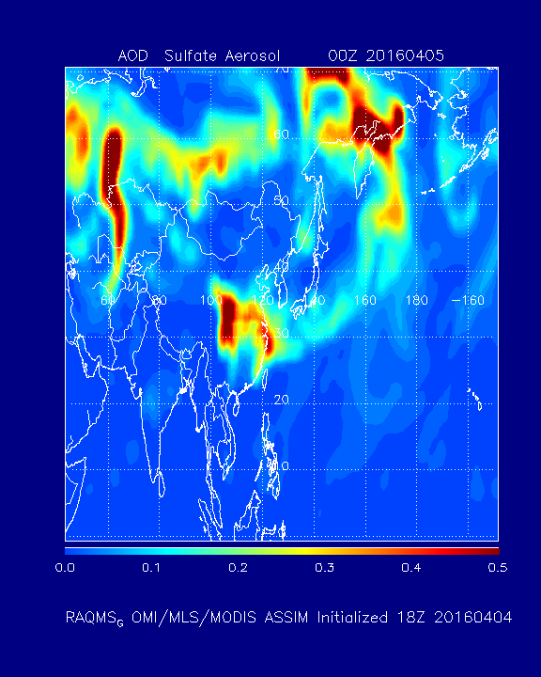
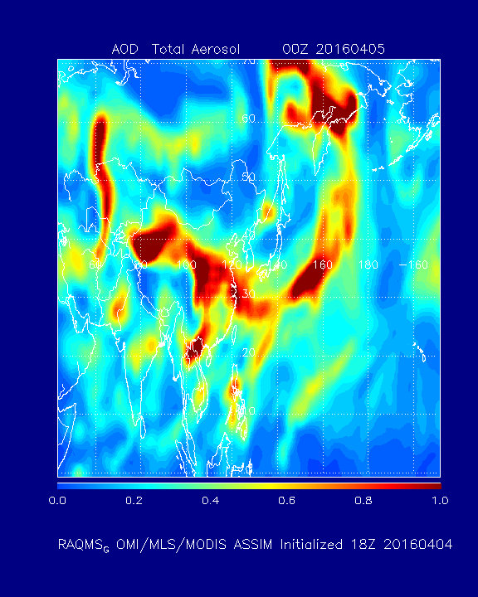
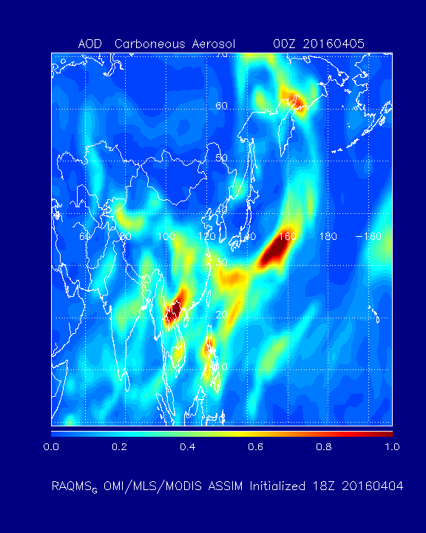
RAQMS Analyzed Dust AOD
RAQMS Analyzed Sulfate AOD
Taklimakan Desert (Dust)
Sichuan Province (Sulfate)
RAQMS Analyzed Total AOD
RAQMS Analyzed Carboneous AOD
Laos (Carboneous)

Slide 8
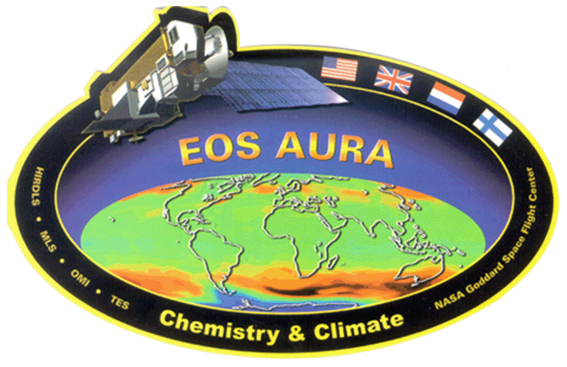
RAQMS Aura Chemical Reanalysis: 2006-2016
Project Summary
  Utilize the Real-time Air Quality Modeling System (RAQMS) to conduct a multi-year global chemical and aerosol reanalysis using NASA Aura and A-Train measurements.
  Follows the path lead by the European Center for Medium Range Weather Forecasting (ECMWF) for development of operational air quality forecasting (http://atmosphere.copernicus.eu/)
  Provides a comprehensive chemical and aerosol analyses for assessing global air quality and for providing lateral boundary conditions for regional air quality management activities.
Assimilated Satellite Data (NOAA GSI Analysis Scheme)
Terra/Aqua MODIS Aerosol Optical Depth and Fire Detection
Aqua AIRS Carbon Monoxide Retrieval
Aura MLS and OMI ozone Retrievals
Aura OMI Tropospheric NO2 Retrievals
New
Funded by the NASA Health and Air Quality Applications Program
Notes:
Monitoring Atmospheric Composition and Climate - Interim Implementation (MACC-II) project

Slide 9
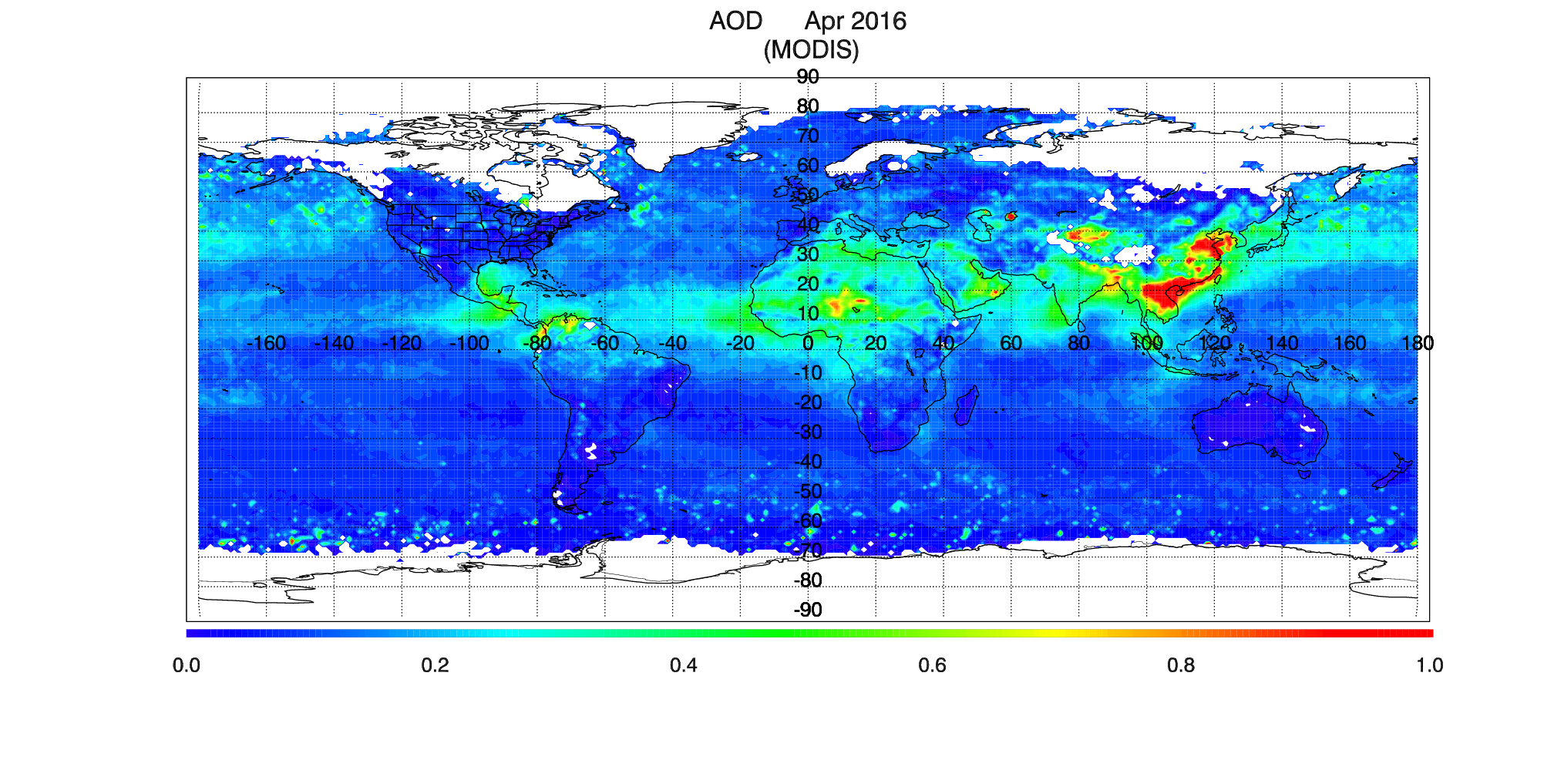
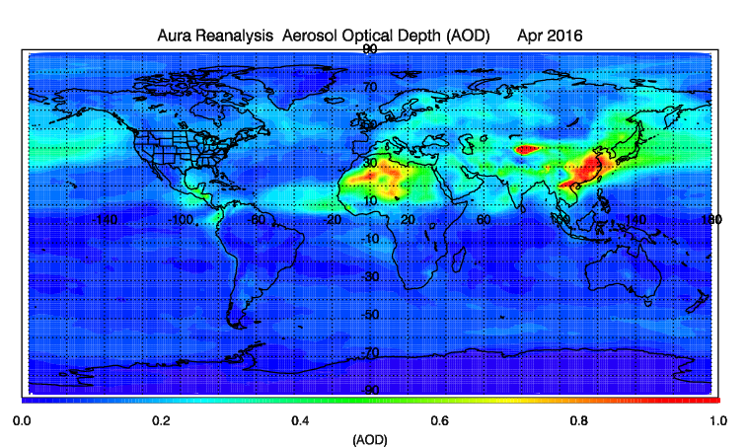
RAQMS Aura Aerosol Reanalysis: April 2016
MODIS Aqua Combined Dark Target and Deep Blue AOD
RAQMS Aura Reanalysis AOD

Slide 10
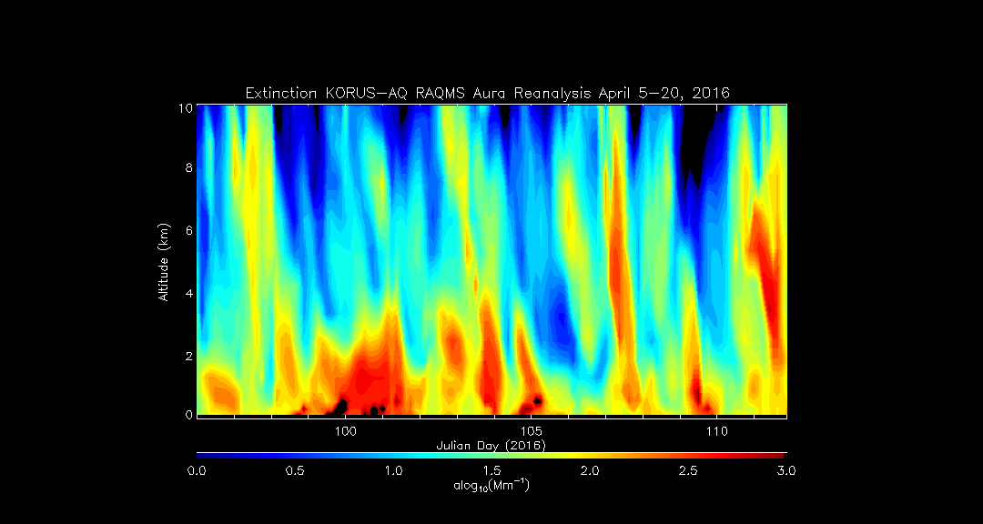

HSRL Observed Extinction Profile
University of Wisconsin Lidar Group
(Ed Eloranta, eloranta@lidar.ssec.wisc.edu)
RAQMS Aura Reanalysis (1x1 degree global full chemistry+aerosols) is available at 3 hour intervals from January 2006-December 2016) for anyone interested!
Aura Re-analysis reduces mid-tropospheric background and improves agreement with HSRL Observations
(GSI MODIS AOD assimilation, cirrus virga parameterization)
RAQMS Analyzed Extinction Profile
http://lidar.ssec.wisc.edu/

Slide 11
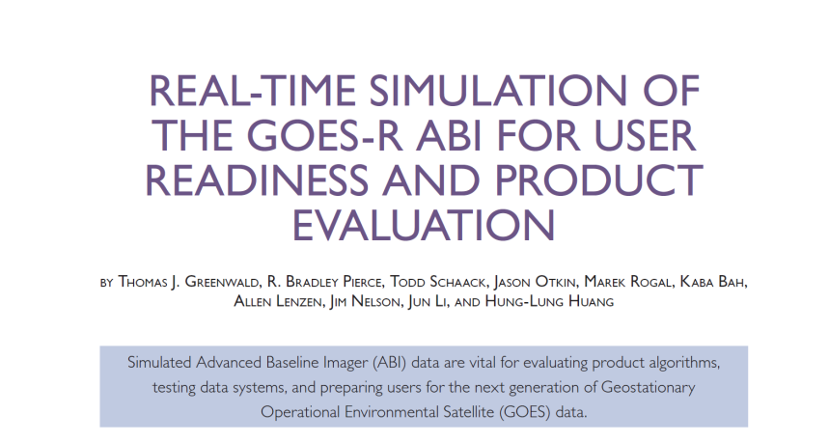
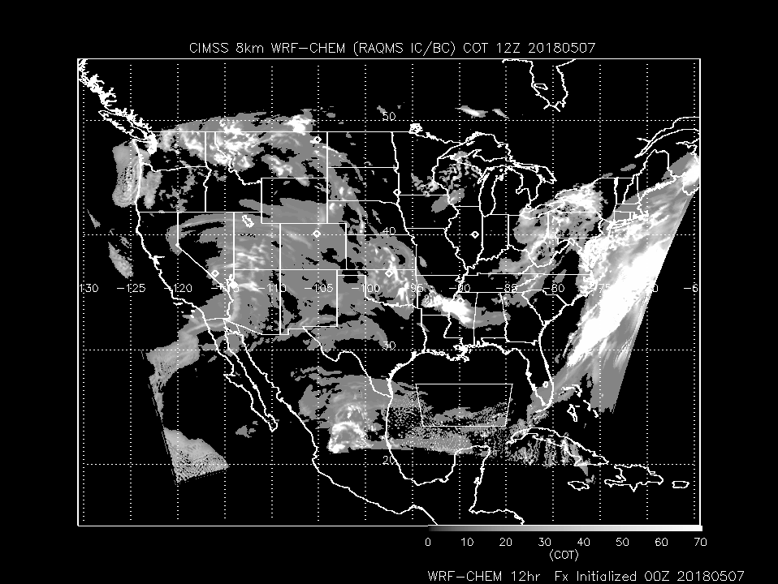
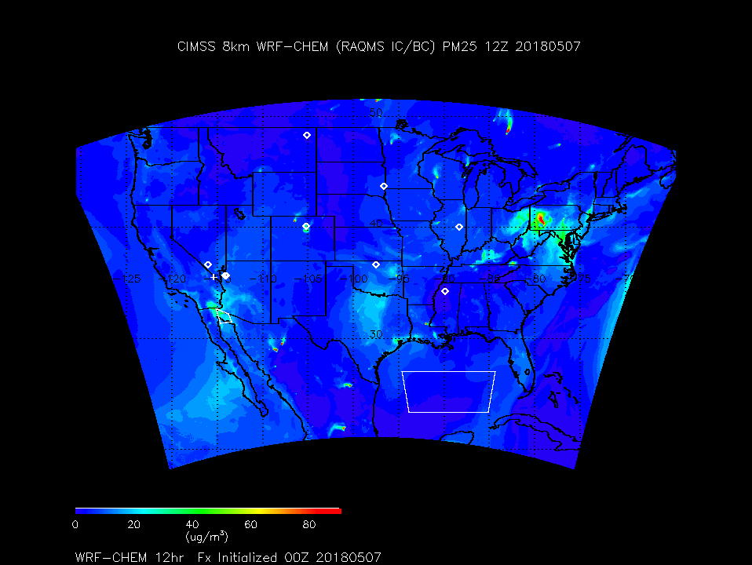
Regional Aerosol Forecasting: Nested RAQMS/WRF-Chem
8km (cloud resolving) Weather Research and Forecasting (WRF) Model coupled with chemistry (WRF-Chem) using GOCART Aerosol scheme
Aerosol initial conditions and boundary conditions obtained from RAQMS
https://doi.org/10.1175/BAMS-D-14-00007.1

Slide 12
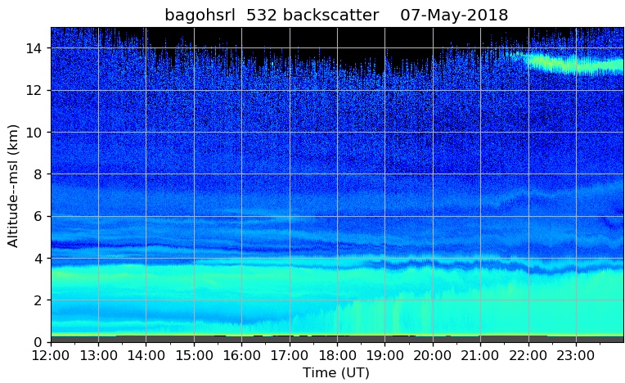
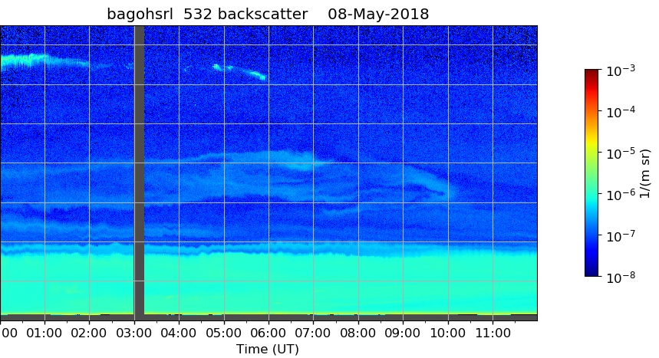
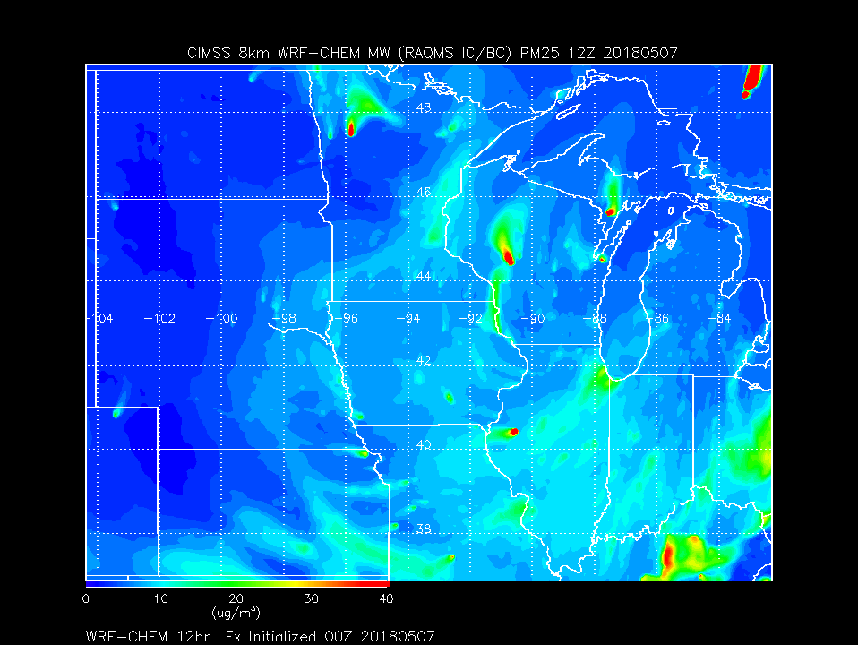
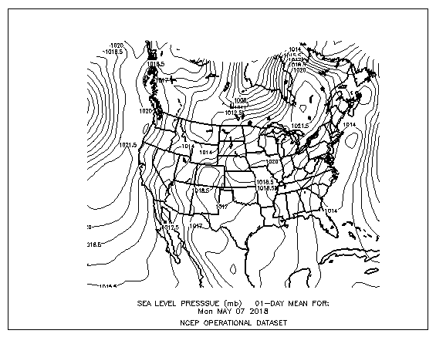
University of Wisconsin Lidar Group
(Ed Eloranta)
High pressure system over Wisconsin bringing PM2.5 in from the South

Slide 13
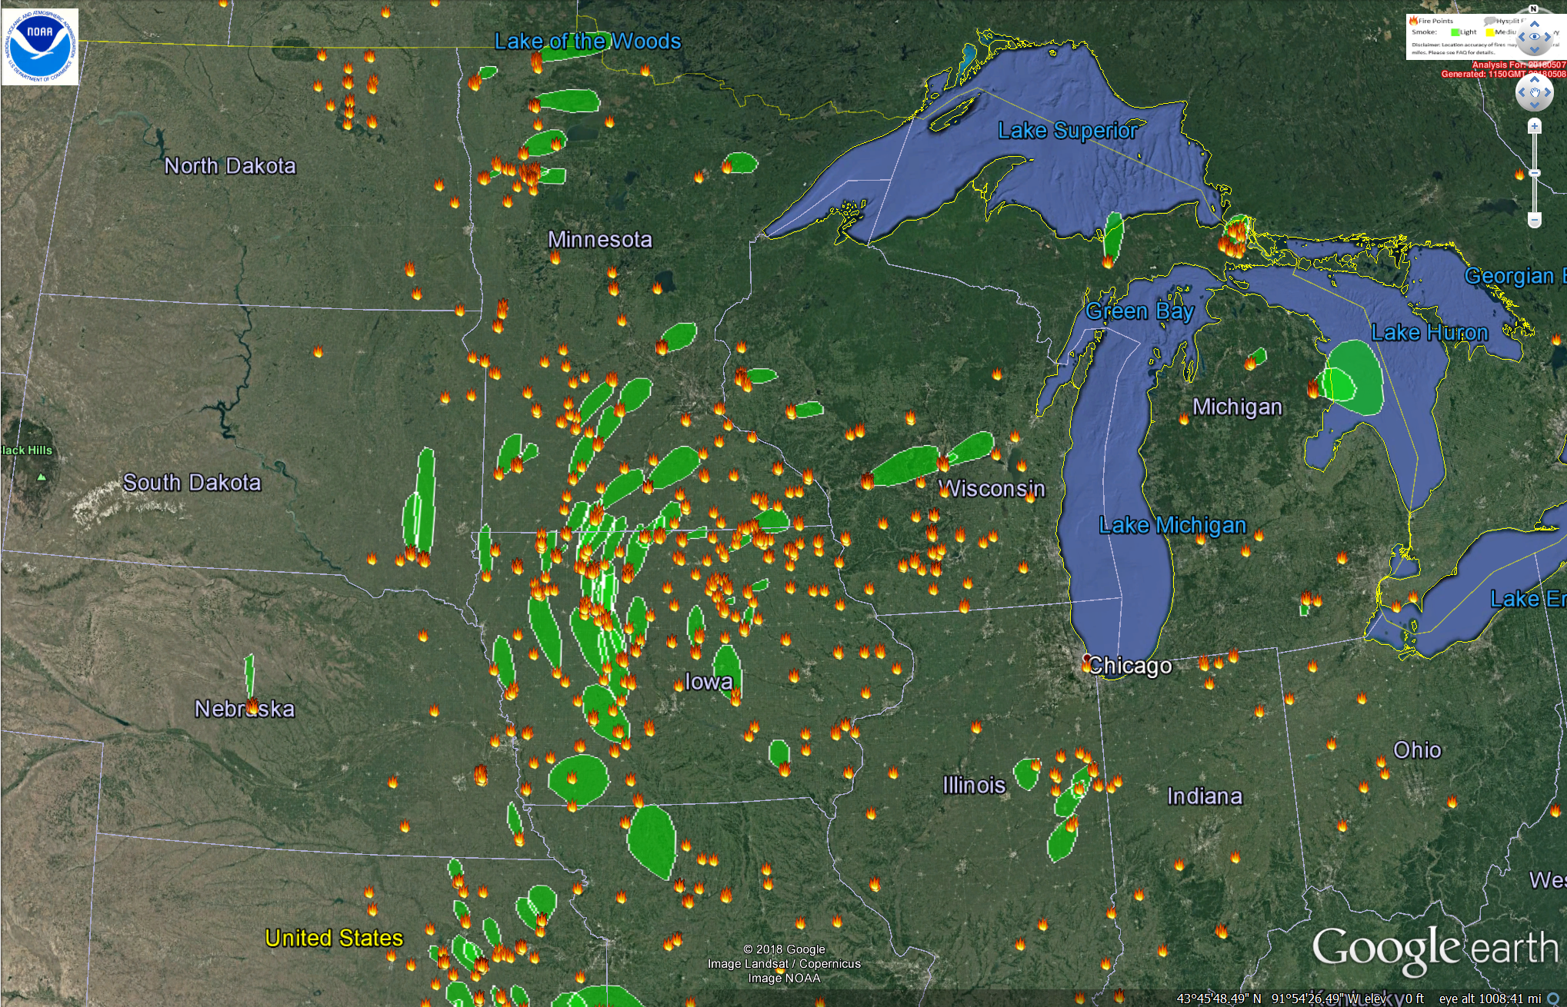
NESDIS Hazard Mapping System 05/07/2018
Much of Midwest aerosol enhancements due to agricultural biomass burning
http://satepsanone.nesdis.noaa.gov/cgi-bin/fire_viirs.pl

Slide 14
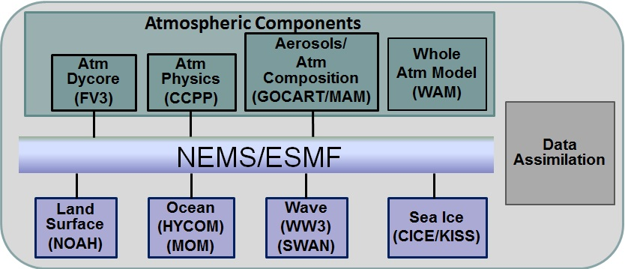
NOAA Next Generation Global Prediction System (NGGPS)
Finite Volume (FV3) dynamical core (GFDL/GMAO)
NOAA/ESRL implementing GOCART Aerosol
NESDIS/SSEC implementing RAQMS reduced chemistry (Development on S4)

