Slide 1
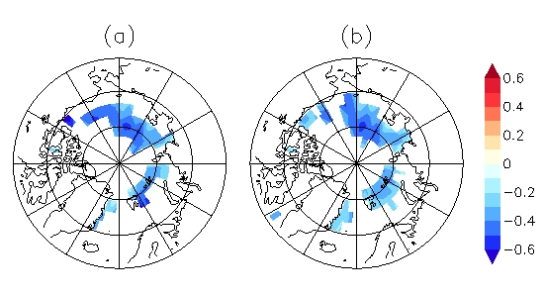
Advances in Real-time Assimilation of Satellite Trace Gas and Aerosol Retrievals for Air Quality Forecasting
CIMSS Science Symposium
Thursday 17 April 2014
R. Bradley Pierce NOAA/NESDIS/STAR @ CIMSS Todd Schaack and Allen Lenzen UW-Madison/SSEC

Slide 2
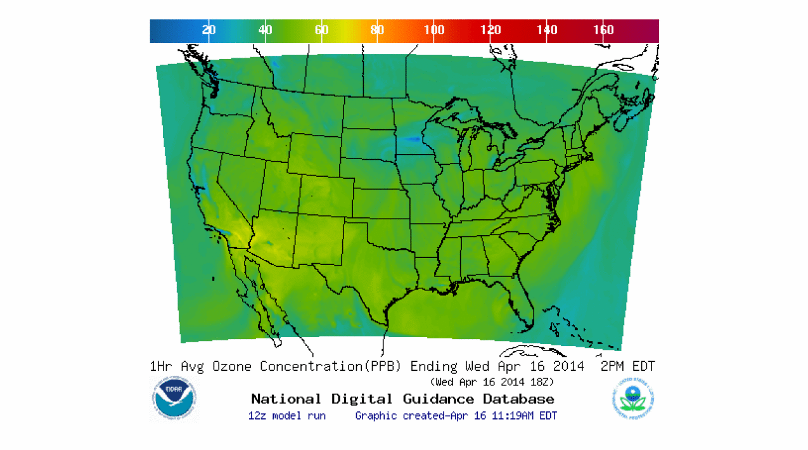
Background
NWS National Air Quality Forecasting Capability (NAQFC) provides operational predictions of ozone and wildfire smoke nationwide and operational predictions of airborne dust over the contiguous 48 states.
http://airquality.weather.gov/

Slide 3
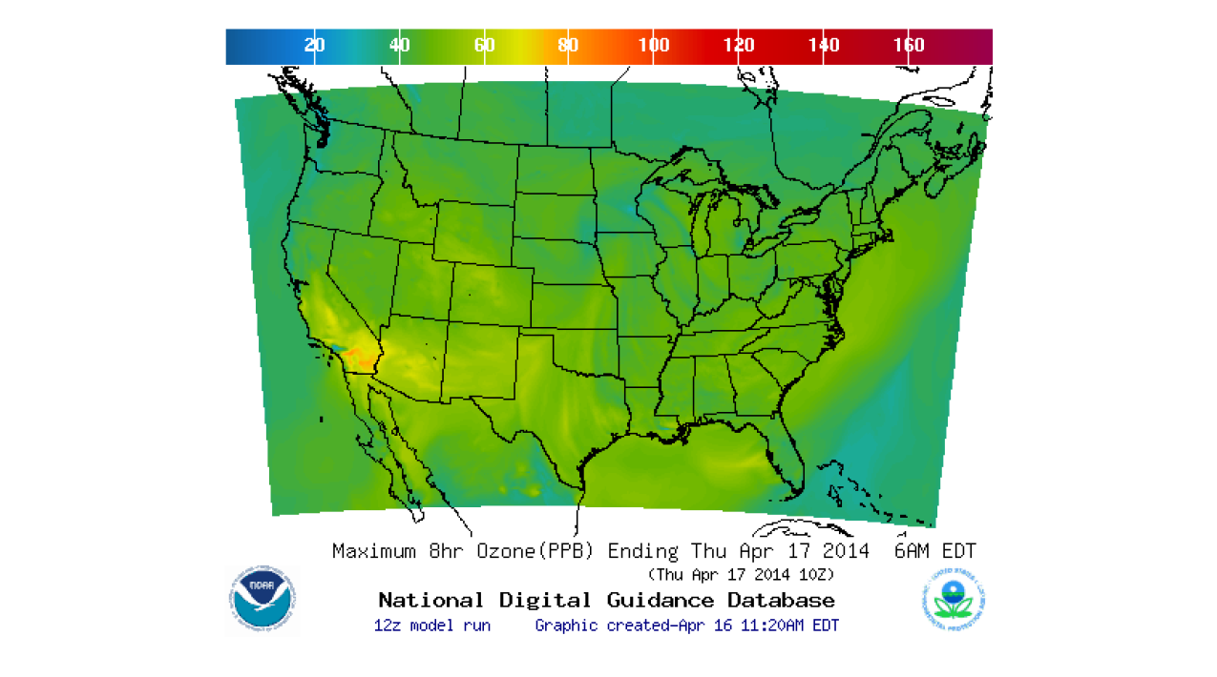
Background
State and local Air Quality forecasters use the NWS forecast guidance to determine whether the surface ozone will exceed the National Ambient Air Quality Standards (NAAQS) of maximum 8hr average ozone > 75ppbv.
http://airquality.weather.gov/

Slide 4
Focus of this presentation
Impacts of intercontinental pollution transport and stratosphere/tropospheric exchange processes on regional scale air quality predictions
Advances in real-time trace gas and aerosol assimilation within the Real-time Air Quality Modeling System (RAQMS)
Collaborative NESDIS/ESRL real-time nested global/regional air quality forecasting

Slide 5
Online global chemical and aerosol assimilation/forecasting system
UW-Hybrid Dynamical Core
Real-time assimilation:
Microwave Limb Sounder (MLS) stratospheric ozone profiles (above 50mb)
Ozone Monitoring Instrument (OMI) total ozone column (cloud cleared)
Moderate Resolution Imaging Spectroradiometer (MODIS) Aerosol Optical Depth (AOD)
Real-time fire detection:
Moderate Resolution Imaging Spectroradiometer (MODIS)
RAQMS has been used to develop capabilities to assimilate global satellite composition measurements and support airborne field missions
http://raqms-ops.ssec.wisc.edu/

Slide 6
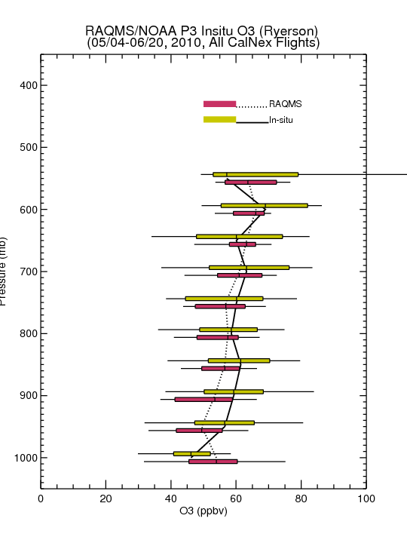
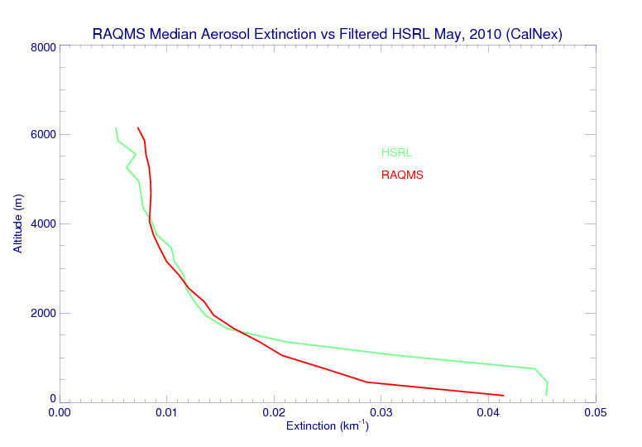
Comparison with CalNex airborne Measurements
(CalNex primarily LA Basin/Central Valley)
NOAA P3 Flight Tracks
Assimilation of MLS+OMI O3 retrievals results in good agreement with airborne insitu O3 over Southern California
NASA King Air Flight Tracks
RAQMS free tropospheric median aerosol extinction is in very good agreement with HSRL
Largest biases are found within the LA Basin Boundary Layer (below 1000m) were RAQMS median extinction is low
Insitu O3 from Tom Ryerson, NOAA ESRL HSRL data from Chris Hostetler, NASA LaRC

Slide 7
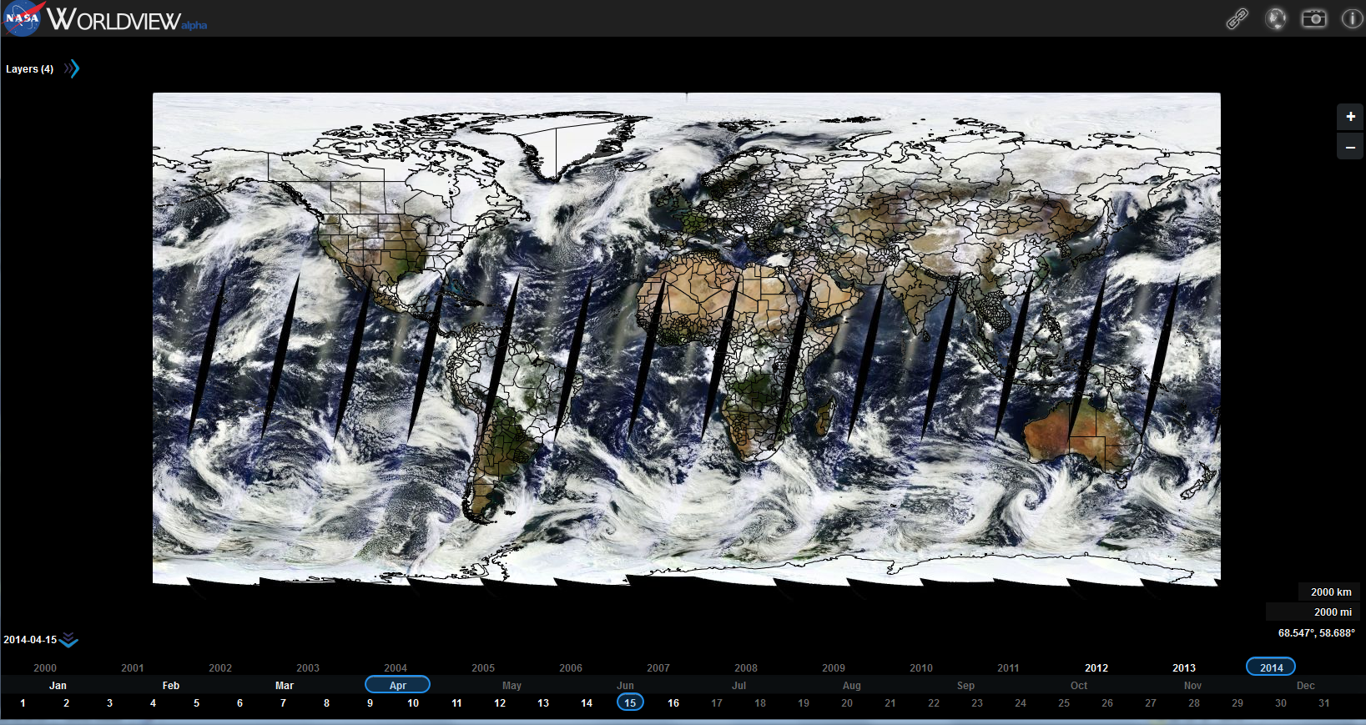
MODIS True Color Image April 15, 2014
https://earthdata.nasa.gov/labs/worldview/

Slide 8
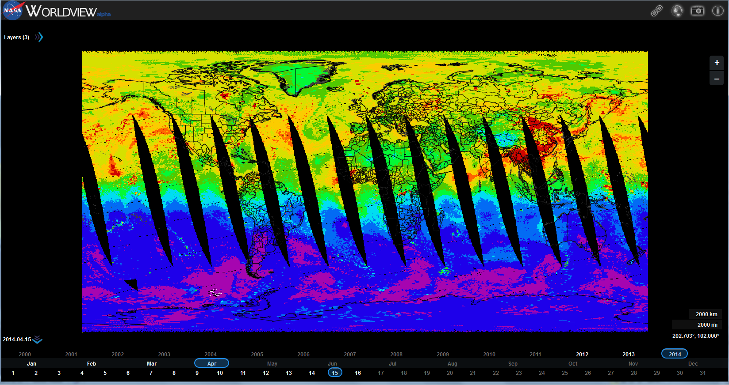
AIRS Carbon Monoxide (CO) Column April 15, 2014
https://earthdata.nasa.gov/labs/worldview/

Slide 9
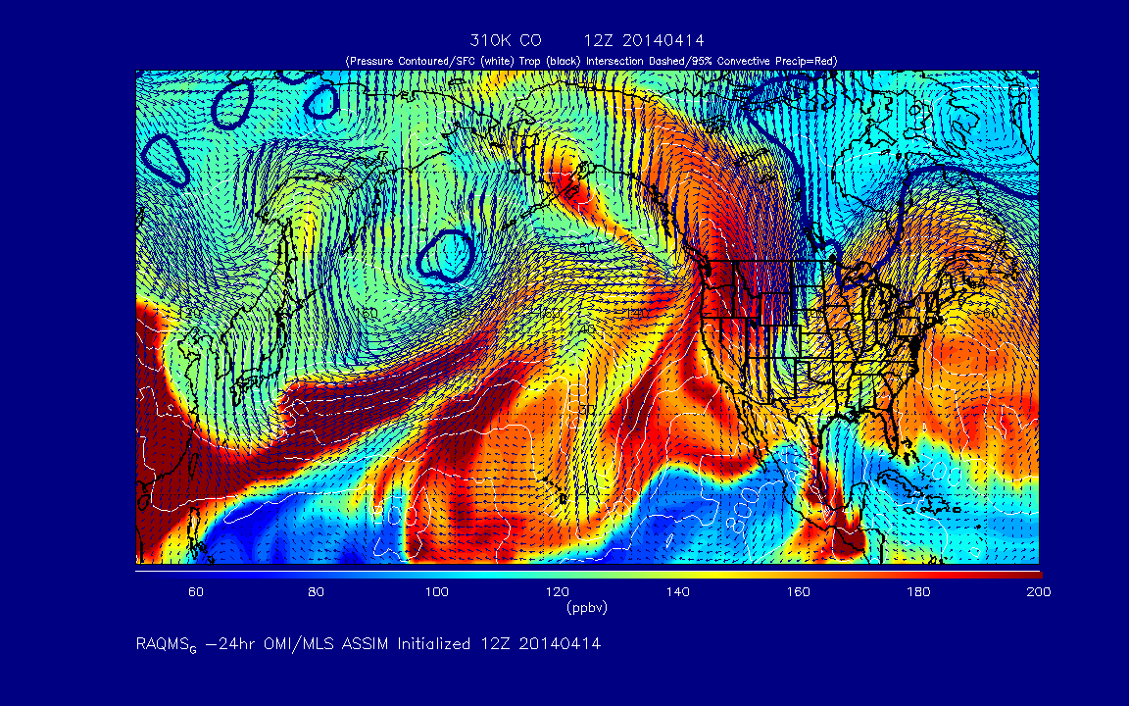
Current real-time RAQMS air quality analysis/forecasts
310K Carbon Monoxide (CO)
http://raqms-ops.ssec.wisc.edu/

Slide 10
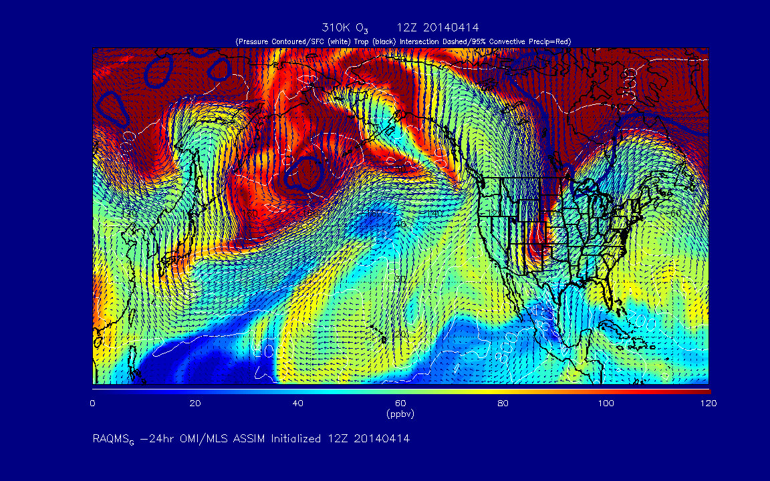
Current real-time RAQMS air quality analysis/forecasts
310K Ozone (O3)
http://raqms-ops.ssec.wisc.edu/

Slide 11
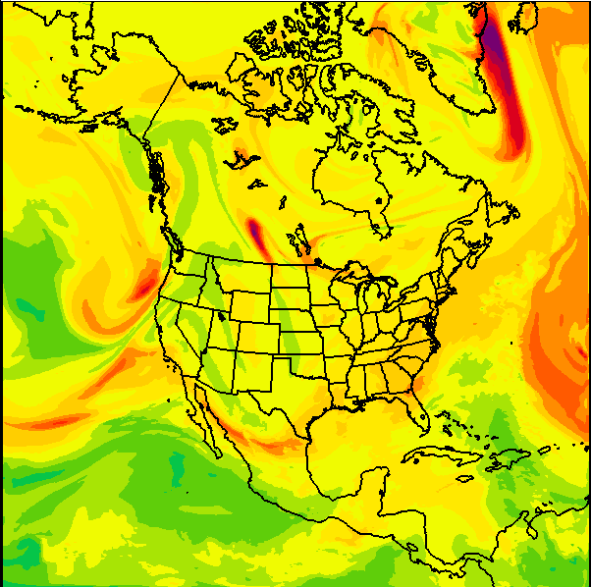
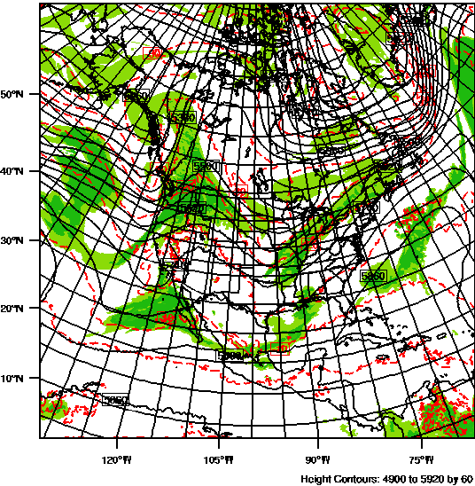
RAQMS/Rapid Refresh (RAP) with Chemistry
Real time weather and air quality forecasts
The 13km Rapid Refresh (RAP) model with chemistry is used to predict air pollution over CONUS twice daily (00Z and 12Z) using RAQMS forecasts for lateral boundary conditions. In collaboration with Georg Grell and Steve Peckham (NOAA/ESRL).
RAP 500mb Ozone (ppbv)
00Z April 18, 2014
RAP 500mb Heights
00Z April 18, 2014
http://rapidrefresh.noaa.gov/

Slide 12
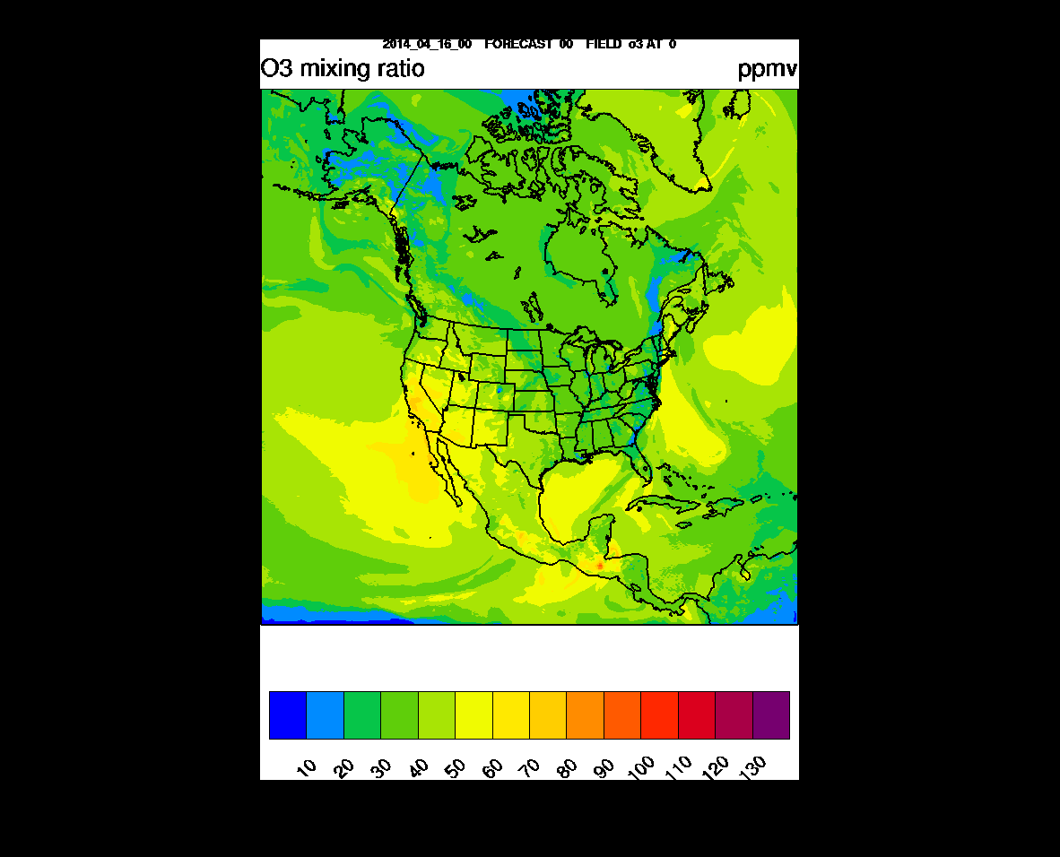
ppbv
RAQMS/RAP-Chem Surface O3 Forecast
00Z April 16 –
00Z April 18, 2014
http://ruc.noaa.gov/wrf/WG11_RT/

Slide 13
Conclusion
Intercontinental pollution transport and stratosphere/troposphere exchange processes can contribute to increased surface ozone and potentially lead to violations of the ozone standard.
EPA is proposing to strengthen the 8-hour “primary” ozone standard to a level within the range of 60-70 parts per billion (ppb), which will likely lead to more violations in the western US.
Assimilation of trace gas and aerosol retrievals within a global chemical and aerosol data analysis system can provide improved constraints on the impacts of intercontinental pollution transport and stratosphere/tropospheric exchange processes on regional scale air quality predictions.

