Slide 1
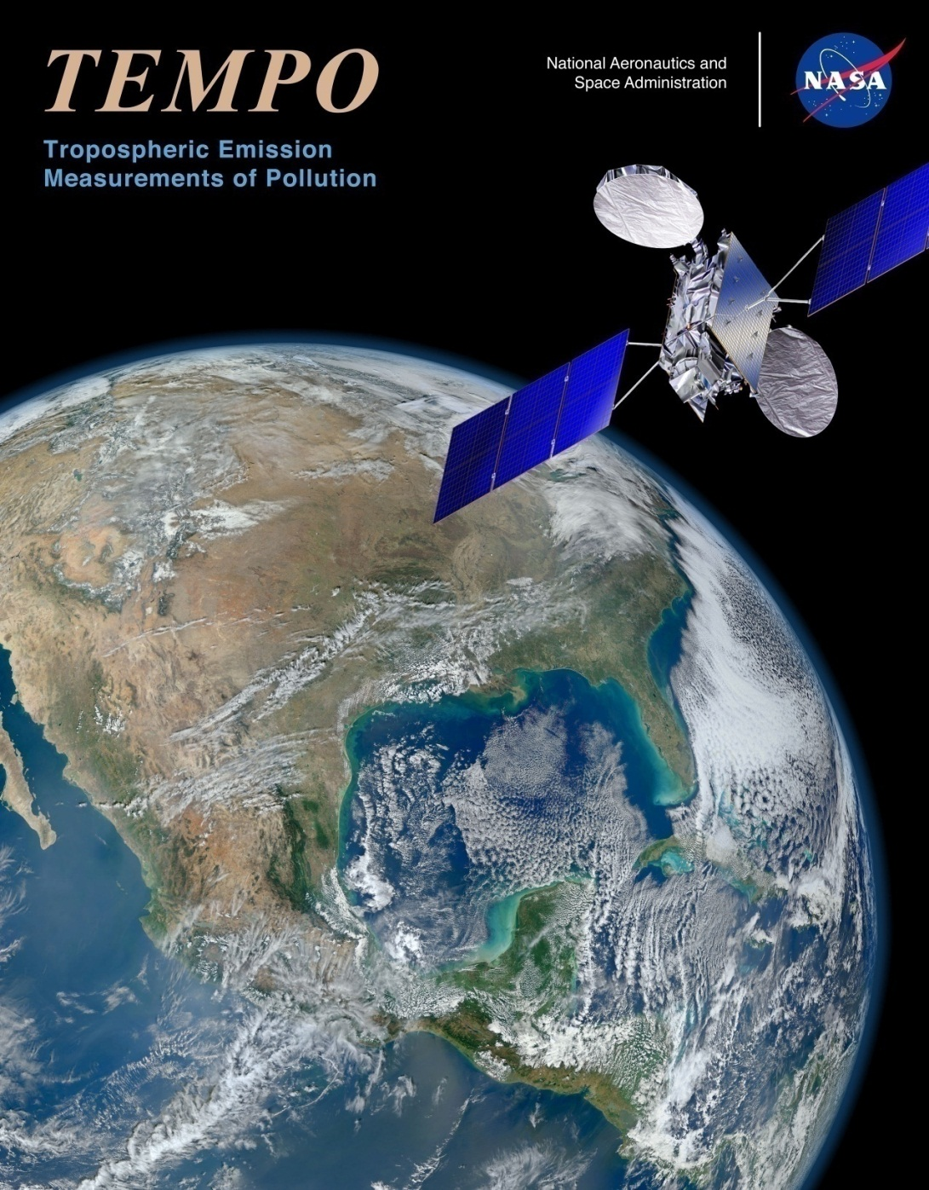
TEMPO, keeping the beat with Air Quality
Tropospheric Emissions: Monitoring of Pollution
Kelly Chance (Smithsonian Astrophysical Observatory, PI)
Tropospheric Emissions:
Monitoring of Pollution
Presented at the 12/12/12
CIMSS Science Symposium by
Brad Pierce (NOAA/NESDIS)
yeah... yeah... yeah...

Slide 2
TEMPO is part of NASA's Earth Venture Instrument program that includes small, targeted science investigations designed to complement NASA's larger research missions. TEMPO is NASA's first Earth Venture Instrument award under the agency's Earth System Science Pathfinder program.
Completed in 2017 at a cost of not more than $90 million, TEMPO will share a ride on a commercial satellite as a hosted payload with a target launch in 2019
TEMPO spectroscopic measurements in the ultraviolet and visible provide a tropospheric measurement suite that includes the key elements of tropospheric air pollution chemistry: ozone (O₃), nitrogen dioxide (NO₂), sulfur dioxide (SO₂), formaldehyde (H₂CO), glyoxal (C₂H₂O₂), water vapor (H₂O), aerosols, cloud parameters, and UVB radiation.
TEMPO provides much of the atmospheric measurement capability recommended for GEO-CAPE in the 2007 National Research Council Decadal Survey, Earth Science and Applications from Space: National Imperatives for the Next Decade and Beyond. TEMPO will launch at a prime time to be a component of a global GEO constellation for pollution monitoring, with a major focus on intercontinental pollution transport, along with Europe (Sentinel-4) and Asia (Geostationary Environment Monitoring Spectrometer).

Slide 3
Sun-synchronous nadir heritage*
Instrument | Detectors | Spectral Coverage [nm] | Spectral Resolution [nm] | Ground Pixel Size [km²] | Global Coverage
GOME (1995-2011)‏ | Linear Arrays | 240-790 | 0.2-0.4 | 40×320 (40×80 zoom) | 3 days
SCIAMACHY (2002-2012)‏ | Linear Arrays | 240-2380 | 0.2-1.5 | 30×30/60/90 30×120/240 (depending on product) | 6 days
OMI (2004)‏ | 2-D CCD | 270-500 | 0.42-0.63 | 15×30 - 42×162 (depending on swath position) | daily
GOME-2a,b (2006, 2012)‏ | Linear Arrays | 240-790 | 0.24-0.53 | 40×40 (40×80 wide swath; 40×10 zoom) | near-daily
OMPS-1 (2011) | 2-D CCDs | 250-380 | 0.42-1.0 | 50×50 250×250 (depending on product) | daily
*Thanks to the late Dieter Perner of MPI
Previous experience (since 1985 at SAO and MPI)
Scientific and operational measurements of pollutants O₃, NO₂, SO₂, H₂CO, C₂H₂O₂ (& CO, CH₄, BrO, OClO, ClO, IO, H₂O, O₂-O₂, Raman, aerosol, ….)

Slide 4
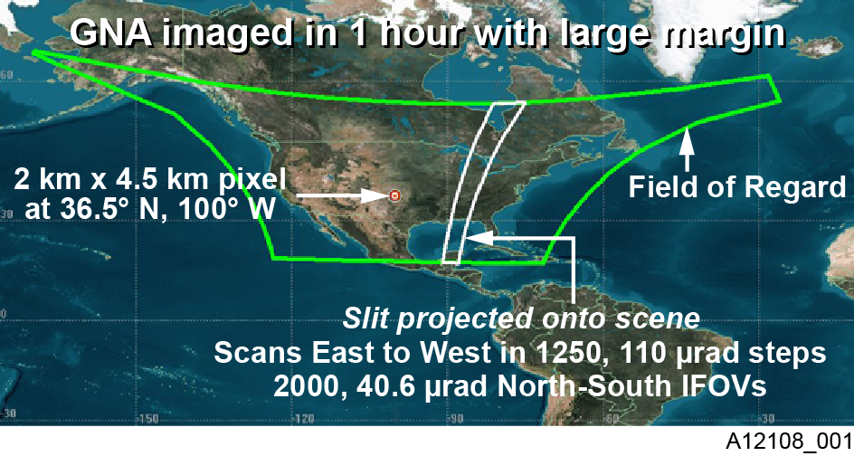
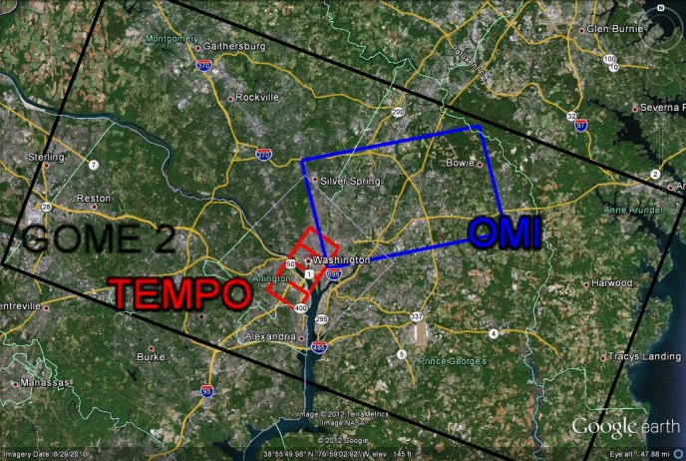
355 times GOME-2 spatial resolution
50 times OMI spatial resolution

Slide 5
Each 2 km × 4.5 km pixel is a 2K element spectrum from 290-690 nm!
GEO platform selected by NASA for viewing greater North America

Slide 6
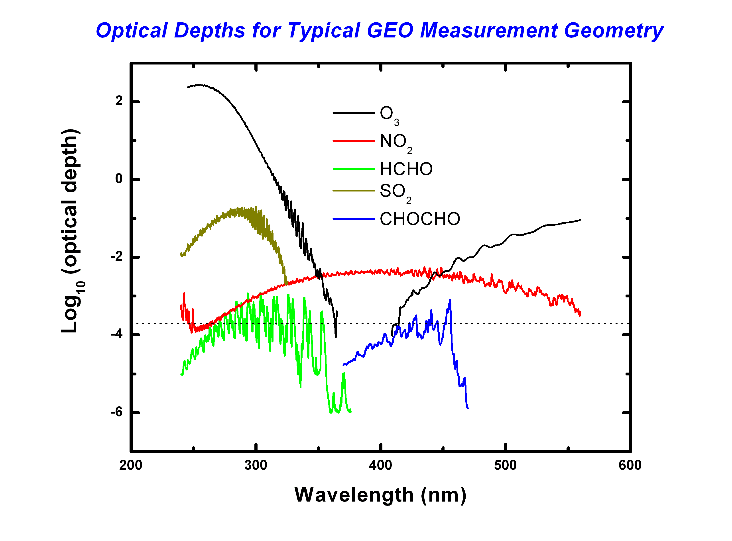
Important!
Best fitting to date:
2.0×10⁻⁴ full-scale radiance
(Instrument vs. algorithm: Tied! S/N drives instrument if meas. requirements can be met
Notes:
$$$ to improve light bucket size

Slide 7
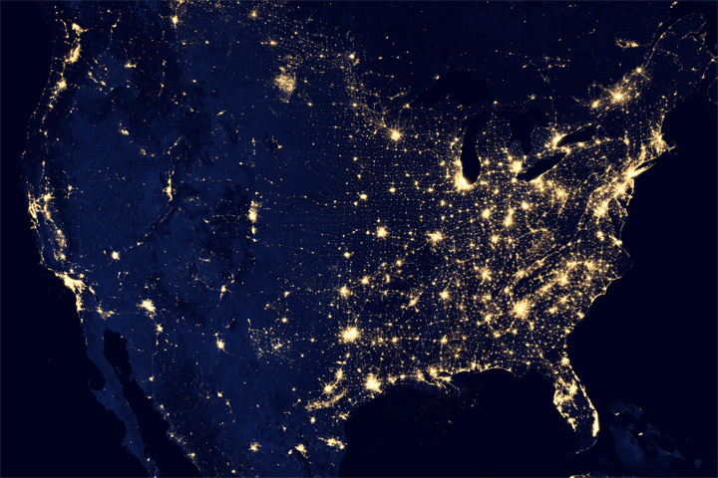
Composite assembled from data acquired by the Suomi NPP satellite in April and October 2012 using Visible Infrared Imaging Radiometer Suite (VIIRS) “day-night band”

Slide 8
What’s this?

Slide 9
What’s this -> 1999 National Emission Inventory (NEI) Carbon Monoxide (CO) emissions
NO₂ emissions look similar

Slide 10
What’s missing?

Slide 11
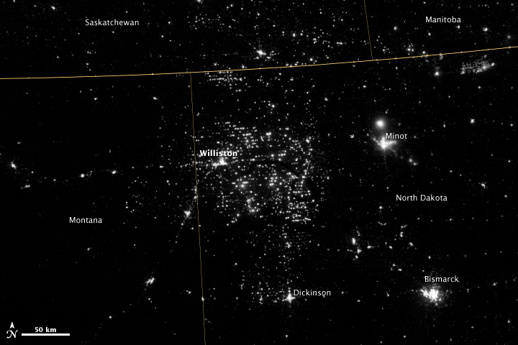
What’s missing ->Natural Gas flares from oil production at the Bakken shale formation.

Slide 12
OMI NO₂ trends over the Canadian oil sands
McLinden, C. A., et al. (2012), Air quality over the Canadian oil sands: A first assessment using satellite observations, Geophys. Res. Lett., 39, L04804, doi:10.1029/2011GL050273.

Slide 13
TEMPO measurements will capture spatial structure in NO₂ emissions that are not captured by current LEO observations
OMI NO₂ trends over the Canadian oil sands
McLinden, C. A., et al. (2012), Air quality over the Canadian oil sands: A first assessment using satellite observations, Geophys. Res. Lett., 39, L04804, doi:10.1029/2011GL050273.

Slide 14
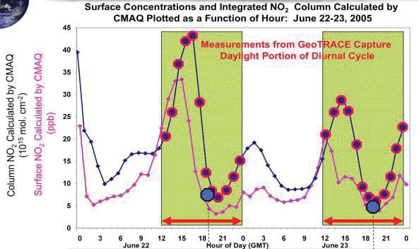
TEMPO measurements will capture the diurnal cycle of NO₂ that is missed by current LEO observations
Average summertime (April–September) OMI BEHR NO2 column densities for 2005, (From Russell et al., Atmos. Chem. Phys. Discuss., 12, 15419–15452, 2012)

Slide 15
TEMPO UV-Vis observations significantly
improve sensitivity to O3 near the surface
over the use of UV only
Zoogman et al. (2011) used an OSSE framework to demonstrate
substantial improvement in comparison with surface ozone concentrations when UV+Vis measurements, such as from TEMPO, are assimilated
Surface O₃ RMSE

Slide 17
TEMPO Science Team: Data product developers, in bold, conduct TEMPO space-based validation with other satellites
Team Member | Institution | Role | Responsibility
K. Chance | SAO | PI | Overall science development; Level 1b, H₂CO, C₂H₂O₂
X. Liu | SAO | Deputy PI | Science development, data processing; O₃ profile, tropospheric O₃
J. Carr | Carr Astronautics | Co-I | INR Modeling and algorithm
M. Chin | GSFC | Co-I | UV aerosol product, AI
R. Cohen | U.C. Berkeley | Co-I | NO₂ validation, atmospheric chemistry modeling, process studies
D. Edwards | NCAR | Co-I | VOC science, synergy with carbon monoxide measurements
J. Fishman | St. Louis U. | Co-I | Education/Public outreach
D. Flittner | LaRC | Project Scientist | Overall project development; STM; instrument cal./char.
J. Herman | UMBC | Co-I | Validation (PANDORA measurements)
D. Jacob | Harvard | Co-I | Science requirements, atmospheric modeling, process studies
S. Janz | GSFC | Co-I | Instrument calibration and characterization
J. Joiner | GSFC | Co-I | Cloud, total O₃, TOA shortwave flux research product
N. Krotkov | GSFC | Co-I | NO₂, SO₂, UVB
M. Newchurch | U. Alabama Huntsville | Co-I | Validation (O₃ sondes, O₃ lidar)
R.B. Pierce | NOAA/NESDIS | Co-I | AQ modeling, data assimilation
R. Spurr | RT Solutions, Inc. | Co-I | Radiative transfer modeling for algorithm development
R. Suleiman | SAO | Co-I, Data Mgr. | Managing science data processing, BrO, H₂O, and L3 products
J. Szykman | EPA | Co-I | AIRNow AQI development, validation (PANDORA measurements)
O. Torres | GSFC | Co-I | UV aerosol product, AI
J. Wang | U. Nebraska | Co-I | Synergy w/GOES-R ABI, aerosol research products
J. Leitch | Ball Aerospace | Collaborator | Aircraft validation, instrument calibration and characterization
R. Martin | Dalhousie U. | Collaborator | Atmospheric modeling, air mass factors, AQI development
D. Neil | LaRC | Collaborator | GEO-CAPE mission design team member
J. Kim | Yonsei U. | Collaborators, Science Advisory Panel | Korean GEMS, CEOS constellation of GEO pollution monitoring
J. McConnell | York U. Canada |  | CSA PHEOS, CEOS constellation of GEO pollution monitoring
B. Veihelmann | ESA |  | ESA Sentinel-4, CEOS constellation of GEO pollution monitoring

Slide 18
At CIMSS, RAQMS and WRF-CHEM chemical data assimilation activities will utilize TEMPO O3 and NO2 measurements to improve air quality forecasting capabilities

Slide 19
Alignment with 2007 Decadal Survey
The NRC 2007 Decadal Survey “Earth Science and Applications from Space: National Imperatives for the Next Decade and Beyond” recommended missions including Geostationary Coastal and Air Pollution Events (GEO-CAPE). The atmosphere part of GEO-CAPE is recommended to include the measurements proposed here.
TEMPO makes all the requisite GEO-CAPE UV/visible measurements, including O₃, NO₂, H₂CO, and aerosols (plus several additional species including SO₂). Together with the proposed IR instrument for CO measurements, all GEO-CAPE atmospheric requirements for North America are fulfilled.

Slide 21
TEMPO 2019

Slide 22
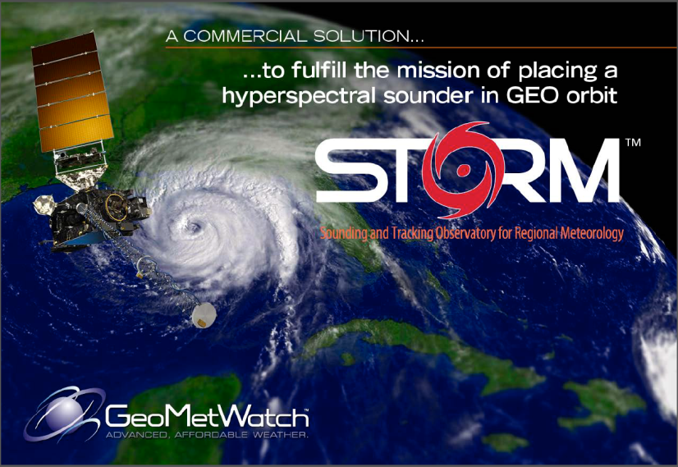
US Geostationary IR sensor would complete the integrated global observing system!
TEMPO 2019

