Slide 1

The relationship between Observed and Modeled AOD and Surface PM₁₀ During an Eastern Mediterranean Dust Event
Burcu Kabatas¹, R. Bradley Pierce², Alper Unal³, Marek Rogal¹, Todd Schaack¹, Allen Lenzen¹
1. University of Wisconsin-Madison, Space Science and Engineering Center
2. NOAA/NESDIS/STAR
3. Istanbul Technical University, Eurasia Institute of Earth Sciences
98th AMS Annual Meeting
7–11 January 2018, Austin, TX

Slide 2

CONTENT
Introduction and scope of the study
Methodology
  Ground-monitoring data
  Modeling system (RAQMS & WRF-Chem)
Results
  Statistical Analysis
Discussion and conclusion
  Synoptic Analysis
  Aerosol Optical Depth Analysis

Slide 3
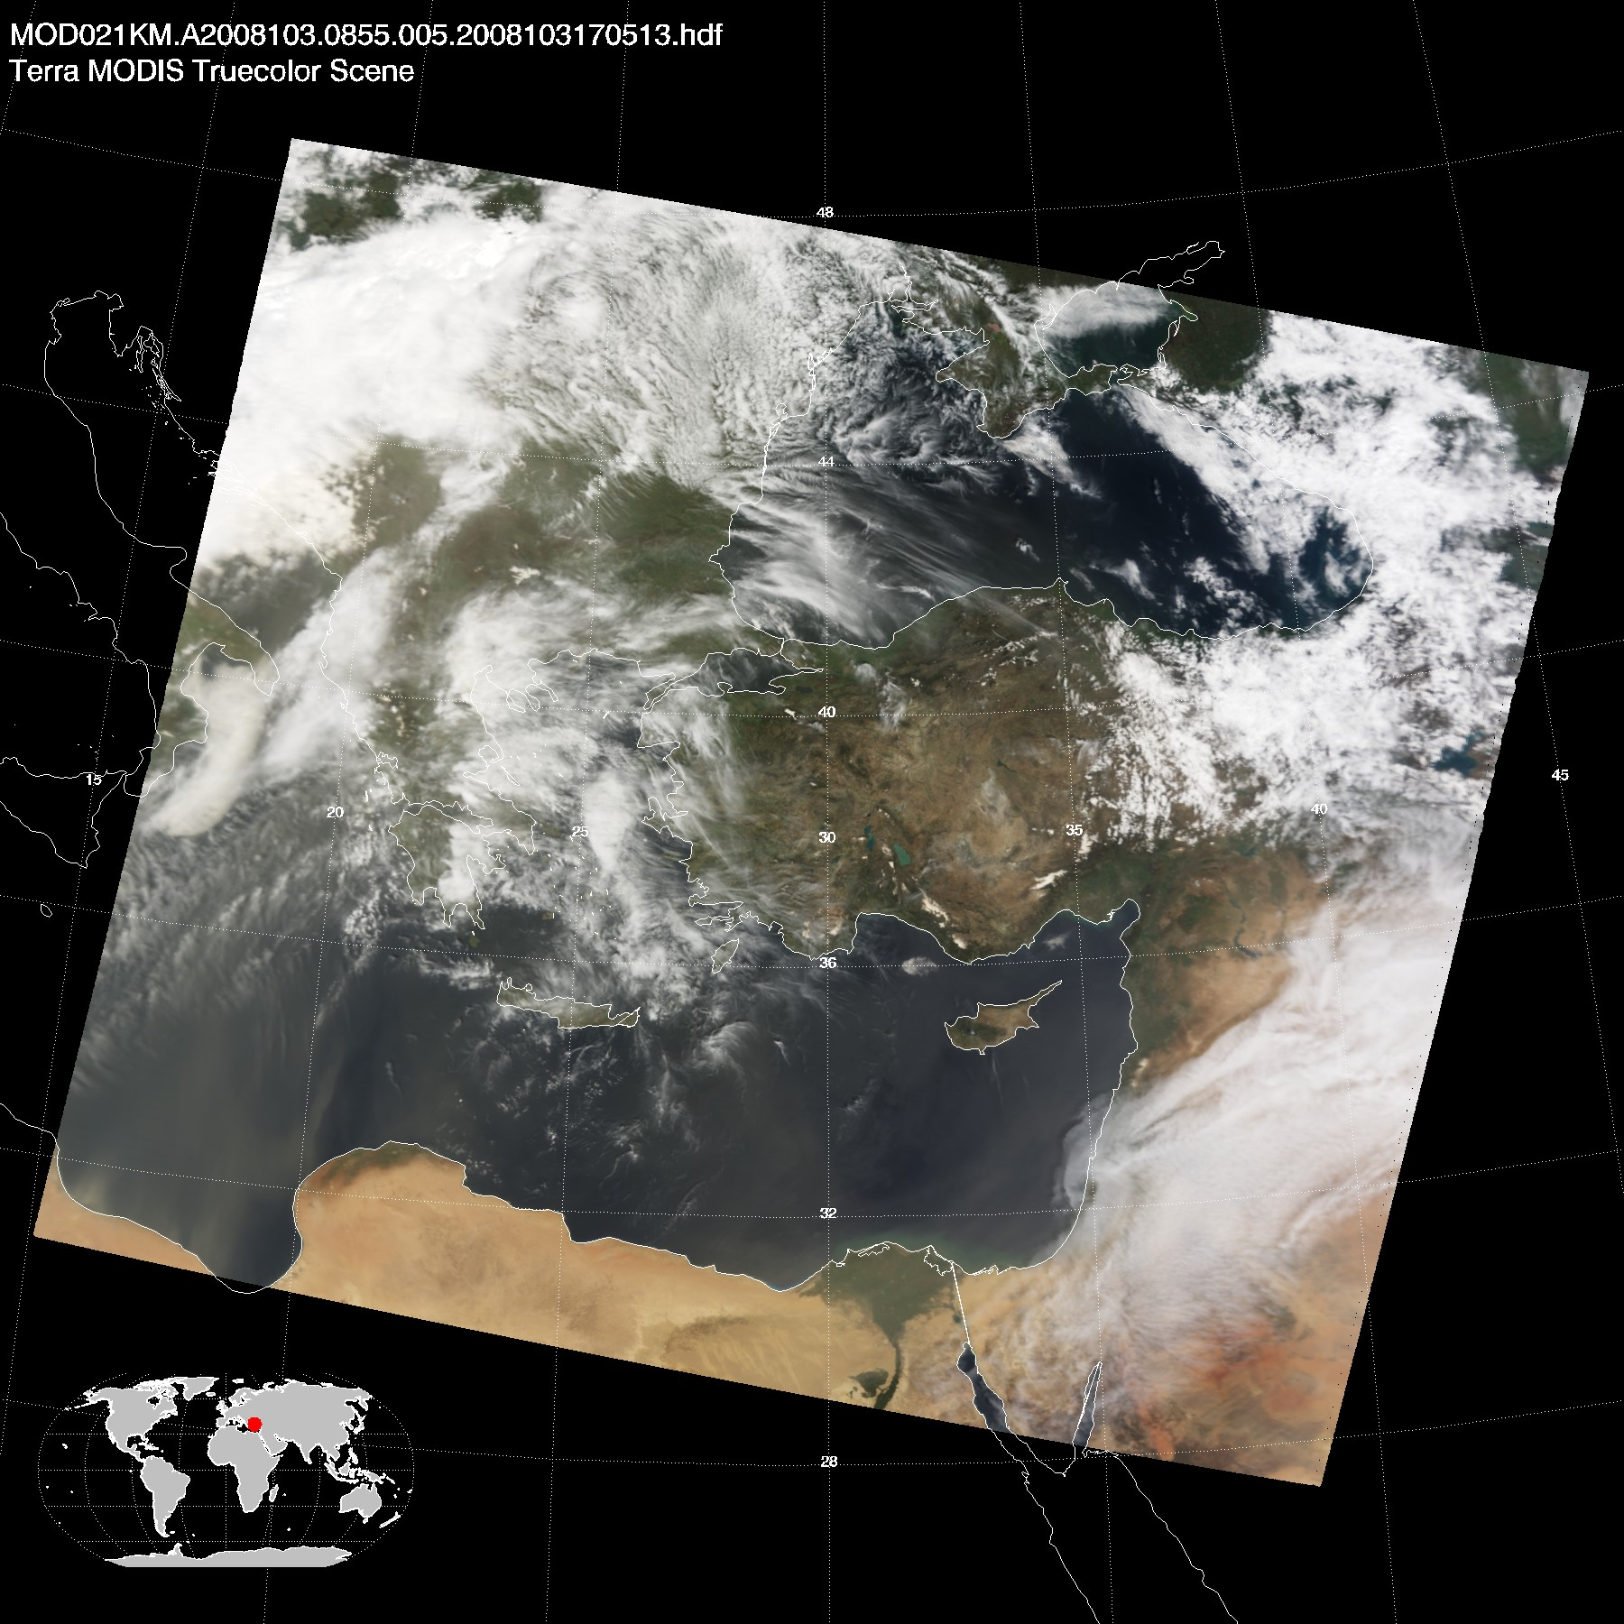
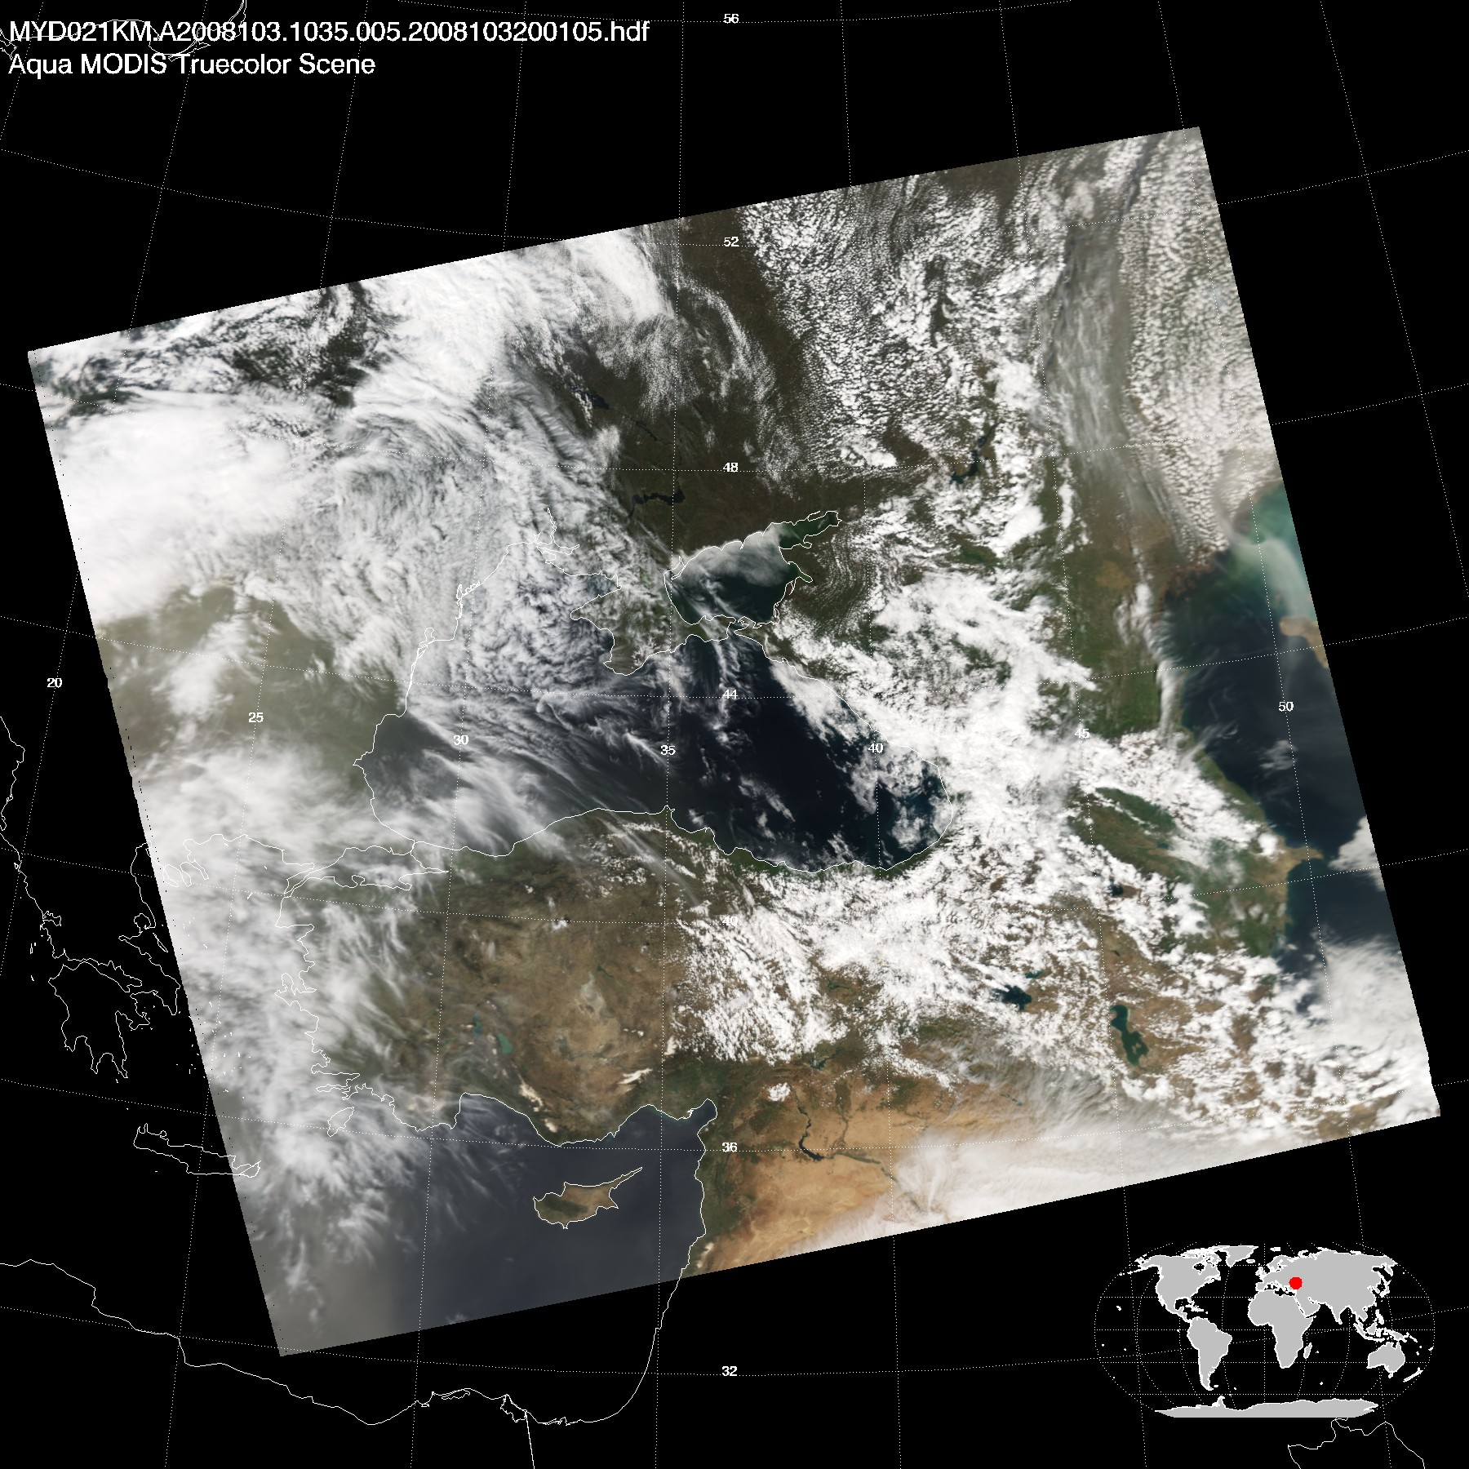
Motivation
To explain the possible effect of Saharan dust on high levels of PM₁₀ measured in the Anatolian Peninsula in April 2008.
L1B Granule Images of MODIS on board of Terra and Aqua satellites, April 12, 2008. http://modis-atmos.gsfc.nasa.gov/IMAGES/
INTRODUCTION METHODOLOGY RESULTS DISCUSSION

Slide 4
Air Quality and Health
PM₁₀ | 10 μg/m³ increase -> increase in all-cause daily mortality between 0.6 and 1.2 %. | Pope, 2006
PM₁₀ | Children in high exposure group have full-scale and verbal IQ scores 4.31 and 4.67 points lower than those of less-exposed children. | Perera, 2009
PM_{2.5-10} | 10 µg/m³ increase in coarse articulate matter (PM_{2.5-10}) during Saharan dust outbreaks -> increases total mortality by 2.8%. | Tobias et al. (2011)
PM₁₀ | 75+ people -> the respiratory death rates increase by 22% on the days with Saharan dust. | Sajani et al. (2011)
INTRODUCTION METHODOLOGY RESULTS DISCUSSION
Notes:
In another study, Perera et al. [2009], monitored children from birth till 5 years of age and showed that children in high exposure group had full-scale and verbal IQ scores that were 4.31 and 4.67 points lower, respectively, than those of less-exposed children.
chronic obstructive pulmonary disease (COPD).
PM affects more people than any other pollutant (The major components of PM are sulfate, nitrates, ammonia, sodium chloride, carbon, mineral dust).
In their study, Tobias et al. (2011) showed a 10 µg/m³ increase in coarse particulate matter (PM_{2.5-10}) during Saharan dust outbreaks also increases total mortality by 2.8% compared to 0.6% increase during non-dust days in Madrid. Sajani et al. (2011) stated that for people over 75 years old, the respiratory death rates increase by 22% on the days with Sahara dust.

Slide 5

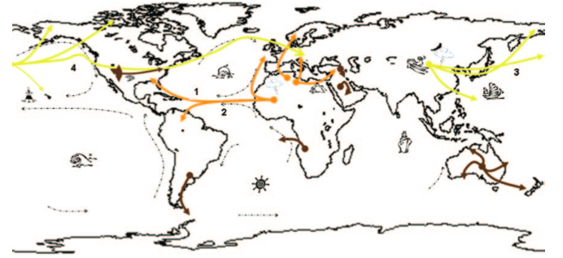
Region
Eastern Mediterranean
Primary sources of desert dust and their atmospheric pathways (Griffin D. W., 2007).
The desert of Sahara is one of the major sources of mineral dust on Earth, producing around 200 Tg/yr.
Figure: MODIS, Courtesy of NASA
INTRODUCTION METHODOLOGY RESULTS DISCUSSION
Notes:
Mediterranean Sea is one of the areas in the world having optically thick aerosol layer.
Saharan dust outbreaks over the Eastern Mediterranean follow a pathway starting from the source areas to the Eastern Mediterranean Sea (Papayannis et al., 2005). (1) During summer in the Northern Hemisphere (approximately June through October), African desert dust is transported across the Atlantic to the northern Caribbean and North America. (2) During winter in the Northern Hemisphere (approximately November through May), African desert dust is transported across the Atlantic to the southern Caribbean and South America. (3) The Asian dust season typically lasts from late February to late April. (4) Large Asian dust events can travel significant distances in the Northern Hemisphere. Yellow lines show Asian desert dust atmospheric routes, orange lines show African dust routes, brown lines show routes of other desert dust sources, and broken black lines depict wind patterns.

Slide 6
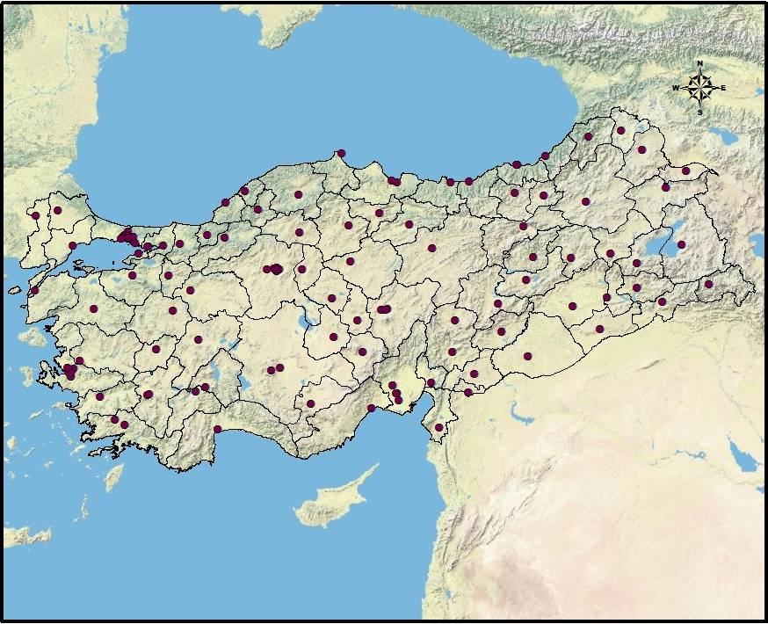
Methodology
Monitoring Data
Turkish Ministry of Environment and Urbanization operates 118 air quality stations distributed in 81 cities (As of 2015, 195 ground based, and 4 mobile monitoring systems are being operated).
Air monitoring network measures hourly values of PM₁₀, O₃, NO, NO₂, NO_{x}, CO, SO_{2.}
The monitoring system uses a beta gauge, which measures the mass of particulates, and allows an accurate determination of particulate concentration under all conditions,.
Air quality stations located in Turkey
INTRODUCTION METHODOLOGY RESULTS DISCUSSION
Notes:
we used the ground observations conducted in Turkey by Turkish Ministry of Environment and Urbanization. Daily averages of PM10 data are obtained from 118- air quality stations distributed throughout Turkey for 2008.
783,356 km2 almost 3 times larger than the texas.

Slide 7
Methodology
Analysis of PM₁₀ Concentrations
2008 Annual PM₁₀ Concentration in Turkey
2008 Seasonal averages
Winter (109 μg/m³)
Spring (80 μg/m³)
Summer (62.5 μg/m³)
Fall (72.5 μg/m³)
2008 Annual Average
(Kabatas et al, 2014)
INTRODUCTION METHODOLOGY RESULTS DISCUSSION
Notes:
High levels of PM10 for winter is expected as during this period pollution sources (both local and regional) are significant and atmospheric conditions do not favor dispersion.
It is known that peak PM10 values caused by Saharan dust outbreaks occur in the transition seasons. So high levels of pm10 measured in spring, especially in april might be related to saharan dust outbreak.
August: resulting in the destruction of more than 15,000 hectares of woodlands

Slide 8
Methodology
Analysis of PM₁₀ Concentrations
Boxplots of daily PM₁₀ concentration obtained from ground observations
(Kabatas et al, 2014)
INTRODUCTION METHODOLOGY RESULTS DISCUSSION
Notes:
It lasted 5 days, and destructed more than 15,000 hectares of woodlands

Slide 9
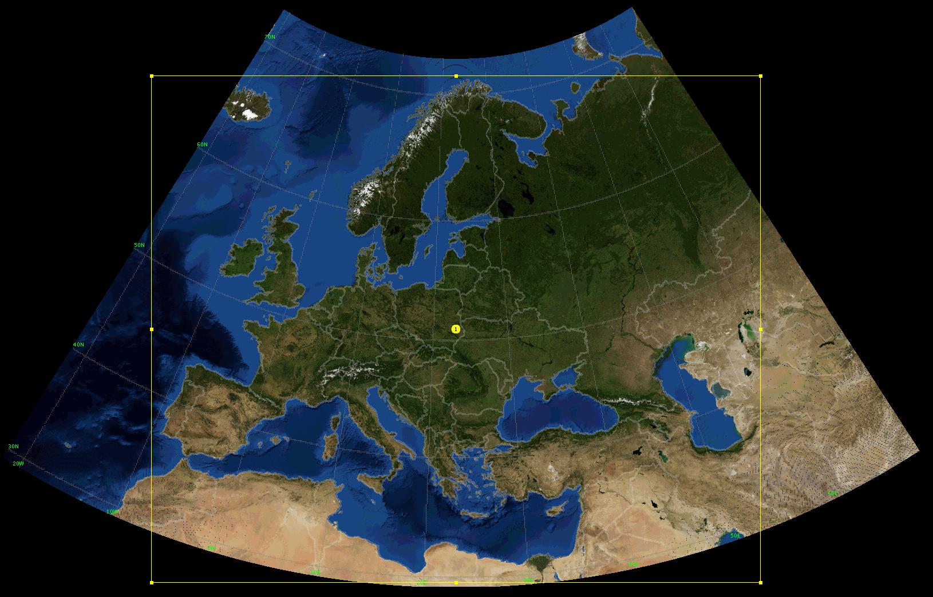
WRF-Chem Experiment
Model Description
WRF-Chem¹ v.3.5.1 which is an online coupled model, configured to cover Eastern Mediterranean.
0.1×0.1 degree HTAP² is used for anthropogenic emission inventory.
Goddard Chemistry Aerosol Radiation and Transport (GOCART) aerosol module.
6 hourly Global Forecast System (GFS) 0.5x0.5 degree analyses (Meteorological IC/LBC).
6 hourly Real-time Air Quality Modeling System (RAQMS) 2x2 degree global analyses (Chemical IC/LBC).
Wild Fire Automated Biomass Algorithm (WF-ABBA) biomass burning emissions.
¹ Weather Research and Forecasting (WRF-Chem) model with chemistry; ² Hemispheric Transport of Air Pollution
INTRODUCTION METHODOLOGY RESULTS DISCUSSION
Notes:
Such a small grid size is not feasible for regional model applications because the data demands and operating requirements are far too large.
We are not allowing interaction, we only have online chemistry, which improves transport and convective mixing.
Burning Algorithm (WF-ABBA) wildfire products (Prins and Menzel, 1994). WF-ABBA uses SEVIRI3 data to detect and characterize biomass burning.
WRF-Chem domains configured to cover Eastern Mediterranean (30km outer domain) and Anatolian Peninsula (10km inner domain) with topography map
WRF- Chem supports high resolution (up to 4km) anthropogenic emissions from the National Emissions Inventory (NEI) over the continental United States (CONUS), but uses low resolution (1° × 1°) Emission Database for Global Atmospheric Research (EDGAR) emissions for other regions. In order to improve the representation of the local emissions during the dust outbreak over Eastern Mediterranean, a higher resolution EDGAR anthropogenic emission inventory developed in cooperation with the Task Force on Hemispheric Transport of Air Pollution (TF HTAP)) that consists monthly 0.1° × 0.1° global grids for year 2008 is used. We substituted EDGAR HTAP SO₂, OC, BC, PM₁₀, PM_{2.5} emissions from Energy, Industry, Transport, and Residential sectors in original EDGAR emission inventory to create higher resolution anthropogenic emissions over Eastern Mediterranean.

Slide 10
WRF-Chem Experiment
Data Assimilation
The NOAA GSI¹ (3DVAR) data assimilation system is used to assimilate Terra and Aqua MODIS (col. 6) Aerosol Optical Depth (AOD) retrievals.
GSI uses Community Radiative Transfer Model (CRTM) to calculate AOD.
Experiment design:
  WRF-Chem Control (30km Domain): DOES NOT employ Data Assimilation (DA)
  WRF-Chem/GSI (30km Domain): Employs DA.
¹ Gridpoint Statistical Interpolation
INTRODUCTION METHODOLOGY RESULTS DISCUSSION

Slide 11
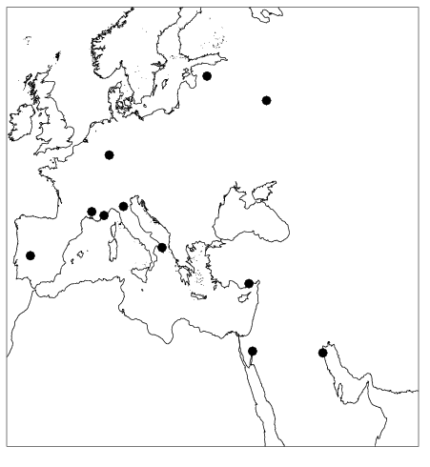
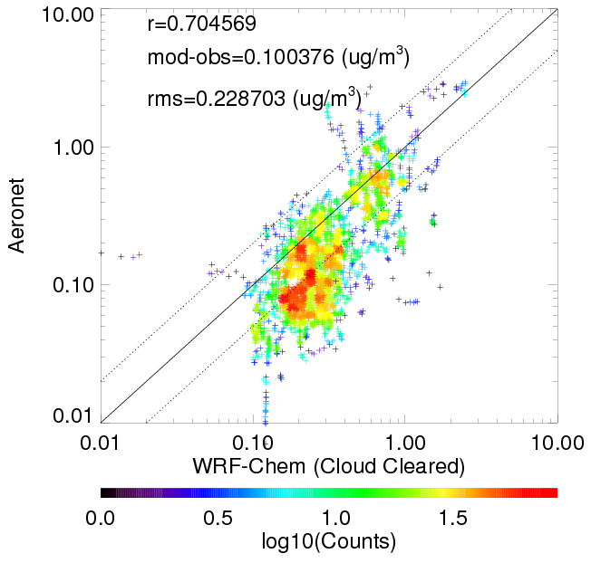
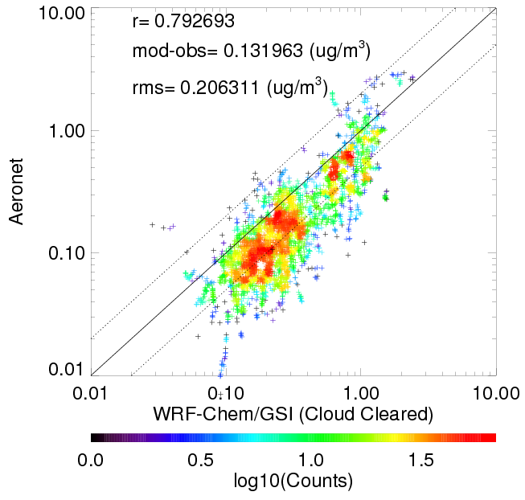
WRF-Chem Experiment
Comparison with Aeronet Stations
AERONET Stations
AERONET vs Control Run
AERONET vs Assimilation Run
Assimilation improves correlation and reduces RMS errors but increases bias compared to Aeronet.
INTRODUCTION METHODOLOGY RESULTS DISCUSSION

Slide 12
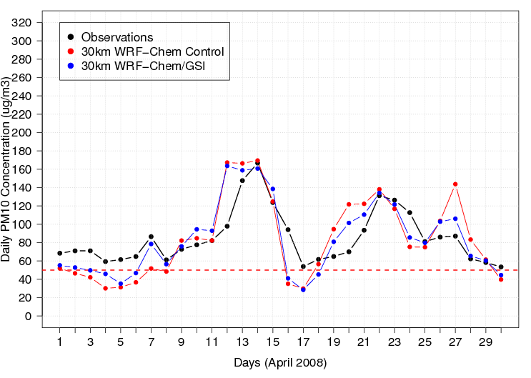
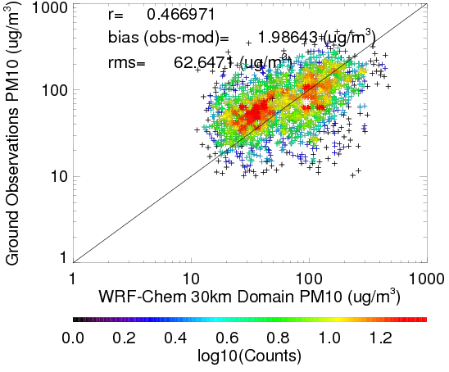
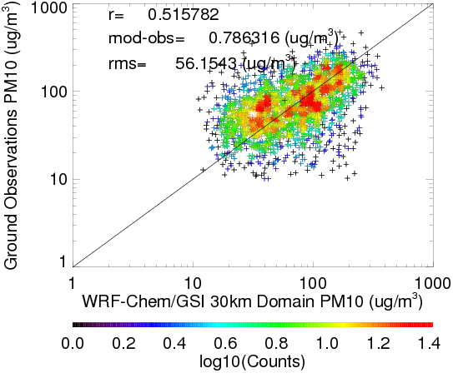
WRF-Chem Experiment
Statistical Analysis
Time-series Comparisons
Ground Obs. vs Control Run
Ground Obs. vs Assimilation Run
Assimilation improves correlation and reduces RMS errors and bias compared to ground observations.
INTRODUCTION METHODOLOGY RESULTS DISCUSSION

Slide 13
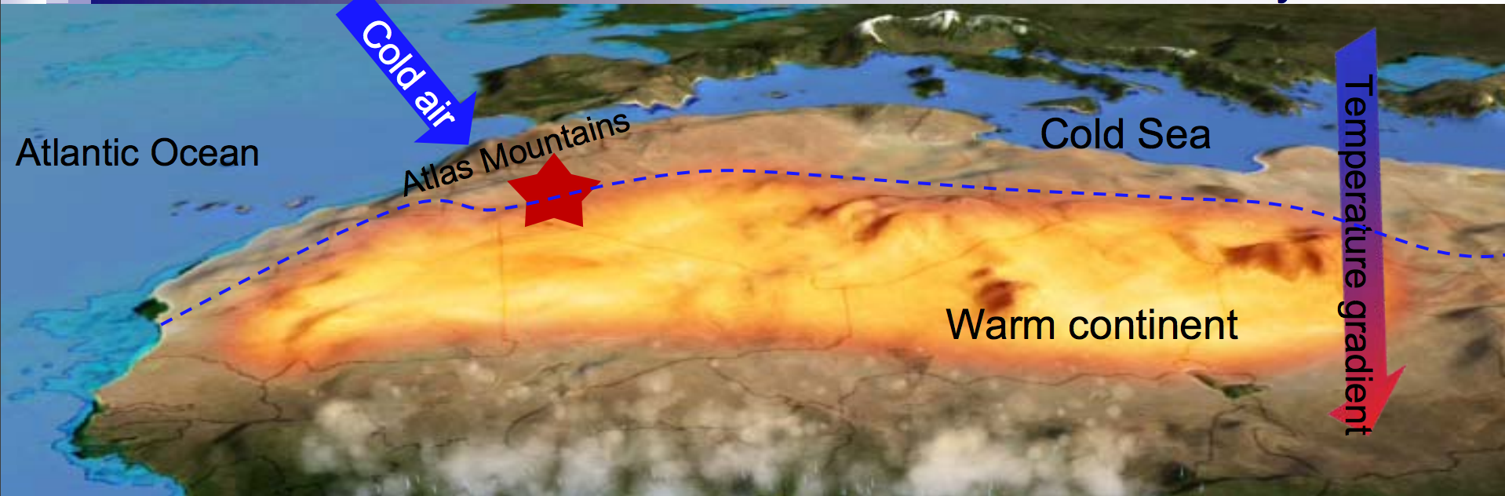
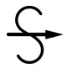
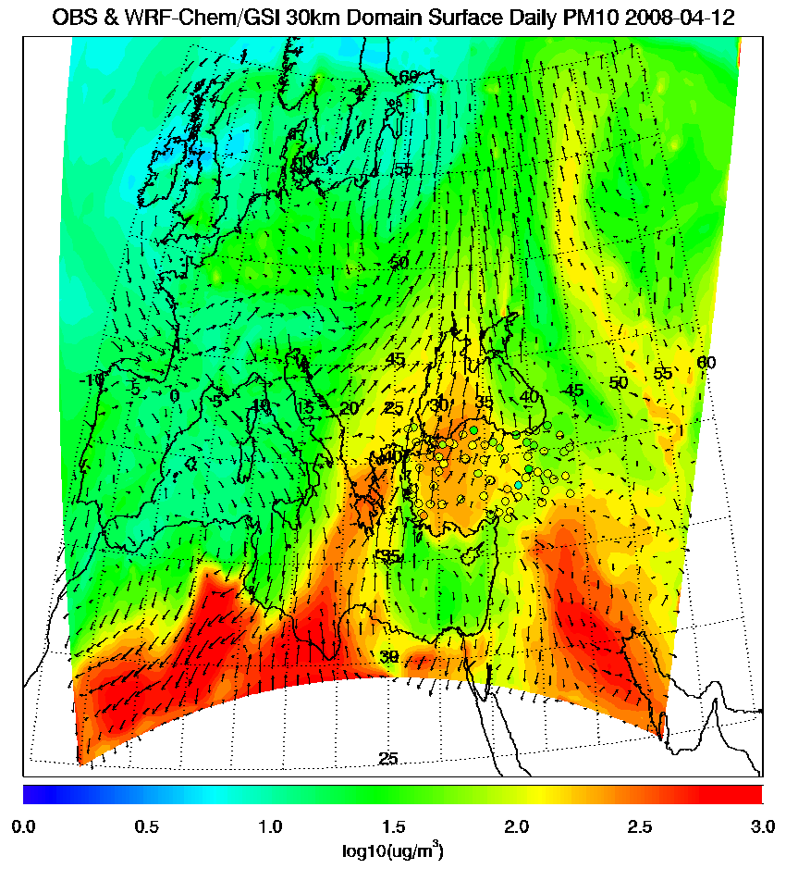
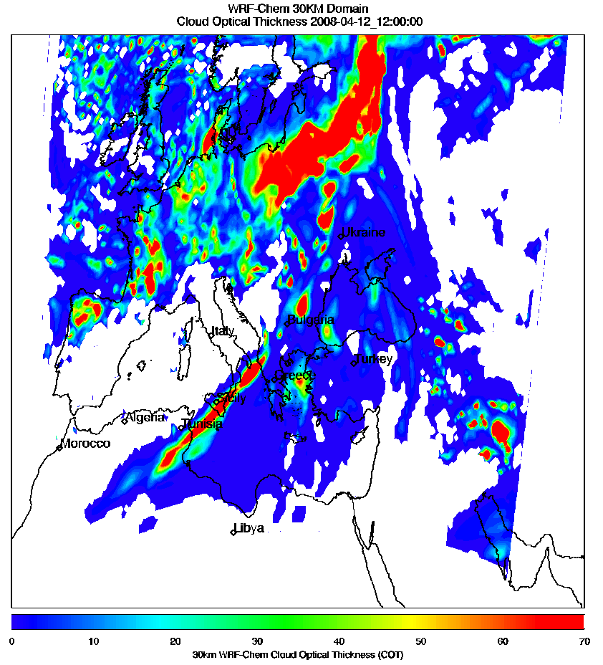
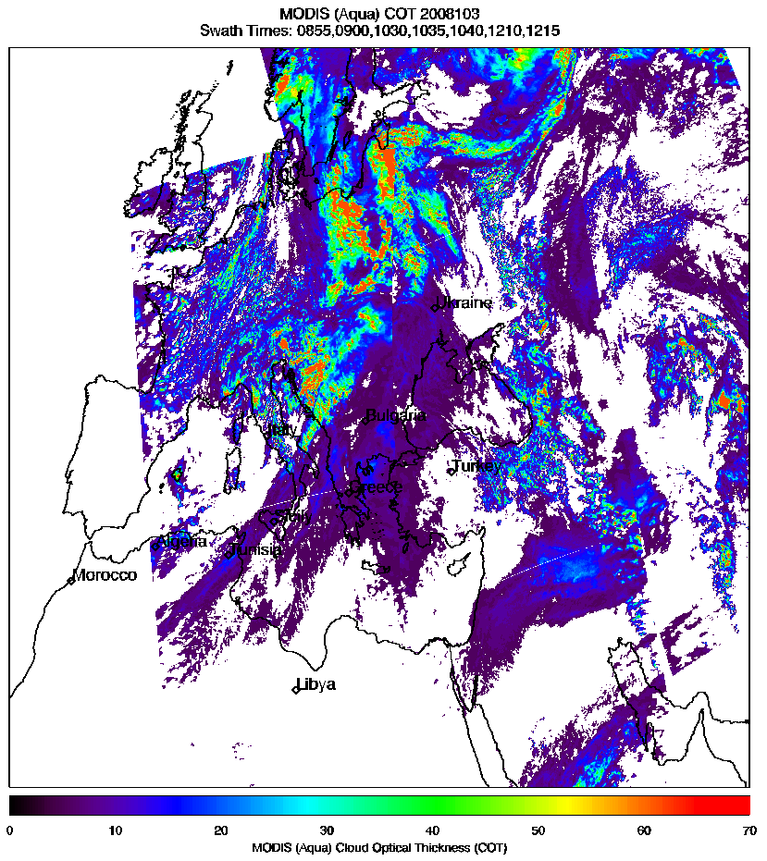
WRF-Chem Experiment
Synoptic Analysis
Sharav cyclone that transports dust toward Europe and the Mediterranean Basin develops on the downwind of Atlas Mountains due to the strong thermal difference along the northern African coast (Karam et al., 2009).
Africa
WRF-CHEM Surface PM₁₀
WRF-CHEM COT
MODIS (Aqua) COT
INTRODUCTION METHODOLOGY RESULTS DISCUSSION

Slide 14
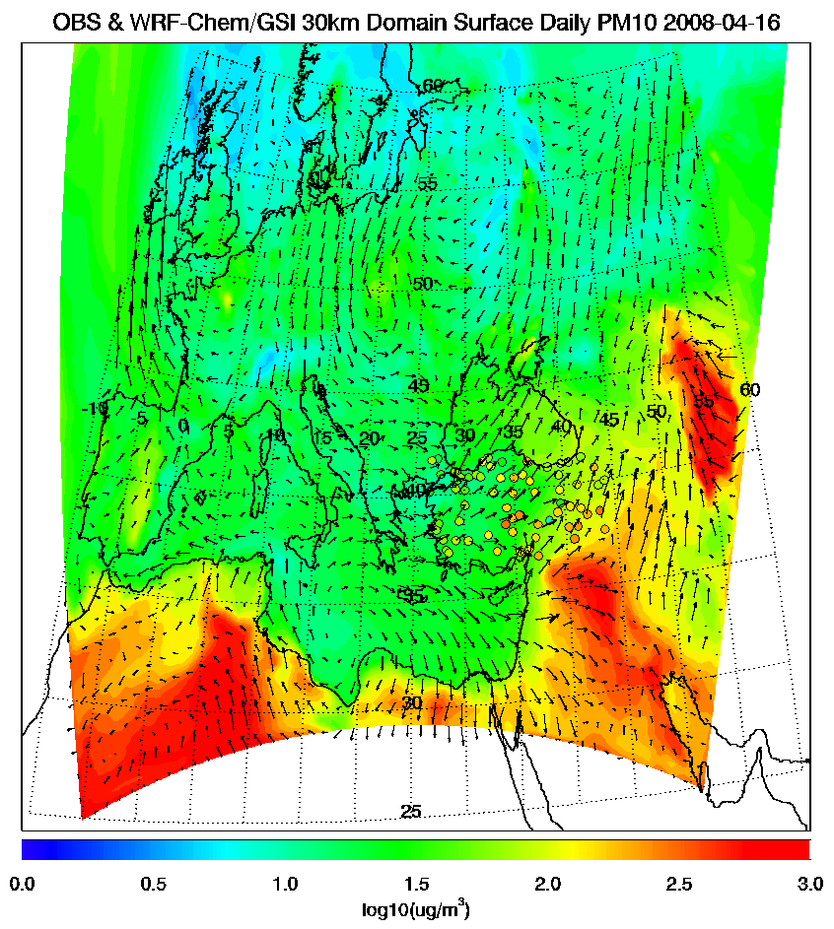
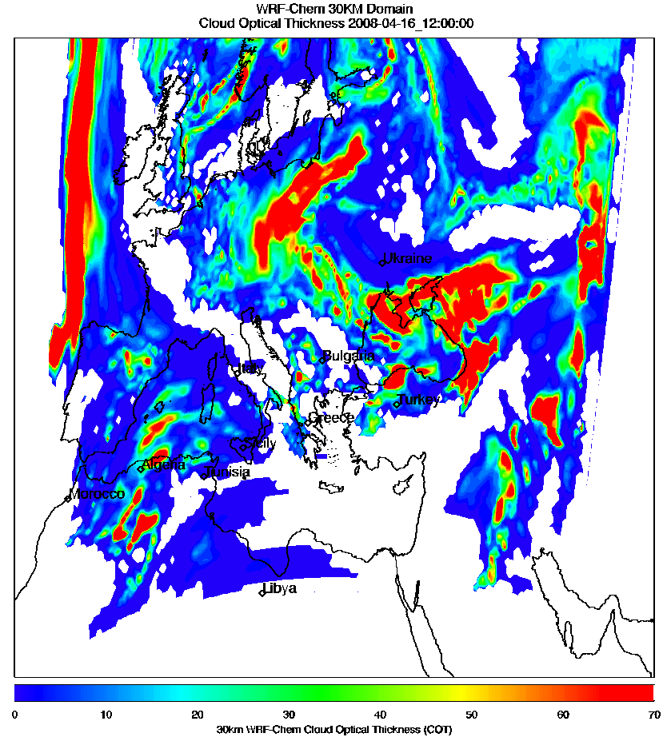
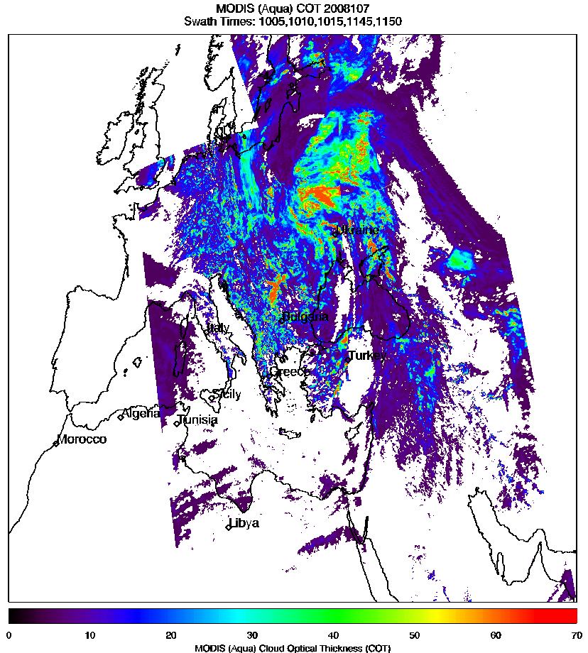
WRF-Chem Experiment
Synoptic Analysis
Errors in synoptic transport cause an overestimate in surface PM₁₀ at the beginning of the event by moving the dust plume faster than the observed, and an underestimate at the end of the episode due to transport of relatively clean continental air over Turkey sooner than was observed.
WRF-CHEM Surface PM₁₀
WRF-CHEM COT
MODIS (Aqua) COT
INTRODUCTION METHODOLOGY RESULTS DISCUSSION
Notes:
Fix labels with bigger text

Slide 15
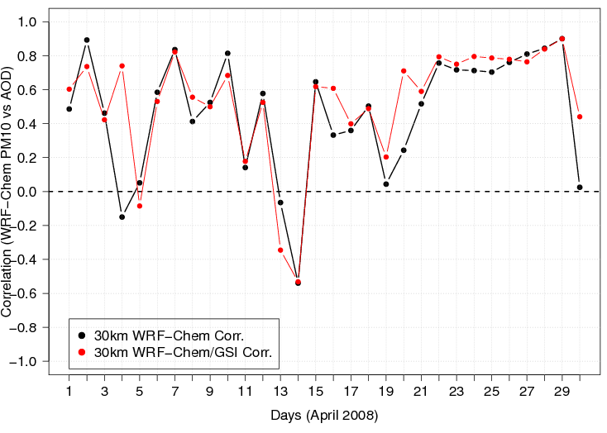
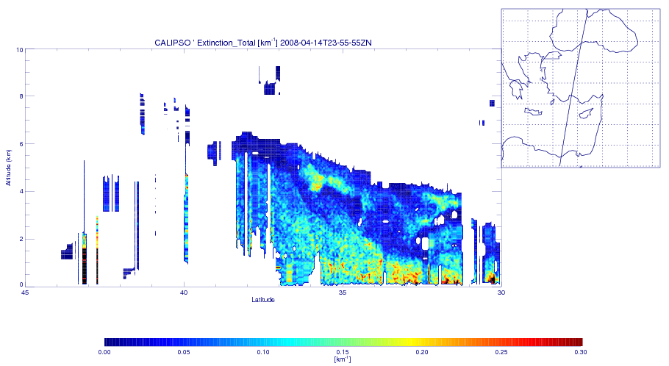
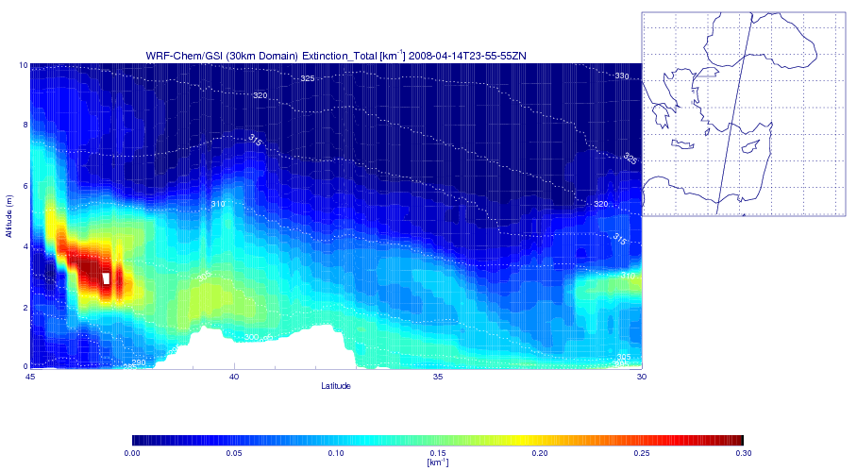
WRF-Chem Experiment
How is Surface PM10 related to AOD?
Modeled AOD vs Modeled PM₁₀ Correlations
CALIPSO Aerosol Total Extinction
Assimilation Aerosol Total Extinction
The negative correlations between surface PM₁₀ and AOD on April 14, 2008 occur because the aerosols are aloft.
INTRODUCTION METHODOLOGY RESULTS DISCUSSION

Slide 16
CONCLUSIONS
Assimilation of MODIS AOD improved correlations with both ground observations and Aeronet stations.
Errors in synoptic transport cause an overestimate in surface PM₁₀ at the beginning of the event and an underestimate towards the end of the event.
Comparison of CALIPSO and WRF-Chem shows that during the peak aerosol event day (April 14, 2008) negative correlations between AOD and surface PM10 were caused by lofting of the aerosol into the free troposphere.
Notes:
error in synoptic transport should be fixed in order to accurately predict the timing of the event.

Slide 17
THANK YOU!
burcu.kabatas@ssec.wisc.edu

