Slide 1
Beijing Municipal Environmental Protection Monitoring Center (BJMEMC)
Air Quality monitoring research and applications
RAQMS Aura Chemical Reanalysis
NAM-CMAQ/TROPOMI Data Assimilation
CIMSS WRF-Chem
Brad Pierce
UW-Madison SSEC

Slide 2
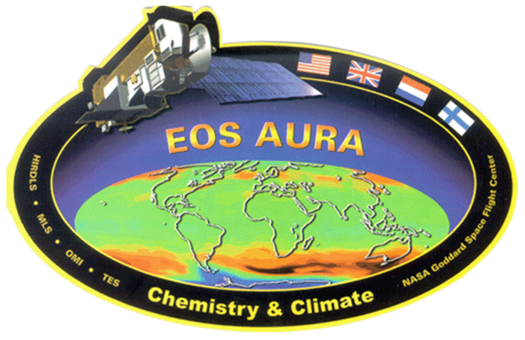
RAQMS Aura Chemical Reanalysis
Project Summary
  Utilize the Real-time Air Quality Modeling System (RAQMS) to conduct a multi-year global chemical and aerosol reanalysis using NASA Aura and A-Train measurements.
  Follows the path lead by the European Center for Medium Range Weather Forecasting (ECMWF) for development of operational air quality forecasting.
  Provides a comprehensive chemical and aerosol analyses for assessing global air quality and for providing lateral boundary conditions for regional air quality management activities.
Assimilated Satellite Data
Terra/Aqua MODIS Aerosol Optical Depth and Fire Detection
Aqua AIRS Carbon Monoxide Retrieval
Aura MLS and OMI ozone Retrievals
Aura OMI Tropospheric NO2 Retrievals
Funded by the NASA Health and Air Quality Applications Program
Notes:
Monitoring Atmospheric Composition and Climate - Interim Implementation (MACC-II) project

Slide 3
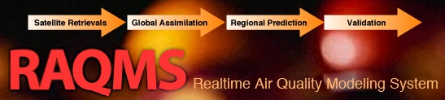

RAQMS Description
Online global chemical and aerosol assimilation/ forecasting system
UW-Madison hybrid θ−η coordinate model (UW-Hybrid) dynamical core
Unified stratosphere/troposphere chemical prediction scheme (LaRC-Combo) developed at NASA LaRC
Aerosol prediction scheme (GOCART) developed by Mian Chin (NASA GSFC).
http://raqms-ops.ssec.wisc.edu/index.php
RAQMS was developed by NASA Langley Research Center and the UW- Madison SSEC and has provided real-time global air quality forecasts since January, 2010
Notes:
3

Slide 4
Aura Chemical Reanalysis in support Air Quality Applications
  Developed approach to use RAQMS NOx emission sensitivity experiments and RAQMS/GSI OMI NO2 data assimilation adjust 2010 global Hemispheric Transport of Air Pollution (HTAP) monthly NO2 emissions
  Developed an approach to use the adjusted HTAP NO2 emissions and multiple linear regression of OMI urban NO2 trends to generate 2005-2015 global NO2 HTAP emissions
Notes:
Will first discuss “Constraining 2010 Hemispheric Transport of Air Pollution (HTAP) NO2 emissions with RAQMS/GSI OMI NO2 data assimilation”

Slide 5
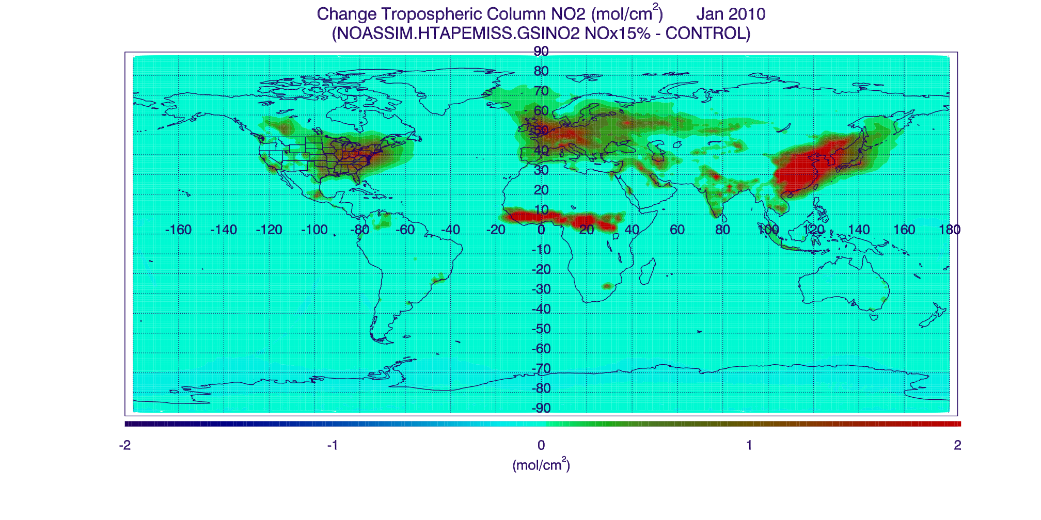
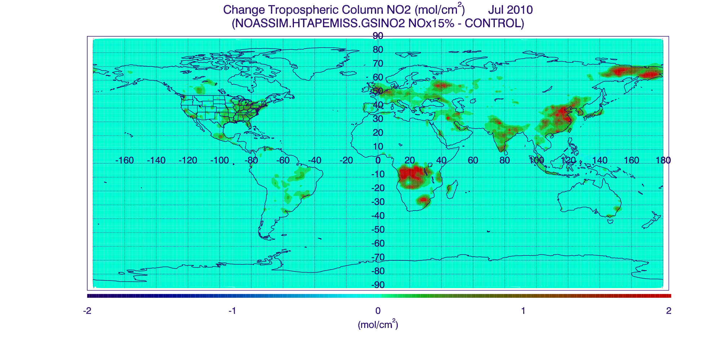
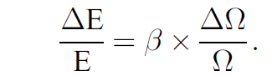
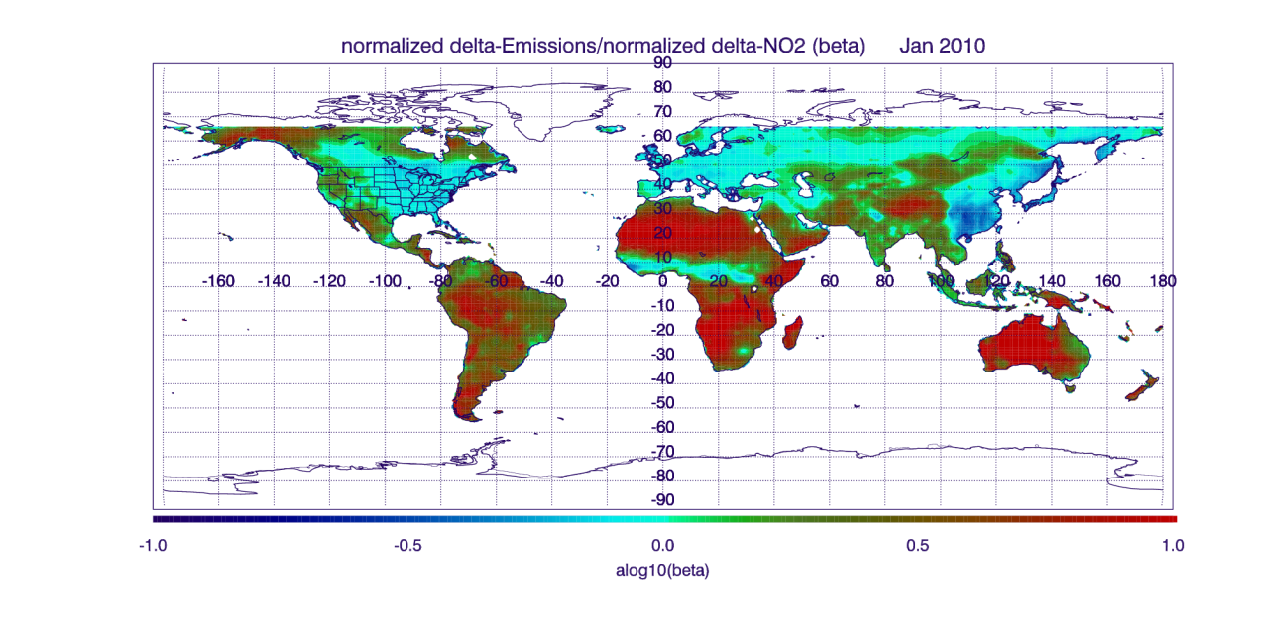
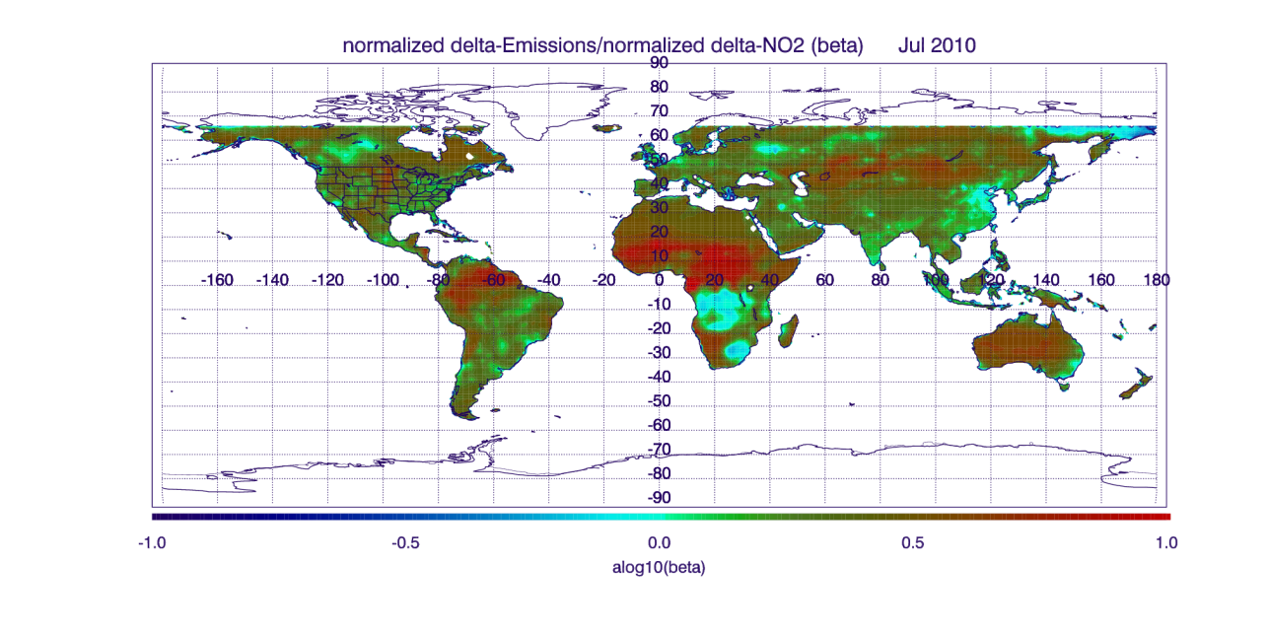
Constraining 2010 HTAP NO2 emissions with RAQMS/GSI OMI NO2 data assimilation
Change in Tropospheric NO2 Column (10¹⁵ mol/cm²) January 2010
(15% emission perturbation-Control)
Change in Tropospheric NO2 Column (10¹⁵ mol/cm²) July 2010
(15% emission perturbation-Control)
(10¹⁵ mol/cm²)
(10¹⁵ mol/cm²)
Monthly mean NO2 Jacobians (β=normalized delta-Emissions/normalized delta-NO2) are computed from the 2010 RAQMS NO2 emission perturbation experiment following (Lamsal, et al, 2012)
Lamsal, L. N., et al. (2011), Application of satellite observations for timely updates to global anthropogenic NOx emission inventories, Geophys. Res. Lett., 38, L05810, doi:10.1029/2010GL046476.
Notes:
Based on the work of Lamsal et al (2011) determine relationship between change in emissions and change in tropospheric NO2 column (NO2 Jacobians, or βετα) to account for non-linear response
Showing results from 15% emissions sensitivity experiment for January (left) and July (right) 2010
Show what is being calculated in equation on right
Regions of high beta (red) are regions with low changes and are associated with transport from source regions (not important)
Regions with high change in NO2 column have beta values that are generally less than 1 (blue)
The beta values vary with season due to different NO2 lifetimes

Slide 6
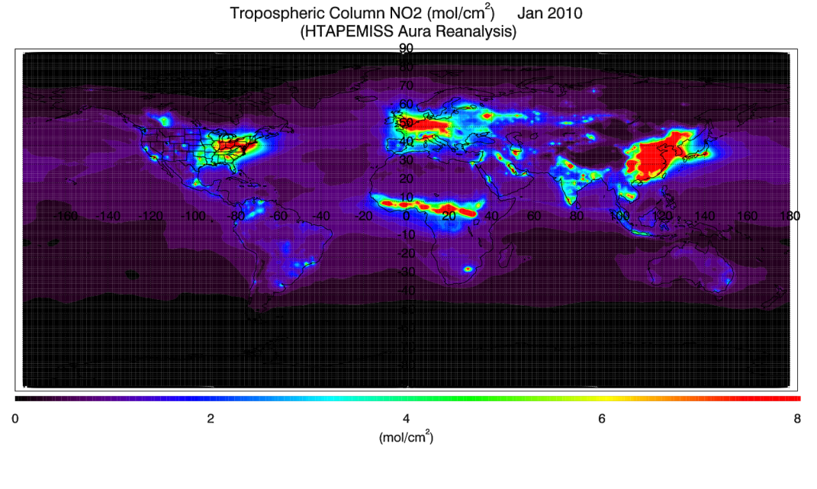
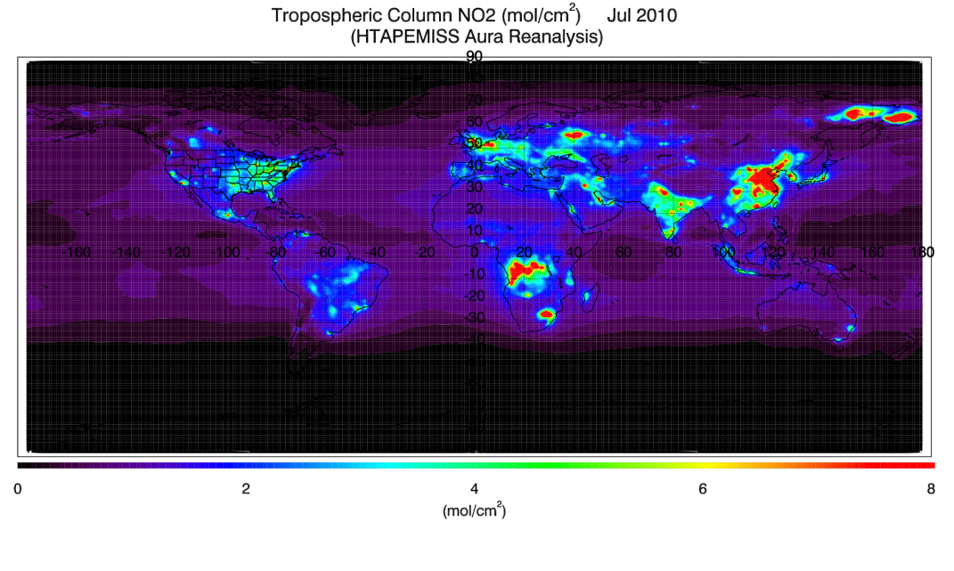
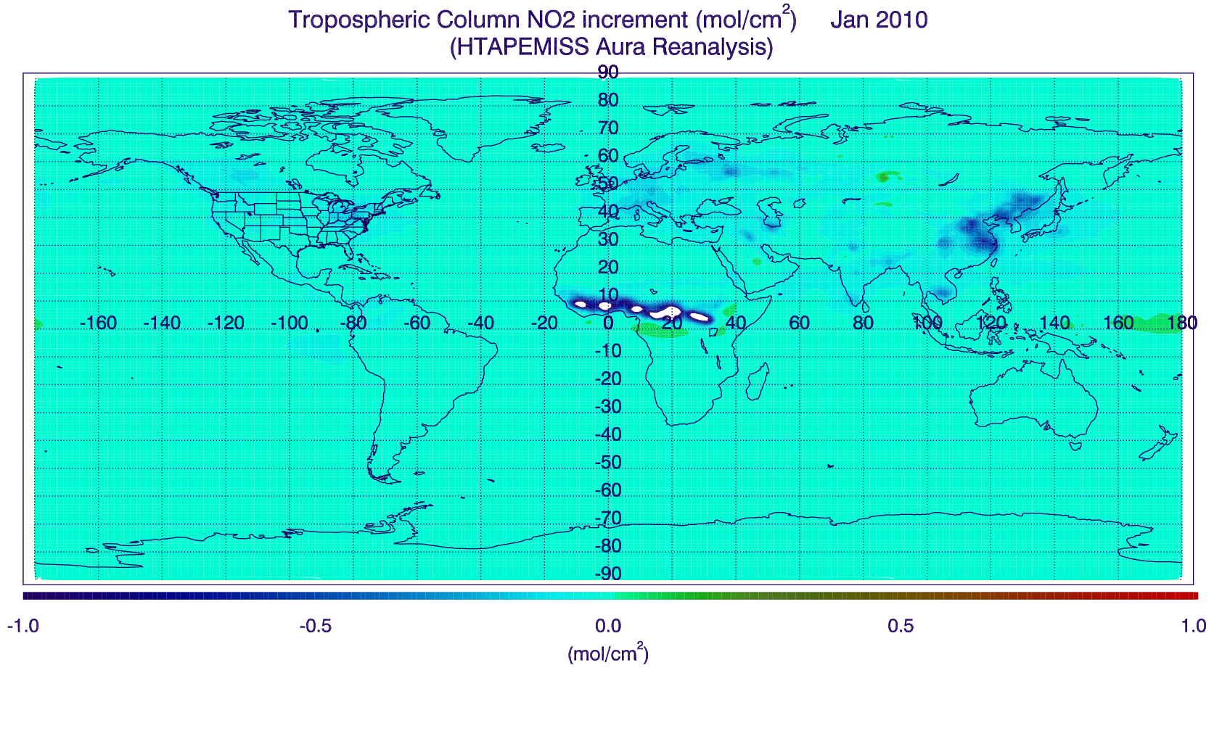
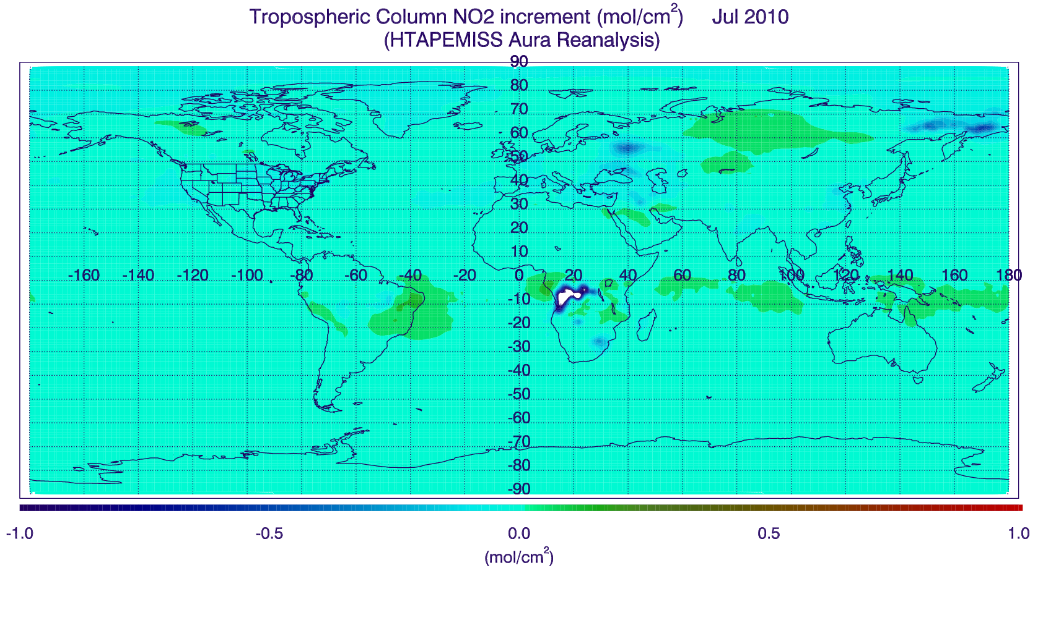
Constraining 2010 HTAP NO2 emissions with RAQMS/GSI OMI NO2 data assimilation
Tropospheric NO2 Column (10¹⁵ mol/cm²) January 2010
(HTAPEMISS Aura Reanalysis)
Tropospheric NO2 Column (10¹⁵ mol/cm²) July 2010
(HTAPEMISS Aura Reanalysis)
(10¹⁵ mol/cm²)
(10¹⁵ mol/cm²)
Monthly mean tropospheric NO2 column assimilation increments are computed from the 2010 RAQMS Aura Reanalysis OMI NO2 assimilation (used to define normalized delta-NO2)
Tropospheric NO2 Column Increment (10¹⁵ mol/cm²) January 2010
(HTAPEMISS Aura Reanalysis)
Tropospheric NO2 Column Increment (10¹⁵ mol/cm²) July 2010
(HTAPEMISS Aura Reanalysis)
(10¹⁵ mol/cm²)
(10¹⁵ mol/cm²)
Notes:
RAQMS/GSI NO2 assimilation provides a delta NO2 column that can now be used to adjust the emissions
Note that delta NO2 and high NO2 columns over Equatorial Africa (January) and Eastern Siberia and Southern Africa (July) are associated with fires

Slide 7
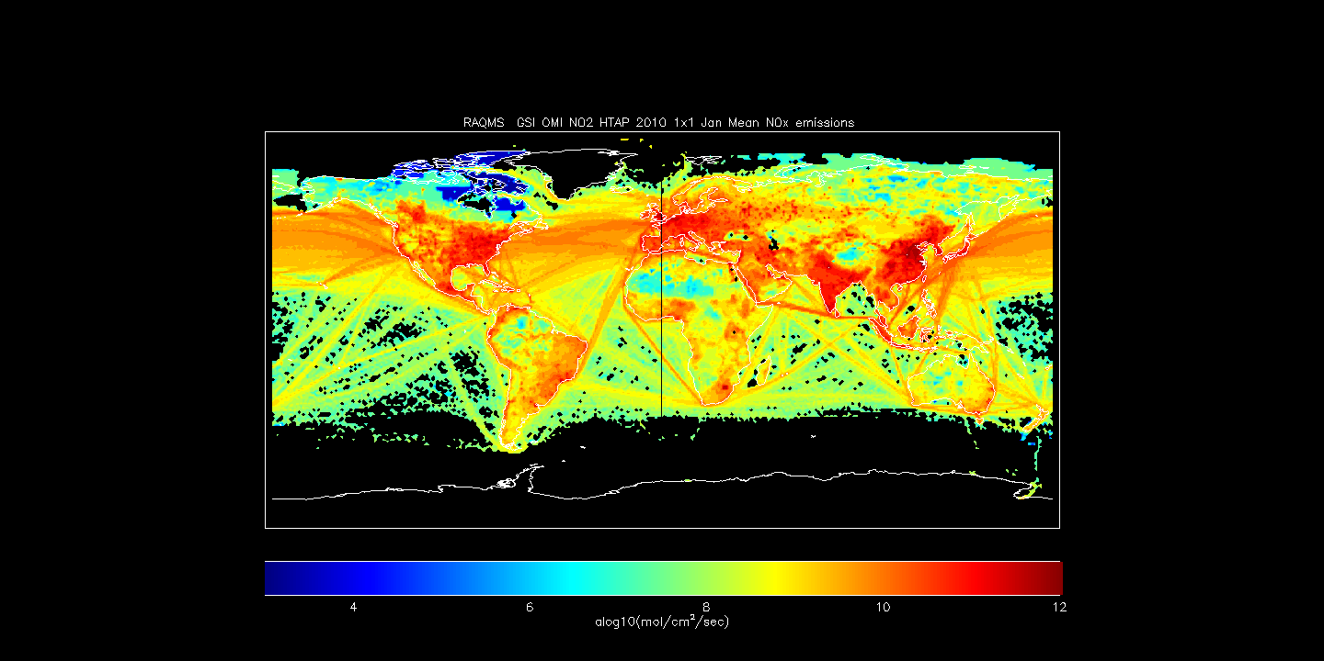
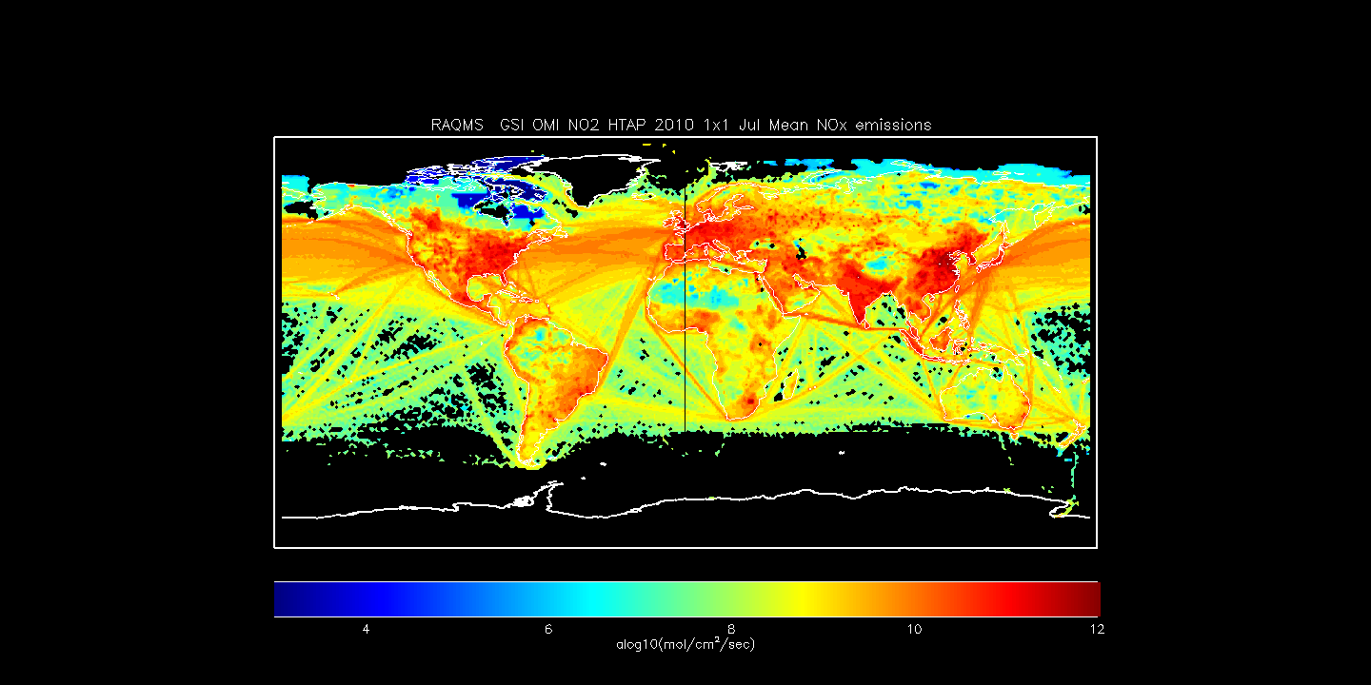
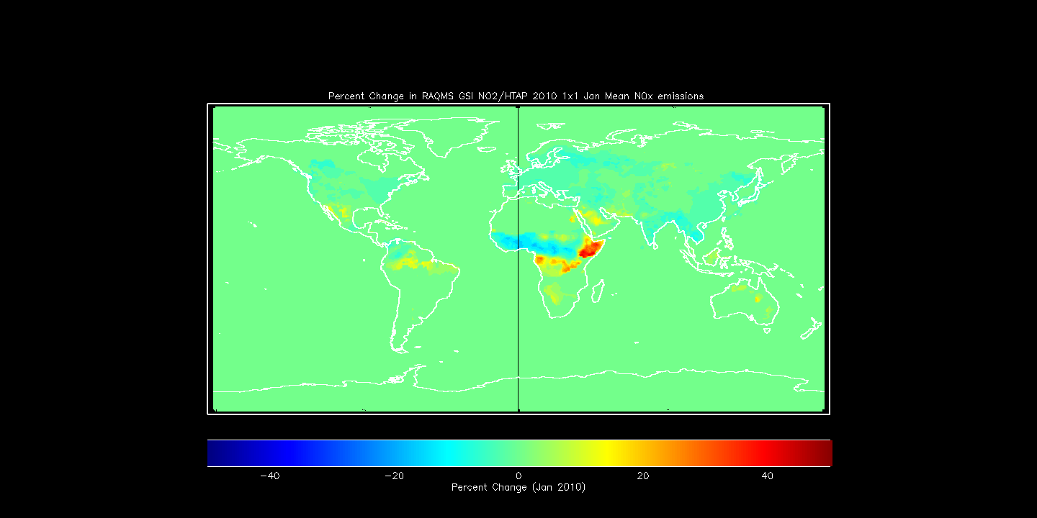
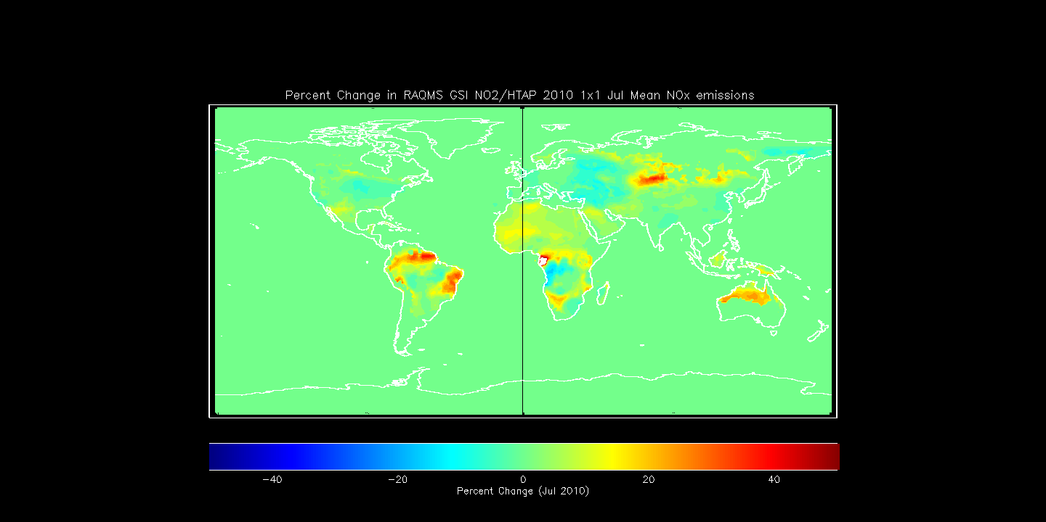
Constraining 2010 HTAP NO2 emissions with RAQMS/GSI OMI NO2 data assimilation
Adjusted HTAP NO2 Emissions (10¹⁵ mol/cm²) January 2010
(Aura Reanalysis RAQMS/GSI OMI DA )
Adjusted HTAP NO2 Emissions (10¹⁵ mol/cm²) July 2010
(Aura Reanalysis RAQMS/GSI OMI DA )
delta-NO2 from OMI NO2 DA and Jacobian (β) from NO2 emissions perturbation experiment are used to adjust monthly HTAP NO2 emissions
Percent Change in HTAP NO2 Emissions January 2010
Percent Change in HTAP NO2 Emissions July 2010
Notes:
Now use delta NO2 from DA and beta to adjust emissions, next slide will point out main features
If someone asks about high adjustments near fires then say we need to add constraint of >50% total emissions from HTAP to remove fire regions.

Slide 8
Constraining 2010 HTAP NO2 emissions with RAQMS/GSI OMI NO2 data assimilation
Adjusted HTAP NO2 Emissions (10¹⁵ mol/cm²) January 2010
(Aura Reanalysis RAQMS/GSI OMI DA )
Adjusted HTAP NO2 Emissions (10¹⁵ mol/cm²) July 2010
(Aura Reanalysis RAQMS/GSI OMI DA )
Adjustment leads to reductions in emissions in industrialized areas (regions of large positive changes have low anthropogenic emissions)
Percent Change in HTAP NO2 Emissions January 2010
Percent Change in HTAP NO2 Emissions July 2010
Notes:
If someone asks about high adjustments near fires then say we need to add constraint of >50% total emissions from HTAP to remove fire regions.

Slide 9
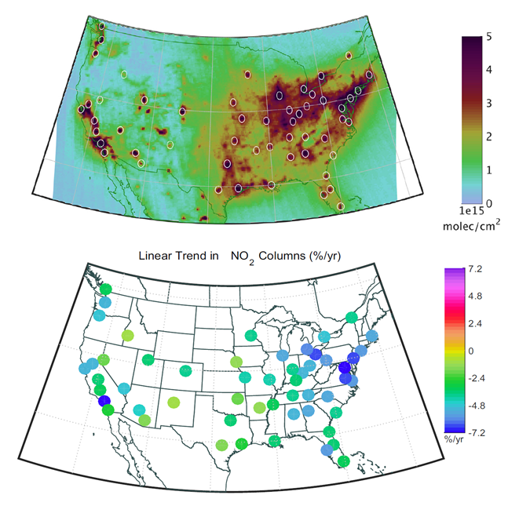
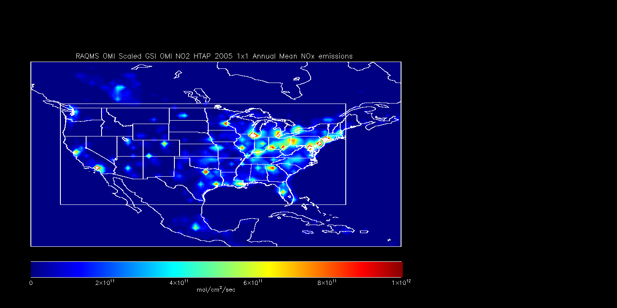
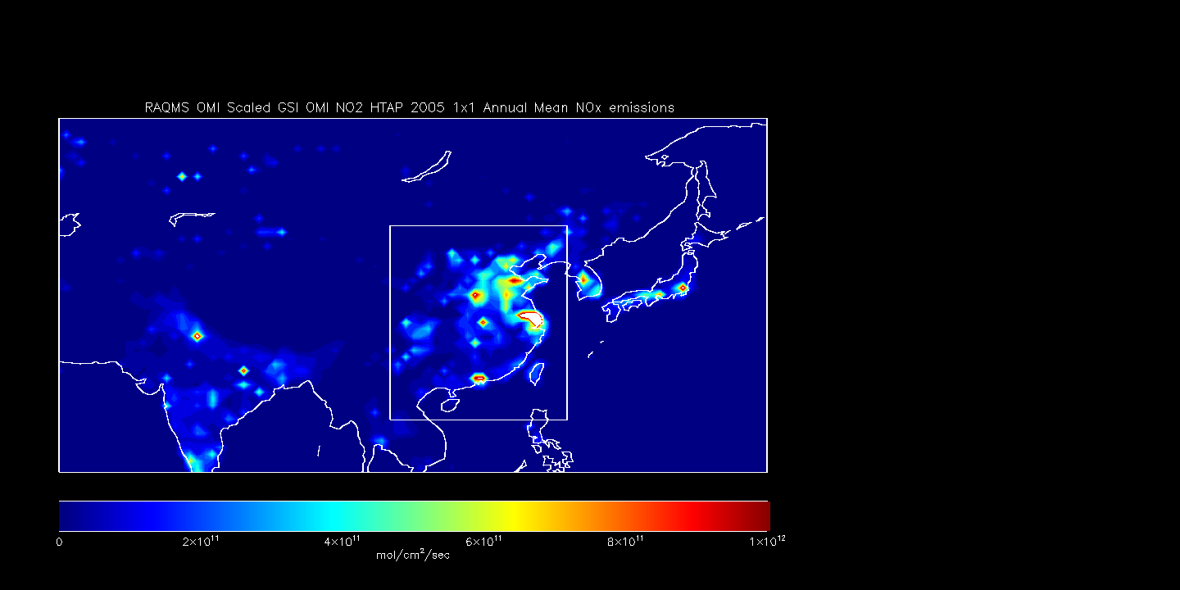
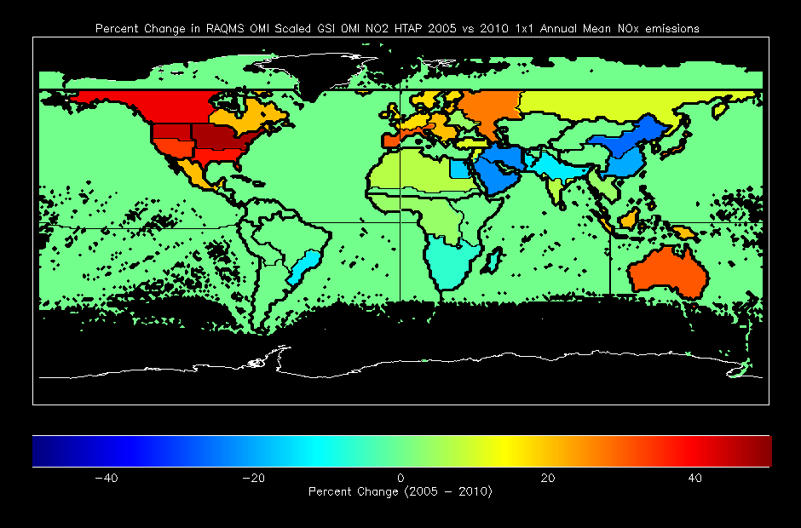
2005-2015 HTAP NO2 emissions for Aura Reanalysis
Multiple Linear Regression
Of OMI urban NO2 trends
Multiple Linear Regression of OMI urban NO2 trends used to generate 2005-2015 global NO2 emissions (applied uniformly across each HTAP region)
Benjamin de Foy, B. et al. (2016), Impacts of control strategies, the Great Recession and weekday variations on NO2 columns above North American cities, http://dx.doi.org/10.1016/j.atmosenv.2016.04.038
Notes:
Collaboration with Ben de Foy at Saint Louis University who provided multiple linear regression of OMI NO2 trends for global cities
Start in Upper left (OMI NO2 with US city locations identified), then map of trends (%/year), then say same done for each HTAP region (note that there are 4 in the US)
Then go to right hand side to discuss results
Trends from multiple cities within each HTAP sub region are used, trend is applied uniformly across each HTAP region
Timeseries are all changes in percent relative to 2010
US time series shows a minimum during the 2007 recession followed by a slight increase and then decline
SE Asian time series shows a maximum in 2011 with sharp decline during 2012 Beijing Olympics and then continuing decline

Slide 10
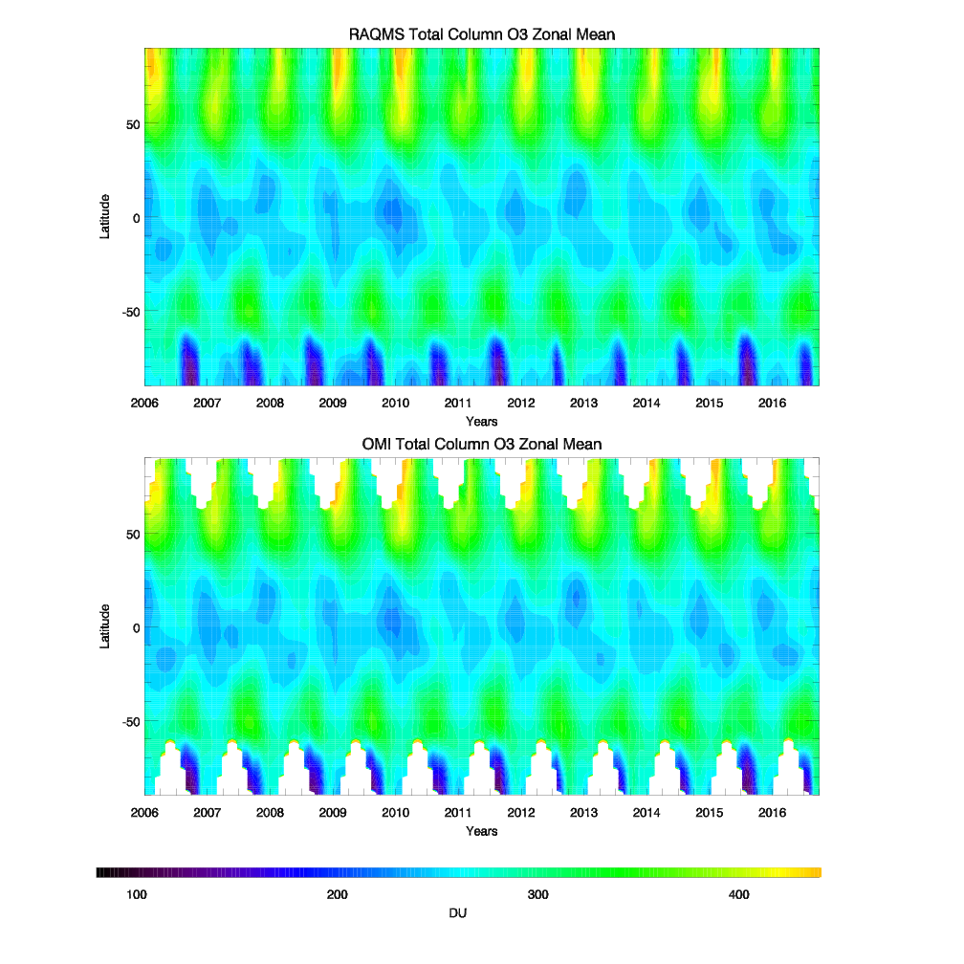
Analyzed vs OMI
Total Column O3
Aura Reanalysis captures inter-annual variability of Total Column O3 including: tropical quasi-biennial oscillation (QBO, Camp et al, 2003), Antarctic ozone hole, and unprecedented Arctic ozone loss in 2011 (Manney et al, 2011)
Provided by Margaret Bruckner (UW-Madison AOS)
Camp, C. D., M. S. Roulston, and Y. L. Yung, Temporal and spatial patterns of the interannual variability of total ozone in the tropics, J. Geophys. Res., 108(D20), 4643, doi:10.1029/2001JD001504, 2003.
Manney, G. L., Santee, M. L., Rex, M., Livesey, N. J., Pitts, M. C., Veefkind, P., et al. (2011).
Unprecedented Arctic ozone loss in. Nature, 478(7370), 469–475.

Slide 11
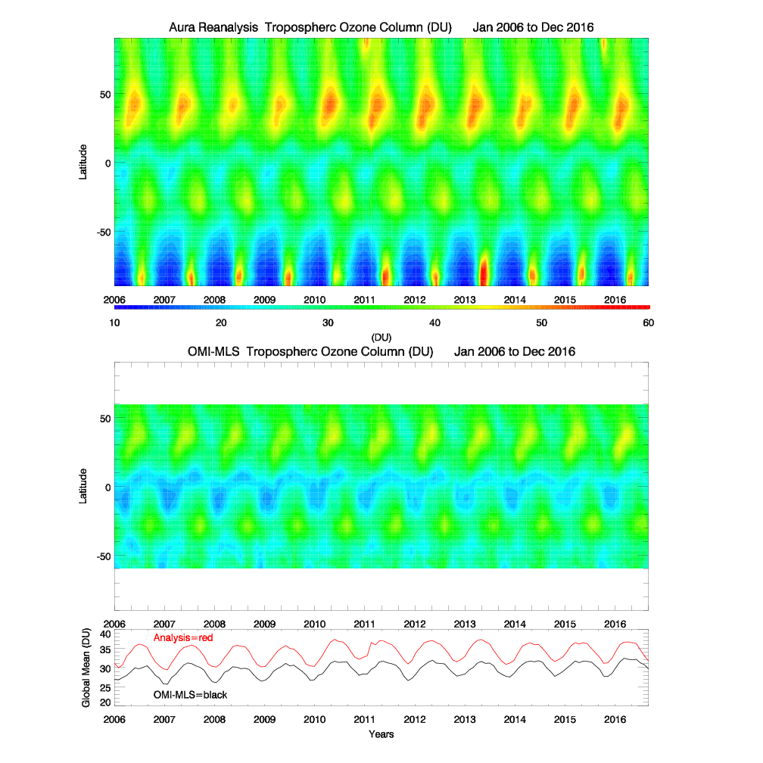
Analyzed Tropospheric Ozone Column (TOC)
vs
OMI-MLS Tropospheric Ozone Residuals (TOR)
Aura Reanalysis captures seasonal variation but shows a systematic high bias relative to the OMI-MLS TOR
Ziemke, et al. (2006), Tropospheric ozone determined from Aura OMI and MLS: Evaluation of measurements and comparison with the Global Modeling Initiative’s Chemical Transport Model, J. Geophys. Res., 111, D19303, doi:10.1029/2006JD007089.

Slide 12
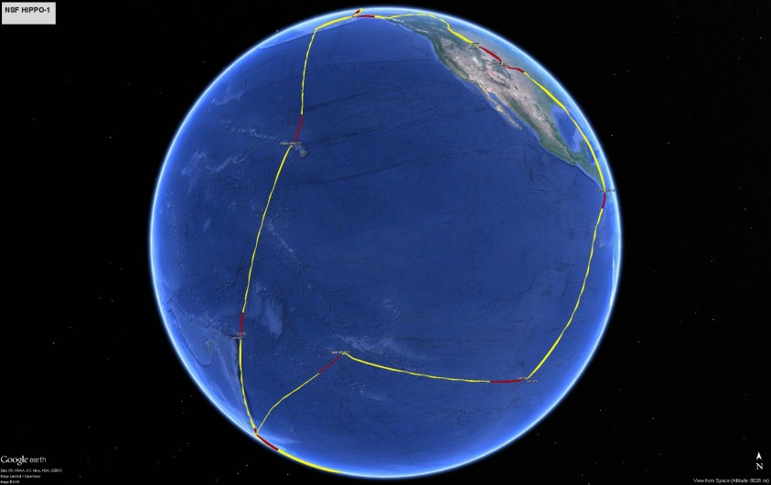

HIPPO Flight Tracks January 2009
HIPPO
Airborne measurements from NSF HIPPO-I field campaign are used to verify Aura Reanalysis TOC over the Pacific Ocean during January 2009
HIPPO
Wofsy S. et al., 2011,HIAPER Pole-to-Pole Observations (HIPPO): fine-grained, global-scale measurements of climatically important atmospheric gases and aerosols, Phil. Trans. R. Soc. A (2011) 369, 2073–2086 doi:10.1098/rsta.2010.0313

Slide 13
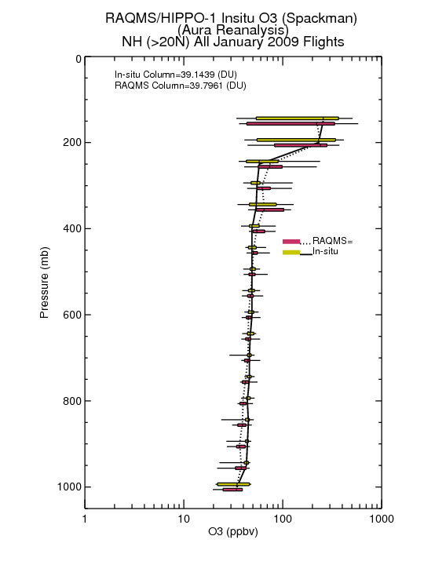
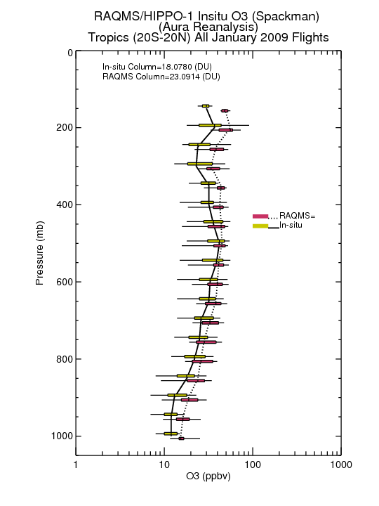
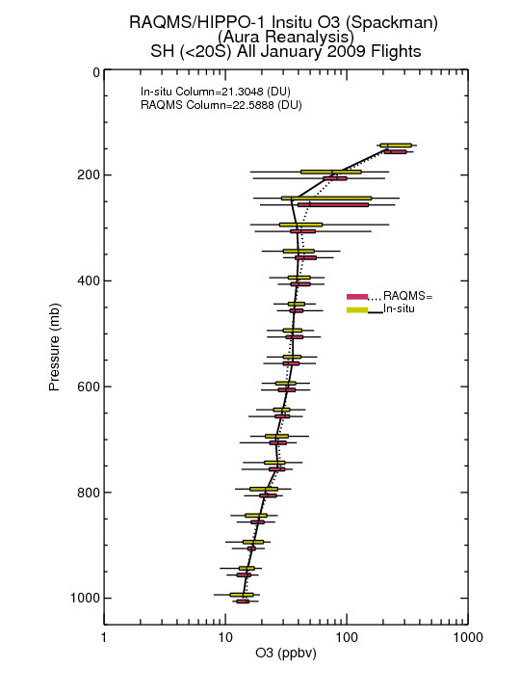
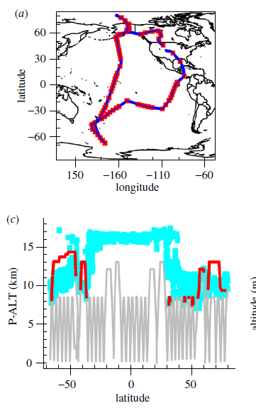
HIPPO-1 January 2009 O3 Verification
Northern Hemisphere
Tropics
Southern Hemisphere
<1DU (<2%) NH Bias
5DU (28%) Tropical Bias
1.3 DU (6%) SH Bias
Tropical Pacific region (20N-20S) dominates the high bias in tropospheric ozone column

Slide 14
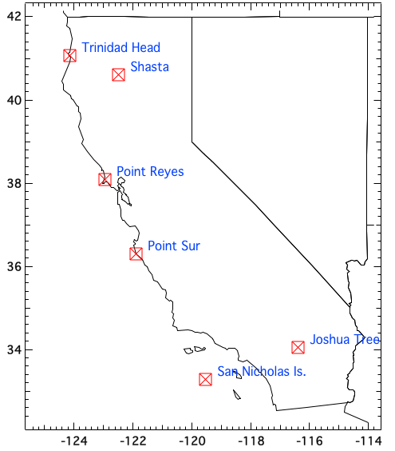
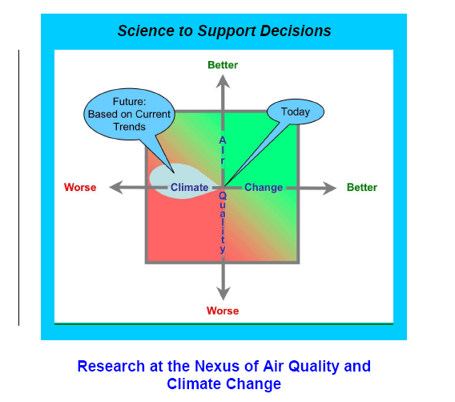
CalNex
Ozonesondes from 2010 CalNex field campaign are used to verify Aura Reanalysis TOC over the West coast of US during May-June, 2010
CalNex
Ryerson, T. B., Andrews, A. E., Angevine, W. M., Bates, T. S., Brock, C. A., Cairns, B., et al. (2013). The 2010 California research at the nexus of air quality and climate change (CalNex) field study.JGR-Atmos, 118, 5830– 5866. https://doi.org/10.1002/jgrd.50331

Slide 15
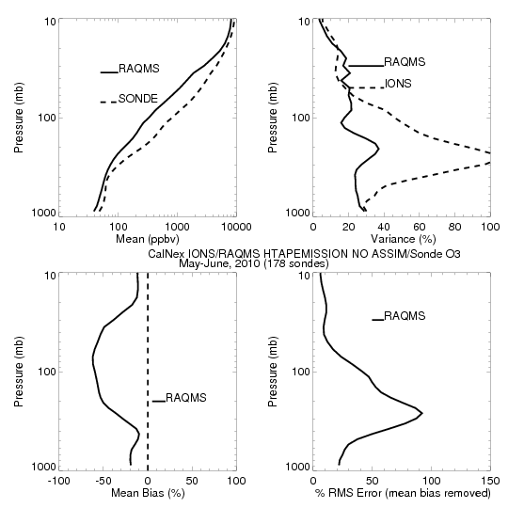
Aura Chemical Reanalysis in support Air Quality Applications
CalNex-2010 O₃ sondes – Owen Cooper (NOAA ESRL)
CalNex Ozonesonde
May-June, 2010
CalNex was organized by the California Air Resources Board (CARB) and NOAA to investigate scientific issues at the nexus between air quality and climate change.
RAQMS baseline (no assimilation) underestimates ozone and ozone variance in the stratosphere and troposphere
+/- 10%
CalNex ozonesonde measurements provide an opportunity to assess the impact of MLS and OMI O3 assimilation on ozone within the Aura Reanalysis along the California coast

Slide 16
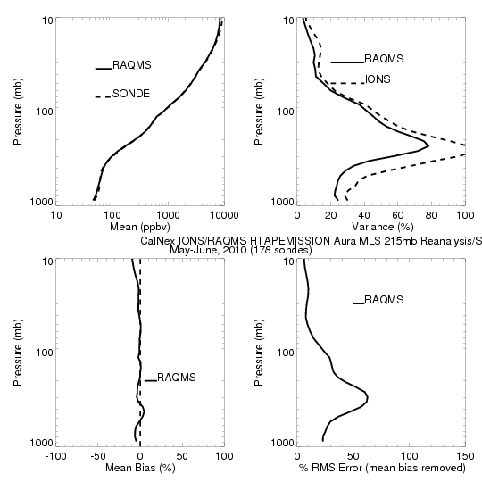
Aura Chemical Reanalysis in support Air Quality Applications
CalNex-2010 O₃ sondes – Owen Cooper (NOAA ESRL)
CalNex Ozonesonde
May-June, 2010
CalNex was organized by the California Air Resources Board (CARB) and NOAA to investigate scientific issues at the nexus between air quality and climate change.
RAQMS Aura Reanalysis improves ozone and ozone variance in the stratosphere and troposphere
+/- 10%
CalNex ozonesonde measurements provide an opportunity to assess the impact of MLS and OMI O3 assimilation on ozone within the Aura Reanalysis along the California coast

Slide 17
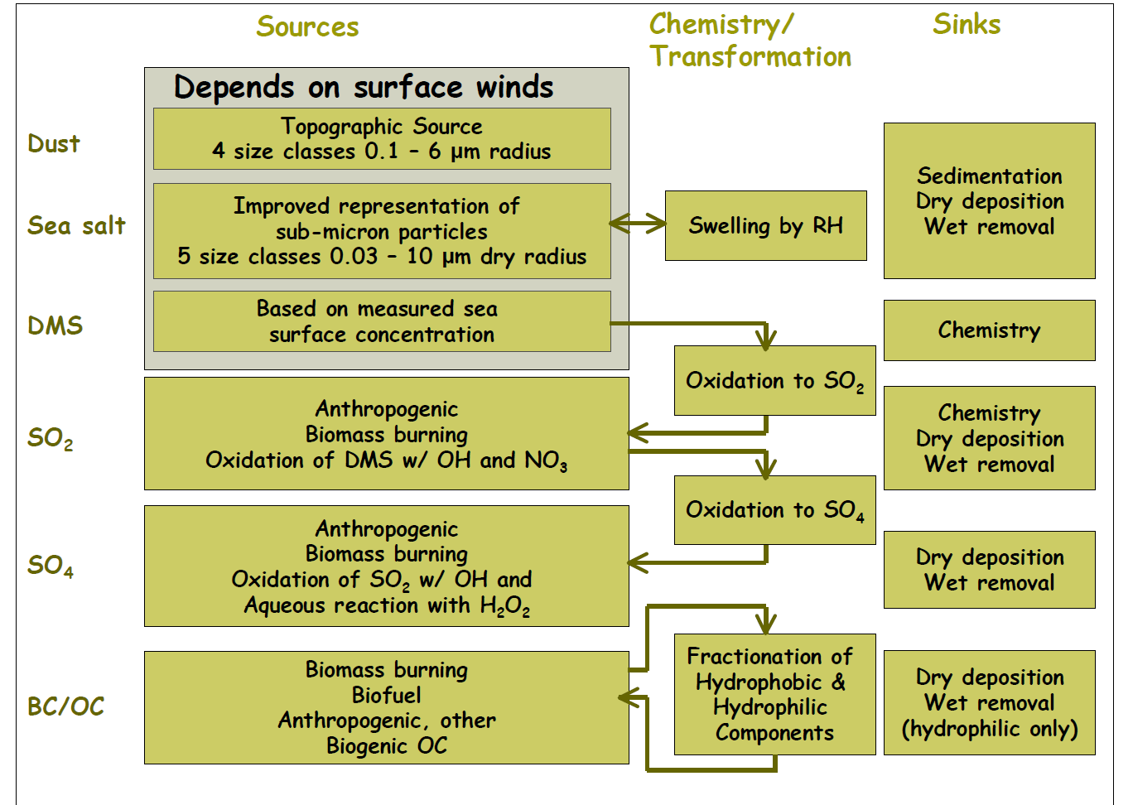
GOCART Aerosol Module

Slide 18

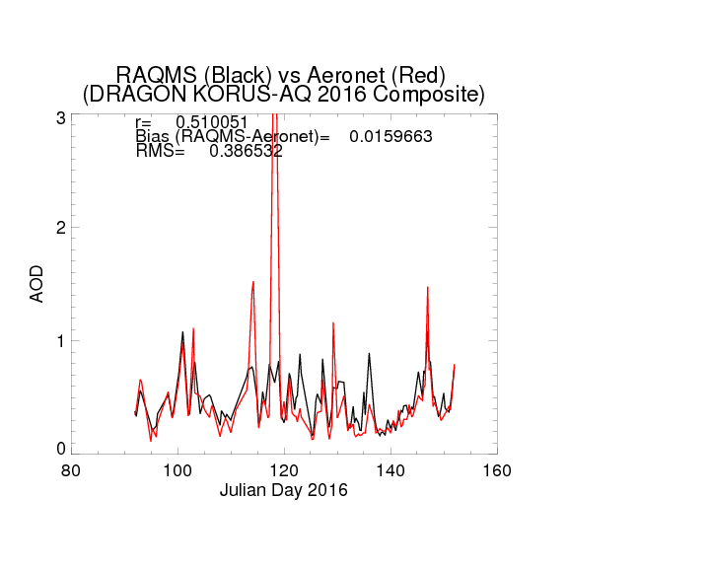
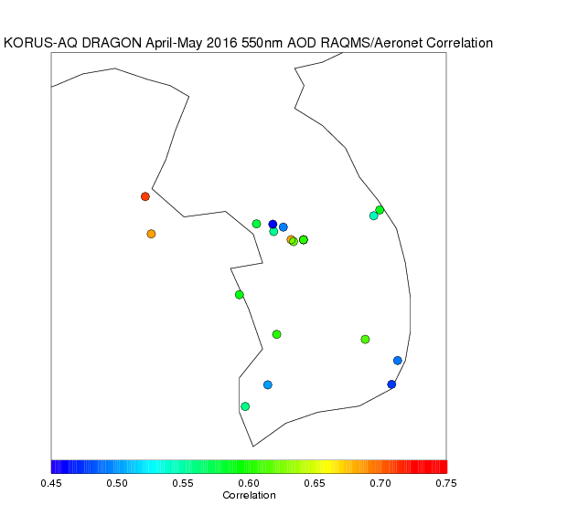
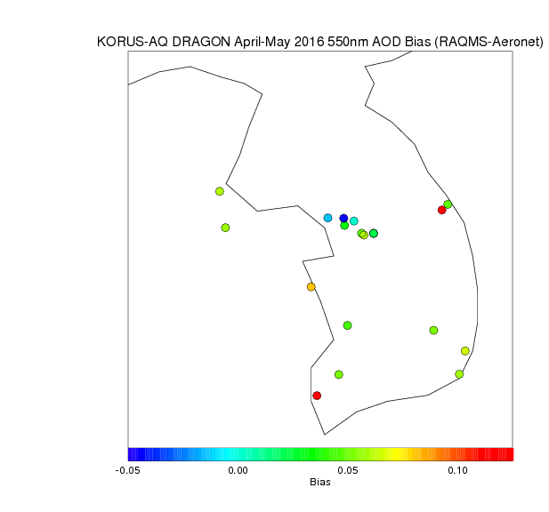
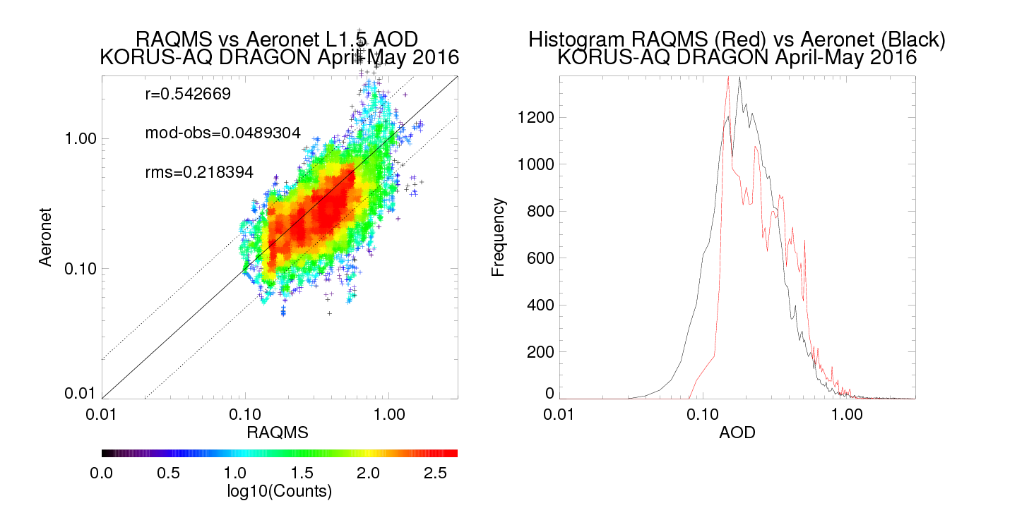
Cirrus?
Focus
Good quantitative agreement with aerosol optical depth observed by the Aeronet KORUS-AQ DRAGON Network during April 01-20, 2016 (Julian Day 92-111) focus period
https://aeronet.gsfc.nasa.gov/

Slide 19
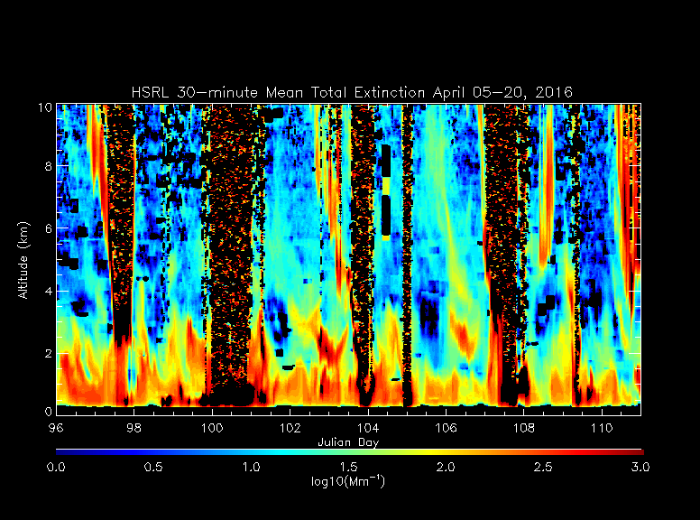
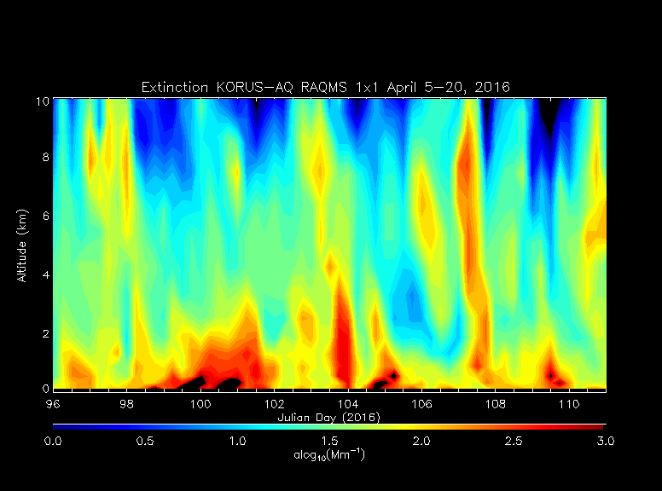
HSRL Observed Extinction Profile
University of Wisconsin Lidar Group
(Ed Eloranta, eloranta@lidar.ssec.wisc.edu)
Good qualitative agreement in vertical distribution of aerosol extinction with High Spectral Resolution Lidar (HSRL) deployed to Seoul, South Korea
RAQMS Analyzed Extinction Profile
Very high extinction (>3000Mm or <0.81mile/1.3km visual range) during April 09-11 (Julian Days 100-102)
http://lidar.ssec.wisc.edu/

Slide 20
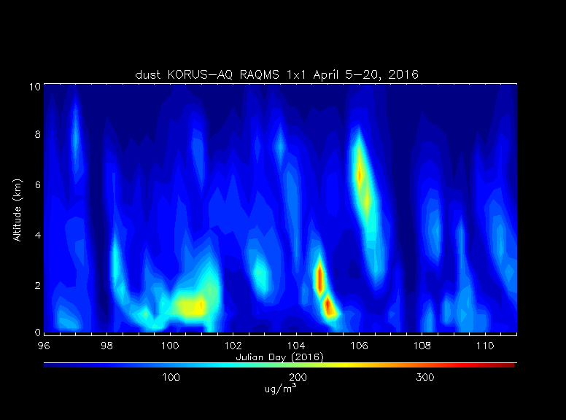
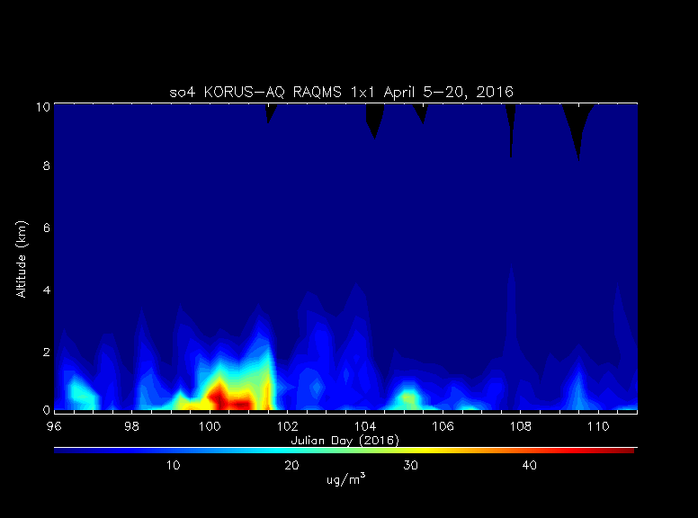
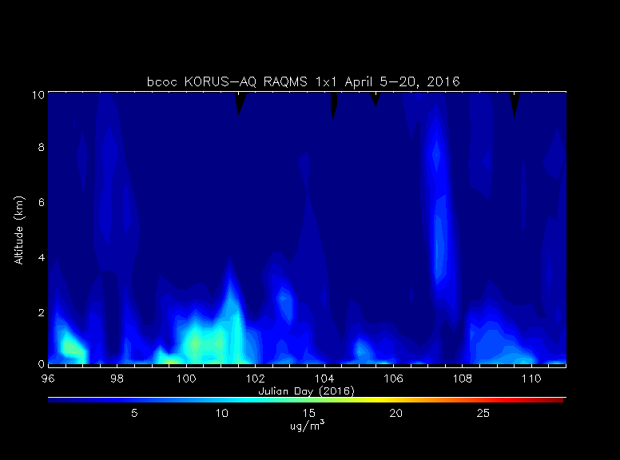
RAQMS Analyzed Dust concentration
RAQMS Analyzed Sulfate concentration
April 09-11. 2016 event includes Dust, Sulfate (so4), and black and organic carbon (bcoc) contributions
RAQMS Analyzed Extinction Profile
Black and Organic Carbon concentration

Slide 21
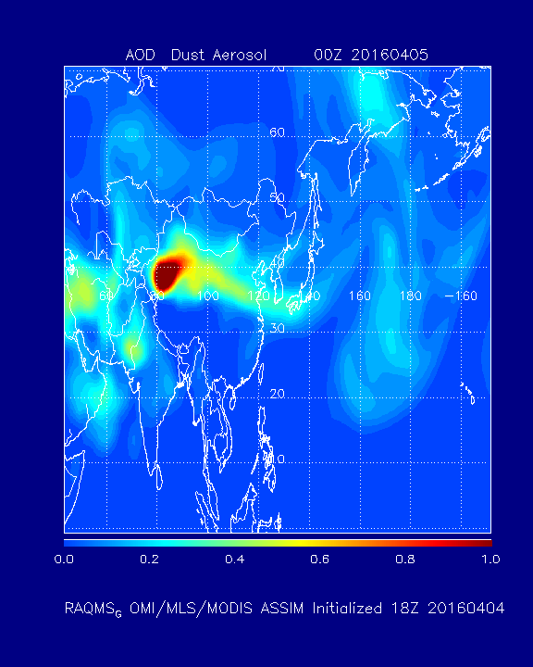
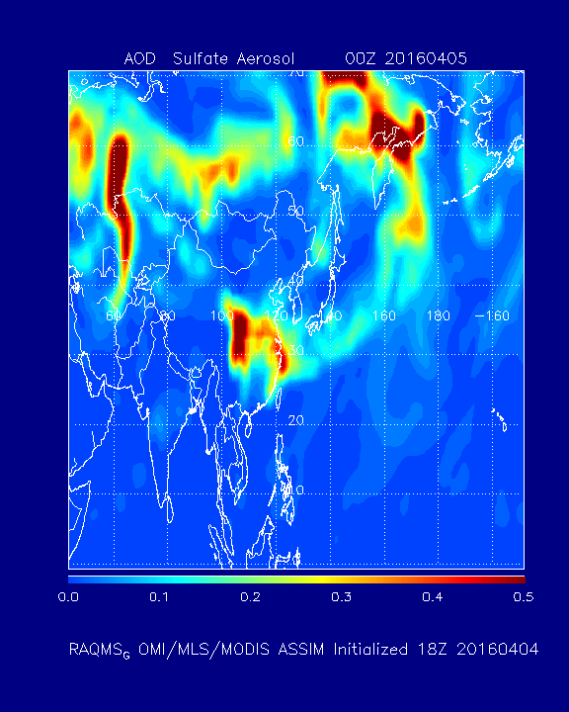
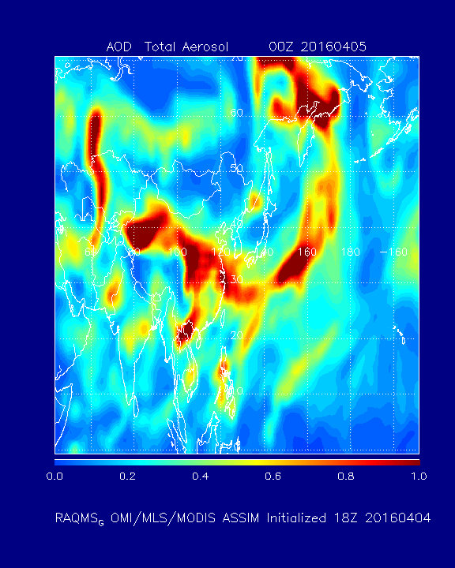
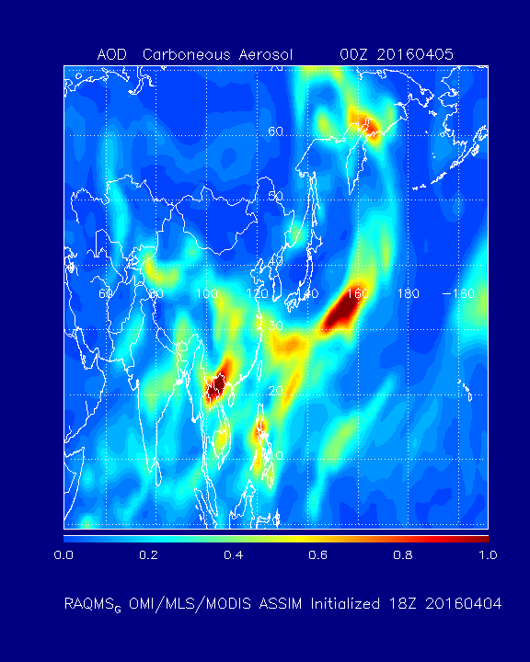
RAQMS Analyzed Dust AOD
RAQMS Analyzed Sulfate AOD
Taklimakan Desert (Dust)
Sichuan Province (Sulfate)
RAQMS Analyzed Total AOD
RAQMS Analyzed Carboneous AOD
Laos (Carboneous)

Slide 22
NAM-CMAQ/TROPOMI
Data Assimilation
Background
  TROPOMI Sentinel-5 Precursor (S5P) satellite
  NWS Regional Air Quality Forecast (NAM-CMAQ)
Objectives and Approach
Accomplishments

Slide 23
Background
One of the key objectives for a Weather Ready Nation outlined in the NOAA Next Generation Strategic Plan is “Healthy people and communities due to improved air and water quality services”.
A key to achieving this objective is high-resolution air quality forecasts. To support this objective, data assimilation capabilities need to be developed to exploit the next generation of satellite based air quality measurements.
Focus on developing capabilities to assimilate TROPOMI retrievals within the NWS regional air quality forecasting system (NAM-CMAQ)

Slide 24

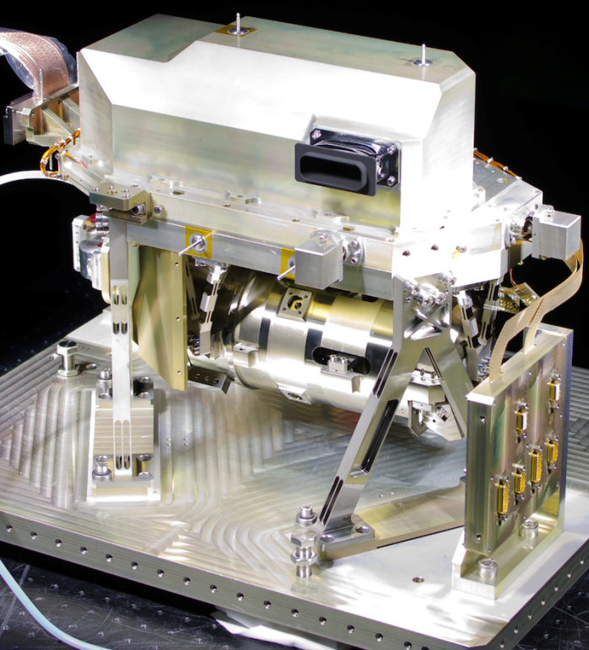

The TROPOspheric Monitoring Instrument (TROPOMI) is the satellite instrument on board the Copernicus Sentinel-5 Precursor (S5P) satellite launched on 13 October 2017.
UV-VIS-NIR-SWIR push-broom grating spectrometer (270-495 nm, 675-775 nm, 2305-2385 nm).
Nadir pixel 7x3.5 km² for all spectral bands, with the exception of the UV1 band (7x28 km²) and SWIR bands (7x7 km²).
S-5P makes measurements within 5-minutes of Suomi-NPP
S5P is a cooperative undertaking between ESA and the Kingdom of the Netherlands.
TROPOMI SWIR module

Slide 25
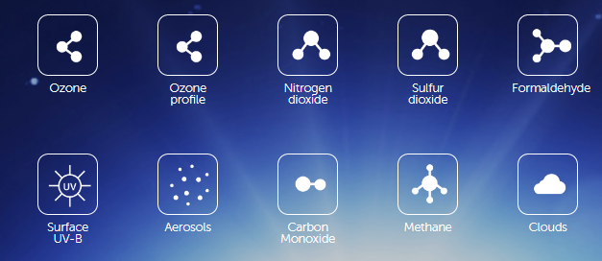
The objective of TROPOMI is to provide accurate and timely observations of key atmospheric species, for services on air quality, climate, and the ozone layer.
The TROPOMI daily global observations will be used for improving air quality forecasts as well as for monitoring the concentrations of atmospheric constituents.

Slide 26
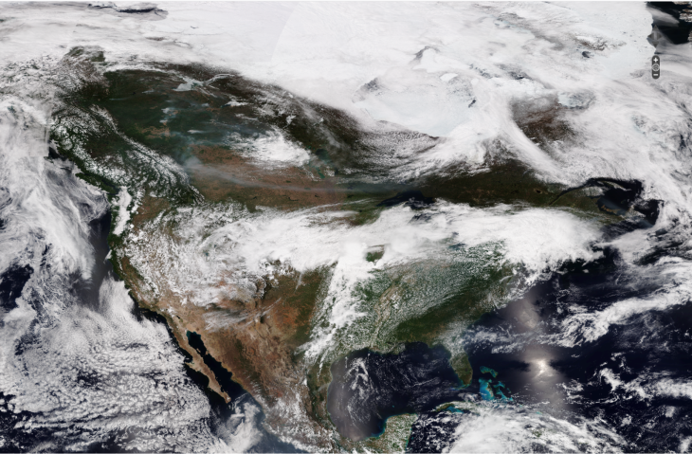
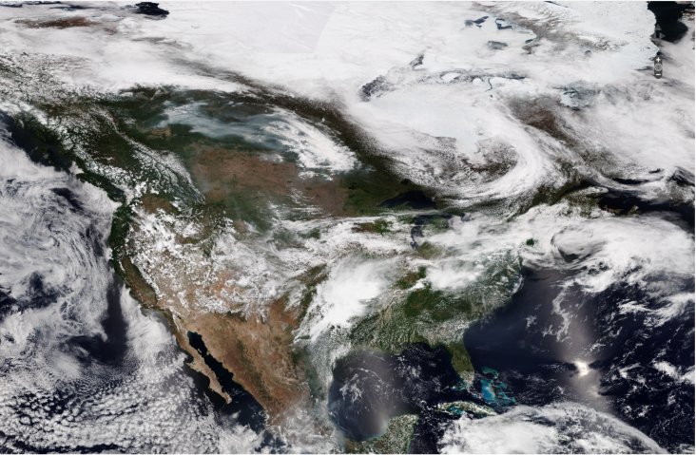
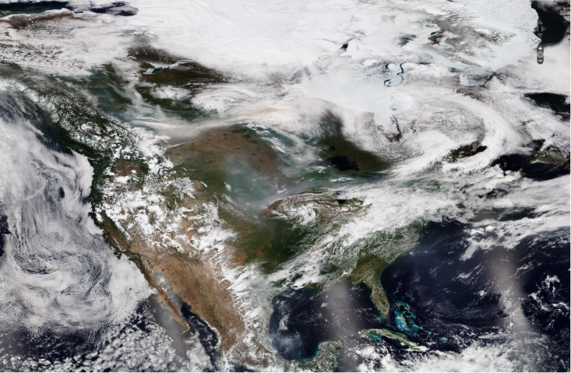
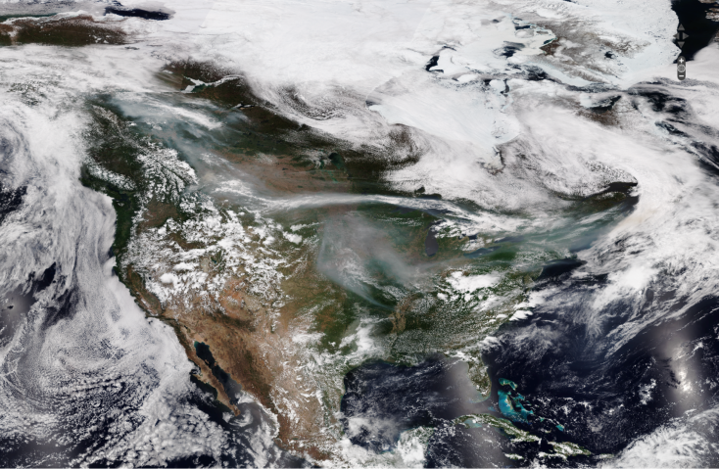
VIIRS True Color Imagery
May 28, 2019
May 29, 2019
May 30, 2019
May 31, 2019

Slide 27




TROPOMI Nitrogen Dioxide (NO2)
May 28, 2019
May 29, 2019
May 30, 2019
https://apps.sentinel-hub.com/eo-browser/
May 31, 2019

Slide 28

OMI vs TropOMI tropospheric NO2 on 07/16/2018
VIIRS Day-Night-Band included to show urban centers
Notes:
OMI, TropOMI and VIIRS McIDAS images from Tommy Jasmin (UW-Madison/SSEC)

Slide 29

https://www.weather.gov/sti/stimodeling_airquality
From Ivanka Stajner (EGU/2015)

Slide 30

  NAM-CMAQ Mean NOx Emissions LISTOS 2018 (July-August, 2018)
ARL parallel run mobile source emissions changed to MOVE2014_v_2 on June 1 2018. Improvement over previous Mobile6 (personal communication, Pius Lee, ARL)

Slide 31
NAM-CMAQ/GSI NOx emission adjustment experiments
Calculate monthly mean NO₂ Jacobian (β) from a 15% NO_{X} emission reduction perturbation experiment following Lamsal et al. 2011
Calculate monthly mean NO₂ analysis increment using NAM-CMAQ/GSI TROPOMI NO₂ assimilation
  NOx emission sensitive background errors (to correct NAM-CMAQ emissions)
Adjust NAM-CMAQ NO_{x} emissions using Jacobian and average analysis increment
Lamsal, L. N., et al. (2011), Application of satellite observations for timely updates to global anthropogenic NOx emission inventories, Geophys. Res. Lett., 38, L05810, doi:10.1029/2010GL046476.

Slide 32
  NAM-CMAQ Beta Calculations for July-August, 2018
Calculate monthly mean NO₂ Jacobian (β) from a 15% NO_{X} emission reduction perturbation experiment following Lamsal et al. 2011
Use baseline NAM-CMAQ and 15% NOx emission reduction experiments

Slide 33

  NAM-CMAQ Beta for July-August 2018
Urban areas and transport corridors (β<1), rural areas (β>1)

Slide 34
  NAM-CMAQ TROPOMI Analysis Increments for July-August 2018
Calculate monthly mean NO2 analysis increment using NAM-CMAQ/GSI TROPOMI NO2 assimilation
Use baseline NAM-CMAQ and 15% NOx emission reduction experiments to compute NOx emission sensitive background errors

Slide 35

  TROPOMI Analysis Increments for July-August 2018
July-August, 2018 mean GSI analysis increment shows large reductions in urban areas.

Slide 36
  NAM-CMAQ Emissions Adjustments July-August 2018
Adjust NAM-CMAQ NOx emissions using Jacobian and average analysis increment
Only adjusted daytime emissions since TROPOMI does not provide constraints on nighttime tropospheric NO2 column abundances.

Slide 37

S5-P Tropospheric Ozone Monitoring Instrument (TropOMI) Tropospheric NO2 column Data Assimilation
NOx emissions adjustments (ΔE) are constrained using TropOMI tropospheric NO2 column analysis increments (ΔΩ)
β accounts for the sensitivity of the NO2 column to changes in NOx emissions following Lamsal et al 2011.
Assimilation of TropOMI NO2 results in (~20%) reductions in NOx emissions over NYC during July-August 2018
Notes:
NAM-CMAQ TropOMI data assimilation experiments conducted by Allen Lenzen (UW-Madison/SSEC)

Slide 38

NAM-CMAQ surface ozone response to TropOMI offline NOx Tropospheric NO2 column Data Assimilation
Daytime (14-21Z) change in surface ozone between the Control and TROPOMI adjusted emissions experiments over the New York region during July-August, 2018.
Mean changes of 4ppbv over Southern Long Island
Notes:
NAM-CMAQ TropOMI data assimilation experiments conducted by Allen Lenzen (UW-Madison/SSEC)

Slide 39


Slide 40

Impact of TropOMI NO2 Offline emission adjustment: Urban Sites
Observed verses predicted daytime surface ozone for the Control Experiment (no emission adjustment).

Slide 41

Impact of TropOMI NO2 Offline emission adjustment: Urban Sites
Observed verses predicted daytime surface ozone for the TROPOMI Adjusted Emissions Experiment (adjusted emissions).

Slide 42
VIIRS True Color Imagery
May 28, 2019
May 29, 2019
May 30, 2019
May 31, 2019

Slide 43




TROPOMI Carbon Monoxide (CO)
May 28, 2019
May 29, 2019
May 30, 2019
https://apps.sentinel-hub.com/eo-browser/
May 31, 2019

Slide 44


Slide 45


Slide 46


Slide 47


Slide 48


Slide 49
CIMSS WRF-Chem
Portable aerosol forecast application for local needs.

Slide 50

Initialization and Lateral Boundary Conditions
The CIMSS WRF-Chem system enables utilization of Real-time Air Quality Modeling System (RAQMS) 1x1 degree global aerosol analyses and forecasts constrained with real time MODIS Terra and Aqua Aerosol Optical Depth (AOD) and fire detection retrievals.
This is a significant improvement since the model gains access to realistic initial conditions and lateral boundary conditions, better suited for the air quality forecasting and analysis.

Slide 51

Emissions
The CIMSS WRF-Chem system enables utilization of standard WRF-Chem options (see EDGAR .5X.5 deg) for global emissions as well as high resolution (.1x.1 deg) Task Force on Hemispheric Transport of Air Pollution (HTAP) emissions.
It is a significant improvement since the model gains access to a high resolution, harmonized emissions data base dataset, better suited for the air quality forecasting and analysis.

Slide 52

HTAP vs EDGAR emissions examples form currently used experimental setups
European/Africa Domain focusing on Saharan Dust transport

Slide 53

HTAP vs EDGAR emissions examples form currently used experimental setups
Mideast domain focusing on local dust events
UAE

Slide 54

May 2014 Abu Dhabi
Surface Dust predictions
FEA Standard
UAE Federal Environment Agency (FEA) Standard for PM10 is 150 μg/m³

Slide 55

May 14-18th, 2014 Abu Dhabi Dust event
UAE

Slide 56

WRF-Chem Turkey Experiment
Model Description
WRF-Chem¹ v.3.5.1 which is an online coupled model, configured to cover Eastern Mediterranean.
0.1×0.1 degree HTAP² is used for anthropogenic emission inventory.
Goddard Chemistry Aerosol Radiation and Transport (GOCART) aerosol module.
6 hourly Global Forecast System (GFS) 0.5x0.5 degree analyses (Meteorological IC/LBC).
6 hourly Real-time Air Quality Modeling System (RAQMS) 2x2 degree global analyses (Chemical IC/LBC).
Wild Fire Automated Biomass Algorithm (WF-ABBA) biomass burning emissions.
¹ Weather Research and Forecasting (WRF-Chem) model with chemistry; ² Hemispheric Transport of Air Pollution
Notes:
Such a small grid size is not feasible for regional model applications because the data demands and operating requirements are far too large.
We are not allowing interaction, we only have online chemistry, which improves transport and convective mixing.
Burning Algorithm (WF-ABBA) wildfire products (Prins and Menzel, 1994). WF-ABBA uses SEVIRI3 data to detect and characterize biomass burning.
WRF-Chem domains configured to cover Eastern Mediterranean (30km outer domain) and Anatolian Peninsula (10km inner domain) with topography map
WRF- Chem supports high resolution (up to 4km) anthropogenic emissions from the National Emissions Inventory (NEI) over the continental United States (CONUS), but uses low resolution (1° × 1°) Emission Database for Global Atmospheric Research (EDGAR) emissions for other regions. In order to improve the representation of the local emissions during the dust outbreak over Eastern Mediterranean, a higher resolution EDGAR anthropogenic emission inventory developed in cooperation with the Task Force on Hemispheric Transport of Air Pollution (TF HTAP)) that consists monthly 0.1° × 0.1° global grids for year 2008 is used. We substituted EDGAR HTAP SO₂, OC, BC, PM₁₀, PM_{2.5} emissions from Energy, Industry, Transport, and Residential sectors in original EDGAR emission inventory to create higher resolution anthropogenic emissions over Eastern Mediterranean.

Slide 57
WRF-Chem Turkey Experiment
Data Assimilation
The NOAA GSI¹ (3DVAR) data assimilation system is used to assimilate Terra and Aqua MODIS (col. 6) Aerosol Optical Depth (AOD) retrievals.
GSI uses Community Radiative Transfer Model (CRTM) to calculate AOD.
Experiment design:
  WRF-Chem Control (30km Domain): DOES NOT employ Data Assimilation (DA)
  WRF-Chem/GSI (30km Domain): Employs DA.
¹ Gridpoint Statistical Interpolation

Slide 58



WRF-Chem Turkey Experiment
Statistical Analysis
Time-series Comparisons
Ground Obs. vs Control Run
Ground Obs. vs Assimilation Run
Assimilation improves correlation and reduces RMS errors and bias compared to ground observations.

Slide 59
Questions?
rbpierce@wisc.edu

