Slide 1


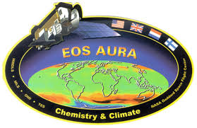

Aura Chemical Reanalysis in support Air Quality Applications
PI Brad Pierce
(NOAA/NESDIS)
Presented by
Allen Lenzen
(UW-Madison, SSEC)
Contributions from
Monica Harkey
(UW-Madison, SAGE)
2017 NASA Health and Air Quality Applications Program Review, September 12-13, 2017, Reno, NV
Notes:
Electronic version at: ftp://ftp.ssec.wisc.edu/pub/raqms/Aura_Reanalysis/NASA_2017_Applied_Science_Program_Review_Pierce_Final.pptx

Slide 2
Aura Chemical Reanalysis in support Air Quality Applications
Solicitation – ROSES 2013 Aura Science Team
Project Summary
  Utilize the Real-time Air Quality Modeling System (RAQMS) in conjunction with the NOAA Operational Gridpoint Statistical Interpolation (GSI) 3-dimensional variational data assimilation (DA) system to conduct a multi-year global chemical and aerosol reanalysis using NASA Aura and A-Train measurements.
Project Objectives
  Provide the air quality community with a multi-year global chemical and aerosol reanalysis using NASA Aura and A-Train measurements.
  Conduct regional chemical data assimilation experiments to quantify the influences in changes in NOx emissions on US air quality during the Aura period.
  Provide global 3 dimensional O3, CH4, N2O production and loss rates for next generation NOAA global forecast system.
  Collaborate with International, Federal, State and Local air quality management communities in the utilization of the Aura and A-Train measurements and reanalysis for air quality assessment activities.
|‌ 2
Notes:
Same as last year, can go through rather quickly

Slide 3
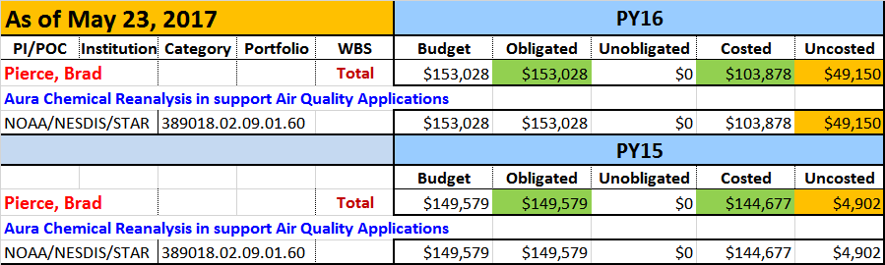
Aura Chemical Reanalysis in support Air Quality Applications
Budget
  FY16 funds (final year, $153,028) were received by NESDIS/STAR on July 19, 2016 due to delays in MOU approval by NOAA legal.
  CIMSS received FY16 funding from NESDIS/STAR on Sept, 15, 2016.
  NESDIS/STAR has requested a 1 year no-cost extension to complete the Aura Reanalysis project, which is currently scheduled to close on Sept 30, 2017.
Notes:
Have spent 40% of the FY16 funds (CIMSS Year 3 proposal goes from 1 July 2016 to 30 June 2017).

Slide 4
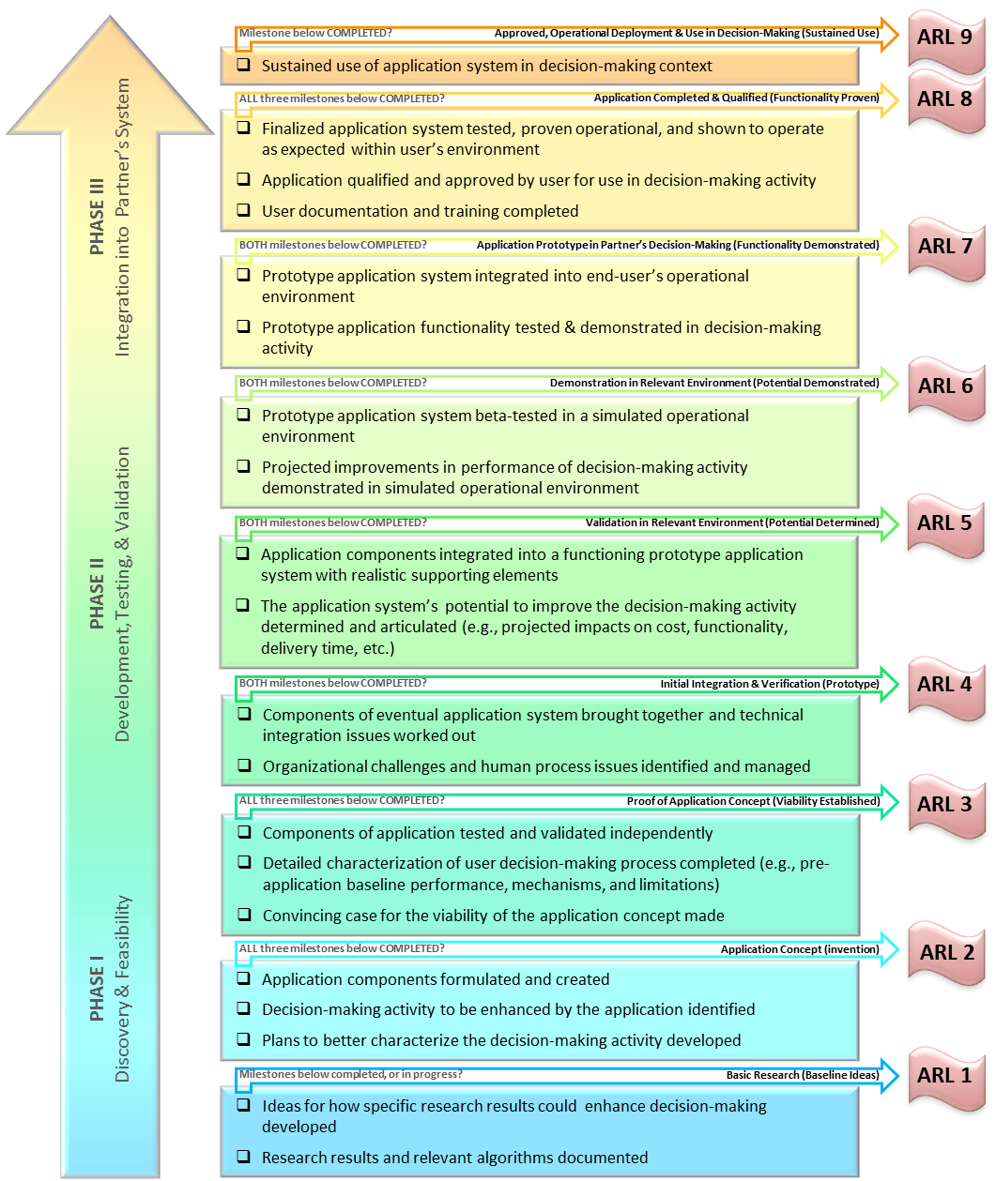
Applications Readiness Level (ARL)
Aura Chemical Reanalysis in support Air Quality Applications
As of July 16, 2015
Started at ARL 3 (Proof of Application Concept) with real-time RAQMS Data assimilation
Reached ARL 4 (Initial Integration and Verification) upon successfully completing the RAQMS/GSI Data Denial experiments (September, 2016)
Reached ARL 5 (Validation in Relevant Environment) upon completion of 2010 RAQMS/GSI analysis (December 2016)
Currently at ARL 6 (Demonstration in Relevant Environment) based on finalizing 2006-2016 emissions constraints, MLS, OMI, AIRS, and MODIS assimilation procedures, and successful completion of the first four years of Aura Reanalysis.
Will reach ARL 7 by the end of requested 1-year no-cost extension with delivery of RAQMS Aura Reanalysis to DAAC.
|‌ 4
Notes:
Currently at Applications Readiness Level (ARL) 6 (Demonstration in Relevant Environment) will reach ARL 7 (Functional) with delivery to DAAC
PI is now getting “ebook” notifications of reporting, and has updated ARL

Slide 5
Aura Chemical Reanalysis in support Air Quality Applications
Results and Milestones (Year 3)
  Completed first 4 years (2006-2009) of the 10 year Aura Reanalysis
  Conducted verification studies to assess the fidelity of the Aura Reanalysis through comparisons with airborne insitu measurements collected during NASA, NOAA and NSF field campaigns
  Completed CMAQ/GSI NOx emission adjustment experiments using offline CMAQ/GSI OMI NO2 assimilation constraints
Notes:
This is the focus of the rest of the presentation, no need to read these, will walk through one at a time

Slide 6
Aura Chemical Reanalysis in support Air Quality Applications
Results and Milestones (Year 3)
  Completed first 4 years (2006-2009) of the 10 year Aura Reanalysis
  Conducted verification studies to assess the fidelity of the reanalysis through comparisons with airborne insitu measurements collected during NASA, NOAA and NSF field campaigns
  Completed CMAQ/GSI NOx emission adjustment experiments using offline CMAQ/GSI OMI NO2 assimilation constraints
Notes:
This is the focus of the rest of the presentation, no need to read these, will walk through one at a time

Slide 7
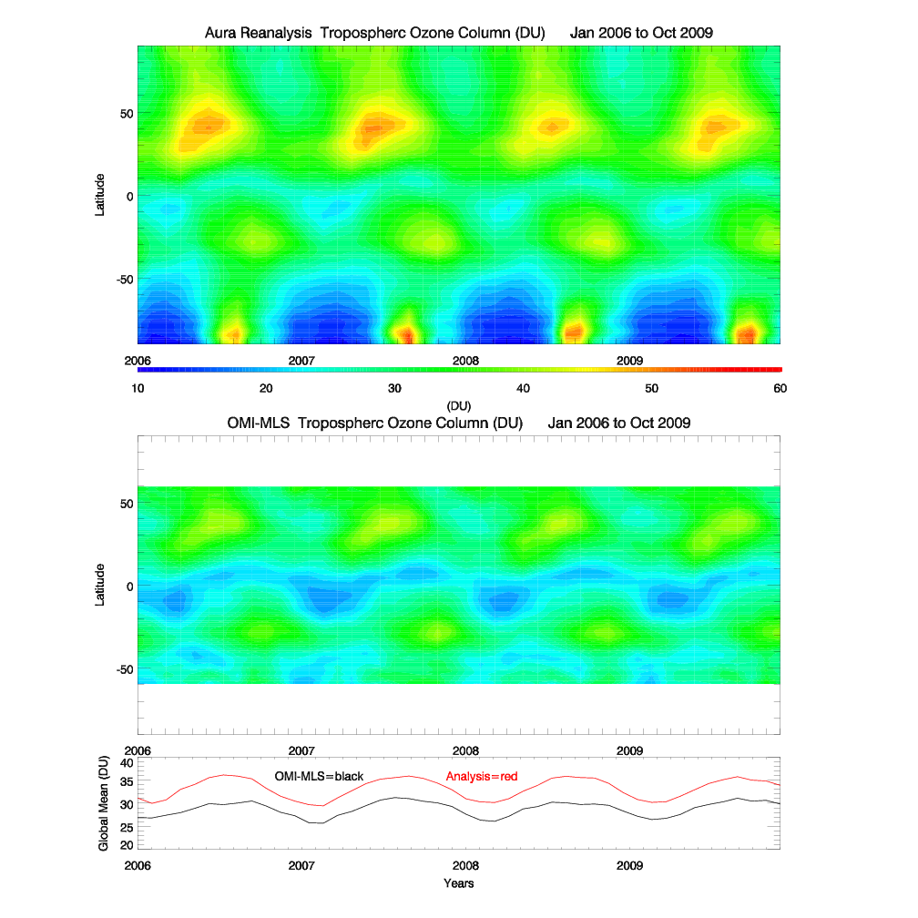
Analyzed Tropospheric Ozone Column (TOC)
vs
OMI-MLS Tropospheric Ozone Residuals (TOR)
Aura Reanalysis captures seasonal variation but shows a systematic high bias relative to the OMI-MLS TOR
Ziemke, et al. (2006), Tropospheric ozone determined from Aura OMI and MLS: Evaluation of measurements and comparison with the Global Modeling Initiative’s Chemical Transport Model, J. Geophys. Res., 111, D19303, doi:10.1029/2006JD007089.

Slide 8
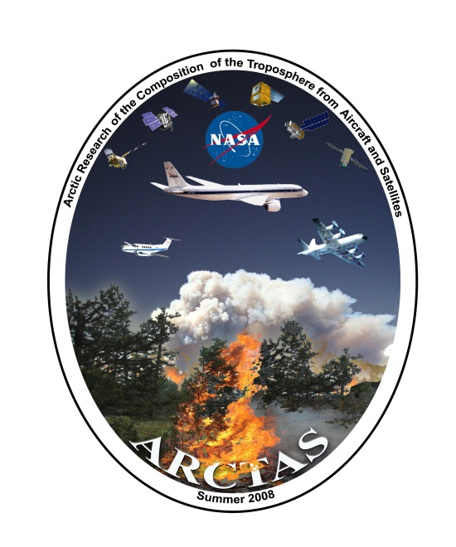
ARCTAS
Airborne measurements from NASA ARCTAS field campaign are used to verify Northern Hemisphere Aura Reanalysis TOC during July 2008
ARCTAS
Ziemke, et al. (2006), Tropospheric ozone determined from Aura OMI and MLS: Evaluation of measurements and comparison with the Global Modeling Initiative’s Chemical Transport Model, J. Geophys. Res., 111, D19303, doi:10.1029/2006JD007089.

Slide 9
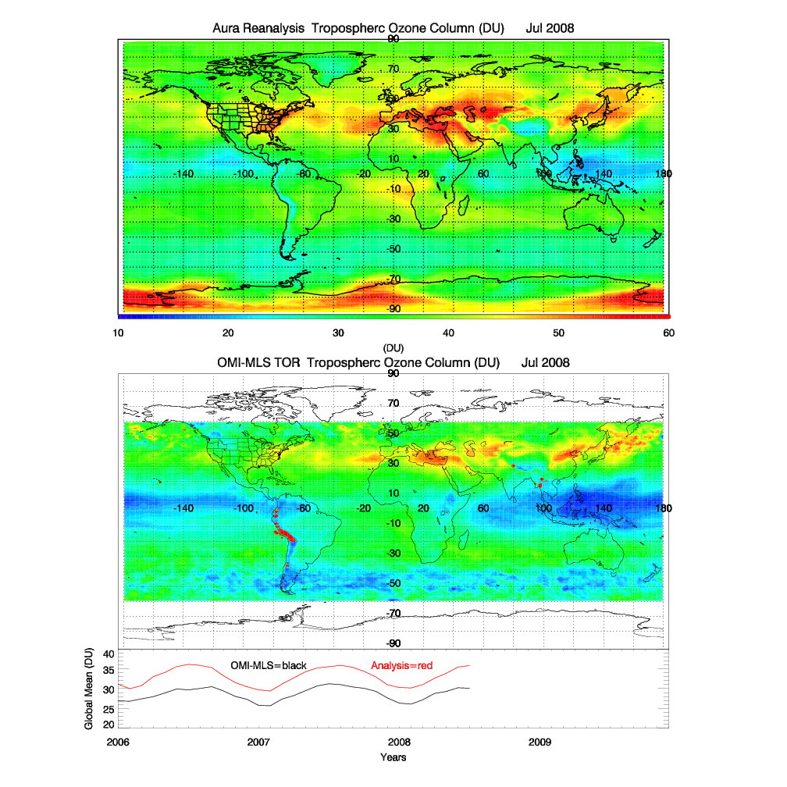
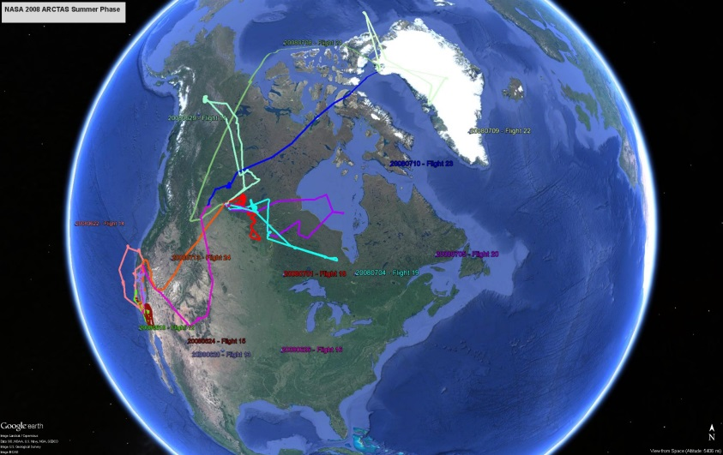
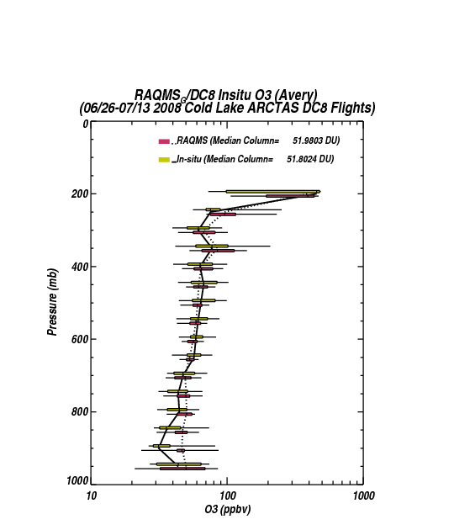
NASA ARCTAS Cold Lake, AB Phase
ARCTAS Flight Tracks July 2008
>1DU High Bias
Aura Reanalysis shows excellent (<1%) agreement with airborne column
Notes:
Aura Reanalysis overestimates observed ozone at ~900mb due to ozone production within wild fire plumes sampled during the July 2008 phase of the ARCTAS campaign (see extra slides)

Slide 10
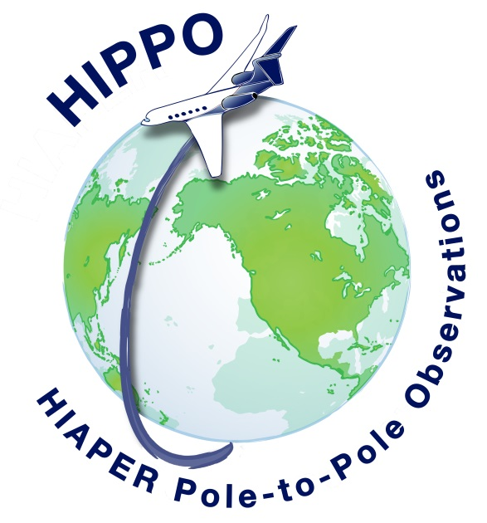
HIPPO
Airborne measurements from NSF HIPPO-I field campaign are used to verify Aura Reanalysis TOC over the Pacific Ocean during January 2009
HIPPO
Ziemke, et al. (2006), Tropospheric ozone determined from Aura OMI and MLS: Evaluation of measurements and comparison with the Global Modeling Initiative’s Chemical Transport Model, J. Geophys. Res., 111, D19303, doi:10.1029/2006JD007089.

Slide 11
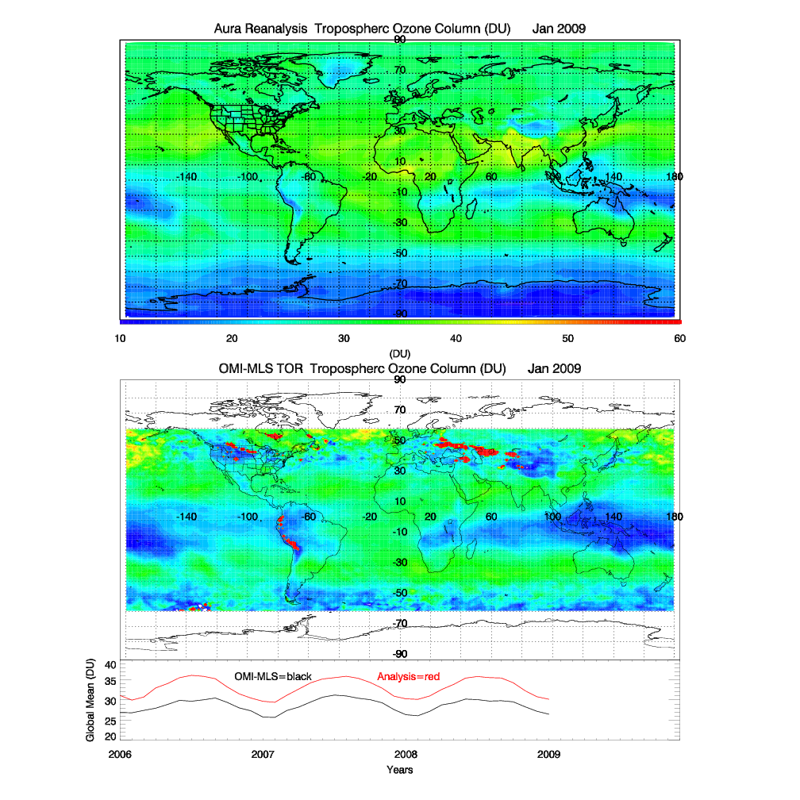
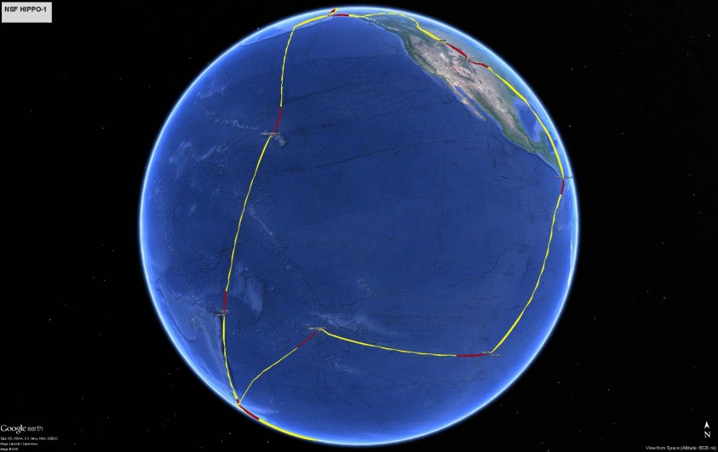
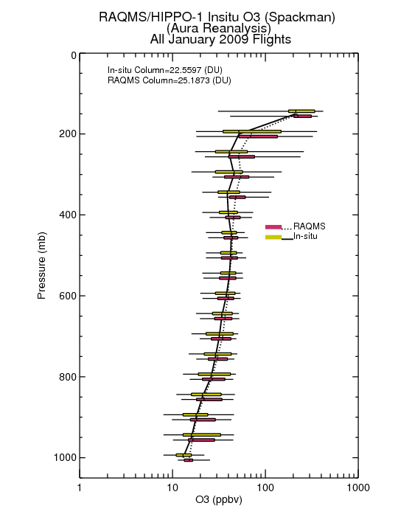
HIPPO-1 January 2009 O3 Verification
HIPPO Flight Tracks January 2009
2.5DU
(10%) High Bias
~4DU
Aura Reanalysis shows 10% high bias relative to airborne column

Slide 12
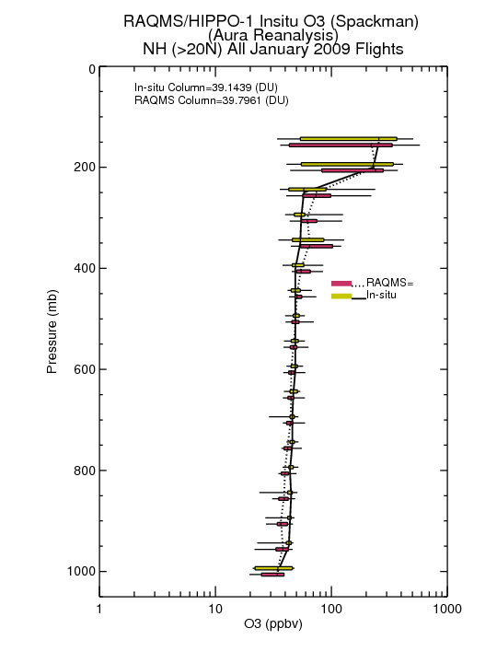
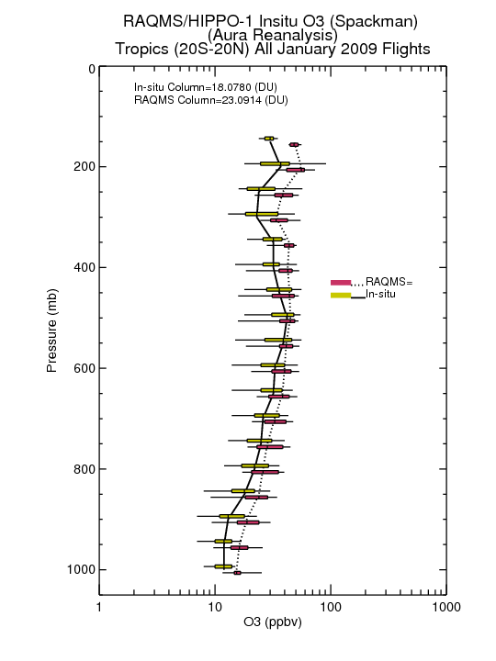
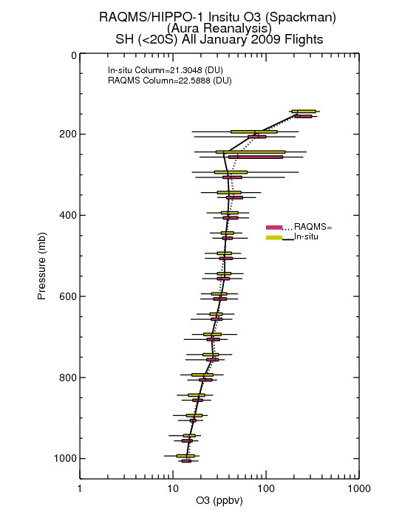
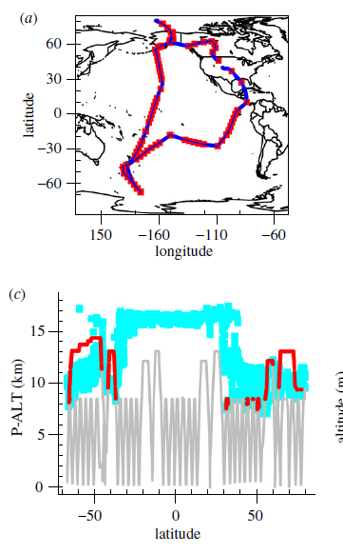
HIPPO-1 January 2009 O3 Verification
Northern Hemisphere
Tropics
Southern Hemisphere
<1DU (<2%) NH Bias
5DU (28%) Tropical Bias
1.3 DU (6%) SH Bias
Tropical Pacific region (20N-20S) dominates the 10% high bias in Tropospheric ozone column

Slide 13
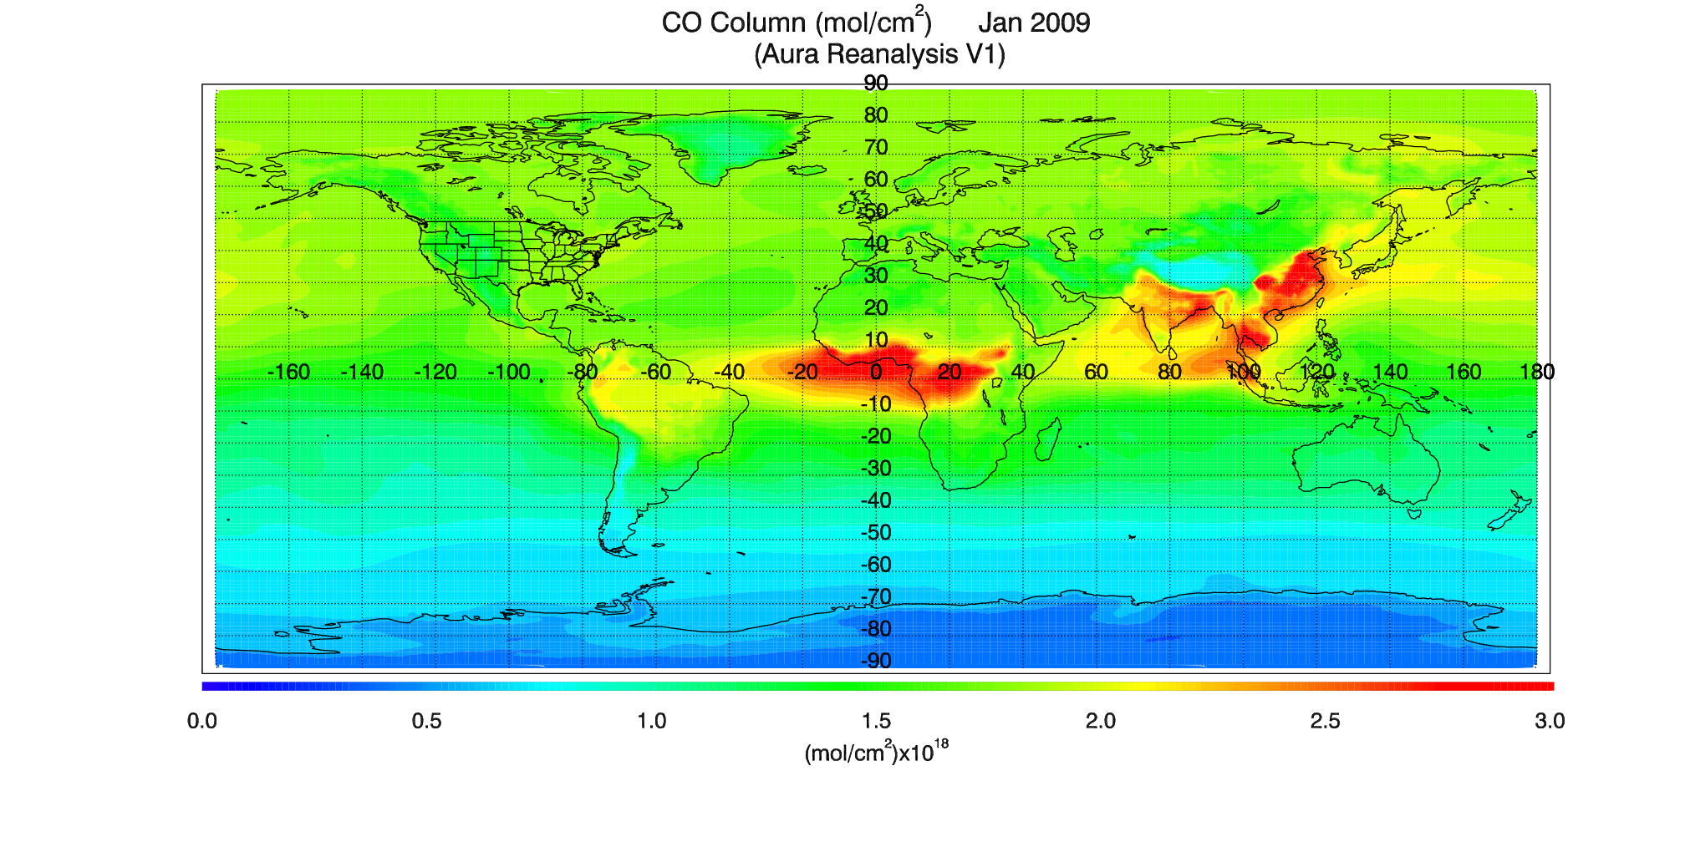
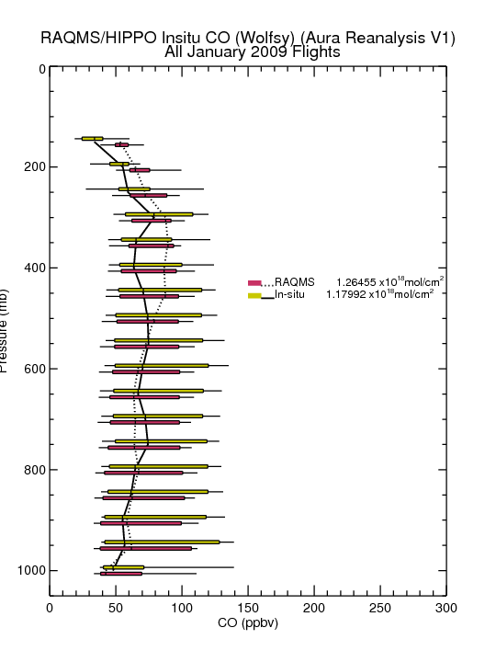
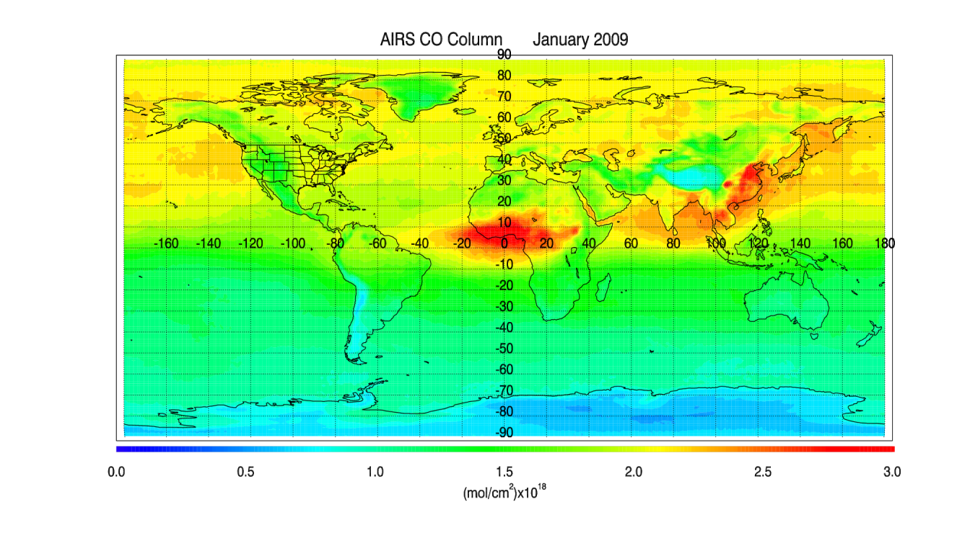
HIPPO-1 January 2009 CO Verification
HIPPO Flight Tracks January 2009
<0.1x10¹⁸ mol/cm²
(7%) High Bias
Aura Reanalysis shows slight high global bias relative to airborne column
Notes:
Note: RAQMS/GSI AIRS CO assimilation removes influence of apriori which accounts for most of the hemispheric differences in the AIRS CO column retrieval

Slide 14
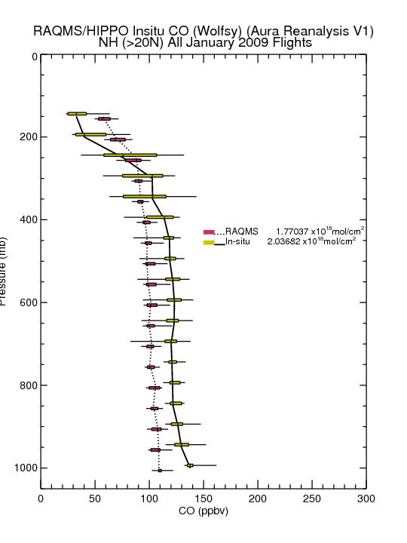
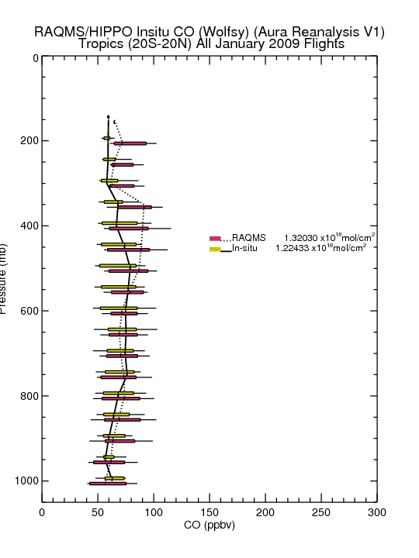
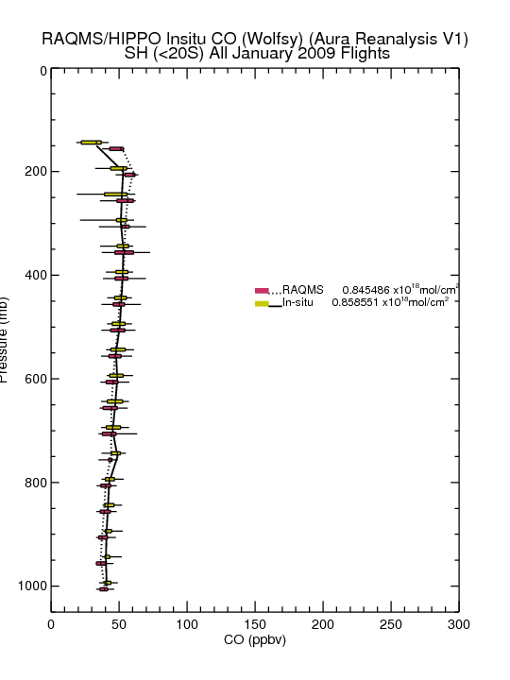
HIPPO-1 January 2009 O3 Verification
Northern Hemisphere
Tropics
Southern Hemisphere
0.27x10¹⁸ mol/cm²
(13%) Low Bias
<0.1x10¹⁸ mol/cm²
(8%) High Bias
<0.1x10¹⁸ mol/cm²
(1.5%) Low Bias
Northern Hemisphere (>20N) has 13% low bias in CO column relative to airborne measurements

Slide 15
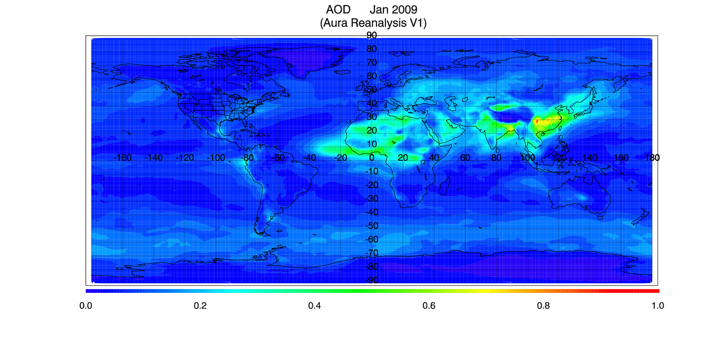
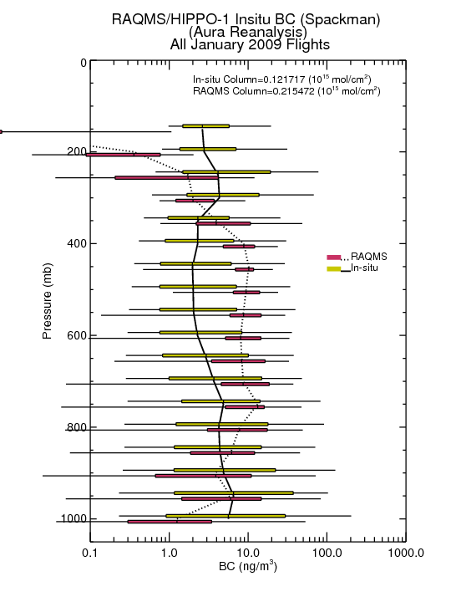
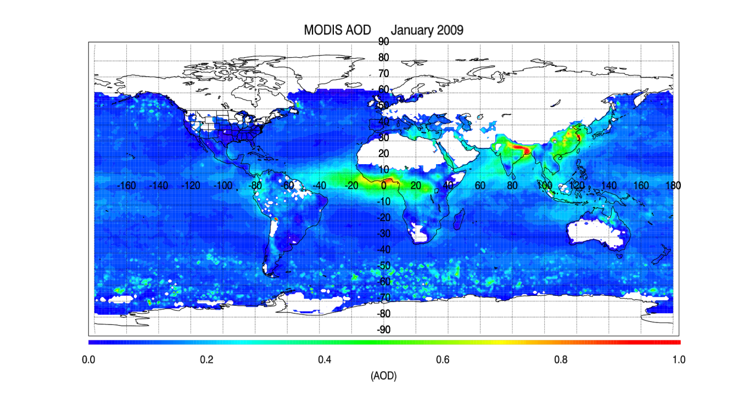
HIPPO-1 January 2009 BC Verification
HIPPO Flight Tracks January 2009
0.1x10¹⁵ mol/cm²
(83%) High Bias
Aura Reanalysis high bias relative to airborne column under low black carbon aerosol loadings

Slide 16
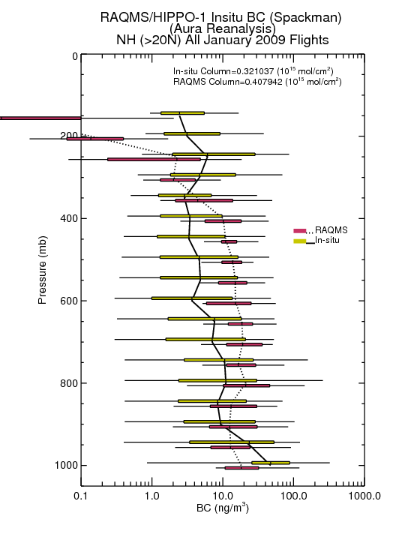
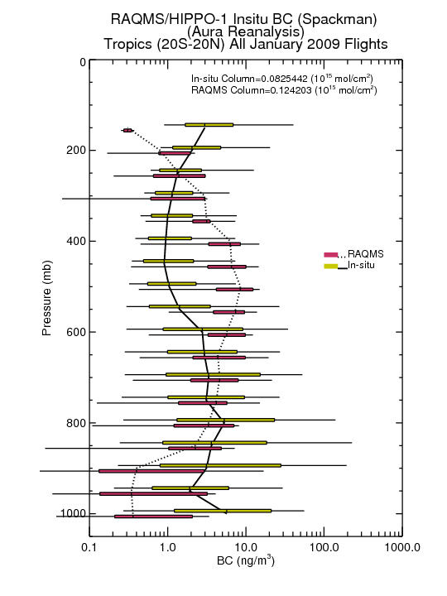
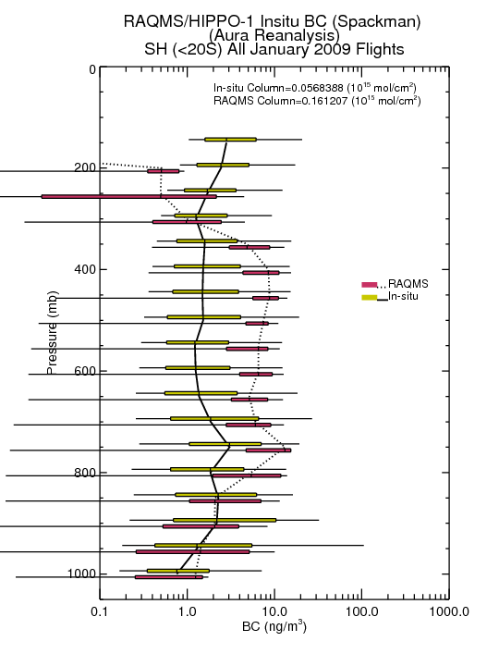
HIPPO-1 January 2009 BC Verification
Northern Hemisphere
Tropics
Southern Hemisphere
0.1x10¹⁵ mol/cm²
(28%) High Bias
<0.1x10¹⁵ mol/cm²
(50%) High Bias
<0.1x10¹⁵ mol/cm²
(65%) High Bias
Mid tropospheric BC overestimates of 2-5x dominate overall high biases in BC column relative to airborne measurements under low aerosol loadings
Notes:
AEROCOM models overestimate the BC concentrations in remote regions by a factor of five on average (Schwarz et al. 2010)

Slide 17
HIPPO-1 January 2009 Verification Summary
Species
NH (>20N)
Tropics
SH (<20S)
All Pacific
2% High Bias
28% High Bias
6% High Bias
10% High Bias
O3
13% Low Bias
8% High Bias
1.5% Low Bias
7% High Bias
CO
28% High Bias
50% High Bias
65% High Bias
83% High Bias*
BC
*AEROCOM models overestimate the BC concentrations in remote regions by a factor of five on average (Schwarz et al. 2010)

Slide 18
Aura Chemical Reanalysis in support Air Quality Applications
Results and Milestones (Year 3)
  Completed first 4 years (2006-2009) of the 10 year Aura Reanalysis
  Conducted verification studies to assess the fidelity of the reanalysis through comparisons with airborne insitu measurements collected during NASA, NOAA and NSF field campaigns
  Completed CMAQ/GSI NOx emission adjustment experiments using offline CMAQ/GSI OMI NO2 assimilation constraints
Notes:
This is the focus of the rest of the presentation, no need to read these, will walk through one at a time

Slide 19
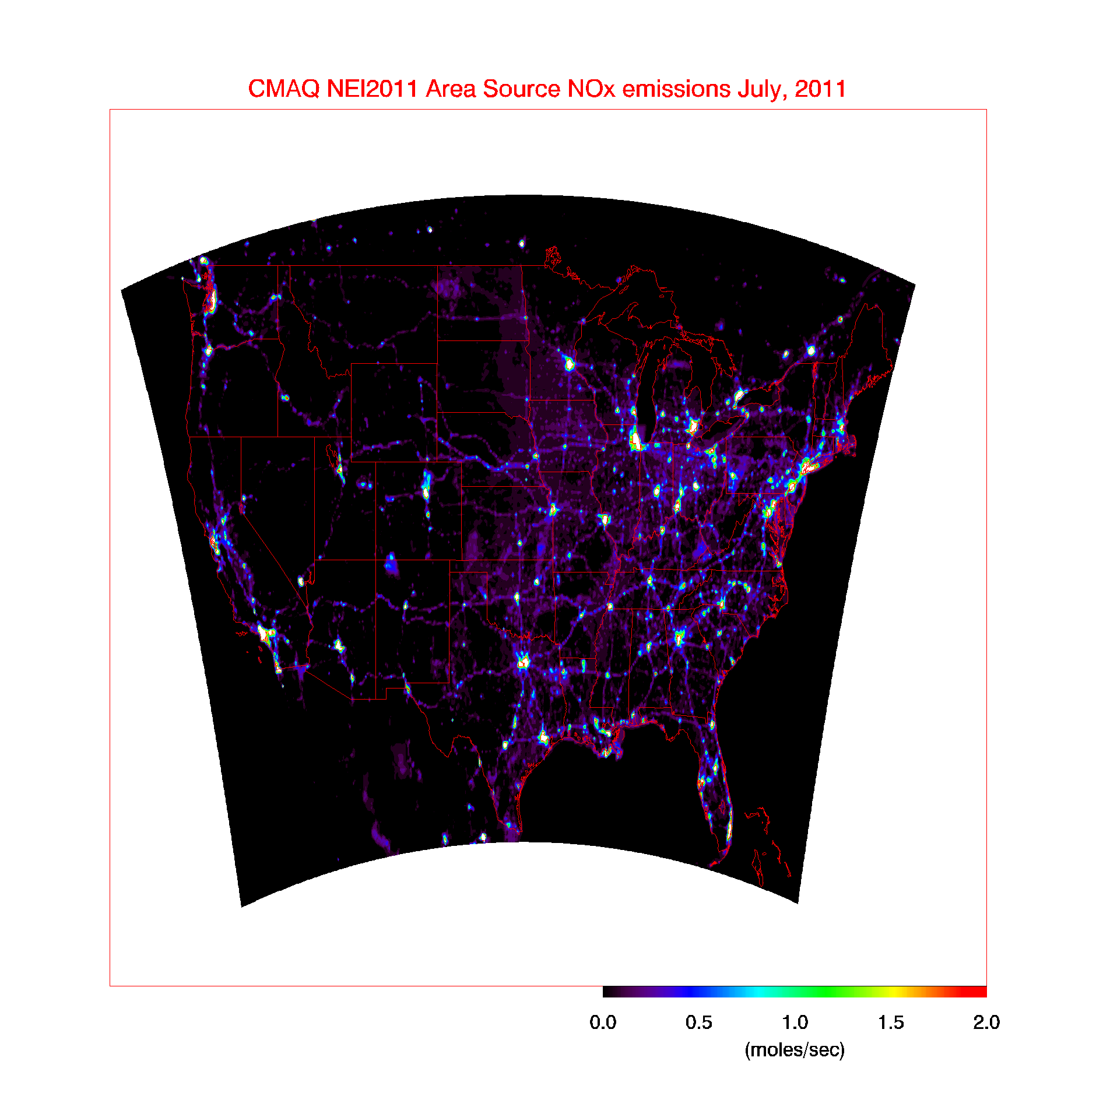
CMAQ/GSI NOx emission adjustment experiments
Offline adjustment of area and point NO_{x} emissions based on OMI Tropospheric NO2 column analysis increments
July 2011 average area emissions (NEI)
(NO₂ lifetime too short to use assimilation to constrain tropospheric column amounts)

Slide 20
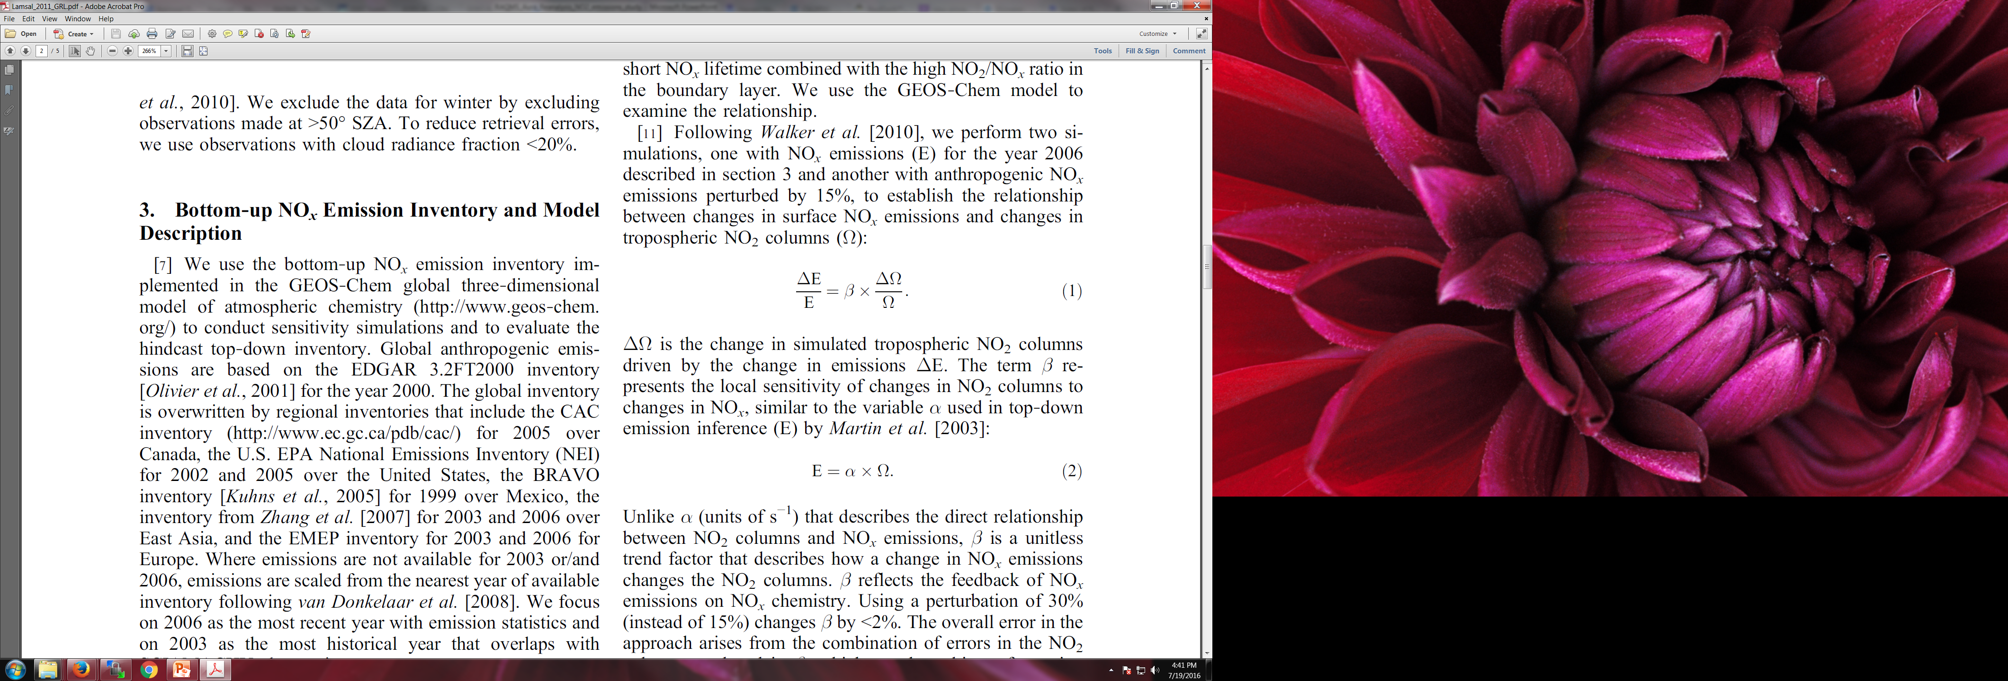
CMAQ/GSI NOx emission adjustment experiments
Calculate monthly mean NO₂ Jacobian (β) from a 15% NO_{X} emission reduction perturbation experiment following Lamsal et al. 2011
Calculate monthly mean NO₂ analysis increment using CMAQ/GSI OMI NO₂ assimilation
  Lightning NOx sensitive background errors (to correct LNOx bias)
  NEI 2011 NOx sensitive background errors (to correct NEI emissions)
Adjust 2011 NEI NO_{x} emissions using Jacobian and analysis increment
Lamsal, L. N., et al. (2011), Application of satellite observations for timely updates to global anthropogenic NOx emission inventories, Geophys. Res. Lett., 38, L05810, doi:10.1029/2010GL046476.

Slide 21
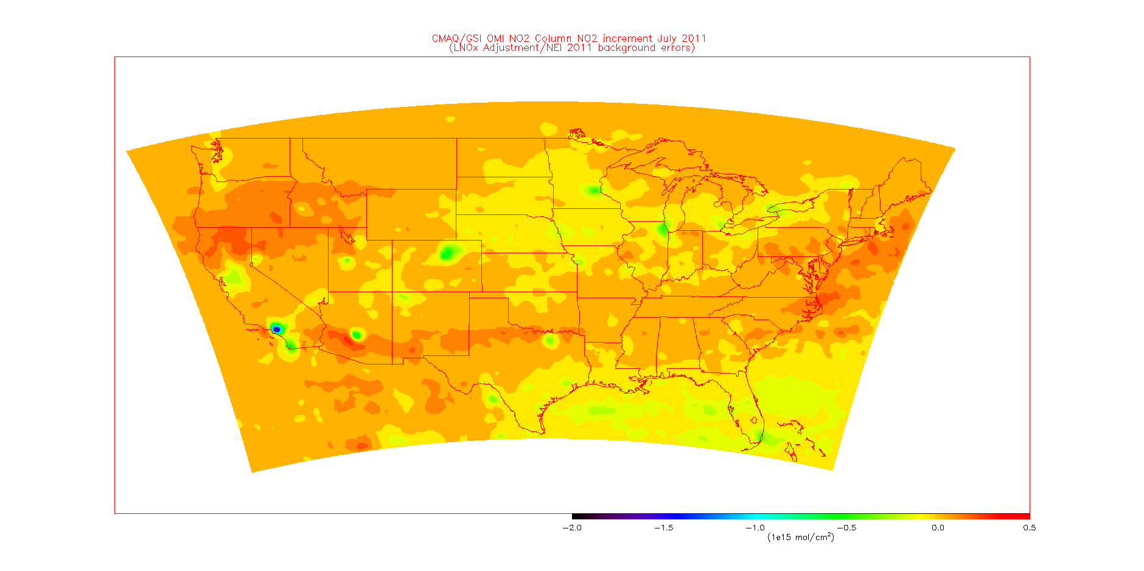
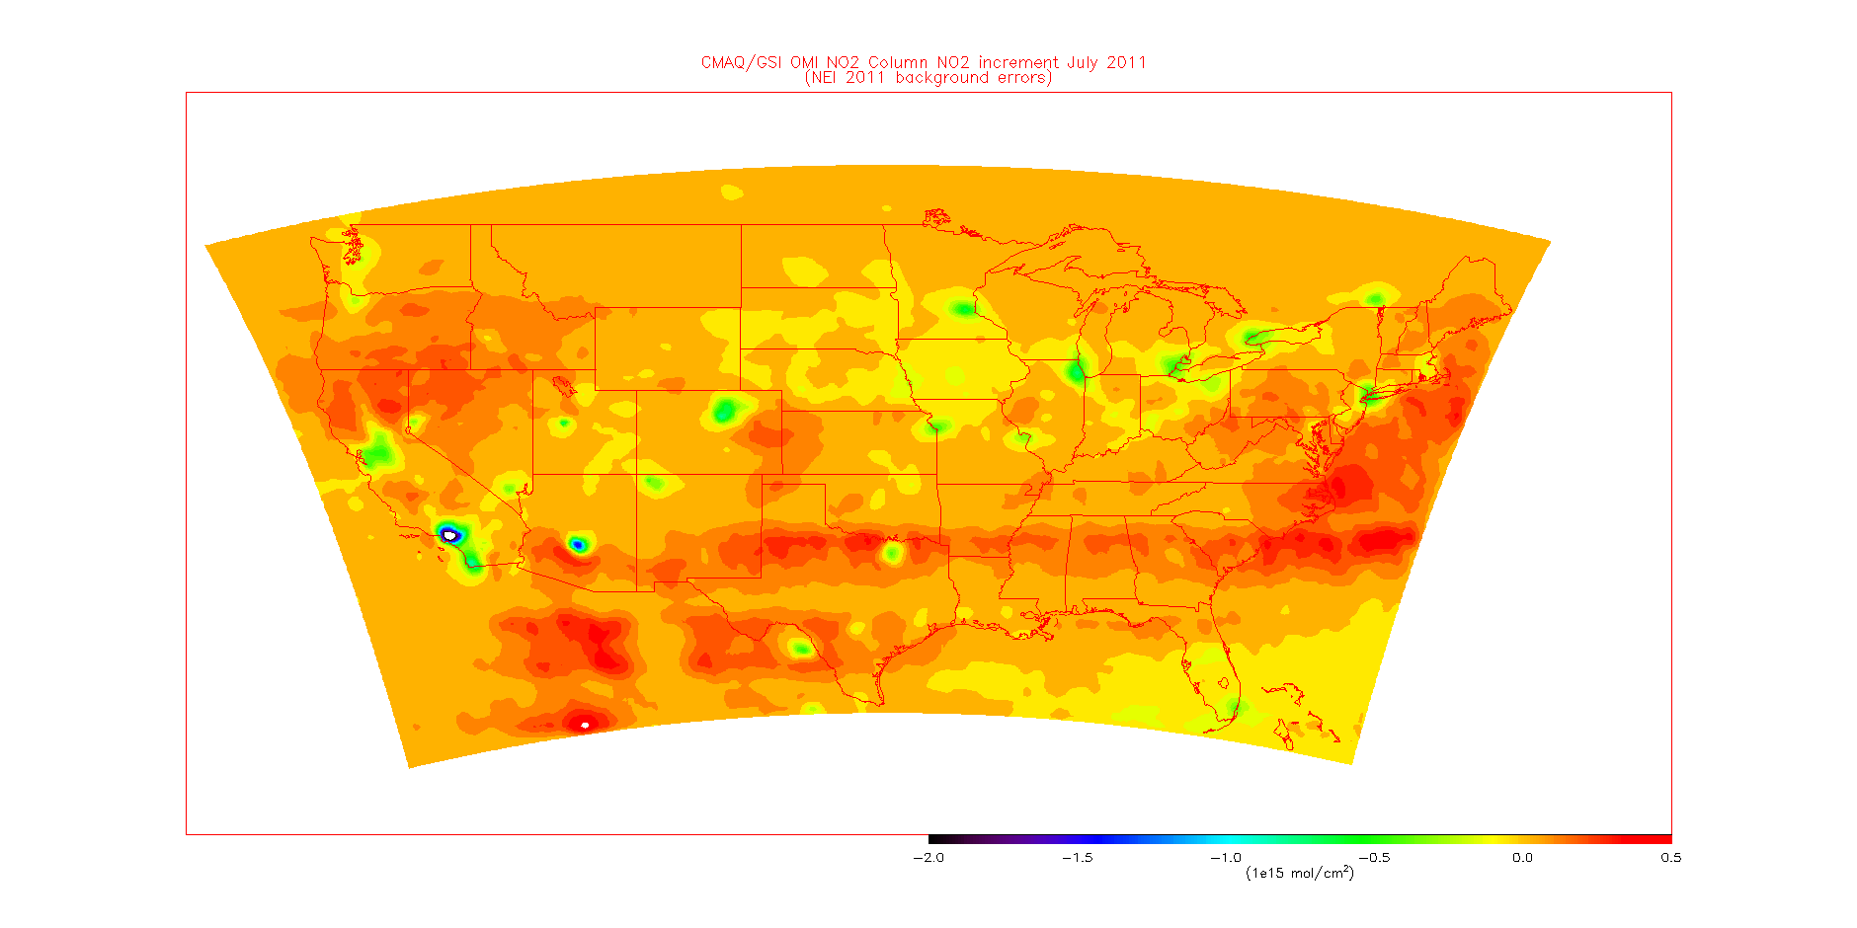
CMAQ/GSI NOx emission adjustment experiments
July 2011 analysis increment
Analysis increment adjusts NO2 columns downward in urban areas
(with adjusted lightning NO_{X} emissions)

Slide 22
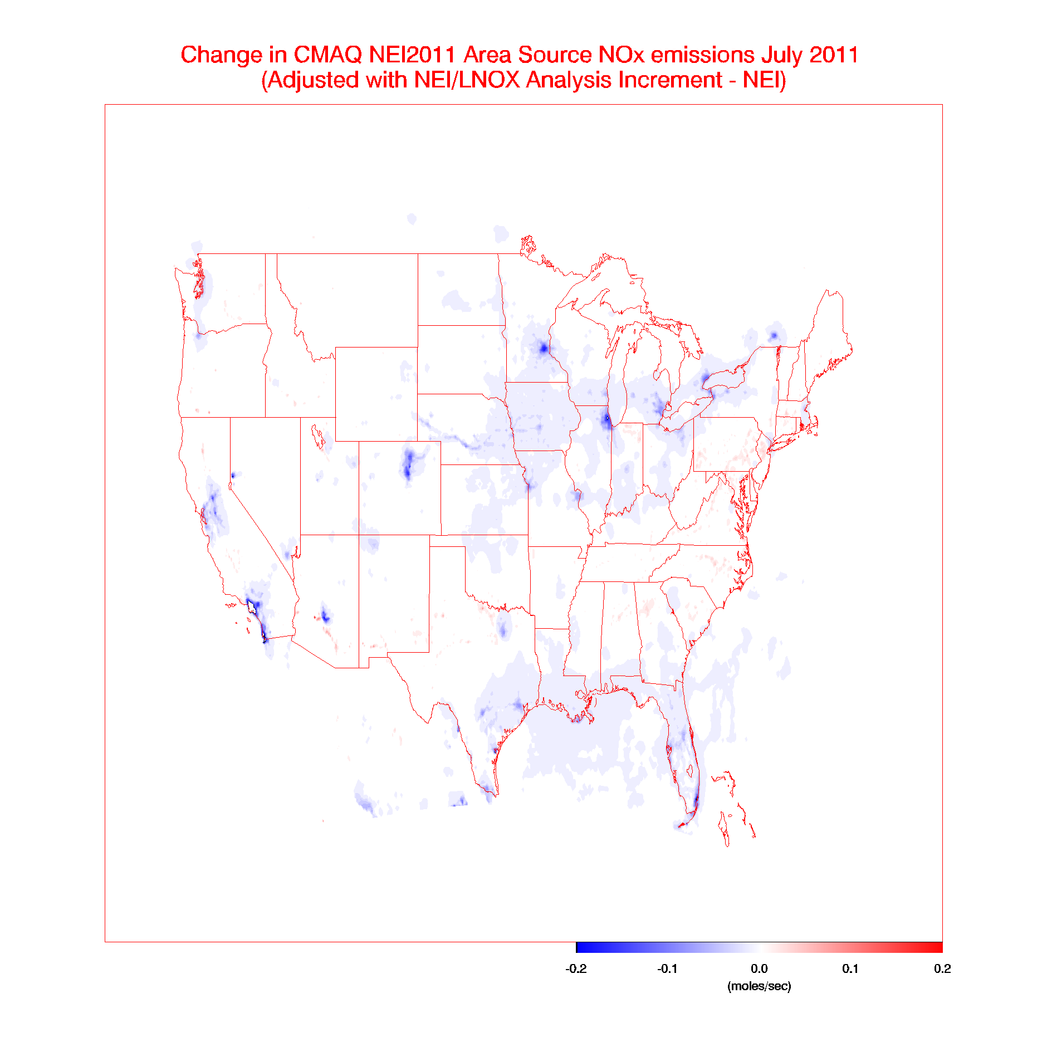
CMAQ/GSI NOx emission adjustment experiments
July 2011 OMI NO₂
July 2011 NEI area-source emissions adjustment
Transportation-related NO_{X} emissions ~ 0.3 moles/sec
(~30% adjustment)
NO_{X} emissions in urban areas ≥ 2 moles/sec
(~10% adjustment)

Slide 23
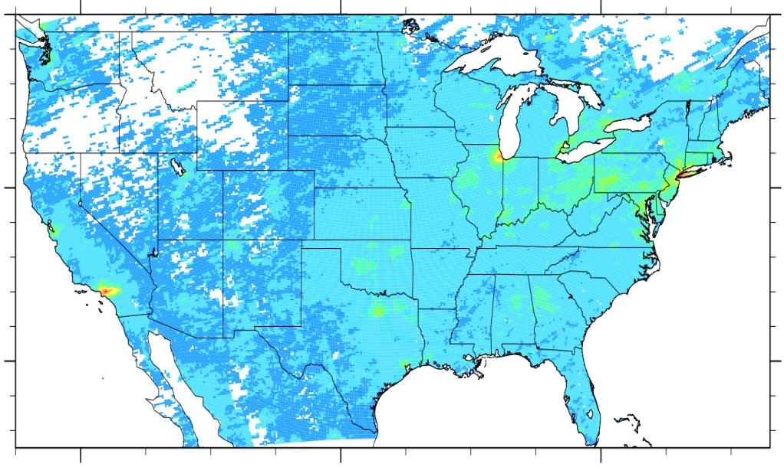
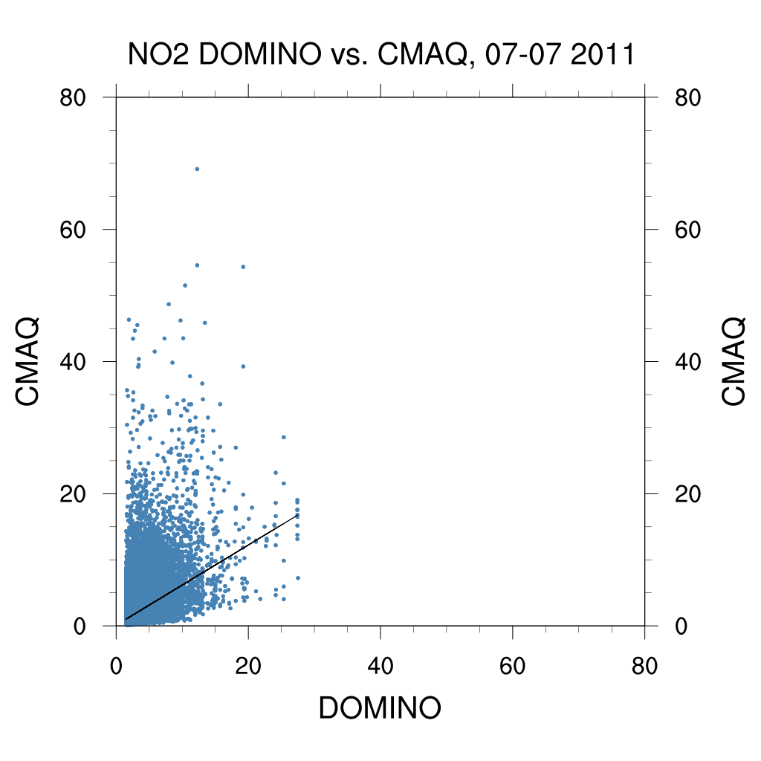
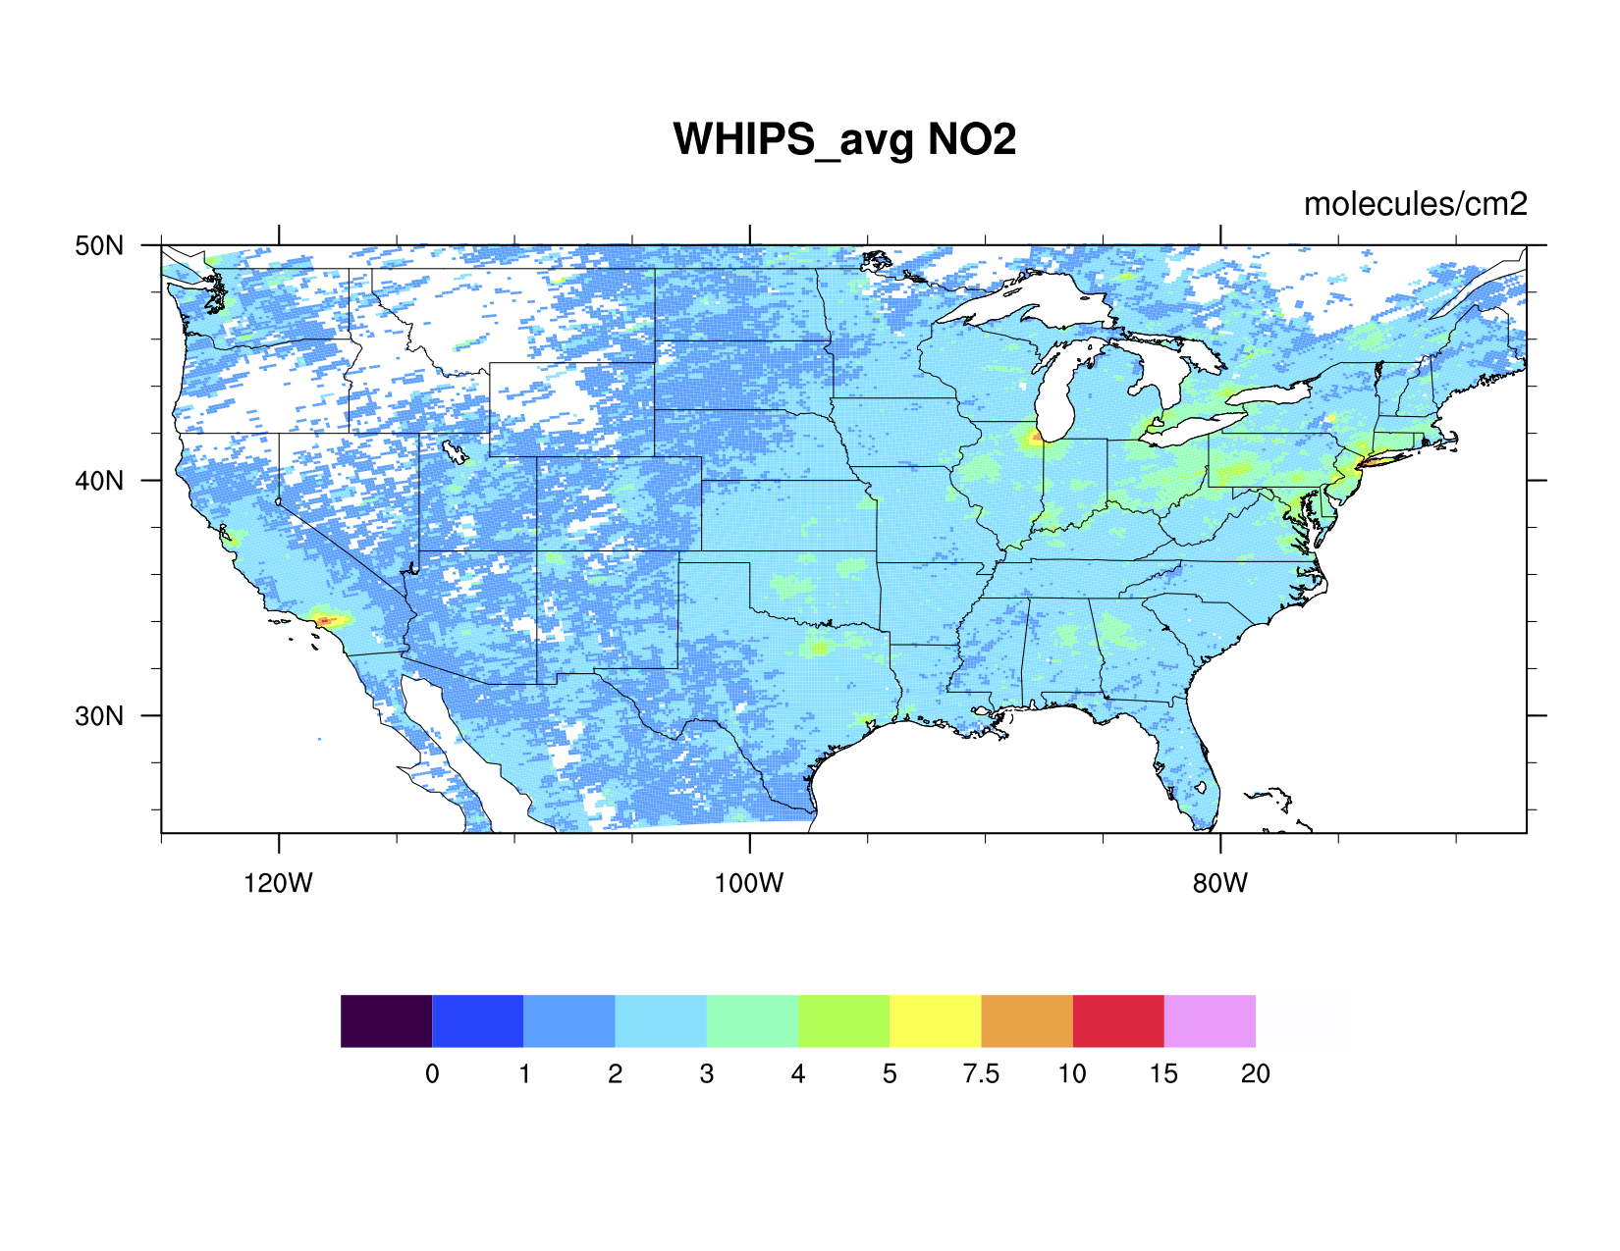
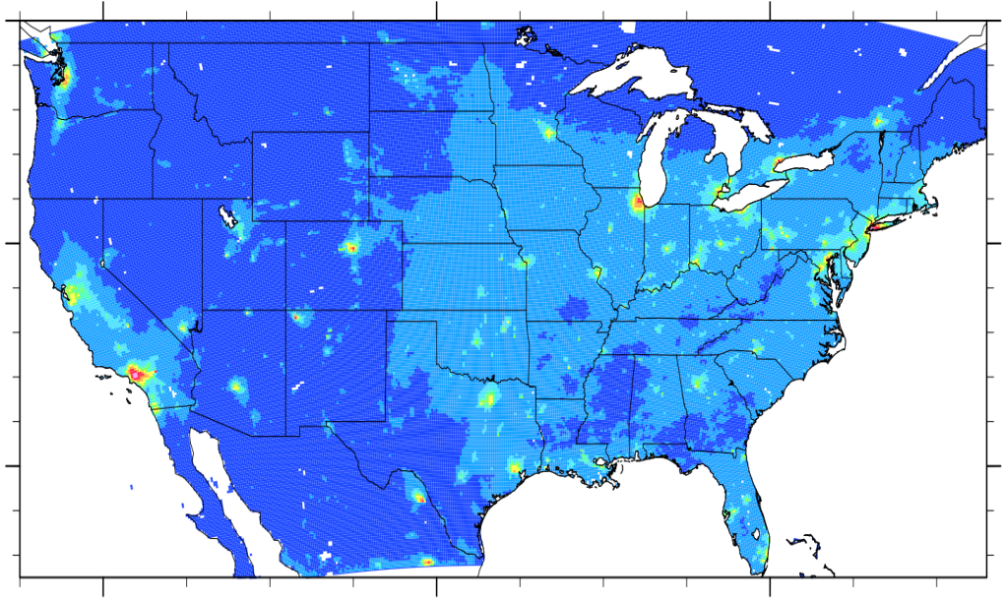
CMAQ/GSI NOx emission adjustment experiments
July 2011 average OMI NO2
mean bias =
-0.84 x 10¹⁵ molecules/cm²
molecules/cm²
July 2011 average CMAQ (original emissions)
R = 0.61
OMI

Slide 24
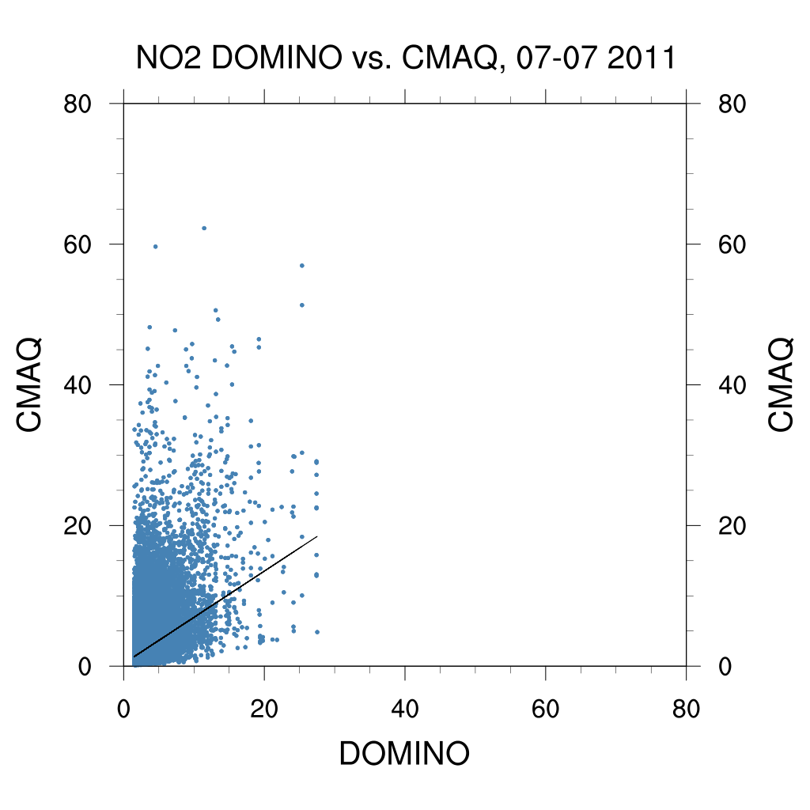
CMAQ/GSI NOx emission adjustment experiments
July 2011 average OMI NO2
CMAQ simulation with adjusted Lighting and NEI Emissions shows reduced low biases and increased correlations with OMI
July 2011 average observed
mean bias =
-0.46 x 10¹⁵ molecules/cm²
molecules/cm²
July 2011 average CMAQ (adjusted emissions)
R = 0.66
OMI

Slide 25
Aura Chemical Reanalysis in support Air Quality Applications
Ongoing activities
PI and Co-I are members of Aerosol and Atmospheric Composition Task Force for development of NOAA’s Next Generation Global Prediction System (NGGPS)
  Funded by NOAA Research Transition Acceleration Program (RTAP) for implementation of reduced troposphere/stratosphere chemistry algorithms into NGGPS.
  Aura Reanalysis will provide climatological regressions for NGGPS N2O and CH4 and ClOx and BrOx catalyzed stratospheric ozone loss
PI is Co-Lead (with Daniel Tong, GMU) of a multi-agency (NOAA, EPA, CDC) HAQAST Tiger Team for improved NEI NOx emissions based on CMAQ/GSI/OMI NO2 DA activities
  OMI based emissions adjustment approaches will be demonstrated within the NOAA NWS National Air Quality Forecasting Capability (NAQFC) and EPA/CDC fusion applications
Notes:
Strong partnership with LADCO and Wisconsin DNR, LMOS 2017 mission concept arose from NASA Air Quality Applied Science Team (AQAST) meetings
NASA committed to providing Geostationary Trace gas and Aerosol Sensor Optimization (GeoTASO) airborne sensor (UVVIS spectrometer like TEMPO to measure O3, NO2, HCHO (formaldehyde)
Link to NOAA Operational global modeling/DA effort through NGGPS
Archived stratospheric halogen (ClOx/BrOx) ozone production from Aura Reanalysis will be used within NGGPS chemistry algorithm

Slide 26
Aura Chemical Reanalysis in support Air Quality Applications
Application to Decision Making
The RAQMS Aura Reanalysis is the first complete global chemical and aerosol reanalysis that has been attempted within the US.
It follows the path lead by the European Monitoring Atmospheric Composition and Climate - Interim Implementation (MACC-II) project within the Copernicus Atmosphere Monitoring Service that is now operational at ECMWF.
The RAQMS Aura Reanalysis will provide comprehensive chemical and aerosol analyses for assessing global air quality and for providing lateral boundary conditions for regional air quality management such as State Implementation Planning (SIP) activites.
Notes:
Strong partnership with LADCO and Wisconsin DNR, LMOS 2017 mission concept arose from NASA Air Quality Applied Science Team (AQAST) meetings
NASA committed to providing Geostationary Trace gas and Aerosol Sensor Optimization (GeoTASO) airborne sensor (UVVIS spectrometer like TEMPO to measure O3, NO2, HCHO (formaldehyde)
Link to NOAA Operational global modeling/DA effort through NGGPS
Archived stratospheric halogen (ClOx/BrOx) ozone production from Aura Reanalysis will be used within NGGPS chemistry algorithm

Slide 27
Extra Slides

Slide 28
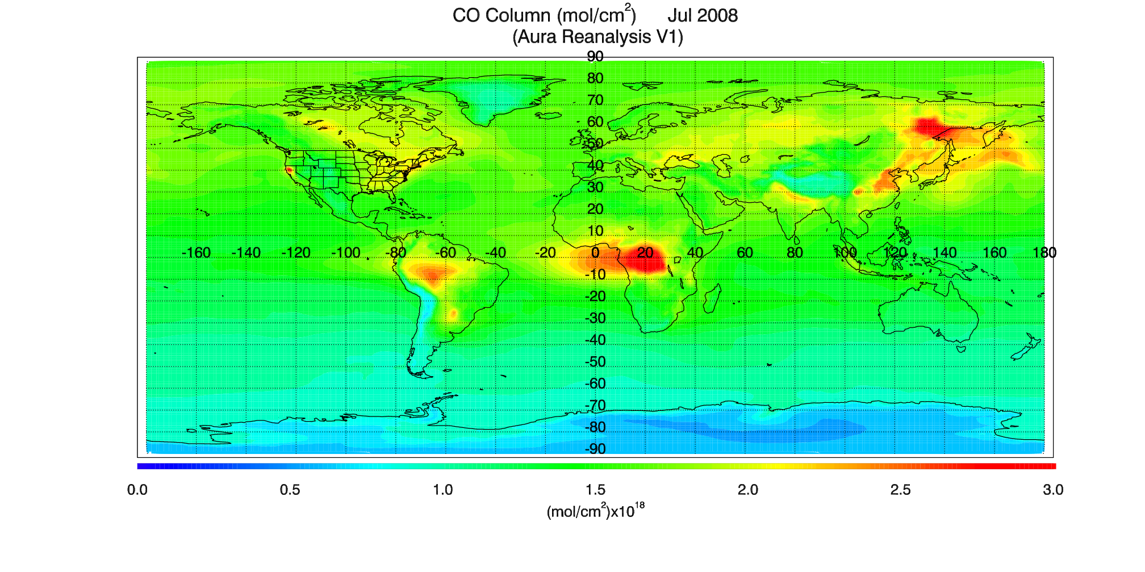
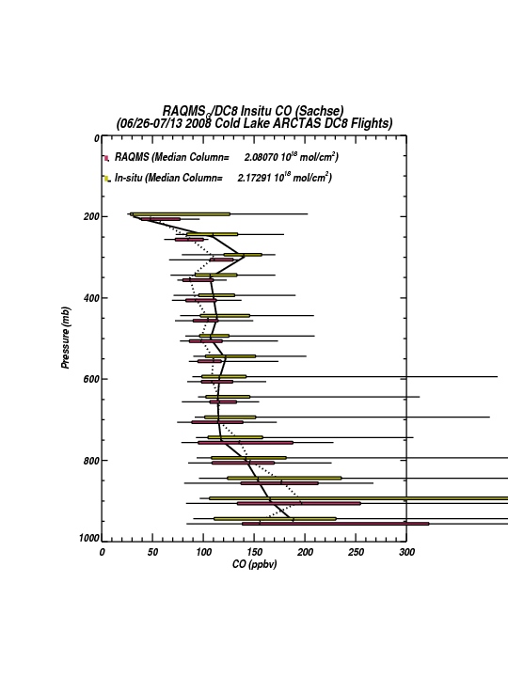
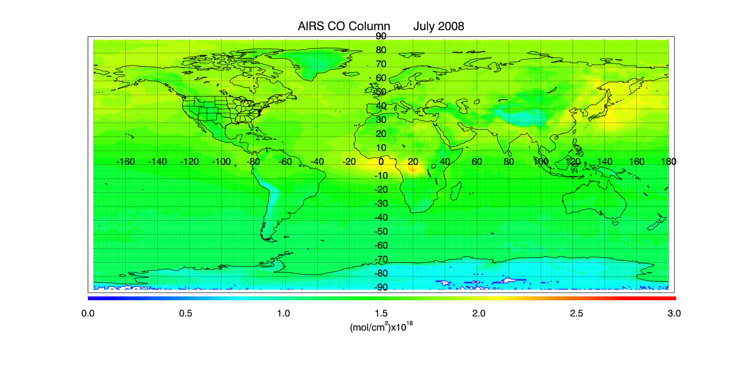
All ARCTAS Cold Lake, AB DC8 Flights
Note: Significant wildfire sampling

Slide 29
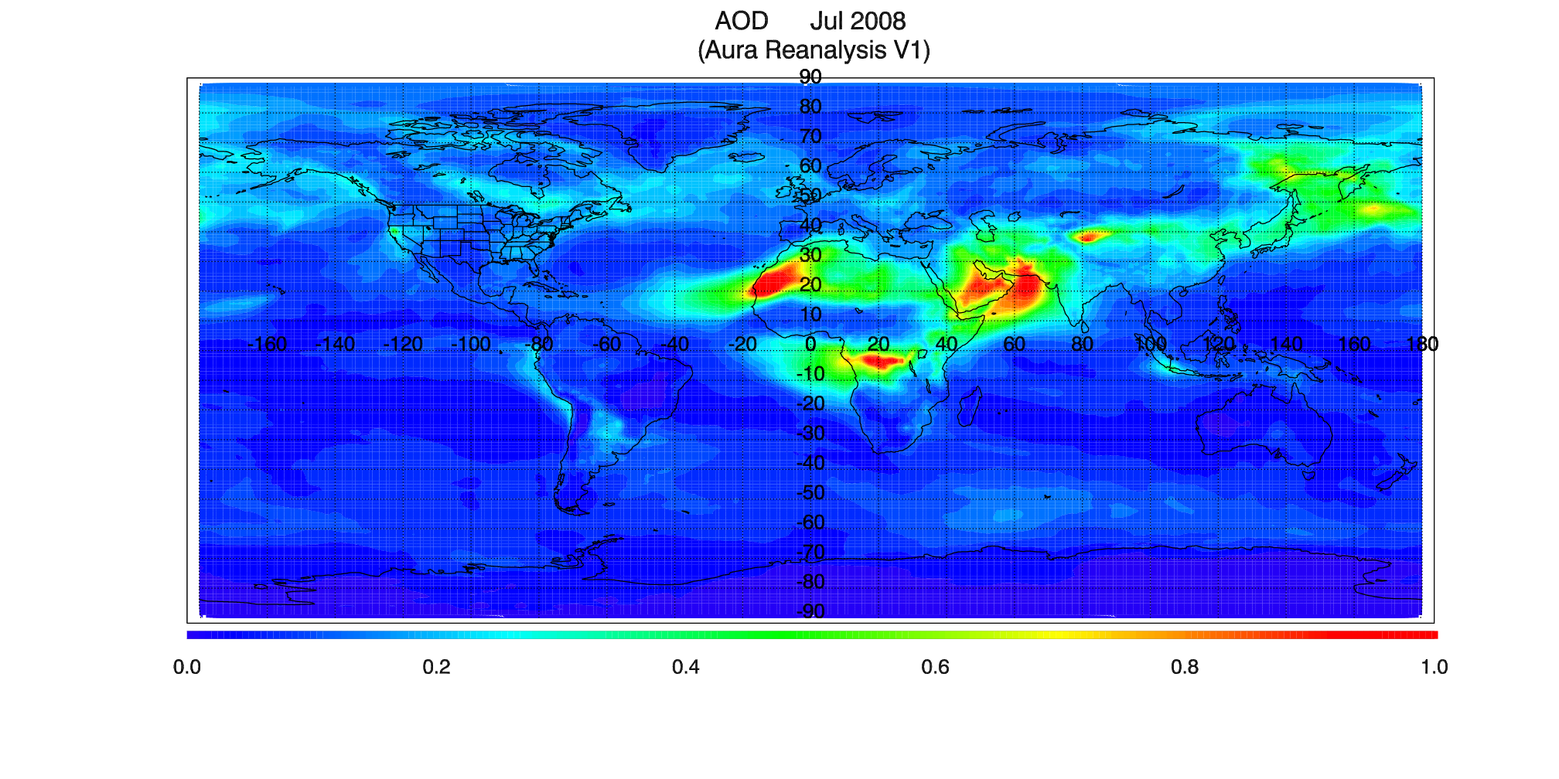
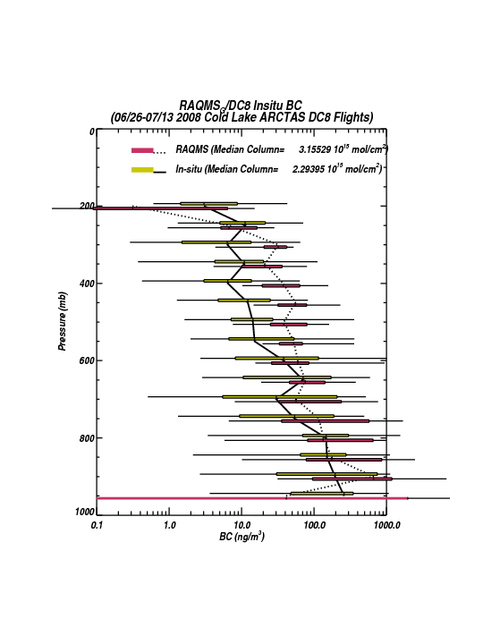
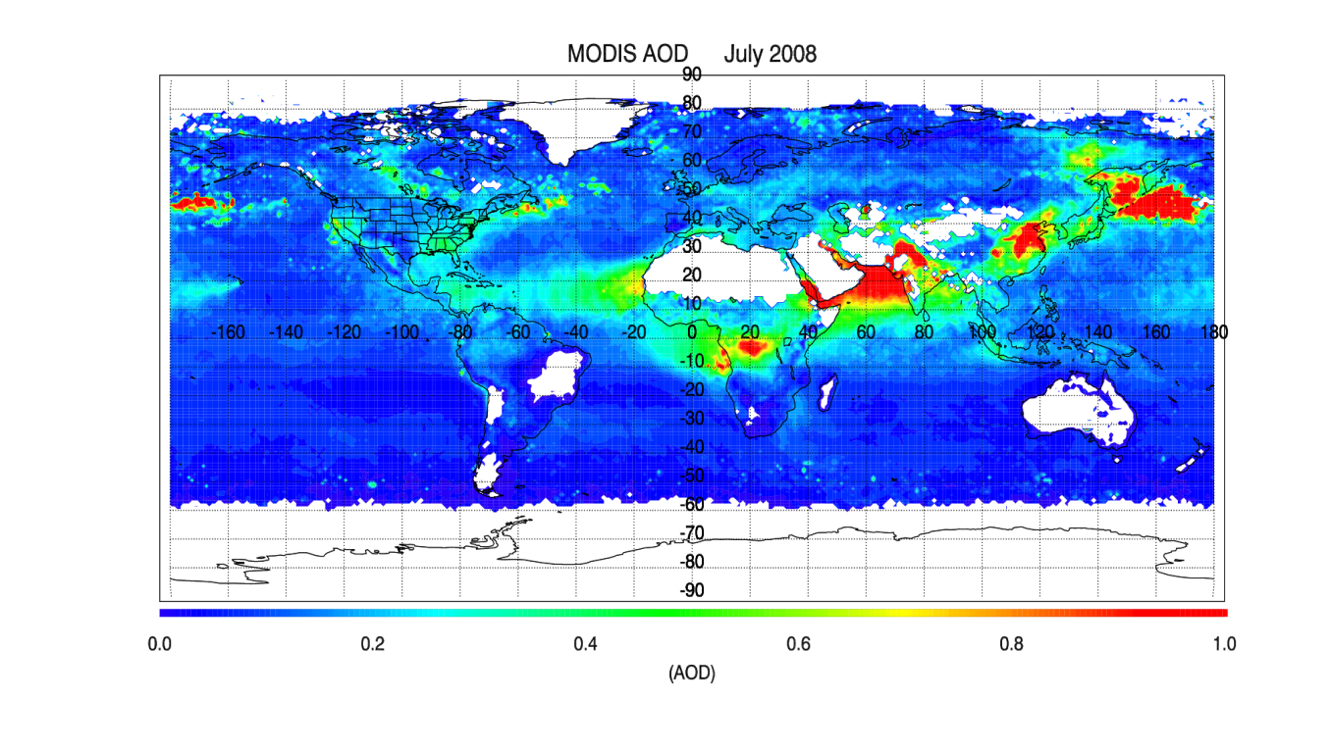
All ARCTAS Cold Lake, AB DC8 Flights
Note: Significant wildfire sampling

Slide 30
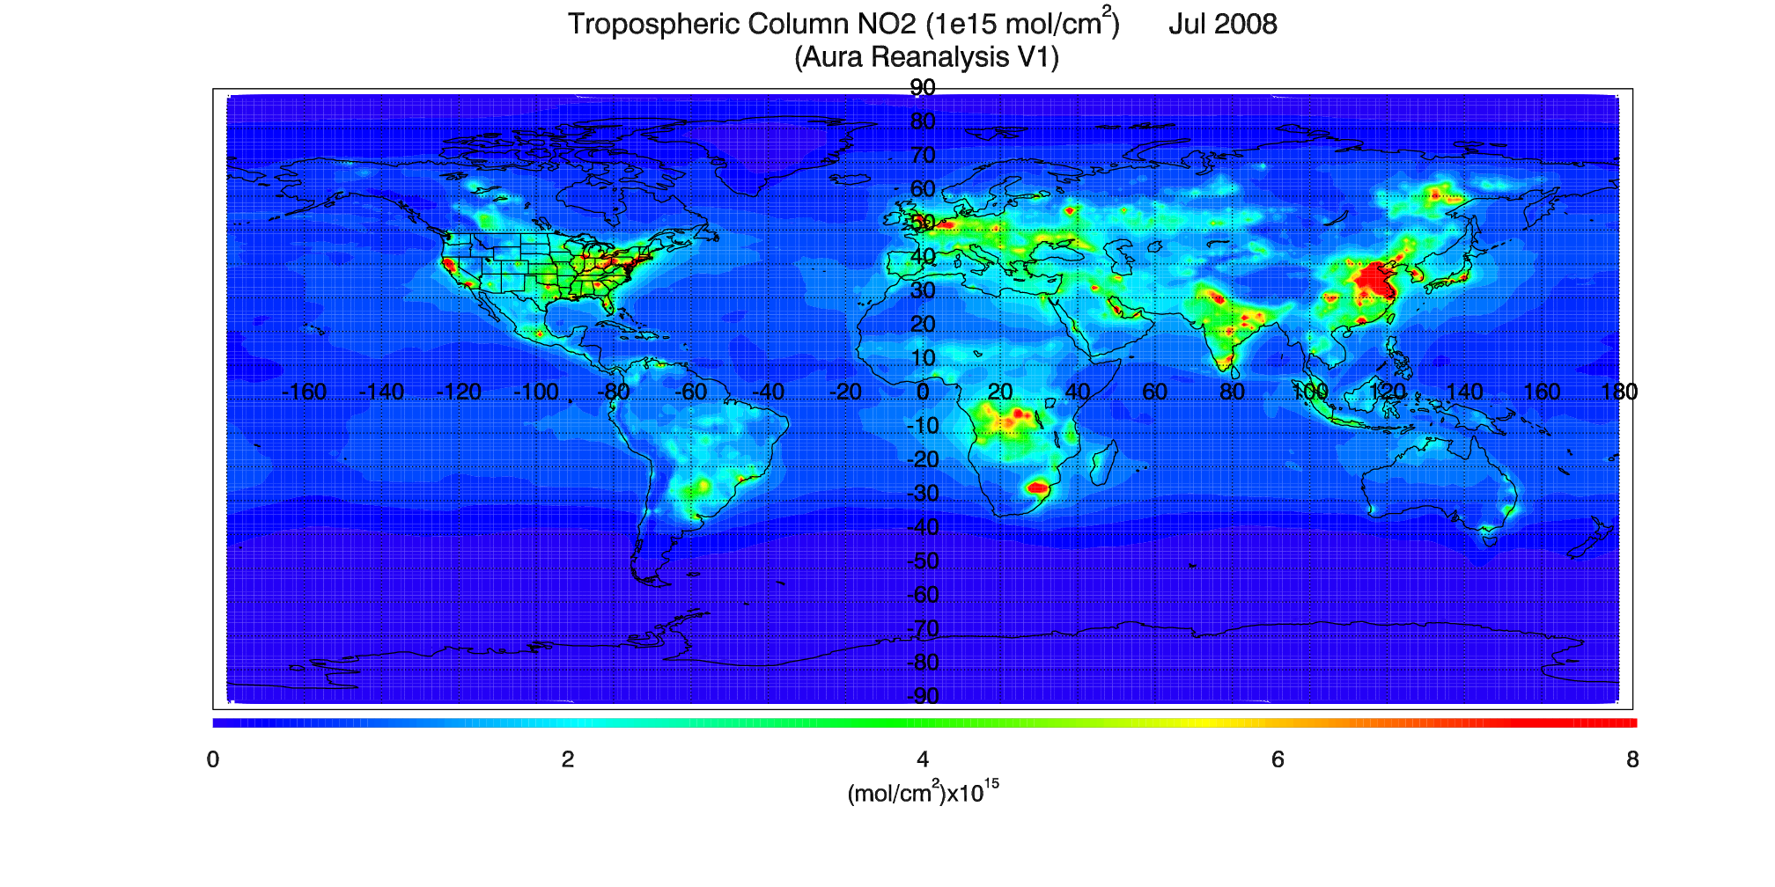
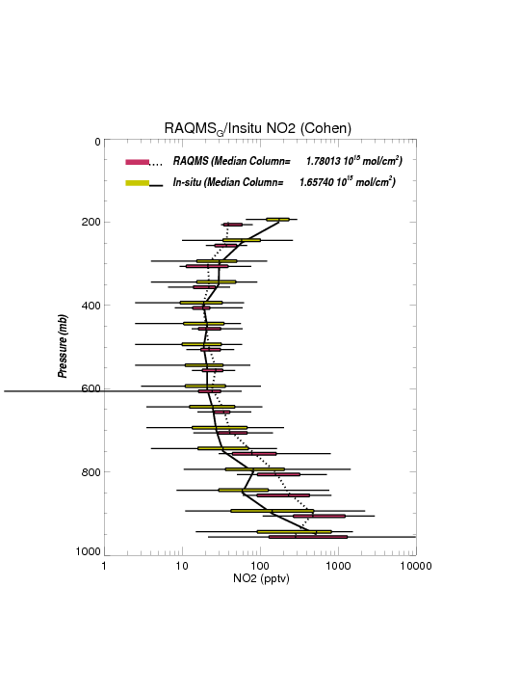
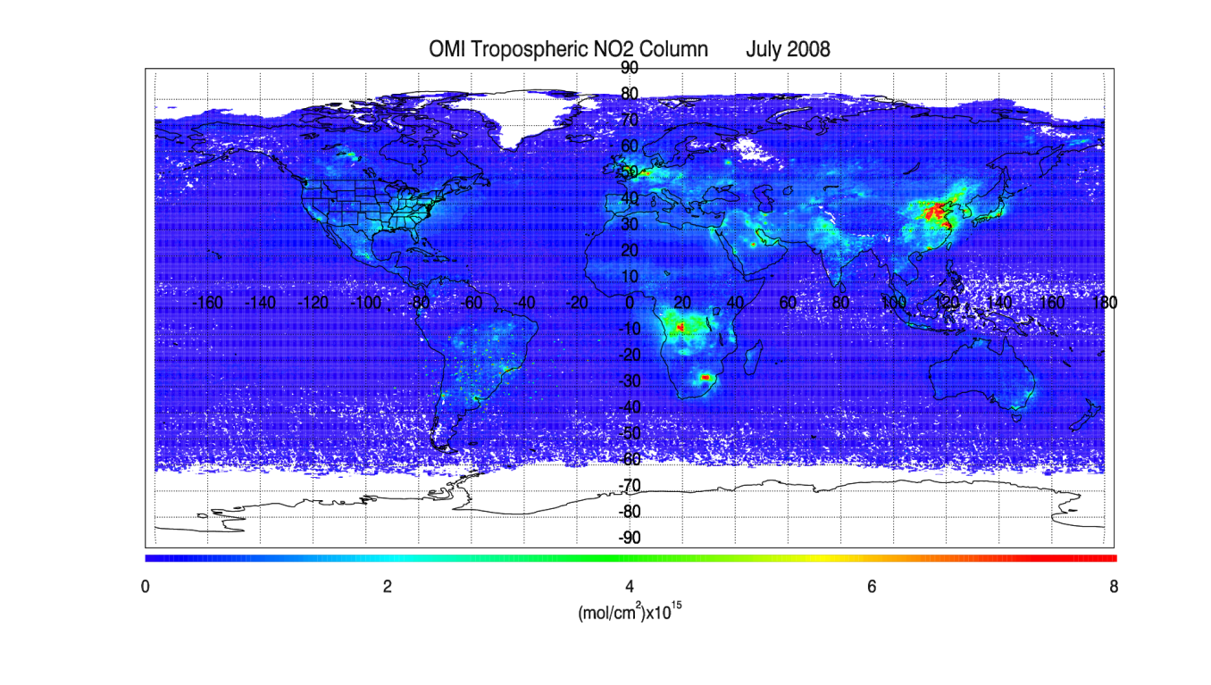
All ARCTAS Cold Lake, AB DC8 Flights
Note: Significant wildfire sampling

