Slide 1
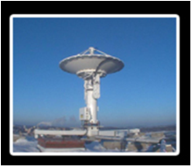






Implementation of IMAPP/IDEA-I over the Po Valley region, northern Italy, for air quality monitoring and forecasting
CSPP/IMAPP
Users’ Group Meeting
Madison, Wisconsin (USA)
21-24 May 2013
Arvani⁽¹⁾ B., Pierce⁽²⁾ R. B.,
Teggi⁽¹⁾ S., Bigi⁽¹⁾ A., Ghermandi⁽¹⁾ G.
(1) University of Modena and Reggio Emilia, Italy
(2) NOAA/NESDIS Advanced Satellite Products Branch, Madison, Wisconsin USA

Slide 2
Outline
Po Valley Domain: area of interest
IMAPP IDEA-International Application
PM₁₀ – AOD Correlation: ground stations over Po Valley
Aerosol vertical distribution: analysis of PBL information
PM₁₀ – AOD Correlation improvement: use of PBL information over the Po Valley
Conclusion
Outgoing and Future work
CSPP/IMAPP Users' Group Meeting 2013

Slide 3
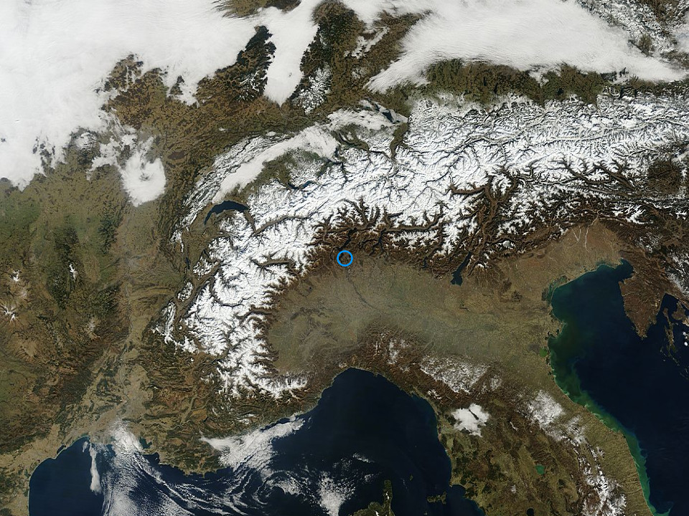
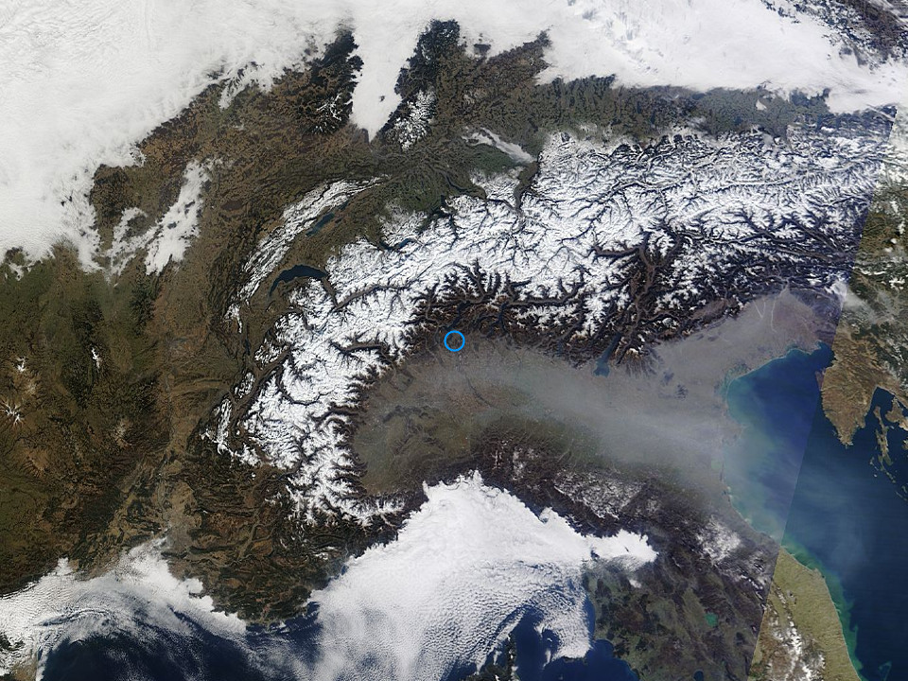
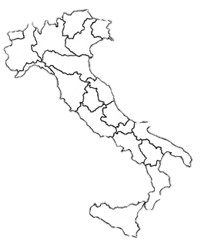
Po Valley IDEA-Internation Application (I)
March 1, 2012
March 2, 2012
Pollution
AERONET_Ispra.2012061.terra.1km
AERONET_Ispra.2012062.terra.1km
CSPP/IMAPP Users' Group Meeting 2013

Slide 4
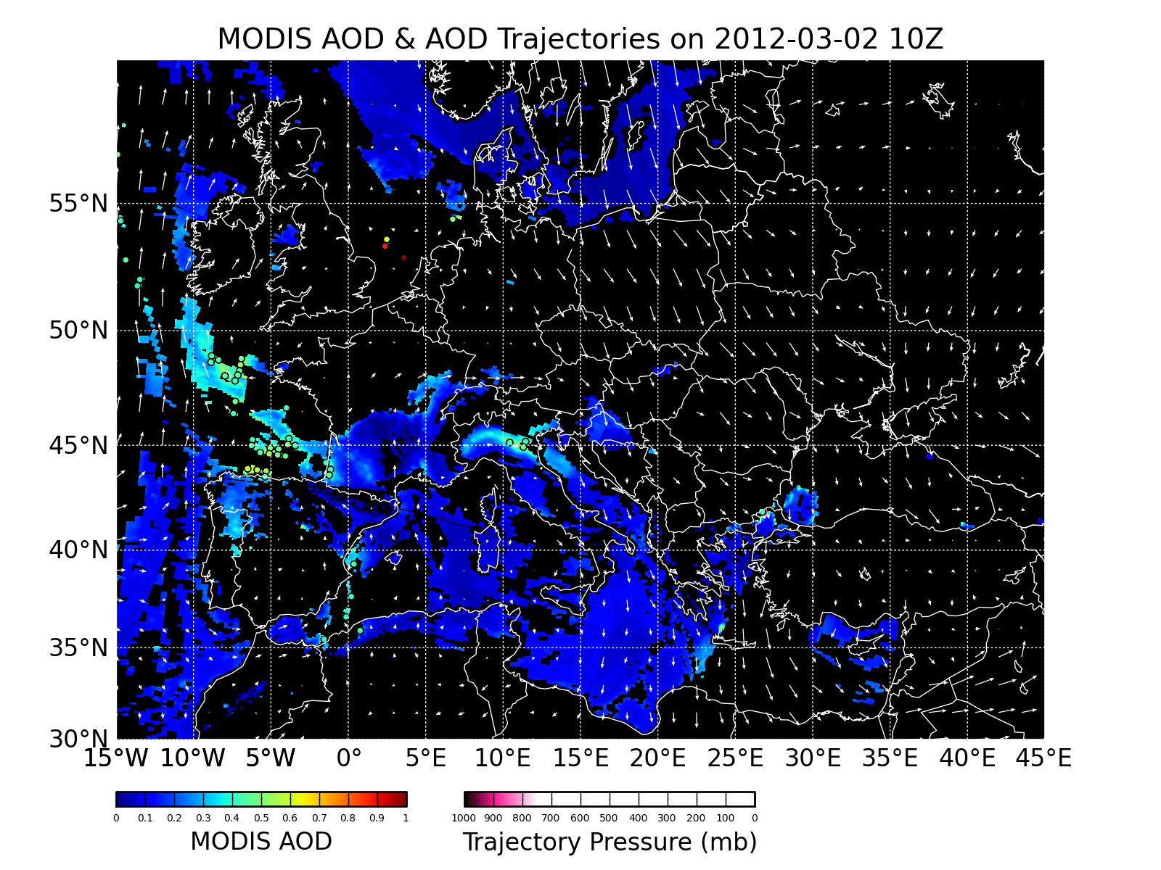
Po Valley IDEA-Internation Application (I)
VENTING OF AEROSOL TO SOUTH-EAST FOR THE DAYS AFTER
THIS COMPLETE ANALYSIS HELPS US TO UNDERSTAND ANOMALOUS SITUATION:
↑ PM₁₀
↓ AOD
CSPP/IMAPP Users' Group Meeting 2013

Slide 5
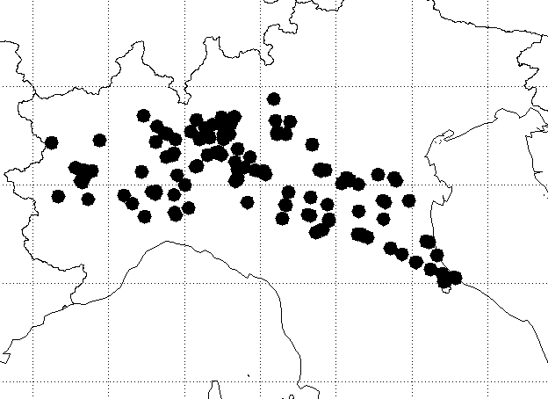
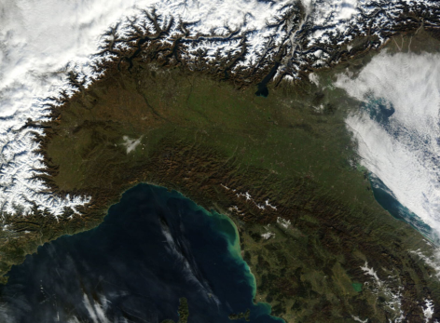
Po Valley Surface PM10 Network (I)
Specific geographic domain of interest
The largest industrial, trading and agricultural area with a high population density
DISTRIBUTION OF
126 AIR QUALITY GROUND MONITORING STATIONS OF ARPA NETWORK FOR PM₁₀ MEASUREMENTS
MI
Area with the most severe air pollution problems in the country
TO
40° - 50° N
MODIS (Terra) AOD DATA AT 0.55 μm WITH
10x10 km² OF SPATIAL RESOLUTION
5° - 15° E
Alpine chain act as a barrier to winds blowing from Northern Europe and the Mediterranean,
favoring the stagnation of pollutants
Notes:
«THE SPATIAL CO-LOCATION OF MODIS PIXELS WITH PM10 STATIONS DEFINITED BY CALCULATING THE DISTANCE BETWEEN MODIS PIXEL – PM10 STATION. ALL MODIS PIXELS WITHIN A DISTANCE OF 0.25° ARE AVERAGED FOR EACH PM10 STATION”

Slide 6
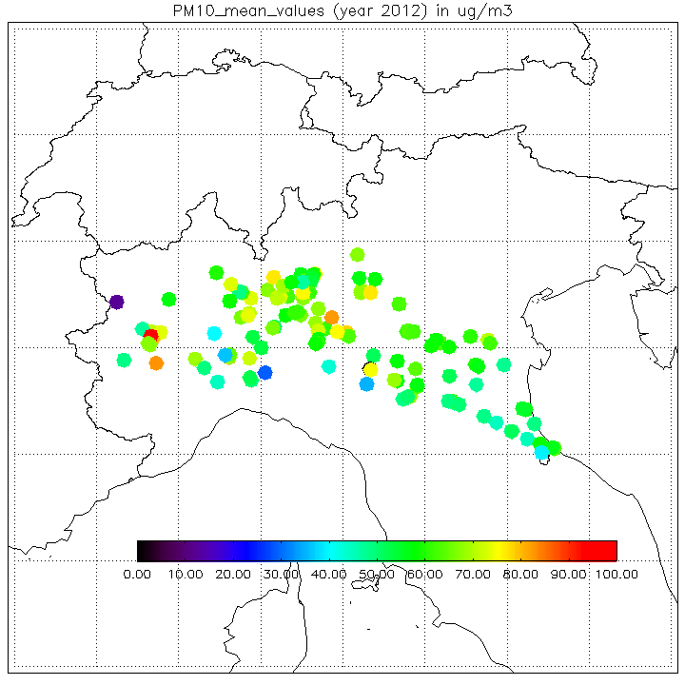
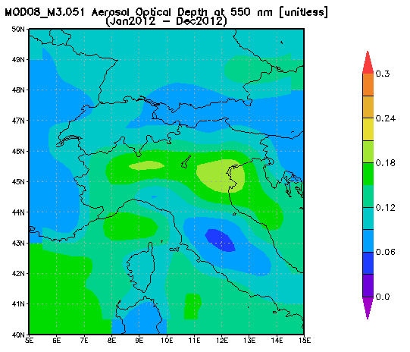
Po Valley Surface PM10 vs AOD (II)
HIGHER VALUE OF
MEAN AOD
Work on figure quality, change right panel to mean AOD at PM10 sites (I’ll help)
CSPP/IMAPP Users' Group Meeting 2013

Slide 7
PM₁₀ – AOD Correlation (I)
TRENDS NOT COMPARABLE FOR THE FALL/WINTER SEASONS
YEAR 2012
Variation in PM₁₀ mass concentration (μgm⁻³) and MODIS AOD at 0.55 μm over Po valley during 2012
56.8
22.6
0.22
0.10
APR
SEP
CSPP/IMAPP Users' Group Meeting 2013

Slide 8
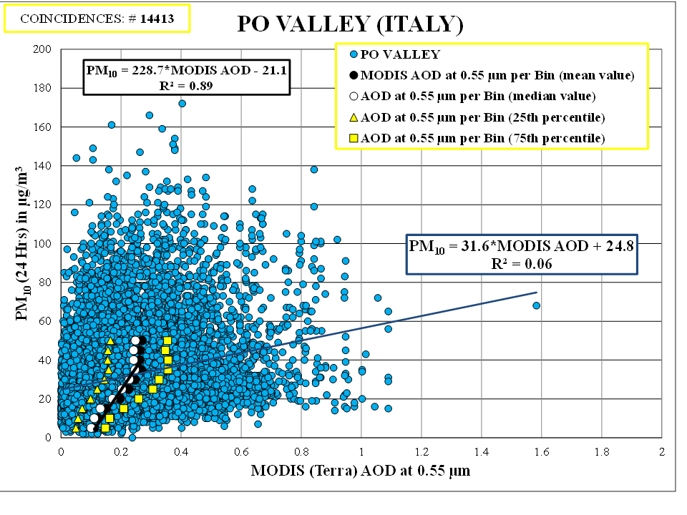
LINEAR REGRESSION EQUATION DERIVED BY DIVIDING PM₁₀ (24 Hrs) INTO 10 BINS OF 5 μgm⁻³
(Gupta et al., 2006)
PM₁₀ – AOD Correlation (II)
Relationship between PM₁₀ 24 Hrs mass concentration (μgm⁻³) and MODIS AOD at 0.55 μm, over Po valley during 2012
Remove
blue points
and discussion
Make green box new transition slide
Save plot as png in ppt then insert
CORRELATION
IMPROVED BY CONSIDERING METEOROLOGICAL DATA OR VERTICAL DISTRIBUTION OF AEROSOL INFORMATION
CSPP/IMAPP Users' Group Meeting 2013
Notes:
“… as first step, we concentrated our attention on vertical distribution of aerosol”

Slide 9
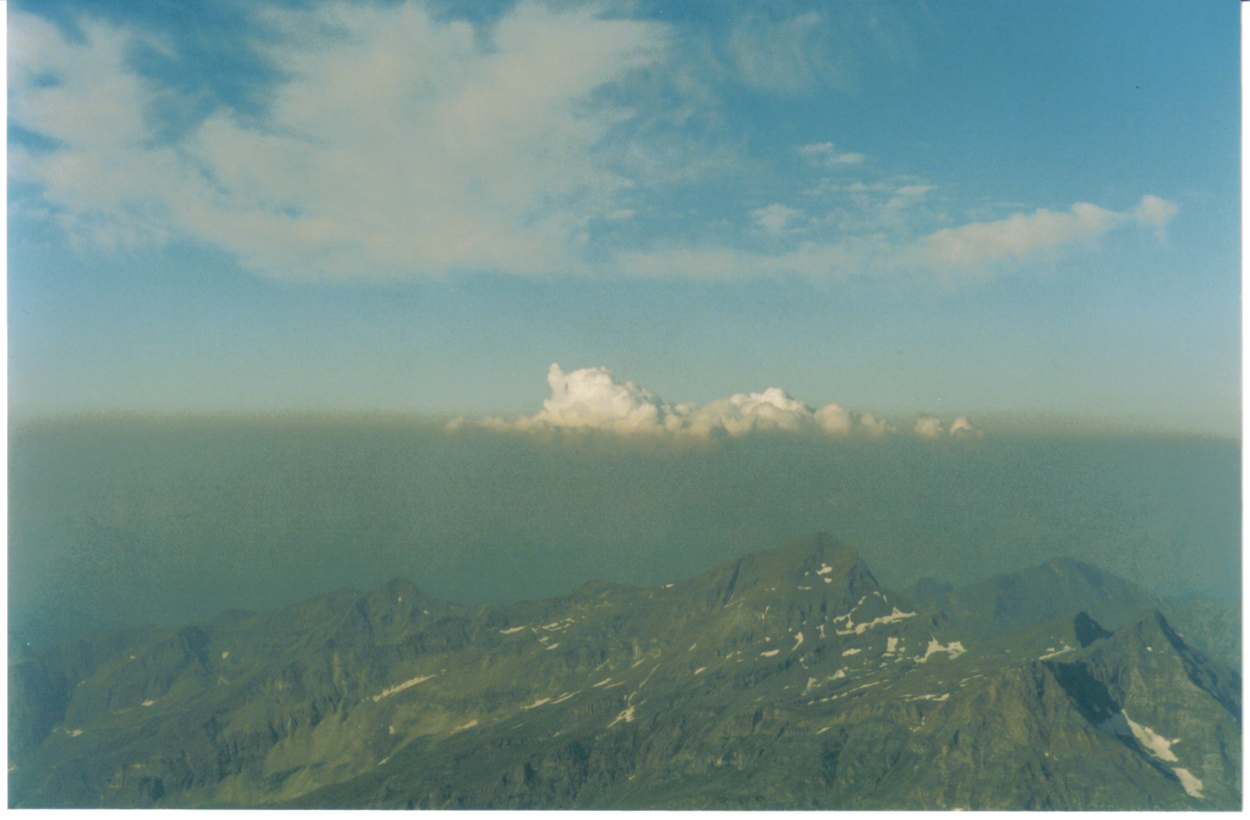

Aerosol vertical distribution:
PBL Information
Planetary Boundary Layer
the lowest part of the atmosphere, directly influenced by its contact with the Earth’s surface.
Aerosol Optical Depth (AOD) from Remote Sensing measurements
A
O
D
AEROSOL CONFINED AND MIXED HOMOGENEOUSLY WITHIN BOUNDARY LAYER
A
O
D
THE VALUES OF AOD NORMALIZED BY PBL HEIGHT (ZPBL) REGARDED AS EXTINCTION (km⁻¹) AS ONE MEASURED AT SURFACE
Height
PBL Height
Extinction coefficient
CSPP/IMAPP Users' Group Meeting 2013

Slide 10
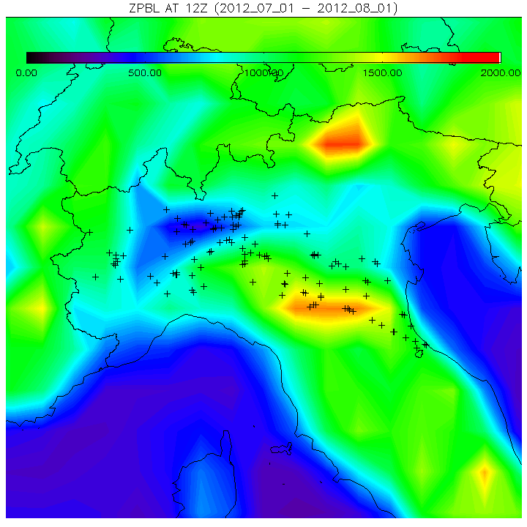
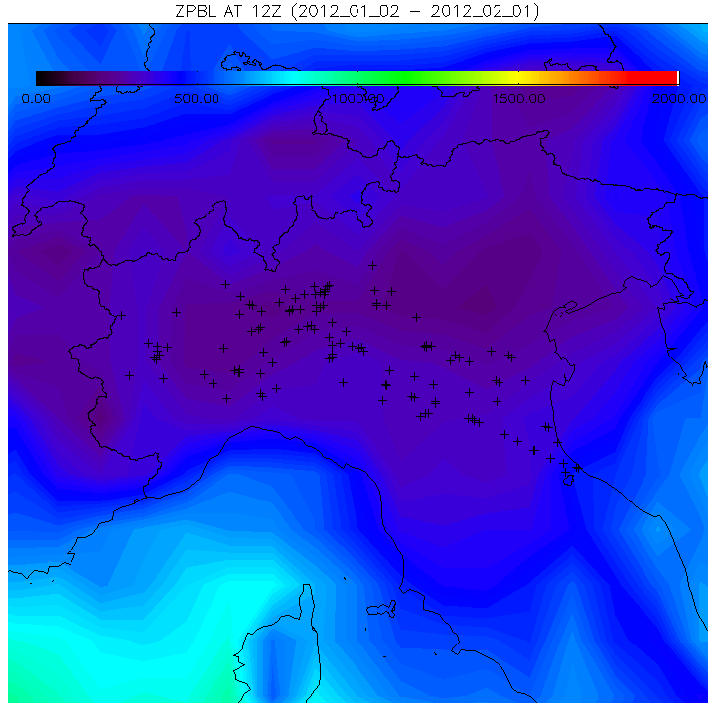
PM₁₀ – AOD Improvement:
use of PBL Information (I)
YEAR 2012
PBL values from GFS grib2 files are used, over Po valley during 2012
0.97
Improve figure
quality
0.30
APR
CSPP/IMAPP Users' Group Meeting 2013
SEP

Slide 11
The majority of aerosol abundance resides in the PBL
The thickness of PBL has direct impacts on the correlation between AOD and PM
PM₁₀ – AOD Improvement (II)
TRENDS MORE COMPARABLE FOR THE FALL/WINTER SEASONS
YEAR 2012
Variation in PM₁₀ mass concentration (μgm⁻³) and normalized MODIS AOD at 0.55 μm by ZPBL over Po valley during 2012
0.65
0.42
56.8
22.6
APR
SEP
CSPP/IMAPP Users' Group Meeting 2013

Slide 12
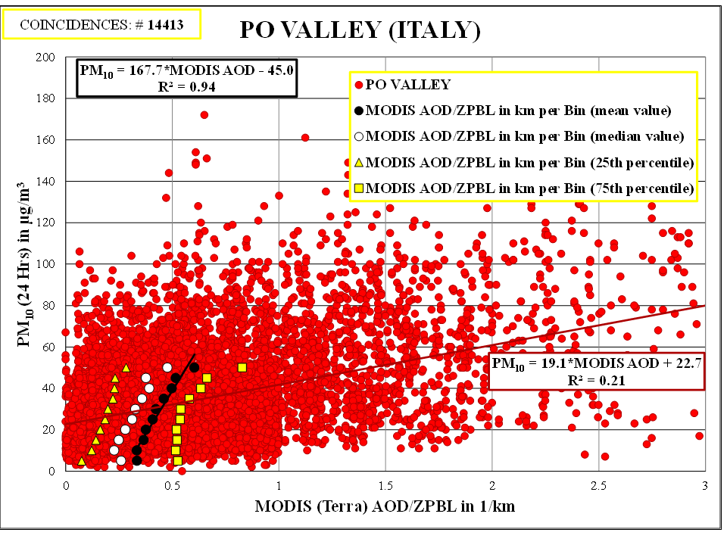
PM₁₀ – AOD Improvement (III)
THE CORRELATION
PM - AOD/ZPBL
IS HIGHER THAN
PM - AOD
YEAR 2012
Relationship between PM₁₀ 24 Hrs mass concentration (μgm⁻³) and MODIS AOD at 0.55 μm, over Po valley during 2012
Same as
before
CSPP/IMAPP Users' Group Meeting 2013

Slide 13

Conclusion
MODIS AOD on NASA’s terra satellite along with co-located ground-based PM10 concentration measurements at 126 stations over the Po valley has been considered
By using a regression analysis, we have derived an empirical relationship between PM₁₀ (μgm⁻³) and AOD at 0.55 μm
$${\text{PM}}_{\text{10}} \text{= 228.7}\text{∙}\text{MODIS} \text{AOD} −\text{ 21.0}$$
R² = 0.89
CSPP/IMAPP Users' Group Meeting 2013

Slide 14

Conclusion
Accounting for the depth of the aerosol layer (use of Planetary Boundary Layer) over the Po valley has improved the remote Sensing – PM₁₀ correlation
$${\text{PM}}_{\text{10}} \text{= 167.7}\text{∙}\text{MODIS} \text{AOD} −\text{ 45.0}$$
Move to first conclusion
R² = 0.94
IMAPP IDEA-I aerosol forecasts heightens the comprehension of air quality within the Po Valley.
CSPP/IMAPP Users' Group Meeting 2013

Slide 15
Outgoing and Future Work
Validation of GFS PBL analyses with CALIPSO measurements
Improvement of spatial resolution of MODIS AOD by using 1km MAIAC retrieval (reference)
CSPP/IMAPP Users' Group Meeting 2013

