Slide 1
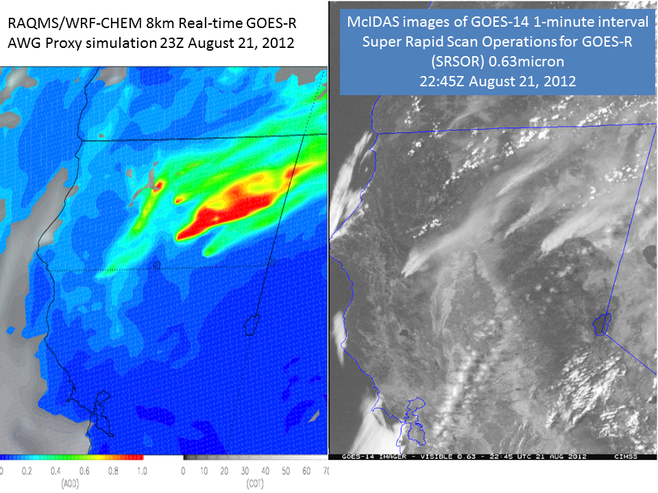
CIMSS/ASPB GOES-R ABI Real-time Proxy
Real-time Proxy Framework Support: WRF-Chem/RAQMS Component
Nested RAQMS/WRF-CHEM aerosol simulations are now being produced in real-time to support GOES-R Proxy Framework
GOES-R Proxy aerosol optical depth (AOD) simulation captures observed smoke due to wildfires in Northern California
Real-time Proxy AOD/COT (left) and GOES-14 visible image (right) of August 21, 2012 Northern California Wildfires
GOES-R Proxy Framework supports GOES-R ABI pre-launch activities by providing real-time GOES Rebroadcast (GRB) files containing synthetic ABI radiances that will be distributed to AIT and Proving Ground partners for testing GOES-R algorithms and data systems in real-time.

Slide 2
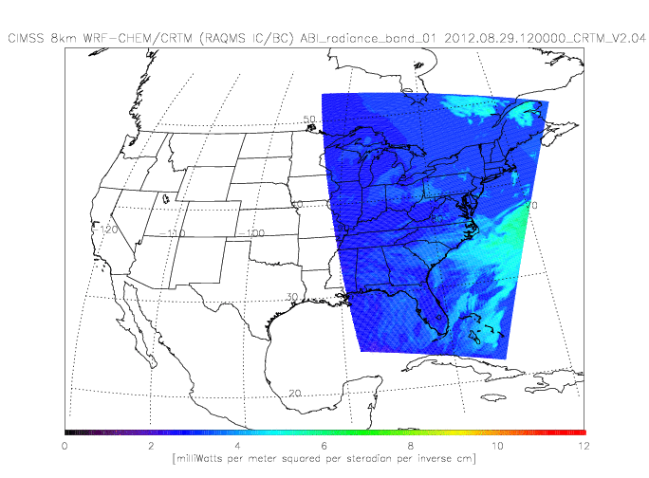
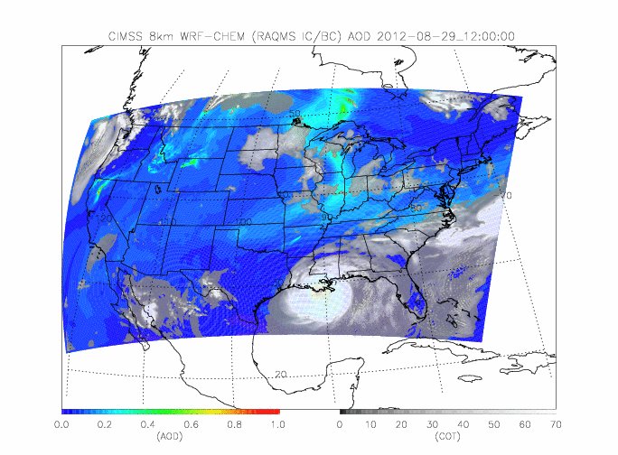
CIMSS/ASPB GOES-R ABI Real-time Proxy
Real-time Proxy AOD/COT (right) and Simulated ABI Band 01 Radiance (left) for August 29-30, 2012 Hurricane Isaac Landfall
Real-time Proxy Framework Support: Real-time Proxy Framework Support: CRTM and Validation Component
CRTM is being used to produce all ABI Bands in real-time to support GOES-R Proxy Framework
Real-time geophysical validation using MODIS AOD/COT is currently being tested.
Real-time radiance validation using GOES visible and IR bands is currently under development
GOES-R Proxy Framework supports GOES-R ABI pre-launch activities by providing real-time GOES Rebroadcast (GRB) files containing synthetic ABI radiances that will be distributed to AIT and Proving Ground partners for testing GOES-R algorithms and data systems in real-time.

Slide 3
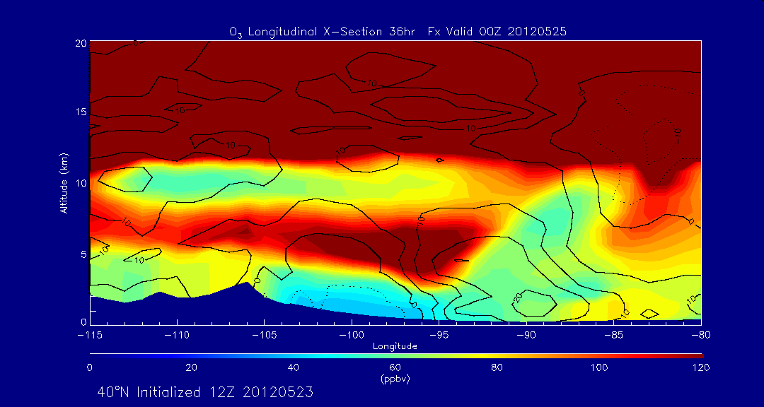
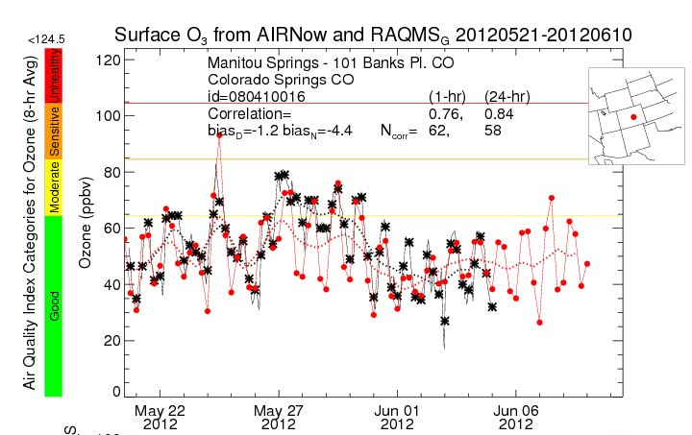
CIMSS/ASPB GOES-R Cal/Val Field Campaign Support
GOES-R Calibration/Validation Field Campaign Support
RAQMS provided daily forecasting support for the NSF Deep Convective Clouds & Chemistry field mission during May-June, 2012
Air Quality forecasters from the Colorado Department of Public Health & Environment used RAQMS forecasts to document the contribution from Stratospheric Intrusions to non-attainment of EPA surface ozone standards.
RAQMS 36hr ozone X-section forecast at 40ºN valid 00Z on May 25th, 2012 (upper) and time series of observed (black) and predicted (red) surface ozone at Colorado Springs, CO during May 21-June 10, 2012
This effort supports validation of GOES-R Advanced Baseline Imager (ABI) aerosol, cloud, land and sounding retrievals during NSF sponsored field campaigns during 2012. The airborne and surface validation tools and procedures developed under this effort will provide the foundation for post-launch ABI validation activities in 2015.

