Slide 1
MODIS Firemap, April 10 – 19, 2008
B
C
A
Fig. 1. MODIS Fire map, April 10 – 19, 2008 showing major fire outbreaks in Thailand (A), Kazakhstan (B), and Siberia (C)

Slide 2
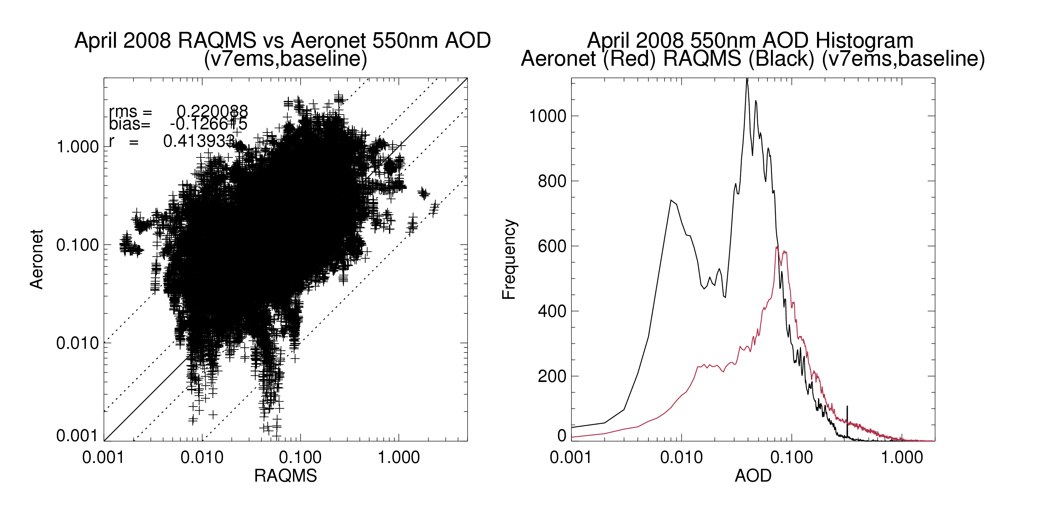
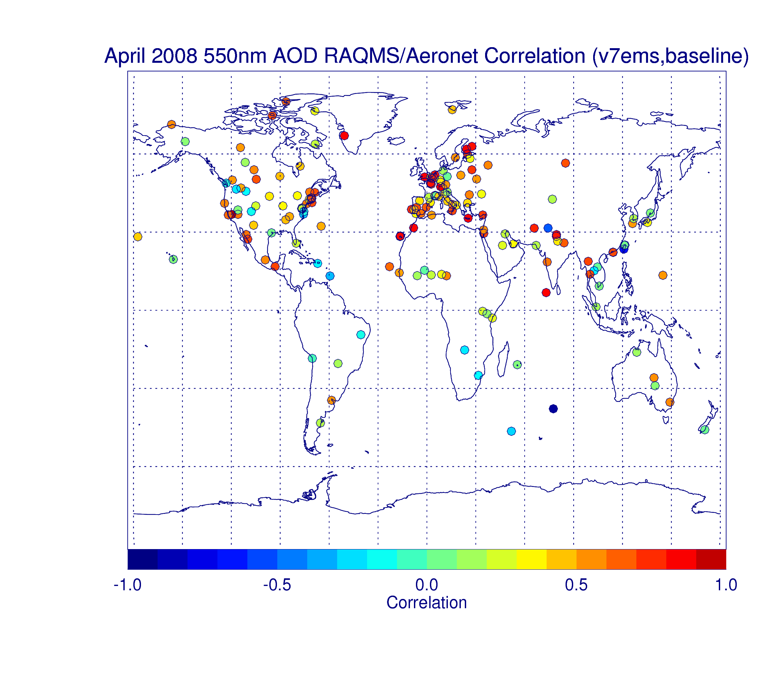
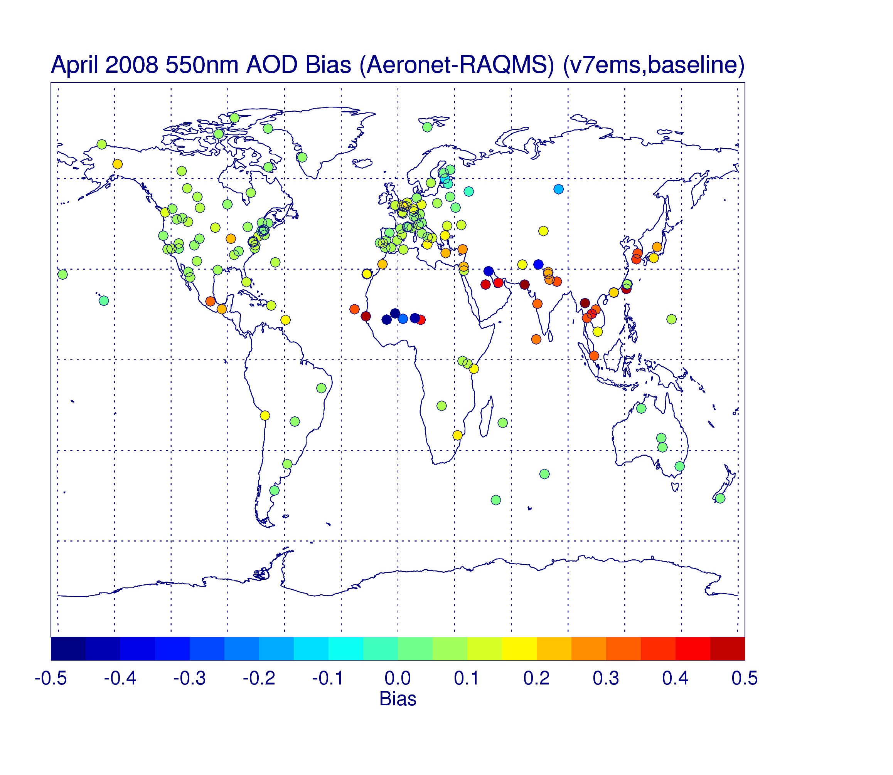
Fig. 2. RAQMS and AERONET 550 nm AOD comparisons for April, 2008

Slide 3
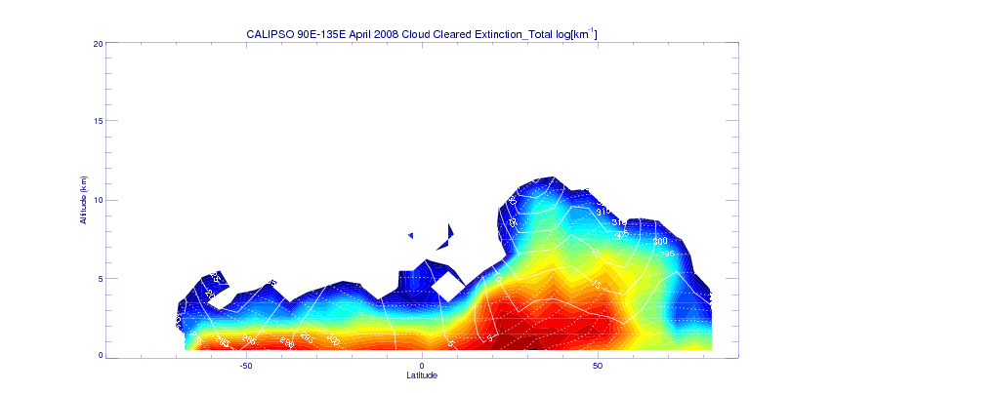
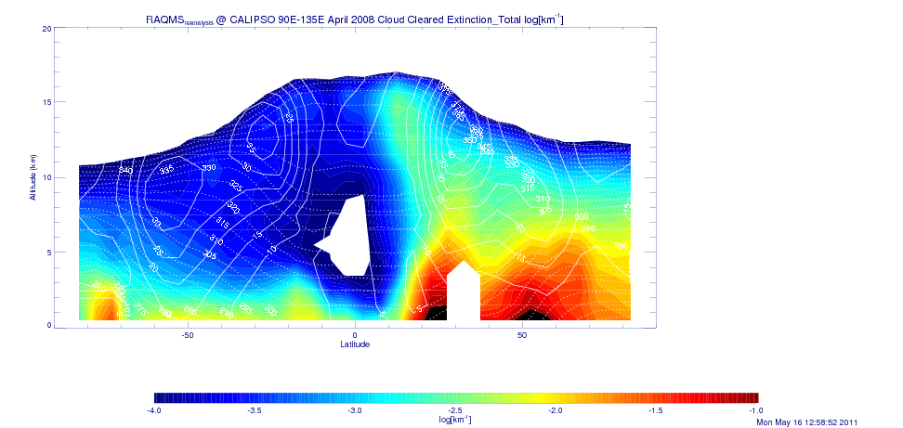
Fig. 3. Total aerosol extinction during April 2008 for 90E-135E longitude sector. (Top) a. Observations from CALIOP. (Bottom) b. RAQMS baseline results at CALIOP locations.

Slide 4
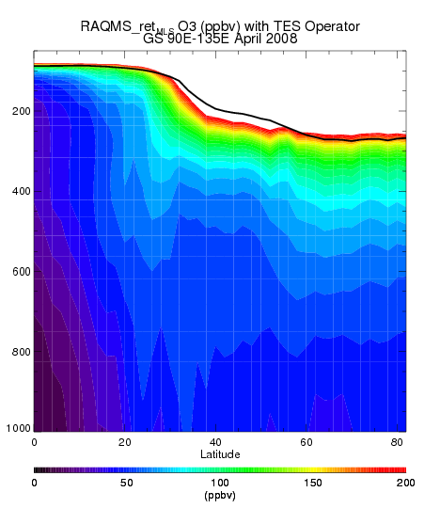
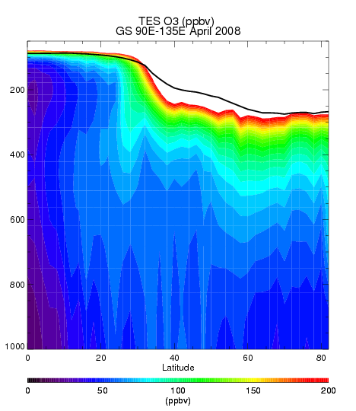
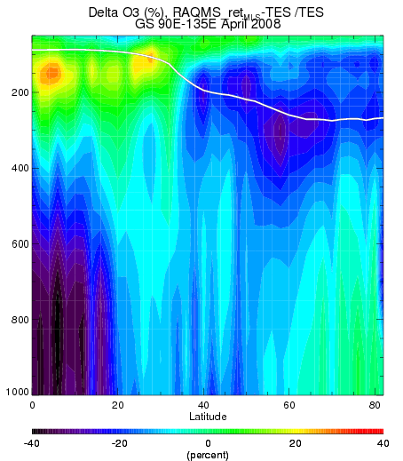
Fig. 4a. (top left) RAQMS O3 with TES averaging kernel at TES locations fro 90E-135E during April 2008. 4b. (top right) TES O3 during April 2008. 4c. (bottom) Percent difference RAQMS O3 versus TES O3.

Slide 5
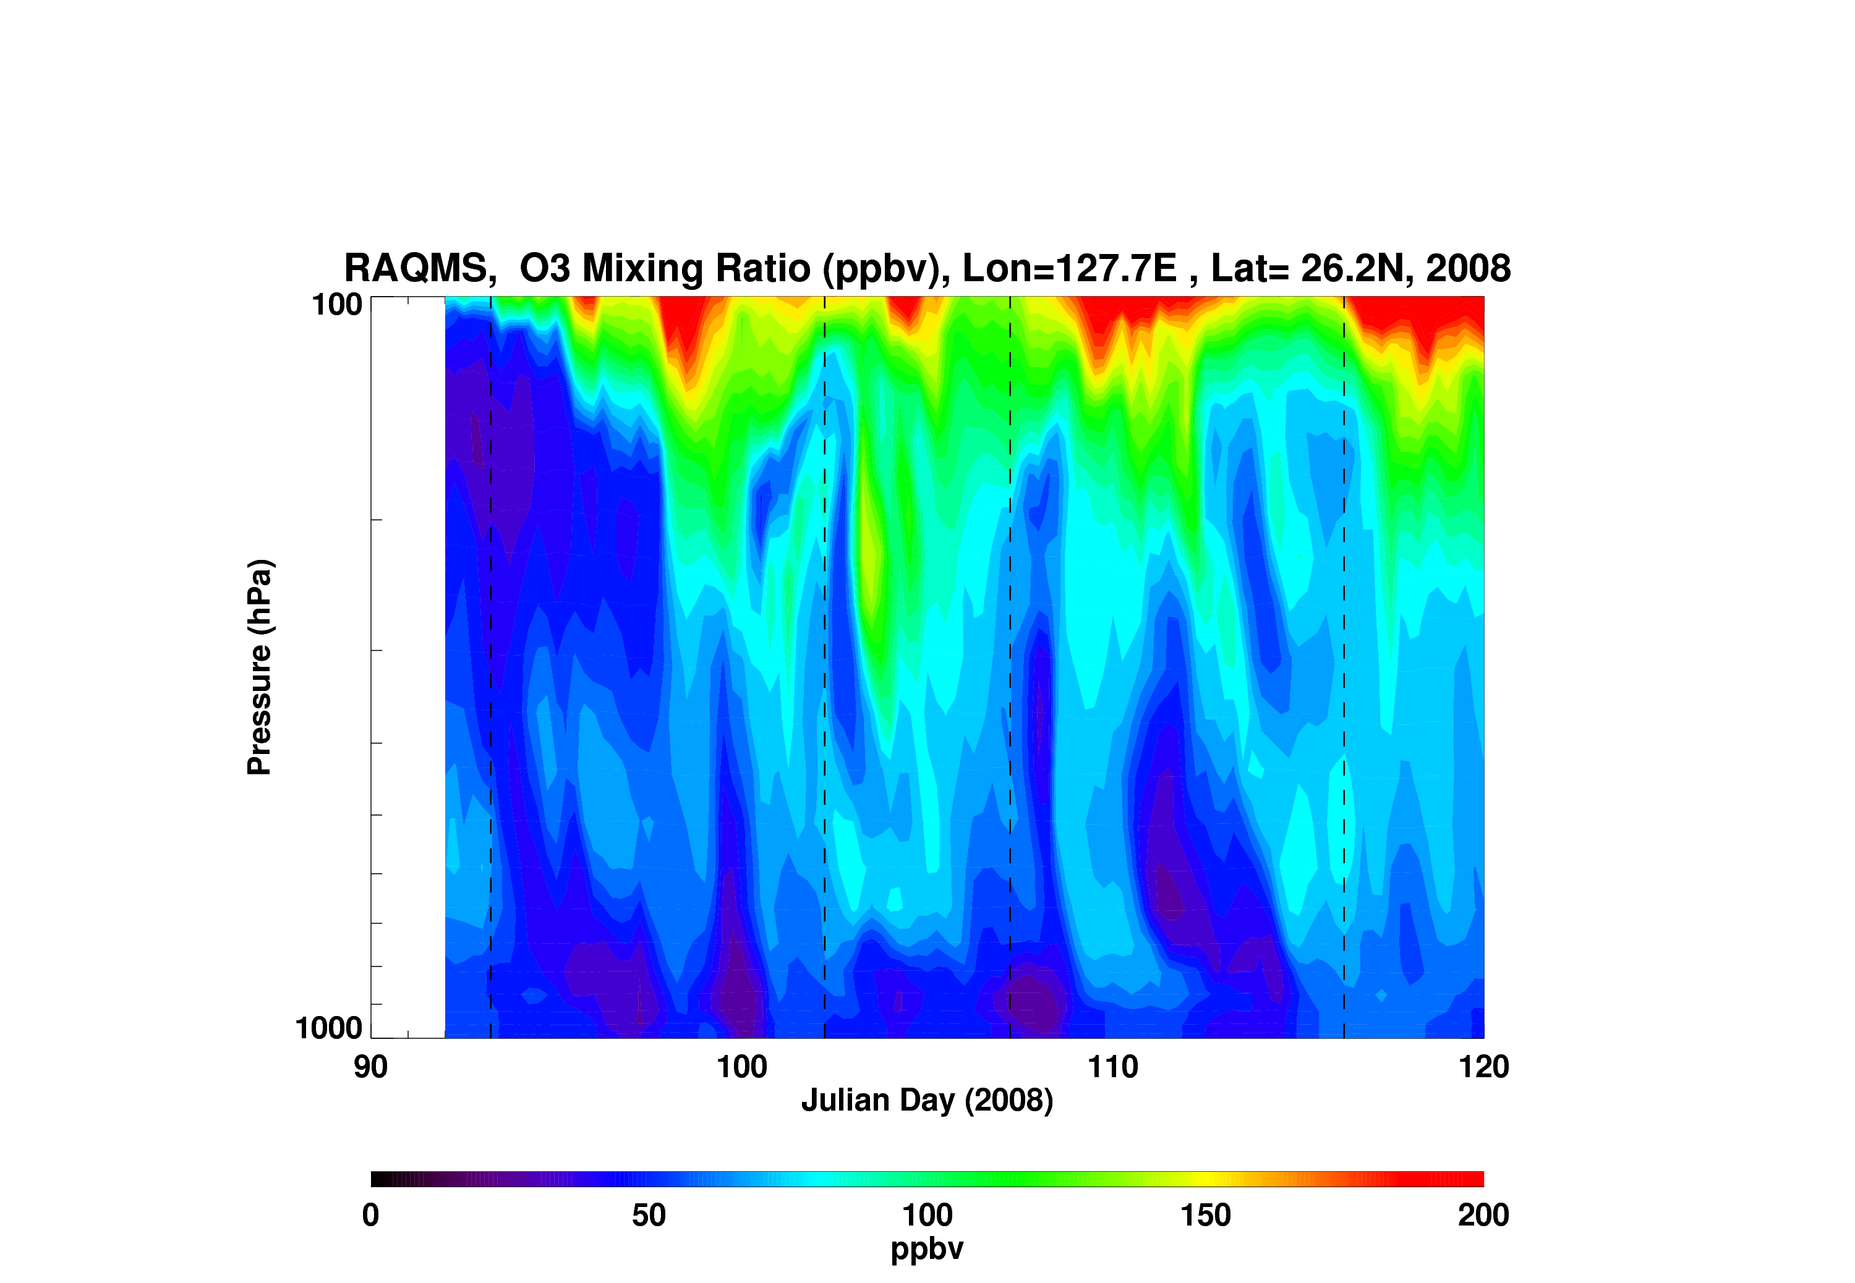
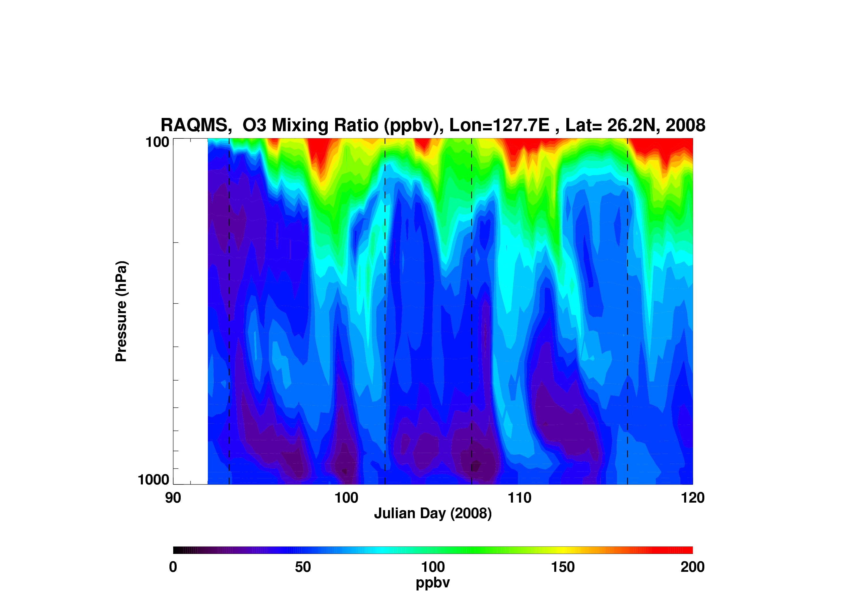
With Fires
Without Fires
Fig 5. Tropospheric Ozone mixing ratio time series at Naha from RAQMS simulations with Asian fires (left) and without fires (right)

Slide 6
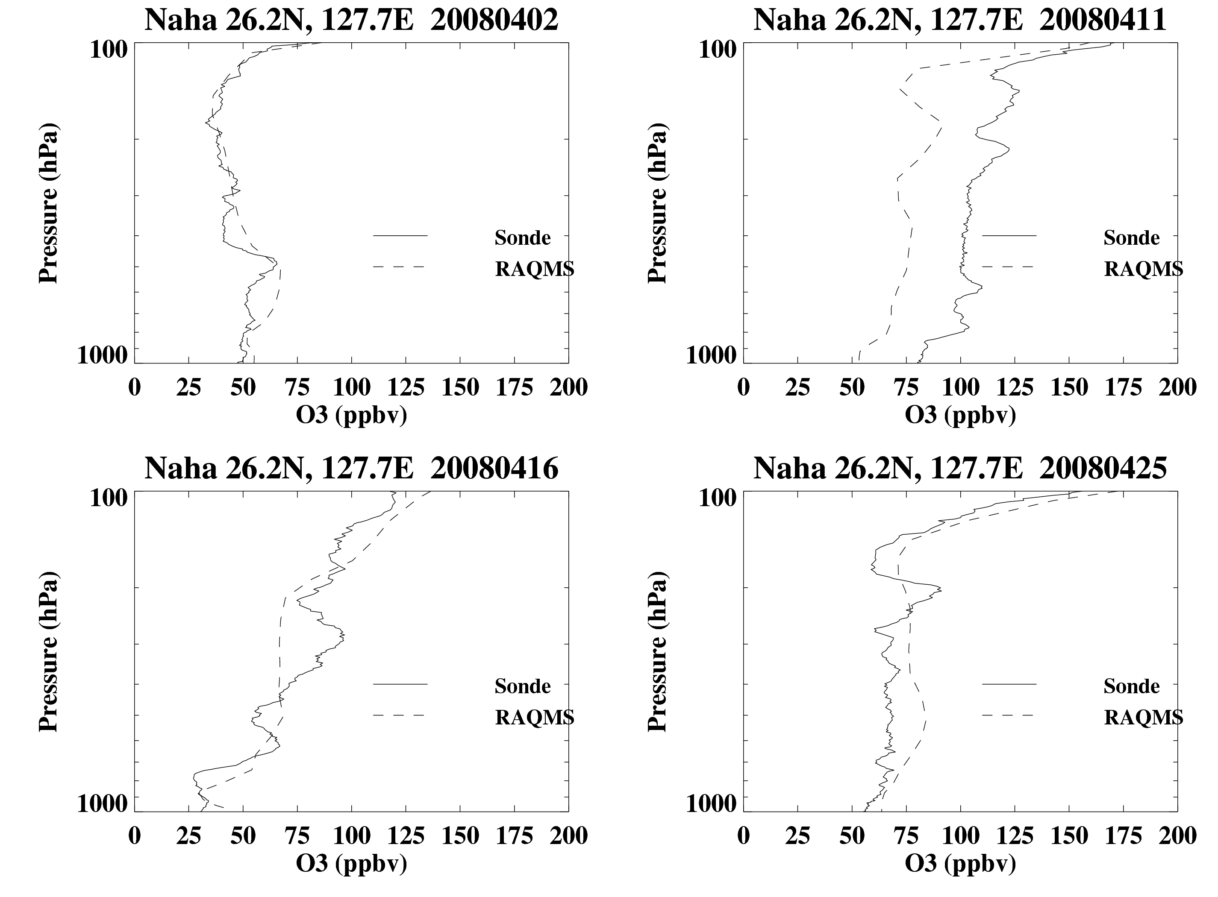
Fig. 6. RAQMS O3 versus Ozonesonde at Naha during April, 2008

Slide 7
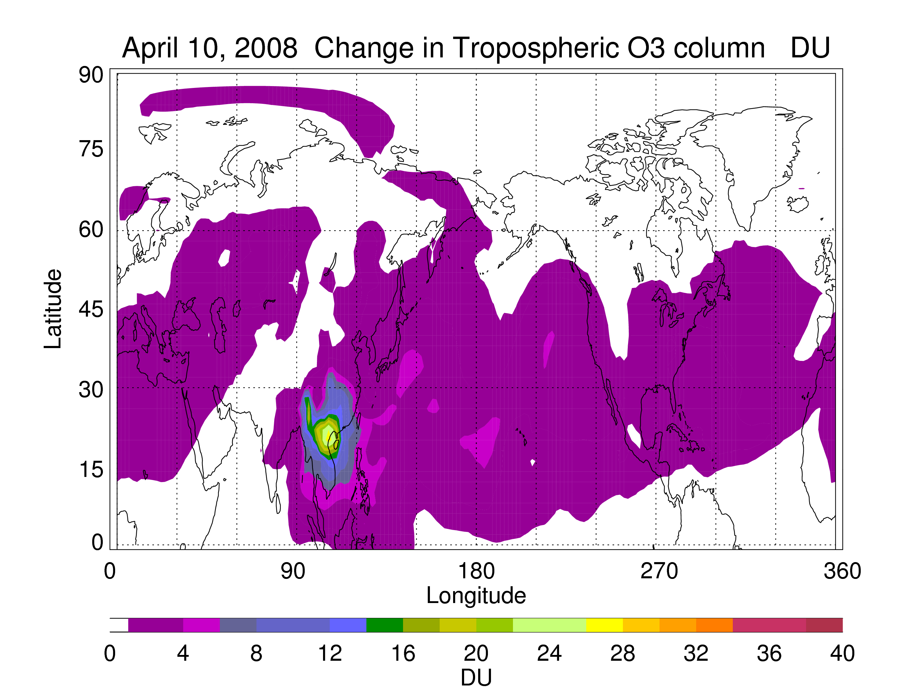
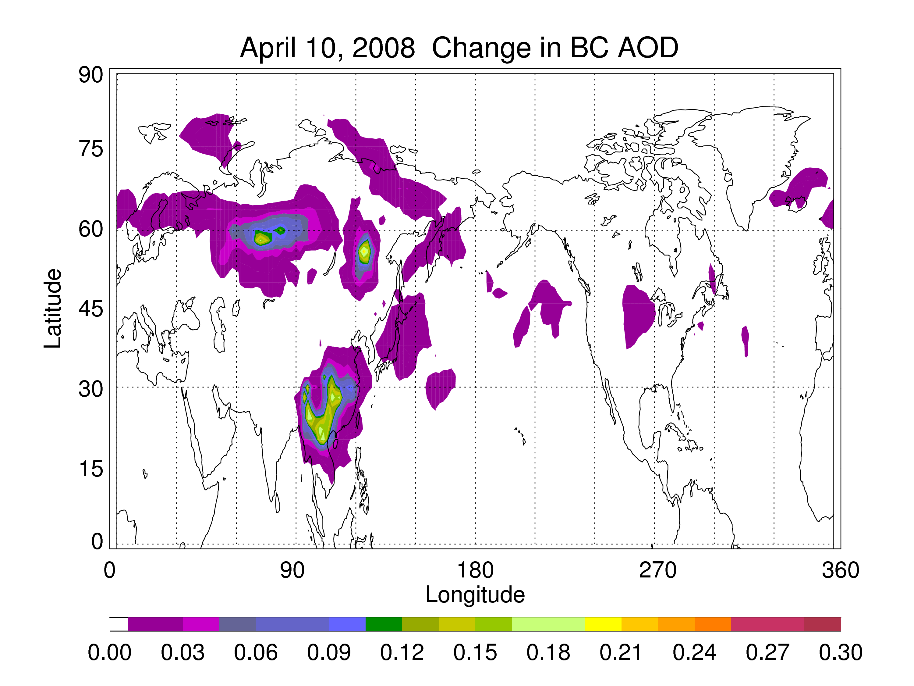
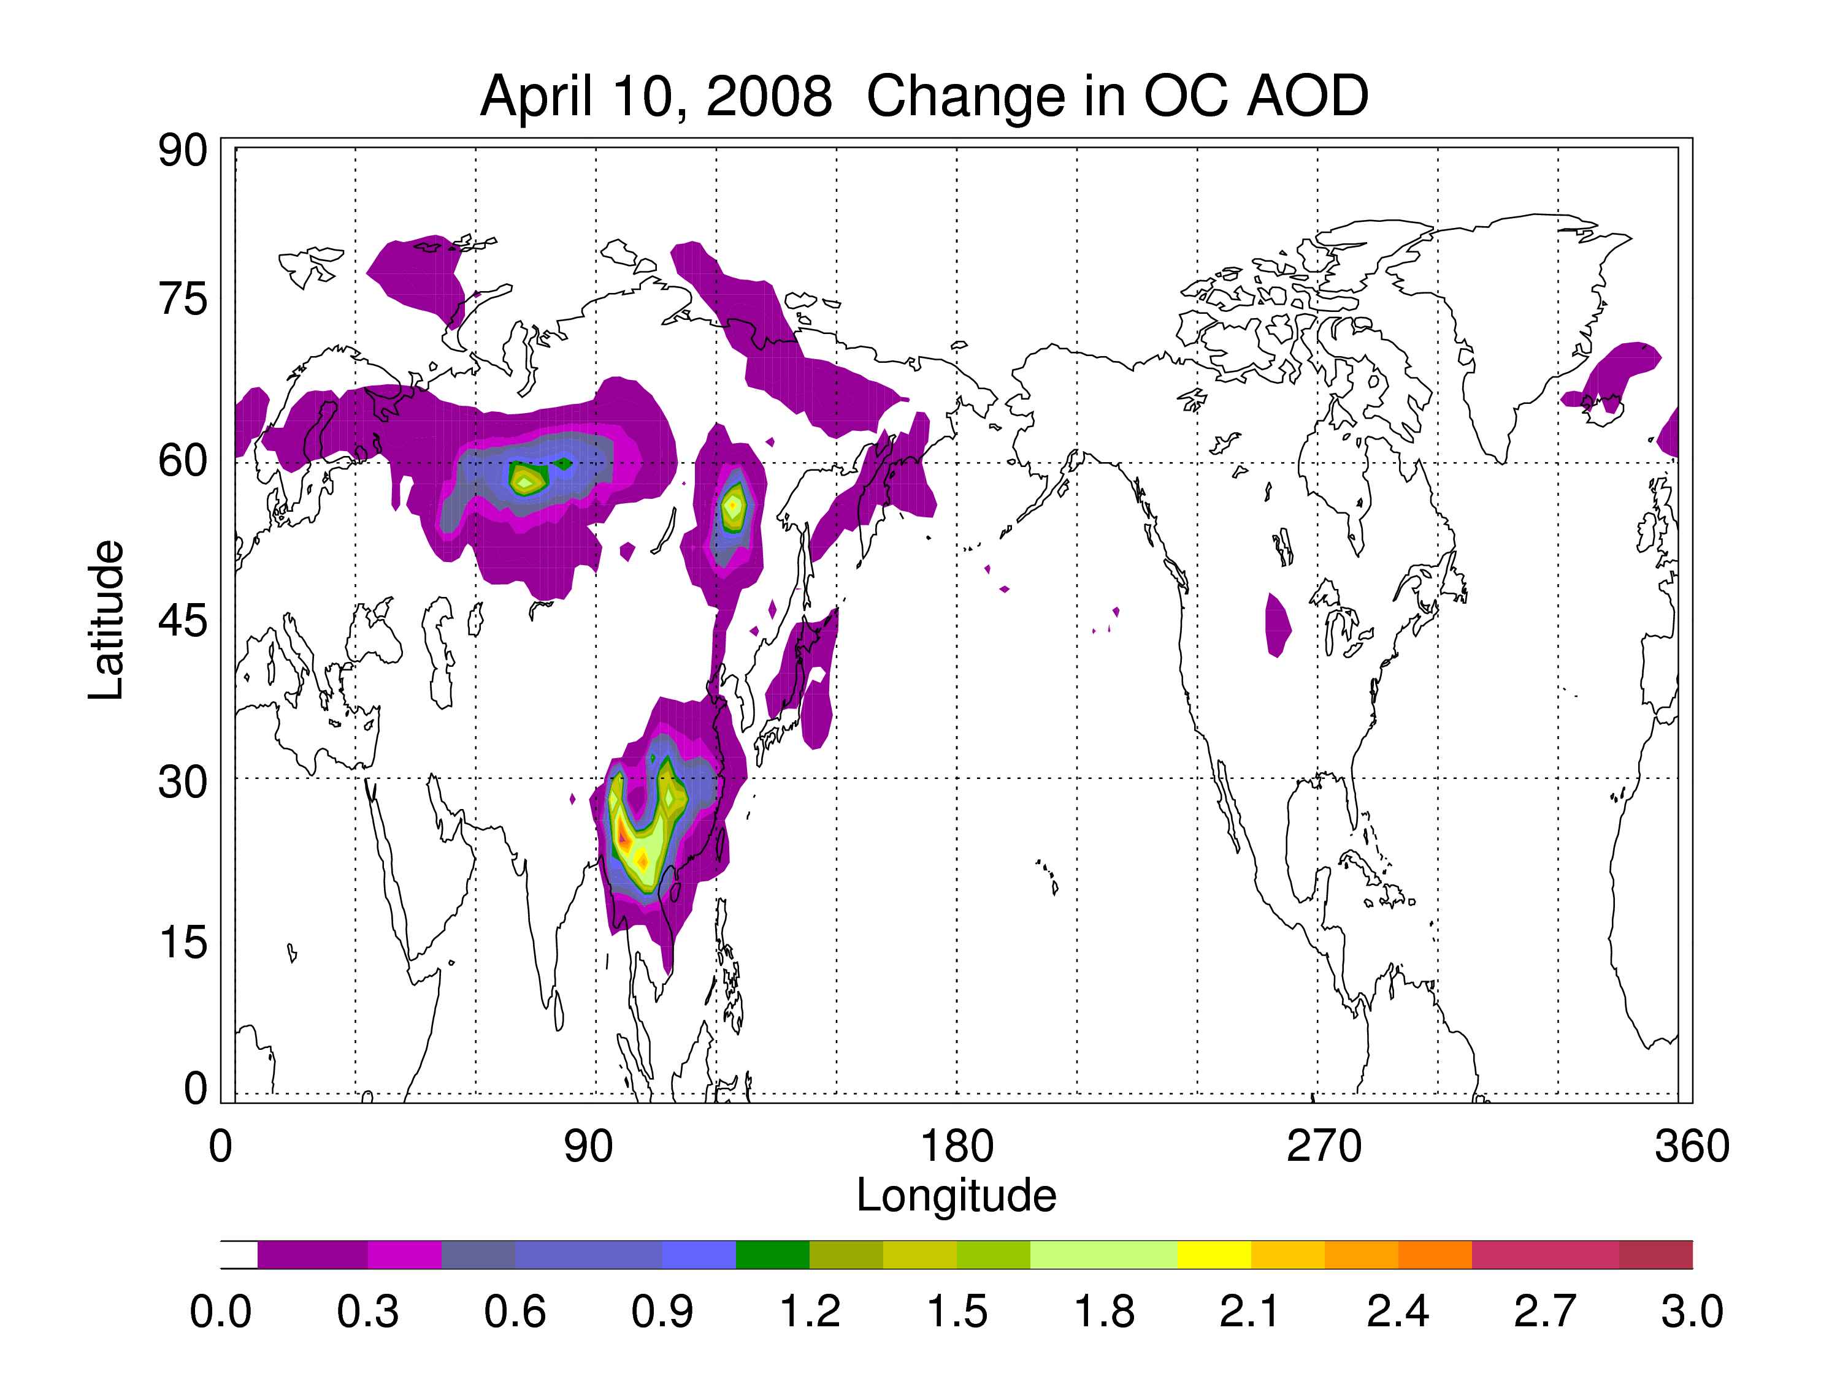
Fig. 7. Change in RAQMS tropospheric O3 column, and BC and OC AOD for April 10,2008.

Slide 8
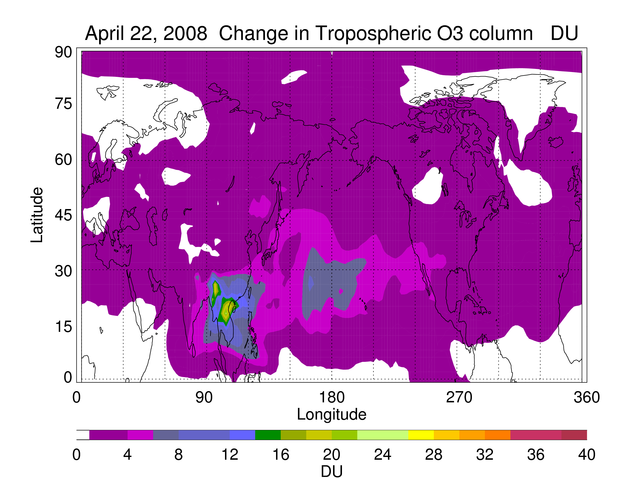
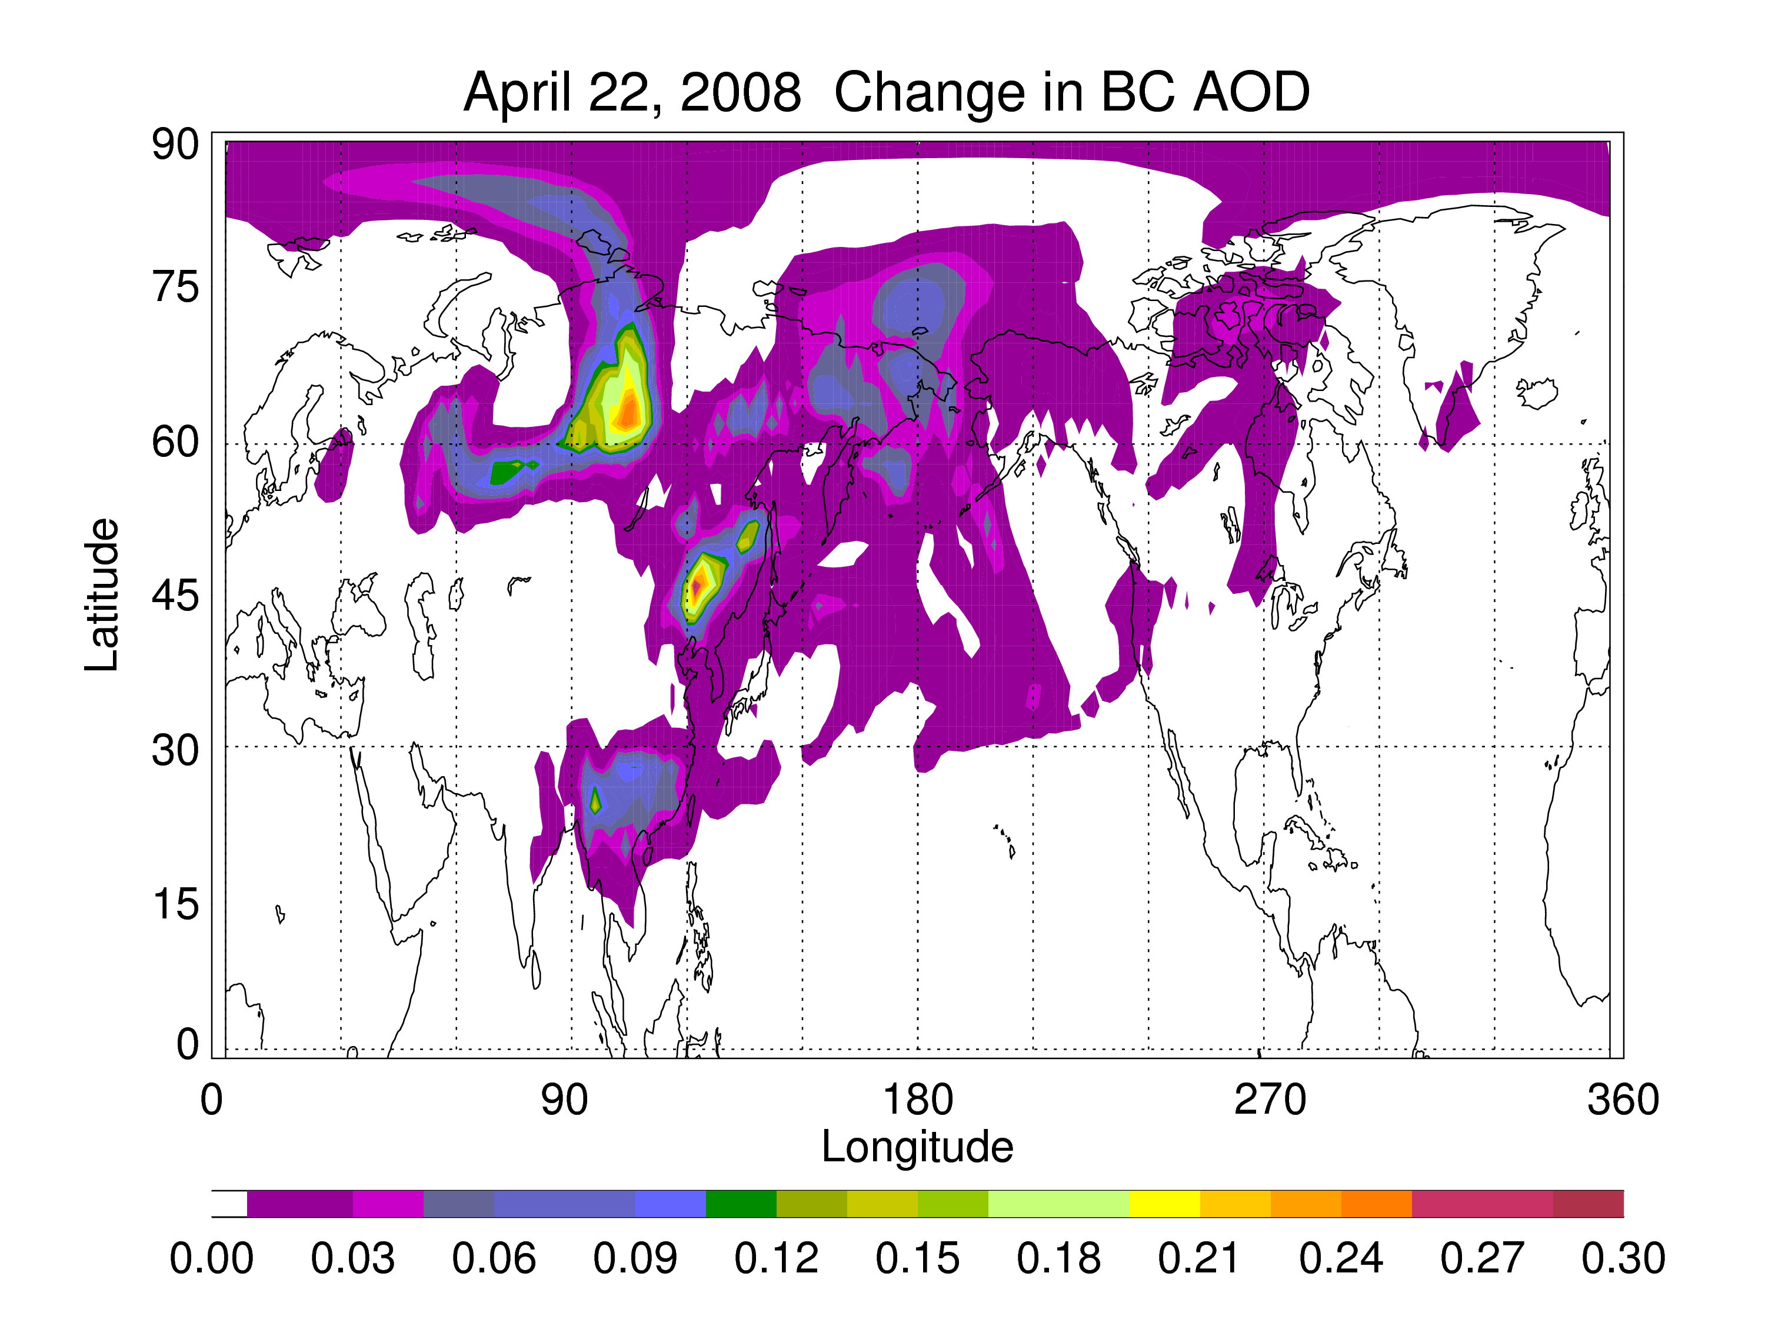
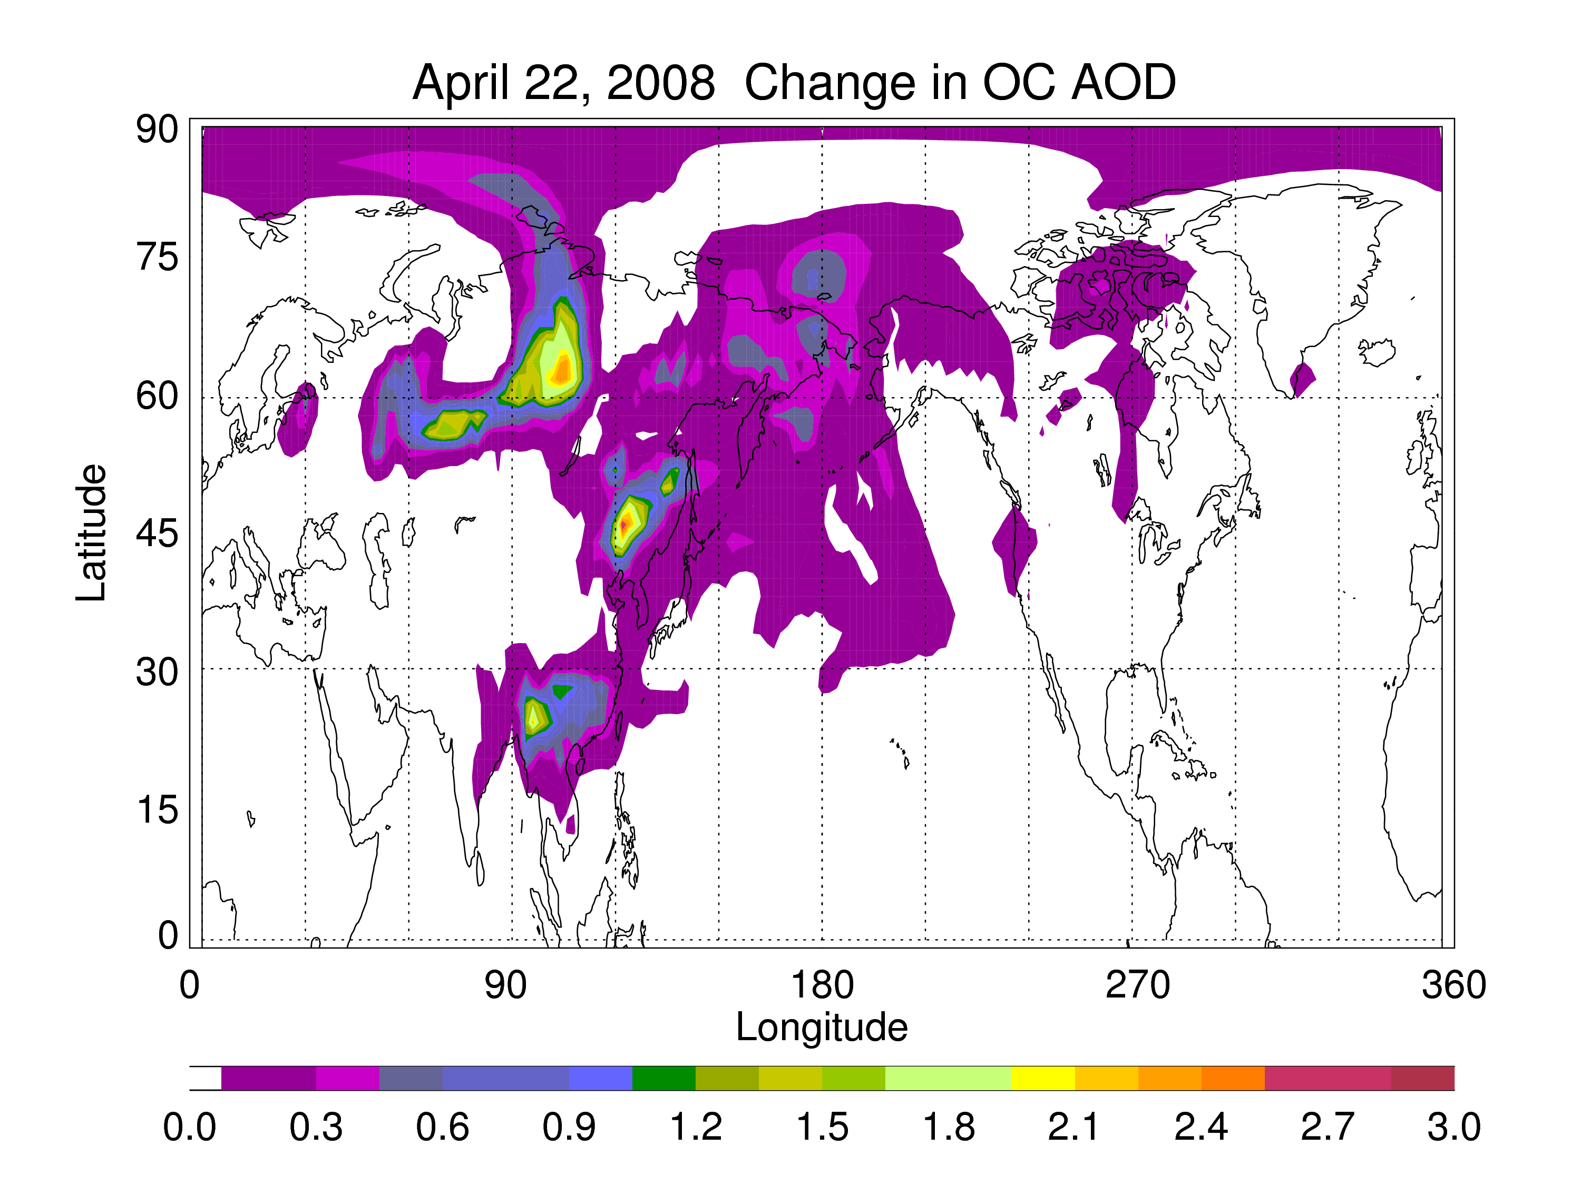
Fig. 8. Same as fig 7. but for April 22, 2008.

Slide 9
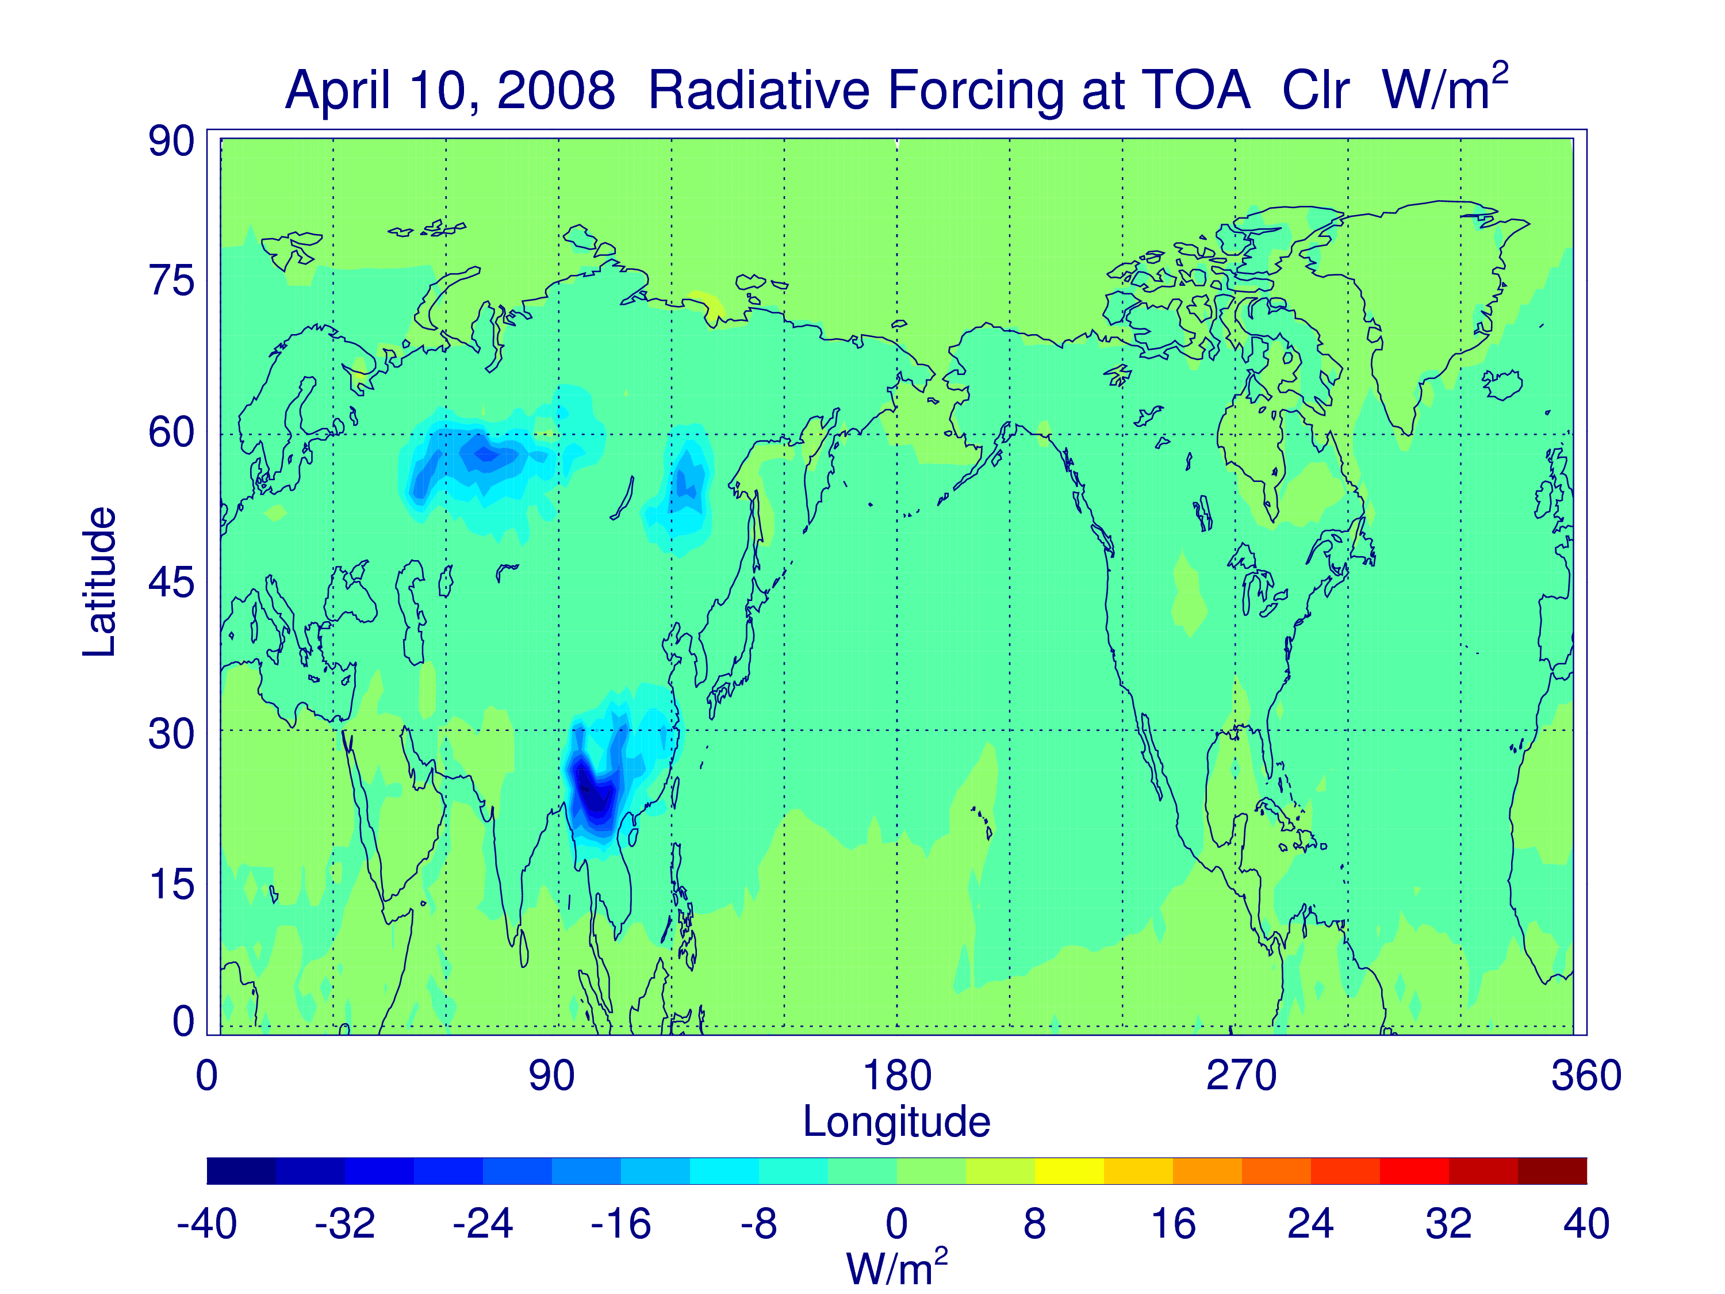
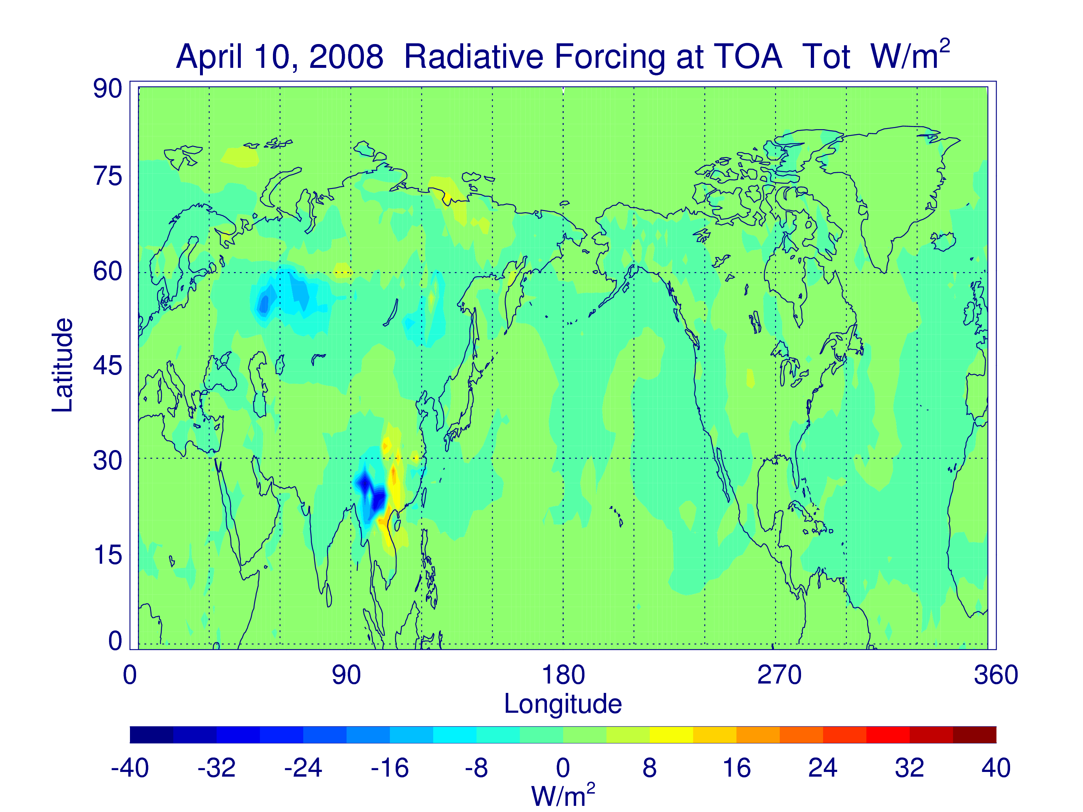
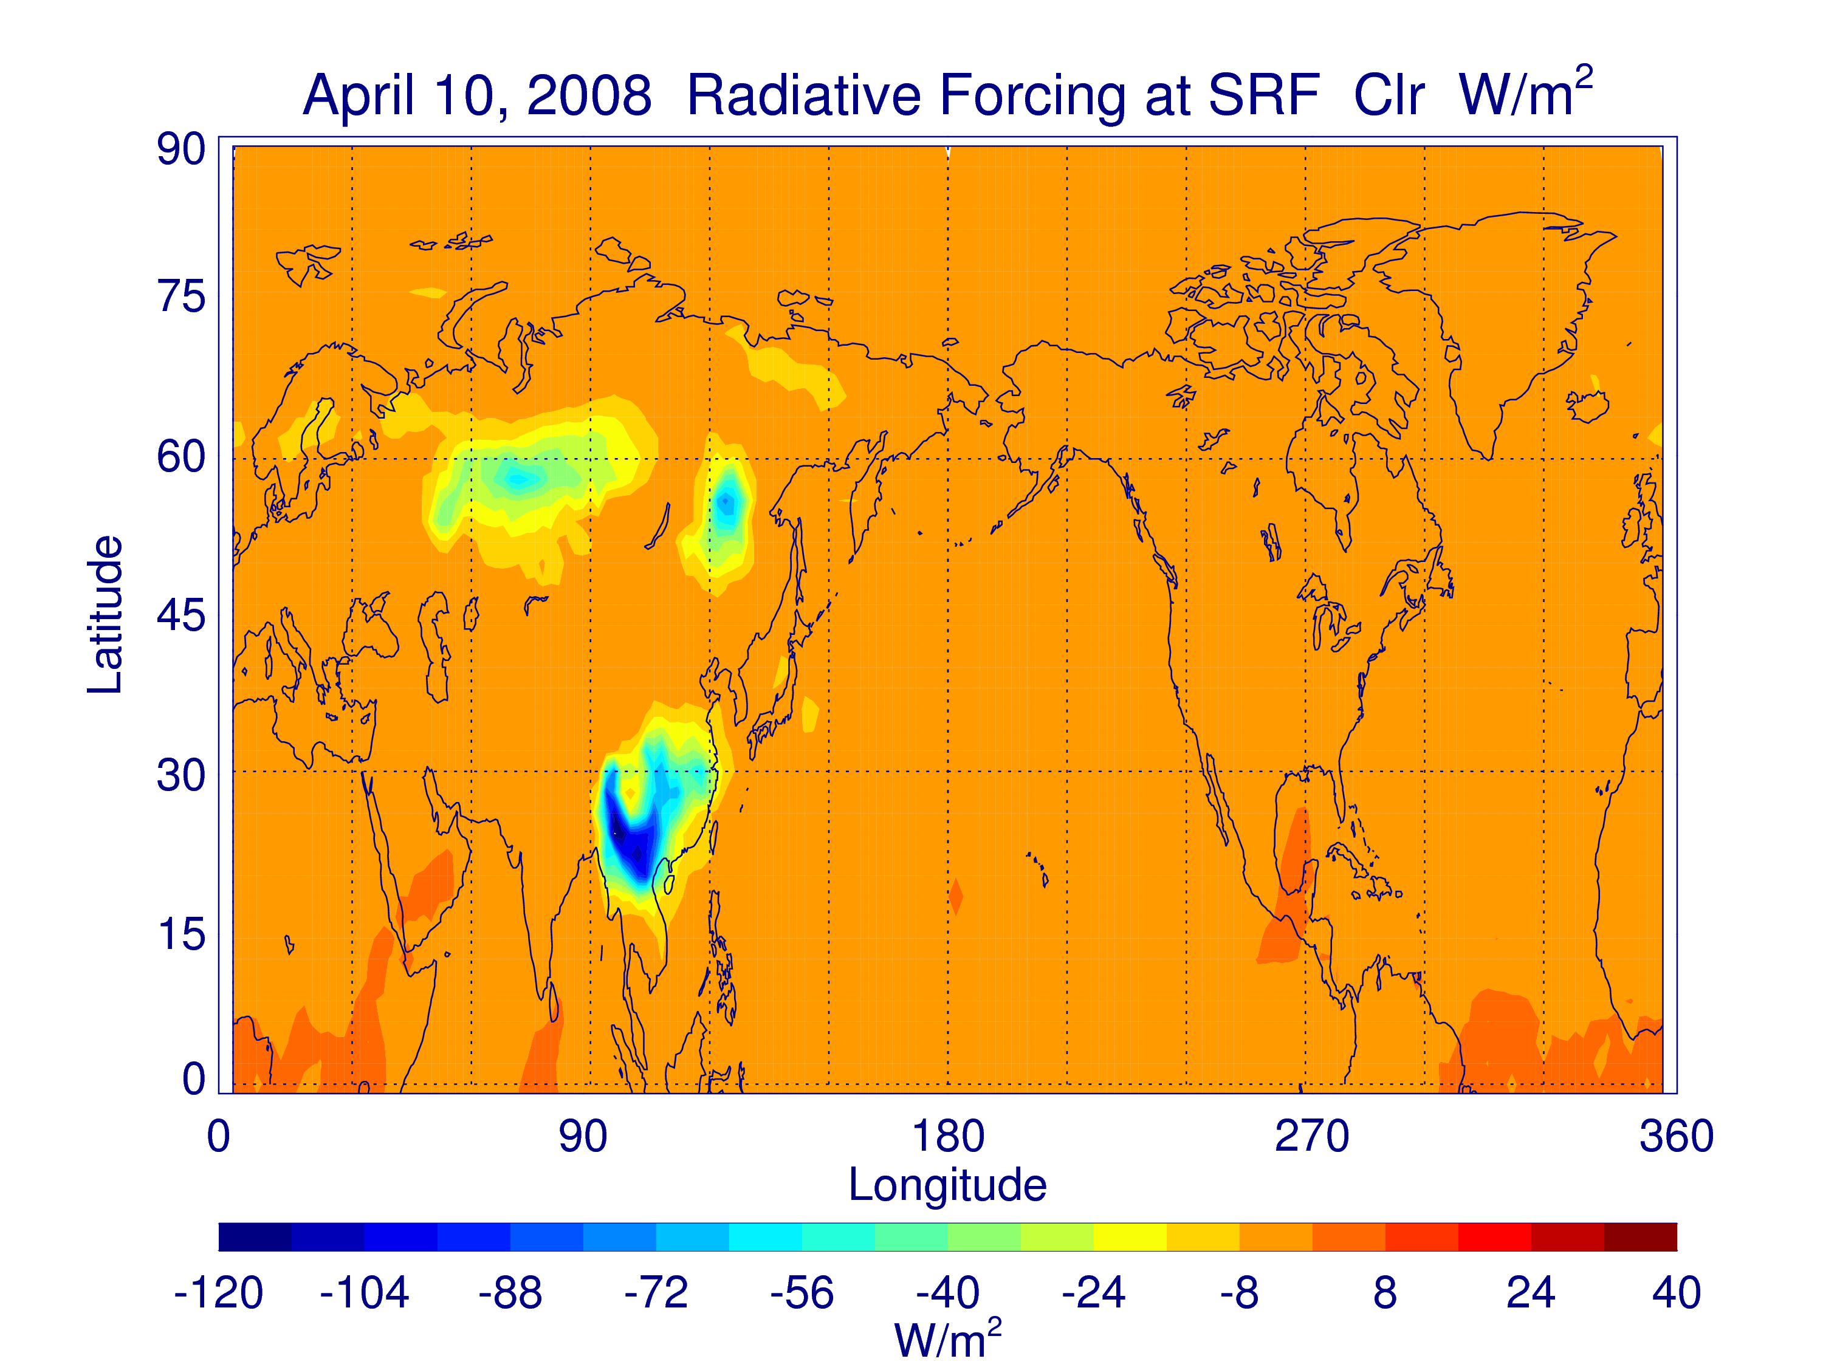
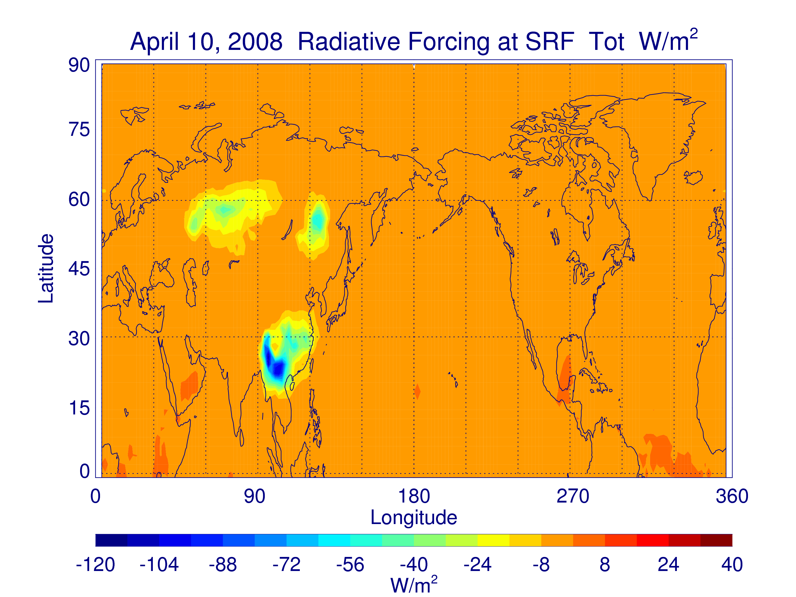

Slide 10
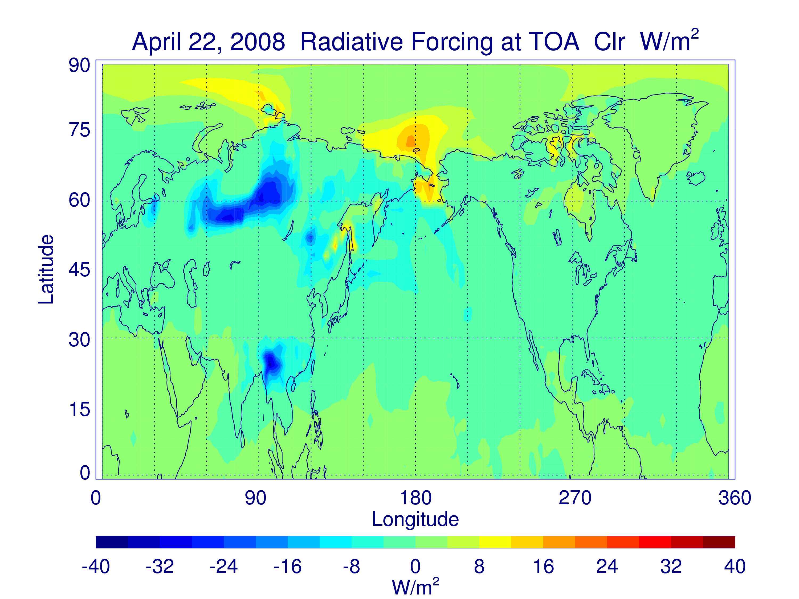
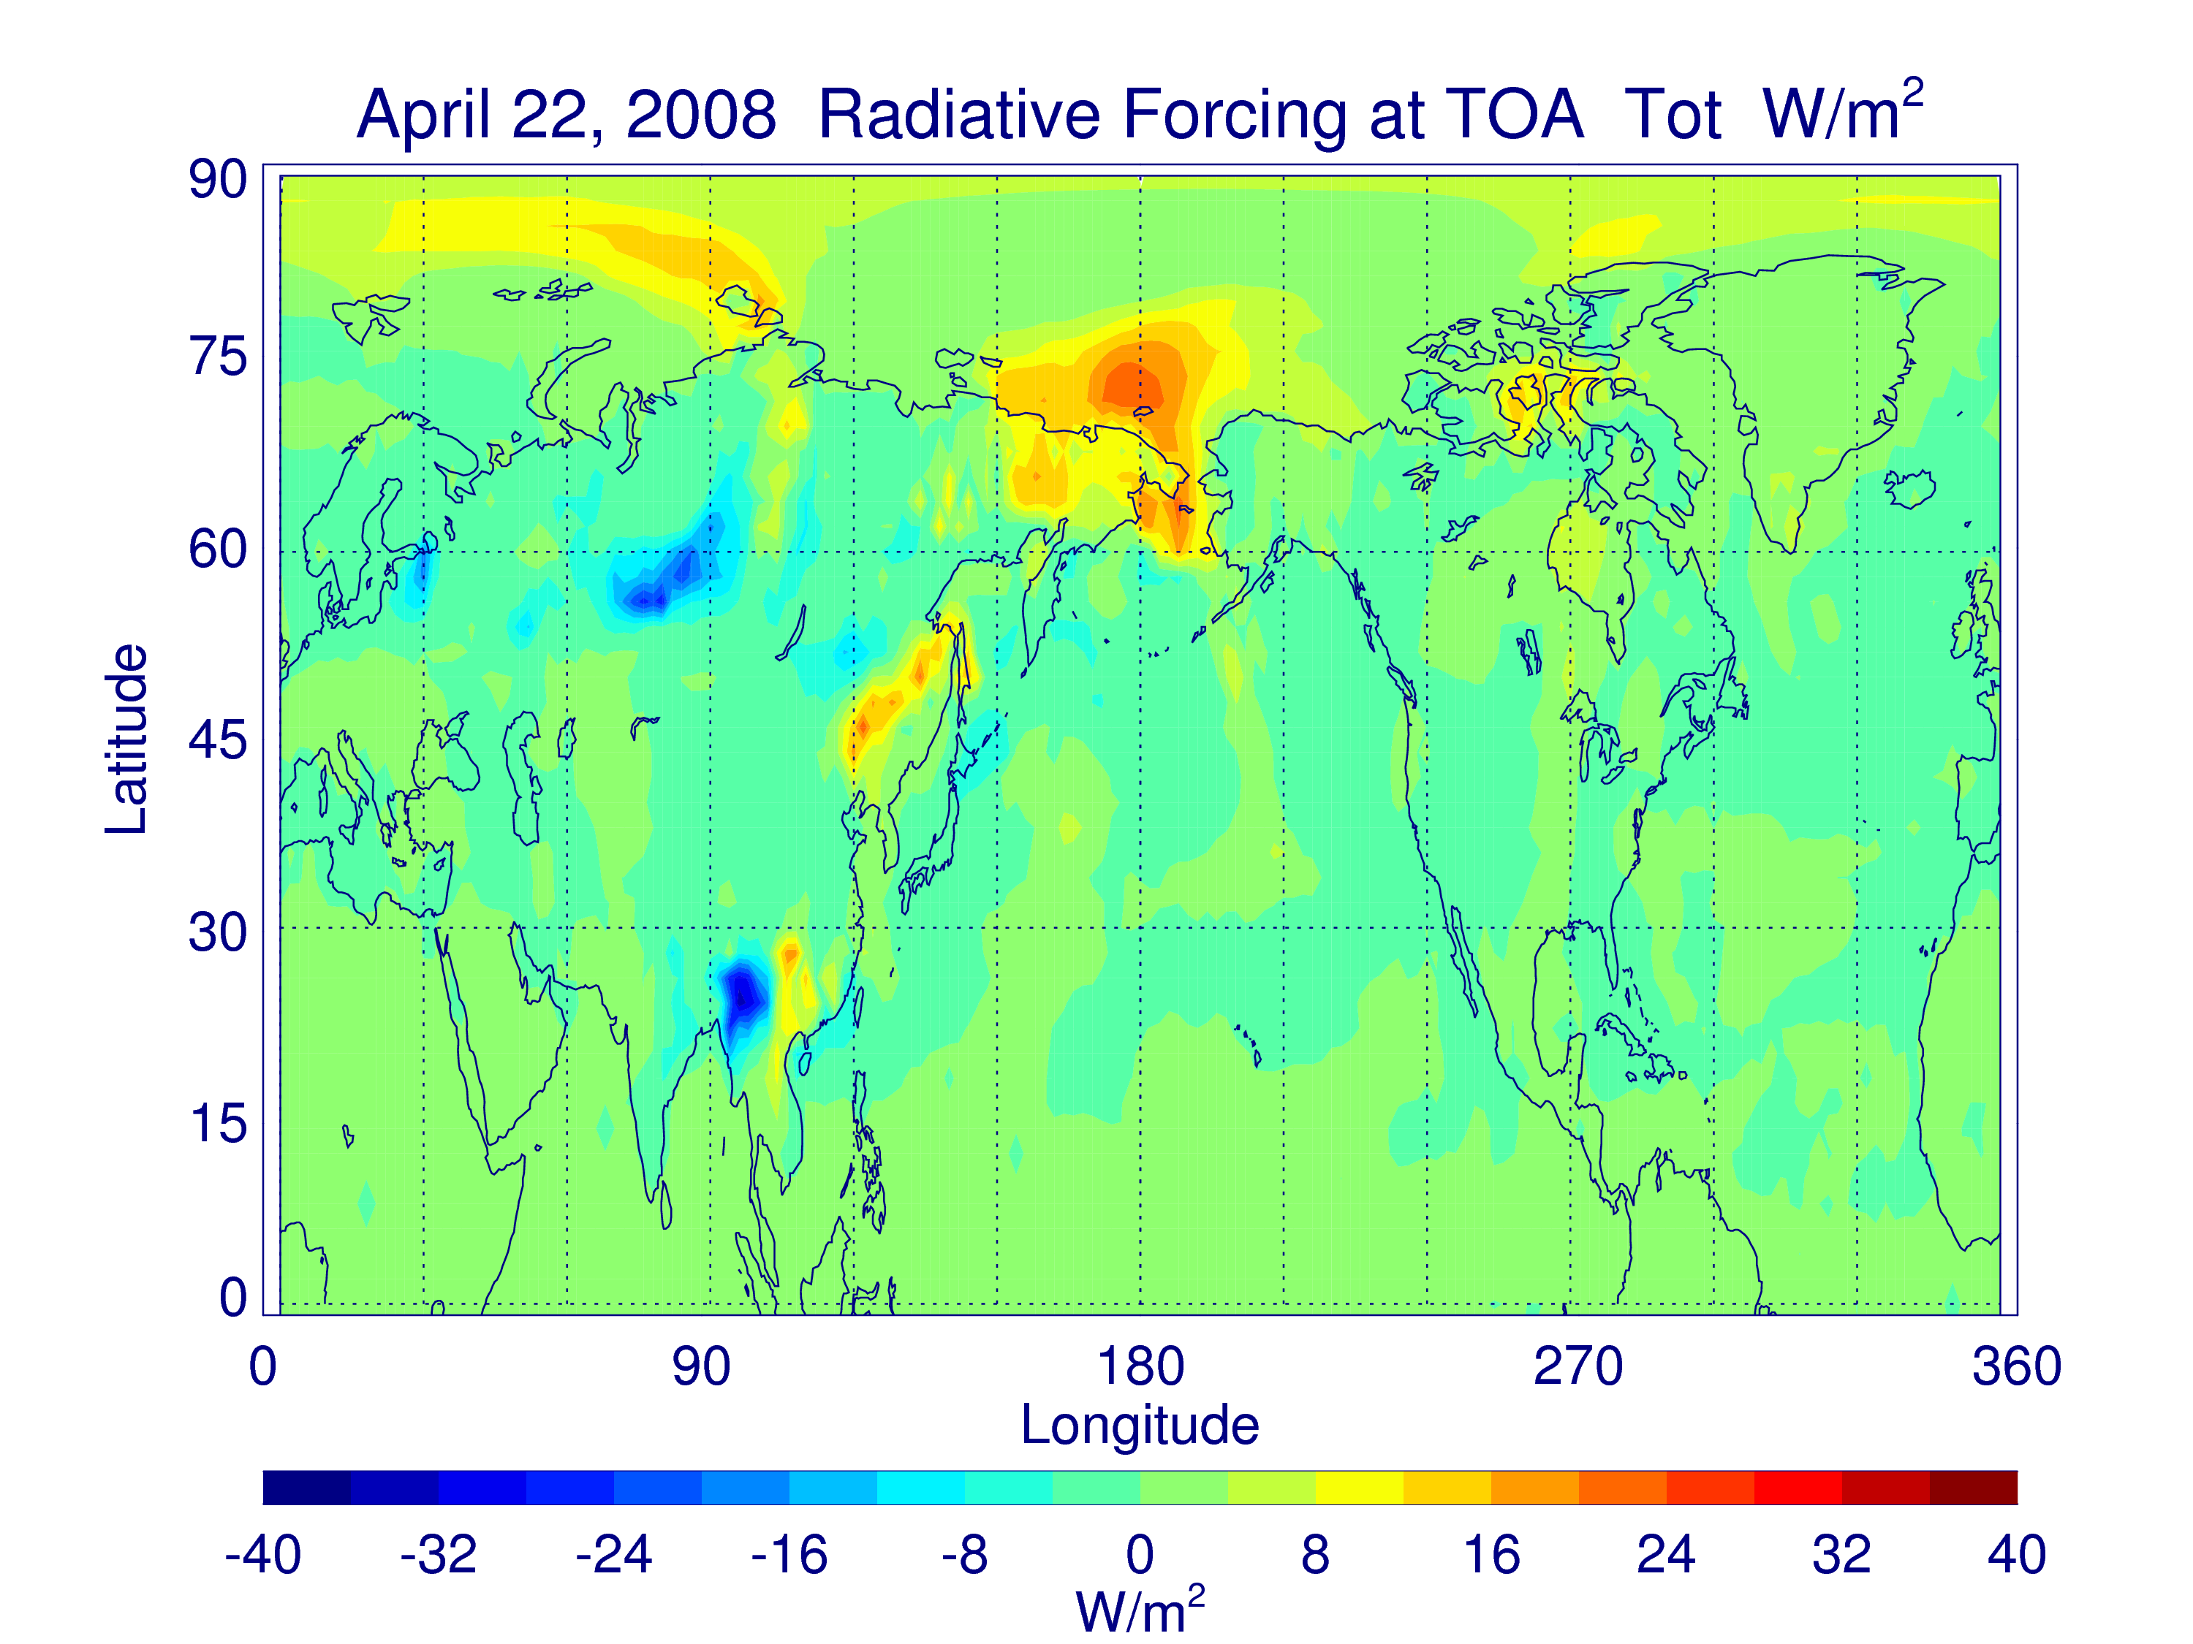
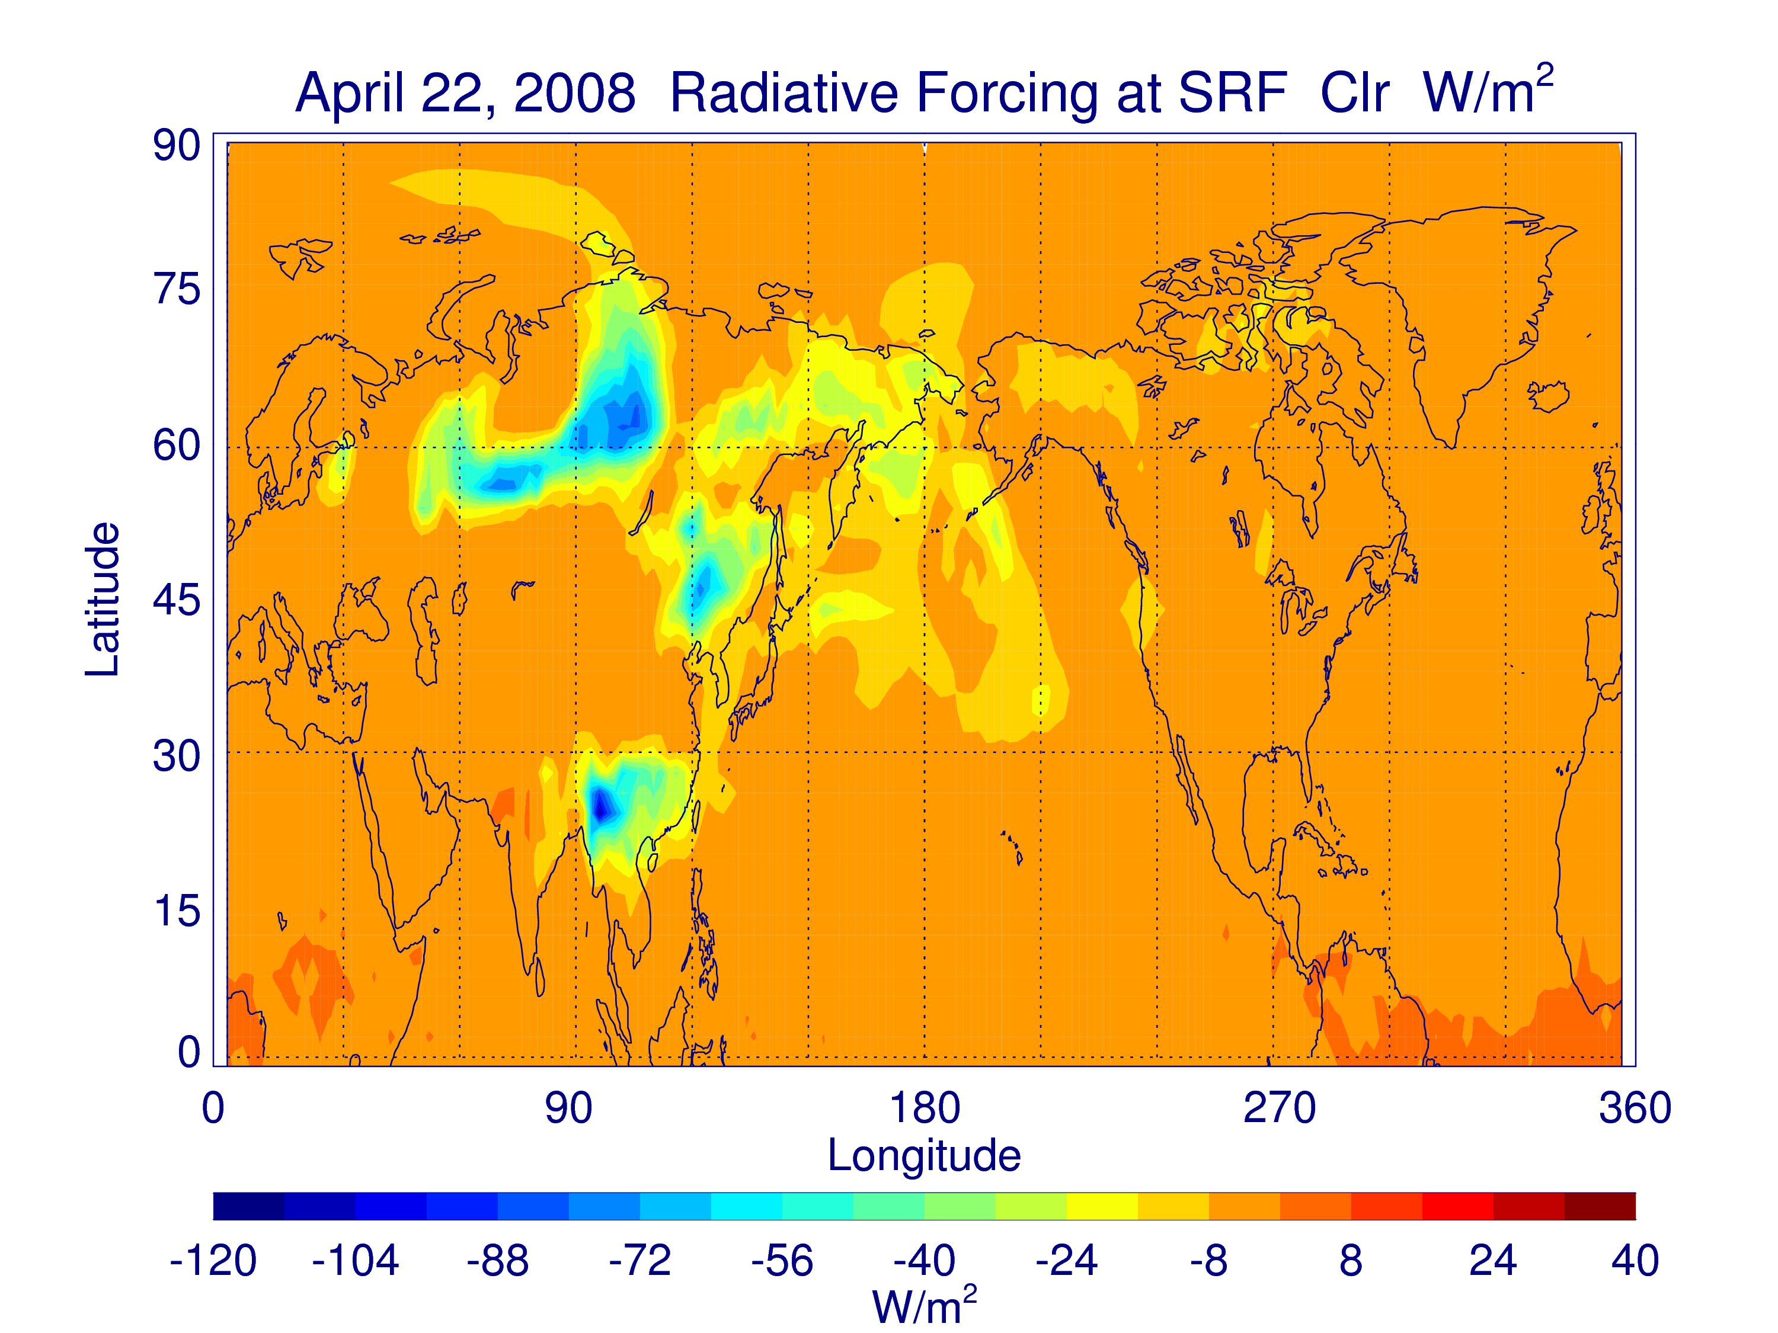
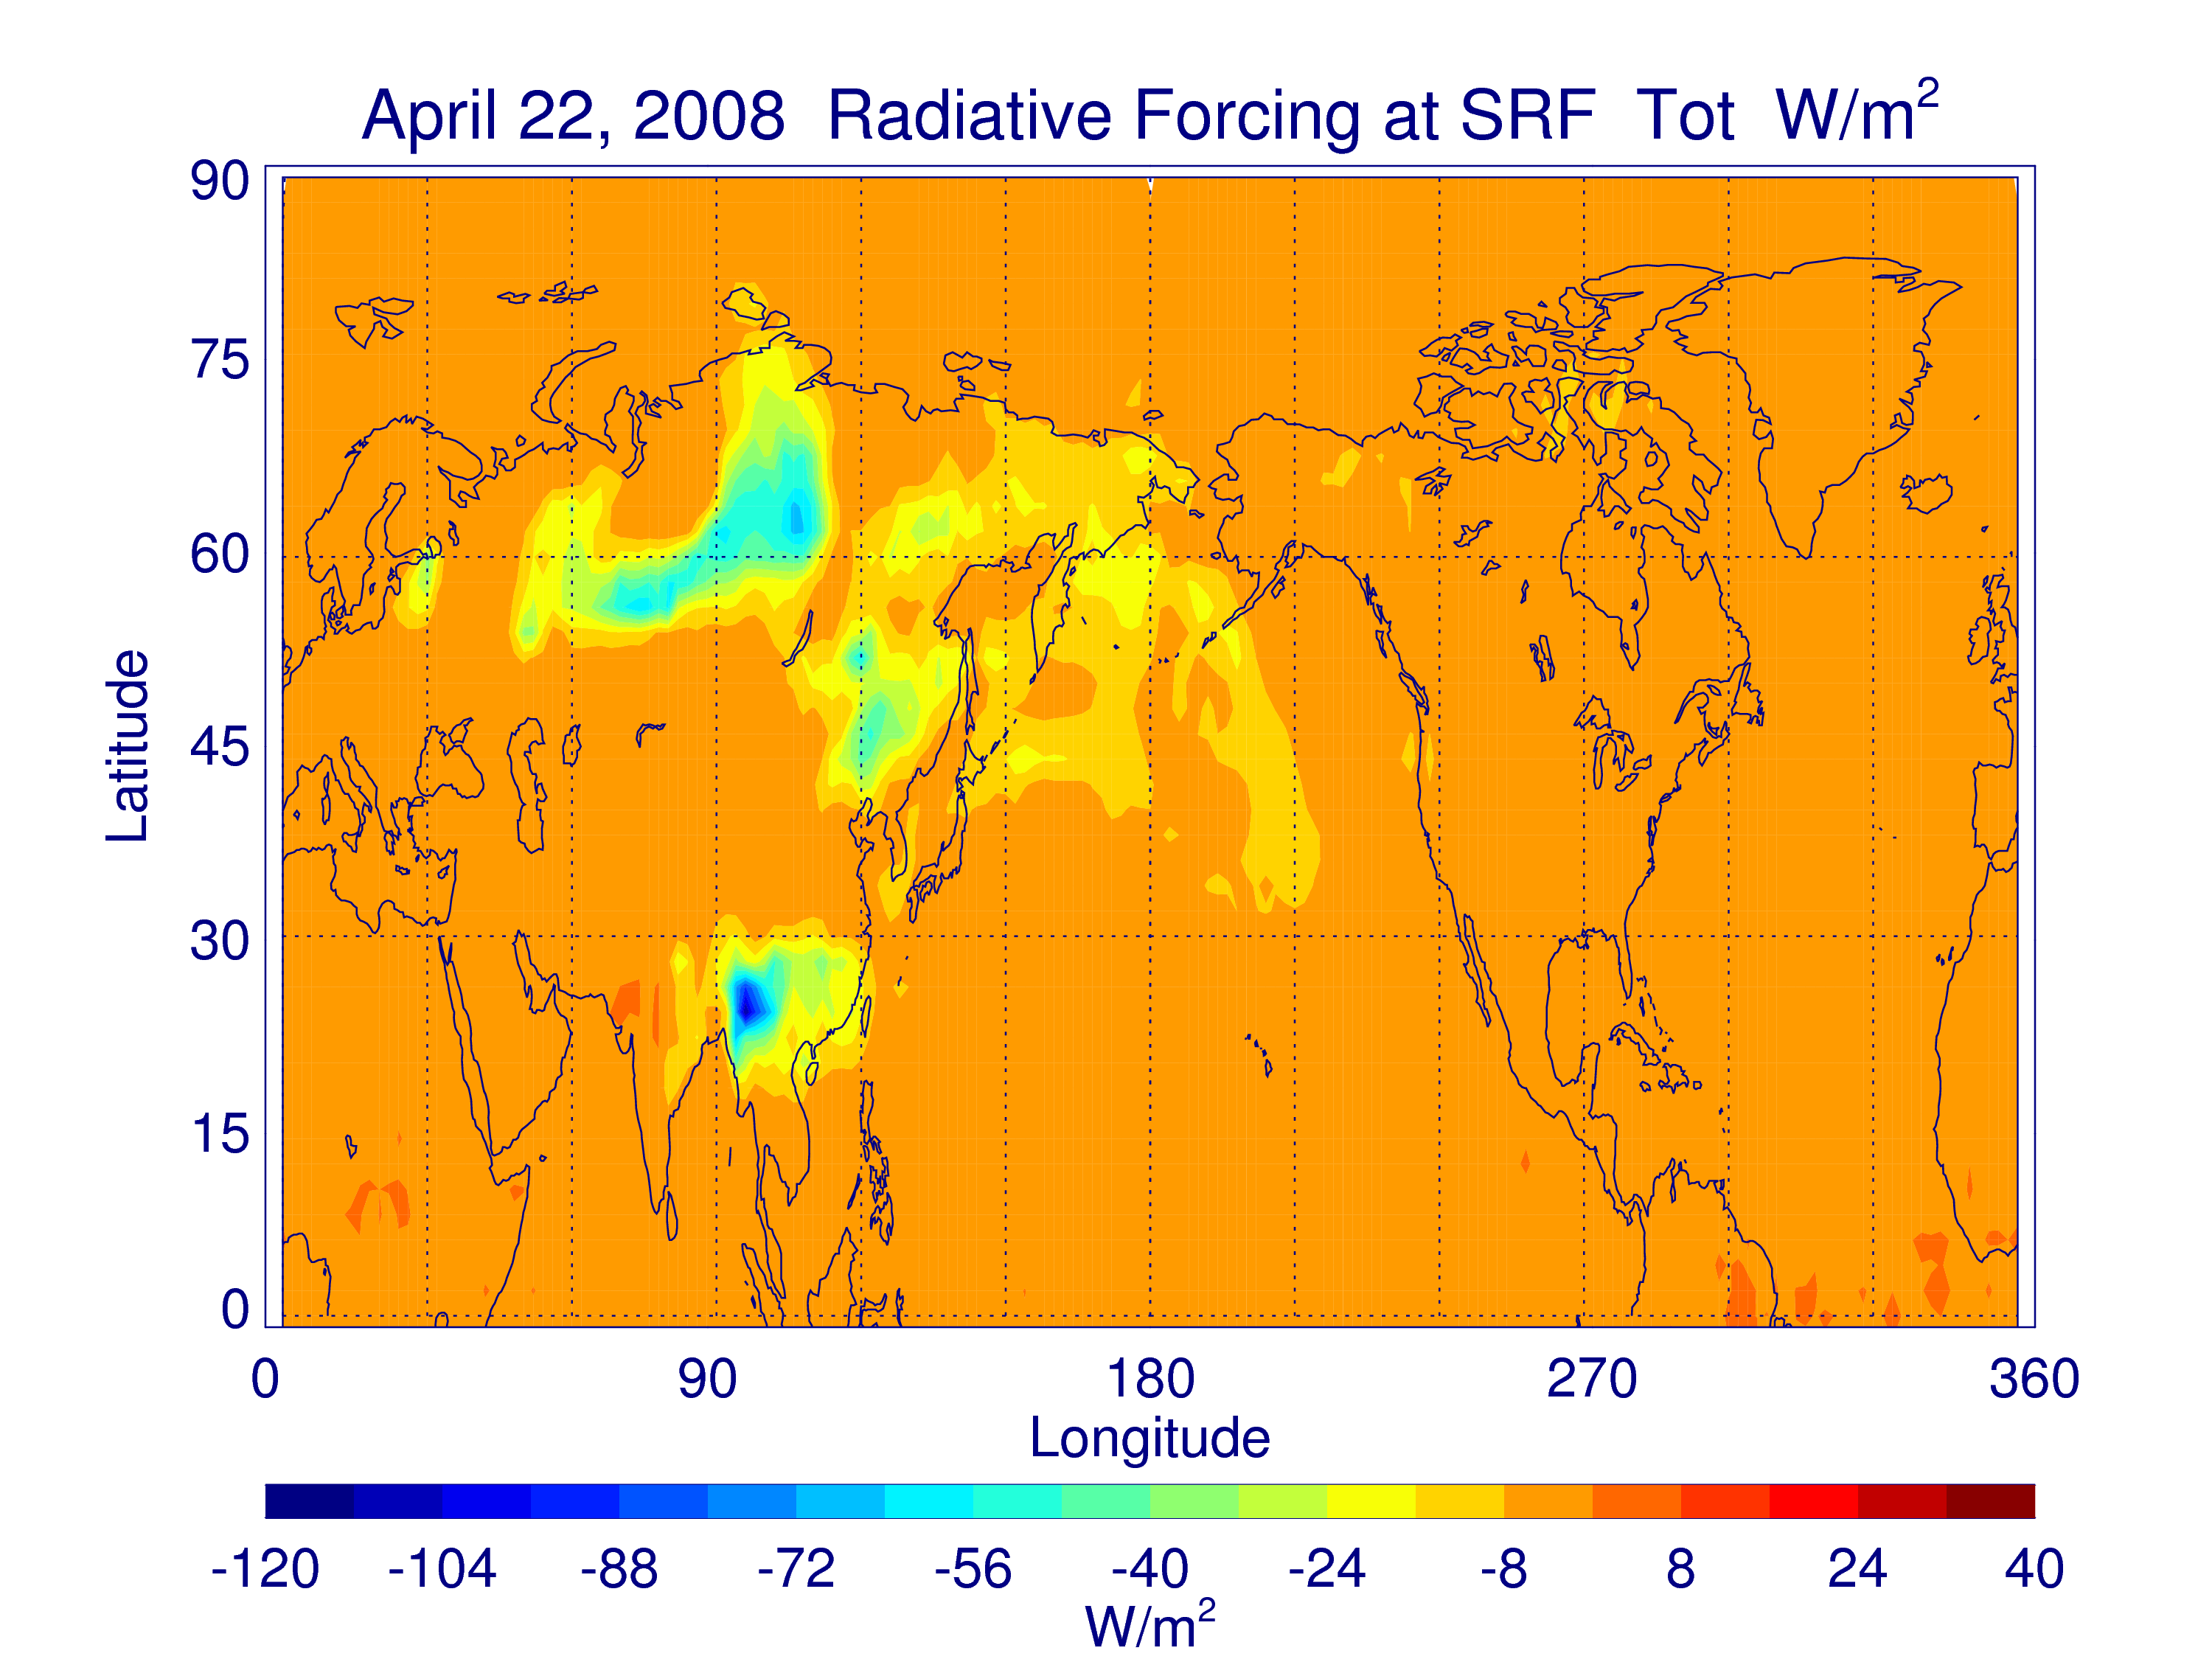

Slide 11
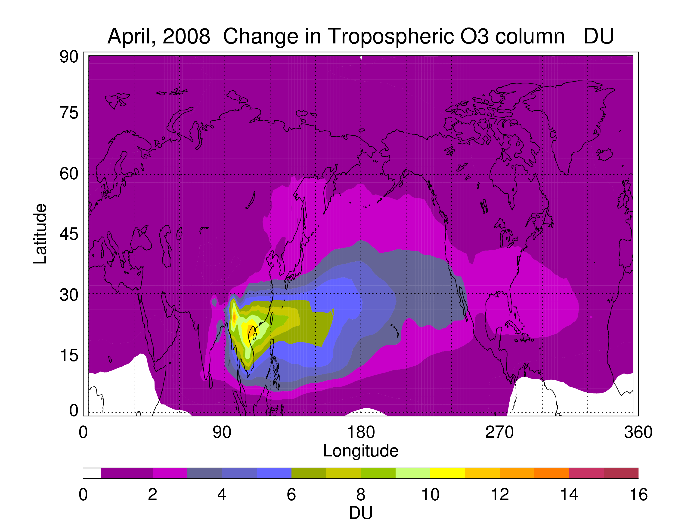
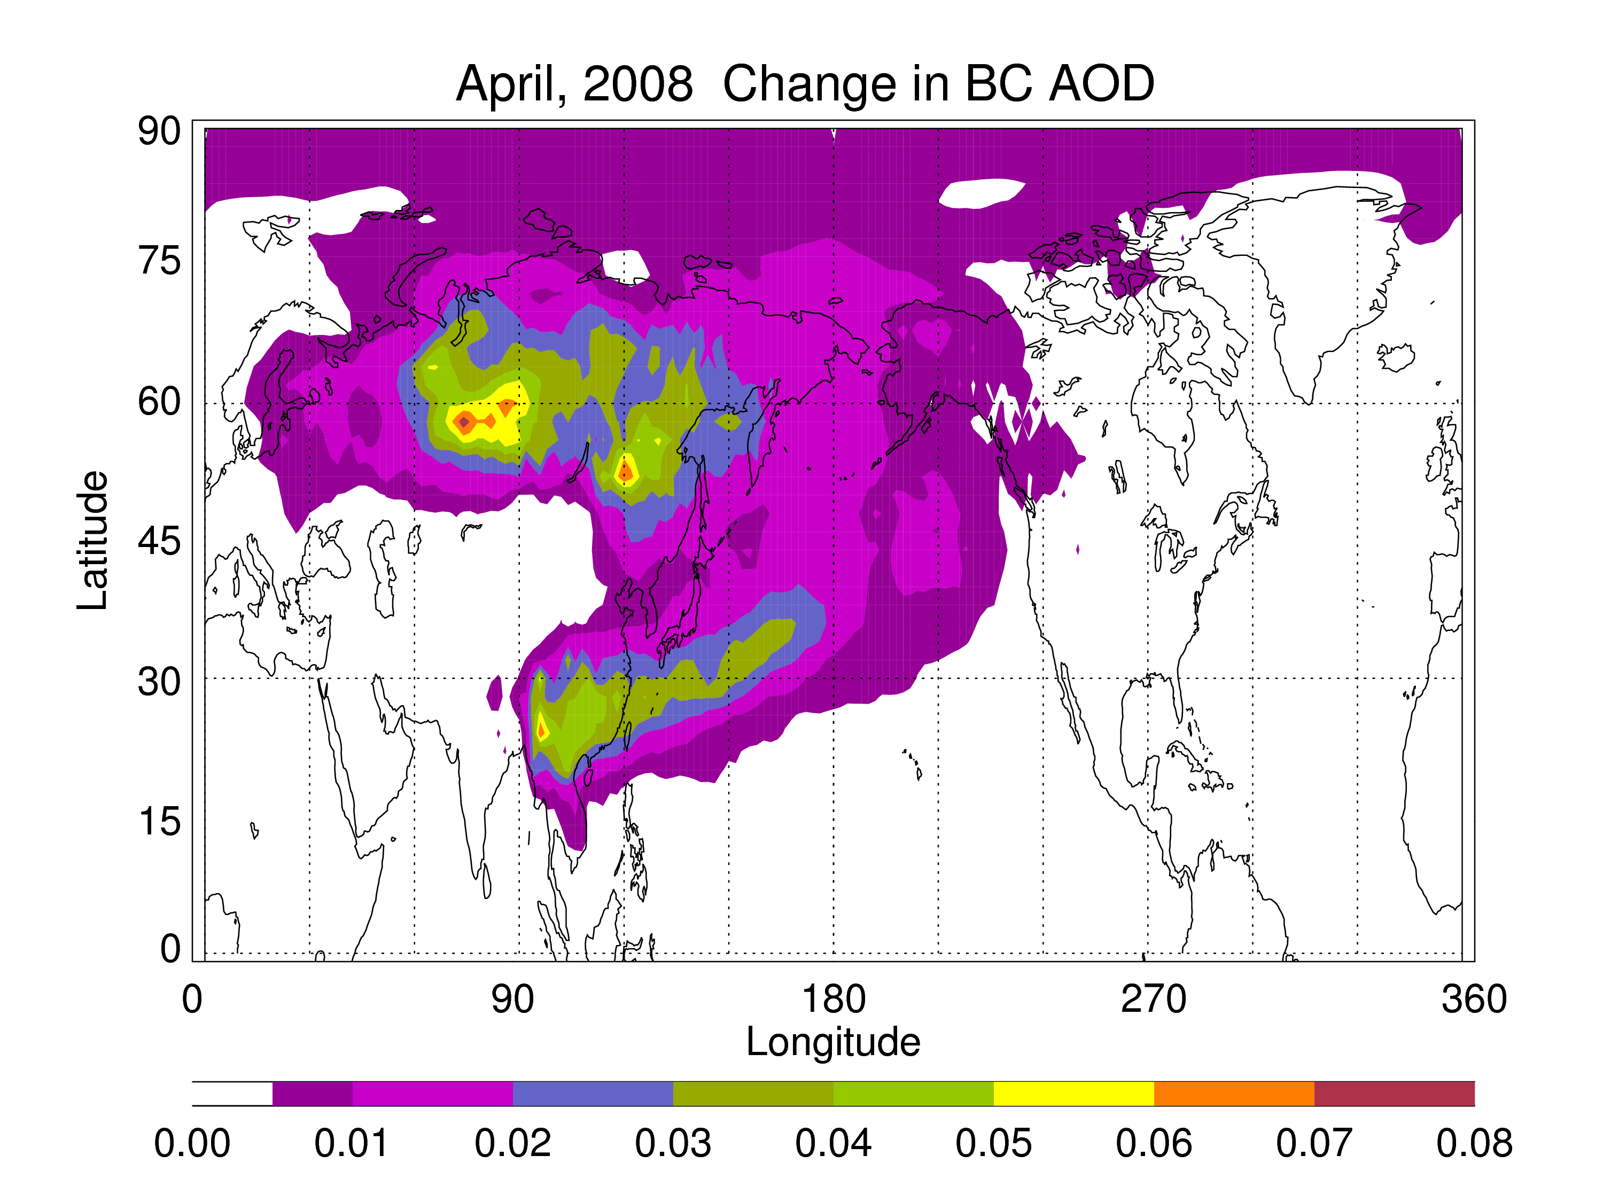
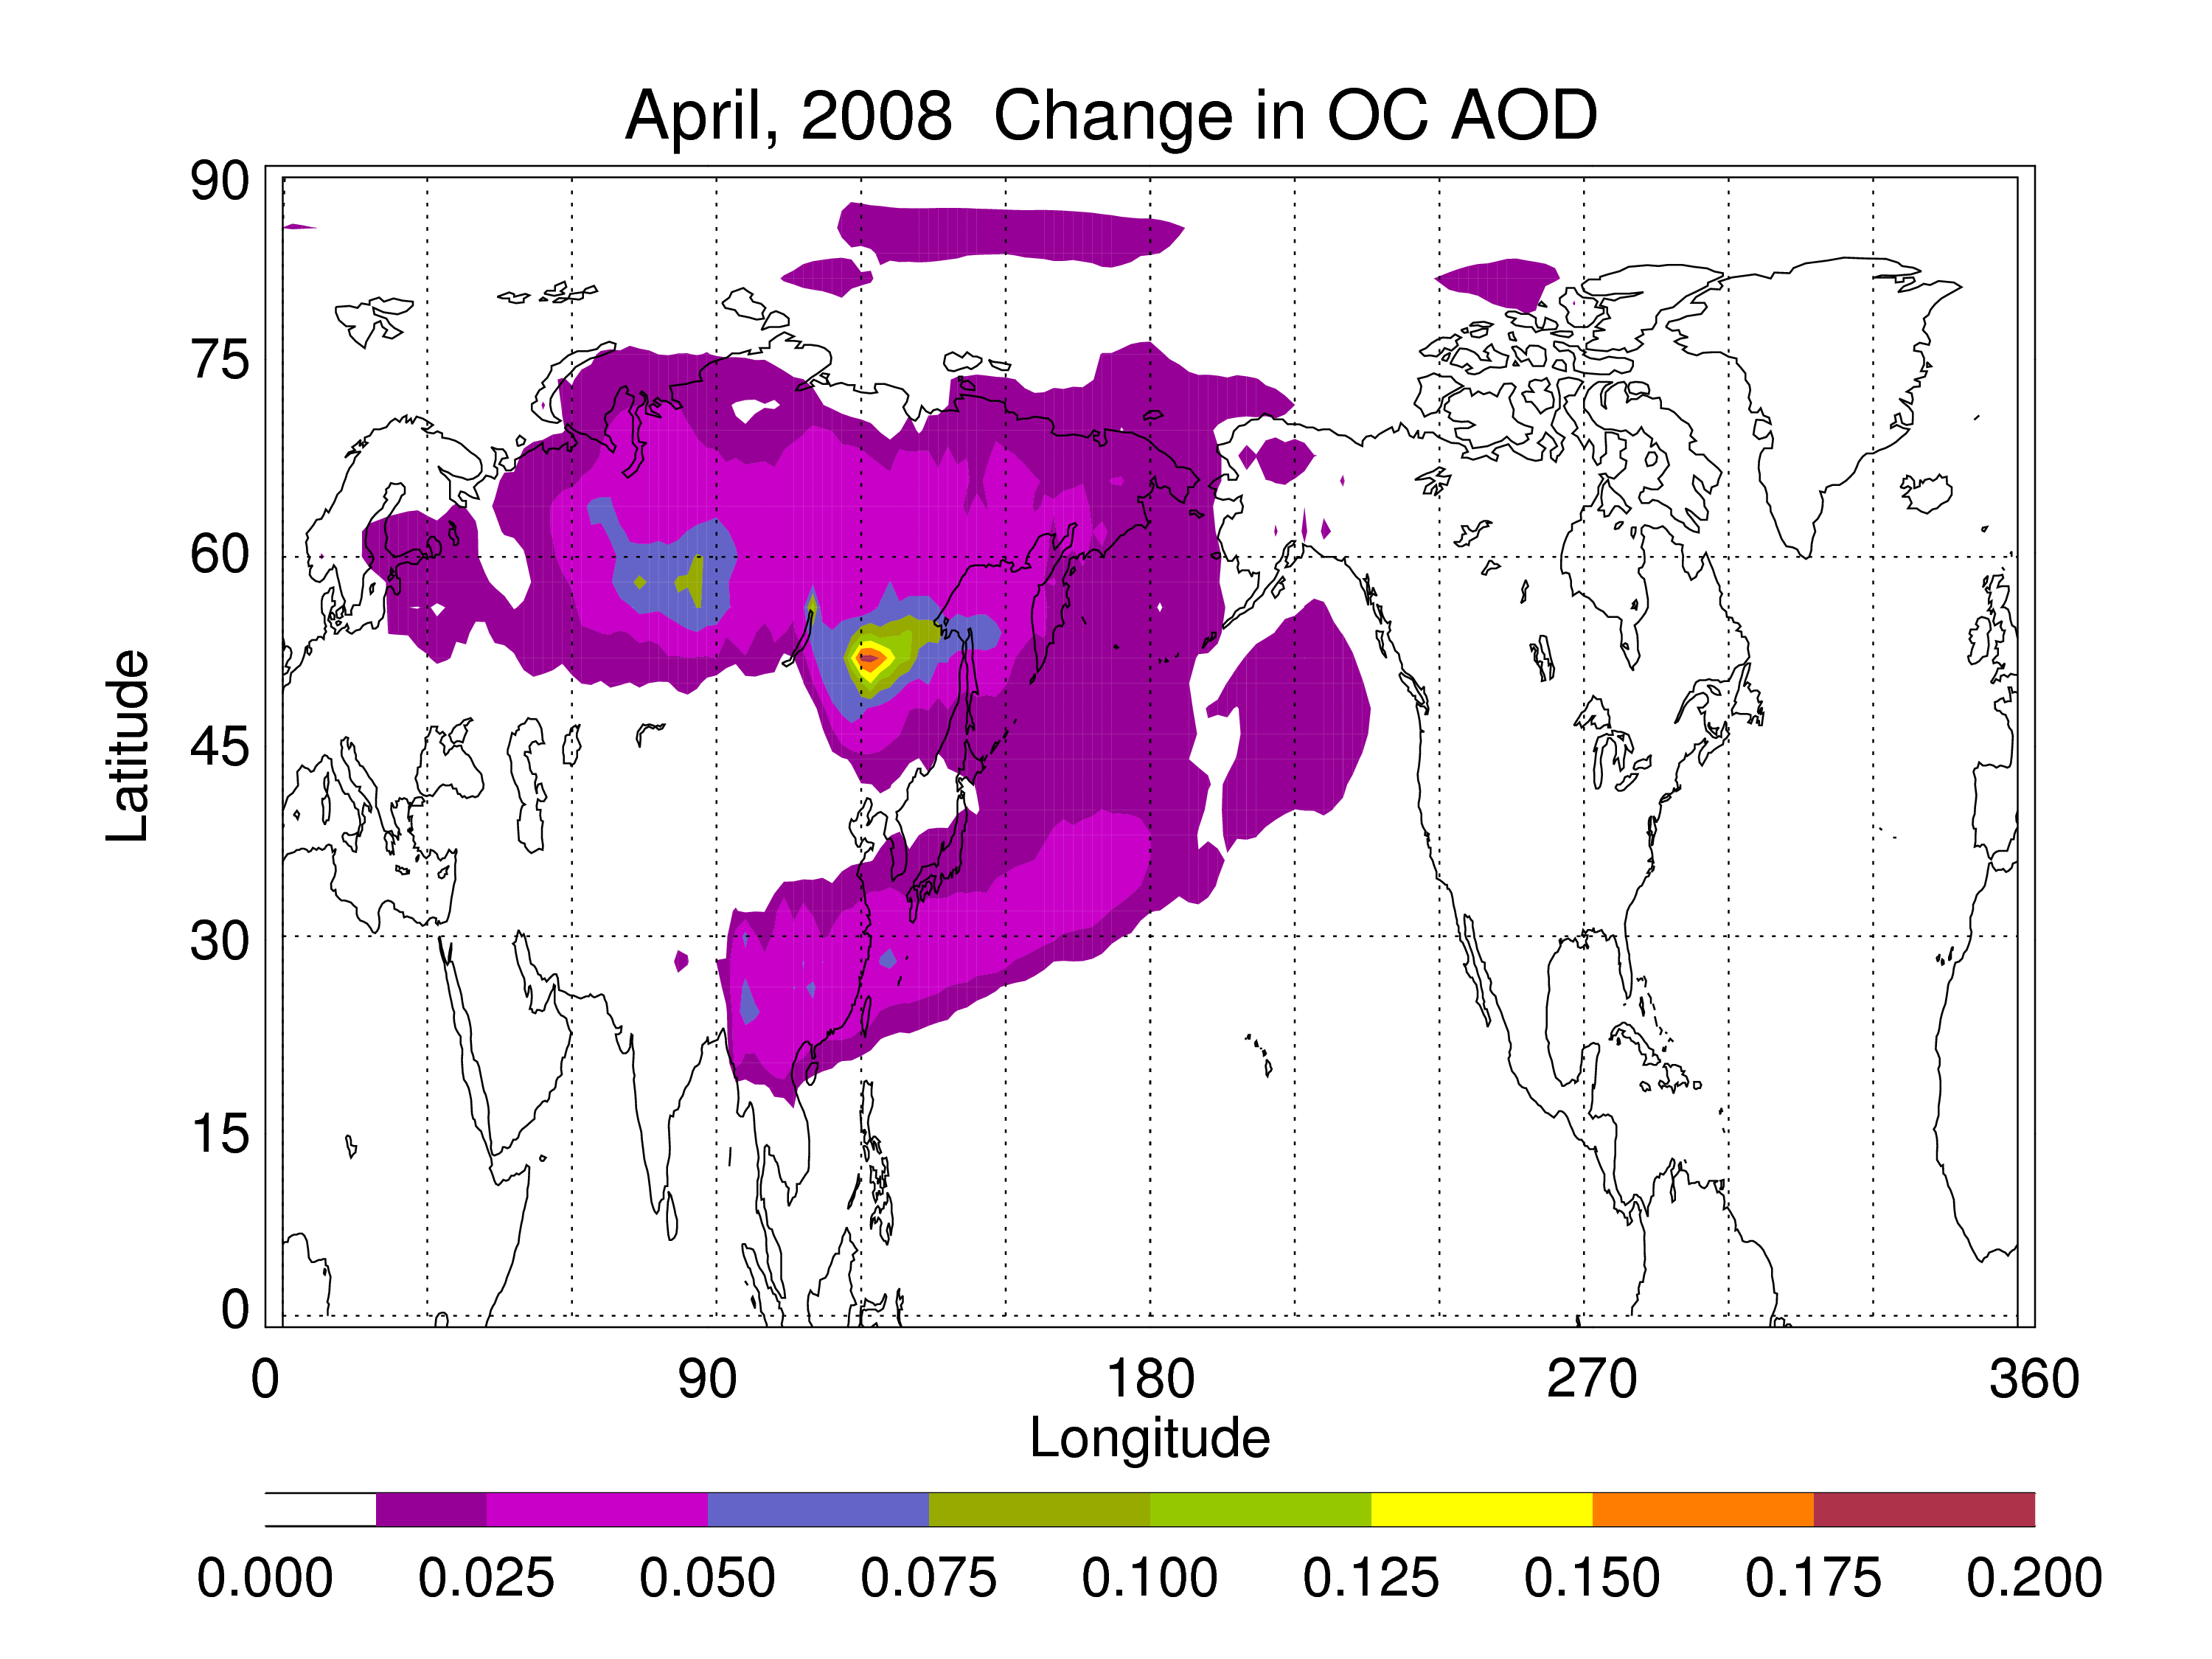
Fig. 11. Same as fig 7, but averaged over April, 2008.

Slide 12
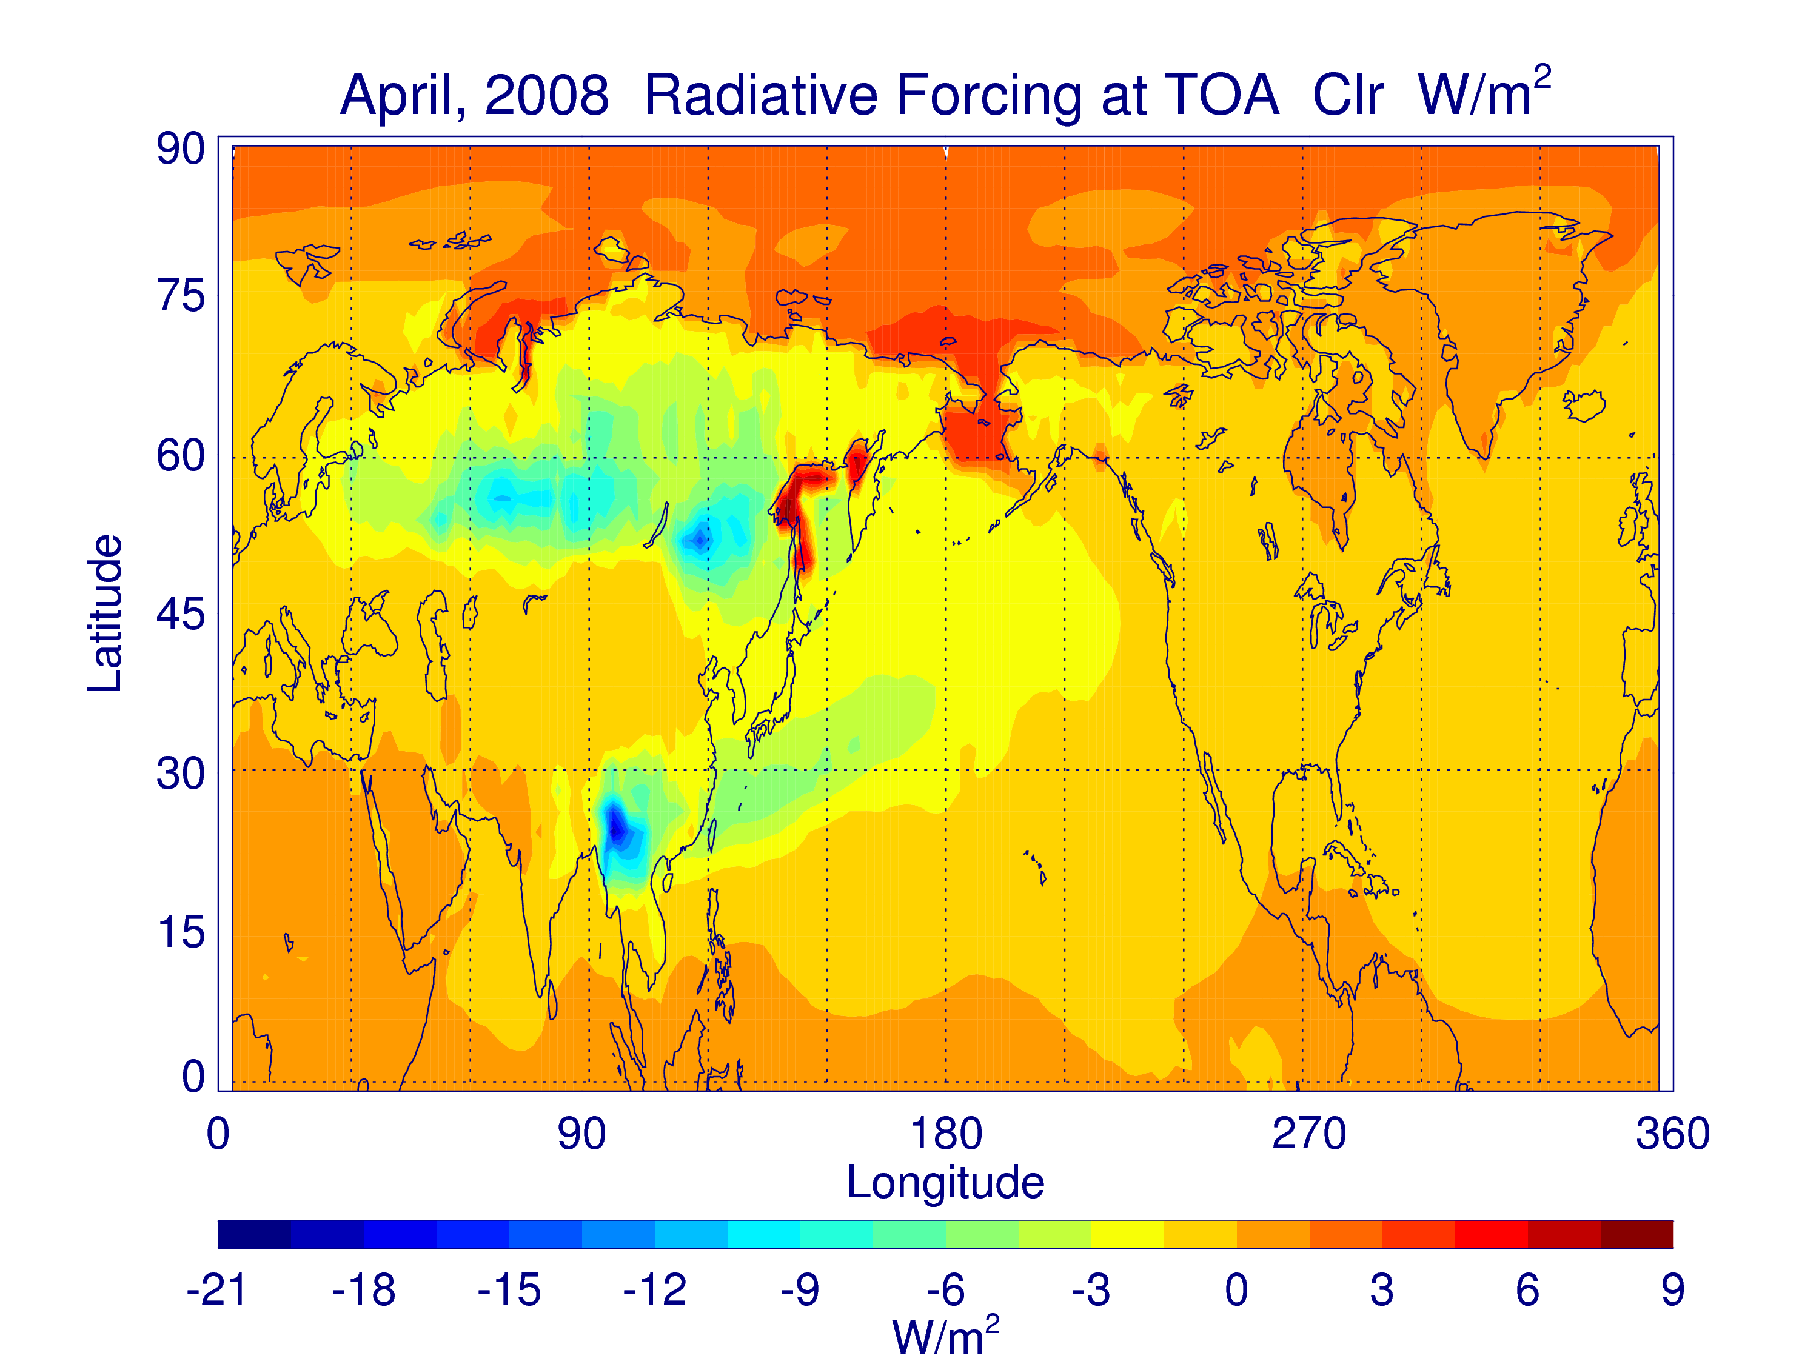
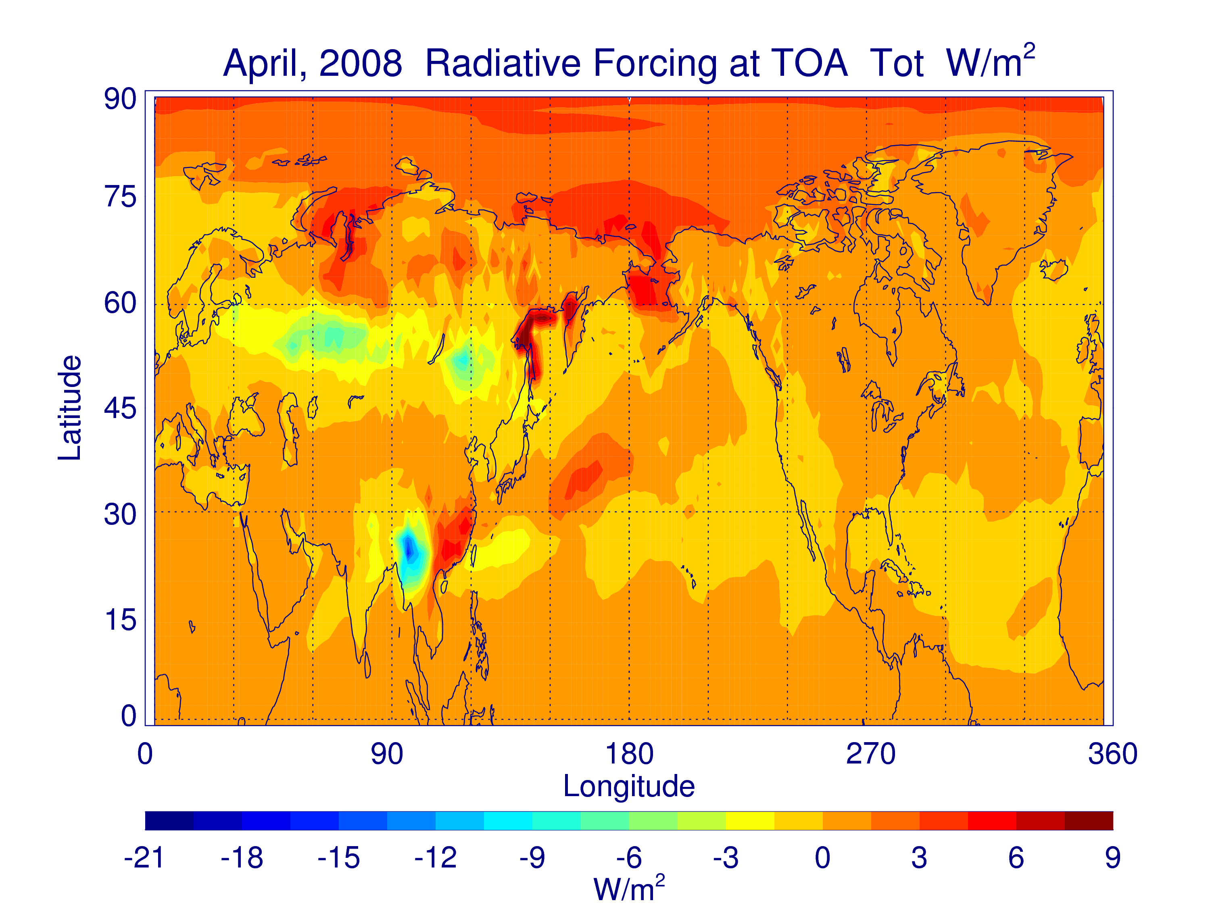
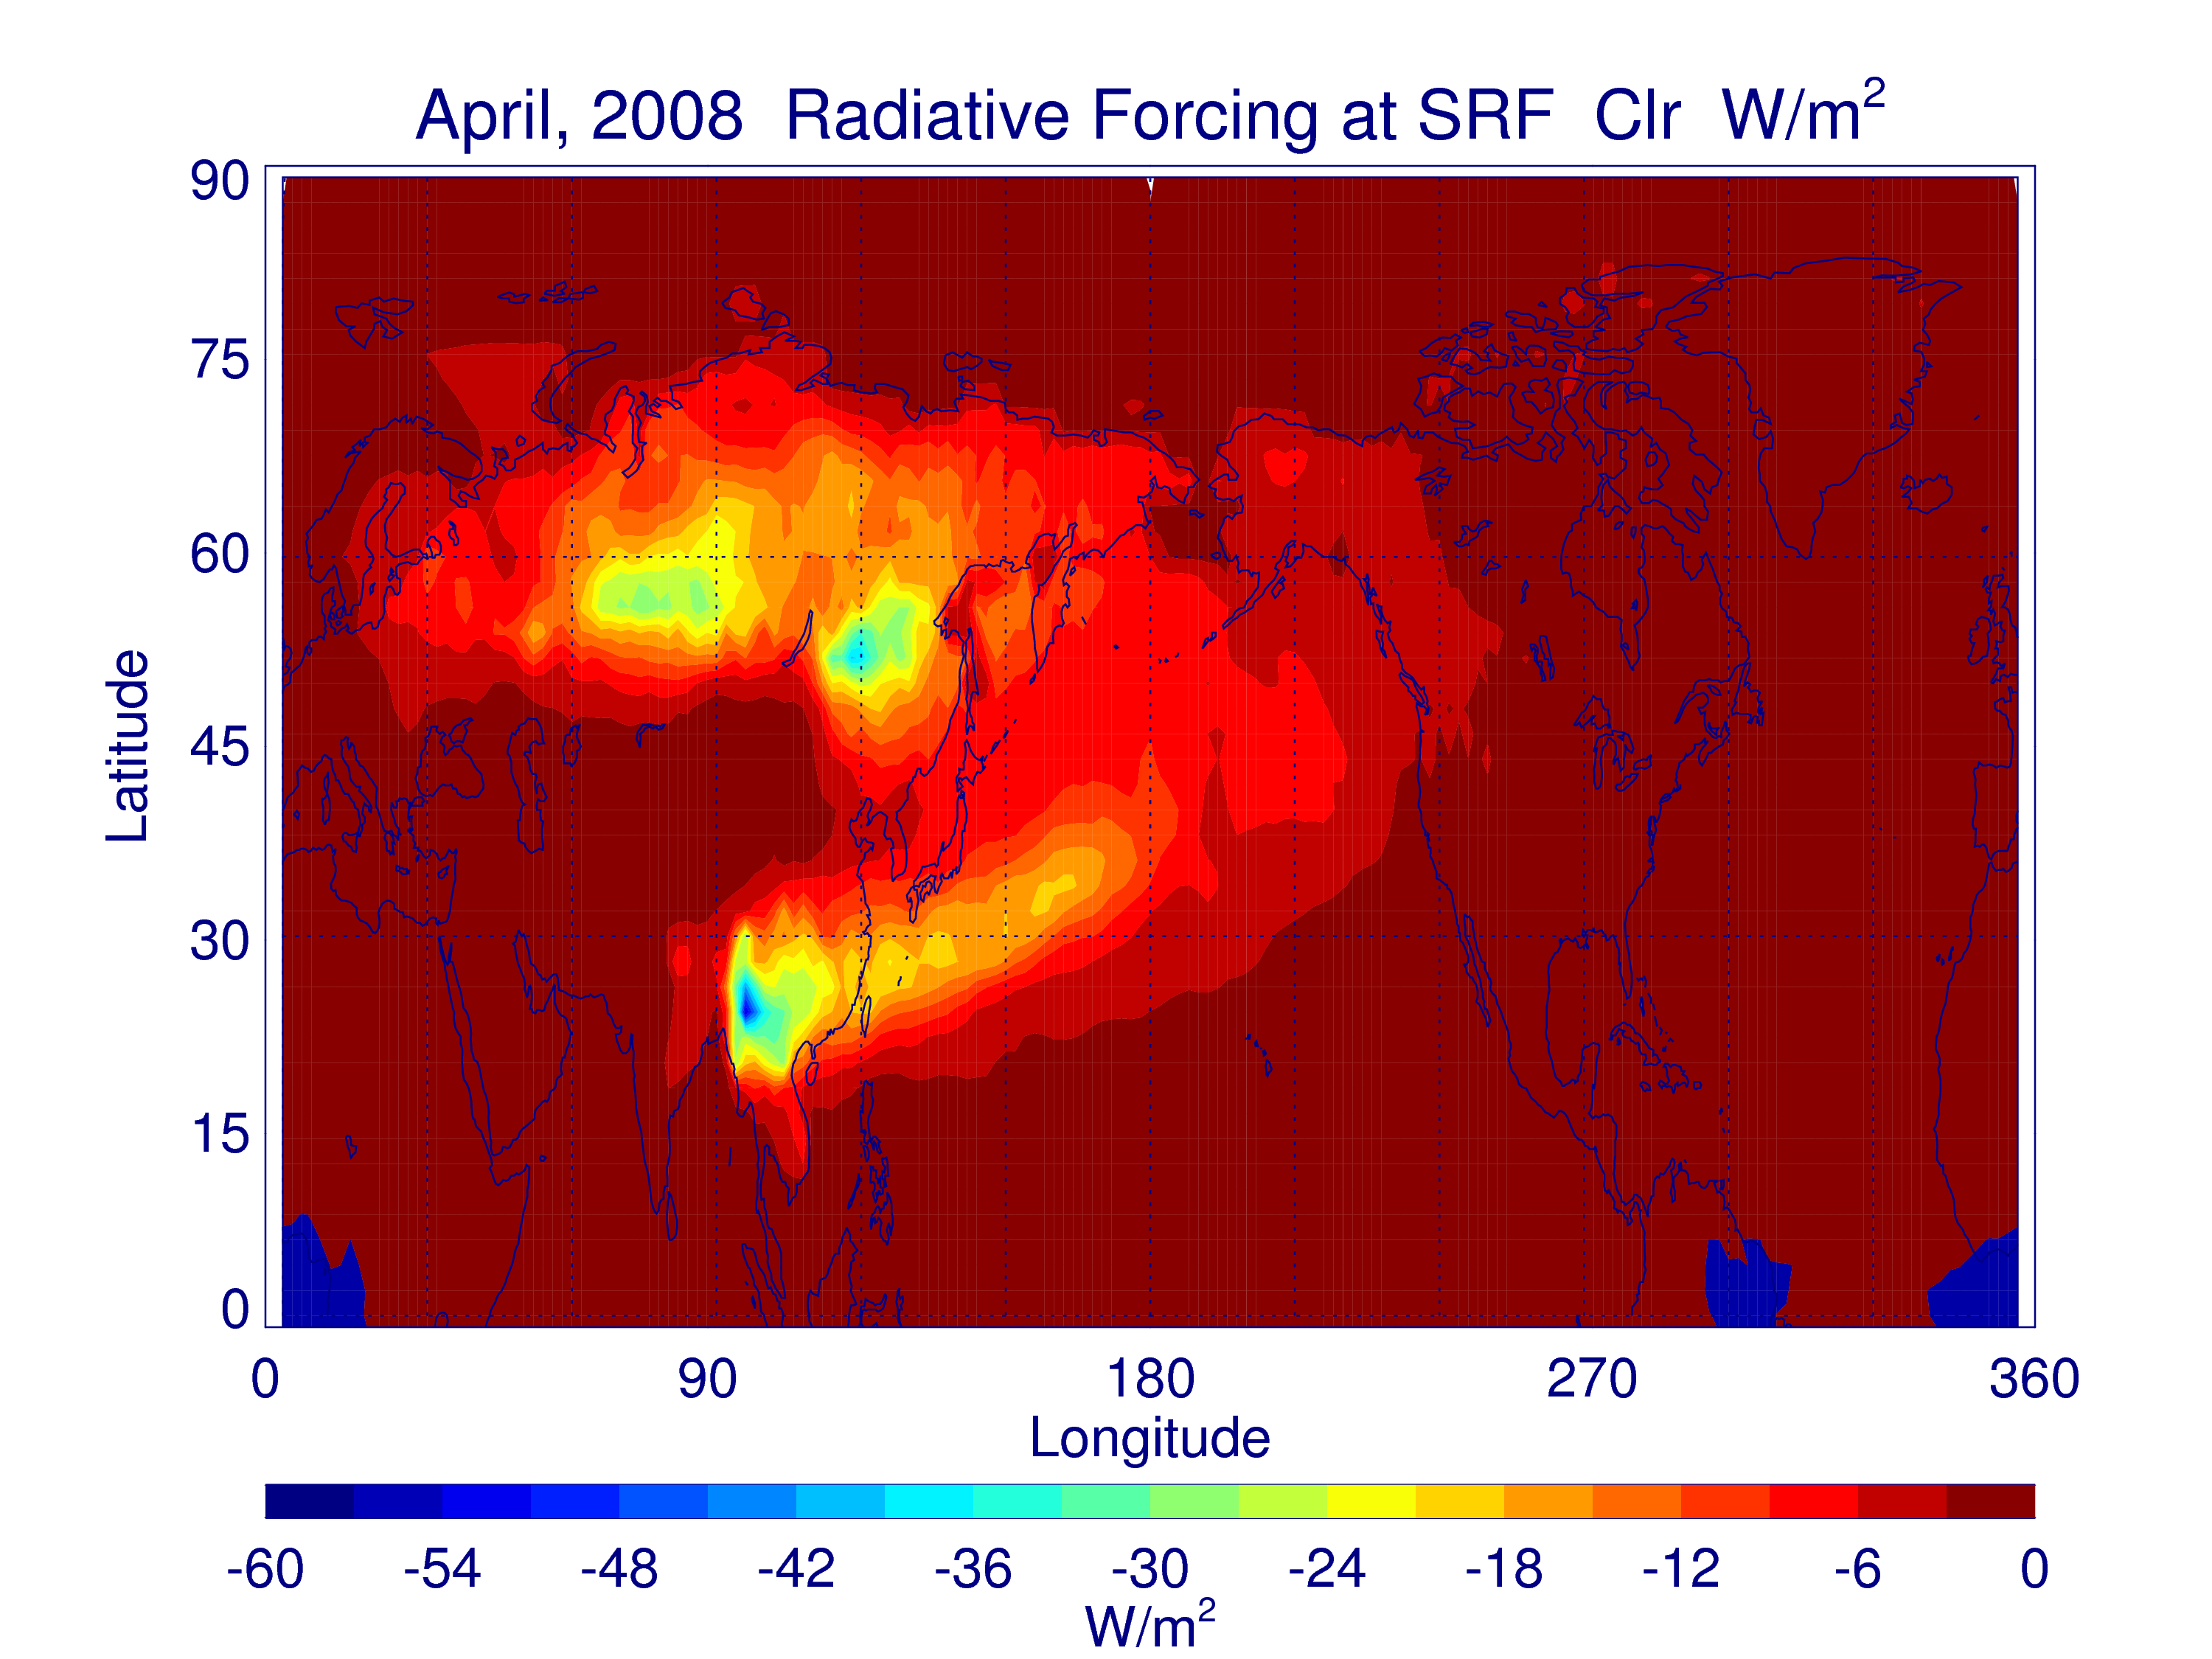
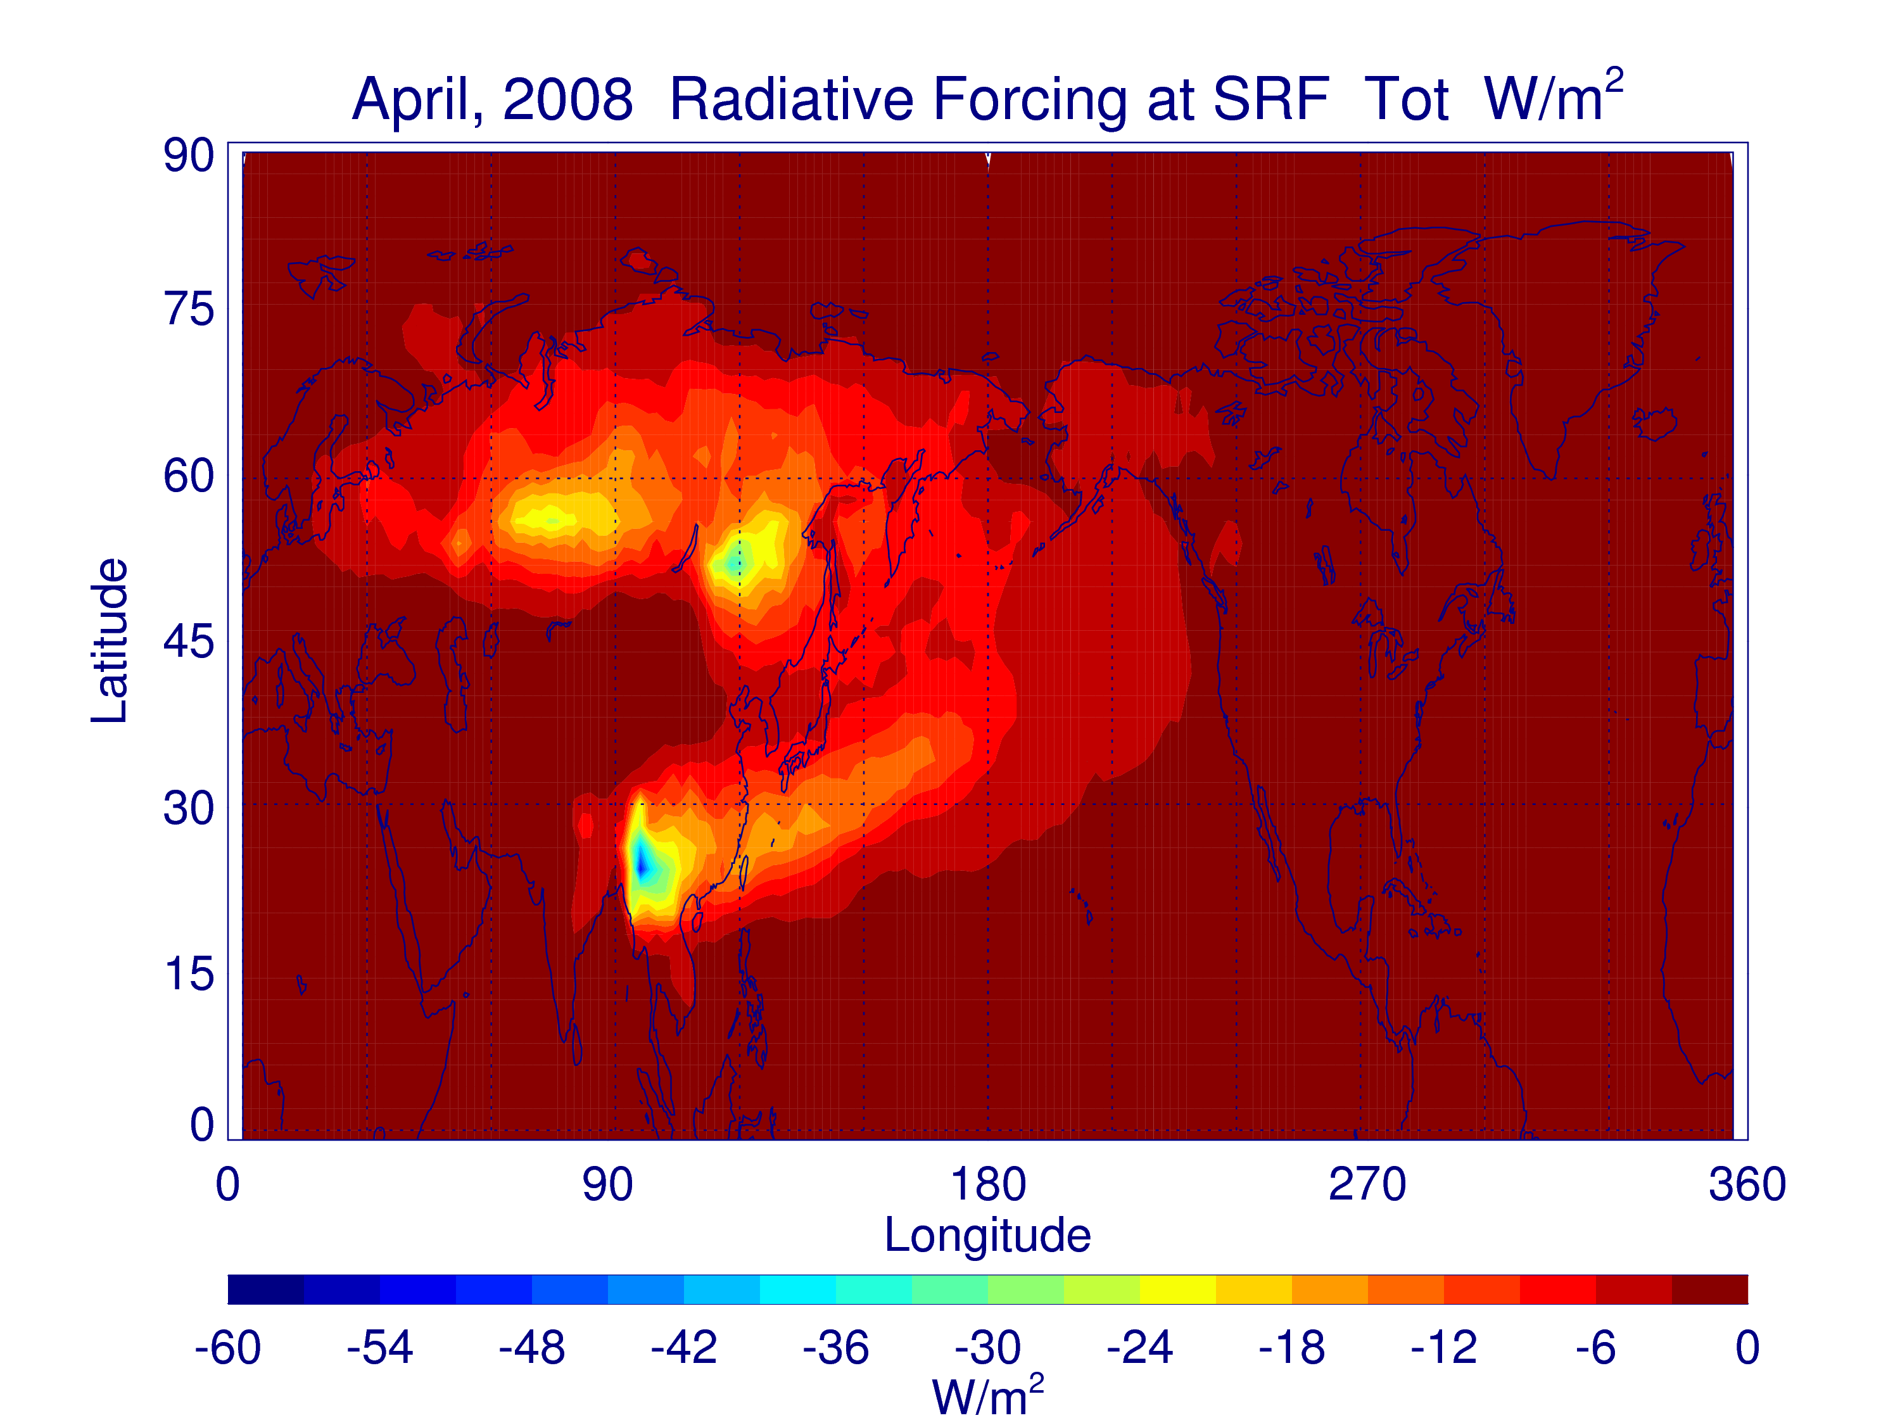

Slide 13
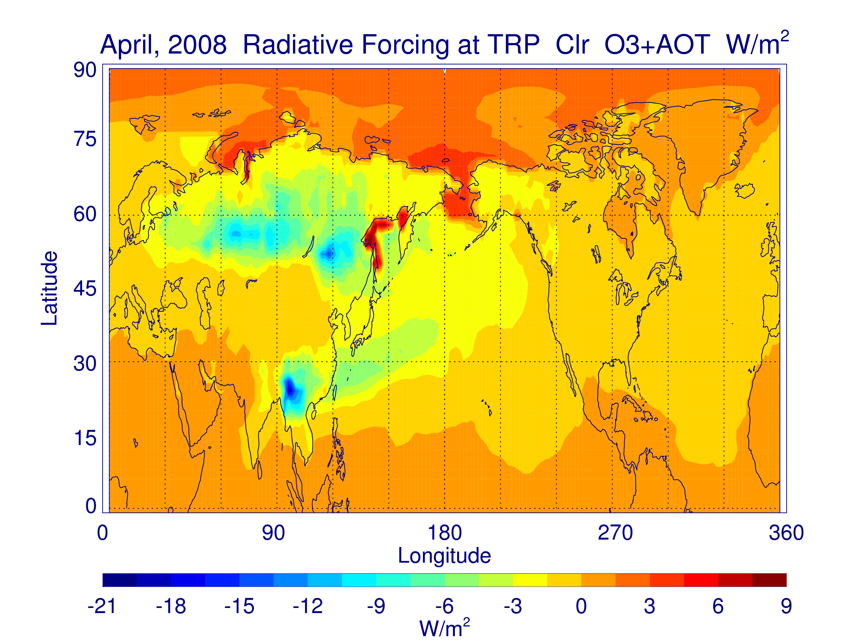
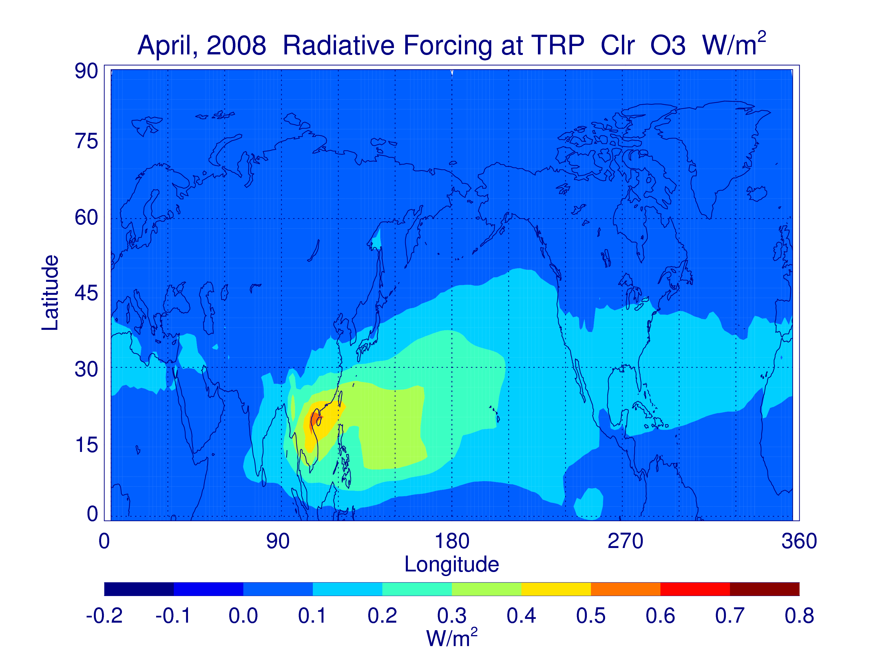
Fig. 13. Radiative forcing at the tropopause due to changes in
O3+AOT (left) and in O3 only (right))
(Note the difference in color scales for the two panels)

