Slide 1
AQAST Tiger Team Project FY2013
Satellite based support for Stratospheric Intrusion Exceptional Event Analysis and Secondary Visibility Standard Implementation Planning
PI:R. Bradley Pierce, NOAA/NESDIS
AQAST Co-Is: Daniel Jacob, Arlene M. Fiore, James Szykman, Greg Carmichael, Tracey Holloway, Steve Ackerman
AQ management contacts: Gail Tonnesen, US EPA Region 8, Patrick Reddy, Air Pollution Control Division, Colorado Department of Public Health & Environment, Donna Kenski, Lake Michigan Air Directors Consortium (LADCO), Tom Moore, Western Regional Air Partnership (WRAP)
Task 1:Provide satellite based support to state and local air quality management for stratospheric intrusion (SI) related exceptional event analysis. (Gail Tonnesen and Pat Reddy POCs)
Develop a RAQMS public website with products adapted for SI forecasting in Western US and evaluate its effectiveness during spring 2013 SI.
Add capabilities to IDEA-I to produce trajectory based SI forecasts initialized with real-time Satellite ozone retrievals.
Conduct retrospective nested high resolution RAQMS/WRF-CHEM SI forecasts for May 2010 and 2012 and provide assessment to the EPA SI Working Group.
Task 2: Provide satellite based support to regional air quality management agencies for developing implementation plans for the regional haze midcourse review and potential new secondary fine particle standard for urban visibility. (Donna Kenski, Tom Moore, POCs)
Implementation of the GOES-R aerosol visibility algorithm into IMAPP for realtime delivery and generation of retrospective (2011-2012) GOES-R aerosol visibility retrievals. (MODIS V5 AOD algorithm within IMAPP is outdated and biased relative to regression)
Comparison of GOES-R visibility retrievals, ASOS, IMPROVE and CSN visibility to GEOS-CHEM 2011-2012 nested-grid model fields during 2011-2012 provided by Daniel Jacob under his IP effort. (Awaiting TT funding)
Comparison of GOES-R visibility retrievals, ASOS, IMPROVE and CSN visibility to estimates from regional AOD/PM2.5 assimilation for selected case studies determined by LADCO, Region 8, Colorado Department of Public Health & Environment , and WRAP management and conducted by Greg Carmichael (supported in part under this Tiger Team proposal). (Awaiting TT funding)
Delivery of retrospective GOES-R aerosol visibility retrievals to the EPA Remote Sensing Information Gateway (RSIG) for use by regional air quality management. Jim Szykman is the RSIG PI. (Awaiting TT funding)

Slide 2
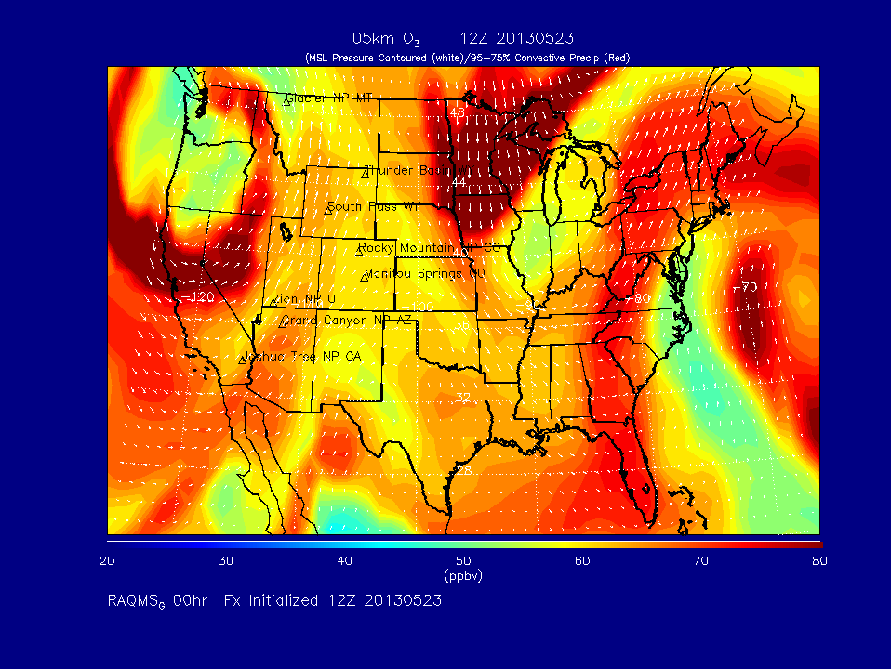
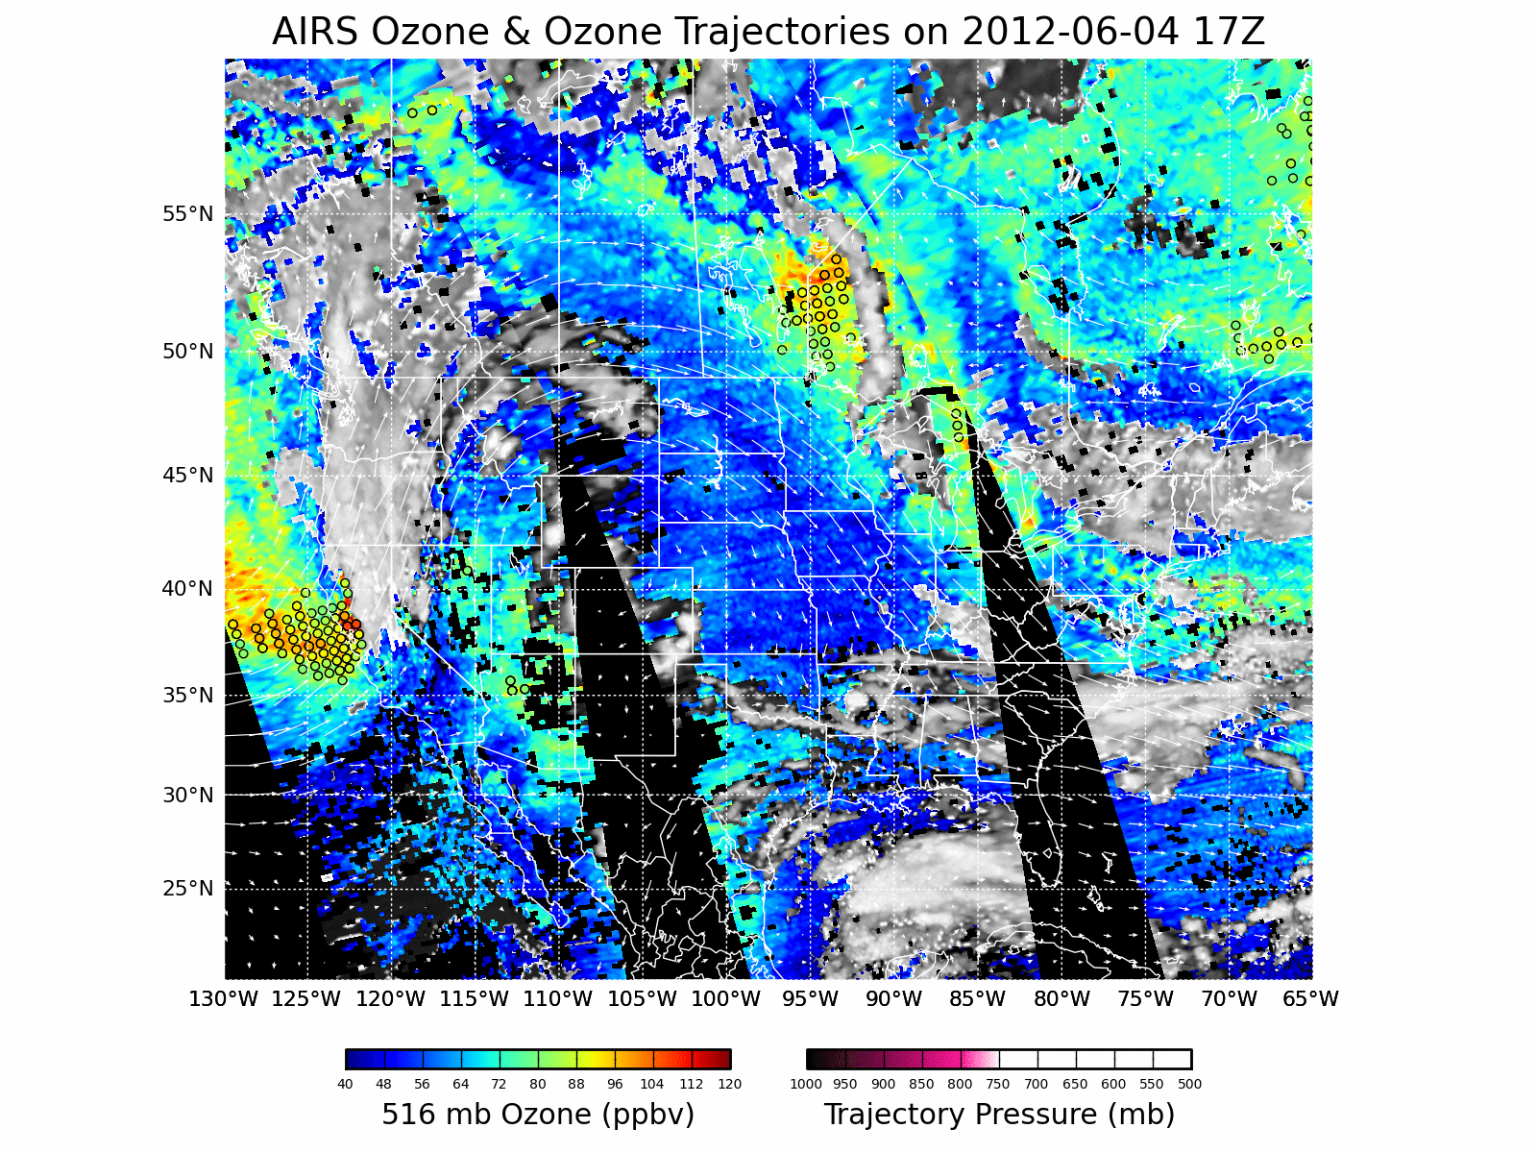
Preliminary Results
http://deq.state.wy.us/aqd/Exceptional%20Events/June_6_2012ThunderBasin/
June_6_2012_SI_Package.pdf
Results from Real-time Air Quality Modeling System (RAQMS) ozone analyses and Lagrangian trajectory analysis were used determine the genesis of a stratospheric intrusion (SI) event observed by the NASA Ames Alpha Jet Atmospheric eXperiment (AJAX) over California on June 5, 2012 that led to surface ozone exceedances on June 6, 2012 at the Thunder Basin ozone monitor in NE Wyoming.
http://raqms.ssec.wisc.edu/forecast/calendar/
RAQMS daily forecasts have been provided to EPA SI working group members during SI event periods to provide guidance for coordinated airborne (AJAX, NASA/Ames) and ground based (JPL Table Mountain Lidar Facility, NOAA/ESRL LVOS Lidar) measurements to support 2013 Exceptional Event demonstration.
http://sunset.ssec.wisc.edu/idea-test2/
The Infusing Satellite Data Into Environmental Applications - International (IDEA-I) SI forecast is being developed under the Community Satellite Processing Package (CSPP) and is IDEA-I AIRS, CrIS, and IASI SI forecast capability is currently being beta tested at CIMSS using the UW-Madison Dual Regression retrieval.

