Slide 1
Weather History for KMKE: July 17, 2011 (http://www.wunderground.com)

Slide 2
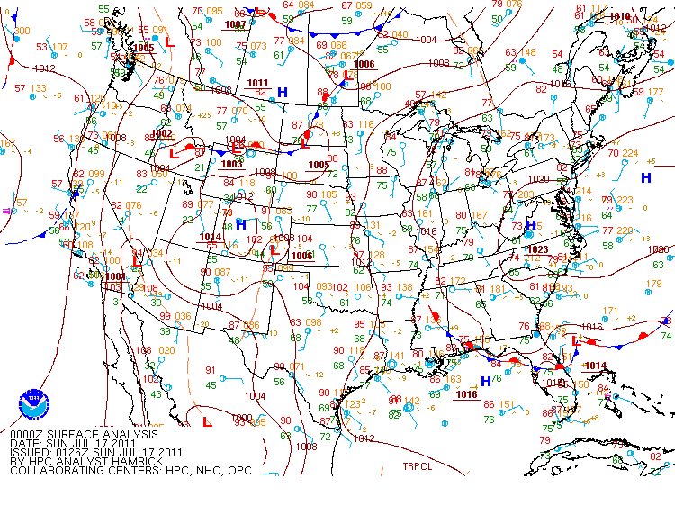
NAM Surface Analysis
00Z 07/17 to 21Z 07/17, 2011
(7:00pm Central 07/16 to
4:00pm Central 07/17, 2011)
http://www.ncdc.noaa.gov/data-access/quick-links

Slide 3
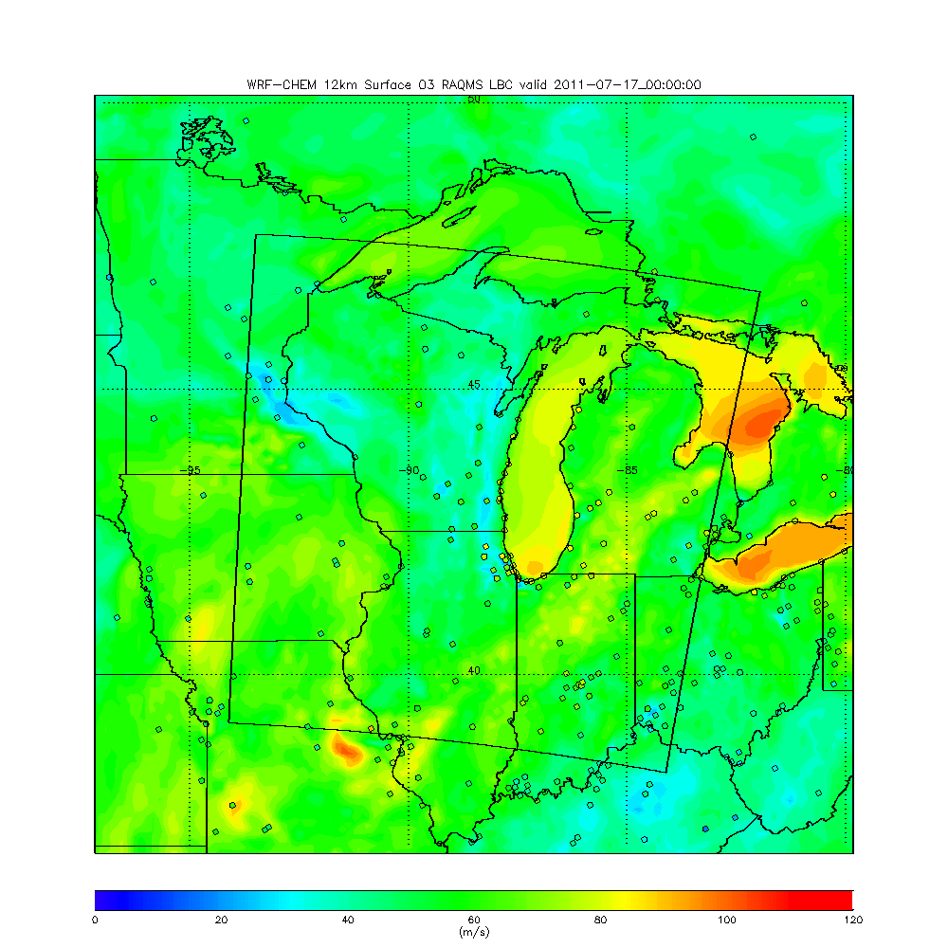
12km WRF-CHEM
Surface O3
00Z 07/17 to 23Z 07/17, 2011
(7:00pm Central 07/16 to
6:00pm Central 07/17, 2011)
Madison-Muskegon Cross-section in red

Slide 4
4km WRF-CHEM
Surface O3
00Z 07/17 to 23Z 07/17, 2011
(7:00pm Central 07/16 to
6:00pm Central 07/17, 2011)
Madison-Muskegon Cross-section in red

Slide 5
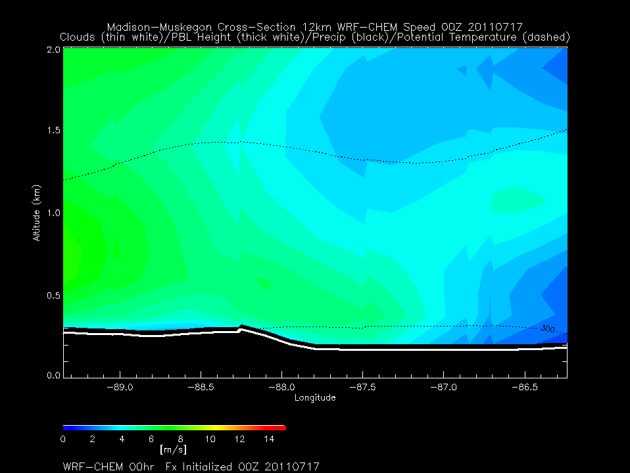
Nocturnal Jet at top of PBL over land, lake breeze develops off shore during the day
12km WRF-CHEM
Madison-Muskegon Wind Speed
00Z 07/17 to 23Z 07/17, 2011
(7:00pm Central 07/16 to
6:00pm Central 07/17, 2011)
Madison
Muskegon
Potential Temperature (Black dashed)
Precipitation (Black solid)
Cloud (White)
PBL Height (Bold White)

Slide 6
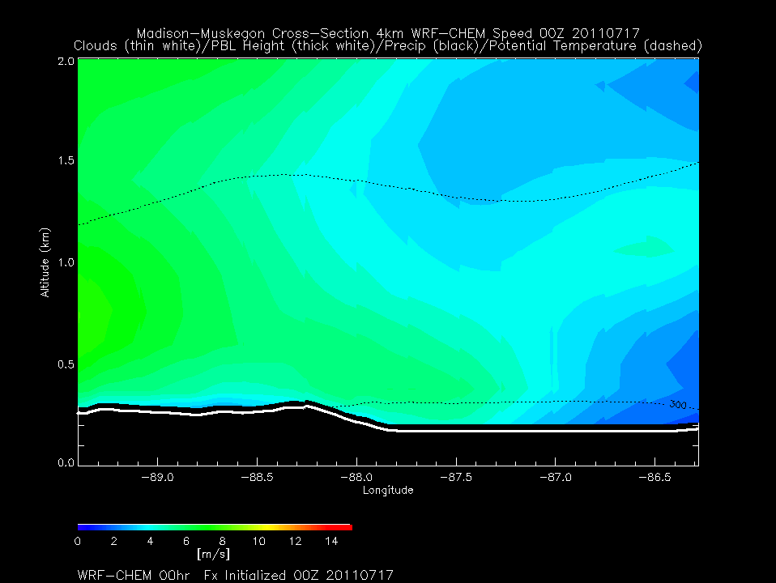
Nocturnal Jet at top of PBL over land, lake breeze develops off shore during the day – 4km shows weaker nocturnal Jet and stronger lake breeze
4km WRF-CHEM
Madison-Muskegon Wind Speed
00Z 07/17 to 23Z 07/17, 2011
(7:00pm Central 07/16 to
6:00pm Central 07/17, 2011)
Madison
Muskegon
Potential Temperature (Black dashed)
Precipitation (Black solid)
Cloud (White)
PBL Height (Bold White)

Slide 7
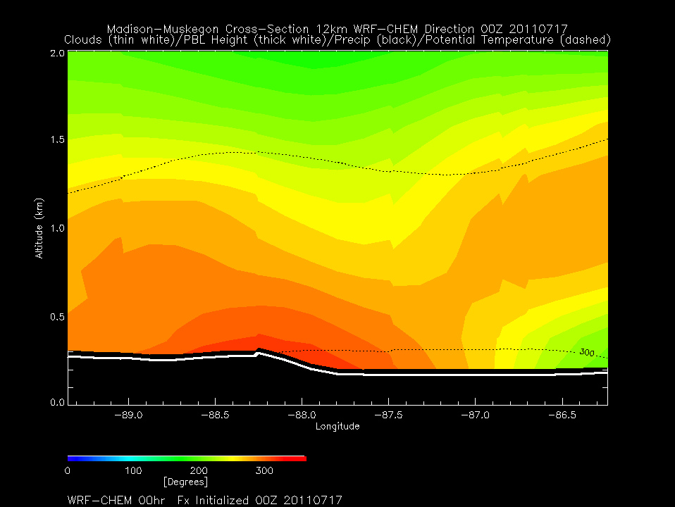
Initially broad NW winds (GFS 00Z IC)
SW winds over land during the night
NW winds develop over lake during the Daytime
12km WRF-CHEM
Madison-Muskegon Wind Direction
00Z 07/17 to 23Z 07/17, 2011
(7:00pm Central 07/16 to
6:00pm Central 07/17, 2011)
Madison
Muskegon
Potential Temperature (Black dashed)
Precipitation (Black solid)
Cloud (White)
PBL Height (Bold White)

Slide 8
Initially broad NW winds (GFS 00Z IC)
SW winds over land during the night
NW winds develop over lake during the Daytime - 4km shows sharper
Wind shift and surface front
4km WRF-CHEM
Madison-Muskegon Wind Direction
00Z 07/17 to 23Z 07/17, 2011
(7:00pm Central 07/16 to
6:00pm Central 07/17, 2011)
Madison
Muskegon
Potential Temperature (Black dashed)
Precipitation (Black solid)
Cloud (White)
PBL Height (Bold White)

Slide 9
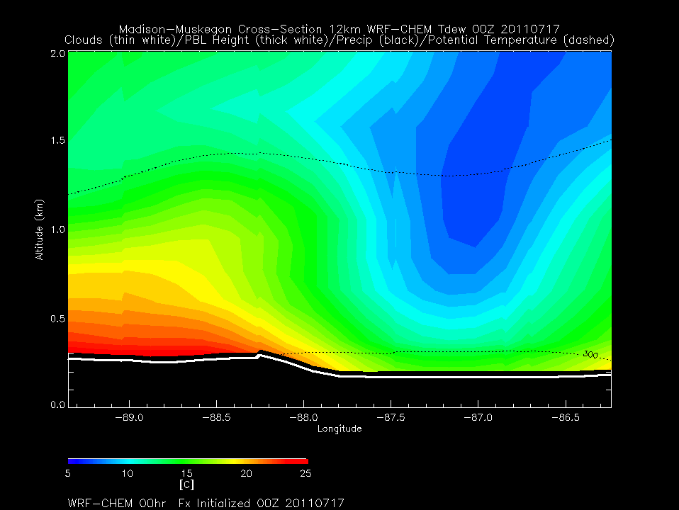
Moist air moves out over lake
above shallow PBL
12km WRF-CHEM
Madison-Muskegon Tdew
00Z 07/17 to 23Z 07/17, 2011
(7:00pm Central 07/16 to
6:00pm Central 07/17, 2011)
Madison
Muskegon
Potential Temperature (Black dashed)
Precipitation (Black solid)
Cloud (White)
PBL Height (Bold White)

Slide 10
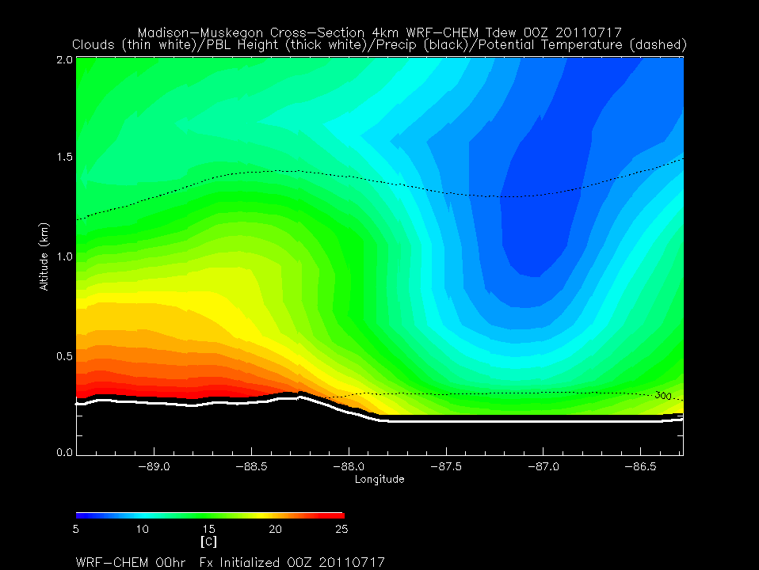
Moist air moves out over lake
above shallow PBL – 4km moist air moves further out over lake
4km WRF-CHEM
Madison-Muskegon Tdew
00Z 07/17 to 23Z 07/17, 2011
(7:00pm Central 07/16 to
6:00pm Central 07/17, 2011)
Madison
Muskegon
Potential Temperature (Black dashed)
Precipitation (Black solid)
Cloud (White)
PBL Height (Bold White)

Slide 11
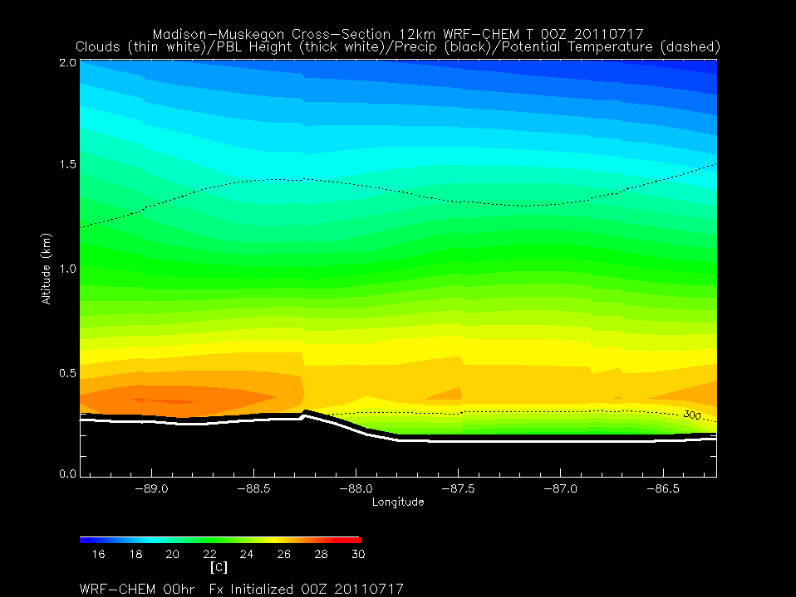
Nocturnal inversion lost to daytime heating over land. Movement of warm air out over lake above strong low level inversion
12km WRF-CHEM
Madison-Muskegon T
00Z 07/17 to 23Z 07/17, 2011
(7:00pm Central 07/16 to
6:00pm Central 07/17, 2011)
Madison
Muskegon
Potential Temperature (Black dashed)
Precipitation (Black solid)
Cloud (White)
PBL Height (Bold White)

Slide 12
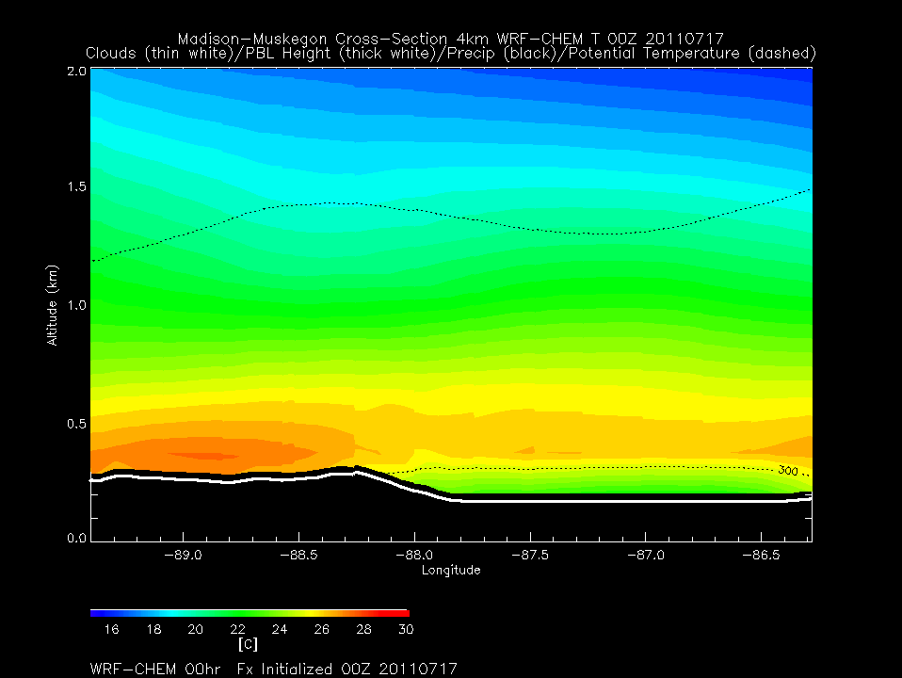
Nocturnal inversion lost to daytime heating over land. Movement of warm air out over lake above strong low level inversion – 4km warm air moves further out over lake
4km WRF-CHEM
Madison-Muskegon T
00Z 07/17 to 23Z 07/17, 2011
(7:00pm Central 07/16 to
6:00pm Central 07/17, 2011)
Madison
Muskegon
Potential Temperature (Black dashed)
Precipitation (Black solid)
Cloud (White)
PBL Height (Bold White)

Slide 13
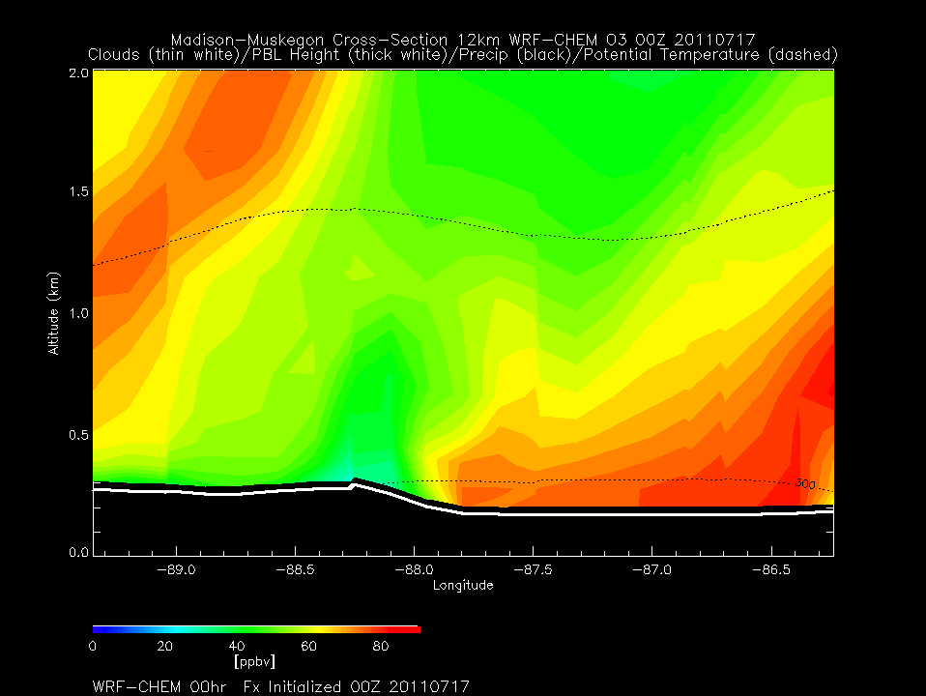
12km WRF-CHEM
Madison-Muskegon O3
00Z 07/17 to 23Z 07/17, 2011
(7:00pm Central 07/16 to
6:00pm Central 07/17, 2011)
Higher O3 aloft moves over lake and appears to descend. Minimum in O3 along coast
Madison
Muskegon
Potential Temperature (Black dashed)
Precipitation (Black solid)
Cloud (White)
PBL Height (Bold White)

Slide 14
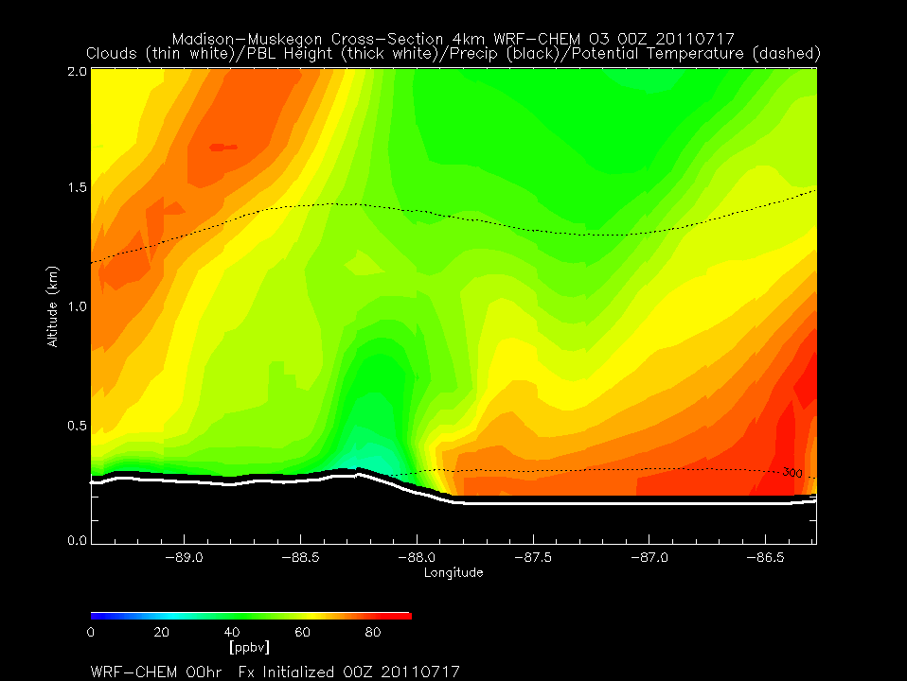
4km WRF-CHEM
Madison-Muskegon O3
00Z 07/17 to 23Z 07/17, 2011
(7:00pm Central 07/16 to
6:00pm Central 07/17, 2011)
Higher O3 aloft moves over lake and appears to descend. Minimum in O3 along coast - 4km shows significantly higher O3 over lake
Madison
Muskegon
Potential Temperature (Black dashed)
Precipitation (Black solid)
Cloud (White)
PBL Height (Bold White)

Slide 15
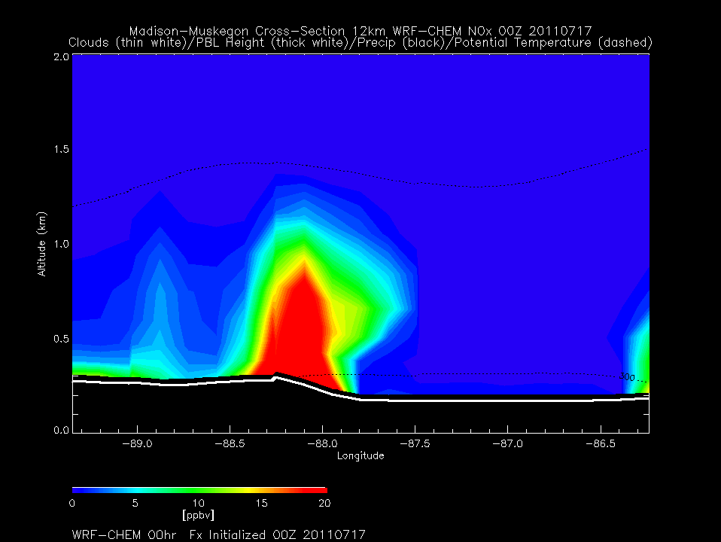
Nocturnal transport out over lake
Daytime lofting along lake breeze front
12km WRF-CHEM
Madison-Muskegon NOx
00Z 07/17 to 23Z 07/17, 2011
(7:00pm Central 07/16 to
6:00pm Central 07/17, 2011)
Madison
Muskegon
Potential Temperature (Black dashed)
Precipitation (Black solid)
Cloud (White)
PBL Height (Bold White)

Slide 16
Nocturnal transport out over lake
Daytime lofting along lake breeze front – 4km shows more low level enhancement on eastern side of Lake and along lake breeze front
4km WRF-CHEM
Madison-Muskegon NOx
00Z 07/17 to 23Z 07/17, 2011
(7:00pm Central 07/16 to
6:00pm Central 07/17, 2011)
Madison
Muskegon
Potential Temperature (Black dashed)
Precipitation (Black solid)
Cloud (White)
PBL Height (Bold White)

Slide 17
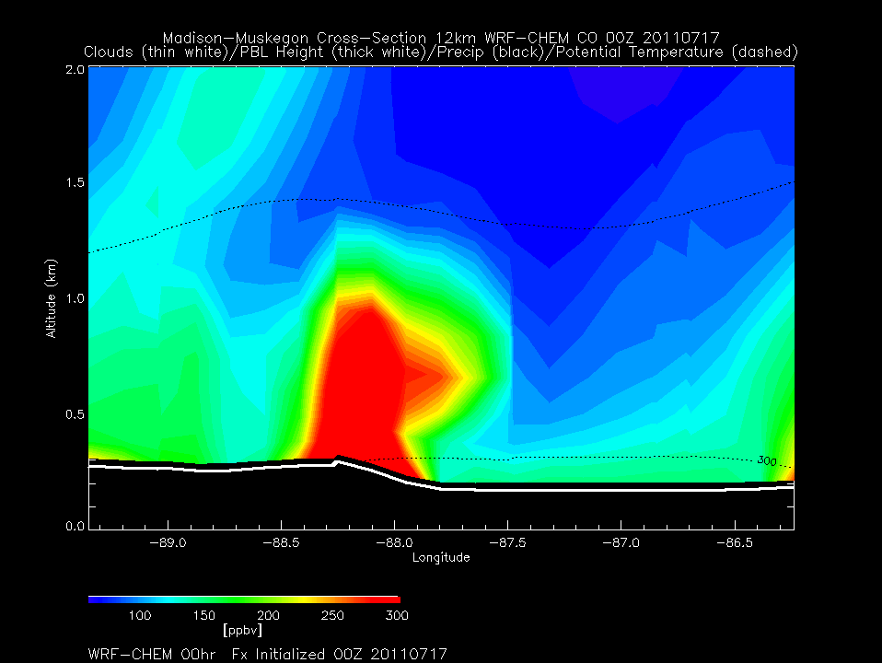
Nocturnal transport out over lake
Daytime lofting along lake breeze front
12km WRF-CHEM
Madison-Muskegon CO
00Z 07/17 to 23Z 07/17, 2011
(7:00pm Central 07/16 to
6:00pm Central 07/17, 2011)
Madison
Muskegon
Potential Temperature (Black dashed)
Precipitation (Black solid)
Cloud (White)
PBL Height (Bold White)

Slide 18
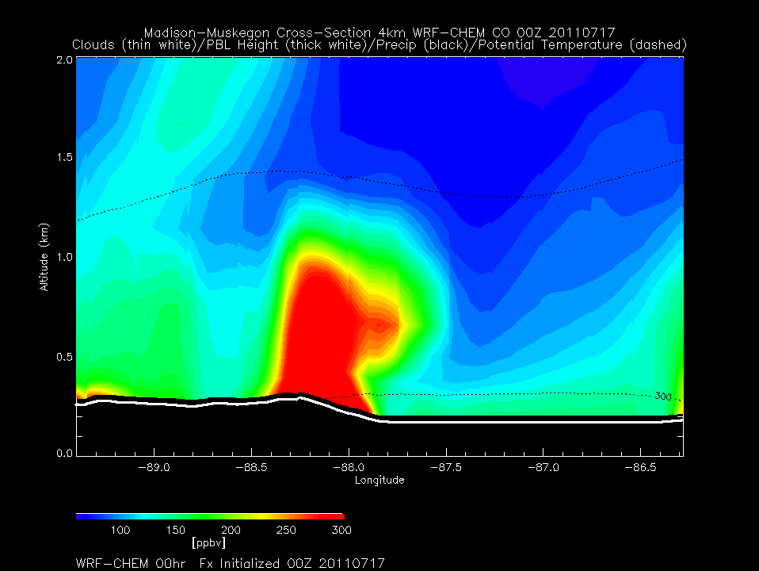
Nocturnal transport out over lake
Daytime lofting along lake breeze front – 4km shows more low level enhancement on eastern side of Lake and along lake breeze front
4km WRF-CHEM
Madison-Muskegon CO
00Z 07/17 to 23Z 07/17, 2011
(7:00pm Central 07/16 to
6:00pm Central 07/17, 2011)
Madison
Muskegon
Potential Temperature (Black dashed)
Precipitation (Black solid)
Cloud (White)
PBL Height (Bold White)

Slide 19
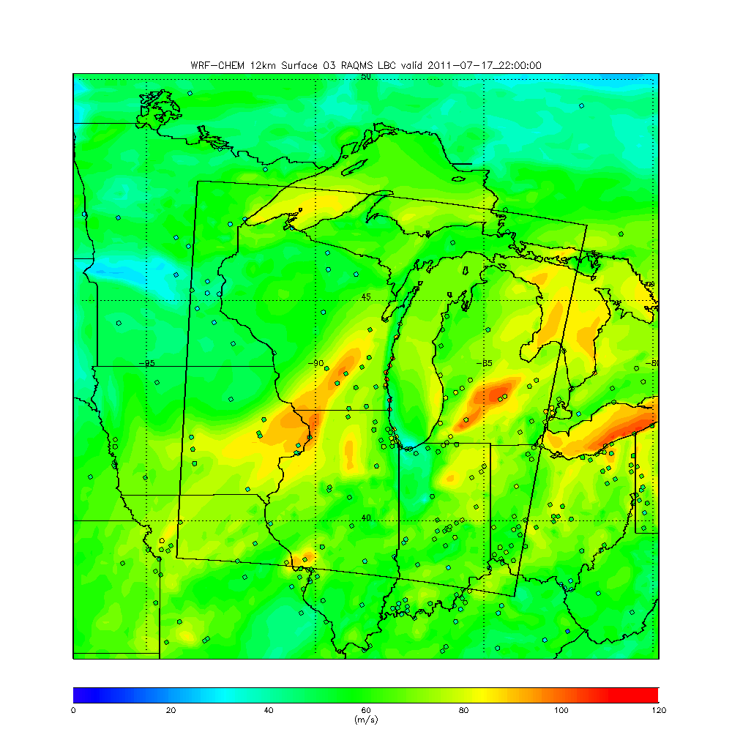
12km WRF-CHEM
Surface O3
22Z 07/17, 2011
(5:00pm Central 07/17, 2011)
Madison-Muskegon Cross-section in red

Slide 20
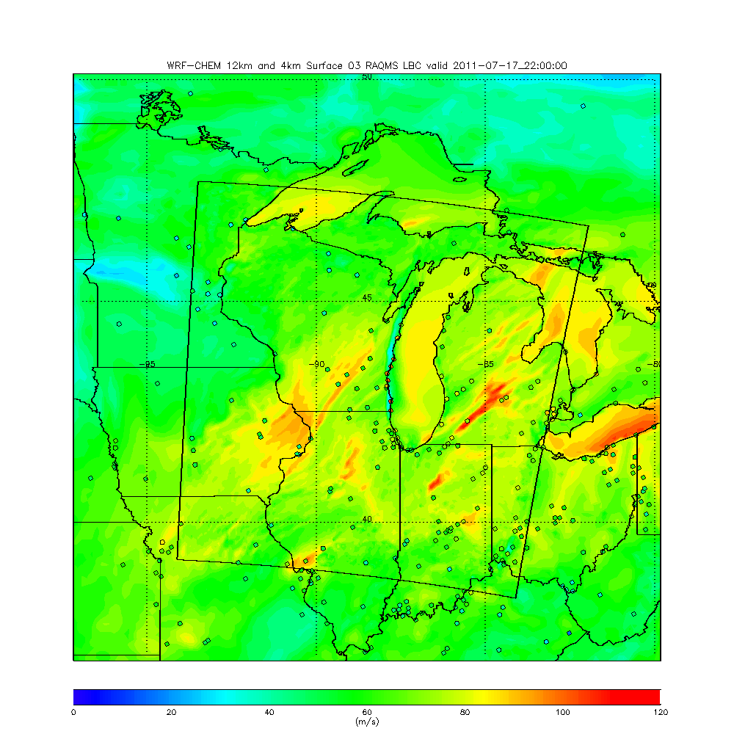
4km WRF-CHEM
Surface O3
22Z 07/17, 2011
(5:00pm Central 07/17, 2011)
Madison-Muskegon Cross-section in red

Slide 21
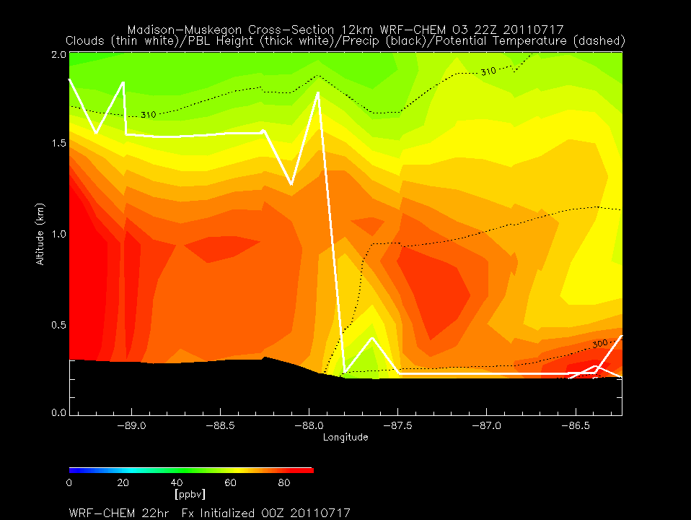
12km WRF-CHEM
Madison-Muskegon O3
22Z 07/17, 2011
(5:00pm Central 07/17, 2011)
Madison
Muskegon
Potential Temperature (Black dashed)
Precipitation (Black solid)
Cloud (White)
PBL Height (Bold White)

Slide 22
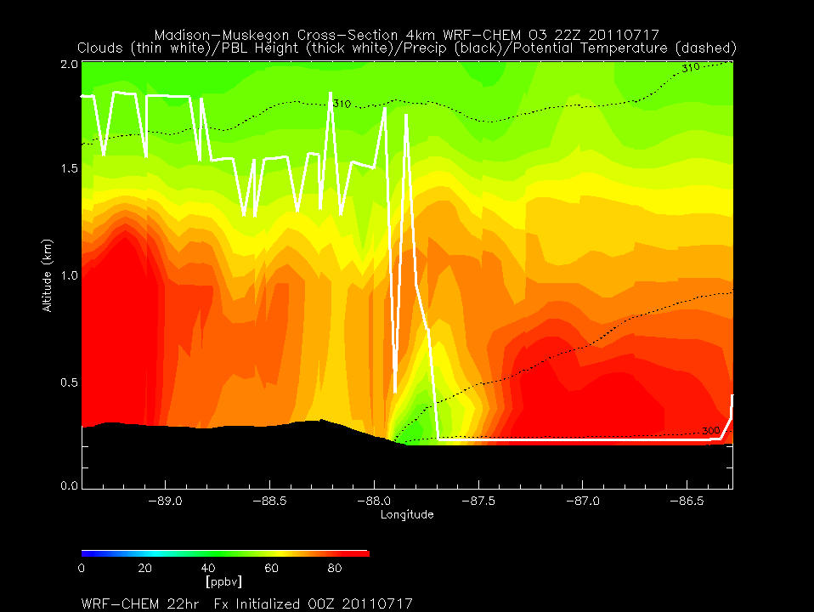
4km WRF-CHEM
Madison-Muskegon O3
22Z 07/17, 2011
(5:00pm Central 07/17, 2011)
Madison
Muskegon
Potential Temperature (Black dashed)
Precipitation (Black solid)
Cloud (White)
PBL Height (Bold White)

Slide 23
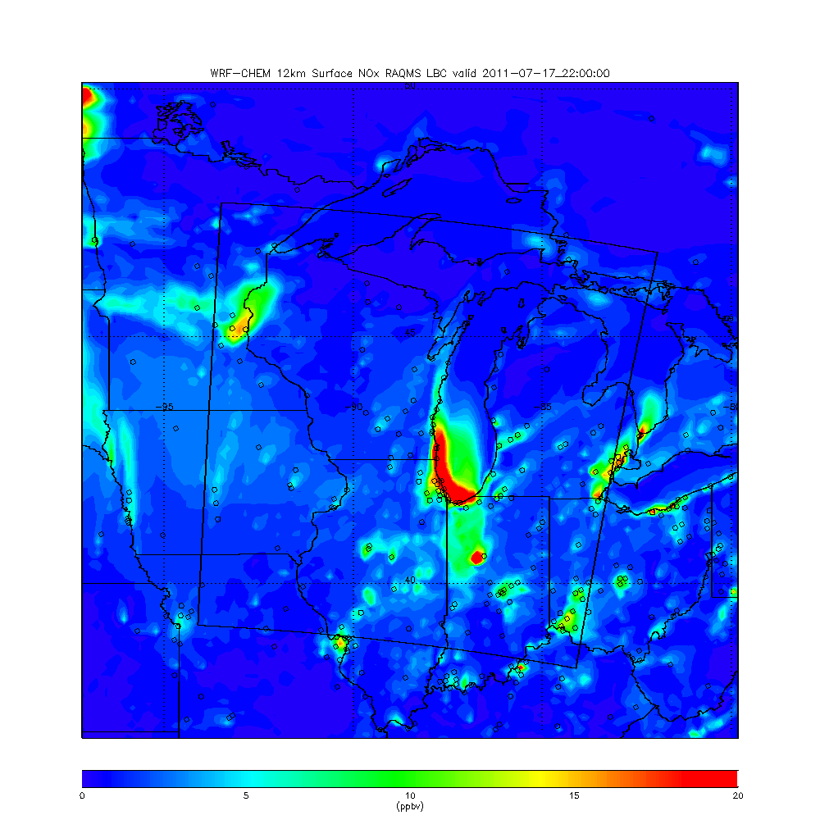
12km WRF-CHEM
Surface NOx
22Z 07/17, 2011
(5:00pm Central 07/17, 2011)
Madison-Muskegon Cross-section in red

Slide 24
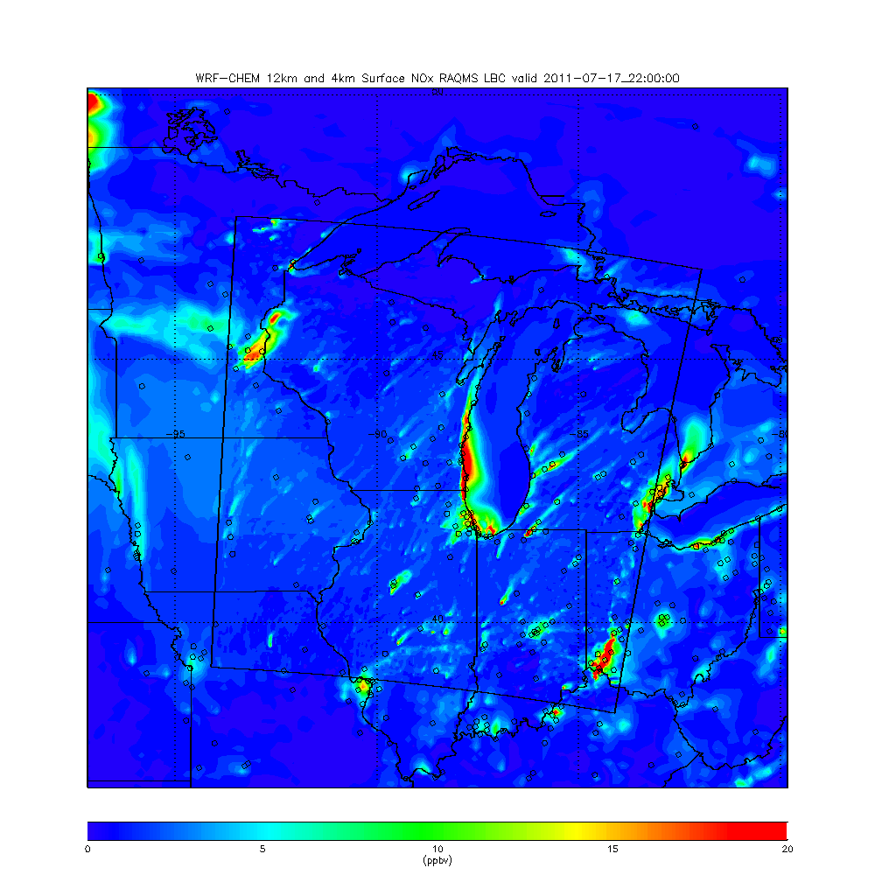
4km WRF-CHEM
Surface NOx
22Z 07/17, 2011
(5:00pm Central 07/17, 2011)
Madison-Muskegon Cross-section in red

Slide 25
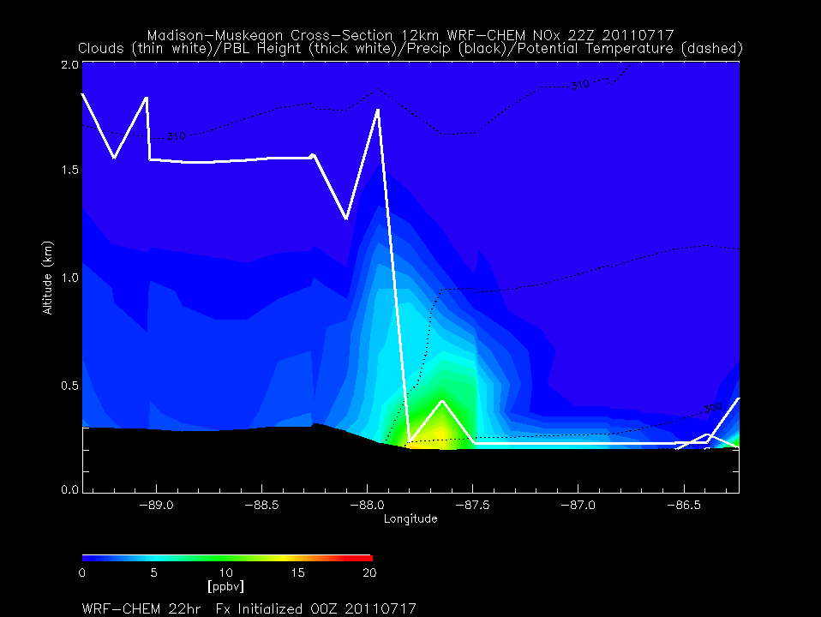
12km WRF-CHEM
Madison-Muskegon NOx
22Z 07/17, 2011
(5:00pm Central 07/17, 2011)
Madison
Muskegon
Potential Temperature (Black dashed)
Precipitation (Black solid)
Cloud (White)
PBL Height (Bold White)

Slide 26
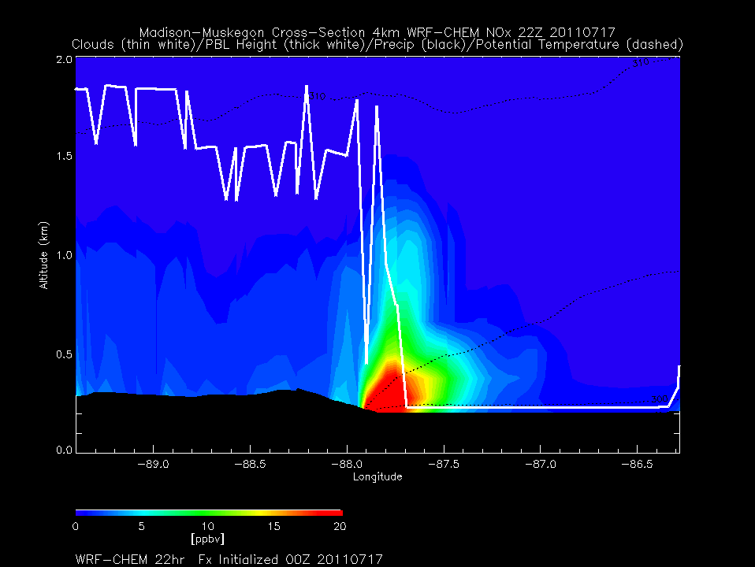
4km WRF-CHEM
Madison-Muskegon NOx
22Z 07/17, 2011
(5:00pm Central 07/17, 2011)
Madison
Muskegon
Potential Temperature (Black dashed)
Precipitation (Black solid)
Cloud (White)
PBL Height (Bold White)

Slide 27
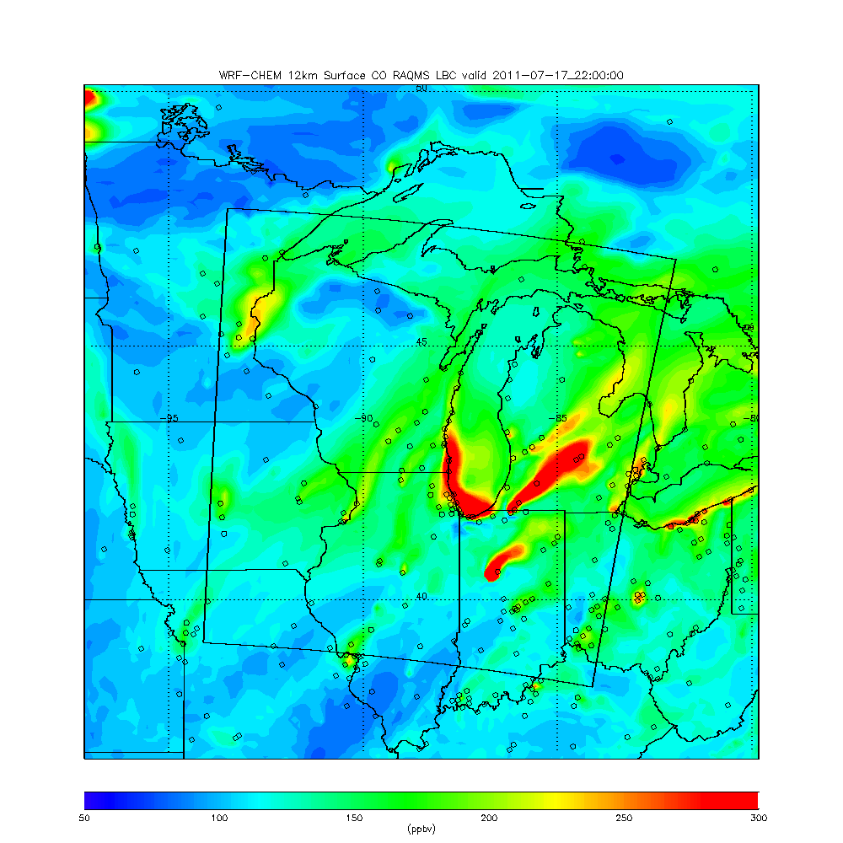
12km WRF-CHEM
Surface CO
22Z 07/17, 2011
(5:00pm Central 07/17, 2011)
Madison-Muskegon Cross-section in red

Slide 28
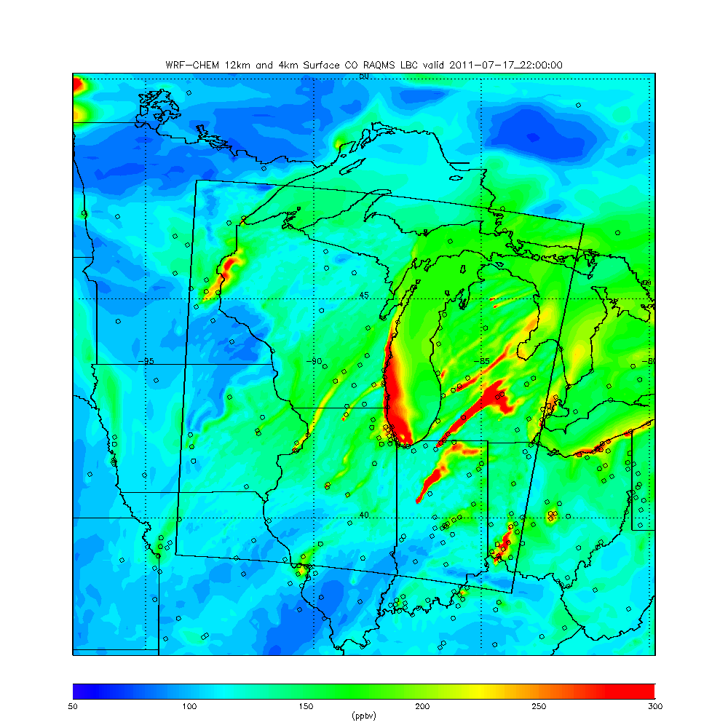
4km WRF-CHEM
Surface CO
22Z 07/17, 2011
(5:00pm Central 07/17, 2011)
Madison-Muskegon Cross-section in red

Slide 29
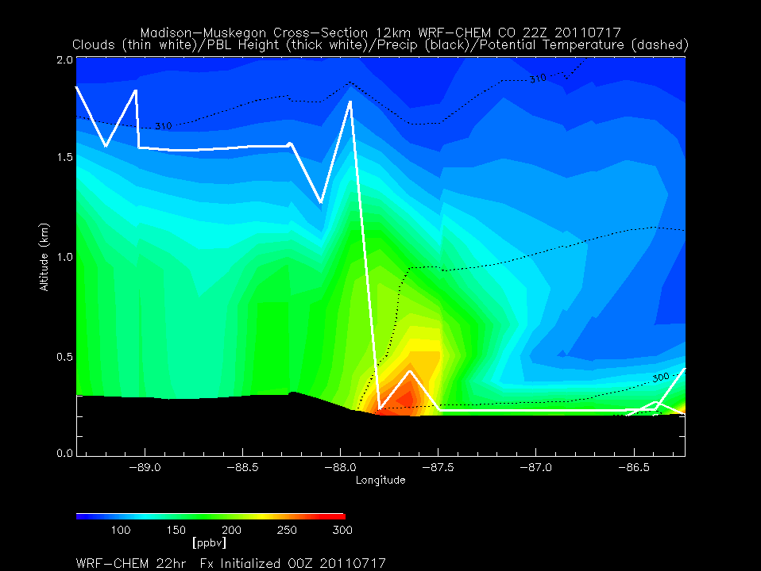
12km WRF-CHEM
Madison-Muskegon CO
22Z 07/17, 2011
(5:00pm Central 07/17, 2011)
Madison
Muskegon
Potential Temperature (Black dashed)
Precipitation (Black solid)
Cloud (White)
PBL Height (Bold White)

Slide 30
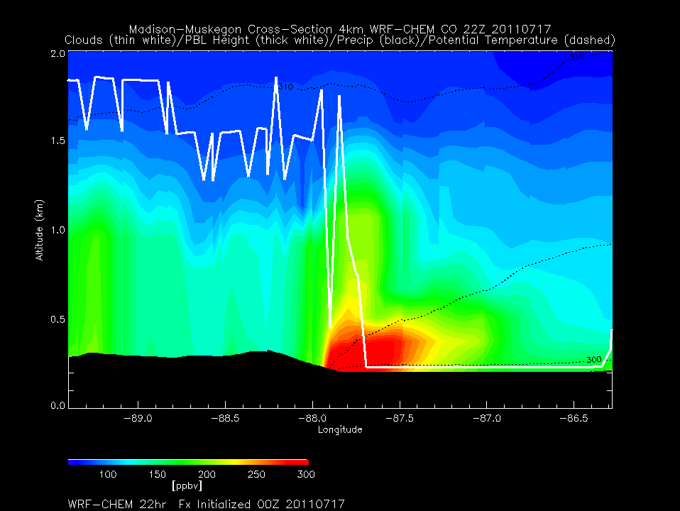
12km WRF-CHEM
Madison-Muskegon CO
22Z 07/17, 2011
(5:00pm Central 07/17, 2011)
Madison
Muskegon
Potential Temperature (Black dashed)
Precipitation (Black solid)
Cloud (White)
PBL Height (Bold White)

Slide 31
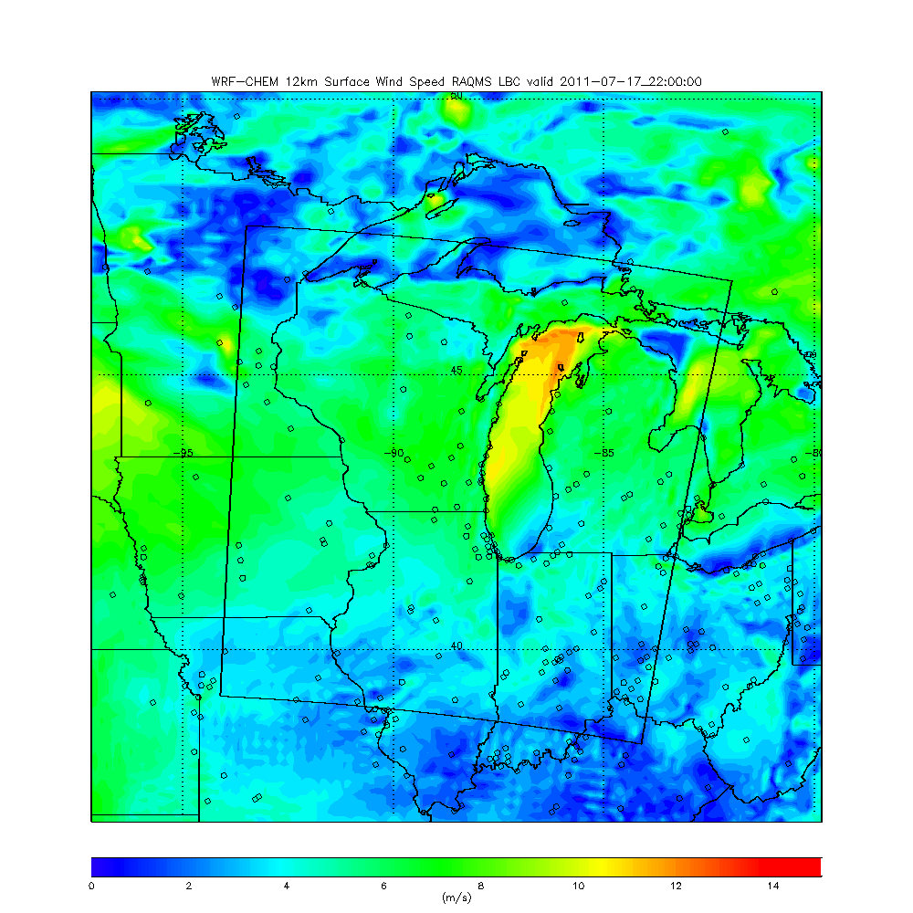
12km WRF-CHEM
Surface Wind Speed
22Z 07/17, 2011
(5:00pm Central 07/17, 2011)
Madison-Muskegon Cross-section in red

Slide 32
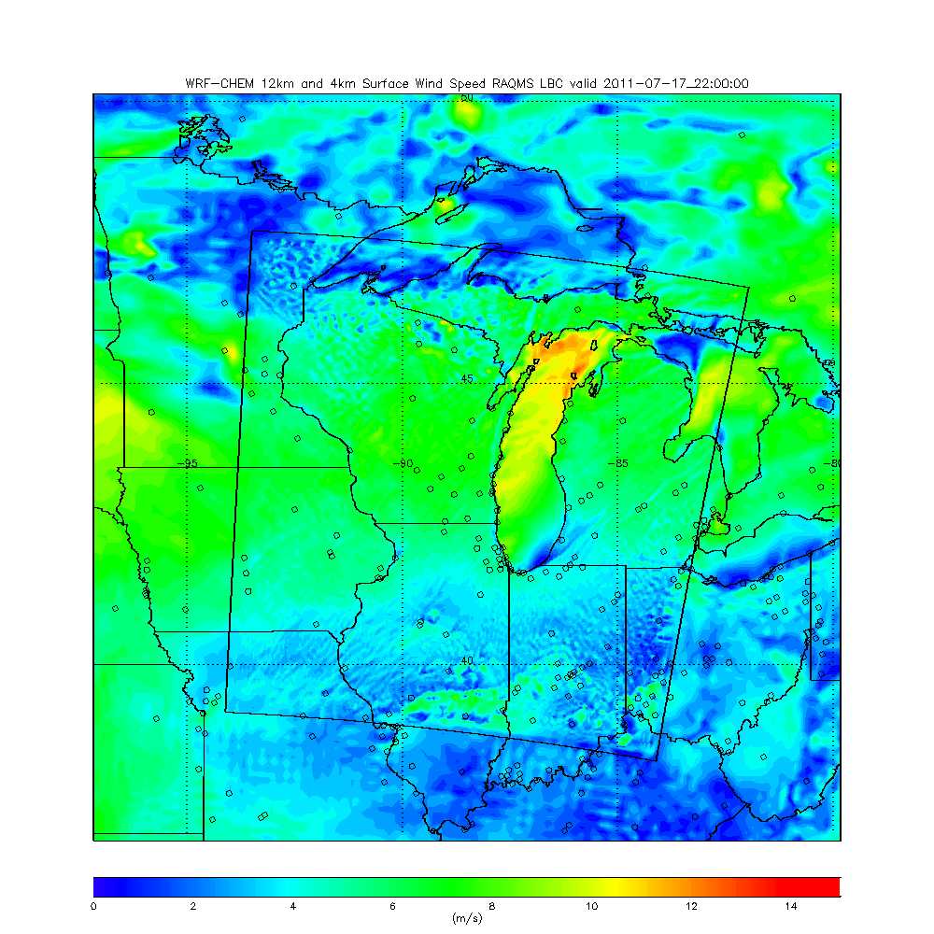
4km WRF-CHEM
Surface Wind Speed
22Z 07/17, 2011
(5:00pm Central 07/17, 2011)
Madison-Muskegon Cross-section in red

Slide 33
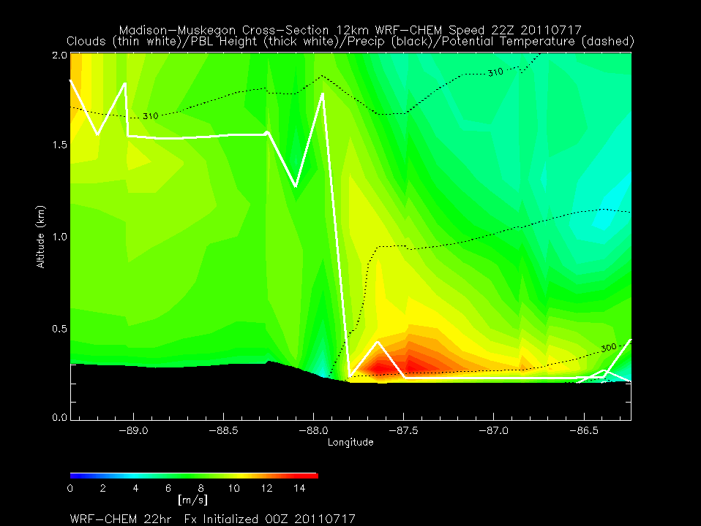
12km WRF-CHEM
Madison-Muskegon Wind Speed
22Z 07/17, 2011
(5:00pm Central 07/17, 2011)
Madison
Muskegon
Potential Temperature (Black dashed)
Precipitation (Black solid)
Cloud (White)
PBL Height (Bold White)

Slide 34
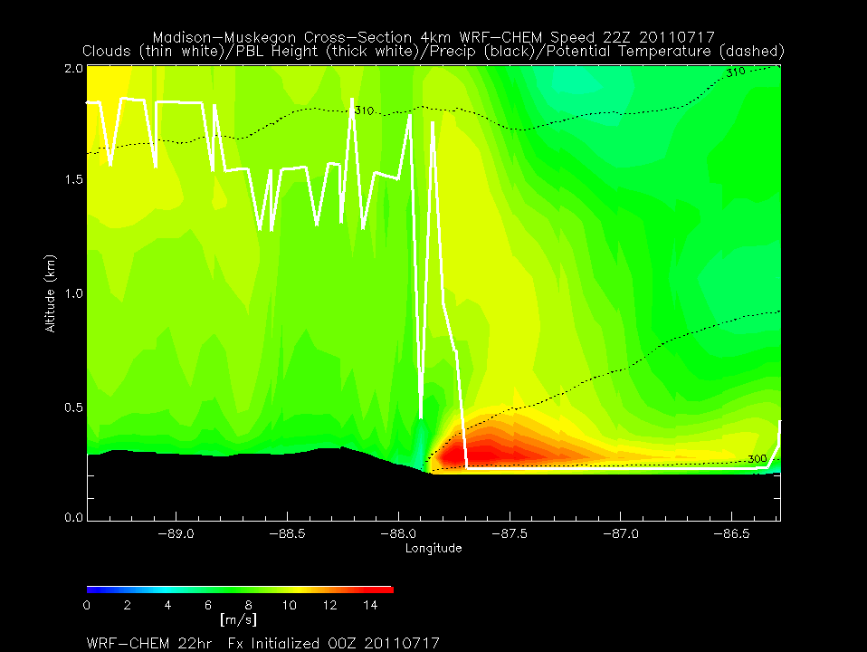
4km WRF-CHEM
Madison-Muskegon Wind Speed
22Z 07/17, 2011
(5:00pm Central 07/17, 2011)
Madison
Muskegon
Potential Temperature (Black dashed)
Precipitation (Black solid)
Cloud (White)
PBL Height (Bold White)

Slide 35
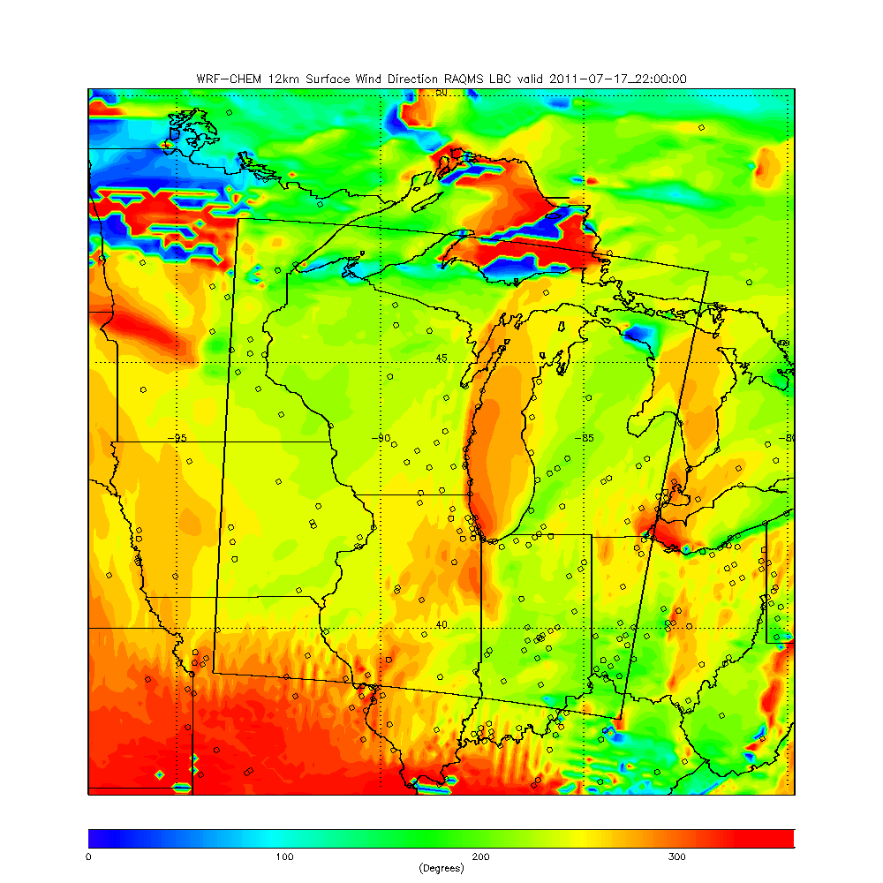
12km WRF-CHEM
Surface Wind Direction
22Z 07/17, 2011
(5:00pm Central 07/17, 2011)
Madison-Muskegon Cross-section in red

Slide 36
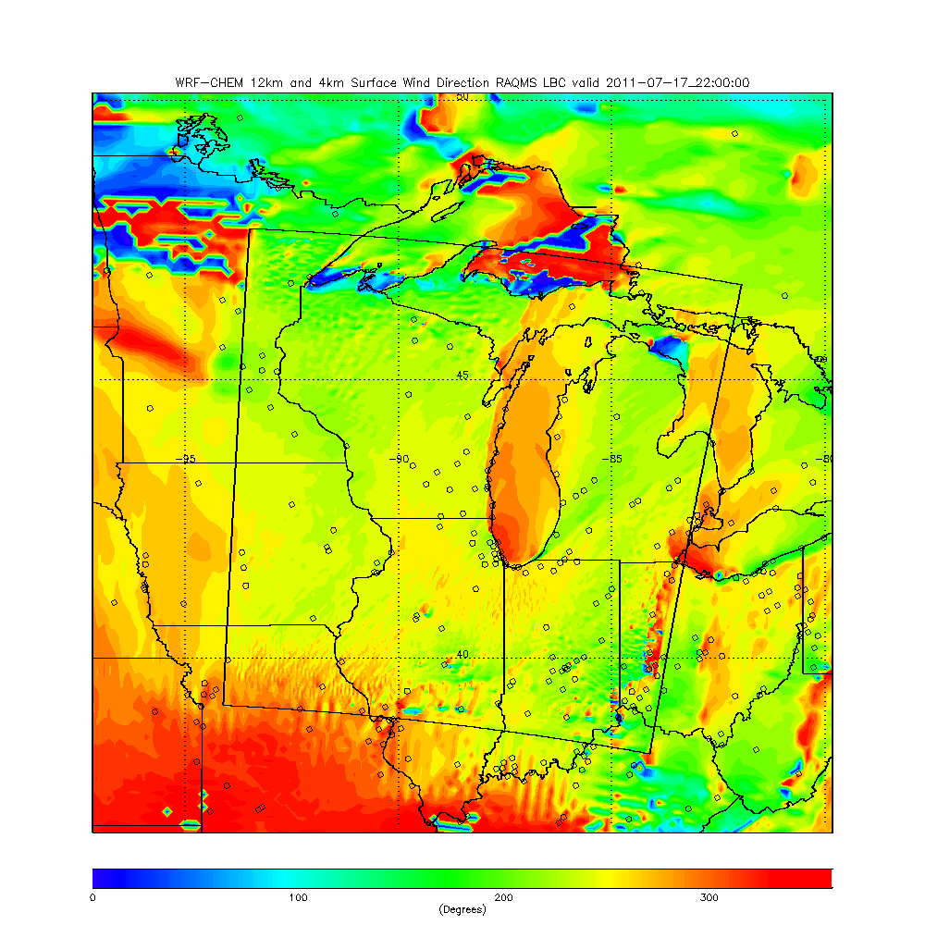
4km WRF-CHEM
Surface Wind Direction
22Z 07/17, 2011
(5:00pm Central 07/17, 2011)
Madison-Muskegon Cross-section in red

Slide 37
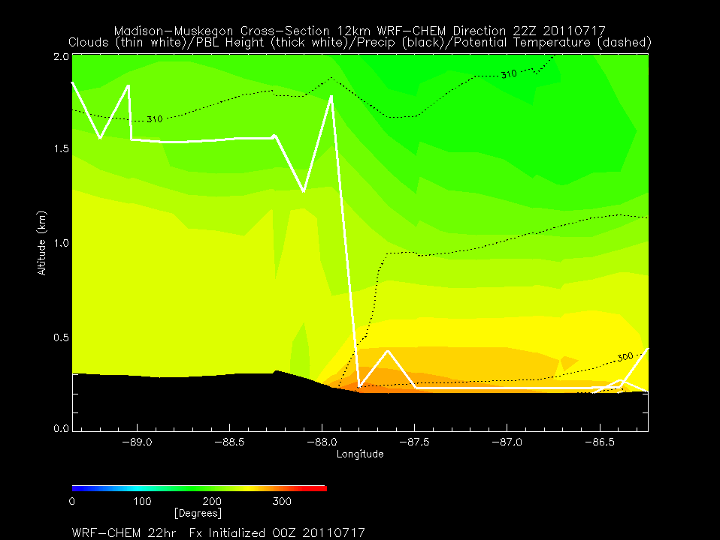
12km WRF-CHEM
Madison-Muskegon Wind Direction
22Z 07/17, 2011
(5:00pm Central 07/17, 2011)
Madison
Muskegon
Potential Temperature (Black dashed)
Precipitation (Black solid)
Cloud (White)
PBL Height (Bold White)

Slide 38
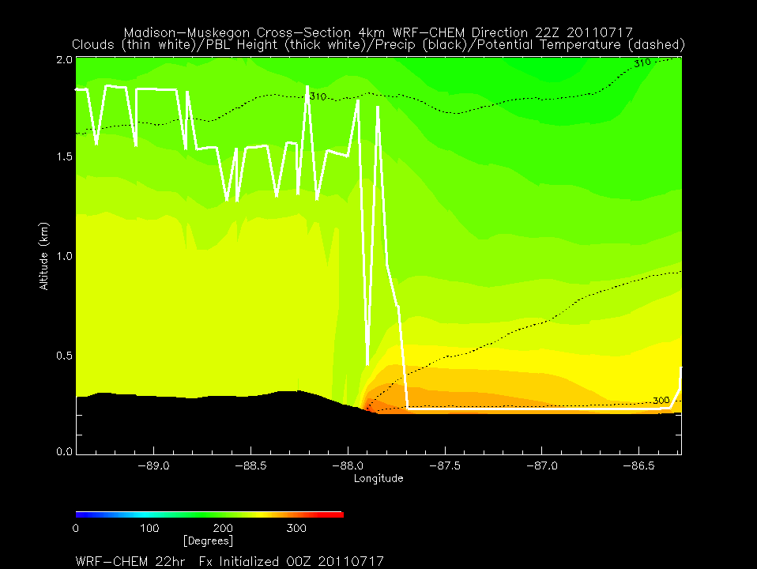
4km WRF-CHEM
Madison-Muskegon Wind Direction
22Z 07/17, 2011
(5:00pm Central 07/17, 2011)
Madison
Muskegon
Potential Temperature (Black dashed)
Precipitation (Black solid)
Cloud (White)
PBL Height (Bold White)

Slide 39
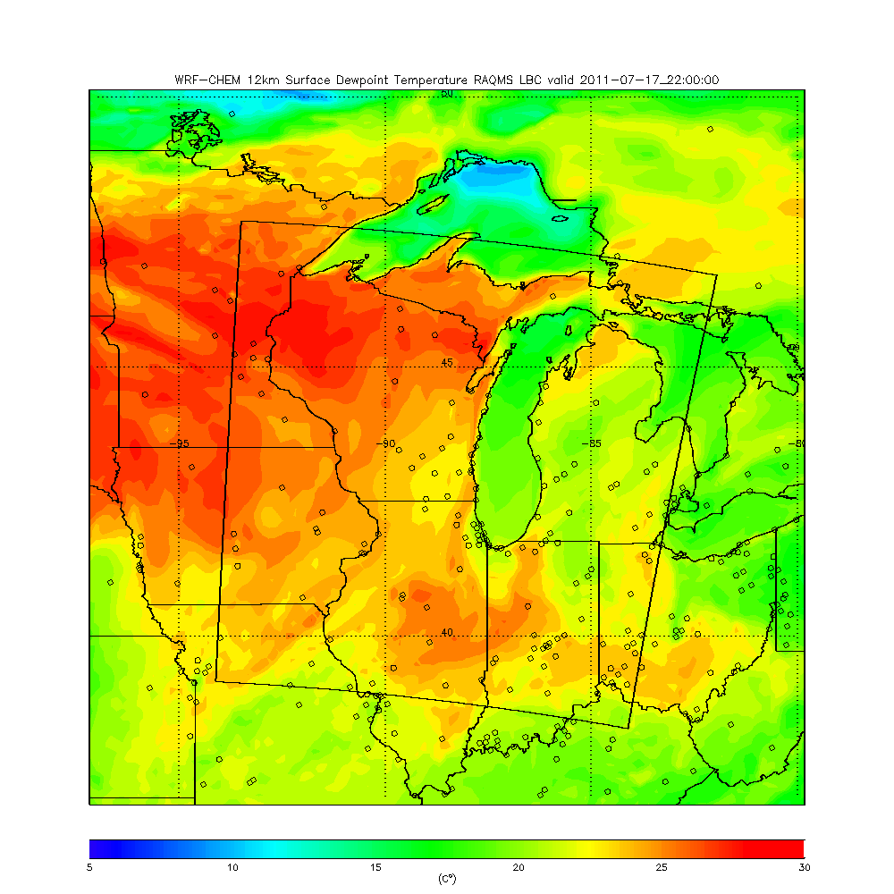
12km WRF-CHEM
Surface Dew Point Temperature
22Z 07/17, 2011
(5:00pm Central 07/17, 2011)
Madison-Muskegon Cross-section in red

Slide 40
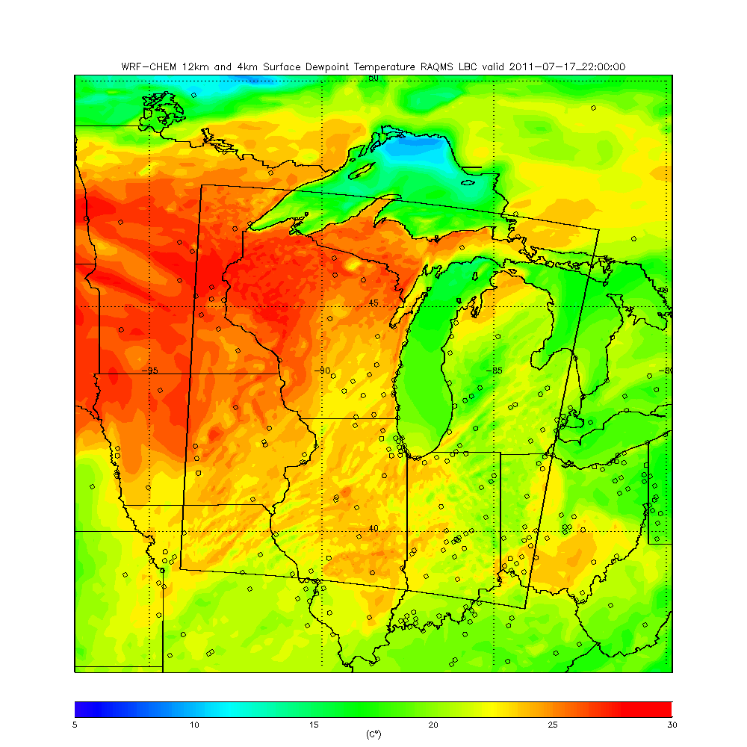
4km WRF-CHEM
Surface Dew Point Temperature
22Z 07/17, 2011
(5:00pm Central 07/17, 2011)
Madison-Muskegon Cross-section in red

Slide 41
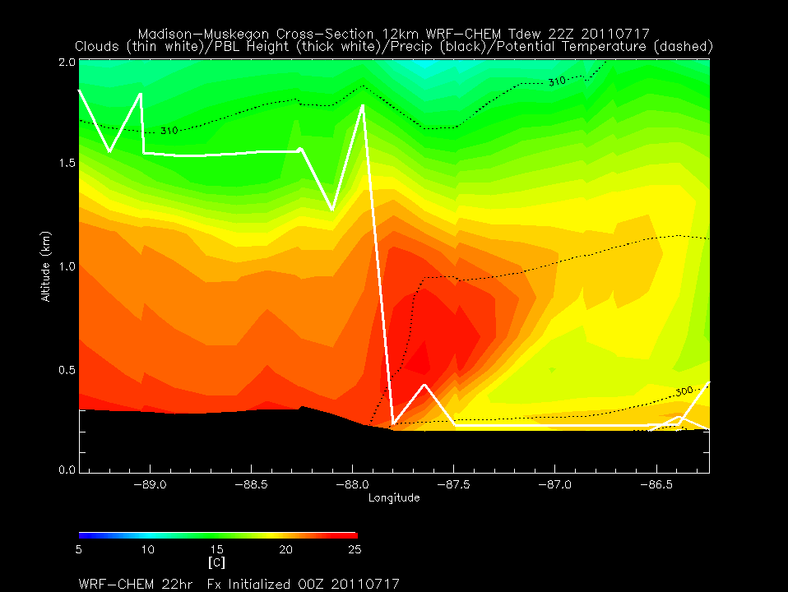
12km WRF-CHEM
Madison-Muskegon Dew Point Temperature
22Z 07/17, 2011
(5:00pm Central 07/17, 2011)
Madison
Muskegon
Potential Temperature (Dashed)
PBL Height (bold white)

Slide 42
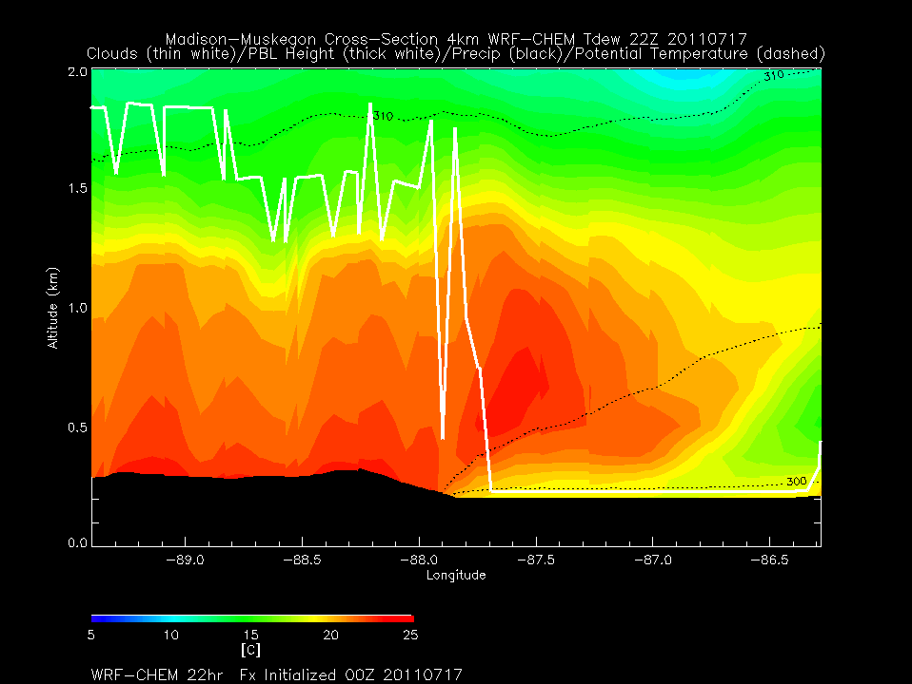
4km WRF-CHEM
Madison-Muskegon Dew Point Temperature
22Z 07/17, 2011
(5:00pm Central 07/17, 2011)
Madison
Muskegon
Potential Temperature (Black dashed)
Precipitation (Black solid)
Cloud (White)
PBL Height (Bold White)

Slide 43
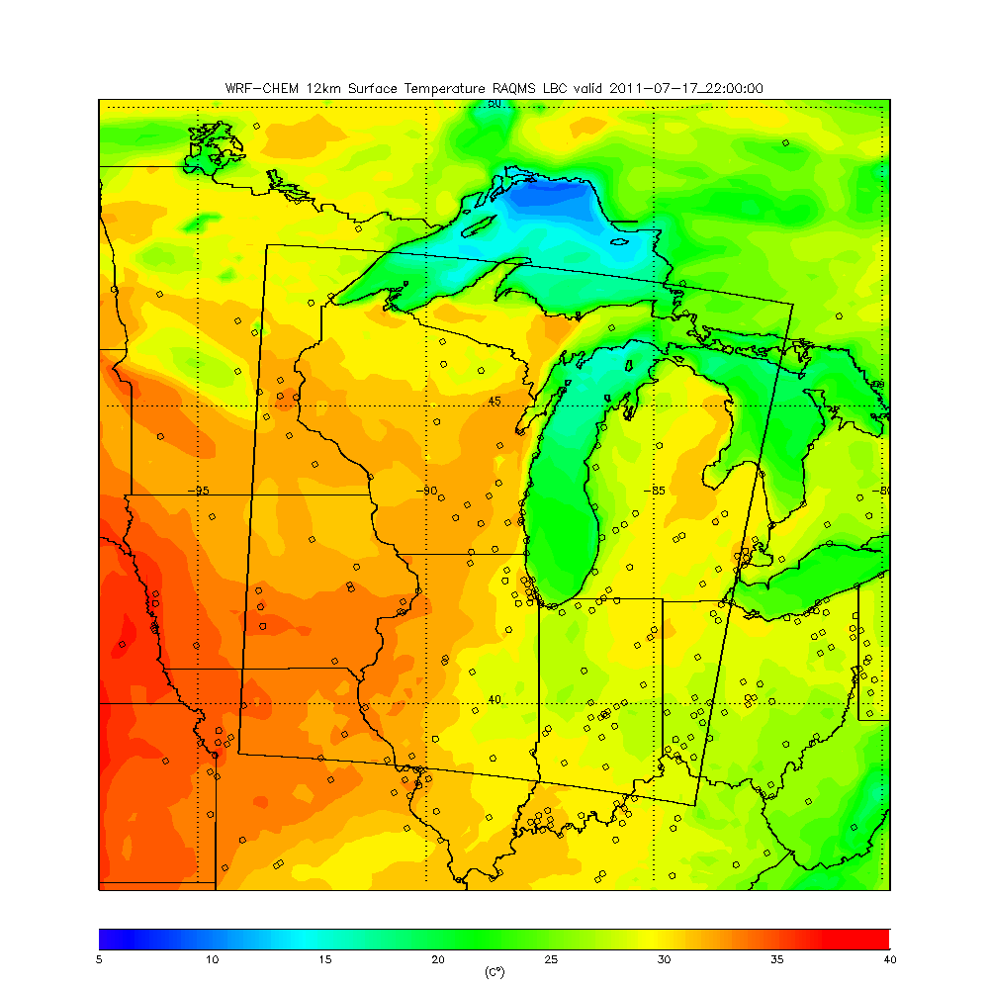
12km WRF-CHEM
Surface Temperature
22Z 07/17, 2011
(5:00pm Central 07/17, 2011)
Madison-Muskegon Cross-section in red

Slide 44
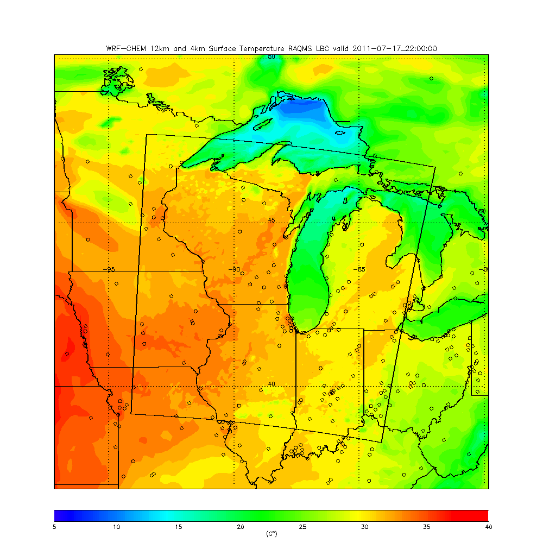
4km WRF-CHEM
Surface Temperature
22Z 07/17, 2011
(5:00pm Central 07/17, 2011)
Madison-Muskegon Cross-section in red

Slide 45
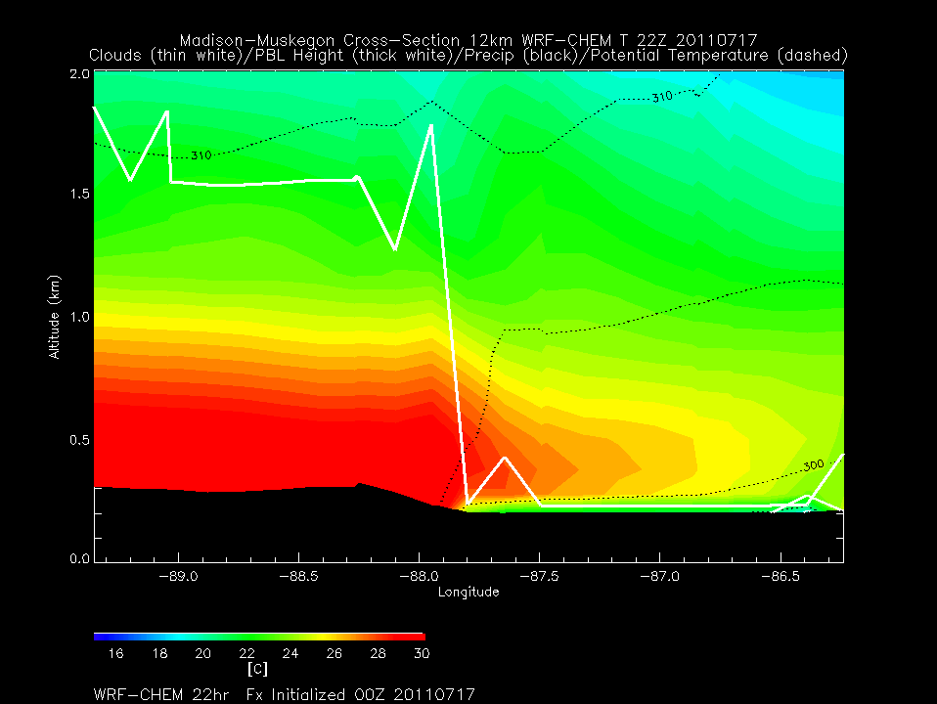
12km WRF-CHEM
Madison-Muskegon Temperature
22Z 07/17, 2011
(5:00pm Central 07/17, 2011)
Madison
Muskegon
Potential Temperature (Black dashed)
Precipitation (Black solid)
Cloud (White)
PBL Height (Bold White)

Slide 46
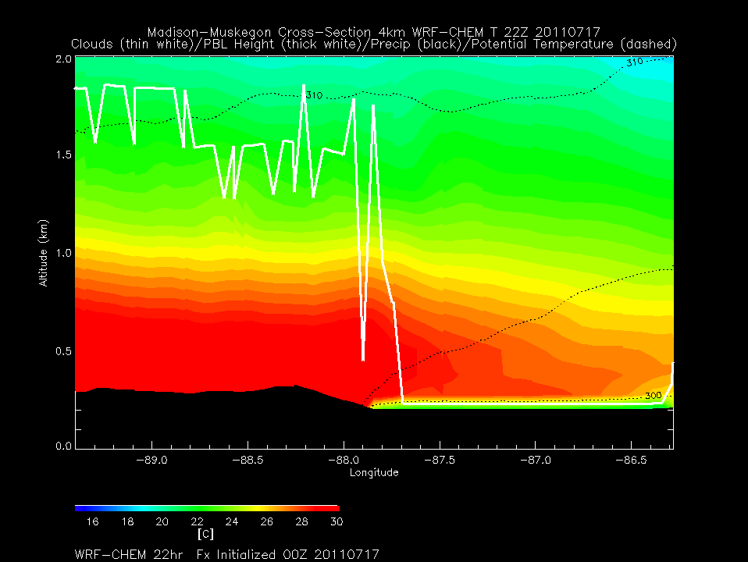
4km WRF-CHEM
Madison-Muskegon Temperature
22Z 07/17, 2011
(5:00pm Central 07/17, 2011)
Madison
Muskegon
Potential Temperature (Black dashed)
Precipitation (Black solid)
Cloud (White)
PBL Height (Bold White)

