Slide 1
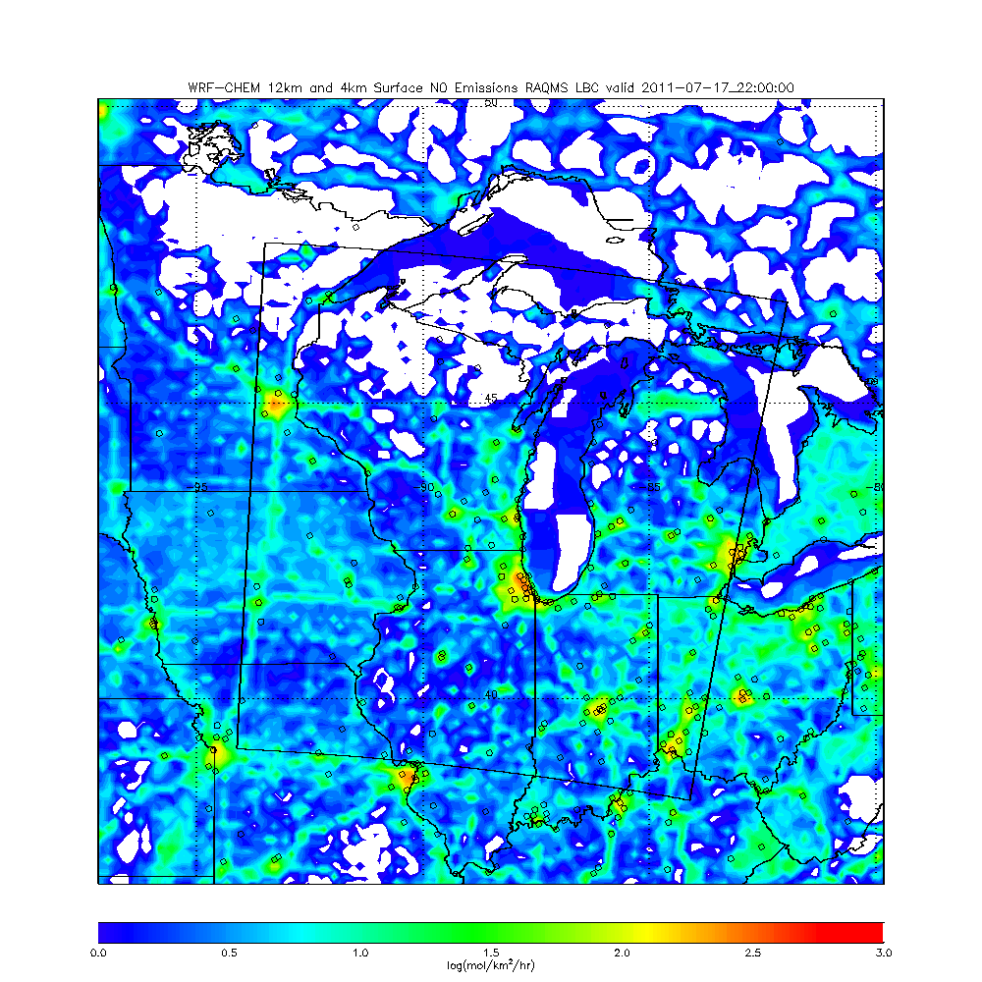
WRF-CHEM 12km Surface NO emissions (NEI 2011)
Location of AIRNOW sites shown as open circles
4km nest boundaries also shown
Log10 of NO emissions are shown

Slide 2
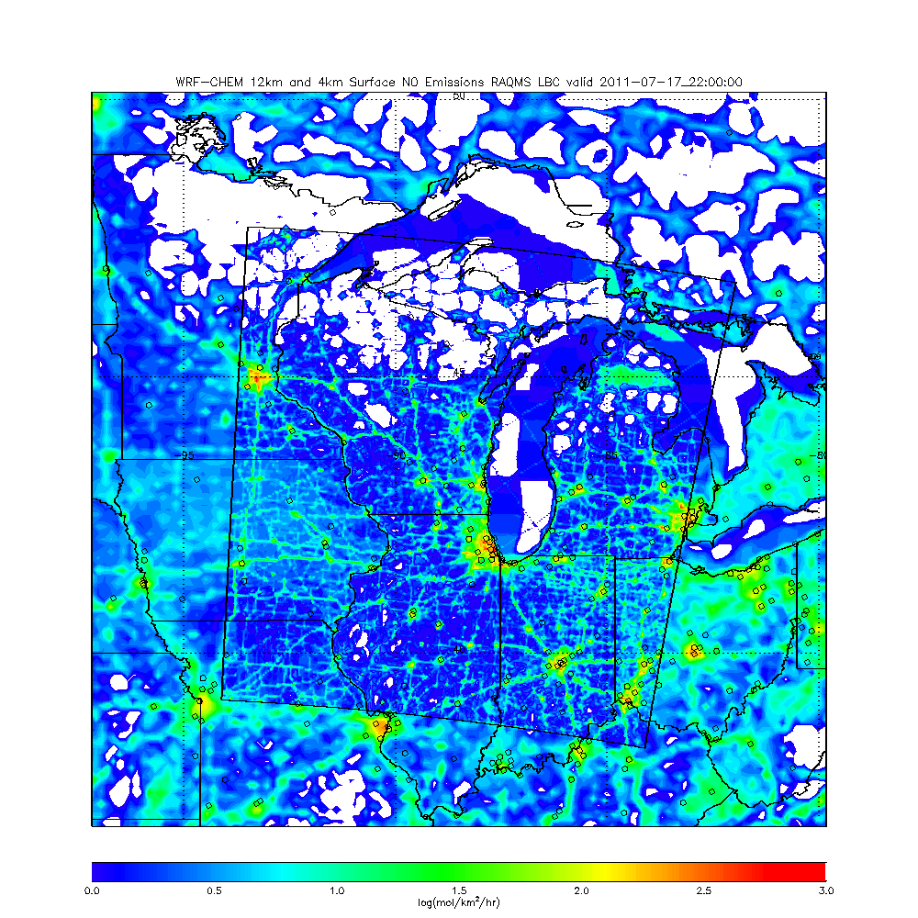
WRF-CHEM 12km and Nested 4km Surface NO emissions (NEI 2011)
Location of AIRNOW sites shown as open circles
4km nest boundaries also shown
Log10 of NO emissions are shown

Slide 3
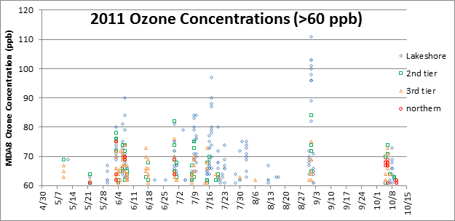
Focusing on the July 17, 2011 event
12km CONUS and 4km Midwest runs for July 01-31, 2011

Slide 4
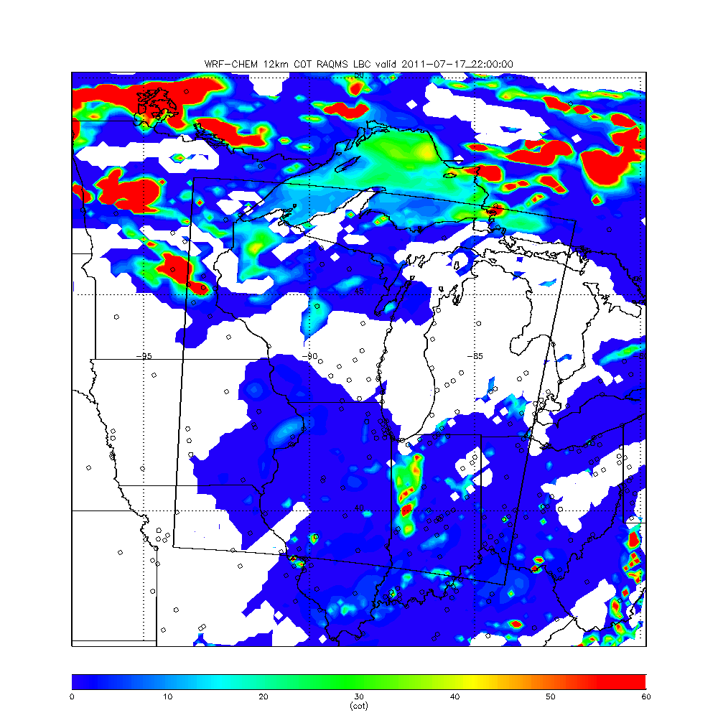
WRF-CHEM 12km Cloud Optical Thickness (COT) 22Z (5:00pm Central) July 17, 2011

Slide 5
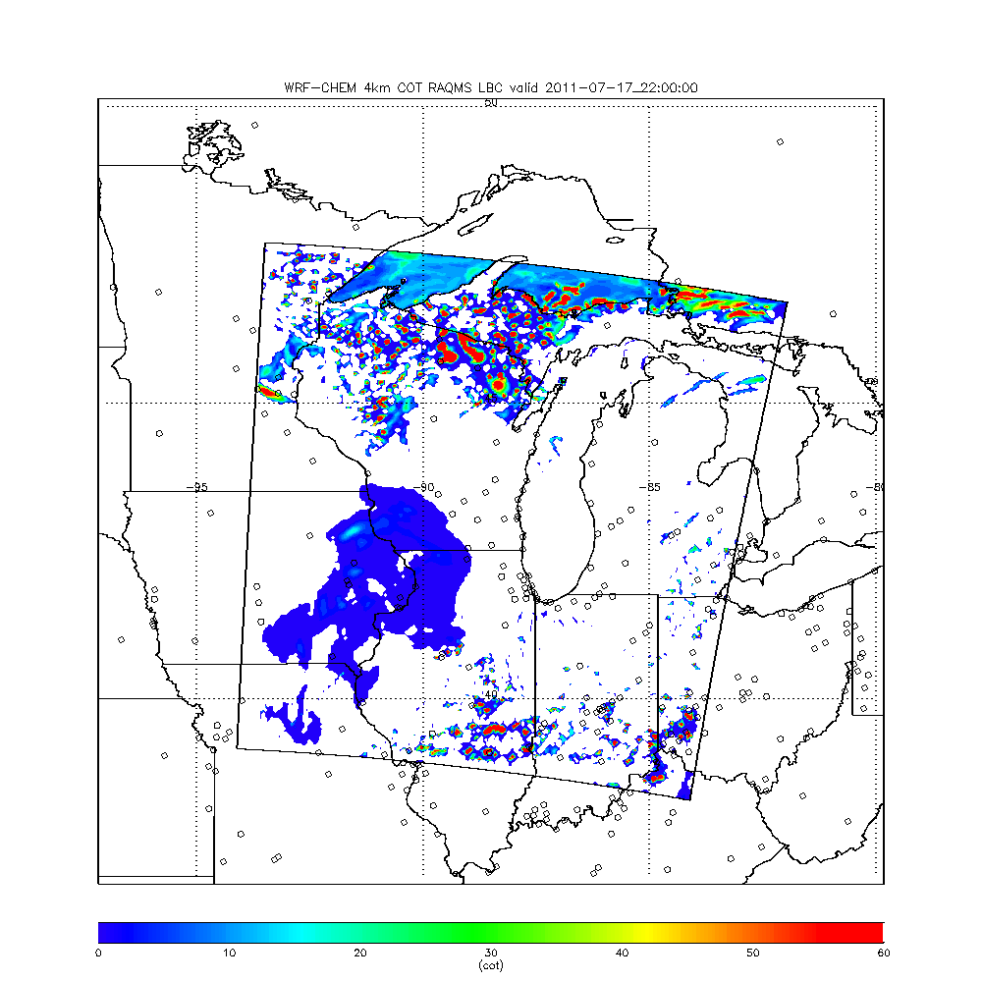
WRF-CHEM 4km Cloud Optical Thickness (COT) 22Z (5:00pm Central) July 17, 2011
Clear Skies over most of Western Shore of Lake Michigan and SE part of domain – 4km run with explicit convective clouds

Slide 6
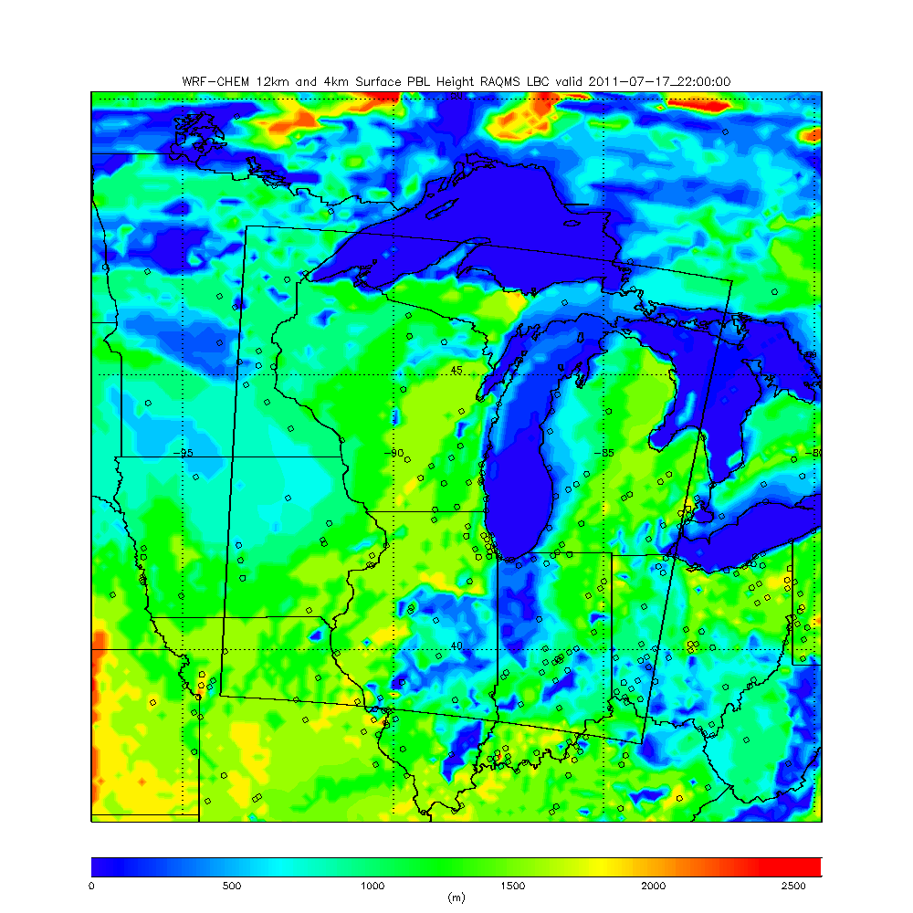
WRF-CHEM 12km Planetary Boundary Layer Depth (PBL) 22Z (5:00pm Central) July 17, 2011
12km PBL low over NW Indiana due to clouds

Slide 7
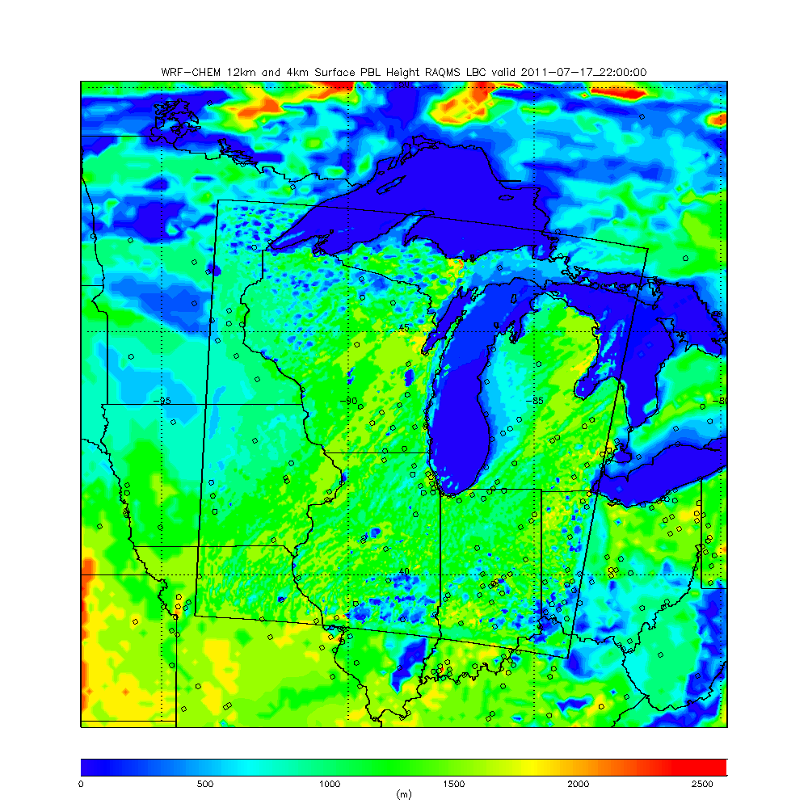
WRF-CHEM 4km Planetary Boundary Layer Depth (PBL) 22Z (5:00pm Central) July 17, 2011
4km PBL NOT low over NW Indiana due to LACK OF clouds

Slide 8
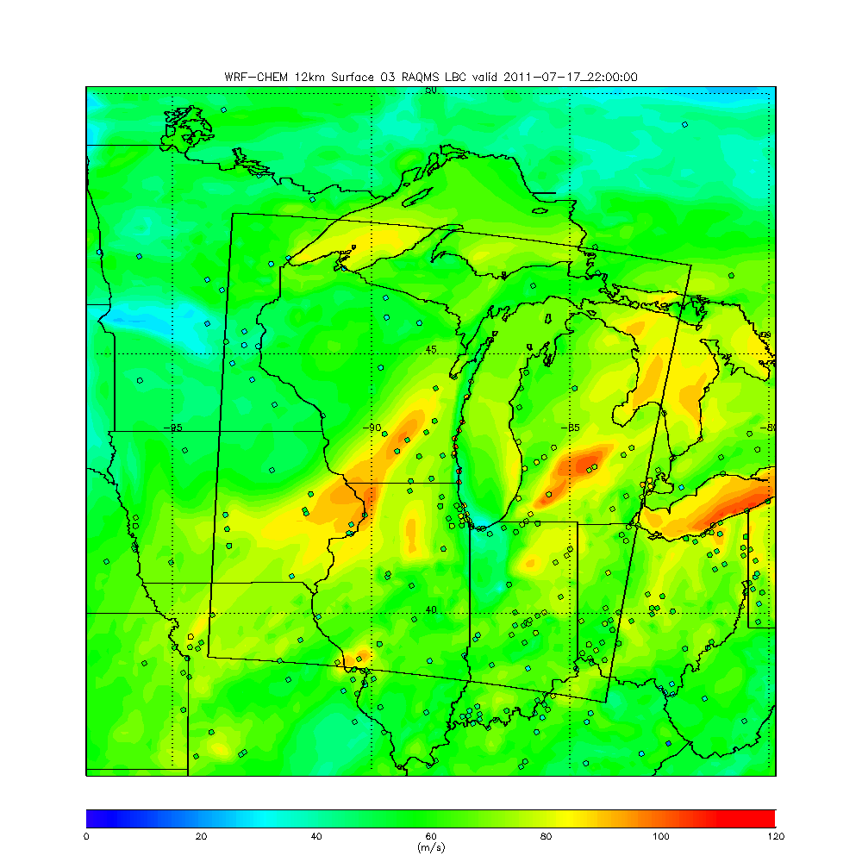
WRF-CHEM 12km Surface O3 22Z (5:00pm Central) July 17, 2011
12km WRF-CHEM does not capture observed enhancement along Western Shore of Lake Michigan

Slide 9
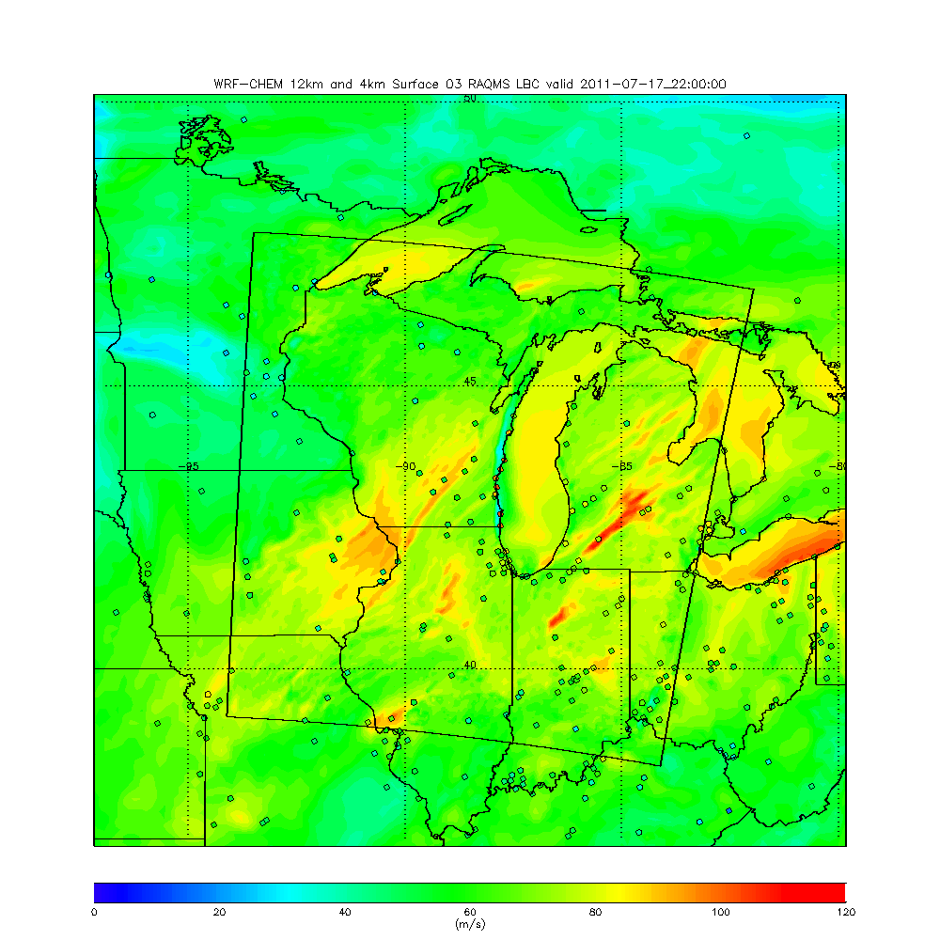
WRF-CHEM 4km Surface O3 22Z (5:00pm Central) July 17, 2011
4km WRF-CHEM shows significant increase in surface O3 over Lake Michigan but actually shows lower surface O3 than 12km along Western Shore of Lake Michigan

Slide 10
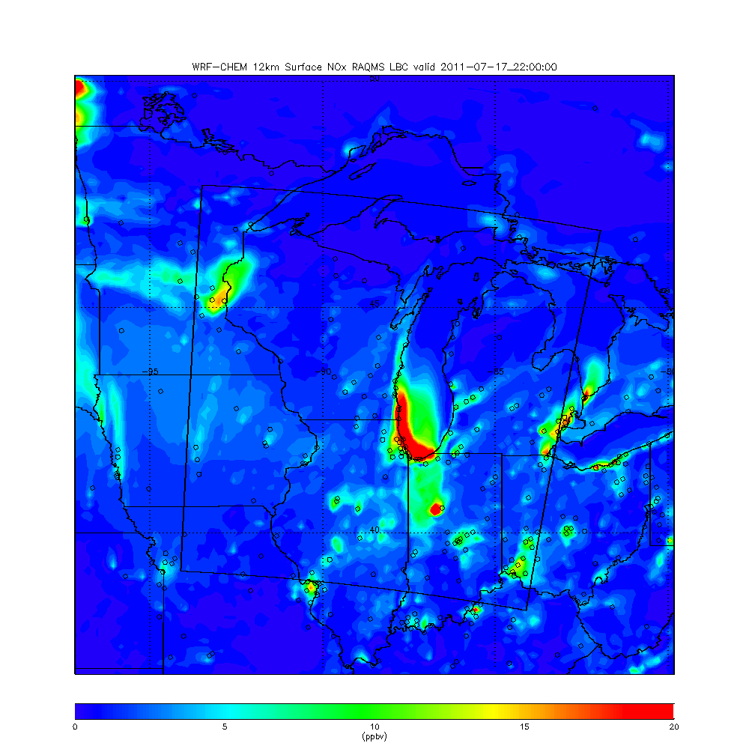
WRF-CHEM 12km Surface NOx 22Z (5:00pm Central) July 17, 2011
12km WRF-CHEM shows broad region of higher surface NOx over southern Lake Michigan and NW Indiana
12km NOx high over NW Indiana due to low PBL

Slide 11
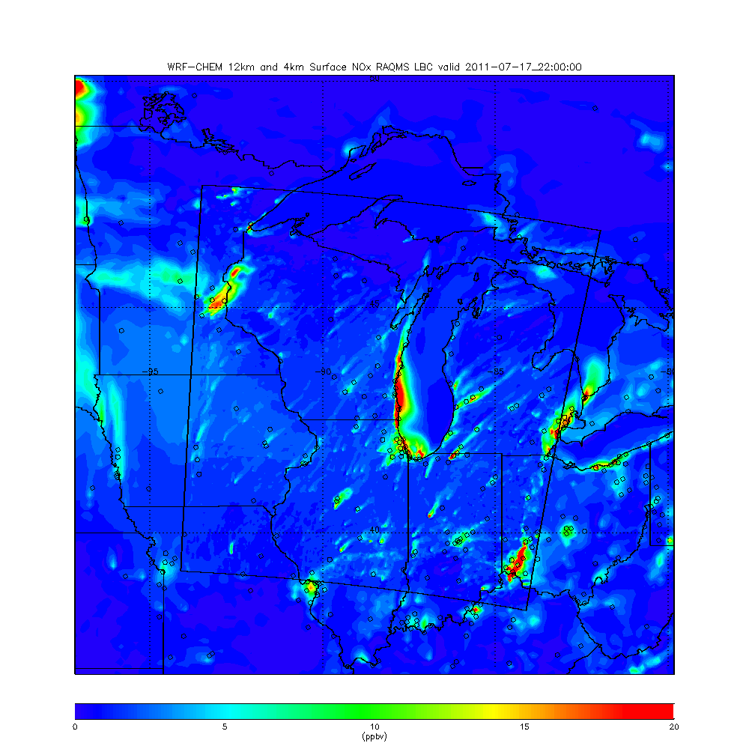
WRF-CHEM 4km Surface NOx 22Z (5:00pm Central) July 17, 2011
12km WRF-CHEM shows narrow region of higher surface NOx over Western shore of Lake Michigan
12km NOx NOT high over NW Indiana due to LACK of low PBL

Slide 12
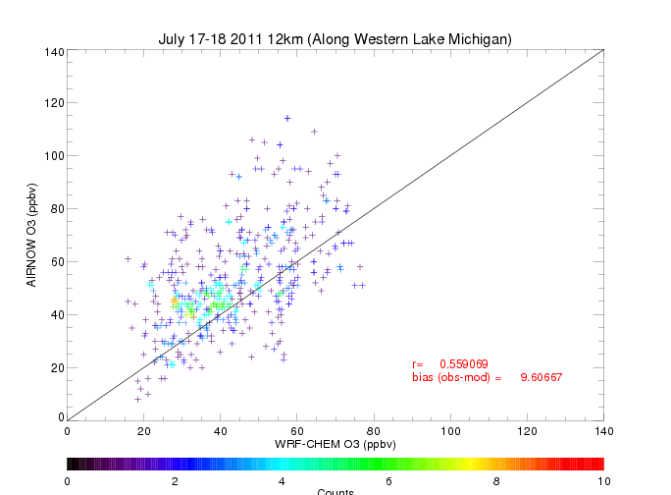
12km WRF-CHEM run has mean low bias of 9.6 ppbv along Western Shore of Lake Michigan
Model ranges from 40-70ppbv where AIRNOW ranges from 90-115ppbv

Slide 13
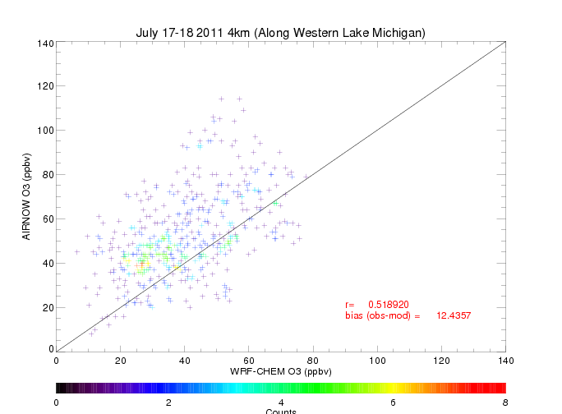
4km WRF-CHEM run has mean low bias of 12.4 ppbv along Western Shore of Lake Michigan
Model ranges from 35-65ppbv where AIRNOW ranges from 90-115ppbv

Slide 14
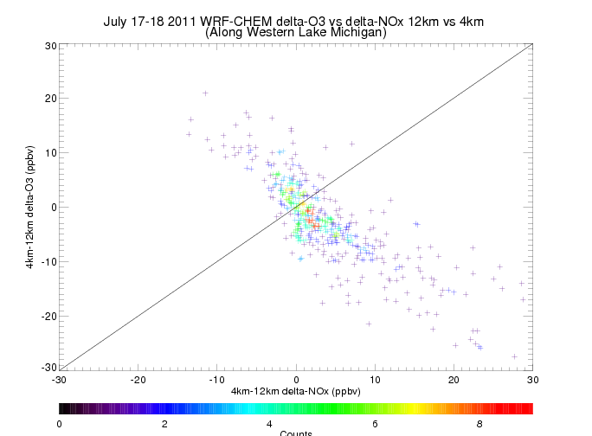
Increases (decreases) in surface NOx result in decreases (increases) in surface O3 at AIRNOW sites along the Western Shore of Lake Michigan on July 17-18, 2011

Slide 15
Preliminary Conclusions:
4km simulation leads to more O3 production over Lake Michigan but not along the western shore where high O3 was observed. In fact, the 4km simulation shows lower O3 along the western shore then the 12km simulation.
This may occur because the 4km nest shows stronger lake breeze circulation along western shore of Lake Michigan which results in transport of high NOx plume further north along the lake shore and overall reductions in ozone
Suggests that NEI 2011 NO emissions are too high in Chicago

Slide 16
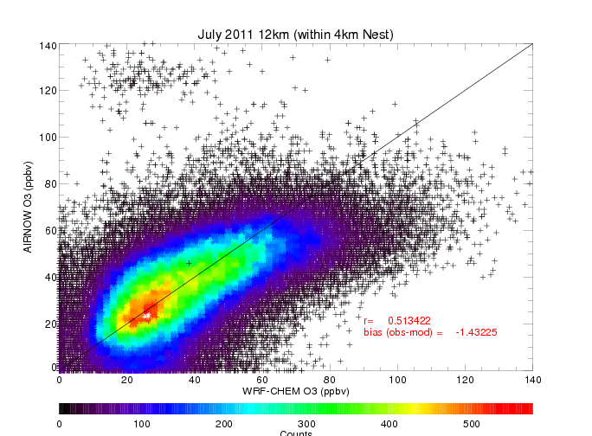

Slide 18
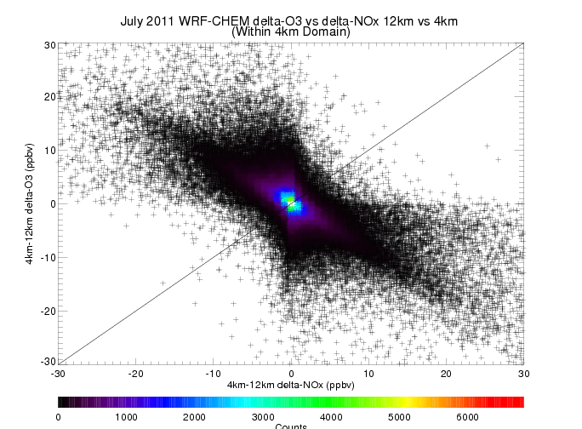
In general, increases (decreases) in surface NOx result in decreases (increases) in surface O3 at AIRNOW sites within 4km nest

