Slide 1
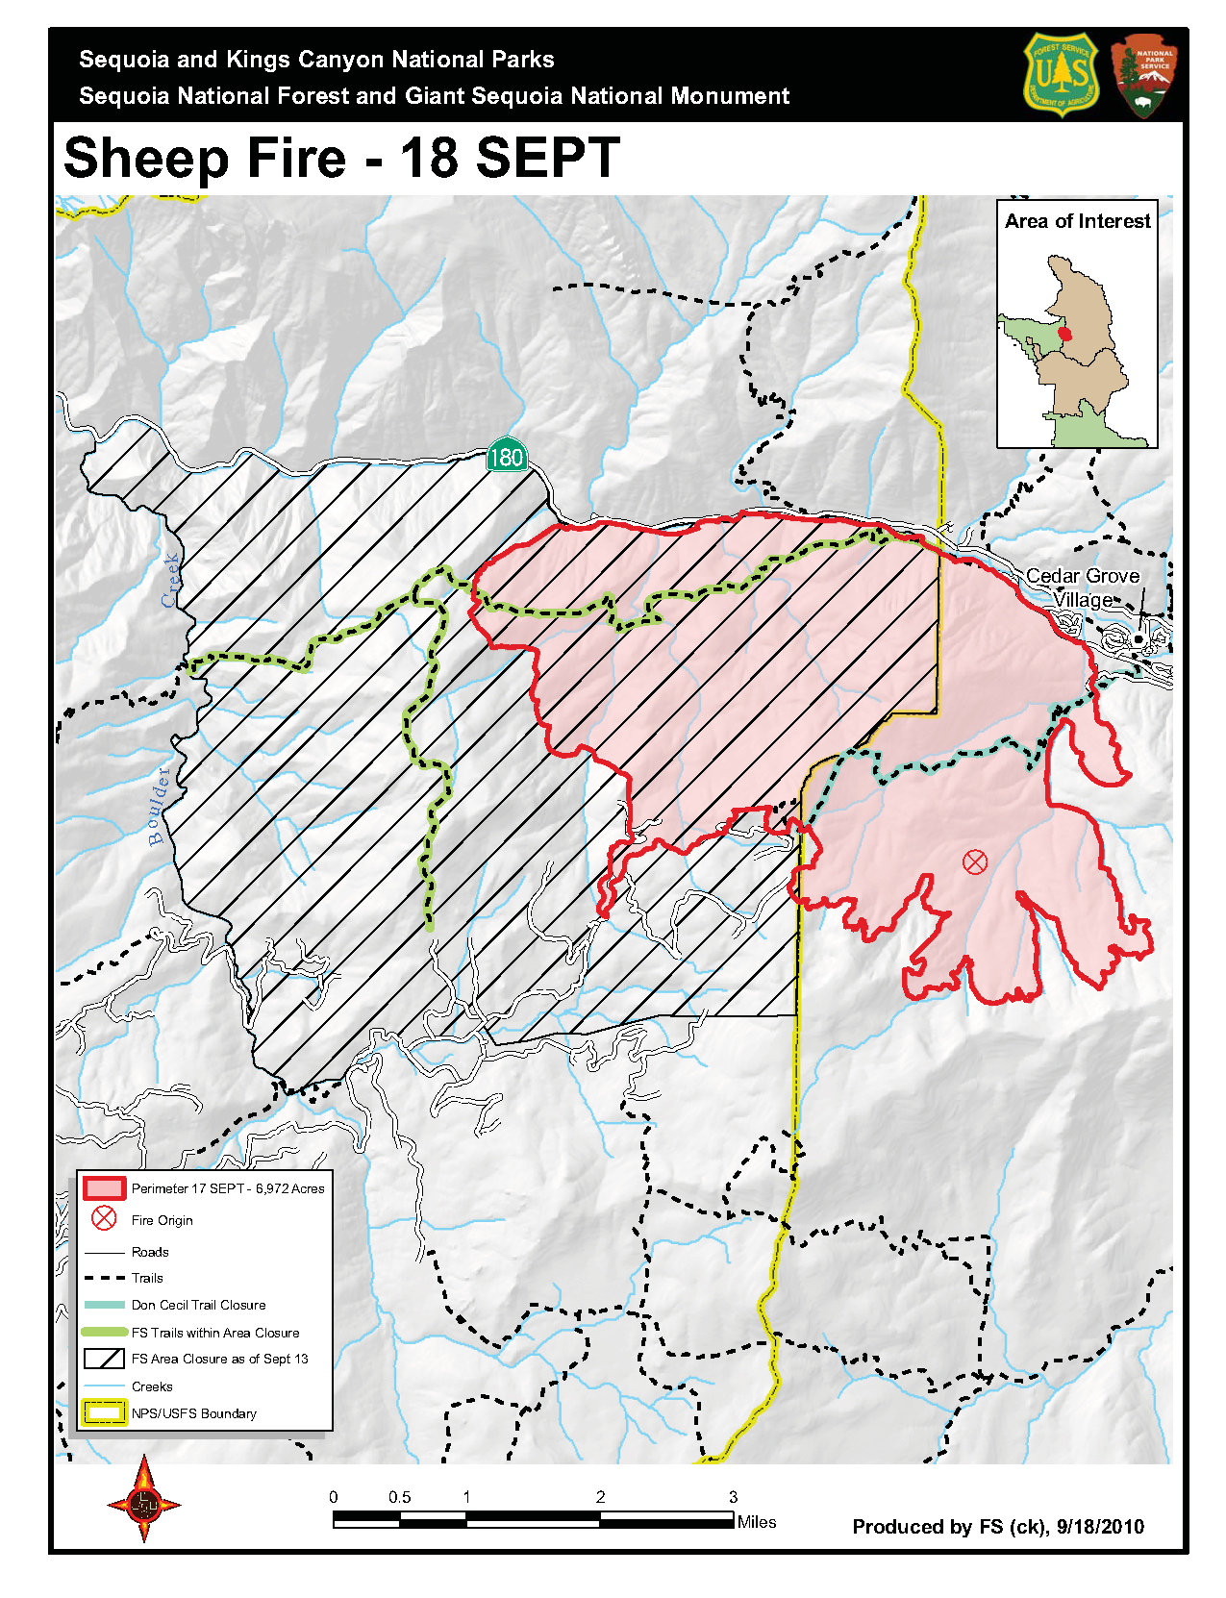
GOES 11 visible band (0.65 micron)
15 minute imagery for Sheep Fire on August 18, 2010 and September 18, 2010.
Illustration of potential GOES Rapid Scan Operations (RSO) during Fall 2013 Hume Lake Ranger District planned burn

Slide 2
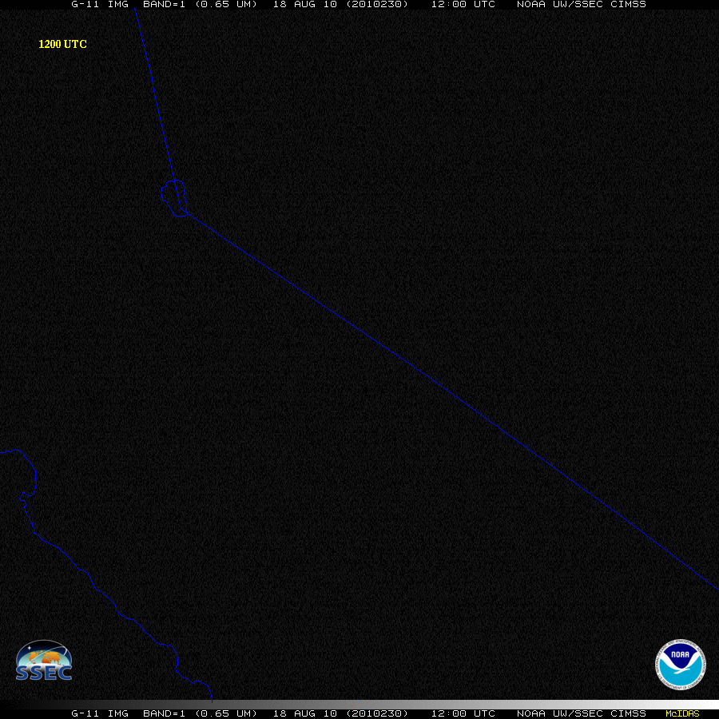
Status as of 08/18/2010
Acreage - 1246 acres

Slide 3
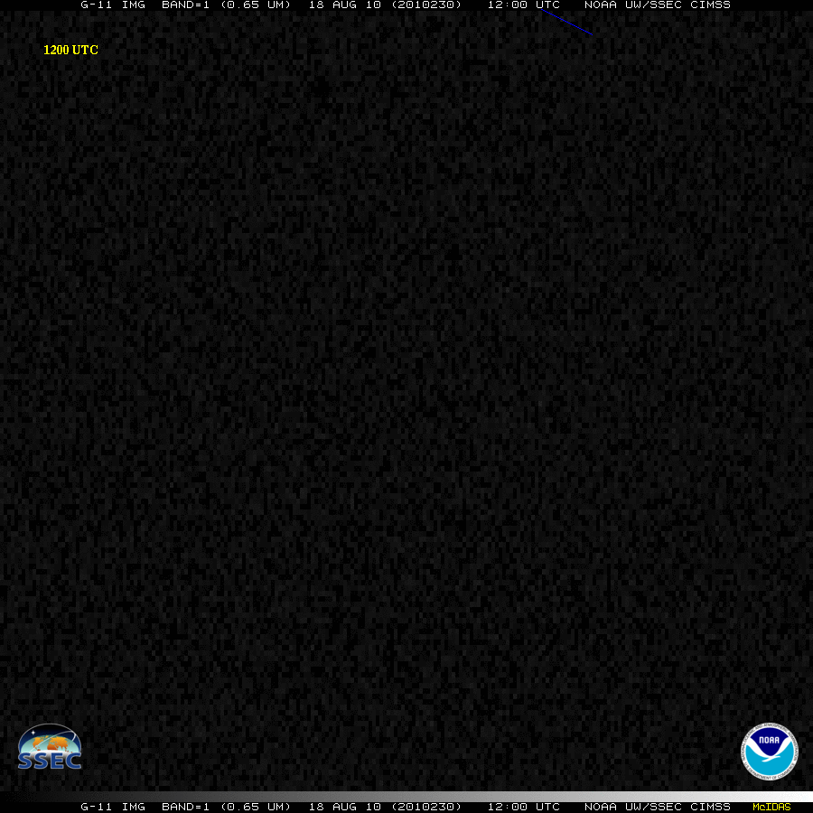
Status as of 08/18/2010
Acreage - 1246 acres
Zoom

Slide 4
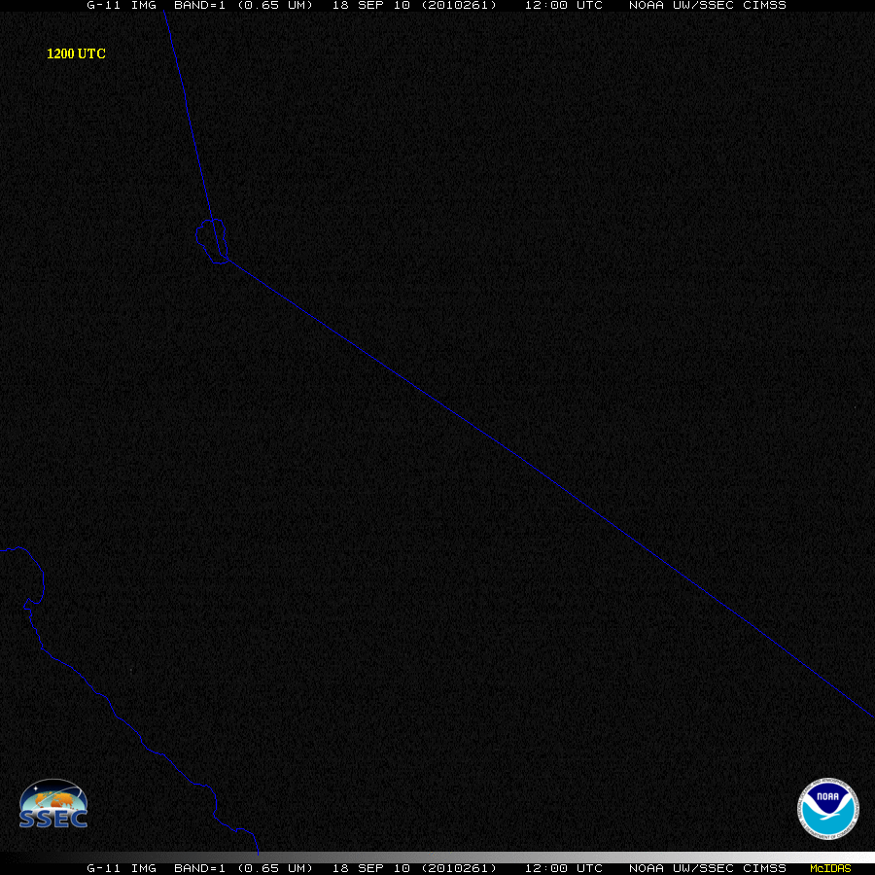
Status as of 09/18/2010
Acreage - 6,990 acres

Slide 5

Status as of 09/18/2010
Acreage - 6,990 acres
Zoom

Slide 6
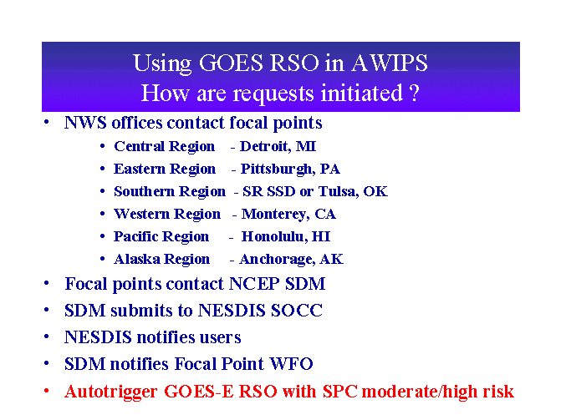
http://rammb.cira.colostate.edu/visit/rso/title.asp

Slide 7
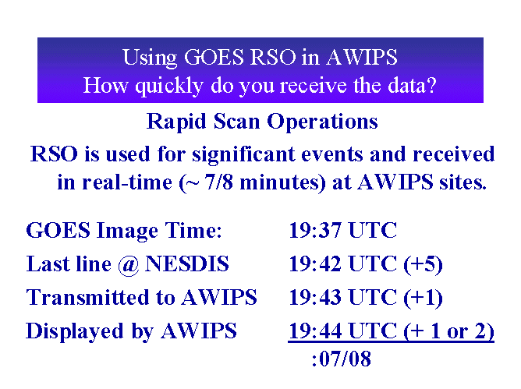
http://rammb.cira.colostate.edu/visit/rso/title.asp

Slide 8
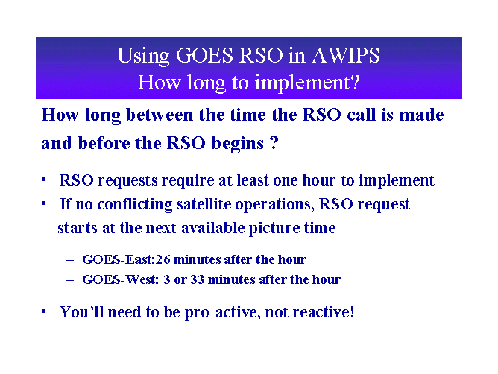
http://rammb.cira.colostate.edu/visit/rso/title.asp

