Slide 1
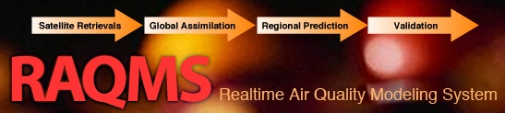

Development
and applications of Air Quality Models
Real-time Air Quality Modeling System
R. Bradley Pierce
NOAA/NESDIS/CIMSS
ES/AOS 535 Air Quality Modeling and Analysis February 11, 2016

Slide 2
A Proposal to the NASA Langley Research Center 2000 Creativity and Innovation Program
Title: Regional Air Quality Modeling System (RAQMS)
Topic Area: Global Climate and Environmental Quality
Principle Investigator: R. Bradley Pierce (864-5817, r.b.pierce@larc.nasa.gov)
LaRC Co-Investigators: T. Duncan Fairlie (t.d.fairlie@larc.nasa.gov),
Jassim A. Al-Saadi (j.a.al-saadi@larc.nasa.gov), Jennifer R. Olson
(j.r.olson@larc.nasa.gov), James H. Crawford (j.h.crawford@larc.nasa.gov)
Doreen O. Neil (d.o.neil@larc.nasa.gov), Jack Fishman (j.fishman@larc.nasa.gov)
University of Wisconsin Co-Investigators: Donald R. Johnson (donj@ssec.wisc.edu),
Matthew H. Hitchman (matt@meteor.wisc.edu), Gregory J. Tripoli
(tripoli@meteor.wisc.edu)
EPA Co-Investigator: James J. Szykman (j.j.szykman@larc.nasa.gov )
Abstract: This proposed joint effort between LaRC and the University of Wisconsin-Madison (UW) aims to develop a meteorological and chemical modeling system for assimilating remote and in-situ observations of chemical composition, and provide predictions of air quality within any region of planet Earth. The combination of UW meteorological modeling capabilities and LaRC photochemical modeling expertise will yield a powerful capability that advances the science of air quality prediction using observations from new remote sensing platforms and will revolutionize weather forecasting by paving the way for air quality predictions. Developing a capability to assimilate meteorological and chemical observations within RAQMS will provide NASA with outreach opportunities as governmental agencies such as NOAA and EPA move toward operational prediction of air quality in the coming decades.

Slide 3
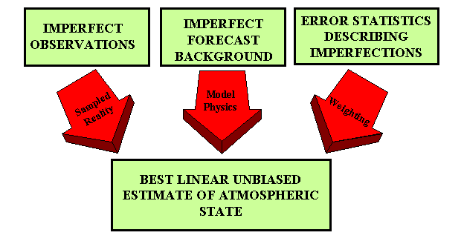

Analysis/Forecast Cycle
Current observations are combined with previous knowledge (first guess) to produce a forecast of the weather
Observations
Model
Forecast
Increment:
OBS-FX
Analysis
FX IC
Statistical
Blending

Slide 4
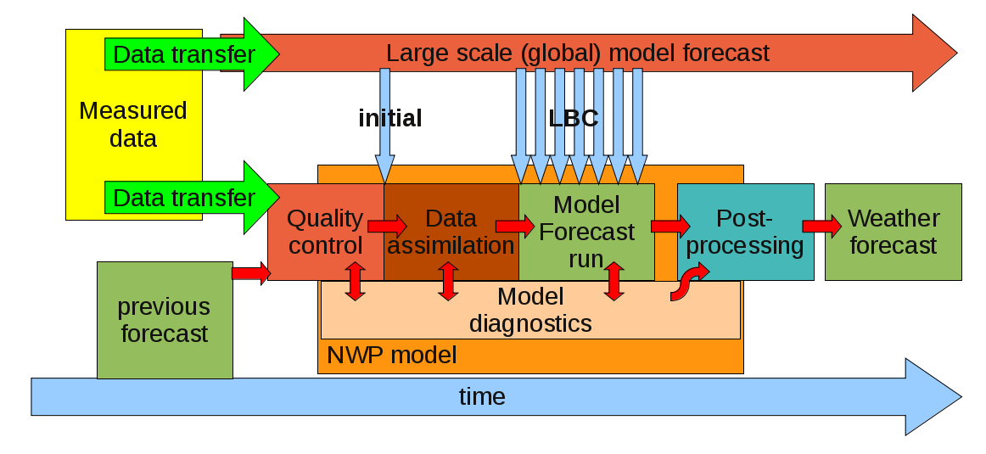
Schematic of an Operational
Numerical Weather Prediction (NWP) modeling system

Slide 5
Schematic of an Operational
Numerical Weather Prediction (NWP) modeling system

Slide 6
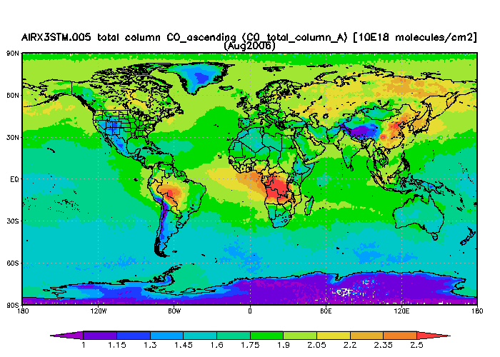
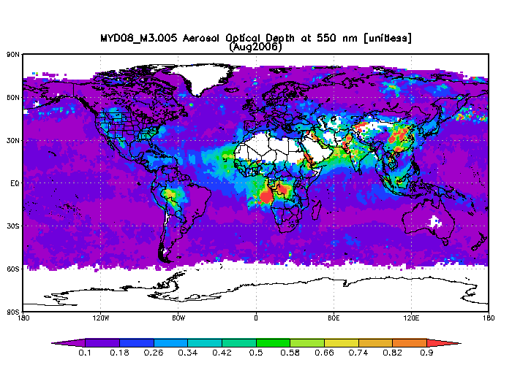
Satellite Aerosol and Carbon monoxide measurements
August 2006
Global distribution of carbon monoxide (CO)
From the Atmospheric Infrared Sounder (AIRS)
Global distribution of aerosol optical depth (AOD) from the Moderate Resolution Imaging Spectroradiometer (MODIS)
AIRS, and MODIS maps were produced with the Giovanni online data system [http://disc.sci.gsfc.nasa.gov/giovanni/]

Slide 7
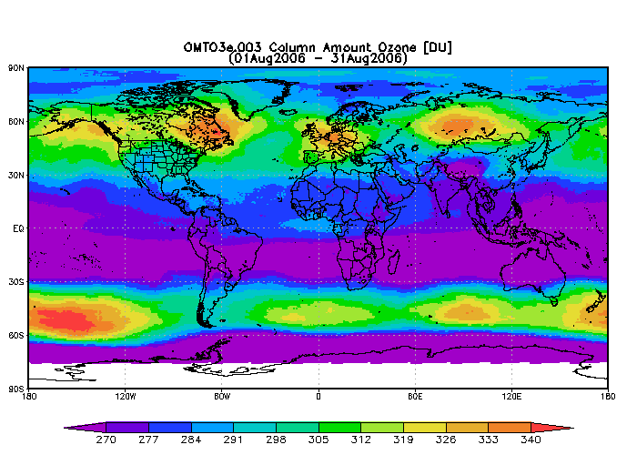
Satellite O₃ measurements
Challenge for O3 assimilation is separation of the stratosphere from troposphere to provide constraints on tropospheric analysis
AIRS and OMI maps were produced with the Giovanni online data system [http://disc.sci.gsfc.nasa.gov/giovanni/]

Slide 8
Schematic of an Operational
Numerical Weather Prediction (NWP) modeling system

Slide 9
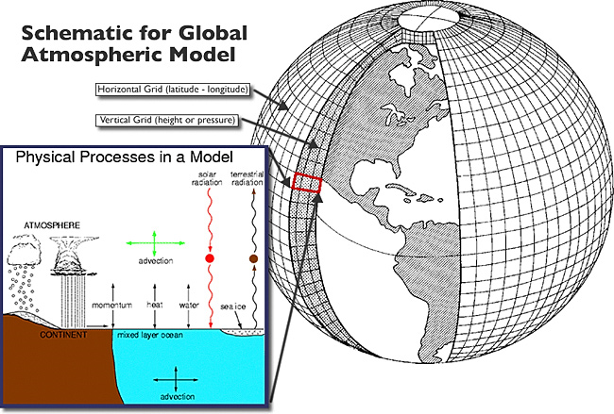
The Atmospheric Model
The primitive equations are a set of nonlinear differential equations that are used to approximate global atmospheric flow and are used in most atmospheric models. They consist of three main sets of equations:
Conservation of momentum: Consisting of a form of the Navier–Stokes equations that describe hydrodynamical flow on the surface of a sphere under the assumption that vertical motion is much smaller than horizontal motion and that the fluid layer depth is small compared to the radius of the sphere
A thermal energy equation: Relating the overall temperature of the system to heat sources and sinks
A continuity equation: Representing the conservation of mass.
Add continuity equations for each chemical species, as well as sources (emissions, photochemical and microphysical sources), and sinks (wet and dry deposion, photochemical loss) and you have RAQMS

Slide 10
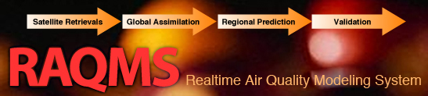
Model Description
Online global chemical and aerosol assimilation/ forecasting system
UW-Madison sigma-theta hybrid coordinate model (UW-Hybrid) dynamical core
Unified stratosphere/troposphere chemical prediction scheme (LaRC-Combo) developed at NASA LaRC
Aerosol prediction scheme (GOCART) developed by Mian Chin (NASA GSFC).
Statistical Digital Filter (OI) assimilation system developed by James Stobie (NASA/GFSC)

Slide 11
Model Description
Online global chemical and aerosol assimilation/ forecasting system
UW-Madison sigma-theta hybrid coordinate model (UW-Hybrid) dynamical core
Unified stratosphere/troposphere chemical prediction scheme (LaRC-Combo) developed at NASA LaRC
Aerosol prediction scheme (GOCART) developed by Mian Chin (NASA GSFC).
Statistical Digital Filter (OI) assimilation system developed by James Stobie (NASA/GFSC)

Slide 12
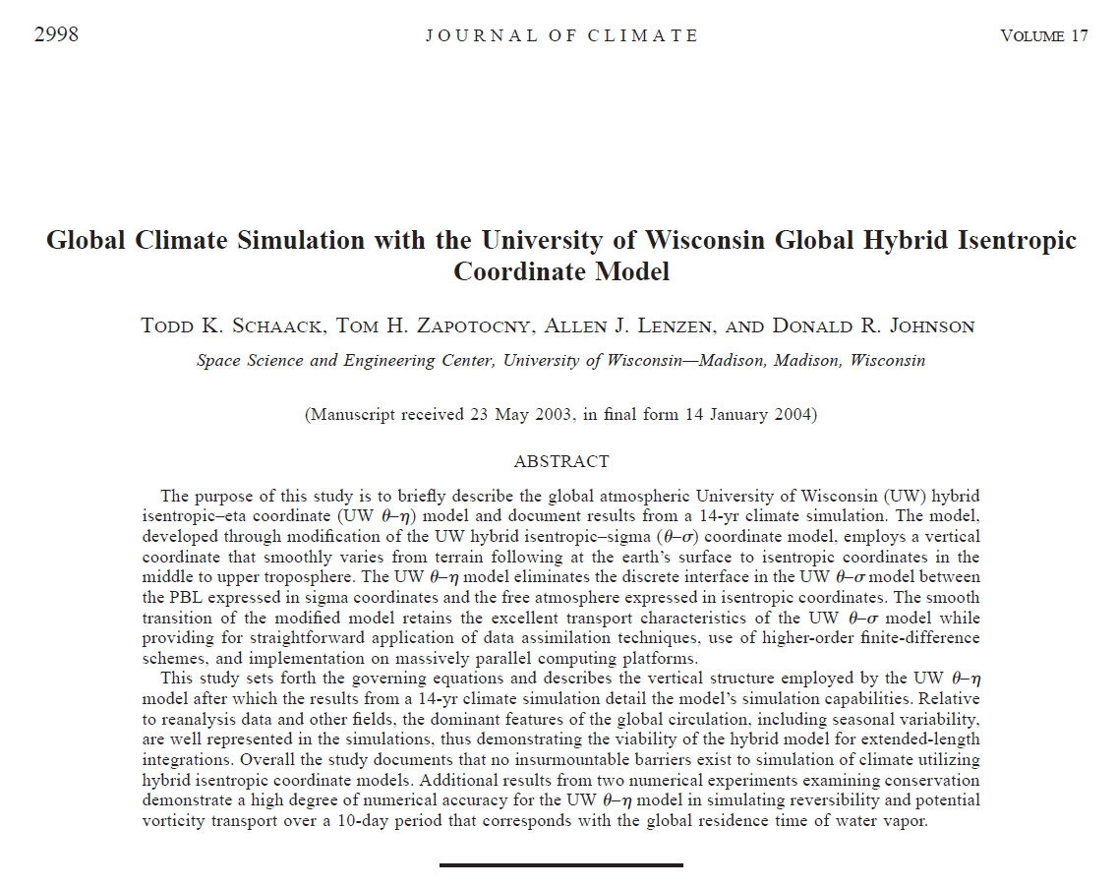
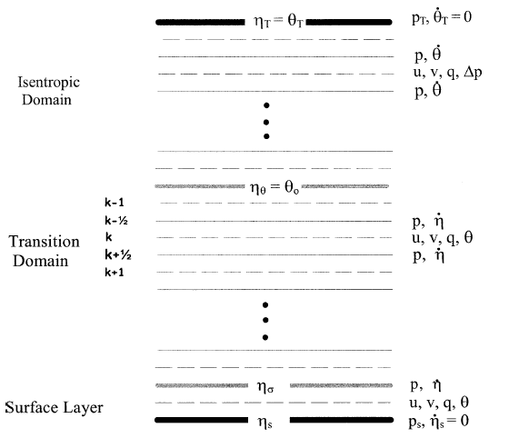
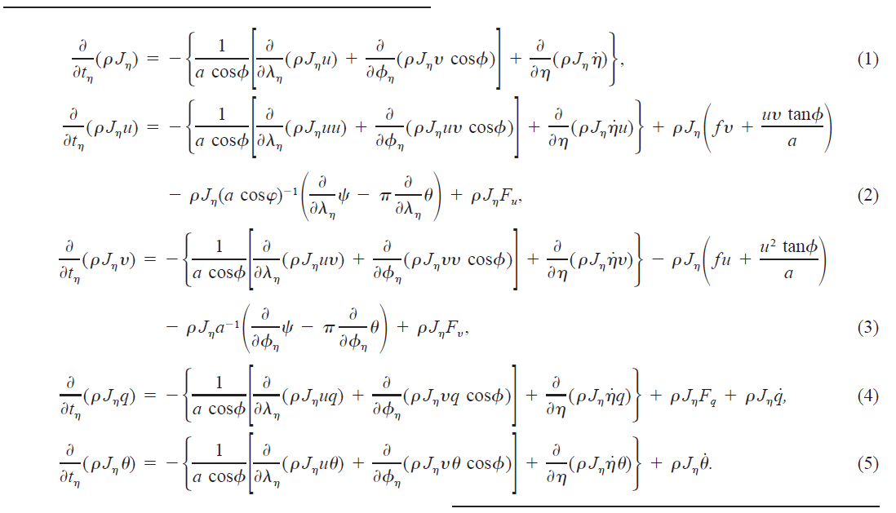
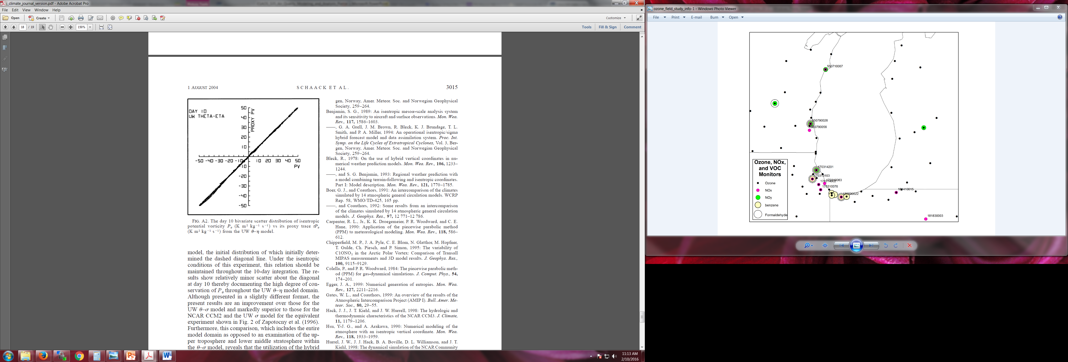
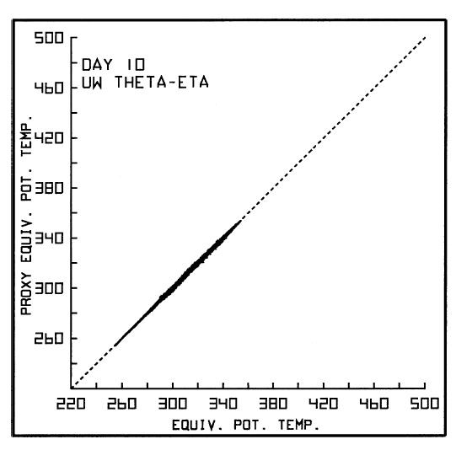
UW-Hybrid Vertical Grid
UW-Hybrid Equations
UW-Hybrid Conservation Properties

Slide 13
Model Description
Online global chemical and aerosol assimilation/ forecasting system
UW-Madison sigma-theta hybrid coordinate model (UW-Hybrid) dynamical core
Unified stratosphere/troposphere chemical prediction scheme (LaRC-Combo) developed at NASA LaRC
Aerosol prediction scheme (GOCART) developed by Mian Chin (NASA GSFC).
Statistical Digital Filter (OI) assimilation system developed by James Stobie (NASA/GFSC)

Slide 14
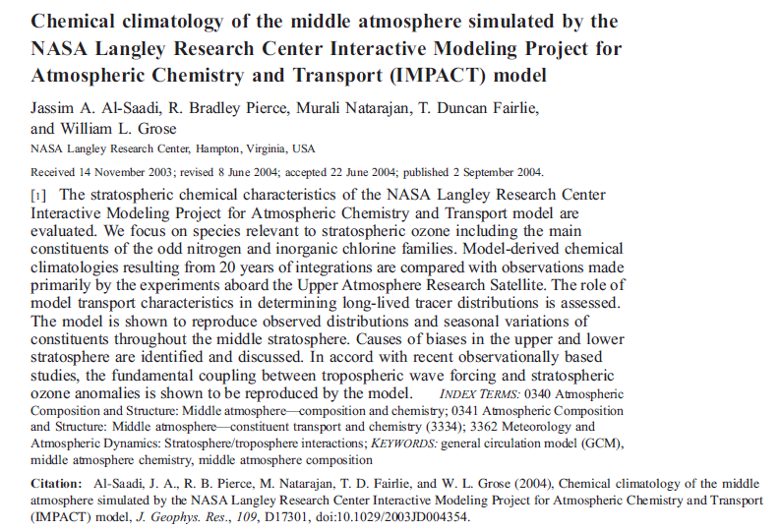
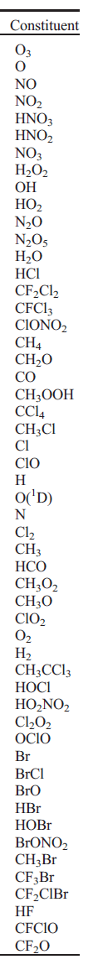
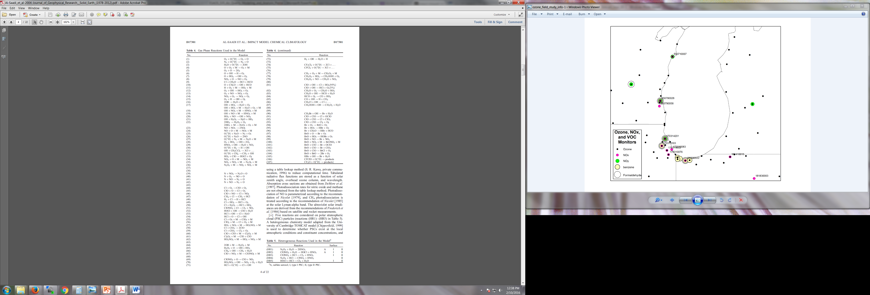
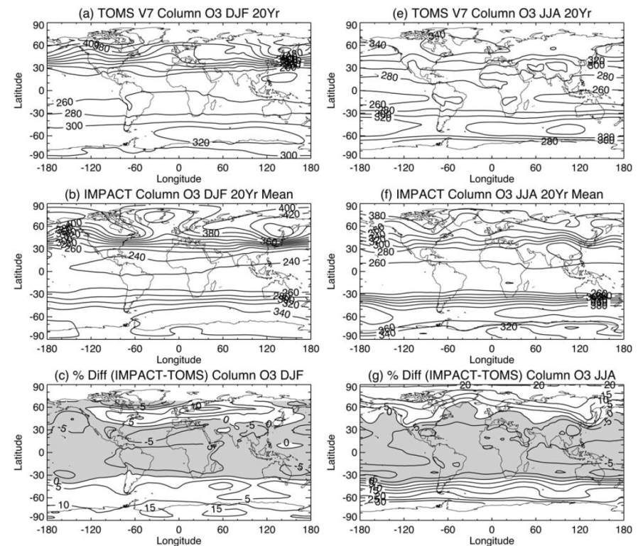

Slide 15
Model Description
Online global chemical and aerosol assimilation/ forecasting system
UW-Madison sigma-theta hybrid coordinate model (UW-Hybrid) dynamical core
Unified stratosphere/troposphere chemical prediction scheme (LaRC-Combo) developed at NASA LaRC
Aerosol prediction scheme (GOCART) developed by Mian Chin (NASA GSFC).
Statistical Digital Filter (OI) assimilation system developed by James Stobie (NASA/GFSC)

Slide 16
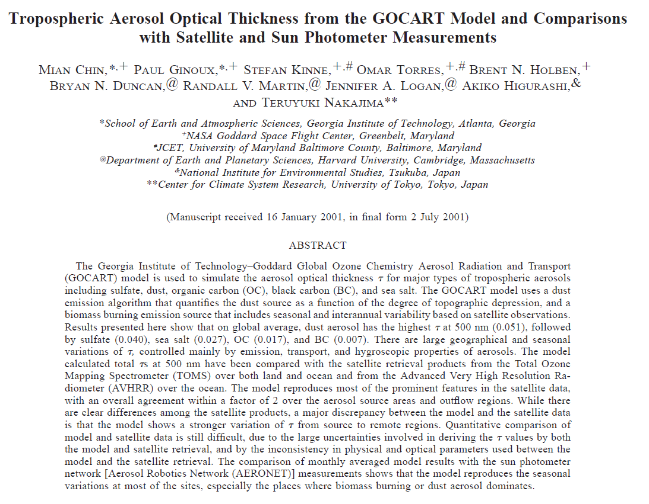
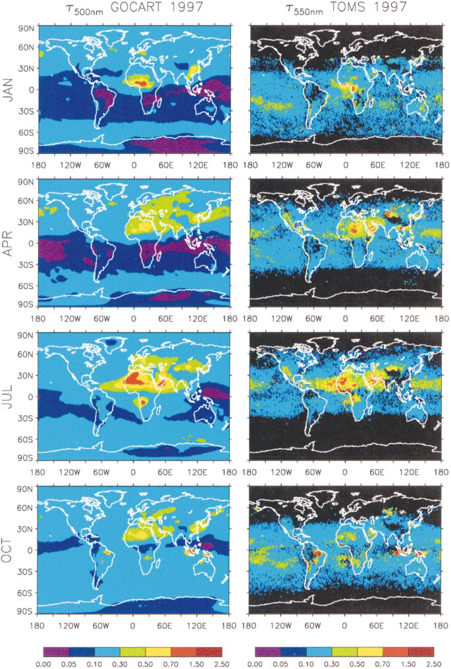
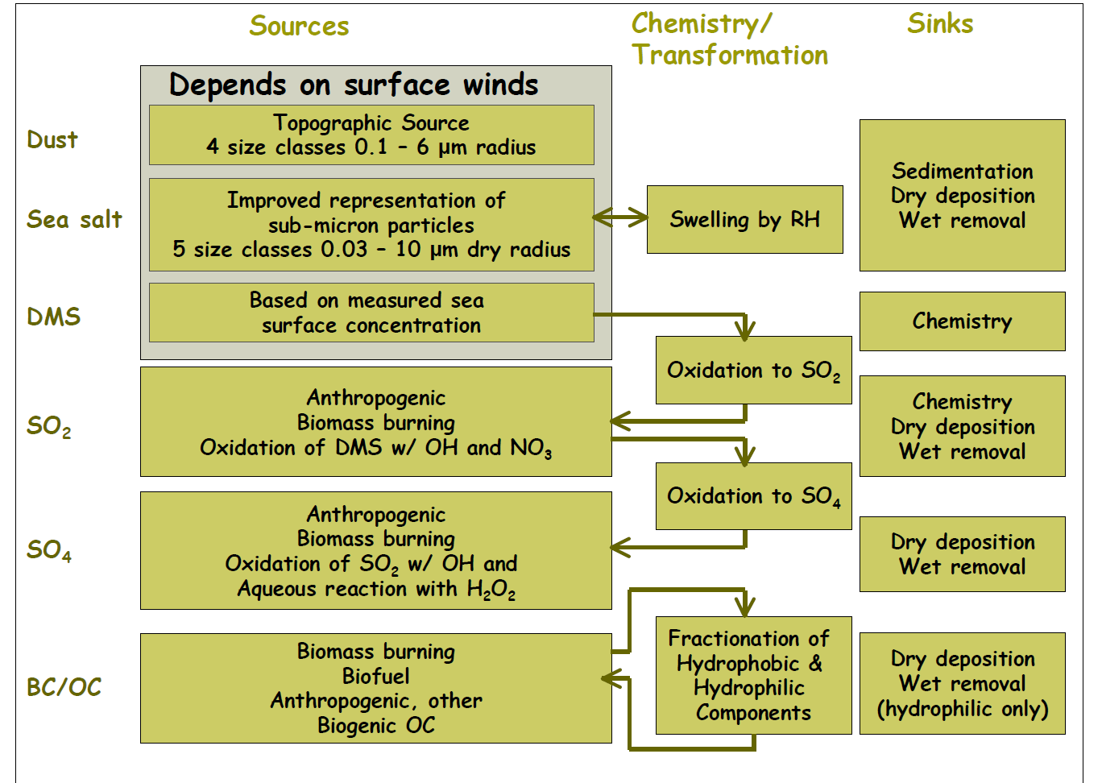

Slide 17

REMOTE SENSING OF TROPOSPHERIC POLLUTION FROM SPACE:
JACK FISHMAN, KEVIN W. BOWMAN, JOHN P. BURROWS, ANDREAS RICHTER, KELLY V. CHANCE,DAVID P. EDWARDS, RANDALL V. MARTIN, GARY A. MORRIS, R. BRADLEY PIERCE, JERALD R. ZIEMKE,JASSIM A. AL-SAADI, JOHN K. CREILSON, TODD K. SCHAACK, AND ANNE M. THOMPSON
(Top) August 2006 O3 and CO columns from Realtime Air Quality Modeling System (RAQMS) chemical analyses. (Bottom) Comparisons for Houston and Huntsville IONS ozonesonde sites.
“Remote Sensing of Tropospheric Pollution from Space” (BAMS June 2008 Cover Article)
  current capabilities for assimilation of composition measurements (RAQMS)
  role of trace gas measurements within the context of GEOSS
  national priorities for space-based measurements in the next decade (NRC Decadal Survey)

Slide 18
RAQMS Applications

Slide 19
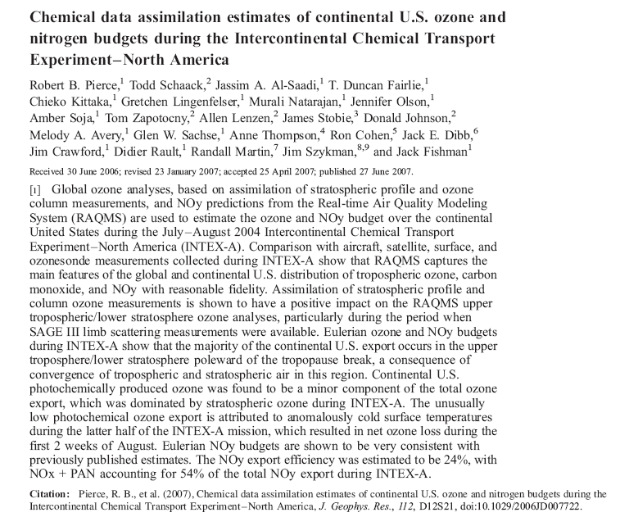
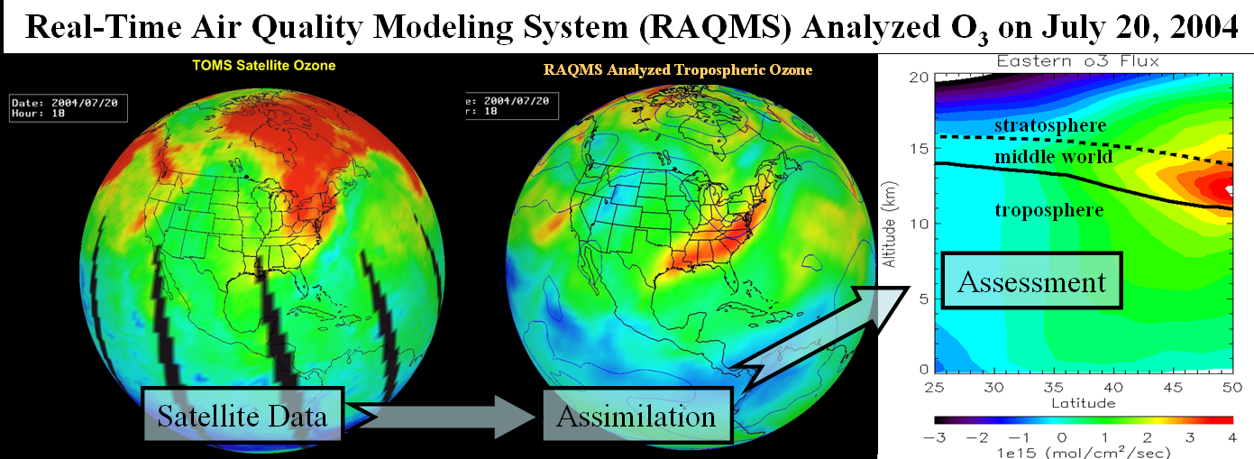
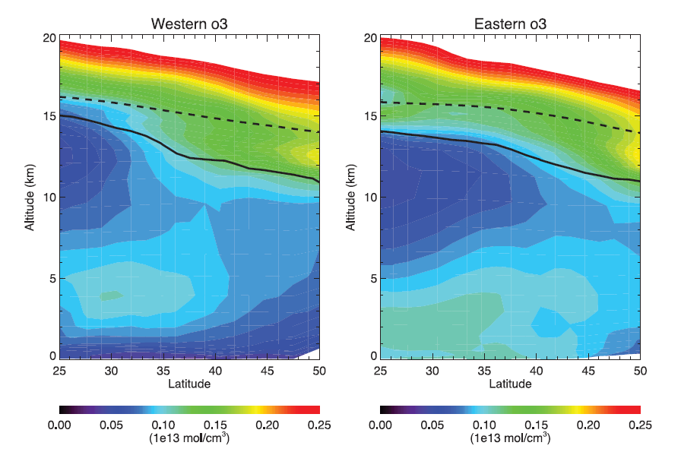
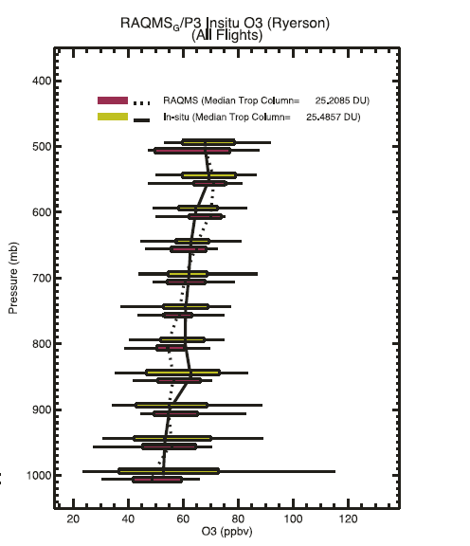
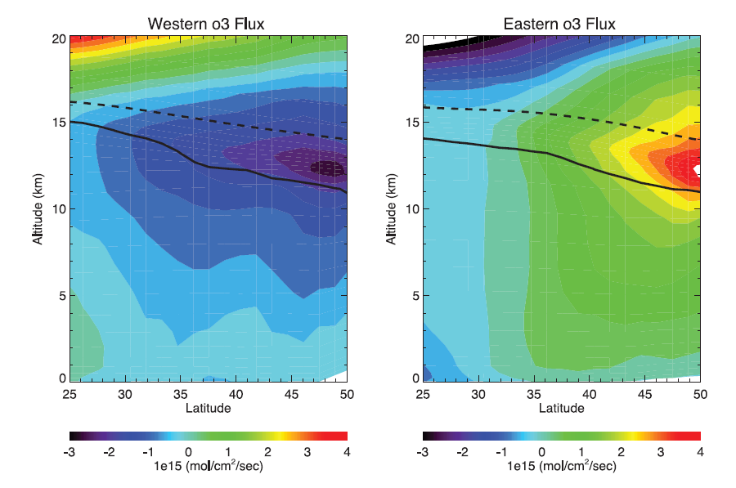
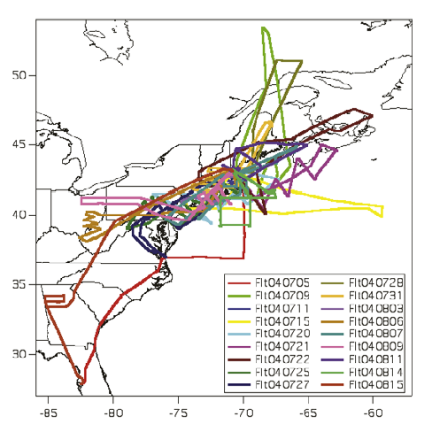
NOAA P3 Flights

Slide 20
Schematic of an Operational
Numerical Weather Prediction (NWP) modeling system

Slide 21
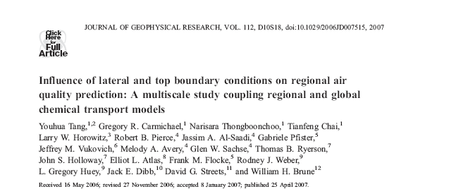
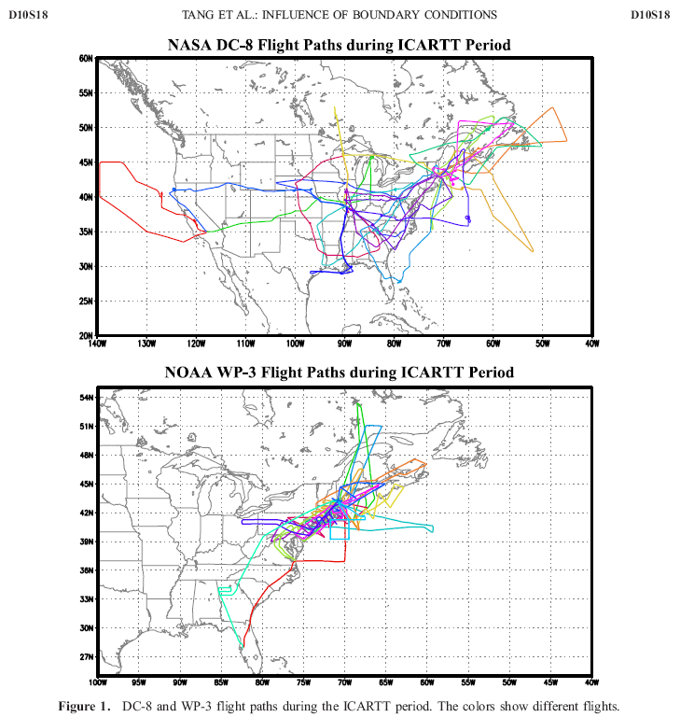
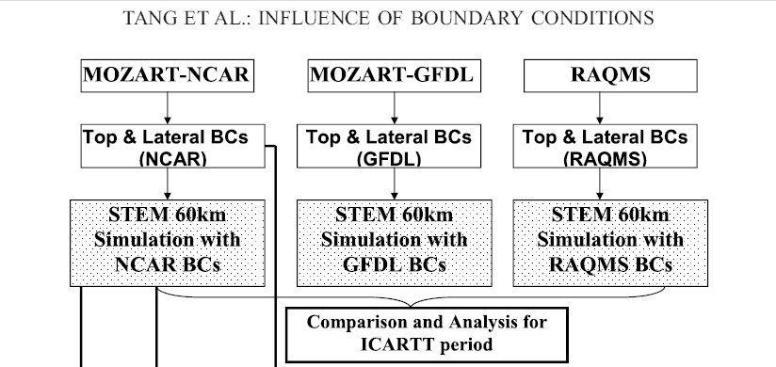
Impacts on Continental Scale
Air Quality Prediction
Continental
Background
Northeast
Corridor

Slide 22
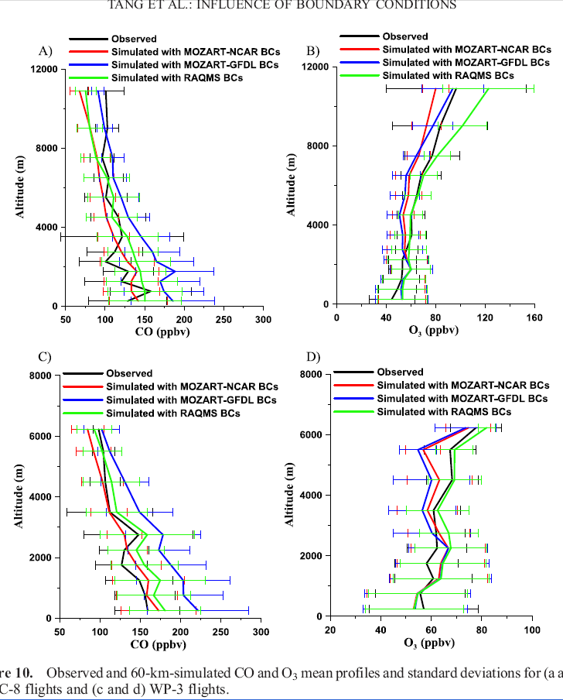
DC8 CO
The effects of CO BCs are most important near the surface.
The effects of O3 BCs are most important above 4 km.
Significant implications for operational AQ forecasting
DC8 O3
P3 CO
P3 O3

Slide 23
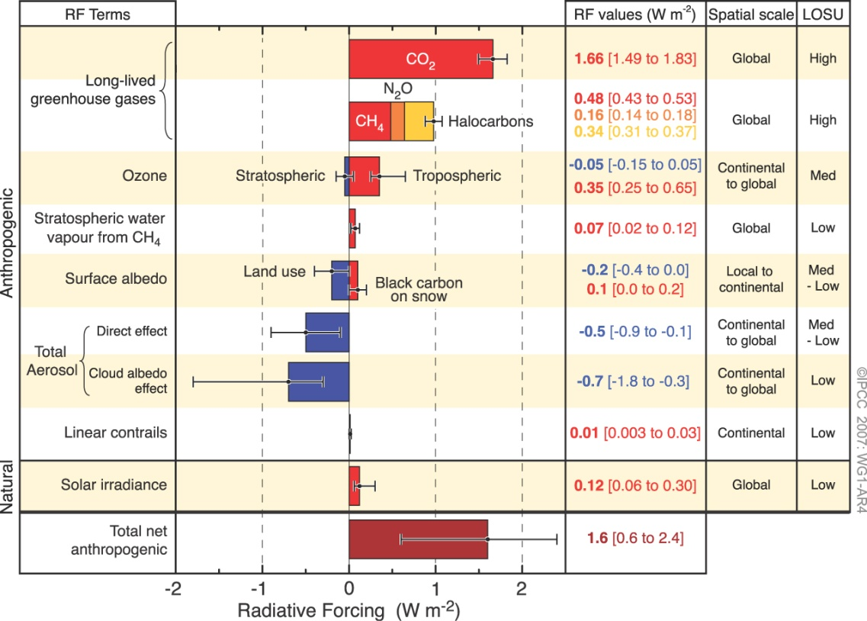
Air Quality
Links between air quality and global climate change
Fourth Assessment Report of the Intergovernmental Panel on Climate Change, 2007
Notes:
23

Slide 24
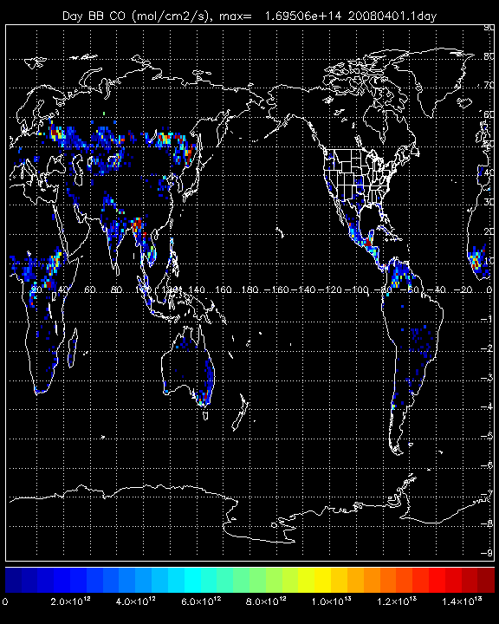
April 2008 Biomass Burning CO Emissions
Kazakhstan
Baykal
Thailand
Notes:
24

Slide 25
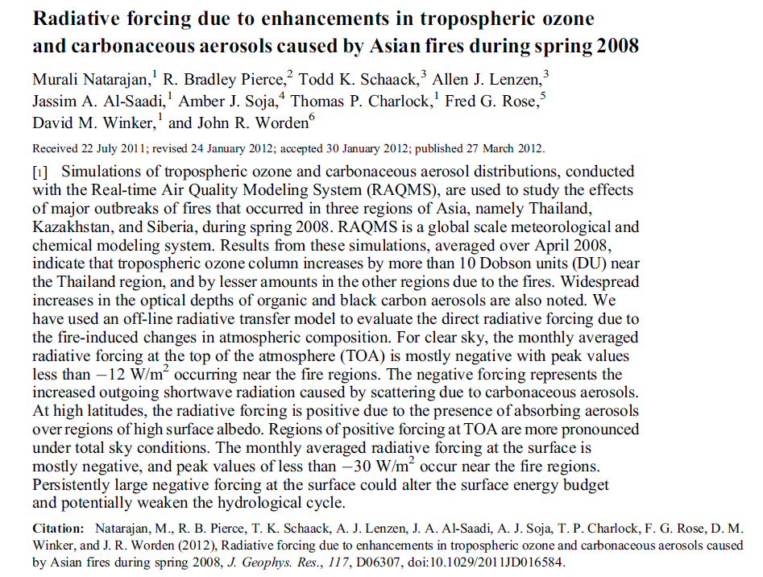
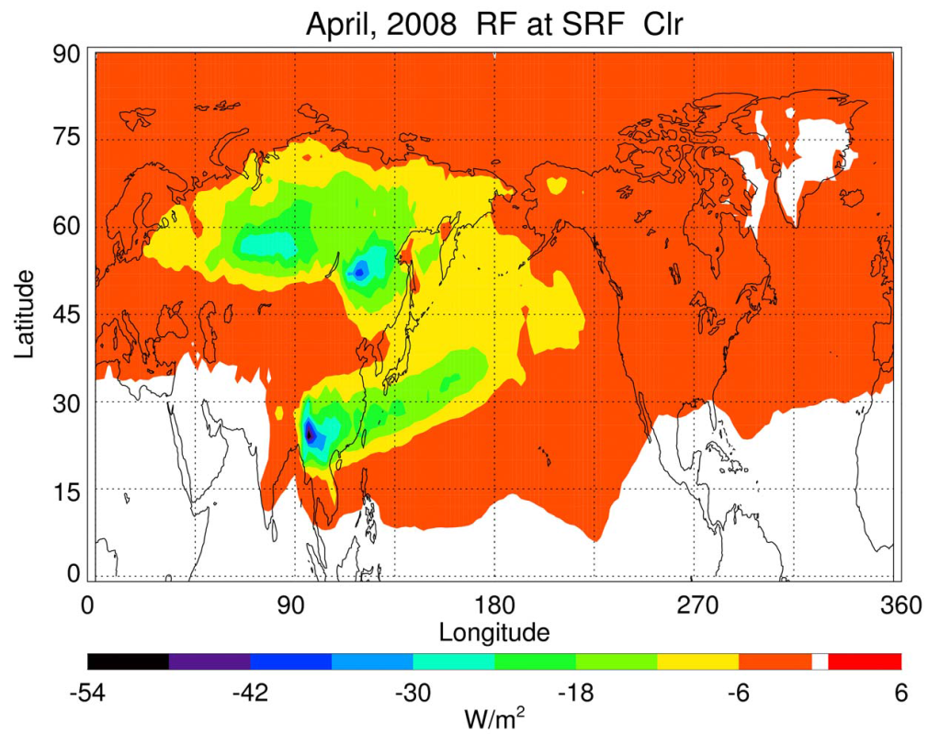
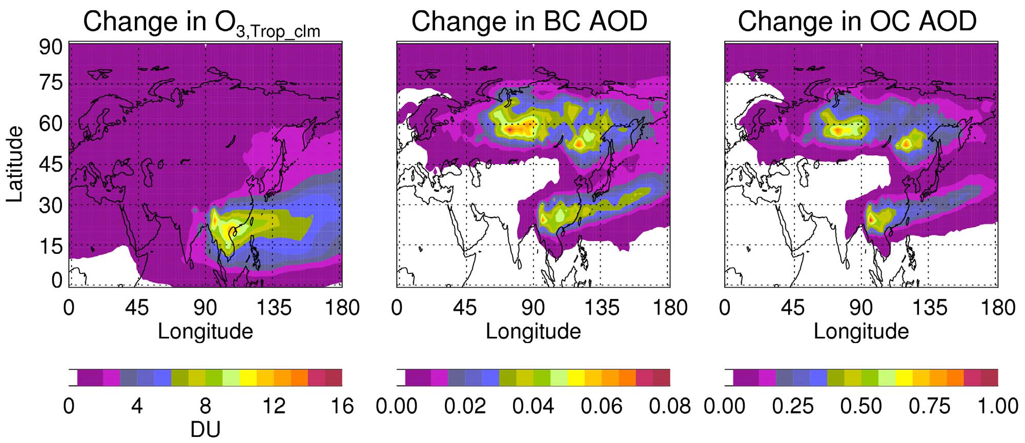

Slide 26
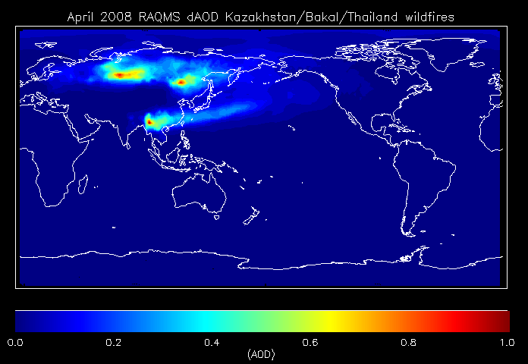
Impacts of Kazakhstan/Baykal/Thailand wildfires
Impact of Kazakhstan/Baykal/Thailand wildfires on tropospheric aerosols extends into North America with potential US Air Quality impacts
Notes:
26

Slide 27
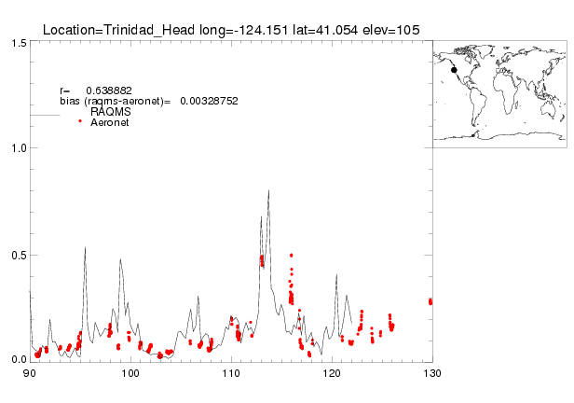
Trinidad Aeronet vs RAQMS AOD: April 2008
April 22nd,2008
Biomass burning aerosols observed at Trinidad Head on April 22, 2008
Aerosol Robotic Network (AERONET)
is global network of Sun photometers
[Holben et al., 1998]

Slide 28

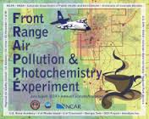
The Front Range Air Pollution and Photochemistry Éxperiment (FRAPPÉ) field campaign took place from July 16 to August 18, 2014.
  FRAPPE was collaborative effort between the Colorado Department of Public Health
  and the Environment and NCAR.
The mission was closely coordinated with the NASA DISCOVER-AQ project, which agreed to conduct their final aircraft deployment in the Colorado Front Range.
  DISCOVER-AQ, a NASA Earth Venture program funded mission, stands for Deriving Information on Surface Conditions from Column and Vertically Resolved Observations Relevant to Air Quality.
Research aircraft and ground-based research mission to understand summertime air quality along the Colorado Northern Front Range Metropolitan Area (NFRMA)

Slide 29
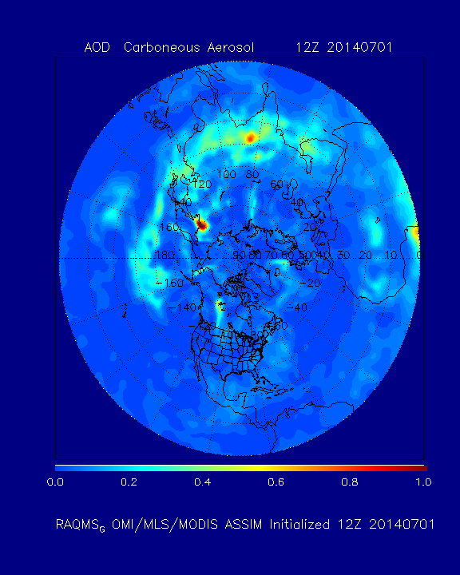
RAQMS Black and Organic Carbon (BCOC) Aerosol optical depth (AOD) Analysis
July-August, 2014

Slide 30
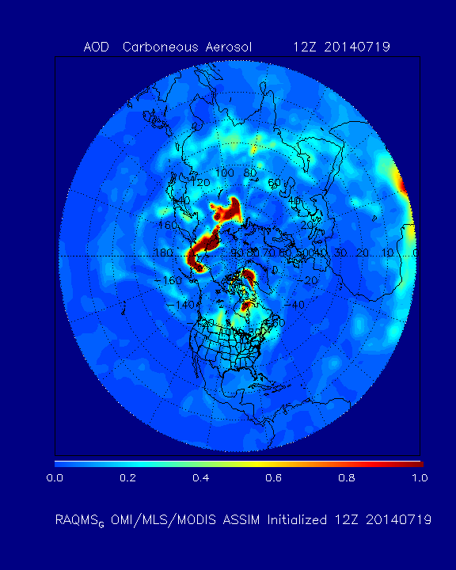
RAQMS Black and Organic Carbon (BCOC) Aerosol optical depth (AOD) Analysis
12Z July 19, 2014

Slide 31
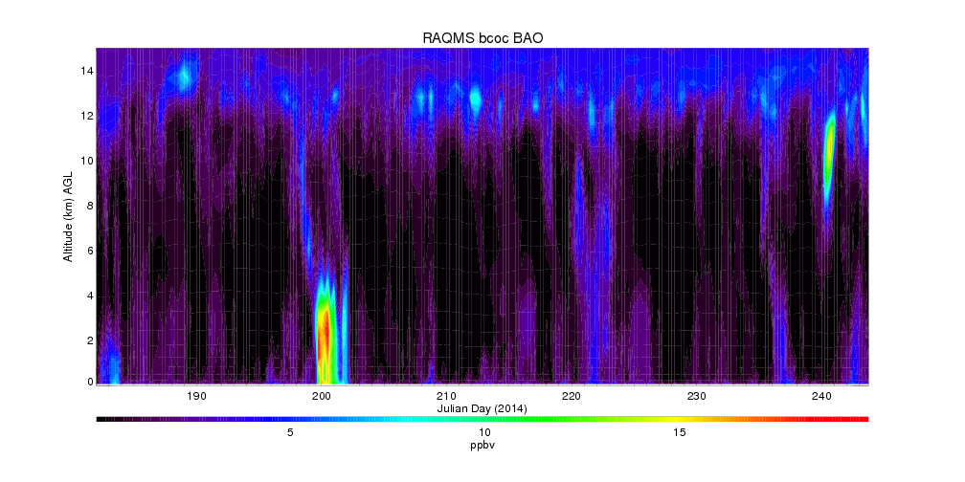
RAQMS smoke (Black and Organic Carbon) Analysis
BAO July-August 2014
July 16-20, 2014

Slide 32
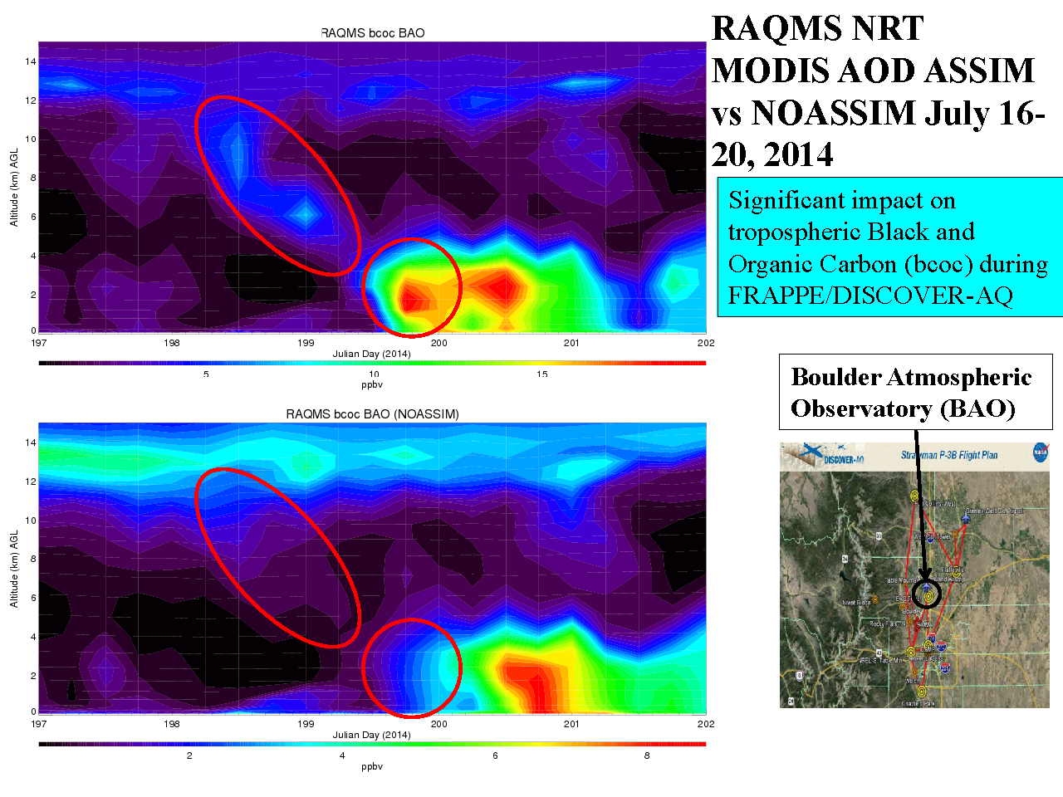
RAQMS Smoke prediction (with MODIS AOD Assimilation)
RAQMS MODIS AOD ASSIM vs
NO ASSIM
July 16-20, 2014
RAQMS Smoke prediction (no MODIS AOD Assimilation)

Slide 33
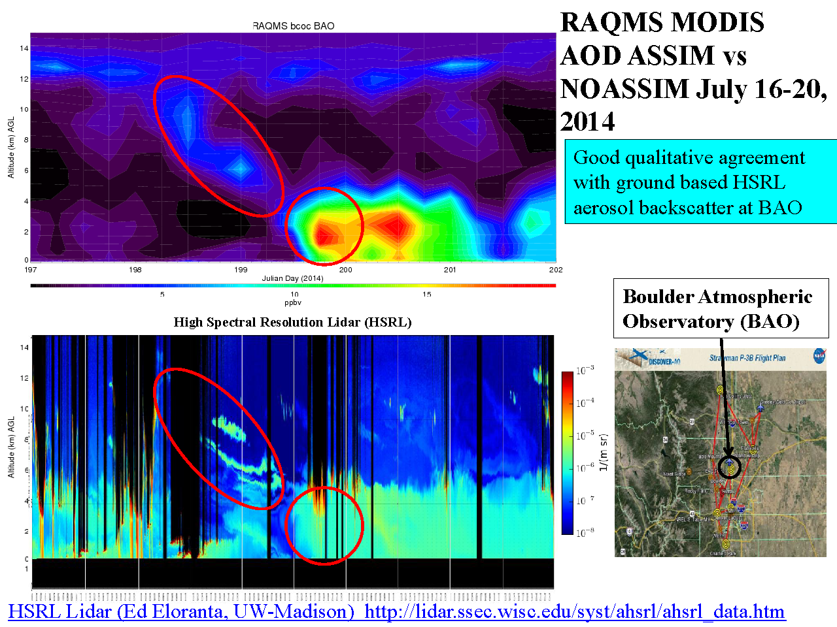
RAQMS Smoke prediction (with MODIS AOD Assimilation)
RAQMS MODIS AOD ASSIM vs
UW HSRL
July 16-20, 2014

Slide 34
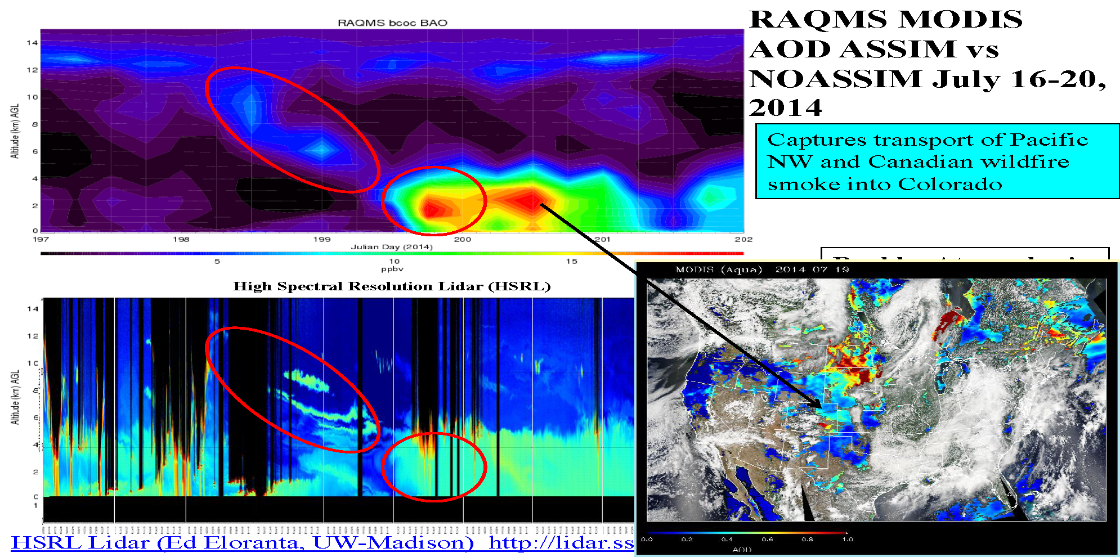
RAQMS Smoke prediction (with MODIS AOD Assimilation)
RAQMS MODIS AOD ASSIM vs
UW HSRL
July 16-20, 2014

Slide 35
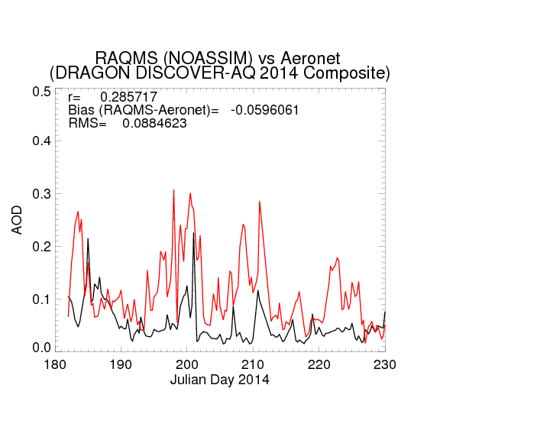
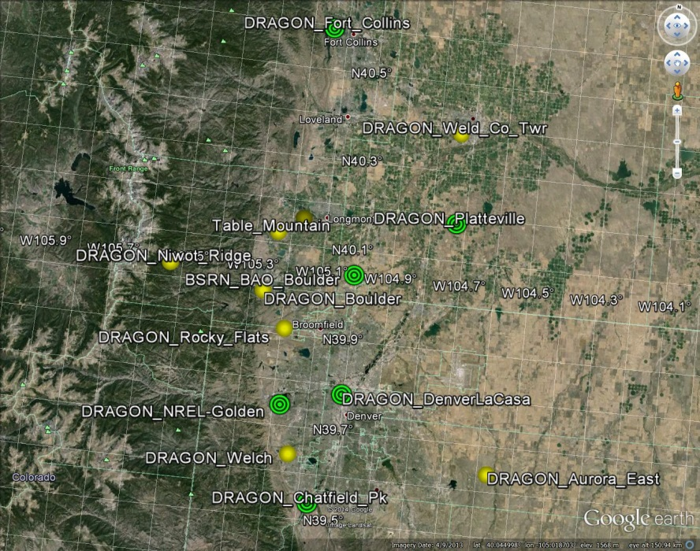
Distributed Regional Aerosol Gridded Observation Networks (DRAGON)-USA
2014 Colorado Front Range Urban Corridor
July 16-20
DRAGON
RAQMS
(DRAGON-USA, Brent Holben, NASA/GSFC)
http://aeronet.gsfc.nasa.gov/new_web/DRAGON-USA_2014_Colorado.html

Slide 36
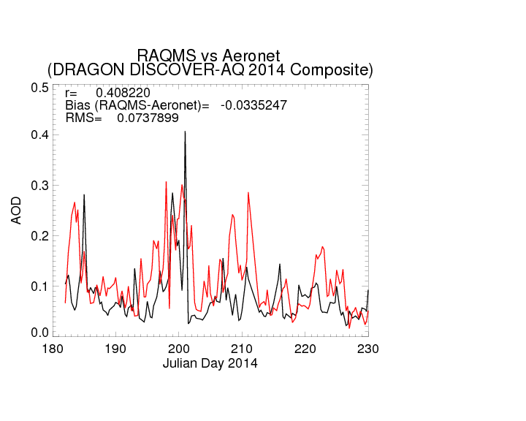
Distributed Regional Aerosol Gridded Observation Networks (DRAGON)-USA
2014 Colorado Front Range Urban Corridor
July 16-20
DRAGON
RAQMS
(DRAGON-USA, Brent Holben, NASA/GSFC)
http://aeronet.gsfc.nasa.gov/new_web/DRAGON-USA_2014_Colorado.html

Slide 37
Schematic of an Operational
Numerical Weather Prediction (NWP) modeling system

Slide 38
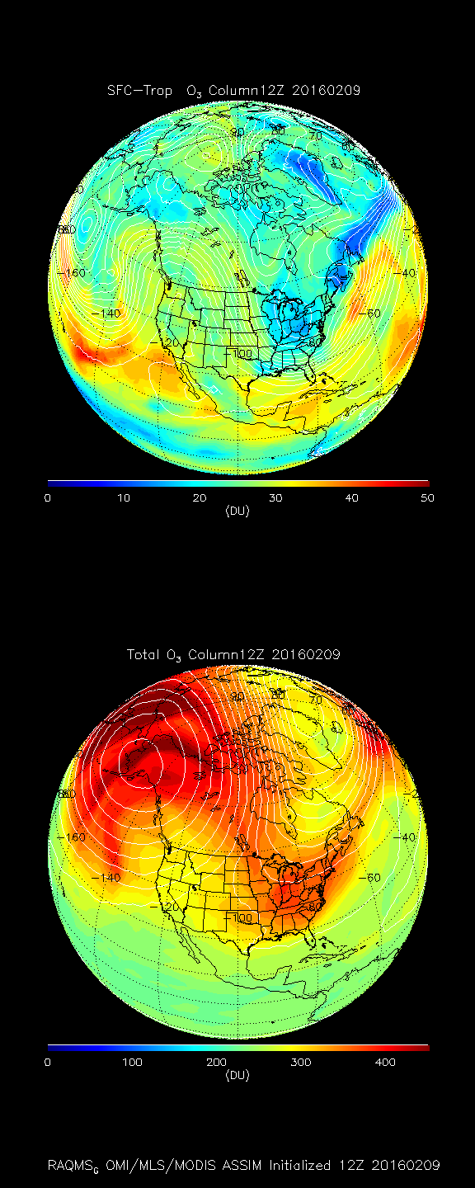
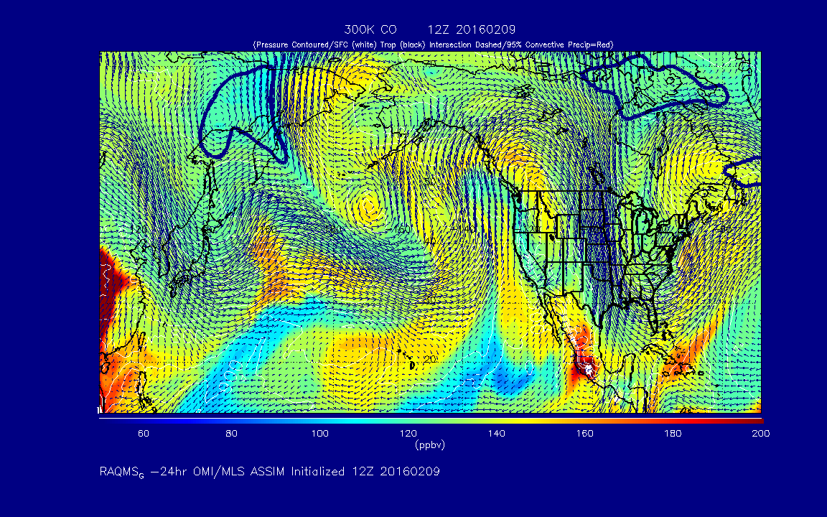
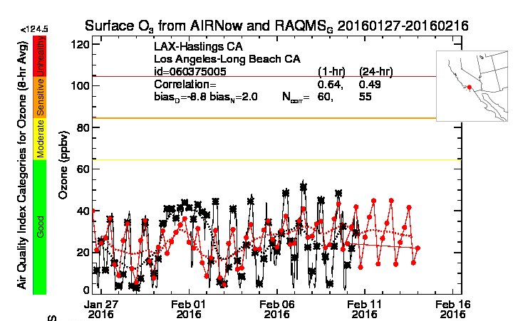
Today’s Forecast
http://raqms-ops.ssec.wisc.edu/

Slide 39



RAQMS/WRF-Chem
PM2.5 forecast Feb 11, 2016
http://raqms.ssec.wisc.edu/
Today’s Forecast

Slide 40
Questions?
Brad.pierce@noaa.gov

