Slide 1
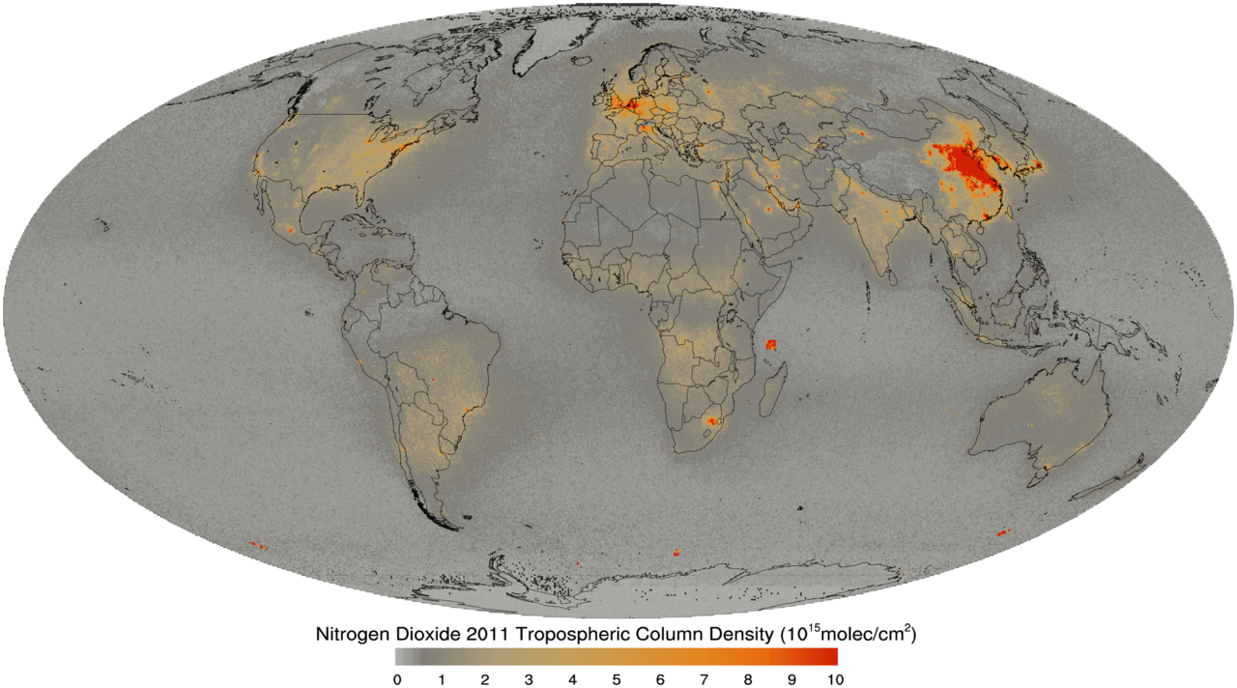
Using VIIRS DNB
and
OMI NO2 retrievals
for
constraining NOx Emissions
Brad Pierce
NOAA/NESDIS
UW-Madison AOS Senior Capstone Seminar Monday March 9, 2015, Madison WI

Slide 2
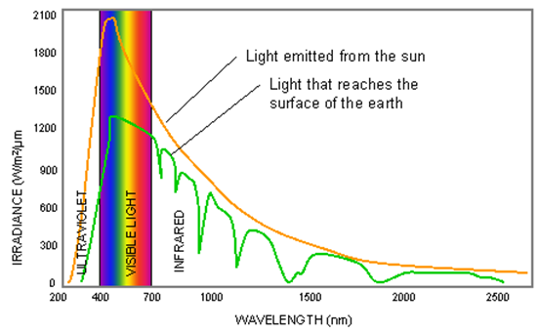
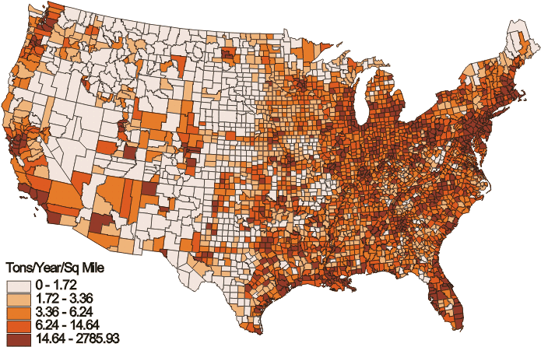
Visible/Infrared Imager/Radiometer
Suite (VIIRS), Day/Night Band (DNB)
Ozone Monitoring Instrument (OMI)
Solar Spectrum
1 billion times fainter than sunlight
Solar absorption Spectra
Nitrogen Oxide (NOx)
Emissions
Low light
Imaging
This Talk
Spectral
Fitting
Nano-watts/cm²sr

Slide 3
Tropospheric ozone (O3) is formed when certain precursor trace
gases are oxidized in the atmosphere by the hydroxyl radical (OH).
The two most important precursor trace gases are carbon monoxide (CO)
and a class of gases known as Volatile organic compounds (VOCs).
However, the amount of O3 that forms is most critically dependent on
the available concentration of nitrogen oxides (NOx), which are primarily
the sum of NO and NO2
There are two potential pathways:
VOC (or CO) + OH + sunlight -> H2O + CO2 (no NOx)
or
VOC (or CO) + OH + sunlight -> O3 + H2O + CO2 (with NOx)
From satellites, we can measure Formaldehyde (HCHO, a surrogate for VOC), CO, O3, and NO2 (one of the two primary components of NOx)
Fishman, J. et al., Remote Sensing of Tropospheric Pollution from Space, Bull. Amer. Meteor. Soc., 89, 805–821. doi: http://dx.doi.org/10.1175/2008BAMS2526.1

Slide 4
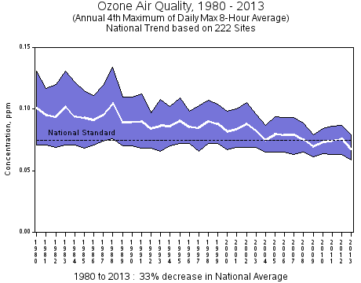
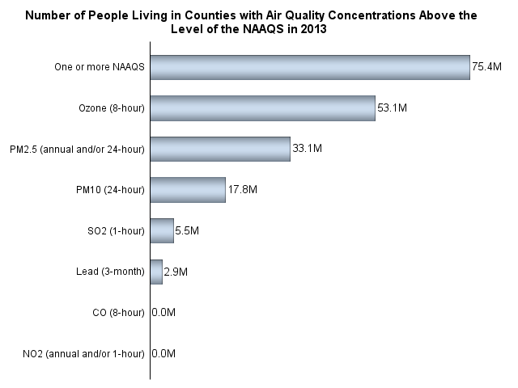
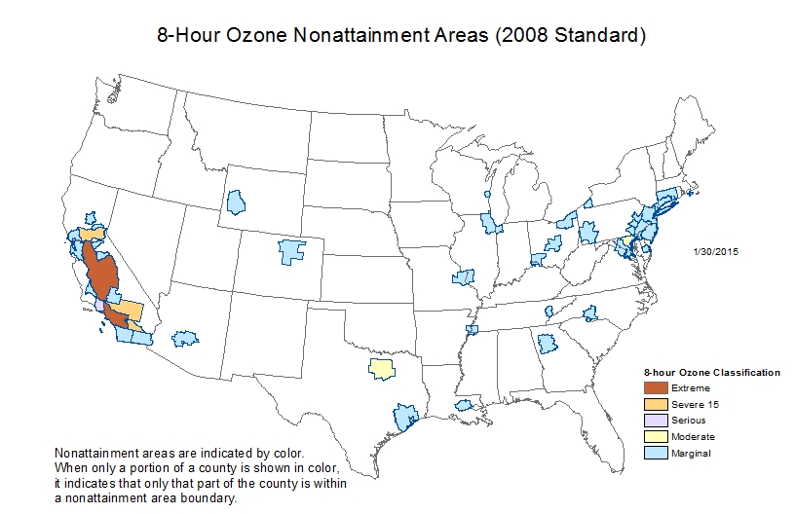
Background: National Trends in Ozone (O3) Levels
Nationally, average ozone levels declined in the 1980's, leveled off in the 1990's, and showed a notable decline after 2002.
O3 standard is currently 75ppbv based on annual fourth-highest daily maximum 8-hr concentration, averaged over 3 years
http://www.epa.gov/airtrends/ozone.html

Slide 5
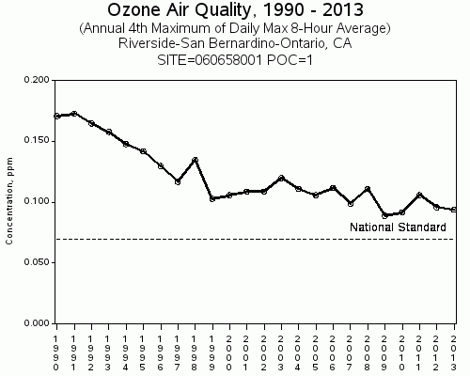
Background: National Trends in Ozone (O3) Levels
Nationally, average ozone levels declined in the 1980's, leveled off in the 1990's, and showed a notable decline after 2002.
O3 standard is currently 75ppbv based on annual fourth-highest daily maximum 8-hr concentration, averaged over 3 years
http://www.epa.gov/airtrends/ozone.html

Slide 6
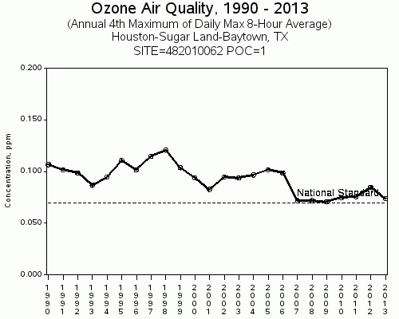
Background: National Trends in Ozone (O3) Levels
Nationally, average ozone levels declined in the 1980's, leveled off in the 1990's, and showed a notable decline after 2002.
O3 standard is currently 75ppbv based on annual fourth-highest daily maximum 8-hr concentration, averaged over 3 years
http://www.epa.gov/airtrends/ozone.html

Slide 7
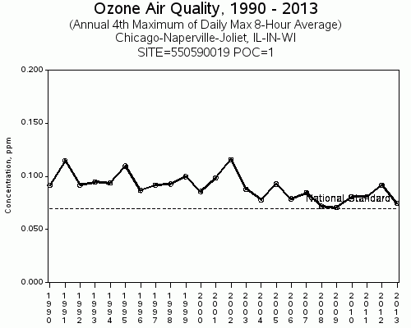
Background: National Trends in Ozone (O3) Levels
Nationally, average ozone levels declined in the 1980's, leveled off in the 1990's, and showed a notable decline after 2002.
O3 standard is currently 75ppbv based on annual fourth-highest daily maximum 8-hr concentration, averaged over 3 years
http://www.epa.gov/airtrends/ozone.html

Slide 8
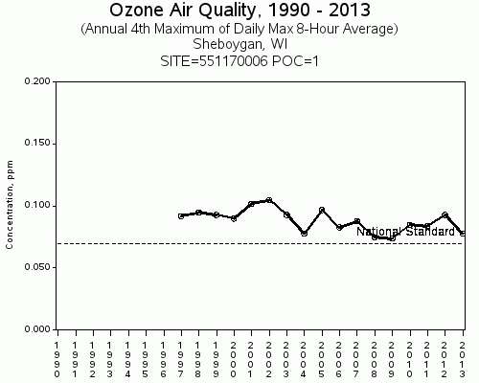
Background: National Trends in Ozone (O3) Levels
Nationally, average ozone levels declined in the 1980's, leveled off in the 1990's, and showed a notable decline after 2002.
O3 standard is currently 75ppbv based on annual fourth-highest daily maximum 8-hr concentration, averaged over 3 years
http://www.epa.gov/airtrends/ozone.html

Slide 9
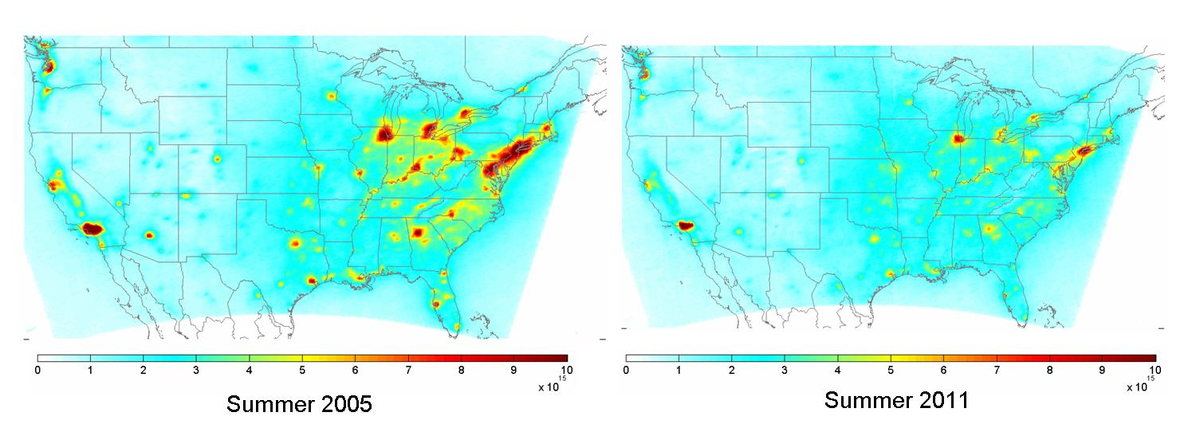
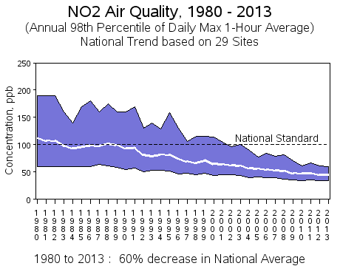
Background: National Trends in Nitrogen Dioxide (NO2) Levels
Overall, surface and column NO2 amounts are declining over the US due to regulations from the Clean Air Act
OMI Berkeley High-Resolution (BEHR) NO2 Column Retrievals
EPA NO2 trends from ground monitoring
32±7% reduction 2005-2011
http://www.epa.gov/airtrends/nitrogen.html
Russell et al., ACP 12, 12197-12209, doi:10.5194/acp-12-12197-2012, 2012.

Slide 10
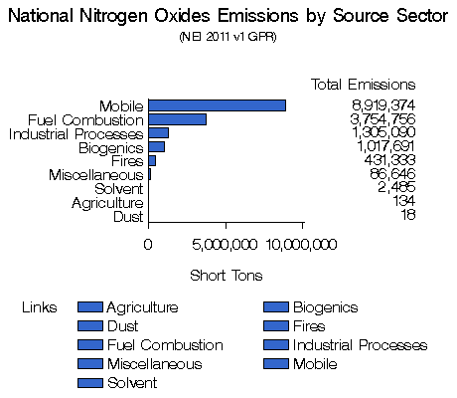
Background: The US EPA 2011 National Emissions Inventory (NEI)
The National Emissions Inventory (NEI) is a comprehensive and detailed estimate of emissions of air pollutants from all air emissions sources.
NEI is used to constrain Air Quality modeling in support of State Implementation Planning (SIP) required by the EPA
http://www.epa.gov/ttn/chief/net/2011inventory.html

Slide 11
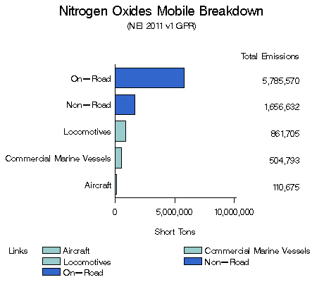
Background: The US EPA 2011 National Emissions Inventory (NEI)
On-road Cars and Trucks are the major source of NO2 emissions

Slide 12
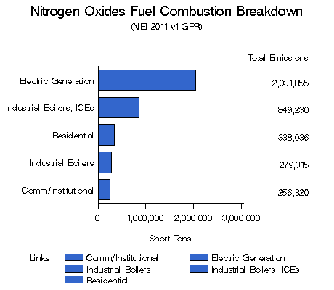
Background: The US EPA 2011 National Emissions Inventory (NEI)
Power Plants are another major source of NO2 emissions

Slide 13
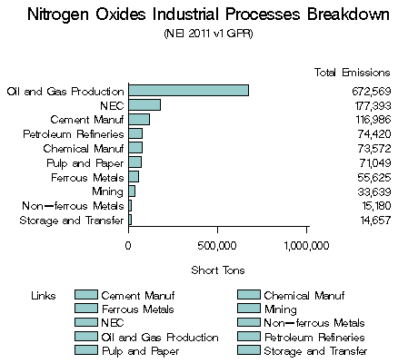
Background: The US EPA 2011 National Emissions Inventory
Oil and Gas Production is another major source of NO2 emissions

Slide 14
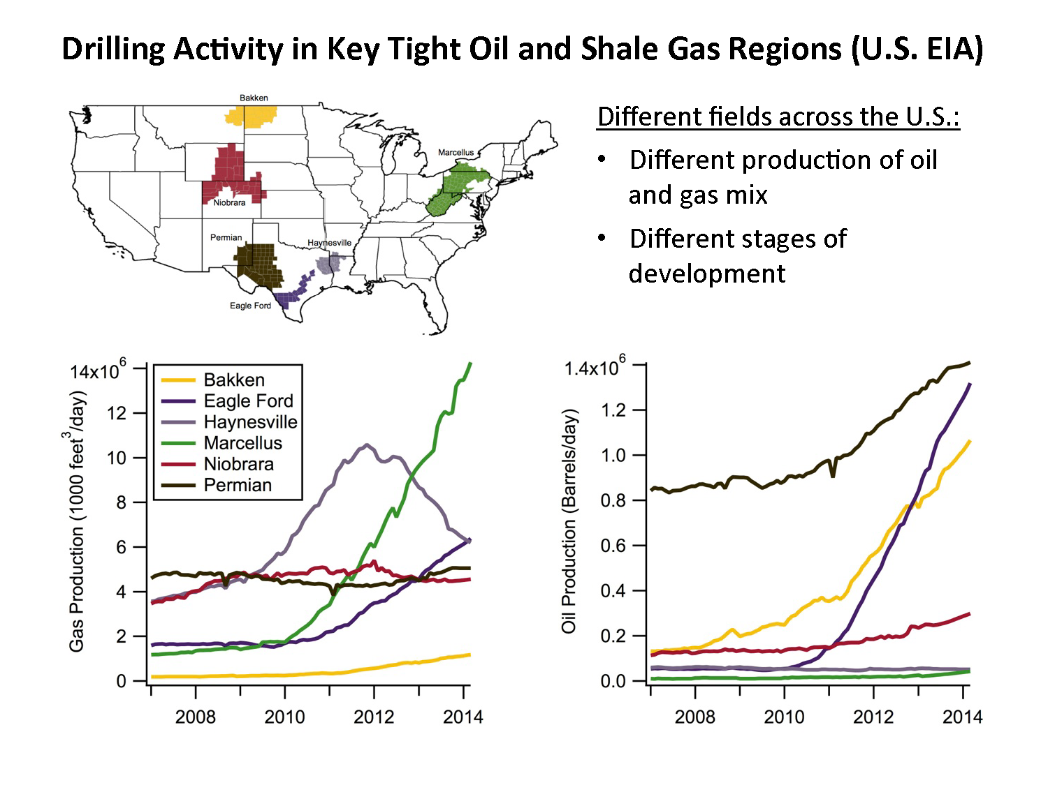
Background: National Trends in Oil and Gas Production
Oil and Gas Production has risen significantly since 2011
U.S Energy Information Administration (http://www.eia.gov/)

Slide 15
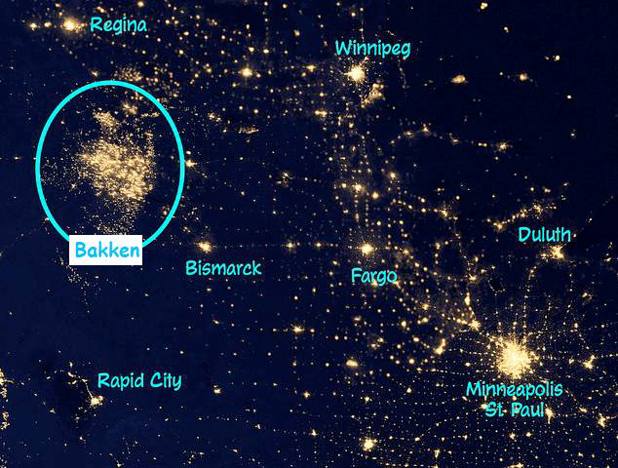
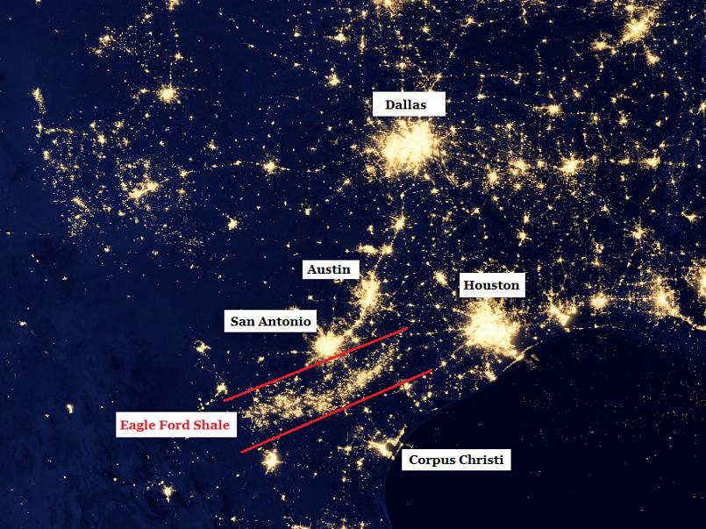
Oil and Gas Production activities can be monitored with the Visible Infrared Imaging Radiometer Suite (VIIRS) Day-Night-Band (DNB) imagery
Can we use VIIRS DNB and OMI NO2 retrievals for constraining NOx Emissions?
VIIRS DNB Composite Imagery from NOAA National Geophysical data Center

Slide 16
Approach
Evaluate the spatial correlation between NEI 2011 NOx emissions and VIIRS DNB on an urban scale
Evaluate the spatial correlation between NEI 2011 NOx emissions and OMI NO2 columns on a urban scale
Use VIIRS DNB radiances to generate a spatially enhanced OMI NO2 column retrieval appropriate for constraining Air Quality model emissions through Data Assimilation

Slide 17
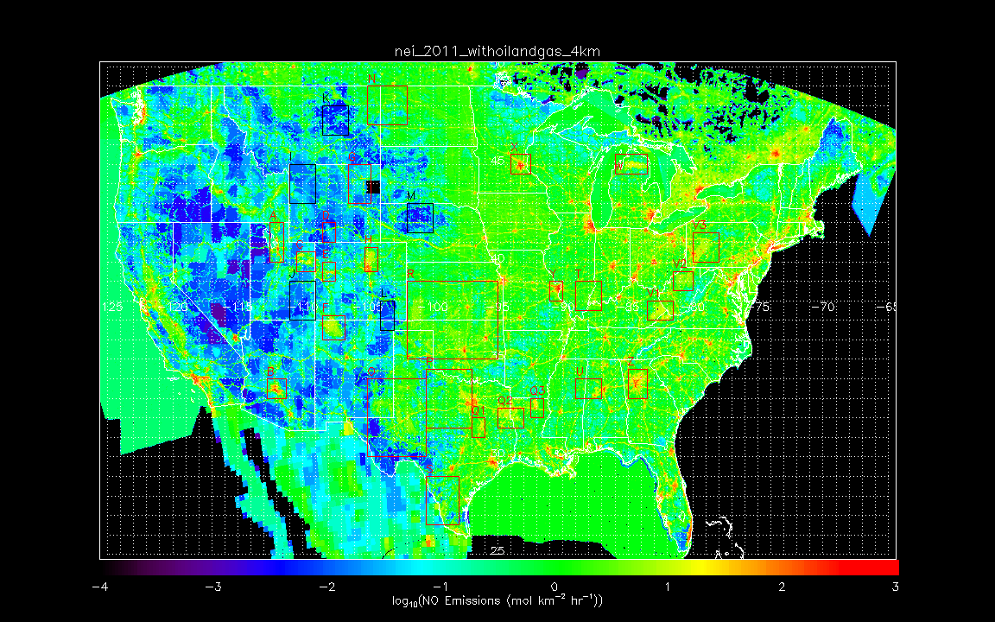
NEI 2011 total NO emissions inventory
(4km all area+point sources)
Provided by Stu McKeen (NOAA/ESRL)

Slide 18
NEI 2011 total NO emissions inventory
(4km all area+point sources)
Provided by Stu McKeen (NOAA/ESRL)
Background
Minneapolis
Background
Salt Lake City
Background
Denver
Background
Background
Phoenix
St. Louis
Atlanta

Slide 19
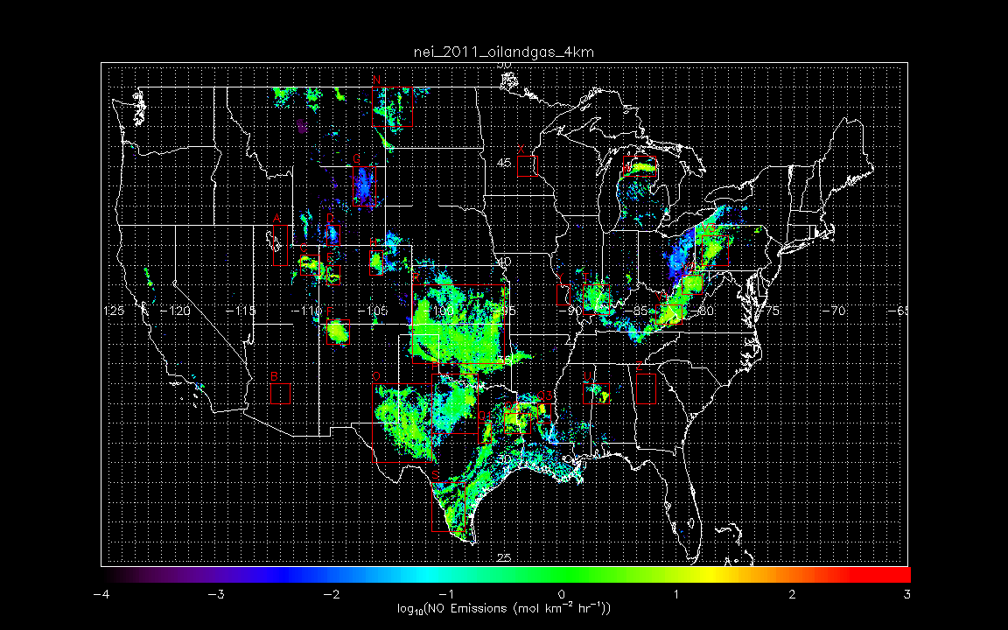
NEI 2011 Oil&Gas NO emissions inventory
(4km all area+point sources)
Provided by Stu McKeen (NOAA/ESRL)
Williston Basin
Antrim
Powder River Basin
Denver-Julesburg Basin
Green River Basin
Woodford
New Albany
Uinta Basin
Piceance Basin
San Juan Basin
Barnett
Marcellus
Floyd-Neal
Permian
Eagle Ford
Haynesville-Bossier

Slide 20
Investigate relationship NEI 2011 emissions and SNPP VIIRS Day Night Band (DNB) radiances (2012 cloud free composite, 15 arc second resolution) for specific urban and oil and gas regions
VIIRS DNB
SNPP VIIRS cloud-free composite (2012/4/18-26 and 2012/10/11-23) DNB data on 15 arc sec grid from Earth Observation Group, NOAA National Geophysical Data Center in GEOTIFF format
http://www.ngdc.noaa.gov/eog/viirs/download_viirs_ntl.html

Slide 21
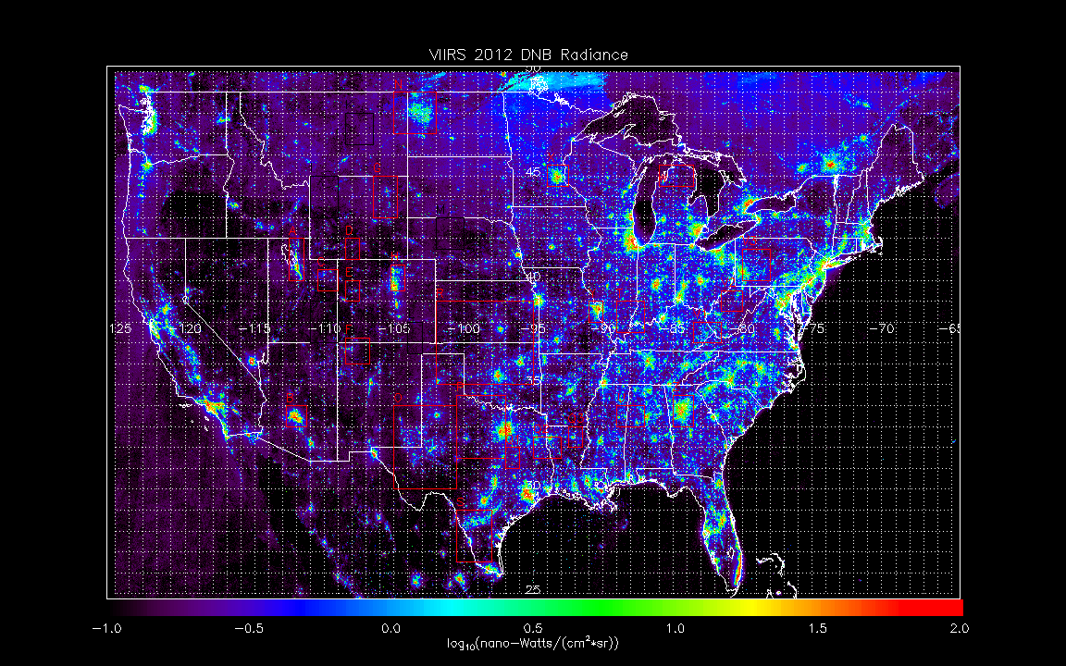
SNPP VIIRS 2012 cloud-free composite
(15 arc sec grid)
Earth Observation Group, NOAA National Geophysical Data Center

Slide 22
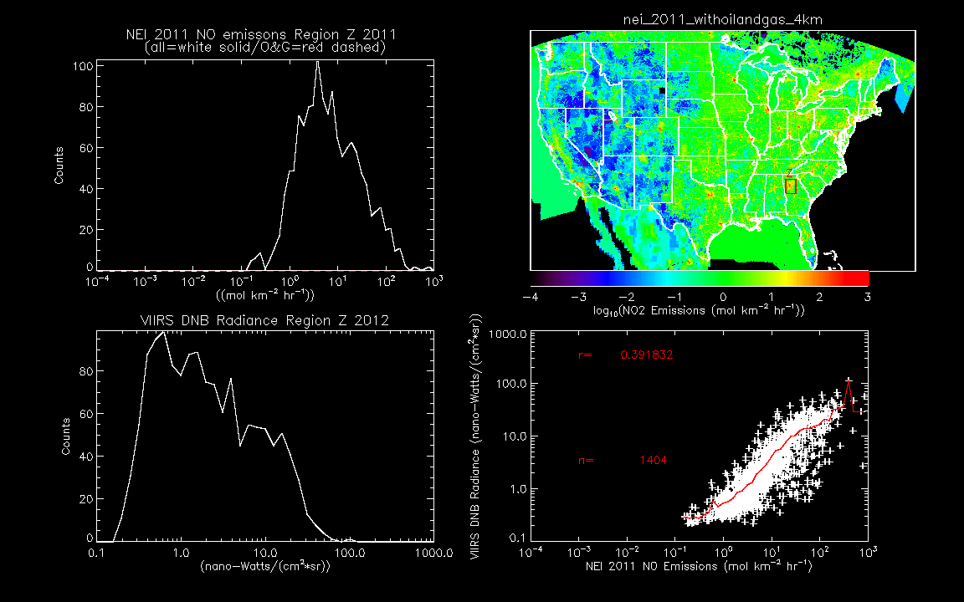
Aggregated VIIRS DNB radiances vs NEI 2011 modeled/gridded NO emissions
Region Z: Atlanta

Slide 23
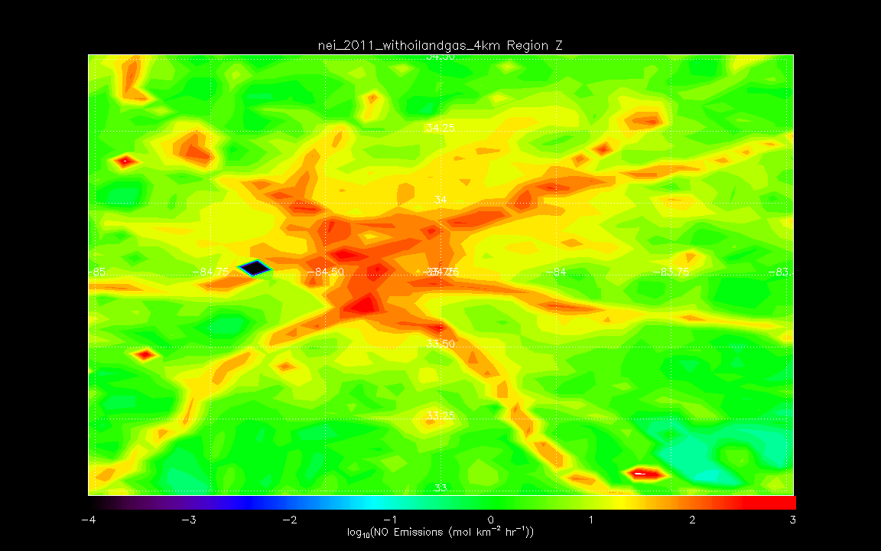
NEI 2011 modeled/gridded NO emissions
Region Z: Atlanta

Slide 24
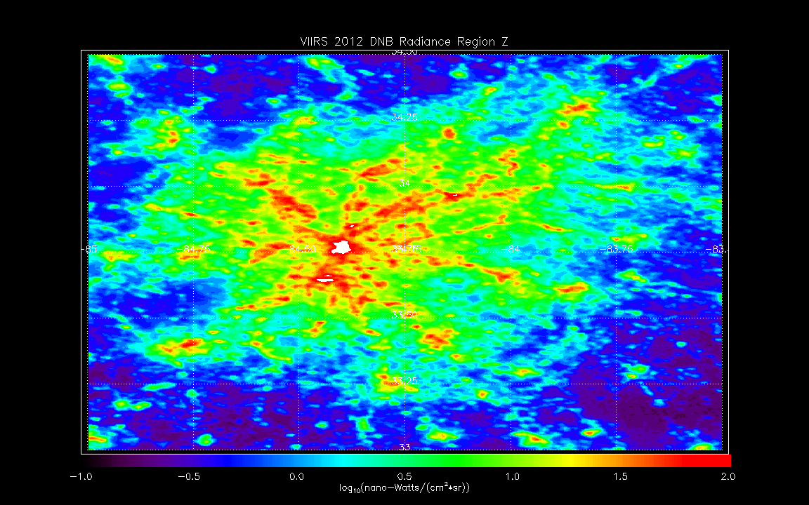
Aggregated VIIRS DNB radiances
Region Z: Atlanta

Slide 25
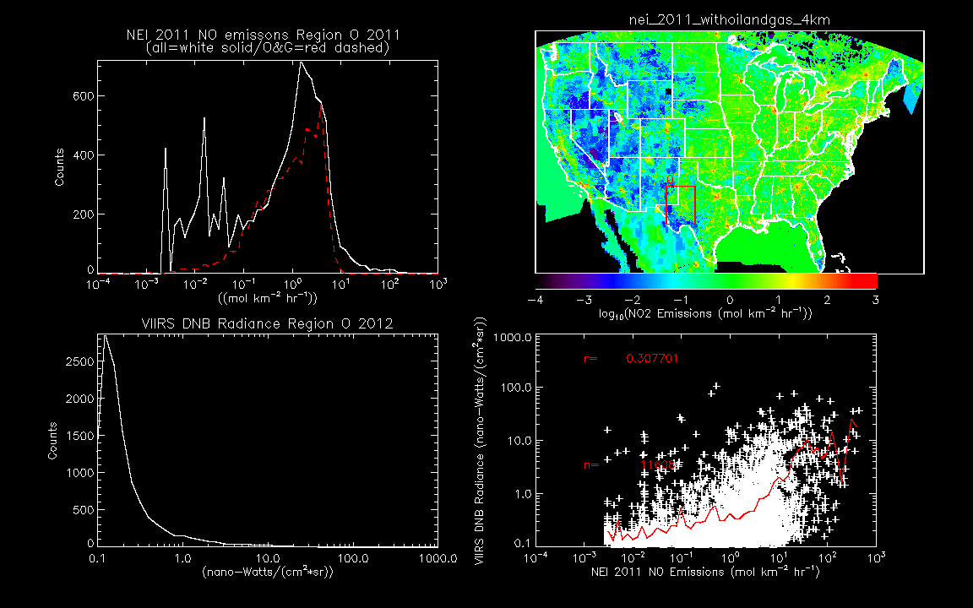
Aggregated VIIRS DNB radiances vs NEI 2011 modeled/gridded NO emissions
Region O: Permian

Slide 26
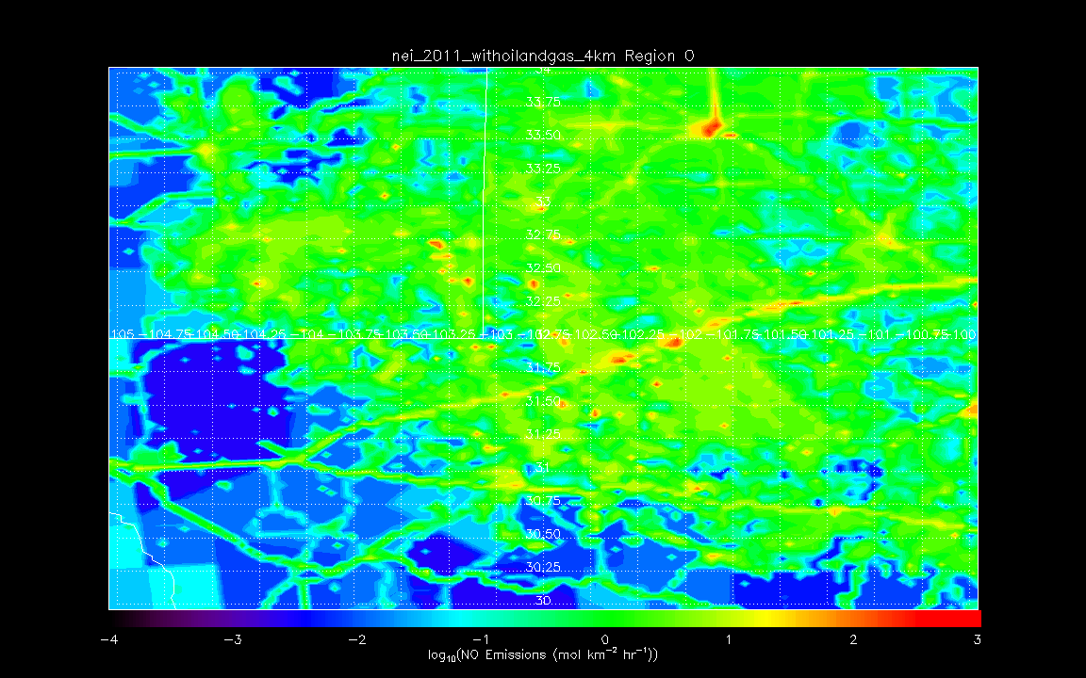
NEI 2011 modeled/gridded Total NO emissions
Region O: Permian
Lubbock, TX
Midland, TX
Odessa, TX

Slide 27
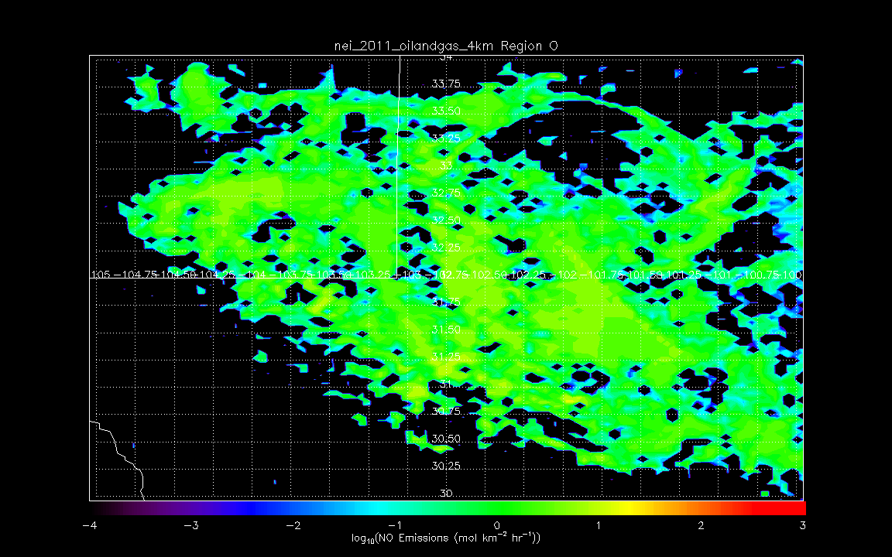
NEI 2011 modeled/gridded Oil & Gas NO emissions
Region O: Permian
Lubbock, TX
Midland, TX
Odessa, TX

Slide 28
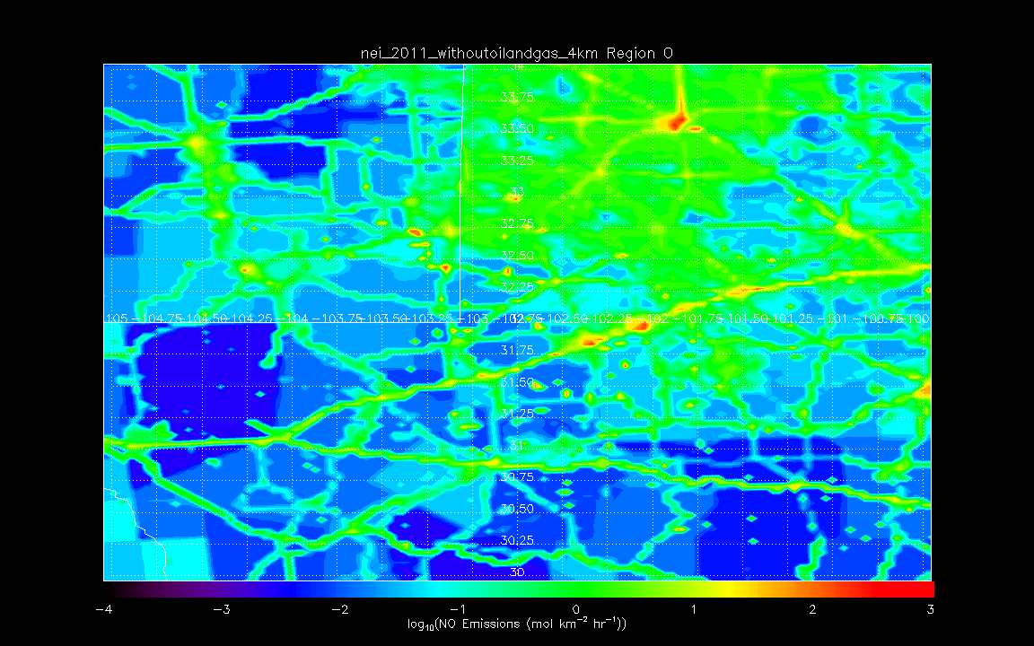
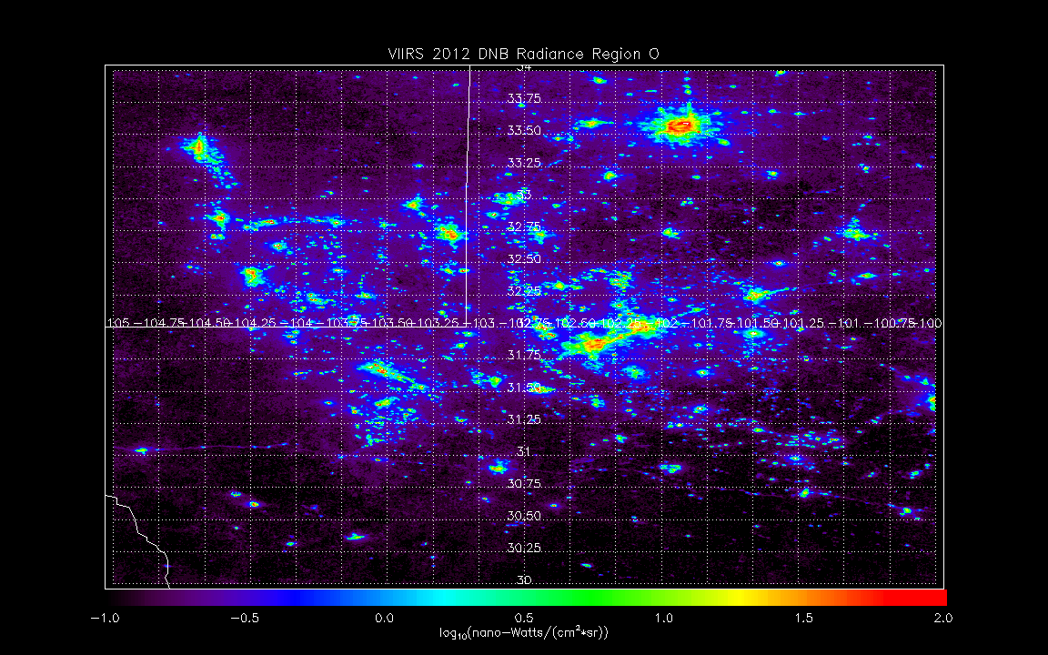
Aggregated VIIRS DNB radiances
Region O: Permian
Lubbock, TX
Midland, TX
Odessa, TX

Slide 29
Aggregated VIIRS DNB radiances
Region O: Permian

Slide 30
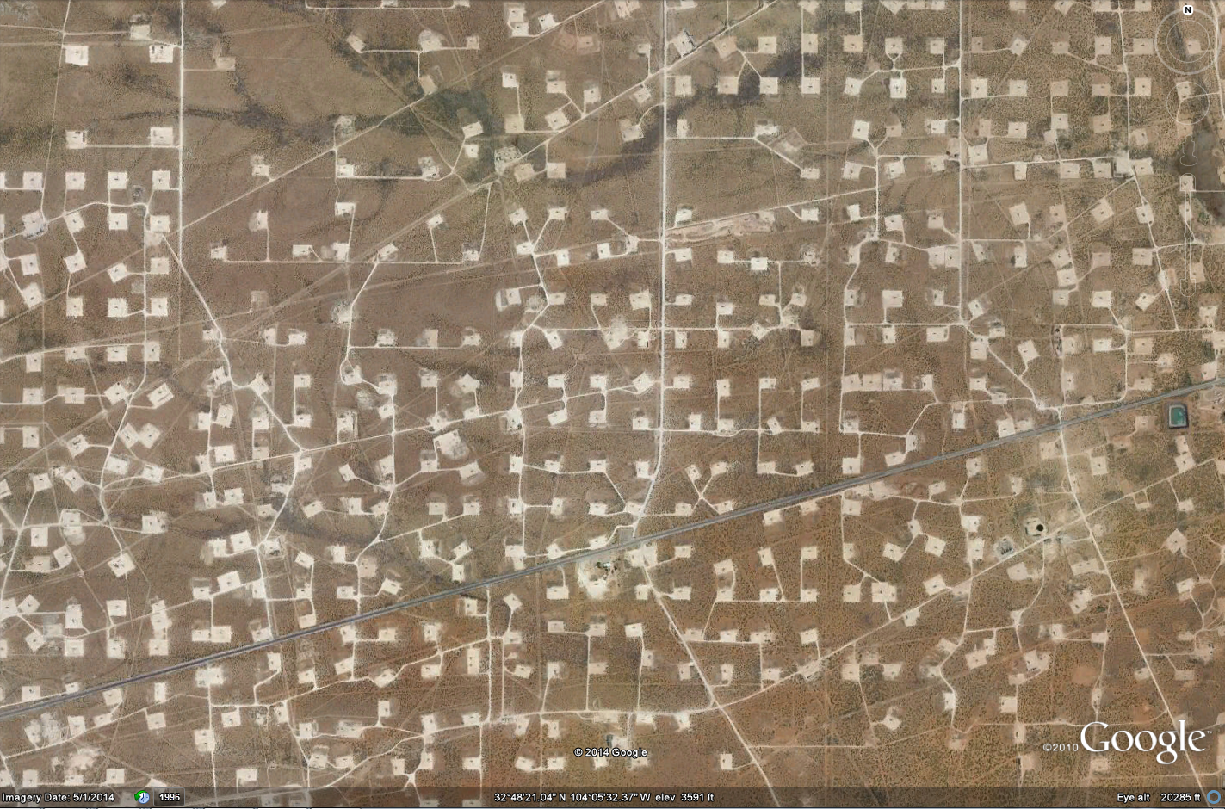
Aggregated VIIRS DNB radiances
Region O: Permian

Slide 31
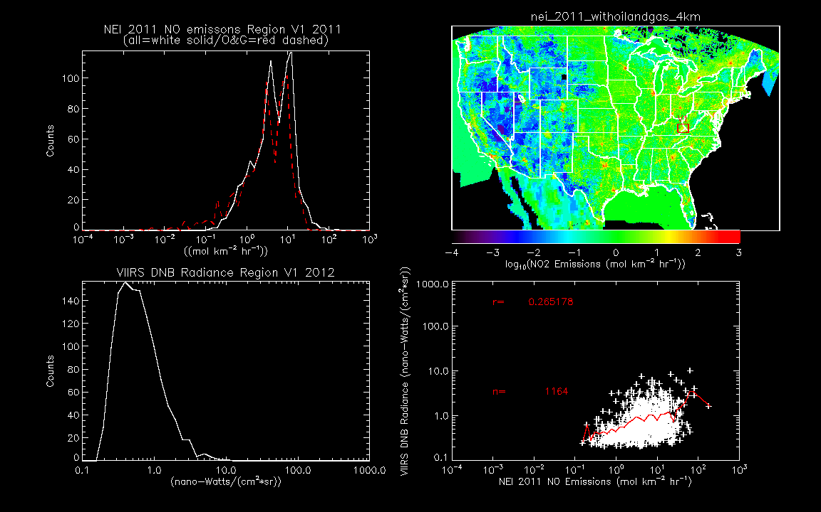
Aggregated VIIRS DNB radiances vs NEI 2011 modeled/gridded NO emissions
Region V1: Southern Marcellus

Slide 32
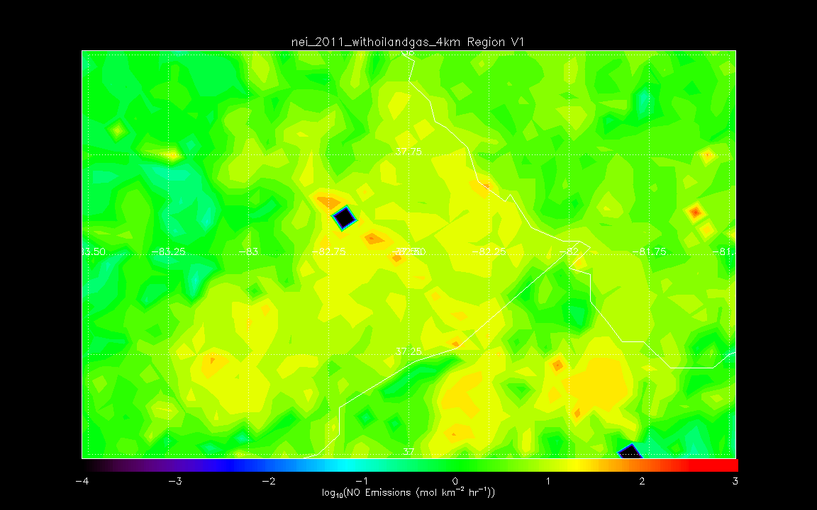
NEI 2011 modeled/gridded Total NO emissions
Region V1: Southern Marcellus
Pikeville KY

Slide 33
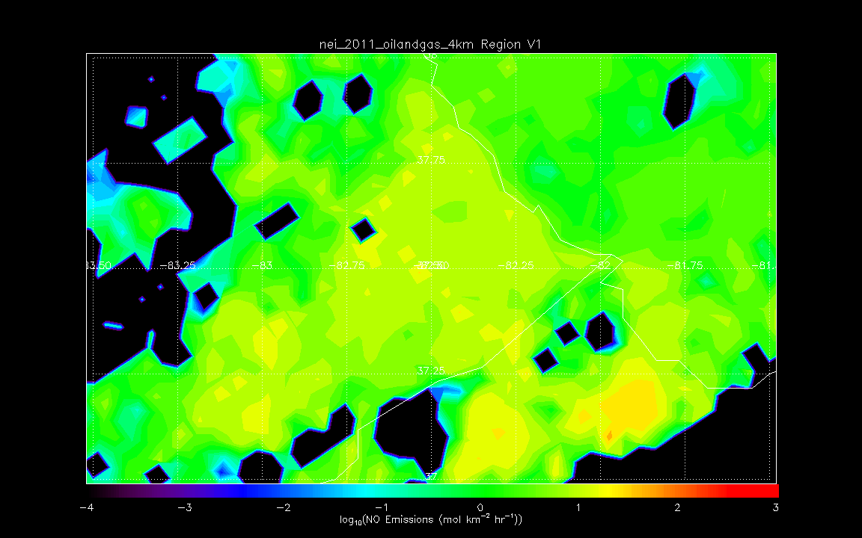
NEI 2011 modeled/gridded Total NO emissions
Region V1: Southern Marcellus
Pikeville KY

Slide 34
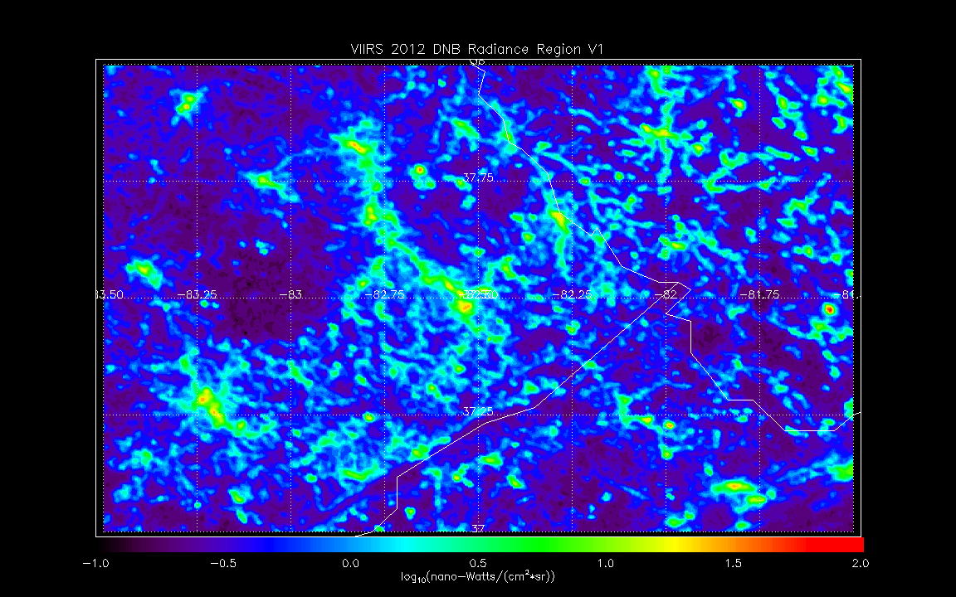
Aggregated VIIRS DNB radiances
Region V1: Southern Marcellus
Pikeville KY

Slide 35
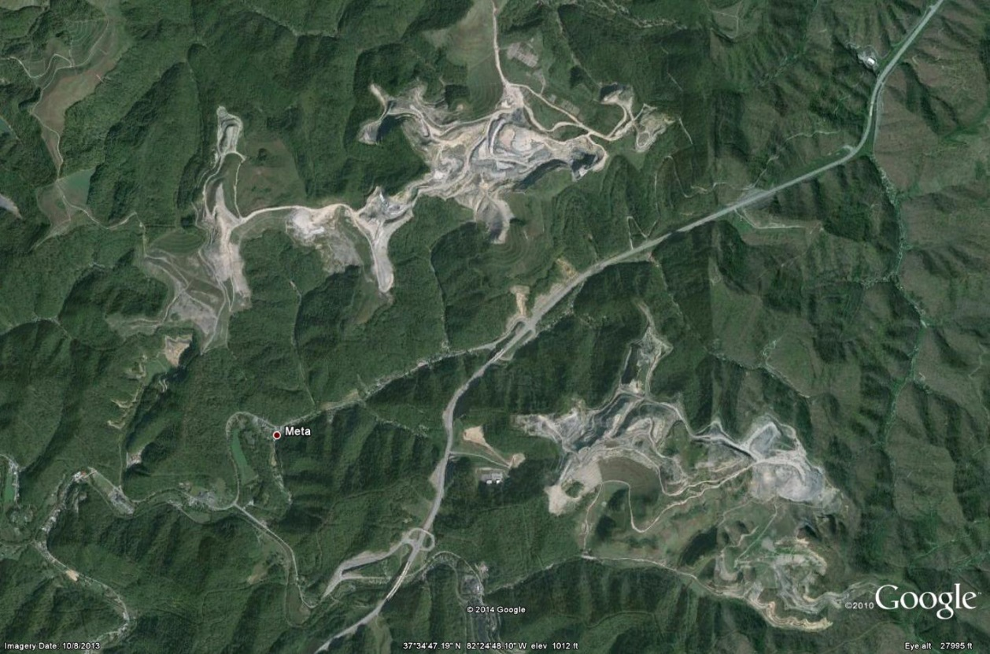
Aggregated VIIRS DNB radiances
Region V1: Southern Marcellus
Mountain Top Removal
Pikeville KY

Slide 36
Aggregated VIIRS DNB radiances
Region V1: Southern Marcellus
McDowell FCI
1,692 Inmates

Slide 37
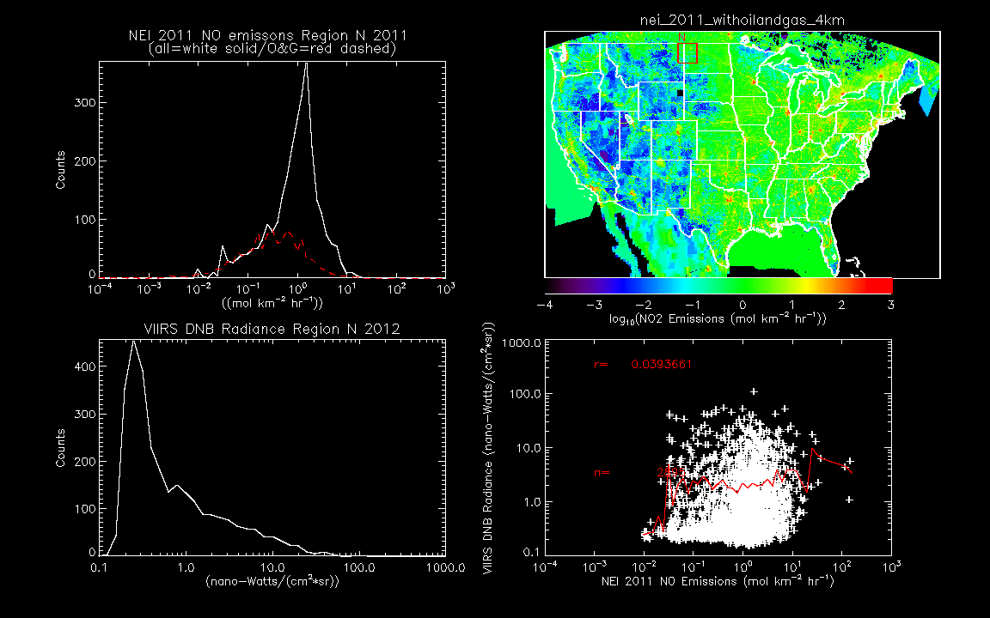
Aggregated VIIRS DNB radiances vs NEI 2011 modeled/gridded NO emissions
Region N: Williston Basin

Slide 38
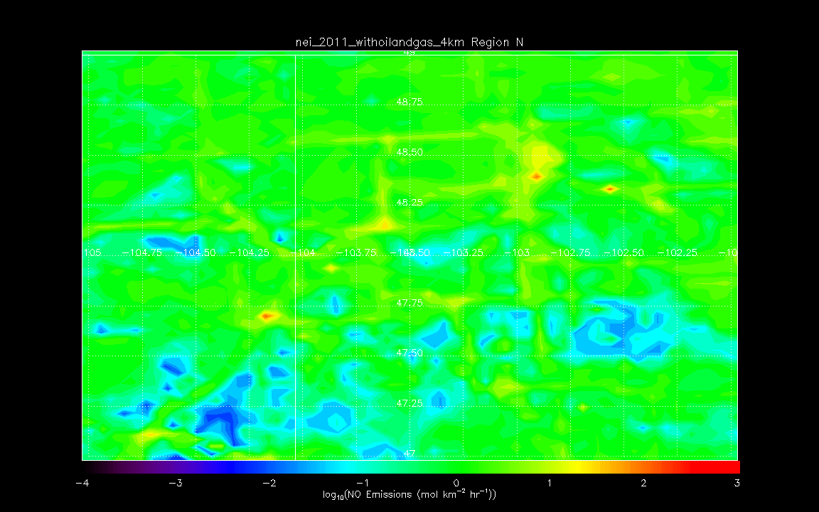
NEI 2011 modeled/gridded Total NO emissions
Region N: Williston Basin
Minot
Williston
Sidney

Slide 39
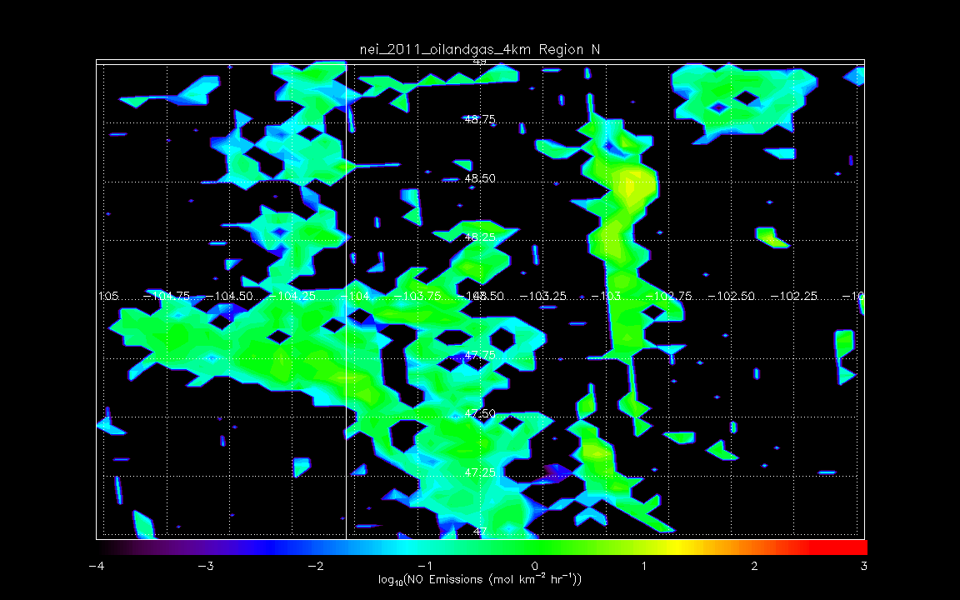
NEI 2011 modeled/gridded Total NO emissions
Region N: Williston Basin
Minot
Williston
Sidney

Slide 40
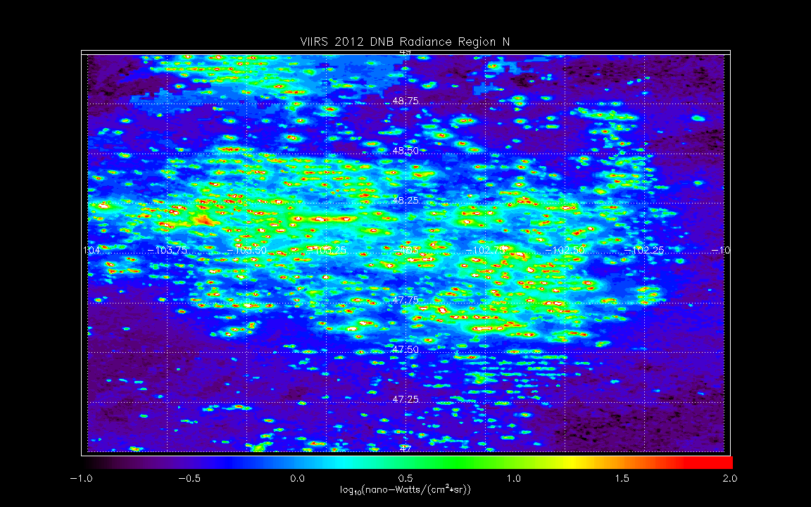
2012 VIIRS DNB Radiances
Region N: Williston Basin
Minot
Williston
Sidney

Slide 41
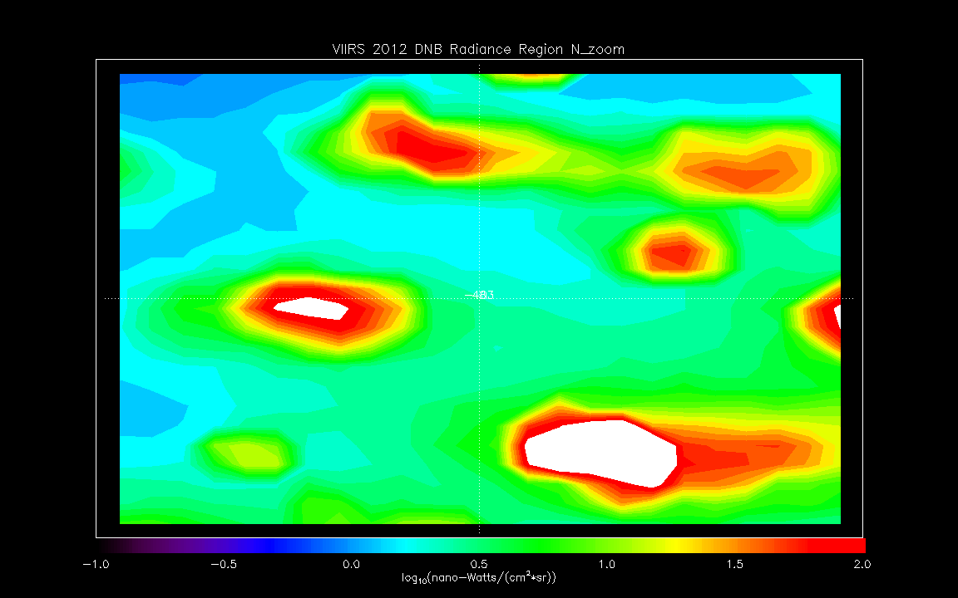
2012 VIIRS DNB Radiances
Region N: Williston Basin (103W 48N 0.1º Zoom)

Slide 42
Google Earth
Region N: Williston Basin (103W 48N 0.1º Zoom)

Slide 43
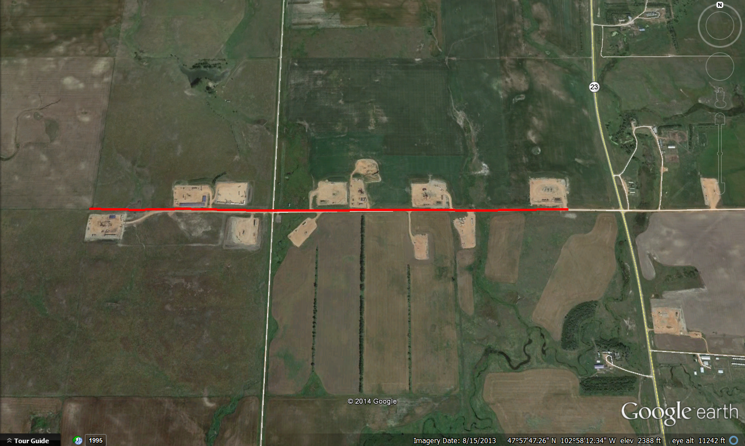
Google Earth Zoom
Region N: Williston Basin
2.5km
1km

Slide 44
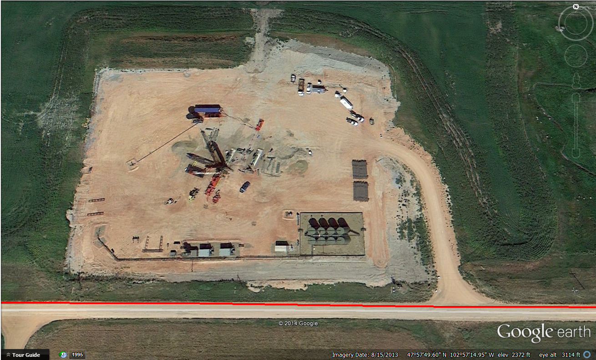
Google Earth Zoom
Region N: Williston Basin

Slide 45
Summary of Regional Correlations 2011
A= Salt Lake City
B=Phoenix
C=Uinta Basin
D=Green River Basin
E=Piceance Basin
F=San Juan Basin
G=Powder River Basin
H=Denver/Denver-Julesburg Basin
I=NW Background
J=SW Background
K=Northern Background
L=SW Background
M=Eastern Background
N=Williston Basin
O=Permian
P=Barnett
Q1=Haynesville-Bossie S
Q2=Haynesville-Bossie C
Q3=Haynesville-Bossie N
R=Woodford
S=Eagle Ford
T=New Albany
U=Floyd-Neal
V1=Marcellus S
V2=Marcellus C
V3=Marcellus N
W=Antrim
X=Minneapolis
Y=St. Louis
Z=Atlanta
A B C D E F G H I J K L M N O P Q1 Q2 Q3 R S T U V1 V2 V3 W X Y Z
Region
VIIRS DNB shows reasonable (0.3-0.7) correlations with aggregated 2011 NEI NO emissions for urban areas (Salt Lake City, Phoenix, Denver/ Denver-Julesburg Basin, Minneapolis, St. Louis, Atlanta) and some O&G regions (Green River, Piceance, Permian, Barnett, Haynesville-Bossie North, Eagle Ford)

Slide 46
Summary of Regional Correlations 2011
A= Salt Lake City
B=Phoenix
C=Uinta Basin
D=Green River Basin
E=Piceance Basin
F=San Juan Basin
G=Powder River Basin
H=Denver/Denver-Julesburg Basin
I=NW Background
J=SW Background
K=Northern Background
L=SW Background
M=Eastern Background
N=Williston Basin
O=Permian
P=Barnett
Q1=Haynesville-Bossie S
Q2=Haynesville-Bossie C
Q3=Haynesville-Bossie N
R=Woodford
S=Eagle Ford
T=New Albany
U=Floyd-Neal
V1=Marcellus S
V2=Marcellus C
V3=Marcellus N
W=Antrim
X=Minneapolis
Y=St. Louis
Z=Atlanta
A B C D E F G H I J K L M N O P Q1 Q2 Q3 R S T U V1 V2 V3 W X Y Z
Region
OMI BEHR NO2 shows lower (0.3-0.4) correlations with aggregated 2011 NEI NO emissions for Western urban areas (Salt Lake City, Phoenix, Denver/ Denver-Julesburg Basin) only

Slide 47
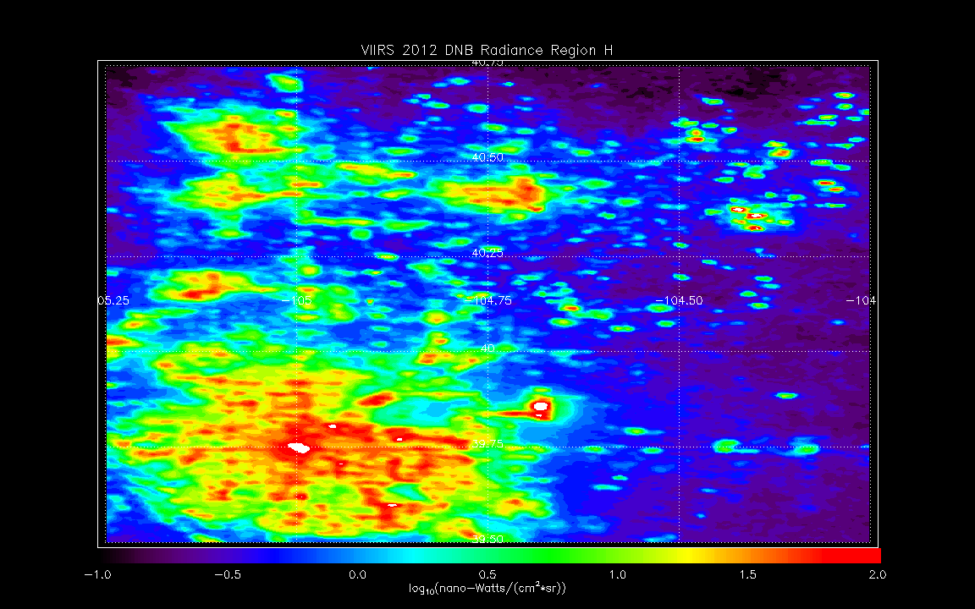
Use VIIRS Day Night Band (DNB) radiances to add sub-pixel (~4x4km) variability to native (13x24km) OMI NO2 retrieval
Region H=Denver/Denver-Julesburg Basin
Native OMI pixel

Slide 48
Use VIIRS Day Night Band (DNB) radiances to add sub-pixel (~4x4km) variability to native (13x24km) OMI NO2 retrieval
Region H=Denver/Denver-Julesburg Basin
Sub-divide each OMI pixel into 4x8 subsectors

Slide 49
Use VIIRS Day Night Band (DNB) radiances to add sub-pixel (~4x4km) variability to native (13x24km) OMI NO2 retrieval
Region H=Denver/Denver-Julesburg Basin
Compute mean DNB radiance for each 4x8 subsectors
Compute linear regression between pixel mean DNB radiance and OMI NO2 for each swath
Use linear regression to redistribute OMI NO2 over sub-pixels
Adjust mean of sub-pixel NO2 to original pixel NO2

Slide 50
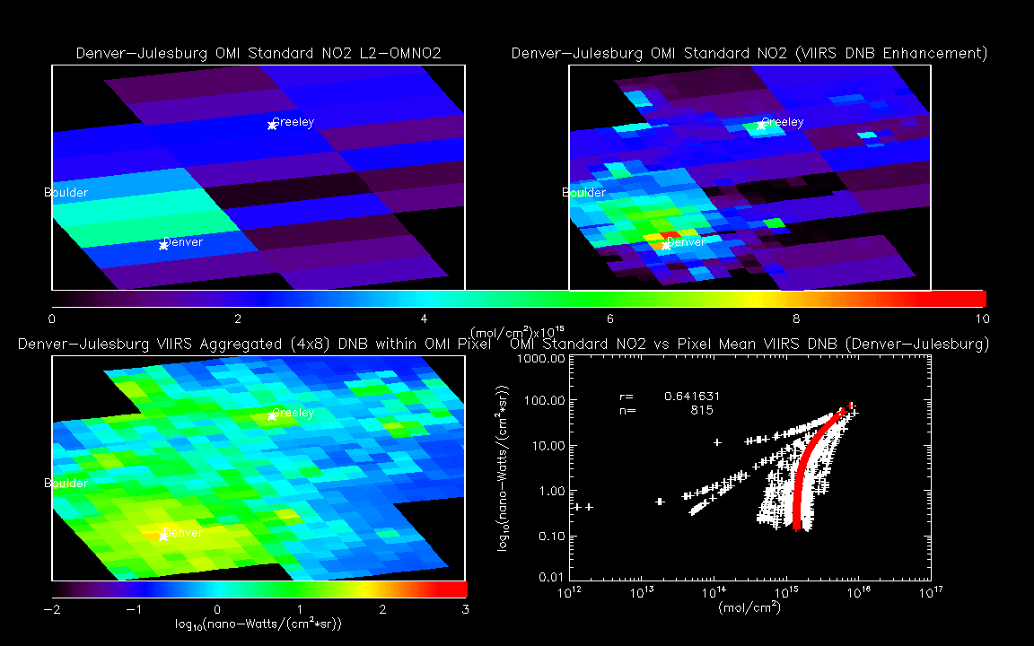
Using VIIRS Day Night Band (DNB) radiances to add (~4x4km) sub-pixel variability to native (13x24km) OMI NO2 retrieval Region H: Denver/Denver-Julesburg on August 02, 2014

Slide 51
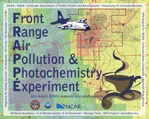
Current efforts:
Validation of high resolution OMI NO2 retrievals
during FRAPPE/DISCOVER-AQ
The airborne Geostationary Trace gas and Aerosol Sensor Optimization (GEO-TASO) instrument flew on the NASA Falcon aircraft during the 2014 FRAPPE/DISCOVER-AQ field mission
GEO-TASO is test-bed for the NASA Tropospheric Emissions: Monitoring of Pollution (TEMPO) mission, which will make air quality measurements from geostationary orbit.

Slide 52
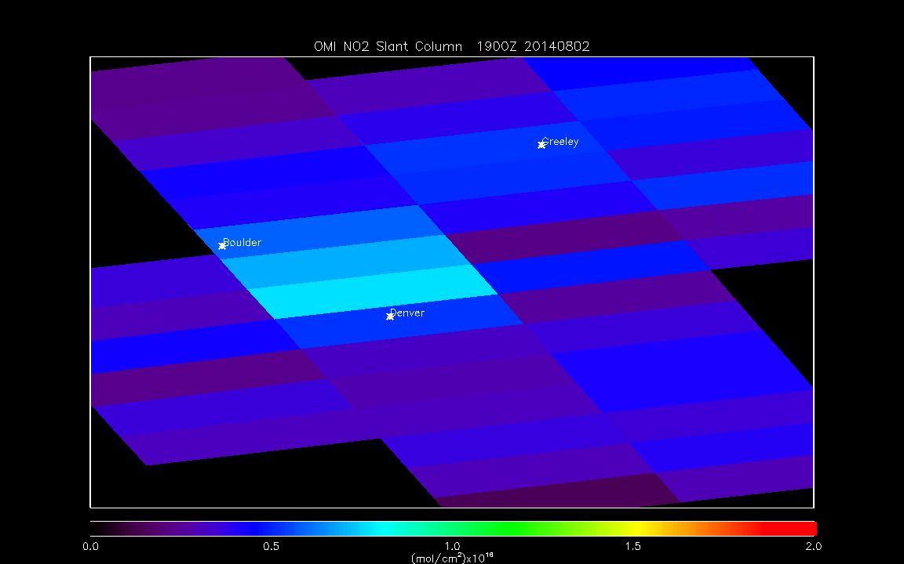
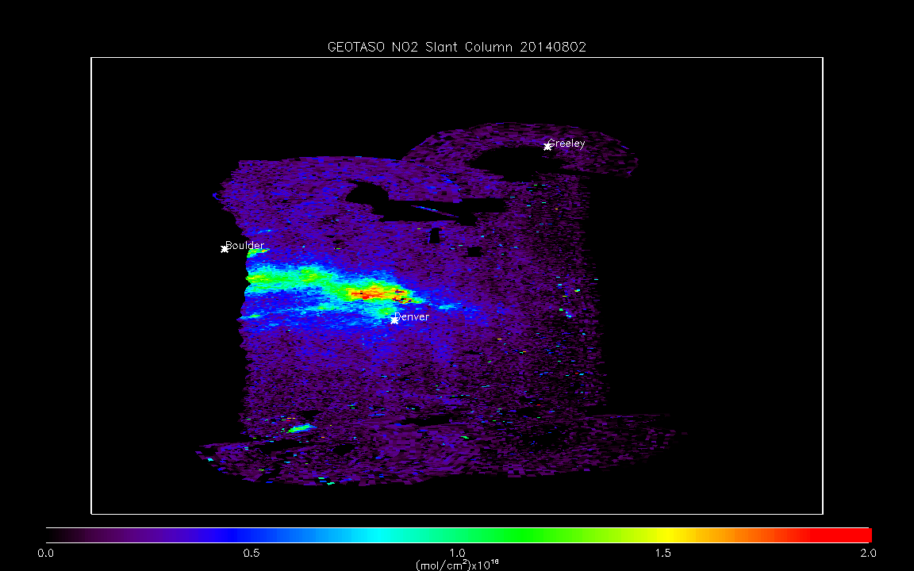
Standard OMI/NO2 vs GEOTASO Slant Column Region H: Denver/Denver-Julesburg on August 02, 2014 (19:55Z)
Standard OMI NO2 Slant Column
GEOTASO NO2 Slant Column
8:00am (14Z) takeoff
1:00pm (19Z) takeoff
0.75x10¹⁶ mol/cm² has been removed from OMI Slant Column to account for stratospheric NO2 contribution

Slide 53
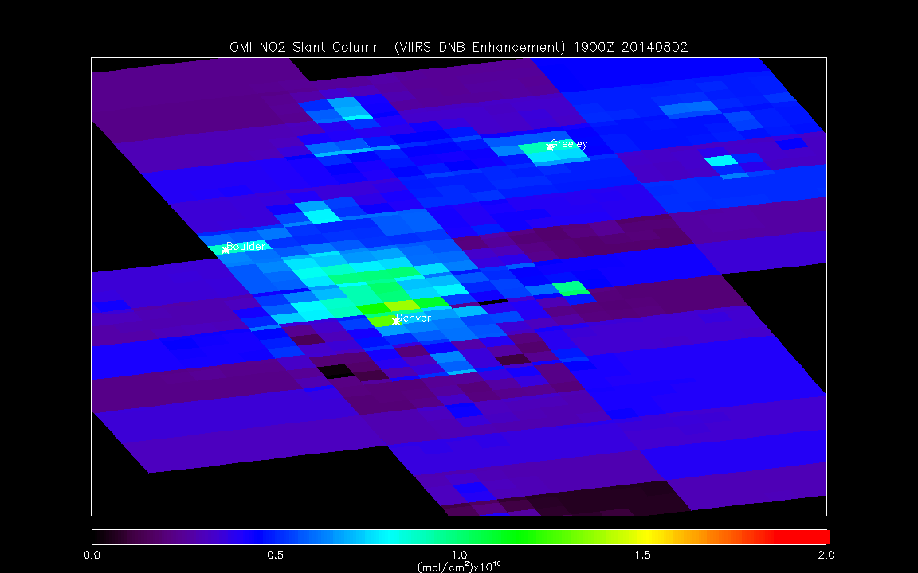
High resolution (4x4km) OMI/NO2 vs GEOTASO Slant Column Region H: Denver/Denver-Julesburg on August 02, 2014 (19:55Z)
High Resolution OMI NO2 Slant Column
GEOTASO NO2 Slant Column
1:00pm (19Z) takeoff
0.75x10¹⁶ mol/cm² has been removed from OMI Slant Column to account for stratospheric NO2 contribution

Slide 54
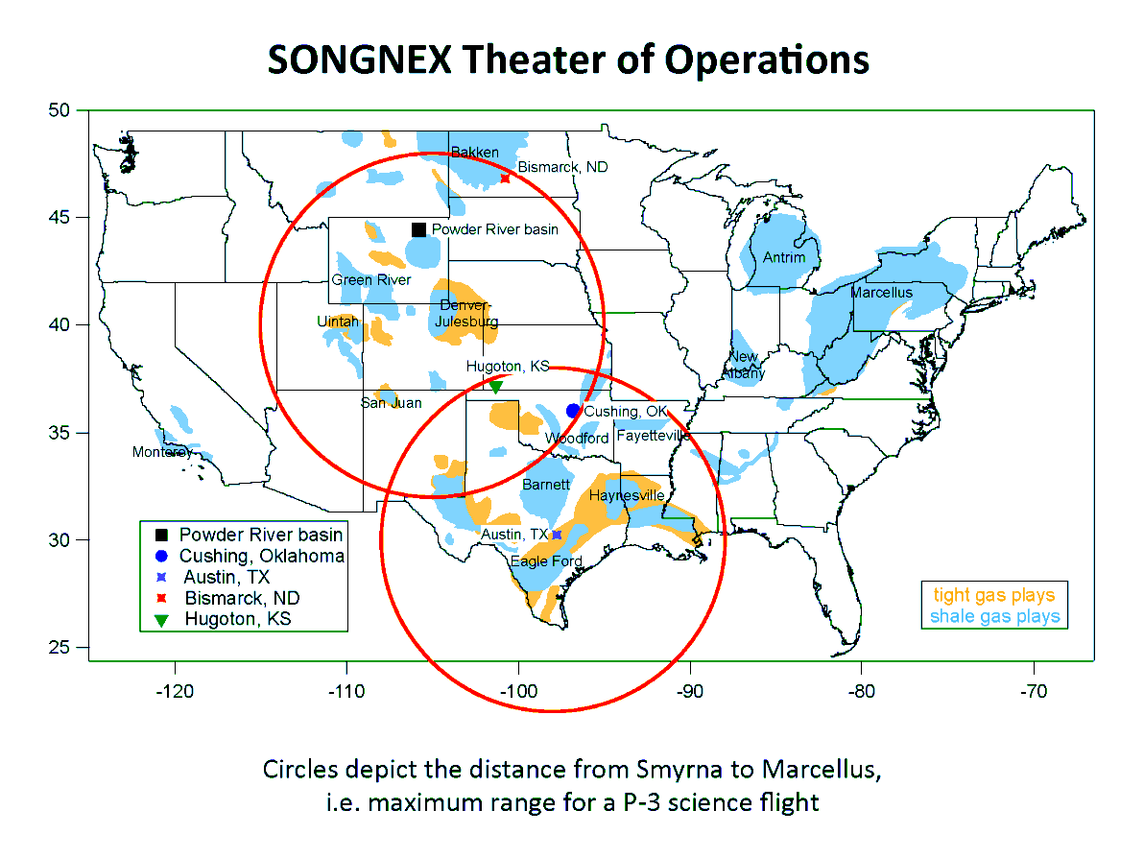
NOAA Shale Oil and Natural Gas Nexus (SONGNEX) field mission: (http://esrl.noaa.gov/csd/projects/songnex/)
Tentative Flight Plans
From Broomfield 6 flights:
Denver-Julesburg, Uintah, Upper Green River, San Juan
From Bismarck 2 flights:
Bakken
From Austin 3-4 flights:
Barnett, Eagle Ford, Haynesville, Permian
From Ohio (optional) 3 flights:
Marcellus
Pikeville KY
March 24 – April 28, 2015

Slide 55
Future Directions
Airborne insitu, Geostationary Trace gas and Aerosol Sensor Optimization (GEO-TASO, Jim Leitch, Ball Aerospace) and Airborne Compact Atmospheric Mapper (ACAM, Scott Janz, NASA/GSFC) will be used to validate the spatially enhanced OMI NO2 retrievals during CalNex, DISCOVER-AQ, FRAPPE, and SONGNEX field missions.
Assimilation experiments will be conducted to assess the impact of spatially enhanced OMI NO2 retrievals on air quality within urban and oil and gas basins within regional air quality modeling systems (WRF-Chem, CMAQ)
brad.pierce@noaa.gov
Acknowledgement:
Funding for this work was provided by the NASA Air Quality Applied Science Team 2013 Oil&Gas Tiger Team Project (Anne Thompson, Lead)

