Slide 1
Overview of the 2017 Lake Michigan Ozone Study
R. Bradley Pierce
Maryam Abdioskouei
Zac Adelman
Jassim A Al-Saadi
Hariprasad Dilip Alwe
Timothy Bertram
Megan Christiansen
Patricia A Cleary
Alan Czarnetzki
Angela F Dickens
Marta Fuoco
Carmichael Gregory
Monica Harkey
Laura Margaret Judd
Donna M Kenski
Dylan B Millet
Charles O Stanier
Elizabeth A. Stone
James Szykman
Luke Valin
Timothy J. Wagner
A53C. Observations and Modeling of Air Quality at Land–Water Boundaries II, Paper A53C-04, Friday, 14 December 2018; 13:40 - 15:40

Slide 2
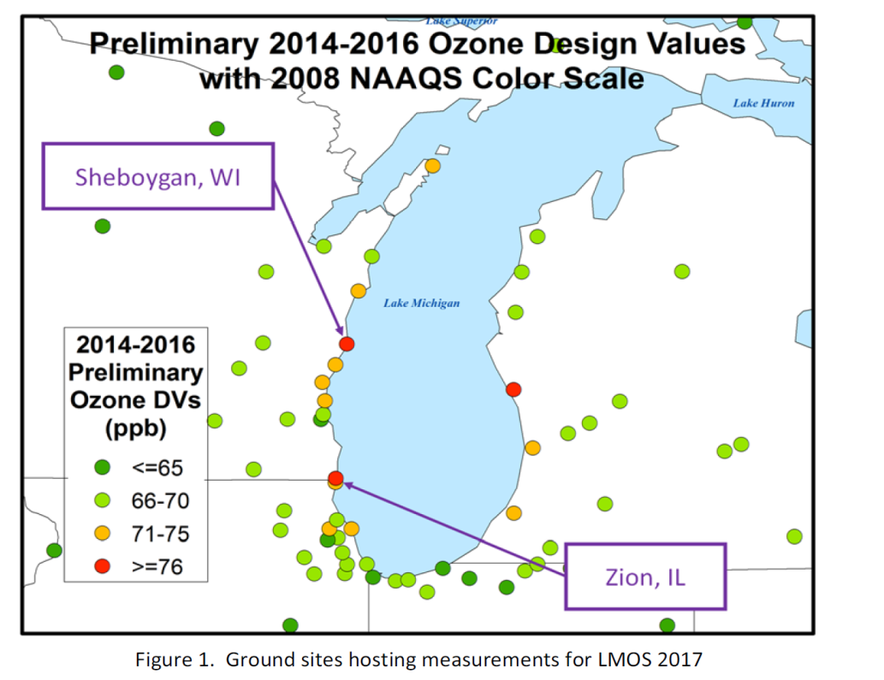
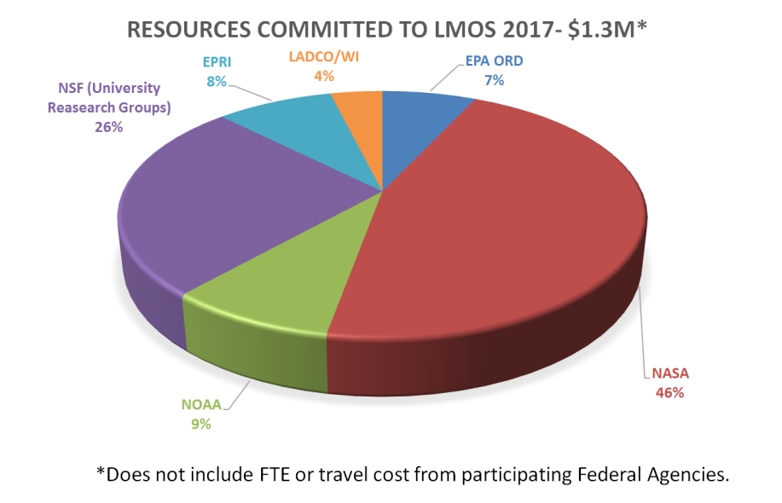
During May and June 2017, federal and state agencies, universities, and other partners measured air quality over Lake Michigan.
Objectives:
Improved ozone forecasts for the region, which states and EPA use to meet state and federal Clean Air Act requirements.
Better understanding of the lakeshore gradient in ozone concentrations, which could influence how EPA addresses future regional ozone issues.
Improved knowledge of how emissions influence ozone formation in the region.
2017 Lake Michigan Ozone Study White Paper: http://www.ladco.org/

Slide 3
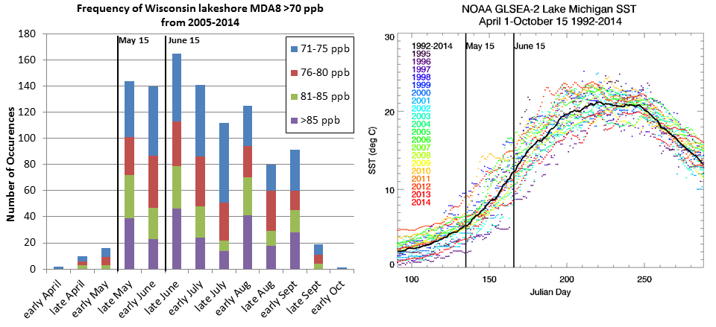
Lake Michigan Ozone Study (LMOS) 2017
Campaign Study Period May 22- June 22, 2017
Primary science objectives focusing on characterizing the recirculation, aging, and mixing of the Chicago and Milwaukee urban plumes as they move over Lake Michigan and their impact on surface ozone.
2017 Lake Michigan Ozone Study White Paper: http://www.ladco.org/

Slide 4
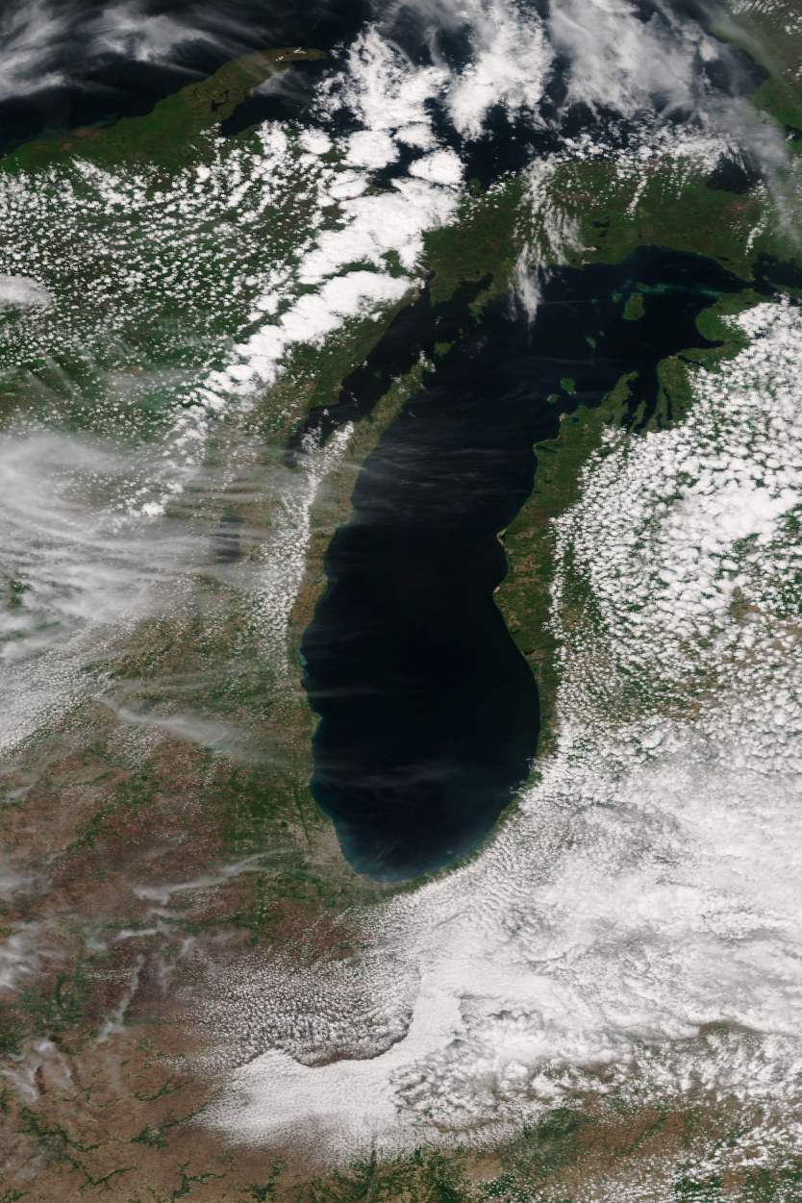
VIIRS Image May 27, 2011
Lake Breeze
Front
Satellite image of Lake Michigan showing
Lake Breeze Front
Prevailing winds

Slide 5
Summary of LMOS 2017 measurements
Location | Measurement* | Research Institution*
Ground Sites
Spaceport Sheboygan | Remote sensing of meteorology (SPARC Trailer) | UW-Madison -SSEC
 | In situ measurements of pollutants | U.S. EPA ORD
Zion, IL | Remote sensing of meteorology (Sodar/MW Radiometer) | Univ. Northern Iowa
 | Detailed in situ chemical and aerosol measurements | Univ. Iowa, UW-Madison, Univ. Minnesota
 | Routine measurements of ozone | Illinois EPA
Various† | Remote sensing of pollutants and boundary layer height (Pandora and Ceilometer) | U.S. EPA ORD
Sheboygan transect | In situ measurements of ozone at four locations | U.S. EPA ORD
Airborne Platforms
Lakeshore region | Airborne remote sensing of NO₂ (GeoTASO) | NASA
 | Airborne remote sensing of clouds (AirHARP) | Univ. Maryland, Baltimore County
 | Airborne in situ profiling of pollutants and meteorology | Scientific Aviation
Shipboard Platform
Lake Michigan | In situ measurements of pollutants | U.S. EPA ORD
 | Remote sensing of pollutants and boundary layer height (Pandora and Ceilometer) | U.S. EPA ORD
Mobile Platforms
Northeast IL and Southeast WI | In situ measurements of pollutants (GMAP) | U.S. EPA Region 5
Grafton to Sheboygan | In situ measurements of ozone and meteorology | UW-Eau Claire

Slide 6
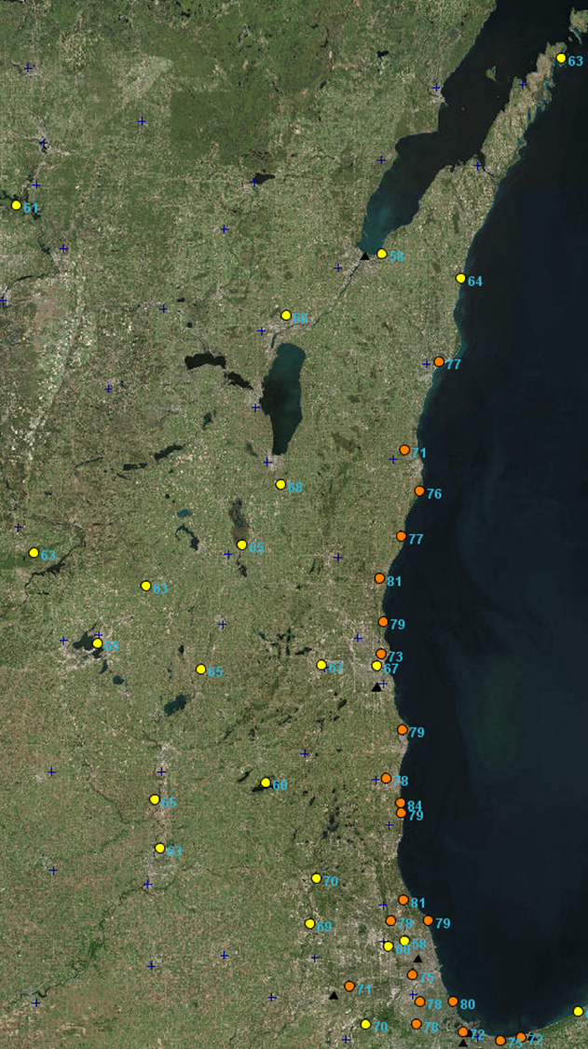
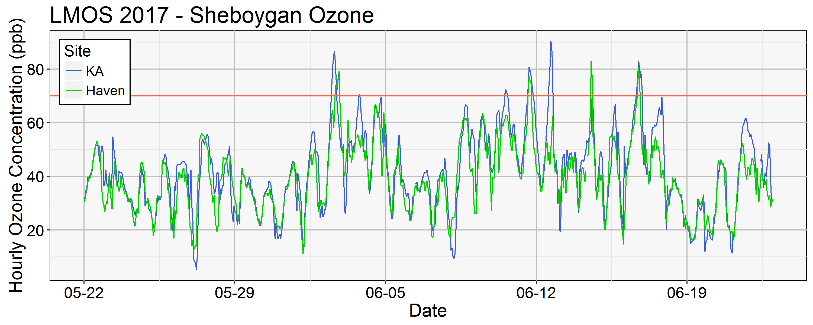
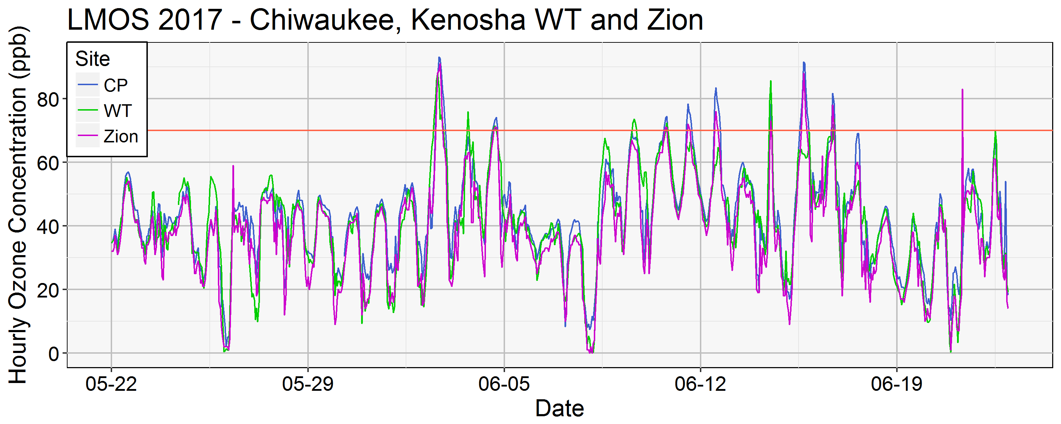
Lakeshore ozone during LMOS 2017
June 02, 2017 MDA8
June 02, 2018
June 02, 2018
Provided by Angie Dickens (WDNR)
MDA8=Maximum Daily 8 hour Average

Slide 7
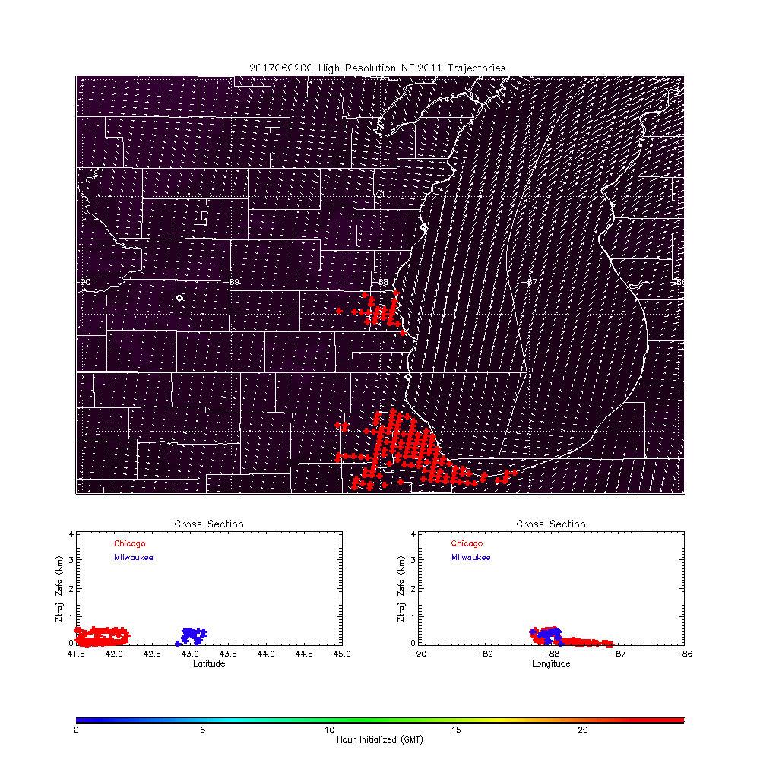
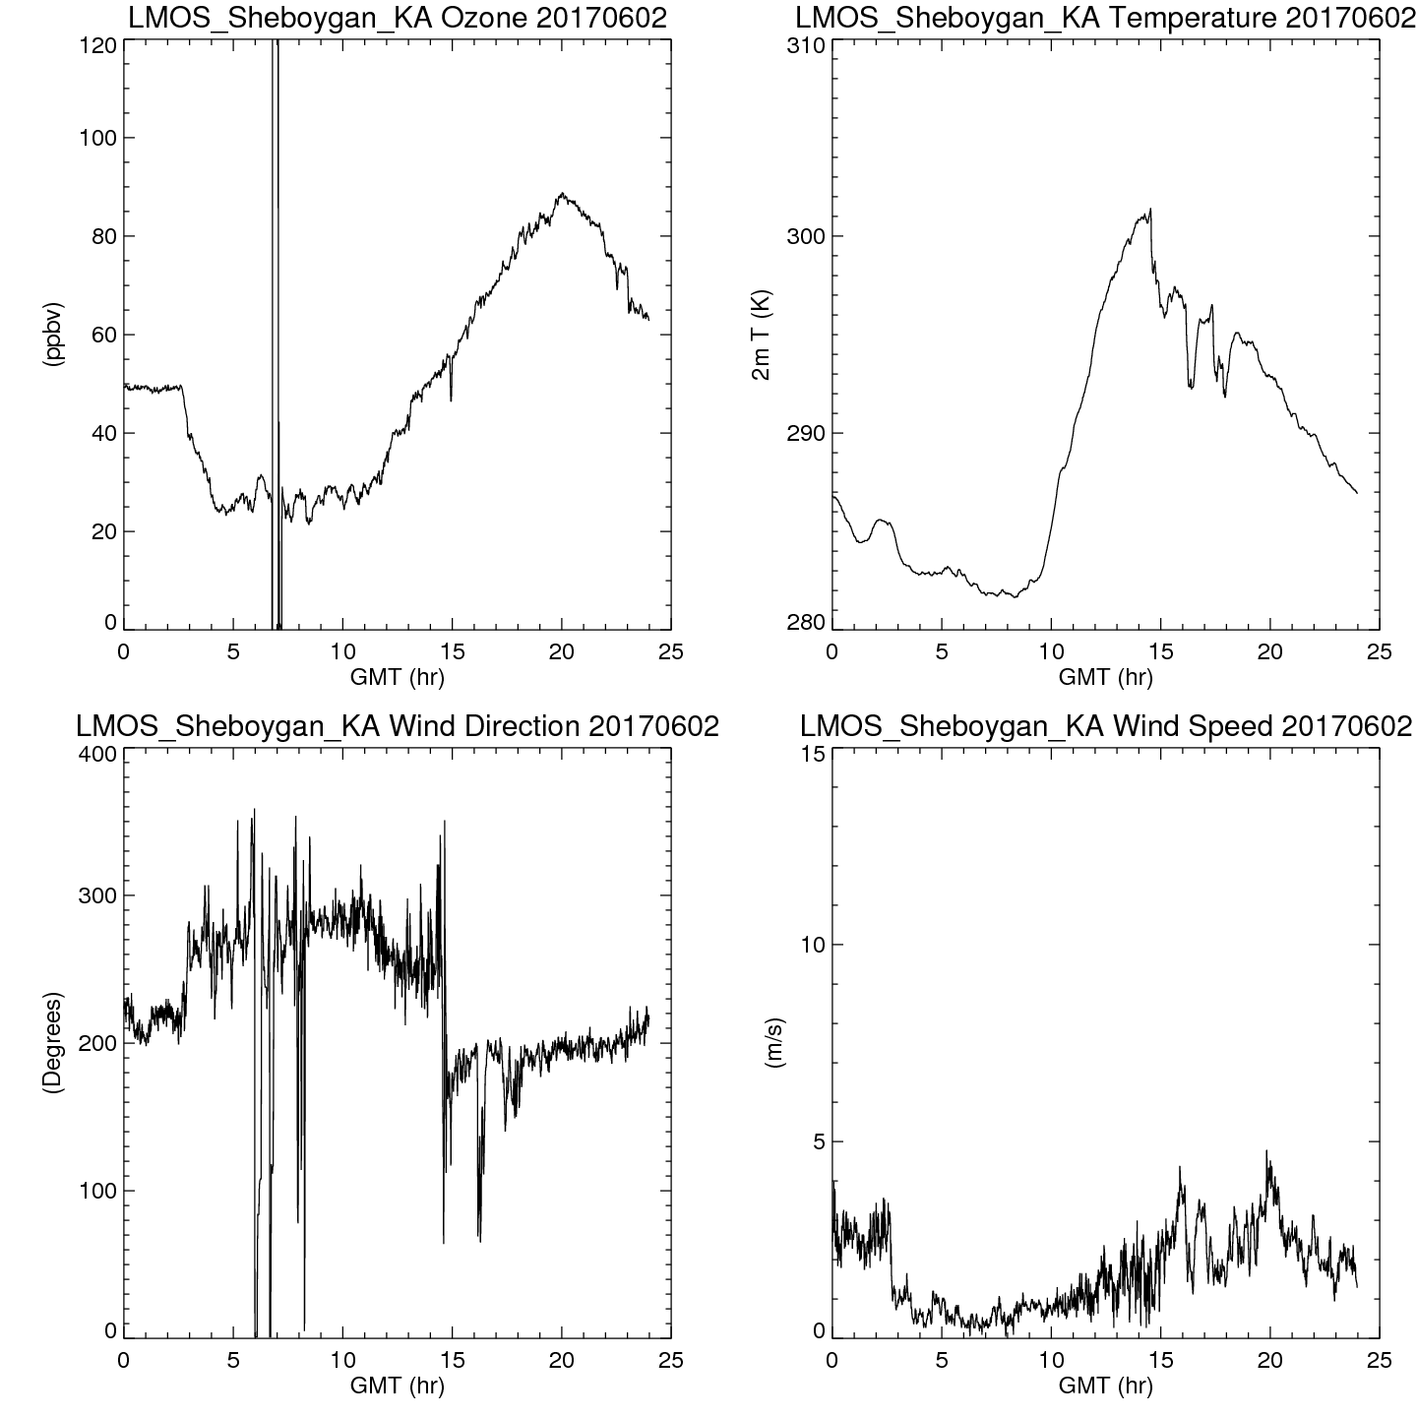
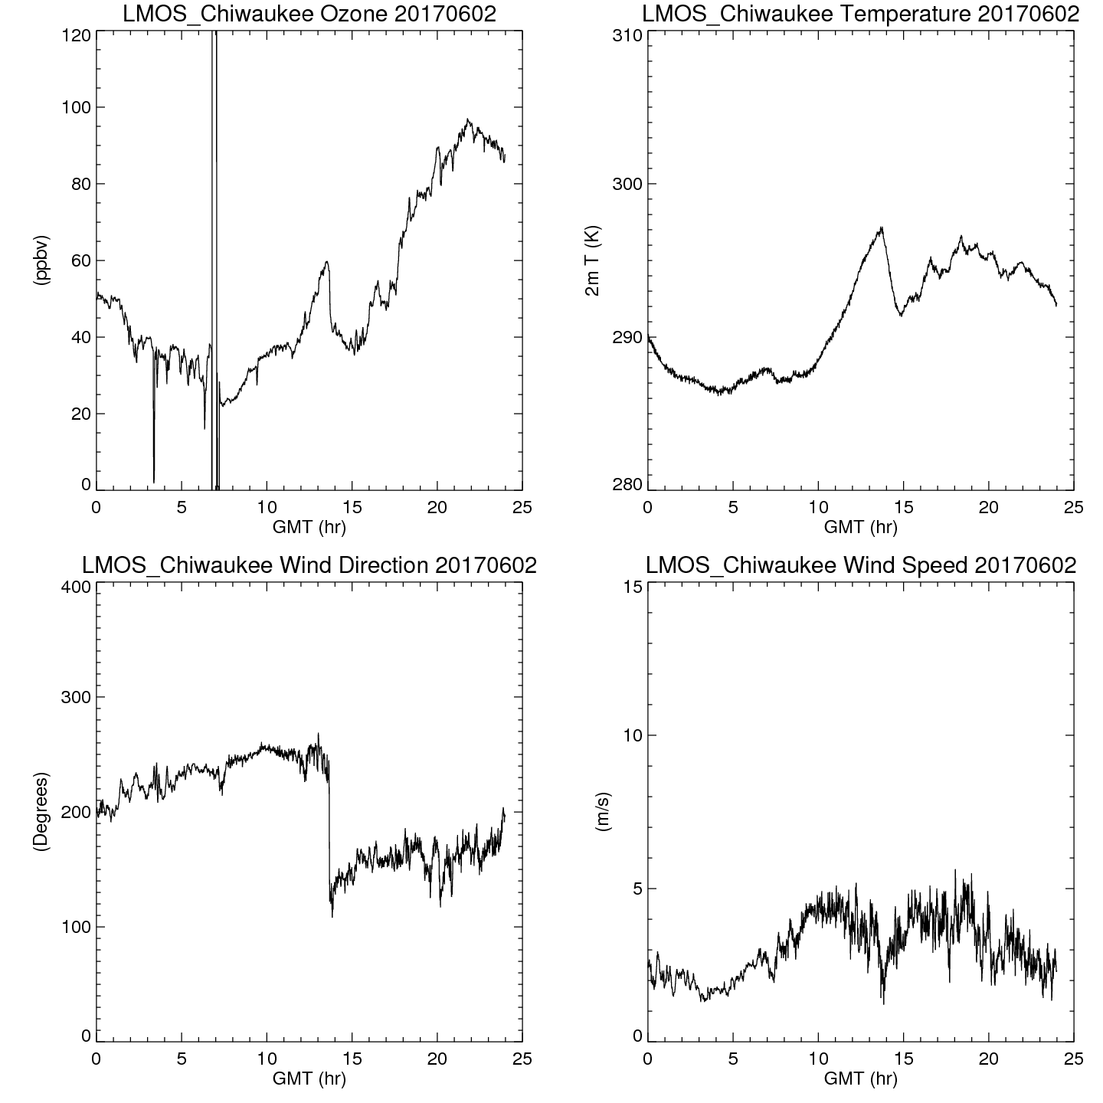
Coastal Ozone Exceedance Day
Sheboygan Kohler-Andrea and Chiwaukee surface ozone and wind direction on June 02, 2017
High resolution (3km) NAM Nest June 02, 2017 trajectory forecasts showing transport of Milwaukee and Chicago NOx emissions

Slide 8
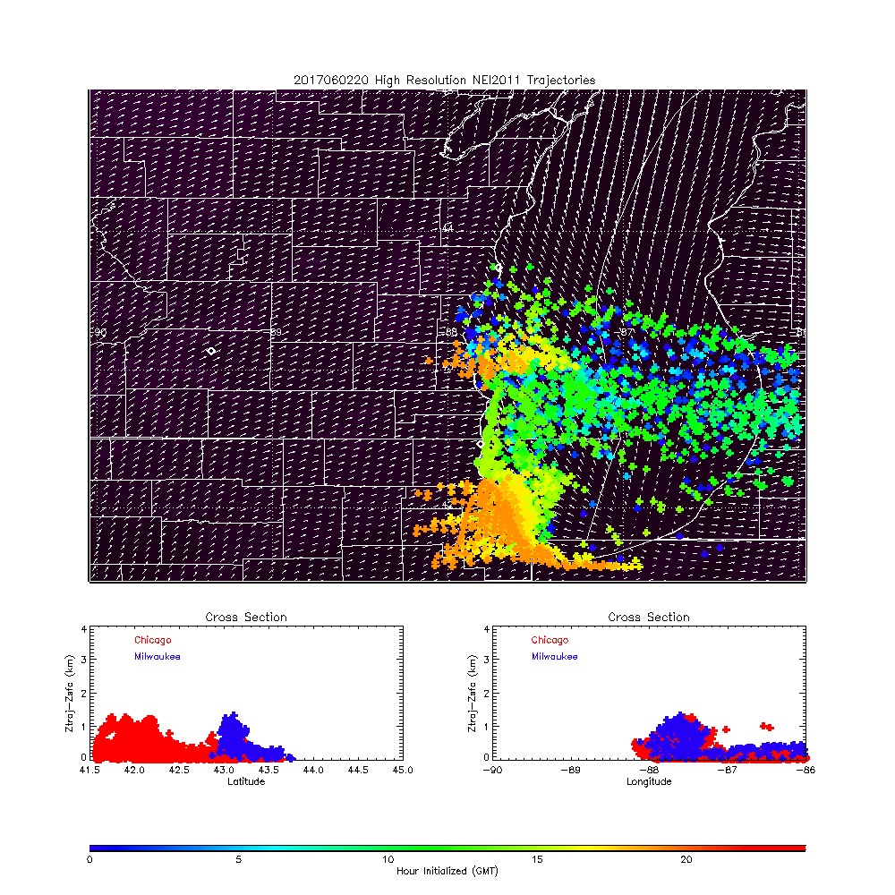
Coastal Ozone Exceedance Day
Sheboygan Kohler-Andrea and Chiwaukee surface ozone and wind direction on June 02, 2017
High resolution (3km) NAM Nest June 02, 2017 trajectory forecasts showing transport of Milwaukee and Chicago NOx emissions

Slide 9
National Weather Service NAM-CMAQ ozone forecasts during LMOS 2017
(http://airquality.weather.gov/)
May 22 through June 22, 2017
During LMOS 2017 NAM-CMAQ underestimates the occurrence of high ozone (>60ppbv) during Southerly and Southwesterly flow at Sheboygan, KA.
The North American Model (NAM) meteorology drives the Environmental Protection Agency’s (EPA) Community Multiscale Air Quality Model (CMAQ)

Slide 10
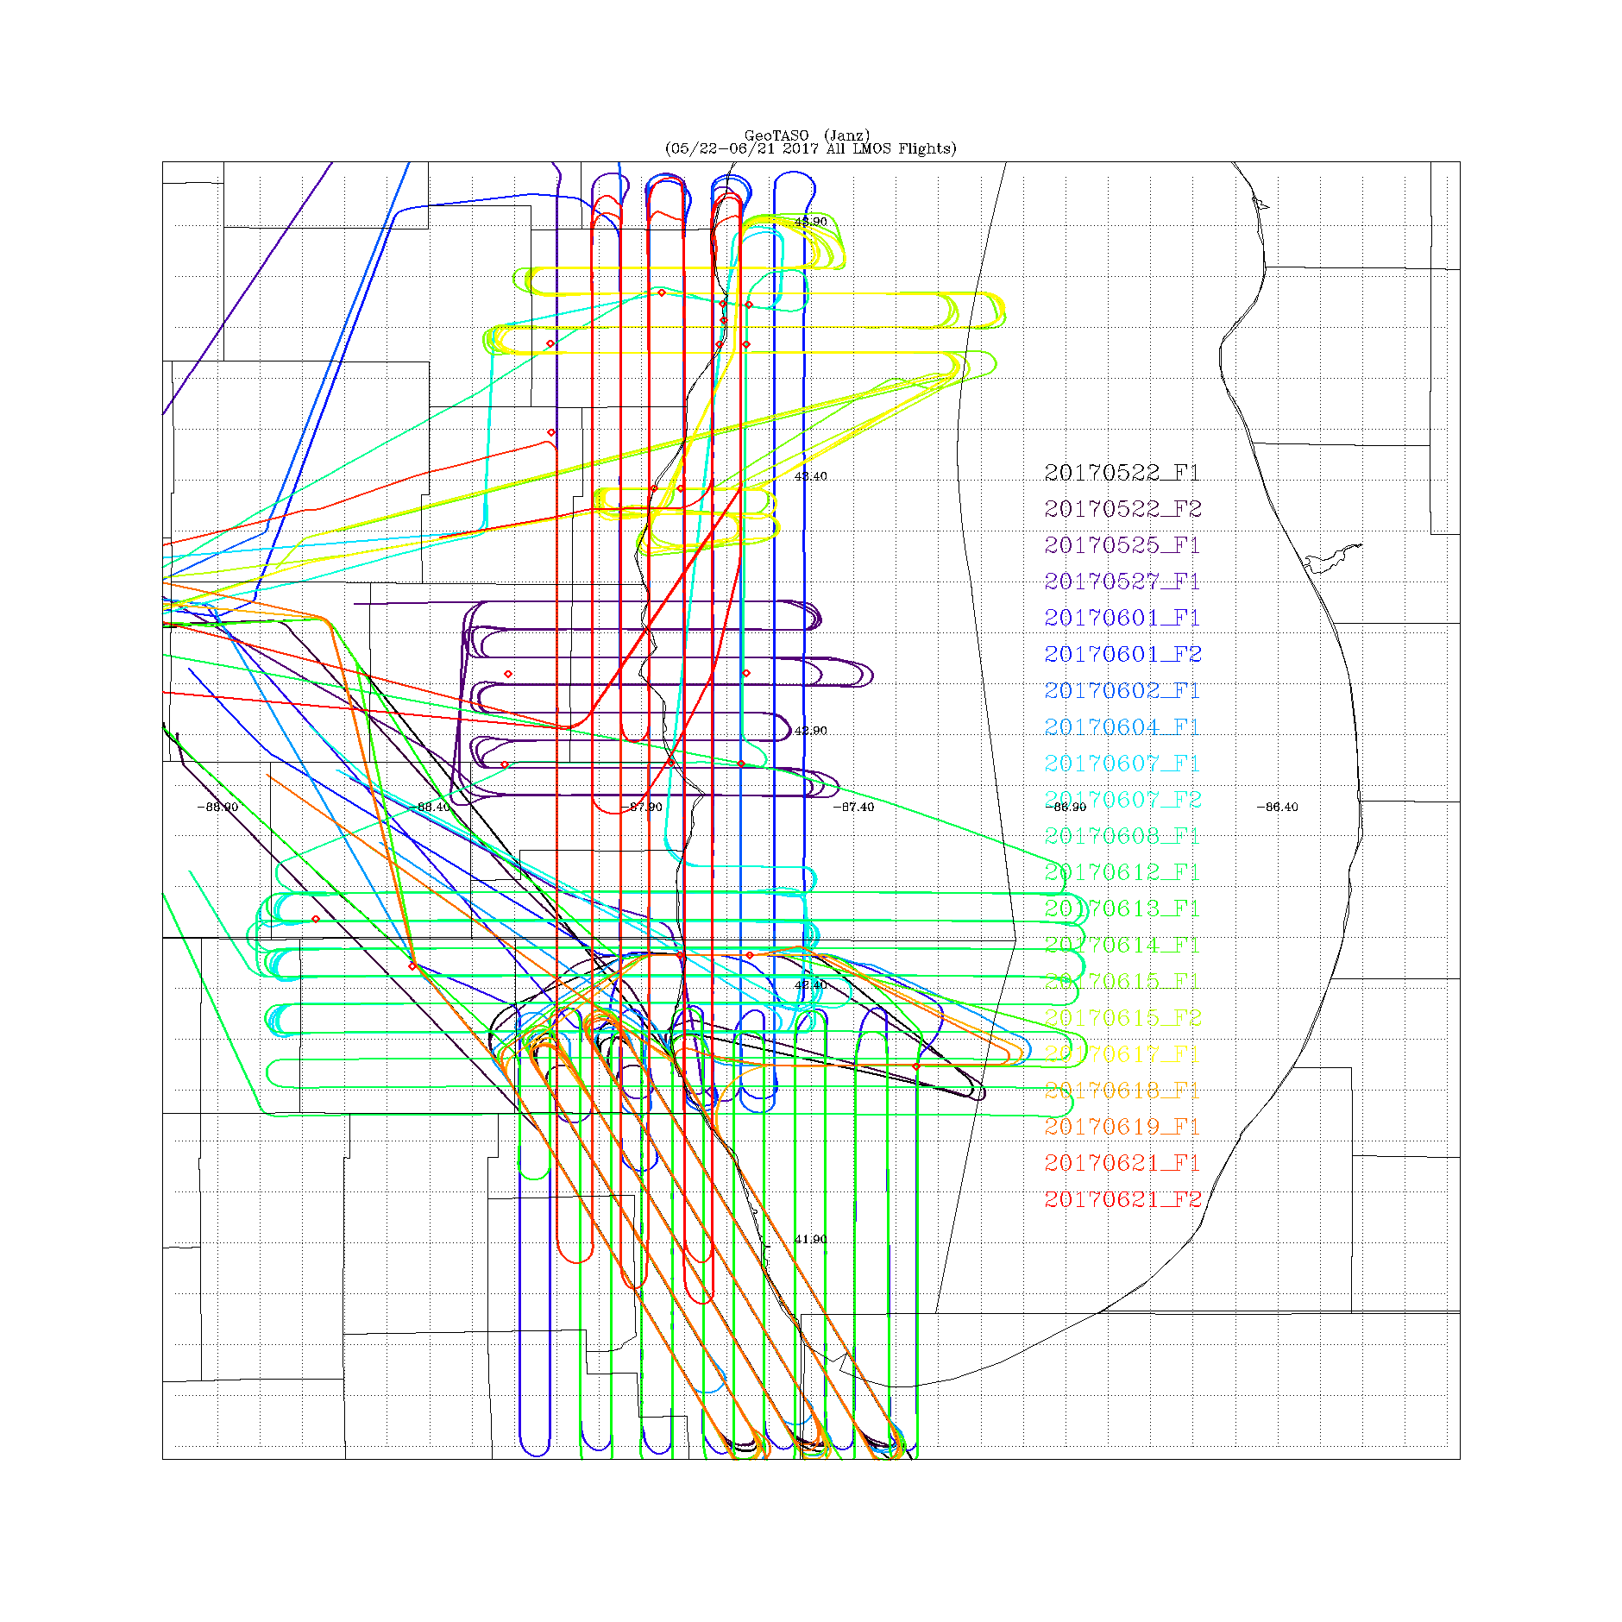
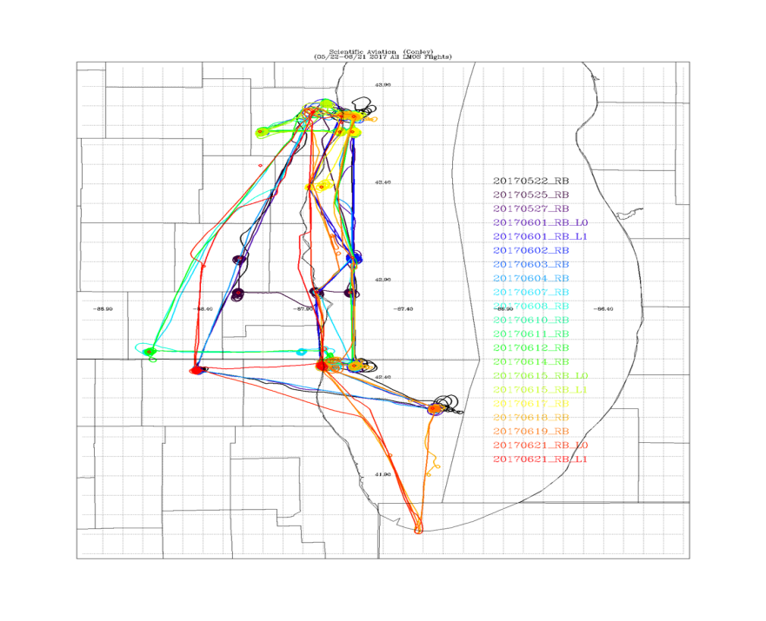
LMOS 2017 Aircraft Measurements
NASA GeoTASO remote sensing Flights
Scientific Aviation insitu sampling Flights
GeoTASO (Geostationary Trace gas and Aerosol Sensor Optimization) is an airborne hyperspectral mapping instrument that is being used as an airborne testbed for future high-resolution trace-gas observations from geostationary sensors such as TEMPO
The Electric Power Research Institute (EPRI) provided funding for Scientific Aviation Flights during LMOS

Slide 11
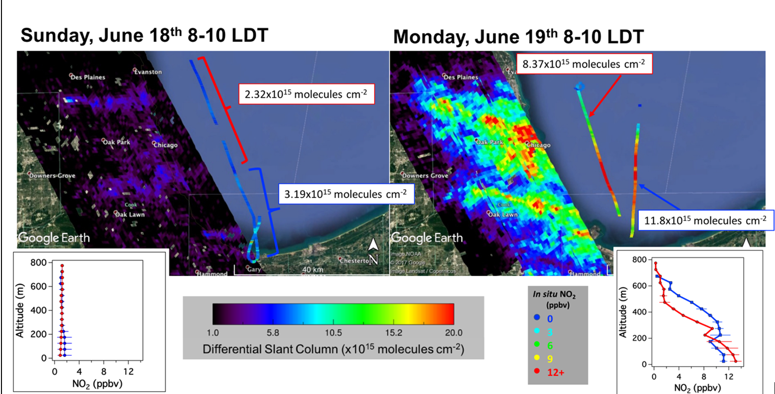
Chicago Emission Mapping Weekend/Weekday
GeoTASO NO2 columns and Scientific Aviation NO2 profiles show large differences between weekend and weekday NO2 abundances. LMOS measurements provide constraints on emissions from commuter traffic (Analysis by Laura Judd, NASA/LaRC)

Slide 12
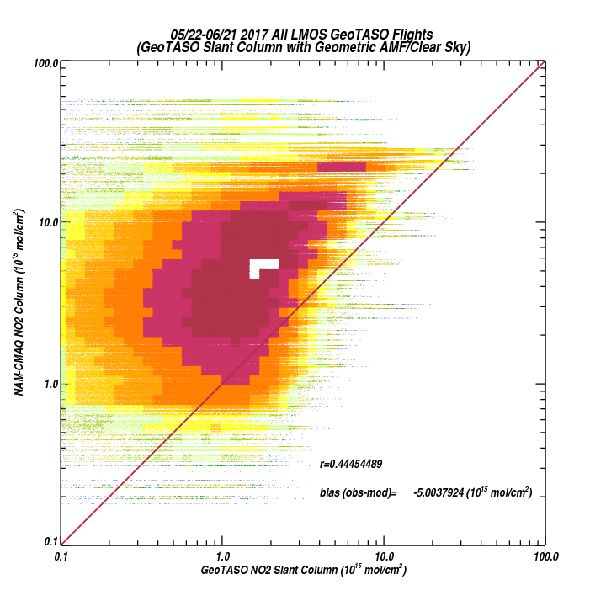
LMOS May 22 through June 21, 2017
NAM-CMAQ vs GeoTASO Differential Slant Column
All GeoTASO Flights
NAM-CMAQ overestimates NO2 columns compared to GeoTASO differential slant columns (currently not accounting for instrument sensitivity to NO2 profile)

Slide 13
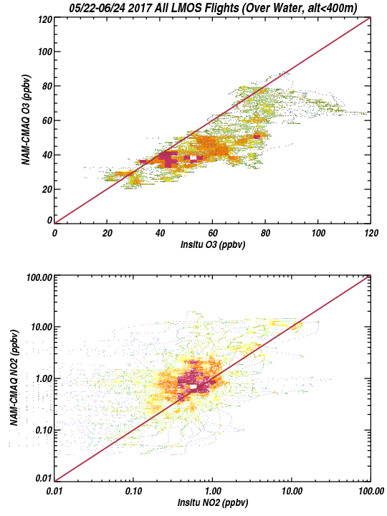
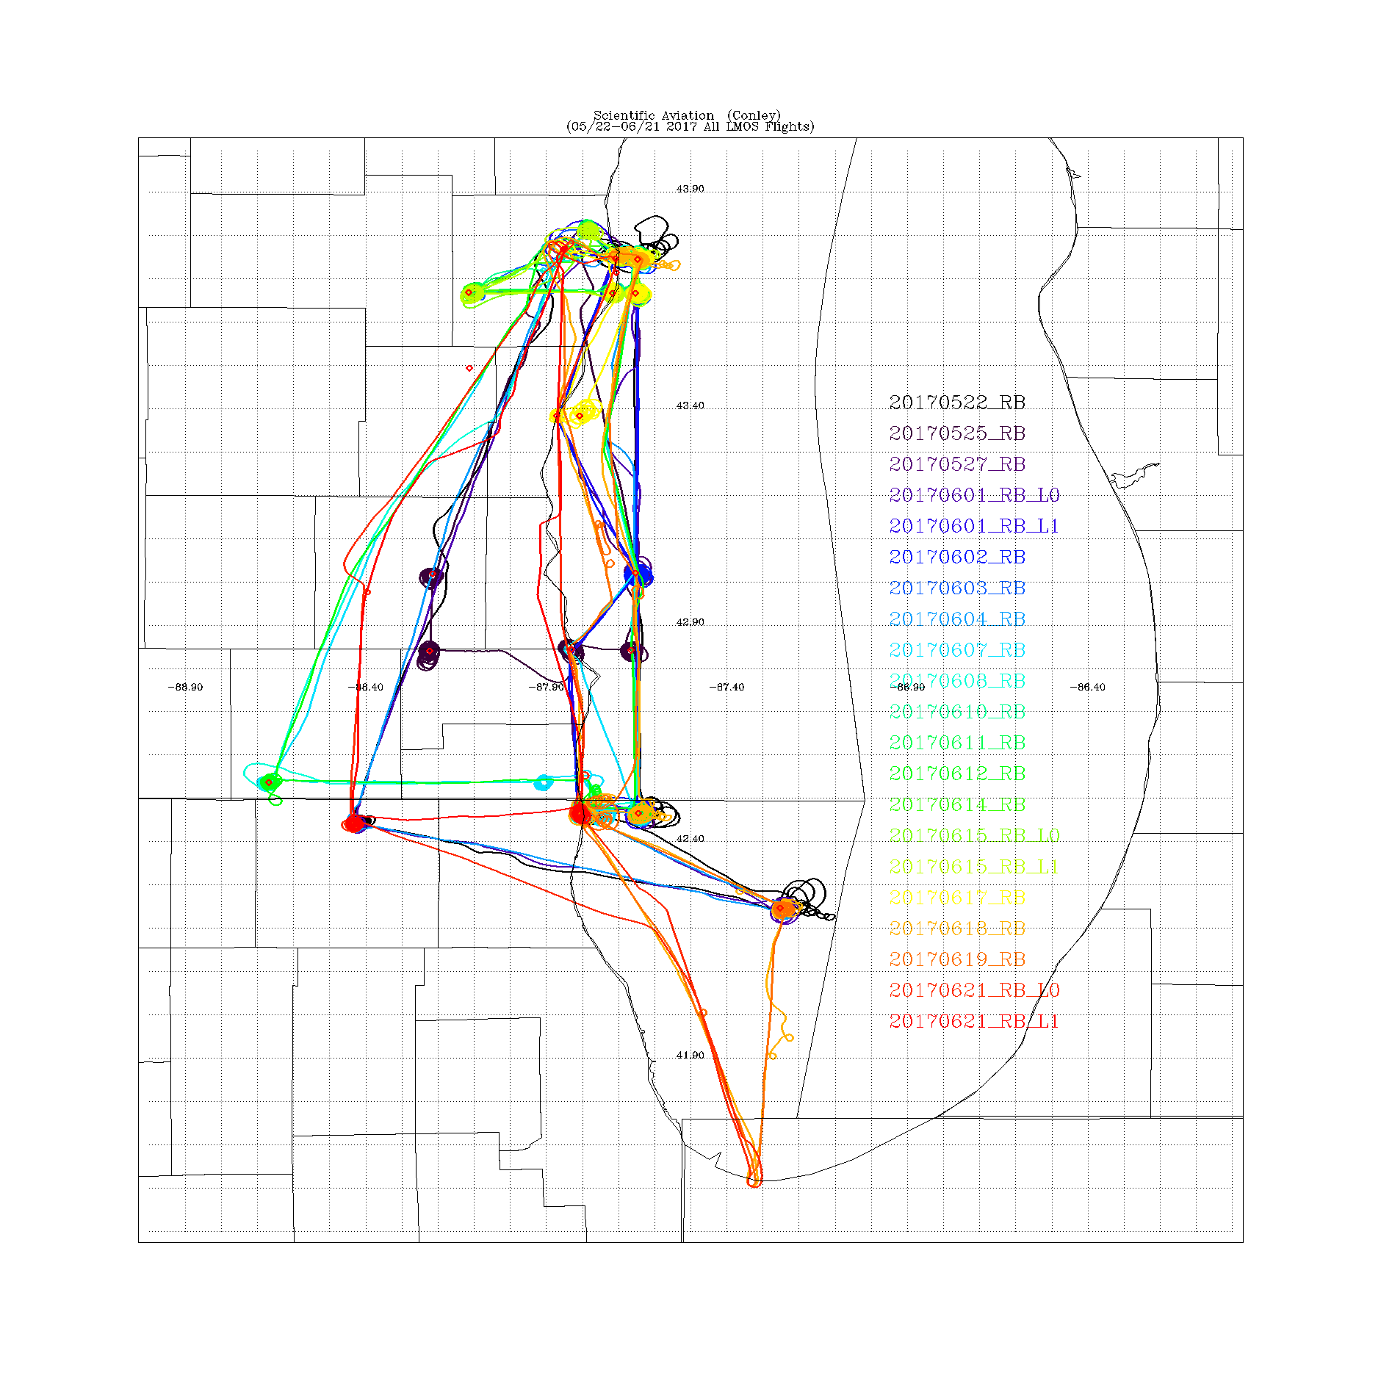
NAM-CMAQ vs Scientific Aviation
(Over Water, Altitude <400m)
1 to 1
+/- 15ppb
All Scientific Aviation Flights
1 to 1
+/- 3X
NAM-CMAQ underestimates O3 and overestimates NO2 over Lake Michigan
Steve Conley (Scientific Aviation PI)

Slide 14
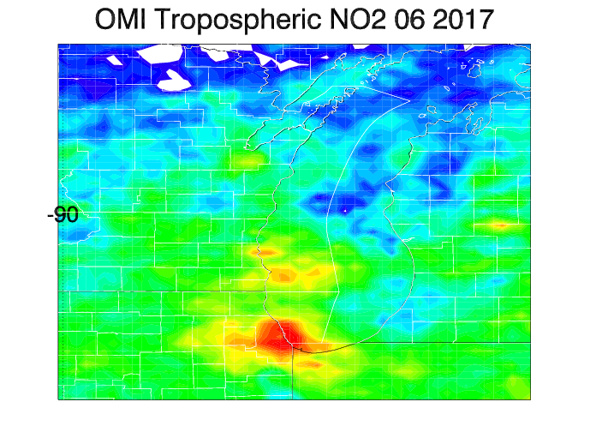
Aura Ozone Monitoring Instrument (OMI) Tropospheric NO2 column Data Assimilation
OMI Tropospheric NO2 column during June 2017
NOx emissions adjustments (ΔE) are constrained using OMI tropospheric NO2 column analysis increments (ΔΩ)
β accounts for the sensitivity of the NO2 column to changes in NOx emissions following Lamsal et al 2011.
Lamsal, L. N., et al. (2011), Application of satellite observations for timely updates to global anthropogenic NOx emission inventories, Geophys. Res. Lett., 38, L05810, doi:10.1029/2010GL046476.

Slide 15
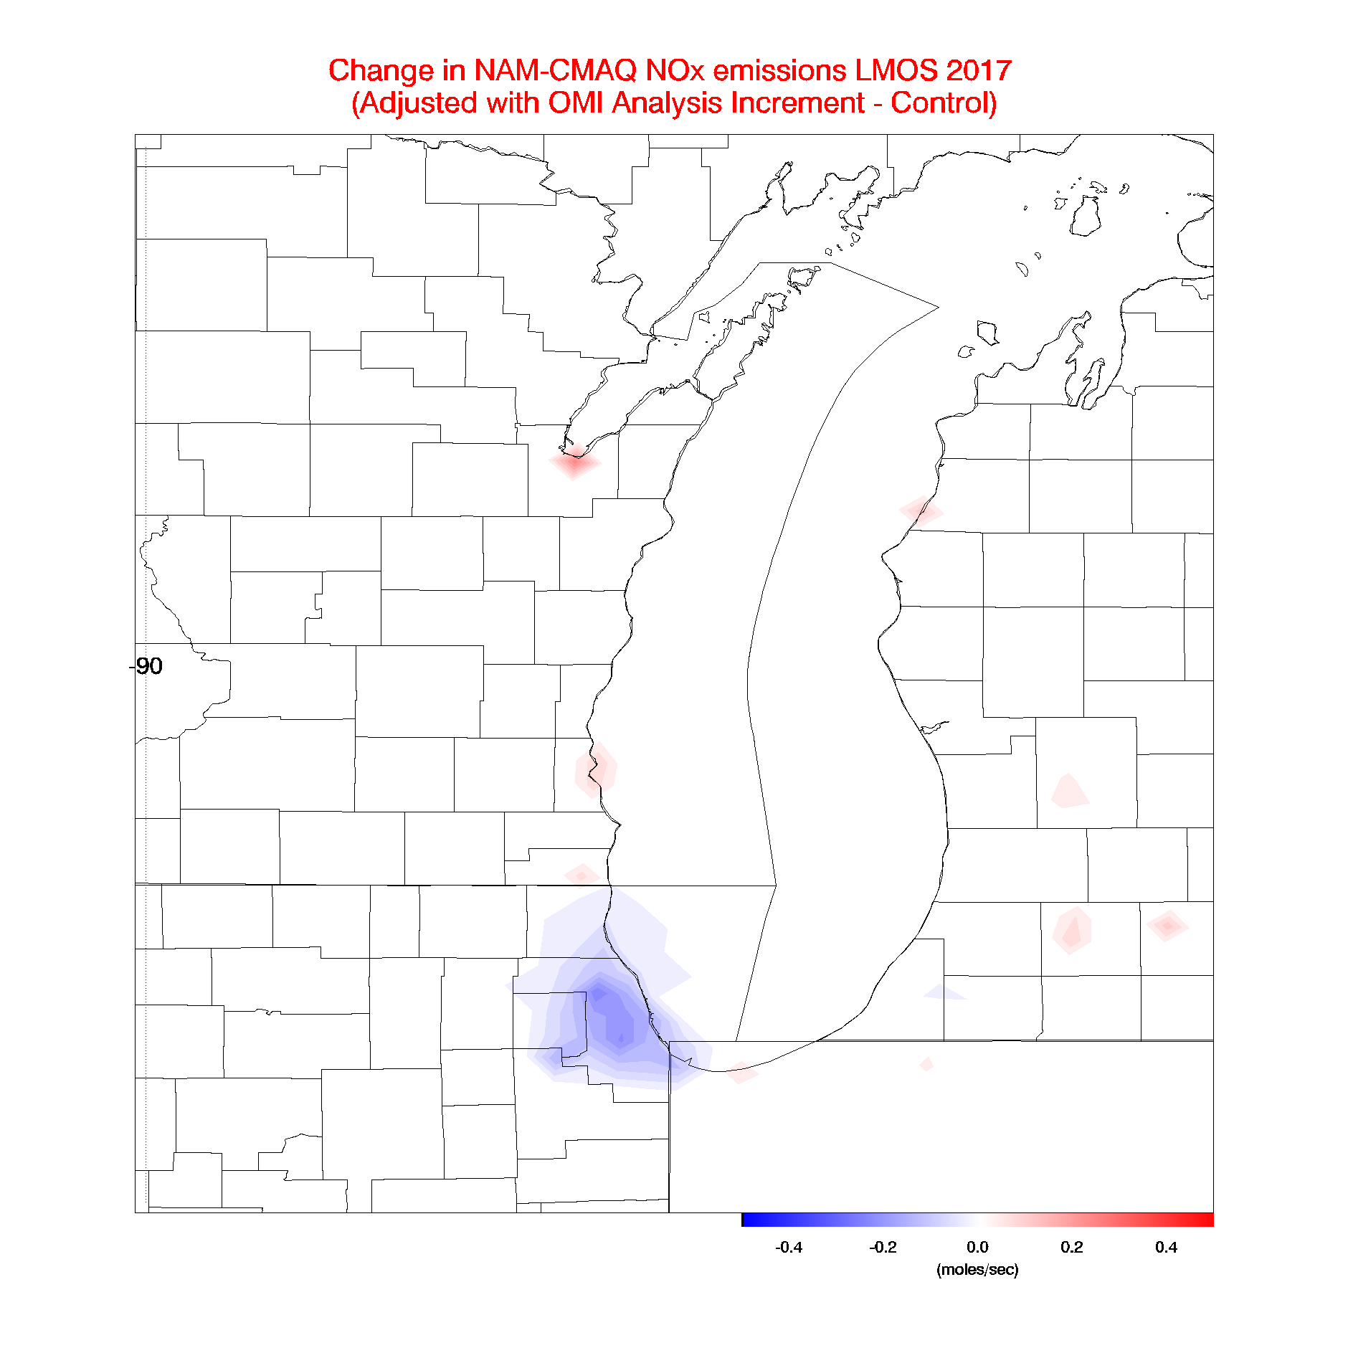
Aura Ozone Monitoring Instrument (OMI) Tropospheric NO2 column Data Assimilation
Assimilation of OMI NO2 results in small (~4%) reductions in NOx emissions over Chicago
Lamsal, L. N., et al. (2011), Application of satellite observations for timely updates to global anthropogenic NOx emission inventories, Geophys. Res. Lett., 38, L05810, doi:10.1029/2010GL046476.

Slide 16
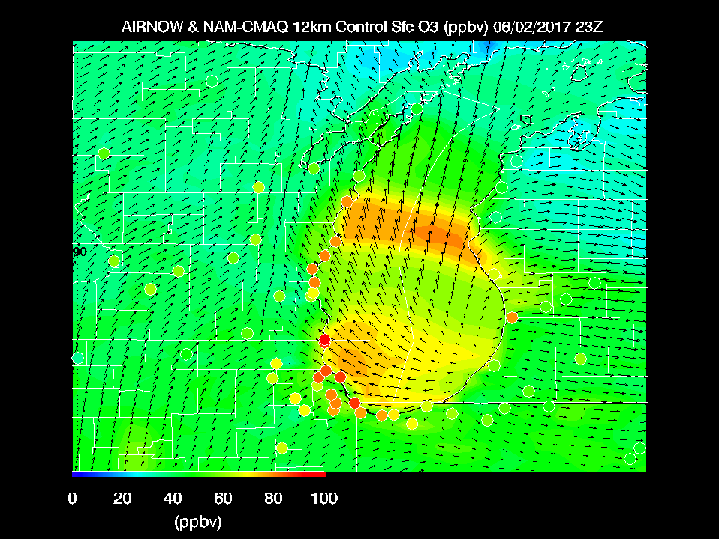
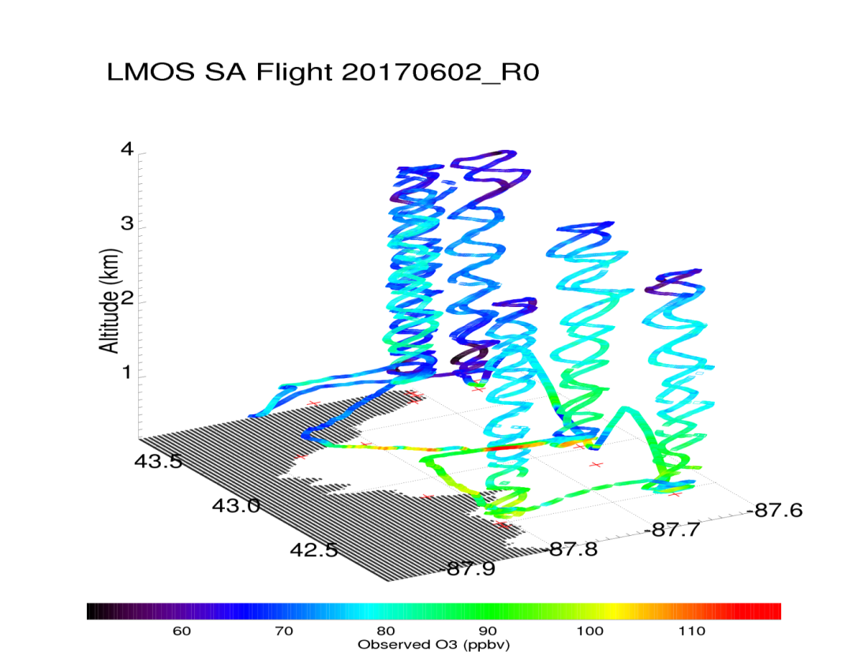
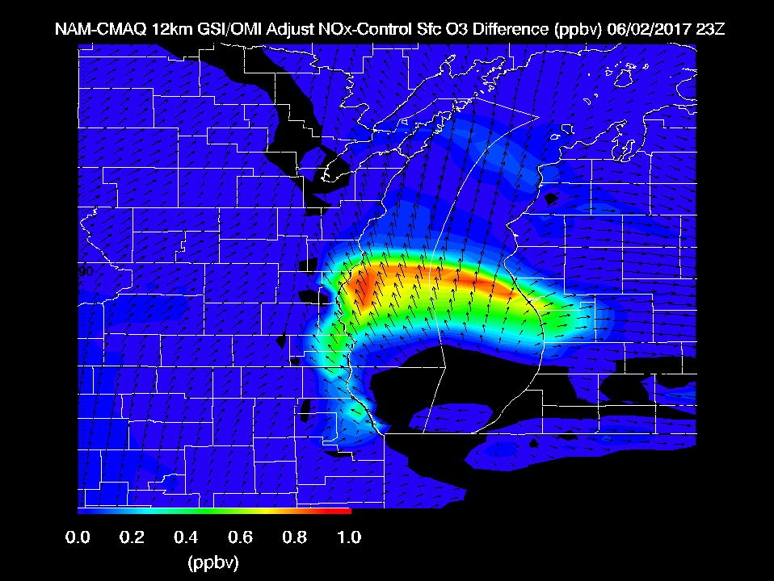
Max Observed O3 > 110ppbv
Reductions in NOx emissions on high ozone day leads to slight (~1ppbv) increases in surface ozone

Slide 18
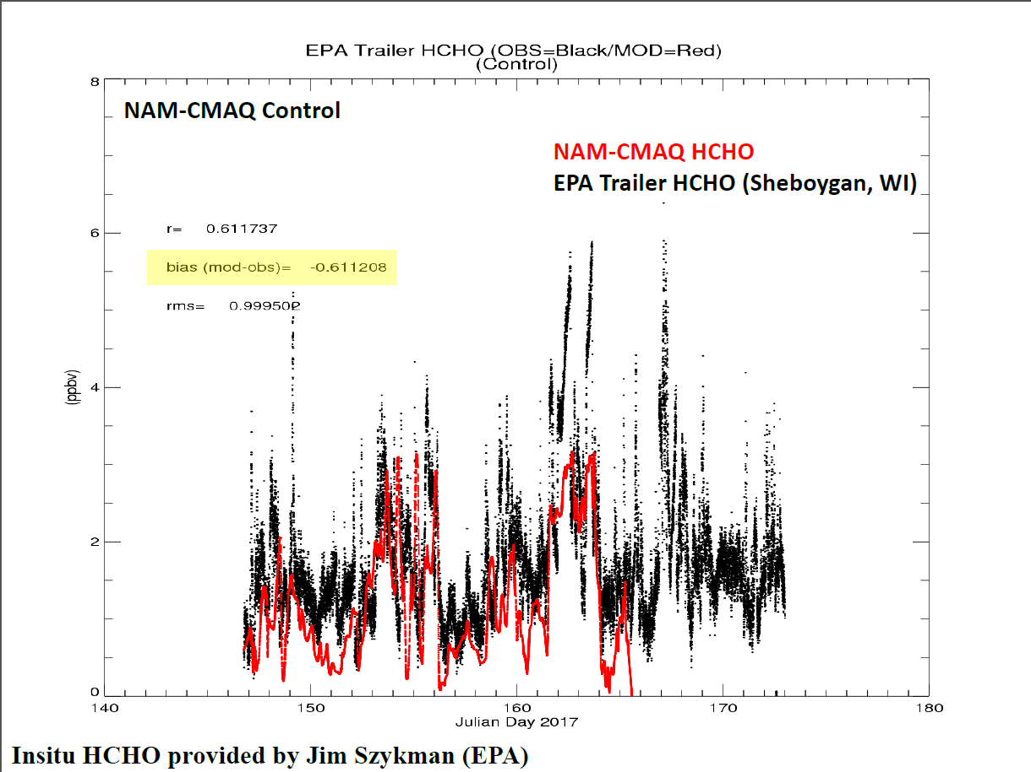
Formaldehyde (HCHO) is a bi-product of Isoprene oxidation

Slide 19
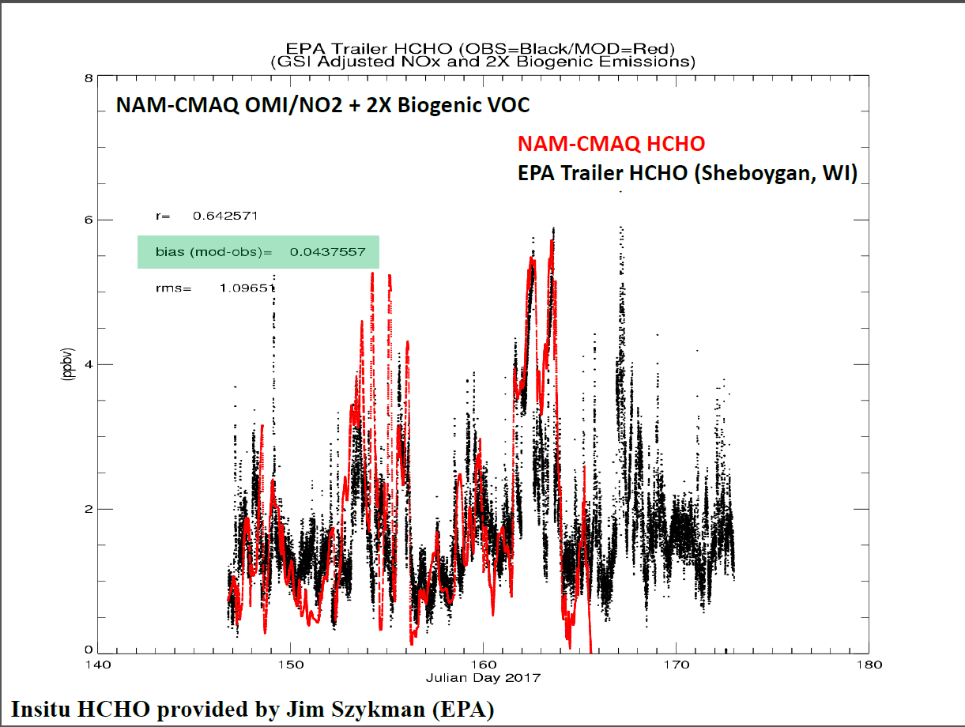
Formaldehyde (HCHO) is a bi-product of Isoprene oxidation

Slide 20
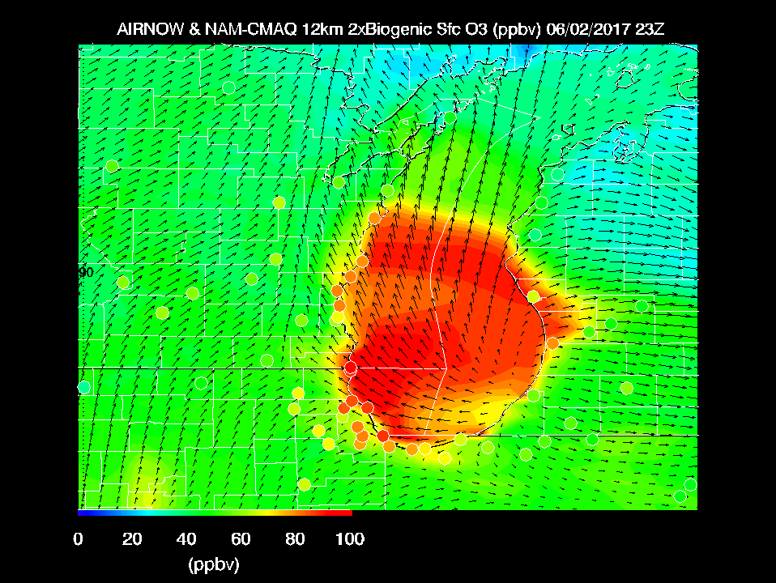
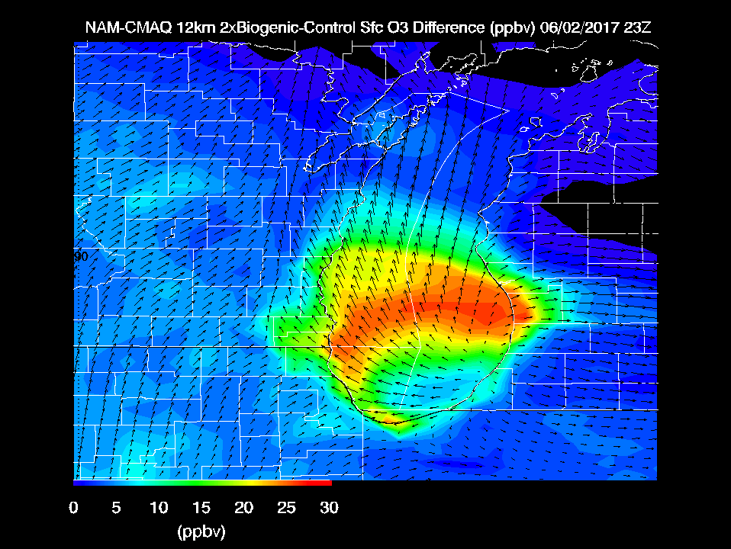
Max Observed O3 > 110ppbv
Doubling Biogenic VOC emissions within NAM-CMAQ leads to large (25-30 ppbv) increases in surface ozone on the June 2nd ozone exceedance day

Slide 21
Summary and Conclusions
Significant ozone events occurred during LMOS 2017, with exceedances of the 70 ppb 8-hr ozone threshold on June 2, June 11-12, and June 14-16. The LMOS 2017 aircraft observed polluted layers with rapid ozone formation occurring in a shallow layer near the Lake Michigan surface.
Modeling and observations show that this polluted layer over the lake is an important factor in coastal ozone exceedance events, but that meteorological and photochemical model skill in forecasting these needs improvement.
Comparisons between NAM-CMAQ forecasts, ground based monitors, in situ, and remote airborne measurements showed that NAM-CMAQ underestimated peak ozone concentrations and overestimated NO2 concentrations during ozone exceedance events during LMOS 2017.
NAM-CMAQ sensitivity studies show that reductions in anthropogenic NOx emissions and increases in biogenic volatile organic compounds (VOCs) emissions are necessary to increase the predicted surface ozone during high ozone events during LMOS 2017.

Slide 22
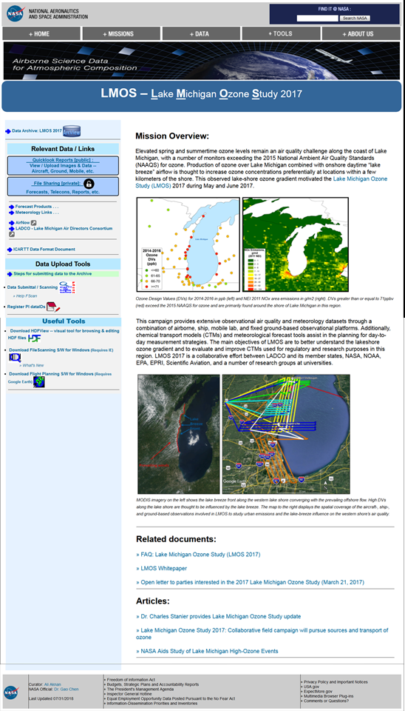
LMOS 2017 Data Archive
https://www-air.larc.nasa.gov/missions/lmos/index.html

