Slide 1
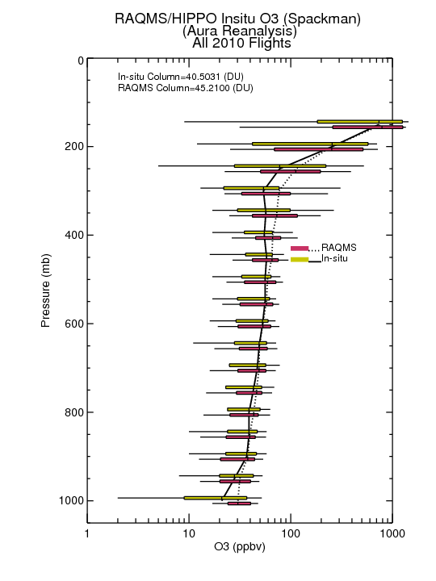
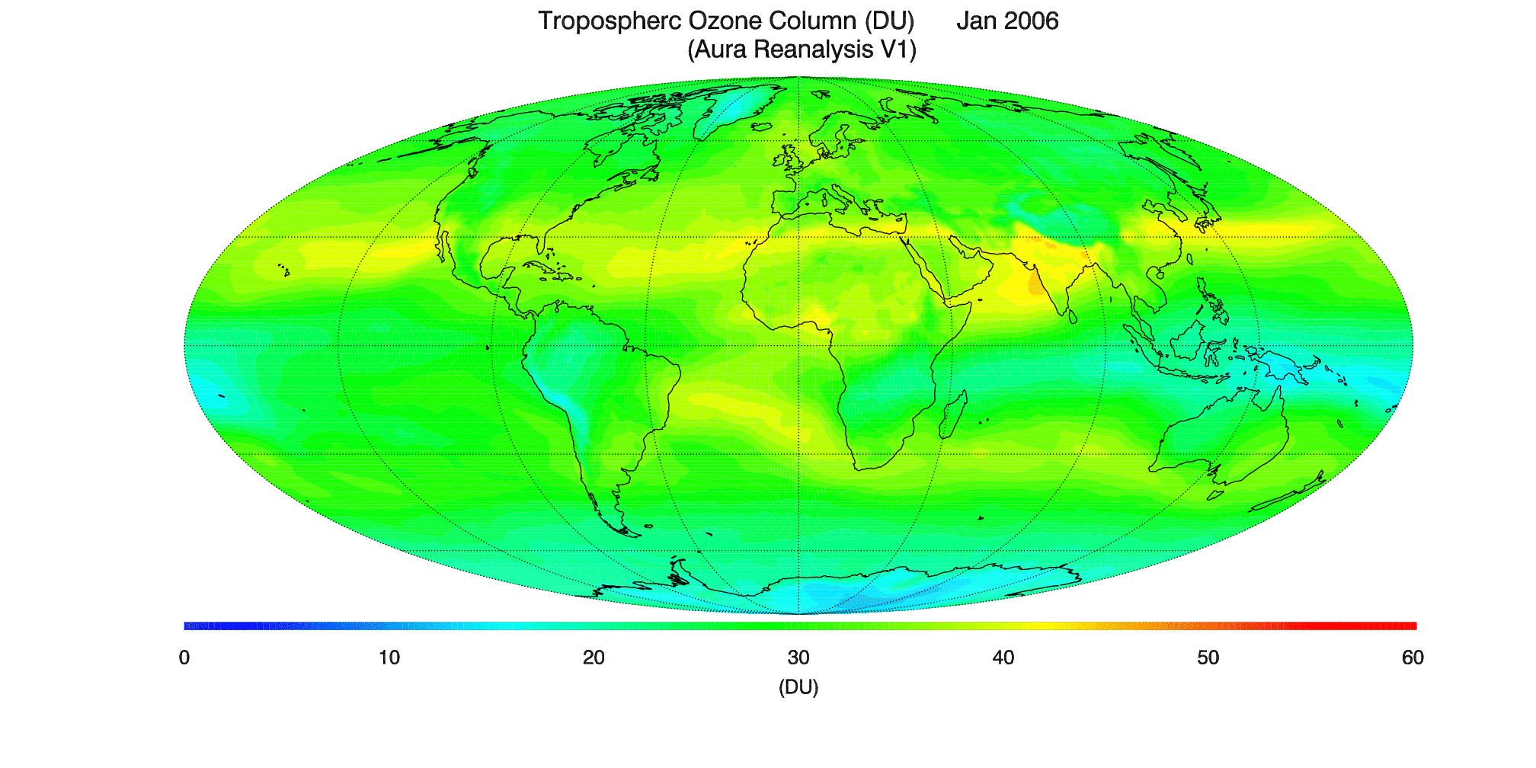
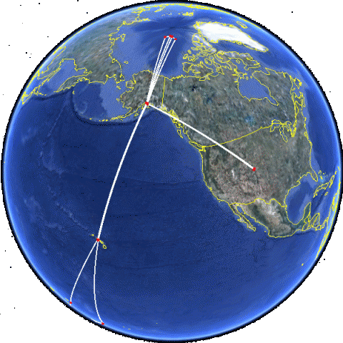
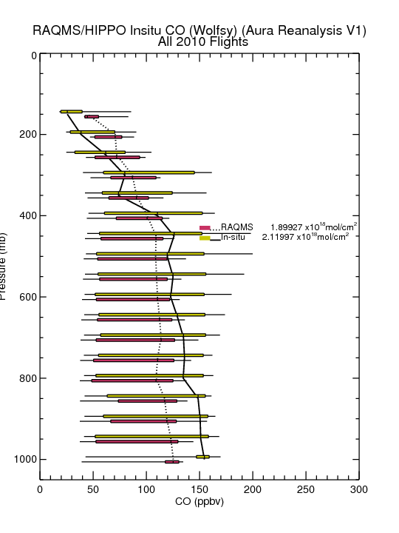
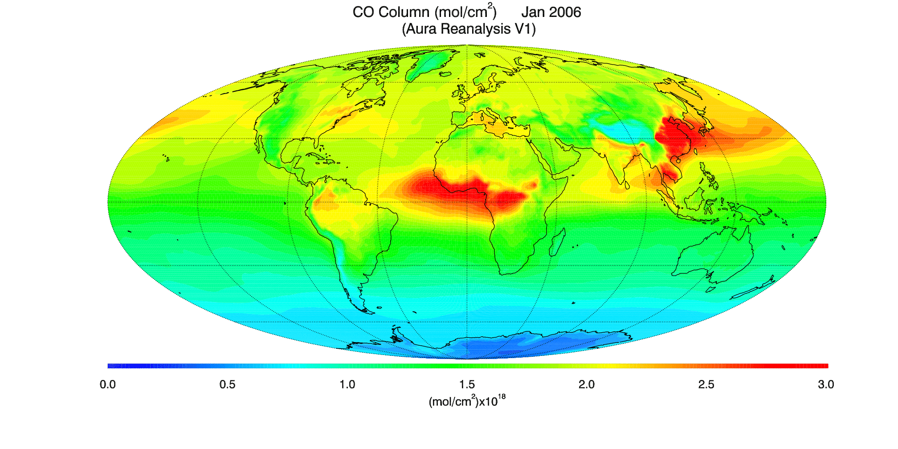
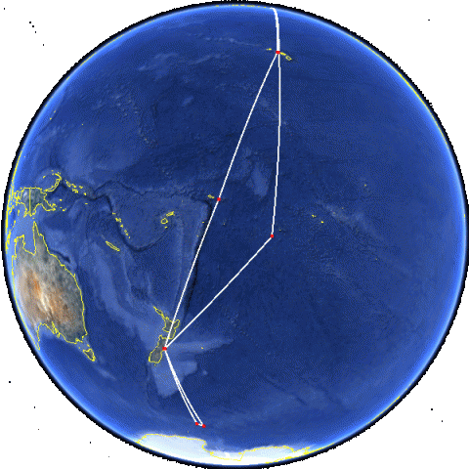
NGGPS Simplified Chemistry
The NGGPS chemical module is based on the Real-time Air Quality Modeling System (RAQMS)
A 6 year (2006-2011) Aura chemical reanalysis funded by the NASA Applied Science Program demonstrates a proof of concept for the NGGPS chemistry
Archived ozone tendencies from the Aura reanalysis will be used to parameterize stratospheric ozone loss due to polar halogen chemistry withing NGGPS
2010 O3
Validation
w/ HIPPO
2010 CO
Validation
w/ HIPPO
The NGGPS reduced chemistry development is funded by the NOAA Research Transition Acceloration Program (RTAP) and led by R. Bradley Pierce (NOAA/NESDIS/STAR) in collaboration with Vijay Tallapragada (NOAA/EMC). The development follows path established by European Monitoring Atmospheric Composition and Climate - Interim Implementation (MACC-II) project that is now operational at ECMWF.
Notes:
The proposed unified chemical module is a “reduced” version of the NASA Langley Research Center (LaRC) chemical module which has been used for more than 2 decades within general circulation models and global chemical data assimilation/forecasting systems. The LaRC unified chemical module has been utilized, along with aerosol predictions from the Goddard Chemistry Aerosol Radiation and Transport (GOCART) module, within the Real-time Air Quality Modeling System (RAQMS) for daily global trace gas and aerosol assimilation and forecasting since 2012. The primary simplifications of the reduced model are that 1) ozone tendencies resulting from the halogen cycles (ClOx and BrOx) are parameterized and 2) oxidation of Non Methane Hydrocarbons (NMHCs) are not considered. The animations show the results of a 6 year (2006-2011) chemical reanalysis using RAQMS in conjunction with the NOAA GSI analysis system to assimilate satellite ozone, carbon monoxide, NO2, and aerosol retrievals.

