Slide 1
High Resolution Trajectory-Based Smoke Forecasts
Using
VIIRS Aerosol Optical Depth and
NUCAPS Carbon Monoxide Retrievals
R. Bradley Pierce¹
Nadia Smith², Chris Barnet², Shobha Kondragunta¹,
James Davies³, Kathy Strabala³
¹NOAA/NESDIS Center for Satellite Applications and Research (STAR)
²Science and Technology Corporation (STC)
³UW-Madison Space Science and Engineering Center (SSEC)
AGU Fall Meeting, December 14, 2016 San Francisco, CA

Slide 2
Goal: Provide low latency, web-based, high resolution forecasts of smoke dispersion for use by NWS Incident Meteorologists (IMET) to support on-site decision support services for fire incident management teams.
Project utilizes VIIRS AOD and NOAA-Unique CrIS-ATMS Processing System (NUCAPS) CO retrievals to initialize trajectory-based, high spatial resolution smoke dispersion forecasts.
NUCAPS trace gas retrievals use CrIS full spectral resolution radiances and provides information on the vertical profile of smoke even in partly cloud FOVs.

Slide 3
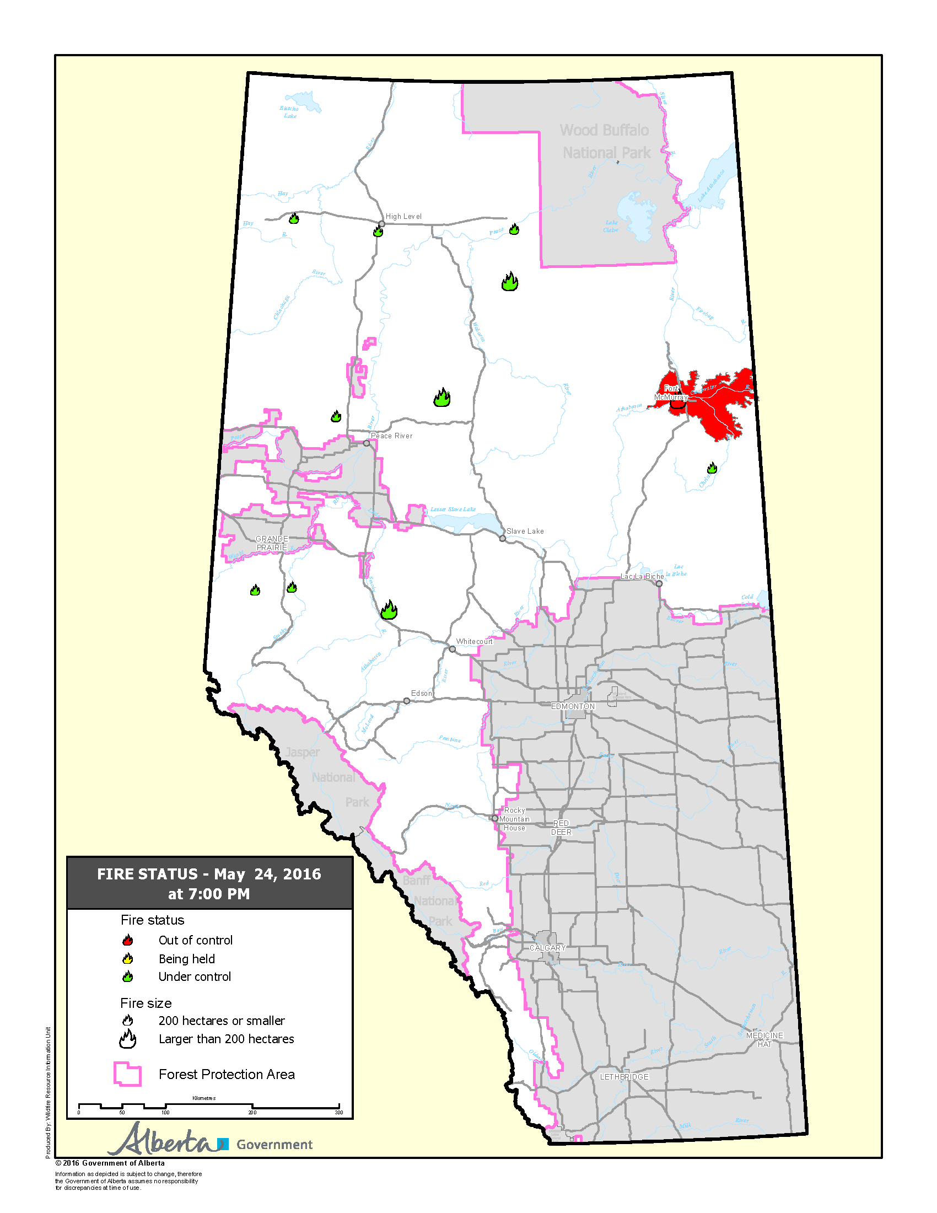
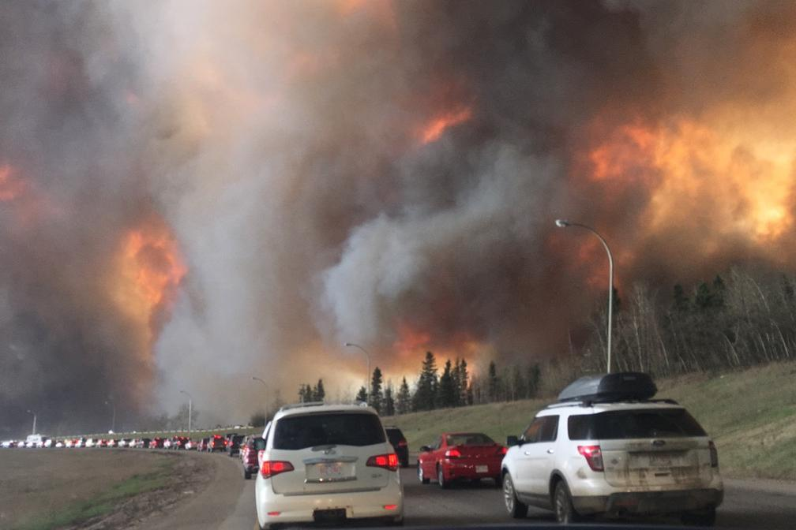
Fort McMurray wildfire Case study
(May 1, 2016) – 9:57 p.m., Mayor Blake has declared a State of Local Emergency in Fort McMurray localized to Gregoire.
(May 4, 2016) –Mandatory evacuation of Anzac, Gregoire Lake Estates and Fort McMurray First Nation.
(May 16, 2016) The evacuation zone has increased north of the city of Fort McMurray.
Photo by DarrenRD (https://commons.wikimedia.org)

Slide 4
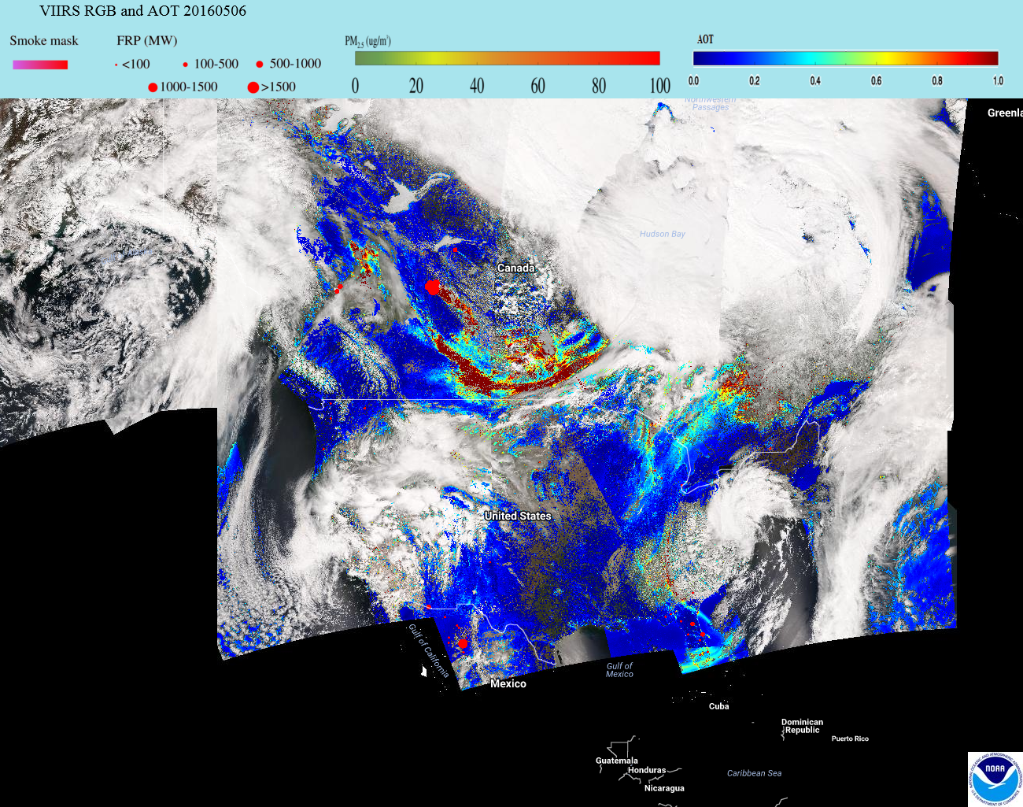
Canadian Wildfires
May 06, 2016
http://www.star.nesdis.noaa.gov/smcd/spb/aq/eidea/index.php

Slide 5
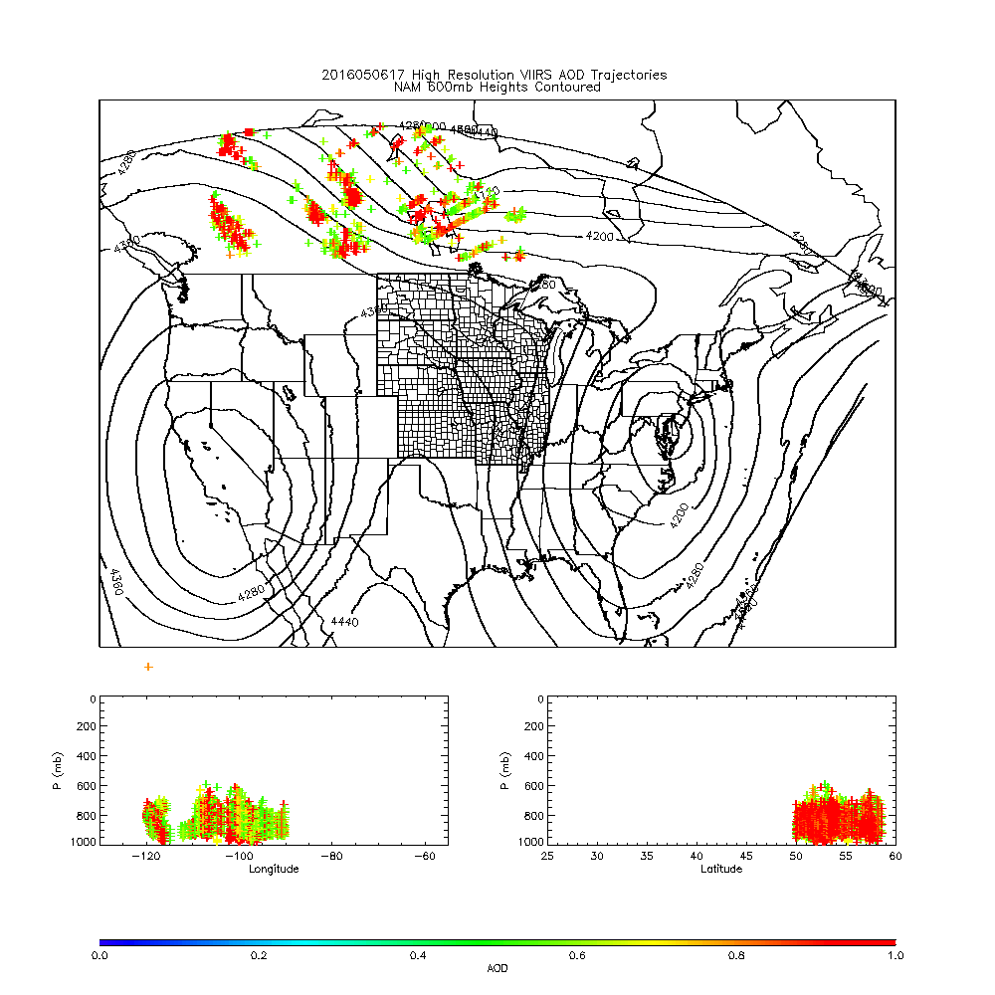
IDEA-I High resolution (NAM 4km) trajectory forecast
Fort McMurray Wildfire
May 06, 2016
IDEA-I high resolution trajectories initialized at each 6km VIIRS pixel (only AOD>0.5 initialized)
Upper panel shows NAM 600mb heights
Lower panels show longitude and latitude cross sections
IDEA-I high resolution trajectory forecast colored by initial AOD

Slide 6
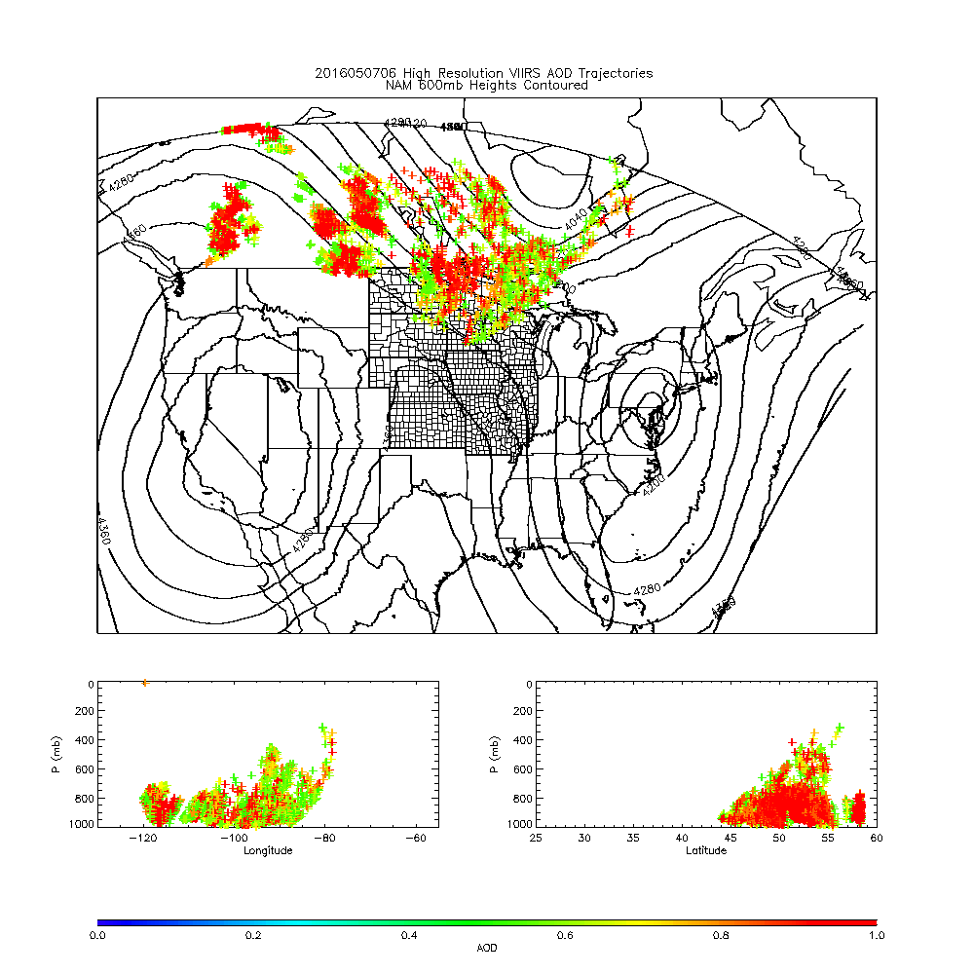
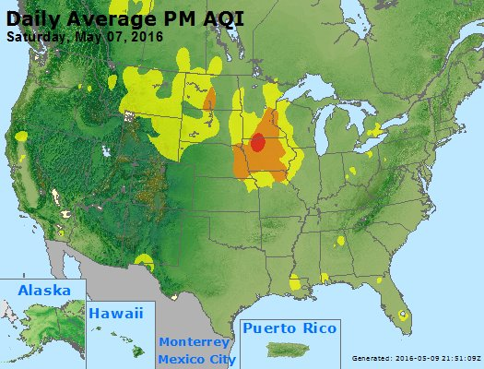
652 WWUS83 KMPX 070627 SPSMPX SPECIAL WEATHER STATEMENT NATIONAL WEATHER SERVICE TWIN CITIES/CHANHASSEN MN 127 AM CDT SAT MAY 7 2016 ...SMOKY CONDITIONS TO PERSIST THROUGH THE OVERNIGHT HOURS... WIDESPREAD SMOKE FROM BOTH THE LARGE CANADIAN WILDFIRES AND A SMALLER WILDFIRE NEAR LAKE HATTIE IN HUBBARD COUNTY MINNESOTA HAS BLOWN INTO CENTRAL MINNESOTA...PARTICULARLY WITHIN AND NEAR THE TWIN CITIES METROPOLITAN AREA...DUE TO STRONG WINDS FROM THE NORTHWEST. VISIBILITIES HAVE BEEN REDUCED TO BETWEEN 1 AND 3 MILES...AND AIR QUALITY HAS BEEN SIGNIFICANTLY IMPACTED.
From Andy Edman/NWS
https://www.airnow.gov/

Slide 7
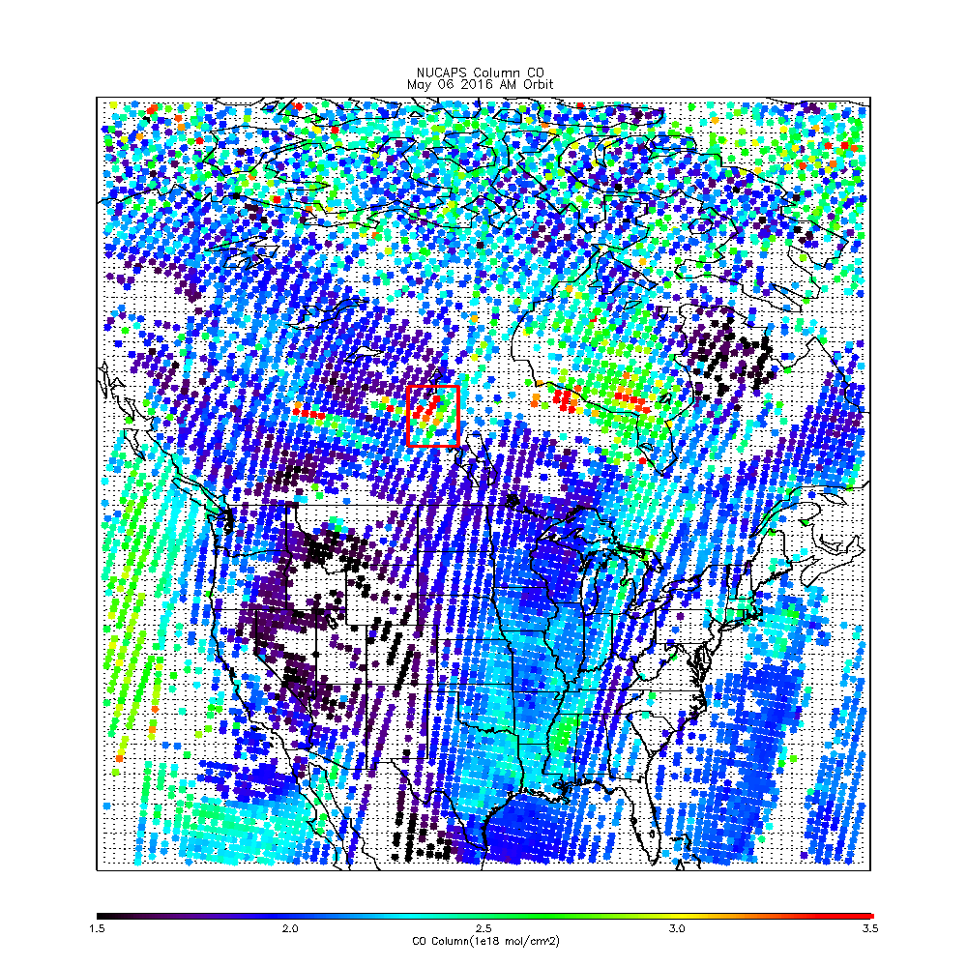
NUCAPS Trace Gas Retrievals (EDR)
Output files include averaging kernel, apriori, interpolation and inverse matrixes for applying to model (or insitu) profiles for data assimilation (or validation) activities.
Files also include surface parameters, degrees of freedom, and combined microwave and infrared quality flags.
Will be used within CSPP for IDEA-I NUCAPS smoke forecasts and also in collaboration with colleagues at NOAA/ESRL for NUCAPS CH4 and CO retrieval validation activities.

Slide 8
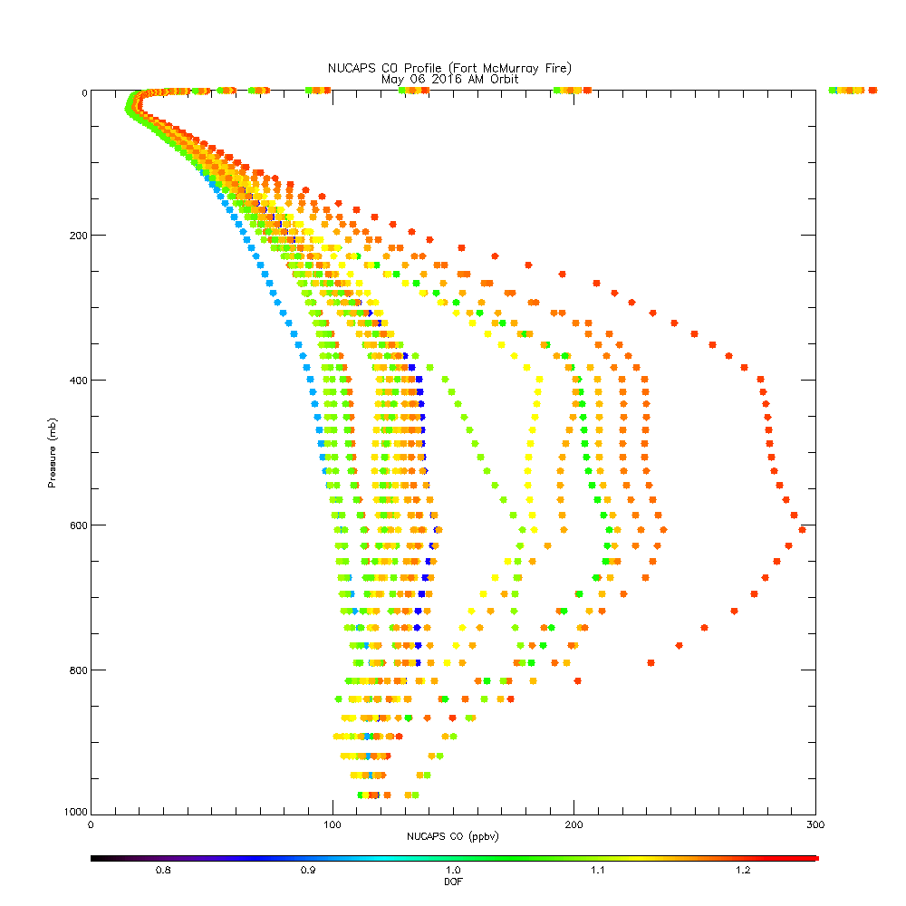
NUCAPS Trace Gas Retrievals (EDR)
Output files include averaging kernel, apriori, interpolation and inverse matrixes for applying to model (or insitu) profiles for data assimilation (or validation) activities.
Files also include surface parameters, degrees of freedom, and combined microwave and infrared quality flags.
Will be used within CSPP for IDEA-I NUCAPS smoke forecasts and also in collaboration with colleagues at NOAA/ESRL for NUCAPS CH4 and CO retrieval validation activities.

Slide 9
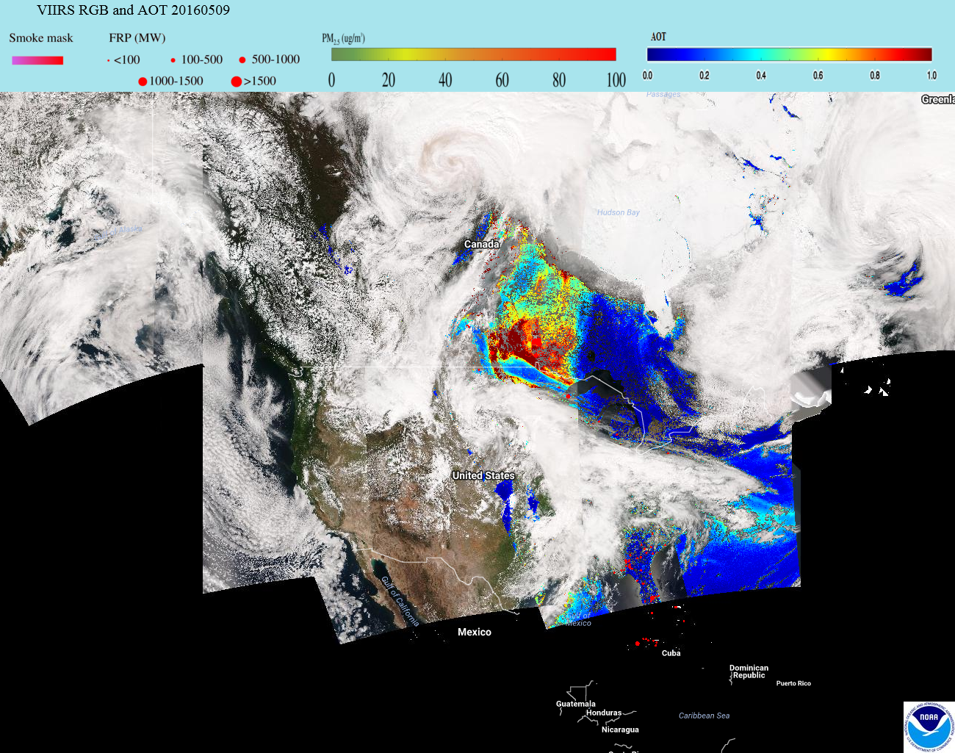
Canadian Wildfires
May 09, 2016
http://www.star.nesdis.noaa.gov/smcd/spb/aq/eidea/index.php

Slide 10
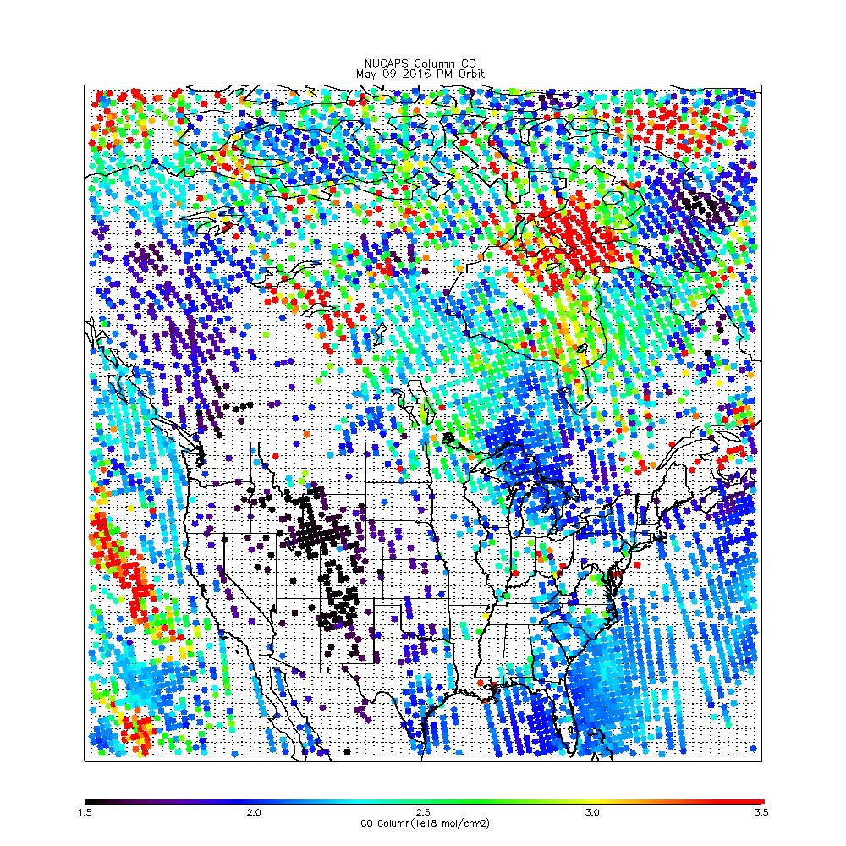
NUCAPS Total Column CO PM Orbit May 9, 2016
Notes:
More clouds on PM retrieval, therefore less NUCAPS yield.

Slide 11
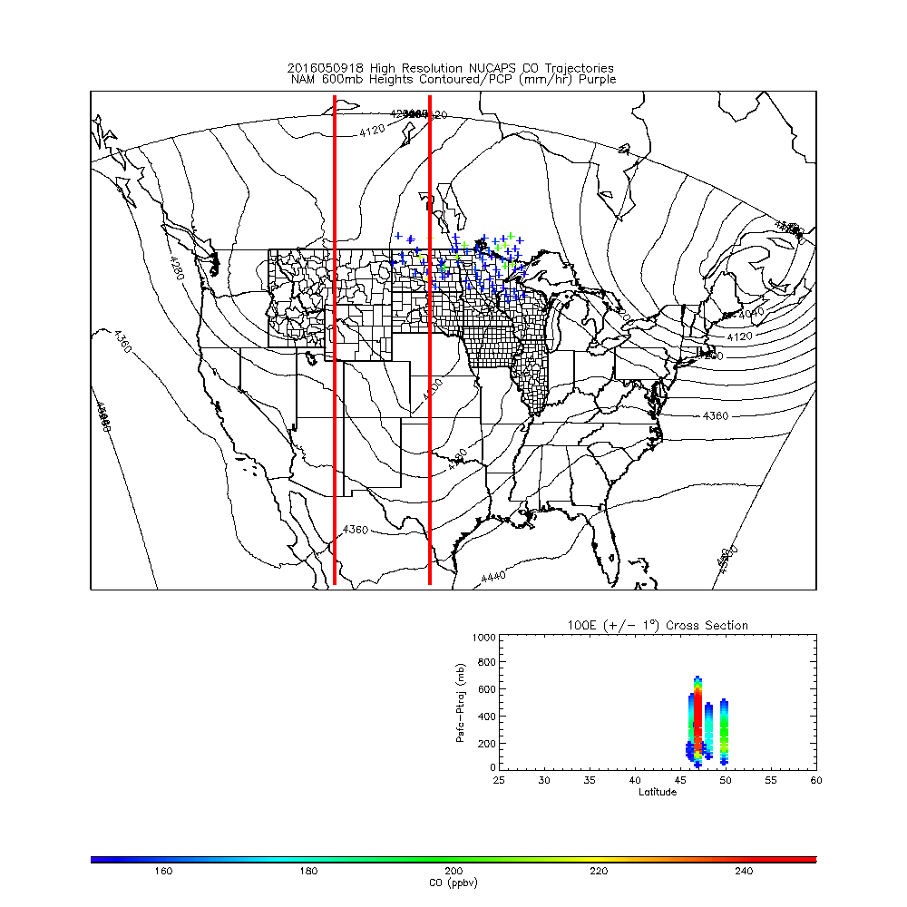
IDEA-I High resolution (NAM 4km) trajectory forecast
Fort McMurray Wildfire
May 09, 2016
IDEA-I high resolution trajectories initialized at each 45km NUCAPS profile (only CO>150ppbv initialized)
Upper panel shows NAM 600mb heights
Lower panels show longitude cross sections at 110W (lower left) and 100W (lower right)
IDEA-I high resolution trajectory forecast colored by initial CO
110 W (+ / -1 °) Cross Section
100 W (+ / -1 °) Cross Section
Notes:
NUCAPS is coarser but provides and actual profile as opposed to AOD which provides one number. Consistent transport patterns because low vertical shear in occluded system.

Slide 12
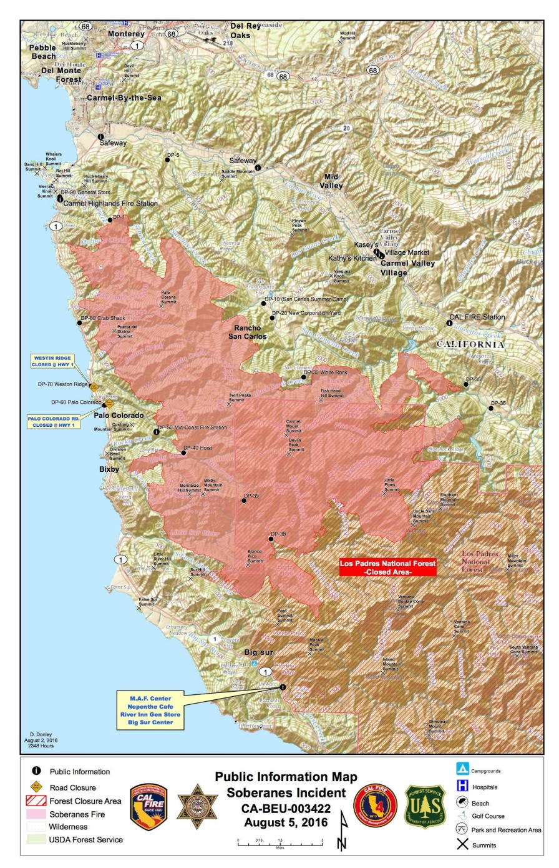
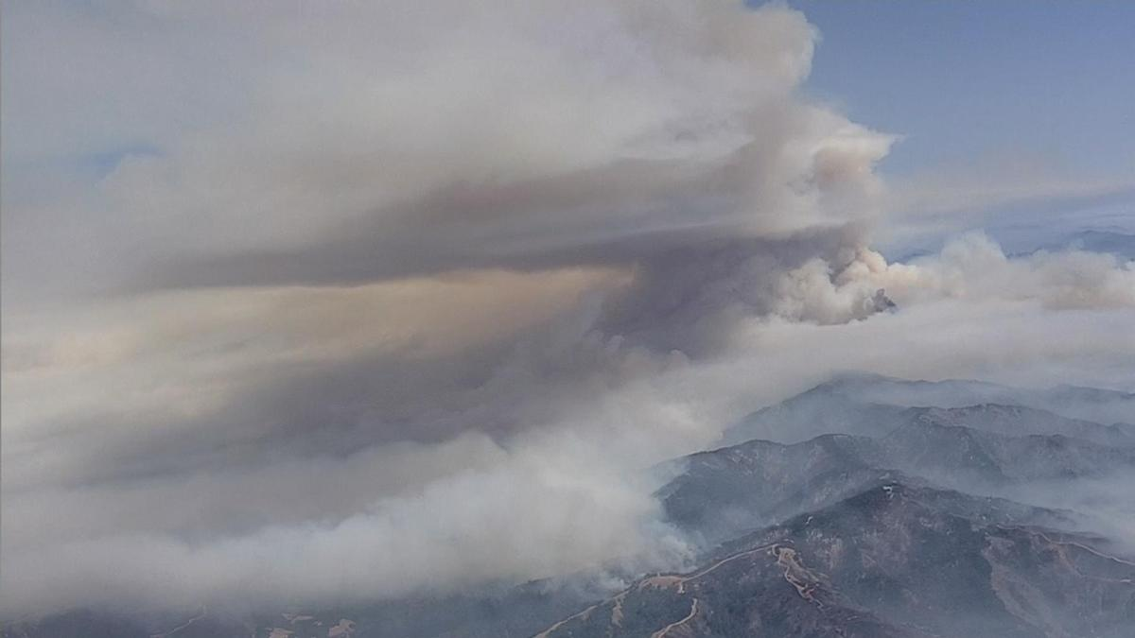
Soberanes wildfire Case study
(July 22, 2016) - Soberanes fire was first reported near Soberanes Creek in Monterey County, CA.
(July 26, 2016) - Governor of California declares a state of emergency in Monterey County due to heavy smoke and risk to lives and property.
(July 30, 2016) - Fire had spread to the Los Padres National Forest and was impacting air quality as far south as the Los Angeles Basin and as far east as Las Vegas
Photo by Associated Press (http://media.nbcbayarea.com)

Slide 13
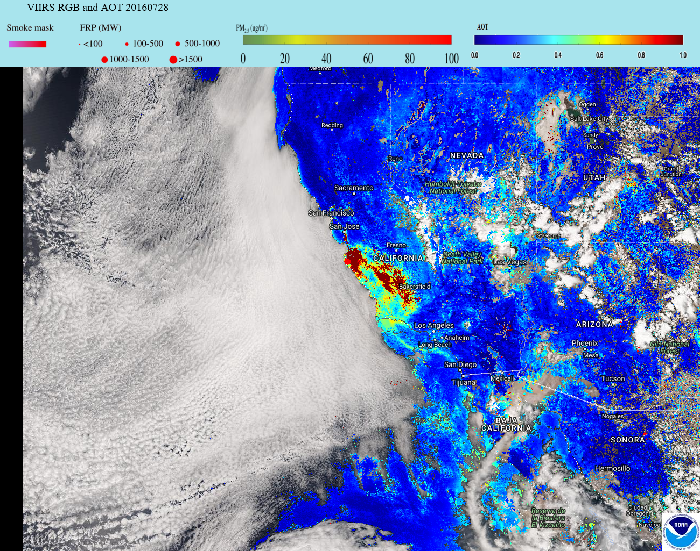
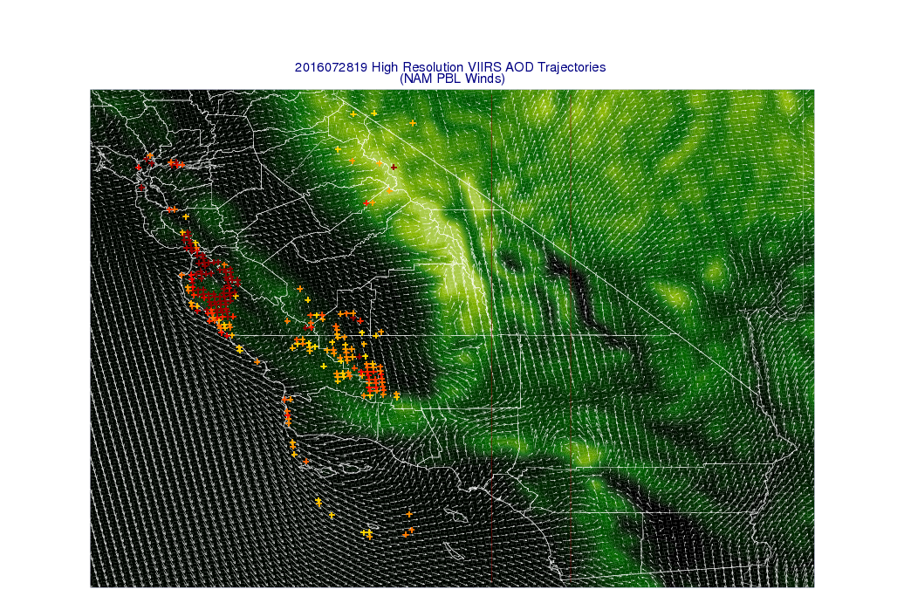
Initial Conditions 19Z July 28, 2016

Slide 14
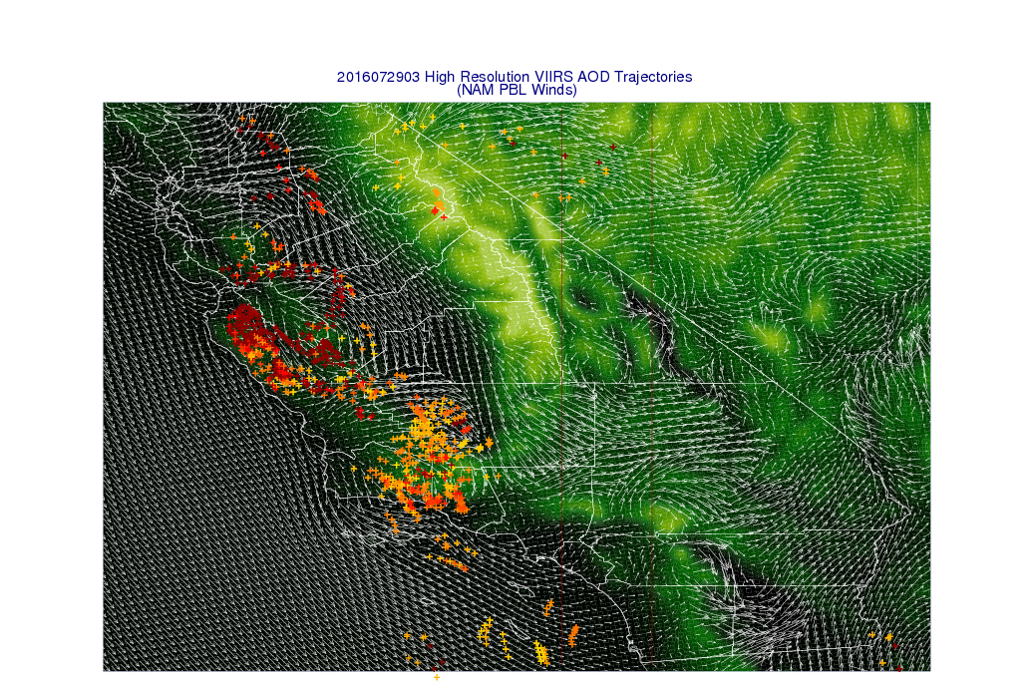
8 hour FX 03Z July 29, 2016

Slide 15
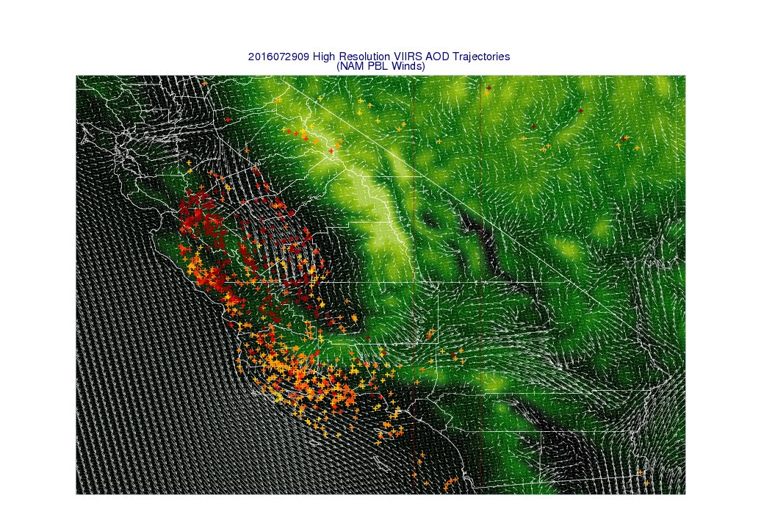
14 hour FX 09Z July 29, 2016

Slide 16
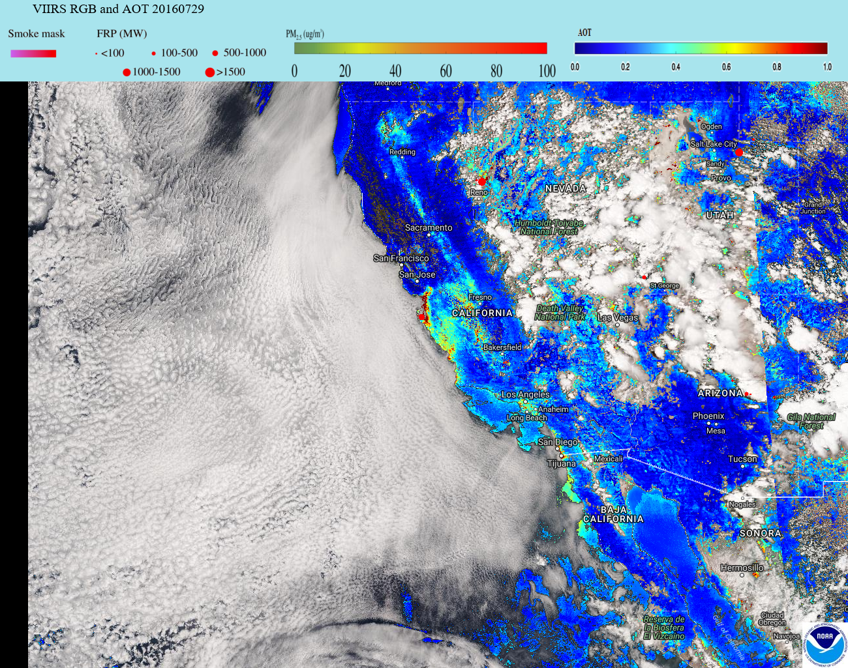
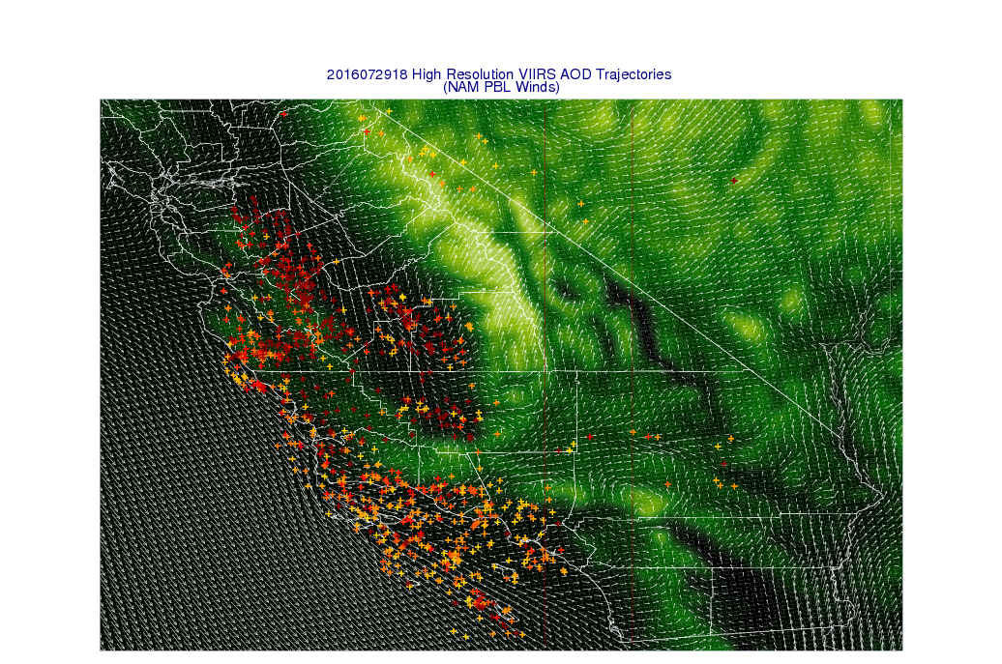
23 hour FX 18Z July 29, 2016

Slide 17
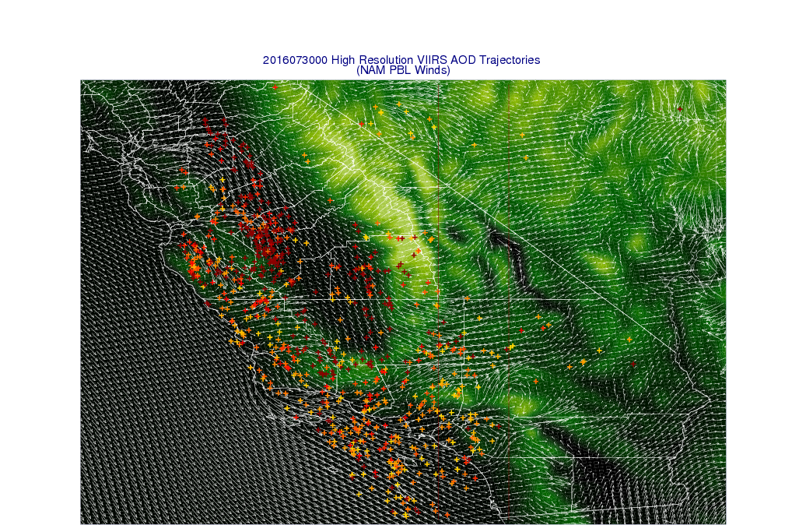
29 hour FX 18Z July 29, 2016

Slide 18
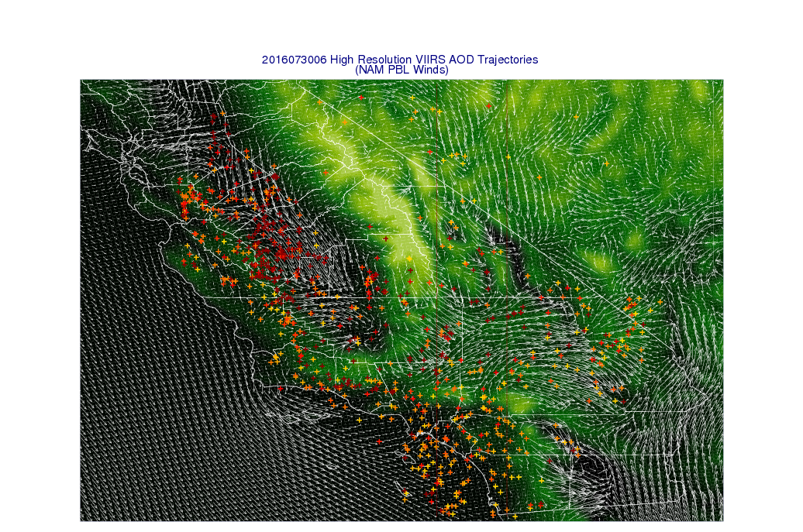
35 hour FX 18Z July 29, 2016

Slide 19
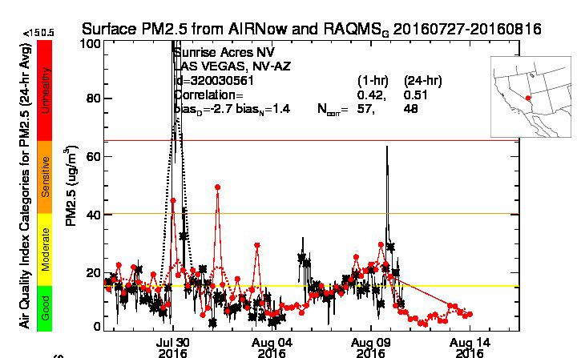
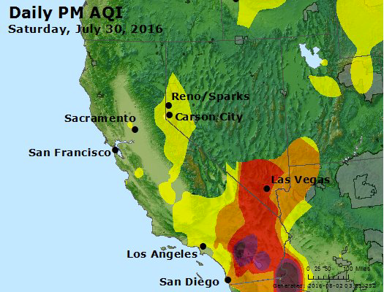
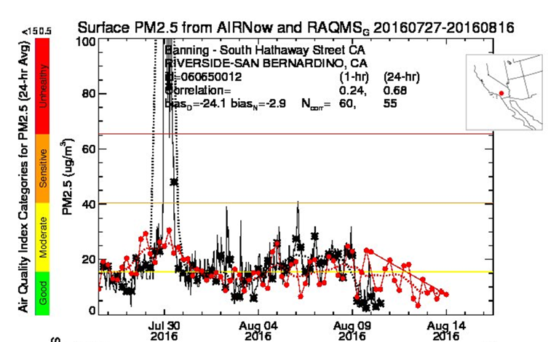
Observed (black) and RAQMS (red) surface PM2.5 at Las Vegas, NV (upper) and Riverside-San Bernardino, CA (lower)
https://www.airnow.gov/

Slide 20
Conclusions
This work addresses the need for low latency, web-based, high resolution forecasts of smoke dispersion for use by NWS Incident Meteorologists (IMET) to support on-site decision support services for fire incident management teams.
Case studies illustrate how long range transport of wild fire smoke can adversely impact surface air quality thousands of kilometers downwind (Fort McMurray) and how local topographic flow can lead to complex transport patterns near the wildfire source region (Soberanes wildfire).
Although coarser, the NUCAPS CO retrievals complement the high resolution VIIRS AOD retrievals by providing retrievals in partially cloudy scenes and also providing information on the vertical distribution of the wildfire smoke.
Funding provided by the NOAA JPSS Proving Ground and Risk Reduction program

Slide 21
Extra Slides

Slide 22
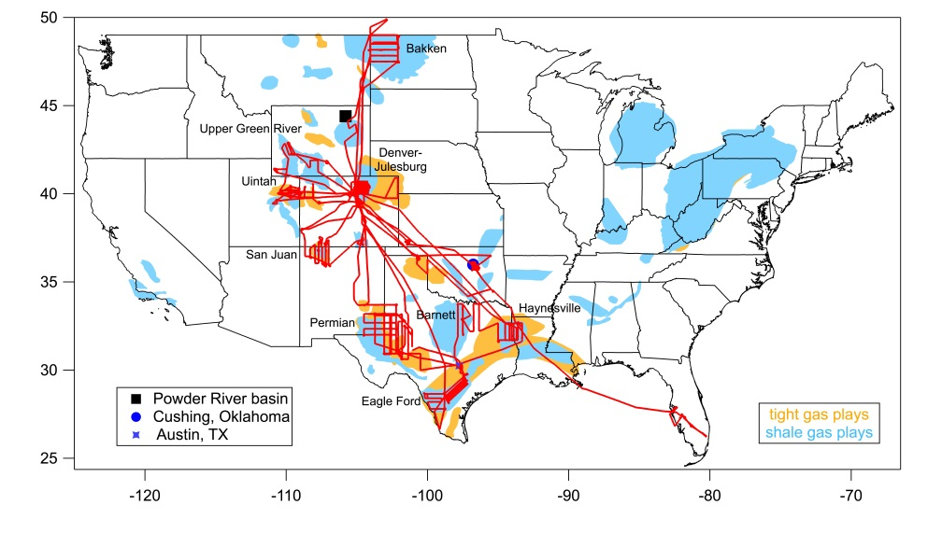
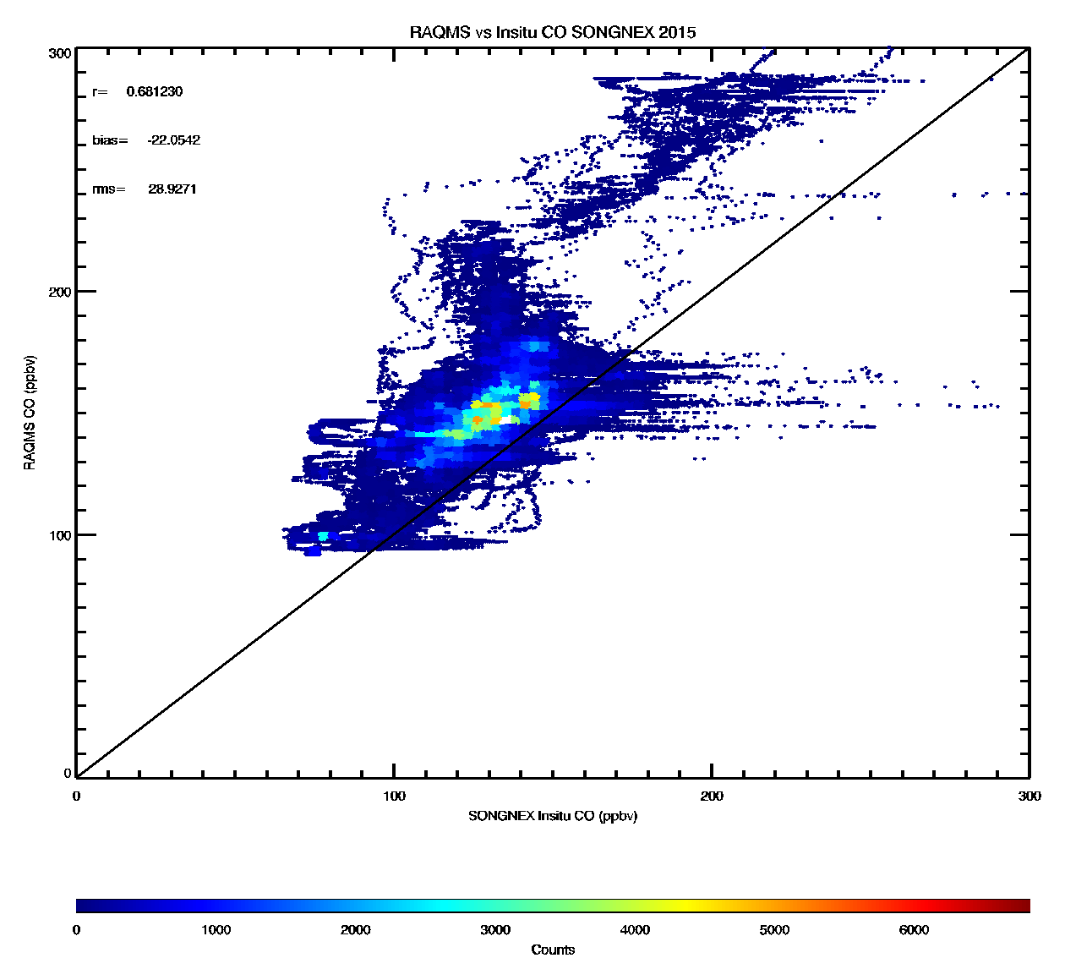
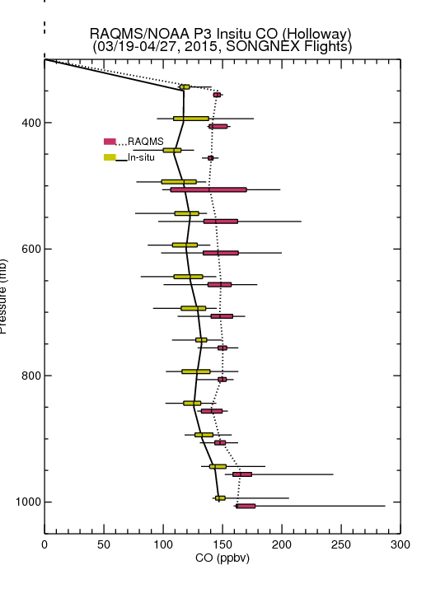
SONGNEX 2015
Shale Oil and Natural Gas Nexus
RAQMS vs Insitu SONGNEX 2015
(March 19-April 27, 2015)
r=0.681230
bias= 22.0542
(RAQMS-insitu)
rms= 28.9271
Evaluation of RAQMS vs insitu CO during NOAA/ESRL SONGNEX 2015 for indirect NUCAPS CO validation
RAQMS CO (ppbv)
Insitu CO (ppbv)
Notes:
Good comparison between instantaneous retrieval and model value. RAQMS is a multiscale meteorological and chemical modeling system for predicting stratospheric and tropospheric chemistry.

Slide 23
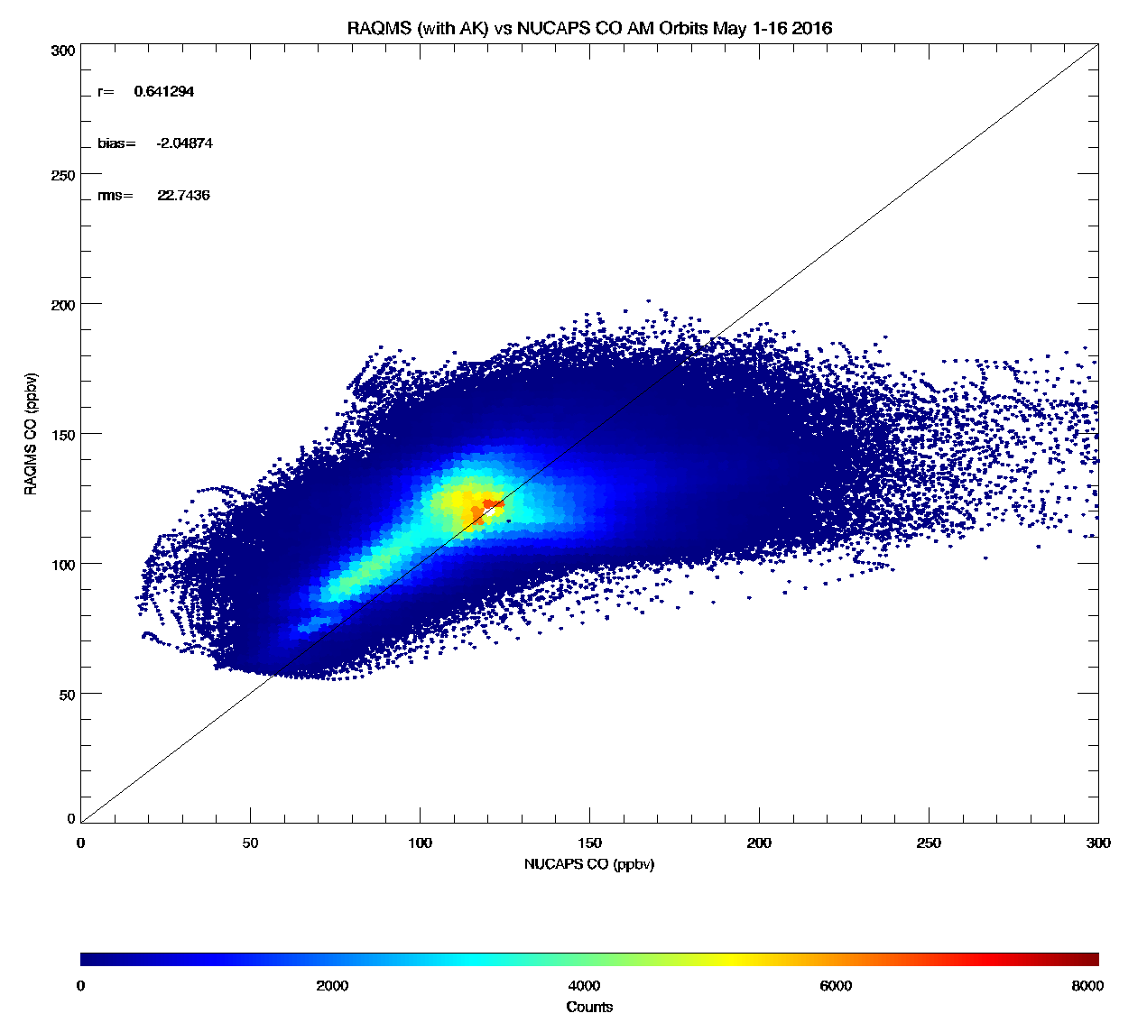
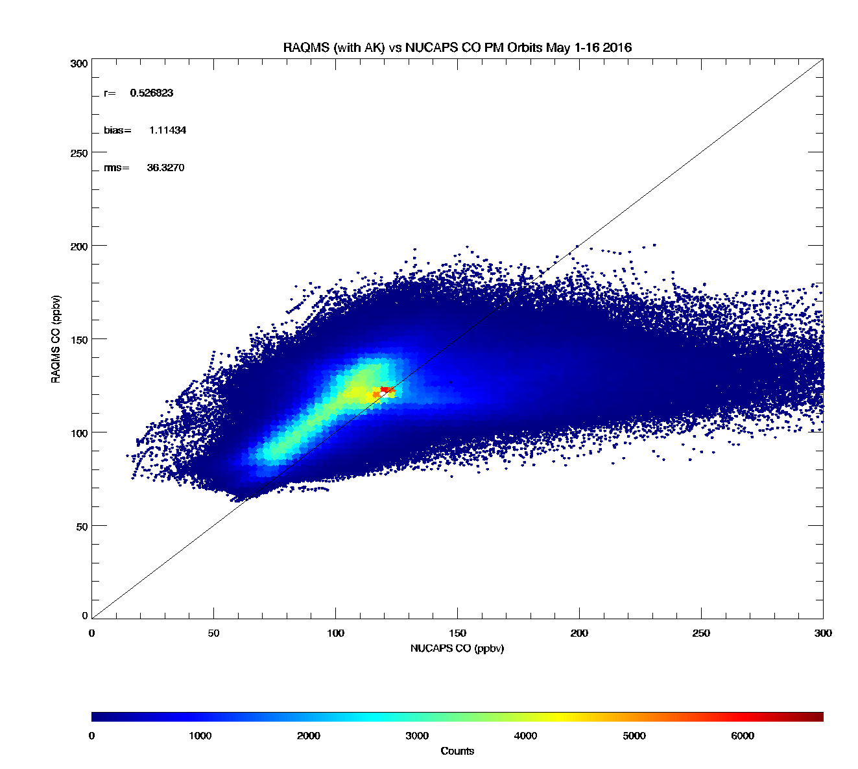
RAQMS vs Insitu SONGNEX 2015
r=0.681230
bias= 22.0542
(RAQMS-insitu)
rms= 28.9271
RAQMS CO (ppbv)
RAQMS vs NUCAPS AM Orbit
(May 1-16, 2016)
RAQMS vs NUCAPS PM Orbit
(May 1-16, 2016)
Insitu CO (ppbv)
r=0.641294
bias=2.04874
(RAQMS-NUCAPS)
rms=22.7430
r=0.526823
bias=-1.11434
(RAQMS-NUCAPS)
rms=36.3270
RAQMS CO (ppbv)
RAQMS CO (ppbv)
NUCAPS CO (ppbv)
NUCAPS CO (ppbv)
Notes:
With the averaging kernals applied

