Slide 1
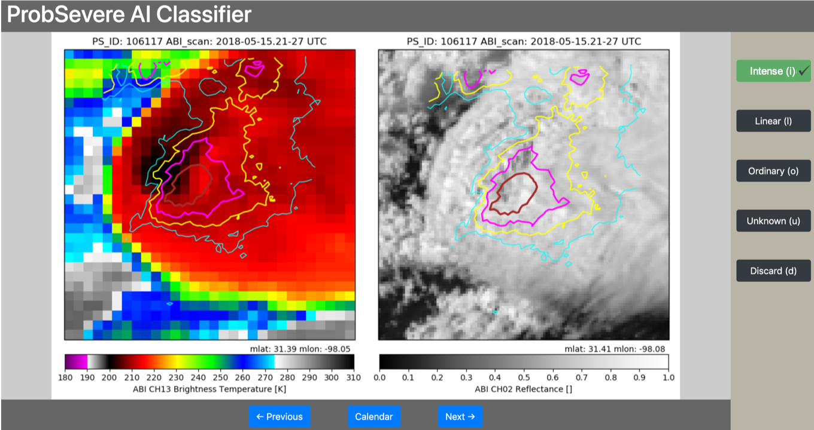
Developed web-based tool to quickly label “intense” convection
Uses JavaScript ‘React’ library and linked to MySQL database backend
Credit: Justin Sieglaff, Bill Bellon

Slide 2
Trained CNN to identify “intense” convection (e.g., strong OTs, bubbling updrafts, cold-U/V thermal couplets)
Dataset: 220k images
Inputs:
ABI 10.35 µm BT
ABI 0.64 µm reflectance
GLM flash extent density
Output:
“Probability of intense convection”
Example: Storms in Argentina →
Automatically identifies features that have proven difficult to do so algorithmically (i.e., no more feature engineering)
Reliably identifies intense convection without ground-based radar data
Funding sources: SSEC 2022; NOAA AI Initiative

