Slide 1
Using GLM to Train a Probabilistic Lightning Prediction Model
GLM Science Meeting
21 September 2021
John Cintineo (UW-CIMSS)
Michael Pavolonis (NOAA/NESDIS)
Justin Sieglaff (UW-CIMSS)
Acknowledgement: GOES-R program

Slide 2
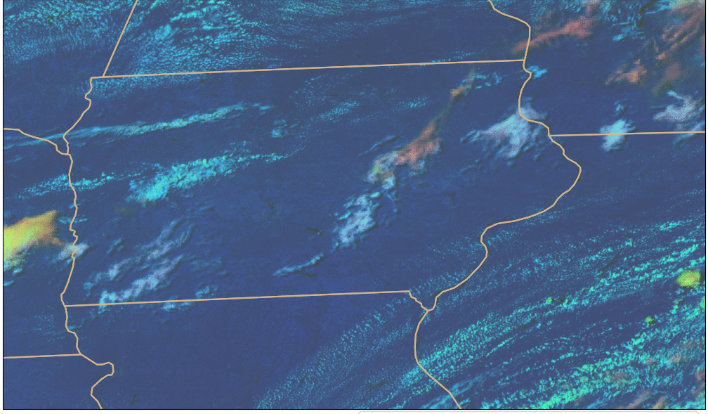
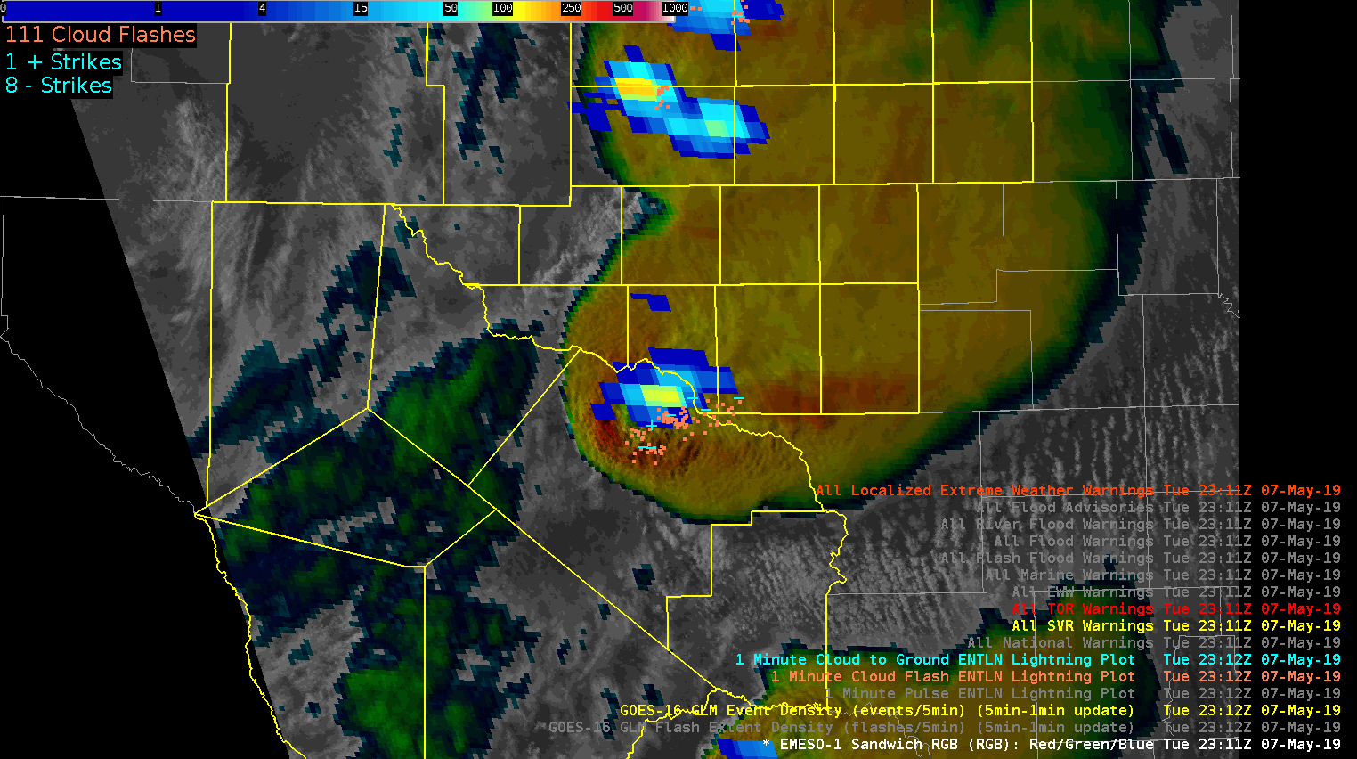
Question: Can the ABI be used to predict where GLM will observe lightning in the future?
Lightning is hazardous for aviation, mariners, and outdoor events and activities.
Geostationary satellite data can provide observations of clouds prior to electrification (CI guidance).
The data can respond to changes in storm structure before radar (e.g., storm intensification or decay).
Credit: NOAA
Notes:
Lightning is hazardous for aviation, mariners, and outdoor events and activities. In this research we are trying to use geostationary satellite imager data to nowcast lightning occurrence in an accurate and timely manner.
Geostationary imagers cover large swaths of our planet and provide high-frequency updates.
The data can provide observations of clouds prior to electrification, potentially increasing lead-time to lightning strikes.

Slide 3
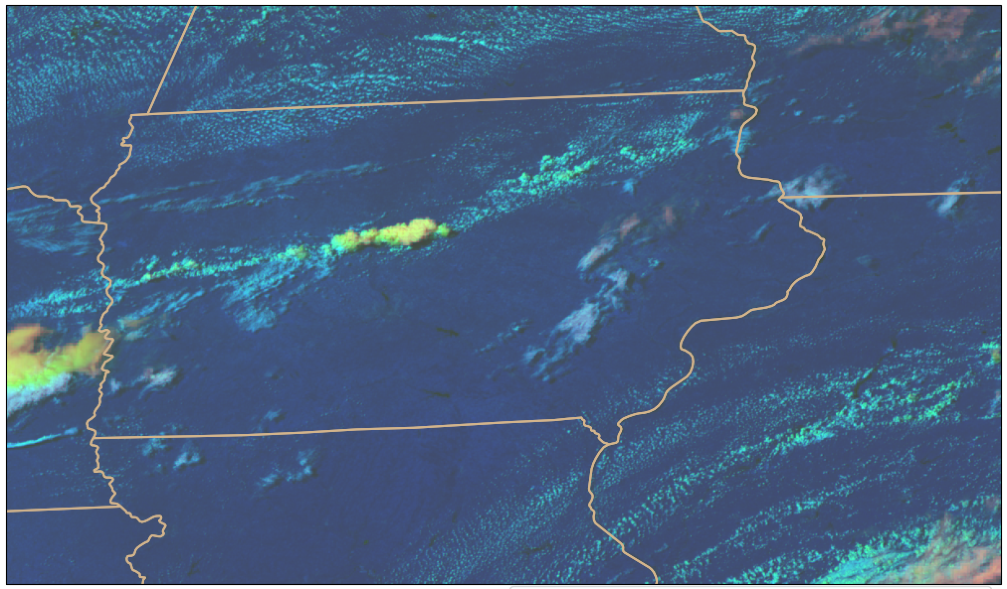
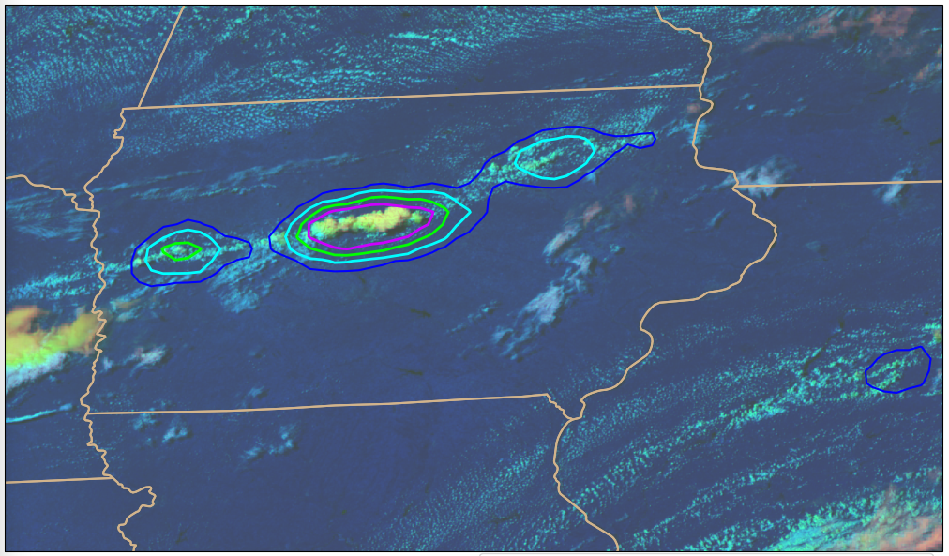
Methods and Data
LightningCast model: AI model (convolutional neural network – CNN)
Learns salient spatial, multispectral features from images
Predictor channels (GOES-16 ABI):
0.64-µm reflectance (CH02; 0.5 km)
1.6-µm reflectance (CH05; 1 km)
10.3-µm BT (CH13; 2 km)
12.2-µm BT (CH15; 2 km)
Still exploring other predictor channels
Target/truth: GLM flash-extent density
Accumulated from t₀ to t₀ + 60 min
DCPD RGB
Output: Pixel-by-pixel probability ≥ 1 GLM flash in the next 60 min

Slide 4
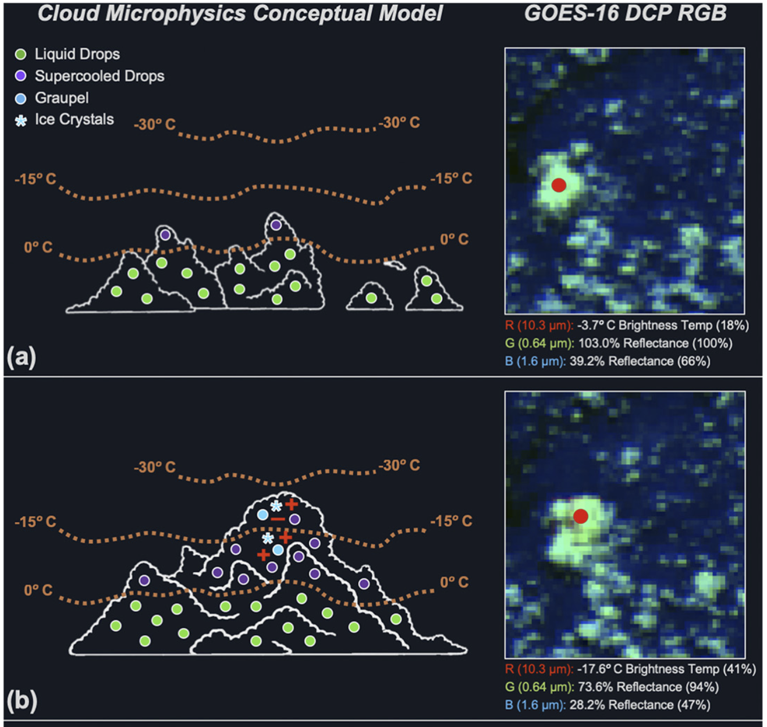
Capitalizes on the Day Cloud Phase Distinction (DCPD) RGB composite imagery (see Elsenheimer and Gravelle, 2019)
Mimics human interpretation of DCPD RGB, while doing so everywhere, all the time, and objectively.
Potential to learn new physical insights.
Not biased by radar coverage.
From Elsenheimer and Gravelle 2019

Slide 5
5 – 25 min lead-time prior to first flash (75%-25%)
15 – 25 min lead-time prior to first flash (75%-25%)
15 – 30 min lead-time prior to first flash (75%-25%)
30 – 70 min lead-time prior to first flash (75%-25%)
Notes:
Clean example with variable lead-time

Slide 6
Notes:
Early morning example with thick cloud cover

Slide 7
Notes:
Meso example with some overlapping clouds

Slide 8
Notes:
Meso example with some overlapping clouds

Slide 9
Notes:
Nothing specific to point out here. Different regime and sat viewing angle.

Slide 10
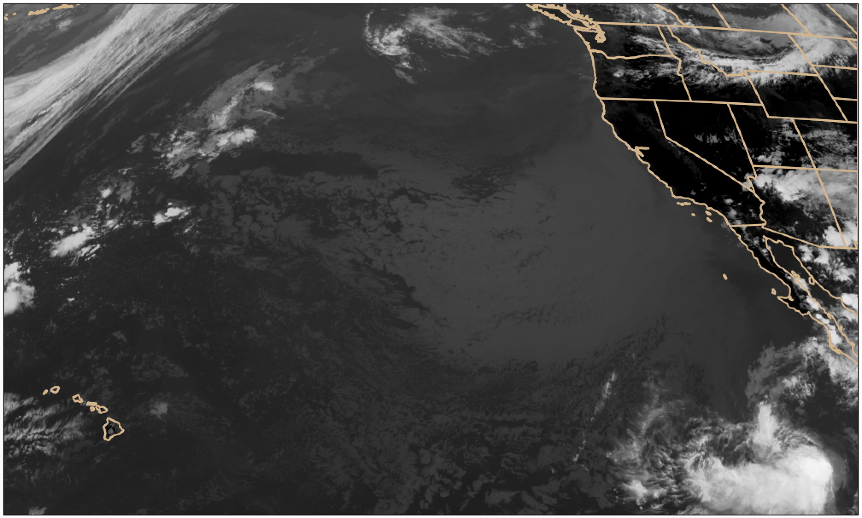
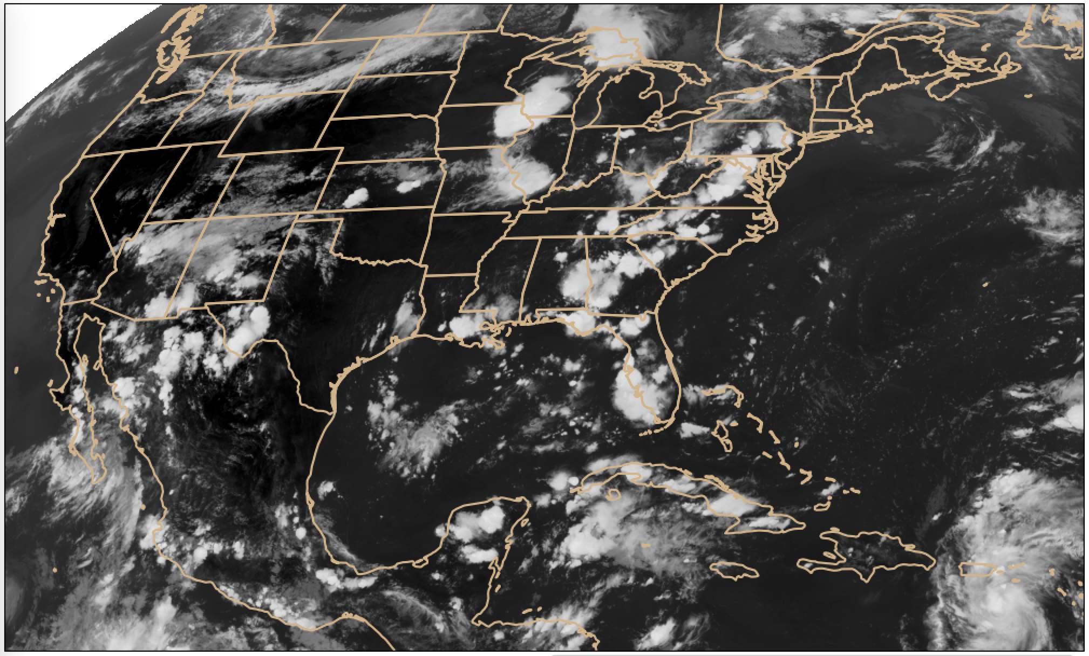
Validation
GOES-17 and GOES-16 PACUS/CONUS sector
5 days of 5-min scans from each month of 2020
G17 evaluation uses model trained with G16 CH02, CH05, and CH13 only to mitigate LHP problem.

Slide 11
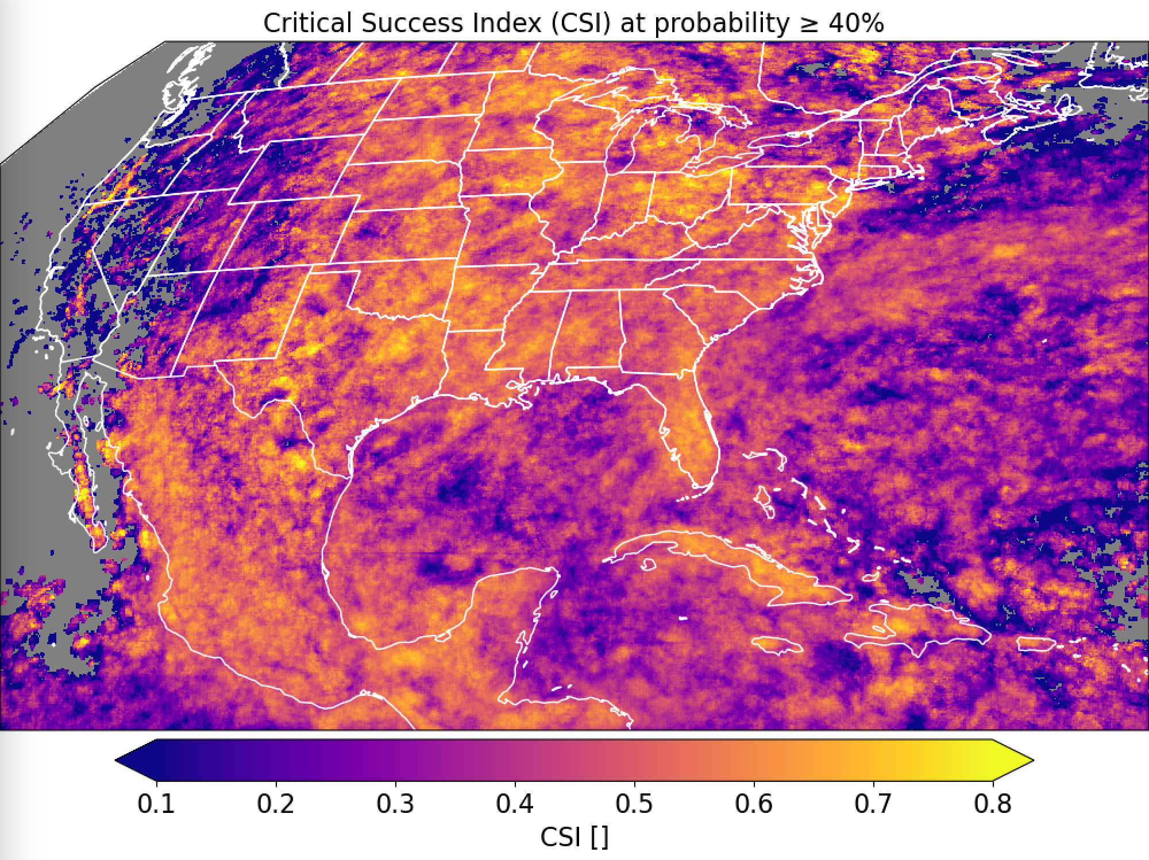
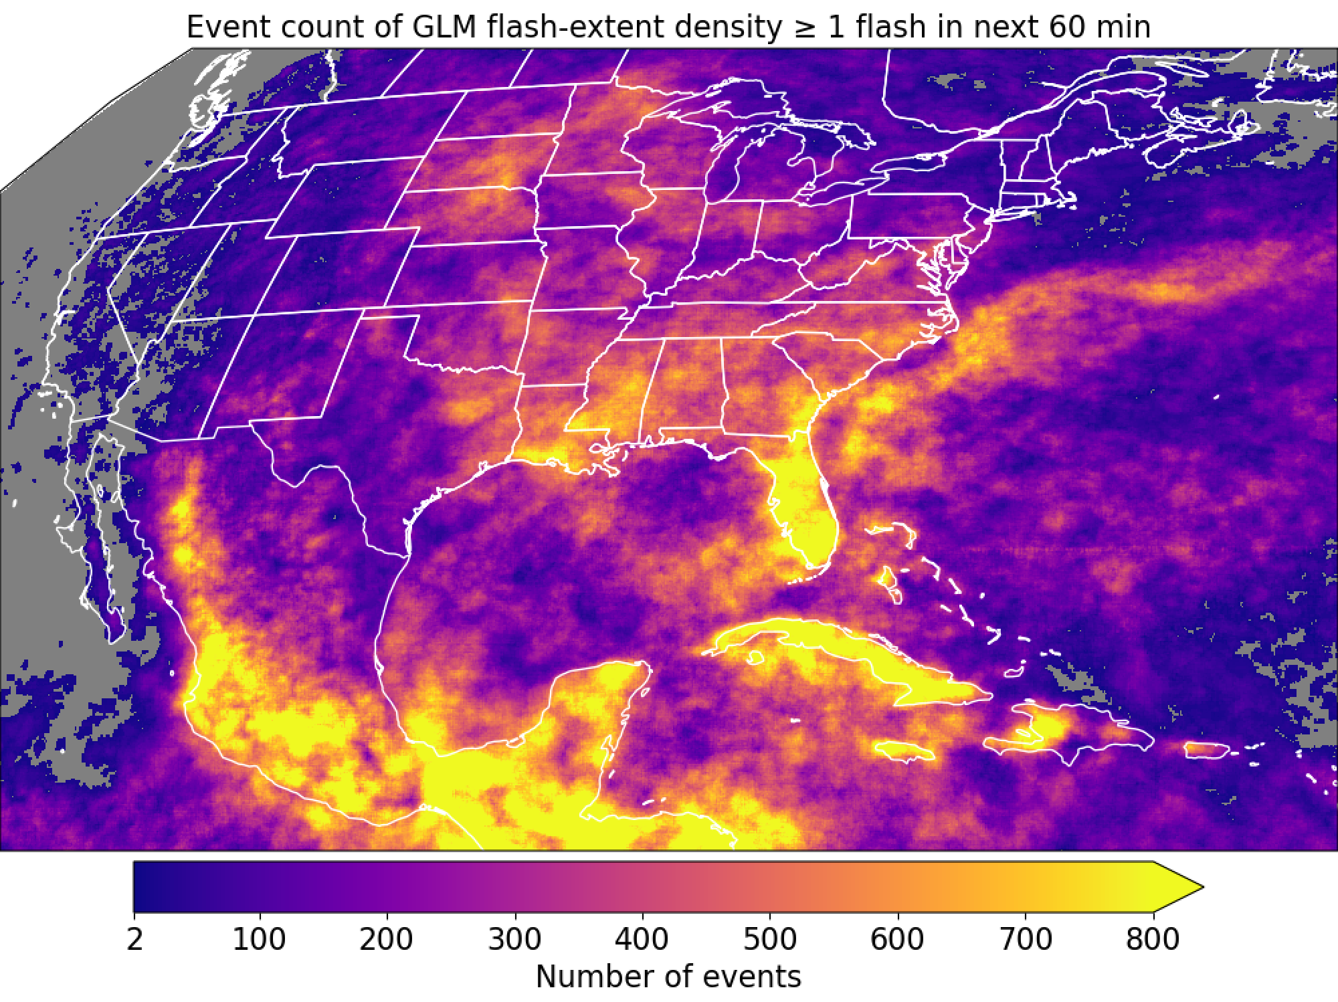
GOES-16

Slide 12
GOES-16

Slide 13
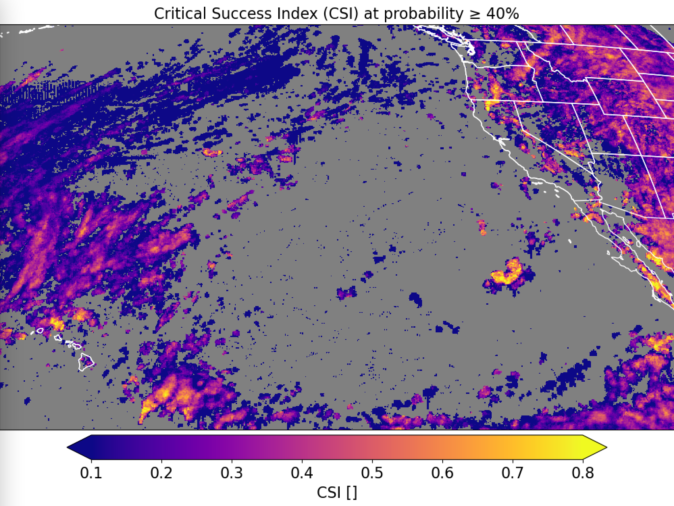
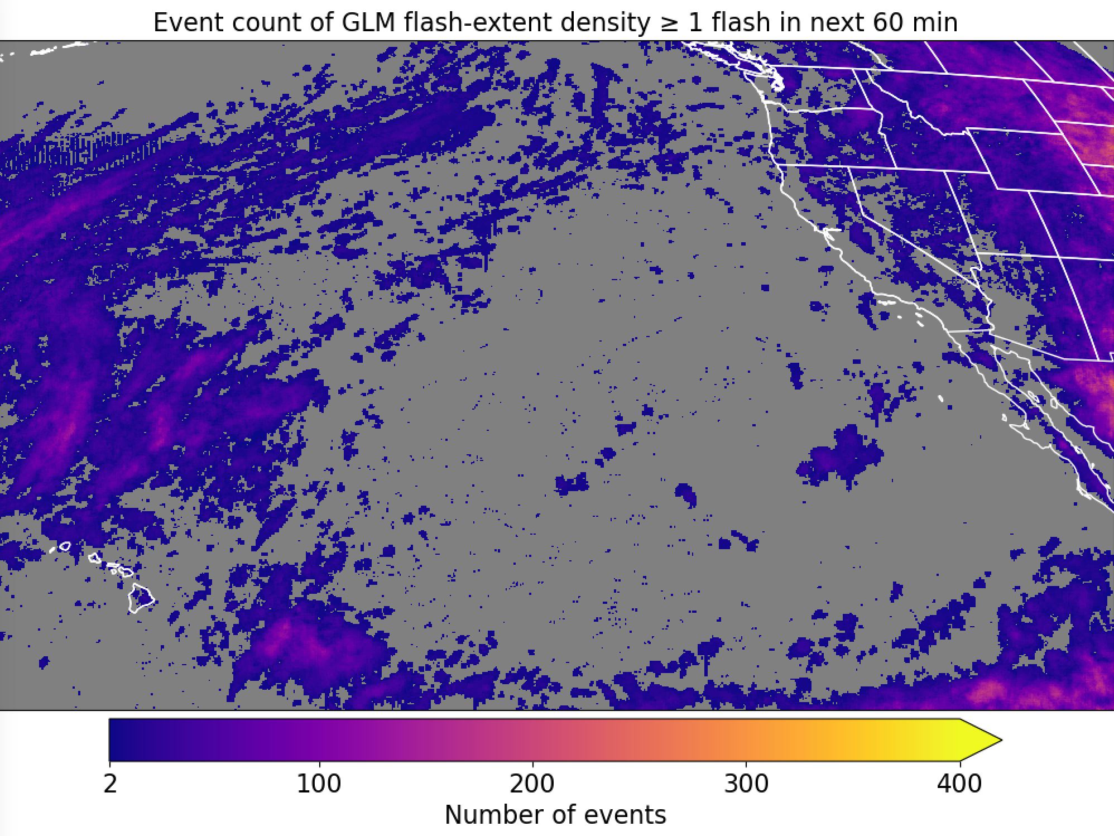
GOES-17
Trained on GOES-16 (CH02 + CH05 + CH13); evaluated on GOES-17

Slide 14
Wrap up
LightningCast is a CNN that predicts lightning (as observed by GLM) up to 60 min in the future
Inputs: ABI CH02, CH05, CH13, CH15
Utilizes the highest spatial resolution (0.5 km for CH02; 1 km for CH05)
Trained on GLM flash-extent density t₀ to t_{0+60 min}
ABI alone can provide skillful short-term prediction for lightning (including LI), day and night, over land and sea. Very fast to compute (≤ 30 seconds for CONUS sector).
Lead-time for LI events often ranges between 10 and 30 minutes.
Near real-time output: https://cimss.ssec.wisc.edu/severe_conv/pltg.html
GOES-16 and GOES-17 CONUS and MESO sectors
In search of:
Mitigate problems in the truth dataset (e.g., low DE, Bermuda bars, etc.)
Database of frequent GLM artifacts?
GLM data quality flags?

Slide 15
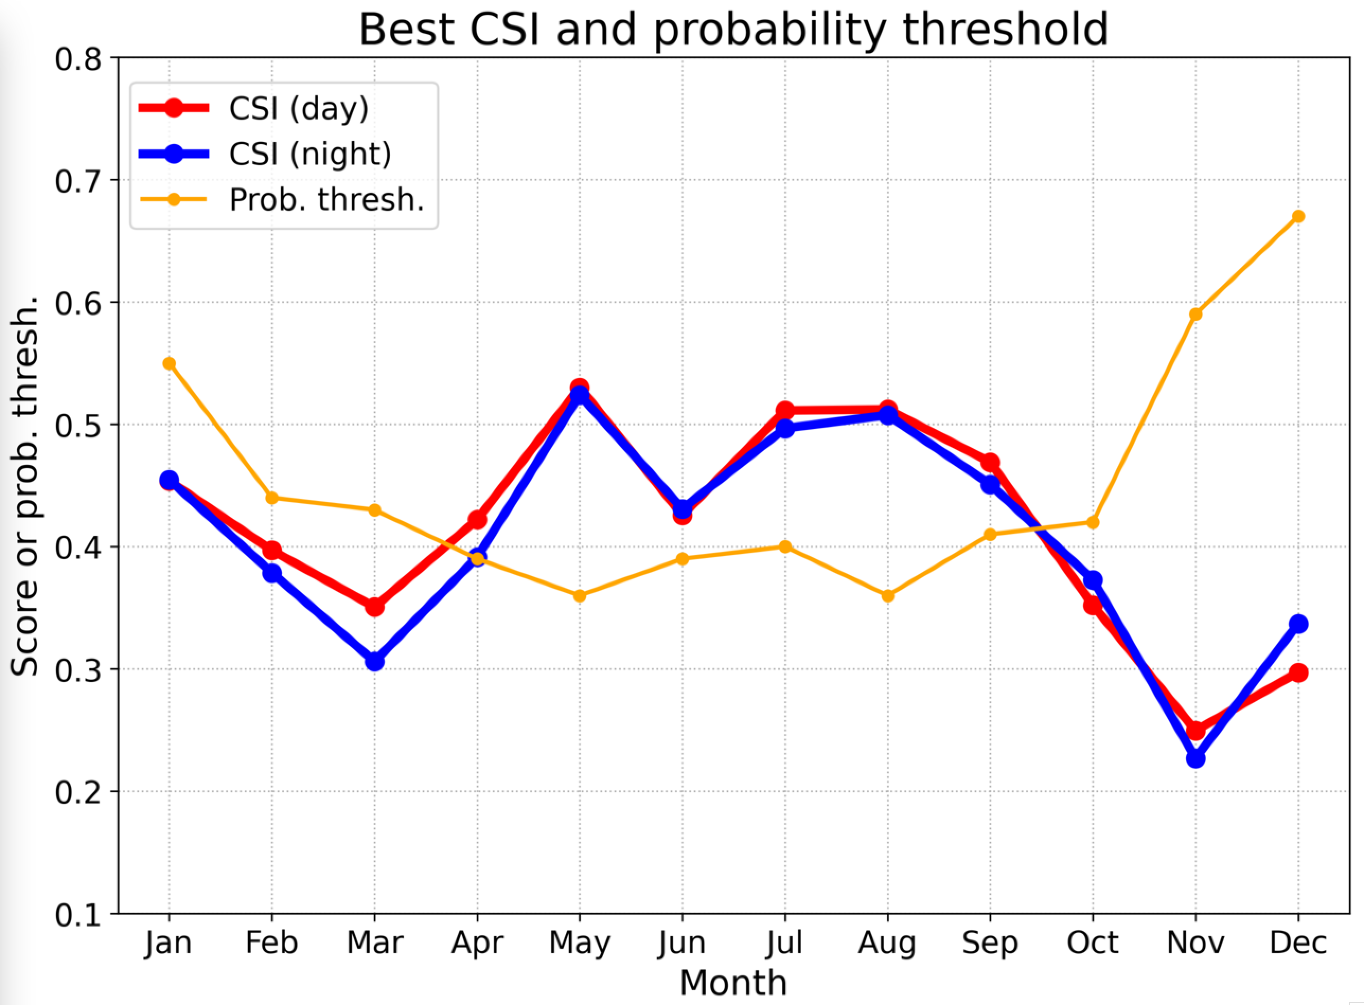
GOES-16

Slide 16
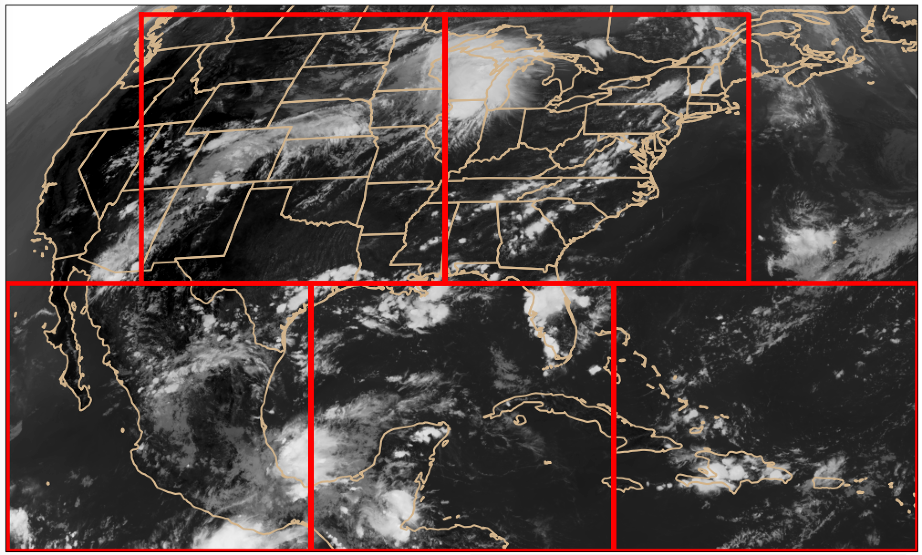
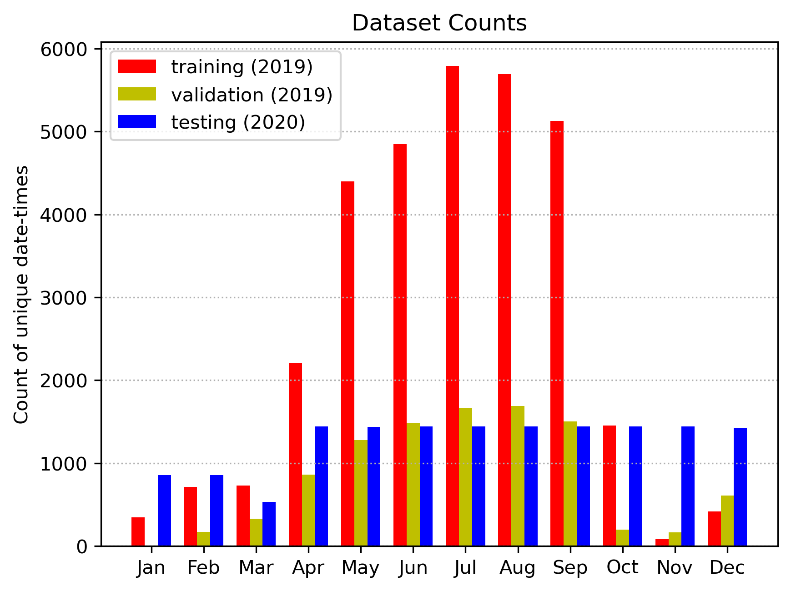
Training and validation data
Training/validation domain: 5 patches from GOES-16 ABI CONUS sector
76,031 training samples
22,539 validation samples

Slide 17
Model: Semantic segmentation, or “U-Net” (Ronneberger et al. 2015)
values indicate layer depth
256
128
128
64
64
32
32
4
16
Input
Conv 3x3 + ReLU
Max-pooling
Upsampling
Concatenation
Conv 1x1 + Sigmoid
16
1

Slide 18
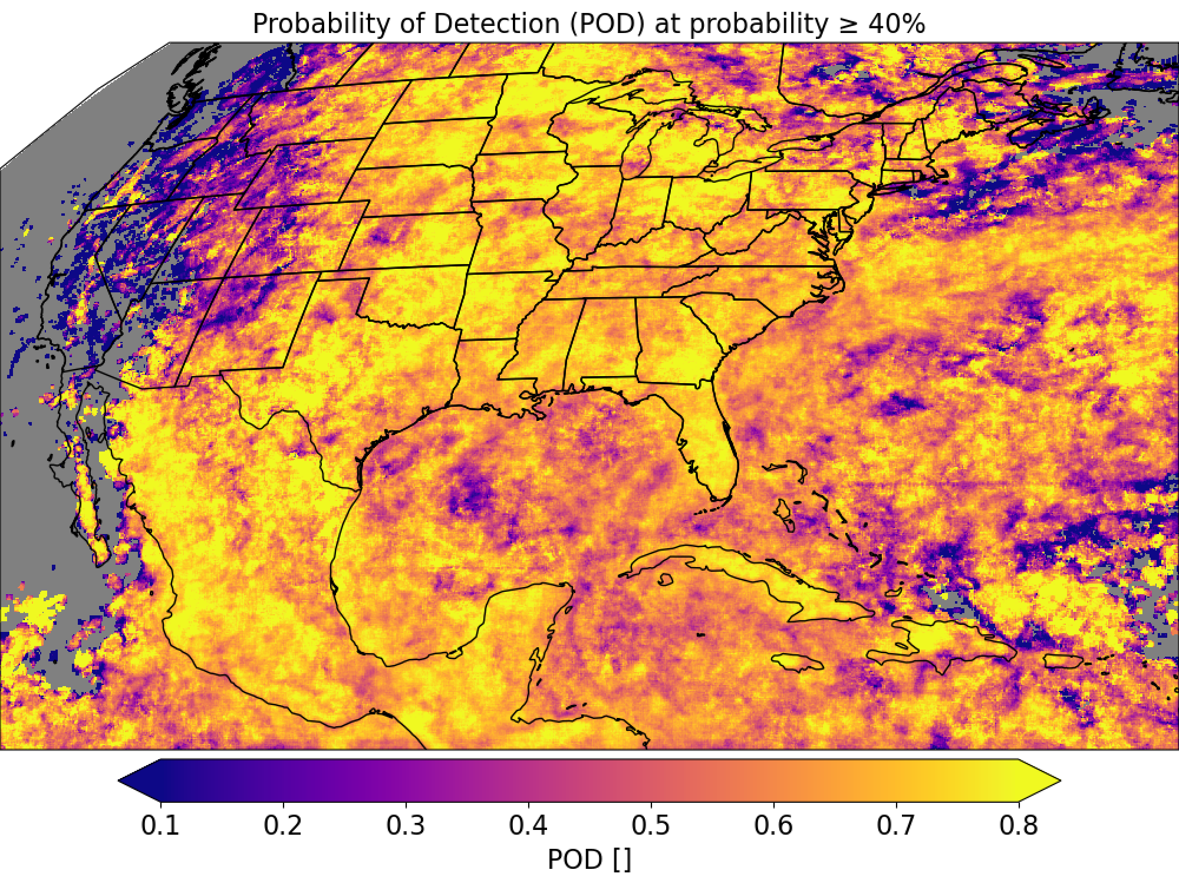
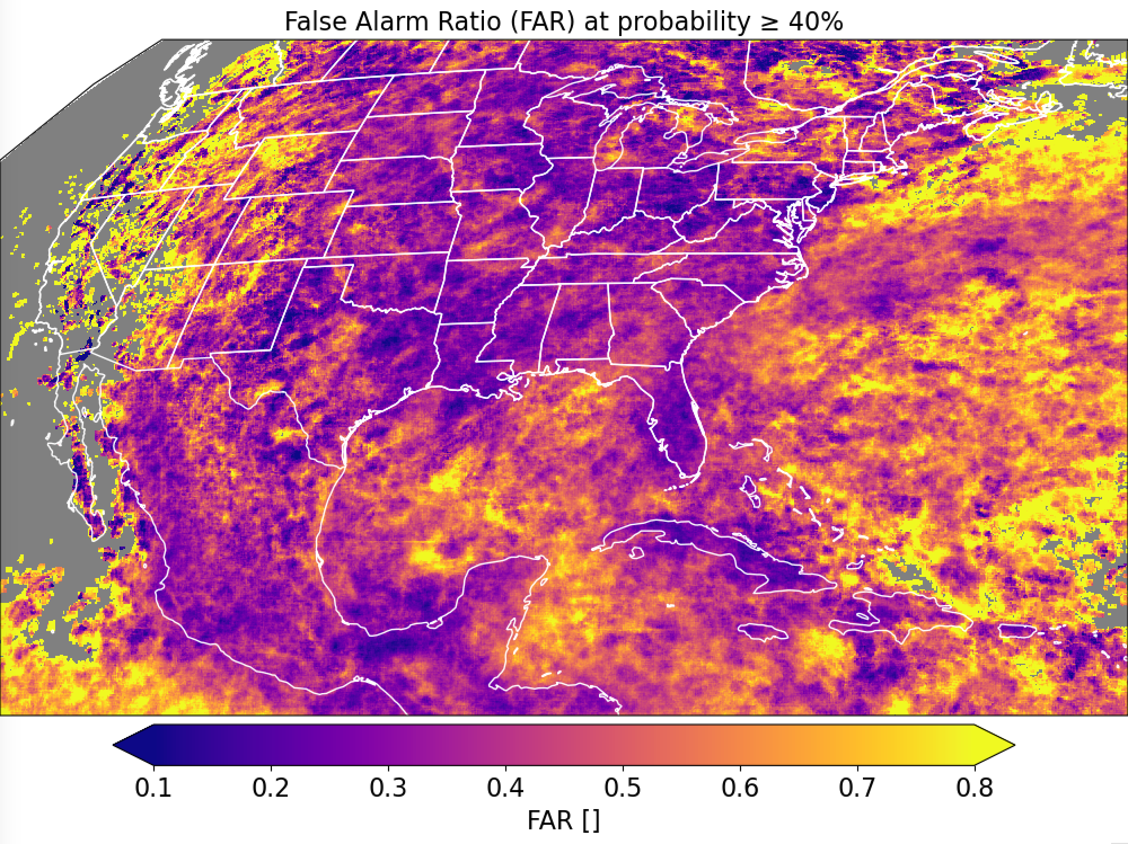
GOES-16

Slide 19
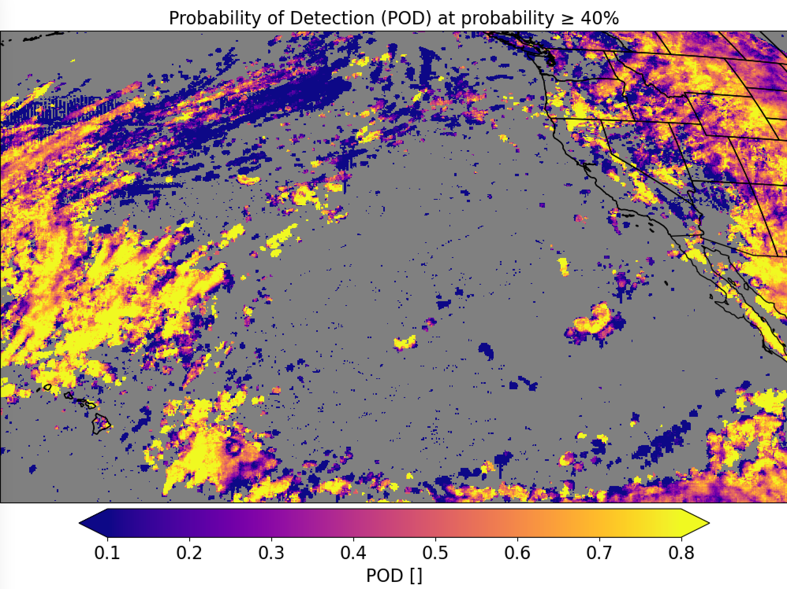
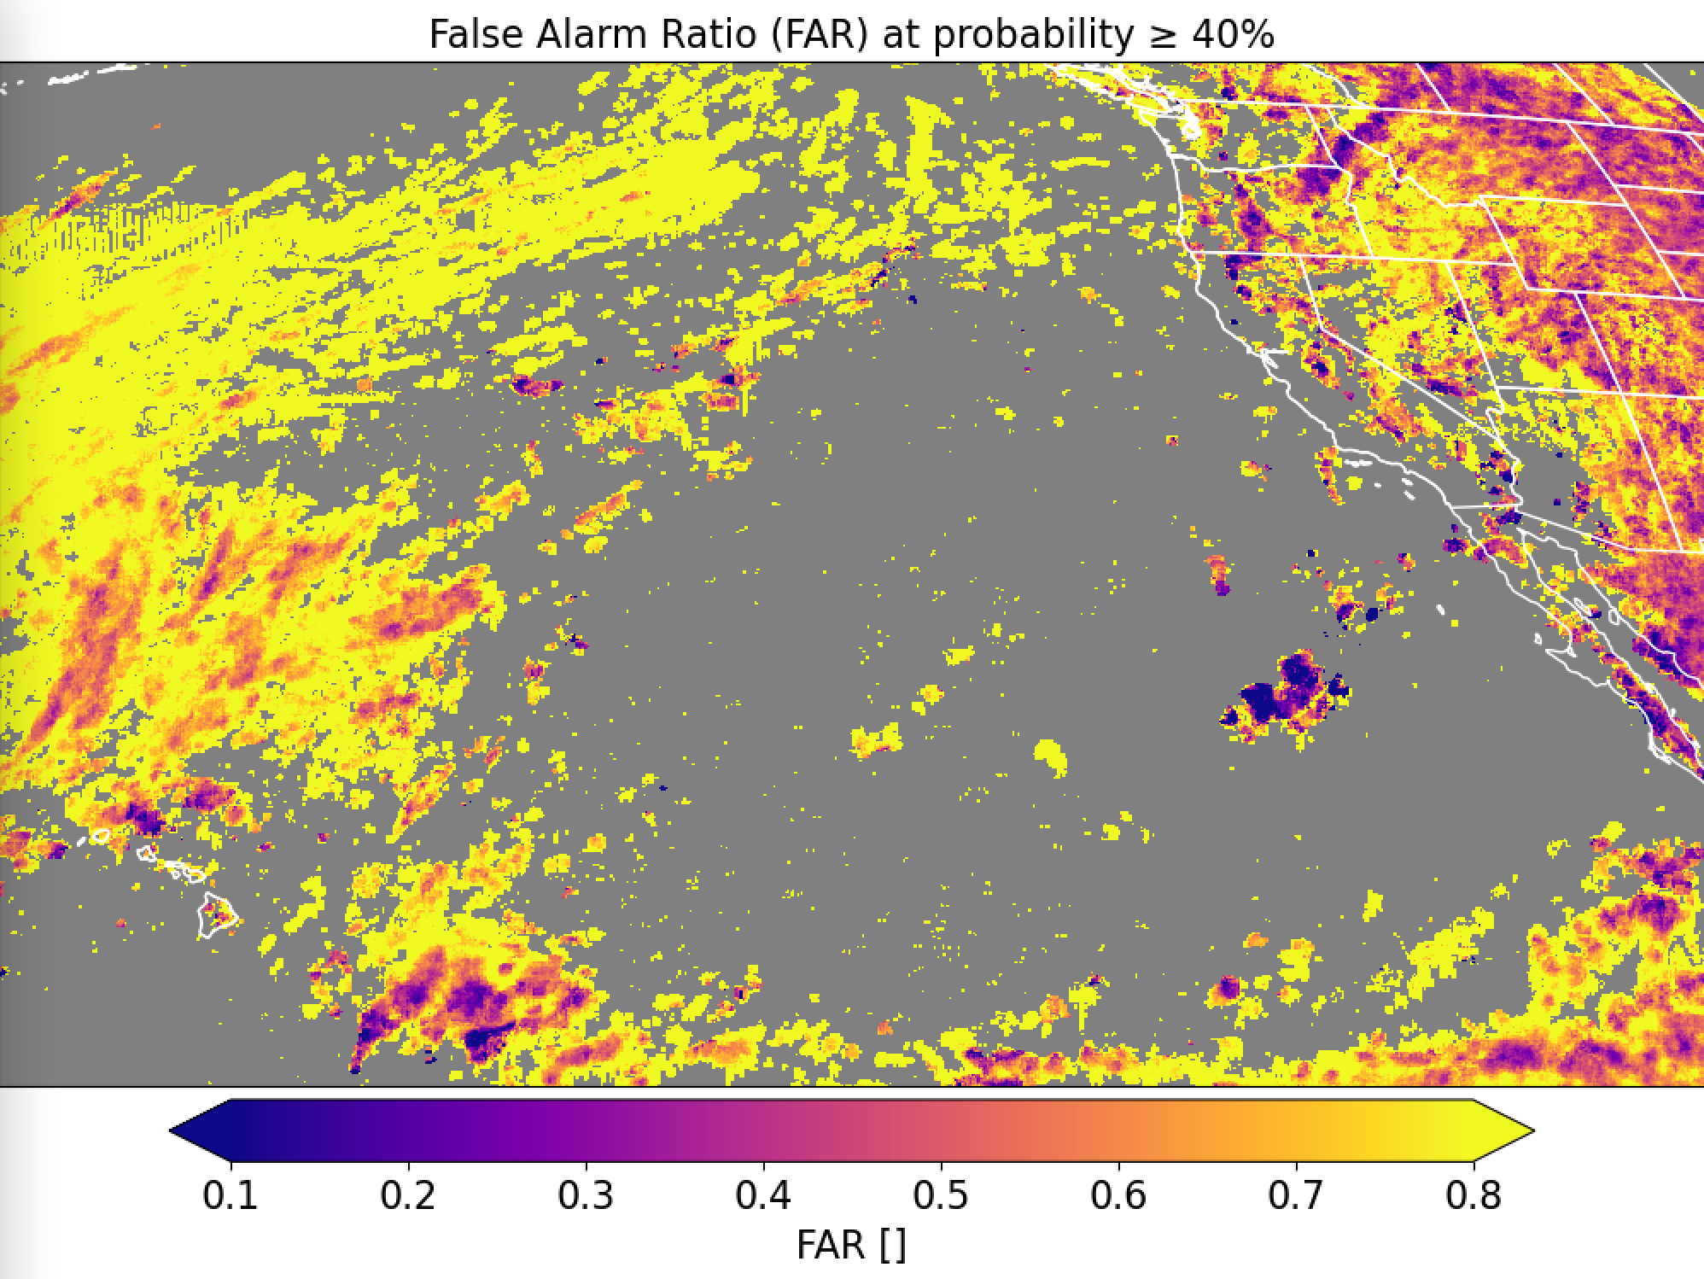
GOES-17
Trained on GOES-16 (CH02 + CH05 + CH13); evaluated on GOES-17

Slide 20
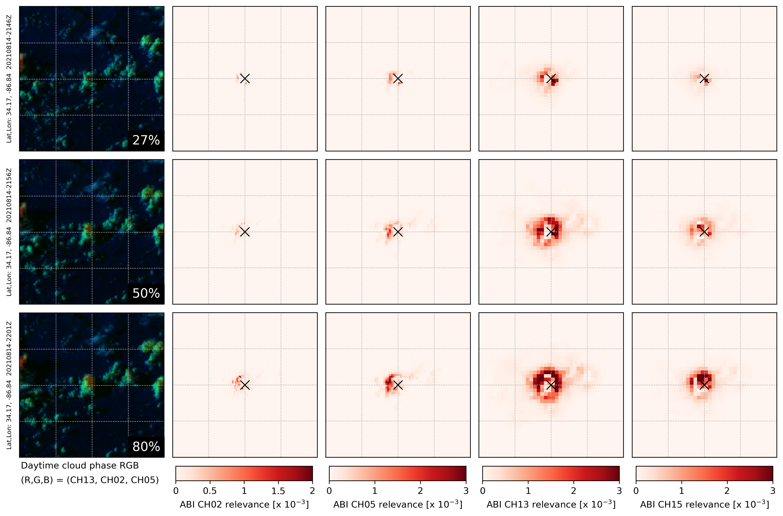
21:46Z
21:56Z
22:01Z

