Slide 1
NOAA/CIMSS ProbSevere
– Processing and requirements overview –
April, 2017

Slide 2
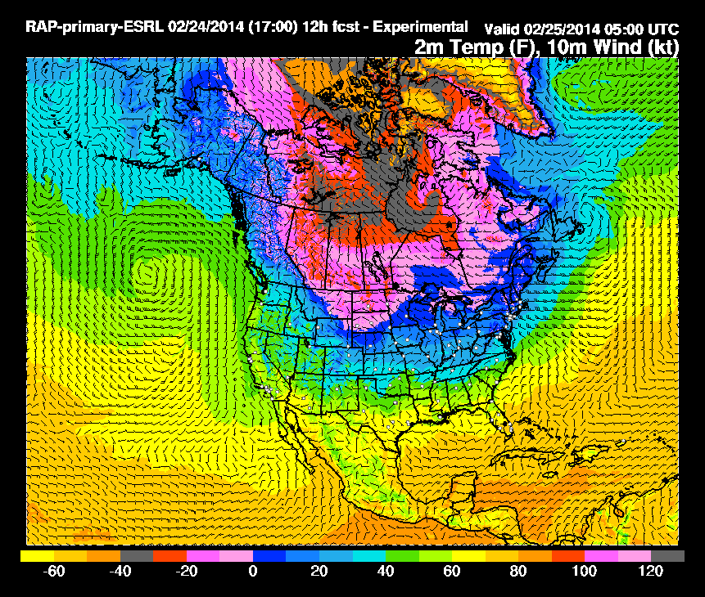
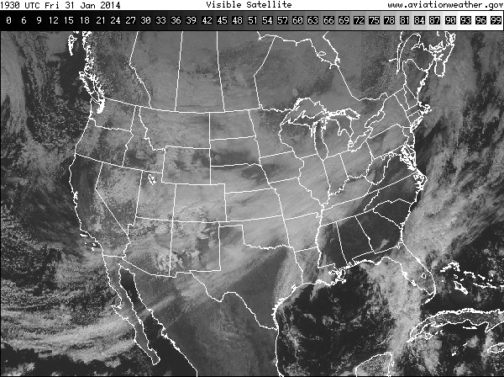
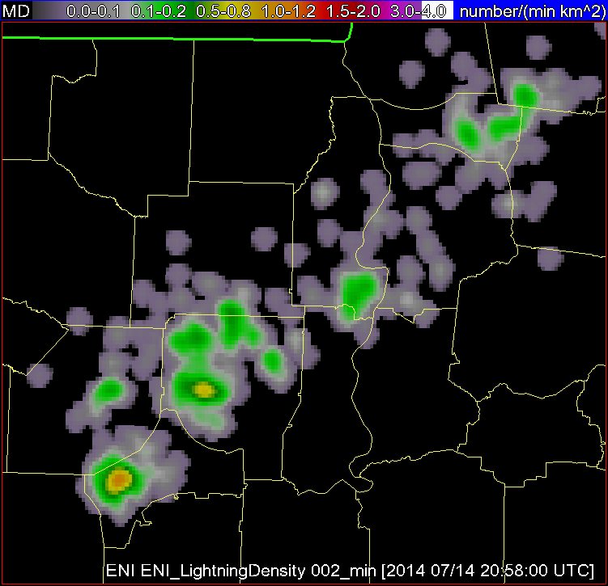
1. NWP
2. Satellite
3. Lightning
4. MRMS
-1F00
F00
F01
Convert grib2 to netCDF (wgrib2, python)
F02
F03
GEOCAT (fortran90)
Convert csv to xml, then to netCDF (python + WDSS-II)
Compute, remap, composite, and smooth fields (python + WDSS-II)
Remap (C + python)
RADAR
PRODUCTS
SATELLITE PRODUCTS
(e.g., top-of-troposphere emissivity, cloud-top phase)
Identification and tracking (WDSS-II)
Lightning products
NWP PRODUCTS (e.g., MUCAPE, effective bulk shear)
Identification and tracking
(WDSS-II + python)
Radar objects
Satellite objects
Use latest lightning products
ProbSevere (python)
-Always listening for new data
-New iteration with new radar objects
-Creates ASCII output for AWIPS2
Use latest satellite products and objects
Use latest NWP products

Slide 3
1. NWP
Inputs:
Previous cycle analysis
Current cycle analysis
Current cycle F01H
Current cycle F02H
Current cycle F03H
Rapid Refresh NWP (RAP)
Source: NOAA/NCEP
Native data format: grib2
Update frequency: 60 min
Spatial resolution: ~13km
Processing
Memory requirement: 2GB (once per hour)
Disk requirement: ~8GB per day
Software
netCDF Operator utilities (NCO)
Python3.5
WDSS-II
w2smooth
-1F00
F00
F01
F02
F03
Compute, remap, composite, and smooth fields (python + WDSS-II)
Compute, remap, composite, and merge fields (python)
NWP PRODUCTS
Intermediate outputs:
netCDFs: Eff. Bulk Shear, SRHelicity, MUCAPE, MLCAPE, MLCIN,
MeanWind_700-900mb, RH_450-700mb, Wetbulb 0C height,
LapseRate 700-500mb
Hourly
0.04deg horizontal resolution
CONUS domain

Slide 4
2. Satellite
GOES 1[3-5] imager data
Source: NOAA/NESDIS/OSPO
Native data format: GVAR
Update frequency: 5-30 min
Spatial resolution: ~4km (using IR channels)
Processing
Memory requirement: 4GB
Disk requirement: 300MB per day for derived fields
Ancillary Data:
6-hourly GFS 12-hour forecast data
grib2 converted to hdf (using FORTRAN90 executable)
Surface emissivity/albedo, instrument data (~16GB)
Software
McIDAS
Converts GVAR to area files
Geostationary Cloud Algorithm Testbed (GEOCAT)
Accepts area files (GOES-1[3-5]) or netCDF (GOES-16)
Creates derived satellite fields:
11-µm top-of-troposphere emissivity (ε_{tot})
Cloud-top phase
Python3.5
WDSS-II
w2segmotionll
GFS ingest
GEOCAT (fortran90)
Remap (python)
SATELLITE PRODUCTS
(top-of-troposphere emissivity, cloud-top phase)
Identification and tracking (WDSS-II + python)
Satellite objects
Intermediate outputs:
~4-8 ε_{tot}, cloud phase, object files per hour (netCDF)
0.04deg horizontal resolution
CONUS domain

Slide 5
2. Satellite
GOES 16+ imager data
Source: NOAA/NESDIS/OSPO
Native data format: netCDF
Update frequency: 5 min
Spatial resolution: ~2km (using IR channels)
Processing
Memory requirement: 8GB
Disk requirement: 4GB
Ancillary Data:
6-hourly GFS 12-hour forecast data
grib2 converted to hdf (using FORTRAN90 executable)
Surface emissivity/albedo, instrument data (~16GB)
Software
Geostationary Cloud Algorithm Testbed (GEOCAT)
Accepts area files (GOES-1[3-5]) or netCDF (GOES-16)
Creates derived satellite fields:
11-µm top-of-troposphere emissivity (ε_{tot})
Cloud-top phase
Python3.5
WDSS-II
w2segmotionll
GFS ingest
GEOCAT (fortran90)
Remap (python)
SATELLITE PRODUCTS
(top-of-troposphere emissivity, cloud-top phase)
Identification and tracking (WDSS-II + python)
Satellite objects
Intermediate outputs:
12 ε_{tot}, cloud phase, object files per hour (netCDF)
0.02deg horizontal resolution
CONUS domain

Slide 6
3. Lightning
Total Lightning Data
Source: Earth Networks Total Lightning Network (ENTLN)
Native data format: csv
Update frequency: 1 min
Spatial resolution: flash point data
Processing
Memory requirement: 200MB
Disk requirement: ~200MB per day
Software
Python3.5
WDSS-II
w2ltg
Convert csv to xml, then to netCDF (python + WDSS-II)
Lightning products
Intermediate outputs:
gridded Lightning Density field (netCDF)
30 grids per hour
0.01deg horizontal resolution
CONUS domain

Slide 7
4. MRMS
Multi-Radar Multi-Sensor Data
Source: NOAA/NCEP
Native data format: grib2
Update frequency: 2 min
Spatial resolution: 0.01deg
Processing
Memory requirement: 17GB
Disk requirement: ~25GB per day
Software
Python3.5
WDSS-II
w2segmotionll (7GB RAM)
Convert grib2 to netCDF and remap (wgrib2, python)
RADAR
PRODUCTS
Identification and tracking (WDSS-II)
Radar objects
Intermediate outputs:
netCDFs: MergedReflectivityQCComposite, MESH, VIL_Density,
MergedAzShear_0-2kmAGL, MergedAzShear_3-6kmAGL,
ClusterID (3 scales), merged_rad_objects, Motion_East, Motion_South
30 grids each per hour
0.01deg horizontal resolution
CONUS domain

Slide 8
ProbSevere algorithm
Python3.5
Always listening for new data
New iteration with new radar objects (every 2 min)
computes new probabilities for every radar object over CONUS
Creates ASCII output for AWIPS2 [final output]
Every 2 min
~50-400kB
Optionally creates python ‘pickle’ files for radar and satellite objects time series
Memory requirement: 3GB
Disk requirement: 200MB – 1.5GB /day
Depending on optional object output

Slide 9
 | Memory | Disk space | CPU load | Input format | Output format
NWP | 2GB | 8GB | 1 | grib2 | netCDF
GOES (legacy) | 4GB | 0.3GB | 2 | GVAR | netCDF
GOES-16 | 8GB | 4GB | 2 | netCDF | netCDF
Lightning | 0.2GB | 0.5GB | 1 | csv | netCDF
MRMS | 17GB | 25GB | 3 | grib2 | netCDF
ProbSevere alg. | 3GB | 0.2-1.5GB | 1 | various | ascii
Total (legacy): | 30.2GB | 34-36GB/day* | 8
Total: | 34.2GB | 38-40GB/day* | 8
*This is the amount of data for derived products. Adding software packages and ancillary data, the total disk space needed is approximately 55-60GB.

Slide 10
WDSS-II version information
WDSS-II built using the build_distribution.pl script.
date completed: Wed Aug 10 09:20:10 2016
run by user: wdssii
Linux devlab6.protect.nssl 3.10.0-327.18.2.el7.x86_64 #1 SMP Fri Apr 8 05:09:53 EDT 2016 x86_64 x86_64 x86_64 GNU/Linux
Red Hat Enterprise Linux Workstation release 7.2 (Maipo)
options:
user (wdssii) -- username on tensor
loc -> [/home/wdssii/WDSS2] -- location of build
branch () -- empty indicates latest
asof () -- empty indicates latest, (any format that -D can accept, including 20031012 or yesterday)
expire (no) -- stop working year from now?
static -> [no] -- or shared libraries
extras -> [--enable-nexrad --with-fam=yes] -- empty indicates default
packages (gdal g2clib netcdf config orpginfr dualpol dualpol-QPE udunits w2 w2ext w2algs w2tools wdssiijava)
java -> [no] -- build Java packages?
optimized -> [yes] -- uses 02 for gcc, 03 for icc
PGOpass (0) -- pass number for profile-guided optimization. Use PGOpass=1, compile, run your executables, then use PGOpass=2 and compile again.
debug (yes) -- debug flag (-g) to compiler and -NDEBUG not on?
legacy (yes) -- Building on pre RedHat 7 systems
doc (no) -- build the documentation?
tar -> [yes] -- make distribution tar file?
icc (no) -- Use the intel compiler?
iccdir (/opt/intel/compiler70/ia32) -- Intel compiler dir
cxxflags -> [ -m64] -- additional compile flags
checkout_3rd -> [no] -- check out 3rd party also?
checkout_dp -> [no] -- check out dualpol also?
checkout -> [no] -- check out or just build?
export (no) -- disable 128-bit encryption.
keyfile -> [/home/wdssii/WDSS2/src/w2/w2config/auth/research/key] -- location of key file -- "no" indicates no authorization required or binary.
researchonly -> [yes] -- if turned on, this build is created without realtime support, for research users only.
gdal (yes) -- build applications that rely on gdal
gtkdisplay -> [yes] -- build the wg display program.
rssd (libinfr) -- rssd type to use: libinfr (push) or glib (pull).
numcpus (32) -- number of CPUS your machine has.
distclean -> [yes] -- do a 'make distclean' in the directory to remove detritus from earlier builds.
fam (yes) -- with Fam support

Slide 11
Python packages
numpy
pygrib
argparse
netCDF4
scipy
pyresample
matplotlib
pyhdf
cython capability
Standard libs:
os
sys
errno
re
time
datetime
calendar
subprocess
glob
pickle

