Slide 1
ProbSevere – wind, hail, tornado update
23 March 2017

Slide 2
ProbTornado:
  Max LLAzShear
  98% LLAzShear vs. SRH 0-1km
  98% MLAzShear vs. max flash density in 30 min
  MeanWind 700-900mb vs. EBShear
  MLCAPE and MLCIN as negative a priori modifiers
ProbWind:
Bayesian between current ProbSevere and ‘type2’ wind
  Type2 wind model:
    MeanWind 700-900mb vs. MLCAPE
    VIL Density
    Flash rate vs. 98% MLAzShear
    MeanWind 700-900mb vs. 98% LLAzShear
    Norm. Sat. Growth Rate
    Glaciation Rate
ProbHail:
  MUCAPE vs. EBShear (control a priori)
  MESH vs. wetbulb 0C hgt.
  Flash rate vs. EBShear (control predictor)
  LapseRate 700-500mb vs. minAvgRH 700-450mb
  Norm. Sat. Growth Rate
  Glaciation Rate

Slide 3
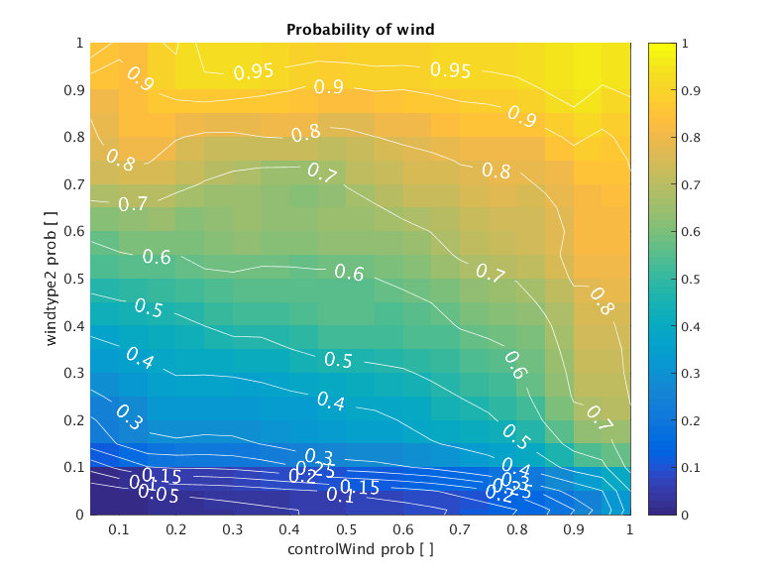

Slide 4
Control vs. Wind
ProbWind vs. Wind
Notes:
This is vs. all reports

Slide 5
Control vs. Hail
ProbHail vs. Hail
Notes:
This is vs. all reports

Slide 6
Control vs. Severe (H, W, or T)
Max(ProbHail, ProbWind, ProbTor) vs. Severe
Notes:
This is vs. all reports

Slide 7
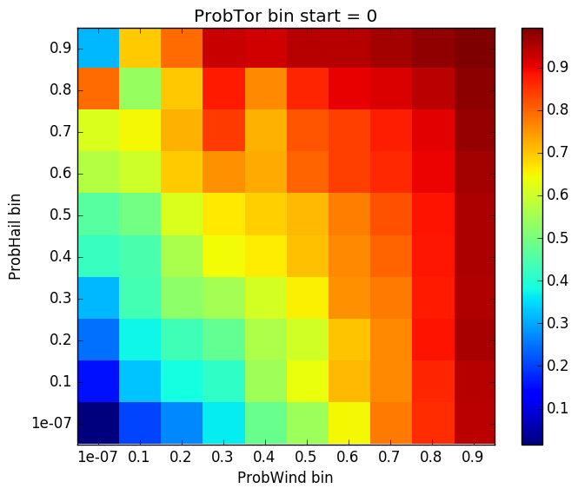
Started with multiple tornado bins, but found >> of observations with ProbTor < 0.01
Condensed into 2D

Slide 8
Bayesian vs. Severe (H, W, or T)
Max(ProbHail, ProbWind, ProbTor) vs. Severe

Slide 15
Max(ProbHail, ProbWind, ProbTor)
ProbSevere (control, 2016)
First report

Slide 16
Max(ProbHail, ProbWind, ProbTor)
ProbSevere (control, 2016)
First report

