Slide 1
NOAA/CIMSS ProbSevere Model
(All Hazards)
– Training Module –
Spring 2018
NWS Milwaukee/Sullivan
Notes:
This is a short training module for users of the NOAA/CIMSS ProbSevere Model.
ProbSevere All Hazards is an improvement to the NOAA/CIMSS ProbSevere model. ProbSevere All Hazards generates probabilities for the 3 severe storm hazards--severe hail, severe straight-line winds, and tornadoes. This training module is designed for users that are already familiar with the legacy NOAA/CIMSS ProbSevere model and provides only information very specific to the ProbSevere All Hazards model—including data used, examples, validation statistics, and best practices for ProbSevere All Hazards usage by operational forecasters.
If you are not familiar with ProbSevere it is recommended you first complete the 2016 ProbSevere training module available at: http://cimss.ssec.wisc.edu/severe_conv/training/training.html

Slide 2
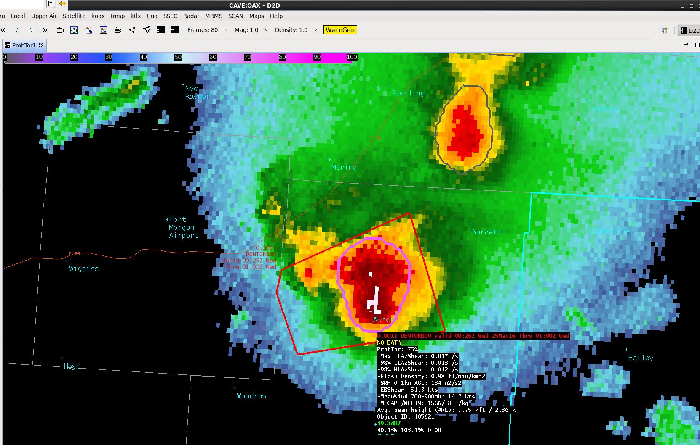
NOAA/CIMSS ProbSevere Model Goals
ProbSevere is a statistical model designed to increase forecaster confidence and/or increase lead-time in severe thunderstorm/tornado warning issuance.
This statistical model predicts the probability that a storm will produce a severe hail, severe wind or a tornado in the near-term (in the next 0-60 min).
ProbSevere can be used as a ‘pre-polygon’ product as well as an aid for warning reissuance.
Notes:
ProbSevere follows the same radar object-based naïve Bayesian statistical framework as the legacy NOAA/CIMSS ProbSevere model and also follows the same display concepts. ProbSevere is the probability a storm will produce severe weather in the next 60 minutes. Users have an option of what to display—the maximum of the three hazard predictions—severe hail, severe wind, and tornado or any individual hazard prediction.
ProbSevere is a statistical model designed to increase forecaster confidence and/or increase lead-time in severe thunderstorm/tornado warning issuance.

Slide 3
NOAA/CIMSS ProbSevere Timeline
2015:
ProbSevere Improved
Derived from:
NWP
GOES-13/15
NEXRAD (MRMS)
2017:
“All Hazards” ProbSevere
Including:
ProbHail, ProbWind, ProbTor
More physically relevant NWP and observational predictors for each hazard
2014:
ProbSevere Introduced
Derived from:
NWP
GOES-13
NEXRAD (MRMS)
2016:
Earth Networks Total
Lightning incorporated into ProbSevere
2018:
GOES-16 ABI incorporated.
Refinements to ProbHail, ProbWind, and ProbTor
Notes:
Starting in 2018 ProbSevere (both the ProbSevere hazard models and legacy ProbSevere) uses GOES-16 ABI data for the entire CONUS, GOES-15 is no longer used. GOES-17 will be incorporated after it becomes operational.
The timeline above shows the development history of ProbSevere and its evaluation within the Hazardous Weather Testbed, including the transition from “legacy” ProbSevere to “All Hazards” ProbSevere in 2017 and transition to use of only GOES-16 ABI data in 2018.

Slide 4
NOAA/CIMSS ProbSevere Model
Probabilities are a function of the dynamic and thermodynamic environment and observations
ProbWind:
a priori: f(MeanWind 1-3 km AGL/ MLCAPE)
VIL Density
Flash Rate vs 3-6 km AzShear
MeanWind 1-3 km AGL vs. 0-2 km AzShear
Satellite Growth Rate
ProbHail:
a priori: 0.03
MESH vs. Wet Bulb 0°C Height
Flash Rate vs. EBS
CAPE in -10°C to -30°C layer vs Precipitable Water
Satellite Growth Rate
ProbTor:
a priori: 0.01
Max 0-2km AzShear
98th %ile 0-2km AzShear vs. 0-1km SRH
98th %ile 3-6km AzShear vs. max flash density
EBS vs. MeanWind 1-3 km AGL
MLCAPE; MLCIN
Notes:
For ProbSevere the most pertinent environmental and observational datasets are utilized for the targeted hazard.
For ProbHail:
a priori: climatology of severe hail producing thunderstorms from database
Maximum Expected Size of Hail (MESH) vs the height of the wet bulb 0C--inclusion of the wet bulb 0C paired with MESH better accounts for lack of melting in low-topped hail storms and increased melting in many southeastern US summertime storms.
Flash Rate (Earth Networks Total Lightning) vs Effective Bulk Shear—measure of updraft strength and potential storm organization
CAPE in -10°C to -30°C layer vs Precipitable Water—Combination of larger CAPE in hail growth zone and lower precipitable water is more favorable for severe hail
Satellite growth rate—Measure of initial updraft intensity
For ProbWind:
a priori: Mean wind (1-3 km AGL)/MLCAPE—measure of environmental momentum to potentially transfer to the surface and potential updraft intensity for mixed-layer parcels (mixed-layer parcels are better for wind, while most unstable parcels are better for hail).
VIL Density—Measure of precipitation core intensity
Flash Rate vs 3-6 km AzShear—measure of updraft intensity and proxy for strength of mid-level storm winds
Mean wind (1-3 km AGL) vs 0-2 km AzShear—measure of environmental momentum to potentially transfer to the surface and proxy for strength of low-level storm winds
Satellite growth rate—Measure of initial updraft intensity
For ProbTor:
a priori: climatology of tornado producing severe thunderstorms in training database
Maximum 0-2km AzShear: Maximum depiction of updraft rotation in lower troposphere
98th percentile 0-2km AzShear vs 0-1 km Storm Relative Helicity: Lower tropospheric updraft rotation intensity vs near surface storm relative helicity
98th percentile 3-6km AzShear vs maximum total lightning flash density: Middle tropospheric updraft rotation vs measure of updraft intensity
Effective Bulk Shear vs Mean Wind 1-3 km above ground level: Storm organization vs momentum present in lower troposphere
MLCAPE and MLCIN: Penalty functions only—too little mixed layer instability or too great mixed layer inhibition reduces likelihood of tornado

Slide 5
AWIPS-II Display

Slide 6
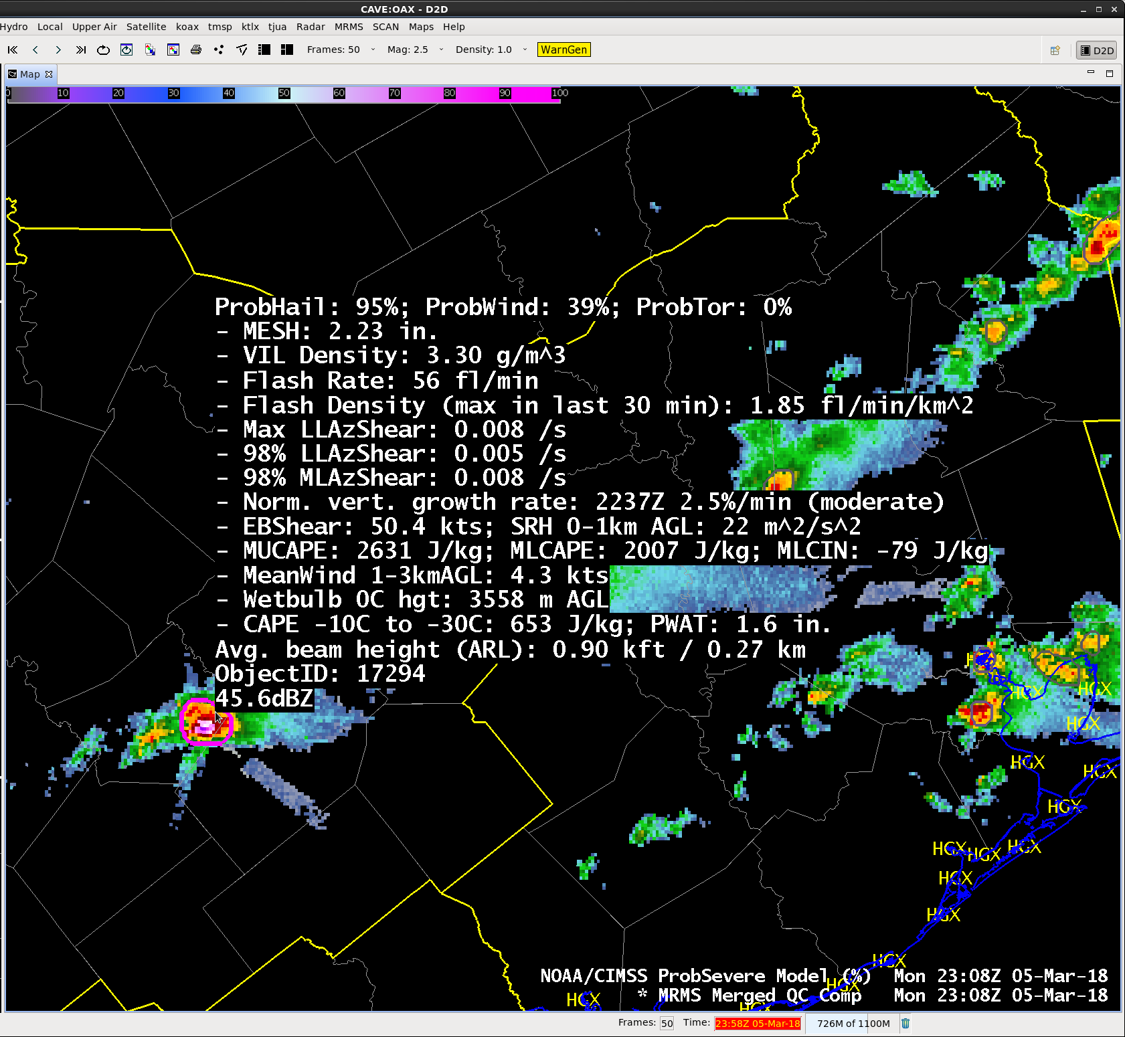
ProbSevere Model AWIPS-II Display
ProbSevere =
MAX(ProbHail, ProbWind, ProbTor)
Model output are shapefiles contoured around radar storm cells.
Enhancement designed for overlay atop radar reflectivity—but can be overlaid on any field (satellite, radar velocity, etc.).
Sampling offers readout of model probability as well as each model predictor.
Notes:
The ProbSevere All Hazards visualization in AWIPS-2 is shown. A contour around an identified radar object is color-coded based on the ProbSevere (or individual hazard) value.
Users have options to load the fully integrated ProbSevere All Hazards (displayed here, where the maximum of ProbHail, ProbWind and ProbTor is the colored contour) or any combination of individual hazard models (shown on the following slide and in examples).

Slide 7
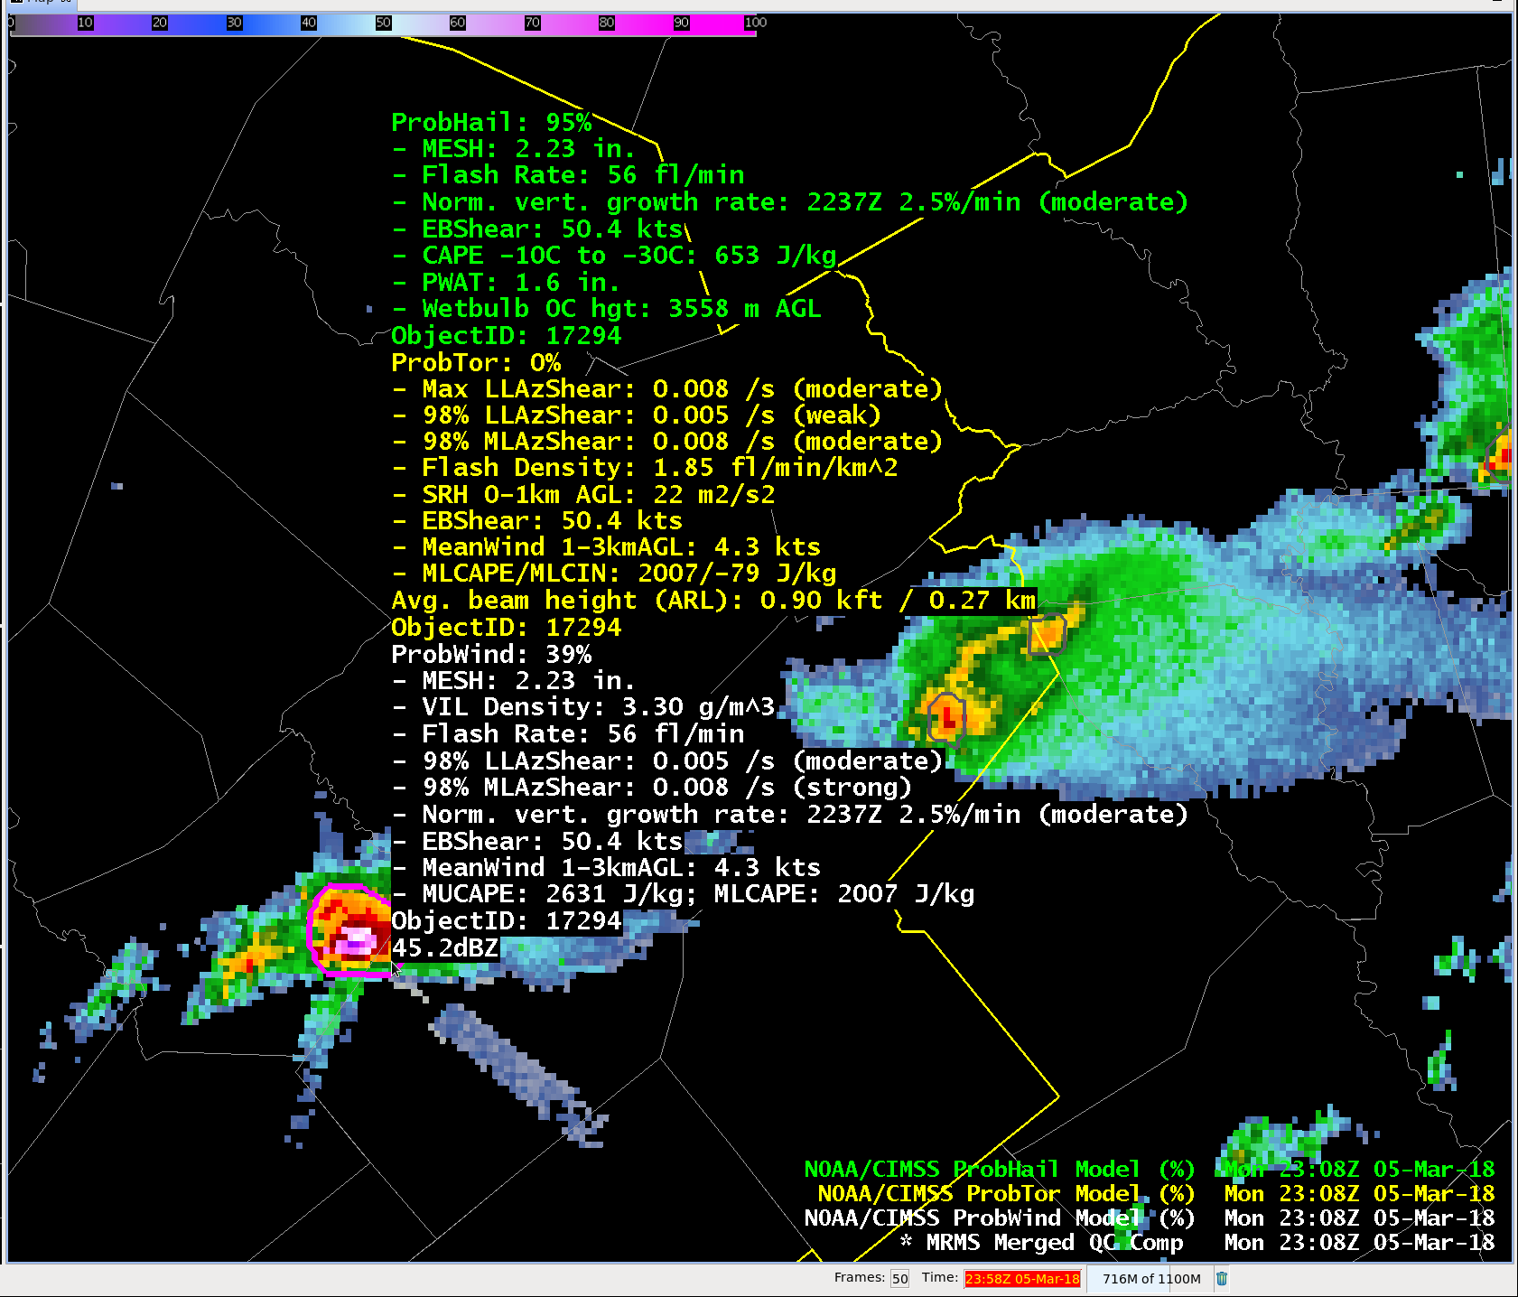
ProbSevere Model AWIPS-II Display
Notes:
Some users may prefer to load each hazard model individually, here ProbHail (green readout), ProbTor (yellow readout) and ProbWind (white readout) are all loaded. The colored contour is the top product in the AWIPS-2 menu (in this case ProbHail).

Slide 8
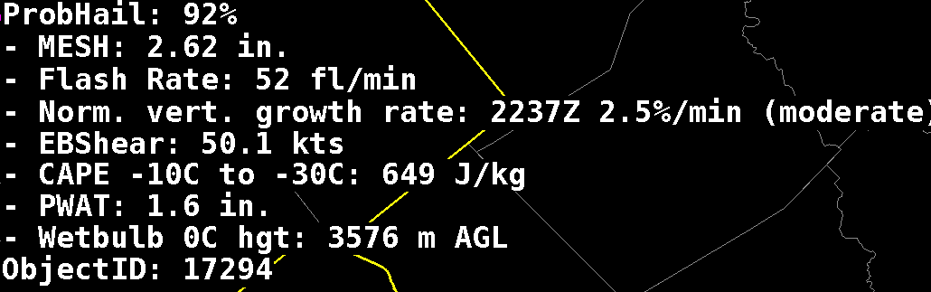
ProbHail Model AWIPS-II Readout
Notes:
Example of AWIPS-2 ProbHail readout. All predictors used by the ProbHail model are included in the read-out, like MESH, CAPE in hail growth region, etc.
See slide 4 for a full description of predictors used.

Slide 9
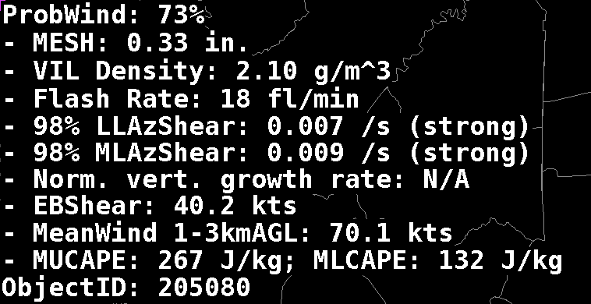
ProbWind Model AWIPS-II Readout
Notes:
Example of AWIPS-2 ProbWind readout. All predictors used by the ProbWind model are included in the read-out, like VIL Density, MRMS AzShear, 1-3km AGL mean wind speed, etc. At request of users, we have added statistically-based descriptors for the MRMS AzShear fields (weak, moderate, and strong).
See slide 4 for a full description of predictors used.

Slide 10
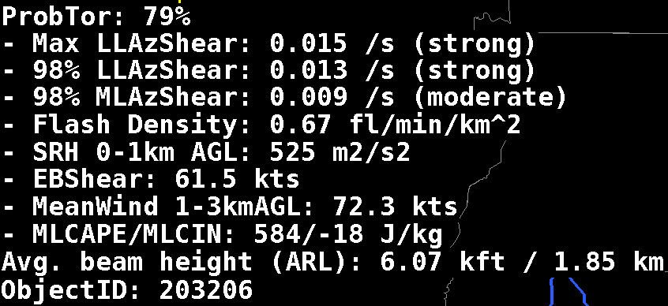
ProbTor Model AWIPS-II Readout
Notes:
Example of AWIPS-2 ProbTor readout. All predictors used by the ProbTor model are included in the read-out, like MRMS AzShear, 0-1km storm relative helicity, etc. At request of users, we have added statistically-based descriptors for the MRMS AzShear fields (weak, moderate, and strong).
See slide 4 for a full description of predictors used.

Slide 11
Examples

Slide 12
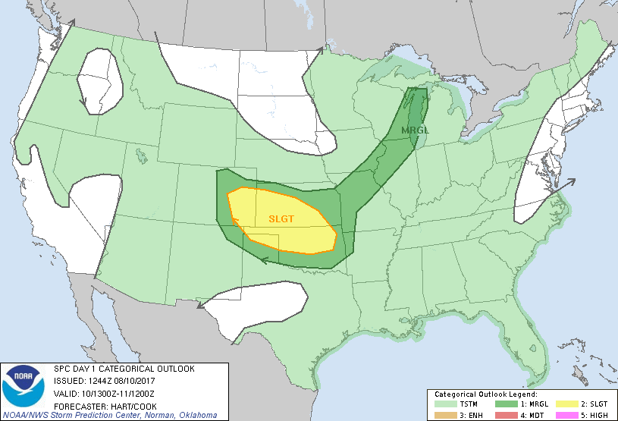
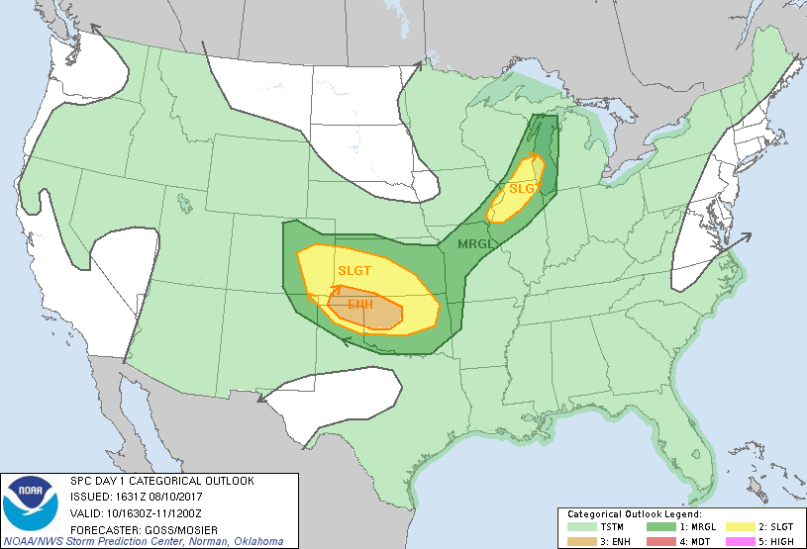
ProbHail and ProbWind - 10 August 2017
1300Z outlook
5% Hail
5% Wind
2% Tor
1630Z outlook
15% Hail
15% Wind
2% Tor

Slide 13
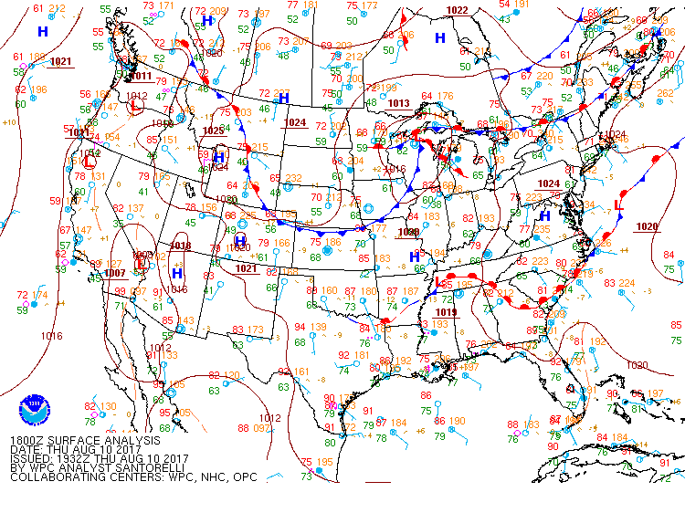
ProbHail and ProbWind - 10 August 2017
1800Z surface analysis

Slide 14
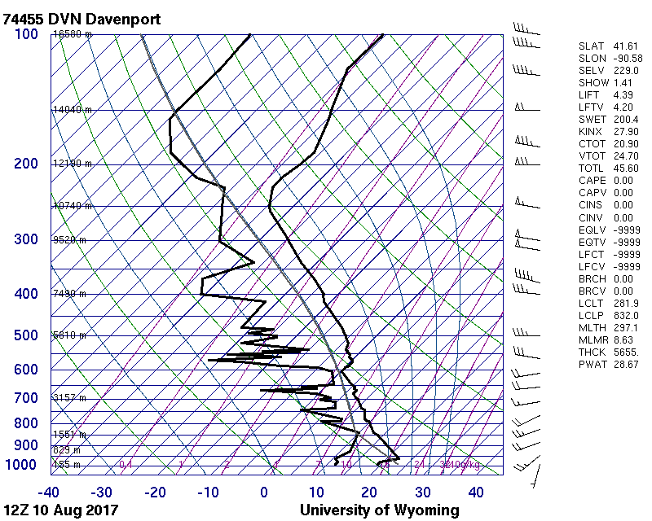
1200Z s0unding
ProbHail and ProbWind - 10 August 2017

Slide 15
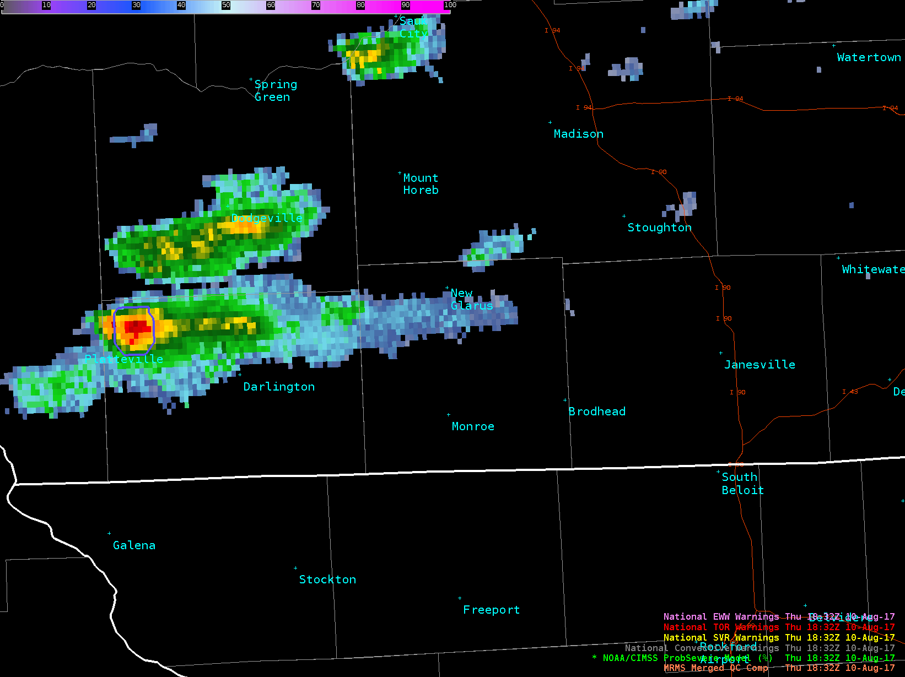
Southern Wisconsin – 1830Z to 2030Z

Slide 16
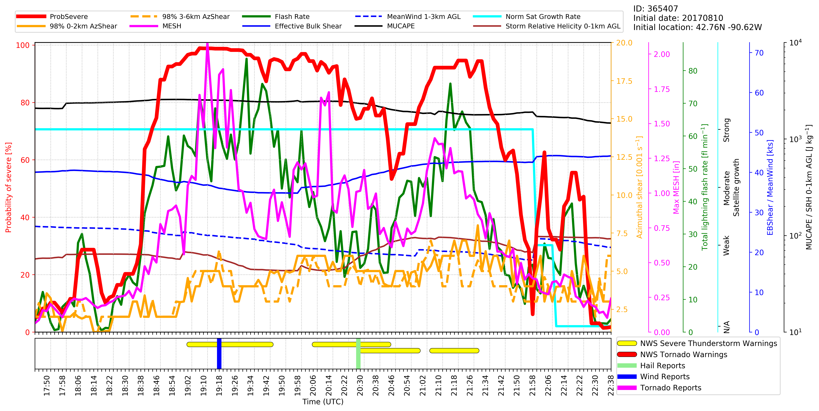
Southern Wisconsin
1830Z to 2030Z
Notes:
ProbHail was a little higher (~5%) in this case

Slide 17
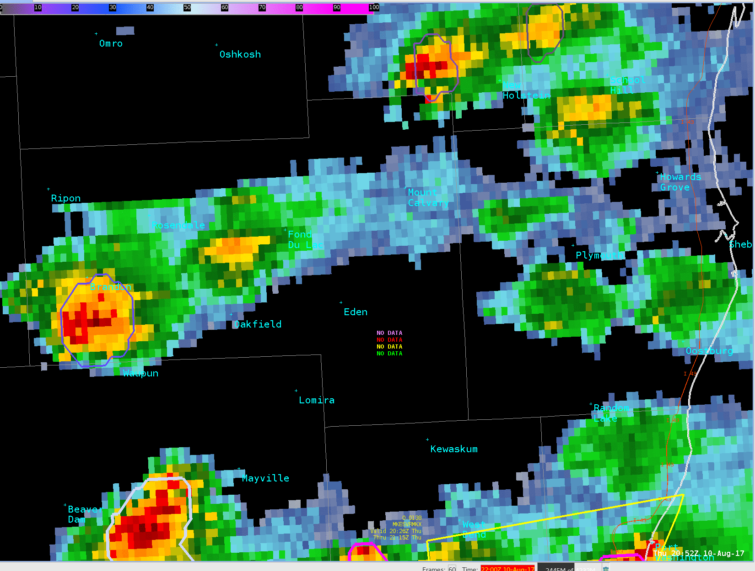
Fond du Lac – 2052Z to 2120Z
MUCAPE: 1500 J/kg
EBShear: 40 kts
Hailcape: 530 J/kg
MESH: 0.04→1.10” in 10 min
FlashRate: 2→34 fl/min in 10 min
SatGrowth: moderate/strong
ProbHail: 2→81% in 10 min

Slide 18
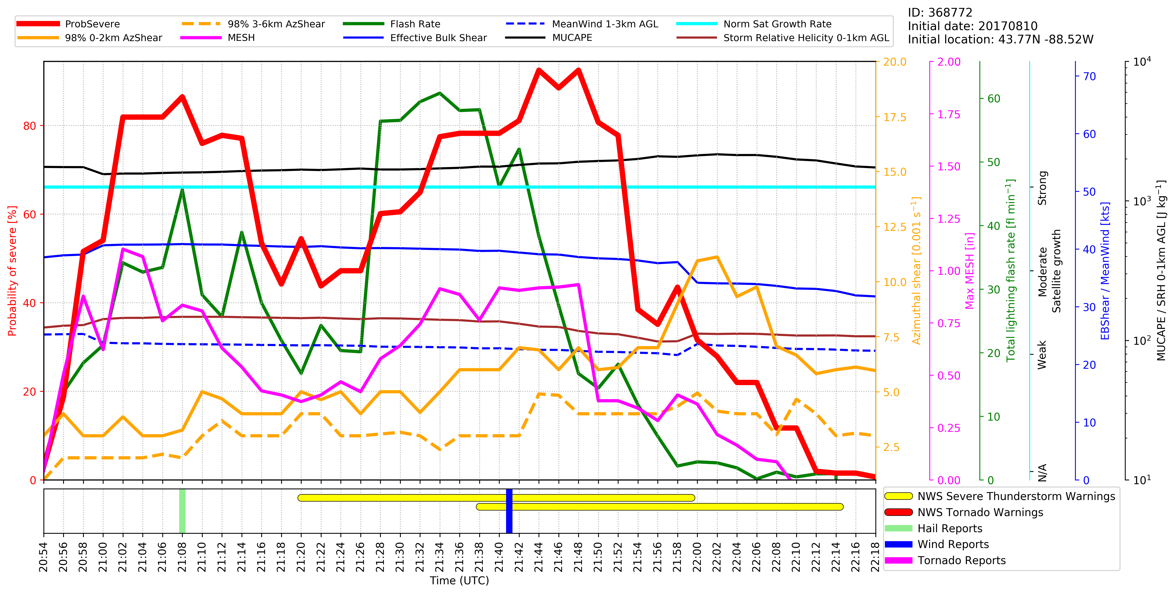
Fond du Lac
2052Z to 2120Z
ProbHail higher
ProbWind higher
Notes:
ProbHail was higher during the hail report and ProbWind was higher during the wind report. But we want to emphasize that this is often not the case. “ProbSevere” (i.e., max of all three) is probably still the best way to go for severe thunderstorm warnings.

Slide 19
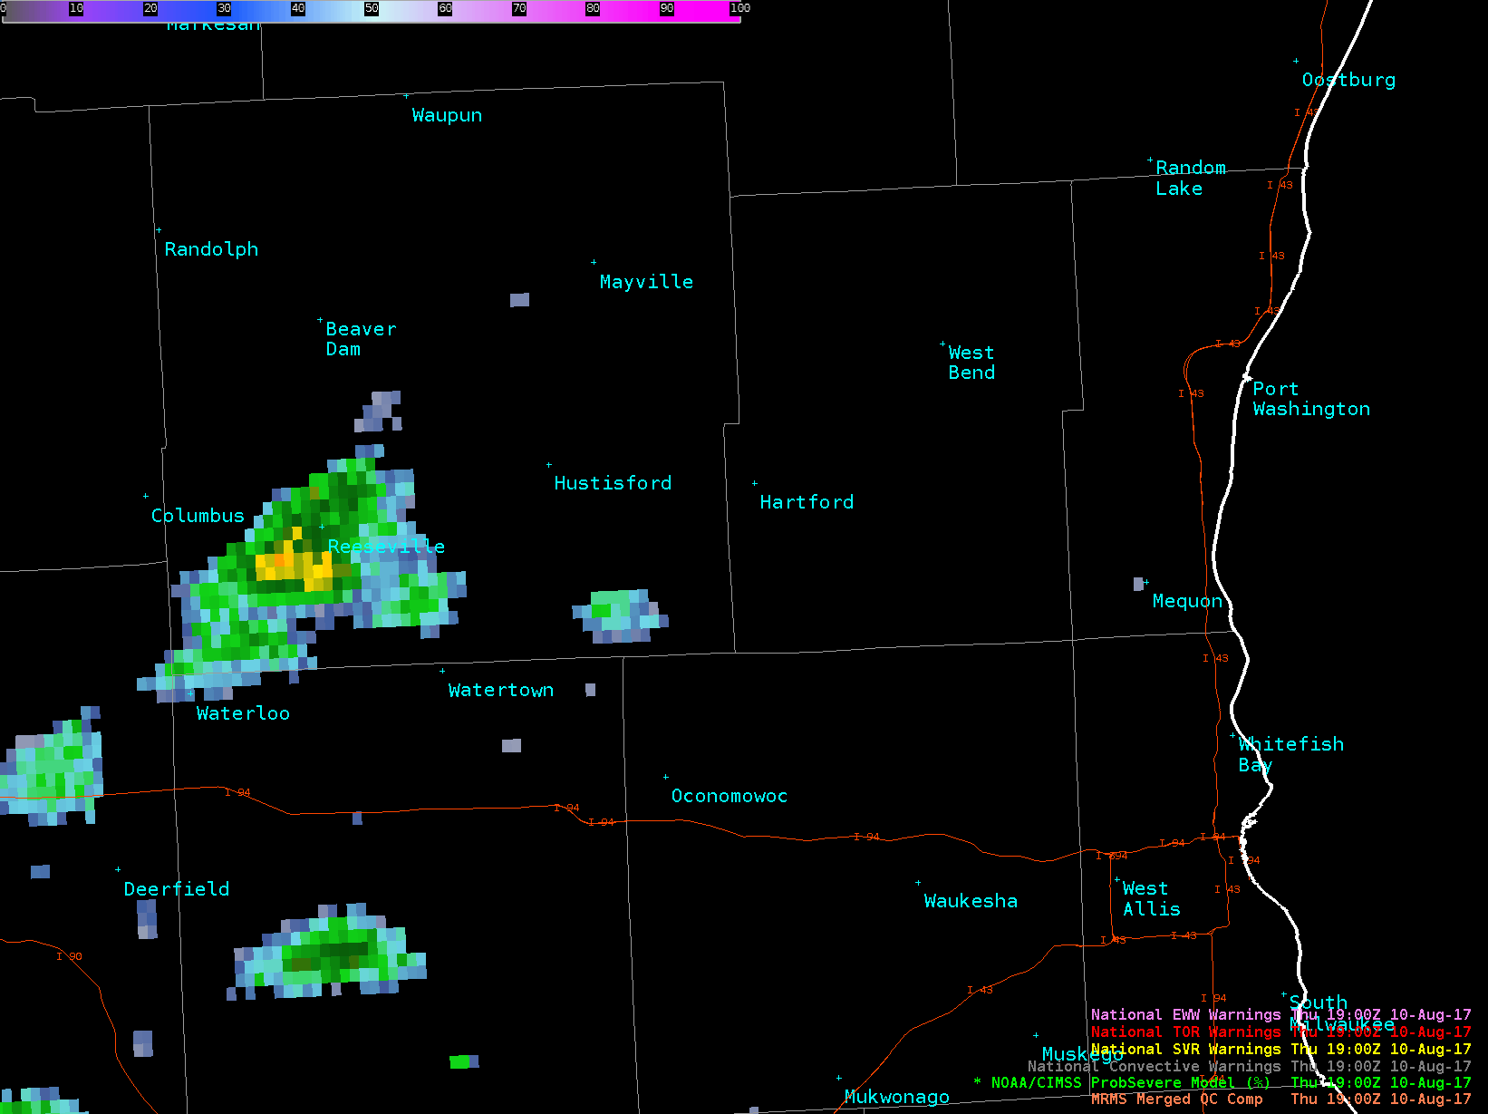
West Bend– 1900Z to 2030Z
Notes:
ProbHail and ProbWind were about the same at first report time (92%).

Slide 20
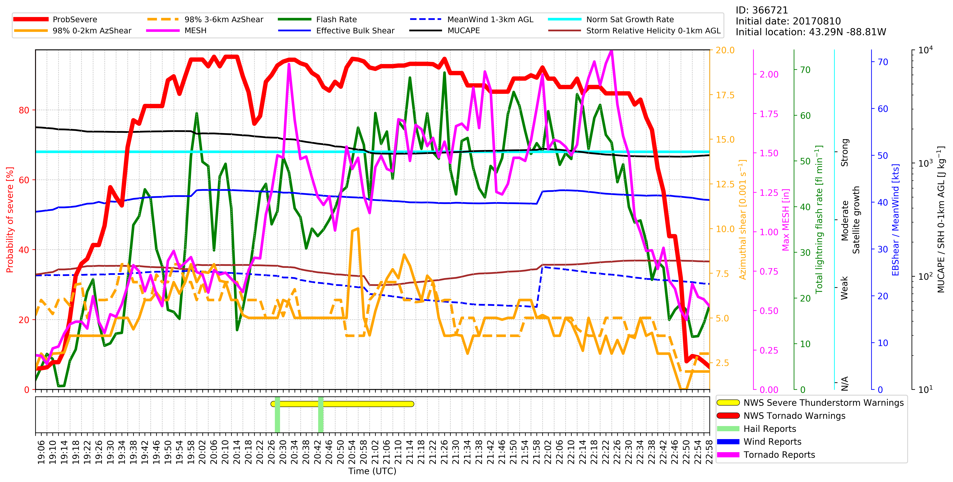
West Bend 1900Z-2030Z
Flash rate: 2 - 25 fl/min
SatGrowth: strong
ProbWind: 5 → 40 %
Flash rate: 12 - 40 fl/min
MESH: 0.5 - 0.75”
ProbWind: 55 → 80 %
ProbHail higher
Over Lake Michigan

Slide 21
ProbTor GR demo
28 June 2017

Slide 22
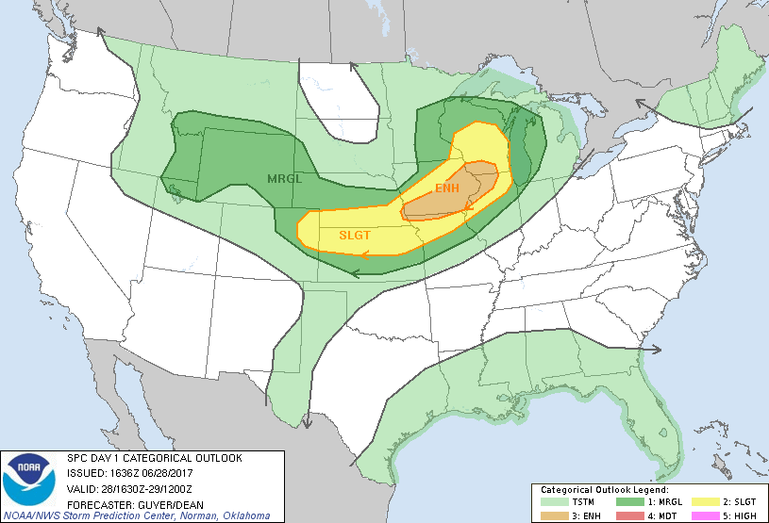
ProbTor – 28 June 2017
1630Z outlook
5% Hail
5% Wind
<2% Tor

Slide 23
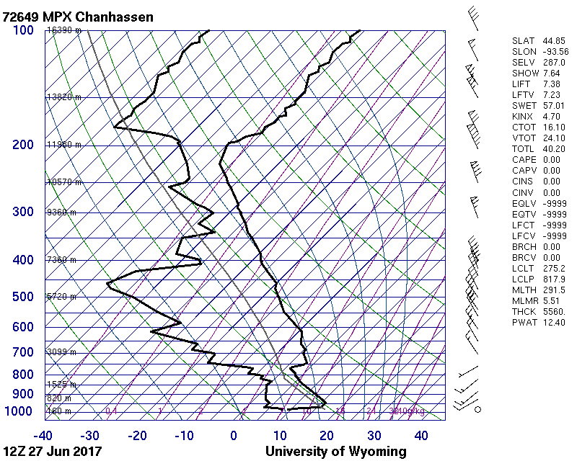
ProbTor – 28 June 2017

Slide 24
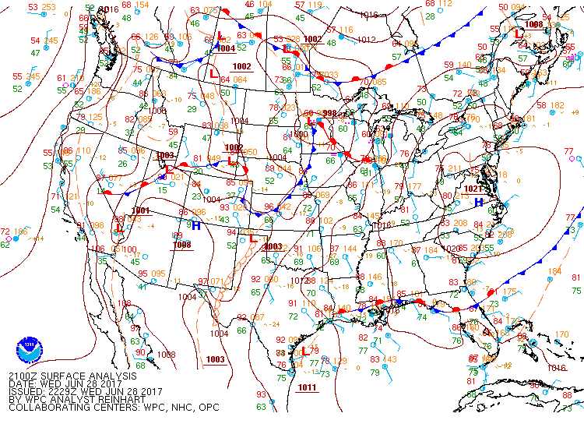

Slide 25
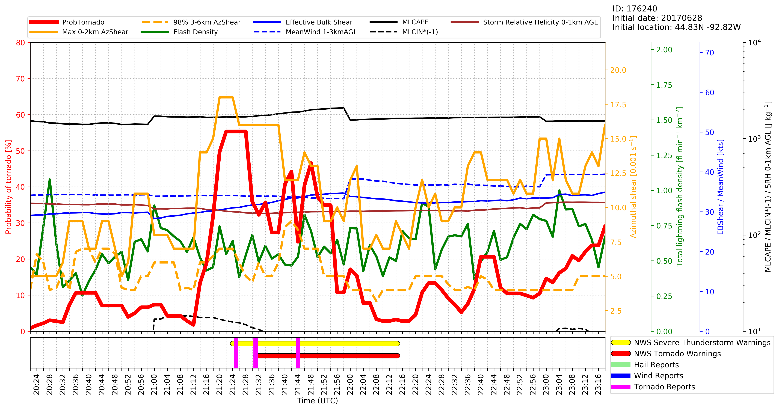
28 June 2017: western Wisconsin tornadoes (all EF1)

Slide 26
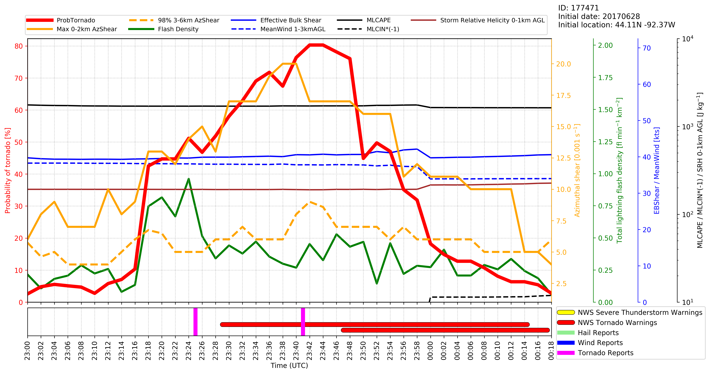
28 June 2017: southeastern Minnesota tornadoes (both EF0)
Flash density: 0.15 – 0.75 fl/min/km²
Max 0-2km AzShear: 8.5 – 12.5 x 0.001 s⁻¹
ProbTor: 10 → 42%

Slide 27
Validation

Slide 28
ProbSevere Model Performance
Under forecast
Over forecast
POD/FAR/CSI
Reliability
Preliminary ProbSevere (All-Hazards) validation uses the maximum probability from ProbHail, ProbWind, and ProbTor.
Skill plots show ProbSevere is less skillful than experienced forecasters (as expected) , but is comparable and offers increased lead-time.
Reliability diagram shows slight over forecast bias for most probability thresholds, but “all hazards” ProbSevere is well calibrated overall
Notes:
The ProbSevere (All-Hazards) preliminary verification shown on this slide includes 2,250 severe storms and 42,000 non-severe storms during 2016. ProbSevere verification uses the maximum probability from ProbHail, ProbWind and ProbTor predictions.
ProbSevere is fairly well calibrated and users should expect verification at the approximate rate as the probability (e.g., a storm achieving a 40% probability will produce severe weather 4 in 10 times, a storm achieving a 80% probability will produce severe weather about 8 in 10 times, and so on).
The skill and lead-time analysis demonstrates that ProbSevere is not as skilled experienced NWS forecasters, yet is comparable. The increased lead-time and well-calibrated probabilities can offer the forecaster 1) increased confidence in their decision making and 2) increased lead-time in making warning decisions.

Slide 29
ProbSevere – Hail Improvement
Skill plots show that the ProbHail component of “all hazards” ProbSevere significantly improves upon the severe probability from the legacy version of ProbSevere.
ProbHail Max CSI: 0.43 vs ProbSevere Legacy Max CSI (for hail): 0.40
Notes:
The ProbHail preliminary verification for hail events shown on this slide includes 800 severe hail producing storms and 42,000 non-severe storms during 2016.
ProbSevere—ProbHail incorporates more physically relevant NWP information than the original version of ProbSevere. As such this figure shows the ProbSevere--ProbHail (red) has higher CSI for most probability thresholds than legacy ProbSevere (orange) when scoring for hail events events (and is also very well calibrated (more reliable), see Additional Info slides at end of presentation).

Slide 30
ProbHail Reliability
Under forecast
Over forecast
Reliability analysis shows ProbHail is well calibrated, with a small over forecast bias for probabilities ≥ 40% and is significantly more reliable than ProbSevere Legacy.
Notes:
The reliability diagram for ProbHail (red) vs ProbSevere legacy (orange) for severe hail reports. The reliability diagram is for the same validation sample on the previous slide (800 severe hail producing storms and 42,000 non-severe storms during 2016).
ProbHail users should utilize the good reliability of the probabilities, for example a storm with 60% ProbHail will produce severe hail a bit less than 6 in 10 times; a storm with 80% ProbHail will produce severe hail a bit less than 8 in 10 times.
For severe hail producing storms, ProbHail exhibits much better reliability than legacy ProbSevere. As such, users may note, compared to legacy ProbSevere, fewer severe hail producing storms will reach the ProbHail 80% and 90% thresholds.

Slide 31
ProbSevere – Wind Improvement
Skill plot show that the ProbWind component of “all hazards” ProbSevere significantly improves upon the severe probability from the legacy version of ProbSevere.
ProbWind Max CSI: 0.31 vs ProbSevere Legacy Max CSI (for wind): 0.26
Notes:
The ProbWind preliminary verification for wind events shown on this slide includes 1,650 severe wind producing storms and 42,000 non-severe storms during 2016.
ProbSevere—ProbWind incorporates more physically relevant NWP predictors and more direct measurements of thunderstorm wind velocity than the original version of ProbSevere. As such this figure shows the ProbSevere--ProbWind (red) has higher CSI for most probability thresholds than legacy ProbSevere (orange) when scoring for wind events (and is also very well calibrated, see Additional Info slides at end of presentation).

Slide 32
ProbWind Reliability
Under forecast
Over forecast
Reliability analysis shows ProbWind is well calibrated, with a small over forecast bias for probabilities ≥ 40% and is significantly more reliable than ProbSevere Legacy.
Notes:
The reliability diagram for ProbWind (red) vs ProbSevere legacy (orange) for severe wind reports. The reliability diagram is for the same validation sample on the previous slide (1650 severe wind producing storms and 42,000 non-severe storms during 2016).
ProbWind users should utilize the good reliability of the probabilities, for example a storm with 40% ProbWind will produce severe wind a bit less than 4 in 10 times; a storm with 80% ProbWind will produce severe wind a bit less than 3 in 4 times.
For severe wind producing storms, ProbWind exhibits much better reliability than legacy ProbSevere—both a result of a lower false alarm rate and increase in probability of detection for many linear severe wind events.

Slide 33
ProbTor Model Performance
Under forecast
Over forecast
POD/FAR/CSI
Reliability
Verification against LSR’s shows that ProbTor is less skillful than experienced forecasters (as expected), but offers increased lead-time
Reliability analysis shows ProbTor tends to slightly under forecast when probability is ≤ 60% and slightly over forecast when the probability is ≥ 70%
Overall, ProbTor is well-calibrated
Notes:
POD/FAR/CSI/reliability statistics are for ALL tornadoes in validation database. (60 days in 2016; 325 tornadic storms; 45,586 non-tornadic storms)
The lead-time statistics are measured to the FIRST tornado report associated with tornadic storms.
ProbTor skill (as expected) is poorer than experienced NWS forecasters, yet still comparable (CSI: ProbTor: 0.18 vs NWS: 0.23). However, ProbTor, in the median, provides 10-minutes greater lead-time than traditional techniques (ProbTor: 35 min vs NWS: 25 min)**.
ProbTor users should utilize the good reliability of the probabilities, for example a storm with 33% ProbTor will produce a tornado a bit more than 1 in 3 times; a storm with 50% ProbTor will produce a tornado a bit more than 1 in 2 times.
**Note the NWS lead-time values are larger than published statistics. This is due to the validation methodology, since ProbTor can count as a hit up to 90 minutes in the future, we do not penalize the NWS for the first TOR report occurring AFTER (spatially ‘down wind’ of) the initial warning, which acts to inflate total lead-time. The difference between the two lead-times is what is significant.

Slide 34
ProbTor: Kinematic Environment Matters!
3%
10%
Vs.
30%
60%
0%
6%
Marginal Kinematics (e.g.)
0-1 km SRH: 100 m² s⁻²
Eff. Bulk Shear: 30 kts
1-3 km AGL MW: 20 kts
Favorable Kinematics (e.g.)
0-1 km SRH: 200 m² s⁻²
Eff. Bulk Shear: 50 kts
1-3 km AGL MW: 40 kts
Do not expect the same ProbTor probability value to give the same results from event to event—the kinematic fields impact ProbTor!
It is best to use ProbTor in a relative fashion—like in the example above.
Notes:
It is best to use ProbTor in a relative sense—how does a storm’s ProbTor value compare to its neighbors opposed to using a fixed ProbTor threshold.
ProbTor is well-calibrated and responds to storm observations (total lightning and MRMS AzShear), but the kinematic environment also plays a significant role in formulating the probabilities. A day with more marginal kinematics will in general have lower probabilities than a day with more favorable kinematics—however the storms that pose the highest threat will still stand-out relative to its neighbors. Therefore forecasters are encouraged not to use a fixed ProbTor threshold, but must also consider the kinematic environment and temporal trends.

Slide 35
Impact of GOES-16 ABI on ProbSevere
Using the subset of storms for which GOES best observed cumulus to cumulonimbus growth during April – July 2017, the GOES-16 ABI increases ProbSevere lead-time by 4 minutes in the median (with nearly identical skill) compared to using the heritage GOES-NOP series imager.
Notes:
During the 2017 convective season, both GOES-16 (ABI) and GOES-13 (NOP) both took measurements over CONUS, allowing for comparisons of the same storms, observed by the two different satellites.
During April-July 2017, for storms which GOES best observed cumulus to cumulonimbus growth , the use of GOES -16 ABI increases ProbSevere lead-time by 4 minutes in the median (with nearly identical skill) compared to using the heritage GOES-NOP series imager. 469 severe storms and 2736 non-severe storms.

Slide 36
ProbSevere: Known Caveats
ProbSevere will not provide lead time to every storm
ProbSevere requires an identifiable object in radar reflectivity
  Most often in linear modes, object identification can become more difficult—the absence of an object (and hence ProbSevere value) does not mean there is no severe weather threat
ProbSevere is impacted by radar beam blockage and increasing beam height away from radar just as reflectivity and base/SRM velocity interrogation
For storms within ~10 miles of NEXRAD sites, use ProbSevere with caution as AzShear values may be artificially high due t0 non-meteorological targets (AzShear is used within ProbWind and ProbTor)
For storms with strong winds located outside the reflectivity core (i.e., ProbWind object) the ProbWind probabilities will be under forecast
Lead-time will be greatest when the satellite can observe the development of the storm from immature cumulus to cumulonimbus

Slide 37
ProbTor: Known Caveats
ProbTor requires an identifiable object in radar reflectivity
  Most often in linear modes, object identification can become more difficult—the absence of an object (and hence ProbTor value) does not mean there is no tornadic threat
ProbTor interpretation can be more difficult in long convective lines
  Pinpointing the portion of a long convective line posing the highest tornadic threats can become difficult since the entire line is identified as single object (we are working toward improving this)
  ProbTor can over forecast in strong convective lines in favorable kinematic environments
ProbTor is impacted by radar beam blockage and increasing beam height away from radar just as base/SRM velocity interrogation
ProbTor will typically have very low probabilities with ‘land spout’ tornadoes
For storms within ~10 miles of NEXRAD sites use ProbTor with caution as AzShear values may be artificially high due t0 non-meteorological targets
ProbTor will under forecast tornado probabilities when input RAP 0-1km SRH values are too low (compared to truth)

Slide 38
ProbSevere: Summary
ProbSevere is a statistical model that incorporates NWP fields, radar observations, and total lightning observations to predict the probability a storm will produce a severe weather (or a specific hazard if using the hazard models) in the next 0-60 minutes.
All ProbSevere hazard models should be used in combination with existing radar interrogation techniques and is designed to increase forecaster confidence and increase lead-time
ProbTor is best used in a relative sense—how a storm’s values compare to neighbors since the kinematic environment will impact probabilities in addition to observations (the ‘best’ probability threshold will change based on the environment).
ProbTor is fairly well-calibrated; so a storm with a 33% probability will produce a tornado about 1 in 3 times and so on.
ProbTor values will fluctuate in response to changes in strength of storm rotation and storm updraft.
GOES-R GLM is not yet incorporated in ProbSevere—but work continues toward including GLM

Slide 39
2018 NOAA/CIMSS & NWS MKX Feedback
We will create two sets of online surveys for feedback
  Brief post-event survey
  End of season (~late September) survey
John Gagan will distribute and solicit replies via email
We welcome email with questions/comments/observations throughout the convective season

Slide 40
Contact and References
Mike Pavolonis (michael.pavolonis@noaa.gov)
John Cintineo (john.cintineo@ssec.wisc.edu)
Justin Sieglaff (justin.sieglaff@ssec.wisc.edu)
Dan Lindsey (dan.lindsey@noaa.gov)
To access this training online and access supplement training please see:
http://cimss.ssec.wisc.edu/severe_conv/training/training.html
ProbSevere All Hazards is also available on the web in real-time:
http://cimss.ssec.wisc.edu/severe_conv/probsevtest.html
ProbTor is also available on the web in real-time:
http://cimss.ssec.wisc.edu/severe_conv/probtor.html
Key References:
https://journals.ametsoc.org/doi/full/10.1175/WAF-D-17-0099.1
https://journals.ametsoc.org/doi/full/10.1175/WAF-D-13-00113.1
Notes:
Please contact the statistical model researchers with questions, suggestions, etc. at the email addresses provided.

Slide 41
Additional Slides

Slide 42
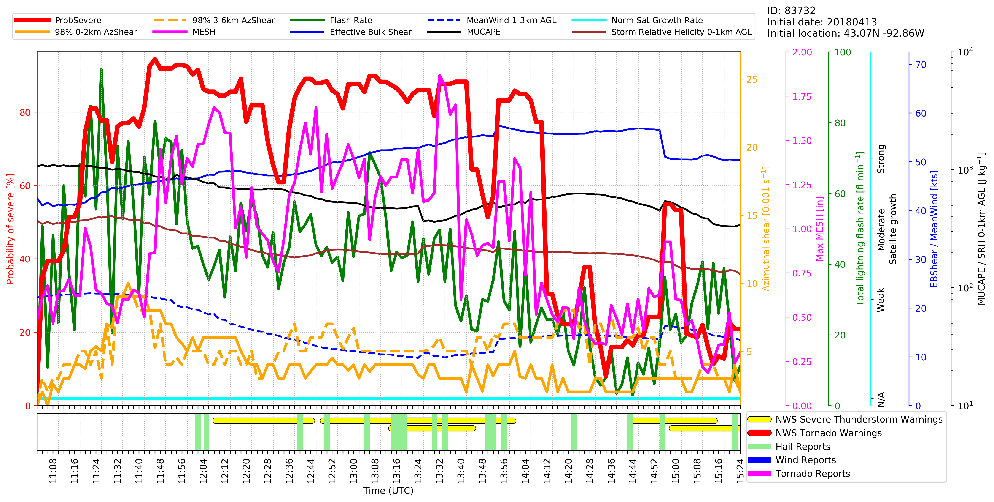
13 April 2018: Iowa and southern Wisconsin

Slide 43
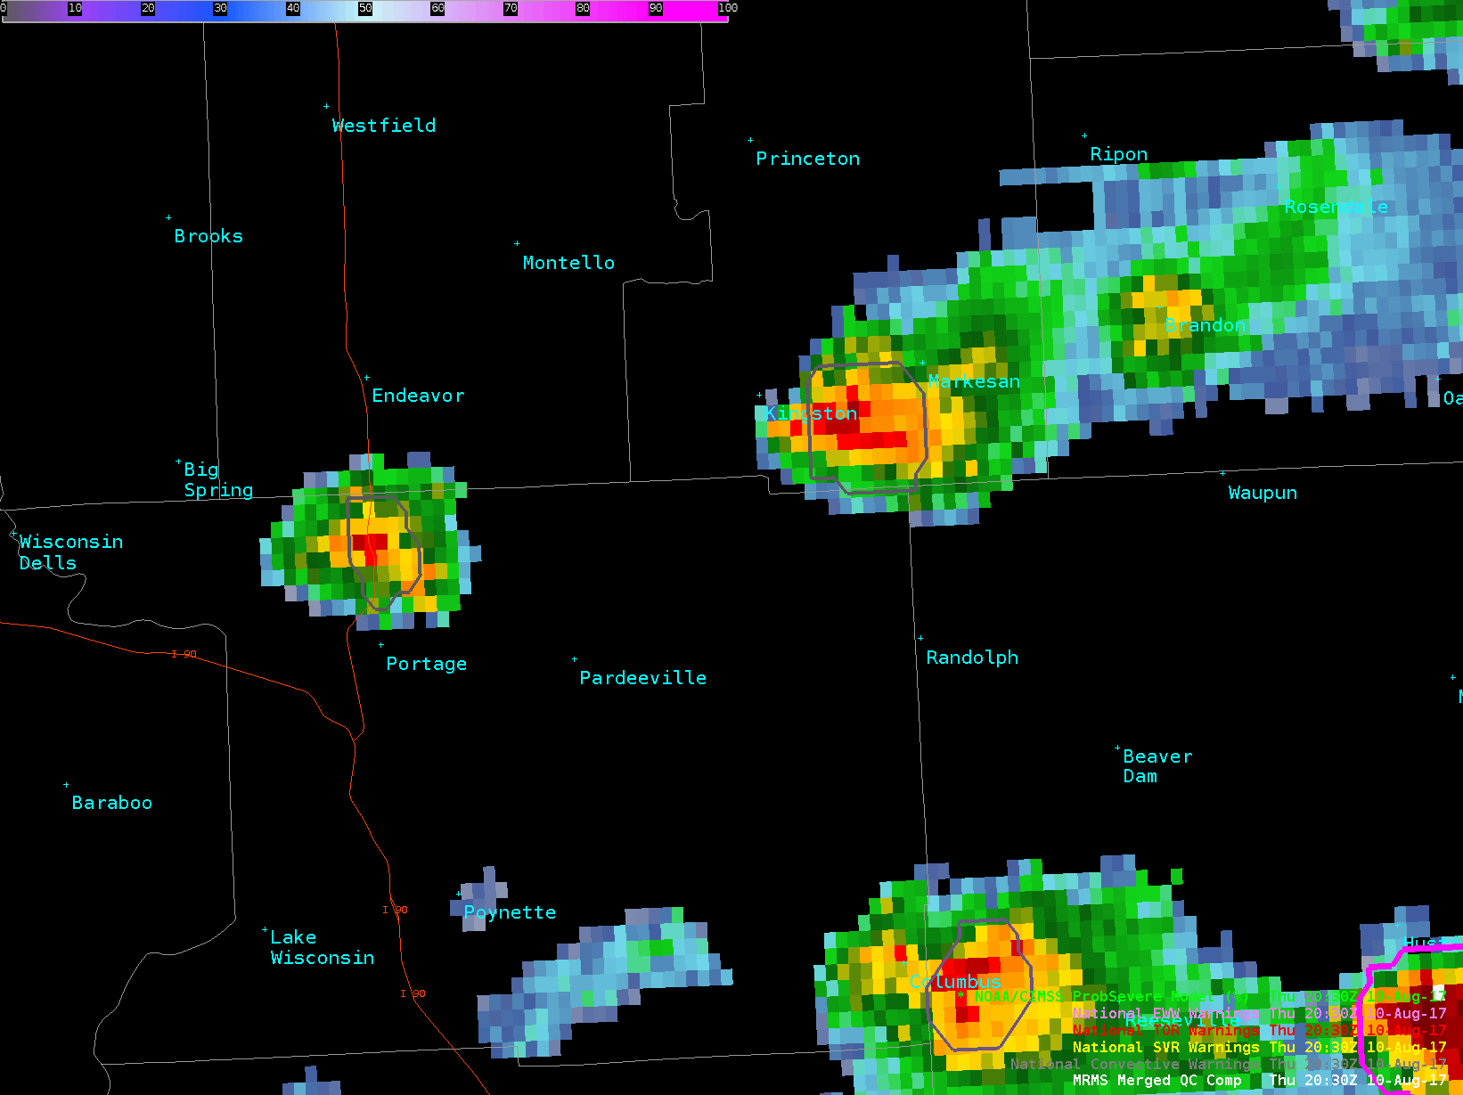
Portage to Kingston – 2030Z to 2116Z

Slide 44
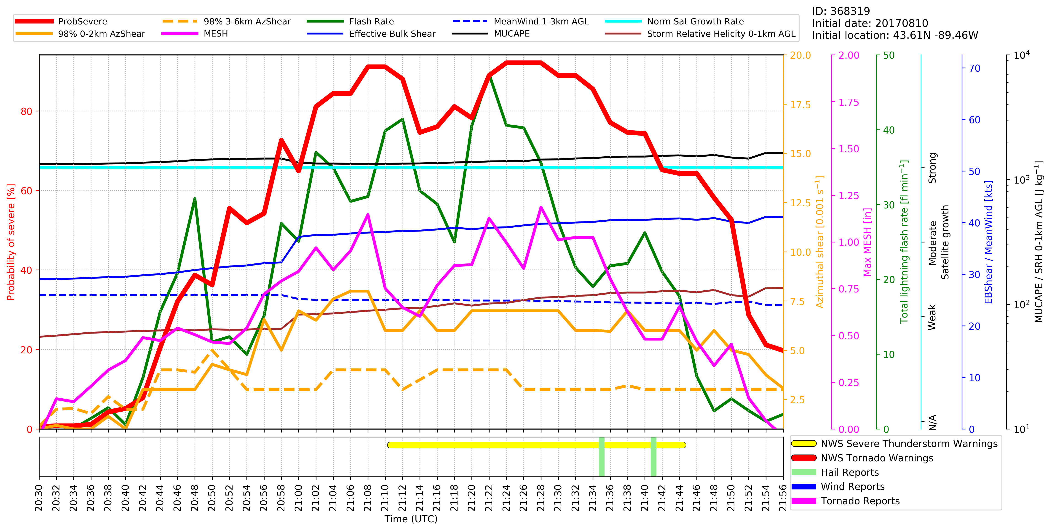
Portage to Kingston
2030Z to 2116Z
Notes:
ProbWind a little higher in this case (5-10%), compared to ProbHail

