Slide 1
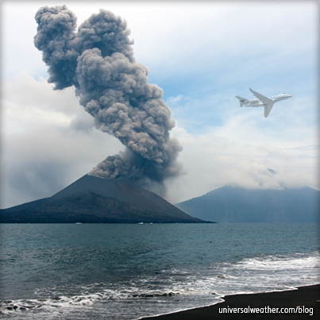
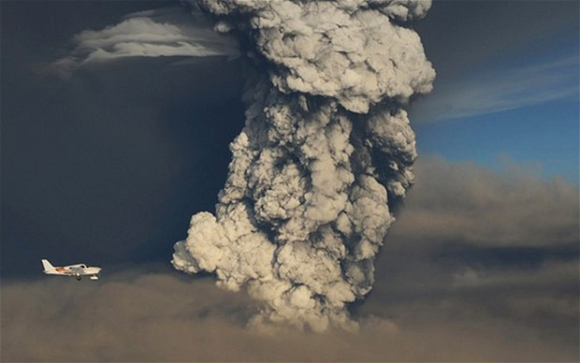
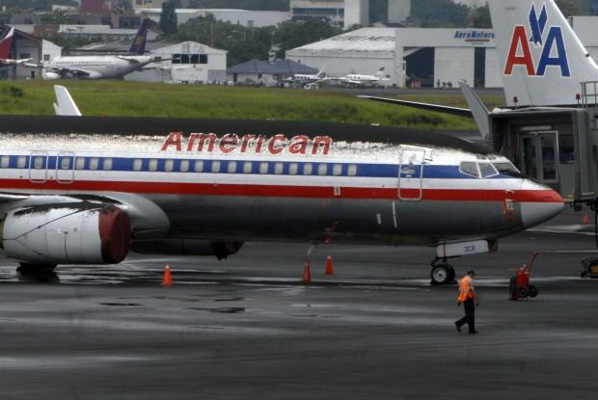
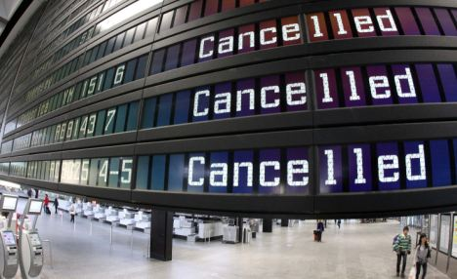
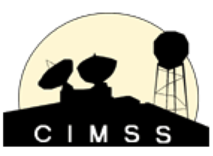
Automated Volcanic Cloud Identification, Tracking, and Characterization Using Next Generation Meteorological Satellites
Michael Pavolonis
NOAA/NESDIS/STAR
John Cintineo and Justin Sieglaff
UW-CIMSS
Notes:
-Value of spectral (improved detection and characterization)
-Value of spatial (plume detection)
-Value of temporal (early detection)
-Value of multi-sensor (SO2)

Slide 2
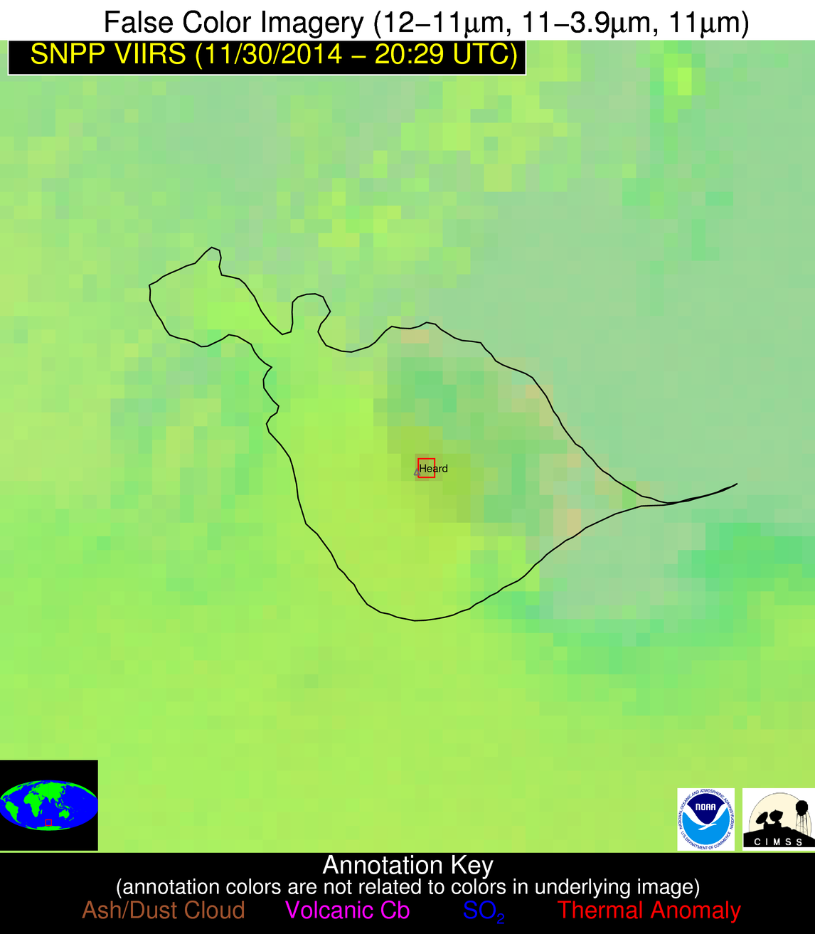
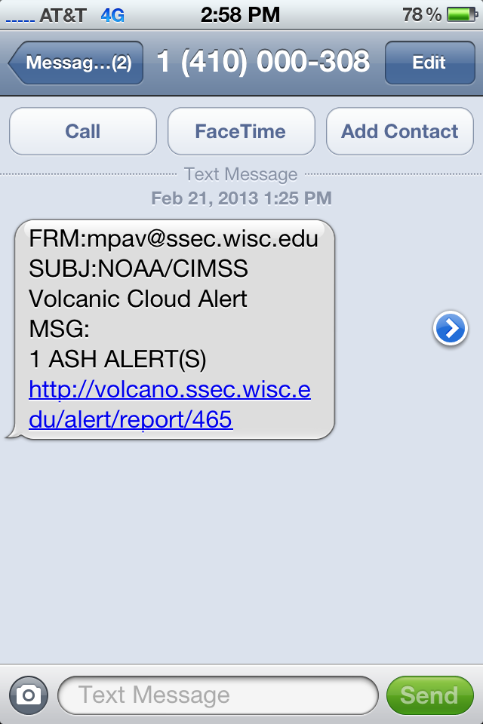
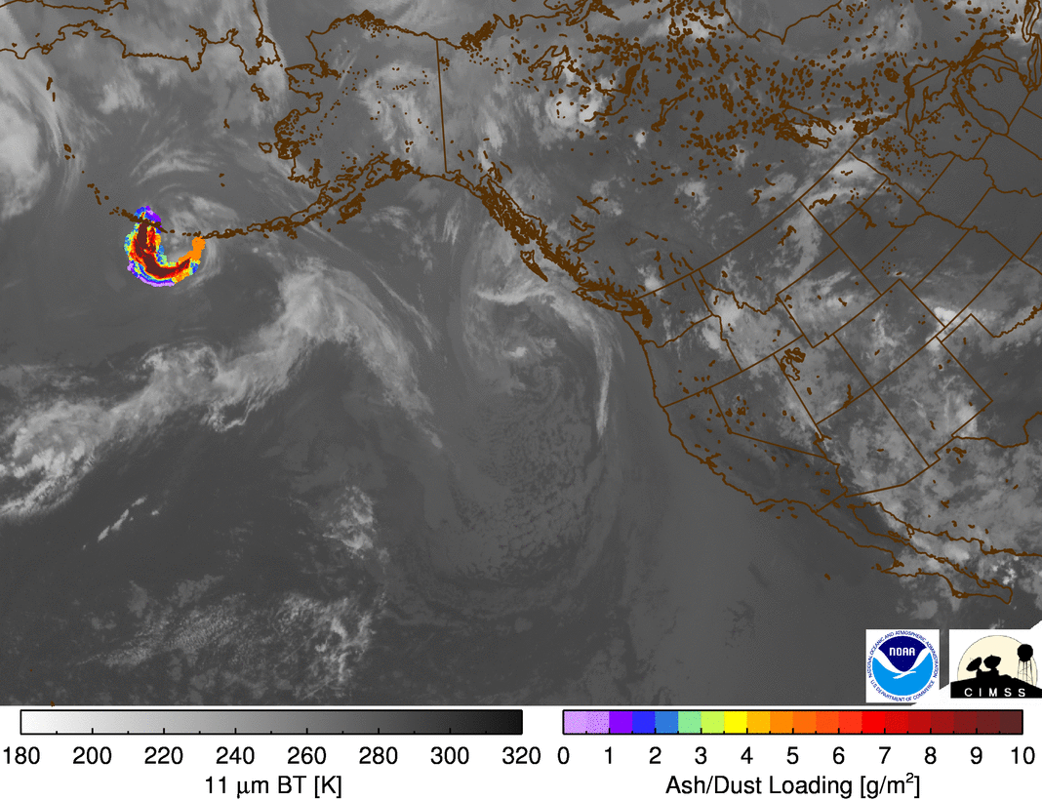
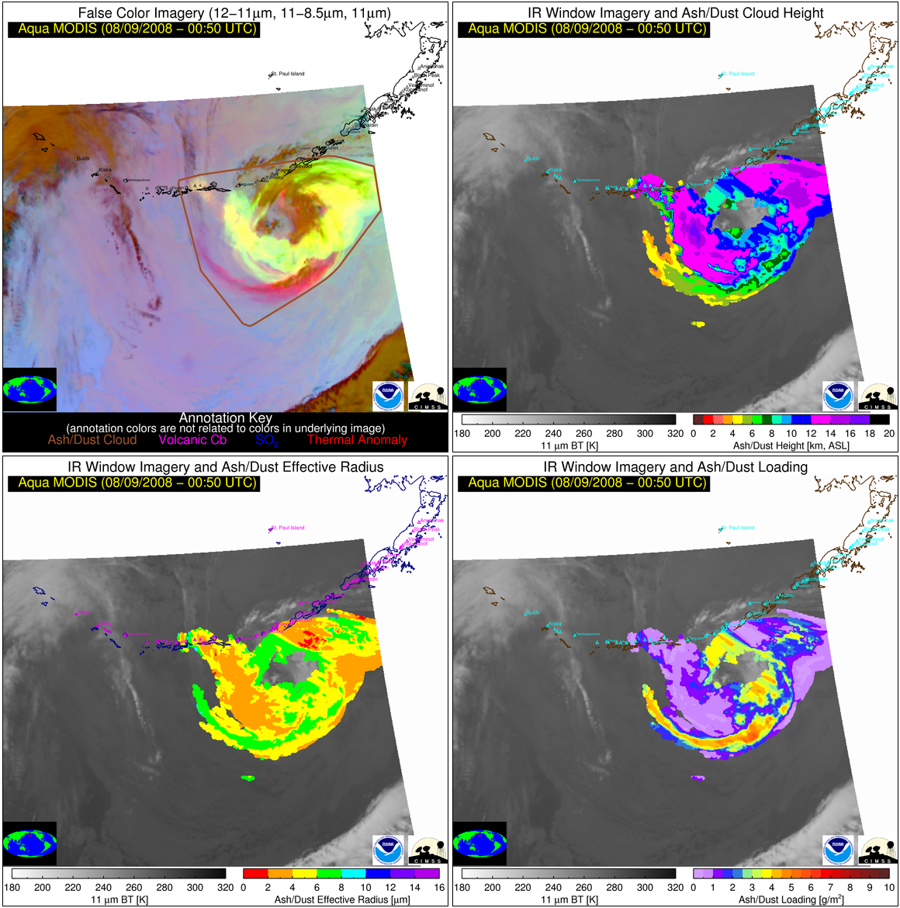
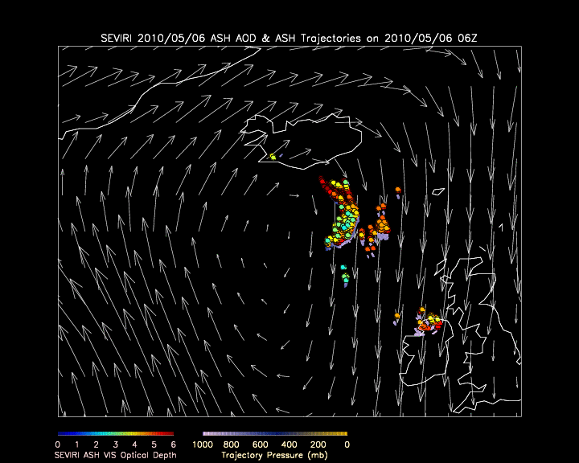
VOLcanic Cloud Analysis Toolkit (VOLCAT)
1). Unrest Alerts
2). Eruption Alerts
3). Volcanic Cloud Tracking
4). Volcanic Cloud Characterization
5). Dispersion Forecasting
Notes:
VOLCAT utilizes a large number of LEO and GEO sensors, including NextGen satellite such as GOES-16 and Suomi-NPP

Slide 3
Information Used by VOLCAT Algorithms
Spectral
Spatial
Temporal
Multi-sensor
Notes:
-No two volcanic clouds are alike and the background environment in which the clouds reside can also be complicated. Thus, full utilization of spectral, spatial, temporal, and multi-sensor capabilities is needed to adequately detect and characterize the full spectrum of volcanic clouds.

Slide 4
Information Used by VOLCAT Algorithms
Spectral
Spatial
Temporal
Multi-sensor
Notes:
Key science: derive spectral metrics that account for background conditions, where possible
Impact of nextgen satellites: More volcanic cloud relevant spectral channels

Slide 5
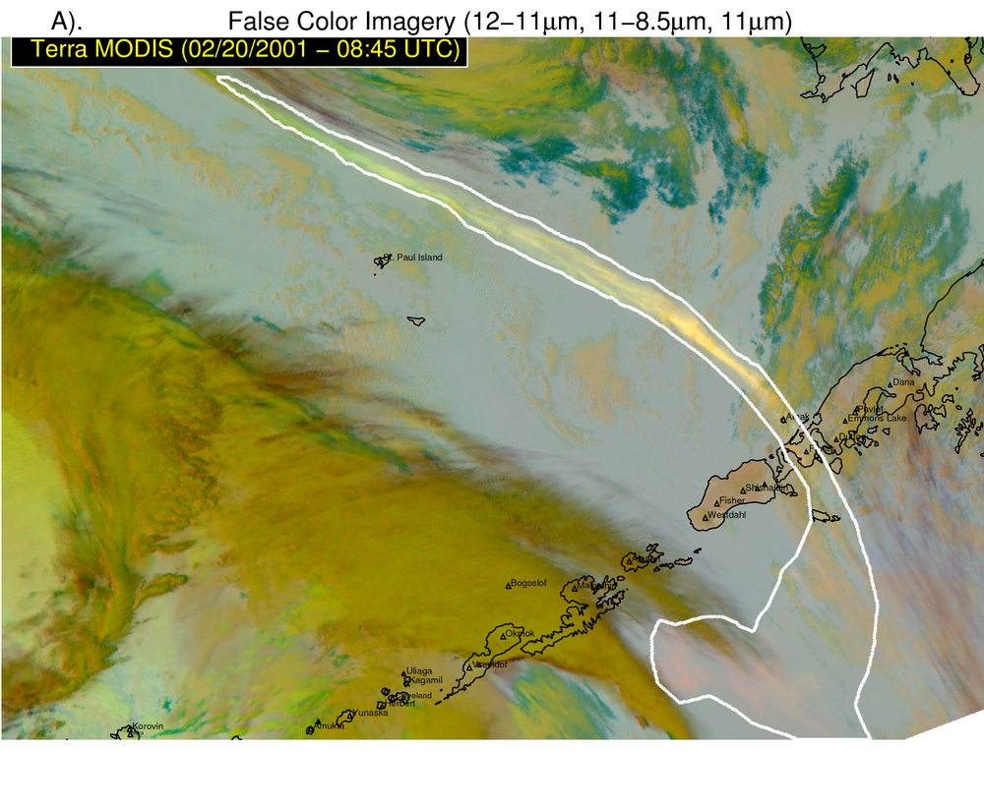
Key Science Concept: Maximize the sensitivity to volcanic ash by utilizing multi-spectral metrics that account for background conditions
Impact of NextGen Satellites: More volcanic cloud relevant spectral channels
Robust metrics such as β-ratios
Measured BT’s, BTD’s and reflectance
Pavolonis et al. 2015a
Notes:
Key science: derive spectral metrics that account for background conditions, where possible
Impact of nextgen satellites: More volcanic cloud relevant spectral channels

Slide 6
Information Used by VOLCAT Algorithms
Spectral
Spatial
Temporal
Multi-sensor
Notes:
Key science: humans rely heavily on spatial pattern recognition to identify volcanic clouds in satellite imagery, so should automated algorithms
Impact of nextgen satellites: Higher spatial resolution improves pattern recognition

Slide 7
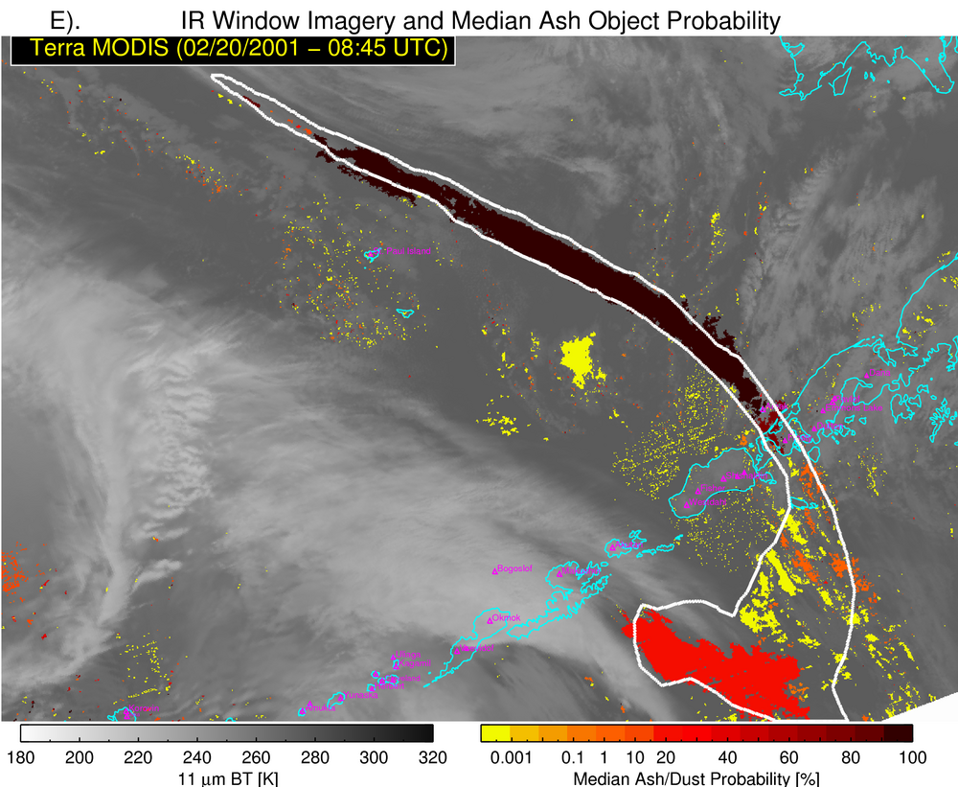
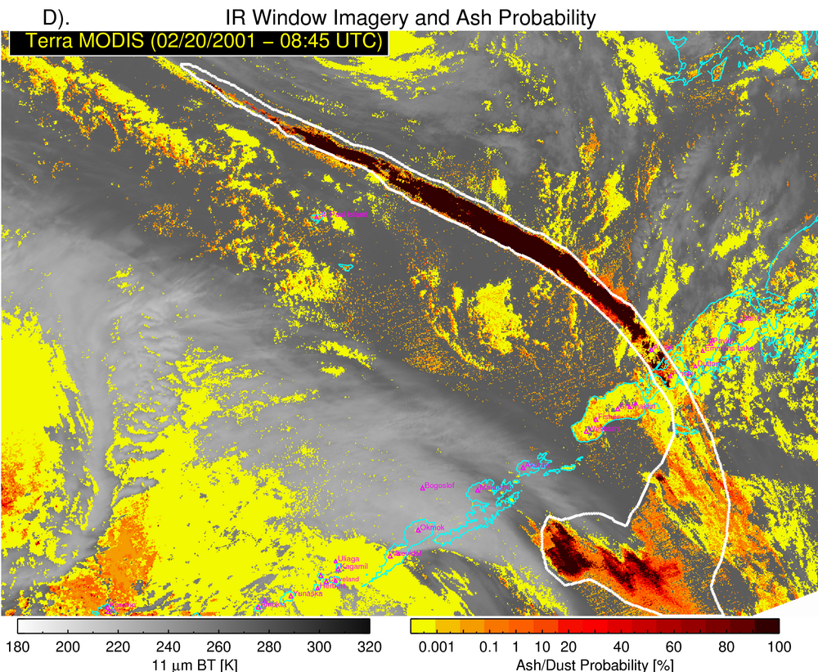
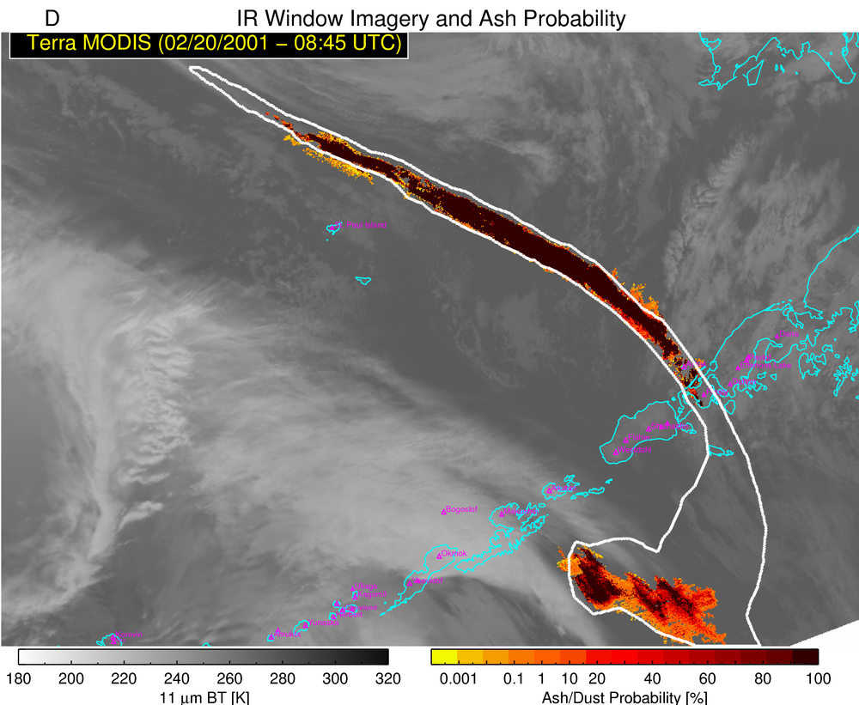
Using a Naïve Bayesian classifier trained with manually analyzed volcanic clouds, spectral metrics are used to estimate ash probability
Spatial Analysis: Cloud Objects
Weak Ash Signature
Strong Ash Signature
Weak Ash Signature
Weak Ash Signature
Pavolonis et al. (2015a);Pavolonis et al. (2015b)
Key Science Concept: Humans rely heavily on spatial pattern recognition to identify volcanic clouds, so should automated algorithms
Impact of NextGen Satellites: Higher spatial resolution aids feature recognition
Strong Ash Signature
Weak Ash Signature

Slide 8
Auto-detected eruption of Fugeo (Guatemala) with GOES-16
Cloud object based volcanic ash detection allows for reliable generation of eruption alerts, which is critical in an era with very large satellite data volumes

Slide 9
The VOLcanic Cloud Analysis Toolkit (VOLCAT)
Automated early detection of volcanic eruptions
Notes:
-given the proximity to Mexico City, even small eruptions have an impact on air traffic
-GOES-16 allows for very early detection

Slide 10
Information Used by VOLCAT Algorithms
Spectral
Spatial
Temporal
Multi-sensor
Notes:
Key science: Volcanic clouds generally emerge from volcanic vents in a sudden manner
Impact of nextgen satellites: More frequent images allows for better characterization of developing clouds

Slide 11
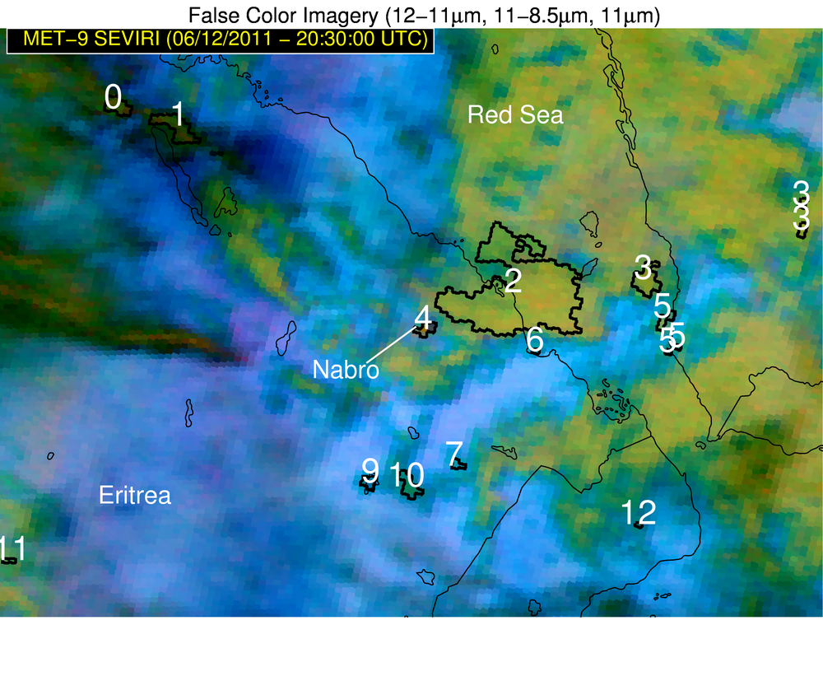
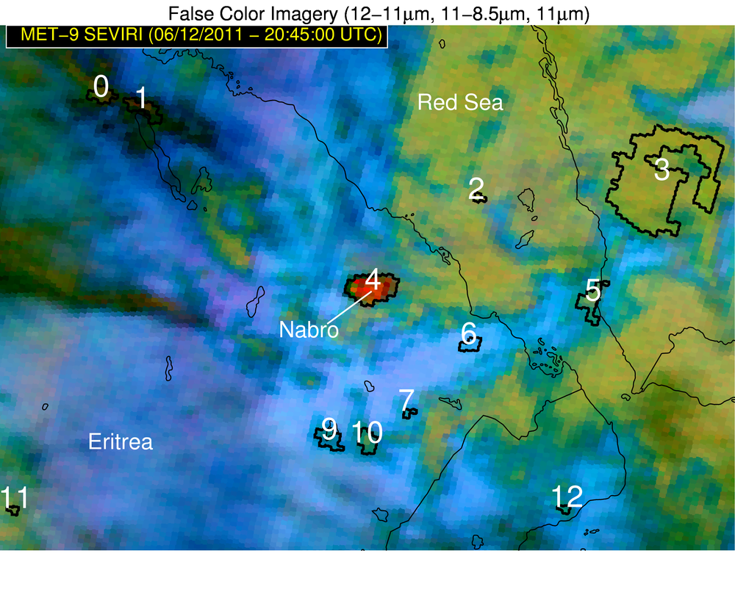
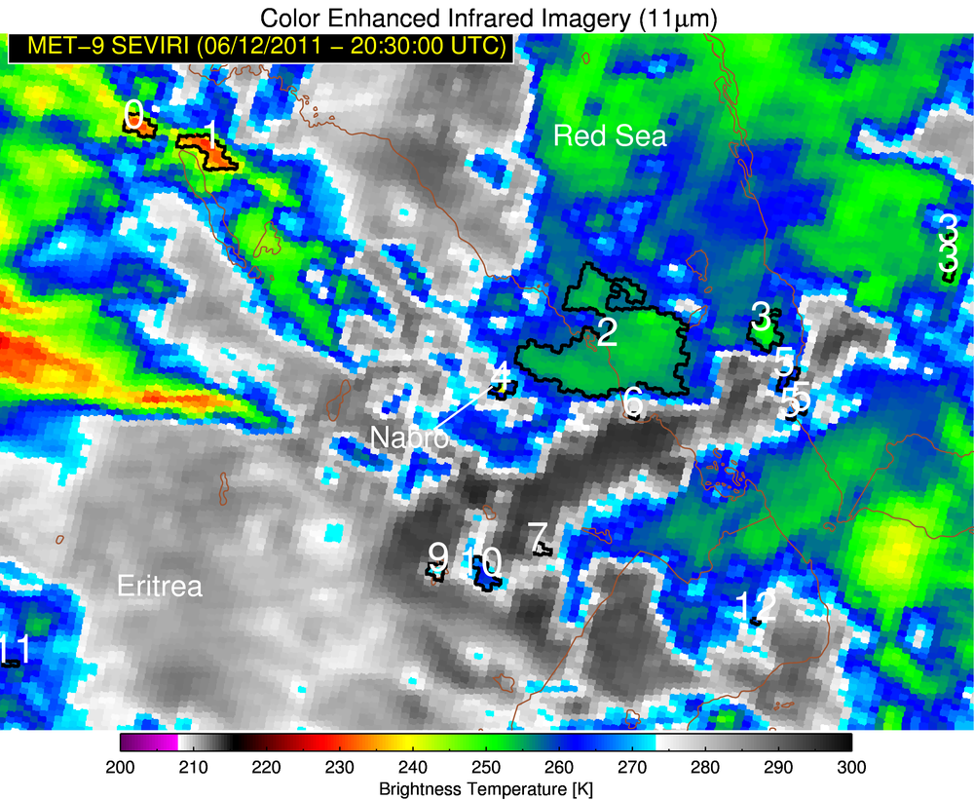
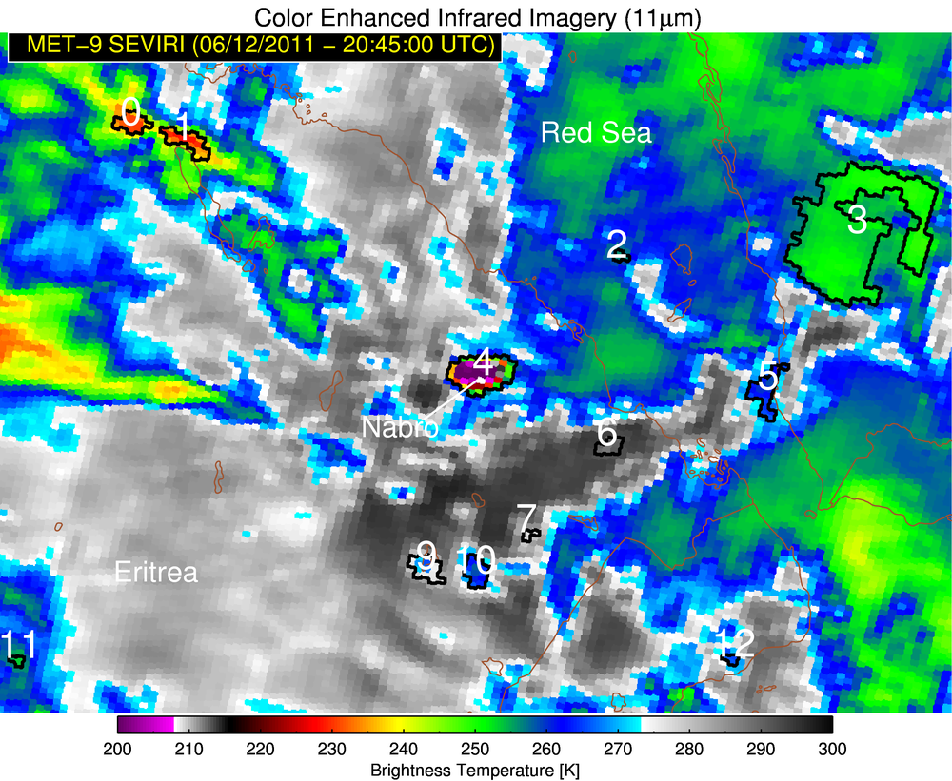
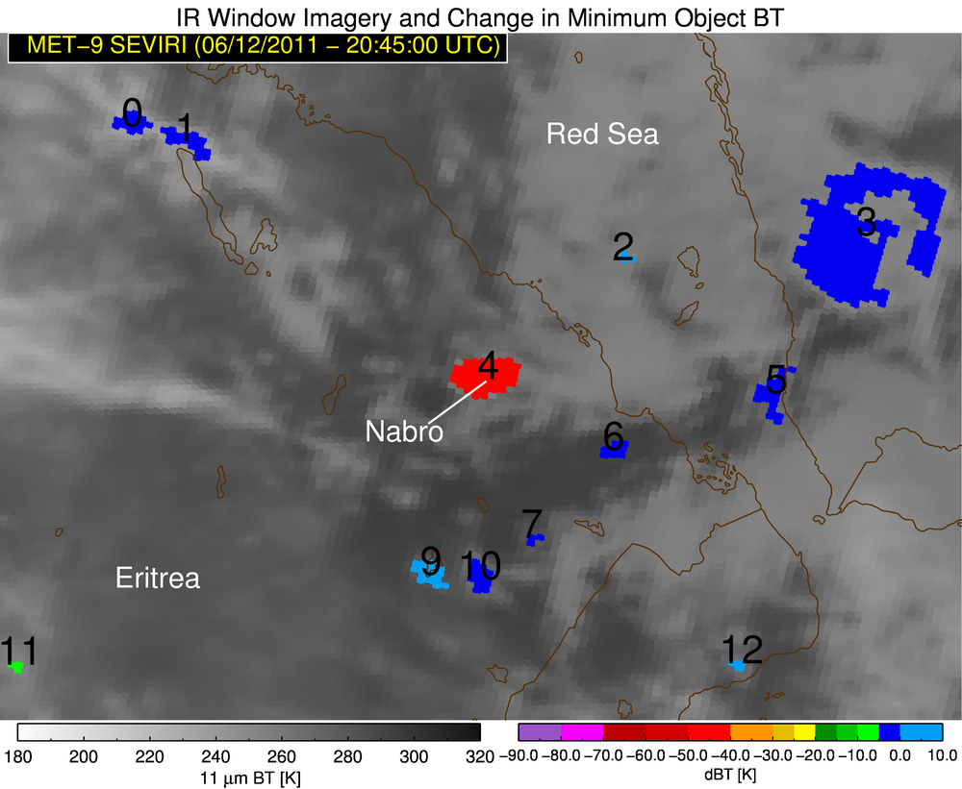
Temporal – Cloud Vertical Growth
Key Science Concept: Volcanic clouds generally emerge from volcanic vents in a sudden manner
Impact of NextGen Satellites: More frequent images allows for better characterization of developing clouds
Pavolonis et al. (2017, in prep)
Notes:
Nabro went undetected for over 7 hours as the multispectral signature was indistinguishable from meteo convection

Slide 12
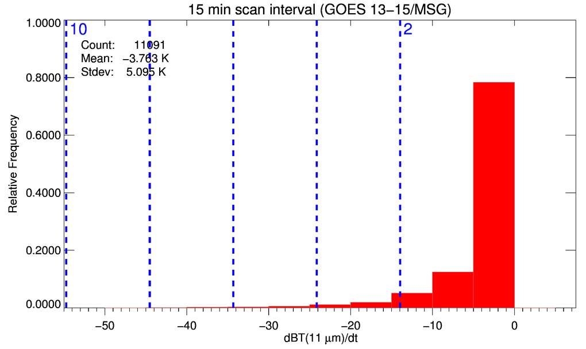
How anomalous is vertical growth of Nabro cloud given the pixel area, time interval between the images, and background cloudiness?
Nabro was an 8 standard deviation growth anomaly

Slide 13
Cloud growth based auto-detection of Sabancaya (Peru) eruption with 5 minute GOES-16 data
The more frequent the images, the better the detection capabilities (accuracy and timeliness)

Slide 14
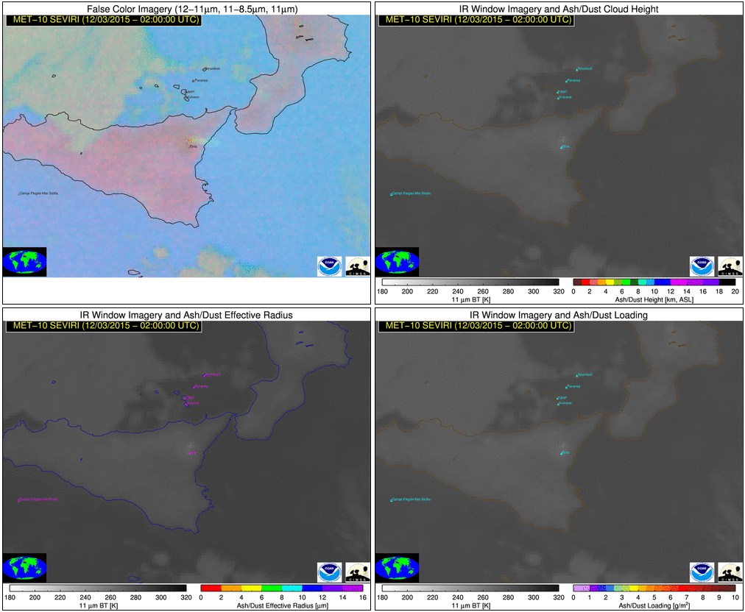
~7 sdev anomaly
Ash Height
Pavolonis et al. 2013
Ash Effective Radius
Ash Mass Loading
Notes:
-Mount Etna (Sicily) on December 3, 2015
-Temporal information is not only used for initial eruption detection, but also to track the cloud in time and improve its characterization
-Several other explosive events from 2013 and 2015 were also detectable using this methodology

Slide 15
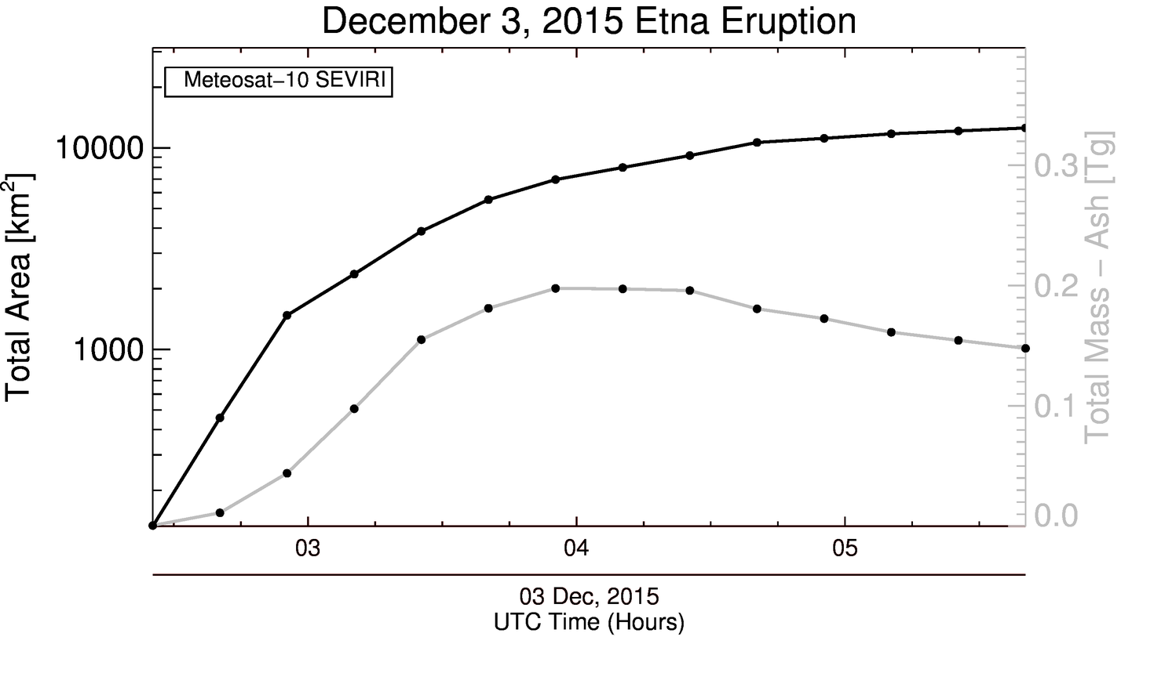
The time evolution of certain volcanic cloud properties (e.g. area) can be used to derive eruption source parameters required to constrain dispersion models
Notes:
-Use of feature tracking allows for auto-generation of volcanic cloud time series, which are useful for deriving the eruption source parameters needed by dispersion models

Slide 16
Information Used by VOLCAT Algorithms
Spectral
Spatial
Temporal
Multi-sensor

Slide 17
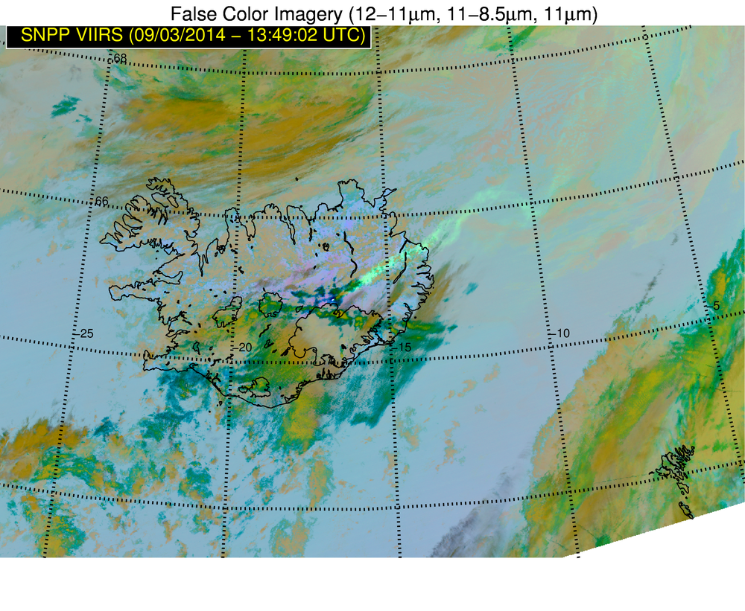
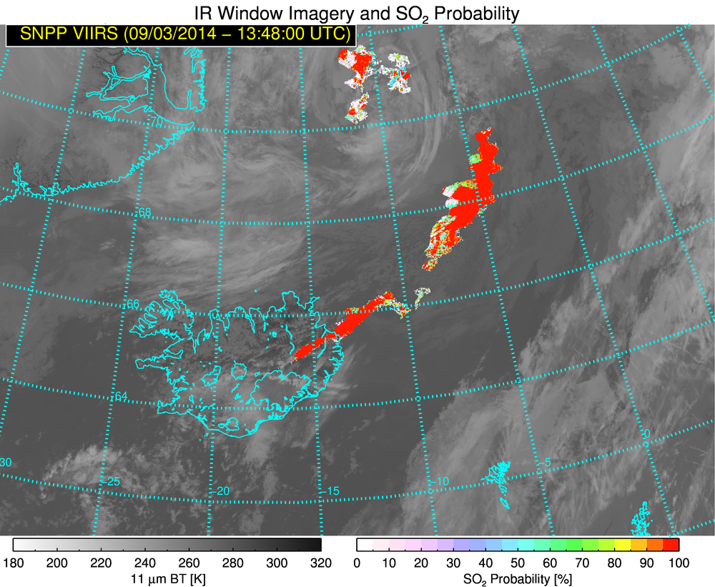
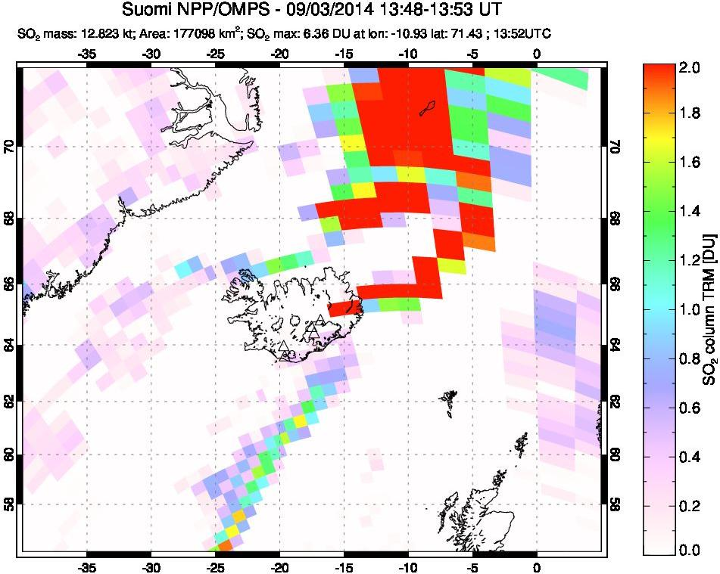
Infrared (high spectral + high spatial)
Application to SO₂
Improved SO₂ Products
SO₂ Probability, Loading, and Height
+
=
UV
Key Science Concept: No single sensor is perfectly optimized to detect and characterize all types of volcanic clouds
Impact of NextGen Satellites: Hyperspectral UV and IR greatly aid in volcanic cloud (including SO₂) detection and characterization

Slide 18
Conclusions
VOLCAT utilizes spectral, spatial, and temporal information to detect and characterize volcanic clouds captured by LEO and GEO satellites
Much improved volcanic cloud detection and characterization is possible with next generation satellites
Automated extraction of information is critical in this still evolving era of very large satellite data volumes
VOLCAT products are generated at the University of Wisconsin and are not currently part of the planned operational GOES-R product suite

Slide 19
References
Pavolonis, M. J., W. F. Feltz, A. K. Heidinger, and G. M. Gallina, 2006: A daytime complement to the reverse absorption technique for improved automated detection of volcanic ash. J.Atmos.Ocean.Technol., 23, 1422-1444.
Pavolonis, M. J., 2010: Advances in Extracting Cloud Composition Information from Spaceborne Infrared Radiances-A Robust Alternative to Brightness Temperatures. Part I: Theory. Journal of Applied Meteorology and Climatology, 49, 1992-2012, doi:10.1175/2010JAMC2433.1 ER.
Pavolonis, M., A. Heidinger, and J. Sieglaff, 2013: Automated retrievals of volcanic ash and dust cloud properties from upwelling infrared measurements, J. Geophysical Research, 118(3), 1436-1458.
Pavolonis, M., J. Sieglaff, and J. Cintineo (2015a), Spectrally Enhanced Cloud Objects (SECO): A Generalized Framework for Automated Detection of Volcanic Ash and Dust Clouds using Passive Satellite Measurements, Part I: Multispectral Analysis, Journal Geophysical Research, 120, 7813-7841.
Pavolonis, M., J. Sieglaff, and J. Cintineo (2015b) Spectrally Enhanced Cloud Objects (SECO): A Generalized Framework for Automated Detection of Volcanic Ash and Dust Clouds using Passive Satellite Measurements, Part II: Cloud Object Analysis and Global Application, Journal Geophysical Research, 120, 7842-7870.

Slide 20
Extra Slides

Slide 21
Number of cloud objects processed per day: ~3 million
Number of growing cloud objects processed per day: 1 million
Average number of false alerts per day: 3-4
Notes:
Globally, the CGA algorithm processes over 3 million cloud objects near volcanoes each day, out of which about 1 million exhibit vertical growth between two consecutive image times. When assessed globally, there are about 2 false alerts each day on average. Thus, less than 1 out of every million objects processed results in a false alert. While some modest improvements are possible, decreasing the global false alert rate to zero is impossible.

