Slide 1
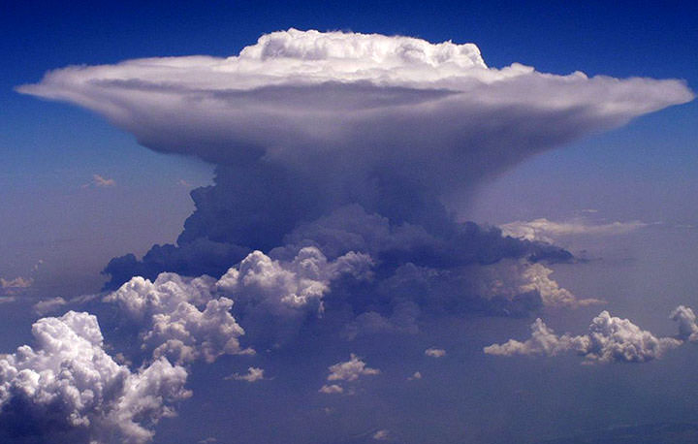
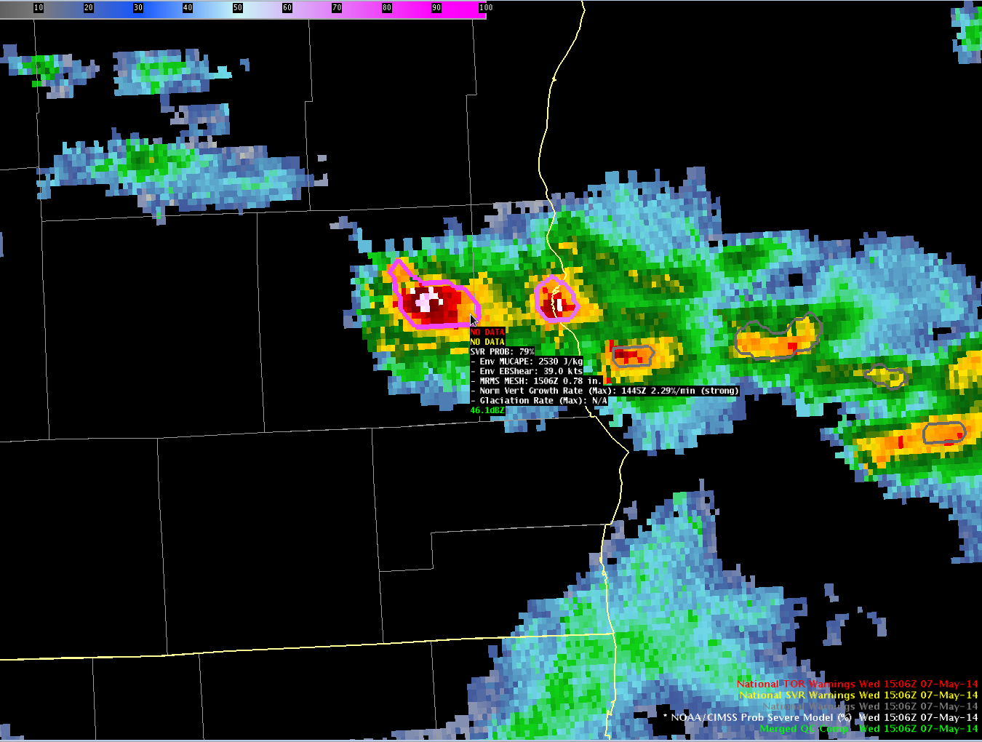
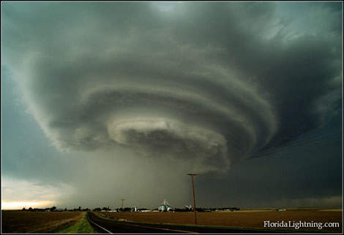
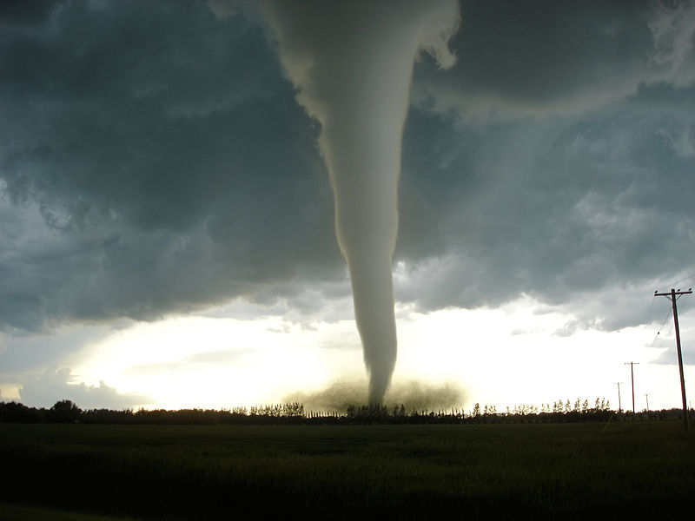


Next Generation Geostationary Satellite Observations in a Multi-Sensor Severe Weather Nowcasting Tool
EUMETSAT Satellite Conference, Rome, Italy
4 October 2017
John Cintineo (UW-CIMSS)
Michael J. Pavolonis (NOAA/NESDIS)
Justin Sieglaff (UW-CIMSS)
Jason Brunner (UW-CIMSS)
Dan Lindsey (NOAA/NESDIS)

Slide 2
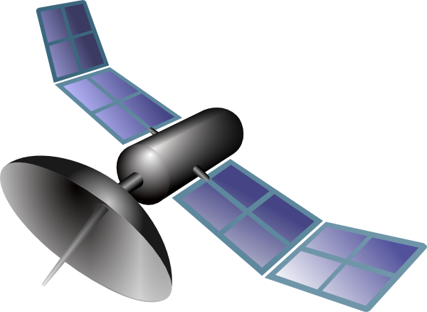
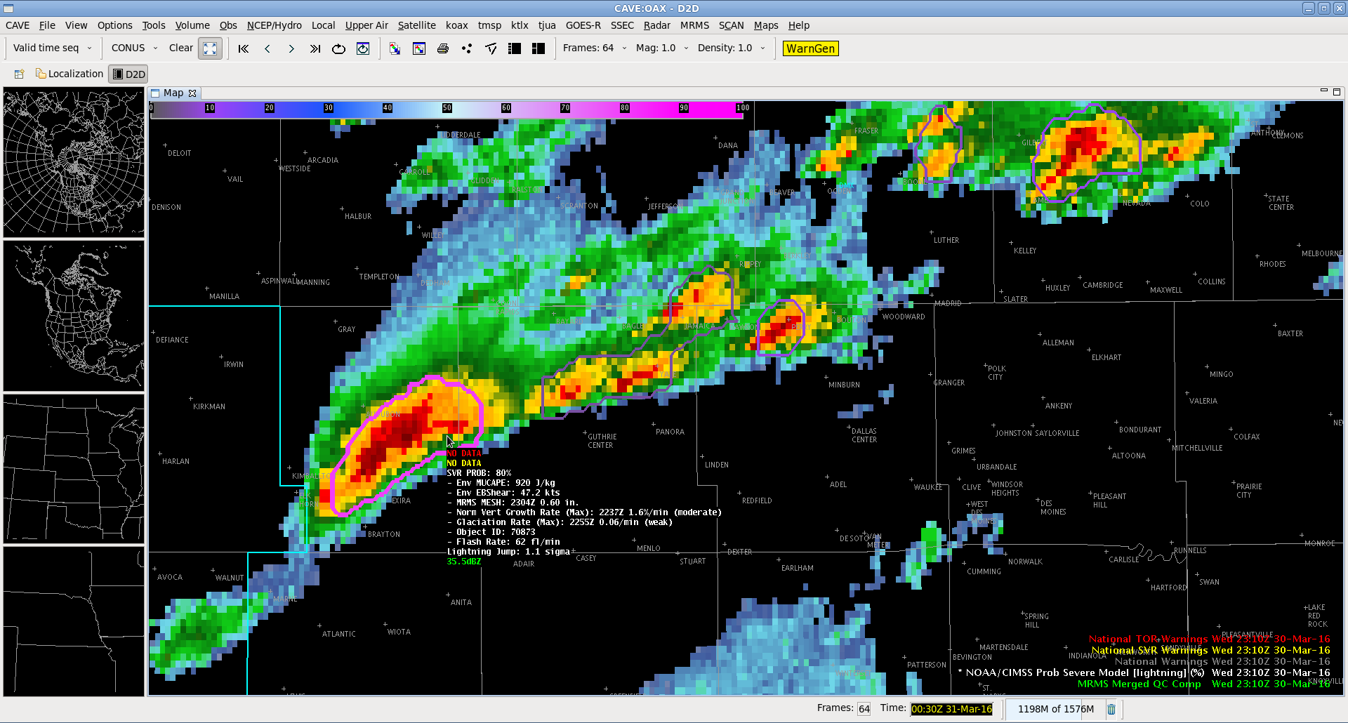

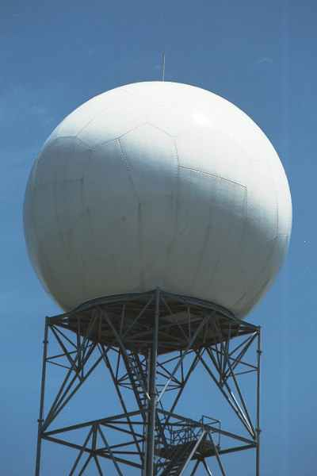
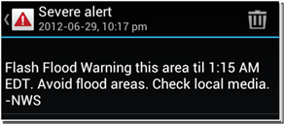
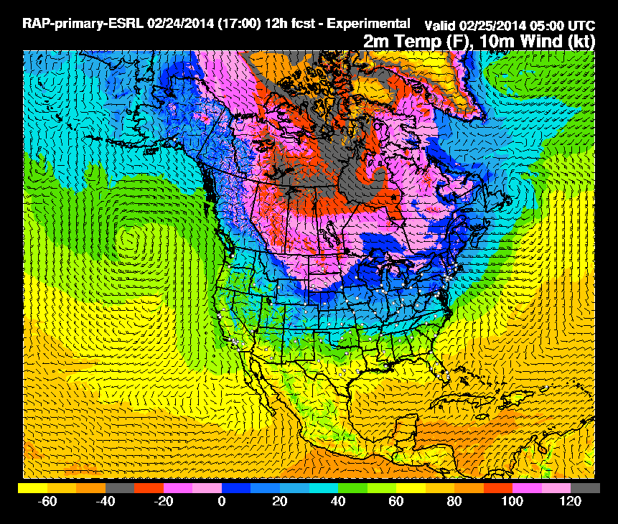
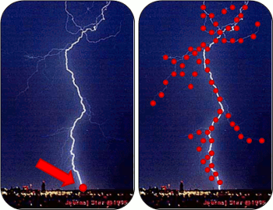
Motivation: convert “Big Data” into
actionable information for weather hazards
Images are from NOAA, NASA, or public domain
Notes:
High-resolution streaming data from a variety of sources

Slide 3
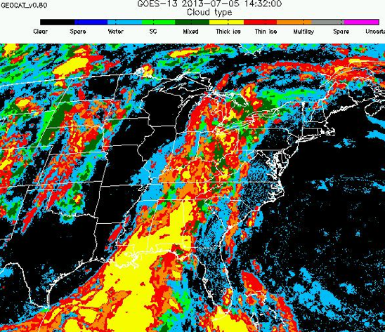
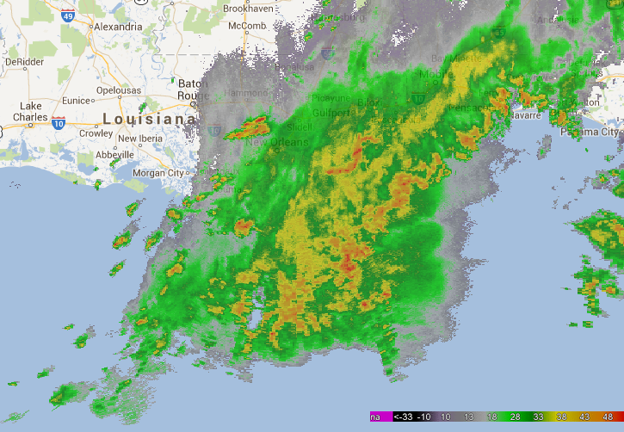
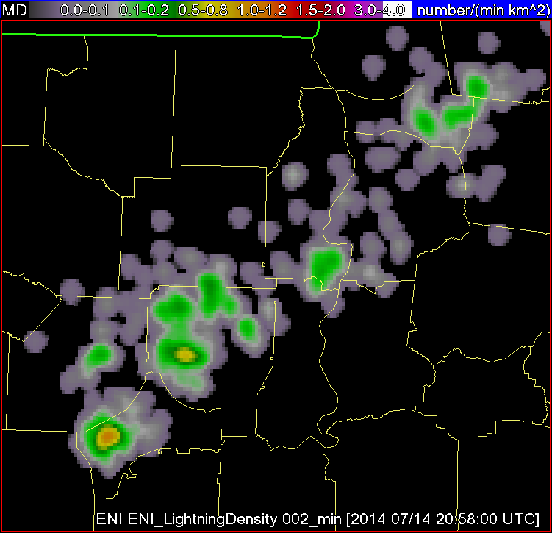
NOAA / CIMSS ProbSevere model
High-resolution NWP Data
Satellite Imagery and Derived Products
Radar Imagery and Derived Products
Total Lightning
evolution of cumulus to cumulonimbus
storm tracking and hydrometeor properties
storm electrification
storm environment
Probability a thunderstorm will produce severe weather in the future (up to 90 minutes)
Images are from NOAA, UW-CIMSS, and OU-CIMMS
Notes:
ProbSevere is a naïve Bayesian model, that is, a statistical model, which integrates data from multiple observation platforms to predict the probability that a thunderstorm will produce severe weather in the near-term (hail ≥25mm diameter, wind gust ≥ 50 kts, tornado). ProbSevere incorporates real-time automated object identification and tracking in both ground-based weather radar reflectivity imagery and satellite imagery. From within the bounds of those identified objects, or storms, data are spatially extracted and certain predictors are computed. Specifically, these predictors are extracted and derived from high-res NWP data, satellite cloud products, radar imagery, and ground-based total lightning data

Slide 4
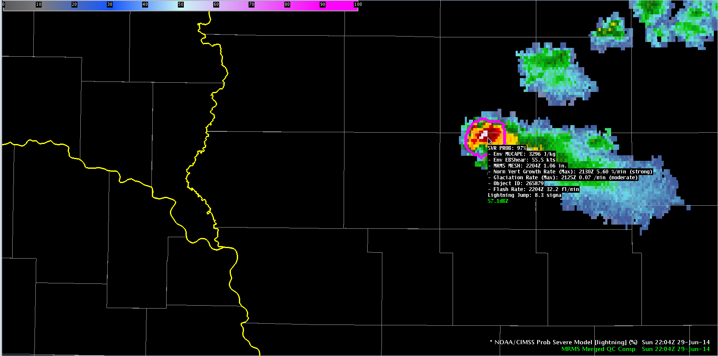
ProbSevere model display
Model output are shapefiles contoured around radar storm cells.
Sampling offers readout of model probability as well as each model input.
Notes:
This is a snapshot of ProbSevere output within a system that the U.S. NWS uses for warning decision making and issuing official products. The satellite predictors computed within the satellite-tracked objects are shared with overlapping radar-identified objects, thereby giving forecasters a more complete picture of how storms evolved from infancy to maturity. Sampling the storm shows forecasters the severe probability, as well as each predictor value. I’ll explain these satellite predictors next.

Slide 5
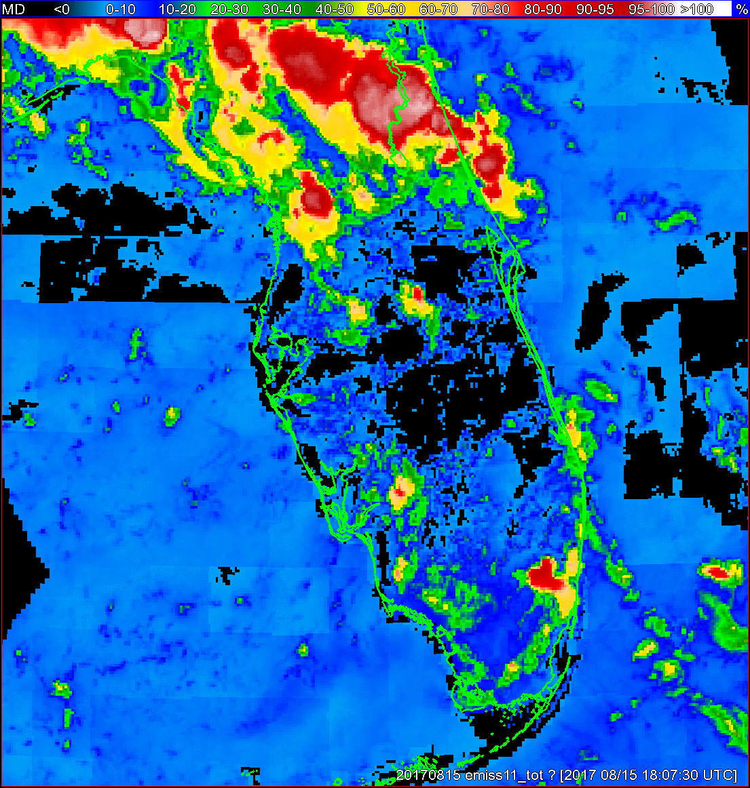
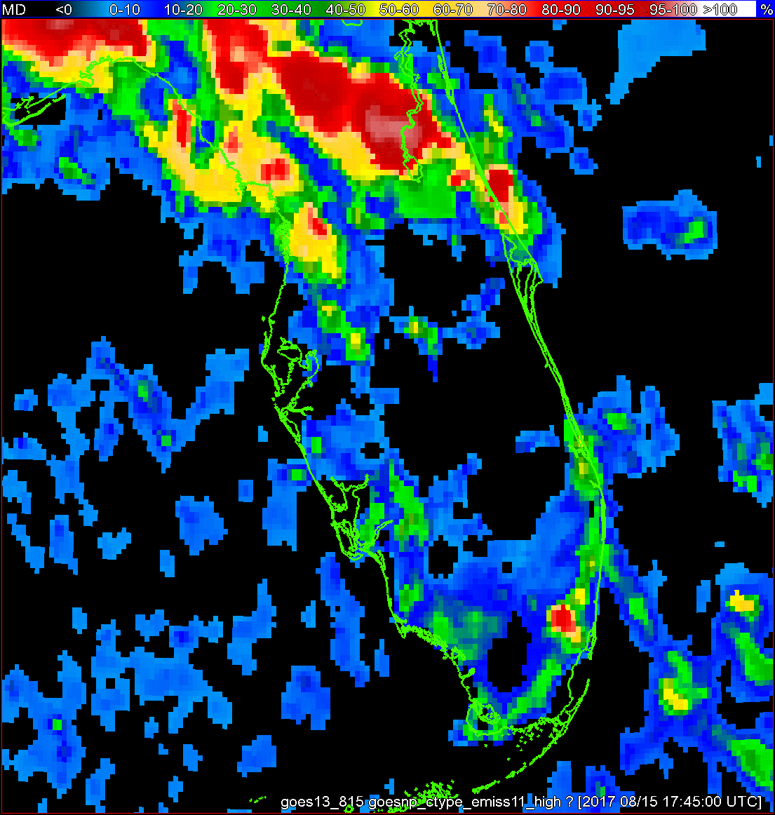
11-µm top-of-troposphere emissivity (ε_{tot})
(Pavolonis 2010)
Emissivity a cloud would have if placed at the tropopause
Reduces impact of surface features identified as clouds (compared to BT)
Less sensitive to depth of troposphere (compared to BT)
Used for satellite object identification and tracking
Predictor: maximum rate of change in ε_{tot} in satellite cloud object (∆ε_{tot}).
  “Normalized vertical growth rate”
Storms with stronger vertical growth rates tend to be more severe (Cintineo et al. 2013)
GOES-16
GOES-13

Slide 6
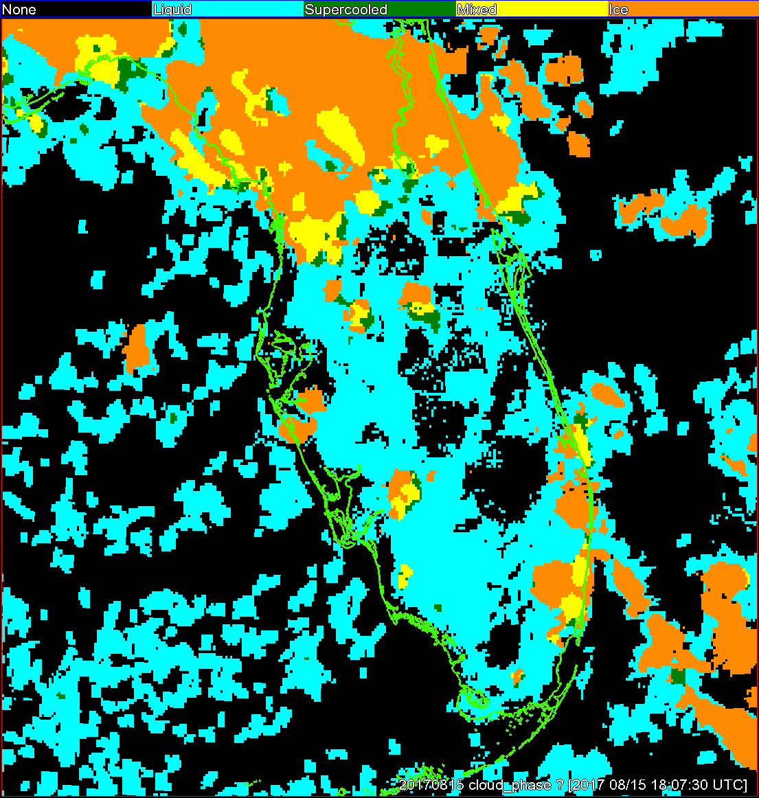
Cloud-top phase
Phase of water at top of cloud (warm liquid, supercooled, mixed phase, ice)
Storms that convert from liquid → ice faster tend to be more severe (Cintineo et al. 2013)
Infer updraft strength
Predictor: maximum rate of change in cloud-top phase (∆ice) in satellite cloud object
  “Glaciation rate”

Slide 7
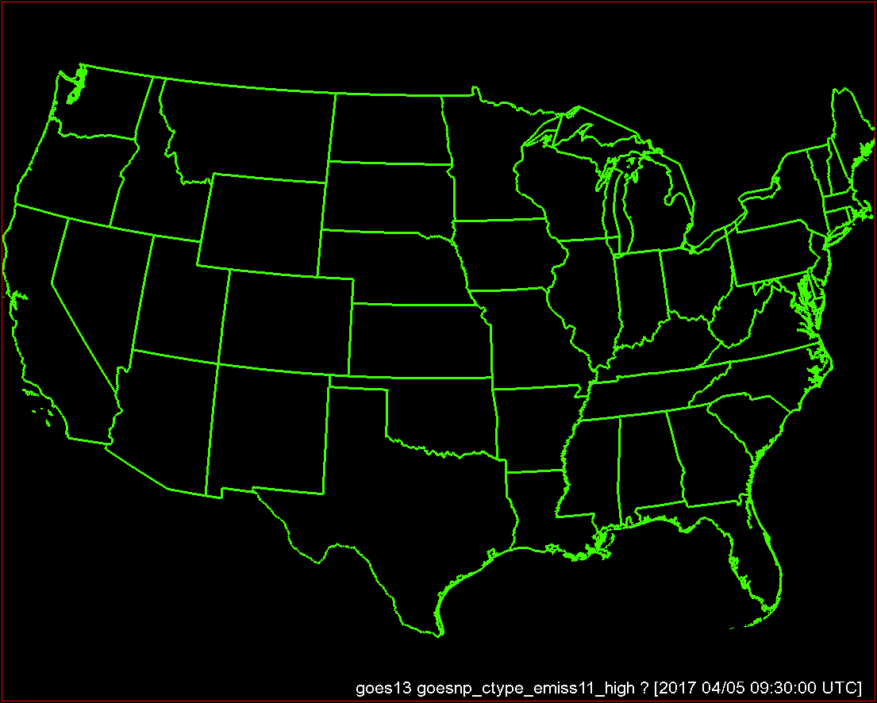
Focus on developing storms along
Mississippi / Alabama border

Slide 8
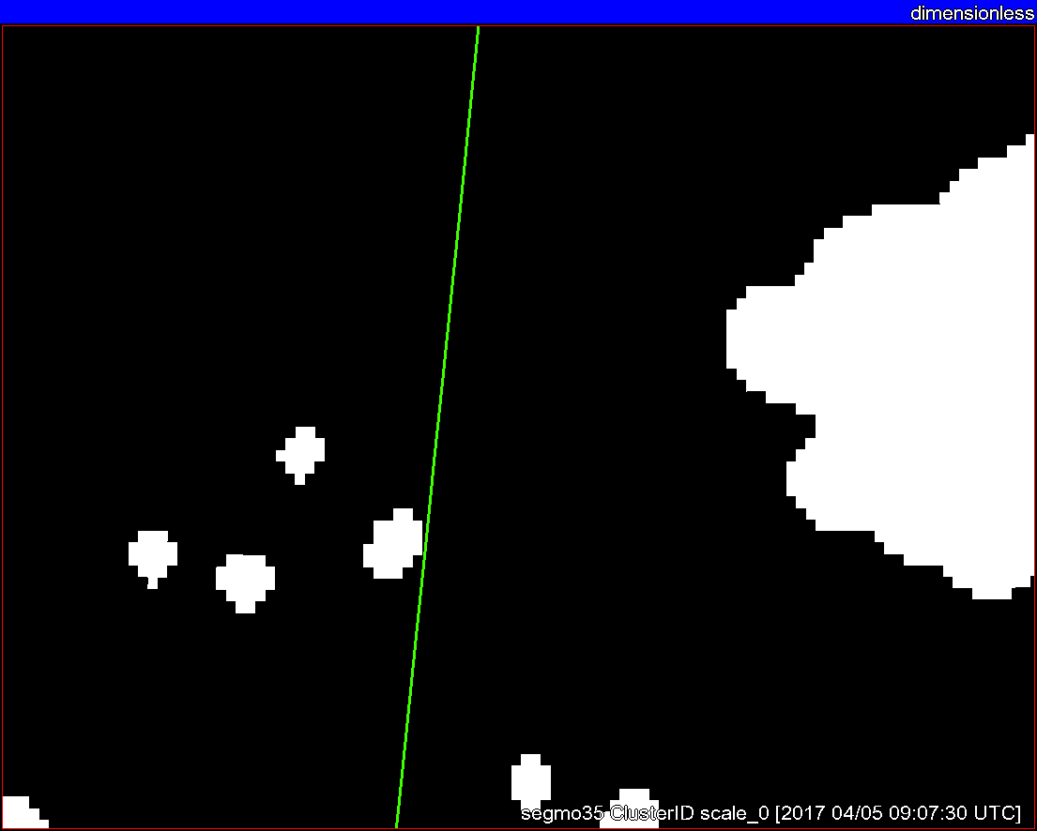
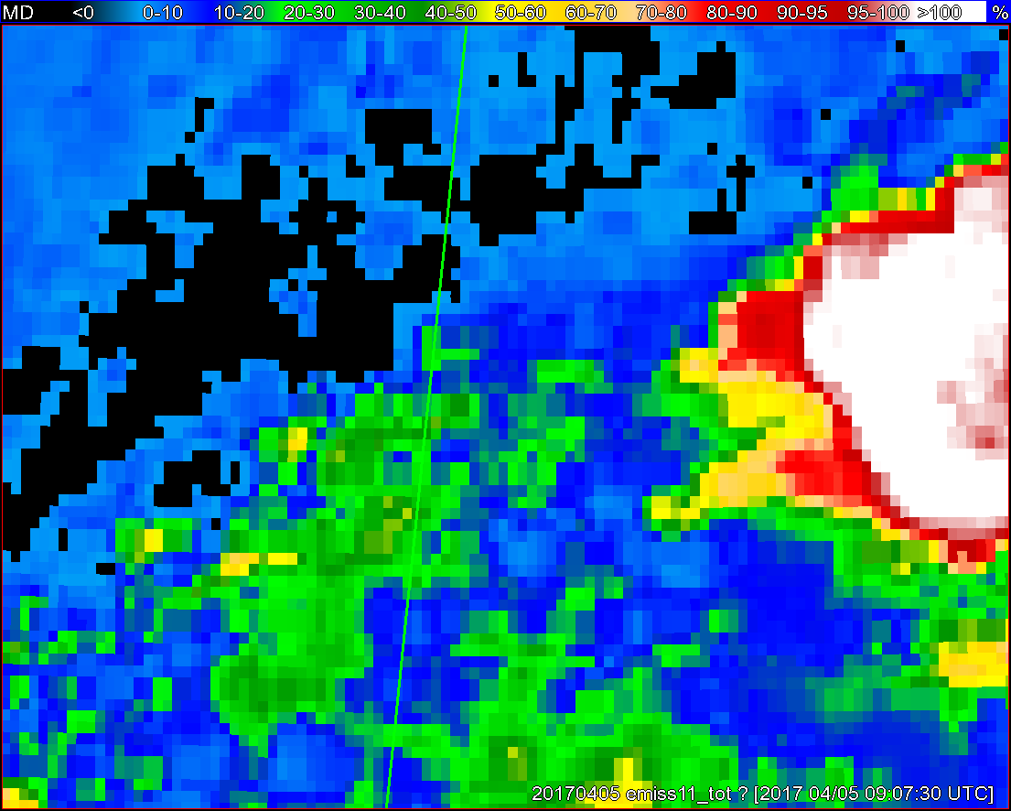
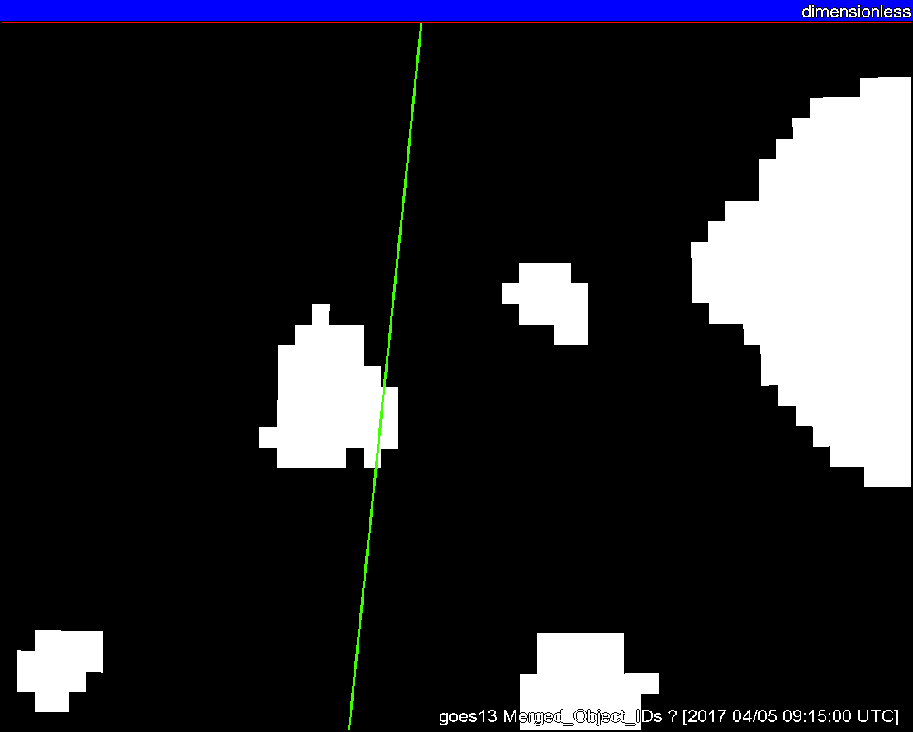
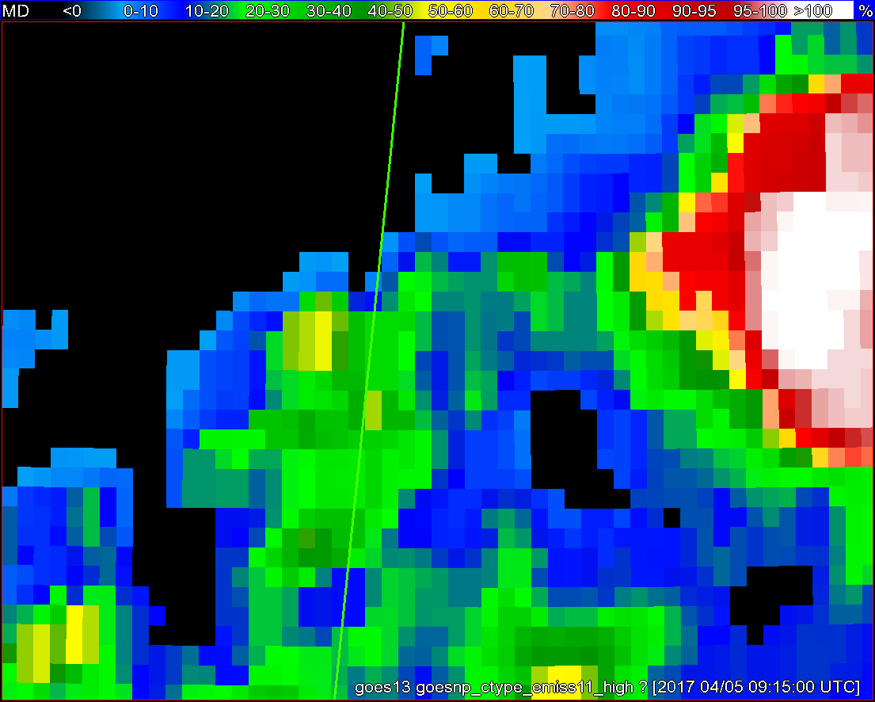
Objects
11-µm top-of-troposphere emissivity
GOES - 16
GOES - 13

Slide 9
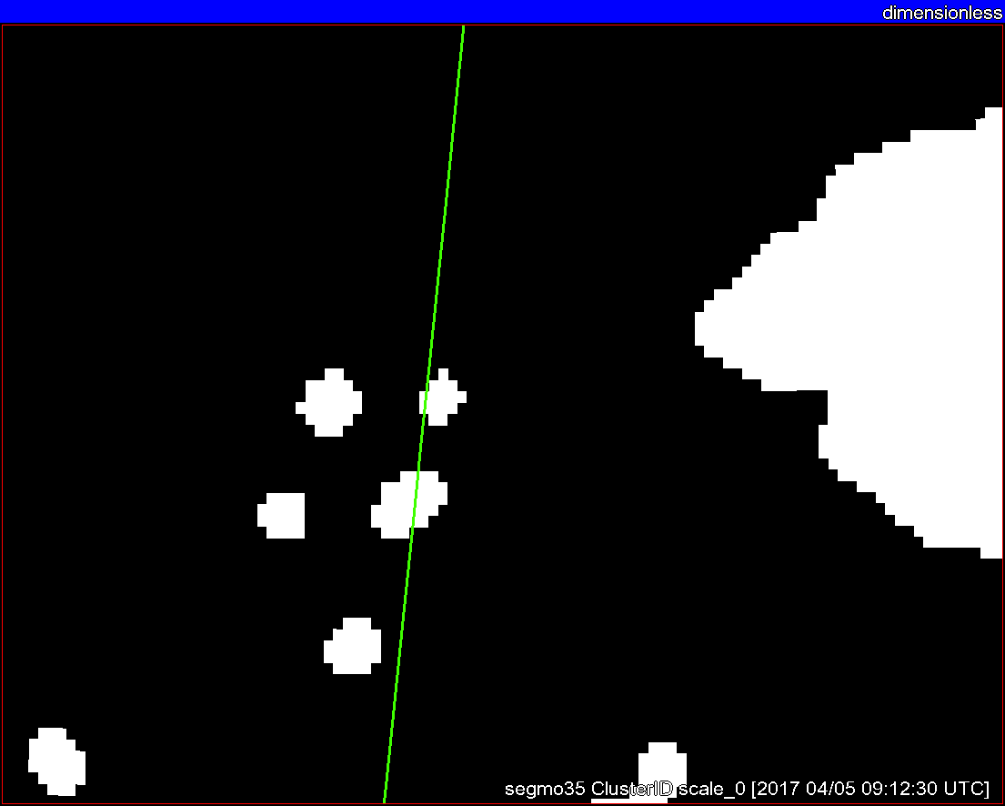
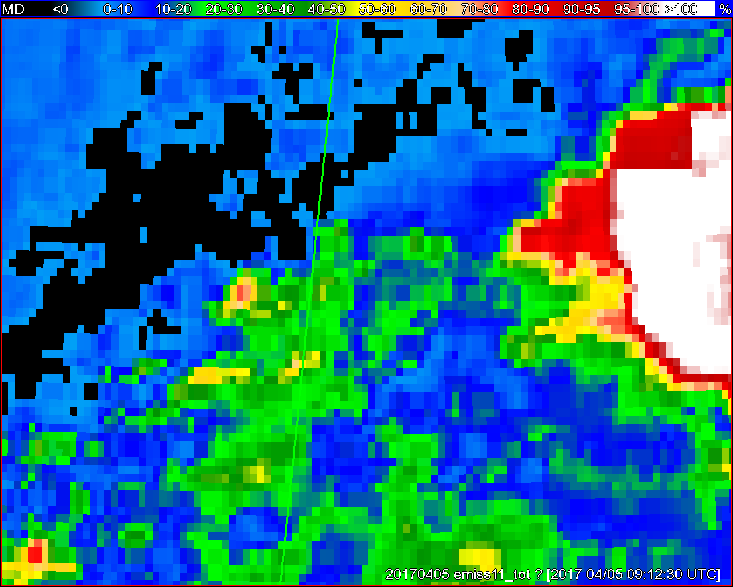
Objects
11-µm top-of-troposphere emissivity
GOES - 16
GOES - 13

Slide 10
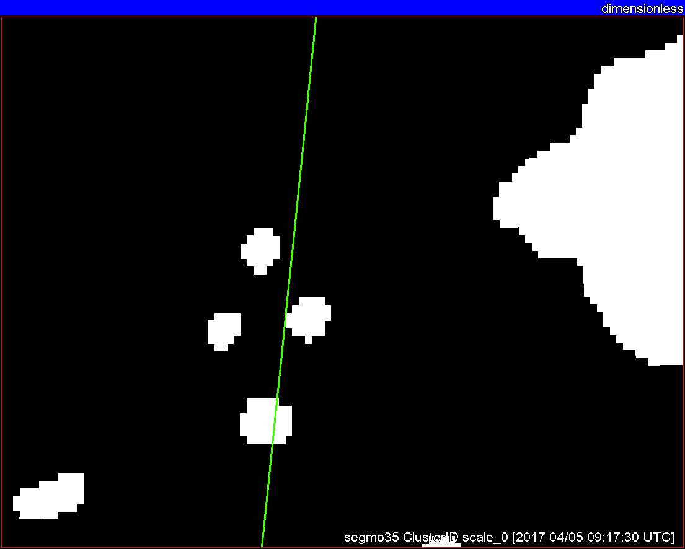
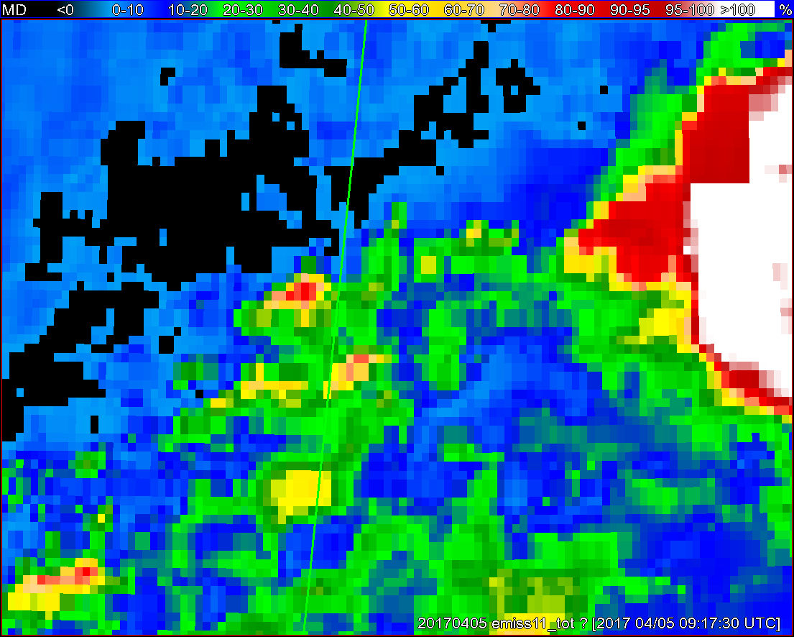
Objects
11-µm top-of-troposphere emissivity
GOES - 16
GOES - 13

Slide 11
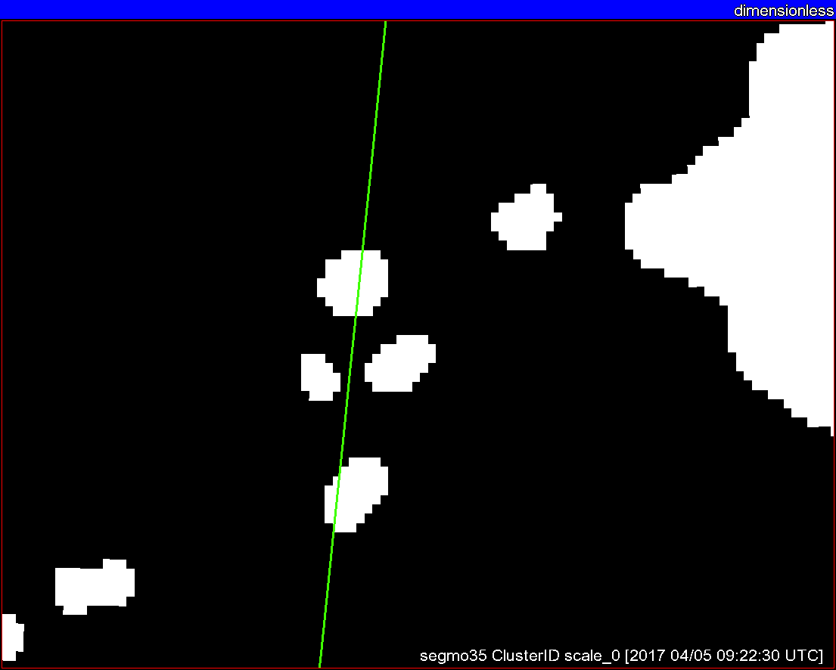
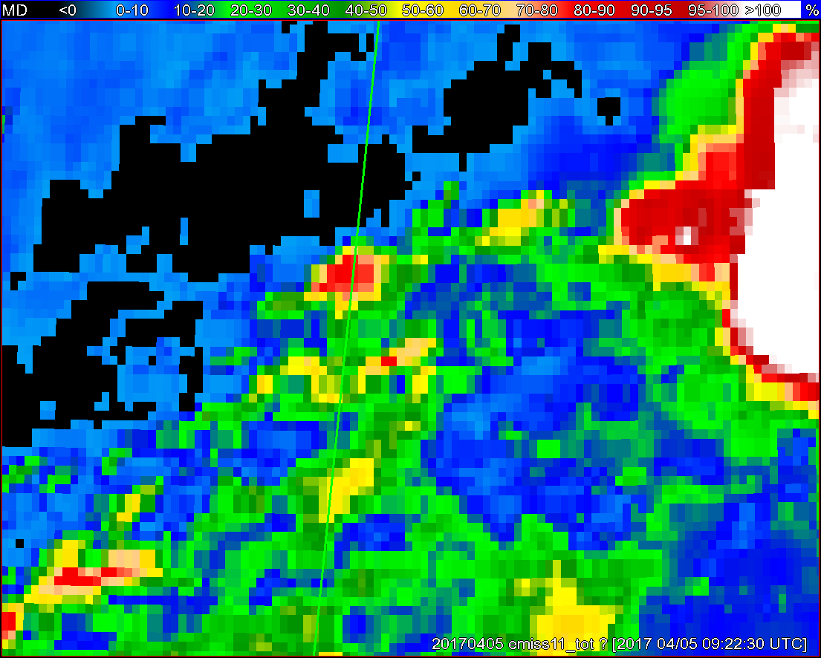
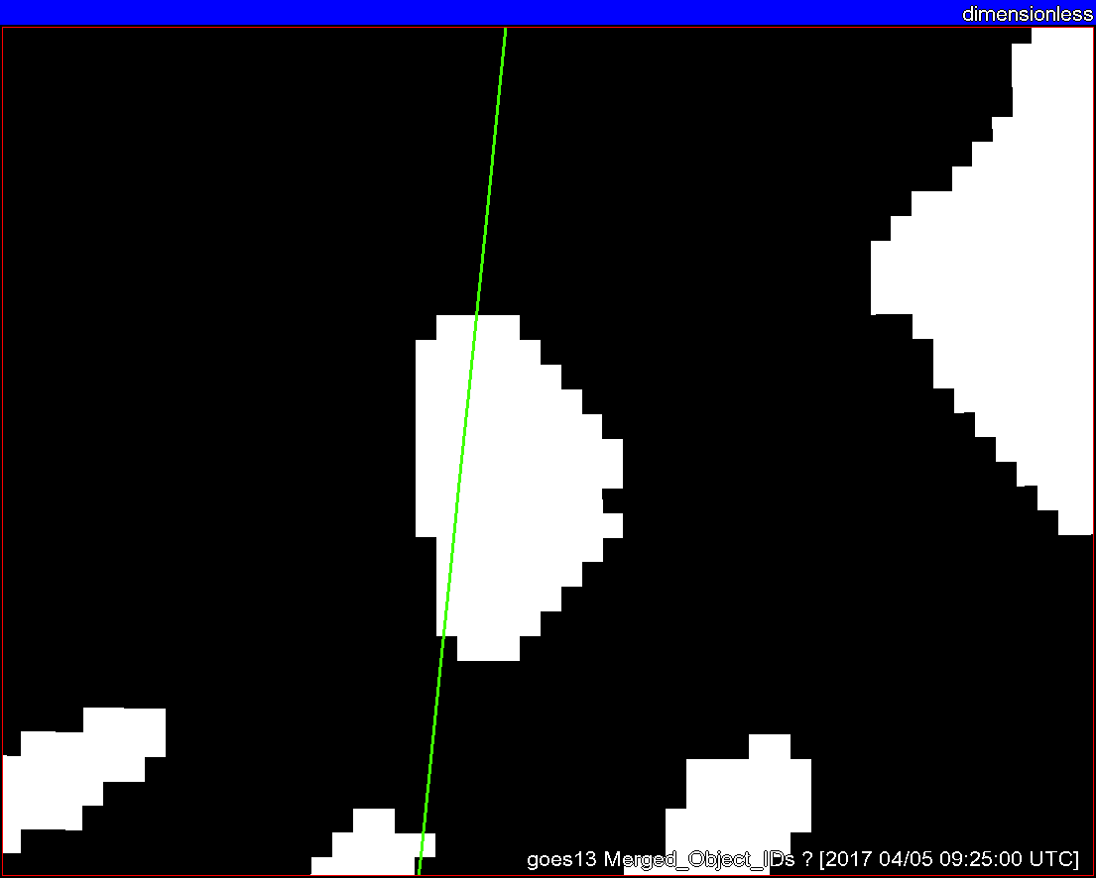
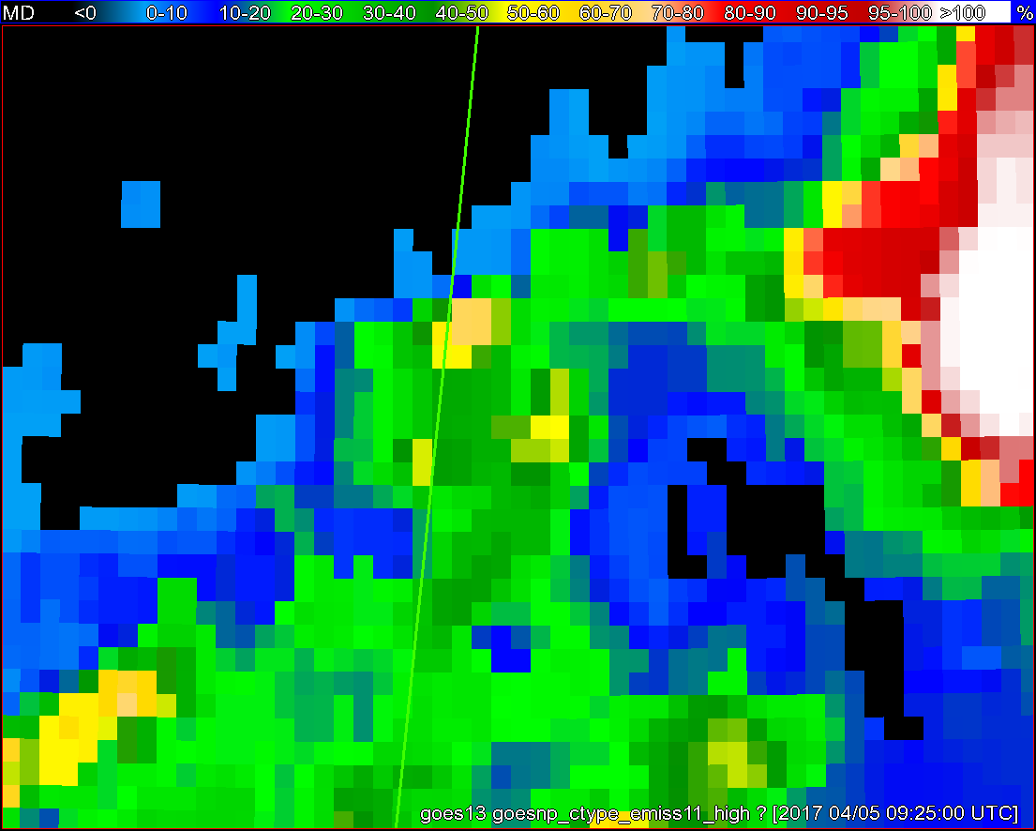
Objects
11-µm top-of-troposphere emissivity
GOES - 16
GOES - 13

Slide 12
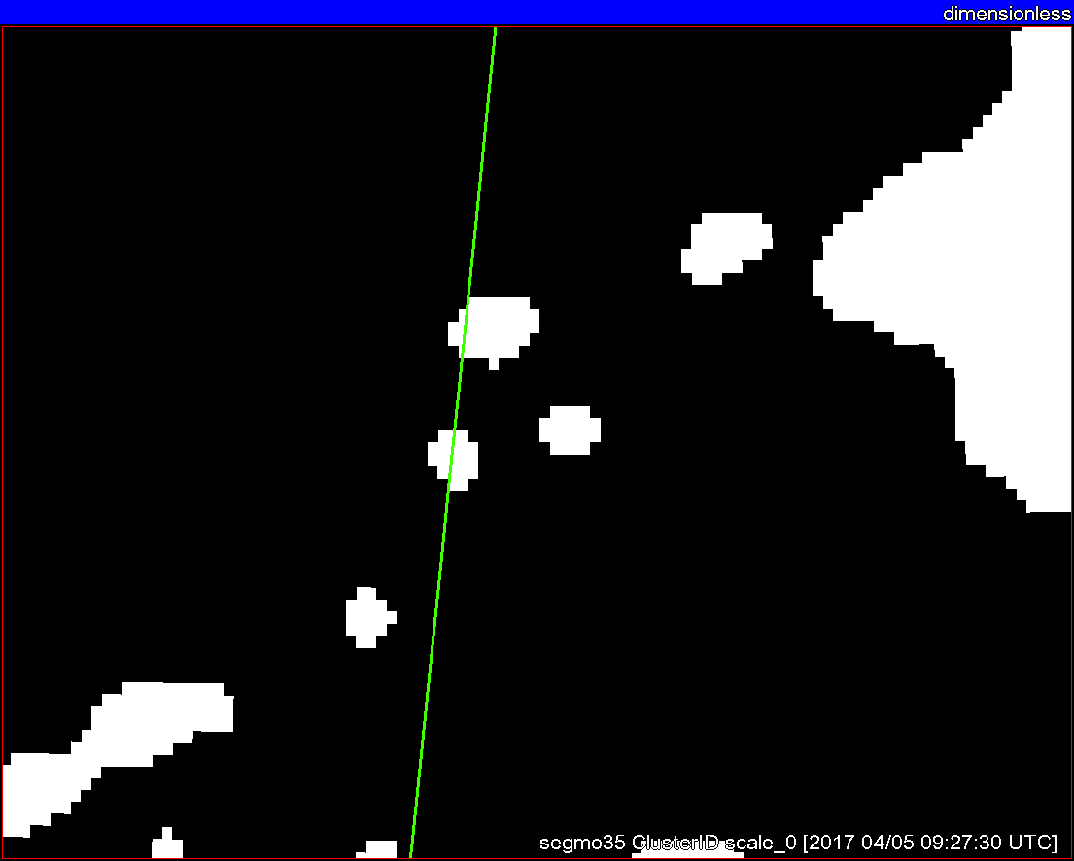
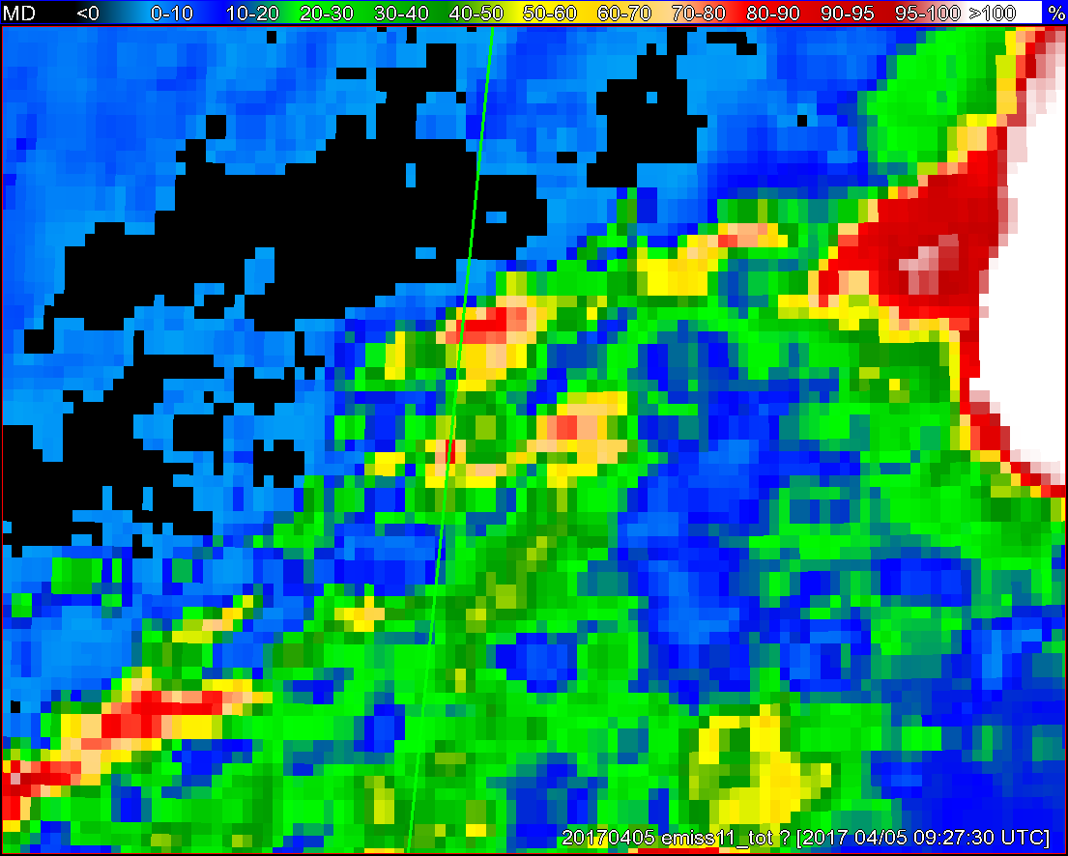
Objects
11-µm top-of-troposphere emissivity
GOES - 16
GOES - 13

Slide 13
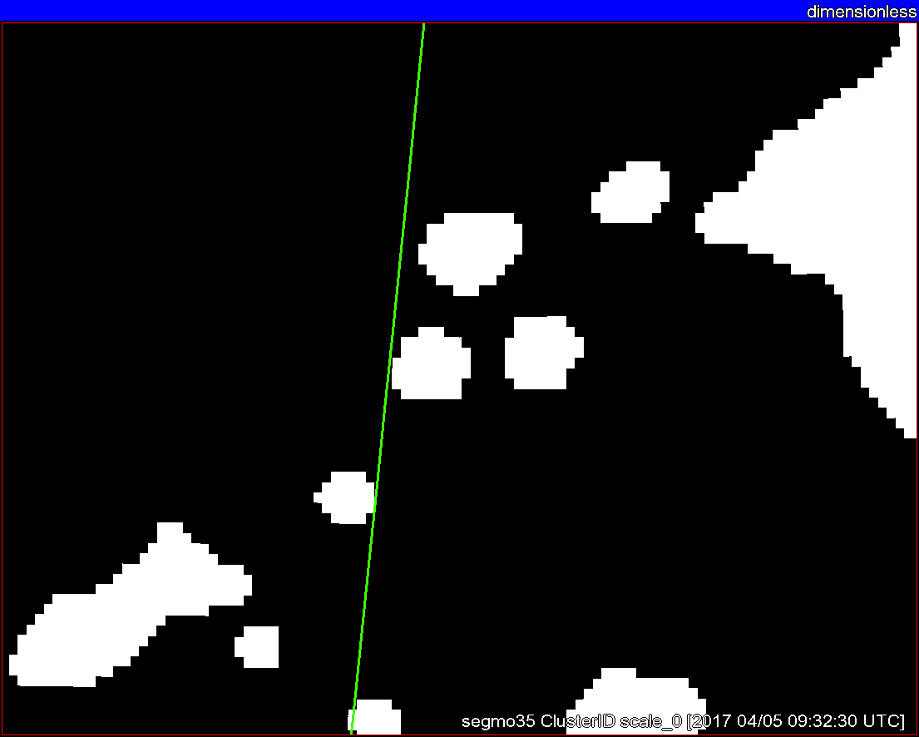
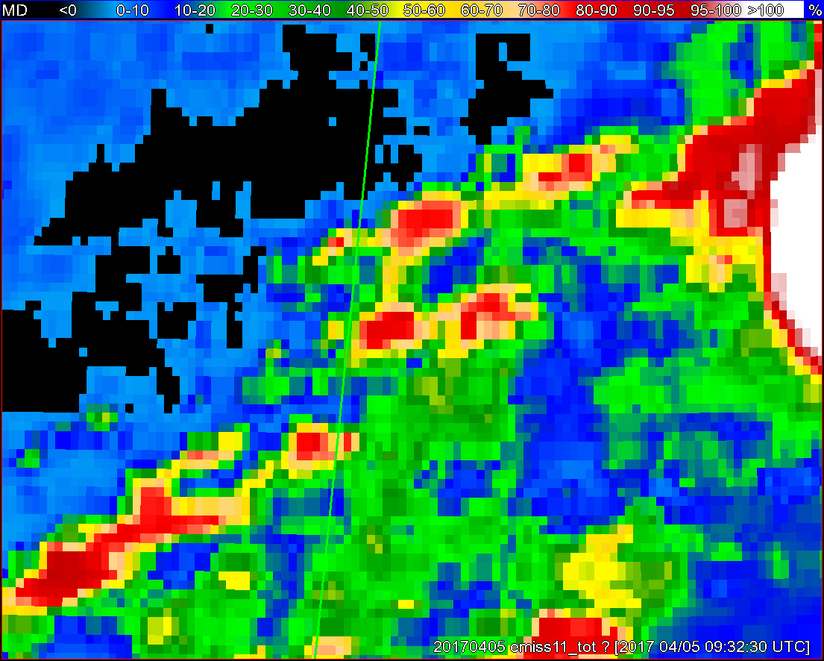
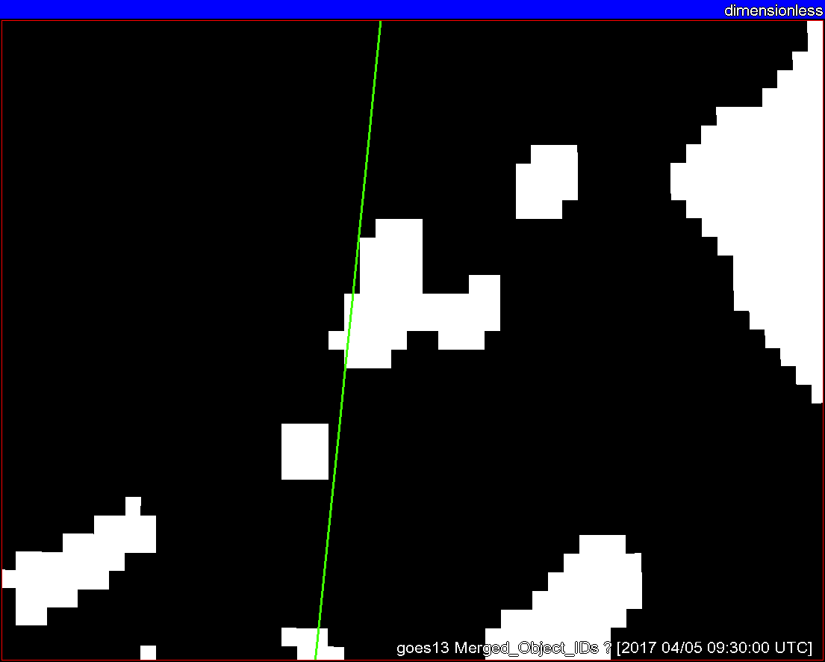
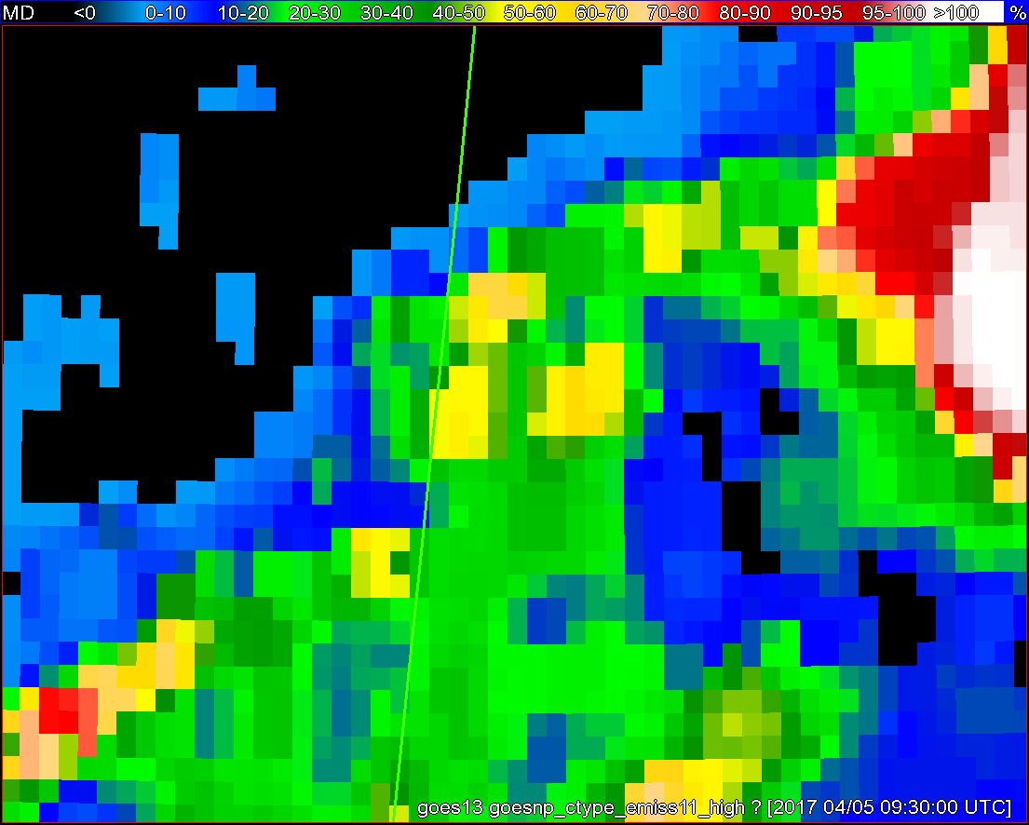
Objects
11-µm top-of-troposphere emissivity
GOES - 16
GOES - 13

Slide 14
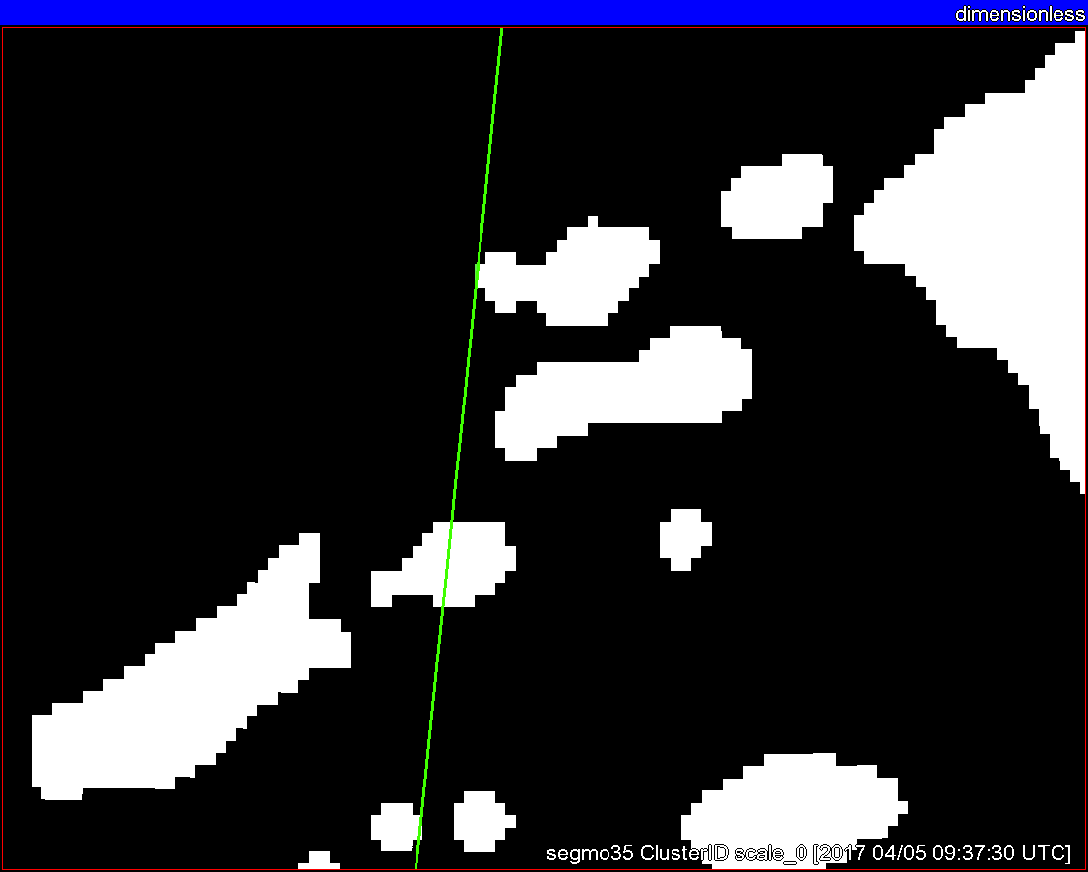
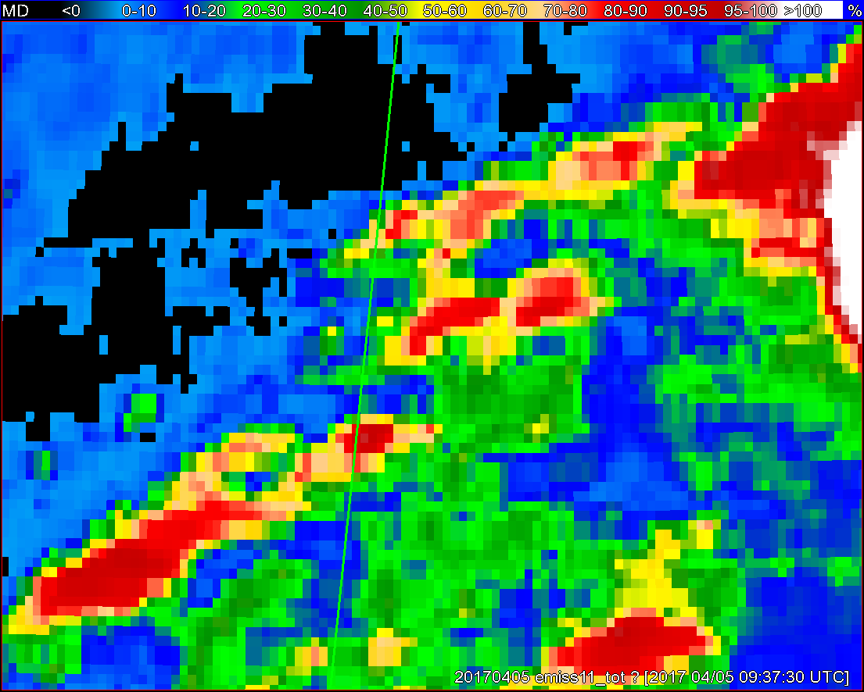
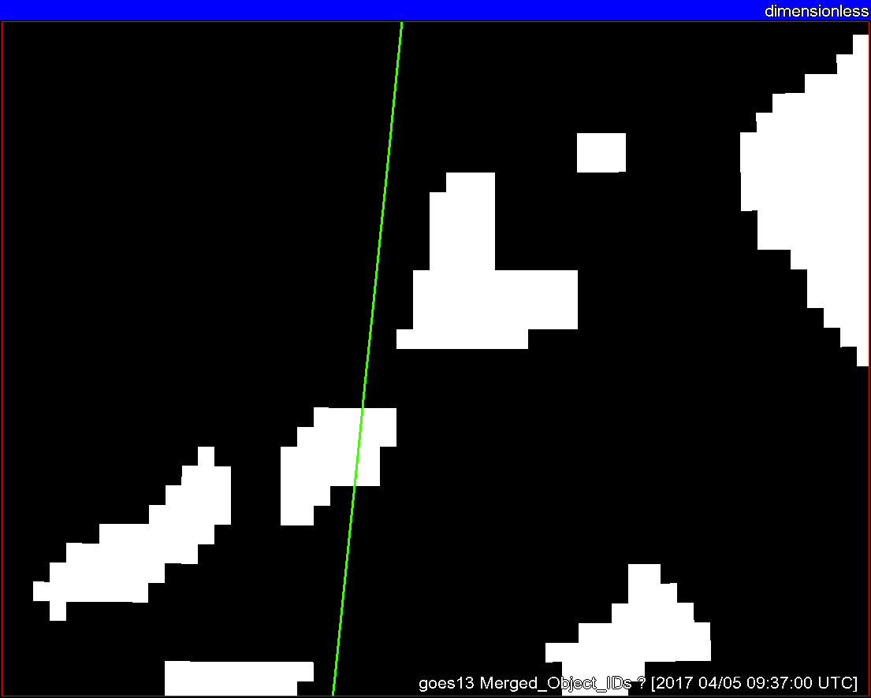
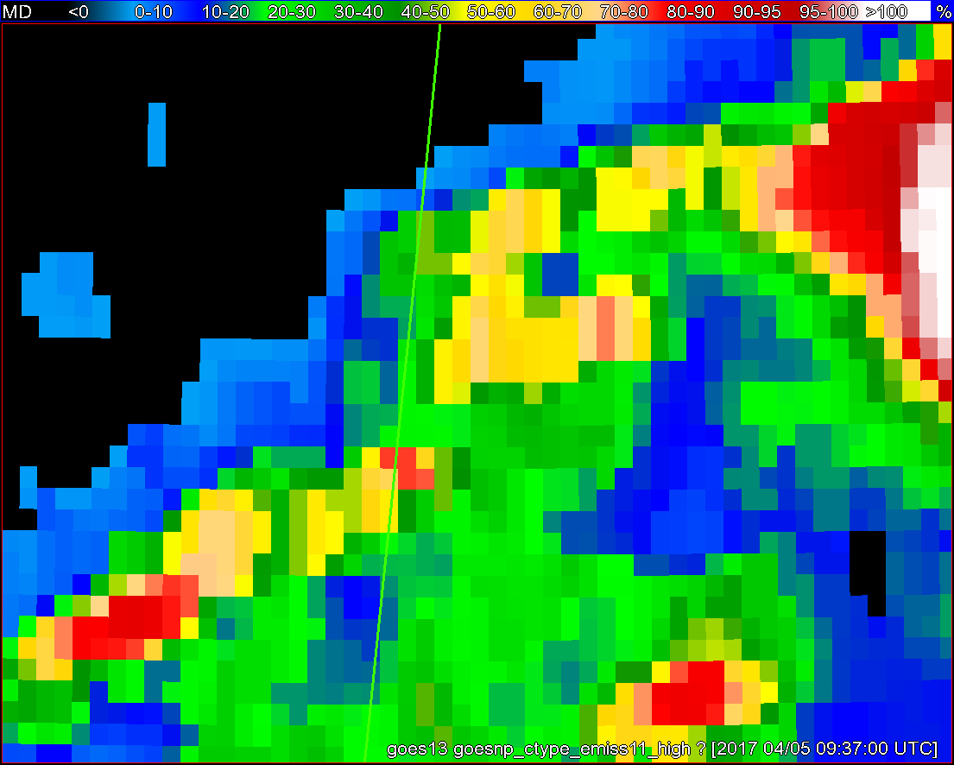
Objects
11-µm top-of-troposphere emissivity
GOES - 16
GOES - 13

Slide 15
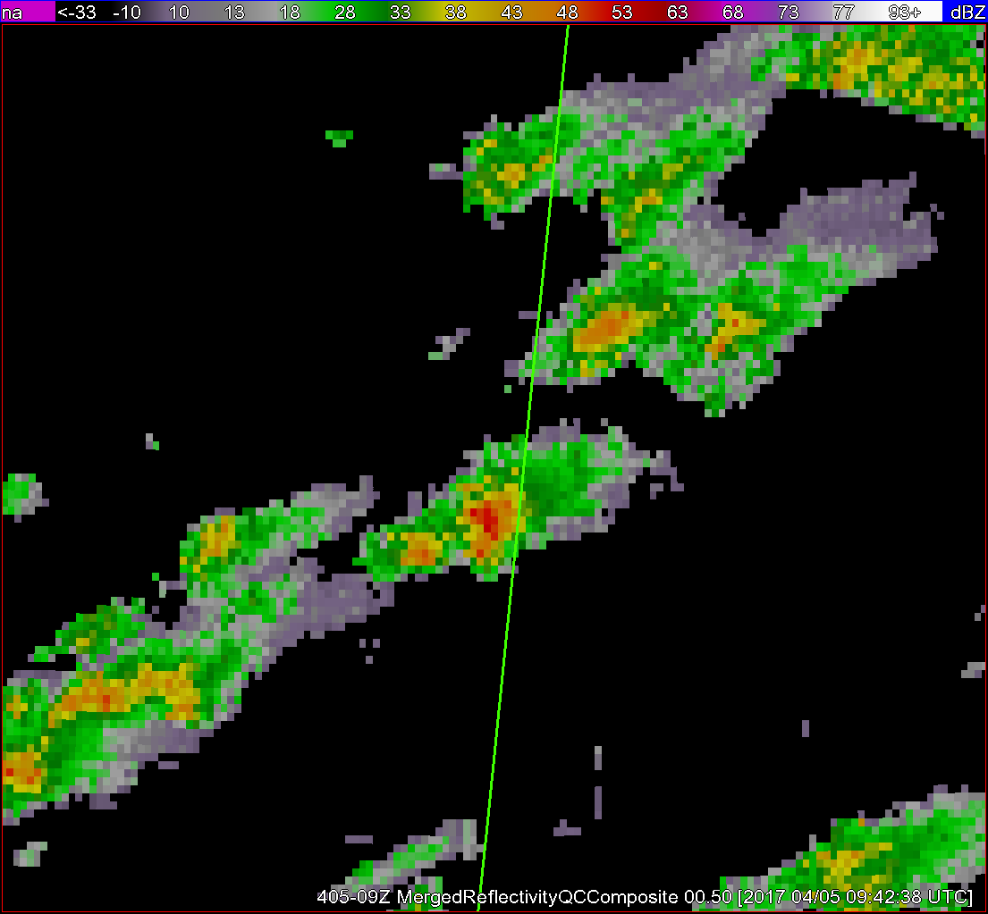
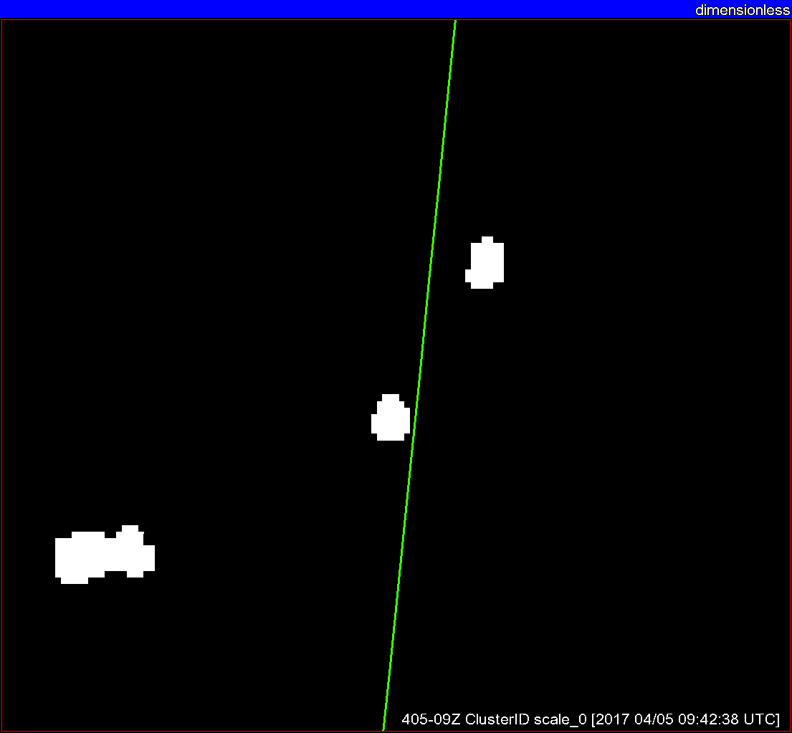
Radar reflectivity
Radar objects
+ G16 satellite objects
Satellite objects
ε_{tot}

Slide 16
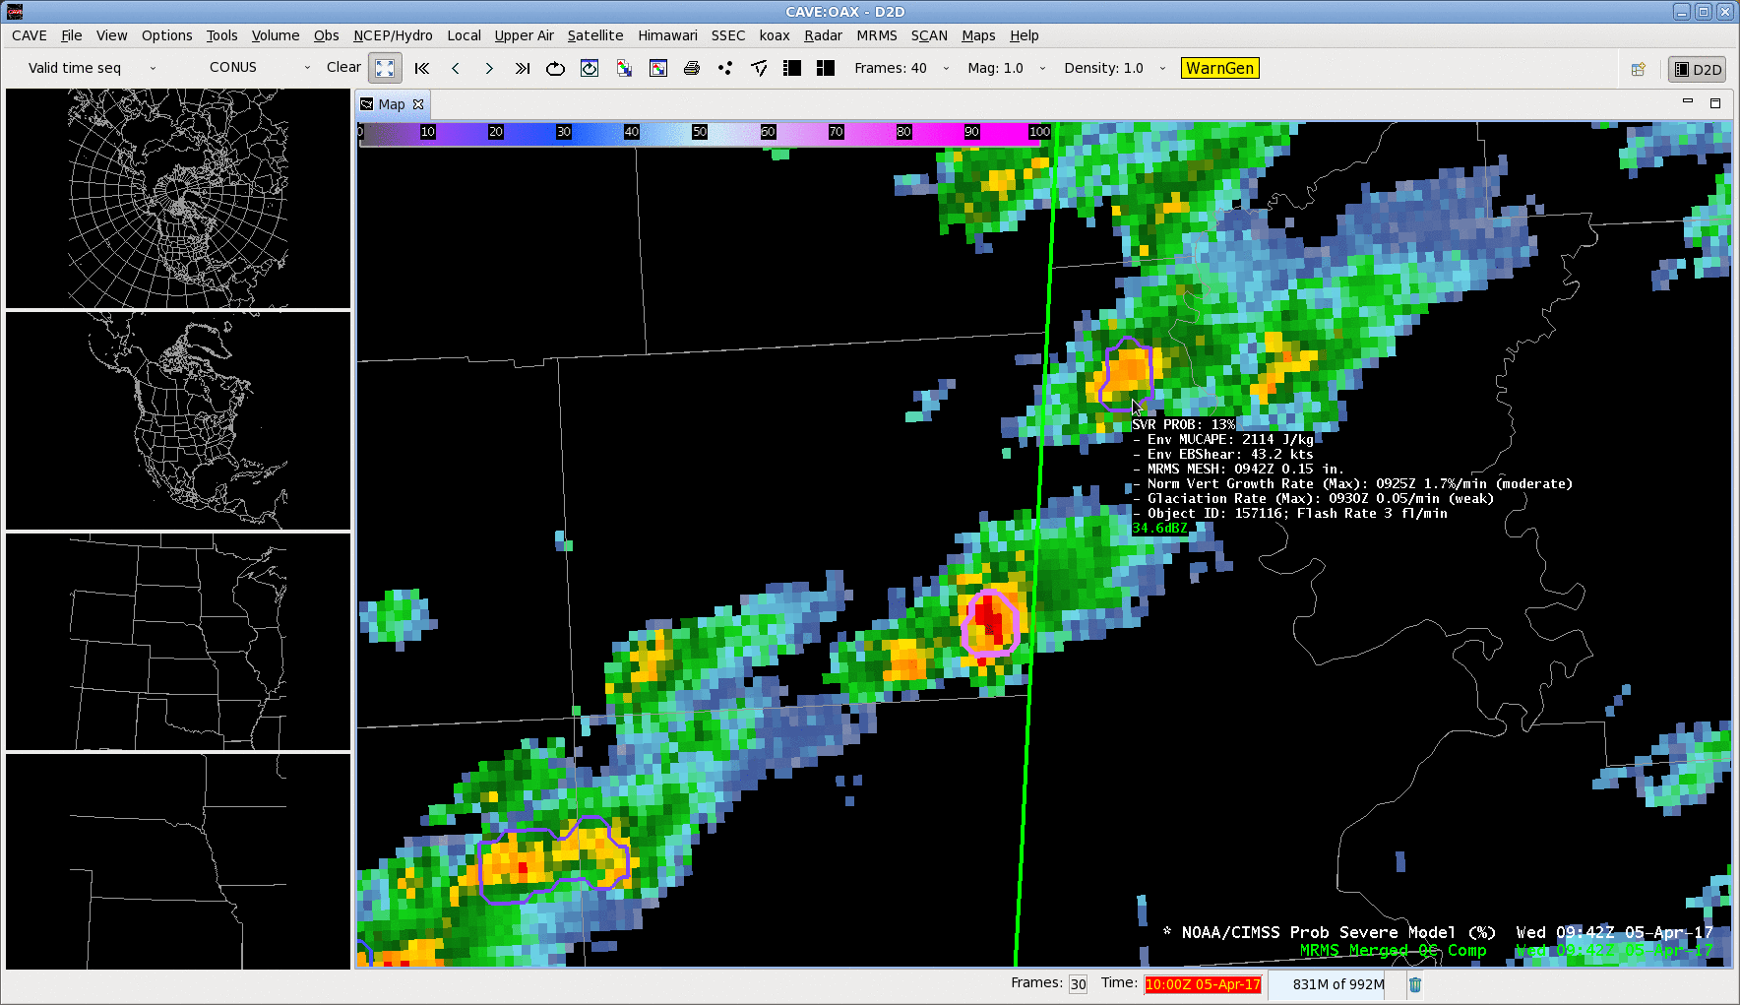

Slide 17
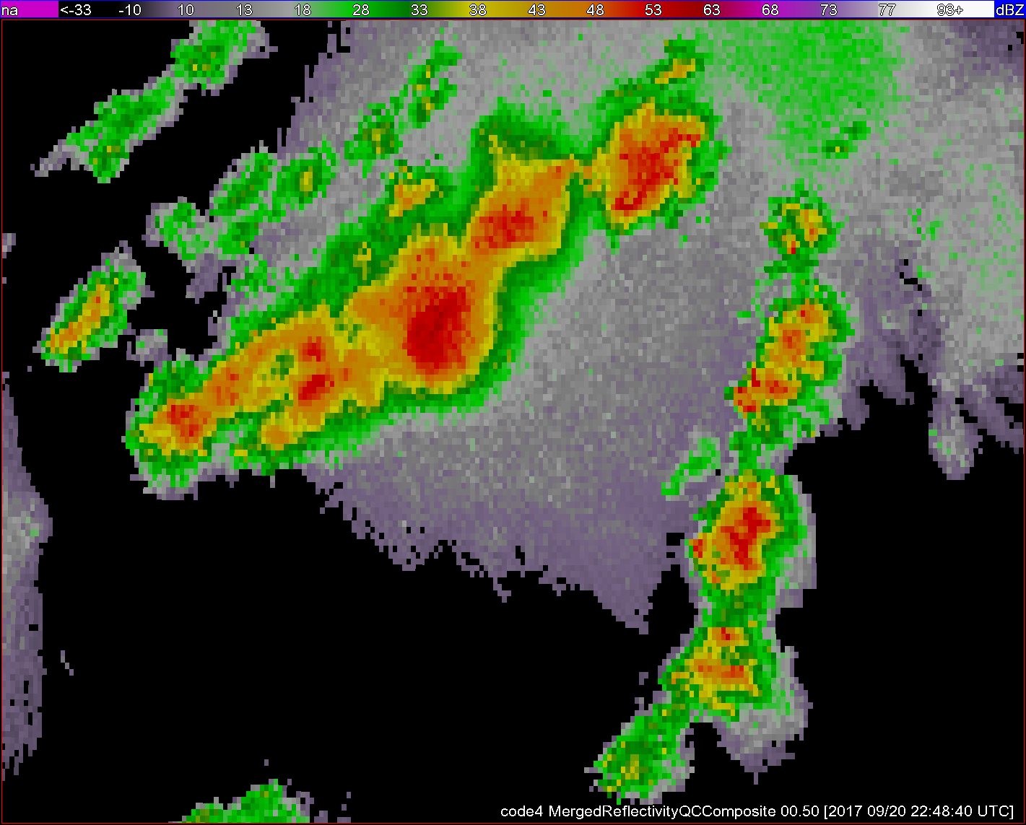
Geostationary Lightning Mapper (GLM) integration

Slide 18
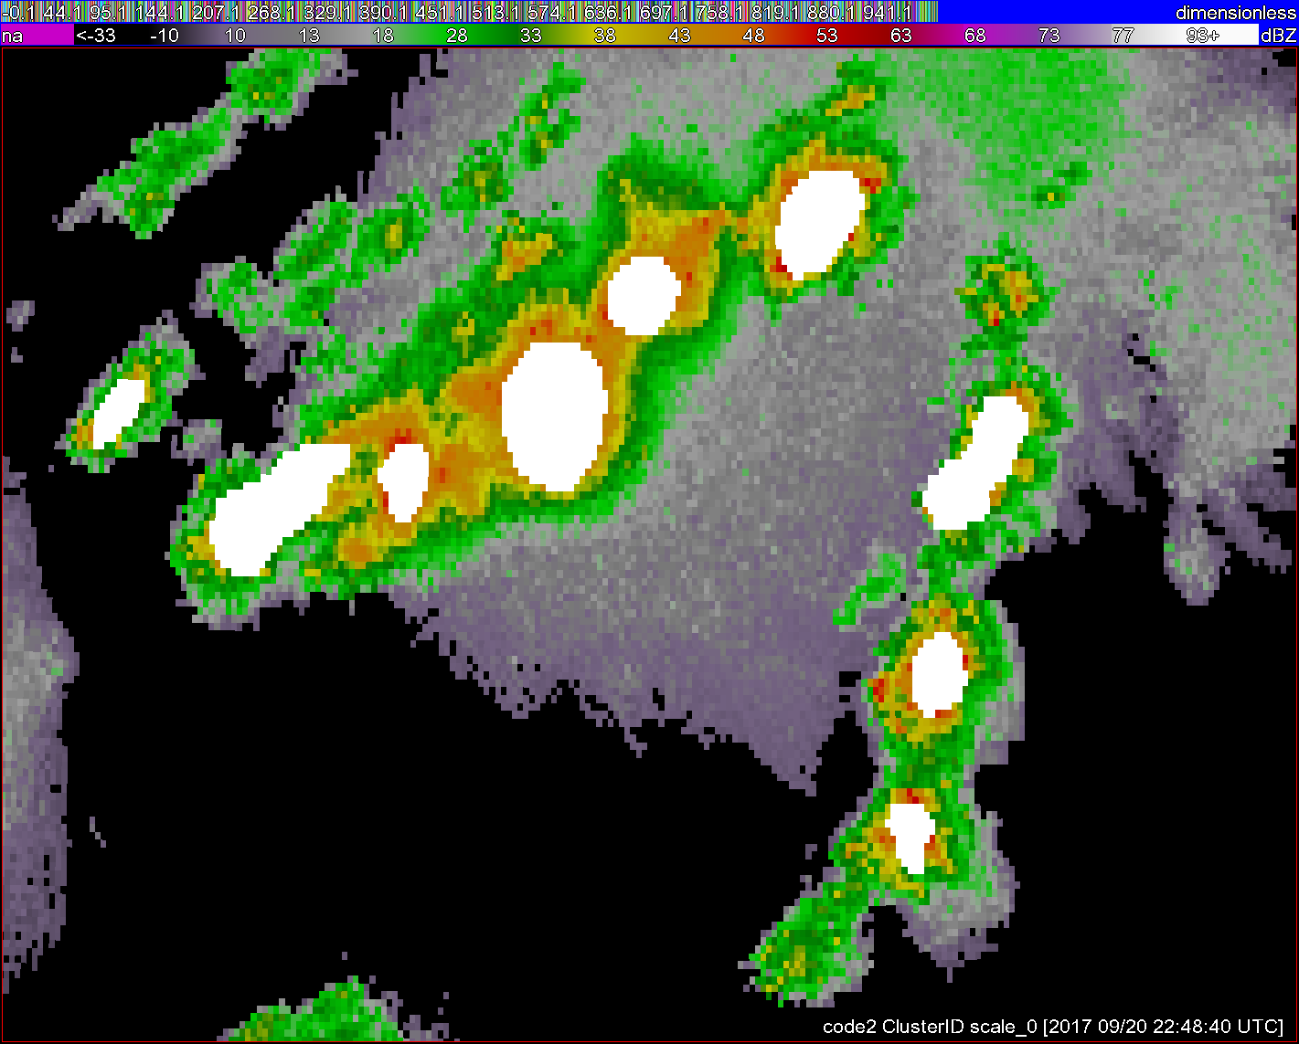
Geostationary Lightning Mapper (GLM) integration

Slide 19
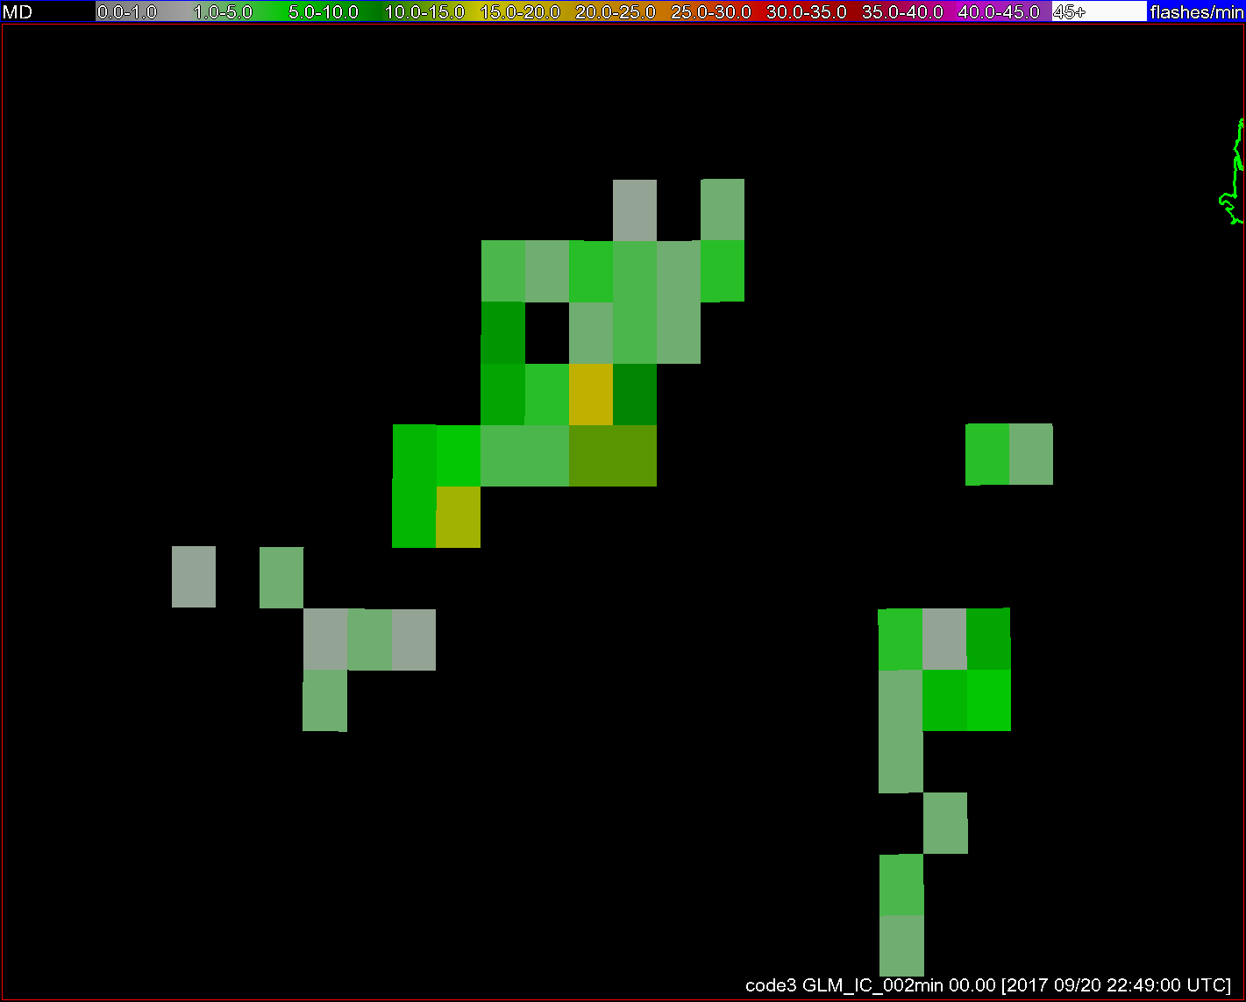
Geostationary Lightning Mapper (GLM) integration
*GOES-16 GLM data are preliminary, non-operational
Notes:
8km at nadir. Near-uniform detection efficiency across its FOV.

Slide 20
Geostationary Lightning Mapper (GLM) integration
*GOES-16 GLM data are preliminary, non-operational
Notes:
We’re excited about the GLM and the near-uniform detection efficiency across its FOV. Working now on integration into ProbSevere. Expect excellent utility, in areas with or without radar coverage.

Slide 21
ProbSevere skill
– for storms with satellite growth –
Using GOES 13/15 and ground-based lightning network (Earth NetworksSM)
Notes:
Skill measured to first large hail, strong wind, or tornado report. NWS = U.S. National Weather Service. POD = probability of detection. FAR = false alarm ration. CSI = critical success index. This is for nearly 2000 severe storms and 30,000 non-severe storms in the warm seasons of 2014 and 2016. We expect skill and lead time to increase with GOES-16 ABI and GLM instruments relative to a radar only model.

Slide 22
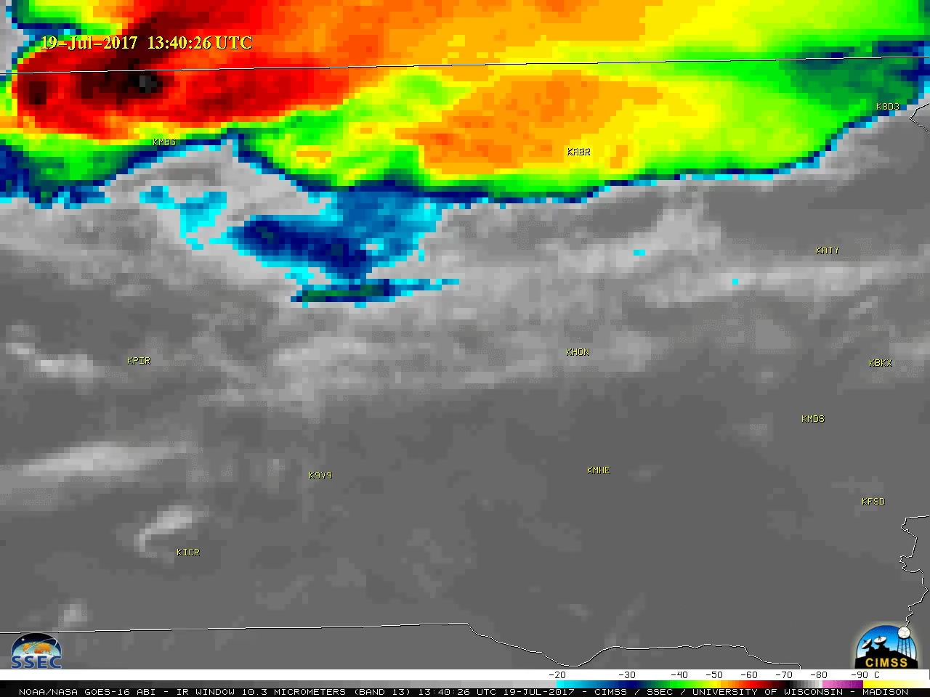
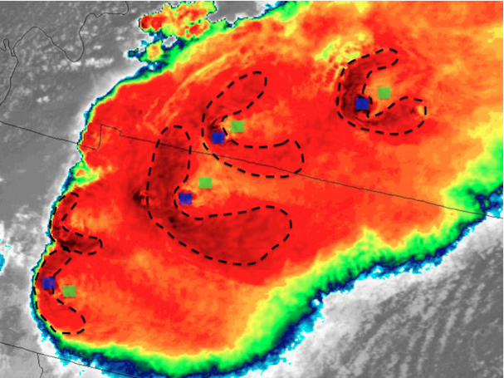
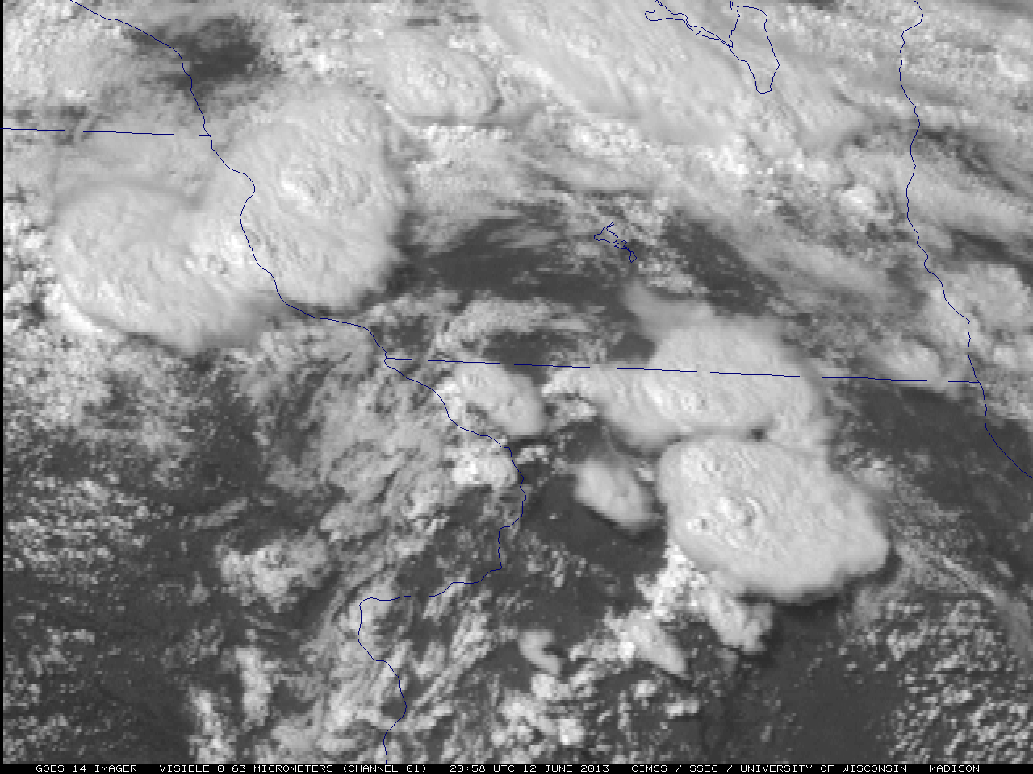
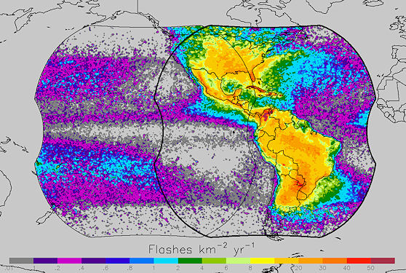


Future Research
Quantitatively assess G16 growth rates (relative to GOES-1[3-5])
Super-rapid scan growth rates (∆t ≤ 1 min)
Cb storm-top properties
Total lightning + satellite imager + NWP only product
Images are from NOAA, NASA, and UW-CIMSS

Slide 23
Take Away Points
“Big Data” era requires mining pertinent information from numerous sources into environmental intelligence
Temporal trends in derived satellite fields help inform severity and add lead time to severe convective hazards
Qualitatively, GOES-16 improves satellite identification/tracking and storm severity prediction (over GOES-1[3-5])
  Working now to measure improvement quantitatively
Working toward GLM total lightning integration
Future work will explore a strong/severe thunderstorm product in the absence of radar data
Images are from NOAA, NASA, and UW-CIMSS

Slide 24
Additional Resources
Mike Pavolonis (michael.pavolonis@noaa.gov)
John Cintineo (john.cintineo@ssec.wisc.edu)
Justin Sieglaff (justin.sieglaff@ssec.wisc.edu)
Dan Lindsey (dan.lindsey@noaa.gov)
ProbSevere training module and supplemental training material:
http://cimss.ssec.wisc.edu/severe_conv/training/training.html
See ProbSevere blog posts:
http://goesrhwt.blogspot.com/search/label/ProbSevere
Real-time ProbSevere on the web:
http://cimss.ssec.wisc.edu/severe_conv/probsev.html
References:
Cintineo, J. L., M. J. Pavolonis, J. M. Sieglaff, D. T. Lindsey, L. Cronce, J. Gerth, B. Rodenkirch, J. Brunner, and C. Gravelle, 2017: The NOAA/CIMSS ProbSevere Model - incorporation of total lightning and validation. Wea. Forecasting, in review
Cintineo, J. L., M. J. Pavolonis, J. M. Sieglaff, and D. T. Lindsey, 2014: An empirical model for assessing the severe weather potential of developing convection. Weather and Forecasting, 29 (3), 639–653.
Cintineo, J. L., M. J. Pavolonis, J. M. Sieglaff, and A. K. Heidinger, 2013: Evolution of severe and nonsevere convection inferred from GOES-derived cloud properties. Journal of Applied Meteorology and Climatology, 52 (9), 2009–2023.
Pavolonis, M. J., 2010: Advances in Extracting Cloud Composition Information from Spaceborne Infrared Radiances-A Robust Alternative to Brightness Temperatures. Part I: Theory. Journal of Applied Meteorology and Climatology, 49, 1992-2012, doi:10.1175/2010JAMC2433.1 ER.

Slide 25
Questions?

Slide 26
Extra slides

Slide 27



Feedback at the NOAA Hazardous Weather Testbed (HWT)
http://goesrhwt.blogspot.com/search?q=ProbSevere
“The normalized vertical growth rate and the glaciation rate were both strong. In this case, I was confident enough to use the ProbSevere by itself to issue a severe thunderstorm warning.”
“These examples show how temporal trends in satellite-derived fields can help signal severe potential in slowly developing and more rapidly developing convection.”
http://goesrhwt.blogspot.com/2015/05/probsevere-in-warning-decision.html
http://goesrhwt.blogspot.com/2014/08/satellite-growth-rate-utility-in.html

