Slide 1
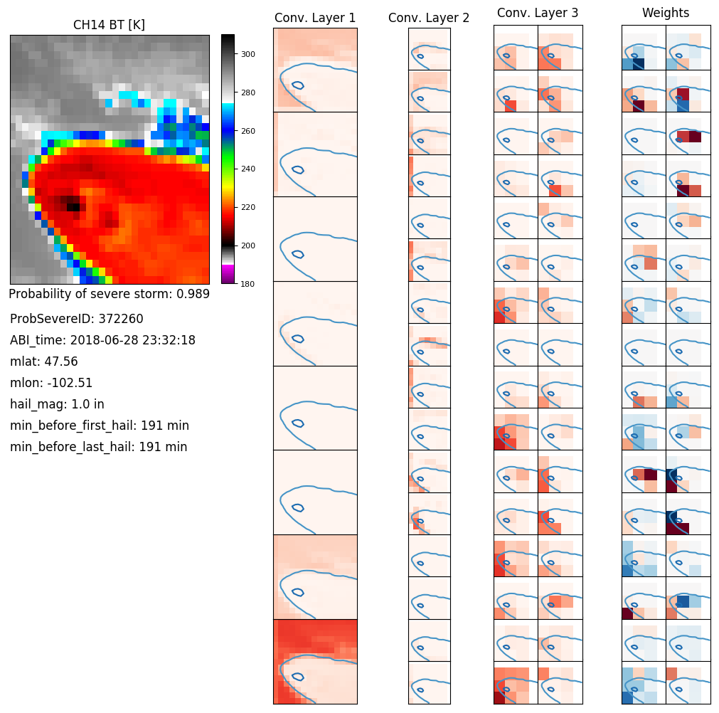
Demonstration Study Using Artificial Intelligence (AI) for the NowCasting of Tornadoes
PI: Mike Pavolonis Team: John Cintineo, Justin Sieglaff, Anthony Wimmers
Motivation: Serve society’s needs for weather and water; provide critical support for the NOAA mission
Objectives: Demonstrate how to use AI with satellite imagery to better nowcast severe convective weather.
Approach: We are building deep learning expertise with convolutional neural networks (CNN) via the Python library Keras using Google’s TensorFlow for the backend. We will use ABI imagery to create a probability of supercell thunderstorm neural network.
Visualization of CNN feature maps for a sample severe storm. This helps us see why the model predicts what it does.
Highlights and Outcomes
Created a skillful probability of severe CNN using CH13 BT (relative to climatology), as a proof of concept
Developed python tools to train CNN models using GPUs
Developed an online database to quickly label images by storm type
Project Funding Source: NOAA/NESDIS/STAR
April, 2019
Notes:
Major Result to go in lower left side: Figures should not be too complex or busy – this example is probably the limit of acceptable complexity.

