Slide 1
Southeast U.S. examples: eastern AL, western GA
July 19, 2016

Slide 2
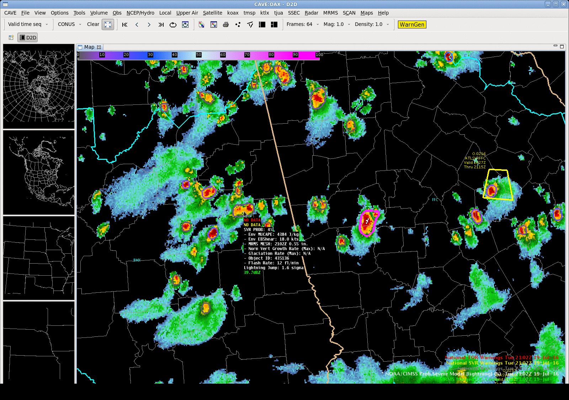
Notes:
Very high MUCAPE and modest effective shear. This storm jumped in probability 4 min before multiple wind reports at 21:10Z (last frame). There was no warning. The strong storm to the east is shown in the next slide.

Slide 3
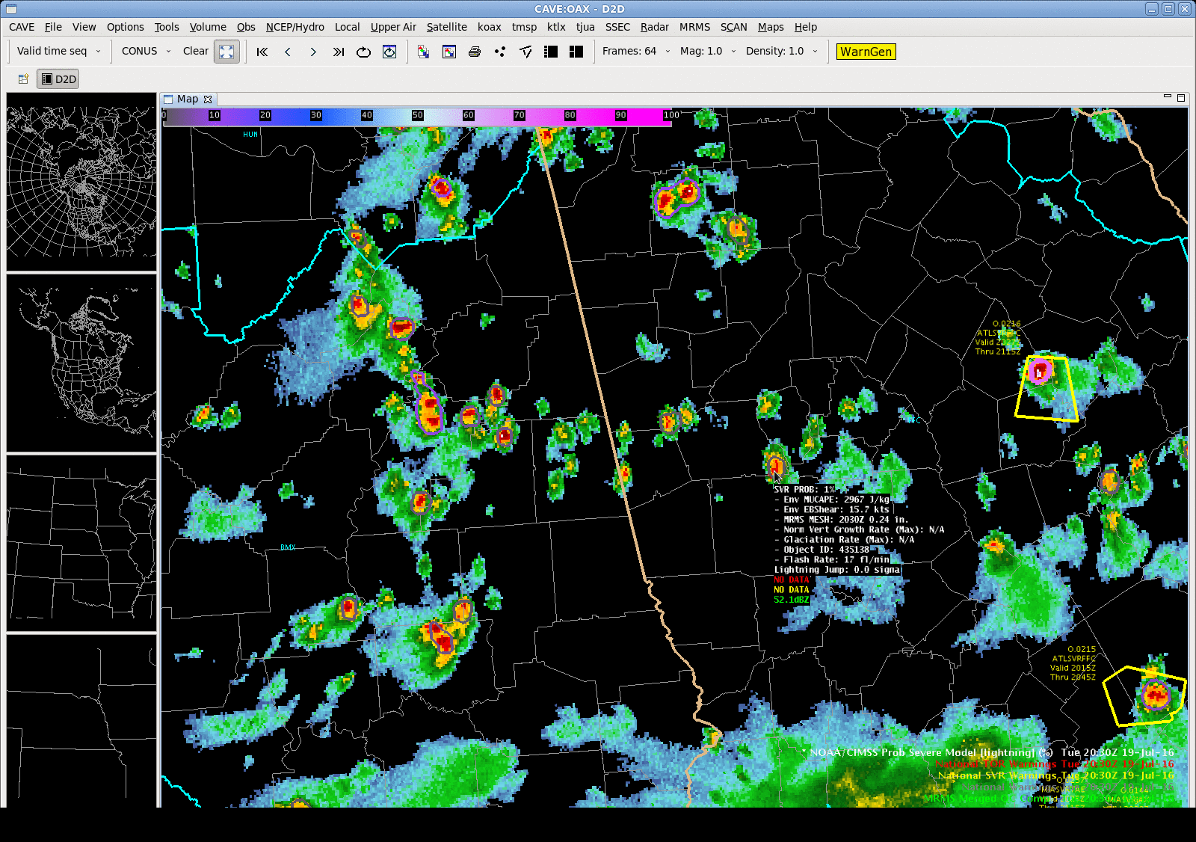
Notes:
A strong normalized satellite growth rate helps jump the probability from 36% to 72%. 1” hail and two wind reports at 21:31Z (13 min after last frame), as the probability is going down (I’m guessing the core is descending). No warning on this storm.

Slide 4
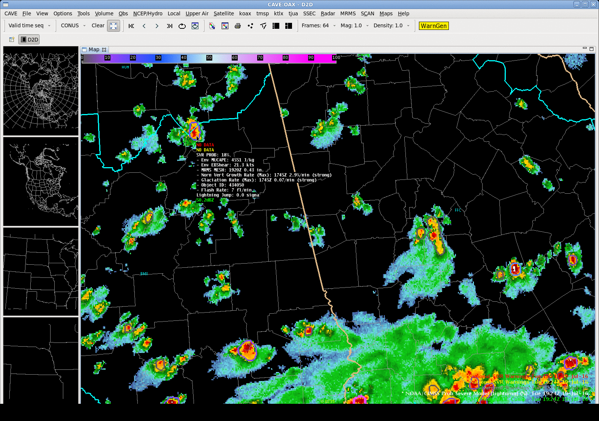
Notes:
This storm had strong satellite growth rates, MESH > 1”, and a high flash rate (40 fl/min), yet no warning and no reports. It looks like it occurred in a rural region. The warned storm in GA stayed below 40%, and did not verify with a report, if anyone asks.

Slide 5
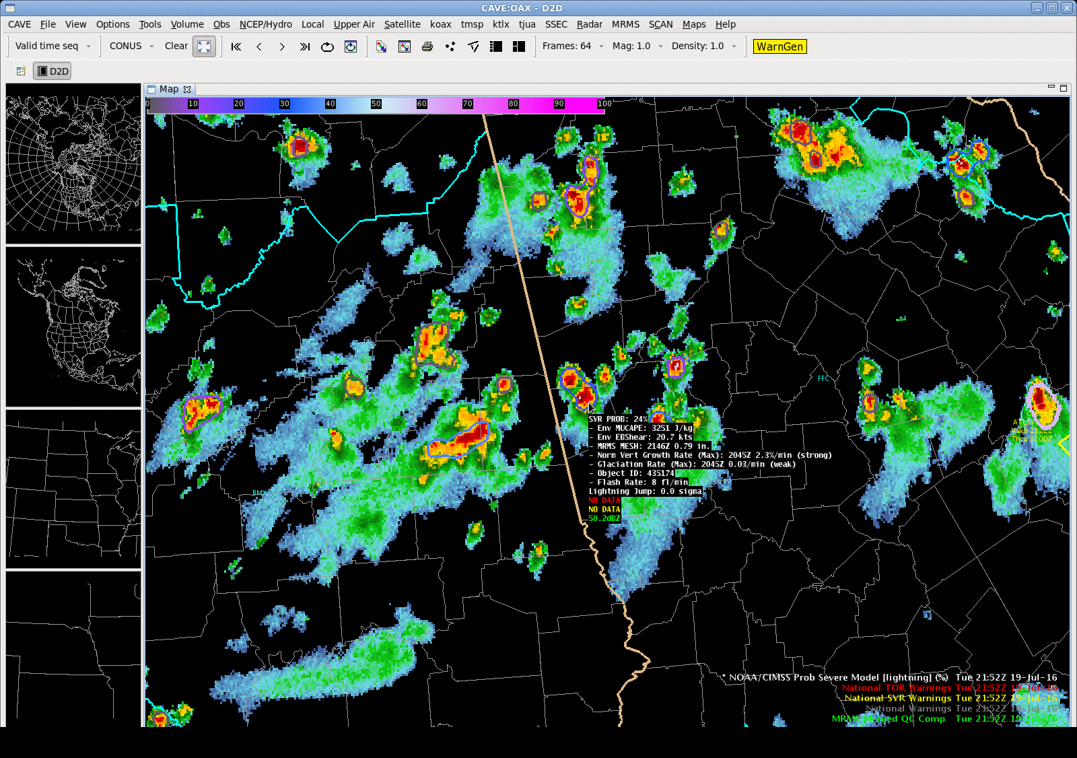
Notes:
This animation just shows how ProbSevere picks out the strongest cells nicely. Not much lead-time on these storms (to the warnings), but the product could enhance confidence. Each warning verified with one wind report, and the southernmost storm also had a hail report.

Slide 6
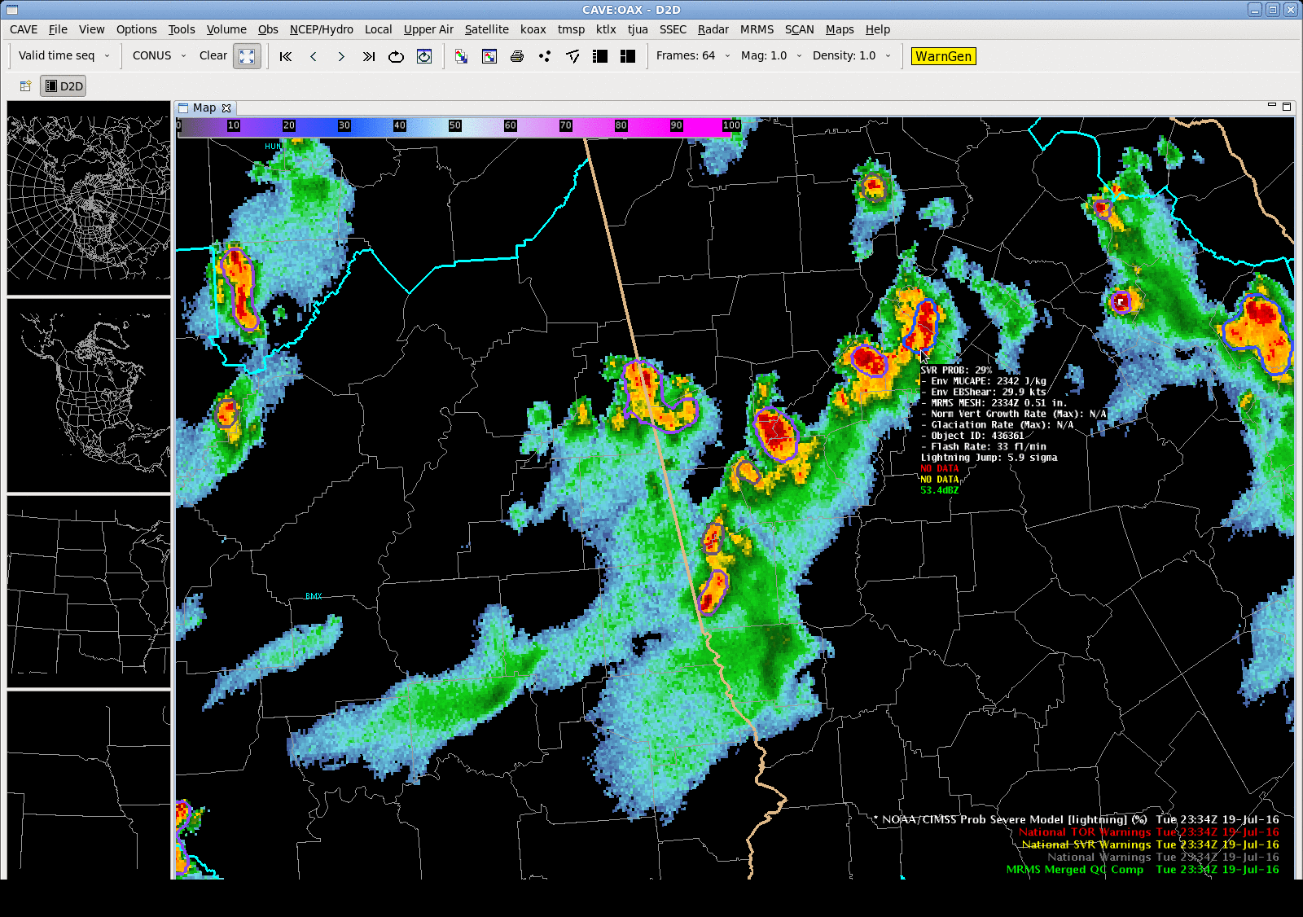
Notes:
Just another example later near Atlanta of ProbSevere picking out the stronger cell. It produced 1” hail. You probably don’t need this example.

Slide 7
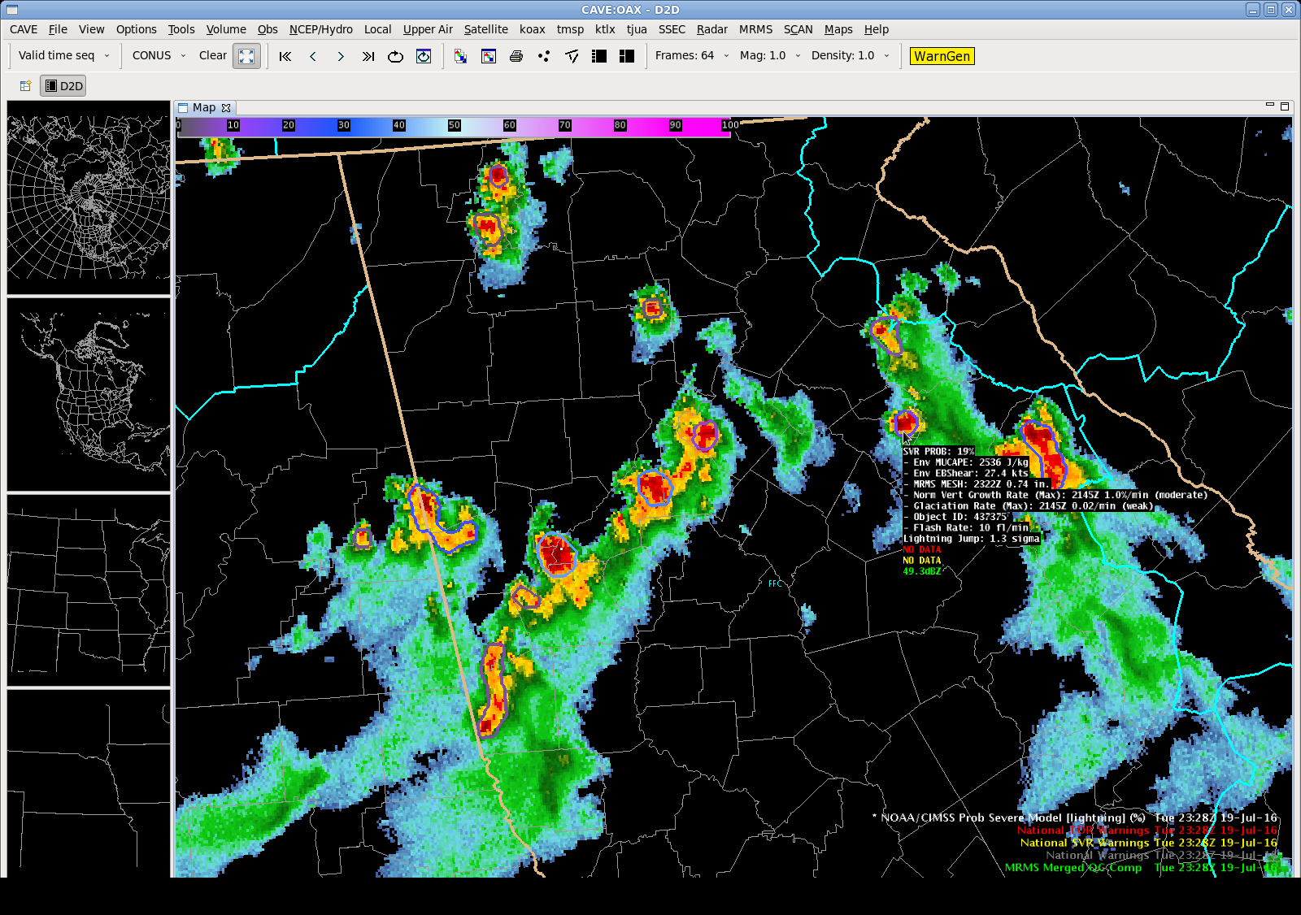
Notes:
A missed wind report near Athens, GA. Highest probability was 19%. No warning. Just want to stress that ProbSevere is guidance and not the answer.

