Slide 1


Visualizing Geostationary and Polar Oribiting Satellite Weather Products in McIDAS-V
Joleen Feltz, Tim Schmit*, Bob Knuteson, Tom Whittaker, Elise Garms
Cooperative Institute for Meteorlogical Satellite Studies (CIMSS)/University of Wisconsin-Madison
*NOAA/NESDIS/Satellite Applications and Research
Advanced Satellite Products Branch (ASPB)

Slide 2
Acknowledgements
Ralph Peterson* and Bill Line (NearCast)
Anthony Wimmers (Tropopause Fold Product)
Elisabeth Weisz (UW/CIMSS SFOV Dual Regression)
John Cintineo and Justin Sieglaff
Kaba Bah
*NOAA/NESDIS/Satellite Applications and Research
Notes:
None of the data products in this talk are my own. I wish to acknowledge the scientist who shared their products and time with me to help highlight the capabilities of this tool. McIDAS-V will only get better with each new direction that is tested.

Slide 3
McIDAS-V
McIDAS-X → VisAD + IDV + HYDRA = McIDAS-V
Integration of Geophysical Data
Remote and Local Data Access
3D Visualization
HYDRA: analysis tools for hyper-spectral data
Simple re-projection of data and sharing of projections between data displays

Slide 4
McIDAS-V Features
Software Package: Open source, free, adaptable, community driven
Portable: Developed in Java
Bundles: users easily share displays and analysis
Python based user computation

Slide 5
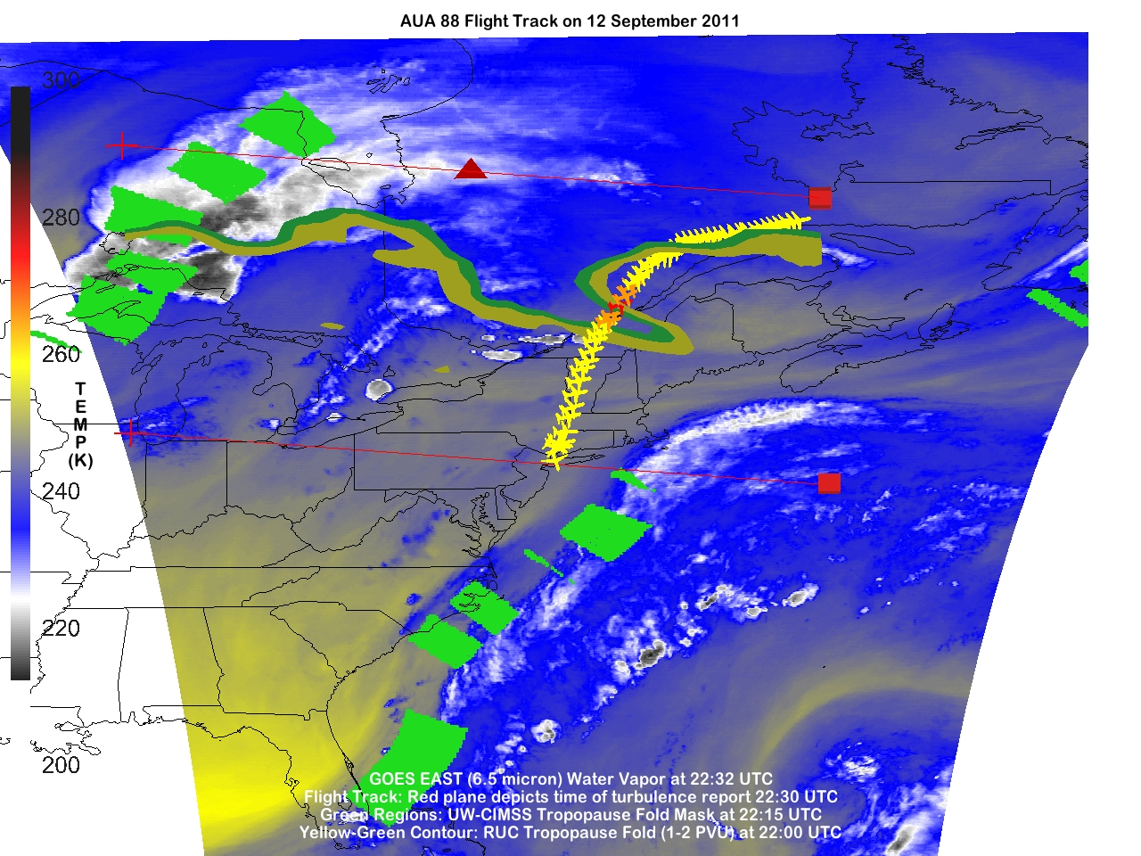
Tropopause Fold Turbulence Product: Anthony Wimmers (CIMSS)
Notes:
The tropopause fold product uses gradients in the GOES water vapor channel to refine possible locations of the tropopause fold. The underlying image is a color-enhanced water vapor image which helps to emphasize where the gradients in water vapor exists. Regions where the product indicated an increased probability of folding are displayed with green boxes. The tropopause fold as analyzed by the RUC is displayed in the yellow and green contours. The location where the plane experienced turbulence is shown by the a red plane. This image alone, shows that the plane experienced turbulence as it flew through a tropopause fold.

Slide 6
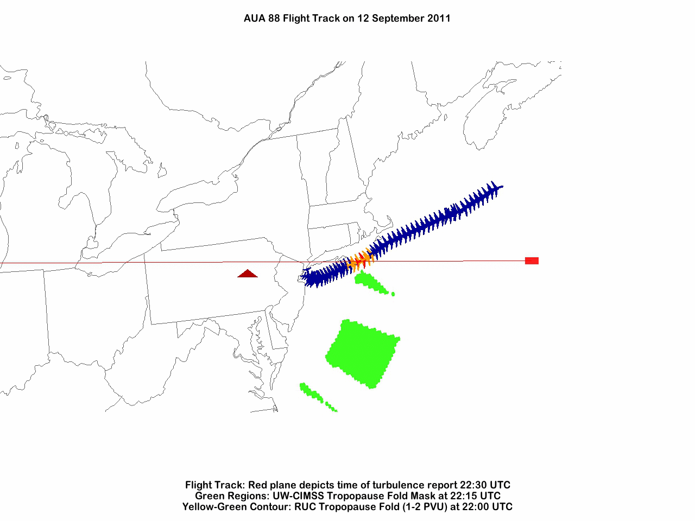
Tropopause Fold Turbulence Product: Anthony Wimmers (CIMSS)
Notes:
A bundle was used to create a rotating movie from a script. McIDAS-V provides a robust means to analyze data with the 3D interactive display. This loop was very useful in demonstrating the capability of this product to the general public.

Slide 7
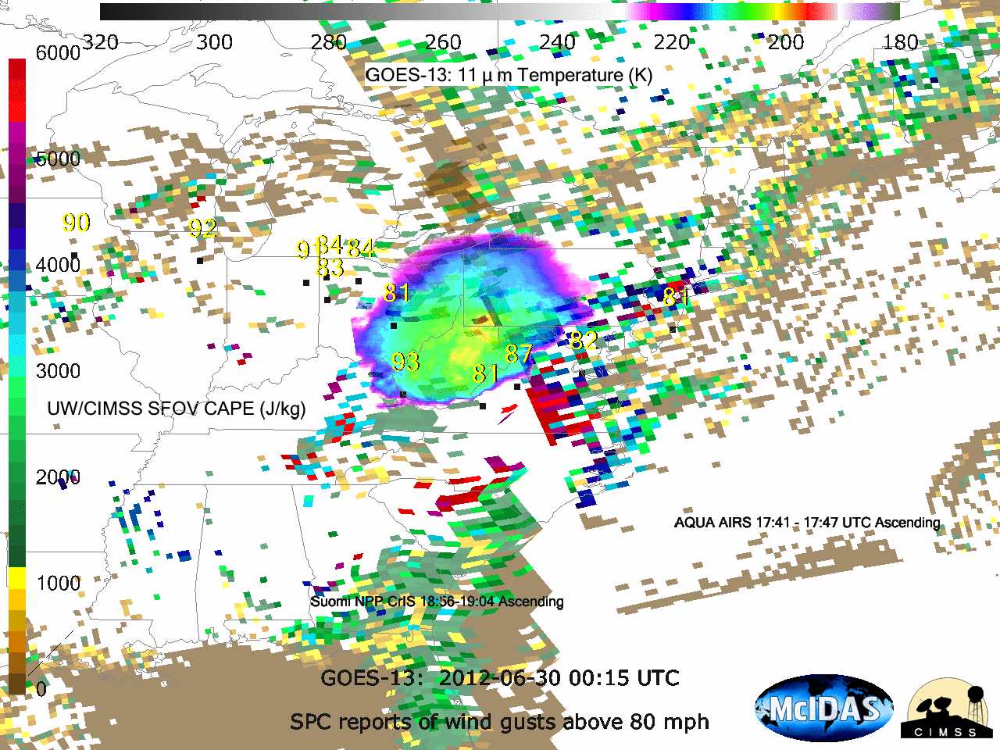
UW/CIMSS Single Field of View Retrievals: Elisabeth Weisz, Bill Smith Sr., Nadia Smith
Notes:
A derecho developed in the midwest on June 29 and traveled eastward, affecting the power grid on the east coast on June 30th. This image shows how easy it is to combine and analyze multiple data types. The grid points on the CAPE results derived using the dual regression model developed by Elisabeth Weisz, Bill Smith and Nadia Smith. In this case, there was an AIRS and Suomi NPP overpass prior to the storm. The moving portion is the GOES 11 micron temperature observations, where transparency has been set to highlight only the coldest clouds. Finally, observations of wind gust reported by the NWS are plotted on the image. In combining these observations and products, it can be seen that there was an area of instability ahead of the storm. By itself, this may not mean much, but if the temperature and moisture fields which good height resolution to cloud top could be used in models, how might they impact the forecast?

Slide 8
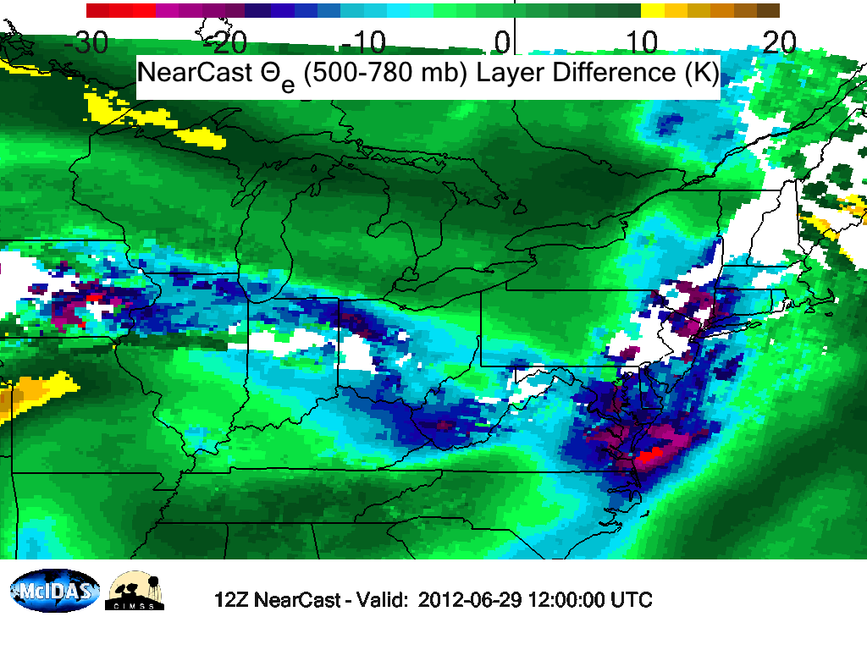
NearCast: Ralph Petersen, Bill Line
Notes:
Here is an example of geostationary data contributing to a forecast. Here is an example of the NearCast product developed by Ralph Peterson. One of the main ingredients into this model is the geostationary sounder DPI moisture product. The sounder revealed significant gradients in moisture long before the storm developed around 18Z. Even in this view, the future track is well defined by a region if enhanced convective instability. In fact, even the redevelopment and split on the east coast is evident.

Slide 9

Notes:
This is the 12Z run of the NearCast model. The observed gusts above 58 mph are plotted as they are reported. It can be seen very clearly how well the model predicts this storm.

Slide 10
Notes:
Here is the 18Z run. Again, the track was well defined and the model is predicting instability on the east coast exactly in the region where some of the larger gusts will occur a few hours later.

Slide 11
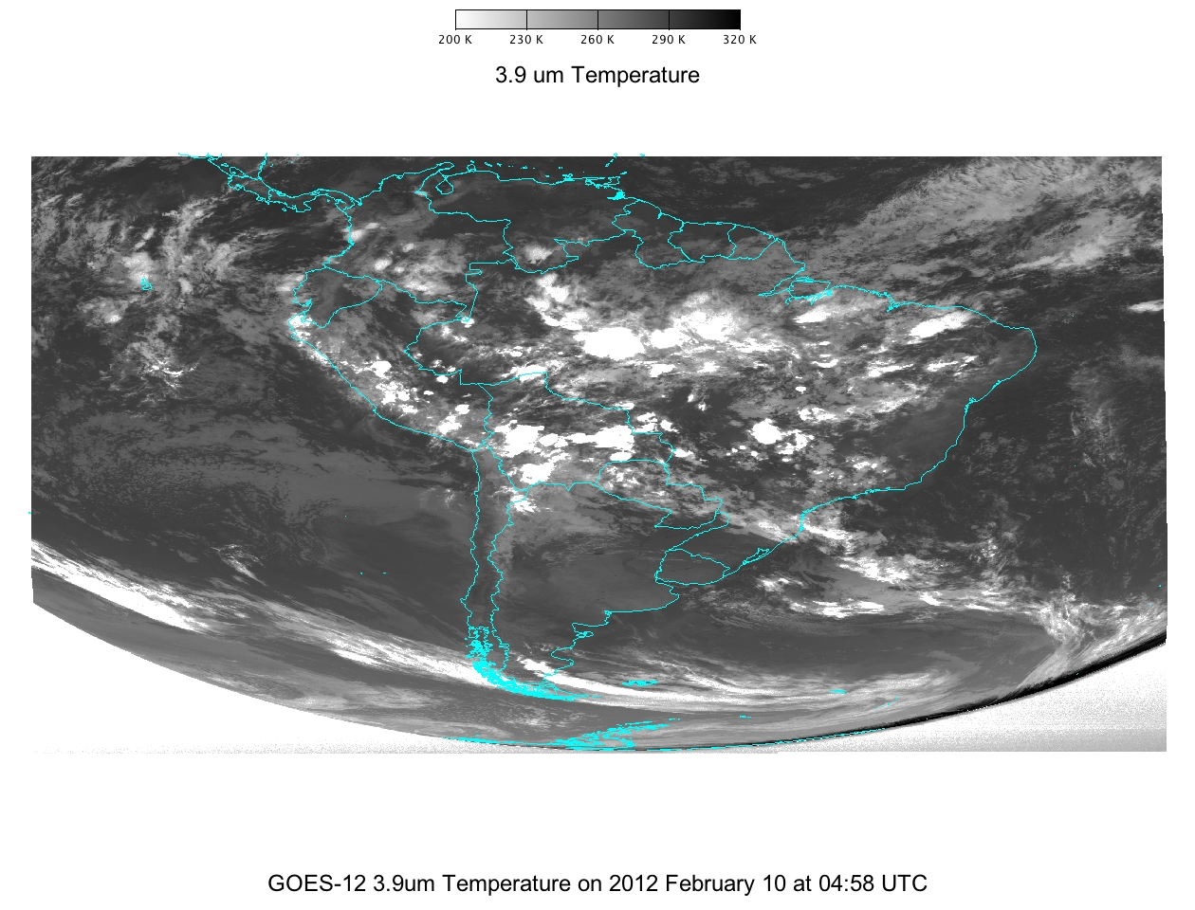
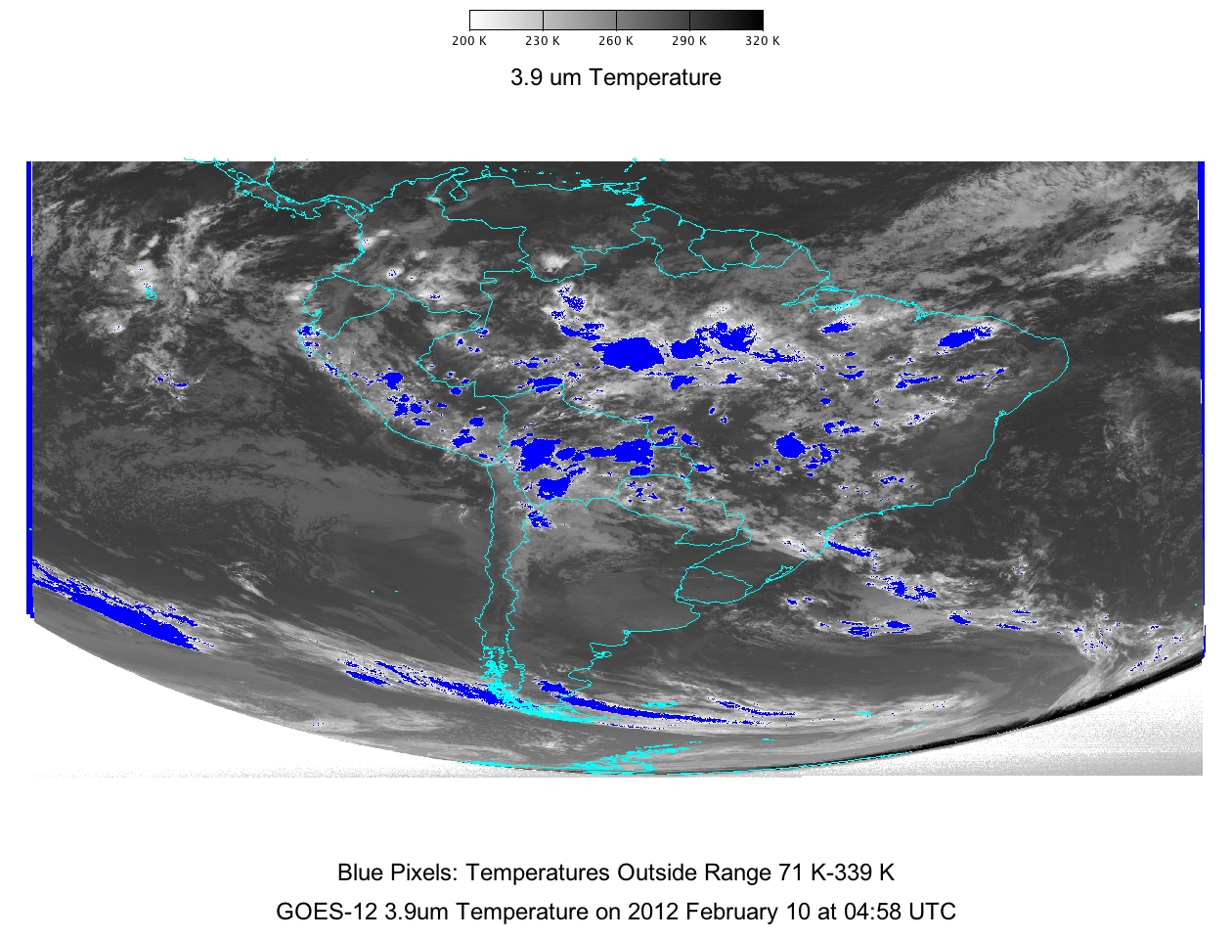
Calibration/Validation
findWithinRange/ maskWithinRange
findOutsideRange/maskOutsiderange
createAreaField
computeSum
Notes:
There is a wrap around issue with very hot pixels in GOES-12. Pixels which exceed saturation temperature will either be returned as very hot (values at or near saturation) or too cold (physically unrealistic values). CIMSS scientist wish to automate the detection of these pixels and determine the size of the areas affected in any image. To help achieve this goal, programmers refined the existing mask and find methods to allow the scientist to the indices of pixels within a specified range. This information can be used in combination with the recently developed methods of createAreaField(returns the area of any given pixel in the field) and computeSum (sums the values) to provide the information needed. This new functionality occurred because of a close collaboration between scientists and developers.
To do some of this work, the libraries from McIDAS-V will be used, without opening the software. After a first cut is made, the deep dive will include defining clusters and determining individual size and location. At that point, visualization will also be done.

Slide 12

CIMSS Proving Ground Website
(Tropospause Fold Product and NearCast)
http://cimss.ssec.wisc.edu/goes_r/proving-ground/SPC/SPC.html
GOES Sounder DPI
http://cimss.ssec.wisc.edu/goes/rt/sounder-dpi.php
International MODIS/AIRS
Processing Package
http://cimss.ssec.wisc.edu/imapp/
McIDAS-V
http://www.ssec.wisc.edu/mcidas/software/v/
Notes:
To find out more about any of these products, please visit these websites.

