Slide 1
VIIRS Sandwich Formulas
April 1, 2025
Dave Santek
Tommy Jasmin
Bob Carp

Slide 2
Background
The Sandwich RGB combines visible and infrared satellite imagery into one display. This RGB allows for visualizing cloud-top infrared temperatures with the texture of the underlying visible data.
The ability to create Sandwich RGB displays from VIIRS data is now available in the McIDAS-V nightly.

Slide 3
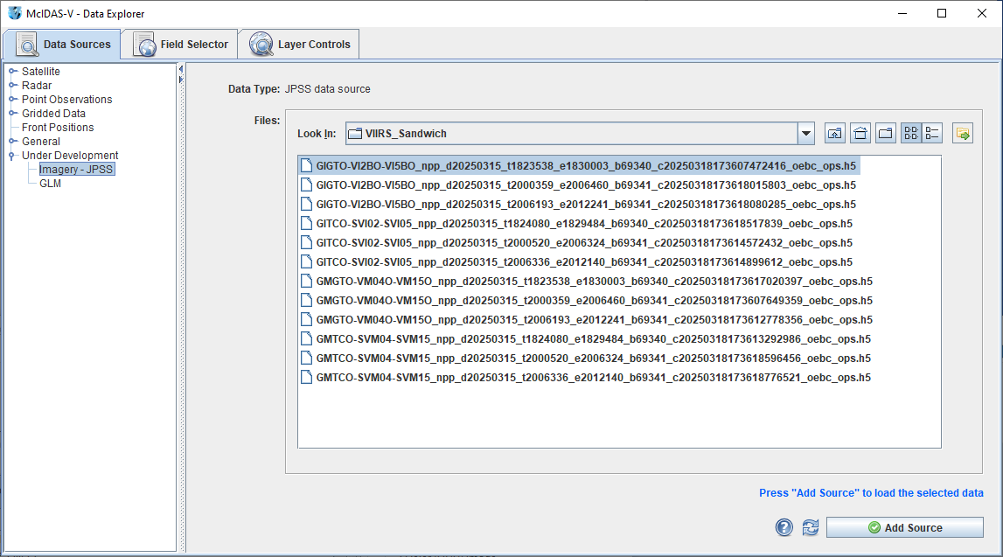
Load Data Source
Valid data types:
Imagery EDR M/I Band
SDR M/I Band

Slide 4
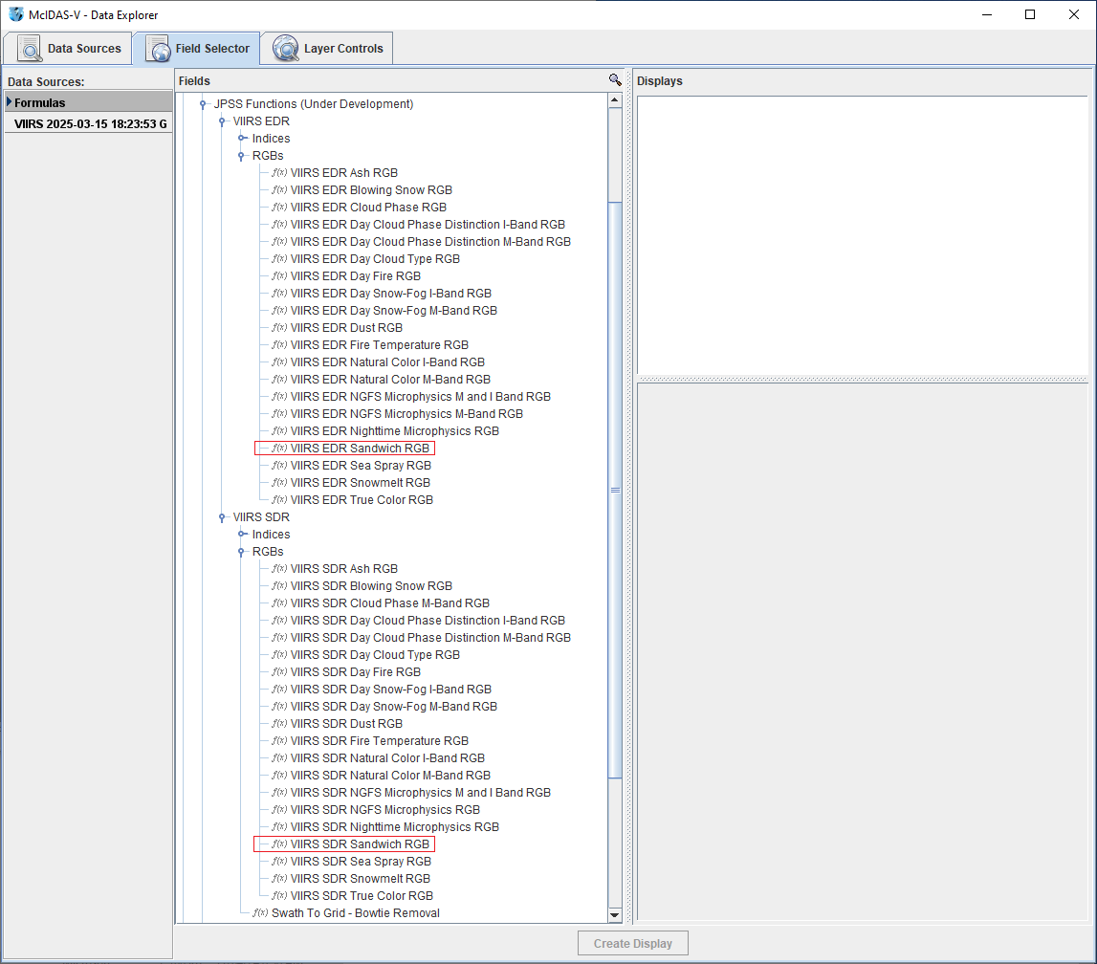
Select Formula
Individual formulas for Imagery EDR
and SDRs. The SDR formula also
removes bowtie deletion lines from
the data.

Slide 5
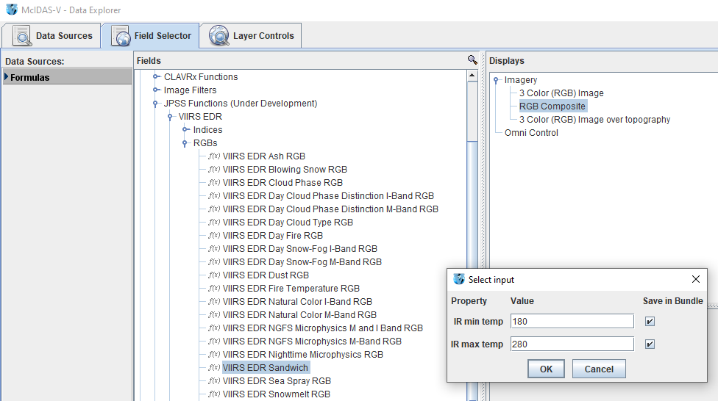
Enter IR Temperature Values
Enter the minimum and
maximum IR temperature
values to enhance in the
final display.
The SDR version of this
window also includes an
input field for the resolution
of the data.

Slide 6
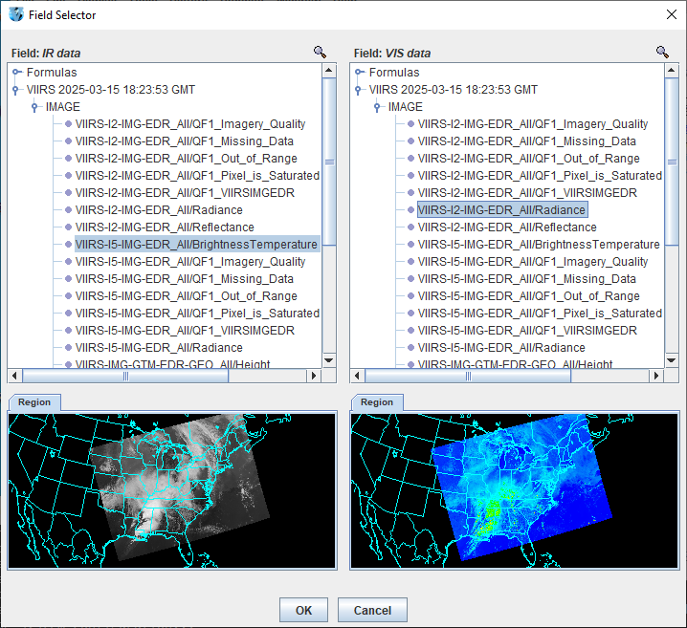
Select the IR and VIS Data
Any IR or VIS band can be selected.
IR data should be a temperature calibration
and visible can be radiance or reflectance.
With no subsetting in the Region tab the
entire domain of the data will be displayed
at the native resolution of the data for
imagery EDRs and the resolution specified
by the user for SDRs.

Slide 7
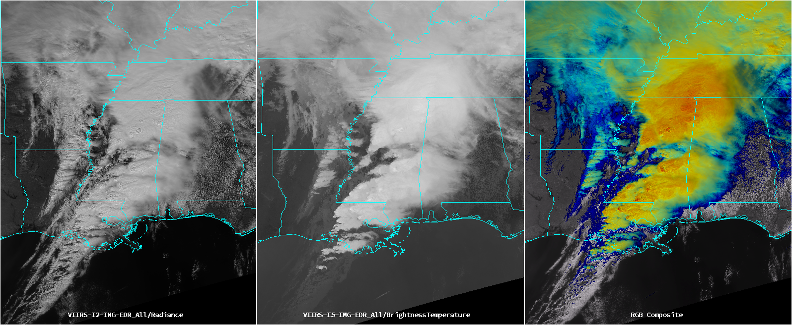
Results: Left=VIS; Center=IR; Right=Sandwich
Severe storms over southeast on 03/15/2025

Slide 8
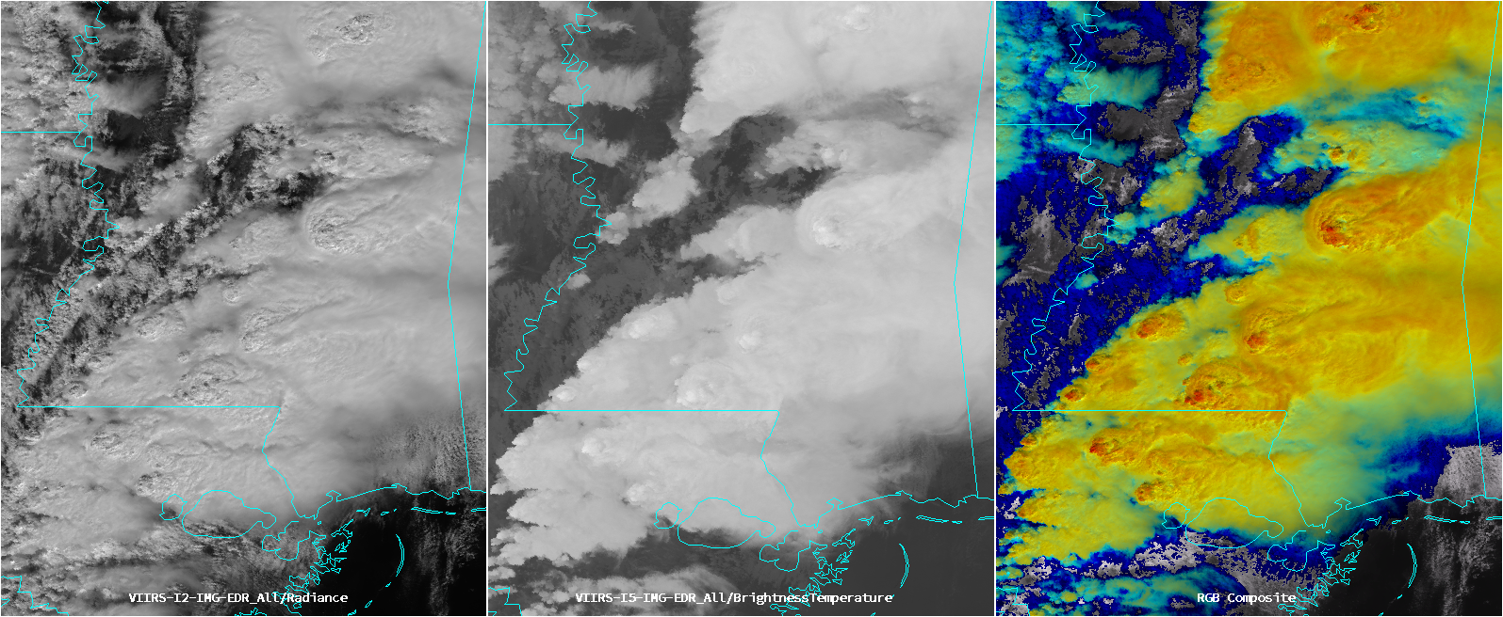
Results: Left=VIS; Center=IR; Right=Sandwich
Severe storms over southeast on 03/15/2025

Slide 9
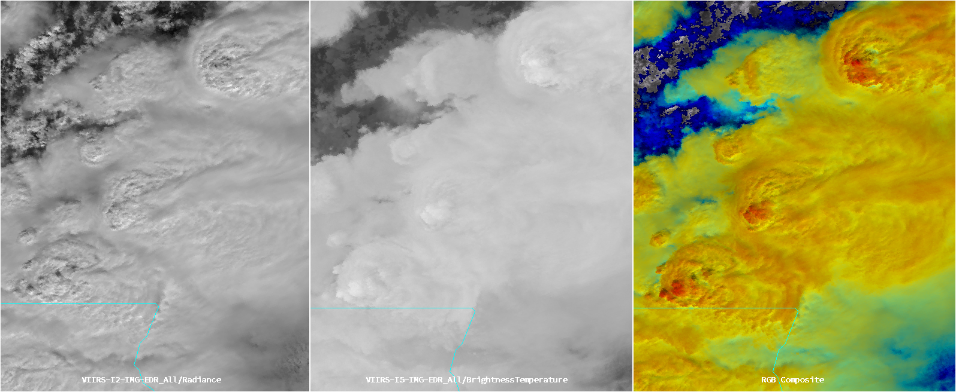
Results: Left=VIS; Center=IR; Right=Sandwich
Severe storms over southeast on 03/15/2025

