Slide 1
GOES-R: The New Generation Begins with Himawari-8
Jordan J. Gerth
Assistant Researcher, Liaison to NWS Pacific Region
Cooperative Institute for Meteorological Satellite Studies
University of Wisconsin at Madison
Timothy J. Schmit
Research Meteorologist
National Environmental Satellite, Data, and Information Service
Bill D. Ward
Environmental and Scientific Services Division Chief National Weather Service Pacific Region Headquarters
Includes contributions from the community

Slide 2
GOES-R spacecraft and solar panel

Slide 3
An update on GOES-R/S launch
GOES-R is tentatively scheduled to launch on October 14, 2016, in Cape Canaveral, Florida
GOES-S will launch approximately one year after the GOES-R launch
Post-launch testing will occur at 89.5 W and GOES-R will be positioned there for approximately one year
Operational location of GOES-R will depend on NWS priorities and the health of the existing GOES satellites

Slide 4
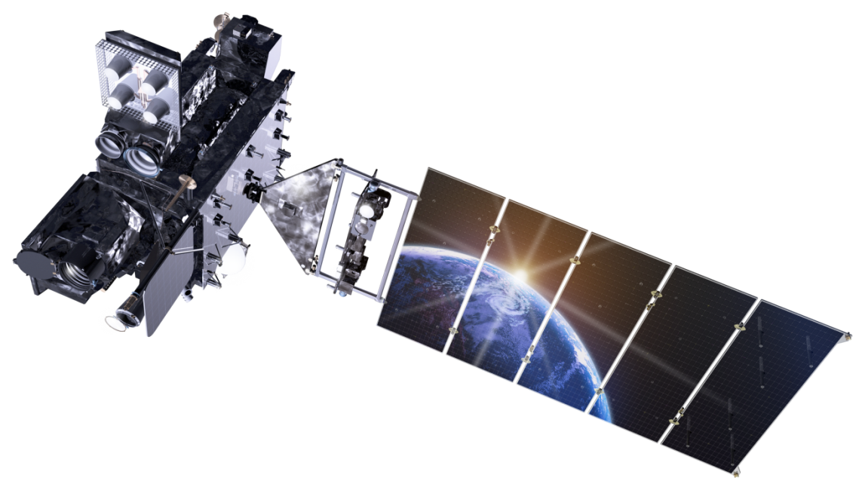
Continuity of GOES through 2036
Fiscal Year
09 | 10 | 11 | 12 | 13 | 14 | 15 | 16 | 17 | 18 | 19 | 20 | 21 | 22 | 23 | 24 | 25 | 26 | 27 | 28 | 29 | 30 | 31 | 32 | 33 | 34 | 35 | 36
GOES-13
GOES East
GOES-14
On-orbit spare
GOES-15
GOES West
Lockheed Martin
GOES-R
GOES-S
On-orbit storage
GOES-T
Test & Checkout
GOES-U
Operational
Fuel-Limited Lifetime
Launch & Orbit Raising
Post-launch Testing (PLT) - 180 Days
Operations -
<=5yrs Storage + >=8.4yrs Ops
Outgas
System Performance Operational Test (SPOT)
Ex-tended Val
PLT Cal/INR
PLPT
12 Days
30 Days
28 Days
60 Days
30 Days
32 Days
6 Mo
Post-launch Calibration, Instrument Navigation and Registration
Post-launch Product Testing

Slide 5
Future GOES-R/S constellation

Slide 6
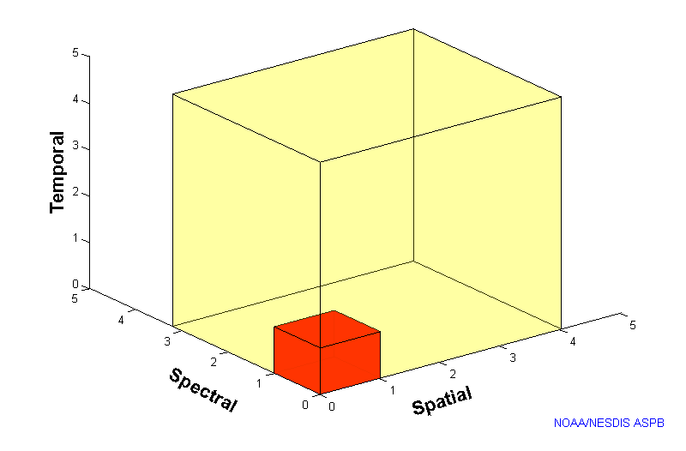
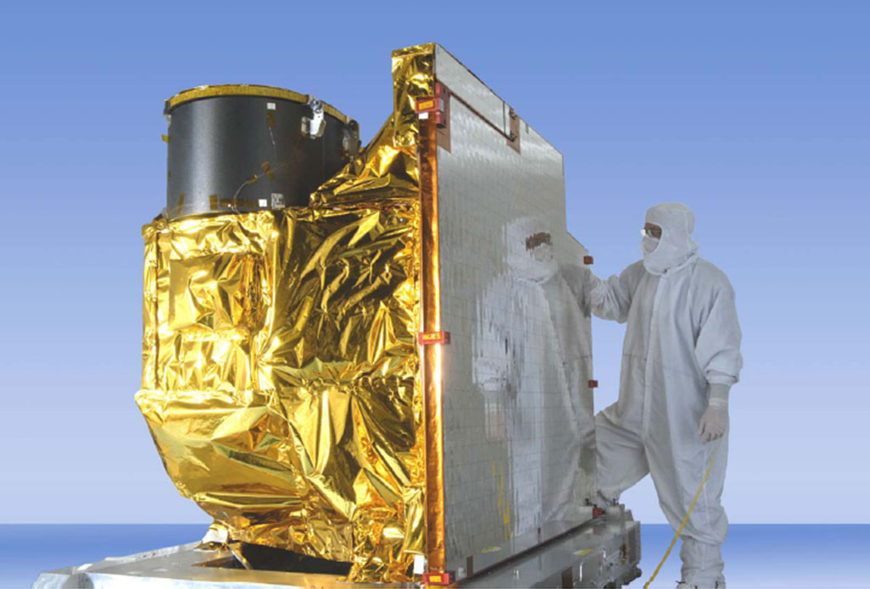
Advanced Baseline Imager (ABI)
5
4
3
X
Faster scanning (5-minute full disk vs. 25-minute)
X
Improved spatial resolution (2 km IR vs. 4 km)
X
More spectral bands (16 on ABI vs. 5)

Slide 7
Advanced Baseline Imager Spectral Bands
AHI Band | AHI Approximate Central Wavelength (μm) | ABI Approximate Central Wavelength (μm) | ABI Band | Type | Nickname
1 | 0.47 | 0.47 | 1 | Visible | Blue
2 | 0.51 |  |  | Visible | Green
3 | 0.64 | 0.64 | 2 | Visible | Red
4 | 0.86 | 0.86 | 3 | Near-Infrared | Veggie
 |  | 1.4 | 4 | Near-Infrared | Cirrus
5 | 1.6 | 1.6 | 5 | Near-Infrared | Snow/Ice
6 | 2.3 | 2.2 | 6 | Near-Infrared | Cloud Particle Size
7 | 3.9 | 3.9 | 7 | Infrared | Shortwave Window
8 | 6.2 | 6.2 | 8 | Infrared | Upper-level Water Vapor
9 | 6.9 | 6.9 | 9 | Infrared | Mid-level Water Vapor
10 | 7.3 | 7.3 | 10 | Infrared | Lower-level Water Vapor
11 | 8.6 | 8.4 | 11 | Infrared | Cloud-Top Phase
12 | 9.6 | 9.6 | 12 | Infrared | Ozone
13 | 10.4 | 10.3 | 13 | Infrared | “Clean” Longwave Window
14 | 11.2 | 11.2 | 14 | Infrared | Longwave Window
15 | 12.4 | 12.3 | 15 | Infrared | “Dirty” Longwave Window
16 | 13.3 | 13.3 | 16 | Infrared | CO₂ Longwave

Slide 8
Improved temporal resolution
Current GOES imager:
CONUS covered once every fifteen minutes, except during rapid scan operations
One full disk every three hours
GOES-R/S ABI:
In one hour:
4 full disk images, 12 CONUS sectors, and 120 mesoscale sectors
OR
Twelve full disk images

Slide 9
ABI Visible Bands
Current GOES imager: one band at 1 km resolution
GOES-R ABI: one band at 0.5 km resolution, one band at 1 km resolution
Benefits to the operational meteorologist:
Better resolution of cloud features and cloud-enhanced boundaries
Easier monitoring of smoke and aerosols
Ability to produce pseudo-true color imagery

Slide 11
ABI Band 2 (0.64 μm) Example from the Advanced Himawari Imager
Kuchinoerabu-jima

Slide 12
ABI Near-Infrared Bands
Current GOES imager: No near-infrared bands
GOES-R ABI: Four near-infrared bands, two at 1 km resolution, two at 2 km resolution
Benefits to the operational meteorologist:
Depiction of vegetation health/coverage
Sharper coastlines and easier detection of inland river flooding
Easier cirrus cloud and cloud-phase discrimination
Nocturnal fire detection

Slide 13
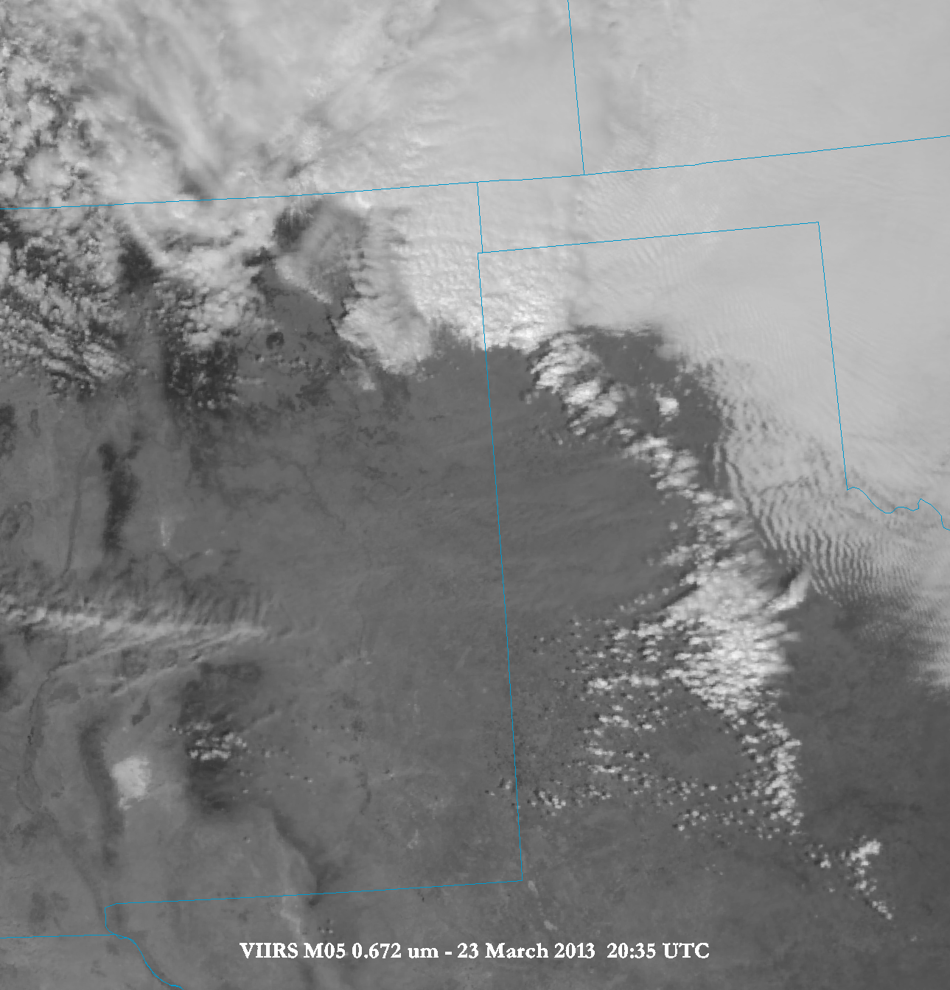
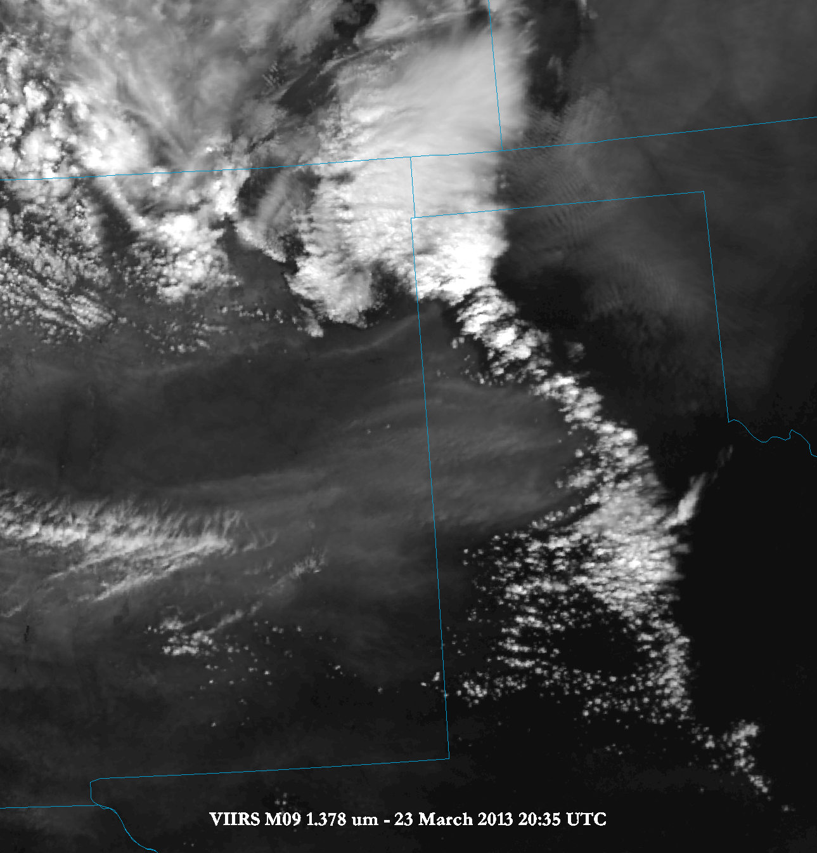
ABI Band 4 (1.4 μm) Example from the Visible Infrared Imaging Radiometer Suite (VIIRS)
In dry environments, the ABI Band 4 is useful for identifying areas of dust, compared to traditional visible imagery.

Slide 14
ABI Band 5 (1.6 μm) Example from the Advanced Himawari Imager
Water clouds
Ice clouds

Slide 15
ABI Infrared Bands
Current GOES imager: four bands at 4 km resolution
GOES-R ABI: ten bands at 2 km resolution
Benefits to the operational meteorologist:
Fire detection with better thermal signal
Resolution of middle and upper tropospheric water vapor features
Detection of sulfur dioxide and upper-atmosphere ozone
Several window channels for discerning low-level water vapor gradients

Slide 16
Extratropical Transition
Typhoon Atsani
AHI Band 8 (6.2 μm)
24 August 2015

Slide 17
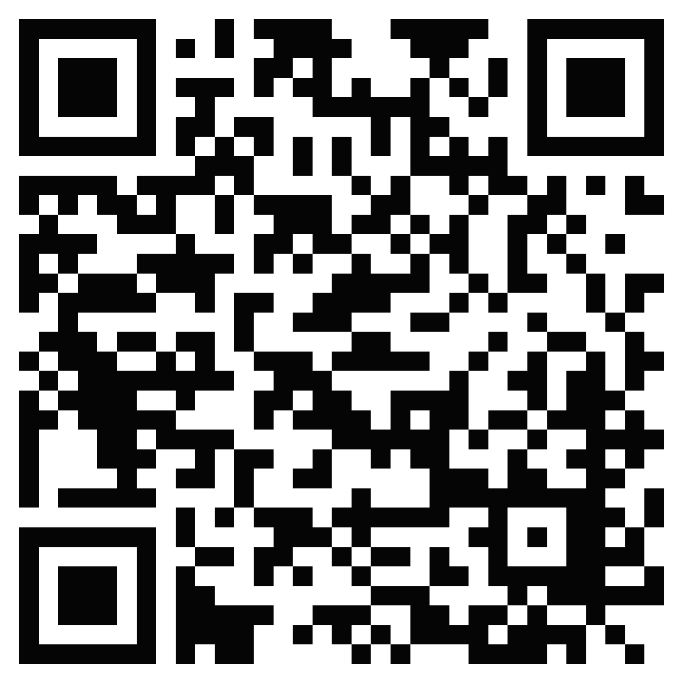
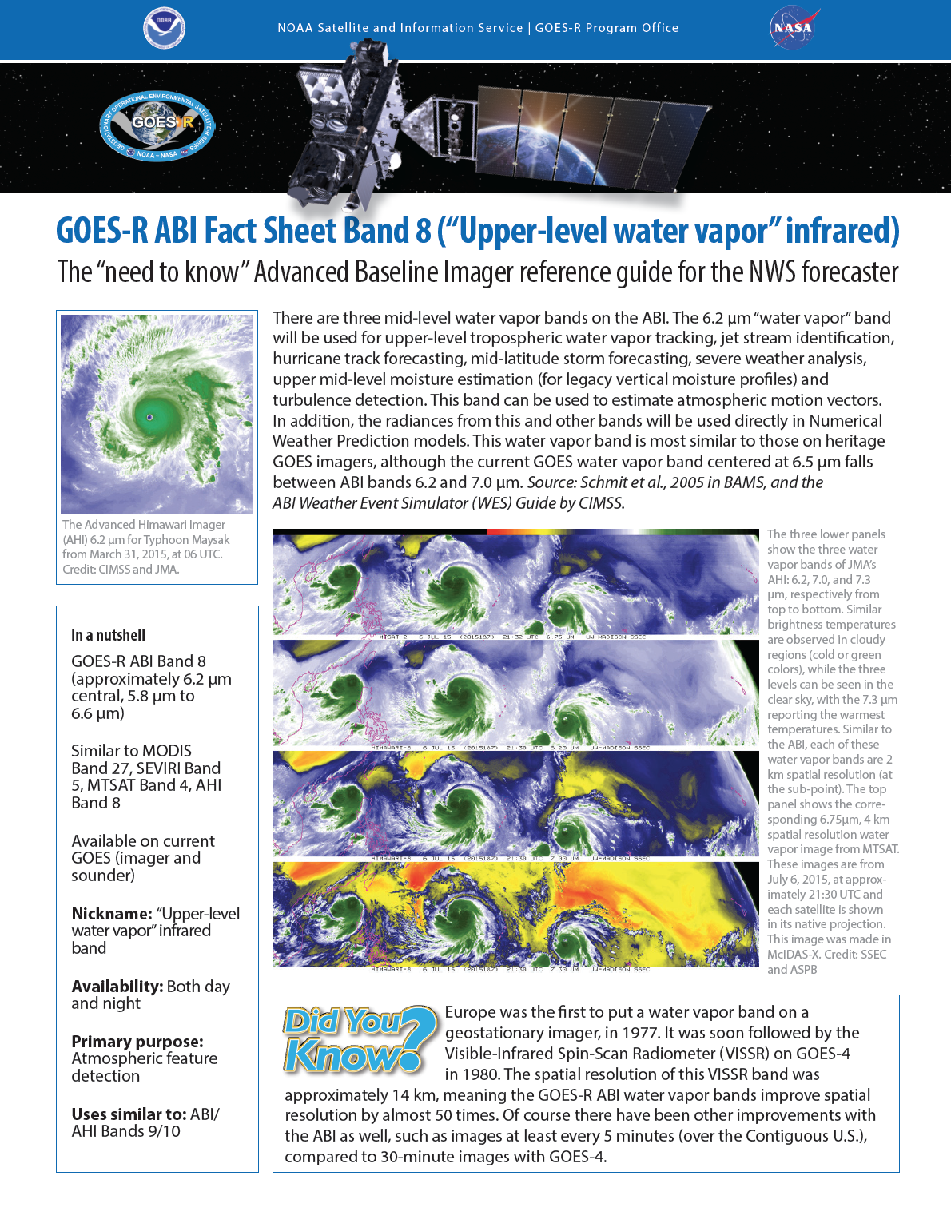
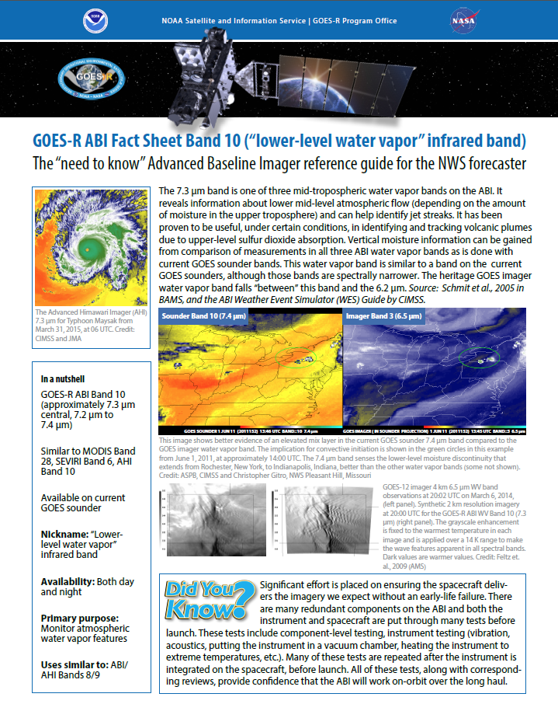
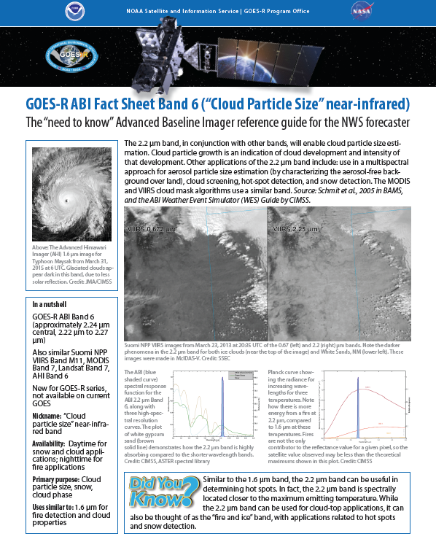
ABI quick reference guides
The University of Wisconsin and NOAA are developing a quick reference guide for each one of the ABI bands with forecaster-pertinent information.
More training on GOES-R is available from COMET
http://www.goes-r.gov/

Slide 19
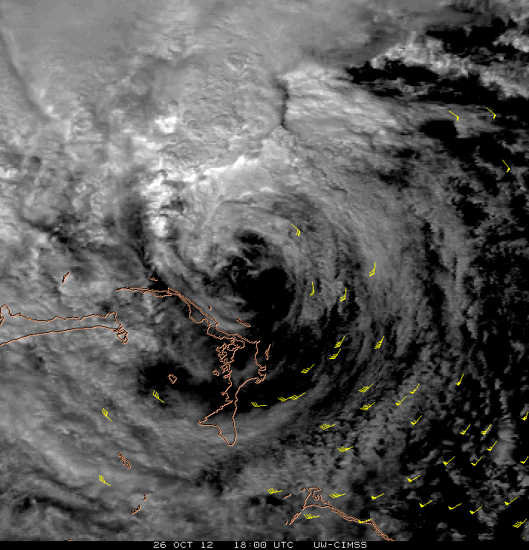
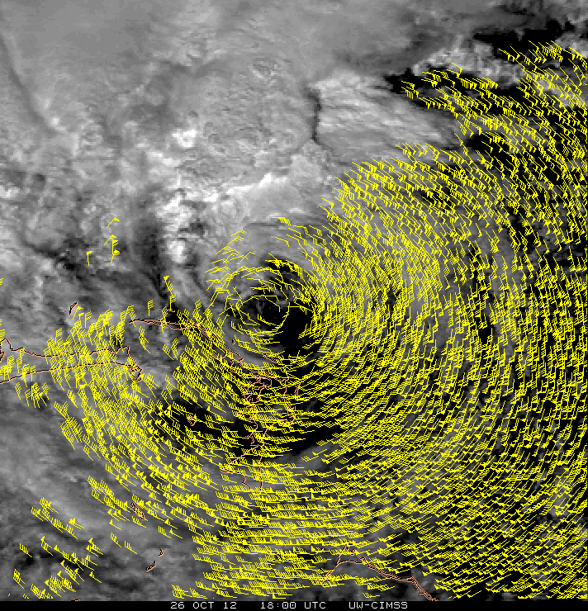
Atmospheric Motion Vectors (AMVs)
Low-Level (700-950 hPa) Vectors from Visible Imagery
AMVs from 15-minute images (routine GOES imager sampling) AMVs from 1-minute images (mesoscale GOES-R ABI sampling)
Hurricane Sandy case from GOES-14 – 18:00 UTC 26 October 2012
C. Velden (CIMSS)
19

Slide 20
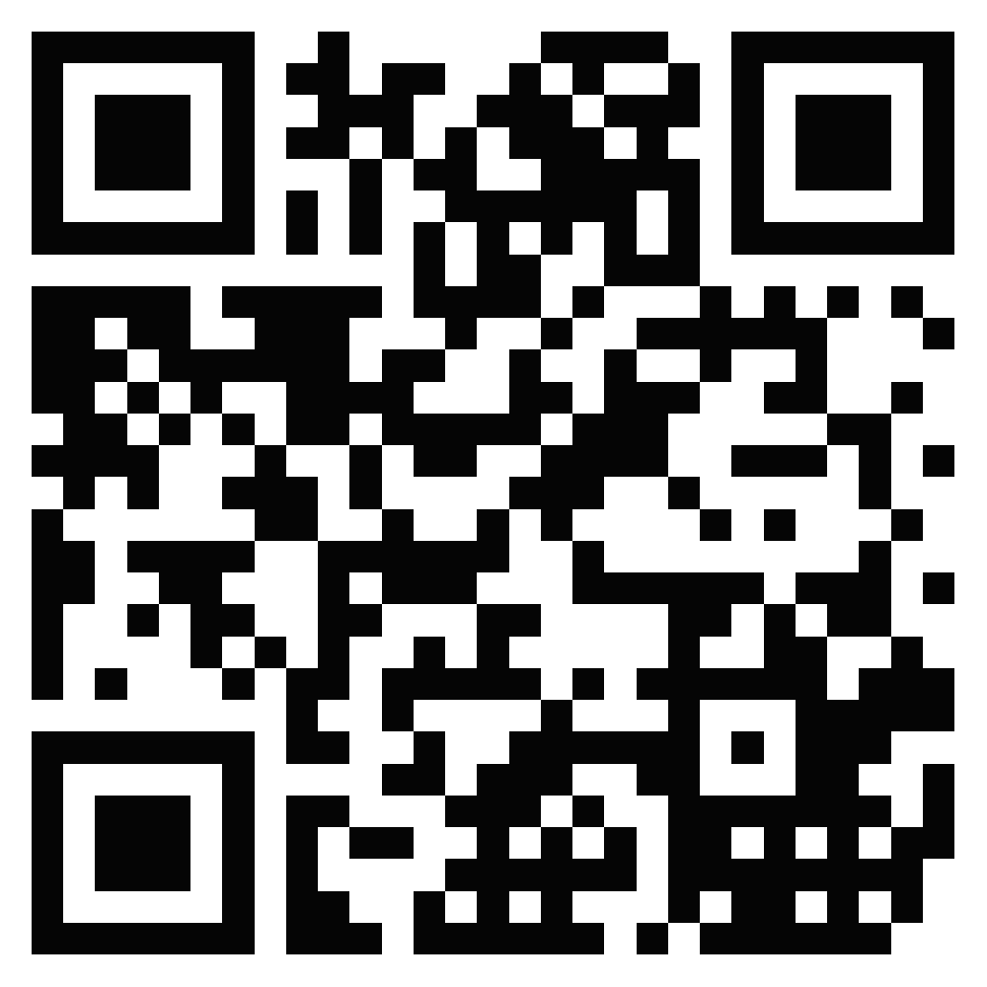
Find Himawari-8 imagery online
Japan Meteorological Agency
http://www.data.jma.go.jp/mscweb/data/himawari/
University of Wisconsin
http://www.ssec.wisc.edu/data/geo/
http://realearth.ssec.wisc.edu/
Colorado State University
http://rammb.cira.colostate.edu/ramsdis/online/himawari-8.asp

Slide 21
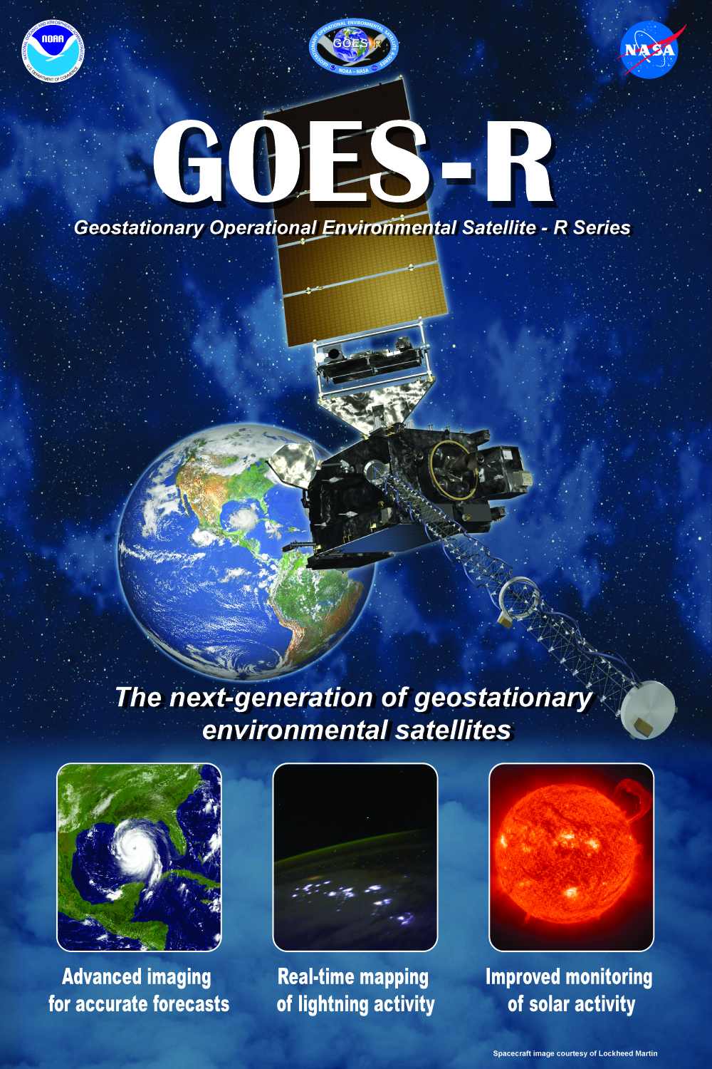
Thank you!
For more information, visit www.goes-r.gov
or e-mail
Jordan.Gerth@noaa.gov
www.facebook.com/GOESRsatellite
www.youtube.com/user/
NOAASatellites
twitter.com/NOAASatellites
www.flickr.com/photos/
noaasatellites

