Slide 1

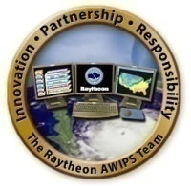
AWIPS II and GOES-R:
When updated information processing systems and new satellites meet
Jordan Gerth, Research Assistant
Cooperative Institute for Meteorological Satellite Studies, University of Wisconsin
Tuesday, November 9, 2010
Eastern Region Virtual Satellite Workshop

Slide 2
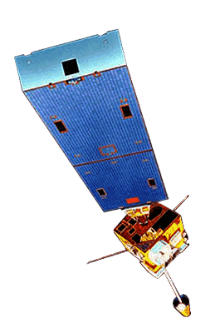

Presentation Outline
Introduction to GOES-R/S Series
  GOES-R Proving Ground and Partners
Introduction to AWIPS II, AWIPS Technology Infusion
Why AWIPS II must be the future
Data Implications from GOES-R
  Is the delivery of high spatial, spectral, and temporal resolution data from GOES-R necessary?
RGB/RGBA Image Combinations
Today’s Primary Delivery Mechanisms
  Case Study: POES Imagery
Delivery Mechanisms of Tomorrow
Conclusions and Future Directions

Slide 3
GOES-R/S Series
Geostationary Operational Environmental Satellite
Scheduled for launch in 2015, and expected for operational use as GOES-West starting in 2017, GOES-R will represent the first significant upgrade in capabilities to the United States’ geostationary satellite series since 1994
GOES-S (East) will launch in 2017 for operational use in 2020
The Advanced Baseline Imager (ABI) will provide 5x faster spatial coverage, 4x improved resolution, and 3x more spectral channels than currently on GOES-13/14/15 (N/O/P)
An optical sensor on the Geostationary Lightning Mapper (GLM) will provide continuous lightning flash rates
No Sounder until at least GOES-U, scheduled for launch in 2027, expected operational in 2028

Slide 4
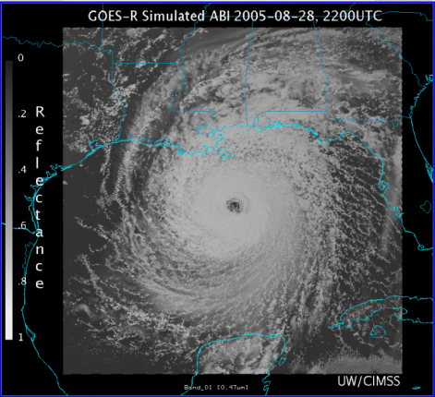
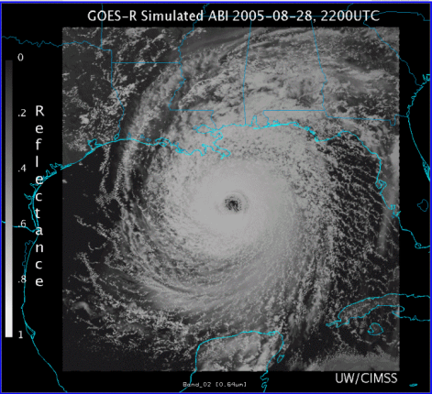
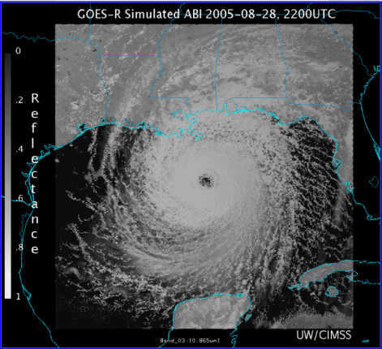
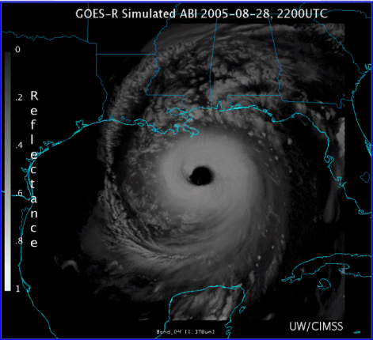
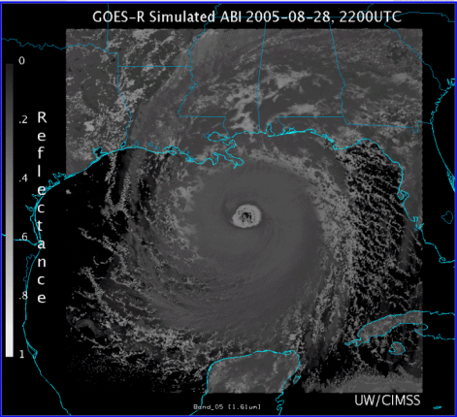
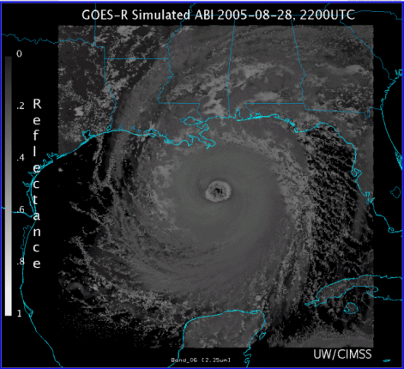
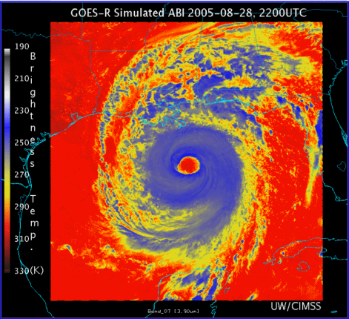
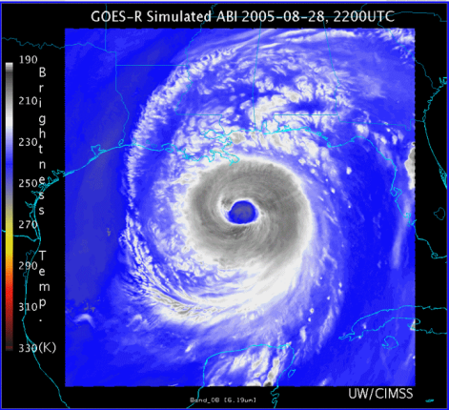
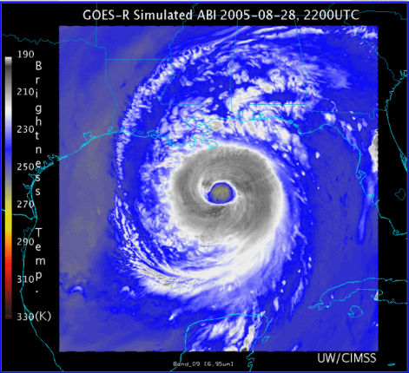
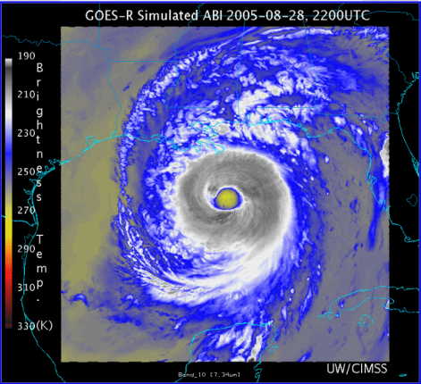
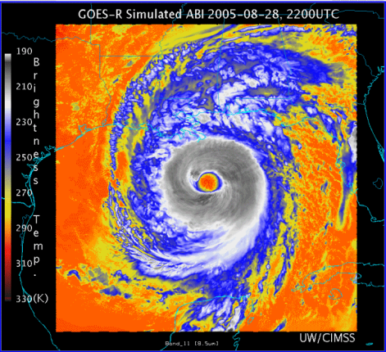
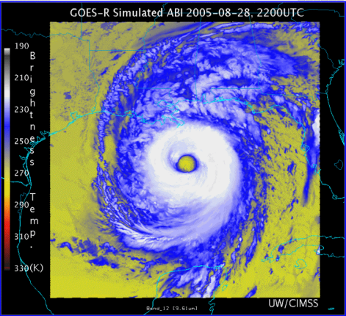
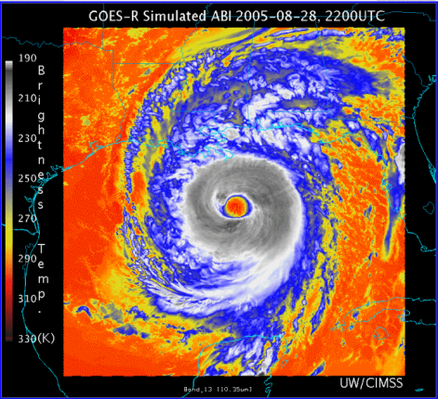
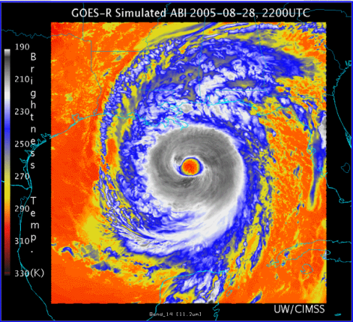
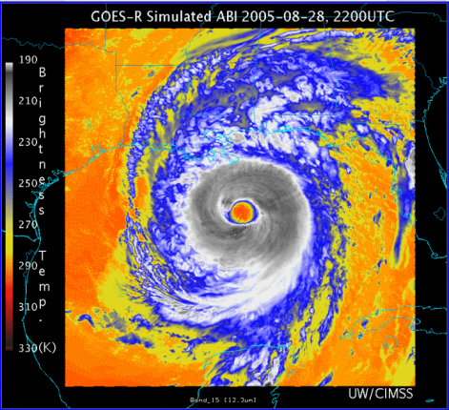
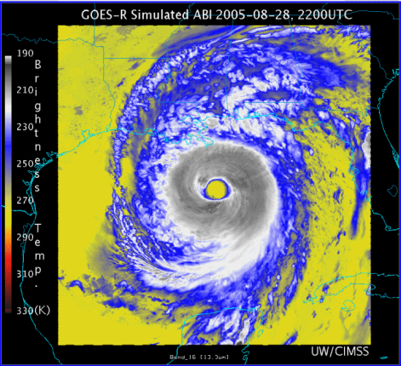
0.47 μm
0.64 μm
0.86 μm
1.38 μm
AWG Proxy ABI Simulations of Hurricane Katrina
1.61 μm
2.26 μm
3.9 μm
6.19 μm
NOAA/NESDIS STAR and GOES-R Imagery Team
6.95 μm
7.34 μm
8.5 μm
9.61 μm
10.35 μm
11.2 μm
12.3 μm
13.3 μm
Notes:
As shown in mcidas-v

Slide 5
GOES-R Proving Ground
A proving ground is designed to showcase future capabilities and identify possible gaps as a forward-thinking exercise to prepare the end user for upcoming science and technology.
The GOES-R Proving Ground connects research and operations to assure widespread day-one readiness through:
  Applying current earth observing systems and numerical weather prediction models to demonstrate GOES-R capabilities today
  Transitioning new algorithms and techniques to the field early to assure forecaster familiarity with GOES-R products
  Making operational meteorologists part of the discussion when it comes to designing and implementing effective GOES-R decision support products and visualization tools
The GOES-R Proving Ground is a collective effort between many NOAA and NOAA-supported agencies and universities.

Slide 6
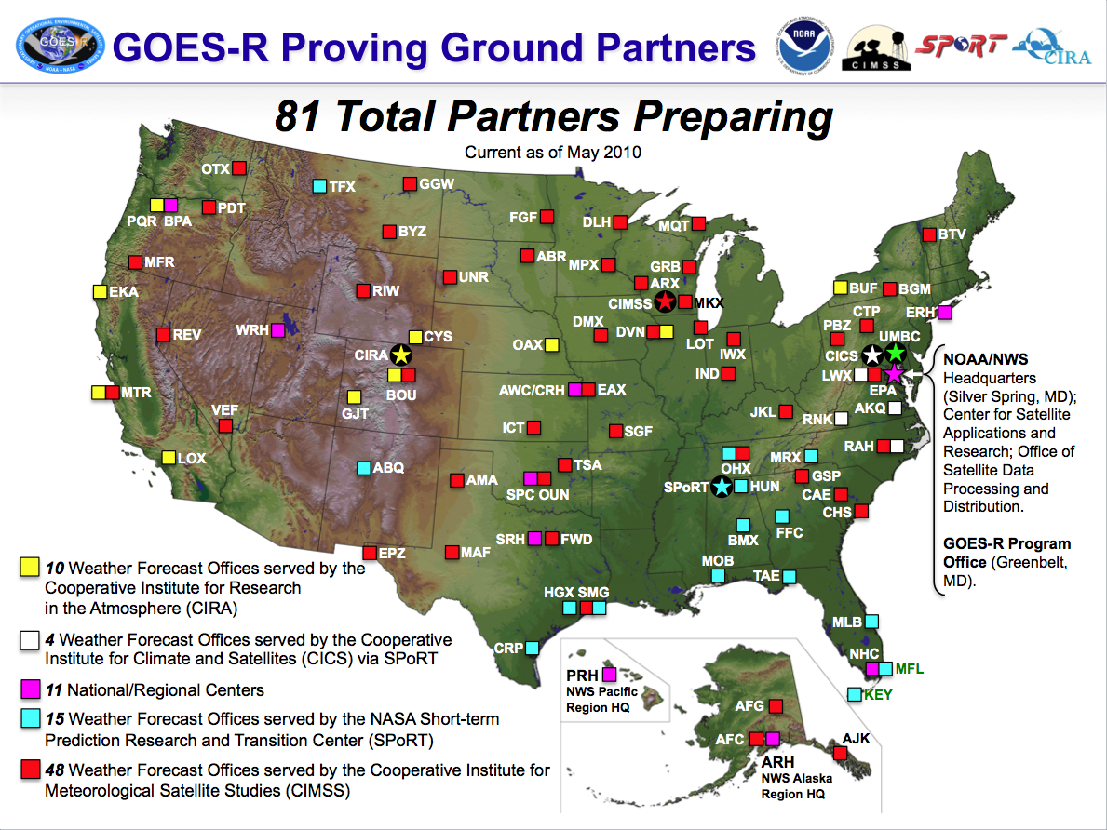

Slide 7
AWIPS “I”
Advanced Weather Interactive Processing System
The primary tool used at National Weather Service offices across the country for weather data visualization and product issuance, fielded in 1998 after a lengthy development throughout the 1990s
Display panes in Display Two-Dimensions
  Six pre-defined scales
  Centric to the geographic location of the NWS forecast office
  Zooming and panning on a pane confined to the scale
  Limited high-resolution data beyond localized area of responsibility
Single-layer data displays restrict the compositing of multiple datasets to provide blended products
  8-bit (256) color
  Only two images are allowed to overlay
  Difficult to synthesize a large amount of information at a single time
Certain datasets confined to specific scales based on spatial resolution
  Expected that radar data would only be viewed on local area scales
  Model data intended for viewing on regional and national scales

Slide 8
AWIPS “II”
AWIPS II brings a new, integrated mapping interface which allows much more flexibility to meteorological analysis and data interrogation over large areas
Gone are
  the resolution restrictions to scales
  the expectations that certain data is only useful on certain scales
AWIPS II represents an end-to-end, design-level overhaul of the legacy AWIPS “1” to respond to changes in technology and data requirements over the previous decade
  Maintains user interface nearly similar to AWIPS I
AWIPS Technology Infusion will occur in two phases:
  Migrating the current functionality over to a service-oriented architecture (SOA) based in Java and employing other open source software to accomplish tasks (Expected deployment in 2011)
  Extending and evolving the functionality across all levels of the NWS enterprise to include the capabilities of the current National Center AWIPS (N-AWIPS) and Weather Event Simulator (WES)
Central components of the migrated software will be available to academic institutions and others through Unidata, but not considered open source
The migrated AWIPS software signals the end of the coupling of the AWIPS software to the data distribution network was has long inhibited the expansion of narrowly focused datasets and model output into the field

Slide 9
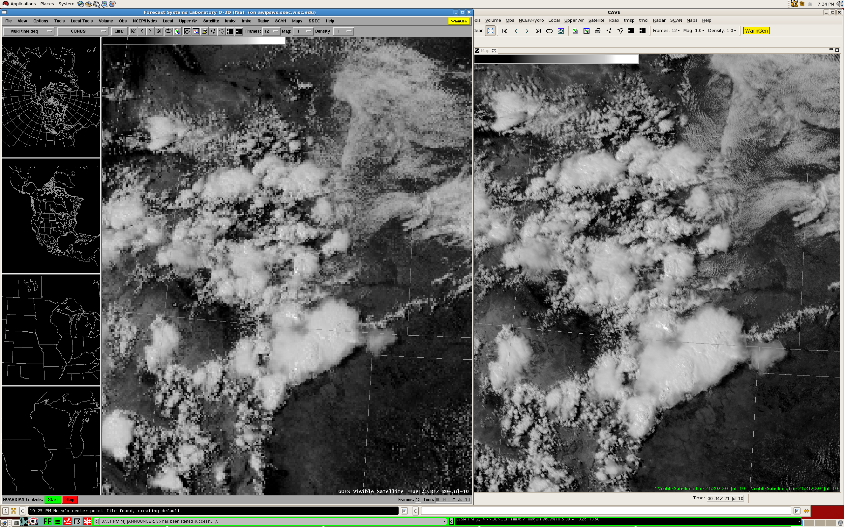
AWIPS II does not regionalize high-resolution geostationary satellite imagery like legacy AWIPS
AWIPS I
AWIPS II

Slide 10
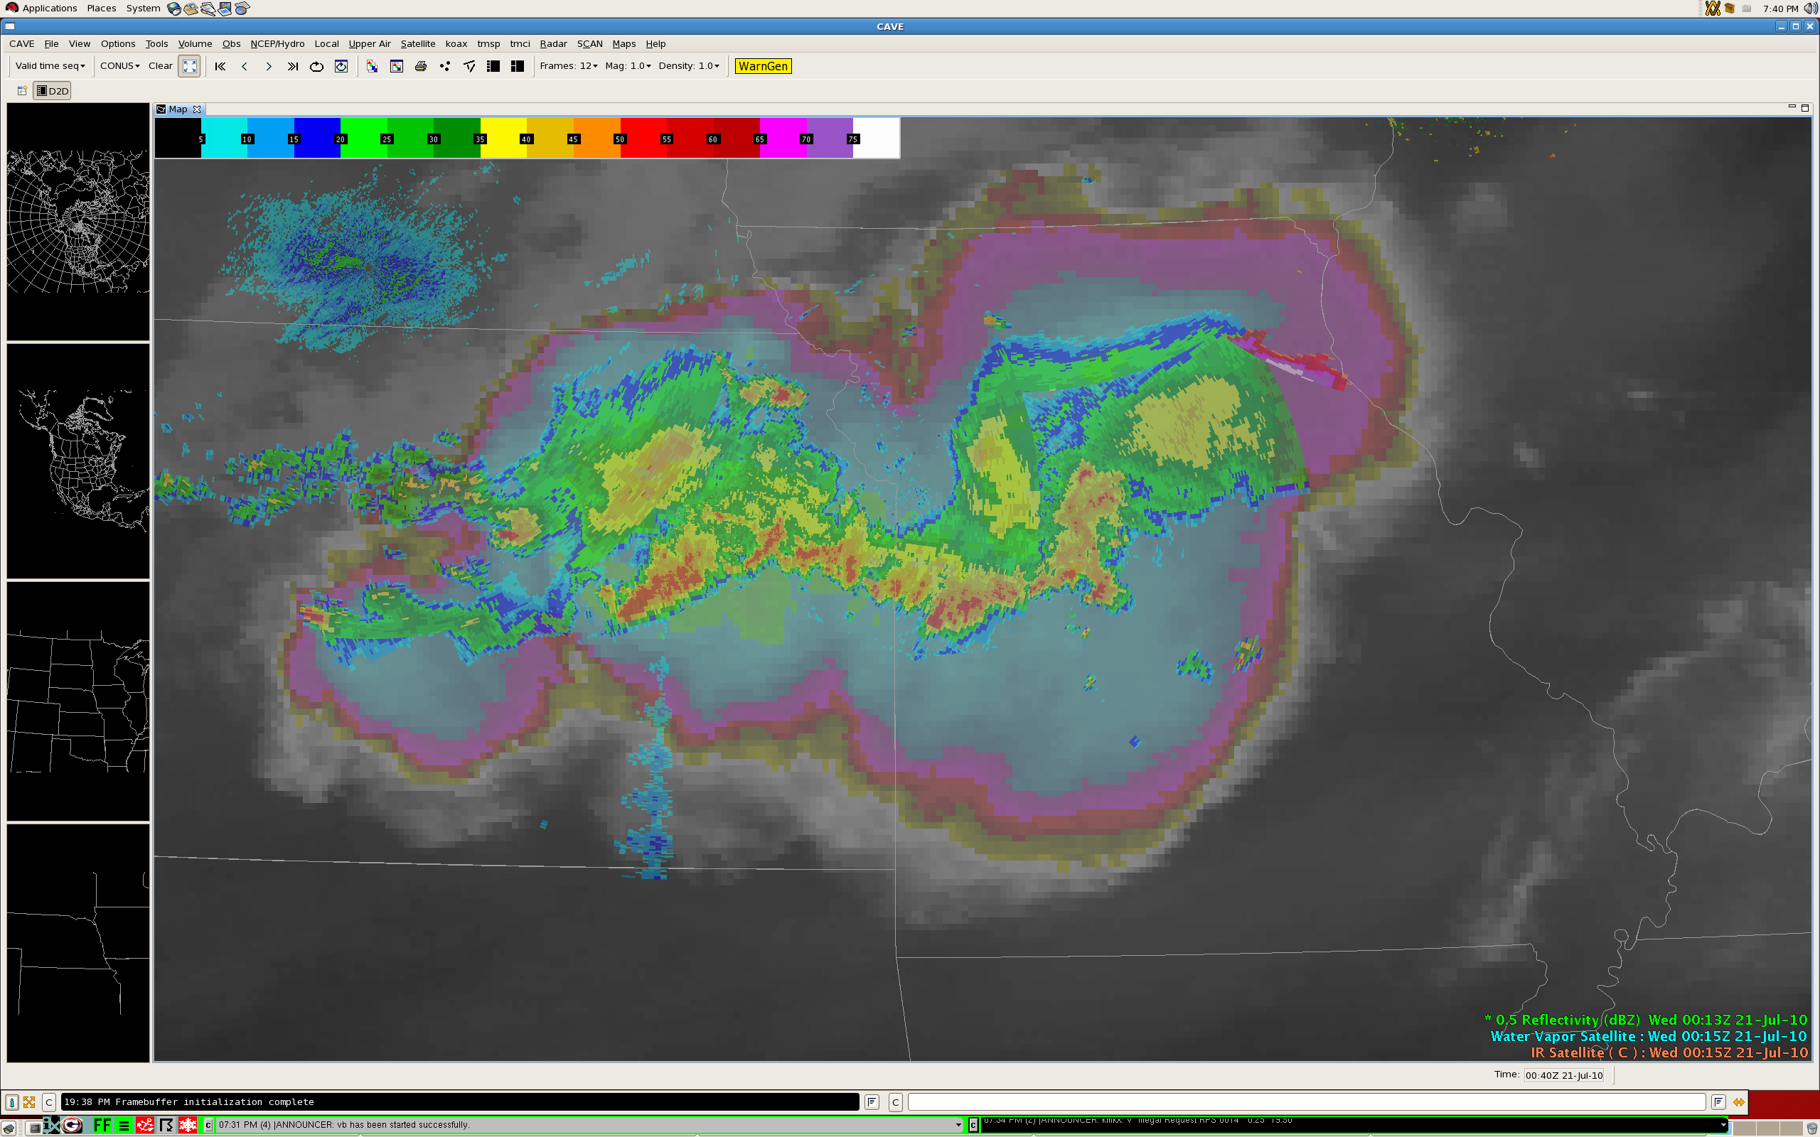

Slide 11
AWIPS II – The Near Term
Necessary to meet the requirements of tomorrow’s hydrometeorological datasets
  Effectively and dynamically producing displays using the graphics card
    Integrating multiple datasets “on the fly” to minimize forecaster use of multiple products for similar information
  Modernizing and standardizing data storage repositories and the discovery database (for metadata)
    Optimizing access attempts for quickest ingest and display
  Development must continue to keep pace with existing technology
Because of the complexities resulting from a service-oriented architecture, developers will need more training to effectively extend the software
Local application development should not occur without adequate governance
  Plug-ins are essentially required to run within AWIPS II, and it is unlikely most will be able to run independently as with legacy AWIPS

Slide 12
GOES-R/S Series – The Far Term
The additional capabilities of the ABI will produce approximately 60 times (5x4x3) more data than the current GOES Imager
If data is delivered at full bit depth (12 to 14 bits), approximately 50% more bandwidth will be required
Delivering geostationary satellite data in 2020 using a similar methodology as today may require up to 90 times more bandwidth than currently, compression aside, not including products
The questions we have to answer:
  Are the visualization tools in place to allow for effective interrogation of this data?
  How can we better devise blended products to deliver more information to the forecaster without requiring the review of multiple images (from different bands, satellites, times)?
  Is all satellite imagery needed by all AWIPS sites all the time?
    Is it time to rethink the delivery paradigm? Delivery data format?

Slide 13
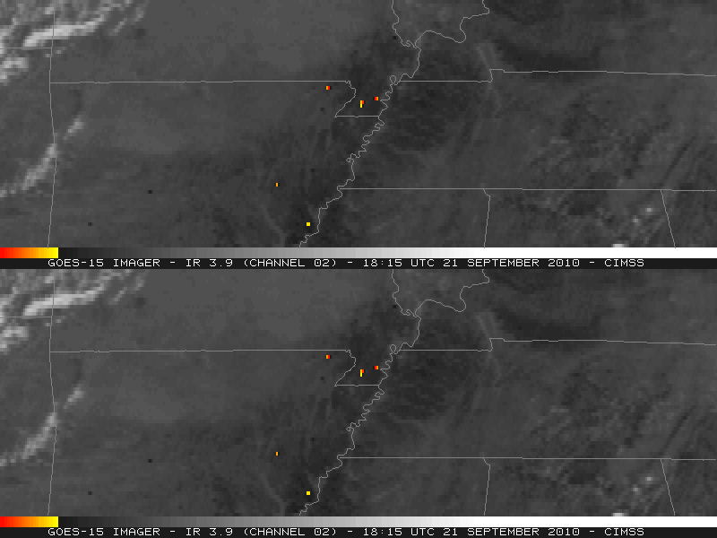
High Temporal Resolution (SRSO)
Fire detection using shortwave infrared (3.9 µm) imagery
1-minute
GOES-15 SRSO
Example courtesy of Scott Bachmeier, CIMSS
15-minute
GOES-15 scans

Slide 14
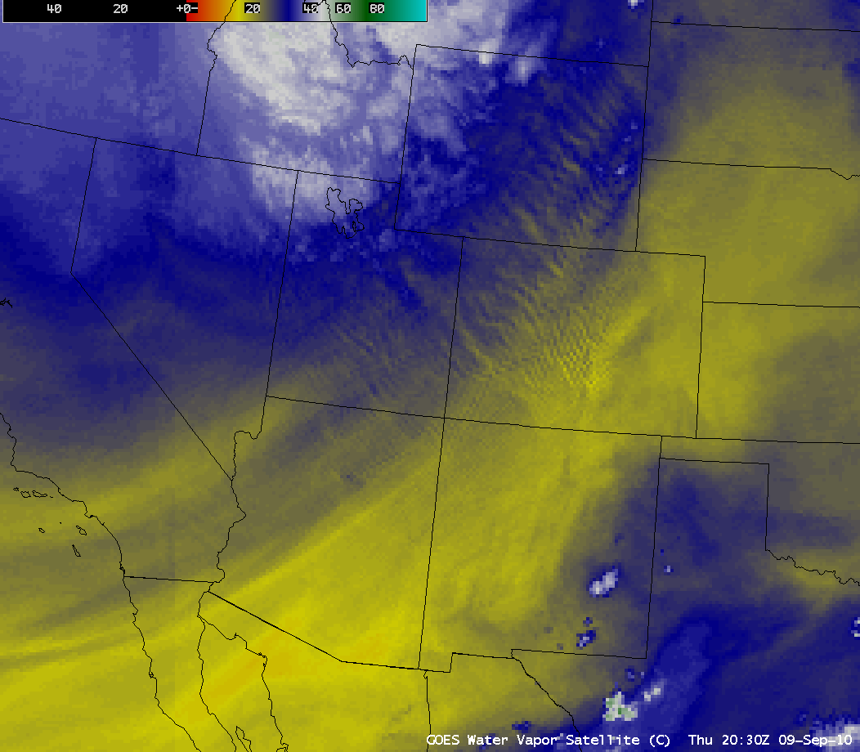
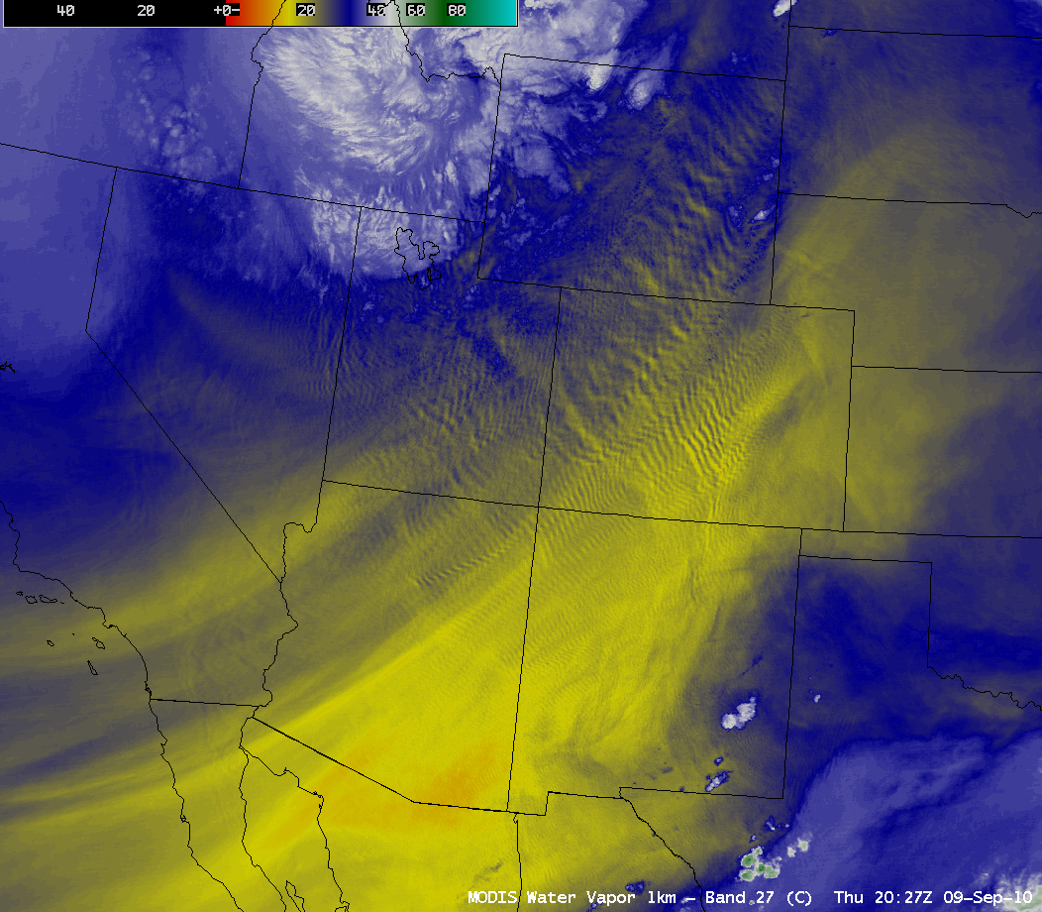
High Spatial Resolution
There will be three water vapor channels on GOES-R at nadir resolution of 2 km.
Mountain wave detection using water vapor imagery
Example courtesy of Scott Bachmeier, CIMSS
GOES 4km Resolution
MODIS 1km Resolution

Slide 15
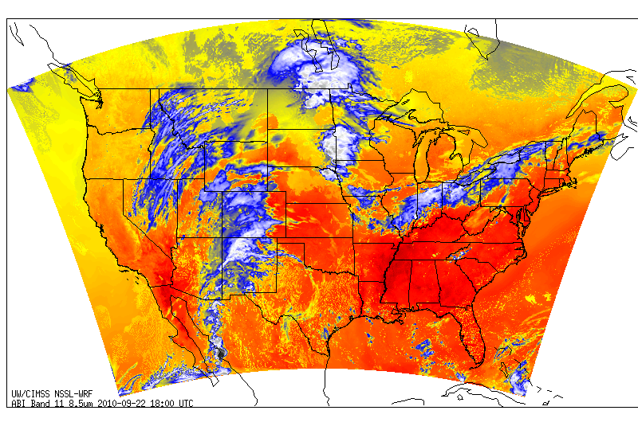
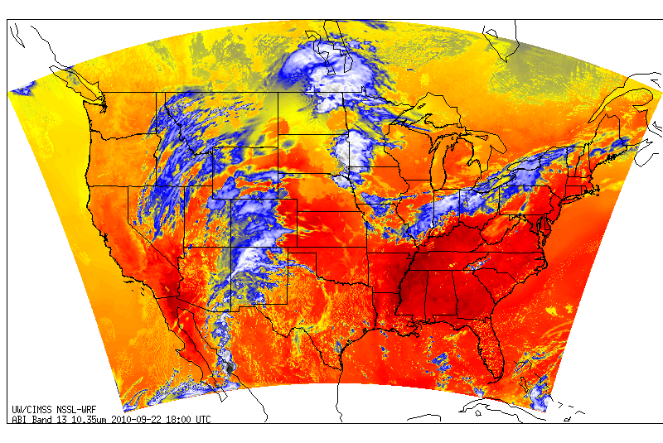
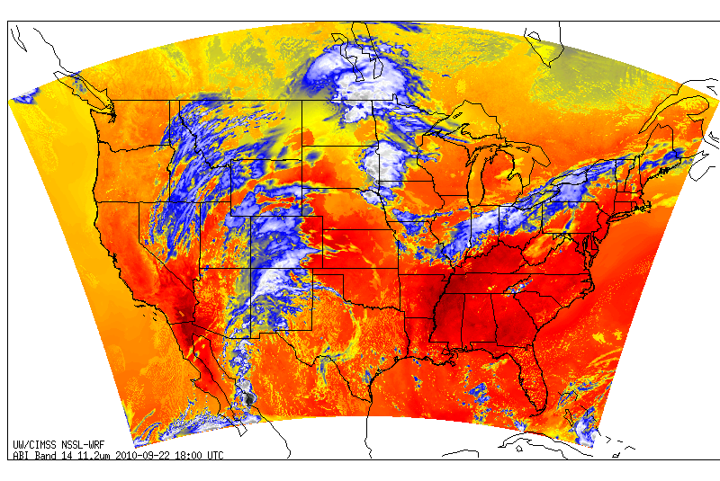
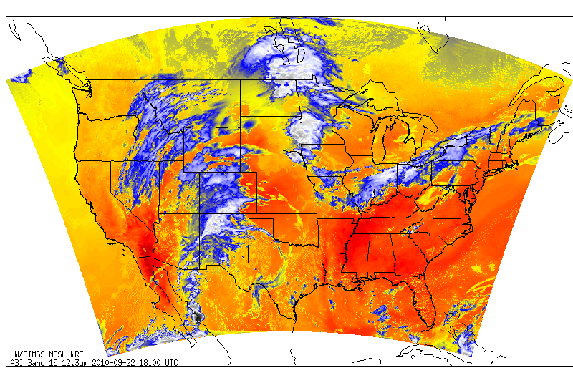
Different Spectral Channels
http://cimss.ssec.wisc.edu/goes_r/proving-ground/nssl_abi/nssl_abi_rt.html
ABI
Band 11 (8.5 µm)
ABI
Band 13 (10.35 µm)
ABI
Band 14 (11.2 µm)
ABI
Band 15 (12.3 µm)
Images courtesy of Justin Sieglaff, CIMSS
Simulated ABI imagery from NSSL-WRF

Slide 16
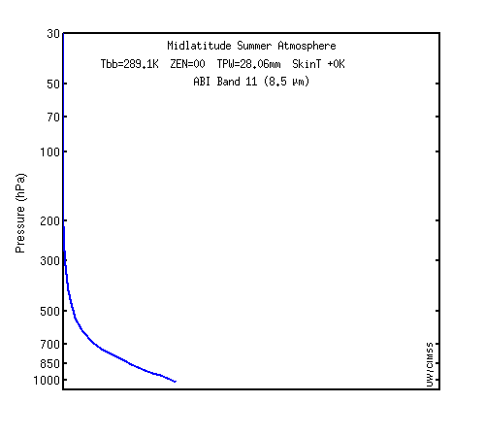
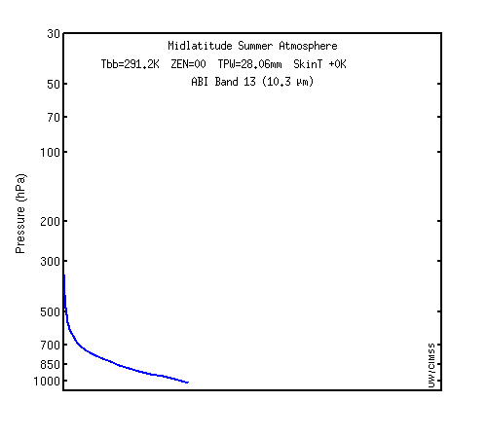
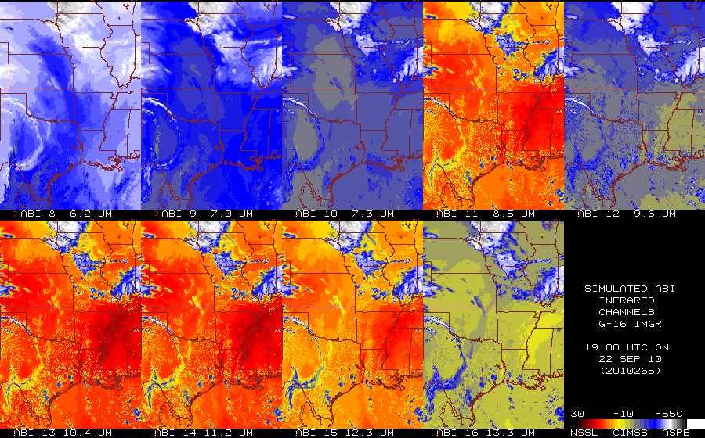
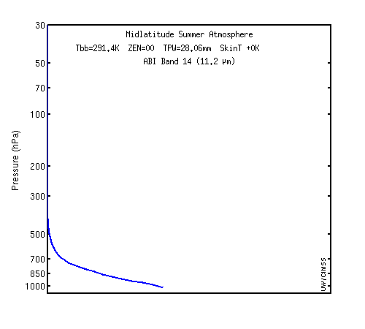
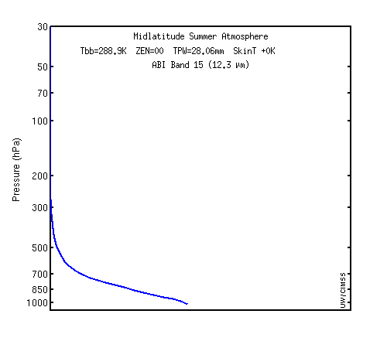
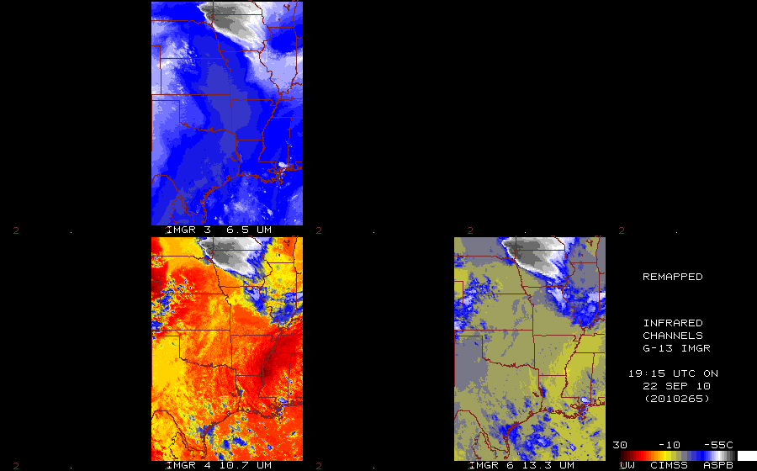
Useful for Operations?
http://cimss.ssec.wisc.edu/goes/wf/ABI/
Simulated GOES-R Imagery
“dirty”
ABI
Band 11 (8.5 µm)
ABI
Band 13 (10.35 µm)
ABI
Band 14 (11.2 µm)
ABI
Band 15 (12.3 µm)
“dirty”
Plots courtesy of Mat Gunshor, CIMSS
GOES-13 Observed Imagery
Midlatitude summer weighting functions

Slide 17
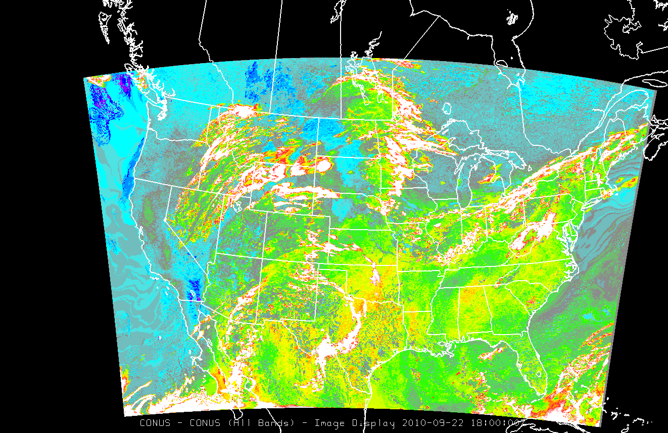

Useful for Operations?
Linear simulated ABI band combination: (11+13)–(15+14)
Clouds
Increased low-level water vapor

Slide 18
RGB/RGBA Image Compositing
In order to maximize the use of current and future satellite imagery and products, as well as the software display, it is necessary to integrate and support a flexible bit depth data format and three-way or four-way (with an alpha channel) image blending functionality into the AWIPS II software.
This would leverage a red-green-blue-alpha (RGBA) capability in pre-release versions of the migrated software.
The implementation of a data format and display system allowing for bit depths greater than the current specification has numerous applications useful to operational weather analysis and forecasting beyond current capabilities and techniques, including but not limited to:
  the discrimination of snow cover from supercooled water droplet clouds,
  the discrimination of snow cover from areas with significant ice accrual,
  determining the areal extent of river flooding,
  assessing fire hot spots and burn scar coverage,
  determining vegetation properties,
  finding convincing damage swaths caused by tornadoes, hail, and wind,
  improved tropical cyclone analysis, and
  diagnosing swaths of wet ground following rain.

Slide 19
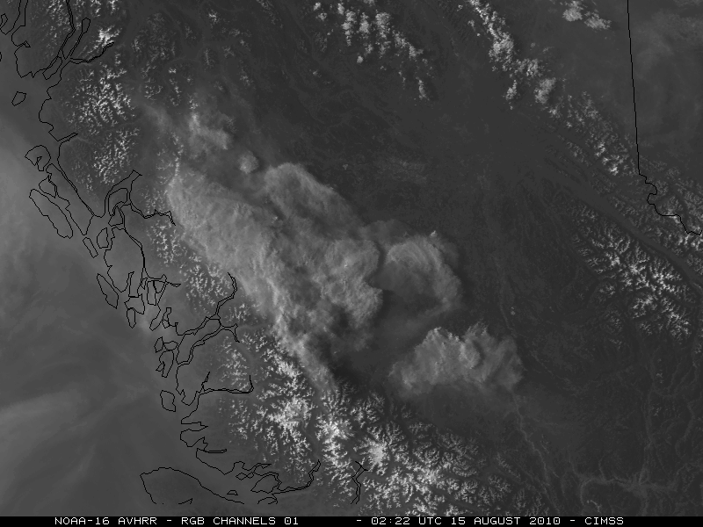
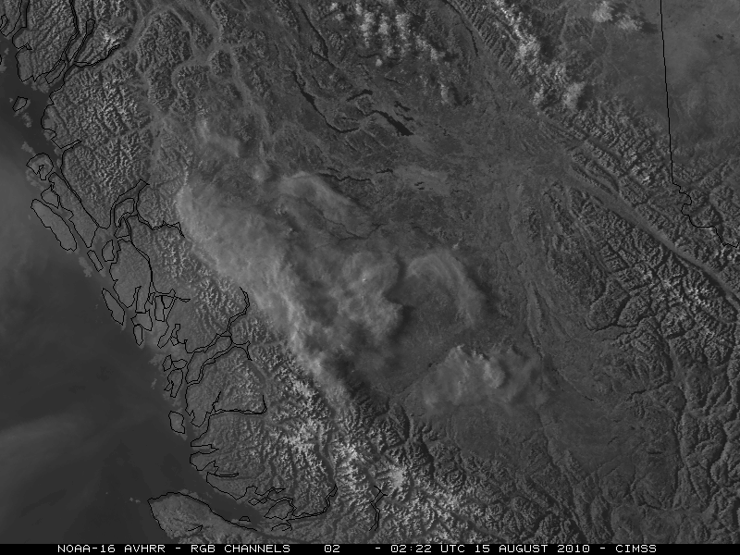
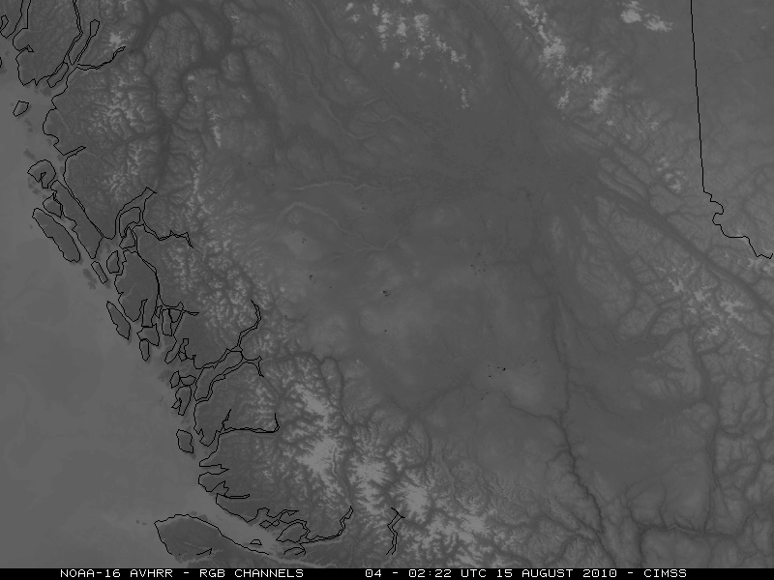
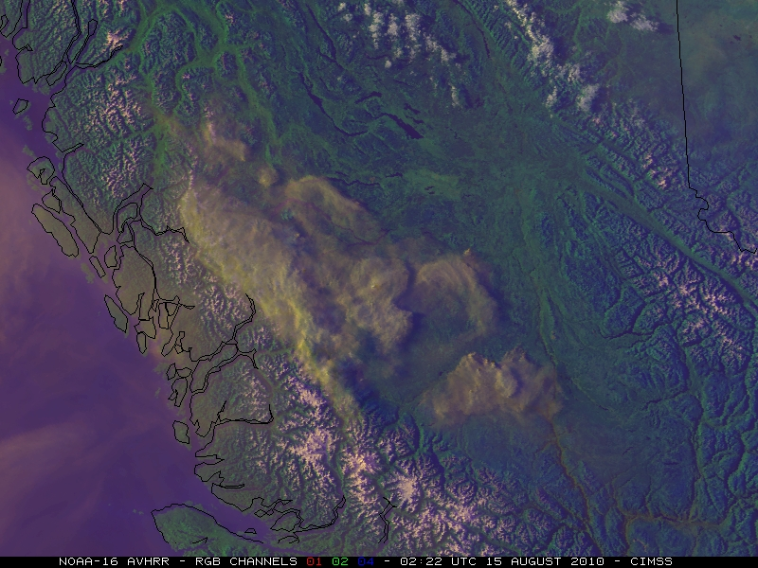
1 2
4 C
Example courtesy of Scott Bachmeier, CIMSS

Slide 20
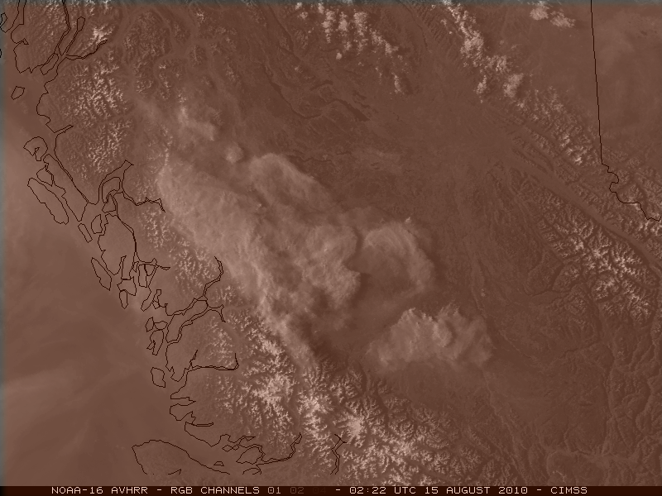
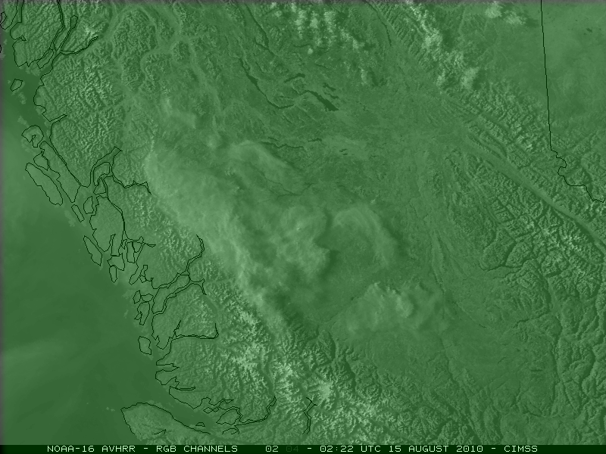
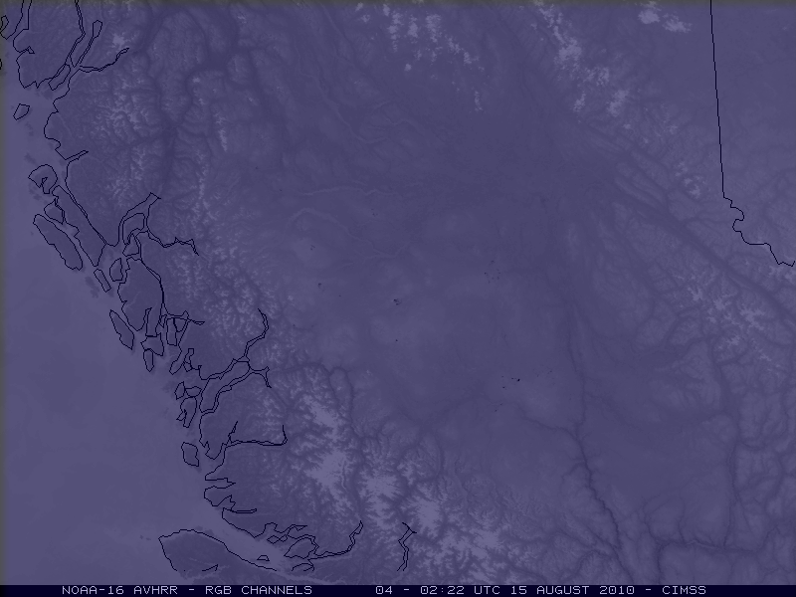
1 2
4 C
Example courtesy of Scott Bachmeier, CIMSS

Slide 21
Today’s Primary Delivery Mechanisms
NOAAPort: Satellite-based system used as the primary delivery mechanism for hydrometeorological data and model output to the field, as well as NOAA’s partners
  Strengths: Reliable and operationally supported, transmits broad range of data, bandwidth increase expected in 2011
  Weaknesses: Approval process for transmission lengthy, not all data within geographic area important to the user
Local Data Manager (LDM): Event-driven data sharing network that utilizes the Internet to mass move various data between NOAA agencies and universities
  Strengths: Easy delivery method to NWS field offices, widespread use throughout NWS enterprise and universities, user configurable to only ingest certain products
  Weaknesses: Not operational, strains bandwidth available to the field, limited connectivity to NOAA partners
Web: Displaying text data or images on a web page
  Widespread access, but outside of AWIPS, so data interrogation limited

Slide 22
Case Study: POES Imagery
In response to NWS AWIPS OB7 requirements, NESDIS planned to add NOAA polar-orbiter visible (0.63 µm), shortwave IR (3.7 µm), and longwave IR (10.8 µm) imagery to NOAAPort on June 7, 2006.
After testing, it was determined that there was an insufficient amount of bandwidth between NESDIS and the Network Control Facility (NCF). Thus, this imagery could not be broadcast and delivered to the field.
In 2009, CIMSS worked with NESDIS to obtain the code for adequately formatting the POES imagery into the standard distributable GINI format (AWIPS I/II decoder compliant), and adapting it to run in real-time at the University of Wisconsin.
Field sites can now obtain this imagery from CIMSS via LDM.
  Additional products also available.
NESDIS may be able to proceed with operational distribution no sooner than April 2011 (likely late 2011).
Eventually NPP/JPSS imagery should be available on NOAAPort.

Slide 23
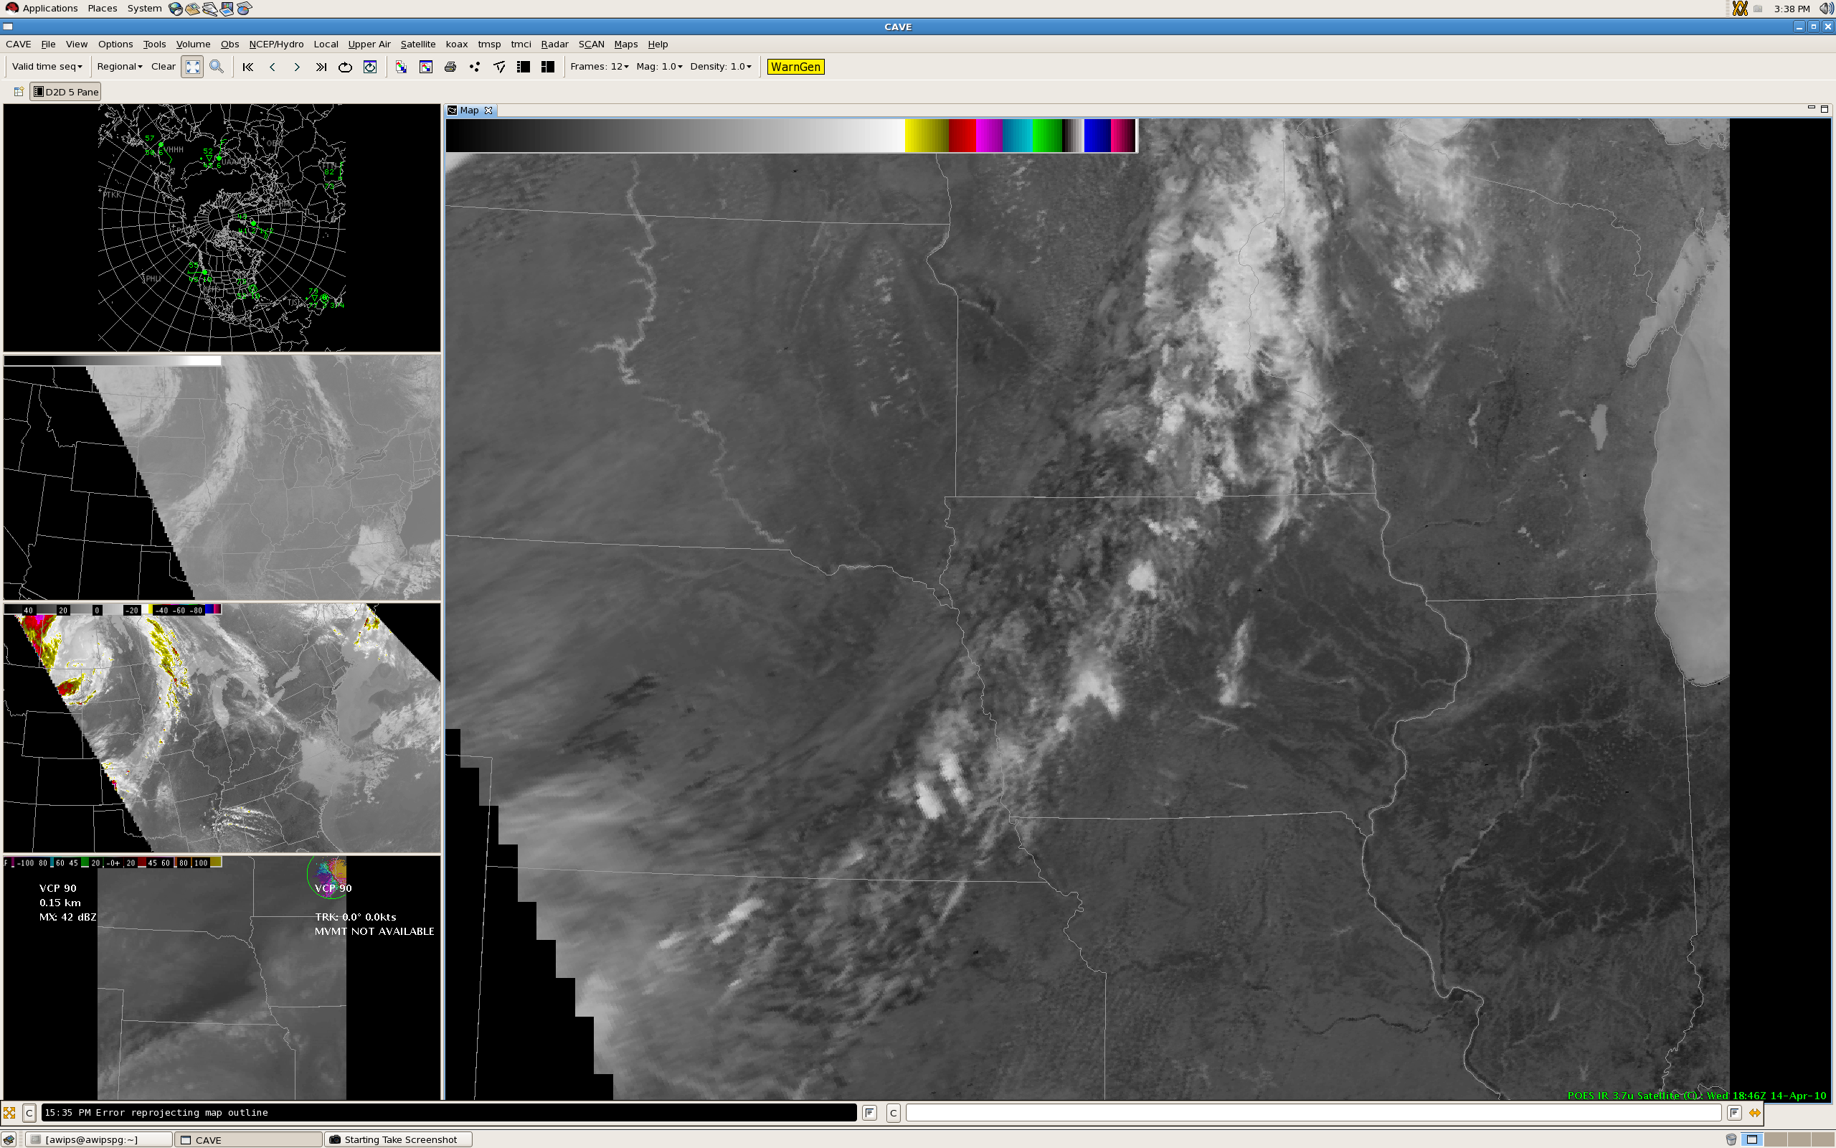

Slide 24
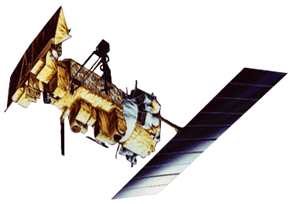
Case Study: POES Imagery
All NOAA Polar Operational Environmental Satellites (POES) are equipped with an Advanced Very High Resolution Radiometer (AVHRR) which has a resolution of 1.09 km at nadir.
Additional AVHRR imagery available includes:
  Band 2 (0.86 µm), for distinguishing land and water
  Band 5 (12.0 µm), for detecting volcanic ash
Additional AVHRR products available include:
  Sea Surface Temperature
  Cloud Type
  Cloud Top Temperature
  Cloud Top Height
  Cloud Optical Depth
  Cloud Particle Effective Radius
GINI Sector | Frequency
Alaska National | 12 to 14 per day
East CONUS | 10 per day
Hawai`i National | 2 per day
Puerto Rico Nat’l | 10 per day
West CONUS | 4 to 6 per day

Slide 25
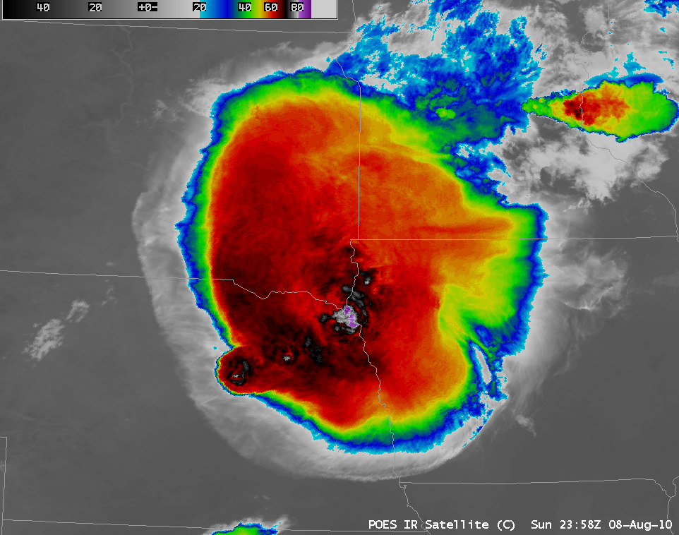
Example courtesy of Scott Bachmeier, CIMSS

Slide 26
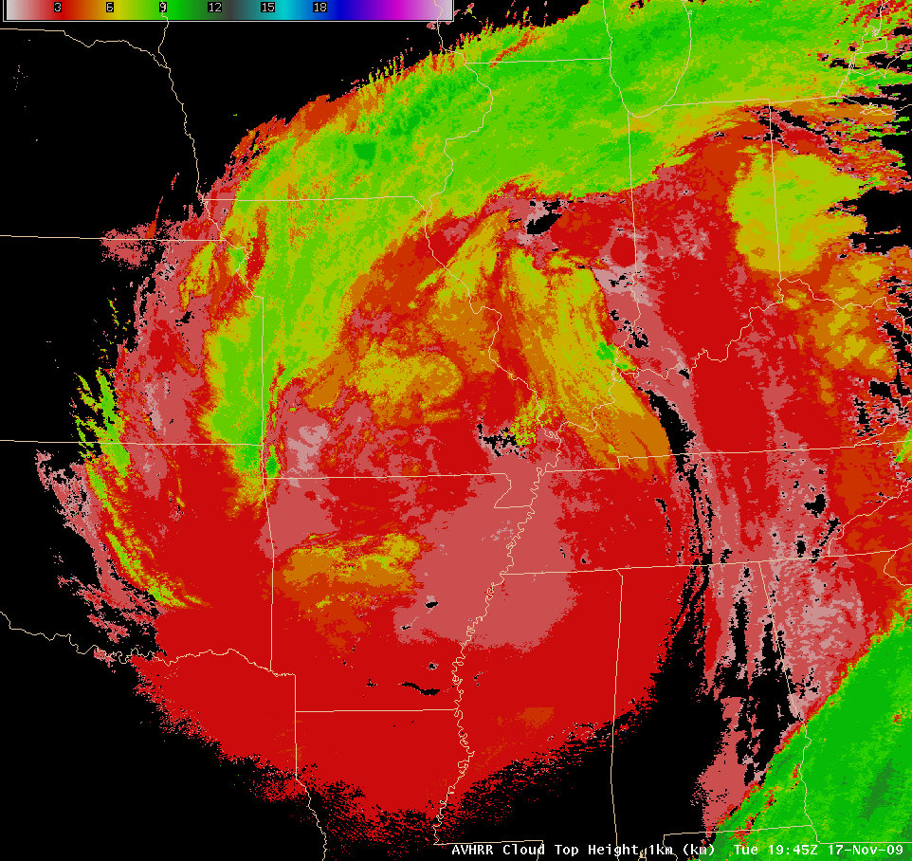
Example courtesy of Scott Bachmeier, CIMSS

Slide 27
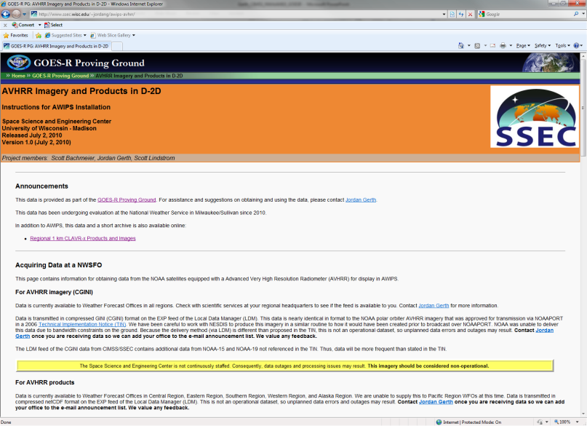
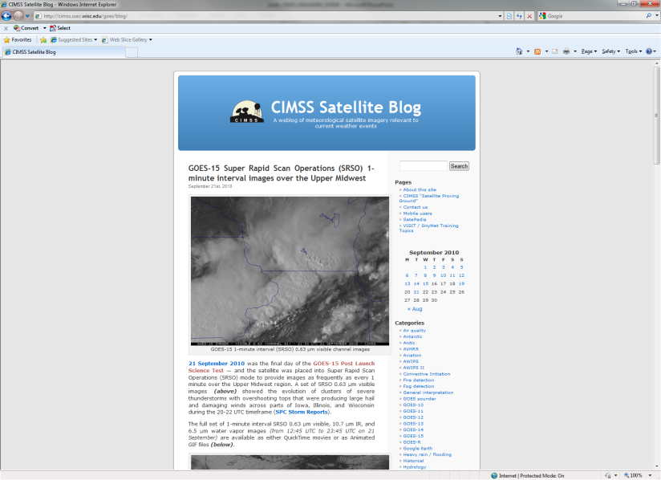

Case Study: POES Imagery
Value to the Forecaster
Near-term (less than 12 hours) forecasts
  Precipitation potential
    Cloud optical depth product
    Cloud particle effective radius product
  Precipitation type: Snow or drizzle?
    Cloud type product
Short-term (12 to 36 hours) forecasts
  Areas of fog formation (10.8–3.7 µm)
  Air temperatures in nearshore areas based on water temperatures
Post-event analysis
  Flooding rivers and tributaries
  Rain-cooled ground on IR Window
  Cloud top temperature and cloud height products
Obtain POES Imagery and Products for your AWIPS:
http://cimss.ssec.wisc.edu/~jordang/awips-avhrr
Just in Time Satellite Training from CIMSS:
http://cimss.ssec.wisc.edu/goes/blog

Slide 28
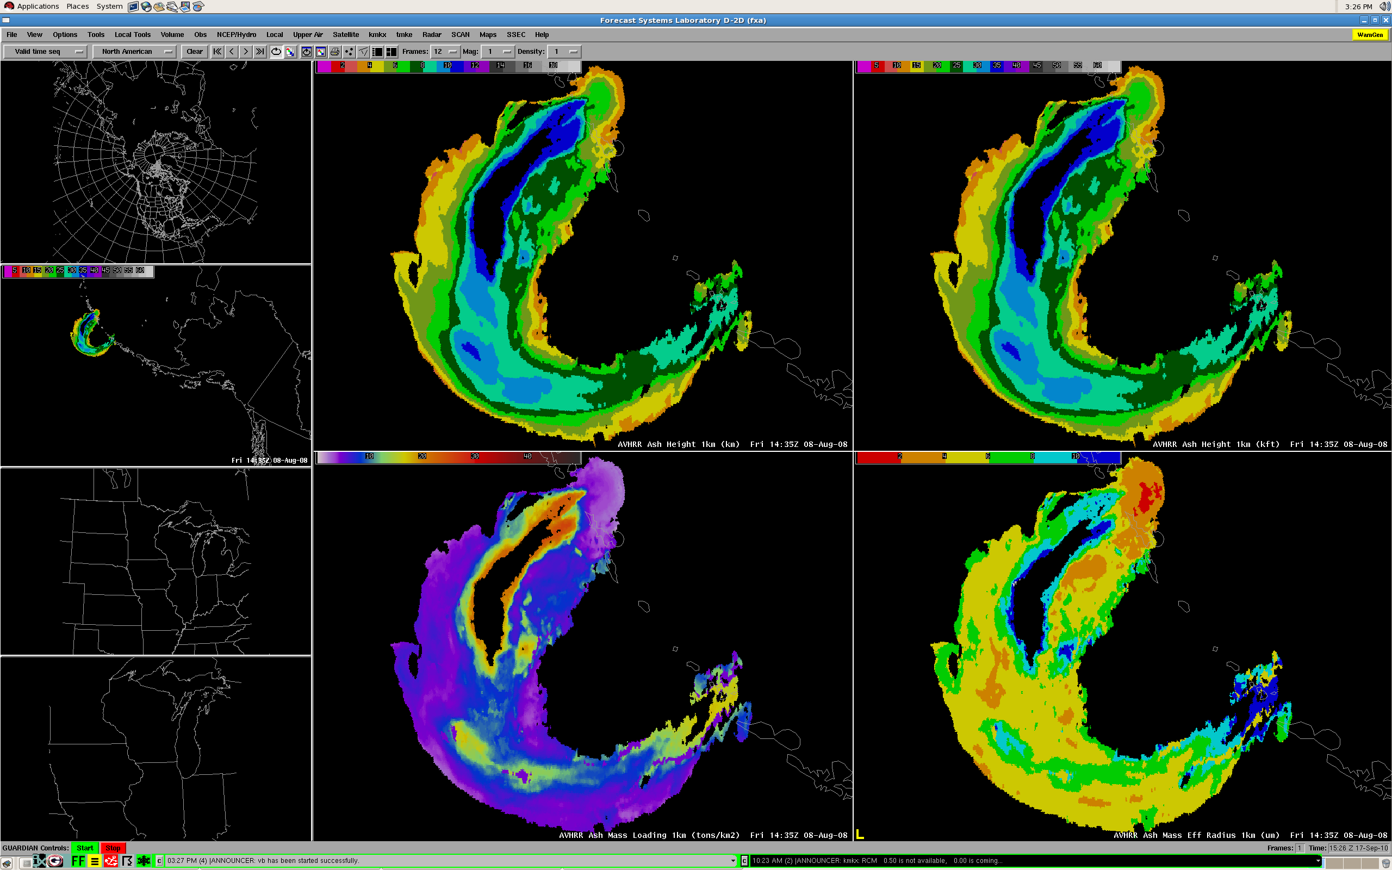
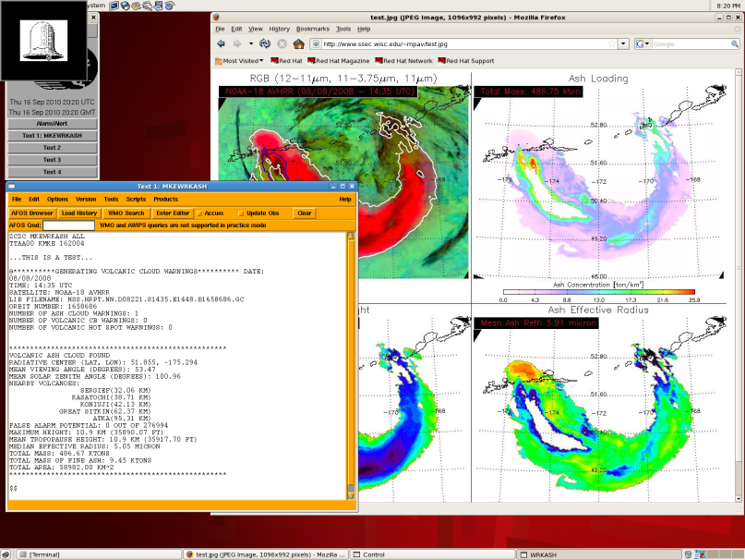
Kasatochi August 2008 Eruption
Products courtesy of Mike Pavolonis, NOAA/ASPB

Slide 29
Delivery Mechanisms of Tomorrow
NOAAPort: In 2011, the delivery bandwidth will increase from 10 Mbps to 30 Mbps as part of upgrading the signal demodulators from DVB-S to DVB-S2. NOAAPort will remain the primary delivery mechanism through at least 2013. (Source: Brian Gockel, NWS OST SEC)
  Increased bandwidth will accommodate transmission of dual-polarization radar data, bias-corrected SREF, other NCEP model output, and new satellite imagery/products (even prior to GOES-R) over the next two years.
  Examine types of data compression as transmitted data continues to rise?
LDM: The LDM will facilitate the raw data ingest from NOAAPort into AWIPS II (no longer confined to the LDAD), such that terrestrial data delivery could be a strong candidate without significant retooling if sufficient Internet bandwidth exists at field offices.
  The well-established LDM network could be leveraged to support backup operations in the event of a downlink failure at one or more sites.
Repository: “Push-pull” and “on-request” technology has been investigated as a way to deliver weather data to remote locations (FxNet and AWIPS II Thin Client), and could be expanded to alleviate bandwidth over NOAAPort for regional data and products.
  Use regional headquarters as GRB hubs? Web mapping services (WMS)?

Slide 30
Conclusions and Future Directions
AWIPS II will play a significant role in promoting the capabilities of GOES-R and new polar-orbiting satellites because the expanded distribution and development group will lead to an implementation of additional features which maximize the utility of satellite imagery and products in concert with other in-situ observations and model output.
  Blended and combined products
It will also allow for the efficient transfer of new science and technology into NWS operations without delay.
  To accomplish this, we will have to investigate and utilize delivery mechanisms outside of NOAAPort
Our future AWIPS will not be confined to NWS offices, but extend to universities and become an integral part of the increasing research to operations activities.
  Unique applications of the software will increase
Now is the time to start investigating data overload, and developing methodology which optimizes the use of data, imagery, products, and tools which are situation and scenario relevant, and leads the decision support thought process.
  Too focused situational awareness decreases overall situational awareness
Questions? Comments? Contact me: Jordan Gerth, Jordan.Gerth@noaa.gov

