Slide 1
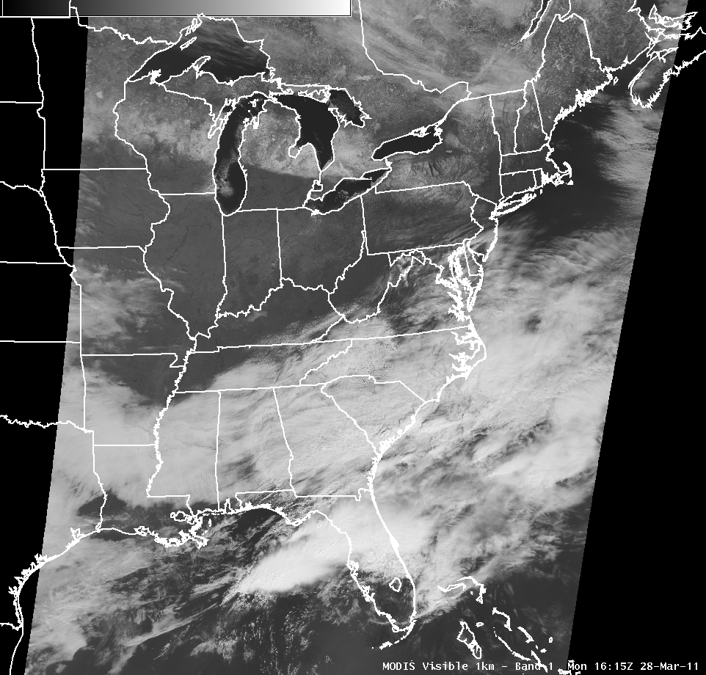
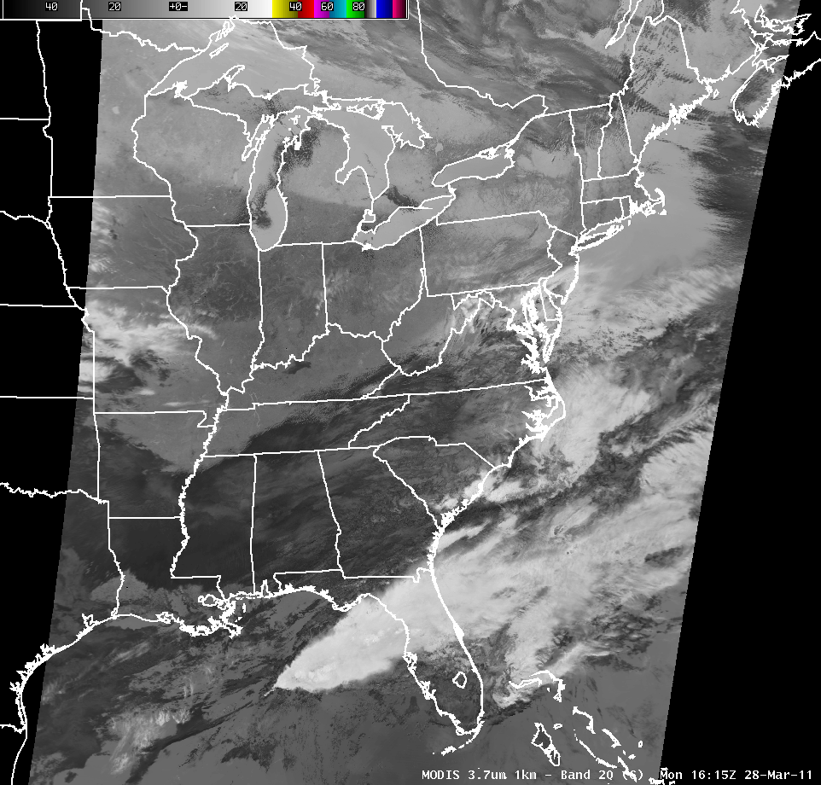
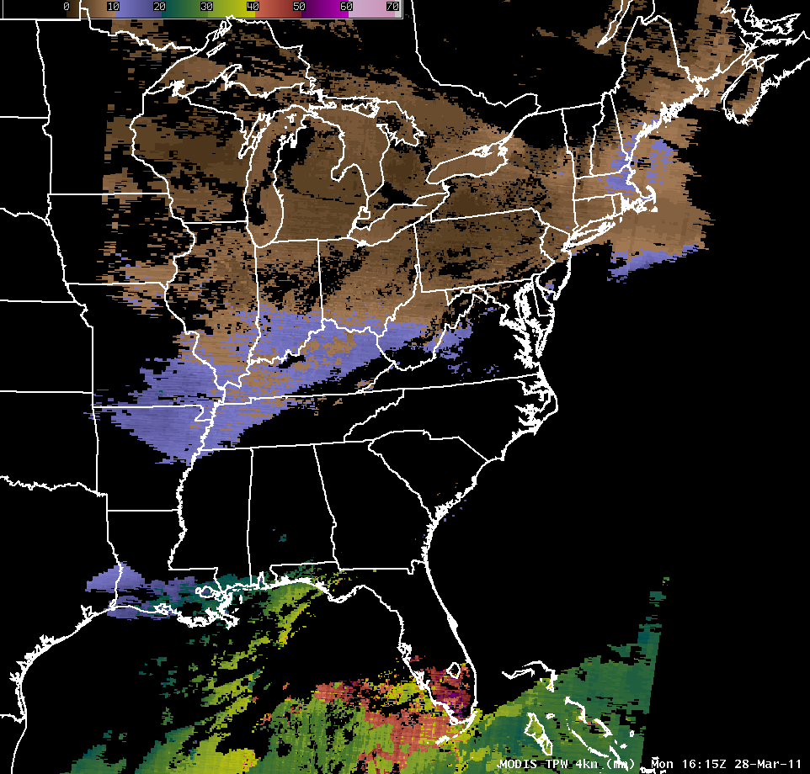
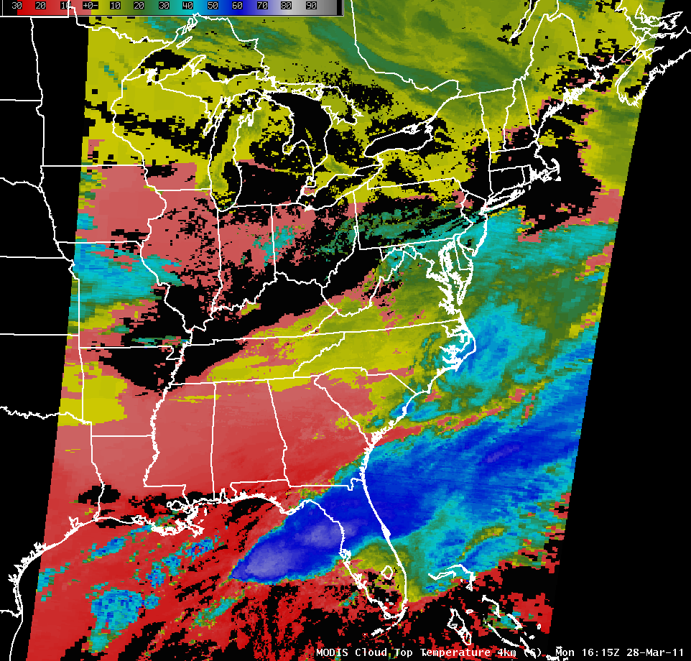
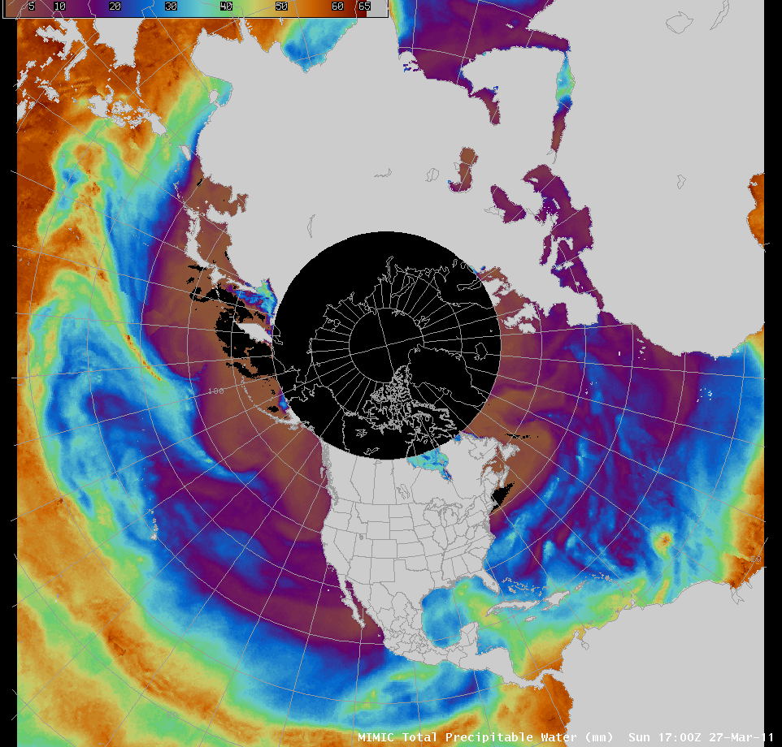
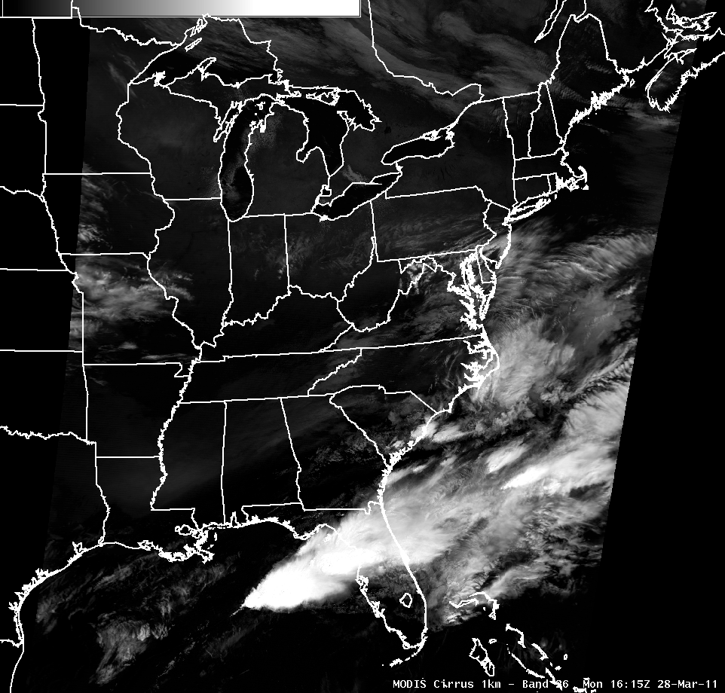
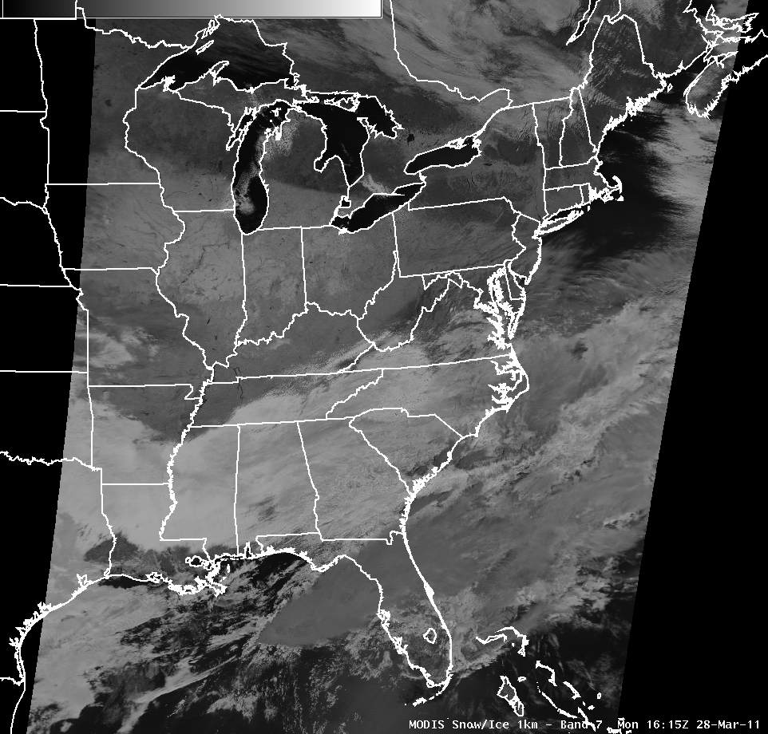
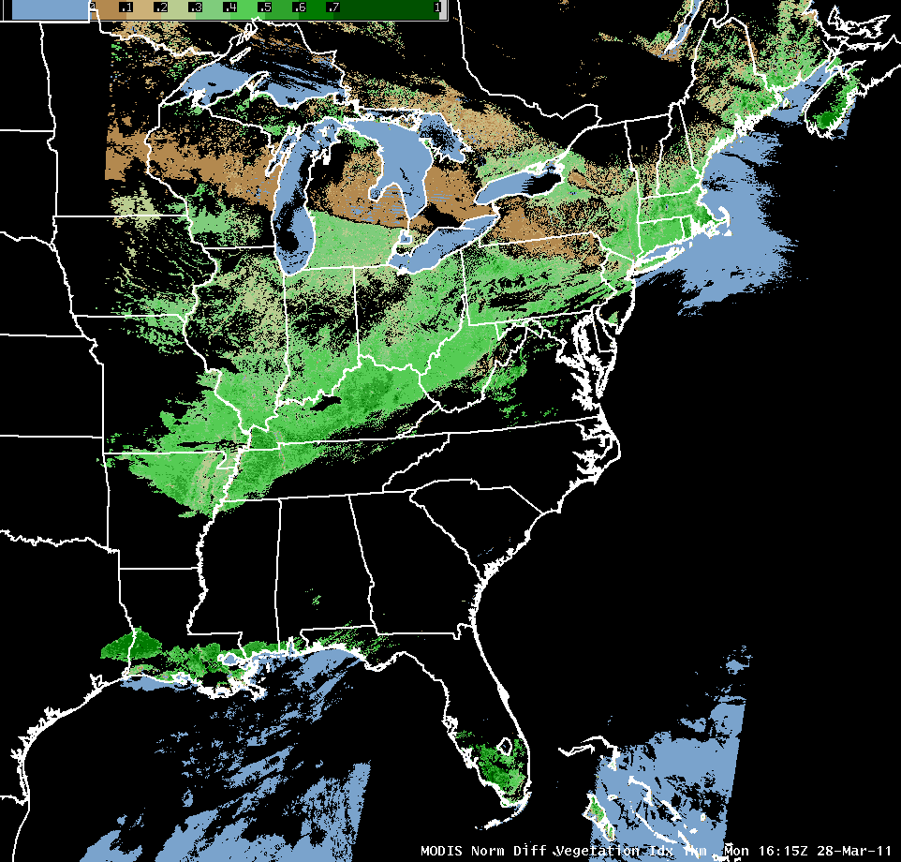
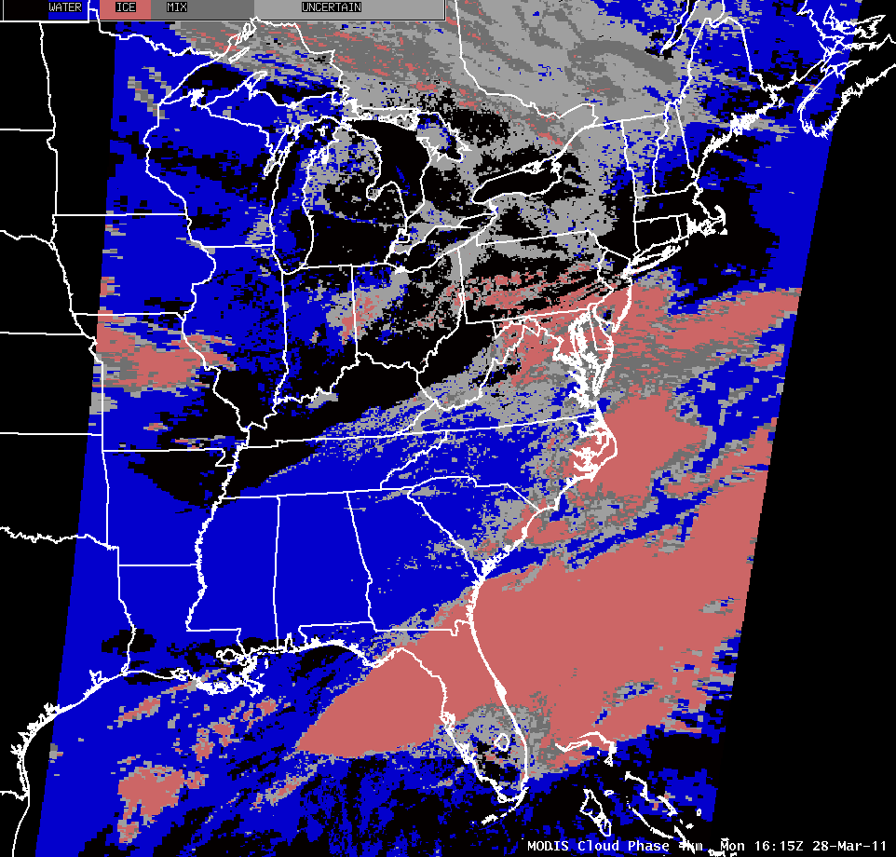
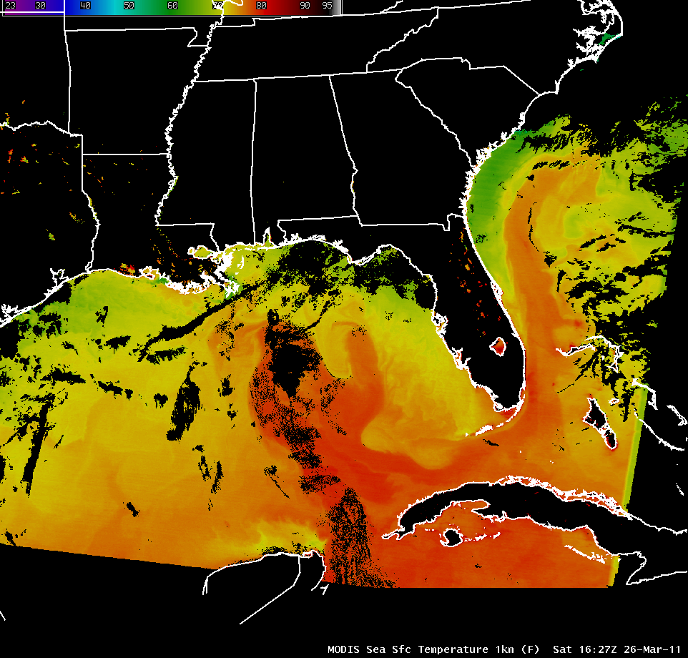
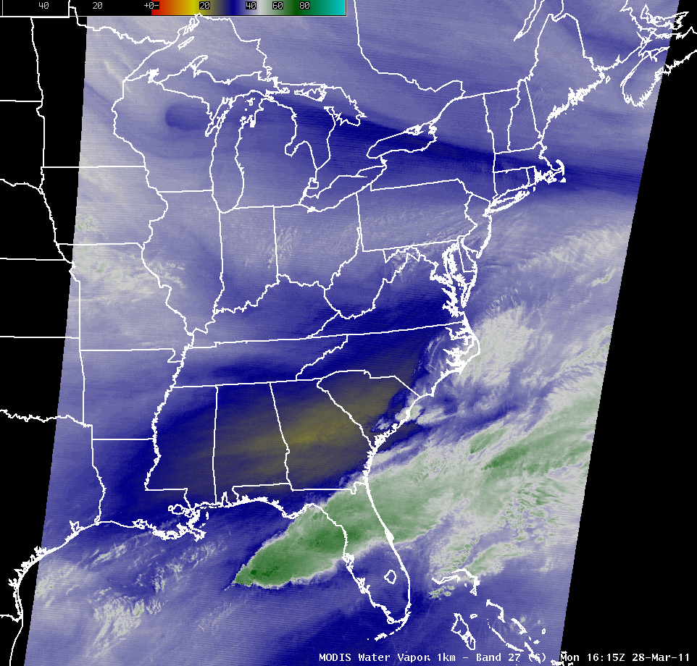
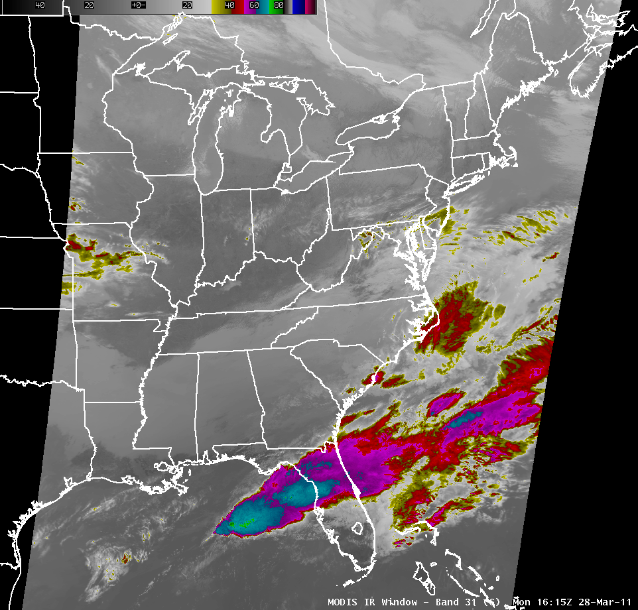
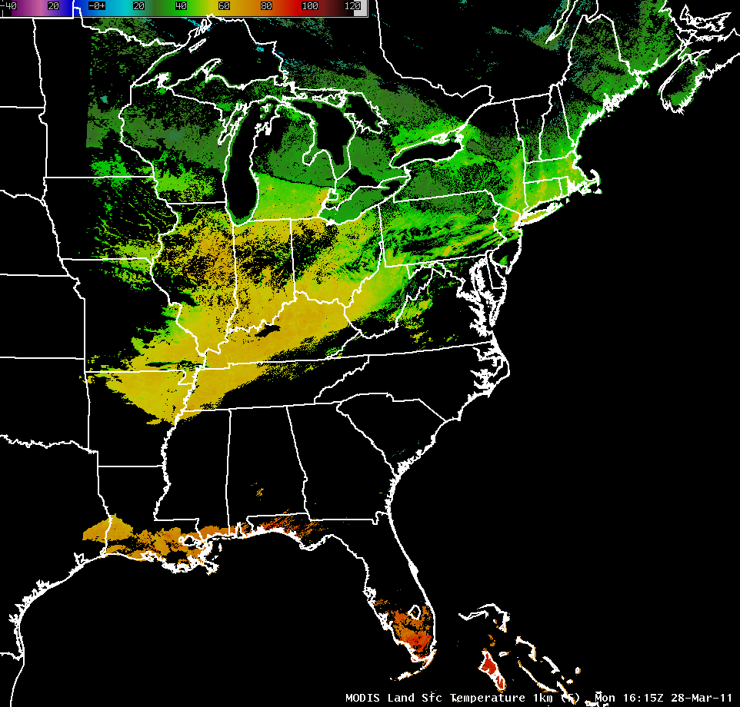
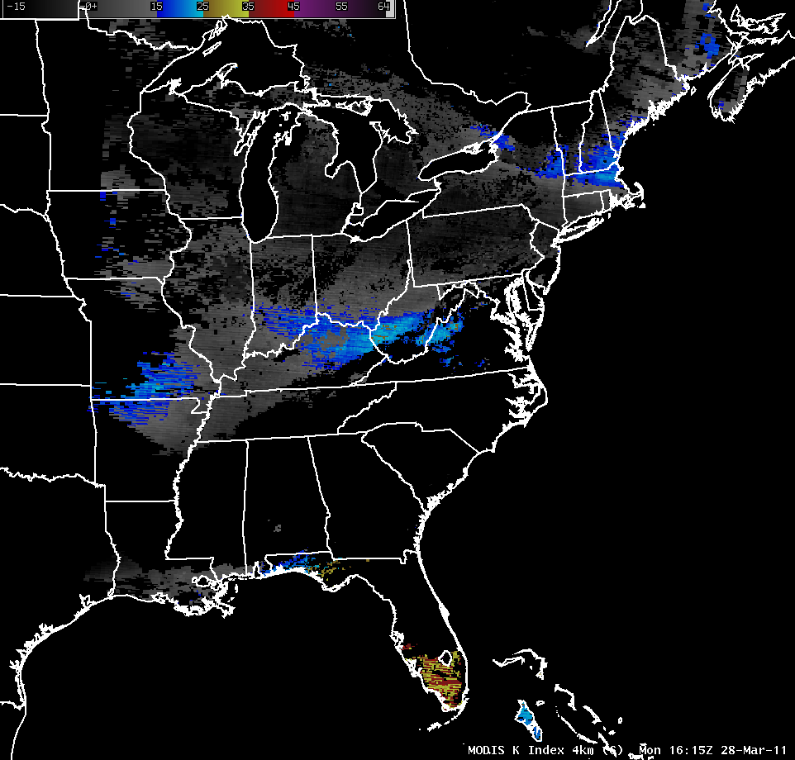
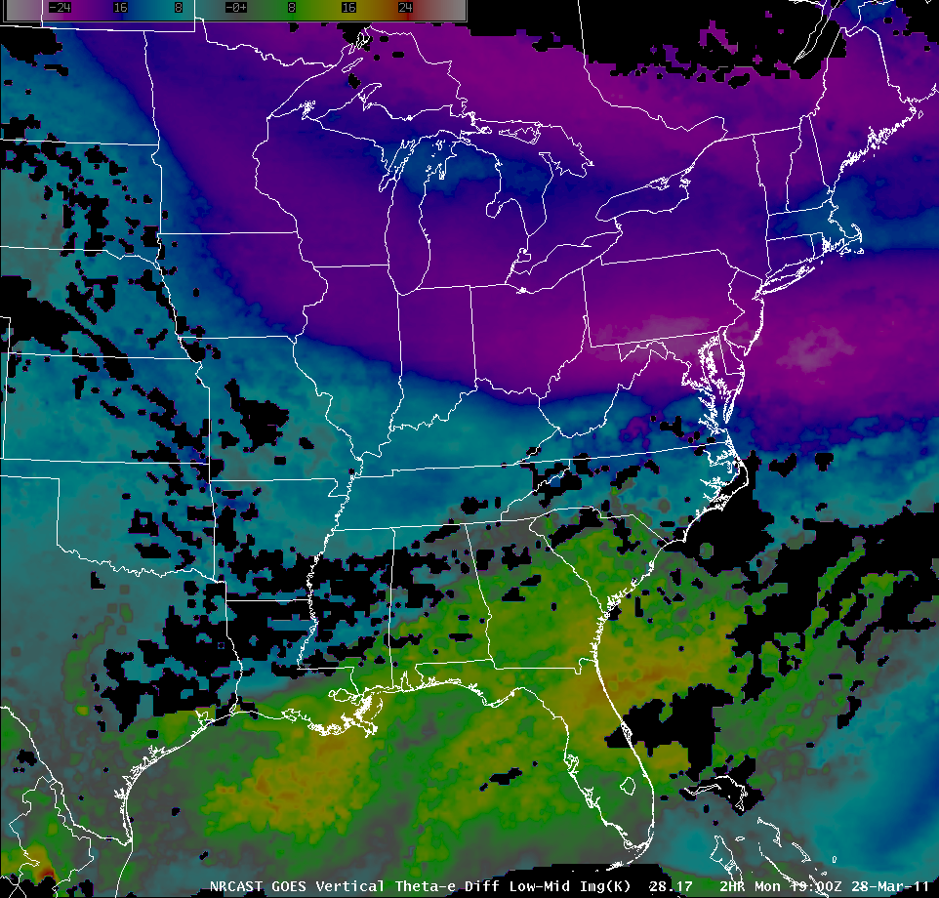
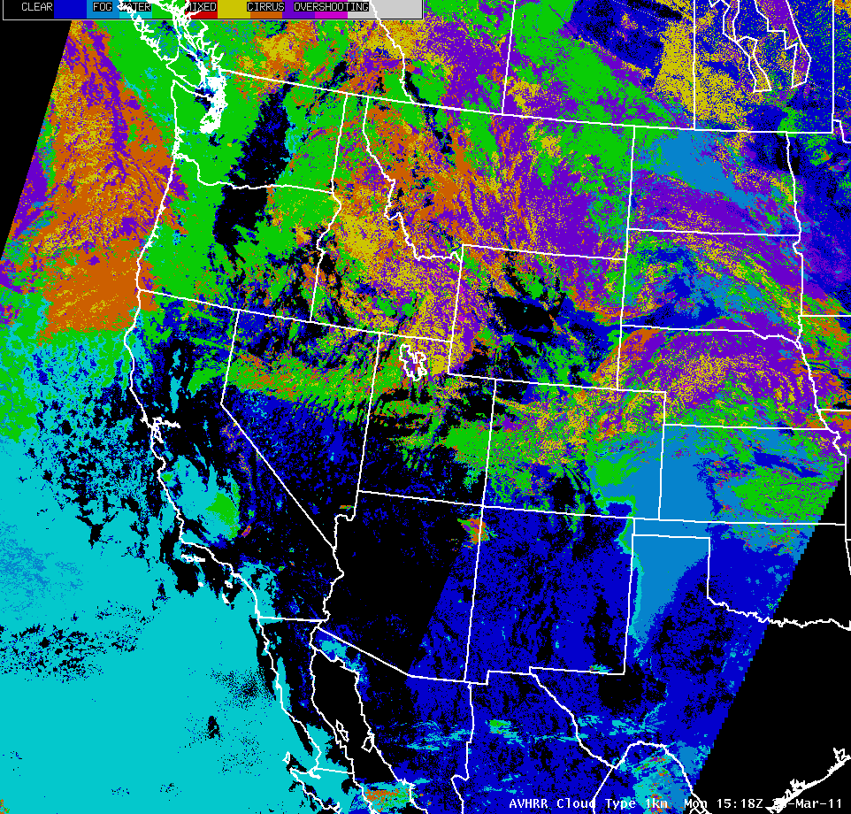
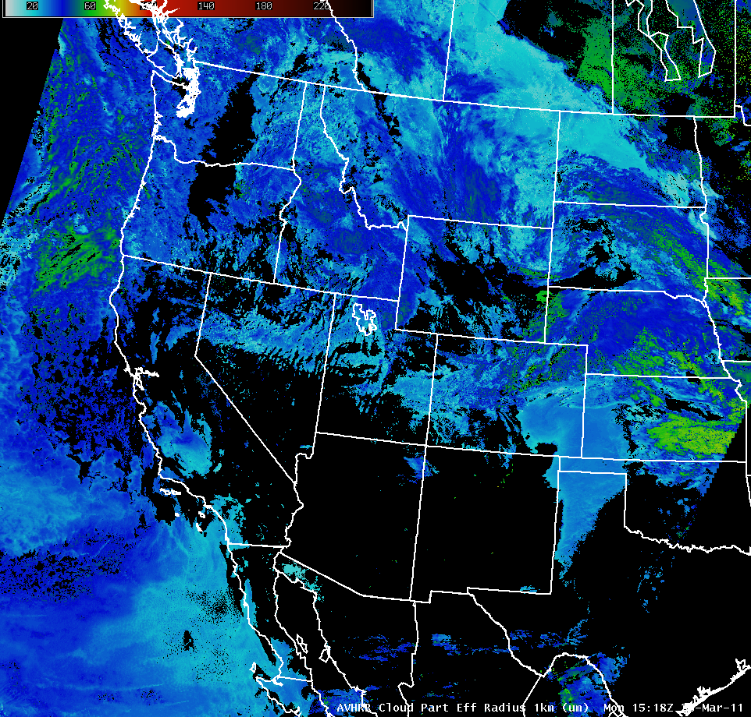
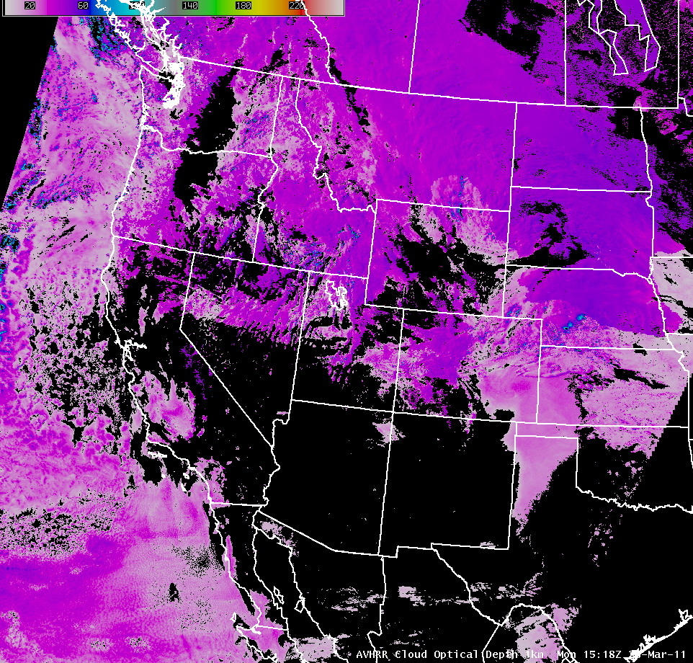
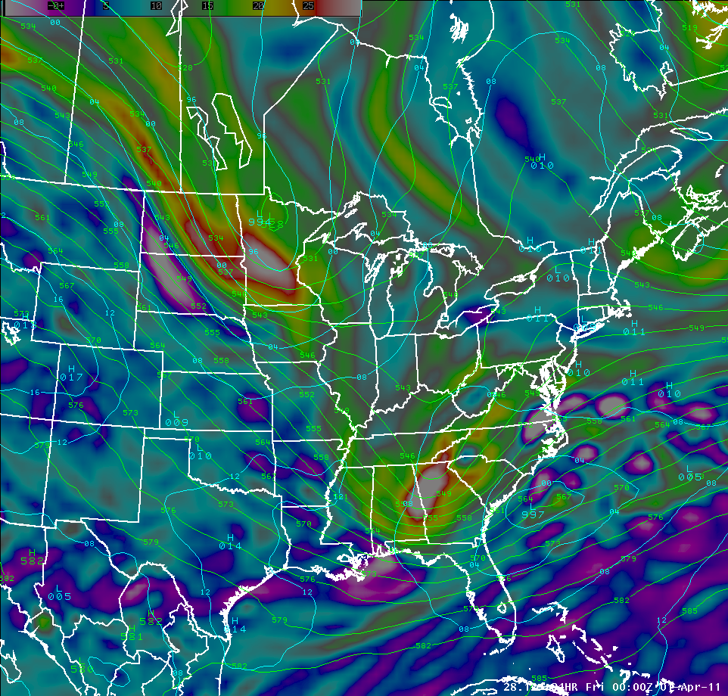
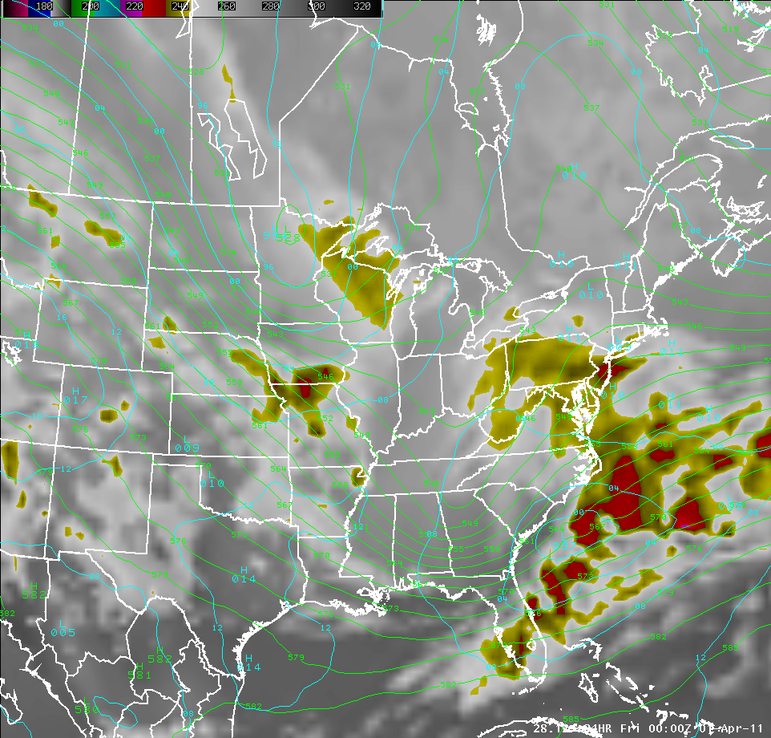
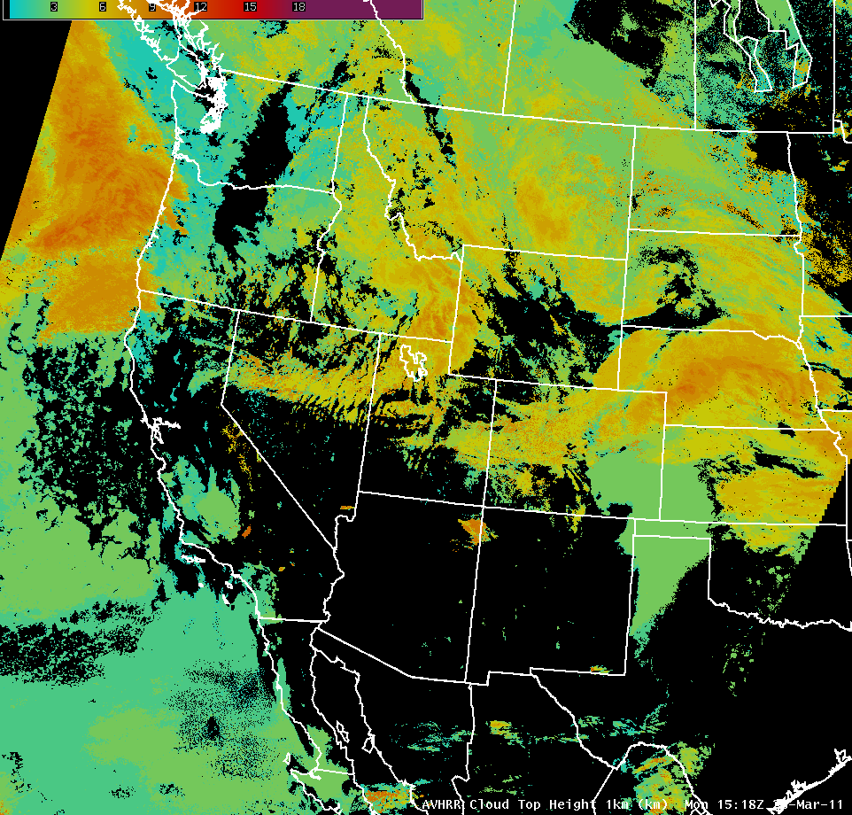
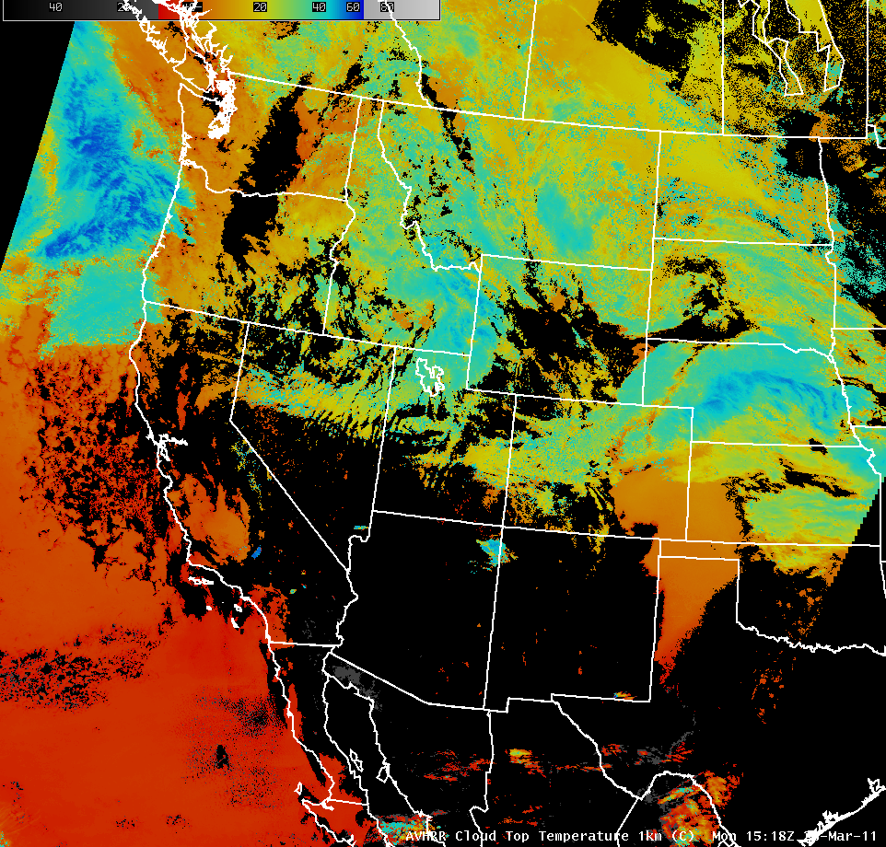
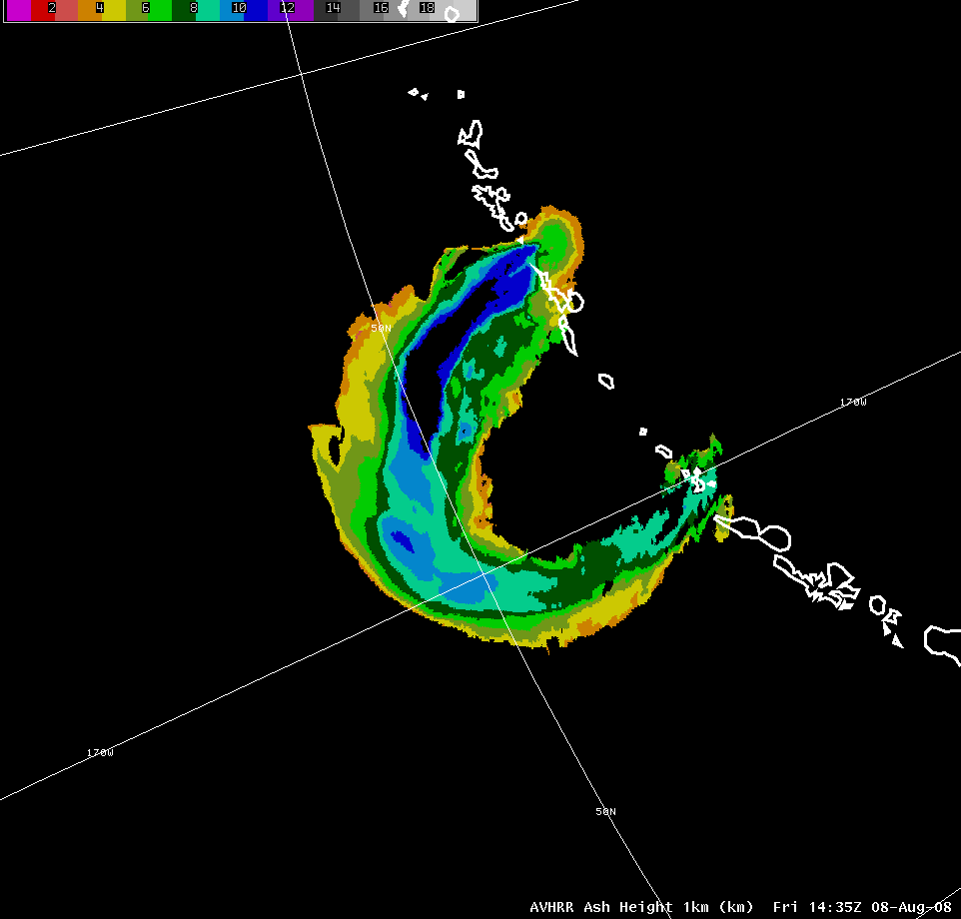
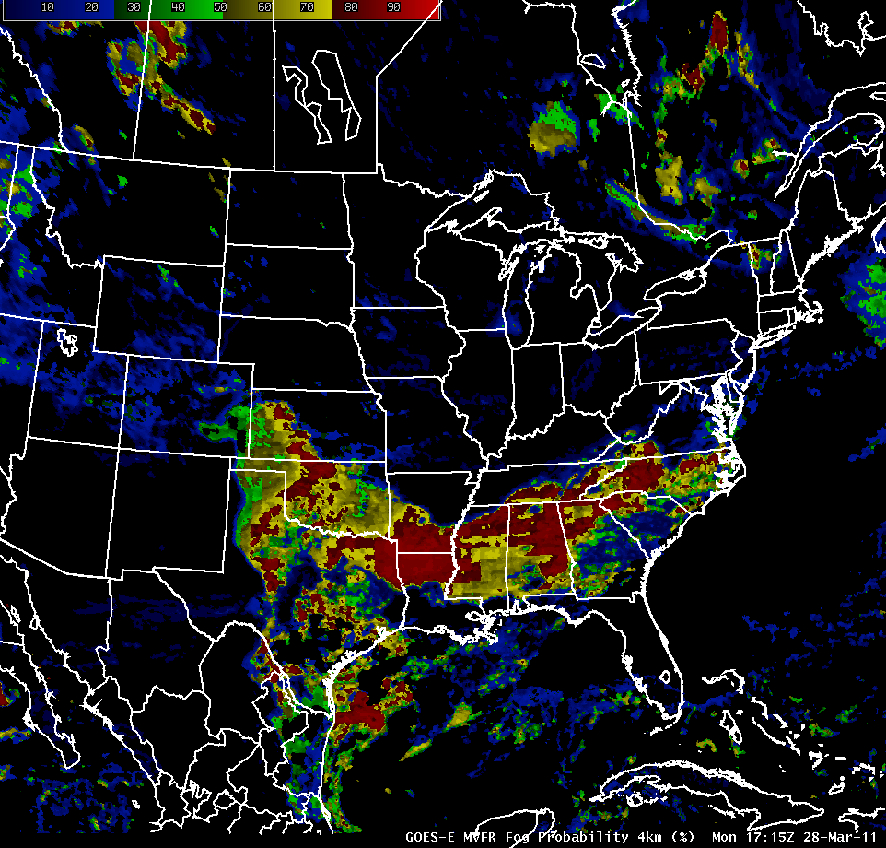
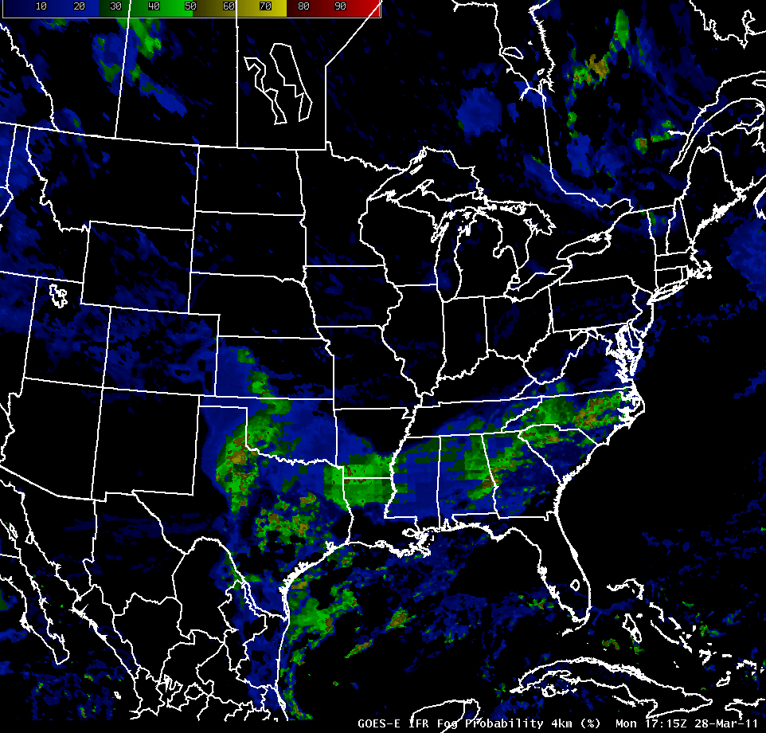
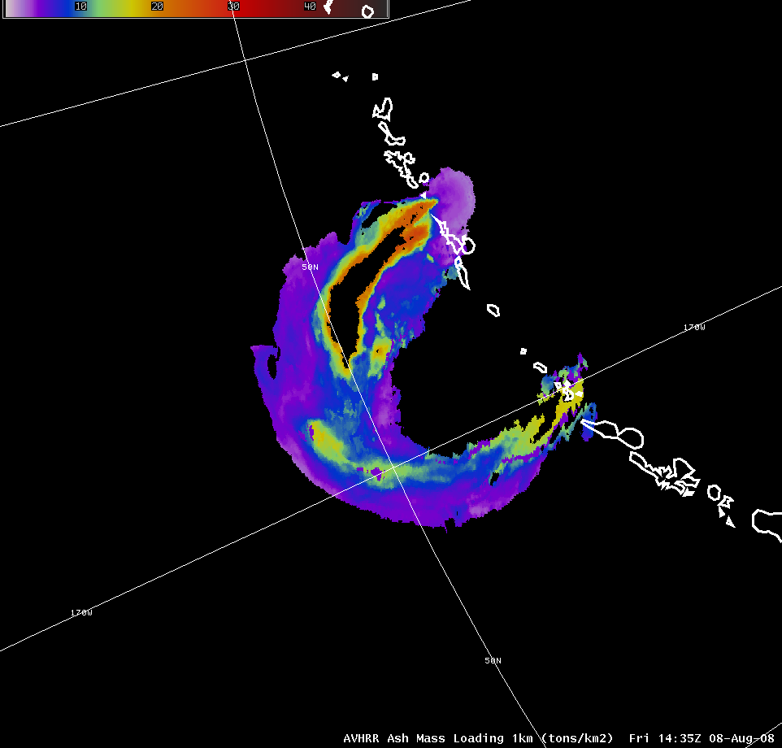
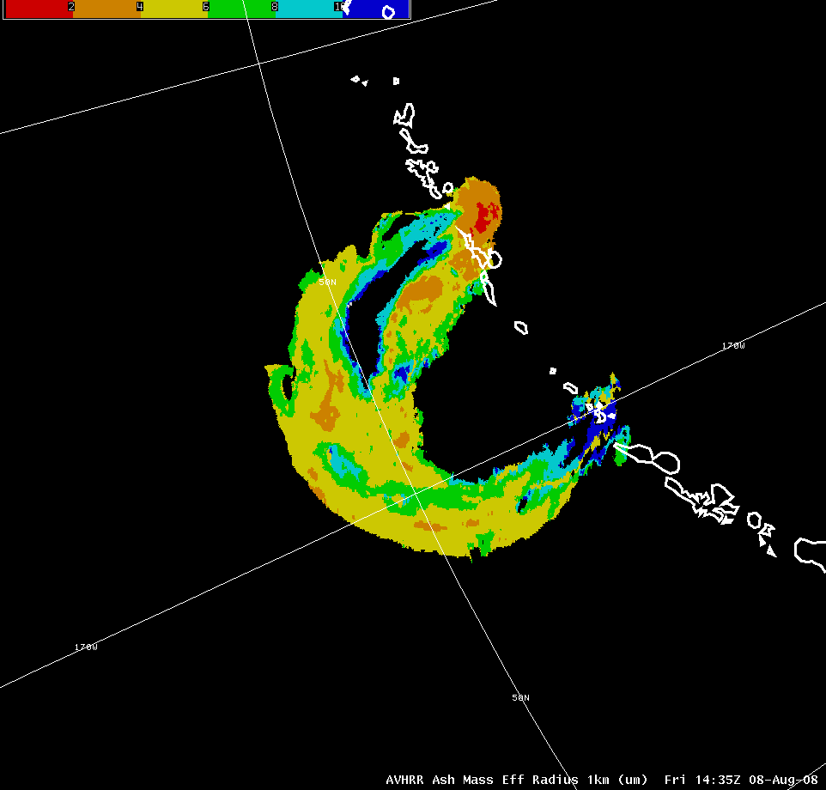
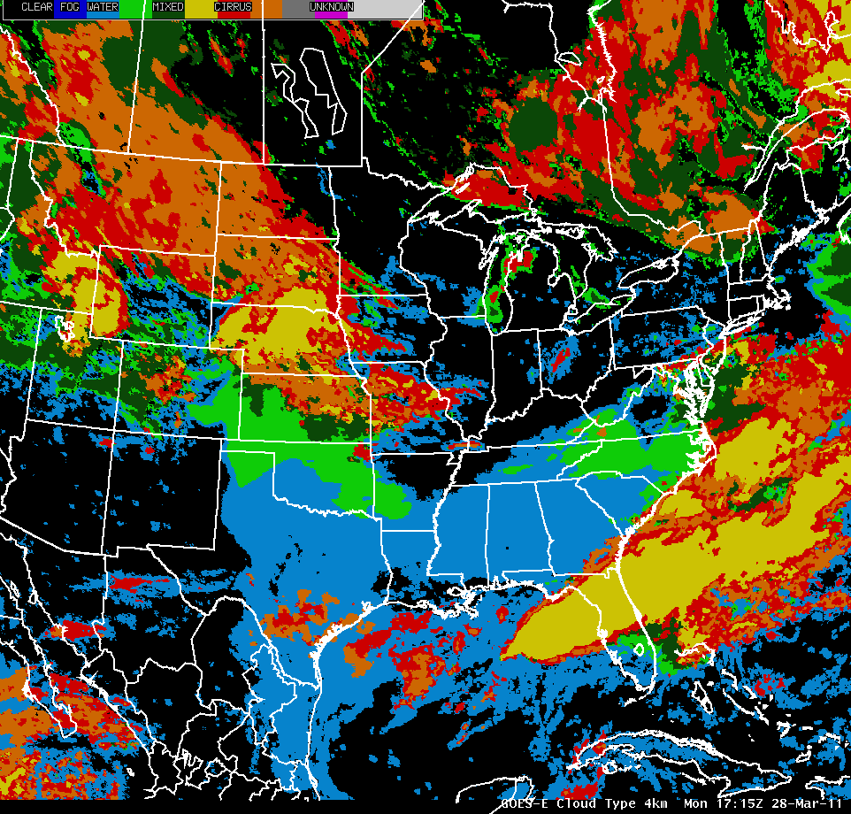
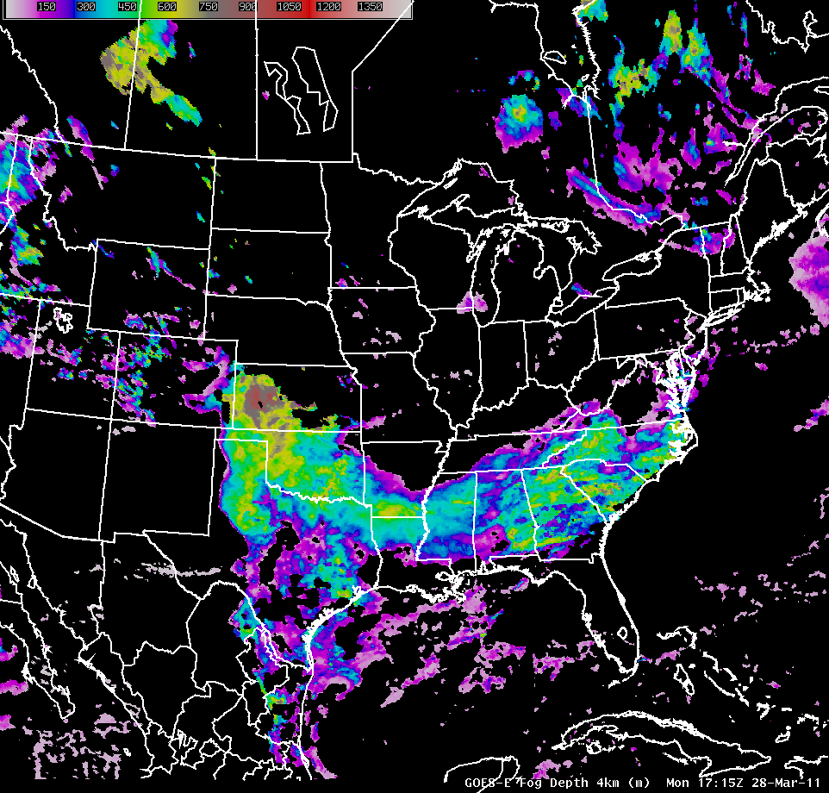
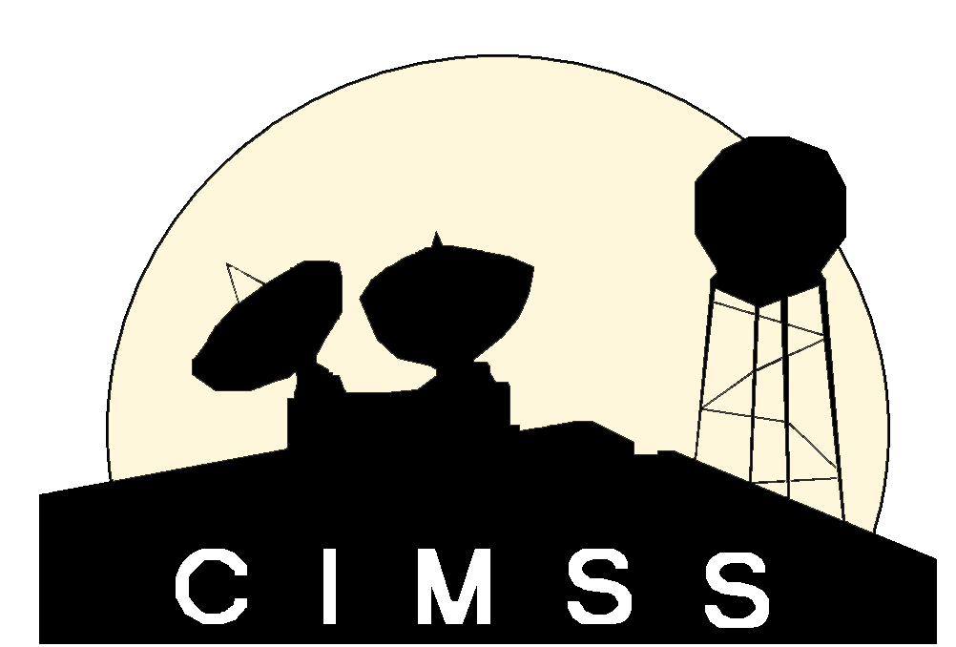
CIMSS’ Role in the GOES-R Proving Ground
Jordan Gerth, Wayne Feltz, and Scott Bachmeier, Cooperative Institute for Meteorological Satellite Studies*, Madison, Wisconsin
MODIS Visible (0.65 micron)
MODIS Shortwave IR (3.7 micron)
MODIS Total Precipitable Water
MODIS Cloud Top Temperature
MIMIC Total Precipitable Water
MODIS Cirrus (1.38 micron)
MODIS Snow/Ice (2.13 micron)
MODIS Norm Difference Vegetation Index
MODIS Cloud Phase
MODIS Sea Surface Temperature
MODIS Water Vapor (6.5 micron)
MODIS IR Window (11 micron)
MODIS Land Surface Temperature
MODIS K Index
GOES Vertical Theta-e Difference Nearcast
AVHRR Cloud Type
AVHRR Cloud Effective Radius
AVHRR Cloud Optical Depth
CRAS 500 hPa Vorticity and Heights, MSLP
CRAS Synthetic IR Window Imagery
AVHRR Cloud Top Height
AVHRR Cloud Top Temperature
AVHRR Ash Height
CIMSS demonstrates GOES-R capabilities and algorithms to over 50 National Weather Service field offices, integrating experimental satellite products into AWIPS, GFE, IC4D, AWIPS II, and N-AWIPS.
GOES-East GEOCAT MVFR Fog Probability
GOES-East GEOCAT IFR Fog Probability
AVHRR Ash Mass Loading
AVHRR Ash Mass Effective Radius
The CIMSS/ASPB Proving Ground Team: Jordan Gerth, Wayne Feltz, Scott Bachmeier, Scott Lindstrom, Gary S. Wade, Michael Pavolonis, Andrew Heidinger, Robert Aune, Justin Sieglaff, Lee Cronce, Kaba Bah, Kathy Strabala, Russell Dengel, William Straka
GOES-East GEOCAT Cloud Type
GOES-East GEOCAT Fog Depth
Notes:
Author: Jordan Gerth, CIMSS; Date: March 28, 2011

