Slide 1
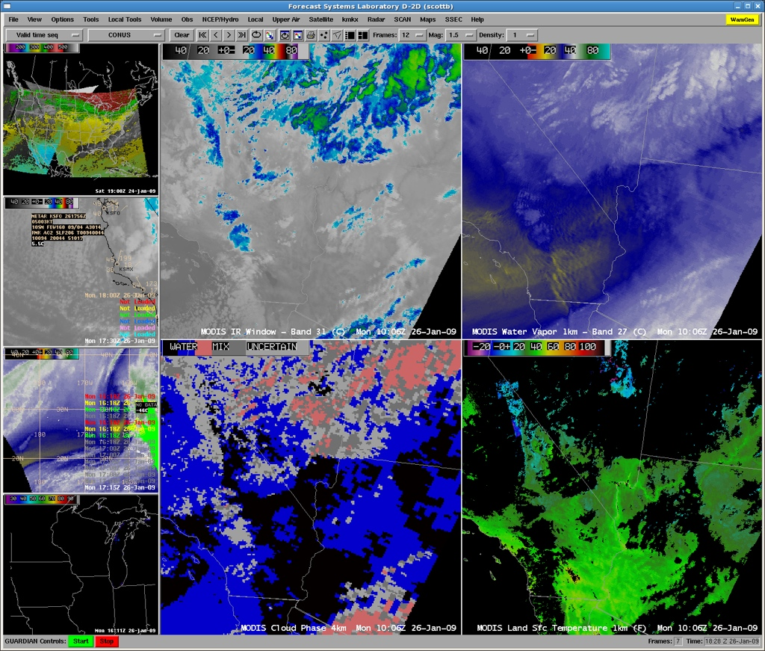
Providing MODIS Satellite Products to National Weather Service Operations
Kathleen Strabala, Scott Bachmeier, Jordan Gerth, Liam Gumley

Slide 2
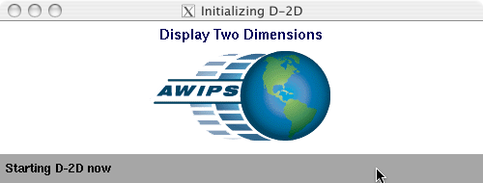
What makes MODIS Products Useful?
More spectral bands – 19 visible, 17 IR
Higher spatial resolution (250m – 1 km)
Atmospheric products at 4 km resolution
Timeliness – DB antenna, near real-time
Preparation for GOES-R and NPOESS

Slide 3
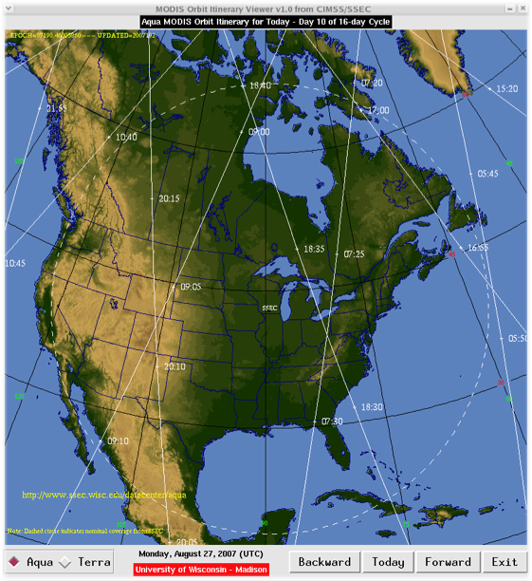
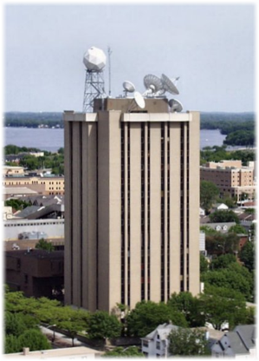
MODIS Direct Broadcast Ground Station
Space Science and Engineering Center (SSEC), UW-Madison
SSEC NWS Regional Headquarters LDM subscription at WFO
SSEC NWS Regional Headquarters LDM subscription at WFO

Slide 4
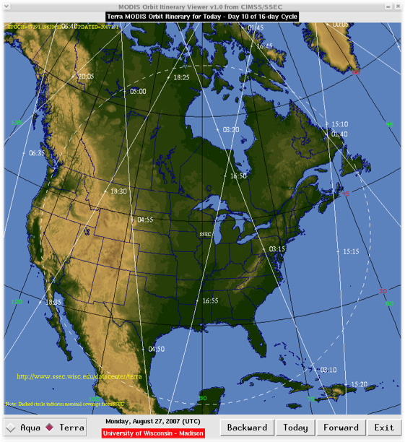
MODIS Direct Broadcast Ground Station
Space Science and Engineering Center (SSEC), UW-Madison
SSEC NWS Regional Headquarters LDM subscription at WFO
SSEC NWS Regional Headquarters LDM subscription at WFO

Slide 5
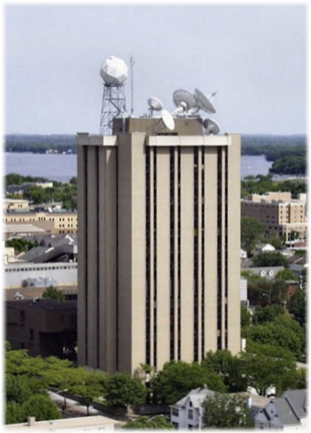
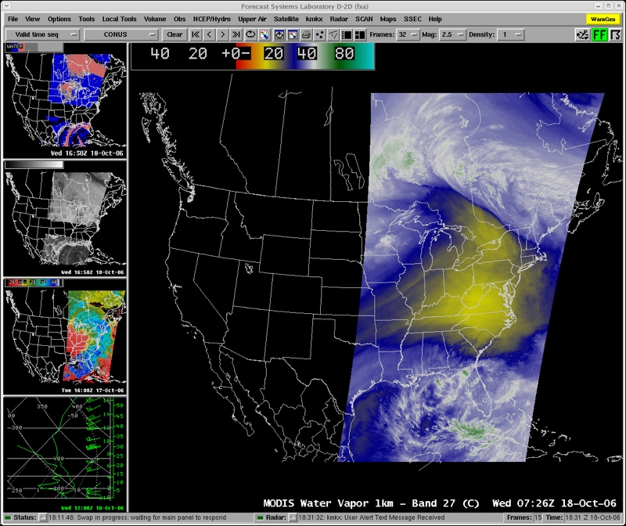
MODIS in AWIPS Project
MODIS direct broadcast
ground station at SSEC
MODIS imagery and products in AWIPS
(since July 2006)
SSEC NWS Regional Headquarters LDM subscription at WFO
SSEC NWS Regional Headquarters LDM subscription at WFO

Slide 6
Virtual Institute for Satellite Integration Training (VISIT) lesson - offered since October 2006

Slide 7
MODIS Products in AWIPS
(October 2006 - January 2009)
53 NWS forecast offices participating

Slide 8
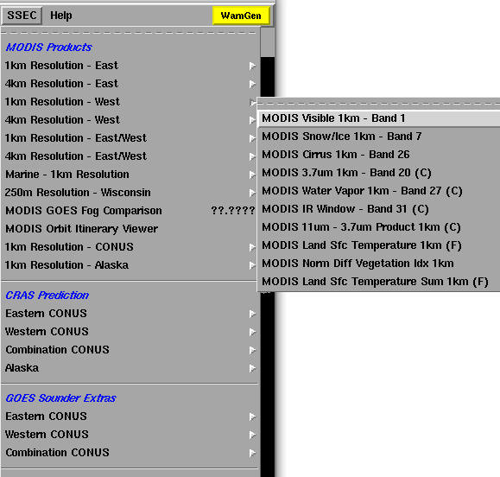
MODIS 1-km Imagery and Products in AWIPS
Band 1 - (0.6µm) - Visible
Band 7 - (2.1µm) - Snow/Ice
Band 20 - (3.7µm) - Shortwave IR
Band 26 - (1.3µm) - Cirrus
Band 27 - (6.7µm) - Water Vapor
Band 31 - (11.0µm) - IR Window
11µm - 3.7µm - Fog/Stratus Product
Land Surface Temperature
Normalized Difference Vegetation Index (NDVI)
AWIPS “SSEC” menu

Slide 9
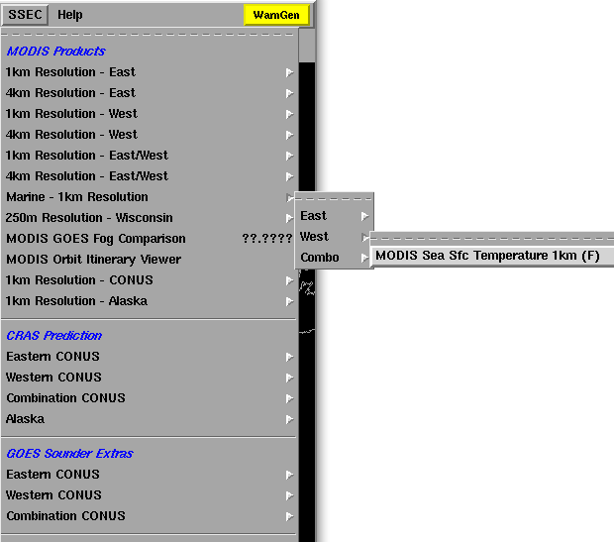
MODIS 1-km Imagery and Products in AWIPS
Sea Surface Temperature (SST)
AWIPS “SSEC” menu

Slide 10
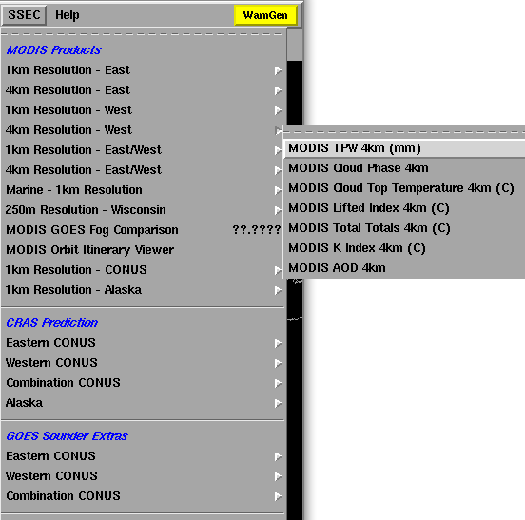
MODIS “4-km” Products in AWIPS
Total Precipitable Water (TPW)
Cloud Phase
Cloud Top Temperature
Lifted Index
Total Totals
K Index
AWIPS “SSEC” menu

Slide 11
Applications

Slide 12
MODIS vs GOES Visible Band
GOES 1km MODIS 1km

Slide 13
MODIS vs GOES Visible Band
GOES 1km MODIS 1km

Slide 14
MODIS vs GOES Visible Band
GOES 1km MODIS 1km

Slide 15
MODIS vs GOES Visible Band
GOES 1km MODIS 1km

Slide 16
MODIS vs GOES Visible Band
GOES 1km MODIS 1km

Slide 17
MODIS vs GOES Visible Band
GOES 1km MODIS 1km

Slide 18
MODIS vs GOES Visible Band
GOES 1km MODIS 1km

Slide 19
MODIS vs GOES Visible Band
GOES 1km MODIS 1km

Slide 20
MODIS vs GOES Water Vapor Band
GOES 4 km MODIS 1 km

Slide 21
MODIS vs GOES Water Vapor Band
GOES 4 km MODIS 1 km

Slide 22
MODIS vs GOES Water Vapor Band
GOES 4 km MODIS 1 km

Slide 23
MODIS vs GOES Water Vapor Band
GOES 4 km MODIS 1 km

Slide 24
MODIS vs GOES Water Vapor Band
GOES 4 km MODIS 1 km

Slide 25
MODIS vs GOES Water Vapor Band
GOES 4 km MODIS 1 km

Slide 26
MODIS vs GOES Water Vapor Band
GOES 4 km MODIS 1 km

Slide 27
MODIS vs GOES Water Vapor Band
GOES 4 km MODIS 1 km

Slide 28
Mountain Waves over Utah

Slide 29
AWIPS images of GOES-13 6.5 µm ‘water vapor channel” data (above) showed a large area of dry air aloft moving southward across the state of Utah behind a shortwave trough axis on 19 January 2011. The 500 hPa wind fields from the RUC80 model indicated that winds turned more northerly and increased in speed behind the trough axis.
At 20:01 UTC, a comparison of the GOES-13 6.5 µm water vapor image with the corresponding 1-km resolution MODIS 6.7 µm water vapor image (below) demonstrated the value of higher spatial resolution for detecting the presence of widespread mesoscale mountain waves that covered a good deal of the state of Utah. Such a mountain wave signature on water vapor imagery can indicate the presence of a potential for turbulence — however, in this case there were no pilot reports of turbulence that showed up over Utah during that particular time period.
There was also an obvious northwestward parallax shift in the image features on the GOES-13 image, due to the large viewing angle from that geostationary satellite (which was positioned over the Equator at 75 degrees West longitude).

Slide 30
Mountain Waves over Utah

Slide 31
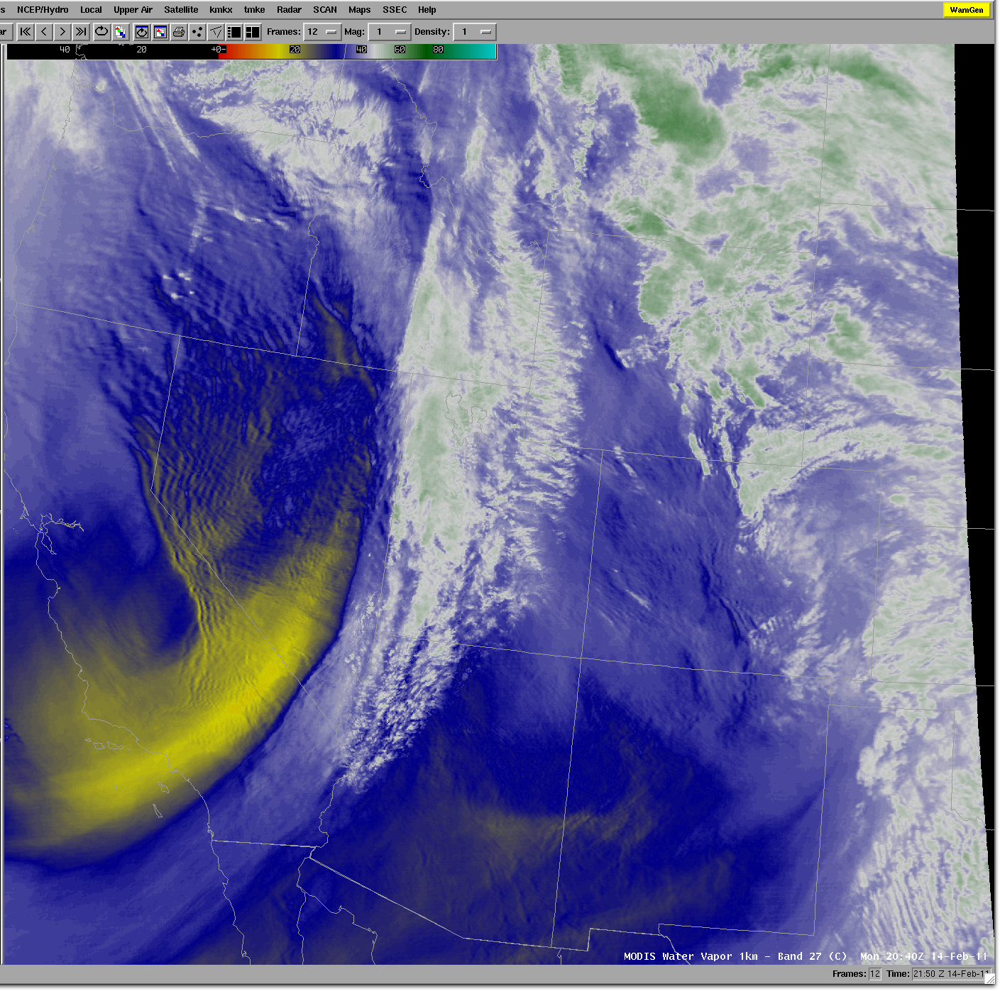
MODIS
Water Vapor
Band 1 km
14 Feb 2011

Slide 33
MODIS WV and Turbulence
Nathan Uhlenbrock, S. A. Ackerman, W. F. Feltz, R. D. Sharman, and J. R. Mecikalski, 2006: The use of MODIS water vapor imagery, NWP model analysis, and pilot reports to diagnose turbulent mountain waves. 12th Conference on Aviation Range and Aerospace Meteorology, the 86th AMS Annual Meeting, P8.4.

Slide 34
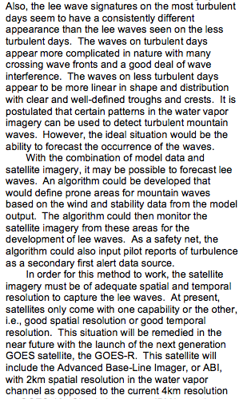
MODIS WV and Turbulence

Slide 35
MODIS water vapor
(credit: NWS forecast office, Reno NV)

Slide 36
(credit: NWS forecast office, Reno NV)

Slide 37
MODIS Products in AWIPS
AREA FORECAST DISCUSSION
NATIONAL WEATHER SERVICE RENO NV
337 AM PST TUE NOV 4 2008
ANOTHER BIG STORY WITH THIS LOW HAS BEEN THE WINDS WITH MANYLOCATIONS REMAINING QUITE WINDY OVERNIGHT AS THE COLD FRONTPASSED. HIGH RES MODIS WATER VAPOR IMAGERY SHOWS GOOD MOUNTAIN WAVE ACTIVITY ALONG THE SIERRA AS THE SUPPRESSED
TROPOPAUSE MOVED THROUGH OVERNIGHT. THIS UPPER FEATURE LIKELY HELPED TO DUCT STRONGER WINDS ALOFT DOWN TO THE SURFACE IN THE STABLE PRE-FRONTAL ENVIRONMENT SOUTH OF THE RENO AND TAHOE AREAS.

Slide 38
Discriminating Low Clouds From Snow

Slide 39
Support for Fire Weather Forecasts
AREA FORECAST DISCUSSION
NATIONAL WEATHER SERVICE ALBUQUERQUE NM
300 AM MST WED DEC 1 2010
.FIRE WEATHER...ONLY MINOR CHANGES TO OVERALL FORECAST THROUGH THE WEEKEND. A 1016MB LEE TROUGH OVER THE PLAINS HAS ALLOWED WESTERLY DOWNSLOPE WINDS TO DOMINATE THE AREA...THUS TEMPS ARE MUCH WARMER AND WINDS SLIGHTLY BREEZIER. AN ISOLATED AREA OF MARGINAL CRITICAL FIRE WX CONDITIONS WILL DEVELOP BTWN CLINES CORNERS...VAUGHN...SANTA ROSA...AND LAS VEGAS BY LATE THIS MORNING HOWEVER NO FIRE WX HIGHLIGHTS WILL BE ISSUED. MELTING SNOWPACK EVIDENT ON THE 2013Z MODIS 1KM VISIBLE IMAGERY TUESDAY IN NEARLY THE EXACT SAME AREA WILL MITIGATE SURFACE FUEL DRYNESS. MIN RH VALUES WILL RANGE FROM 20-25 PCT ALONG THE COLORADO BORDER TO 10-15 PCT ACROSS THE SOUTH. VENT RATES TODAY WILL BE POOR MOST AREAS EXCEPT ALONG THE EAST SLOPES WHERE FAIR VALUES ARE EXPECTED.

Slide 40
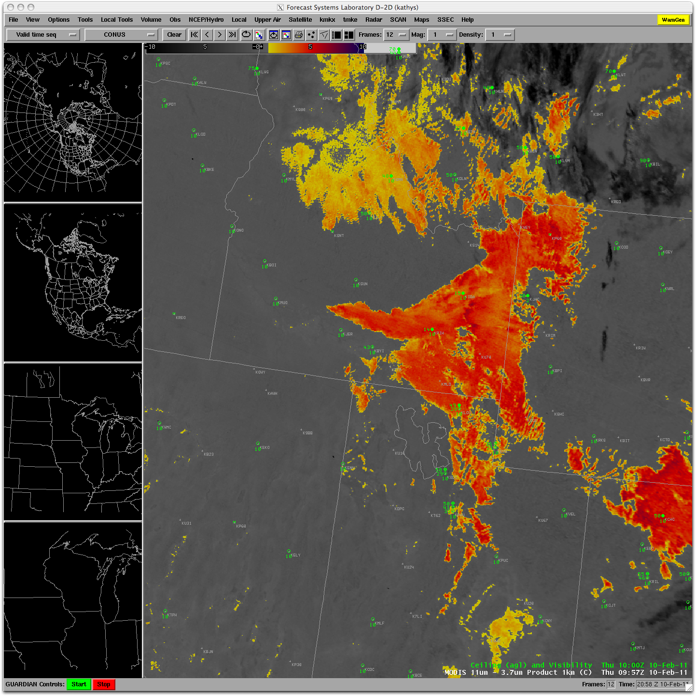
MODIS
Fog/
Low
Cloud
Product
1 km
8 Feb 2011

Slide 41
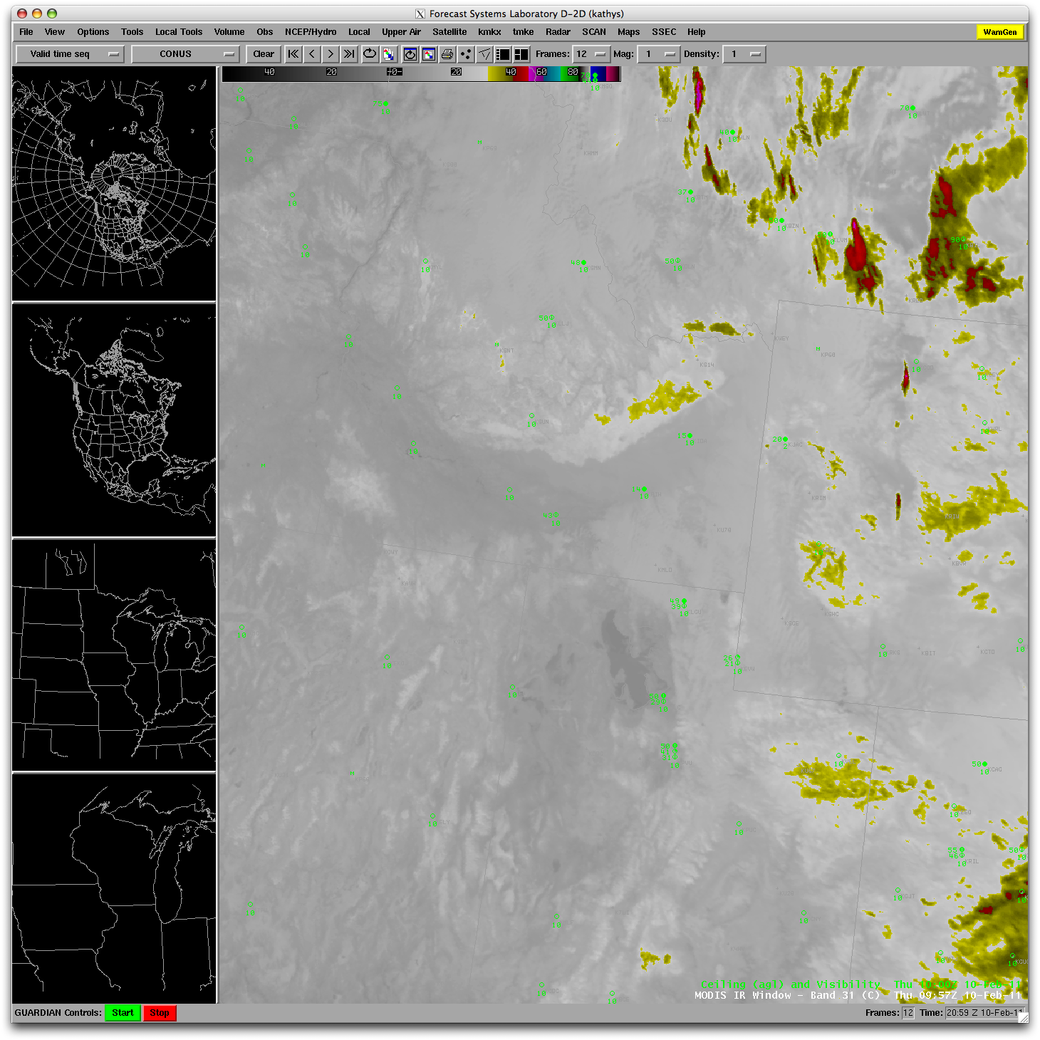
MODIS
IR
Window
Band
1 km
8 Feb 2011

Slide 42
Individual Products

Slide 43
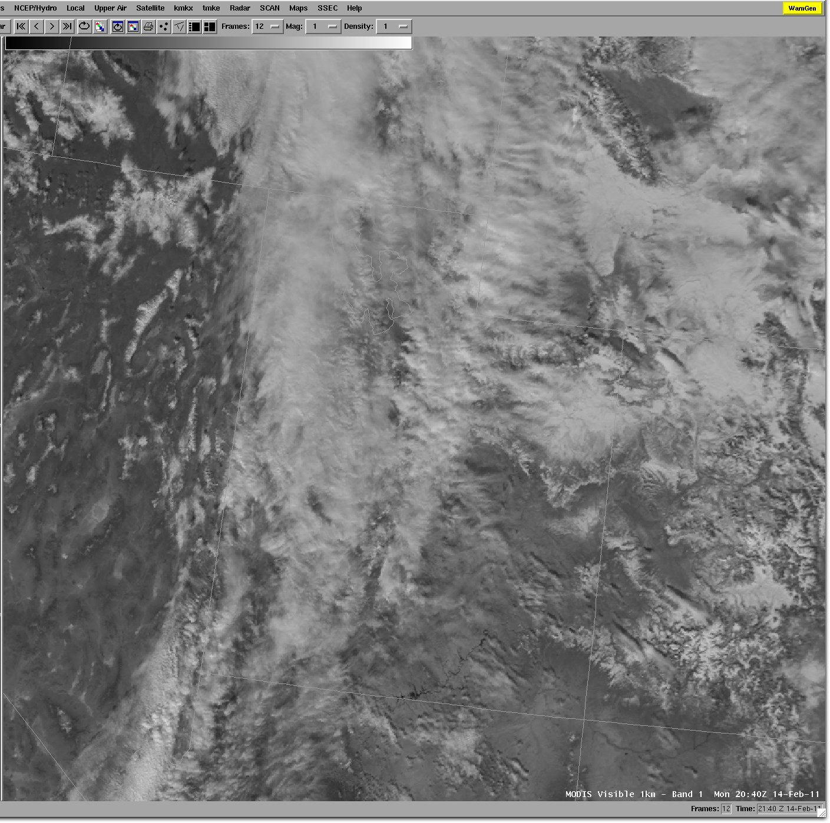
MODIS
Visible
Band 1 km
14 Feb 2011

Slide 44
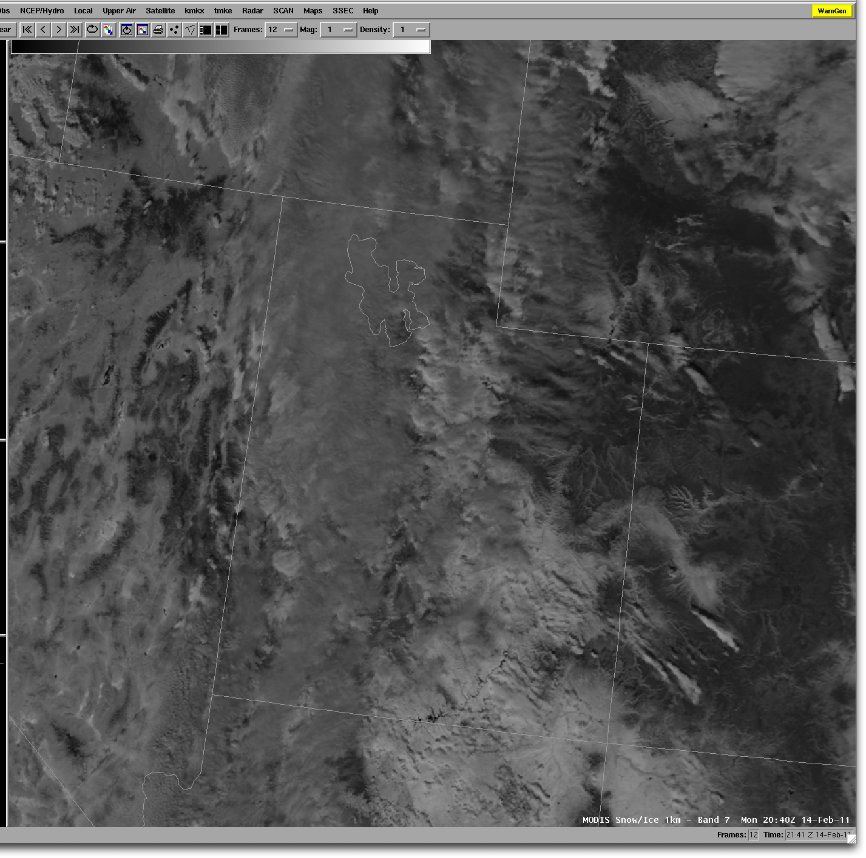
MODIS
Snow/Ice
Band 1 km
14 Feb 2011

Slide 45
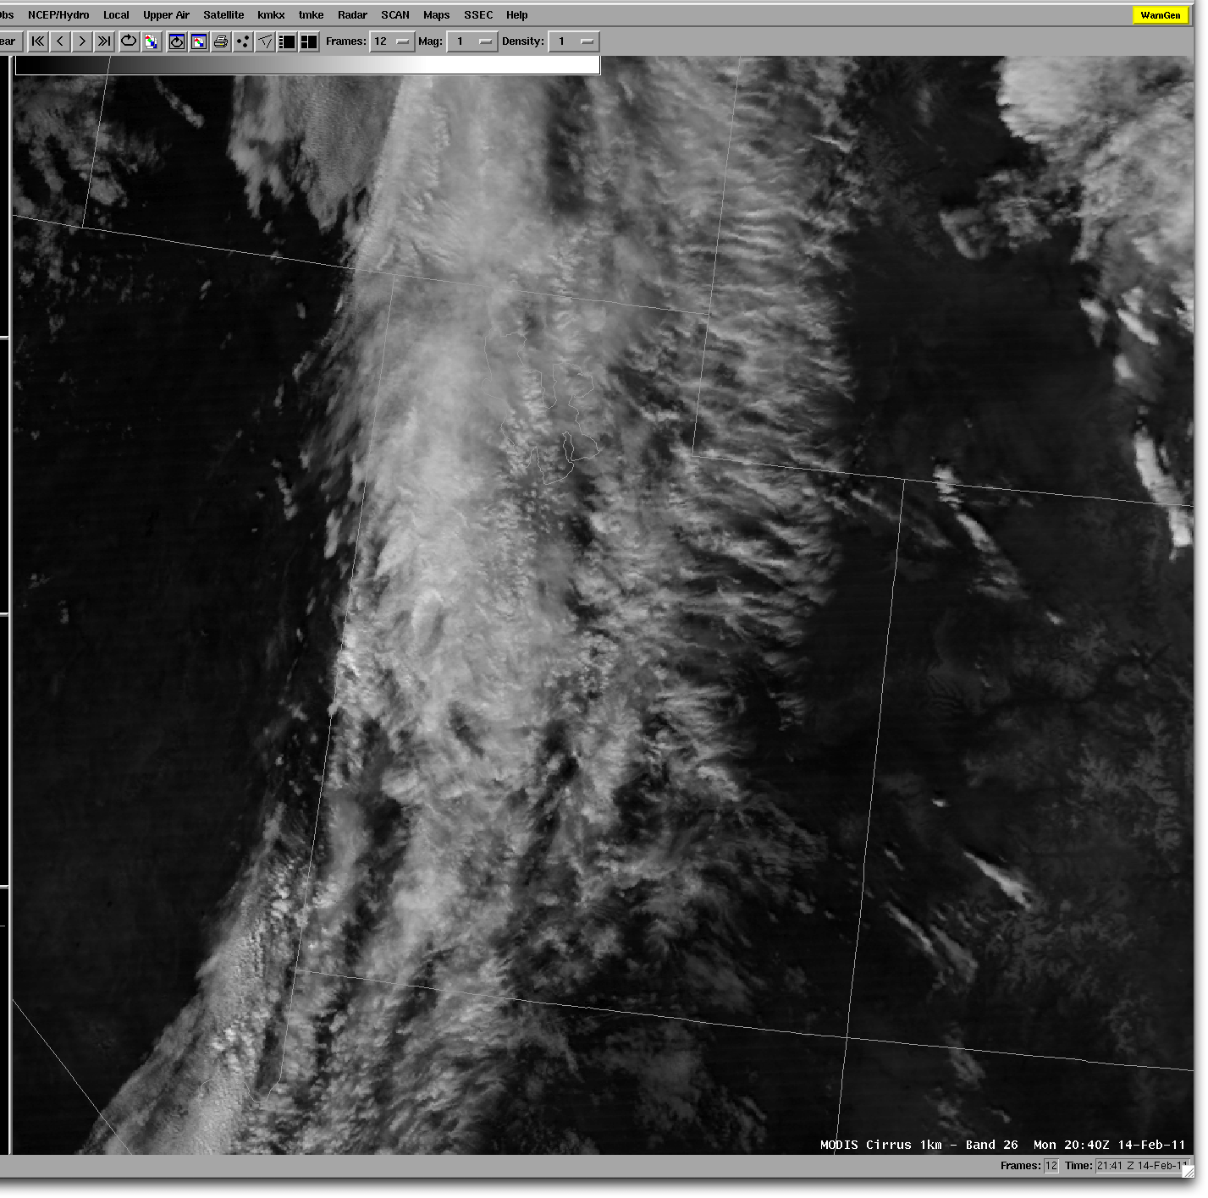
MODIS
Cirrus Band
1 km
14 Feb 2011

Slide 46
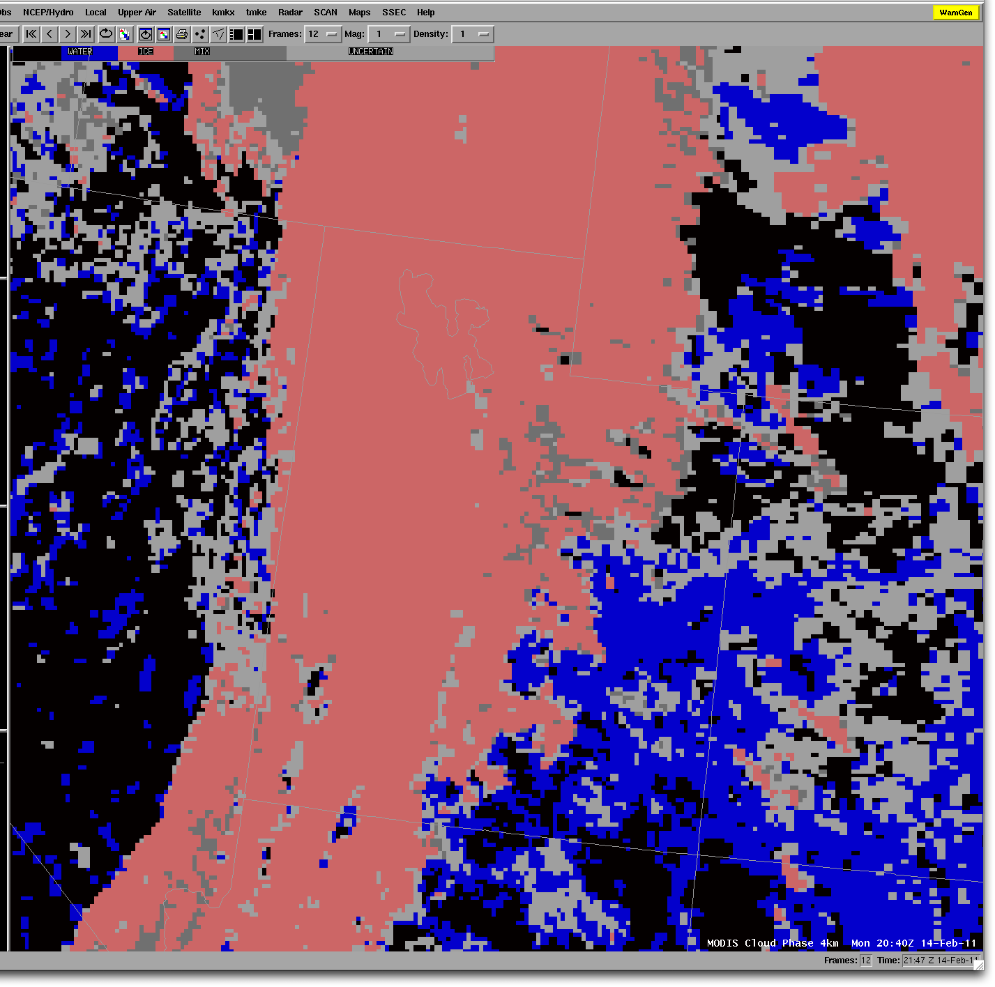
MODIS
Cloud Phase
Product
4 km
14 Feb 2011

Slide 47
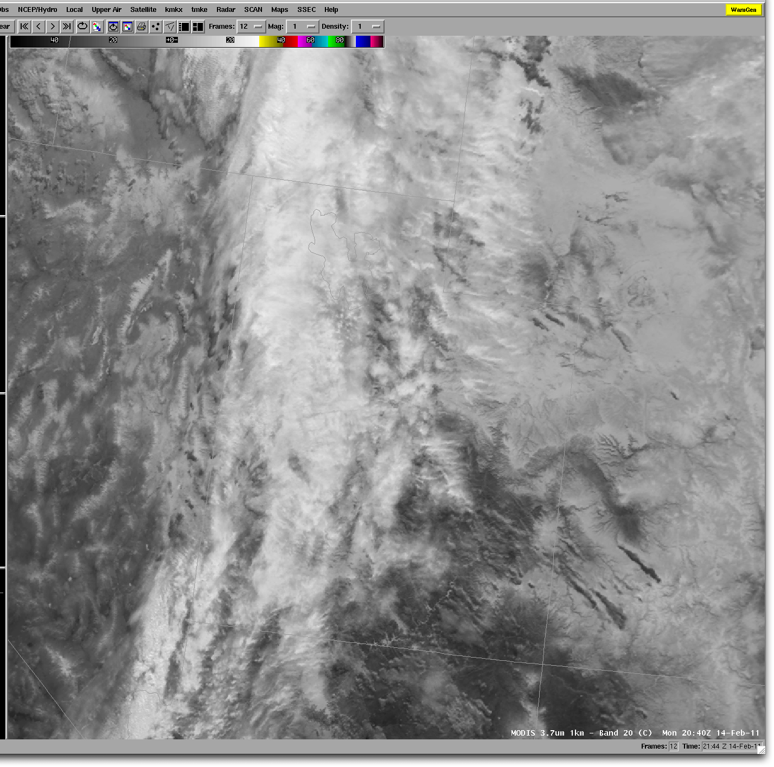
MODIS
3.7 μm Band
1 km
14 Feb 2011

Slide 48
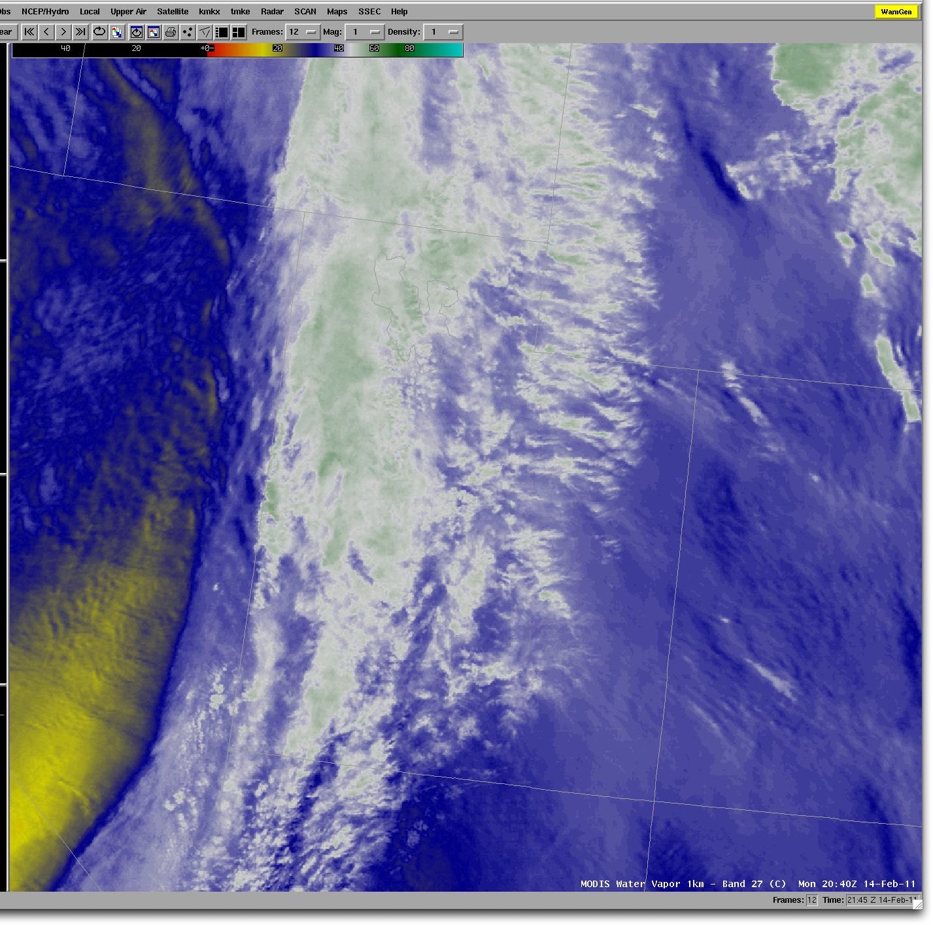
MODIS
Water Vapor
Band 1 km
14 Feb 2011

Slide 49
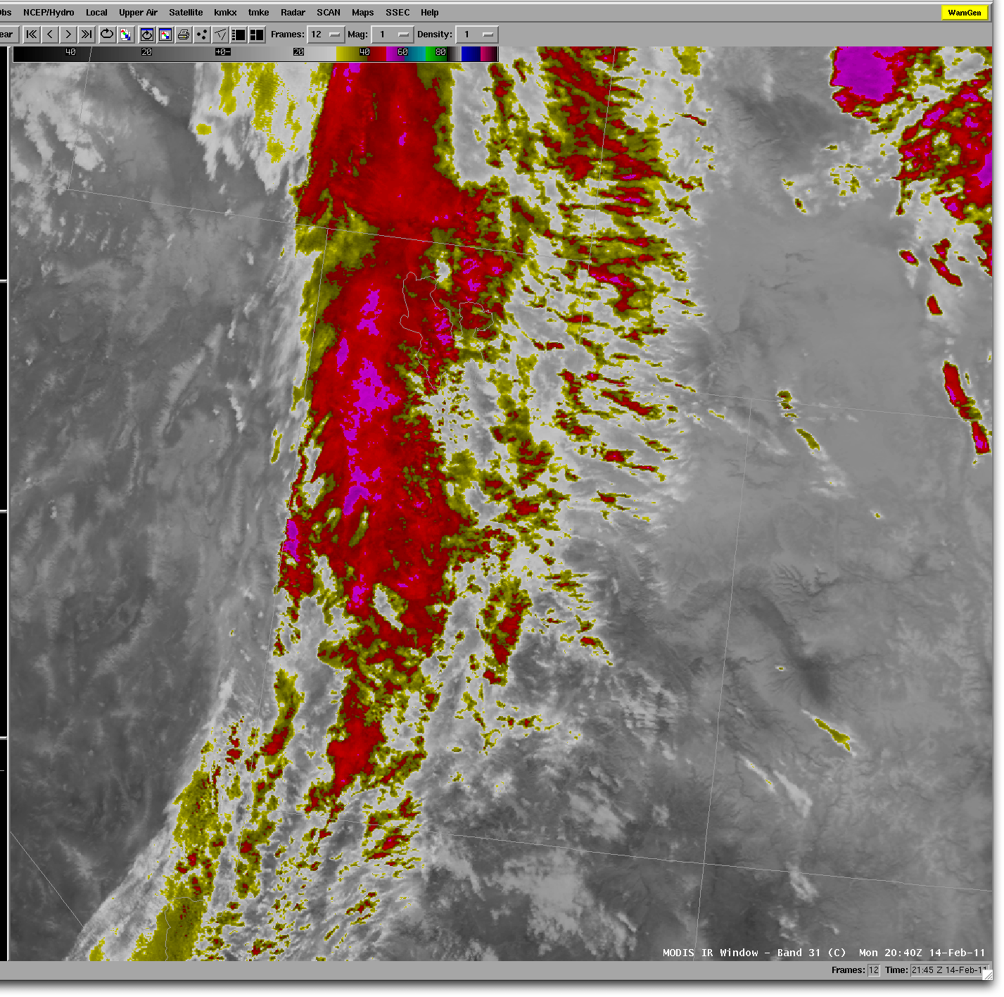
MODIS IR
Window
Band 1 km
14 Feb 2011

Slide 50
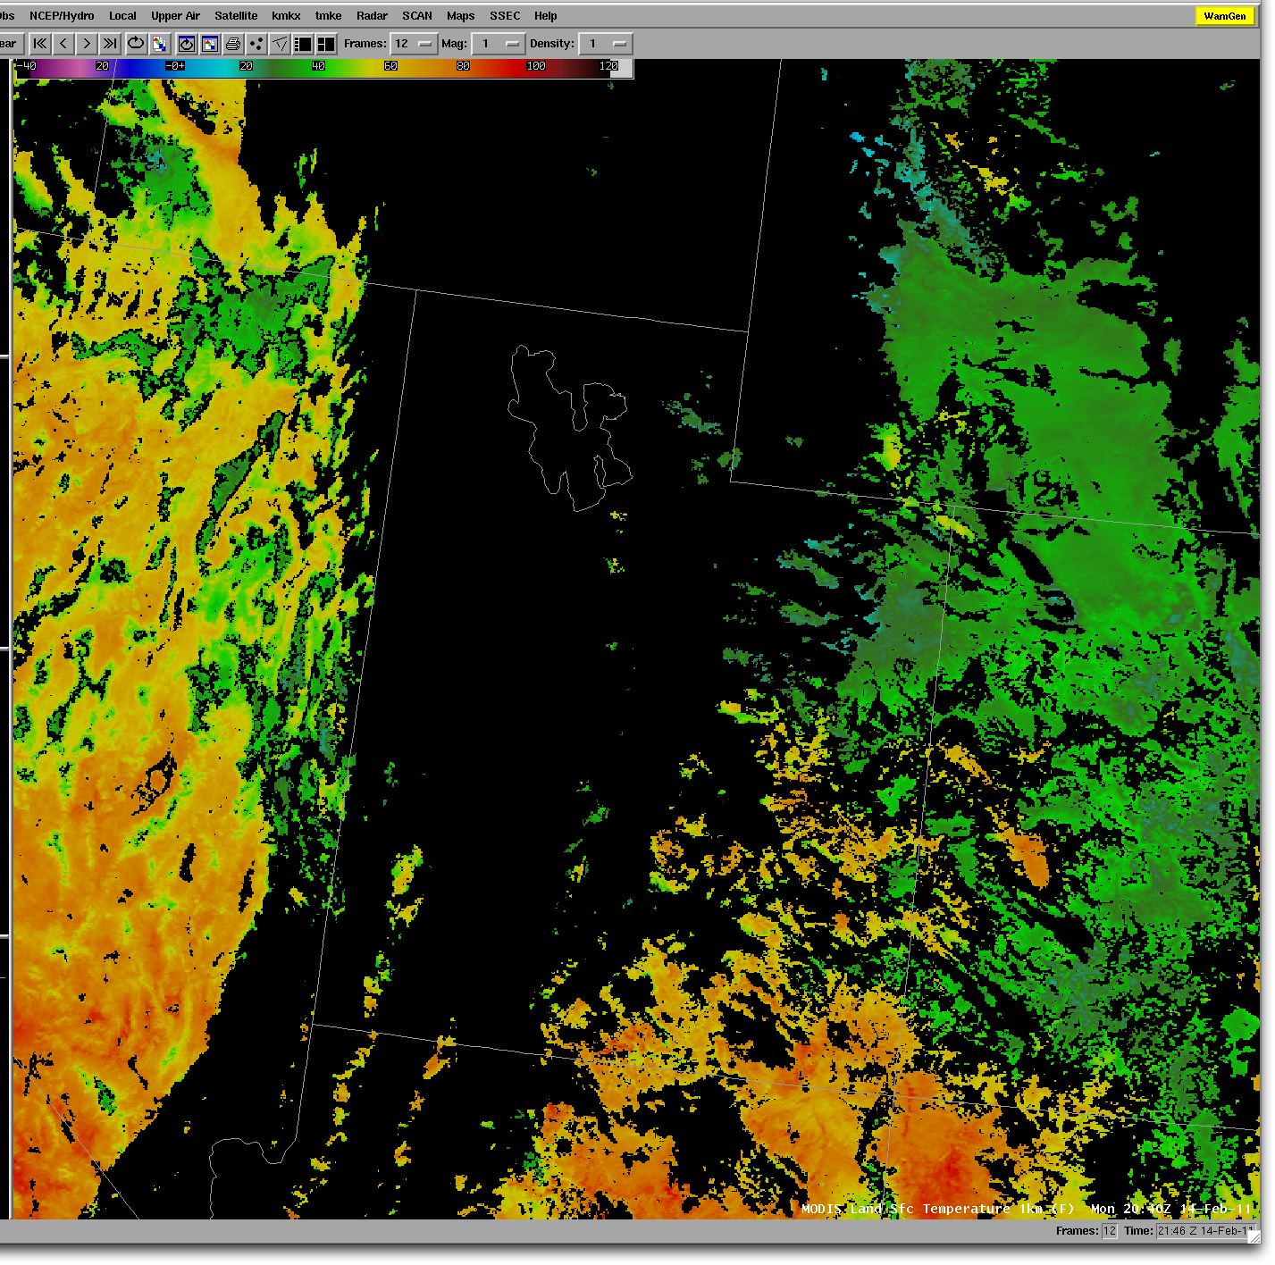
MODIS
Land Surface
Temperature
1 km
14 Feb 2011

Slide 51
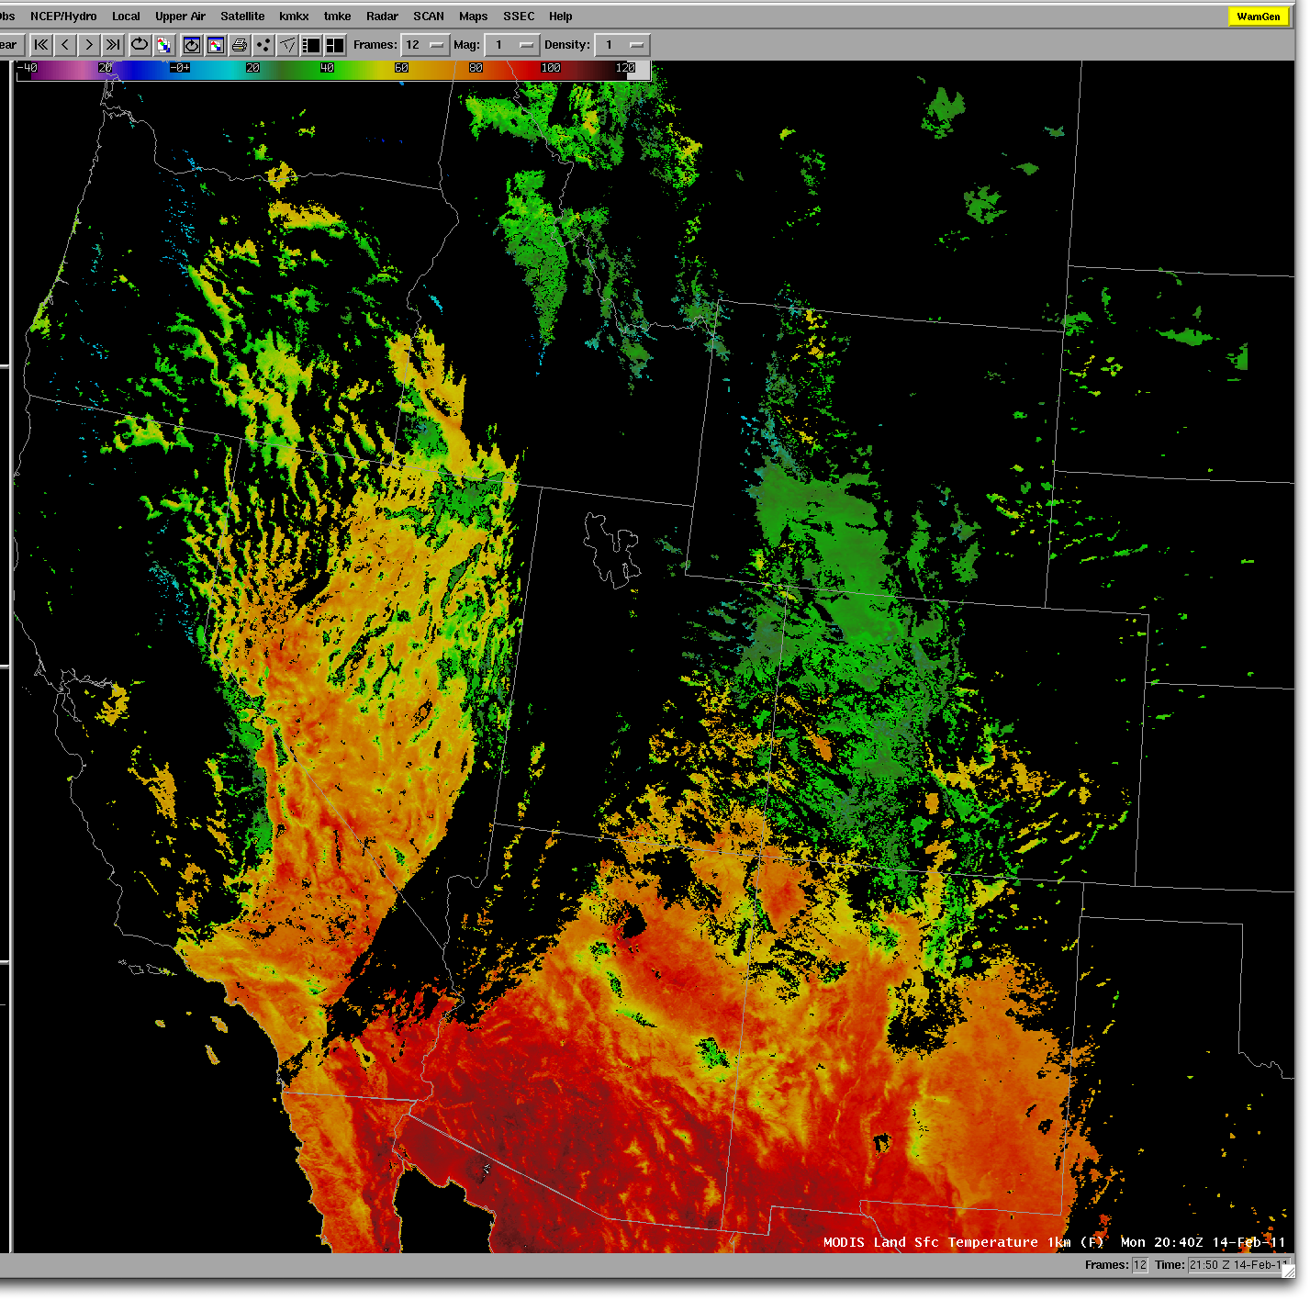
MODIS
Land Surface
Temperature
1 km
14 Feb 2011

Slide 52
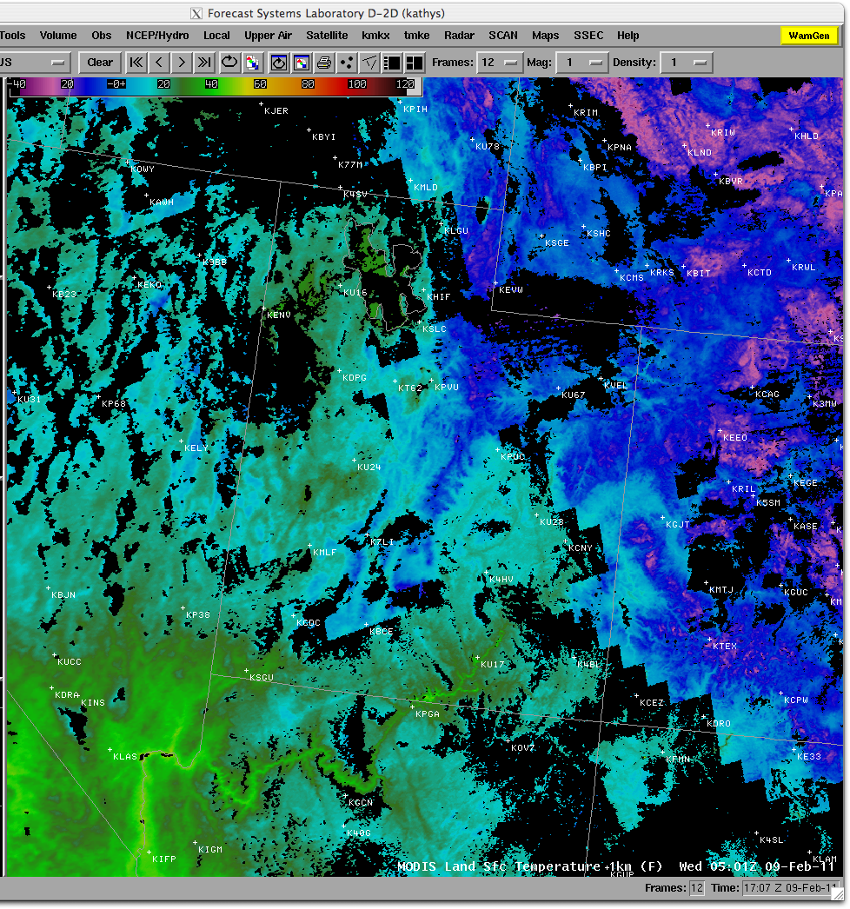
MODIS
Land Surface
Temperature
1 km
(Nighttime)
9 Feb 2011

Slide 53
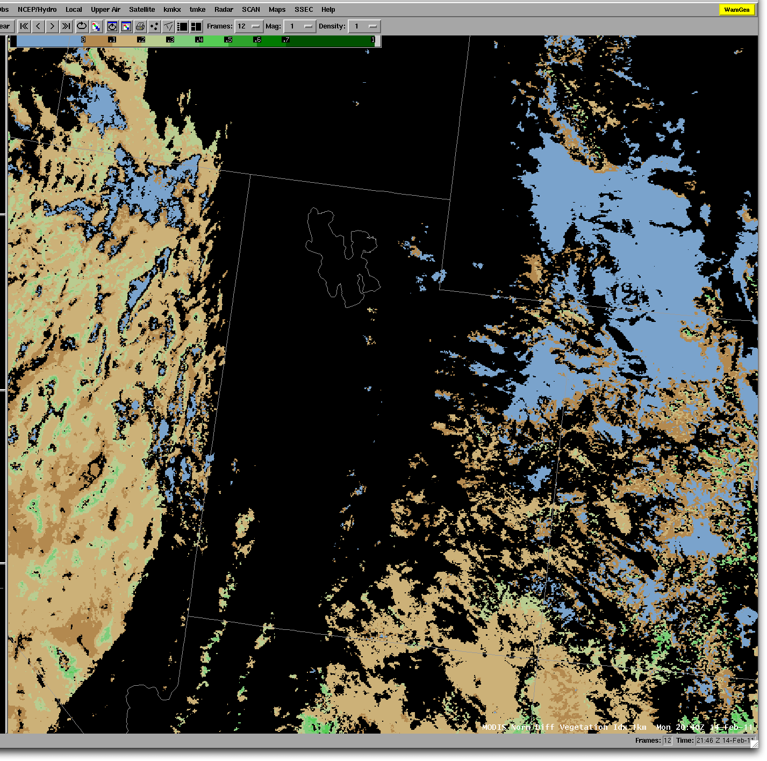
MODIS
NDVI
Product
1 km
14 Feb 2011

Slide 54
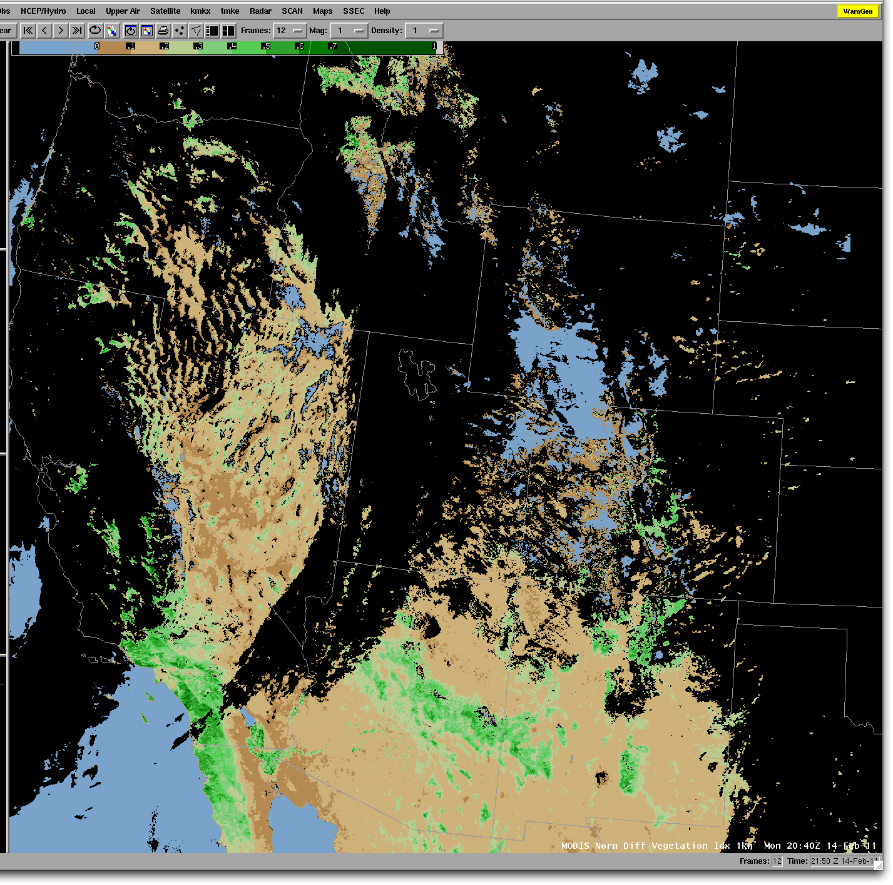
MODIS
NDVI
Product
1 km
14 Feb 2011

Slide 55
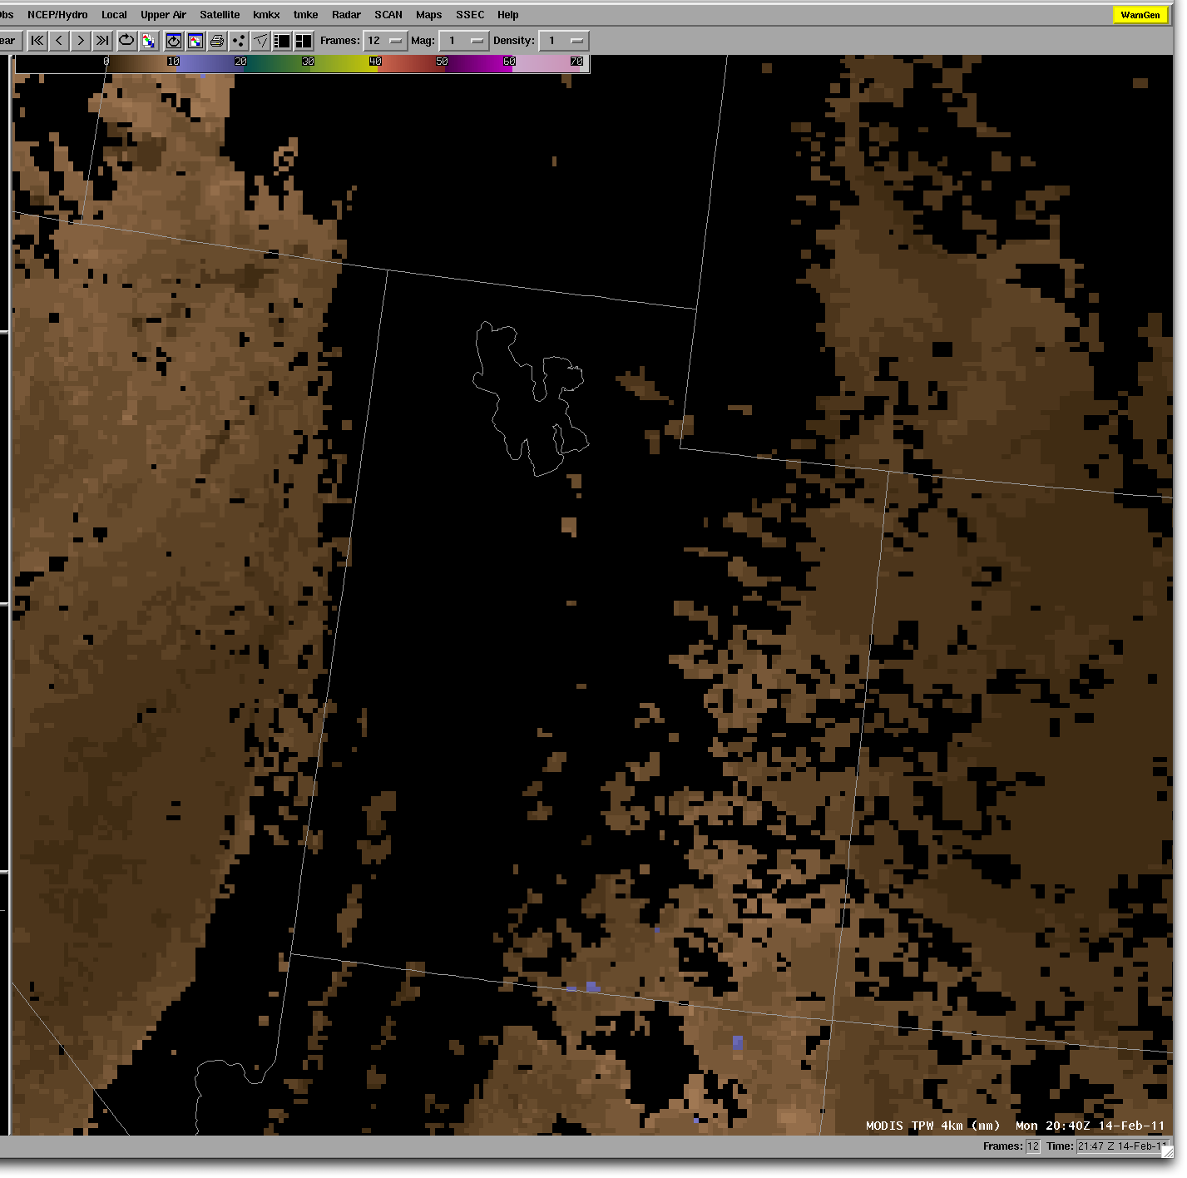
MODIS
TPW
Product
4 km
14 Feb 2011

Slide 56
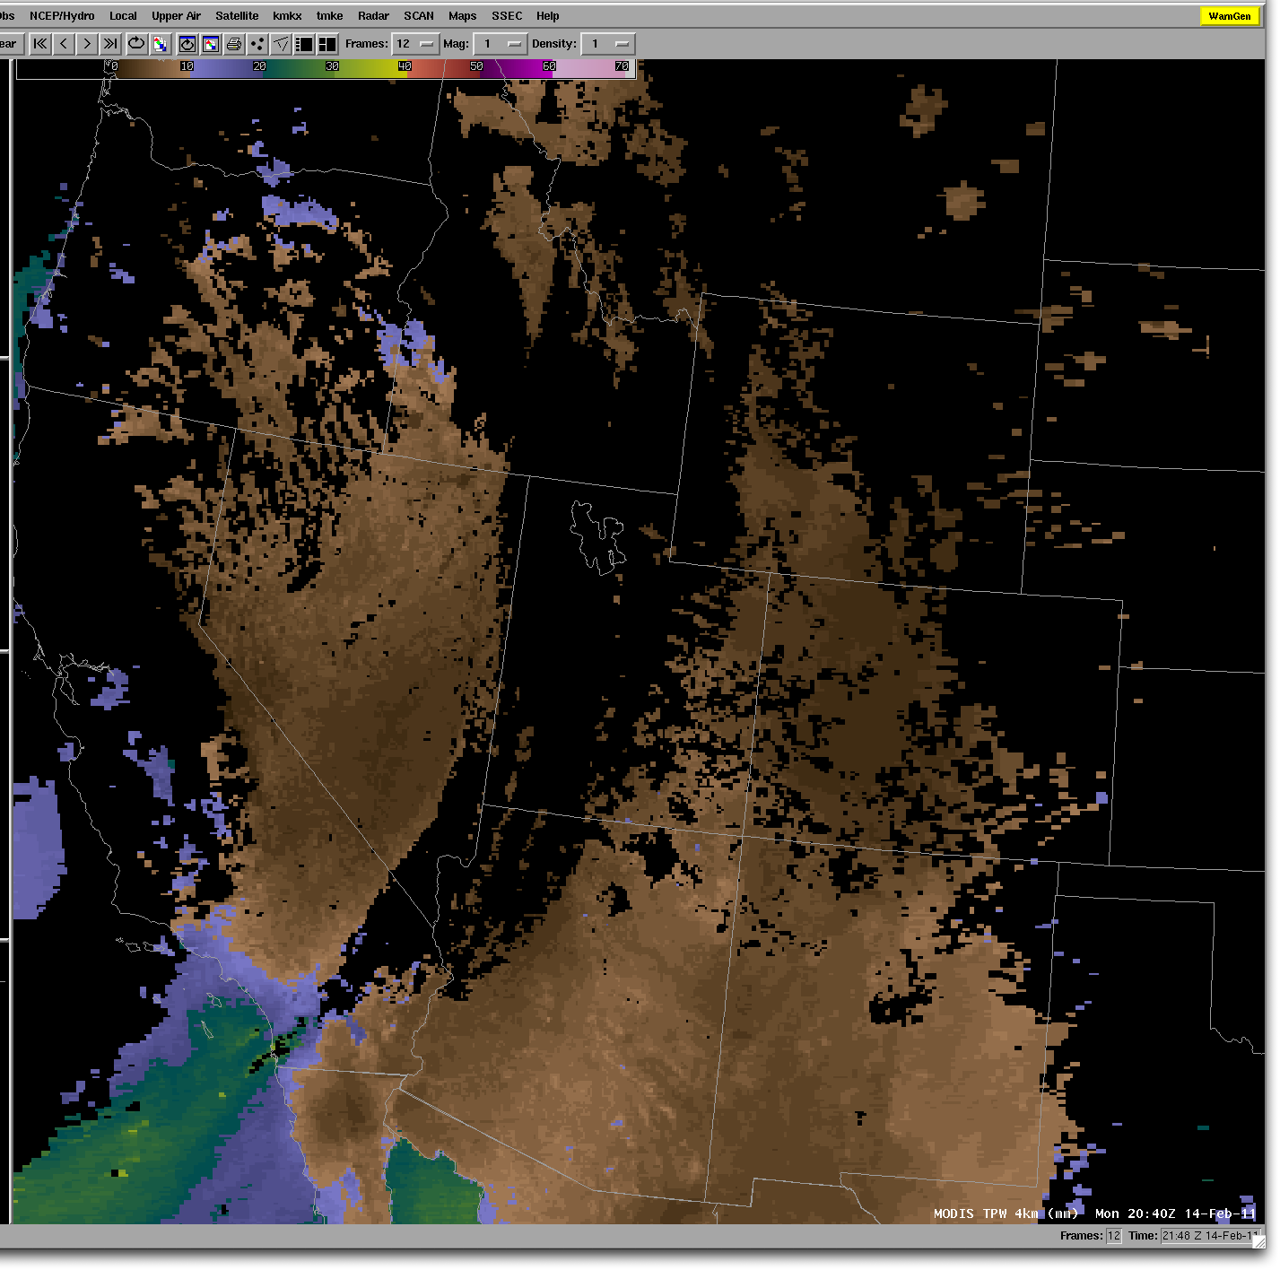
MODIS
TPW
Product
4 km
14 Feb 2011

Slide 57
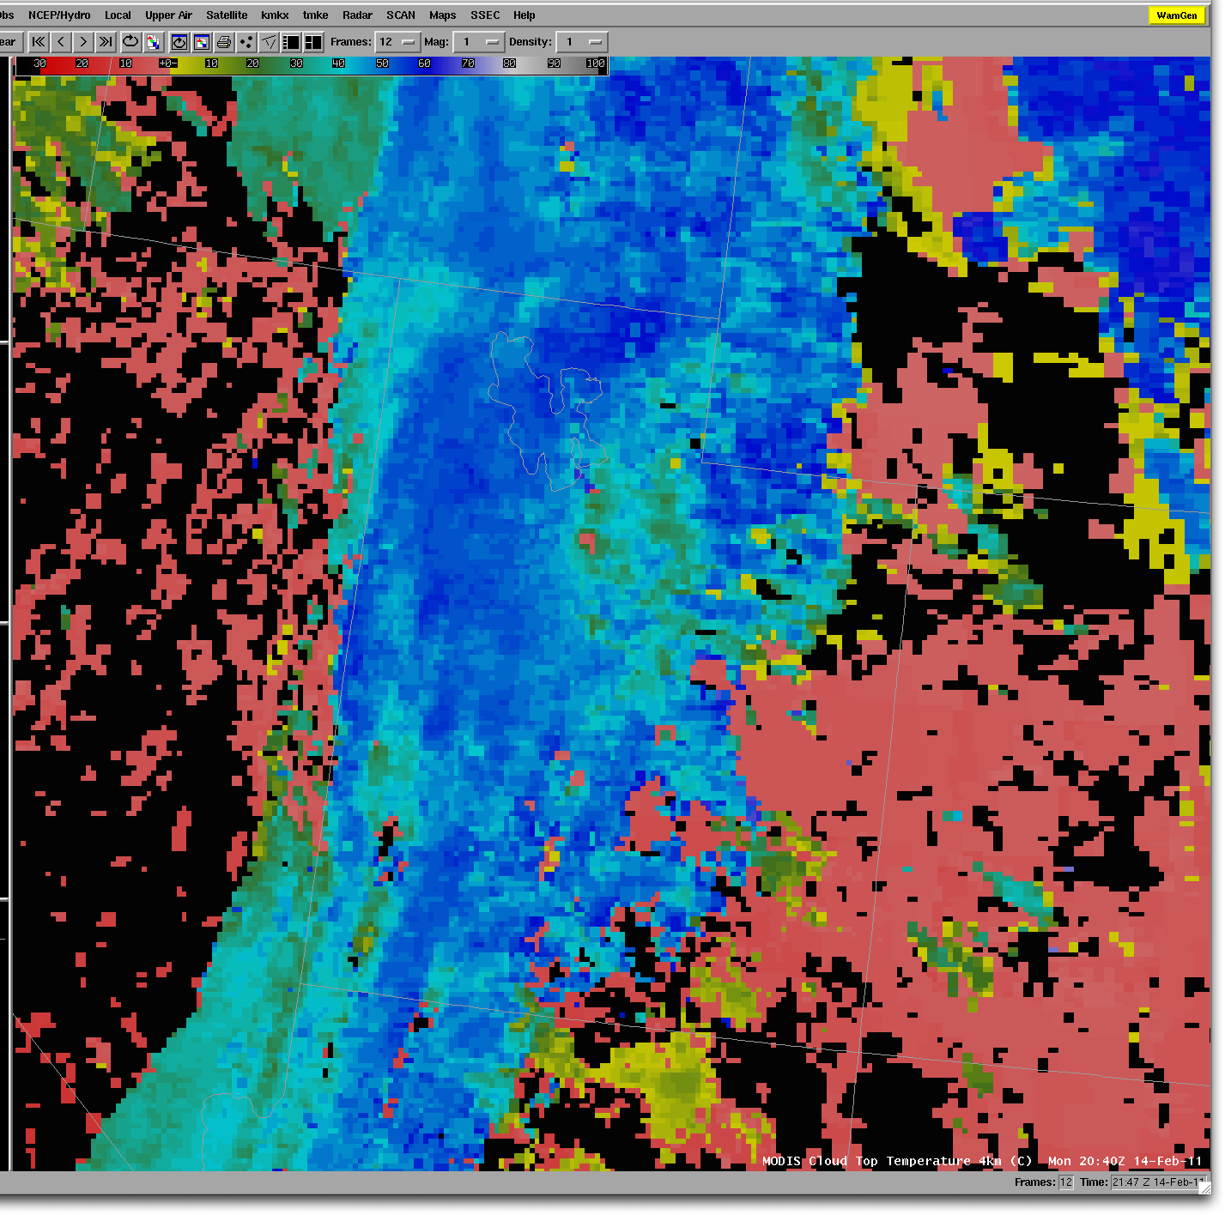
MODIS
Cloud Top
Temperature
Product
4 km
14 Feb 2011

Slide 58
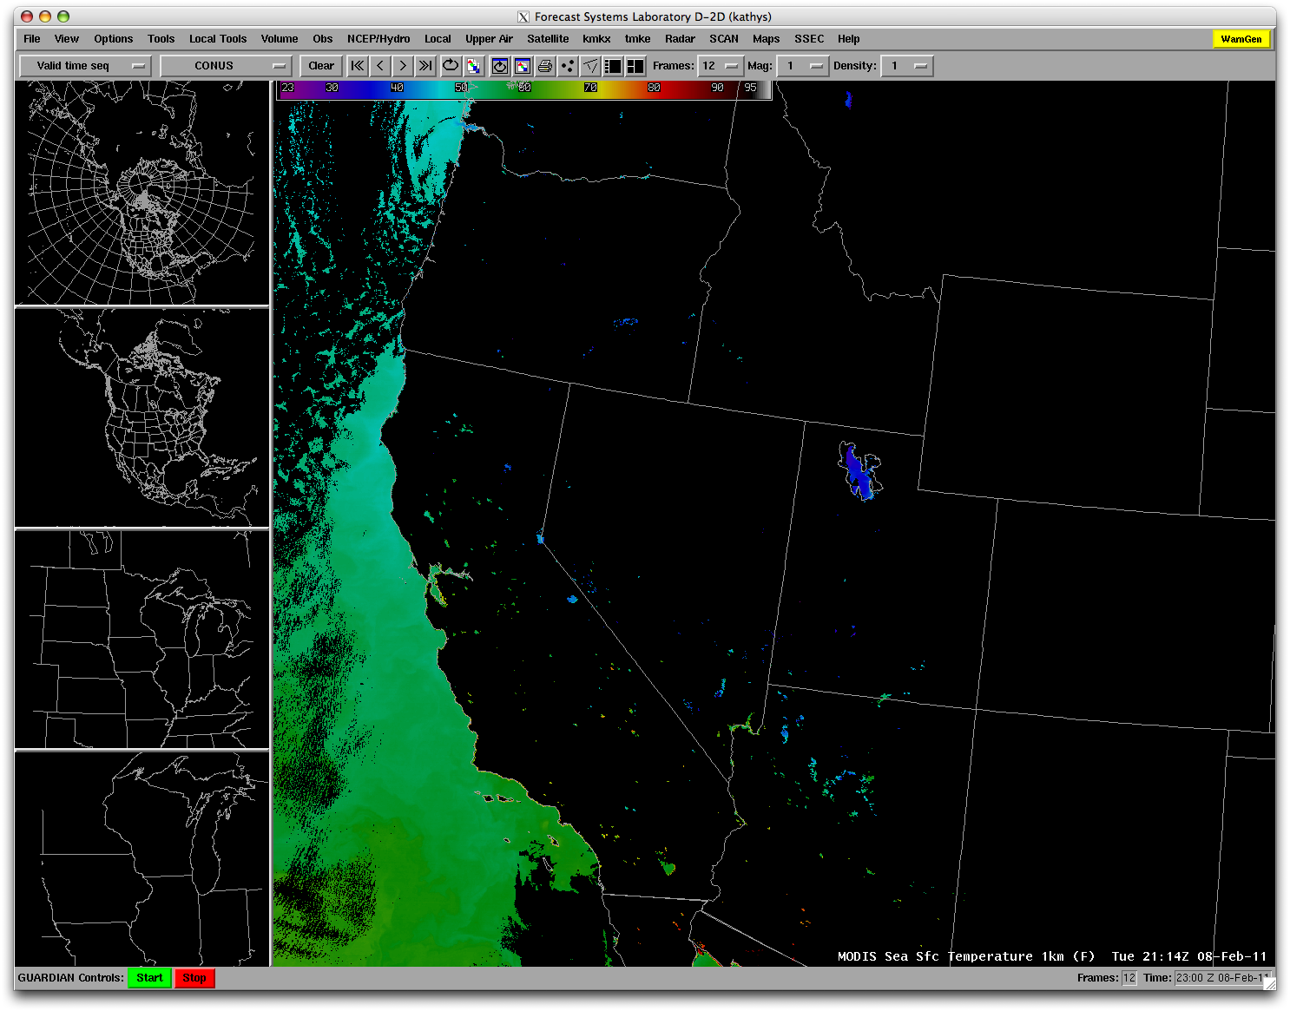
MODIS
Sea Surface Temperature
Product
1 km
8 Feb 2011

Slide 59
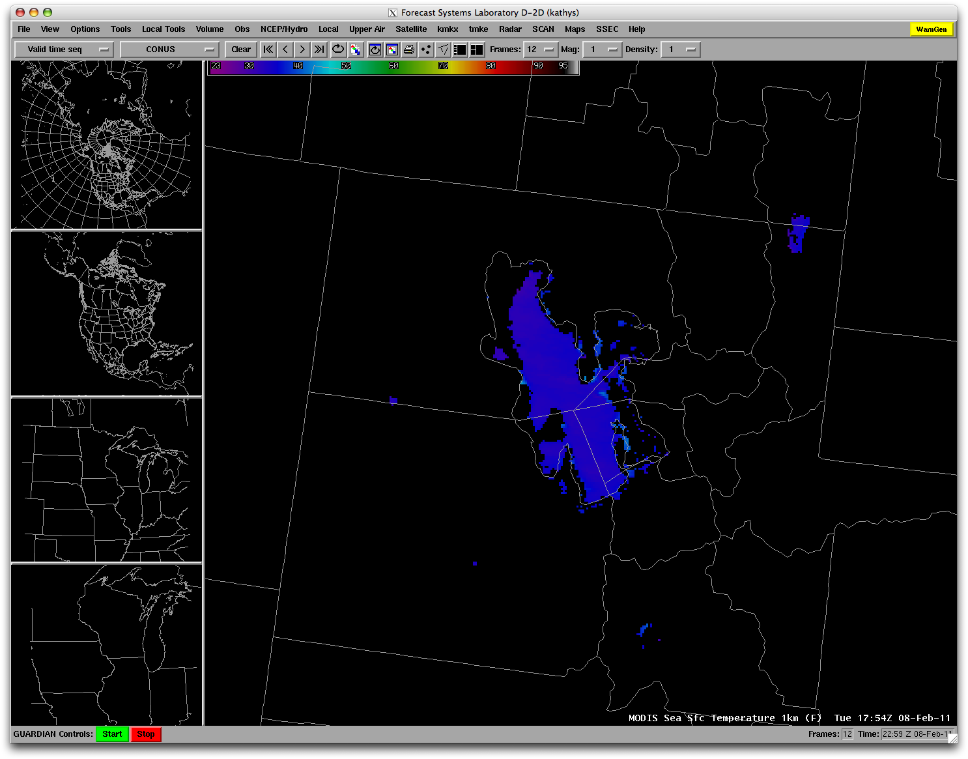

Slide 60
Products Outside AWIPS

Slide 61
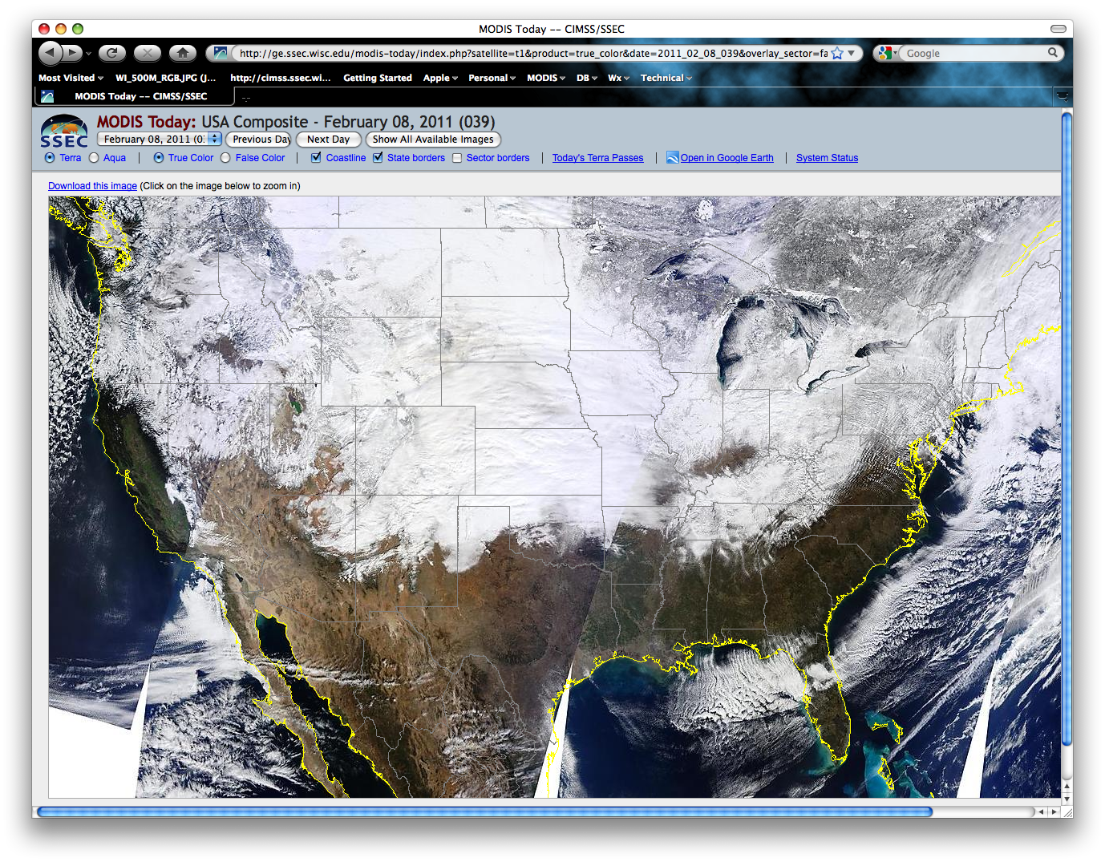
MODIS Today Real Time Web Site http://ge.ssec.wisc.edu/modis-today/

Slide 62
MODIS Today Real Time Web Site http://ge.ssec.wisc.edu/modis-today/

Slide 63
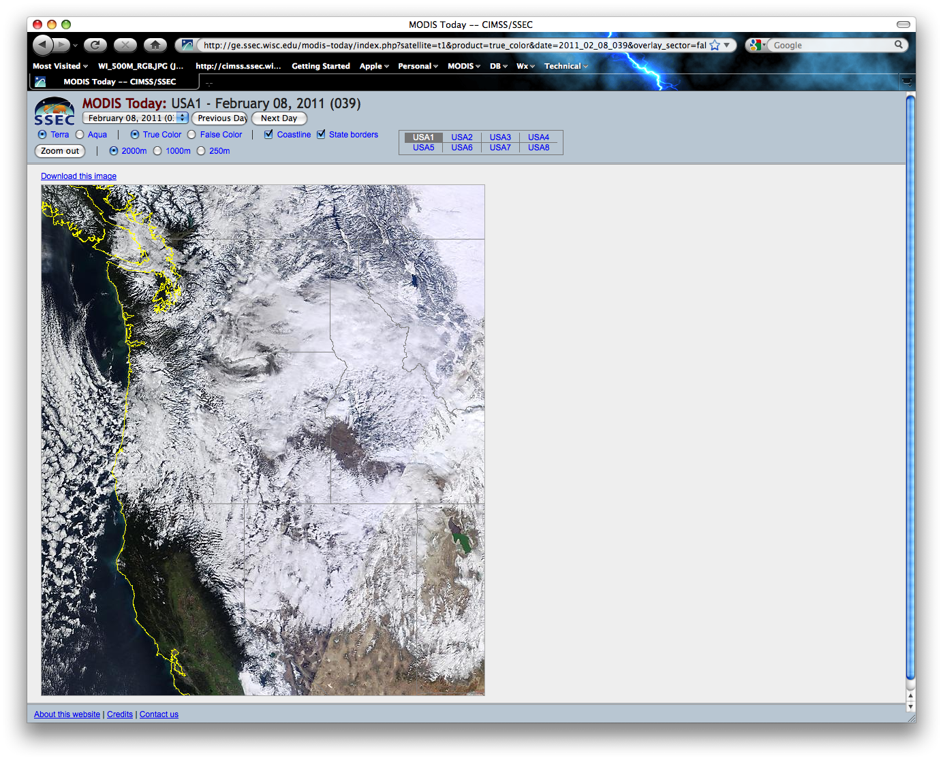

Slide 64
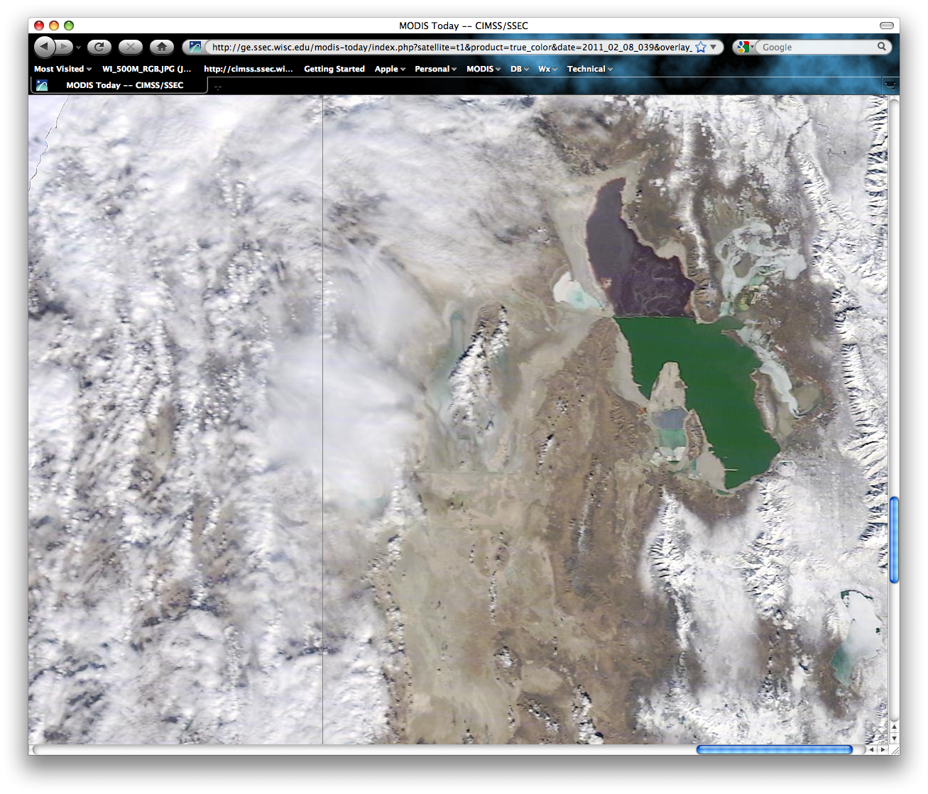

Slide 65
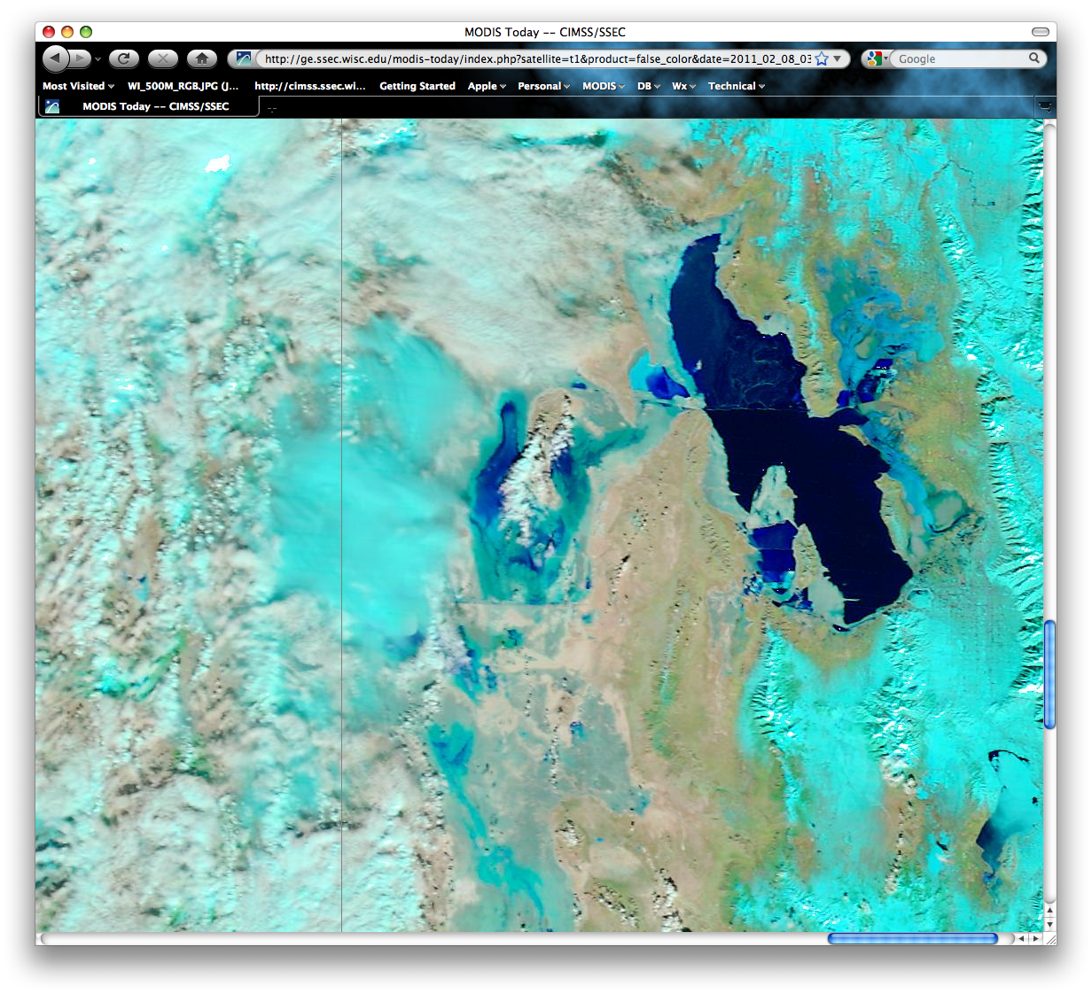

Slide 66
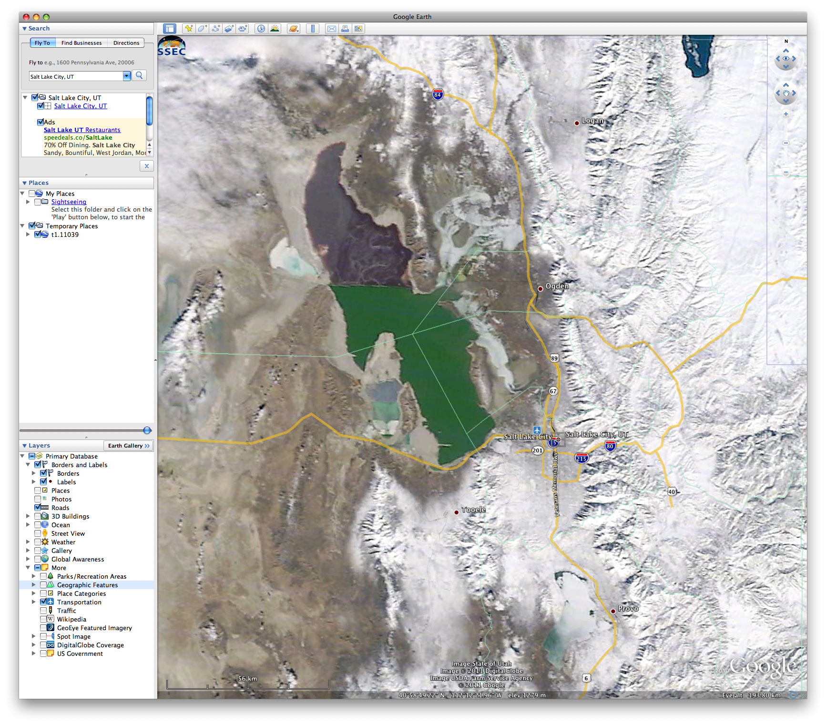

Slide 67
Blowing Dust Example
5 September 2010

Slide 69
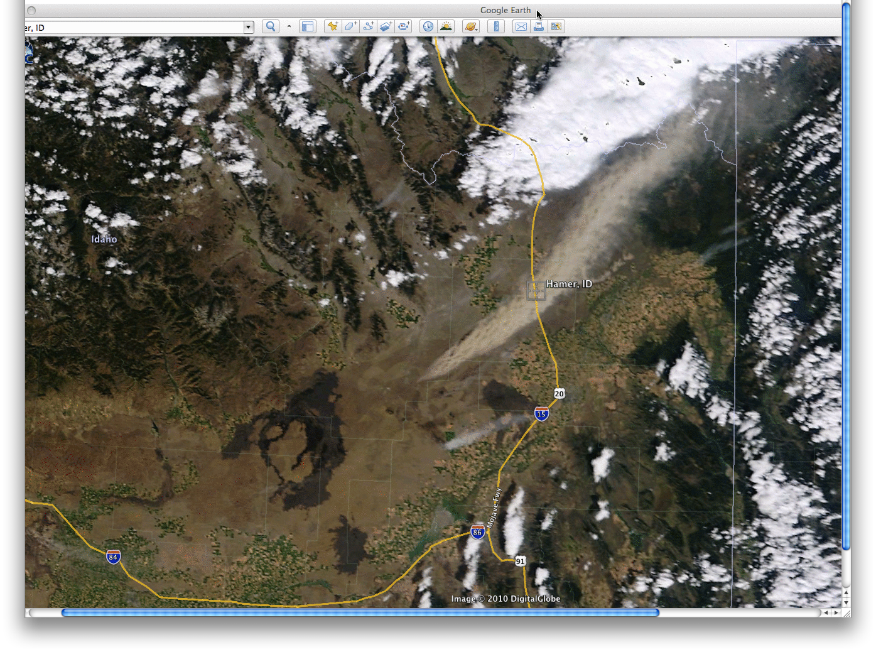
MODIS Image in Google Earth 19:08 UTC 5 September 2010

Slide 70
Storm Report
PRELIMINARY LOCAL STORM REPORT
NATIONAL WEATHER SERVICE POCATELLO
1129 AM MDT SUN SEP 05 2010
..TIME... ...EVENT... ...CITY LOCATION... ...LAT.LON...
..DATE... ....MAG.... ..COUNTY LOCATION..ST. ...SOURCE....
..REMARKS..
1125 AM DUST STORM 2 S HAMER 43.90N 112.20W 09/05/2010 JEFFERSON ID NWS EMPLOYEE
VISIBILITIES FROM DUST AND SMOKE REPORTED ALONG INTERSTATE 15 FROM MILEPOST 135 TO 155. VISIBILITIES SOMETIMES BELOW 1/3 MILE.

Slide 71
Usefulness Measured

Slide 72
University of Wisconsin Direct Broadcast MODIS Data used by the National Weather Service
MODIS DB products have been mentioned in Area Forecast Discussions 192 times

Slide 74
Sources
CIMSS Satellite Blog (Scott Bachmeier)
http://cimss.ssec.wisc.edu/goes/blog/
MODIS Today Web site:
http://ge.ssec.wisc.edu/modis-today/
kathys@ssec.wisc.edu

