Slide 1
Satellite Imagery/Products in Western Region
CIMSS/ASPB Satellite Workshop
02.16.11

Slide 2
Introduction
Satellite/remotely sensed imagery is popular in WR
This results from unique regional obstacles to forecasting…

Slide 3
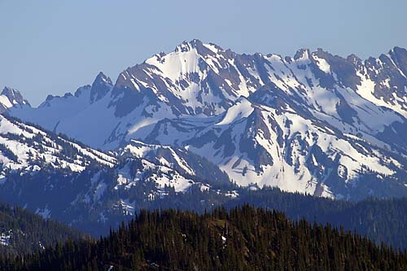
Obstacles in WR
Terrain issues
Meteorological changes occur over short distances
Radar beam blockage

Slide 4
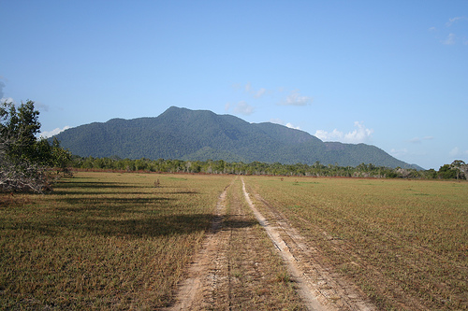
Obstacles in WR
Population density
Difficult to get real-time ground truth

Slide 5
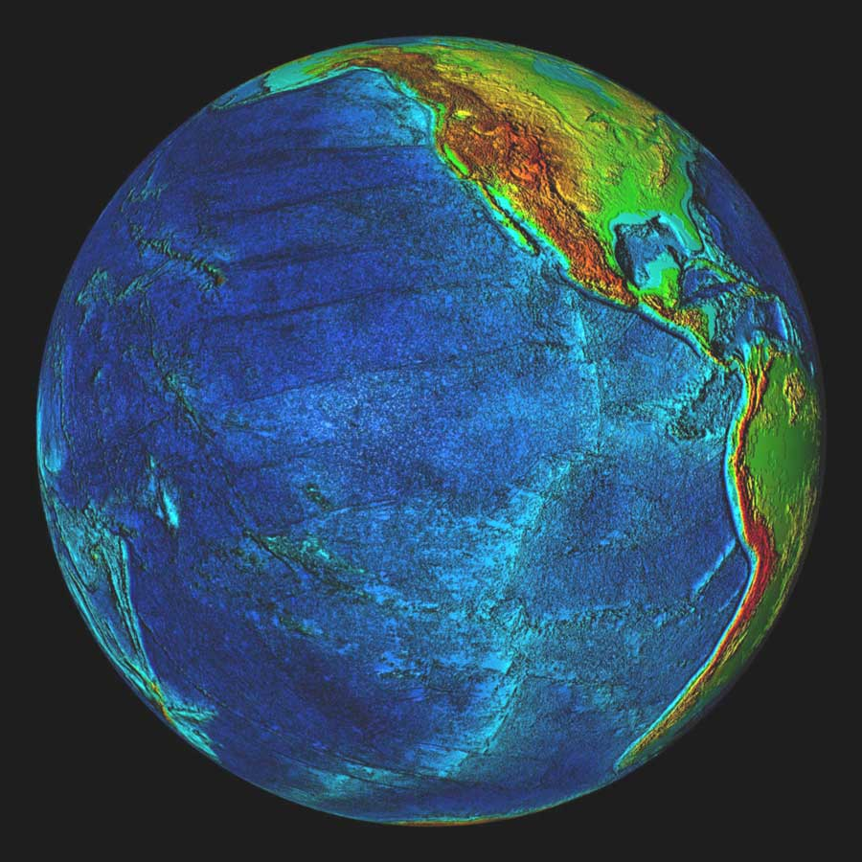
Obstacles in WR
The Pacific
Lack of quality upstream observations

Slide 6
MODIS

Slide 7
Uses of MODIS
Thermal belts (fire weather)
Snow cover
Ice on rivers
Fog if timing is right

Slide 8
River Ice Monitoring Samples
Valley Fog
Bare Ground
Snow in Forests
Snow
Snow in Forests
River and
Lake Ice
Rotting River and
Lake Ice
Clouds
Bow-tie
Effect
Lake Ice
River Ice
Rotting
Lake Ice
Snow
Snow in Forests
Snow in Forests
Clouds
February 21, 2008
April 12, 2008
Courtesy: Gina Loss/WFO Great Falls
Notes:
Montana snow and river ice observations and comparisons using MODIS false color imagery February 21, 2008 (left) and April 12, 2008 (right).

Slide 9
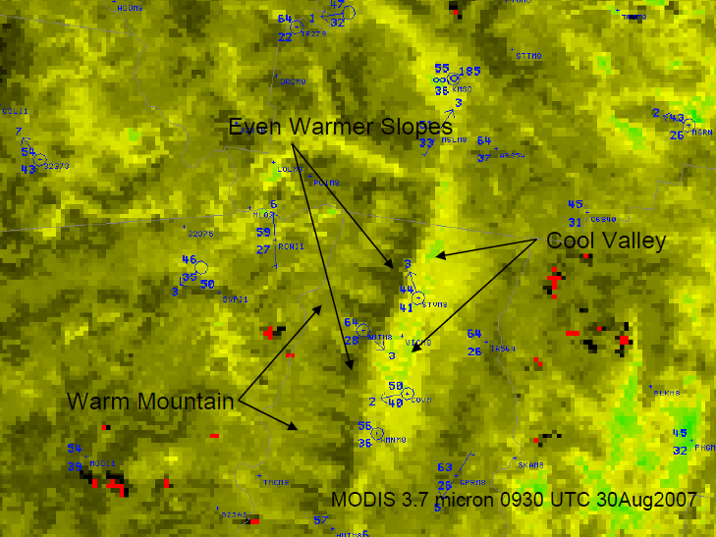
Thermal Belts
Courtesy: Don Moore/WFO Billings/WFO Missoula

Slide 10
CRAS

Slide 11
CRAS
Not much traction in WR
Forecasters still prefer raw model data
Better resolution might change this

Slide 12
Needs of WR

Slide 13
Fire Weather
Surface temperatures
Hot spots
Convective initiation (lightning)

Slide 14
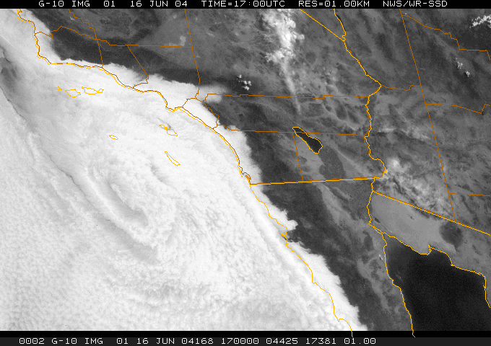
Marine Layer
Modeled sky cover of any form (NWP, CRAS) doesn’t handle this well
We would love a modeled sky cover that reasonably captured coastal stratus!
GFE smartInit

Slide 15
PW products
Atmospheric rivers are a point of emphasis for forecasters during the winter
Assessment of PW field over the Pacific is a key part of the forecasting process!

Slide 16
Questions?

