Slide 1




A History of CIMSS/ASPB Satellite Products Transitioned to National Weather Service Operations
Jordan Gerth
Cooperative Institute for Meteorological Satellite Studies
University of Wisconsin at Madison
16 February 2011
National Weather Service Western Region Headquarters
CIMSS/ASPB Satellite Workshop

Slide 2
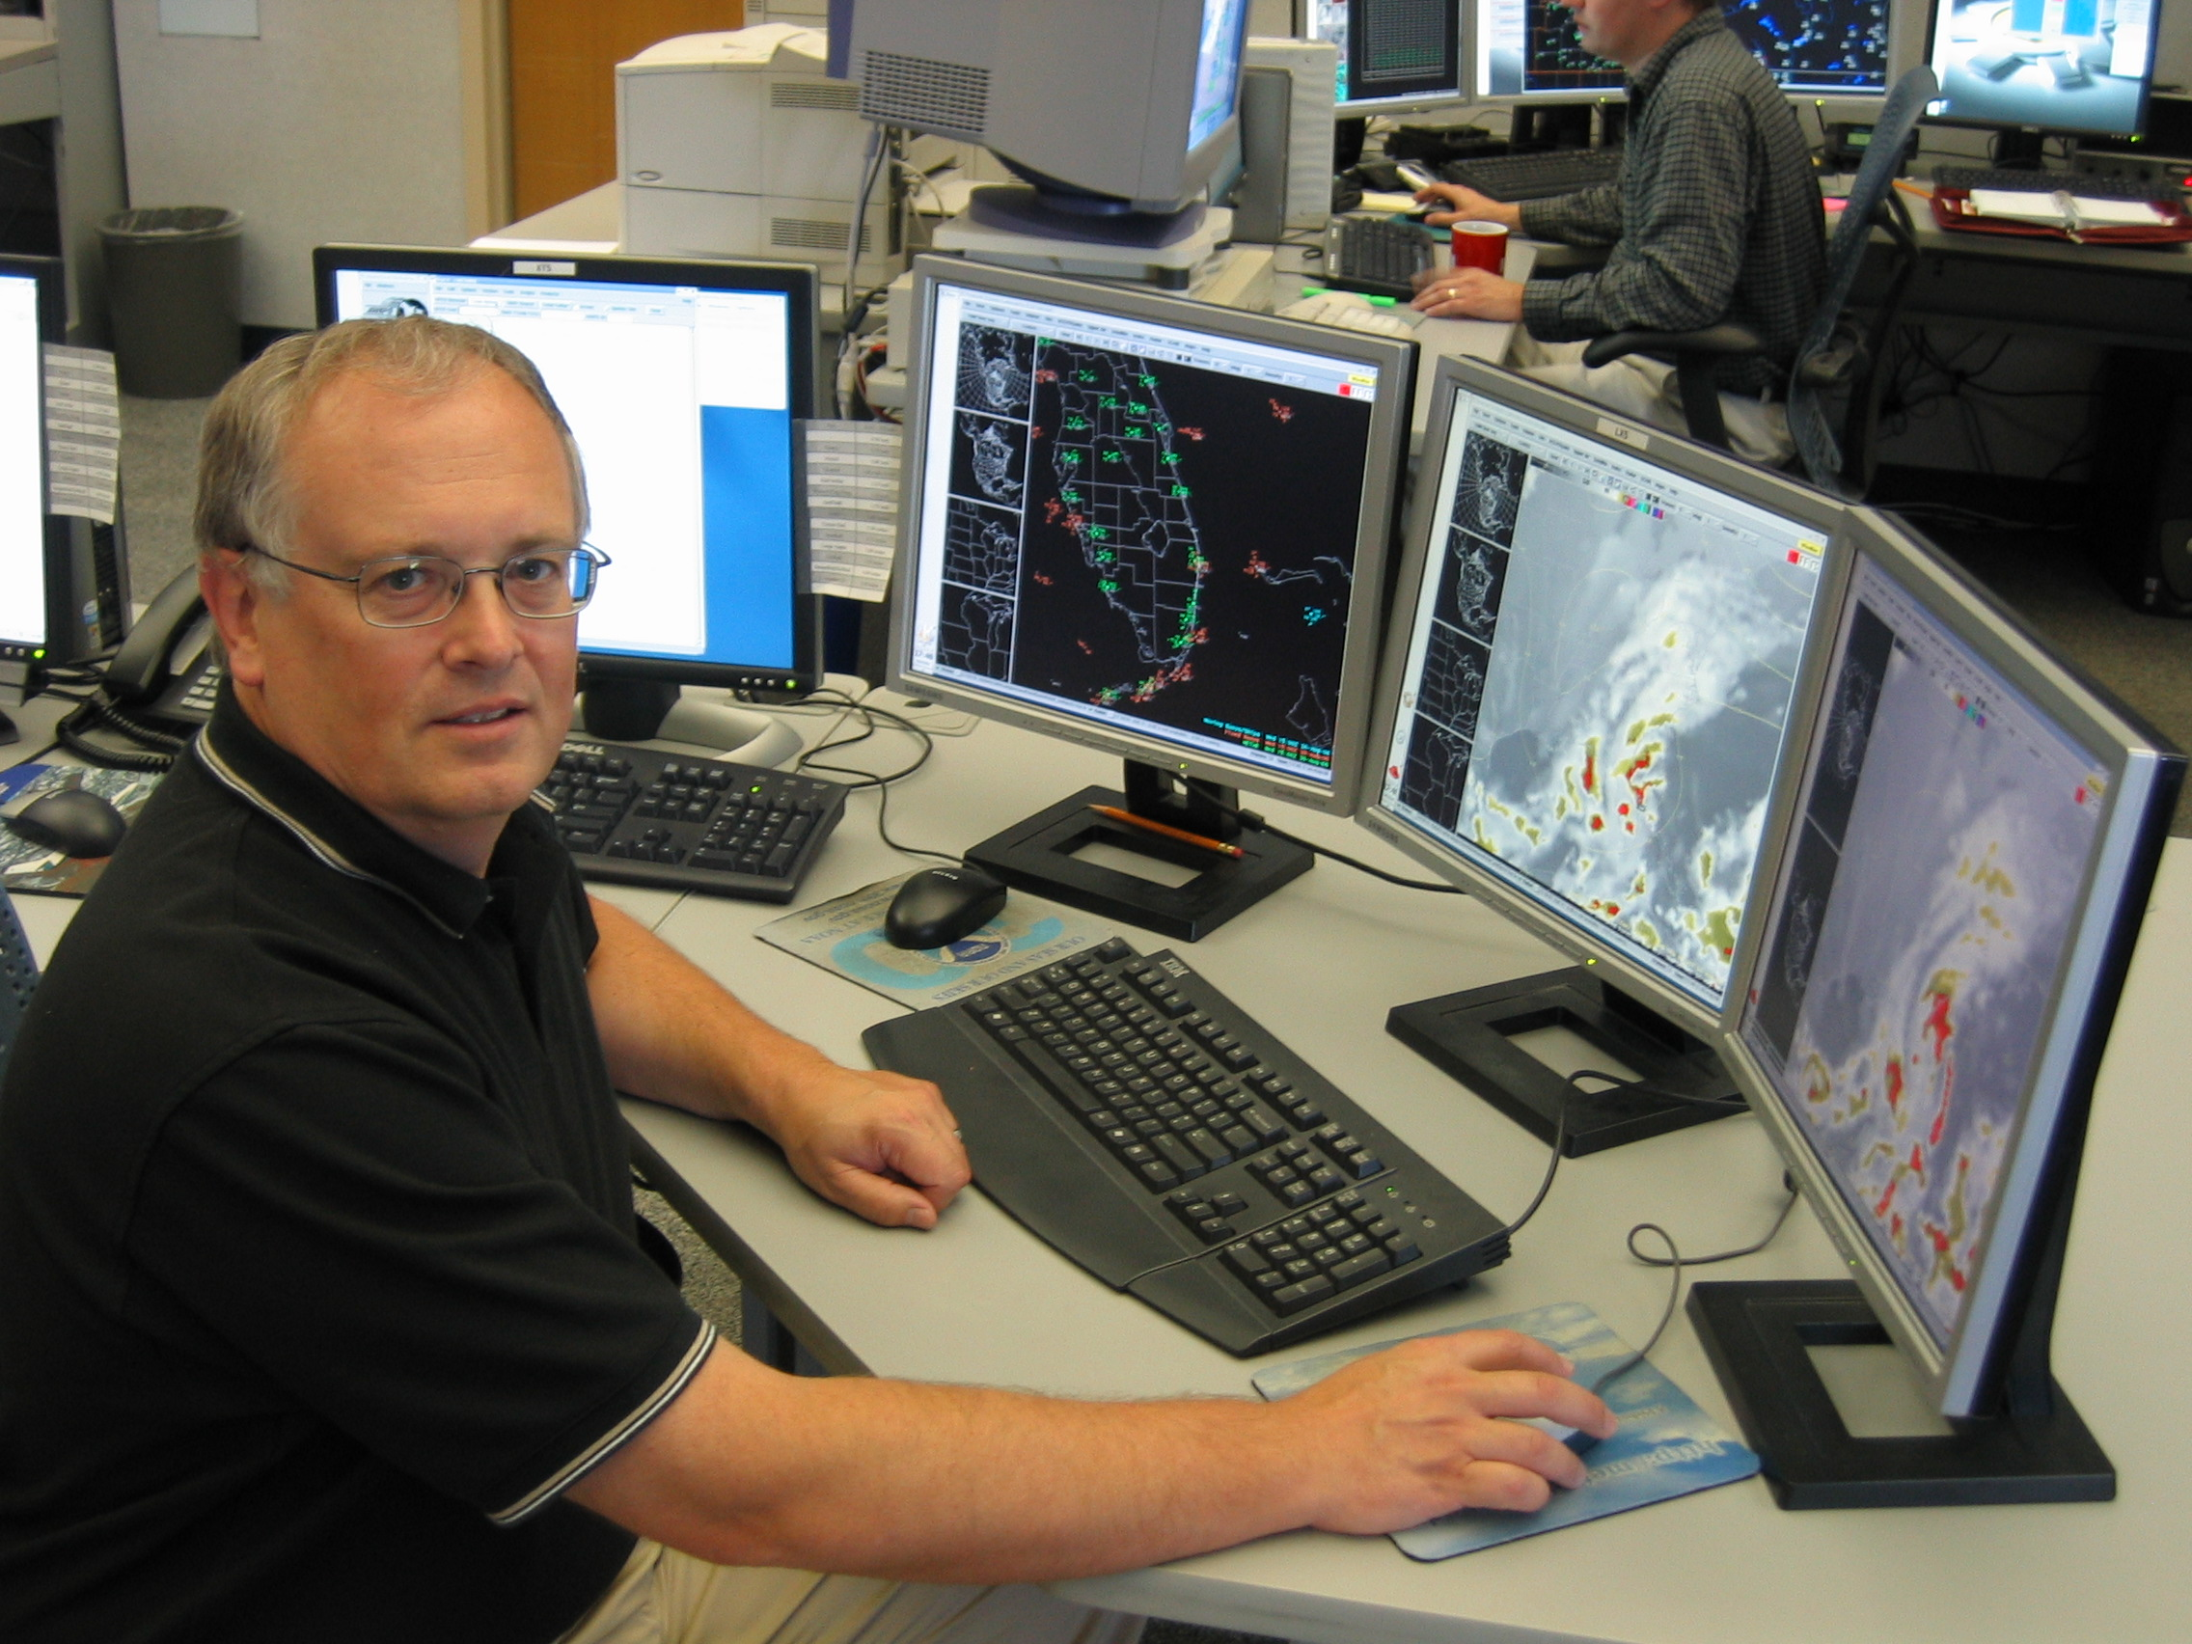
Talk Overview
Introduction
CIMSS Data Delivery
Early Evolution of CIMSS R2O Effort
Expanse of CIMSS R2O Effort Today
GOES-R Proving Ground
Lessons Learned
CIMSS Model for R2O
Field Demonstrations
Case Study
  POES Imagery
Hurdles
Future Directions
Steve Hentz

Slide 3
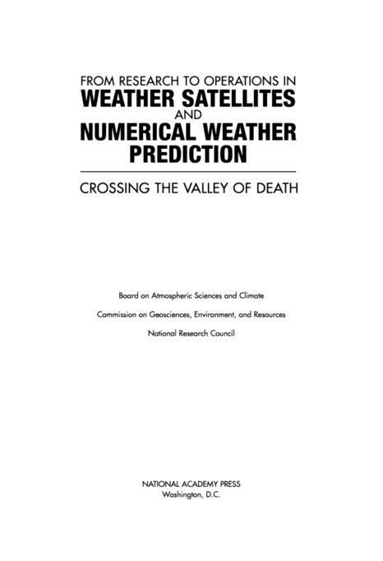
NRC Report
In 2000, a report from the National Research Council (NRC) wrote—
“Successful transitions from R&D to operational implementation always require:
(1) an understanding of the importance (and risks) of the transition,
(2) development and maintenance of appropriate transition plans,
(3) adequate resource provision, and
(4) a continuous feedback (in both directions) between R&D and operational activities.”

Slide 4
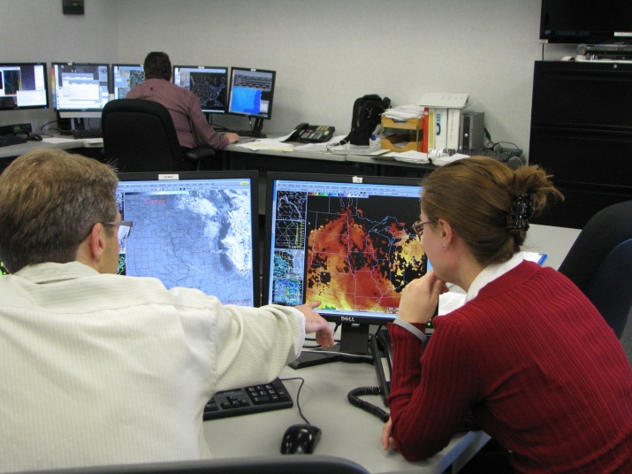
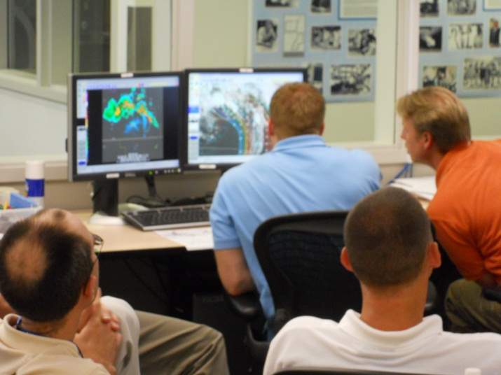
Introduction
This talk discusses advantageous methods of scientists engaging the operational community in a research to operations and technology transfer exercise where the needs of both partners are met as a result of science sharing and problem solving, particularly involving satellite imagery and derived products.

Slide 5
Introduction
The Cooperative Institute for Meteorological Satellite Studies (CIMSS) has developed a growing program in which new satellite imagery and products are developed for, collaborated in conjunction with, and delivered to National Weather Service (NWS) field weather forecast offices (WFOs) without invoking a formalized process or an operational provider, such as the Office of Satellite Data Processing and Distribution (OSDPD) within the National Environmental Satellite, Data, and Information Service (NESDIS).
This program started with 5 WFOs in 2006 and expanded to over 50 WFOs in 2010.

Slide 6

CIMSS Delivers Data via
Local Data Manager (LDM): Event-driven data sharing network that utilizes the Internet to mass move various data between NOAA agencies and universities
  Strengths: Easy delivery method to NWS field offices, widespread use throughout NWS enterprise and universities, user configurable to only ingest certain products
  Weaknesses: Not operational, strains bandwidth available to the field, limited connectivity to NOAA partners
Web: Displaying text data or images on a web page
  Widespread access, but outside of AWIPS, so data interrogation limited

Slide 7
Early Evolution
A joint effort, initiated in 1998, between NWS, NESDIS, and NOAA Cooperative Institutes, such as CIMSS, known as the Virtual Institute for Satellite Integration Training (VISIT), accelerates the transition of the latest in remote sensing science, conducted under the GOES Improved Measurements and Products Activities Plan (GIMPAP) and other research grants, to NWS operations via distance education.
In order to provide effective training, examples drawn from the meteorological data visualization software deployed to NWS WFOs, the Advanced Weather Interactive Processing System (AWIPS), were required.

Slide 8
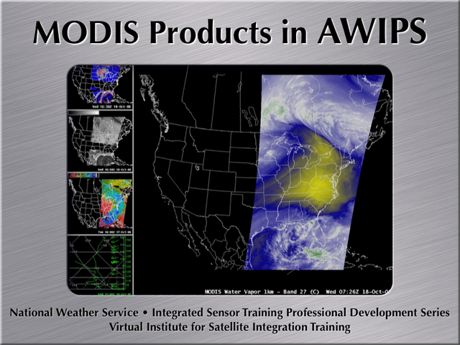
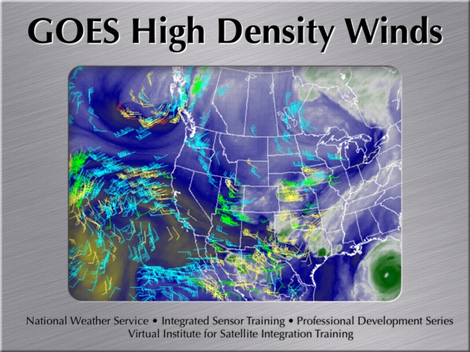
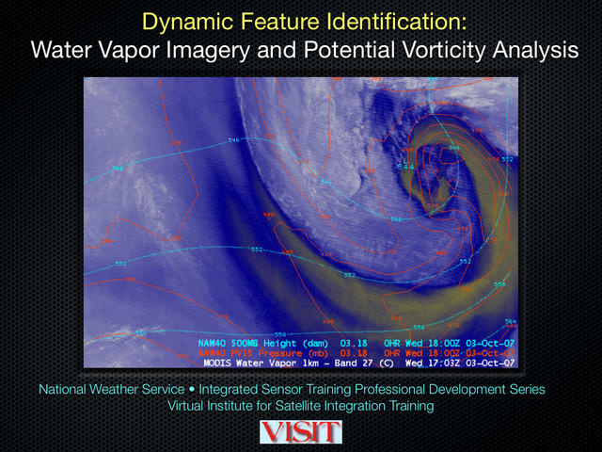
http://rammb.cira.colostate.edu/training/visit/training_sessions/

Slide 9
Early Evolution
In 2005, CIMSS worked to retrofit the AWIPS software for use in a non-operational environment. This required a reconfiguration of the traditional operational data ingest (models, observations, satellite, radar) and, consequently, an understanding of the raw and storage formats.
Workstations and servers to run AWIPS were procured as part of ground systems funding from NOAA.
With this new knowledge, CIMSS started broadcasting new and experimental satellite imagery to NWS field offices in 2006 via the LDM.
Early success was built on a low-cost, limited-bureaucracy, innovative grassroots culture at local NWS field offices.

Slide 10
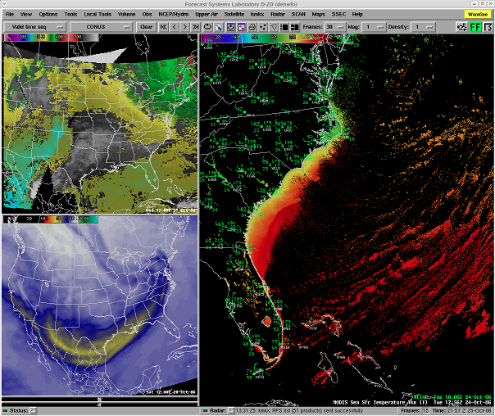

Slide 11
R2O Activities Today
By the end of 2010, CIMSS transitioned over 60 different types of geostationary and polar-orbiting satellite image and product developments to the field for assisting in the analysis and forecast of a variety of atmospheric properties and phenomena, including: low cloud/fog, volcanic ash, convective initiation, cloud phase, stability, precipitable water, and skin temperature. At least one CIMSS product was delivered in an experimental fashion (via LDM) to more than 50 WFOs across the country in 2010.
Since 2006, CIMSS products delivered to the field have influenced over 300 documented forecast decisions.
Funding for some of the continued growth of this work comes from the GOES-R Proving Ground.

Slide 12
GOES-R Proving Ground
A proving ground is designed to showcase future capabilities and identify possible gaps as a forward-thinking exercise to prepare the end user for upcoming science and technology.
The GOES-R Proving Ground connects research and operations to assure widespread day-one readiness through:
  Applying current earth observing systems and numerical weather prediction models to demonstrate GOES-R capabilities today
  Transitioning new algorithms and techniques to the field early to assure forecaster familiarity with GOES-R products
  Making operational meteorologists part of the discussion when it comes to designing and implementing effective GOES-R decision support products and visualization tools
The GOES-R Proving Ground is a collective effort between many NOAA and NOAA-supported agencies and universities.

Slide 13
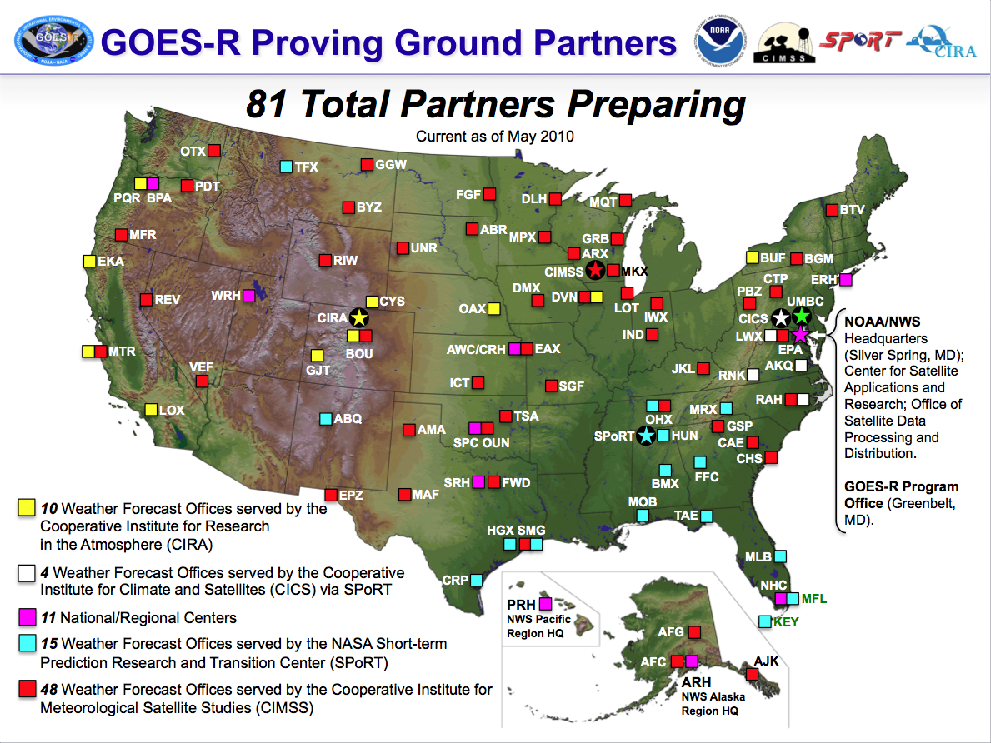

Slide 14
Lessons Learned
Involve operations thoroughly and frequently in transitioning a research product.
First impressions are important.
  Do not expect a second chance. Make sure training is available and questions are resolved in due time.
Forecasters talk.
  A good tip from a fellow forecaster is one way to guarantee the use of the experimental product will expand to other forecasters and offices.
“Consistency. Reliability.”
Ken Rizzo, Former Meteorologist-In-Charge, MKX
  It must be there at the same time, every day, with as little disruption as possible.

Slide 15
Lessons Learned
Some forecasters will not care.
  “I have been using the [Nested Grid Model] for the past 15 years with no problems.”
Listen to those who do!
  R2O activities can be interrupted and delayed by the research sector usurping the role of the evaluator in demonstration exercises.
Check back later.
  Keep a continuing dialogue with the forecasters. If they see and talk to you frequently, they are likely to at least give your products a chance. Offices sometimes do not report outages unless you call them.
  Create quick surveys, but nothing that takes a lot of time.
Do lunch with the forecasters.
  Break down the stereotypes.

Slide 16
Types of R2O Exercises
Expanded delivery
  Research-guided observations introduced to operations
Research-originated implementation
  A research product intended to improve the analyses or forecasts developed by operations is brought to the field for evaluation
Operations-requested development
  The field approaches the research community with a problem where further understanding or additional products are required to support operations
Hybrid or ad hoc

Slide 17
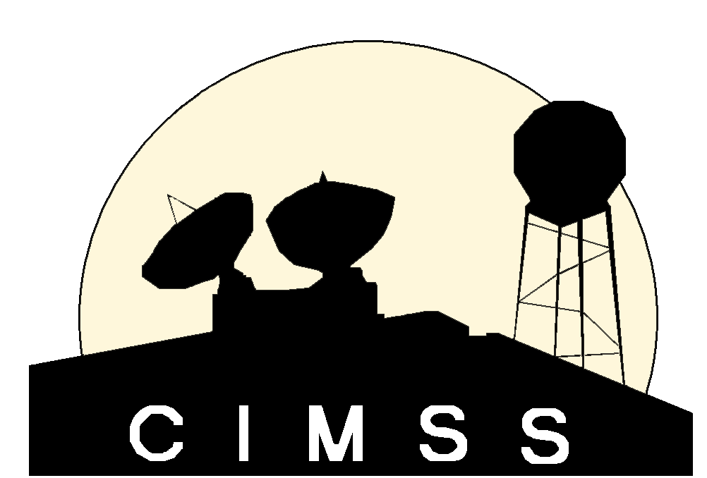
Research to Operations: Our Model
Ask
Determine the problems confronting operational users on multiple levels
Assess
Evaluate possible satellite solutions that may remedy the identified problem
Determine and Develop
Tailor experimental satellite imagery and products to meet the users’ needs
Deliver and Demonstrate
Show operations how satellite data can bring a resolution
Original presentation: Transitioning Satellite Products to National Weather Service Operations,
and Future Directions for the GOES-R Era
Talk, American Meteorological Society Annual Meeting—16th SATMET Conference (Phoenix, Arizona)
January 14, 2009

Slide 18
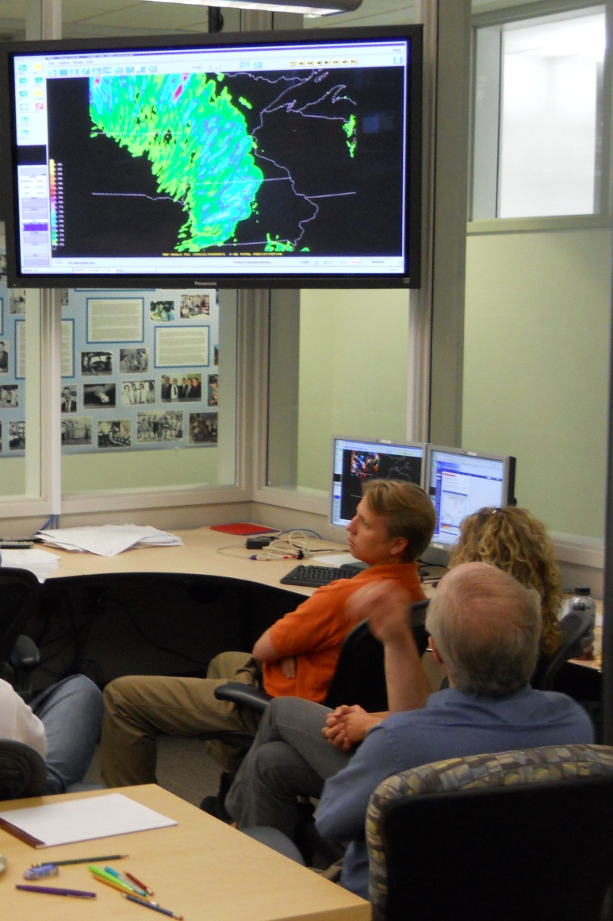
Field Demonstrations
A necessary component of any research-originated implementation, such a proving ground, is to assure a sufficient amount of time has been spent with forecasters to explain the intended benefit of the new product(s).
The GOES-R Proving Ground has recently began participating in the Norman Hazardous Weather Testbed, a R2O interface platform currently in use to connect science and service.

Slide 19
Case Study: POES Imagery
In response to NWS AWIPS OB7 requirements, NESDIS planned to add NOAA polar-orbiter visible (0.63 µm), shortwave IR (3.7 µm), and longwave IR (10.8 µm) imagery to NOAAPort on June 7, 2006.
After testing, it was determined that there was an insufficient amount of bandwidth between NESDIS and the Network Control Facility (NCF). Thus, this imagery could not be broadcast and delivered to the field.
In 2009, CIMSS worked with NESDIS to obtain the code for adequately formatting the POES imagery into the standard distributable GINI format (AWIPS I/II decoder compliant), and adapting it to run in real-time at the University of Wisconsin.
Field sites can now obtain this imagery from CIMSS via LDM.
  Additional products also available.
Notes:
NESDIS may be able to proceed with operational distribution no sooner than April 2011 (likely late 2011).
Eventually NPP/JPSS imagery should be available on NOAAPort.

Slide 20
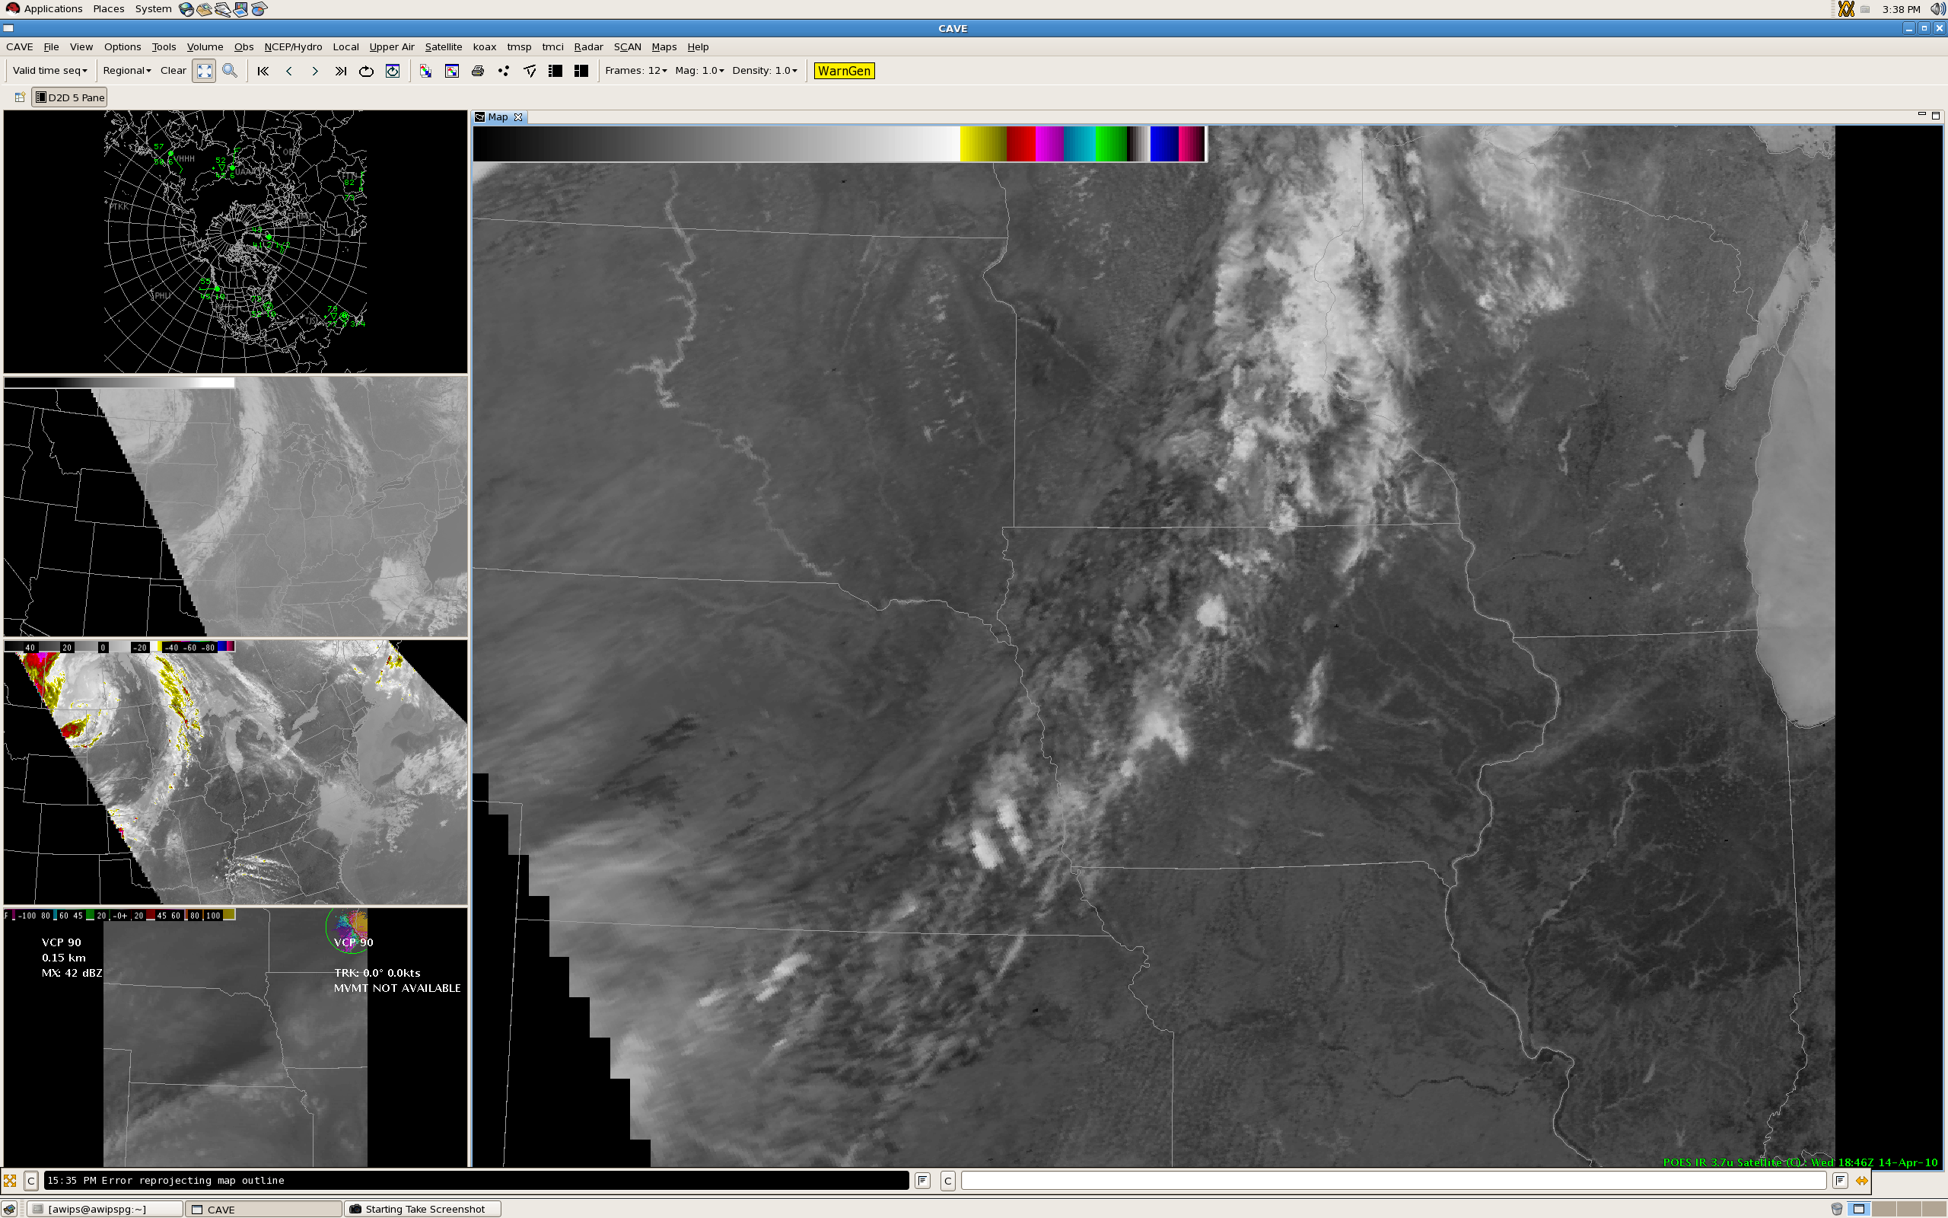

Slide 21
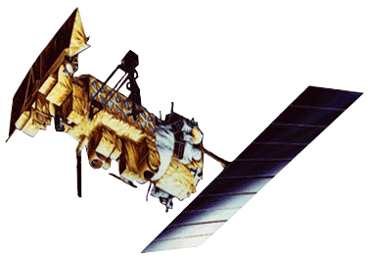
Case Study: POES Imagery
All NOAA Polar Operational Environmental Satellites (POES) are equipped with an Advanced Very High Resolution Radiometer (AVHRR) which has a resolution of 1.09 km at nadir.
Additional AVHRR imagery available includes:
  Band 2 (0.86 µm), for distinguishing land and water
  Band 5 (12.0 µm), for detecting volcanic ash
Additional AVHRR products available include:
  Sea Surface Temperature
  Cloud Type
  Cloud Top Temperature
  Cloud Top Height
  Cloud Optical Depth
  Cloud Particle Effective Radius
GINI Sector | Frequency
Alaska National | 12 to 14 per day
East CONUS | 10 per day
Hawai`i National | 2 per day
Puerto Rico Nat’l | 10 per day
West CONUS | 4 to 6 per day

Slide 22
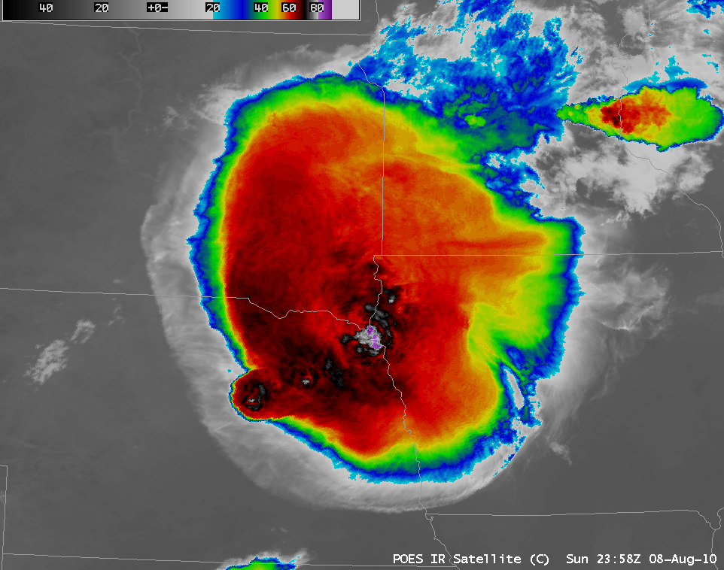
Example courtesy of Scott Bachmeier, CIMSS

Slide 23
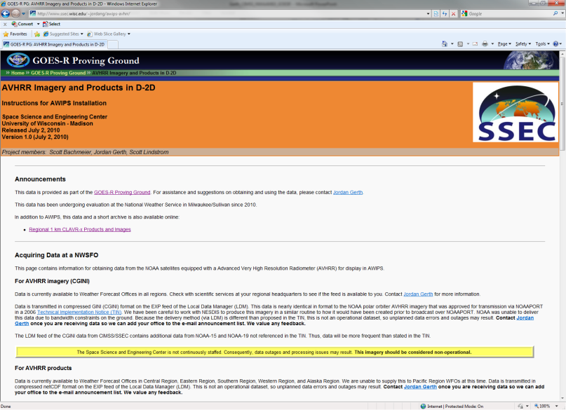
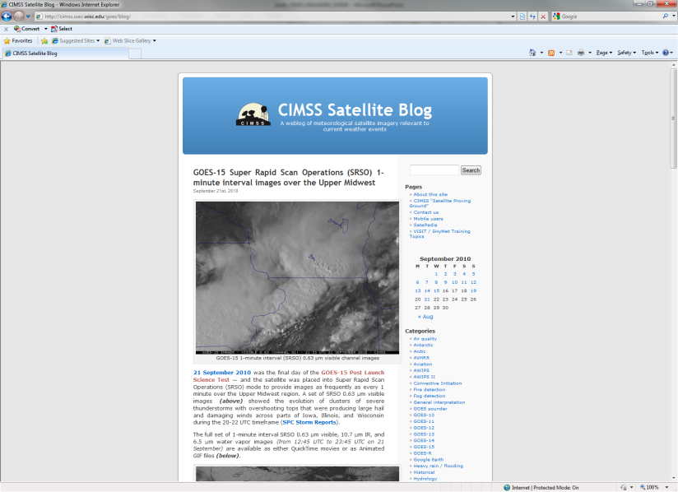

Case Study
Value to the Forecaster
Near-term (less than 12 hours) forecasts
  Precipitation potential
    Cloud optical depth product
    Cloud particle effective radius product
  Precipitation type: Snow or drizzle?
    Cloud type product
Short-term (12 to 36 hours) forecasts
  Areas of fog formation (10.8–3.7 µm)
  Air temperatures in nearshore areas based on water temperatures
Post-event analysis
  Flooding rivers and tributaries
  Rain-cooled ground on IR Window
  Cloud top temperature and cloud height products
Obtain POES Imagery and Products for your AWIPS:
http://cimss.ssec.wisc.edu/~jordang/awips-avhrr
Just in Time Satellite Training from CIMSS:
http://cimss.ssec.wisc.edu/goes/blog

Slide 24
Other Examples
We are working with Central Region Headquarters and NWS Milwaukee to produce a cloud analysis from the current GOES Imager which can be used to verify Sky Cover National Digital Forecast Database (NDFD) grids.
We are working with Alaska Region Headquarters and Pacific Region Headquarters to propose a tool for Interactive Calibration of Four Dimensions (IC4D) which can be used to easily modify multi-layer cloud information necessary for Terminal Aerodrome Forecasts (TAFs).

Slide 25
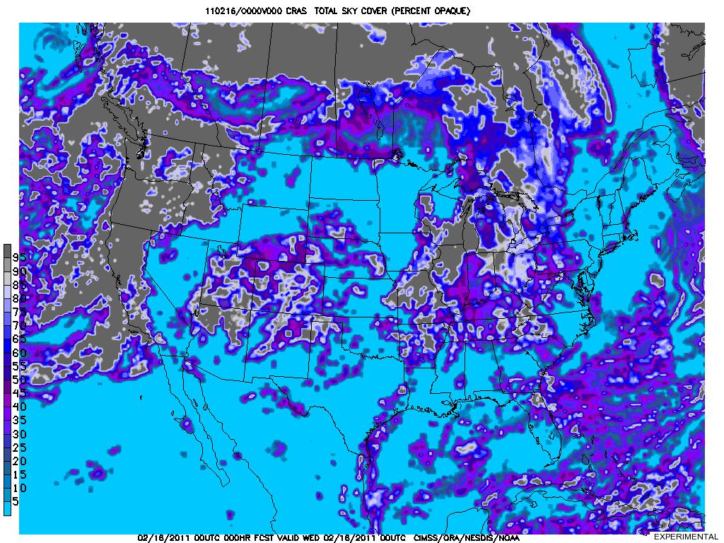

Slide 26
Other Examples
We are working with NWS OST and Raytheon to satisfy a proposed requirement for 24-bit satellite imagery and products in AWIPS “II”. This functionality will greatly assist the field in combining multiple images to gain useful insight about the state of the atmosphere, as single-source data burden on forecasters continues to become a growing problem.
We are developing high-resolution initial conditions with added moisture information from the GOES Sounder for initializing local runs of the Weather Research and Forecast (WRF) model.

Slide 27
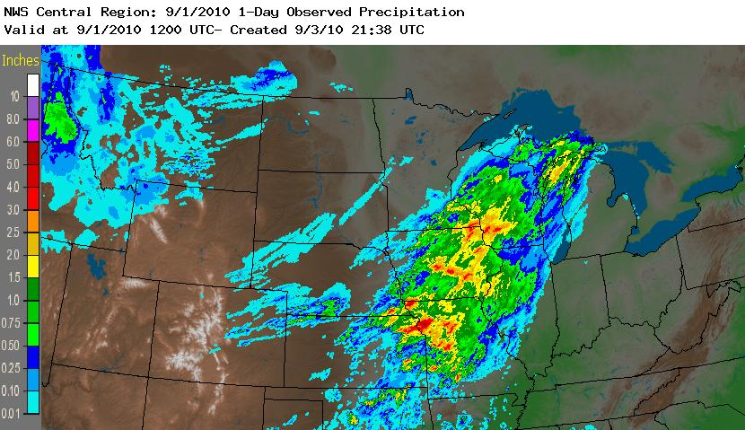
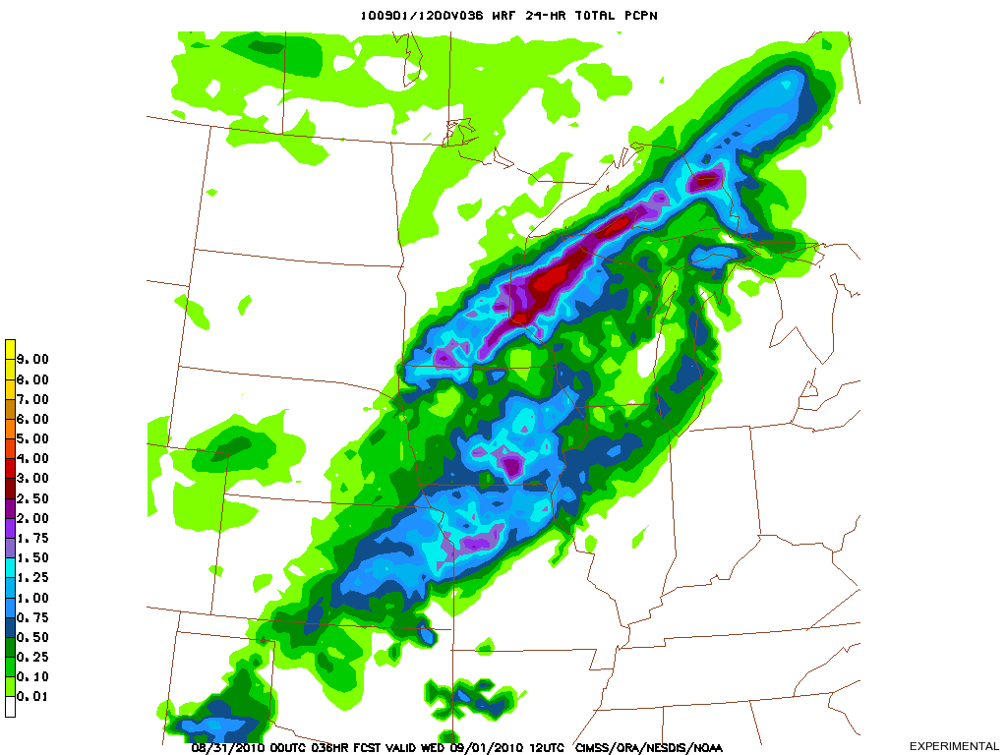
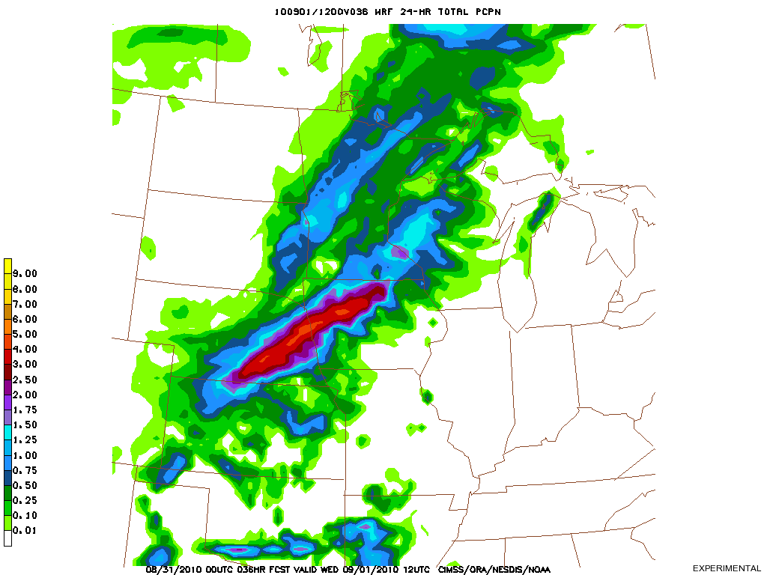
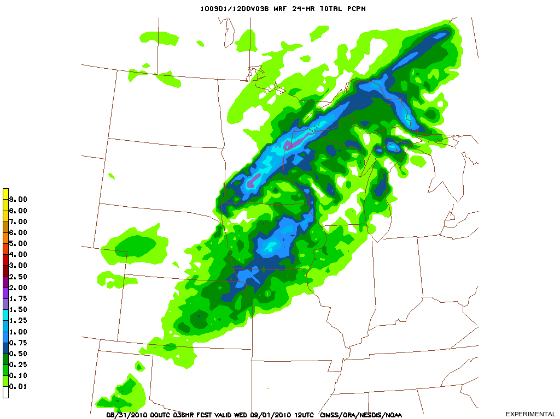
Precipitation output from NWP models is traditionally spatially distributed and lacking in sharp, reliable definition, even in some high resolution models
Precipitation often falls as the result of parameterizations which keep the model numerically stable, or for the wrong reasons (not due to local moisture convergence)
Source: NWS/AHPS
24-hour accum precip prior to 1200 UTC on 1 Sept
24-hour accum precip prior to 1200 UTC on 1 Sept
24-hour accum precip prior to 1200 UTC on 1 Sept
GFS Initial Conditions
CRAS Initial Conditions
GFS Initial Conditions with 90% of Original RH

Slide 28
Hurdles
Tracking recipients of CIMSS satellite imagery and products.
The NWS data delivery network (both NOAAPort and LDM) continues to struggle with the data load.
An adequate, time-effective avenue does not exist to support experimental satellite products in the long-term by alternative means (Satellite Broadcast Network). Technical support is dependent on the internal knowledge of NWS systems by a provider (Cooperative Institutes, etc.) which are predominantly research centric (academic environments).
While strong cooperation is readily available at local levels of the NWS, we are reaching out to the regional headquarters for a more concerted demonstration which helps overcome forecast problems at large.

Slide 29
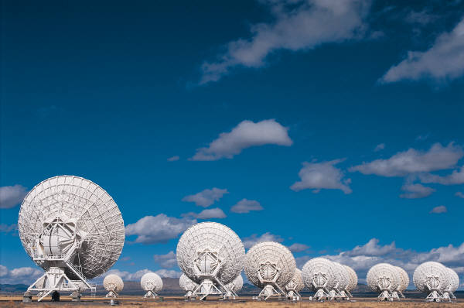
Future Directions
CIMSS will continue to work to prepare for the fielding of the next-generation of AWIPS software in 2012.
Reformatting will be required of many products delivered to the field today for ingest and display on AWIPS “II”.
The GOES-R Proving Ground and similar efforts are necessary steps forward in perfecting the R2O concept, but attention is required to assure the two-way dialogue is maximized and technical implications of additional data sets (bandwidth) are met to support operationally.
Move toward satisfying the NRC recommendation to assure efforts do not become “skeletons in Death Valley”!
Questions? Contact me: Jordan.Gerth@noaa.gov

