Slide 1
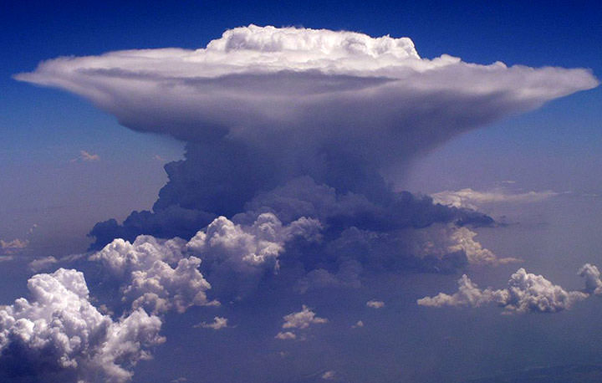
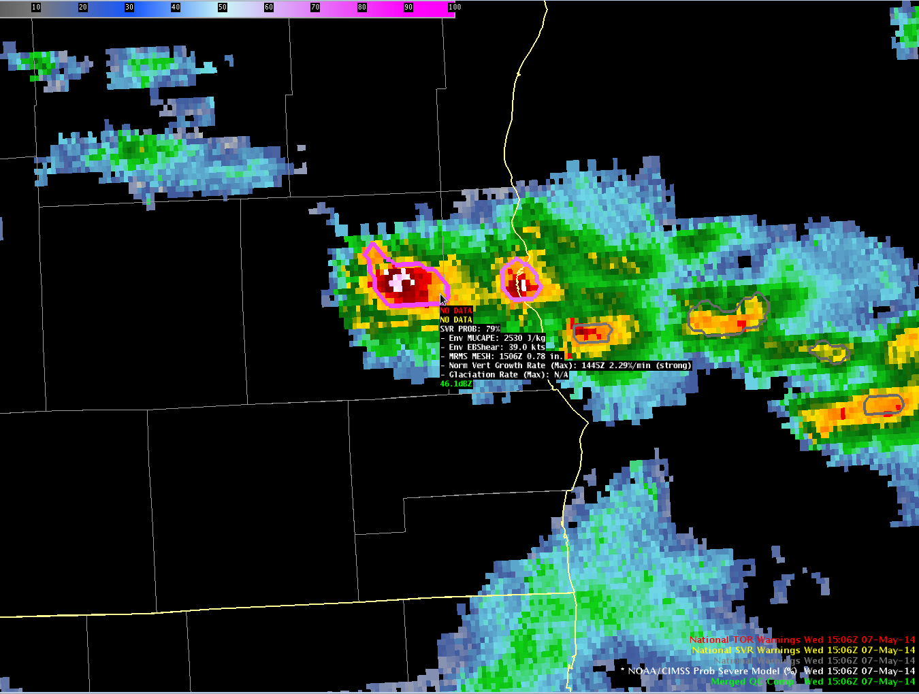
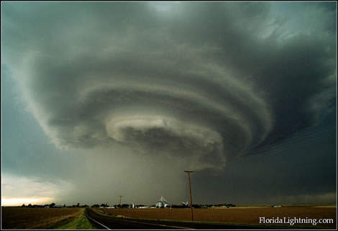
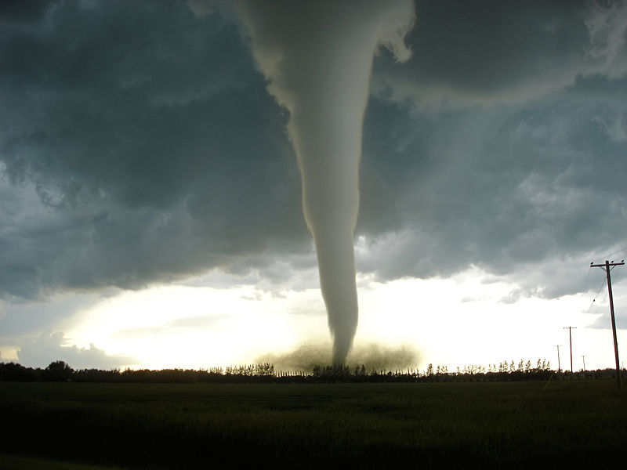


ProbSevere – Recent Upgrades and future outlook
Michael J. Pavolonis (NOAA/NESDIS)
John Cintineo (UW-CIMSS)
Justin Sieglaff (UW-CIMSS)
Dan Lindsey (NOAA/NESDIS)
Lee Cronce (UW-CIMSS)

Slide 2
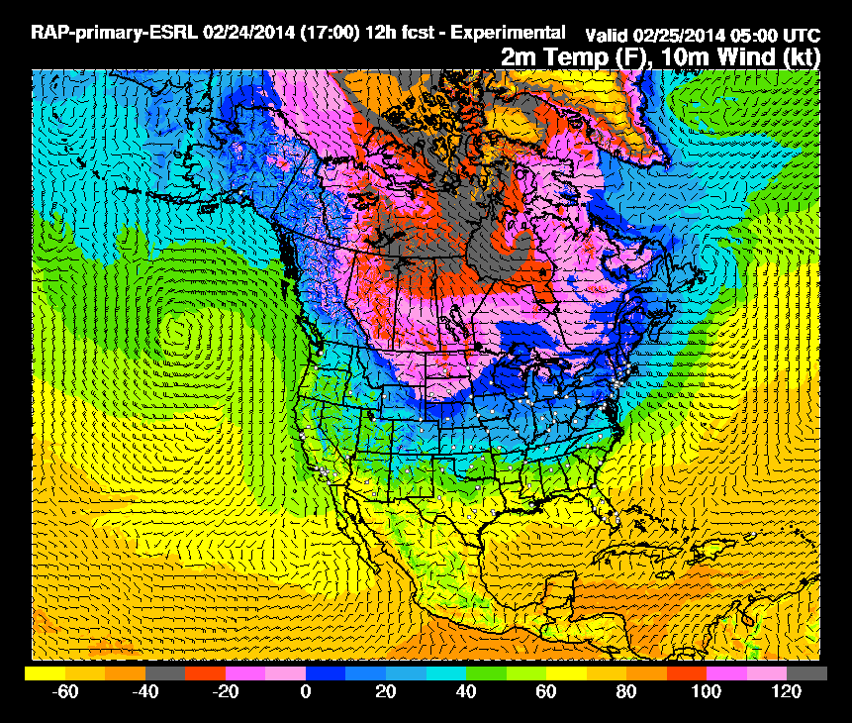
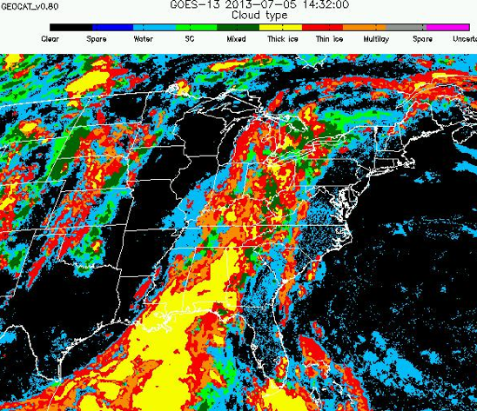
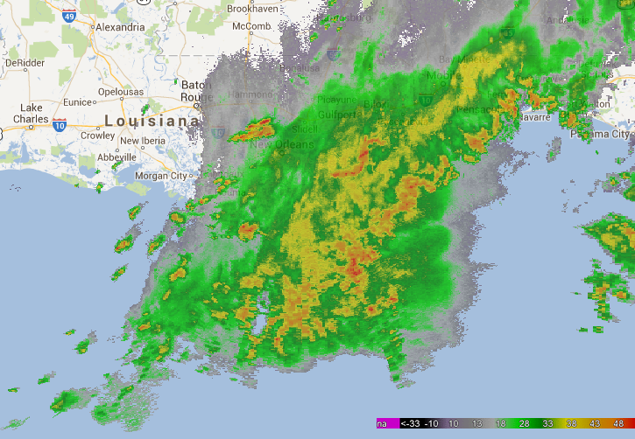
Data to Environmental Intelligence
High-resolution NWP Data
Satellite Imagery and Derived Products
Radar Imagery and Derived Products
Storm Environment
Evolution of Cumulus to Cumulonimbus
Storm Tracking and Hydrometeor Properties
Probability a thunderstorm will produce severe weather in the future (up to 60 minutes)
Notes:
A few more details about the input data into the statistical model are beneficial. The high-resolution NWP data are used to characterize the instability and shear of the environment a storm develops.
The satellite imagery is used in two ways; to track clouds across space and time—in the same way a human views satellite imagery loops and to quantify the cloud growth rates, which are used as predictors in the model.
The radar data are used in a similar manner as the satellite data. The radar data are used to track storm cells in reflectivity imagery—again like how a meteorologist looks at a loop of radar imagery. And to quantify the intensity of the precipitation core of a developing thunderstorm, which is used as a predictor in the model.
The total lightning data are used to quantify the number of lightning flashes per minute within a radar tracked storm cell.
Before discussing a few more details about the input datasets, a schematic of how the statistical model works is presented in the following slide.
.

Slide 3
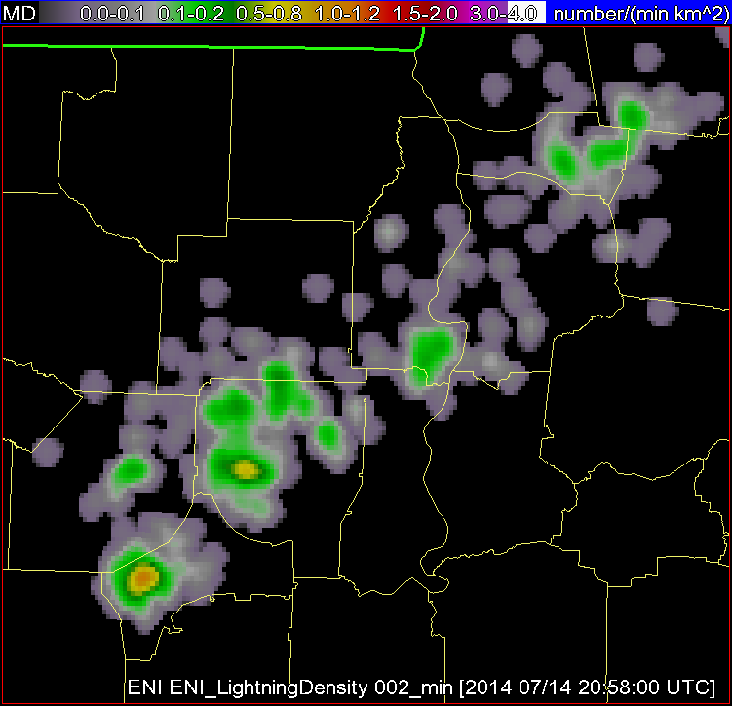
Data to Environmental Intelligence
High-resolution NWP Data
Satellite Imagery and Derived Products
Radar Imagery and Derived Products
Total Lightning
Storm Environment
Evolution of Cumulus to Cumulonimbus
Storm Tracking and Hydrometeor Properties
Storm Electrification
Probability a thunderstorm will produce severe weather in the future (up to 60 minutes)
Notes:
A few more details about the input data into the statistical model are beneficial. The high-resolution NWP data are used to characterize the instability and shear of the environment a storm develops.
The satellite imagery is used in two ways; to track clouds across space and time—in the same way a human views satellite imagery loops and to quantify the cloud growth rates, which are used as predictors in the model.
The radar data are used in a similar manner as the satellite data. The radar data are used to track storm cells in reflectivity imagery—again like how a meteorologist looks at a loop of radar imagery. And to quantify the intensity of the precipitation core of a developing thunderstorm, which is used as a predictor in the model.
The total lightning data are used to quantify the number of lightning flashes per minute within a radar tracked storm cell.
Before discussing a few more details about the input datasets, a schematic of how the statistical model works is presented in the following slide.
.

Slide 4
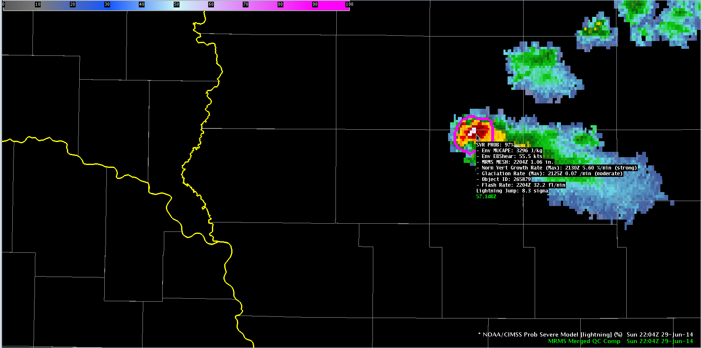
ProbSevere Model AWIPS-II Display
Model output are shapefiles contoured around radar storm cells.
Enhancement designed for overlay on radar reflectivity—but can be overlaid on any field (satellite, radar velocity, etc.).
Sampling offers readout of model probability as well as each model input.
Notes:
We will now transition from discussing how the statistical model works and learning about the input datasets to showing examples of how the model performed in some severe weather events.
The model output is displayed in two ways. One is a probability contour with a color enhancement designed for overlay on top of typical radar reflectivity color tables (e.g. greens, yellows, and reds are avoided in the ProbSevere colortable). The shapefile nature of the output makes the display very flexible—the contours can be overlaid on any field within AWIPS-II (e.g., radar velocity). Additionally, the model probability and each model predictor is displayed as text when sampling is turned on. The following bullets briefly describe the text read-out.
This field is the ProbSevere probability and ranges between 0 and 100% for a given storm cell.
This field is the most unstable CAPE from our RAP composite for the storm cell.
This field is the effective bulk shear from our RAP composite for the storm cell.
This field is the MRMS MESH value—the time and value are provided. Note the MRMS may not match a single radar site MESH algorithm—both time and value.
This field is the normalized vertical growth rate of the storm. It is the maximum value attained during the growth stage of the storm and the time that maximum value occurred. The units are percentage of the troposphere depth the cloud grew per minute. The exact values are not terribly important—we append a statistical measure of intensity with the terms “weak”, “moderate”, or “strong”.
This field is the glaciation rate or the rate at which the storm-top transitioned from liquid water droplets to ice crystals. It is the maximum value attained during the growth stage of the storm and the time that maximum value occurred. The units are a percentage of water to ice conversion per minute. Again we append a statistical measure of intensity with the terms “weak”, “moderate”, or “strong”.
This field is the flash rate--the time and value are provided. Recall the total lightning is part of a 2-D predictor in the ProbSevere model—combining effective bulk shear and total lightning flash rate.
While each model predictor is provided in the text read-out, it is important to emphasize—the sum of the information--the probability--is more valuable than any individual piece of information.

Slide 5
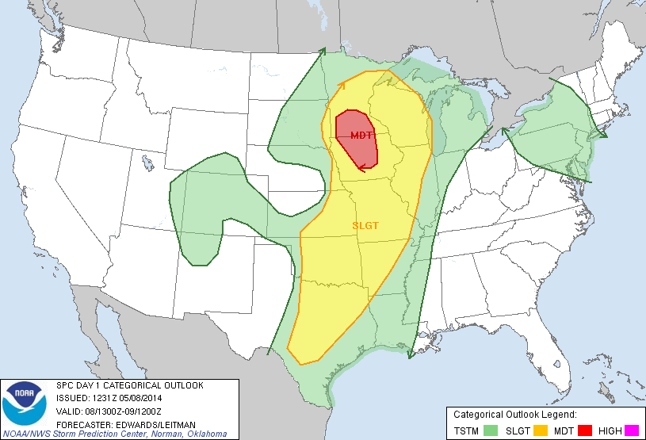
08 May 2014
Notes:
Now getting to examples, the first example is over southeastern South Dakota on the western edge of a slight risk region as depicted by the Storm Prediction Center outlook.

Slide 6
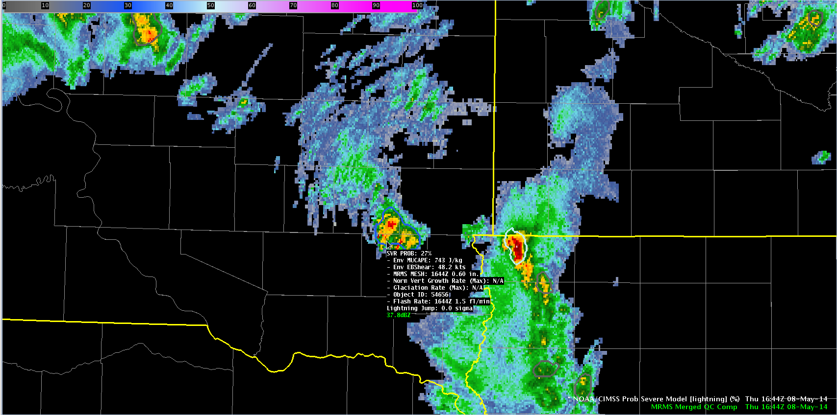
1644 UTC May-08-2014
MUCAPE ~ 750 J kg⁻¹
Eff. shear ~ 48 kts
Prob = 27%
Highly sheared environment
Low MESH
Low lightning
SD
IA
Notes:
In these examples, MRMS composite reflectivity is shaded and the ProbSevere contours are overlaid on the reflectivity data with the text read-out provided for the storm of interest. At 1644UTC a developing storm had marginal instability but significant shear. The probability at this time was low—only 27% as the MRMS MESH and total lightning were fairly low.

Slide 7
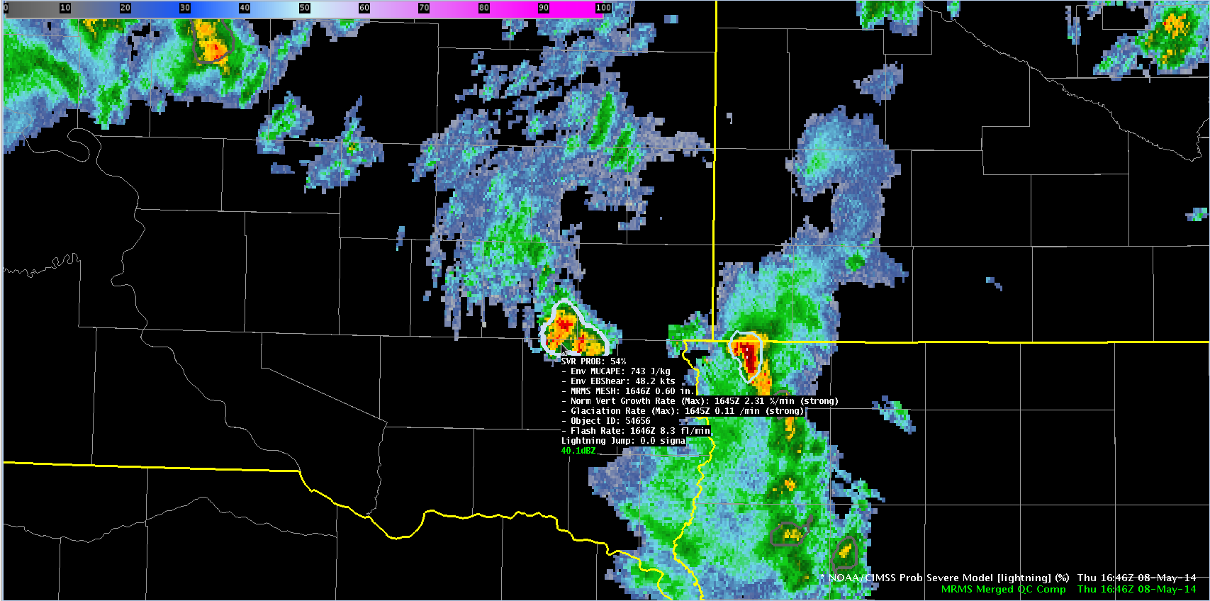
1646 UTC May-08-2014
MUCAPE ~ 750 J kg⁻¹
Eff. shear ~ 48 kts
Prob = 54%
Strong satellite growth and glaciation rates.
Small increase in lightning.
SD
IA
Notes:
At 1646 UTC, satellite growth rates were diagnosed and included into the ProbSevere calculation. Both the vertical growth rate and glaciation rate were in the ‘strong’ category, which drove the probability up to 54%.

Slide 8
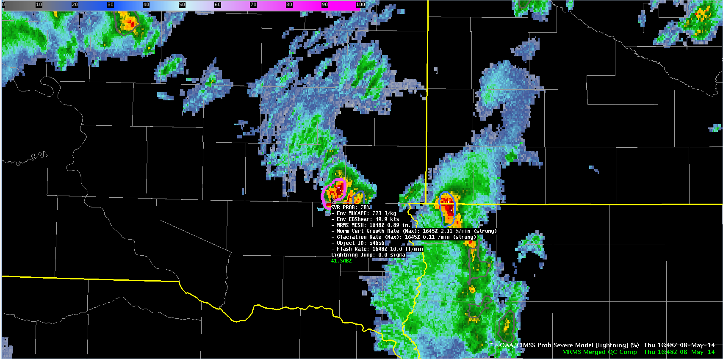
1648 UTC May-08-2014
MUCAPE ~ 750 J kg⁻¹
Eff. shear ~ 48 kts
Prob = 78%
Strong satellite growth and glaciation rates.
MESH increases to 0.89”.
Lightning continues to increase.
SD
IA
Notes:
Two minutes later, the storm continued to intensify as indicated by the MESH and total lightning read-outs. The probably again jumped, now to 78%.

Slide 9
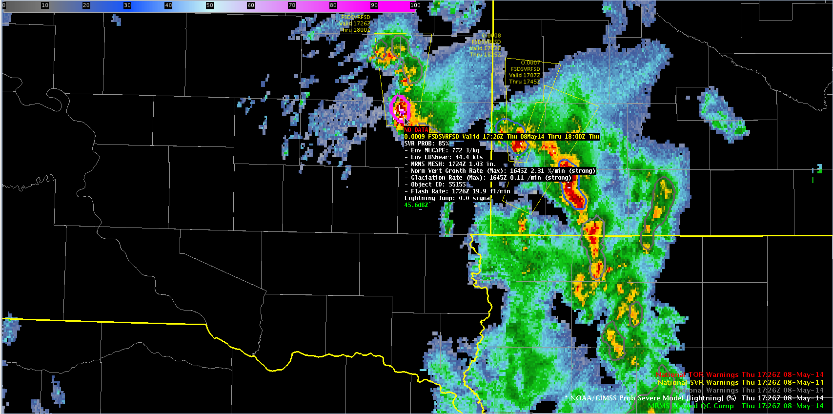
1726 UTC May-08-2014
MUCAPE ~ 750 J kg⁻¹
Eff. shear ~ 48 kts
Prob = 85%
KFSD issues SVR warning @ 1726 UTC.
Golf ball sized hail report @ 1732 UTC.
SD
IA
Notes:
The storm continued to exhibit high probabilities and at 1726 UTC a severe thunderstorm warning was issued by the Sioux Falls WFO. 6 minutes later the first severe report of golf ball sized hail was received. This example demonstrates how ProbSevere can be used to identify a storm that is likely to produce severe weather and potentially be used to increase lead-time. [For those interested, the storms over extreme northwestern Iowa/southwestern MN had lower probabilities and did not produce severe reports.]

Slide 10
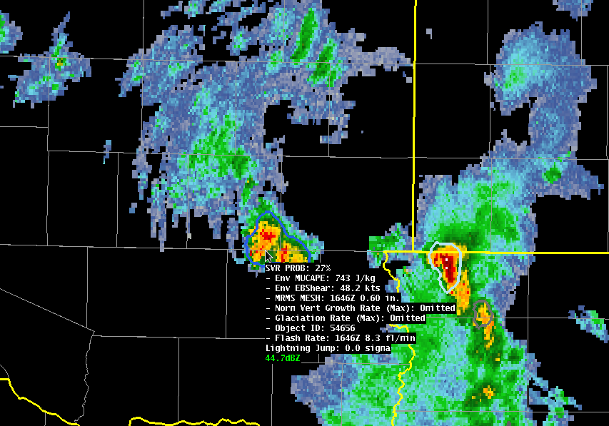
Impact of GOES Data
1646 UTC May-08-2014
Prob = 54%
Prob = 27%
NWP + Satellite + Radar + Lightning
NWP + Satellite + Radar + Lightning
Time (UTC) | With Satellite | Without Satellite
1644 | 27% (no sat. growth yet) | 27%
1646 | 54% | 27%
1648 | 78% | 54%
1728 | 85% | 65%
Notes:
We are often asked, what value do the satellite growth rates provide? Using this example, you can see at 1646 UTC, by removing the satellite observations, the ProbSevere probability is reduced by HALF! Additionally, removing the satellite growth rates reduces the amount of lead-time gained.

Slide 11
ProbSevere – Without Lightning
31 min
19 min
Notes:
A validation for about 5000 storms on 18 convectively active days during 2014 was performed. (Using manual analysis from Eric)

Slide 12
ProbSevere – With Lightning
33 min
19 min
Notes:
A validation for about 5000 storms on 18 convectively active days during 2014 was performed. (Using manual analysis from Eric)

Slide 13
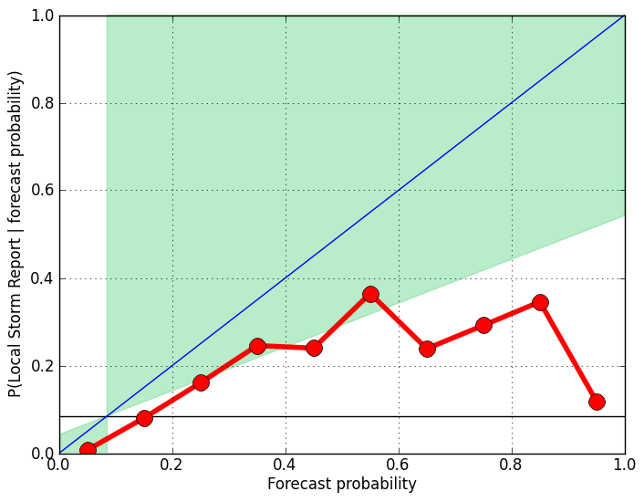
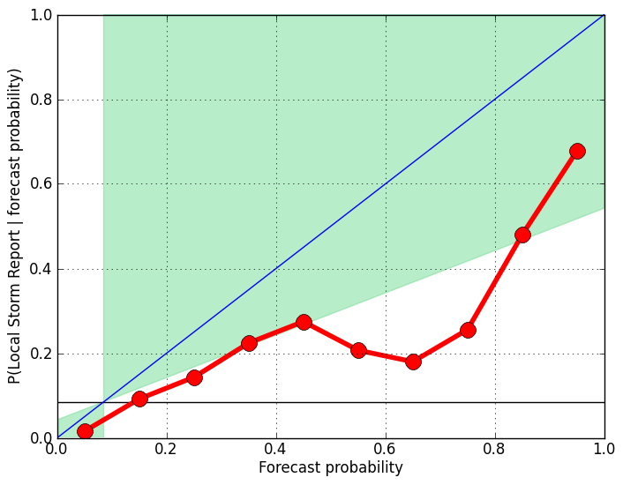
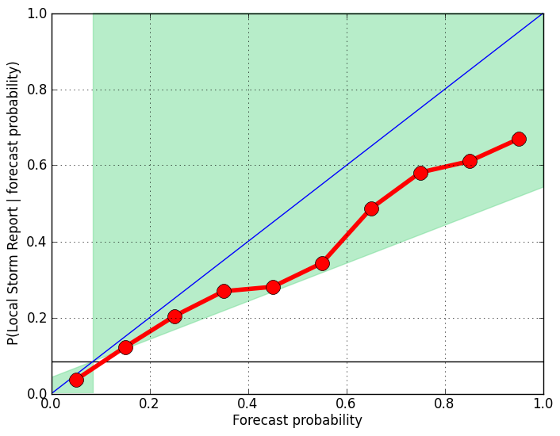
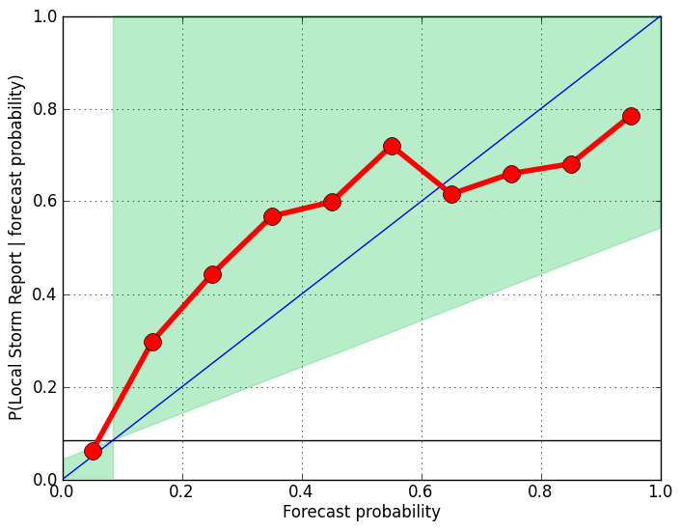
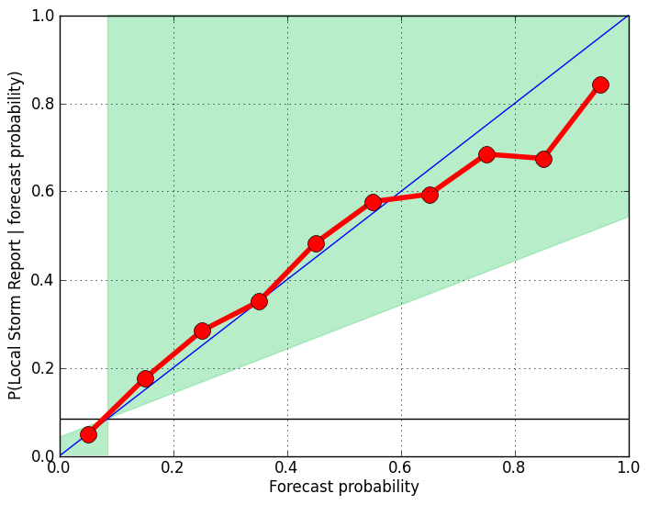
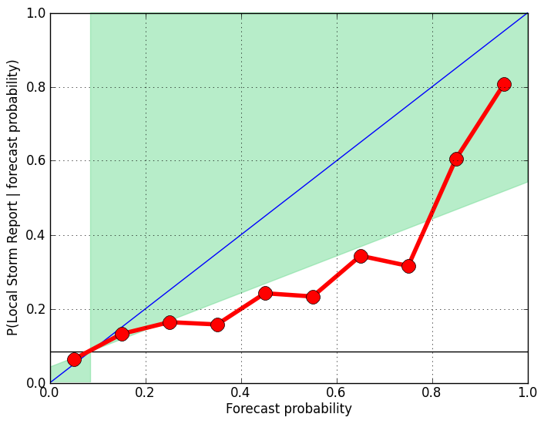
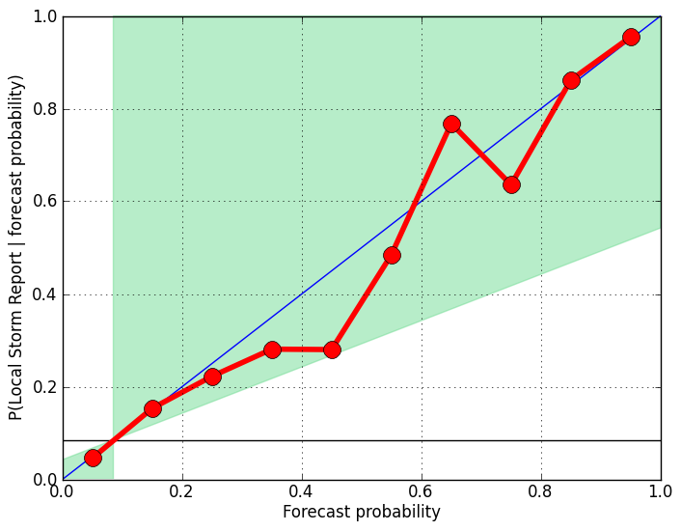
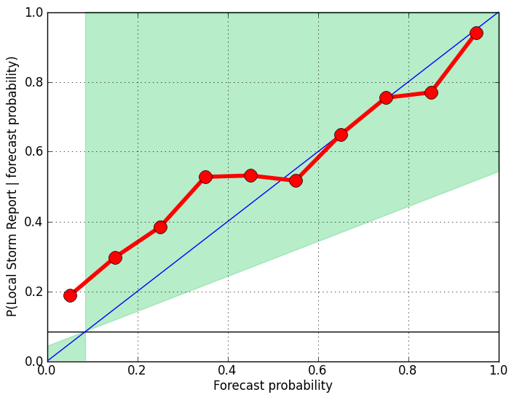
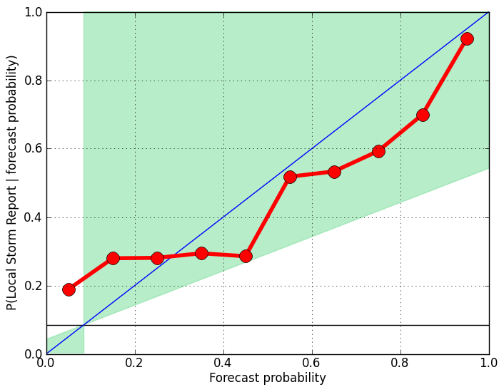
Reliability – With Lightning
CAPE 0-1500 J/Kg
CAPE 1500-2500 J/Kg
CAPE 2500+ J/Kg
Small Sample Size
EBS 0-10 m/s
Small Sample Size
EBS 10-15 m/s
EBS 15+ m/s
Notes:
Validation using ALL storm reports (not just the first)
total_sev_storms= 71 156 181
85 132 69
85 200 110
total_ns_storms= 8328 6667 6124
2090 1381 589
855 773 329

Slide 14
Analysis of Daily Storm Tracks

Slide 15
Analysis of Daily Storm Tracks

Slide 16
Analysis of Daily Storm Tracks

Slide 17
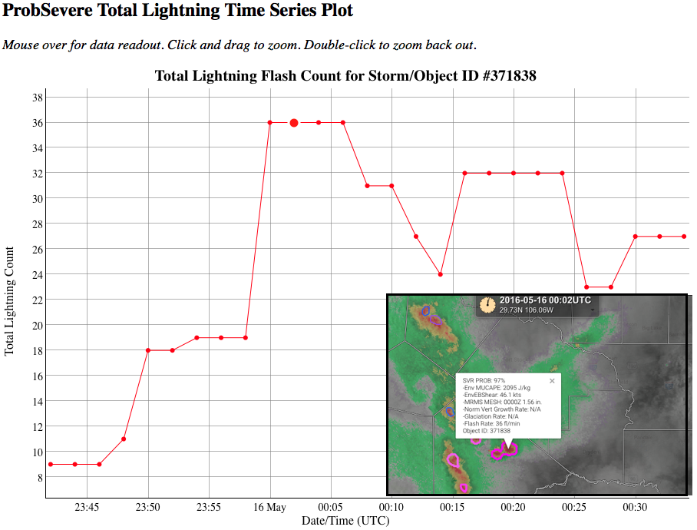
Realtime ProbSevere Time Series Analysis
http://hopwrf.info/ProbSevere/PlotLightning.html
Notes:
Tom Hultquist (SOO at Twin Cities)

Slide 18
Hazardous Weather Testbed (HWT)
http://goesrhwt.blogspot.com
Notes:
HWT: NSSL, SPC, and the Norman WFO
-During multiple experiments that take place in the HWT throughout the year, researchers and forecasters work side-by-side to evaluate emerging research concepts and tools in simulated operational settings, including experimental forecast and warning generation exercises.

Slide 19
2016 HWT

Slide 20
2016 HWT
Notes:
Sometimes delicately worded criticisms.

Slide 21
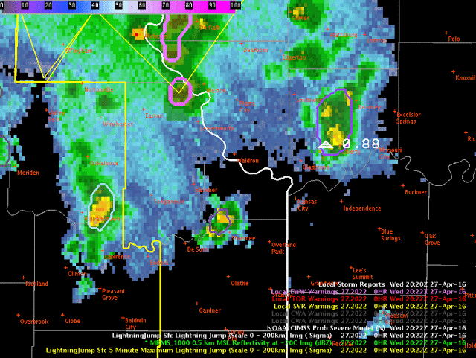
Underestimated MESH? (April 27, 2016)
Notes:
-Underestimated MESH will be most costly when lightning activity is also low.
-NSSL and OU-CIMMS are investigating the impact of radar scanning and the operational settings used to merge data from multiple radars

Slide 22
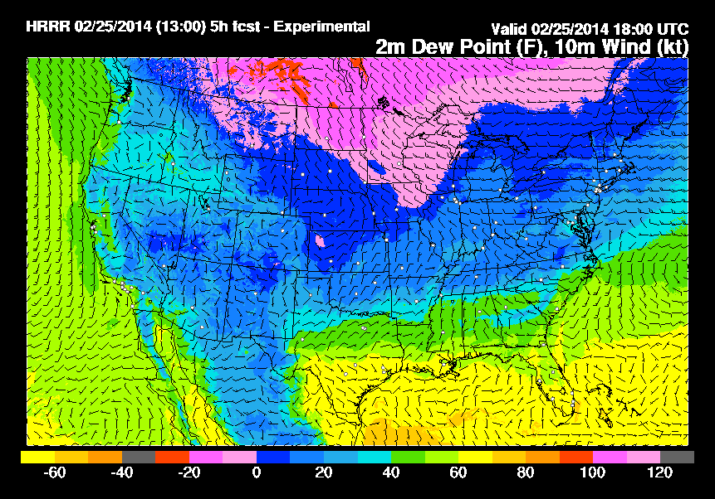
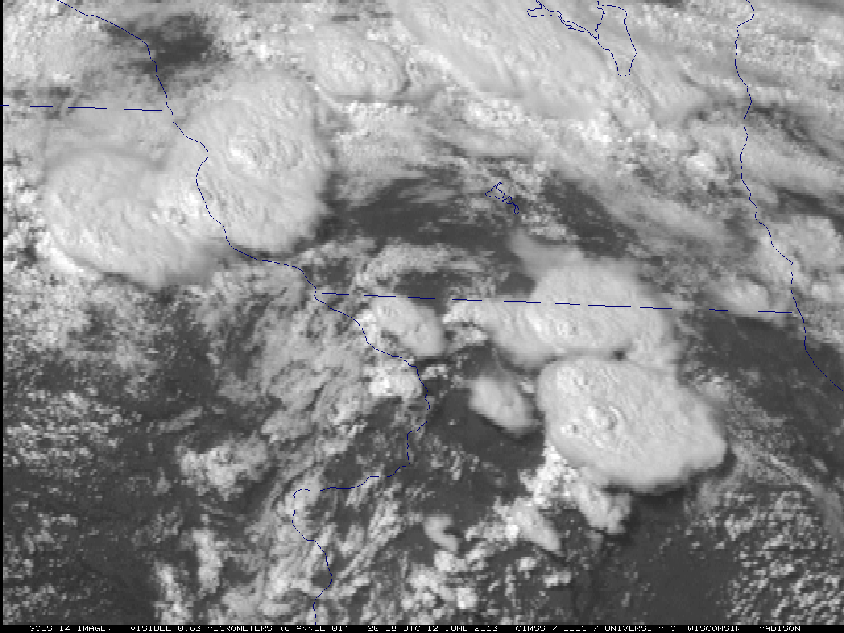
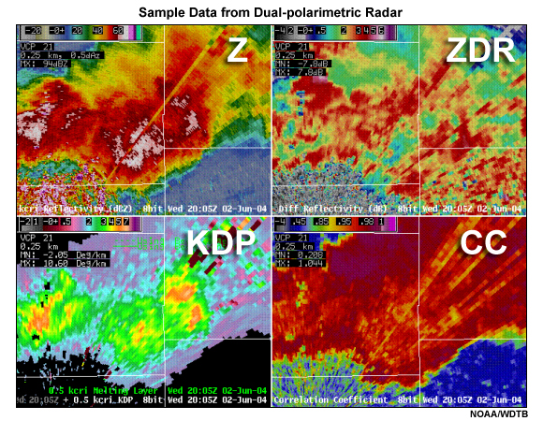
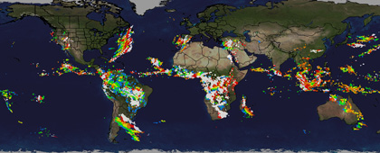
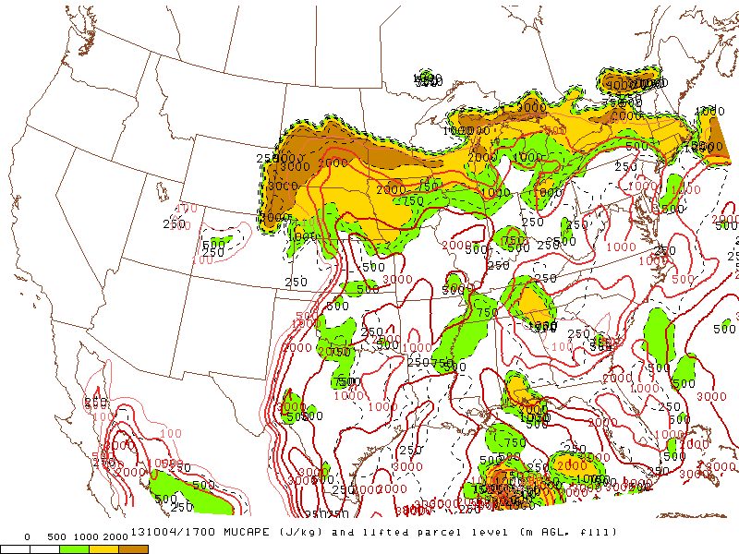
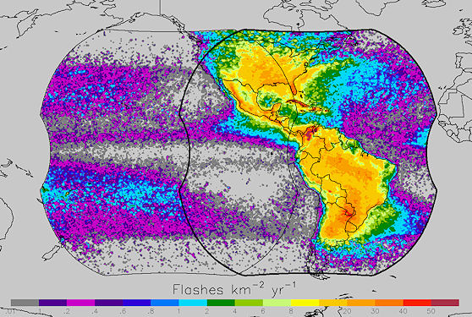
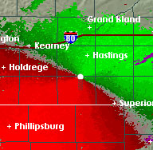
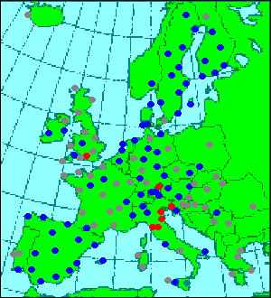
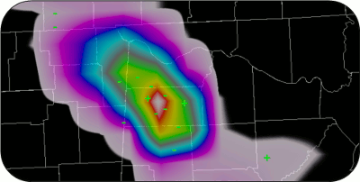
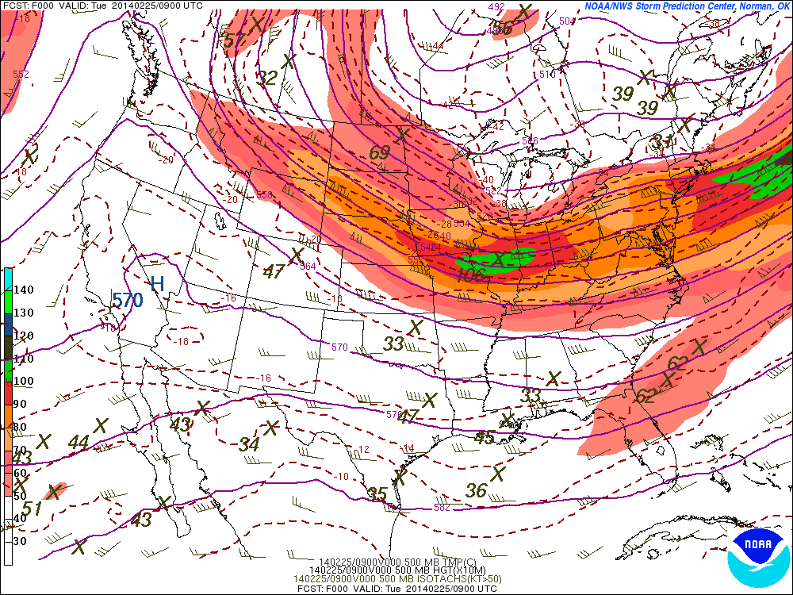
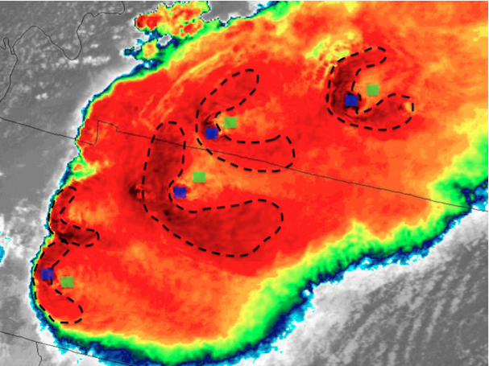
Continued Development
NWP
GOES-R
NEXRAD
Other
HRRR
Super-rapid scan
Dual-pol products
Global lightning
SPC-OA
GLM
Doppler velocities
Additional radars
Create more refined and specific forecasts of severe weather (tornado, hail, wind)
SREF
Cb properties
Images are from NOAA, NASA, UW-CIMSS, and OU-CIMMS
Notes:
-Working on training several versions of the model to account for differing physical mechanisms that produce severe wind.
-Create several models to account for different physical mechanisms for producing different types of severe weather

Slide 23

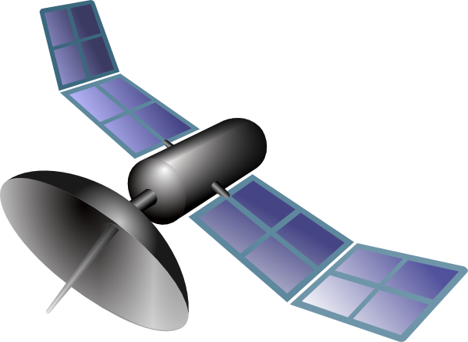
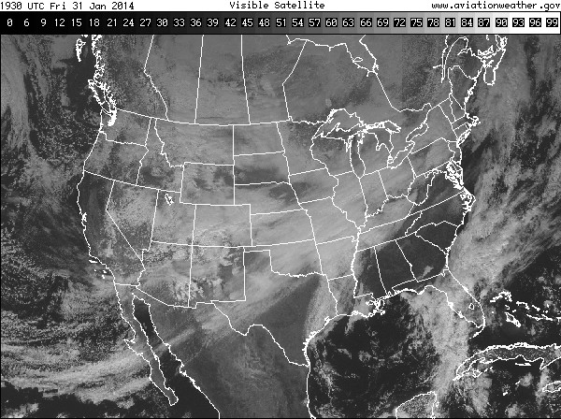
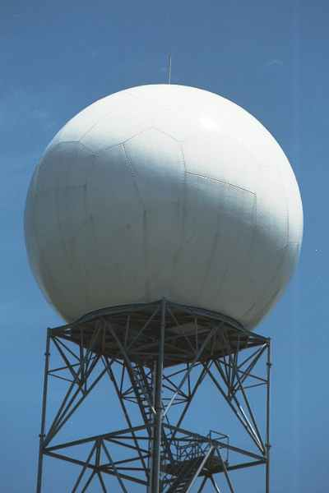
ProbSevere Model Real-Time Operations
Satellite, radar, lightning, and model data have different timescales
ProbSevere probabilities can change each time new data are available
EMC
In one hour…
1 set of RAP grids
8 CONUS satellite scans (in rapid scan)
ProbSevere
30 lightning files
OUTPUT
Input: 1300 MB
30 CONUS radar scans
File size: 0.2 MB
30 output files
Notes:
So how is all this information combined in real-time processing? Unlike most GOES-R related projects that update with each satellite scan—ProbSevere is different. The model updates at the frequency of the MRMS radar data—about every 2 minutes.
When a storm develops and is tracked within satellite imagery, it has information about the storm environment from the RAP composite—which updates every hour. The probabilities are computed for every set of MRMS radar data—about every 2 minutes. The ENI total lightning data is also updated every 2 minutes. The update frequency of the current GOES satellite in routine scan mode is every 15 minutes, or roughly every 7.5 minutes in rapid-scan mode.
The critical point is:
The model does not wait on a satellite scan—it uses the most recent information available from satellite—whether the satellite is in routine scan mode or rapid scan mode. So users should expect updates in AWIPS-II about every 2 minutes.

Slide 24
ProbSevere Model Real-Time Operations
Satellite, radar, lightning, and model data have different timescales
ProbSevere probabilities can change each time new data are available
EMC
In one hour…
With 1 GOES-R ABI
1 set of RAP grids
8 CONUS satellite scans (in rapid scan)
ProbSevere
30 lightning files
OUTPUT
Input: 9000 MB
30 CONUS radar scans
File size: 0.2 MB
30 output files
Notes:
So how is all this information combined in real-time processing? Unlike most GOES-R related projects that update with each satellite scan—ProbSevere is different. The model updates at the frequency of the MRMS radar data—about every 2 minutes.
When a storm develops and is tracked within satellite imagery, it has information about the storm environment from the RAP composite—which updates every hour. The probabilities are computed for every set of MRMS radar data—about every 2 minutes. The ENI total lightning data is also updated every 2 minutes. The update frequency of the current GOES satellite in routine scan mode is every 15 minutes, or roughly every 7.5 minutes in rapid-scan mode.
The critical point is:
The model does not wait on a satellite scan—it uses the most recent information available from satellite—whether the satellite is in routine scan mode or rapid scan mode. So users should expect updates in AWIPS-II about every 2 minutes.

Slide 25
ProbSevere Model Real-Time Operations
Satellite, radar, lightning, and model data have different timescales
ProbSevere probabilities can change each time new data are available
EMC
In one hour…
With 1 GOES-R ABI +
HRRR
1 set of RAP grids
8 CONUS satellite scans (in rapid scan)
ProbSevere
30 lightning files
OUTPUT
Input: 12,500 MB
30 CONUS radar scans
File size: 0.2 MB
30 output files
Notes:
So how is all this information combined in real-time processing? Unlike most GOES-R related projects that update with each satellite scan—ProbSevere is different. The model updates at the frequency of the MRMS radar data—about every 2 minutes.
When a storm develops and is tracked within satellite imagery, it has information about the storm environment from the RAP composite—which updates every hour. The probabilities are computed for every set of MRMS radar data—about every 2 minutes. The ENI total lightning data is also updated every 2 minutes. The update frequency of the current GOES satellite in routine scan mode is every 15 minutes, or roughly every 7.5 minutes in rapid-scan mode.
The critical point is:
The model does not wait on a satellite scan—it uses the most recent information available from satellite—whether the satellite is in routine scan mode or rapid scan mode. So users should expect updates in AWIPS-II about every 2 minutes.

Slide 26
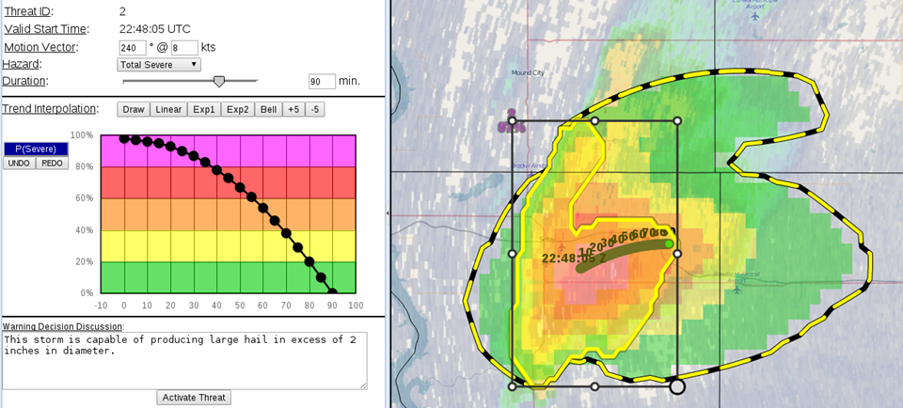
ProbSevere is being tested as automated probabilistic warning guidance in the PHI (Probabilistic Hazards Information) tool, a key component of FACETS.
Notes:
We’re not doing this development in a vacuum. We’re using feedback from HWT forecasters, local PG experiments, leveraging research out of Boulder and Huntsville, AL, and we have a funded collaboration with some folks at NSSL in Norman. Forecasters at HWT were able to view these very experimental gridded threat swaths. So this is where warning operations is potentially headed.

Slide 27
Take Away Points
Goal: ProbSevere is designed to support NWS severe weather warning operations. While skillful and getting better with additional research, ProbSevere will never fully replicate human expertise.
User Readiness: Many NWS forecasters have taken the ProbSevere training and have experience using it at WFO’s or the HWT (predominantly positive feedback)
GOES-R Benefits: GOES-R will increase the skill and lead-time of ProbSevere guidance
ProbSevere Readiness: ProbSevere will not be optimized for GOES-R until real data are collected during the PLT and ProbSevere is re-trained and validated
Reality: ProbSevere is NOT a baseline GOES-R product and there is no R2O plan
Notes:
-Issues with probabilistic guidance?

Slide 28
References
Pavolonis, M. J., 2010: Advances in Extracting Cloud Composition Information from Spaceborne Infrared Radiances-A Robust Alternative to Brightness Temperatures. Part I: Theory. Journal of Applied Meteorology and Climatology, 49, 1992-2012, doi:10.1175/2010JAMC2433.1 ER.
Cintineo, John L.; Pavolonis, Michael J.; Sieglaff, Justin M. and Heidinger, Andrew K. Evolution of severe and nonsevere convection inferred from GOES-derived cloud properties. Journal of Applied Meteorology and Climatology, 52 (9), 2013, 2009–2023.
Cintineo, John L.; Pavolonis, Michael J.; Sieglaff, Justin M. and Lindsey, Daniel T. An empirical model for assessing the severe weather potential of developing convection. Weather and Forecasting, 29 (3), 2014, 639–653.

Slide 29
Additional Resources
Mike Pavolonis (michael.pavolonis@noaa.gov)
John Cintineo (john.cintineo@ssec.wisc.edu)
Justin Sieglaff (justin.sieglaff@ssec.wisc.edu)
Dan Lindsey (dan.lindsey@noaa.gov)
To access the official ProbSevere training module and supplemental training material:
http://cimss.ssec.wisc.edu/severe_conv/training/training.html
See ProbSevere blog posts:
http://goesrhwt.blogspot.com/search/label/ProbSevere
Realtime ProbSevere on the web:
http://cimss.ssec.wisc.edu/severe_conv/probsev.html
Realtime ProbSevere time series:
http://hopwrf.info/ProbSevere/PlotLightning.html

Slide 30
http://cimss.ssec.wisc.edu/severe_conv/probsev.html

Slide 31
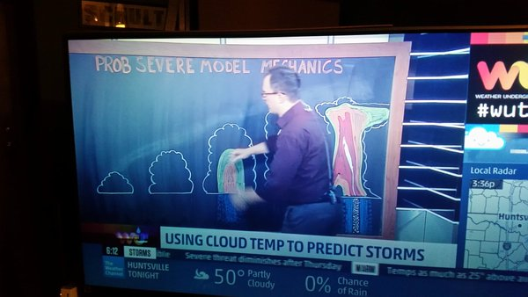

Slide 32
Questions?

Slide 33
Backup Slides

Slide 34
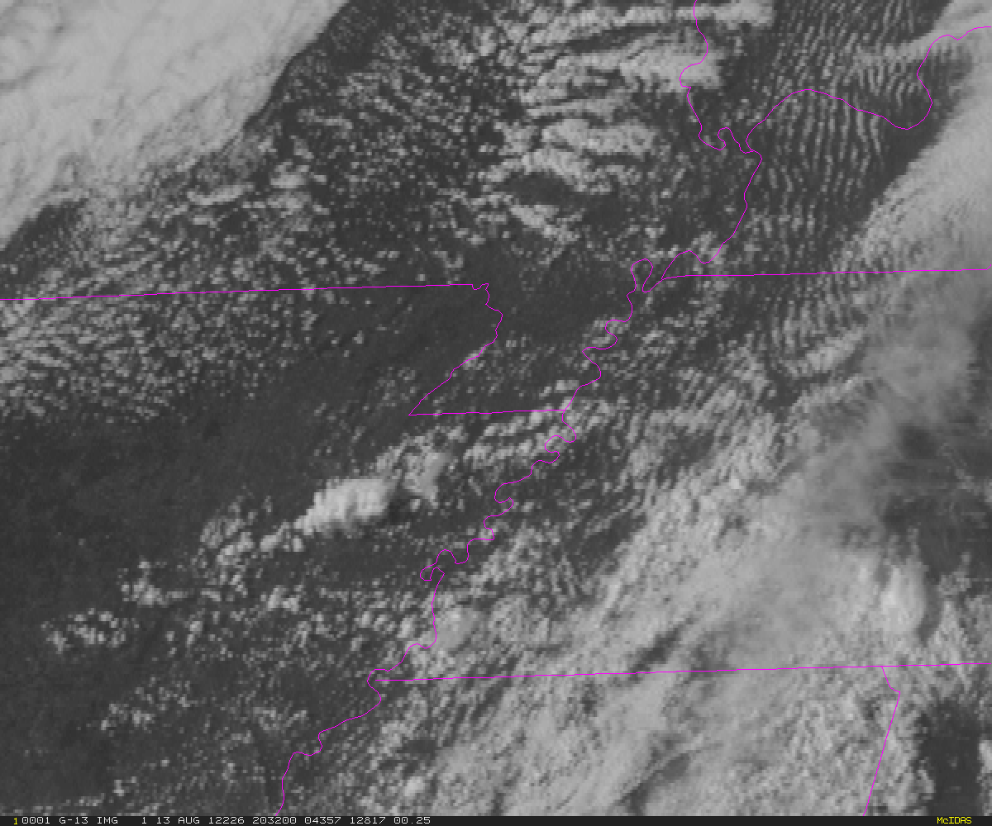
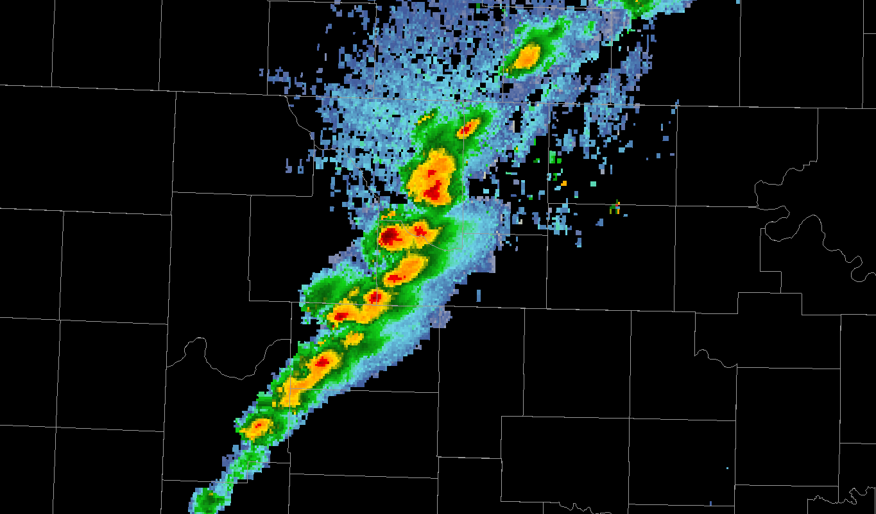
Automated integration of information
A meteorologist sees developing storms and cloud clusters—not satellite pixels or radiances.
The same concepts apply to radar data.
Meteorologists view cells or storms—so the computer needs to identify and track radar cells and their evolution over time.
Notes:
-Extract storm-scale objects and track them in time
-Instantaneous satellite-derived cloud fields are not well-suited to the short-term severe weather forecasting, but temporal trends in those cloud properties are.
-Calculating temporal trends in satellite-derived cloud properties is not a trivial task.
-In order to capture temporal trends in cloud properties, object tracking is needed
-Collaboration with OU-CIMMS and NSSL was essential
-Model output is updated after every radar and satellite scan

Slide 35
Data sources – ENI Total Lightning
Earth Networks Total Lightning (proxy for GOES-R GLM):
  Total flashes contained within radar objects are summed.
Notes:
The total lightning data used as a predictor in the statistical model are the Earth Networks total lightning flashes. For those unfamiliar with total lightning data, total lightning refers to cloud-to-ground strikes PLUS cloud-to-cloud flashes. The ENI total lightning data serves as a proxy for the GOES-R Geostationary Lightning Mapper instrument. The individual lightning flashes are summed within each radar object and have units of flashes per minute. Unlike the satellite and radar based observational predictors, total lightning is not a 1-D predictor, rather it is combined with effective bulk shear and used as a 2-D predictor. This accounts for storms that can have high electrical activity but low effective bulk shear—which will only seldom produce severe weather.

Slide 36
Local Media Coverage: Peoria, IL
https://www.youtube.com/watch?v=493mk5K1pO8

Slide 37
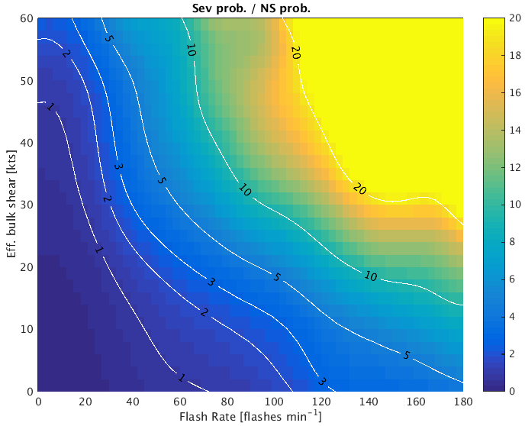

Slide 38
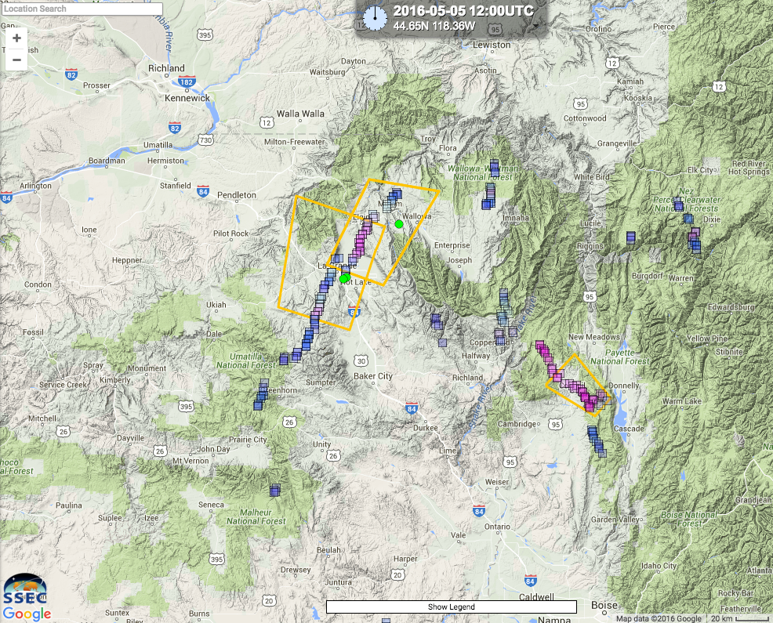

Slide 39
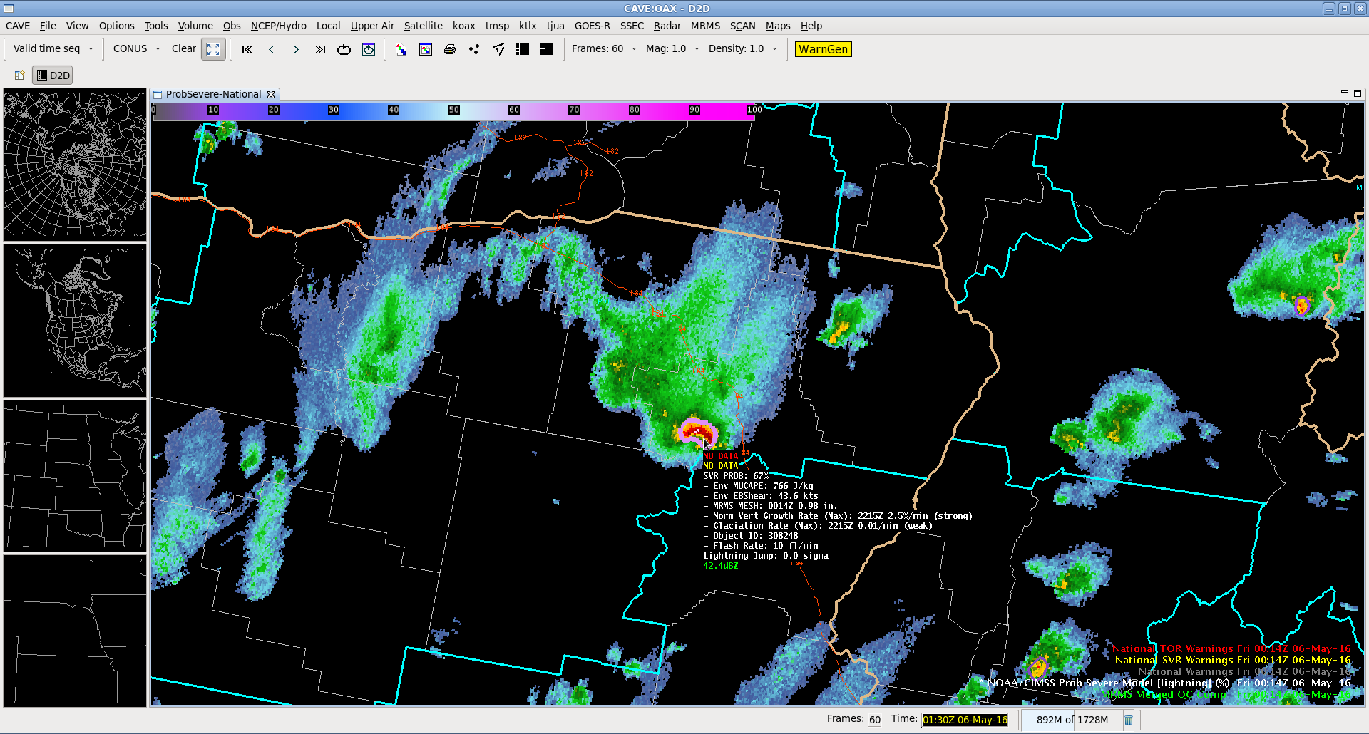

Slide 40
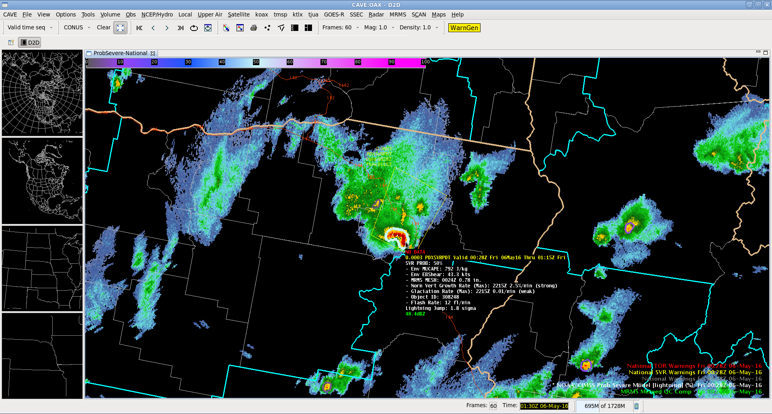

Slide 41
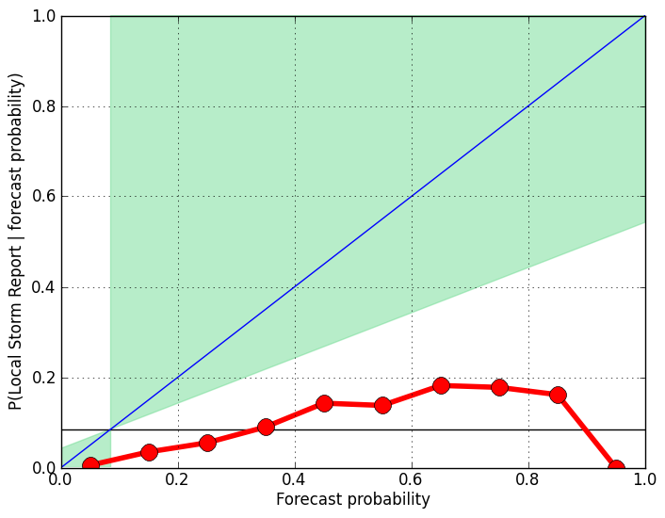
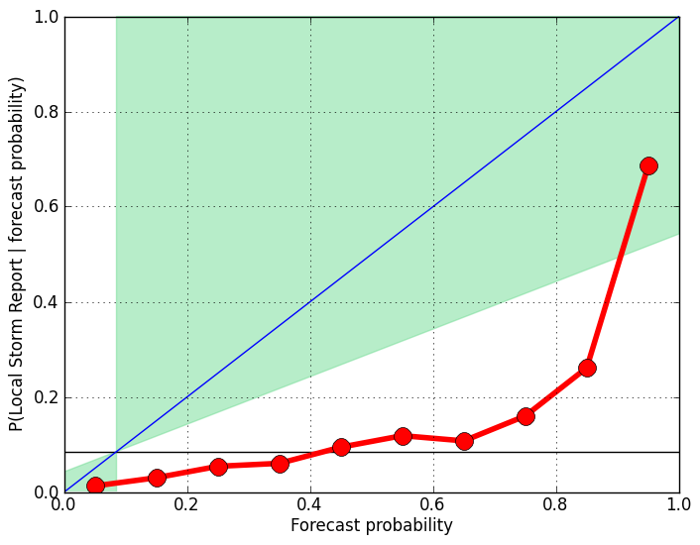







Reliability – Without Lightning
CAPE 0-1500 J/Kg
CAPE 1500-2500 J/Kg
CAPE 2500+ J/Kg
Small Sample Size
EBS 0-10 m/s
Small Sample Size
EBS 10-15 m/s
EBS 15+ m/s
Notes:
Validation using ALL storm reports (not just the first)
total_sev_storms= 71 156 181
85 132 69
85 200 110
total_ns_storms= 8328 6667 6124
2090 1381 589
855 773 329

Slide 42
Reliability – With Lightning
CAPE 0-1500 J/Kg
CAPE 1500-2500 J/Kg
CAPE 2500+ J/Kg
Small Sample Size
EBS 0-10 m/s
Small Sample Size
EBS 10-15 m/s
EBS 15+ m/s
Notes:
Validation using ALL storm reports (not just the first)
total_sev_storms= 71 156 181
85 132 69
85 200 110
total_ns_storms= 8328 6667 6124
2090 1381 589
855 773 329

