Slide 1

GOES-R Risk Reduction Status
Dan Lindsey and Andy Heidinger
Cooperative Research Program (CoRP)
NOAA/NESDIS/STAR
Great Lakes SOO Visit to CIMSS
August 3, 2016

Slide 2
GOES-R Risk Reduction
GOES-R program’s mechanism to ensure GOES-R science and users are engaged.
LOI announcement came out Aug 1.
LOI’s are due September 9.
LOI’s will judged together by a single committee.
Authors of selected LOI’s will be asked to write proposals.
Selections should be made in early 2017 with funding available spring of 2017.

Slide 3
LOI’s should address at least one of these themes*
Climate Adaptation and Mitigation
Weather Ready Nation
Healthy Oceans
Resilient Coastal Communities & Economies
Stakeholder Engagement
Data & Observations
Integrated Environmental Modeling
*NOAA’s Research and Development Objectives in its 5-year Strategic Plan

Slide 4
Highest Priority Topic Areas for GOES-R3 Projects
A. Improving Operational Environmental Prediction: Use of GOES-R data in NWP & Data Assimilation
(DA) that addresses convective initiation, tropical forecasting, flood (hydrological) applications, aviation
hazards support, cryosphere, oceanographic, and space weather applications specifically focused on:
A1. Exploiting benefit of high temporal resolution data expected from GOES-R
A2. Promoting simultaneous use of satellite (GOES-R) with ground based and in-situ
observations in operational NWP systems
A3. Exploiting the capabilities of GLM data.
B. NWS Situational Awareness Monitoring Applications in AWIPS-2 (emphasizing data fusion and
integration):
B1. Convective initiation, convective monitoring, winter storm monitoring (severe storms /
weather warning applications)
B2. Tropical weather monitoring
B3. Hydrological monitoring applicable to flood warnings and forecasts
B4. Blended ocean winds and related oceanographic products
B5. Space weather applications.

Slide 5
Basic Research
In years past, GOES-RRR reserved funds for basic research.
This year, basic research will be done at the CIs (CICS, CIMSS and CIRA).
We encourage you to also engage with these “research” activities at the CIs.
  CICS is doing hydrology related research.
  CIMSS is doing fire, air quality and severe/tropical storms research.
  CIRA is doing research to assimilate/fuse high temporal resolution observations into the HRRR to improve short-term forecasts.

Slide 6
High Impact Weather – CIMSS Initiative
Proposed GOES-R Research Theme
Two Potential Sub-Topics
Fires (200K FY16-FY18, 100K FY19)
Fire Detection and Characterization
Smoke Forecasting and Data assimilation
(Leverages existing STAR/OAR collaboration under JPSS Fire/Smoke Initiative and 2018 NOAA FIREX field campaign)
Severe Storms (300K, FY17-FY18, 400K FY19)
Convective/Winter
Tropical/Hurricanes

Slide 7
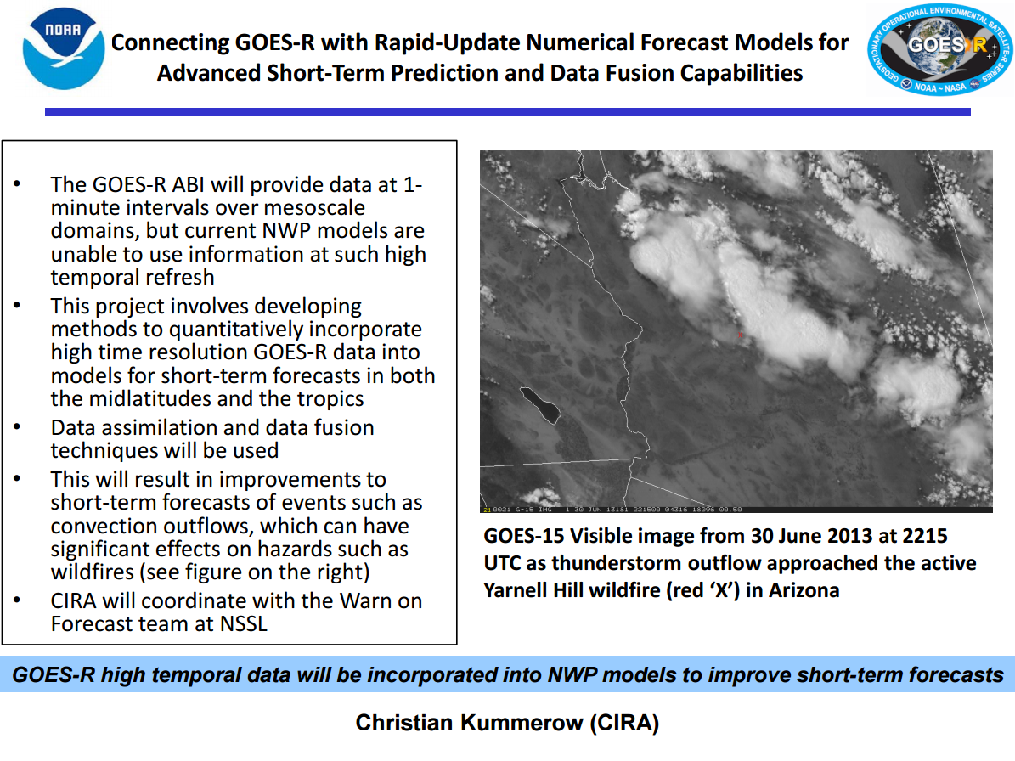

Slide 8
Guidance to NWS SOO’s
View this as an opportunity to influence product and application development.
SOO involvement is a big strength to any proposal.
Therefore, you may be solicited to participate by individual proposers.
Feel free to contact me if you have an idea and want to team up with someone or if you have a question on an LOI sent to you.
(andrew.heidinger@noaa.gov or dan.lindsey@noaa.gov)

Slide 9
Cloud Product Overview
Maturing Applications
Aircraft Icing
Convective Initiation
Fog (IFR and MFR)
ProbSevere
Sky Cover
Expanded CCL
Baseline Products
Cloud Mask
Cloud Phase
Cloud Vertical Extent (pressure, height, temperature)
Cloud Base Height (Ceiling)
Cloud Mass (water path or optical depths)
Cloud particle size at top.
Cloud Cover Layers
Other existing or proposed Cloud Products (RR or PG)
Precipitation from cloud products
Lake effect snow
Glaciation rates
Cloud-top vertical velocities
Cloud mass growth/decay rates.
????

Slide 10
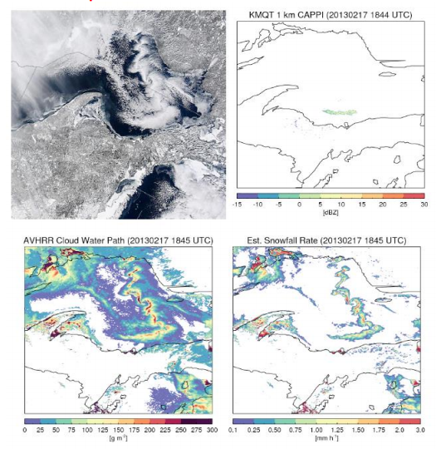
Lake Effect Snowfall
Lake Effect Snow is a common but hazardous feature in the Great Lakes Region.
It forms from shallow clouds over the lakes that are not detected from NWS radars.
In a similar manner to the general VIS/NIR precipitation product, the GOES-R cloud product suite can be mined to generate estimates of Lake Effect Snow as it forms over the water.
Mark Kulie (CIMSS) has developed lake effect snow-fall relationships tuned with radar. He has demonstrated these products to the Marquette, MI and Green Bay, WI NWS forecast offices.

Slide 11
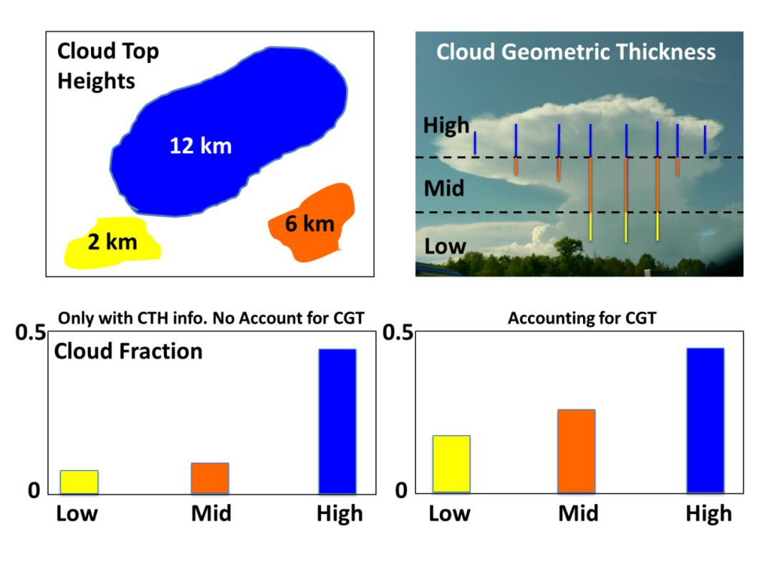
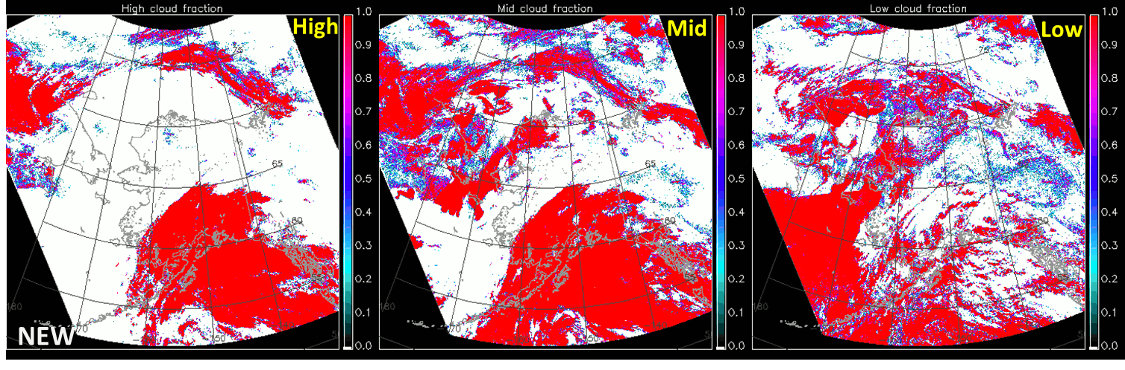
JPSS-PGRR-CCL (Cloud Cover and Layers)
Steve Miller, Y. J. Noh, Curtis Seaman, John Forsythe, Steve Finley, Dan Lindsey (NOAA/NESDIS)
Page 1
This research is a collaboration between CIRA and CIMSS (led by Andy Heidinger) for improved Cloud Cover and Layers products.
The cloud geometric thickness information from the new CBH algorithm is employed to enhance lower cloud layer fractions missed by the previous CCL retrieval.
S-NPP VIIRS 20160223 (2217-2228 UTC)

Slide 12
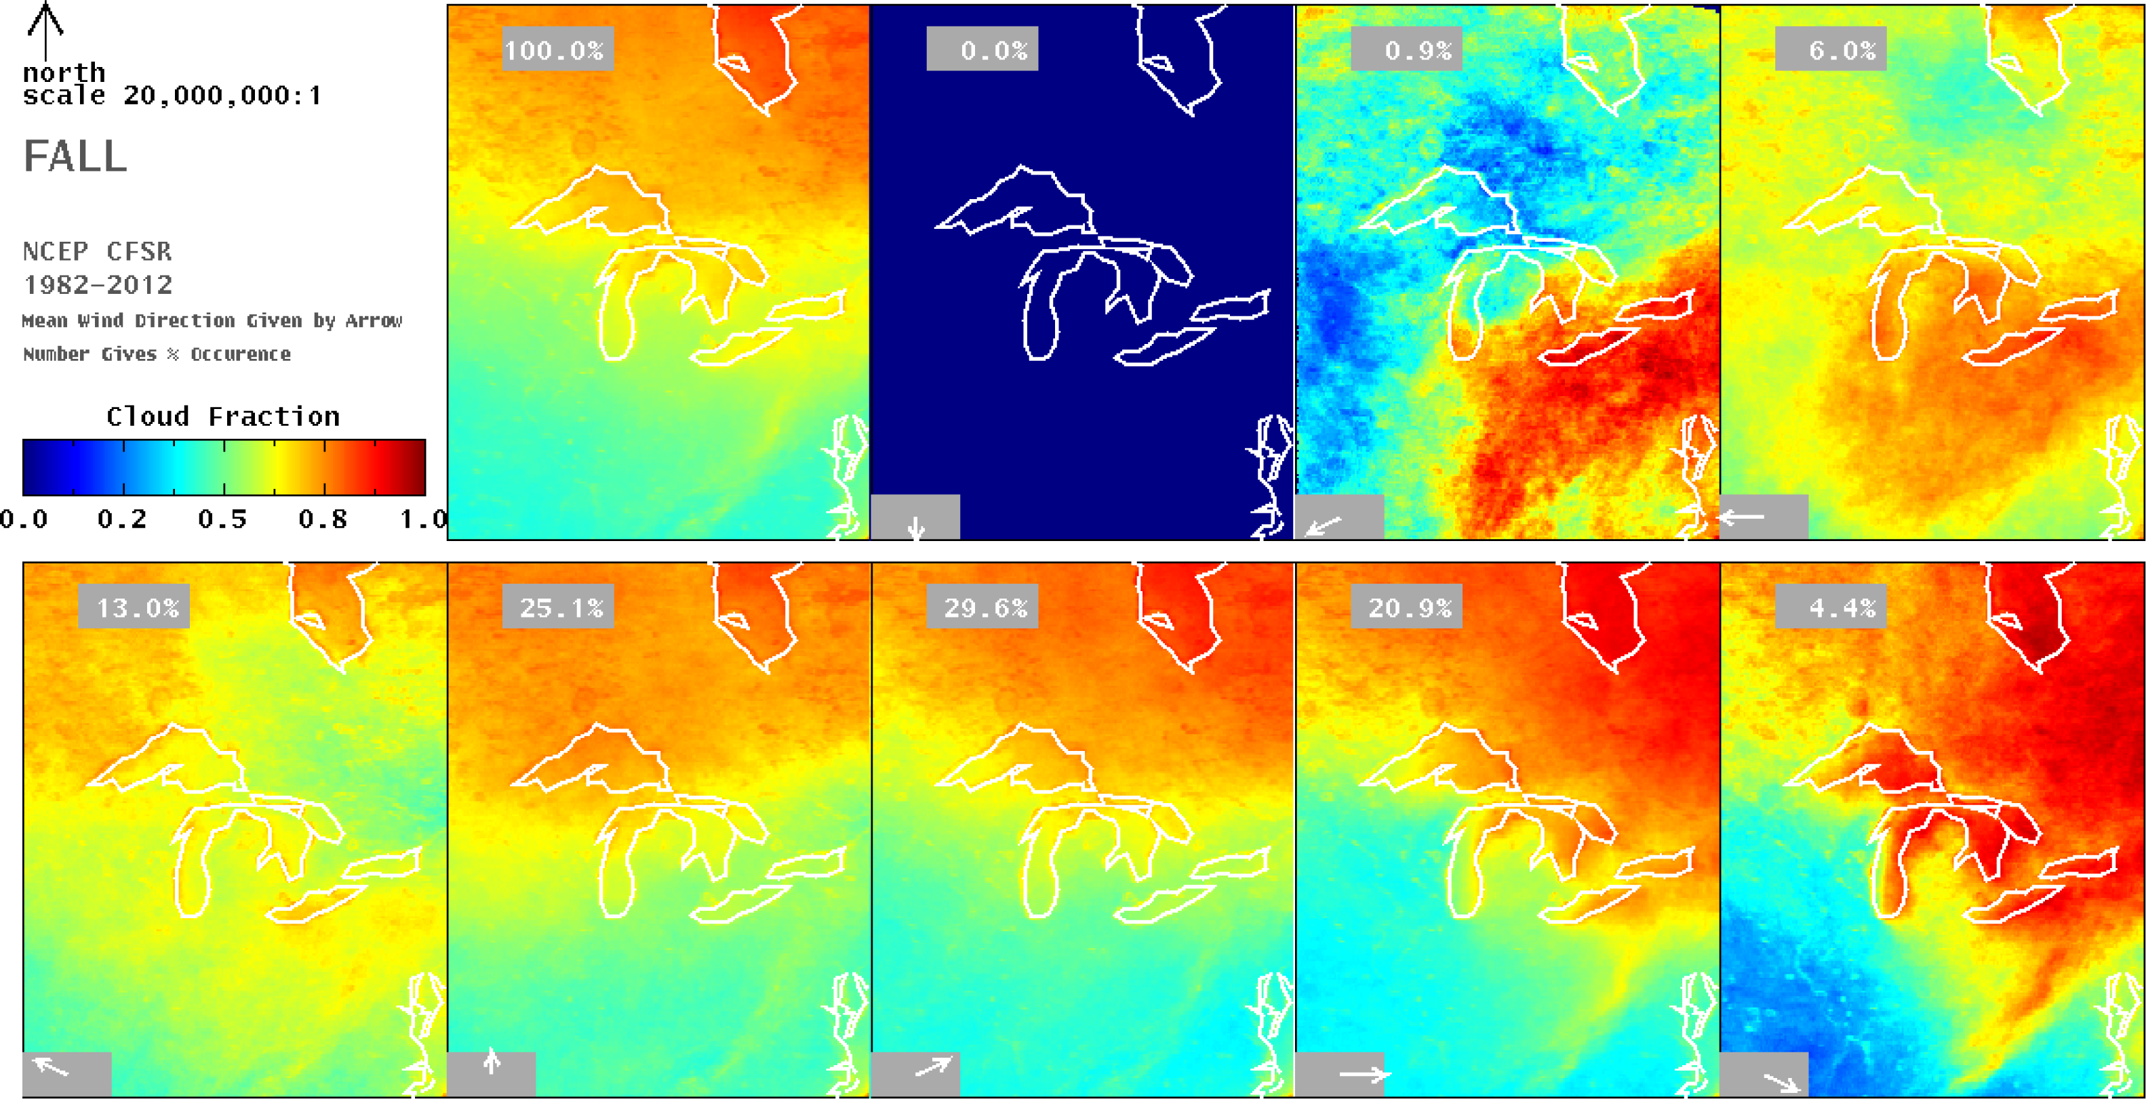
Great Lakes Regional Climate Studies
Remote Sensing 2013, 5(12), 6223-6240; doi:10.3390/rs5126223

Slide 13
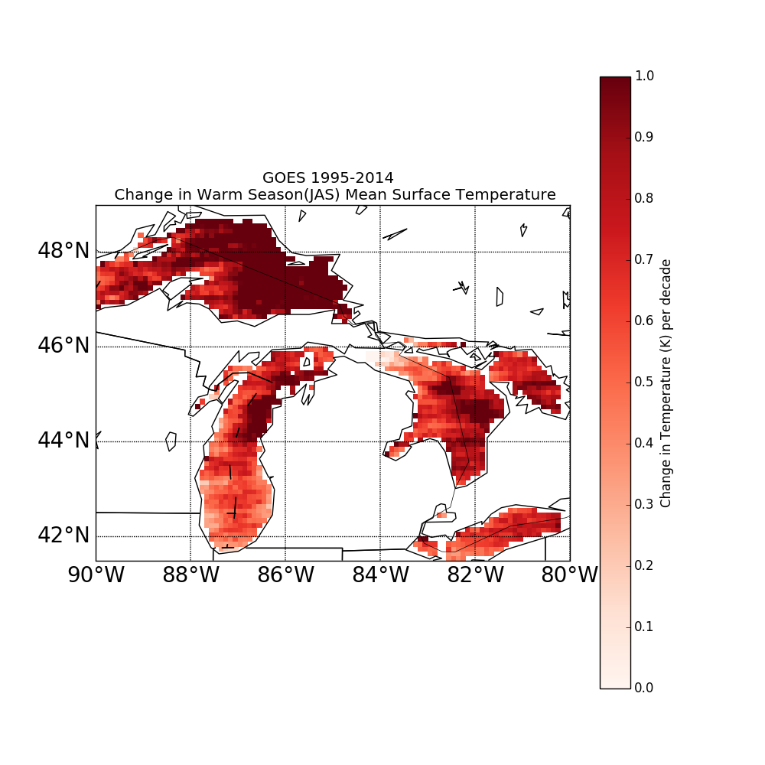
Great Lakes Regional Climate Studies

Slide 14
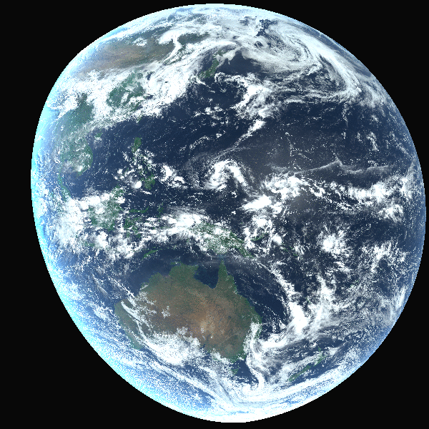
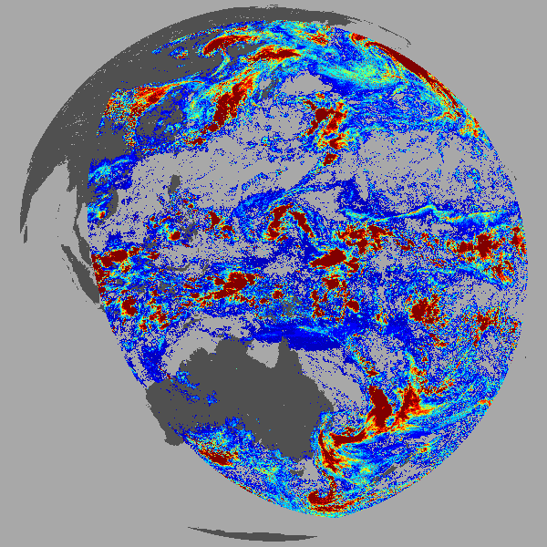

Cloud Water Path (mass)
AHI Cloud Water Path (g/cm²)
Notes:
This is a daytime only product. Fundamental product that reports the mass of water/ice in the column. Complements microwave estimates by providing data over land and is more sensitive to thin cloud and ice cloud. Can not separate ice over water. Not a OCONUS AWIPS offering, but should be.

Slide 15
THANKS

Slide 16
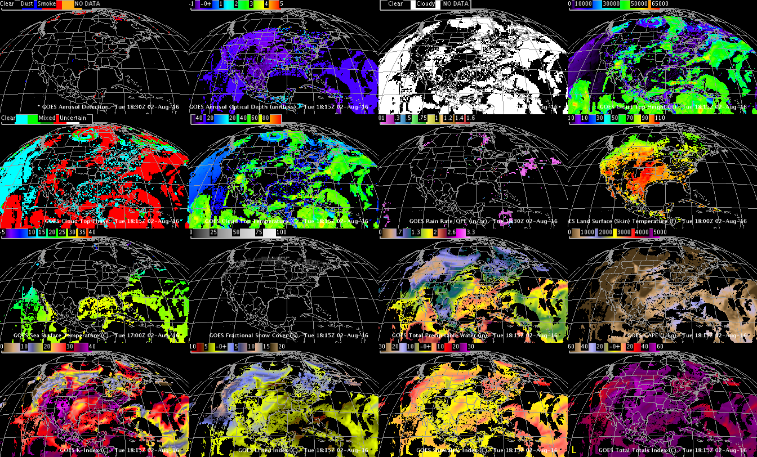
DOE-4 Simulated ABI (select) Derived Products
Aerosol Detection
Aerosol Optical Depth
Cloud Mask
Cloud Top Height
Cloud Top Phase
Cloud Top Pressure
Rain Rate
LST
SST
Snow
TPW
CAPE
K-index
Lifted Index
Showalter
Total Totals
Using GOES-R ABI Imagery simulated at UW via AWG Proxy, processed via the Ground System, acquired via NOAAPort, in AWIPS-II (default enhancements)

Slide 17
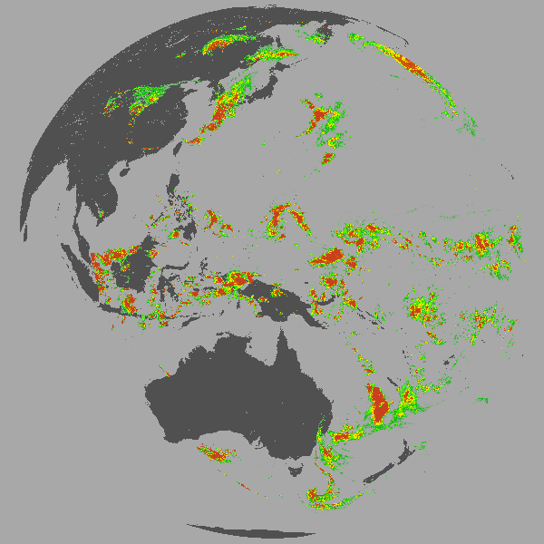
Cloud derived Precipitation (microphysics)
AHI Cloud-Product Rain Rate – computed from optical depth and particle size
Notes:
We show precipitation since it derived from cloud particle size and cloud optical depth. We use an approach from KNMI (EUMETSAT). Cloud particle size is hard to verify and be able to make a decent precip product that means our particle sizes and optical depths are also performing well. This precip is only a sub-part of the total precipitation. This could be used by Bob Kuligowski and the official GOES-R Precip product.

Slide 18
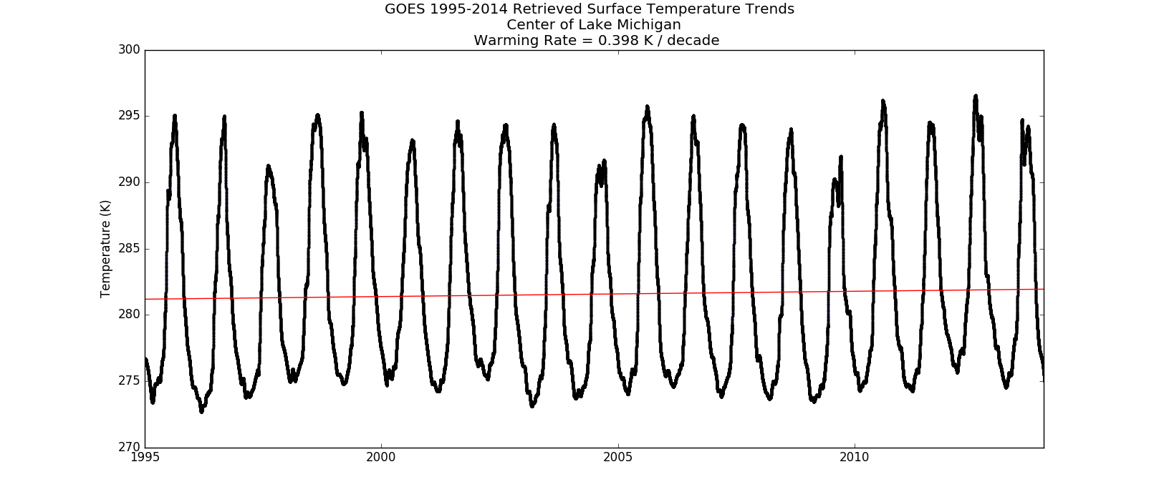
Great Lakes Regional Climate Studies

Slide 19
GOES-R Risk Reduction Projects
We’re currently in the 2nd half of the FY15 funding cycle
FY16 funding cycle begins July 1, 2016
Some projects are finishing this summer, and others continue for one more year (the FY16 funding cycle is July 1, 2016 – June 30, 2017)
Late this summer, a new GOES-R Risk Reduction Request for Proposals will be sent out, asking for Letters of Intent for new FY17-19 projects
As usual, priority will be given to projects whose end goal is a product or decision aid useful for NWS operations

Slide 20
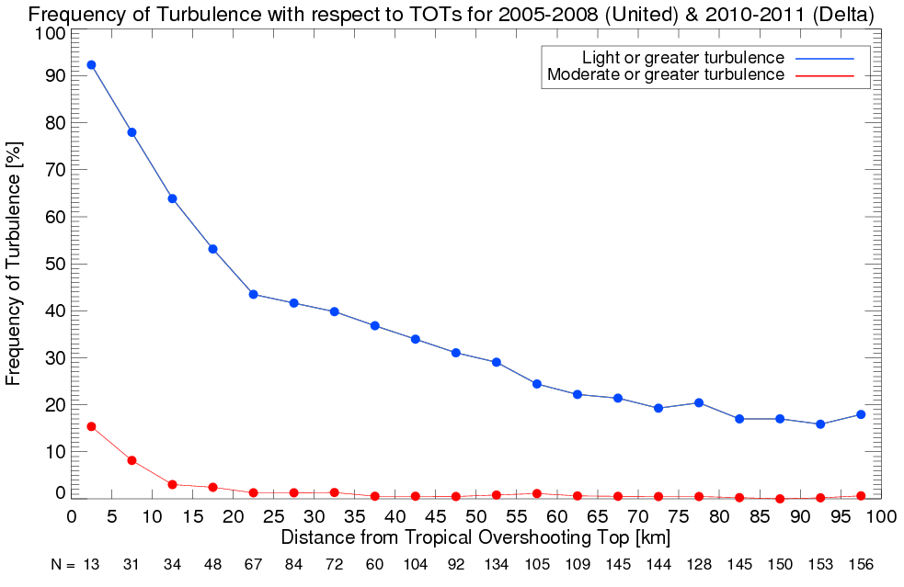
Latest FY15 GOES-R3 Project Highlights
GOES-R Future Capability Proposal: Advancement of Satellite-Detected Overshooting Top (OT) Decision Support Products
Kris Bedka (NASA) and Chris Velden (CIMSS)
Frequency of turbulence with respect to horizontal distance from TOTs. Blue (red) indicates frequency of light or greater (moderate or greater) turbulence experienced.

Slide 21
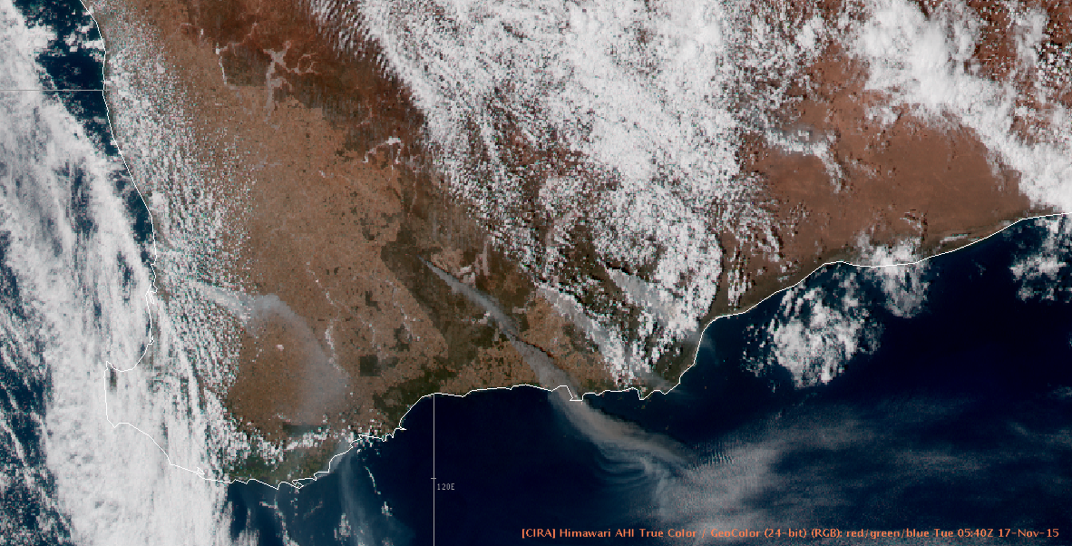
Latest FY15 GOES-R3 Project Highlights
RGB Products in AWIPS-2 and EPDT Work (VSP funded)
Deb Molenar (RAMMB), Gary Jedlovec (SPoRT), Tim Schmit (ASPB)
Scott Longmore (CIRA), Kevin McGrath (SPoRT), Kaba Bah (CIMSS)
Experimental Products Development Team (EPDT)-developed AWIPS-2 plugin allowed for display of some RGB products during a recent OPG experiment, including this Himawari Geocolor example (courtesy of Chad Gravelle)

Slide 22
Latest FY15 GOES-R3 Project Highlights
The GOES-R GLM Lightning Jump Algorithm: A National Field Test for Operational Readiness
Larry Carey (UAH) and Kristin Calhoun (OU/NSSL)
Example of SHAVE and radar Maximum Expected Size of Hail (MESH) verification of the total lightning jump for a case over Northern Alabama LMA on 2014-07-08. Lightning jump occurred 25 minutes before the severe hail occurrence according to SHAVE and also prior to rapid increase (jump) in MESH and maximum MESH.The lightning and radar MESH are fairly well correlated in this case (as MESH increased, lightning increased and both decreased simultaneously.) The large majority of cases (75% to 80%) followed this behaviour.

Slide 23
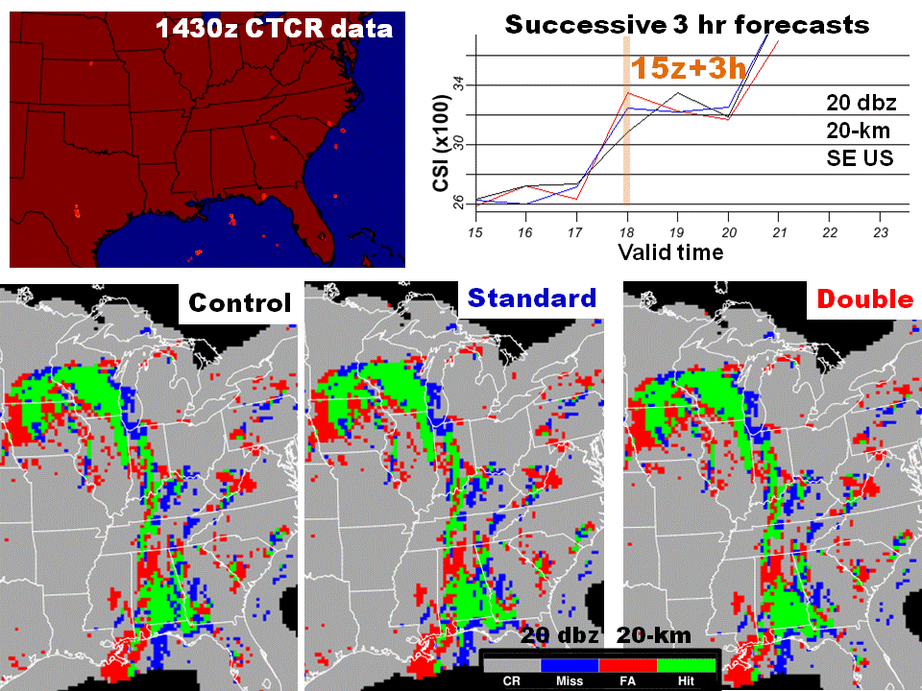
Latest FY15 GOES-R3 Project Highlights
Convective Storm Forecasting 1-6 Hours Prior to Initiation in the GOES–R Era
John Mecikalski (UAH) and Steve Weygandt (ESRL)
Bottom row – HIT-MISS-FALSE ALARM (Green-Blue-Red) plots for RAP 3-h forecasts valid 1800 UTC 26 May 2015 for the control (no CTCR assim) and standard and double strength CTCR assimilation. Top row – Assimilated CTCR data 1430 UTC 26 May 2015 and CSI scores as function of valid-time for successive HRRR 3-h forecasts from retrospective experiment (no CTCR assimilation in parent HRRR).

Slide 24
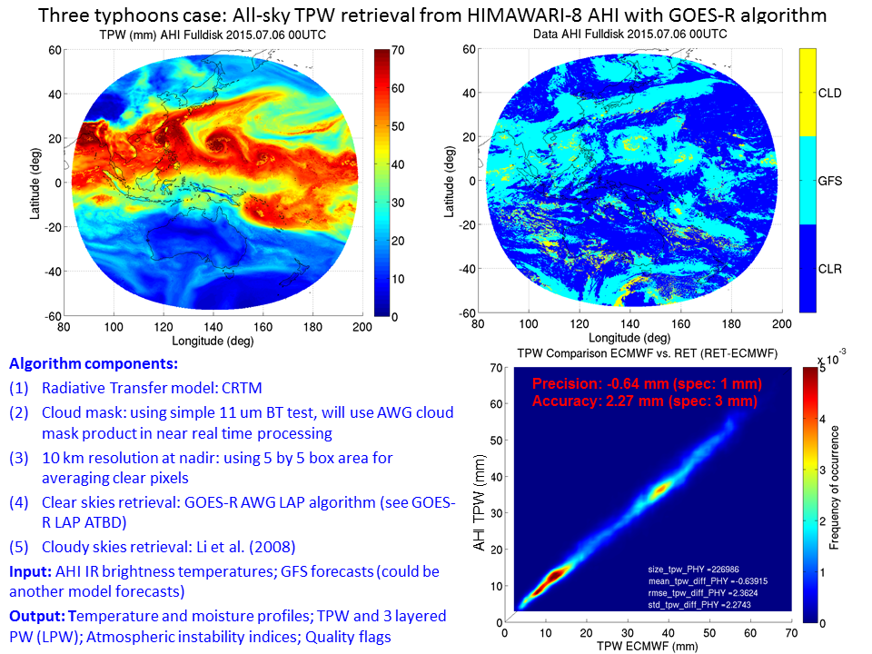
Latest FY15 GOES-R3 Project Highlights
Development of real time all-weather layer precipitable water products in AWIPS II by fusing the GOES-R and NWP for local forecasters
Jun Li (CIMSS)
One example of TPW from AHI (upper left), the retrieval flag (clear retrievals, cloudy retrievals and GFS) (upper right panel), along with the scatterplot between AHI and ECMWF TPWs at 00 UTC on 06 July 2015.

Slide 25
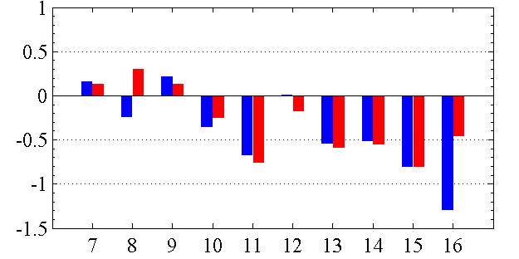
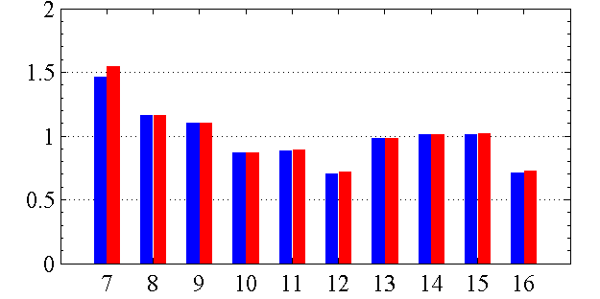
Latest FY15 GOES-R3 Project Highlights
Improving Coastal Precipitation Forecast through Direct Assimilation of GOES-R ABI Radiances in GSI-NAM/HWRF
Fuzhong Weng (STAR)
Biases (left panel) and standard deviations (right panel) of Observed minus Simulated Brightness Temperature for the CRTM (O-B^{CRTM} , blue) and O-B^{RTTOV} (fast Radiative Transfer for TOVS, red) over ocean, for the IR bands 7-16 of the Himawari AHI

Slide 26
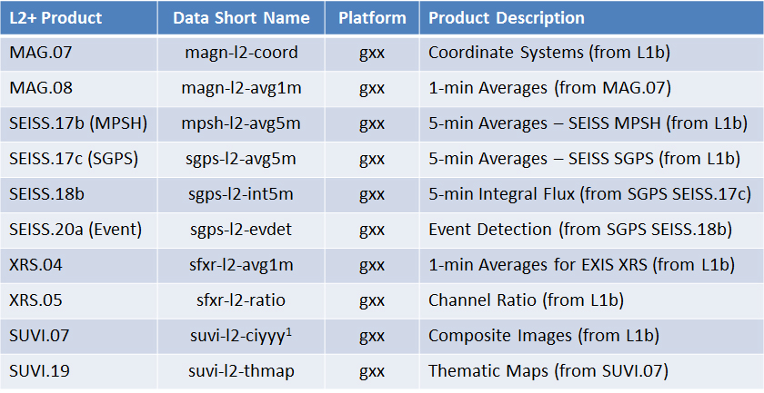
Latest FY15 GOES-R3 Project Highlights
Satellite Product Analysis and Distribution Enterprise System (SPADES) Bill Denig (NESDIS/NCEI)
List of the space weather Level 2+ algorithms that were successfully installed on the SPADES developmental system during Phase 1

Slide 27
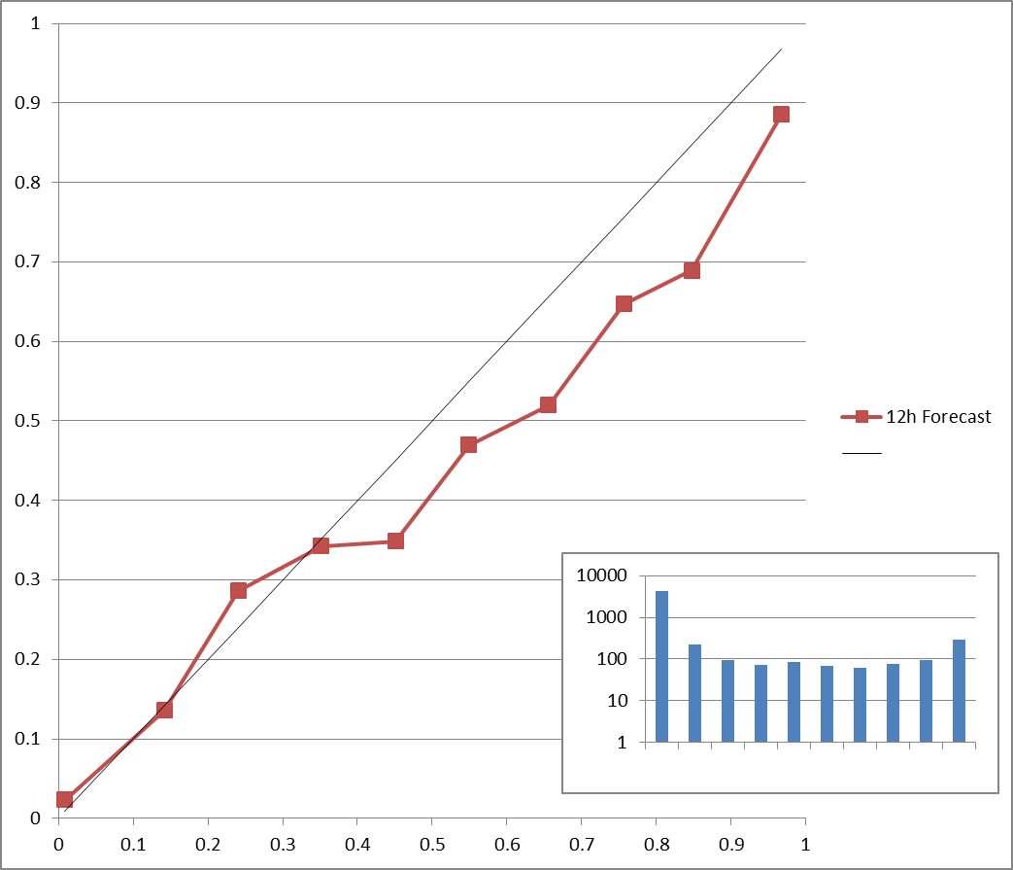
Latest FY15 GOES-R3 Project Highlights
Diagnosis and Anticipation of Tropical Cyclone Behavior from New and Enhanced GOES-R Capabilities
John Knaff (RAMMB)
Reliability diagram showing the calibration of the probabilistic schemes used to predict the probability of an eye forming in 12 hours. These forecasts were developed using Atlantic Basin tropical cyclones (1996-2013). The forecast scheme was then applied to eastern and central Pacific tropical cyclones (1996-2014). The results are thus completely independent.

Slide 28
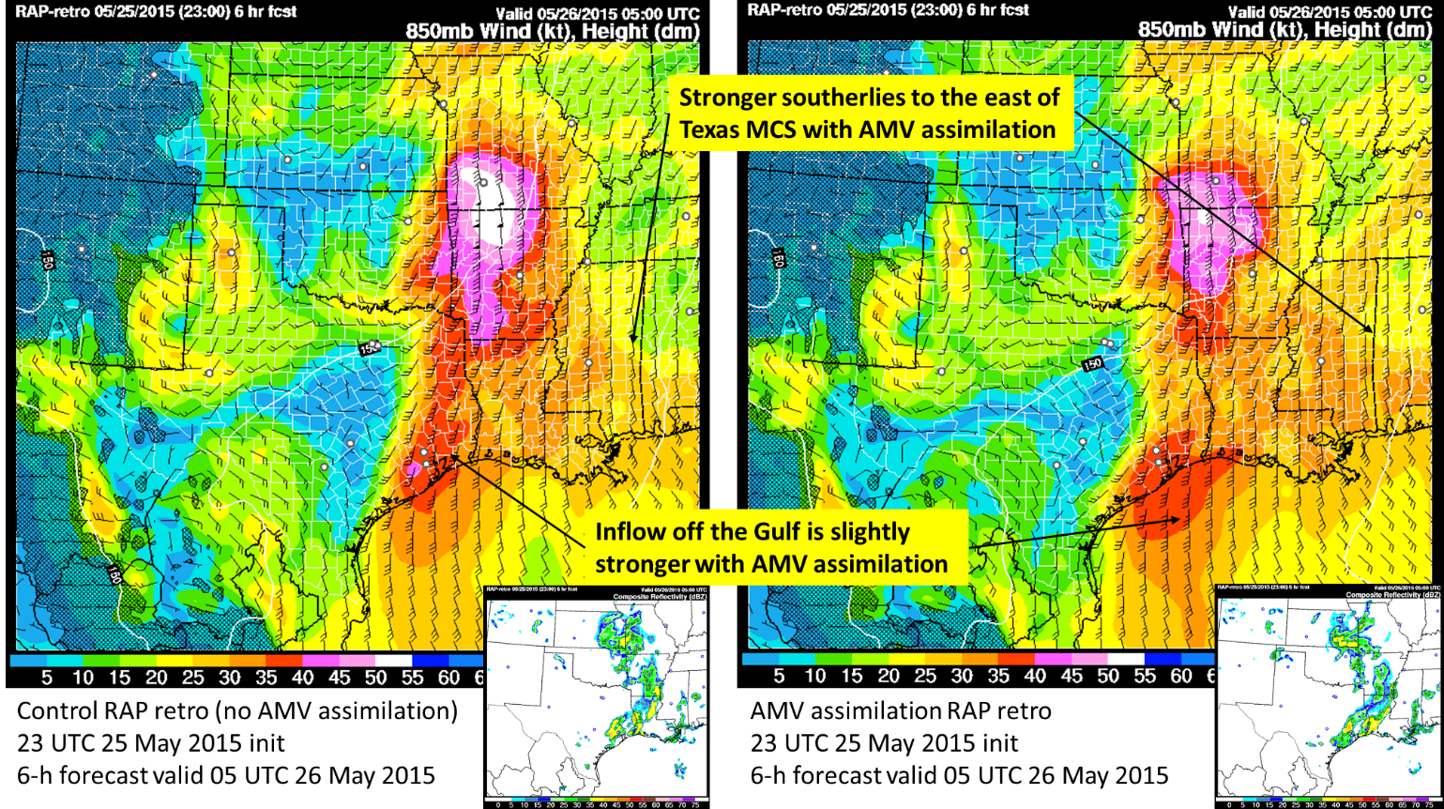
Latest FY15 GOES-R3 Project Highlights
Development and Optimization of Mesoscale Atmospheric Motion Vectors (AMVs) using Novel GOES-R Processing Algorithms on 1-5 min. SRSO Proxy Data, and Demonstration of Readiness for GOES-R Applications via Impact Studies in Mesoscale Data Assimilation and NWP Systems
Chris Velden (CIMSS)
Control RAP simulation (left) compared to the RAP simulation after assimilating AMVs (right) for a severe weather case from 25 May 2015. Both are for 6-hour forecasts. In this case the AMV resulted in stronger southerly 850 mb winds in the southeast US

Slide 29
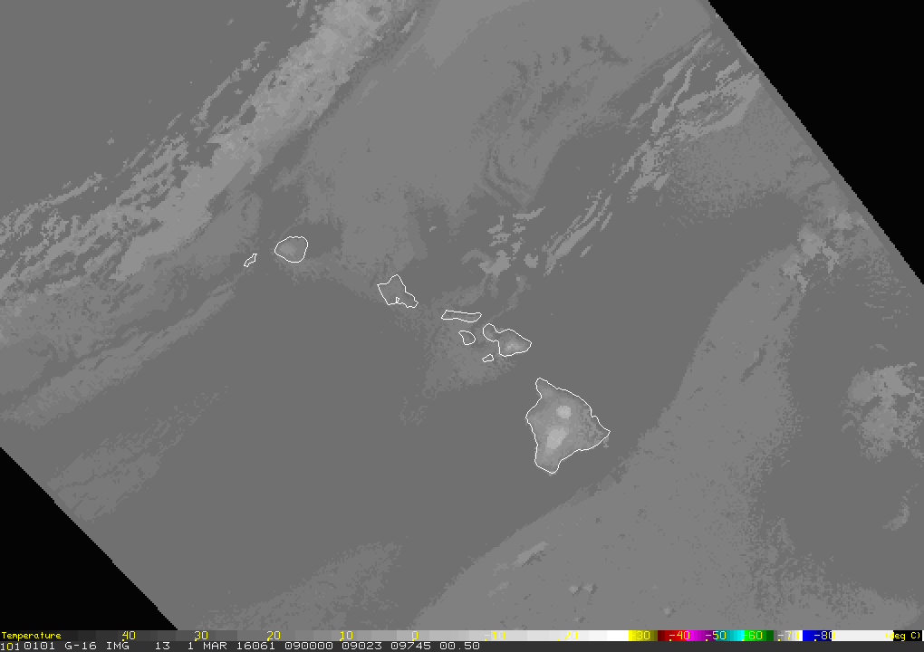
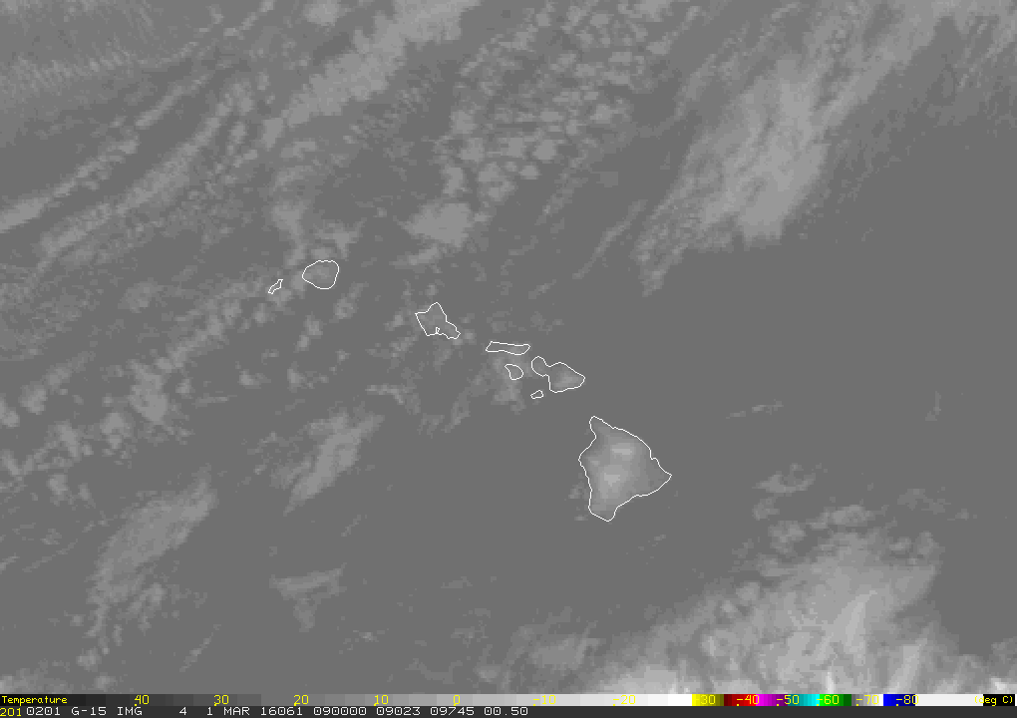
Latest FY15 GOES-R3 Project Highlights
Synthetic Imagery Generation over Alaska and Hawaii for GOES-R Product Development
Dan Lindsey (RAMMB) and Louie Grasso (CIRA)
Forecast 10.4 µm band based on the 1 March 2016 run of the NAM Alaska Nest model (left) compared to the observed GOES-15 10.7 µm band (right)

Slide 30
Latest FY15 GOES-R3 Project Highlights
Applications of concurrent super rapid sampling from GOES14 SRSOR, radar and lightning data
Bob Rabin (NSSL)
GOES14 visible with overlay of GOES14 AMVs at 2147 UTC, 10 June 2015. Pressure levels indicated by color: 1000-850 mb (cyan), 850-600 (green), 640-400 (gold), 400-200 (red), 200-50 (yellow). Note that the lowest altitude winds (1000-850 mb) are limited to a few areas south of the mid level cloud band.

Slide 31
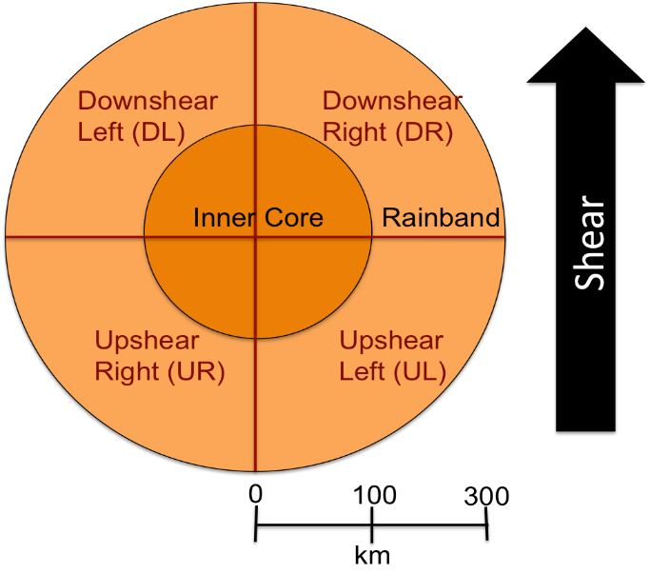
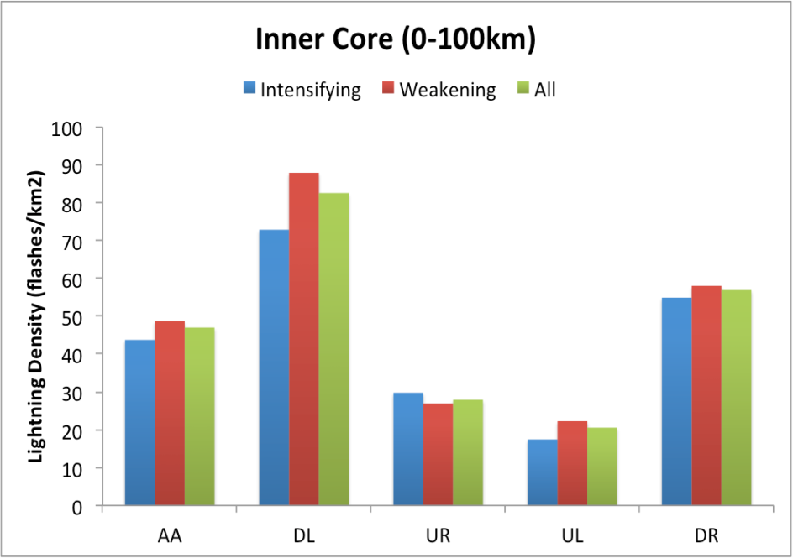
Latest FY15 GOES-R3 Project Highlights
Using total lightning data from GLM/GOES-R to improve real-time tropical cyclone genesis and intensity forecasts
Andrea Schumacher (CIRA) and Alex Fierro (CIMMS)
Schematic depicting the regions over which lightning density was calculated (left), and inner core lightning density (right) for intensifying (blue), weakening (red) and all (green) 2005-2014 Atlantic TCs. AA = azimuthal average and quadrant abbreviations are shown on the left. Lightning data comes from the WWLLN dataset.

Slide 32
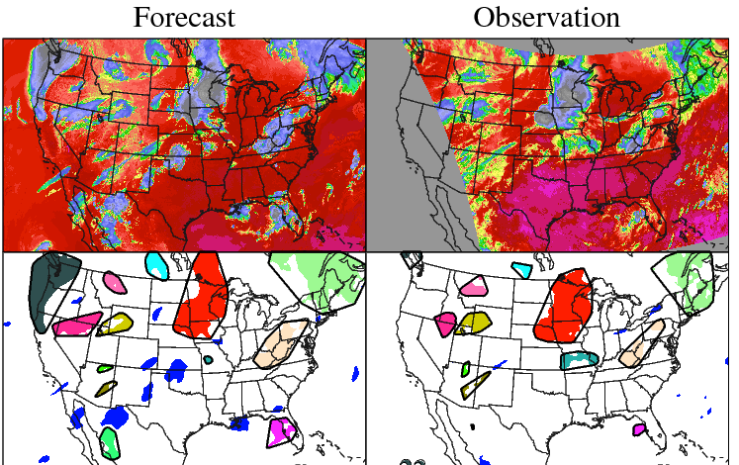
Latest FY15 GOES-R3 Project Highlights
Development of a Near Real-time Satellite Verification and Forecaster Guidance System for the High-Resolution Rapid Refresh (HRRR) Model
Jason Otkin (CIMSS) and Justin Sieglaff (CIMSS)
(top panels) Simulated and observed GOES 10.7 μm brightness temperatures valid at 07 UTC on 18 July 2015. The simulated brightness temperatures are from a 6-hour HRRR forecast starting at 01 UTC on 18 July 2015. (bottom panels) Cloud objects identified by MODE using the simulated and observed brightness temperatures. Matching cloud objects in the forecast and observations are encircled by thick black lines. A brightness temperature threshold of 250 K and a convolution radius of 15 km (five model grid points) was used to identify the cloud objects. The GOES observations were remapped to the HRRR model projection prior to running MODE.

Slide 33
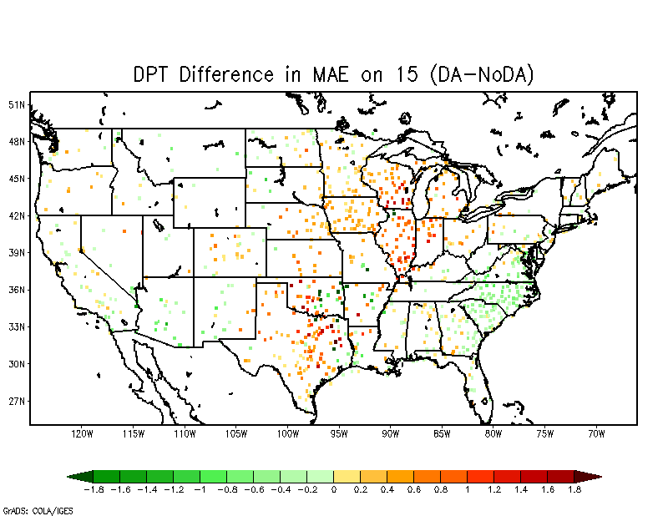
Latest FY15 GOES-R3 Project Highlights
Enhancing NCEP-NAM Weather Forecasts via Assimilating Real-time GOES-R Observations of Land Surface Temperature and Green Vegetation Fraction
Xiwu Zhan (STAR)
Spatial distribution of RMSE difference in 2 m RH (forecast without data assimilation minus forecast with Climate Change Initiative (CCI) Soil Moisture data assimilation over the period of May 10th to May 19th. Positive values (warmer colors) represent value added by the soil moisture assimilation.

Slide 34
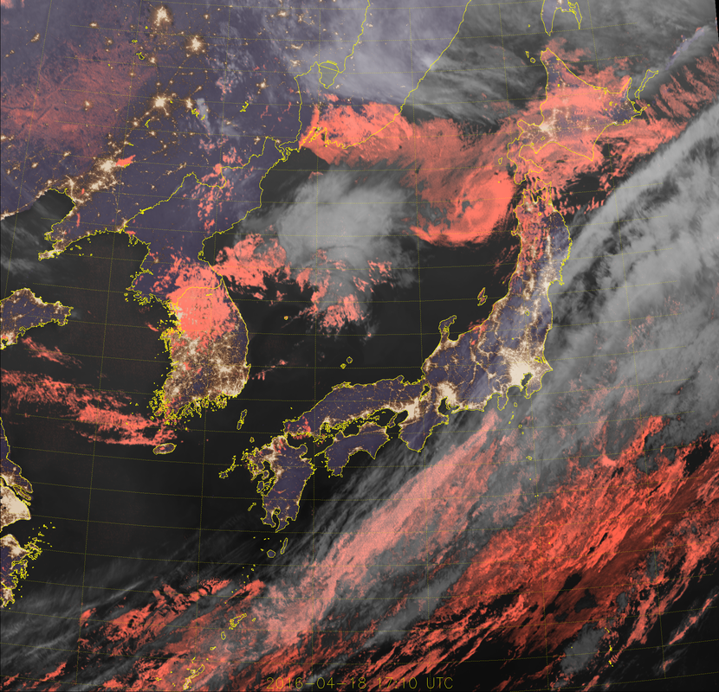
Latest FY15 GOES-R3 Project Highlights
GOES-R ABI Multi-Spectral Imagery for Visibility Hazard Assessment via Himawari AHI
Steve Miller (CIRA)
Example of the Geocolor product from AHI from 18 April 2016 at 1710 UTC over Japan and parts of eastern Asia. This product is now being generated in real time over the AHI full disk. Pink colors represent liquid water clouds and gray shades are ice clouds. It’s a nice tool for identifying potentially hazardous (for aviation, e.g.) stratus clouds, even through thin cirrus.

Slide 35
Latest FY15 GOES-R3 Project Highlights
Using Multi-Sensor Observations for Volcanic Cloud Detection, Characterization, and Improved Dispersion Modeling
Mike Pavolonis (ASPB)
A screenshot of a near-realtime VOLCAT ash alert associated with an eruption of Fuego (Guatemala) on January 20, 2016 is shown in the top panel. The Washington VAAC utilized this alert to issue a Volcanic Ash Advisory (bottom, left panel). A more detailed view of the ash detected by VOLCAT is shown in the bottom, right panel. The VOLCAT products provided unique information, as the Fuego ash cloud was not unambiguously identifiable in the standard satellite products utilized by the Washington VAAC.

Slide 36
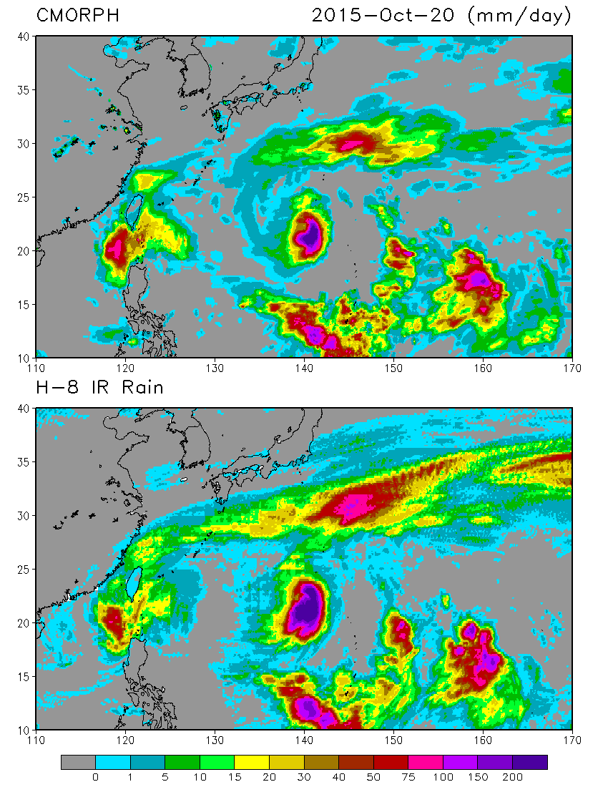
Latest FY15 GOES-R3 Project Highlights
Developing Integrated Satellite and Gauge-Radar-Satellite-Model Fused Precipitation Estimates for Real-time Weather, Hydrometeorology and Hazards Monitoring
Pingping Xie (CPC)
Daily mean precipitation (mm/day) for October 20, 2015, derived from the CMORPH integrated satellite precipitation estimates (top), and from the Himawari-8 Band-13 TBB using the GOES-R Precipitation Estimation (GPE) technique.

Slide 37
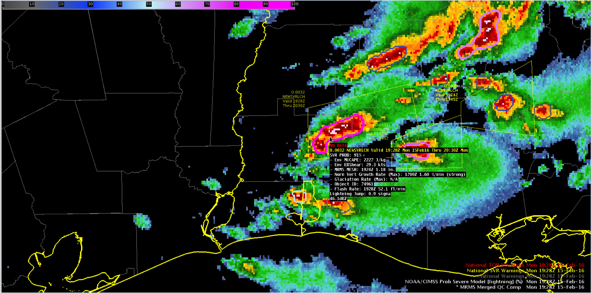
Latest FY15 GOES-R3 Project Highlights
Probabilistic Forecasting of Severe Convection through Data Fusion
Mike Pavolonis (ASPB)
Example of the ProbSevere model displayed in AWIPS2 with lightning information.

Slide 38
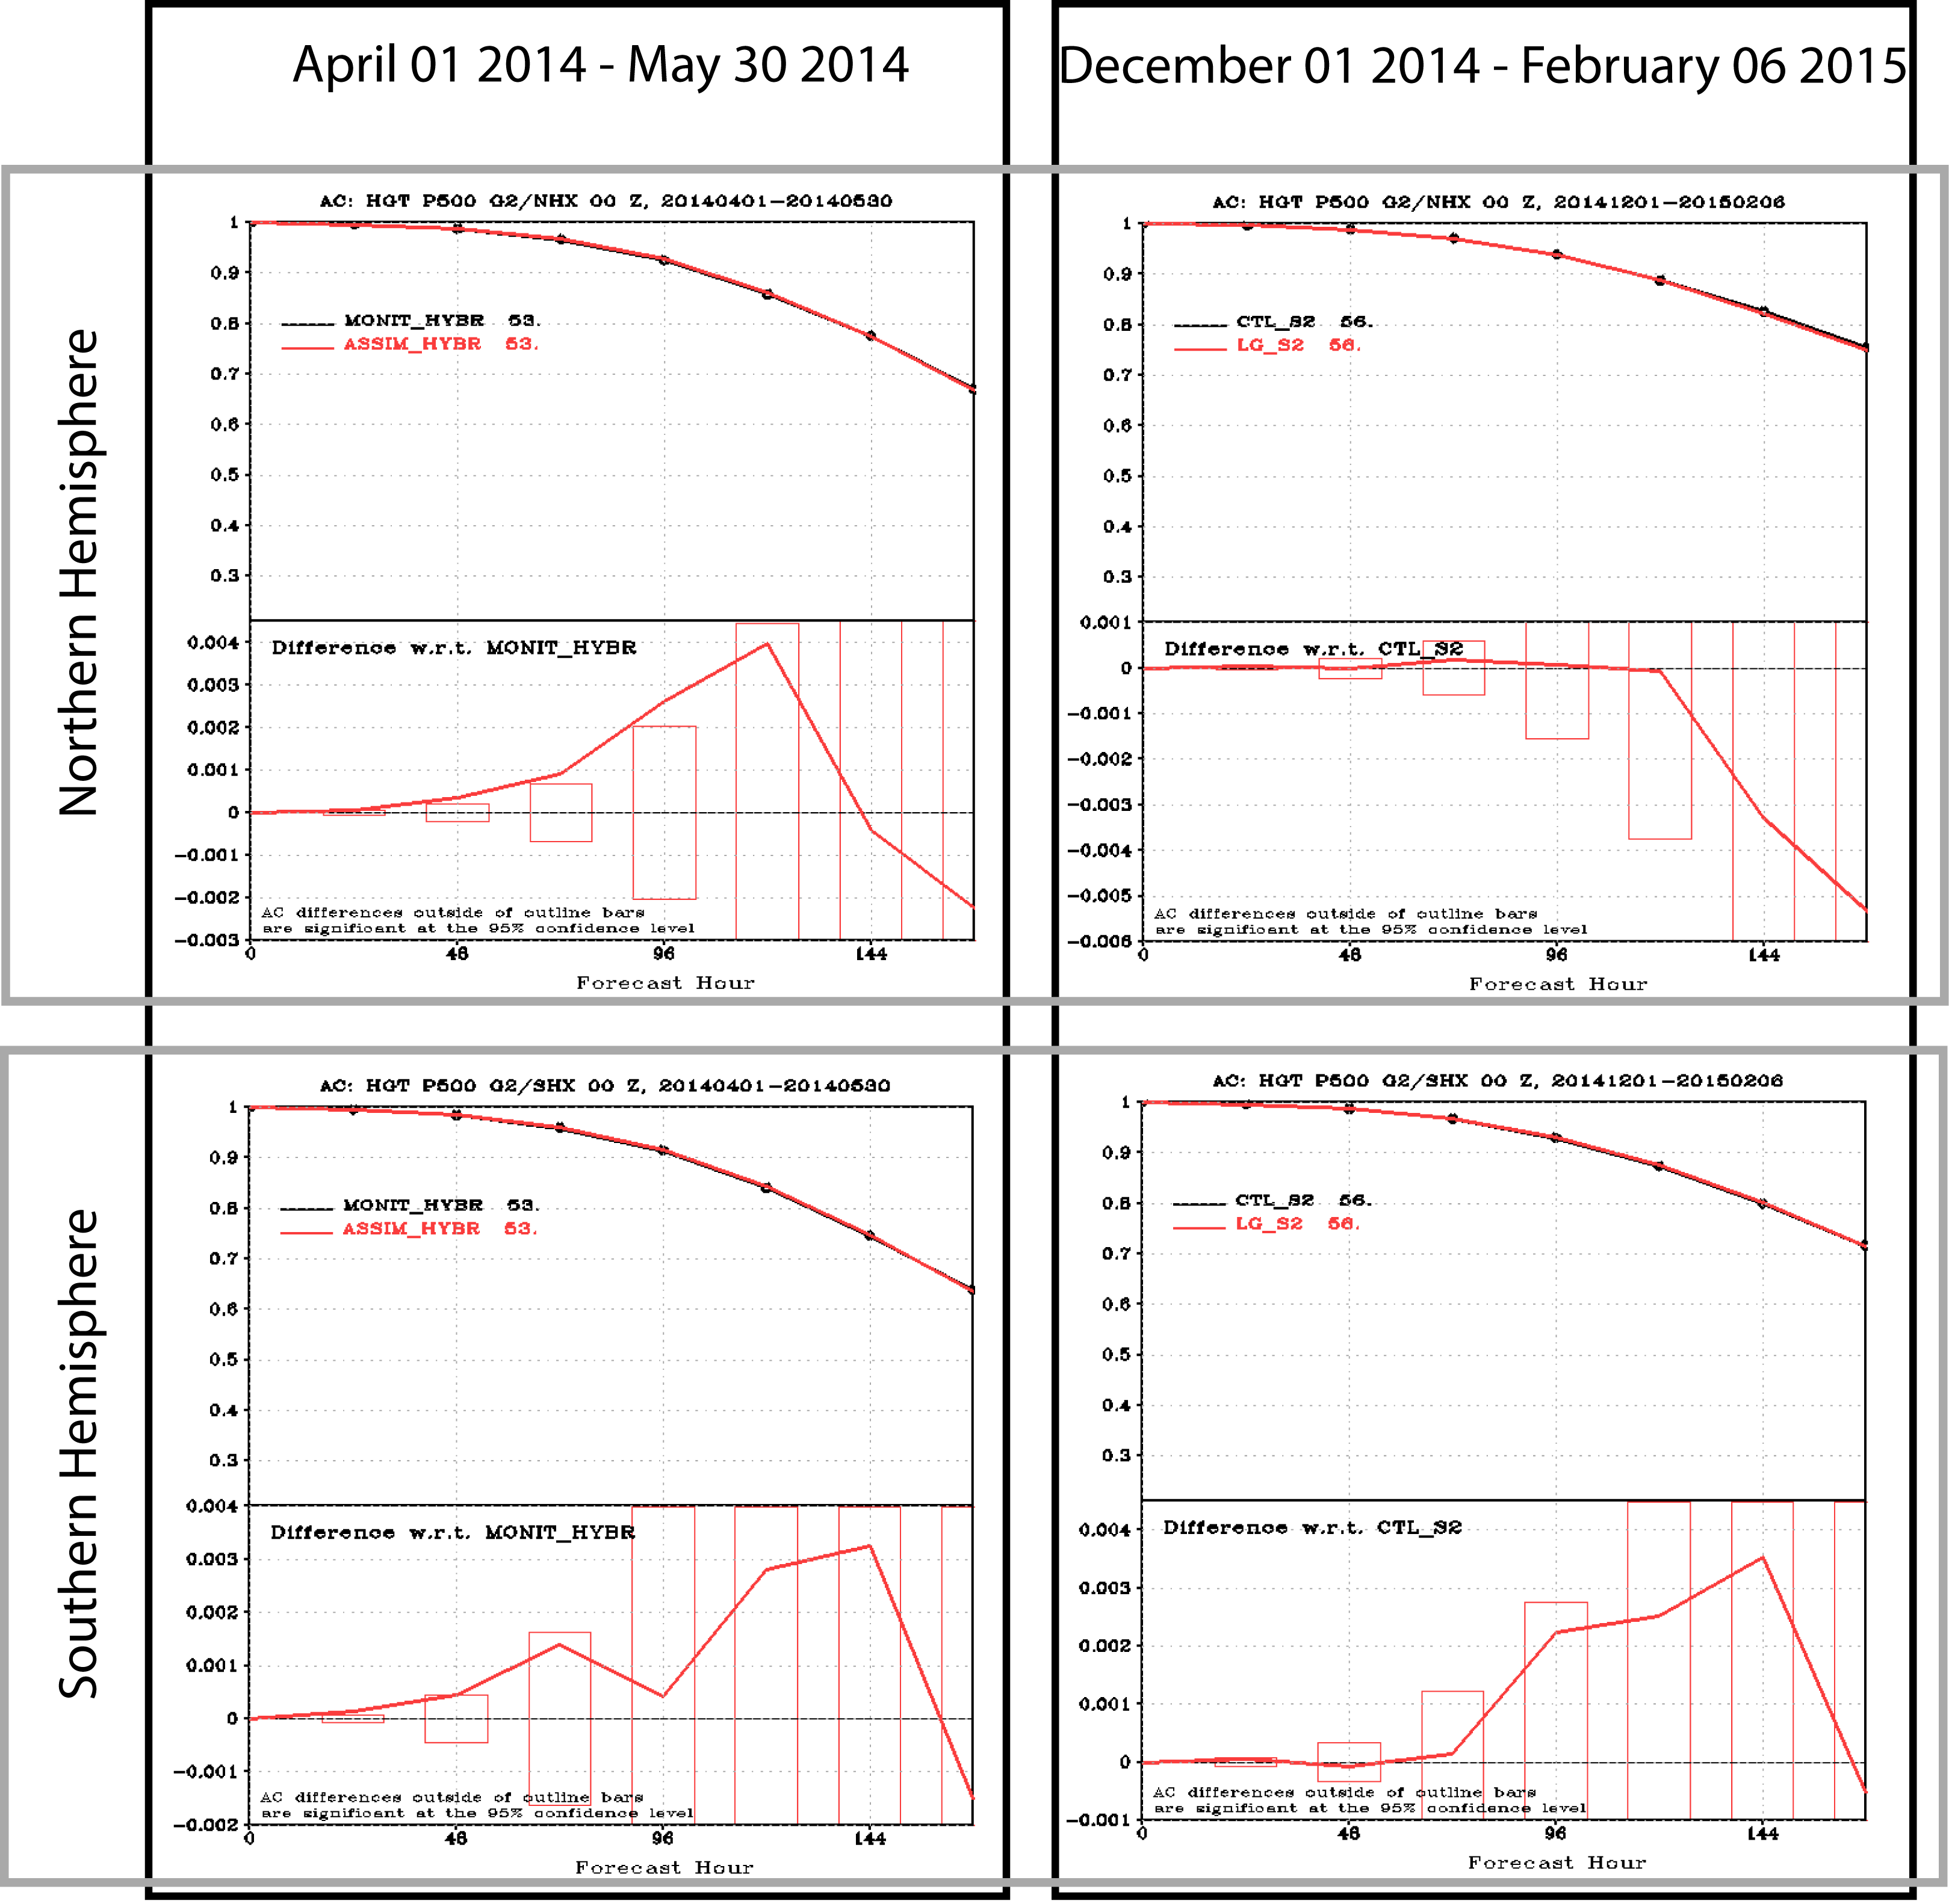
Latest FY15 GOES-R3 Project Highlights
Assimilation and Forecast Impact of High Temporal Resolution Leo/Geo AMVs in the High-Latitude Data-Gap Corridor
Brett Hoover (CIMSS)
Mean 500 hPa geopotential height anomaly correlation scores for LEO/GEO experiments for 0-168 hours from (left) 01 April 2014 – 30 May 2014 and (right) 01 December 2014 – 06 February 2014, for the (top) northern hemisphere and (bottom) southern hemisphere). All four panels show the mean correlation die-off curve for the control in black and the experiment in red on the top half, and on the bottom half the difference (experiment minus control) is shown with bars representing the minimum difference required for 95% statistical significance.

Slide 39
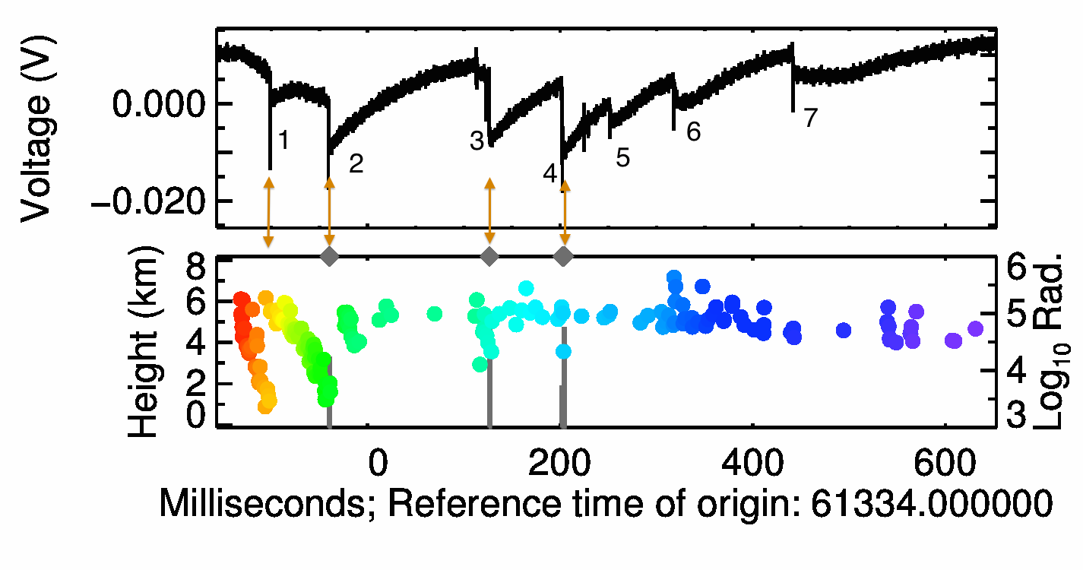
Latest FY15 GOES-R3 Project Highlights
Toward an operational use of stroke level lightning data in severe weather forecasting
Phillip Bitzer (UAH)
A seven stroke negative cloud-to-ground flash that was used to test the logistic regression used to predict the occurrence of LIS groups based on VLF waveform characteristics. The top graph shows the waveform detected by HAMMA, while the lower plot shows the detected LIS groups (gray bars) and LMA sources (colored circles). The orange arrows are predicted LIS groups based on the model inputs. The model correctly predicted the occurrence of three of the LIS groups, and correctly predicted three of the VLF waveforms would not produce dateable emission. The first return stroke was predicted to produce a LIS group; however, it was not detected. Currently, the regression provides a model that successfully predicts the occurrence of a LIS group 75% of the time, with a false alarm rate of 30%.

Slide 40
Latest FY15 GOES-R3 Project Highlights
Development and Demonstration of a Coupled GOES-R Legacy Sounding NearCast with Convective Initiation Products to Improve Convective Weather Nowcasts
Lee Cronce (CIMSS)
GOES-R CI probability of convective initiation valid at 2030 UTC 19 May 2015. Gray hatching represents hypothetical area that would be masked by combining the CIMSS NearCast products with the GOES-R CI algorithm to deduce those areas lacking larger-scale support for convective storm development.

Slide 41
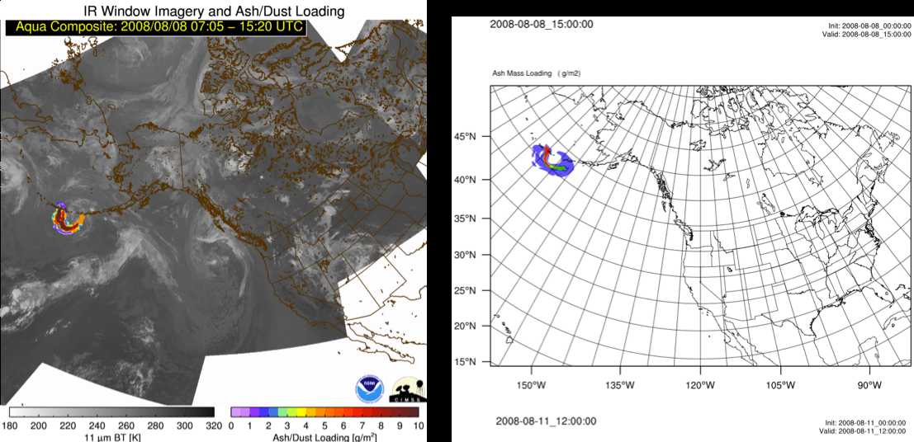
Latest FY15 GOES-R3 Project Highlights
GOES-R Volcanic Ash Risk Reduction: Operational decision support within NOAA’s Rapid Refresh (RAP)
Martin Stuefer and Peter Webley (Univ. Alaska Fairbanks)
Aqua MODIS volcanic ash retrieval of the mass loadings of ash dispersed from the eruptions of Kasatochi volcano from August 8 (left), and WRF-Chem modeled ash mass loadings for the respective times of August 8
(right)

