Slide 1
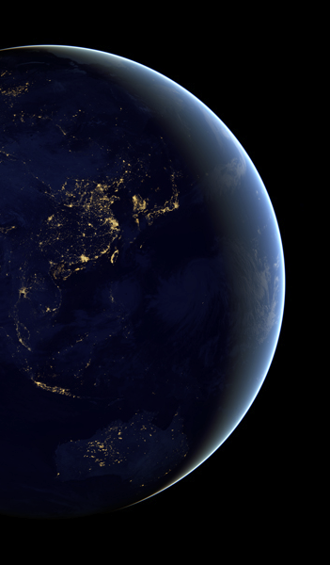
Visualizing Himawari and GOES-R imagery with SIFT
Jordan J. Gerth
Cooperative Institute for Meteorological Satellite Studies Space Science and Engineering Center
University of Wisconsin – Madison 9 October 2018
Ninth Asia/Oceania Meteorological Satellite Users’ Conference, Jakarta, Indonesia

Slide 2
Typical Software Complaints
Complex user interface
Simple tasks are not intuitive to complete
Difficult to find/create the right data format(s)
Cannot use the same software for different satellites or data sets
Cost
Poor performance
Cannot easily export images or animations for presentations or papers
International colleagues use different software
Not for all major operating systems

Slide 3
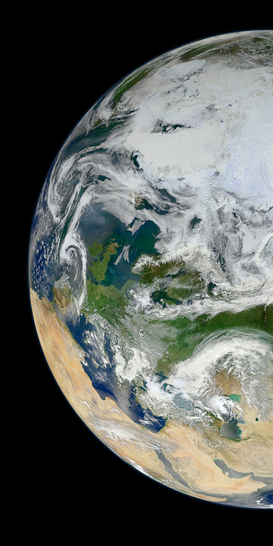
Satellite Information Familiarization Tool
An easy graphical user interface for meteorological satellite users

Slide 4
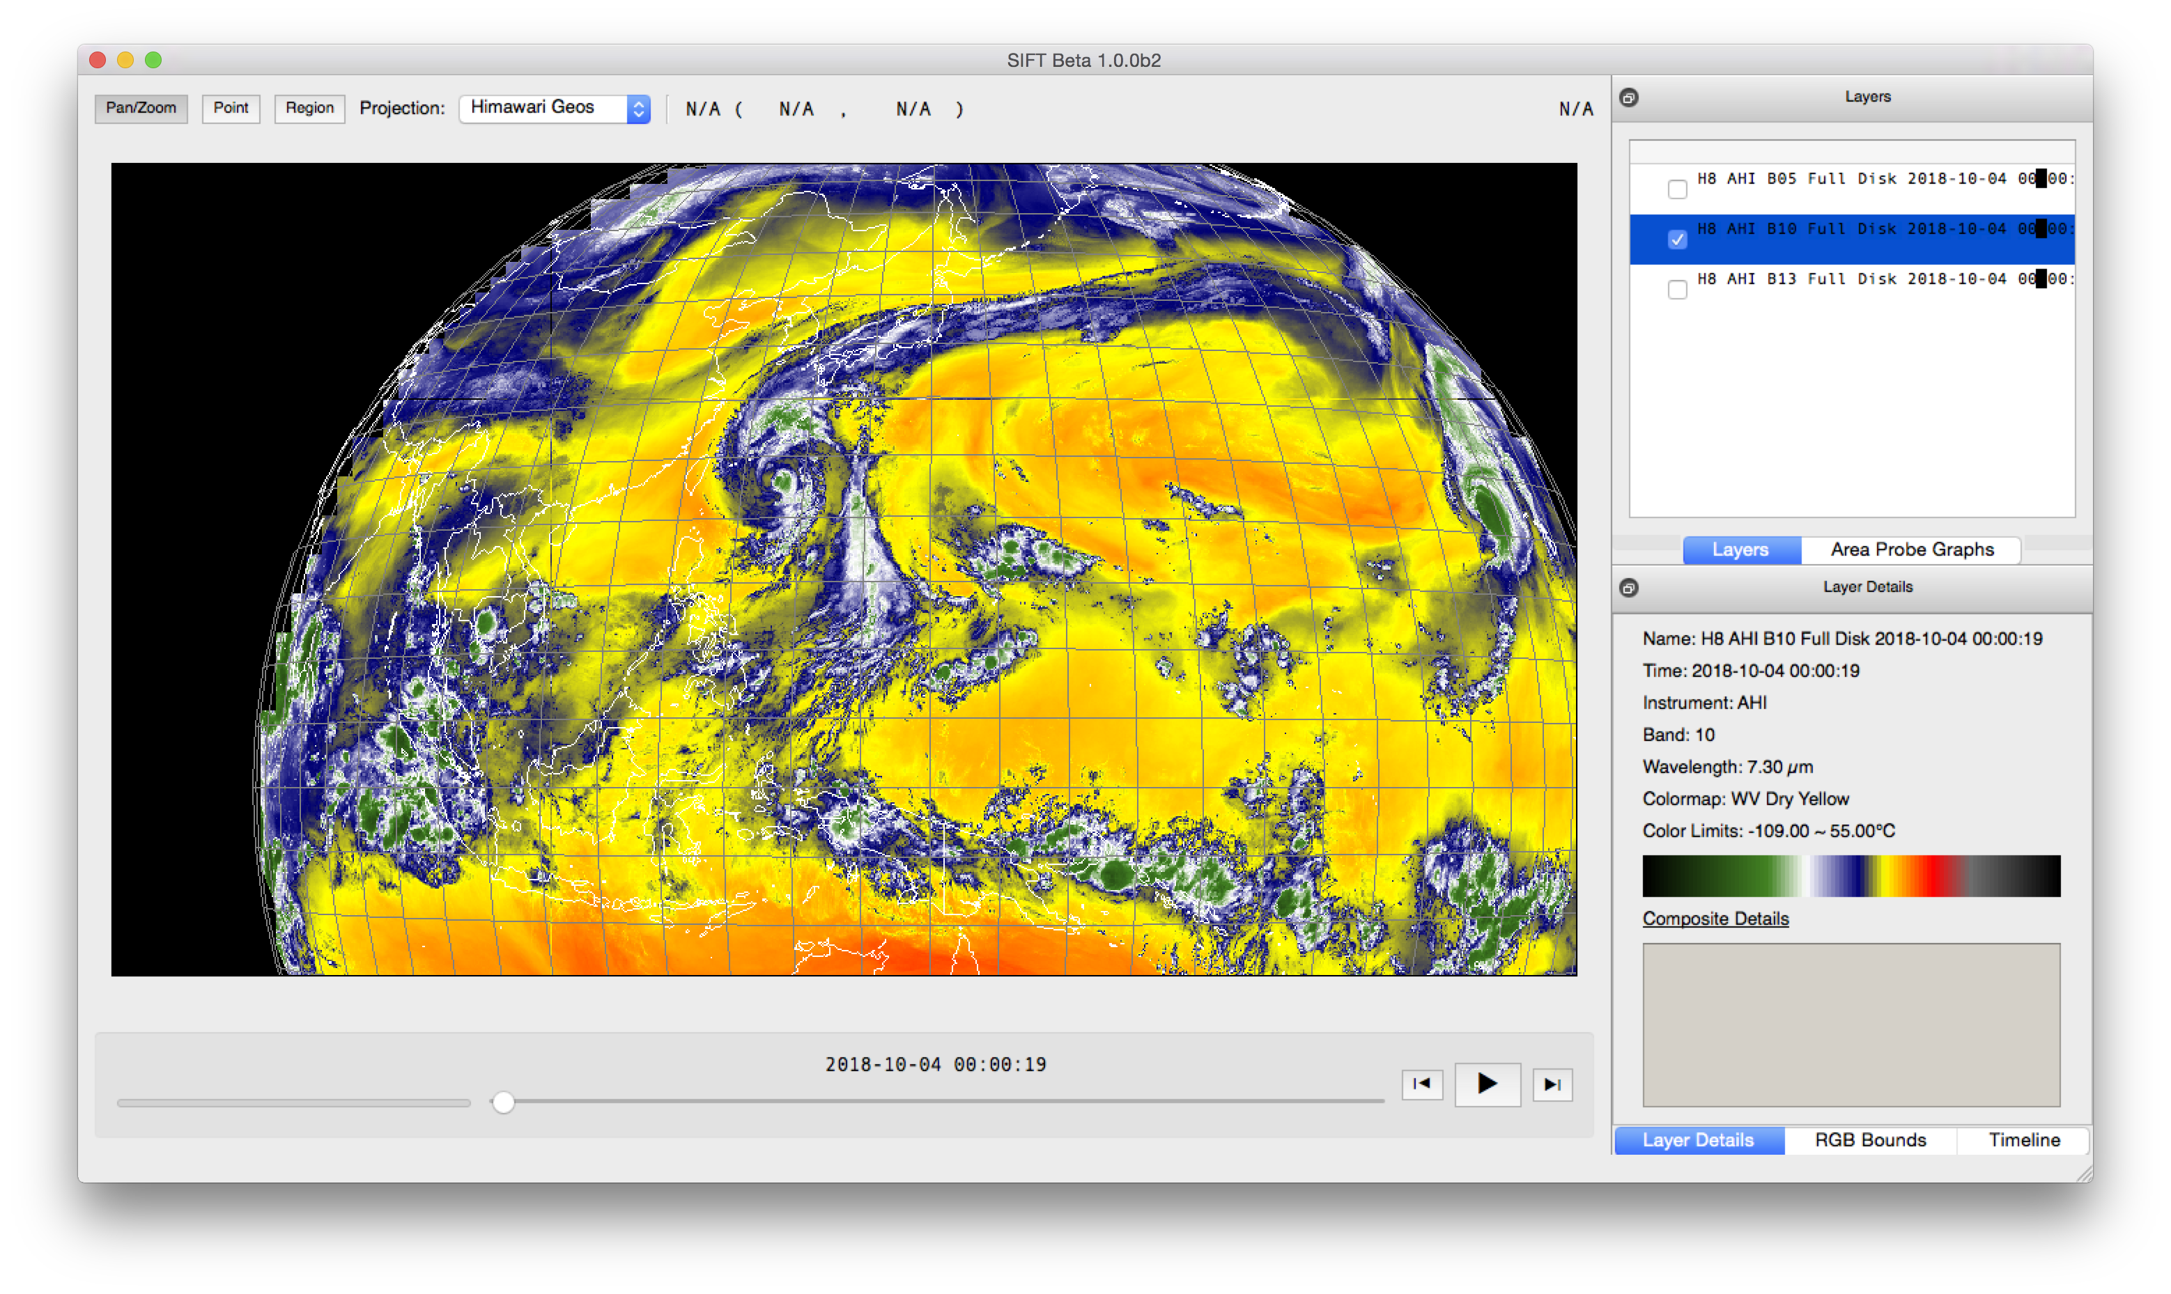

Slide 5
About SIFT
Open source
Based on Python
Originally developed for the United States National Weather Service (NWS) in 2015
Now open to community development
Free (GPLv3 license)

Slide 6
About SIFT
Current operating systems supported:
Windows
MacOS
CentOS/RedHat Linux
A developer version is also available.
Current data formats supported:
GOES-16/17 ABI L1b NetCDF
Himawari-8/9 AHI (after conversion to netCDF)
Gridded Binary (GRIB2)

Slide 7
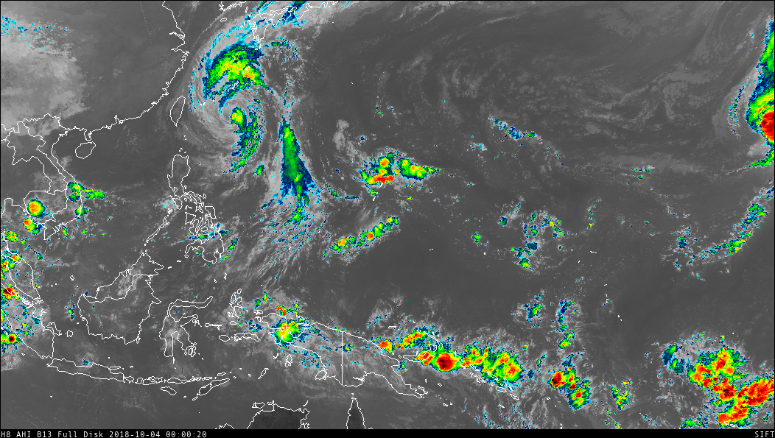
NetCDF
“Kong-Rey”
Notes:
AHI Band 13 IR Window

Slide 8
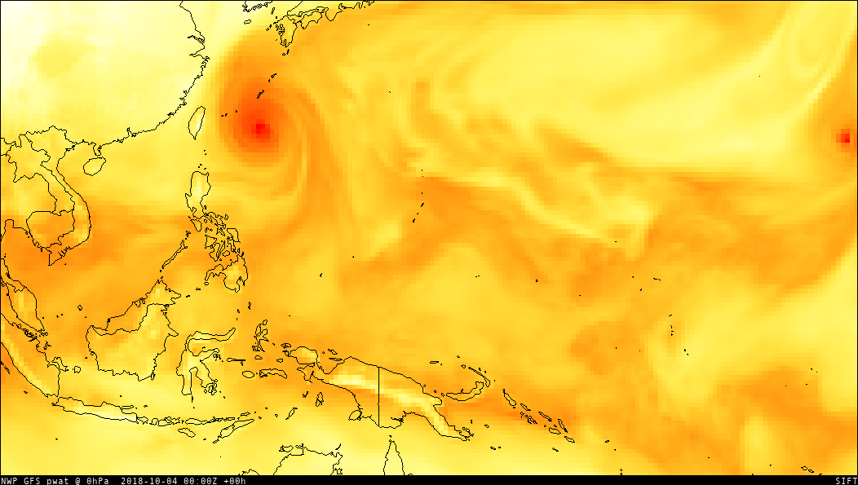
GRIB2
“Kong-Rey”
Notes:
GRIB2 GFS 1.0 deg PWAT (analysis)

Slide 9
SIFT Features
Loop across multiple bands or multiple times
Create Red-Green-Blue (RGB) composites
Calculate arithmetic composite for multiple bands
Change or customize color enhancements
Compare fields over a user-defined area using a density plot
Click to probe layers at a lat-lon coordinate

Slide 10
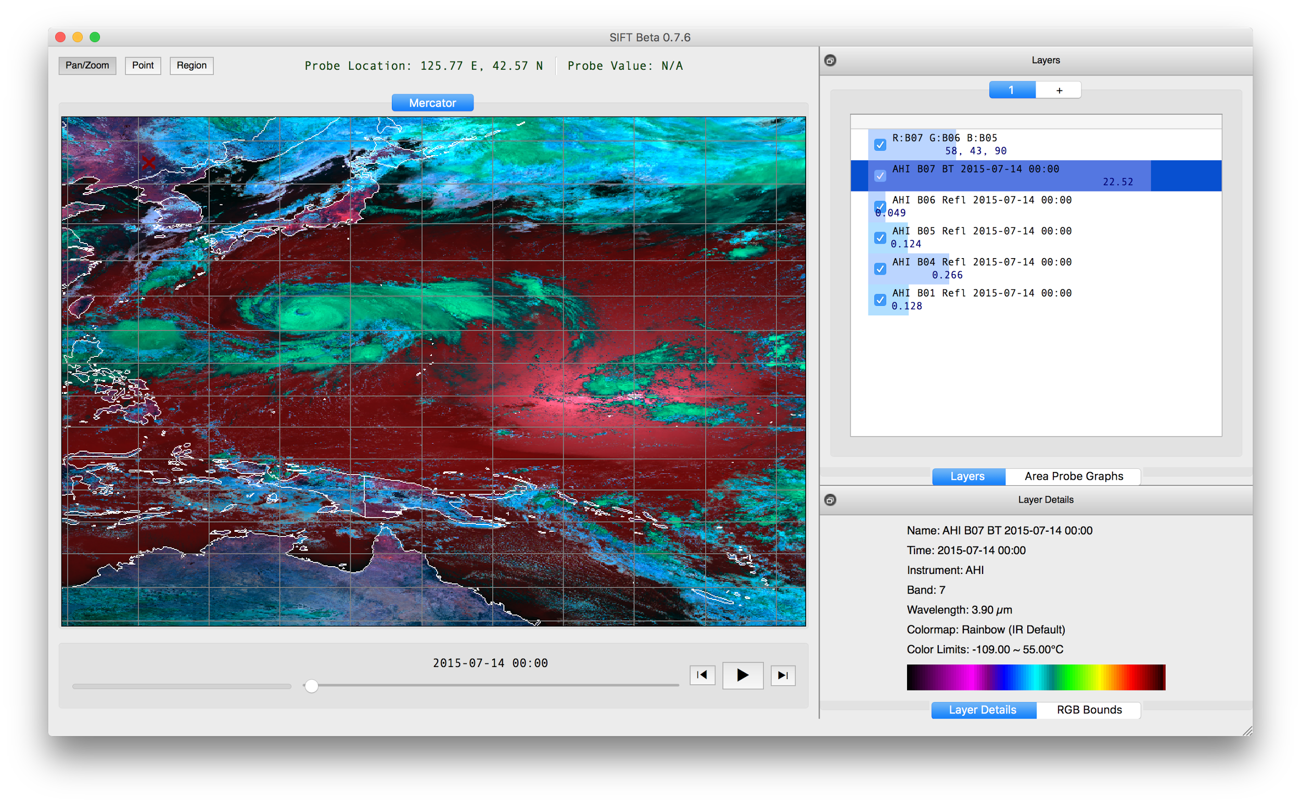
Point Probe Results
Tools
Pan/Zoom
Point Probe
Area Selector
Map Display
Powered by OpenGL/VisPy
Panning and Zooming
Dynamic Resolution
Configurable Outline Colors
Layer List
Reorder Layers
Toggle Visibility
Point Probe Histogram
Animation Control
Step-through or Autoplay
Adjustable Speed Control
Layer Metadata
Band Information
Color Bar and Limits
Background Task Status

Slide 11
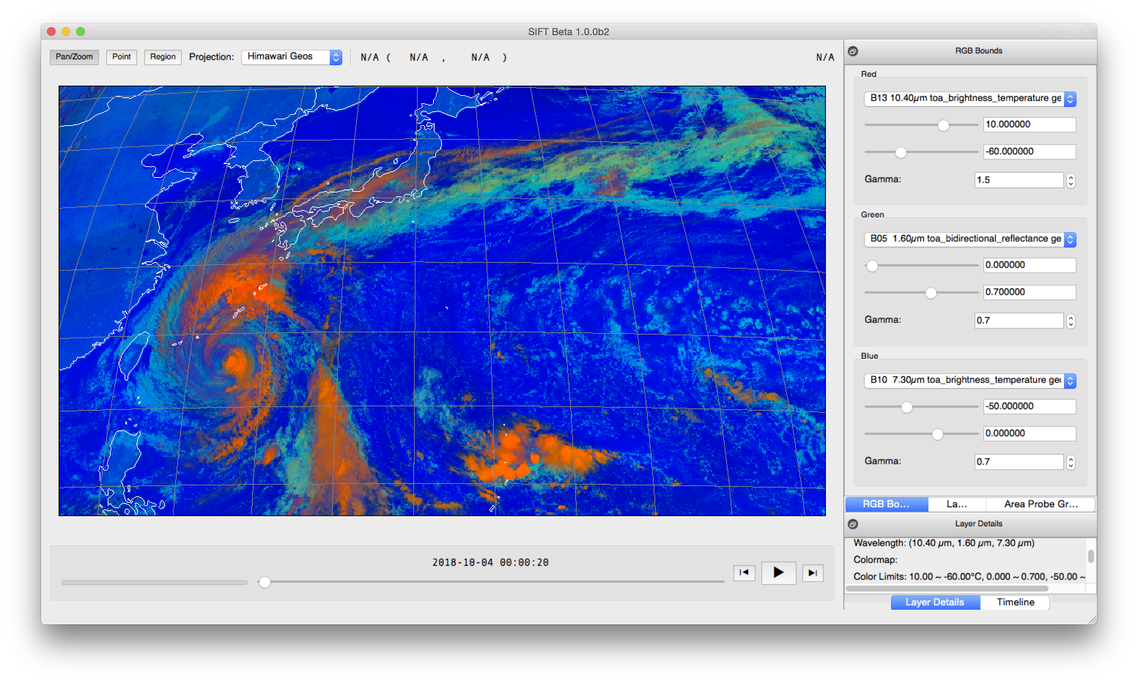
Notes:
R: B13, 10 to -60 (inverted), gamma 1.5 G: B05, 0 to 0.7, gamma 0.7
B: B10, -50 to 0, gamma 0.7

Slide 12
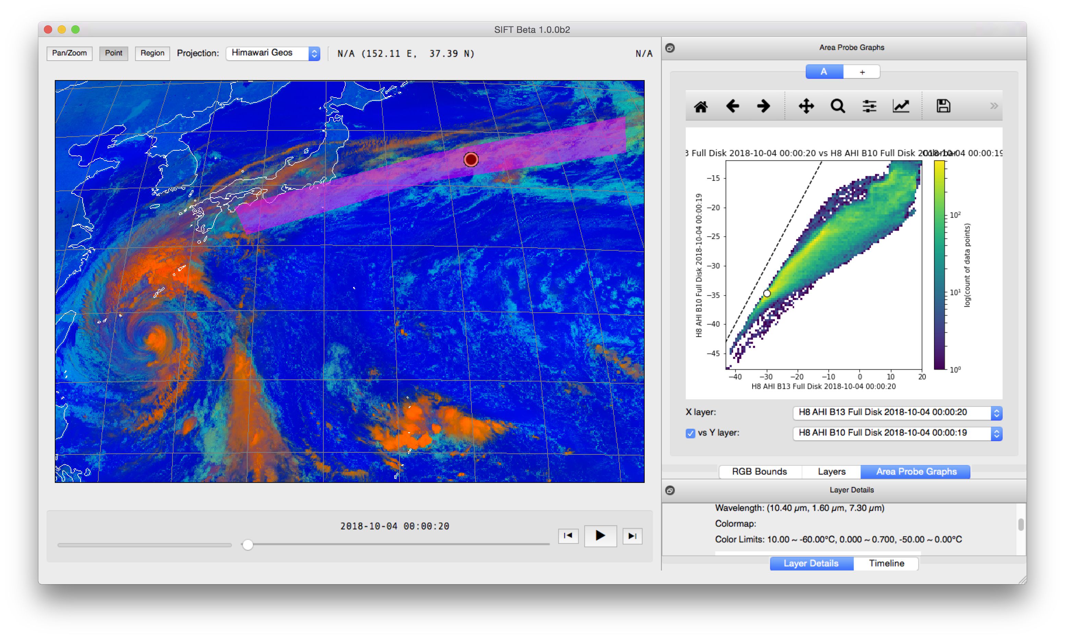
Region Selection
Denoted on map display Semi-transparent
Area Probe Graphs
Single Band Histogram Plot
Two Band Density Plot
Point Probe Indicator
Save Graph Image
Pan/Zoom Graph Image
Publication Ready

Slide 13
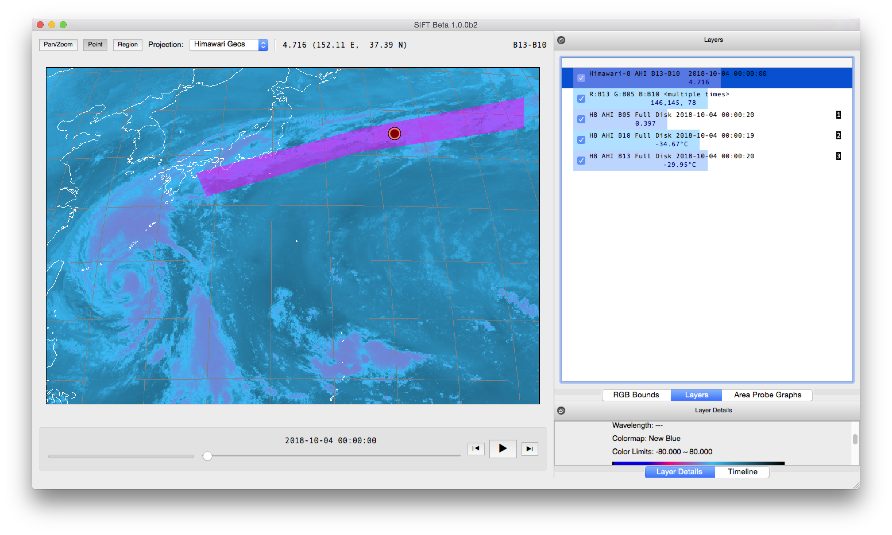
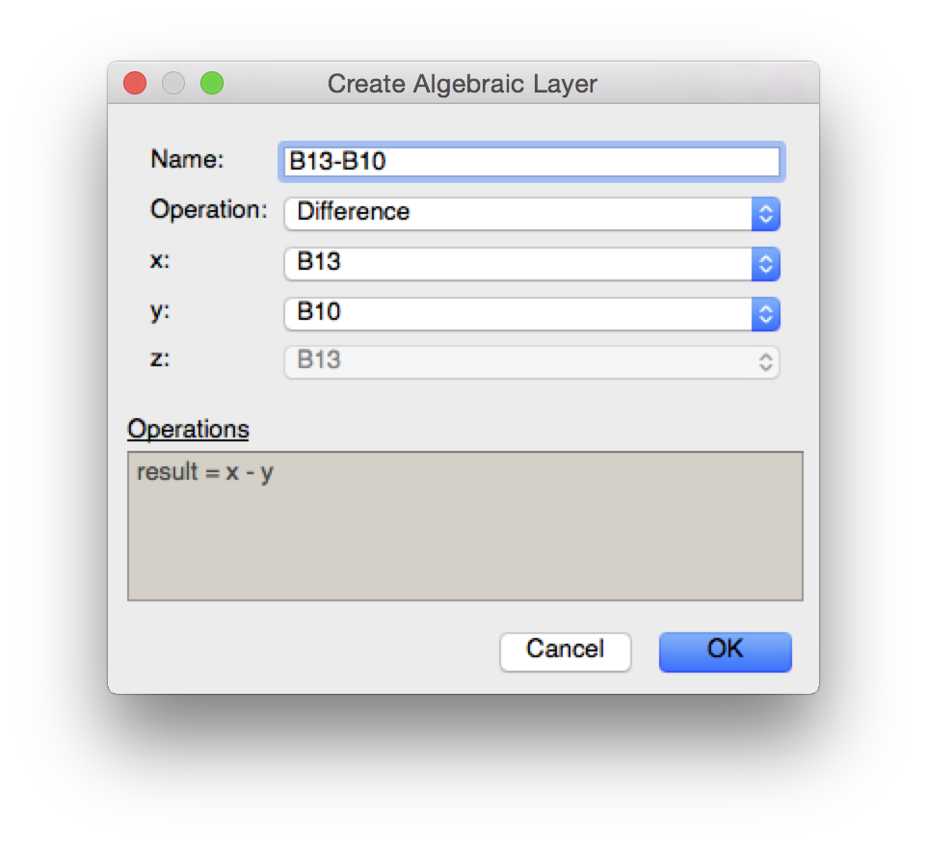

Slide 14
Download SIFT
1.0.0 beta is now available
http://sift.ssec.wisc.edu/
“Very quick. Excellent resolution.”
“Great training tool overall.”

Slide 15
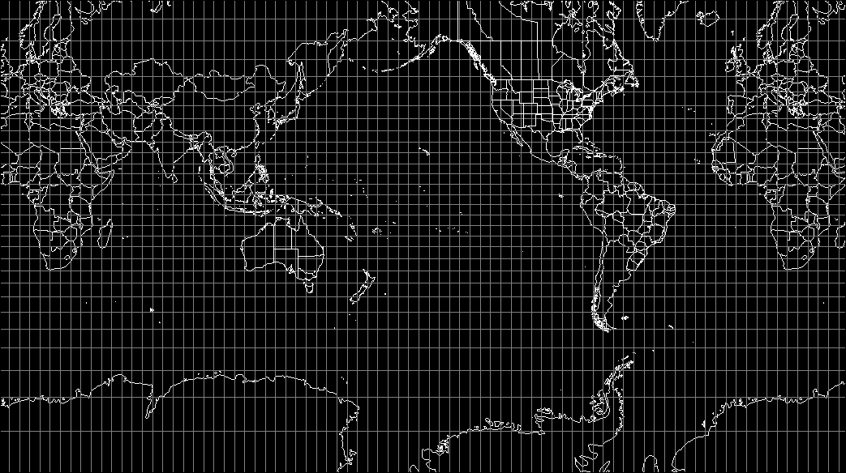
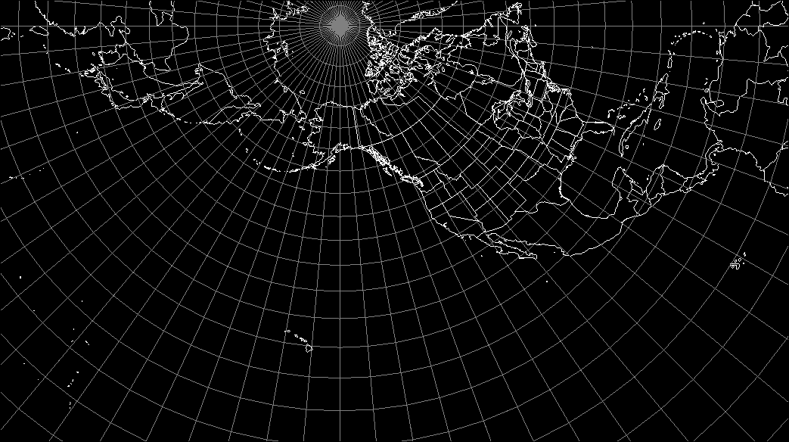
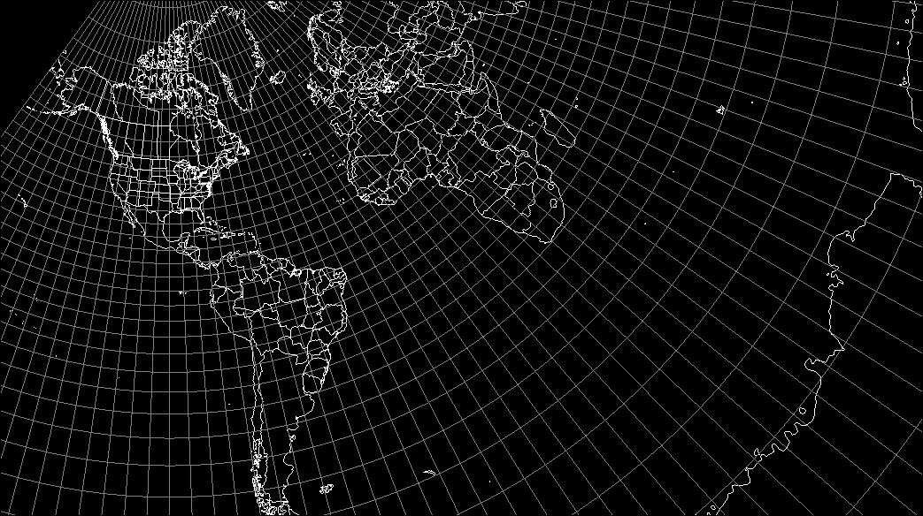
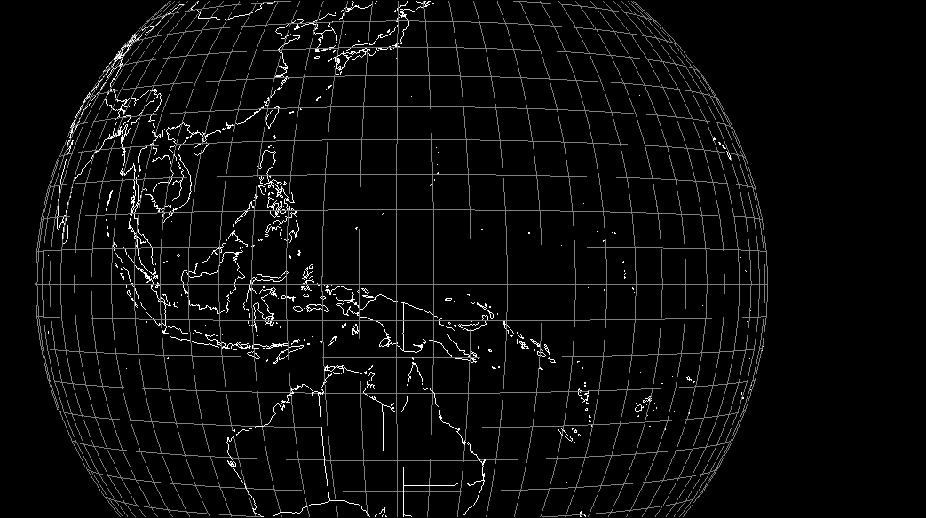
Supported Projections
Mercator
SEVIRI FES
SEVIRI IODC
LCC (CONUS)
Himawari Geos
GOES East
GOES Test
GOES Central
GOES West
Polar (Alaska)
Supported Projections
Mercator
SEVIRI FES
SEVIRI IODC
LCC (CONUS)
Himawari Geos
GOES East
GOES Test
GOES Central
GOES West
Polar (Alaska)
Supported Projections
Mercator
SEVIRI FES
SEVIRI IODC
LCC (CONUS)
Himawari Geos
GOES East
GOES Test
GOES Central
GOES West
Polar (Alaska)
Supported Projections
Mercator
SEVIRI FES
SEVIRI IODC
LCC (CONUS)
Himawari Geos
GOES East
GOES Test
GOES Central
GOES West
Polar (Alaska)
Supported Projections
Mercator
SEVIRI FES
SEVIRI IODC
LCC (CONUS)
Himawari Geos
GOES East
GOES Test
GOES Central
GOES West
Polar (Alaska)

Slide 16
Help SIFT Grow
Seeking new software developers and data providers
Contribute ideas for new features or capabilities
Desire to support all international geostationary weather satellites with accessible data
Expand our user and support base
Establish a community to test future builds

Slide 17
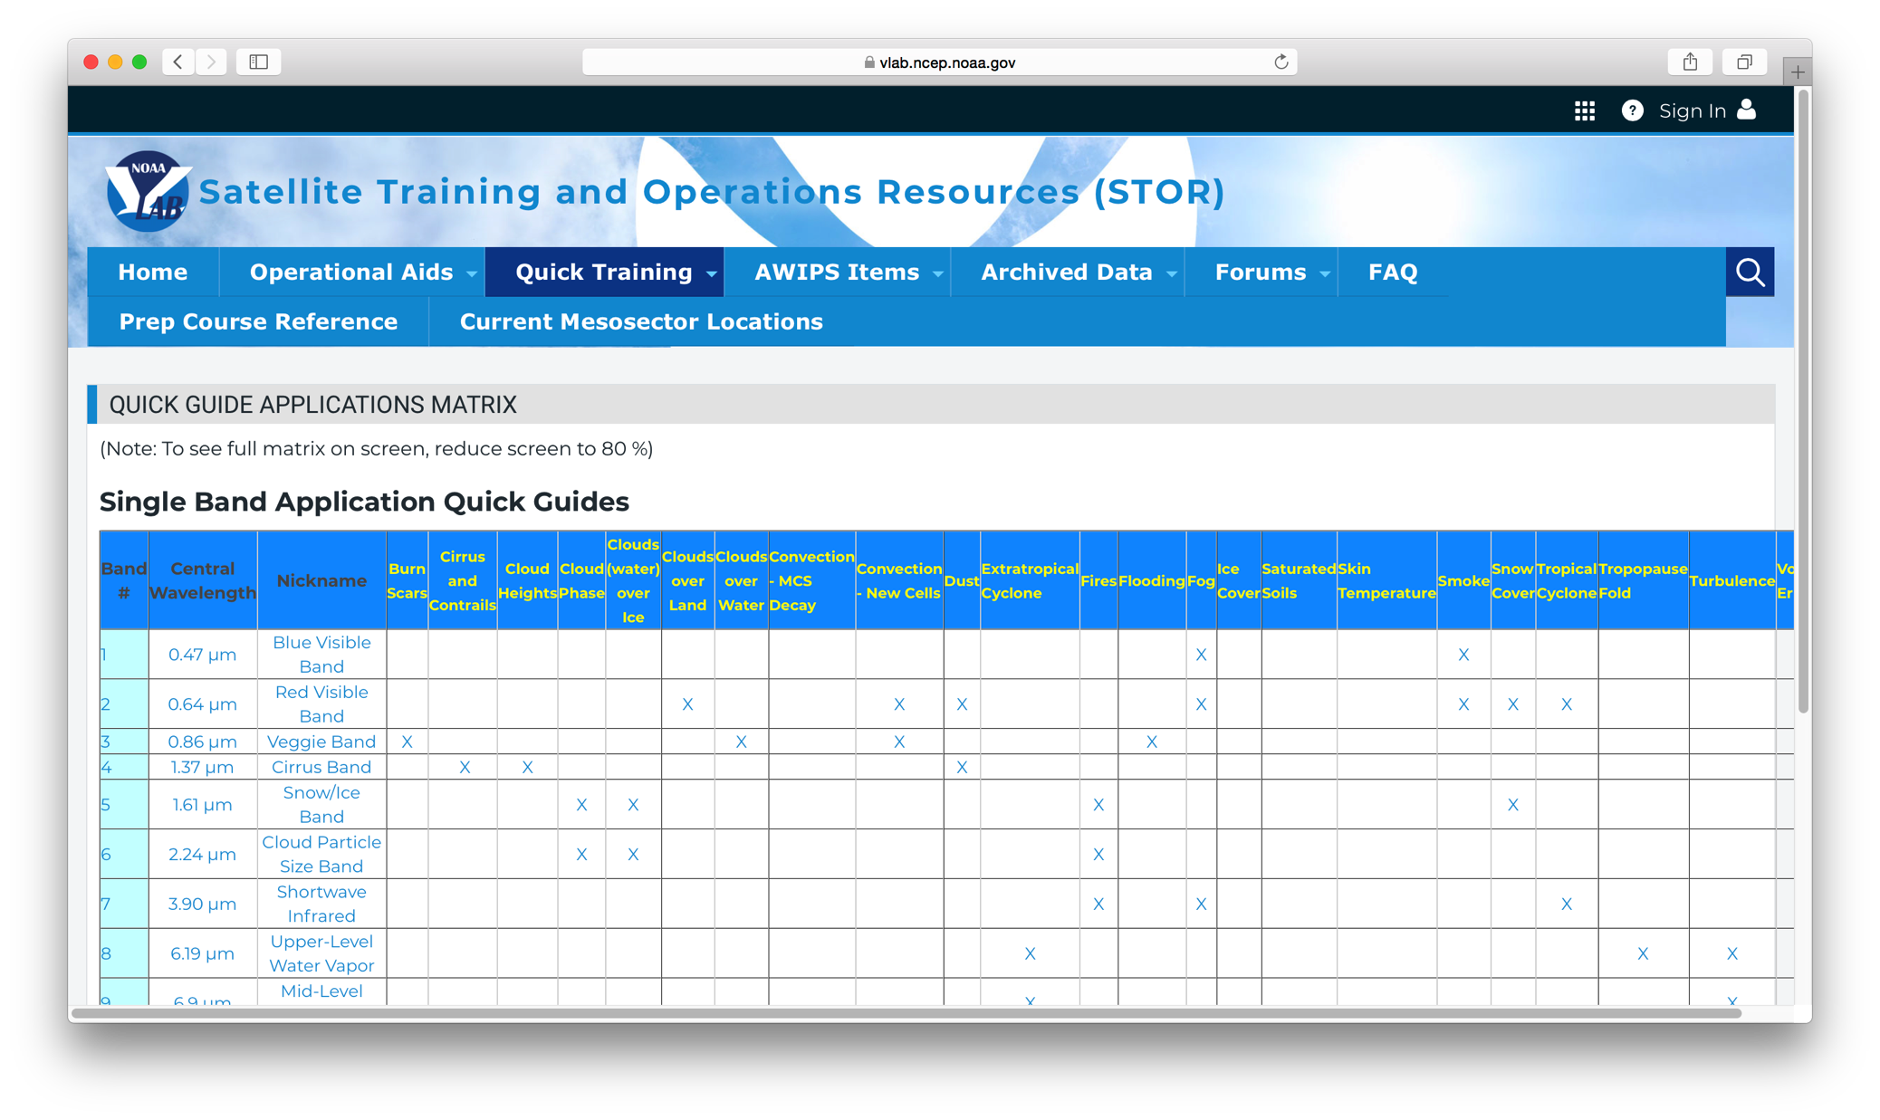
NOAA Satellite Training Site
Satellites:
Geostationary (GOES-R)
Polar (JPSS)
Formats:
Quick Guides
Quick Briefs
Job Aids
https://vlab.ncep.noaa.gov/web/stor

Slide 18
Terima Kasih
Download SIFT: http://sift.ssec.wisc.edu/
Send inquiries: Jordan Gerth, jordan.gerth@ssec.wisc.edu
Thanks to the Wisconsin SIFT team of Ray Garcia, Dave Hoese, Scott Lindstrom, Tim Schmit, and others.
The United States NWS (NMHS) provided initial funding.

