Slide 1
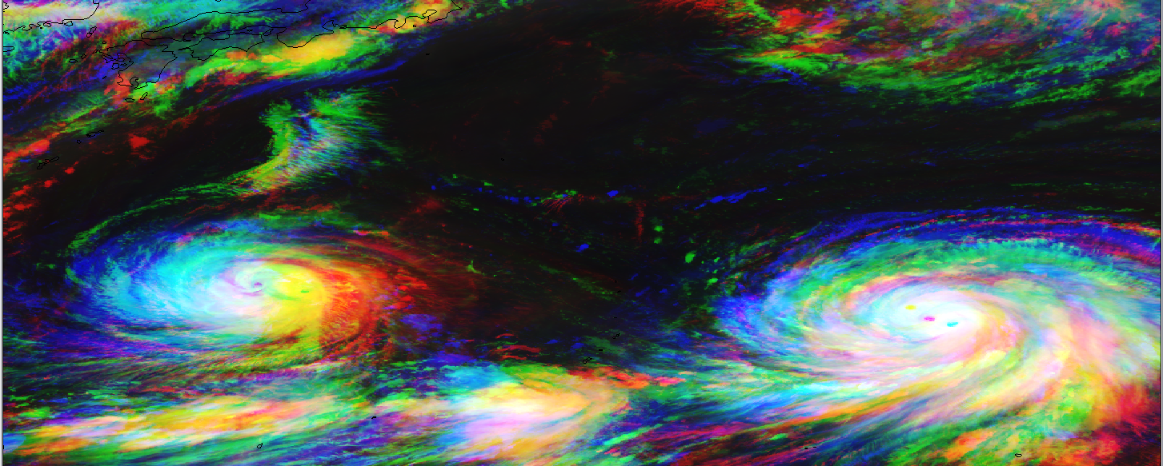
Visualizing new-generation
geostationary satellite imagery
with SIFT
Jordan J. Gerth
R. K. Garcia, D. Hoese, S. Lindstrom, K. Strabala
Cooperative Institute for Meteorological Satellite Studies Space Science and Engineering Center, University of Wisconsin
@jjgerth
American Meteorological Society Annual Meeting  4.3  23 January 2017

Slide 2
The Satellite Information Familiarization Tool (SIFT)
Developed in Python using the PyQt Toolkit
Cross-platform (Windows, Mac, and Linux) graphical user interface (no command line)
Loads GeoTIFFs of archived Himawari-8 imagery stored locally (SSD recommended)
Available to download for free (GPLv3 license)
Development of the software and expansion of the capabilities is ongoing

Slide 3
Motivation for SIFT
Basic, modern, and standalone software to display, loop, and allow for the manipulation of new-generation geostationary satellite imagery was not available.
The intended users are scientists, students, and operational meteorologists.
It is a tool for both training and discovery.
SIFT is part of the United States National Weather Service operational meteorologist training program.

Slide 4
SIFT Features and Functions
Point Probe Results
Tools
Pan/Zoom
Point Probe
Area Selector
Map Display
Powered by OpenGL/VisPy
Panning and Zooming
Dynamic Resolution
Configurable Outline Colors
Layer List
Reorder Layers
Toggle Visibility
Point Probe Histogram
Animation Control
Step-through or Autoplay
Adjustable Speed Control
Layer Metadata
Band Information
Color Bar and Limits
Background Task Status

Slide 5
SIFT Point Probe Feature
Loop Order
By band or by time
Point Probe
Denoted on map display
Coordinates and value shown
Layer List
Probe value shown for all other loaded layers

Slide 6
SIFT Region Selection Feature
Region Selection
Denoted on map display Semi-transparent

Slide 7
SIFT Region Selection Feature
Region Selection
Denoted on map display Semi-transparent
Layer Details
Change based on selected layer in the list

Slide 8
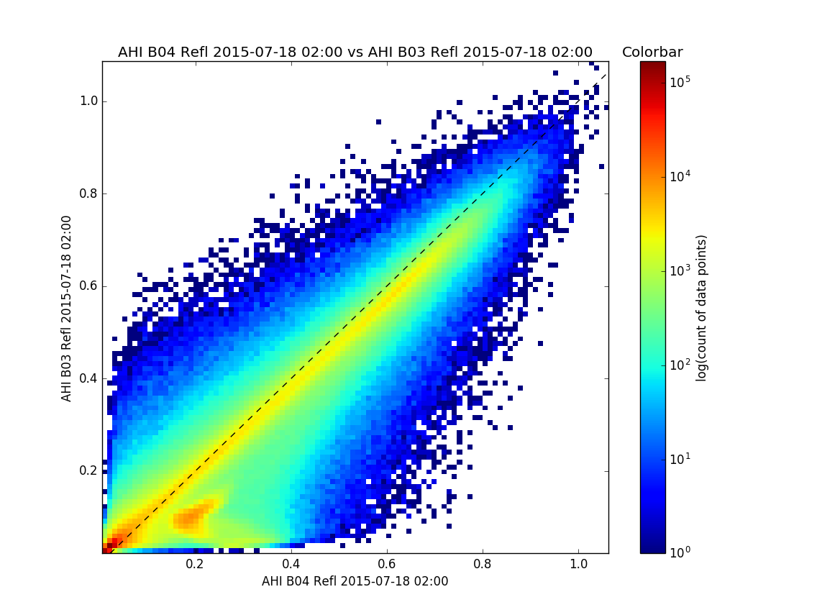
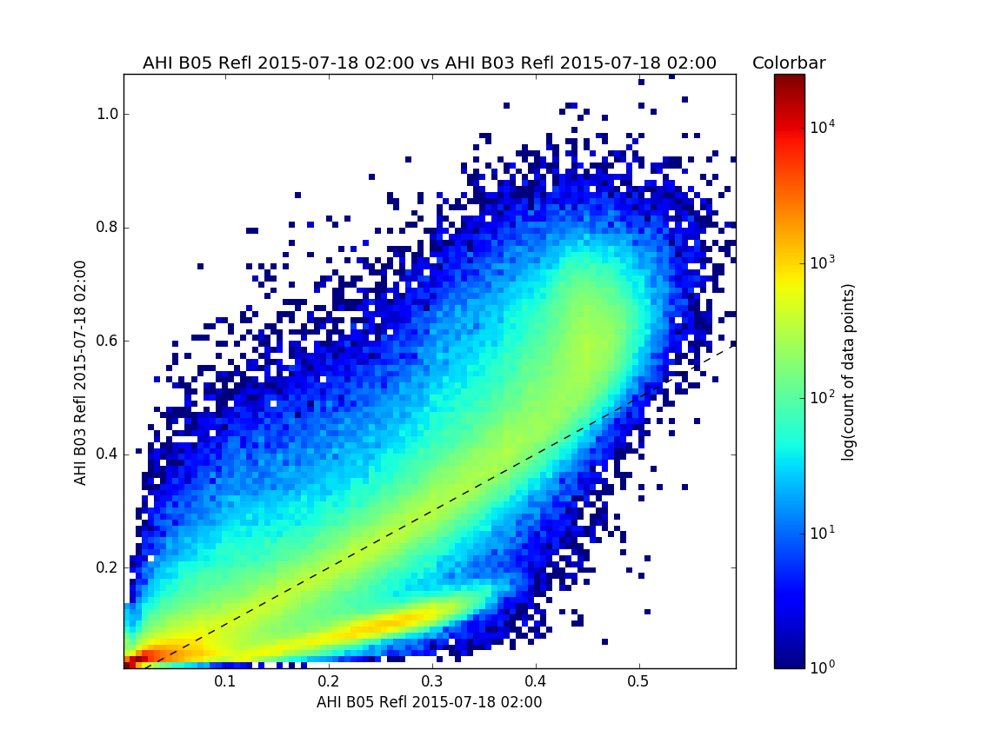
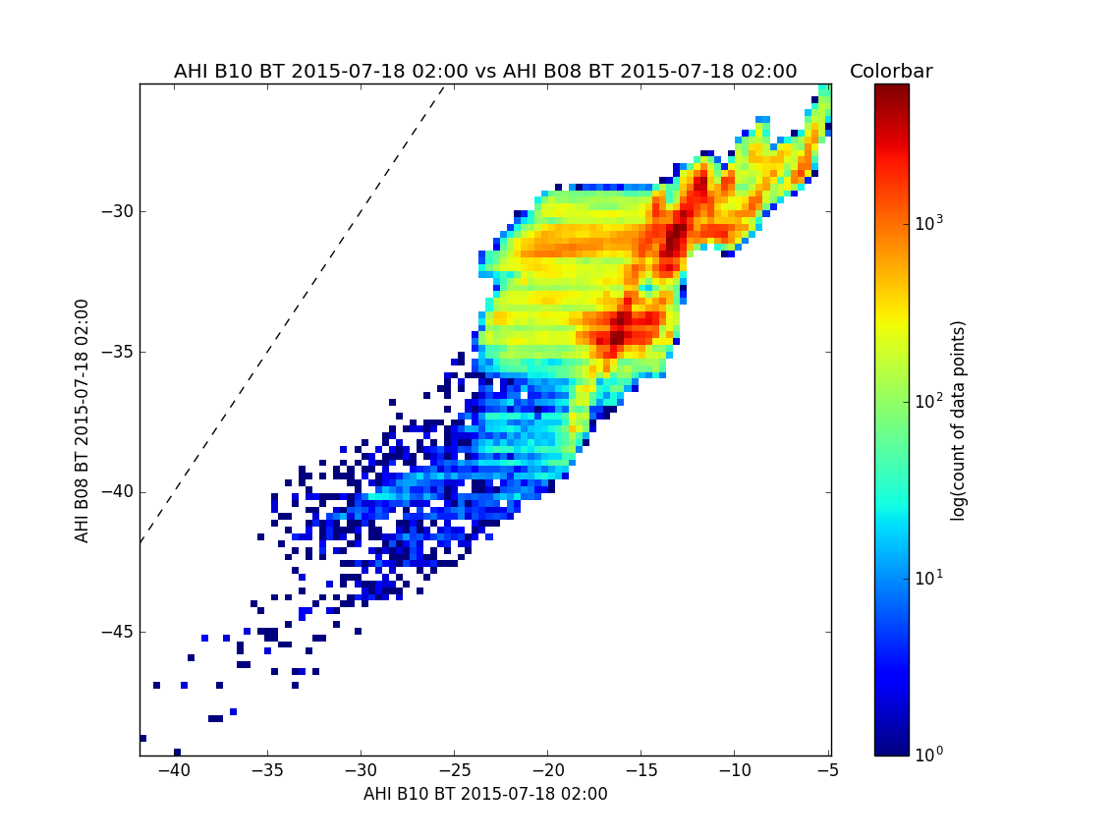
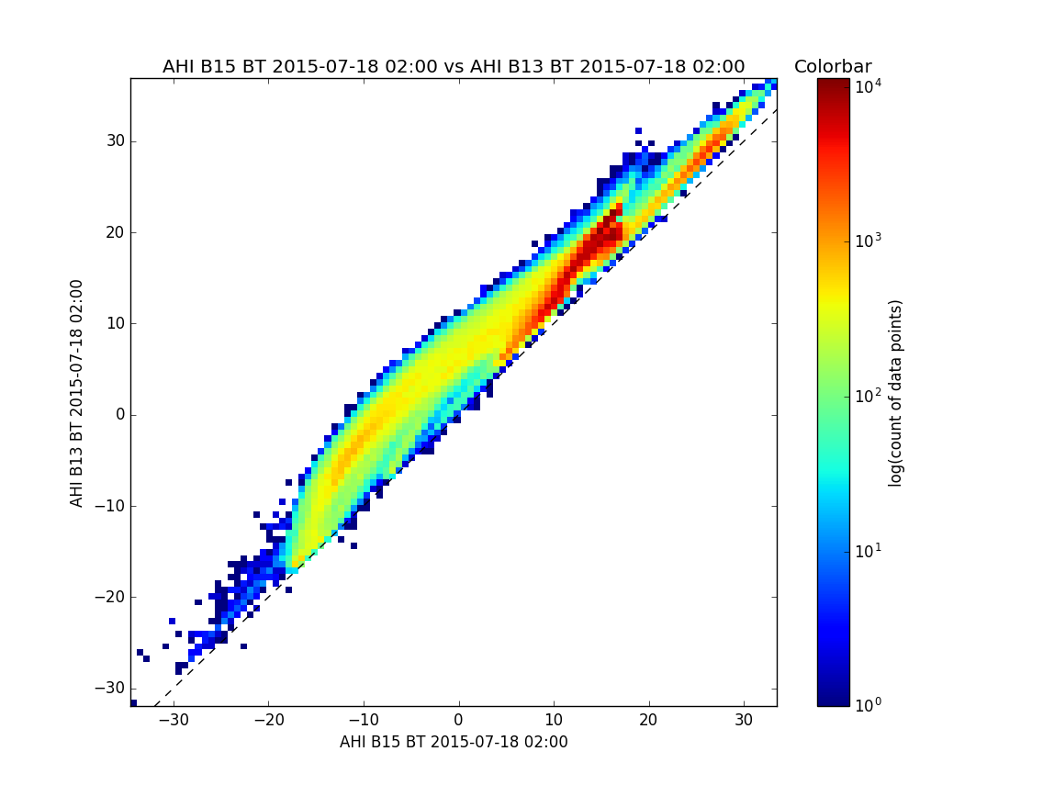
SIFT Area Probe Graphs

Slide 9
Science Training Takeaway:
Land surfaces at 0.86 μm are more reflective than at 0.64 μm
Ice clouds at 1.6 μm are less reflective than at 0.64 μm
SIFT Area Probe Graphs
The 6.2 μm is cooler than the 7.3 μm
The 10.4 μm is warmer than the 12.4 μm

Slide 10
Applying Science Training
Science Training Takeaway | Prospective Application
Land surfaces at 0.86 μm are more reflective than at 0.64 μm | River flooding is more easily identified, but contrast between clouds and land is reduced in the 0.86 μm
Ice clouds at 1.6 μm are less reflective than at 0.64 μm | Thick glaciated clouds can be indicative of thunderstorms
The 6.2 μm is cooler than the 7.3 μm | The water vapor channels can be used to assess the depth of certain tropospheric features
The 10.4 μm is warmer than the 12.4 μm | The difference in brightness temperature for clear fields of view is related to low-level water vapor concentration

Slide 11
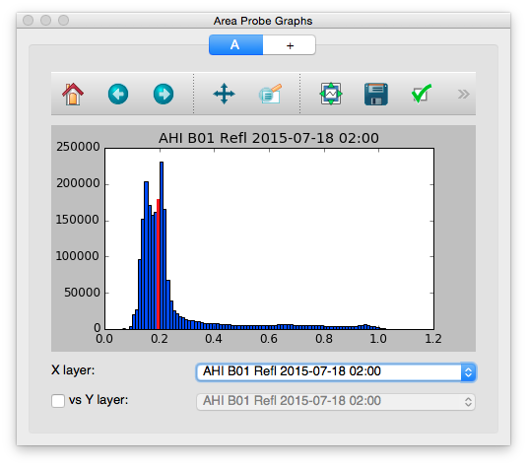
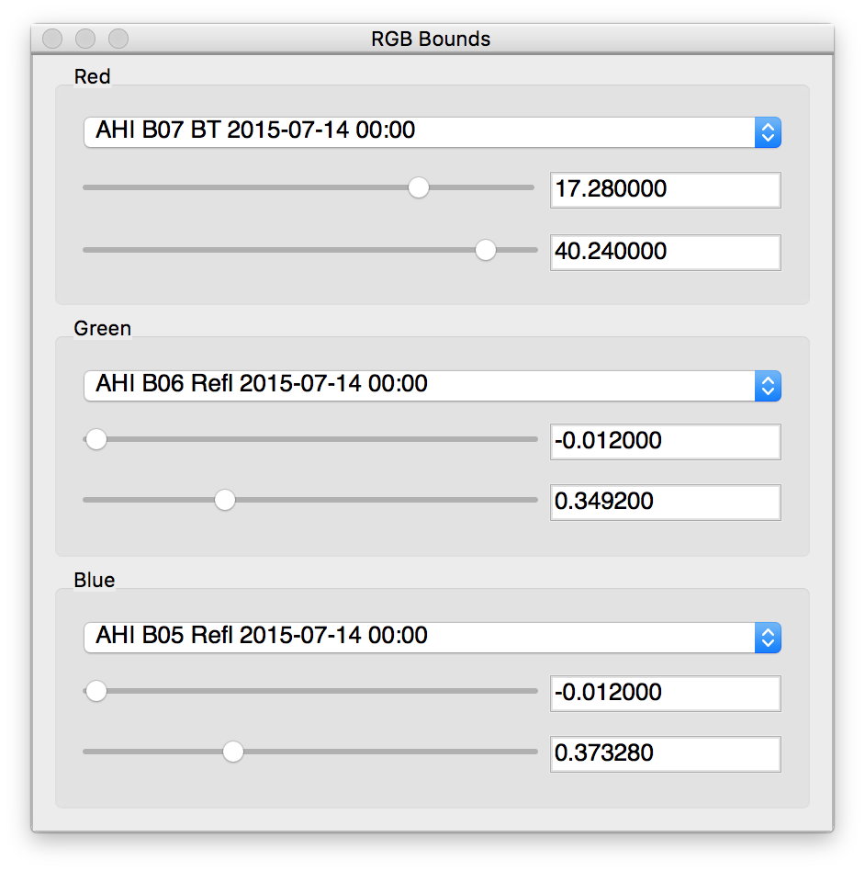
SIFT Features and Functions
RGB Bounds
RGB Channel Selection
Adjust Color Limits
Live Updates on Display
Area Probe Graphs
Single Band Histogram Plot
Two Band Density Plot
Point Probe Indicator
Save Graph Image
Pan/Zoom Graph Image
Publication Ready

Slide 12
Future Enhancements to SIFT
A selection window for users to load a given time range and subset of bands instead of individual files
Improved experience for looping and selecting imagery layers
Additional projections and related changes for GOES-R
Better performance and file support beyond GeoTIFFs
Display and handling for derived products created with the Community Satellite Processing Package for geostationary satellites

Slide 13
SIFT Accolades from Users
“A very interesting way to look for cloud types and layers.”
“All seemed fine to me.”
“Great training tool overall.”
“Nice tool to look at many different channels.”
“SIFT is fast and does not crash.”
“Stable software.”
“Very quick. Excellent resolution.”
Excerpts from written survey results following Honolulu forecast office training workshop

Slide 14
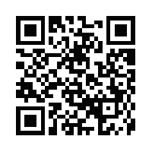
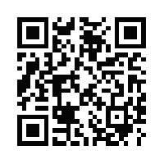
Download SIFT and Case Data
SIFT: ftp://ftp.ssec.wisc.edu/pub/sift/dist/
Windows 7+ exe (118 MB)
Mac OS X dmg (259 MB)
64-bit CentOS/RedHat Linux tar.gz (278 MB)
Case Data: ftp://ftp.ssec.wisc.edu/ABI/sift_data/AHI/
SIFT
Case Data

Slide 15
SIFT and Other Software
SIFT is the latest software in the CIMSS/SSEC arsenal for visualizing satellite imagery.
Other software includes:
HYDRA
Specific training application for polar-orbiting satellite imagery
McIDAS-X
Legacy software with scripting capability
McIDAS-V
Graphical user interface for various meteorological data

Slide 16
Create RGB Composites Online
Real-Time Imagery
from Himawari-8
over western Pacific Ocean
http://bit.ly/2e5KrCY

Slide 17
“Observations Lead the Way”
Observations (or networks) that are needed to benefit your future research, application or product development
Recommended instruments that are needed to make these observations
Your view on the greatest observational needs for your discipline in general

Slide 18
Questions? Comments?
Super Typhoon Maysak as viewed from Himawari-8
Send me an e-mail:
Jordan.Gerth@noaa.gov

