Slide 1
Envisioning RGBA Capabilities in AWIPS II and initial successes
NOAA Satellite Science Week
Jordan Gerth, Research Assistant
Cooperative Institute for Meteorological Satellite Studies
University of Wisconsin, Madison
4 May 2012

Slide 2
RGB/RGBA Image Compositing
It is necessary to integrate and support a flexible bit depth data format and user-driven three-way or four-way (with an alpha channel) image blending functionality into the AWIPS II software.
Maximizes the use of current and future satellite imagery and products, as well as leverages a red-green-blue-alpha (RGBA) capability in pre-release versions of the migrated software
The implementation of a data format and display system allowing for bit depths greater than the current specification has numerous applications useful to operational weather analysis and forecasting beyond current capabilities and techniques.
To support data fusion, image differences, individual bands, and other band manipulations can be assigned to a color in the RGB triplet.

Slide 3
Simulated ABI Longwave Bands
Bands 8 through 16 are produced from the National Severe Storms Laboratory (NSSL) Weather Research and Forecast (WRF) model output.
CompactOPTRAN computes optical depths at each model layer based on temperature and water vapor mixing ratio.
36-hour simulation at 4 km spatial resolution is started once per day at 00 UTC, with imagery available by 12 UTC.
Currently limited distribution in AWIPS and N-AWIPS to select NWS forecast offices and National Centers.
Output available online at http://www.nssl.noaa.gov/wrf/ with imagery at
http://cimss.ssec.wisc.edu/goes_r/proving-ground/nssl_abi/nssl_abi_rt.html

Slide 4
Adding Imagery to AWIPS II
netCDF3 plug-in (NWS/CIMSS)
Primary development by Tom Kretz
Accepts netCDF3 files used with AWIPS I (with modification to global attributes), places them in the data store, and accessible using the Raytheon satellite viz plug-in
The ultimate SOA solution
Beta release of plug-in available, official release this summer
Data array confined to 8 bits
McIDAS plug-in (NWS/Raytheon)
Stores single band files with a re-projected data array
NPP/VIIRS plug-in (Raytheon)
Code released recently, NWS plans to disseminate some VIIRS imagery later this year
Handles netCDF4 files

Slide 5
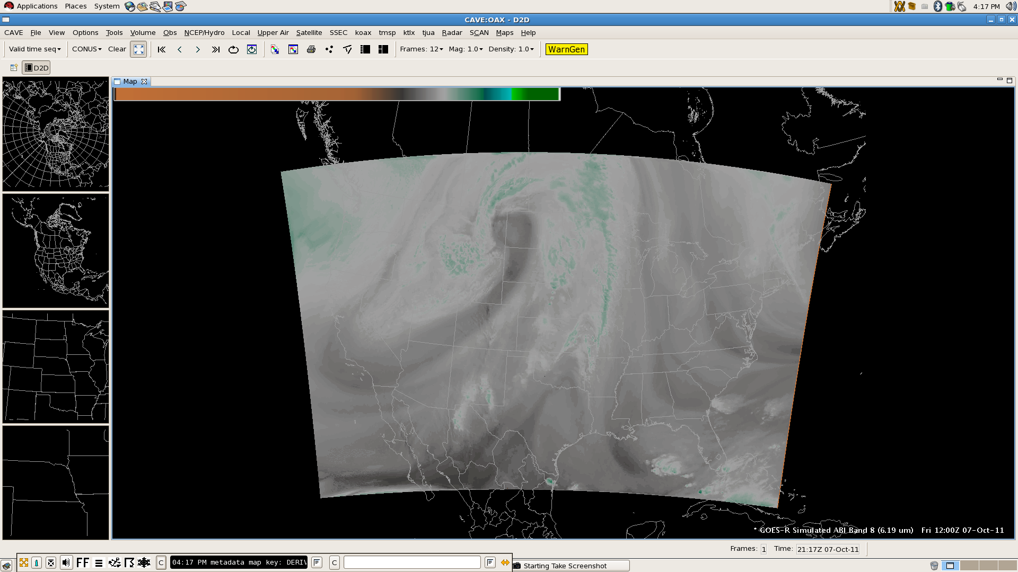
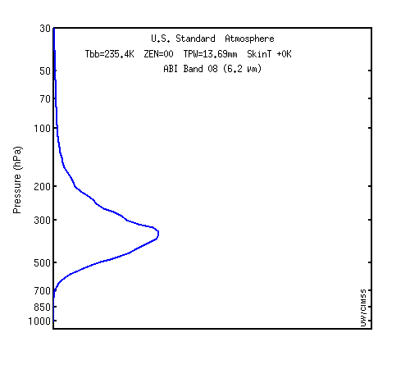
Simulated ABI Band 8 (6.19 µm)
Weighting function for US Standard profile indicates sensitivity to upper tropospheric moisture

Slide 6
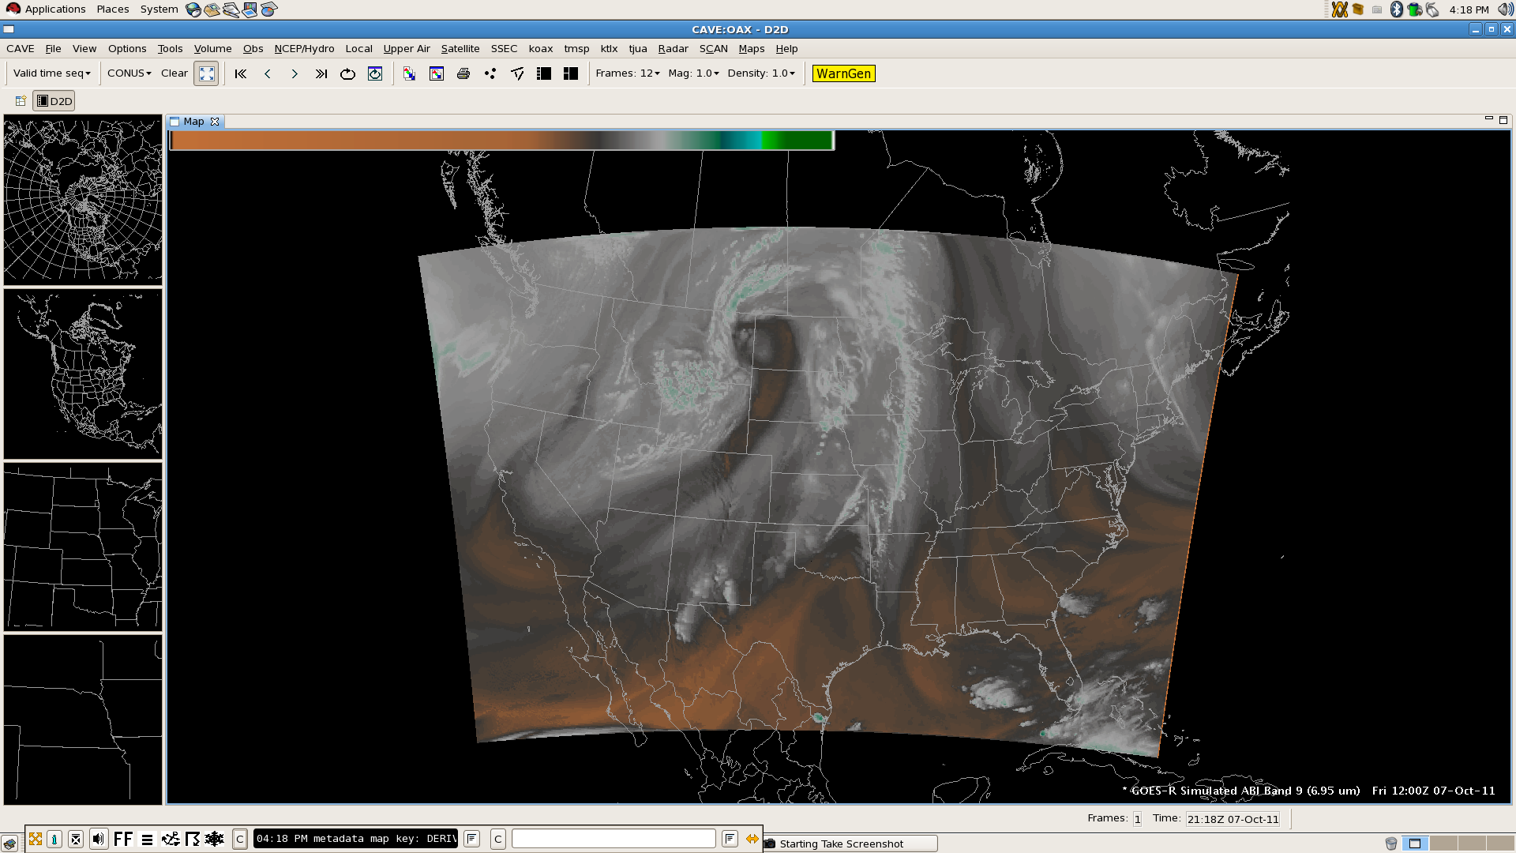
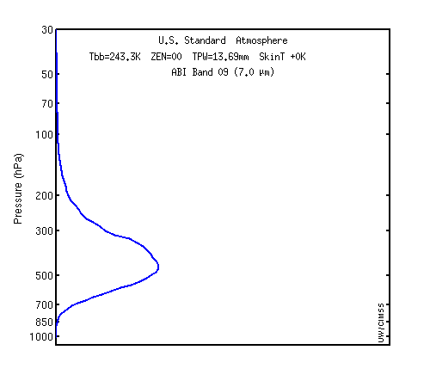
Simulated ABI Band 9 (6.95 µm)
Weighting function for US Standard profile indicates sensitivity to upper middle tropospheric moisture

Slide 7
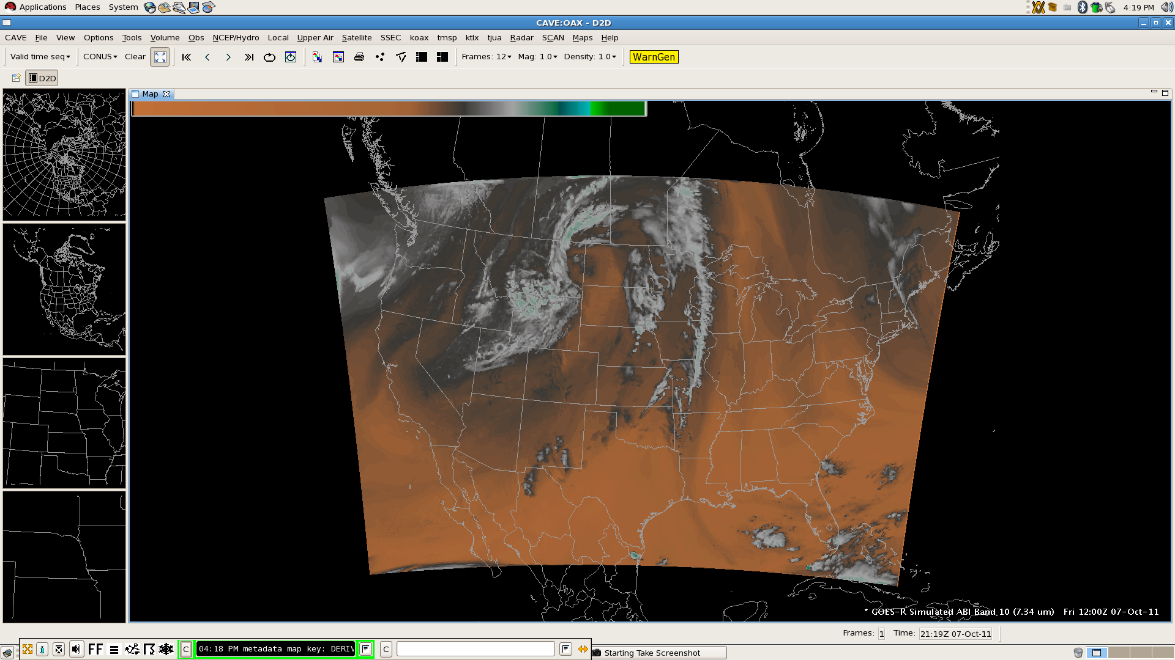
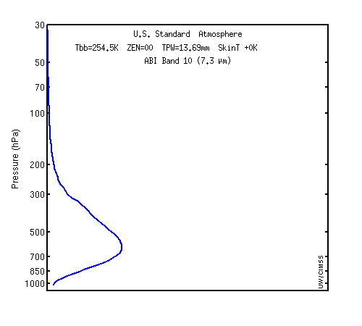
Simulated ABI Band 10 (7.34 µm)
Weighting function for US Standard profile indicates sensitivity to lower middle tropospheric moisture

Slide 8
CIMSS Approach to RGBA
Use satelliteImageryStyleRules.xml
Configure display for individual bands, then layer multiple bands
Advantages:
Leverages the improved display capabilities of the software and service-oriented architecture
RGBA composites can be locally controlled and developed
Components are easily visualized and sampled individually
Allows control over the minimum and maximum display values
Additional bandwidth not required (composite created from bands already delivered on site; transmission of additional product not required)
Graphics card facilitates layering, decreasing resources required on remainder of the system (both server and workstation)

Slide 9
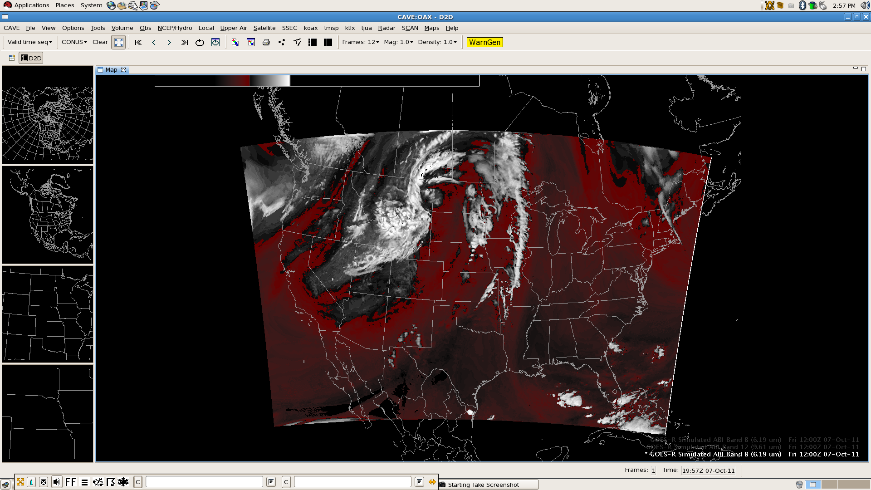
Building an RGB: Band 8 – Band 10
Red with alpha gradient (upper–lower tropospheric moisture difference), white clouds with alpha gradient
Notes:
Red, -50 to -27; White -27 to 0

Slide 10
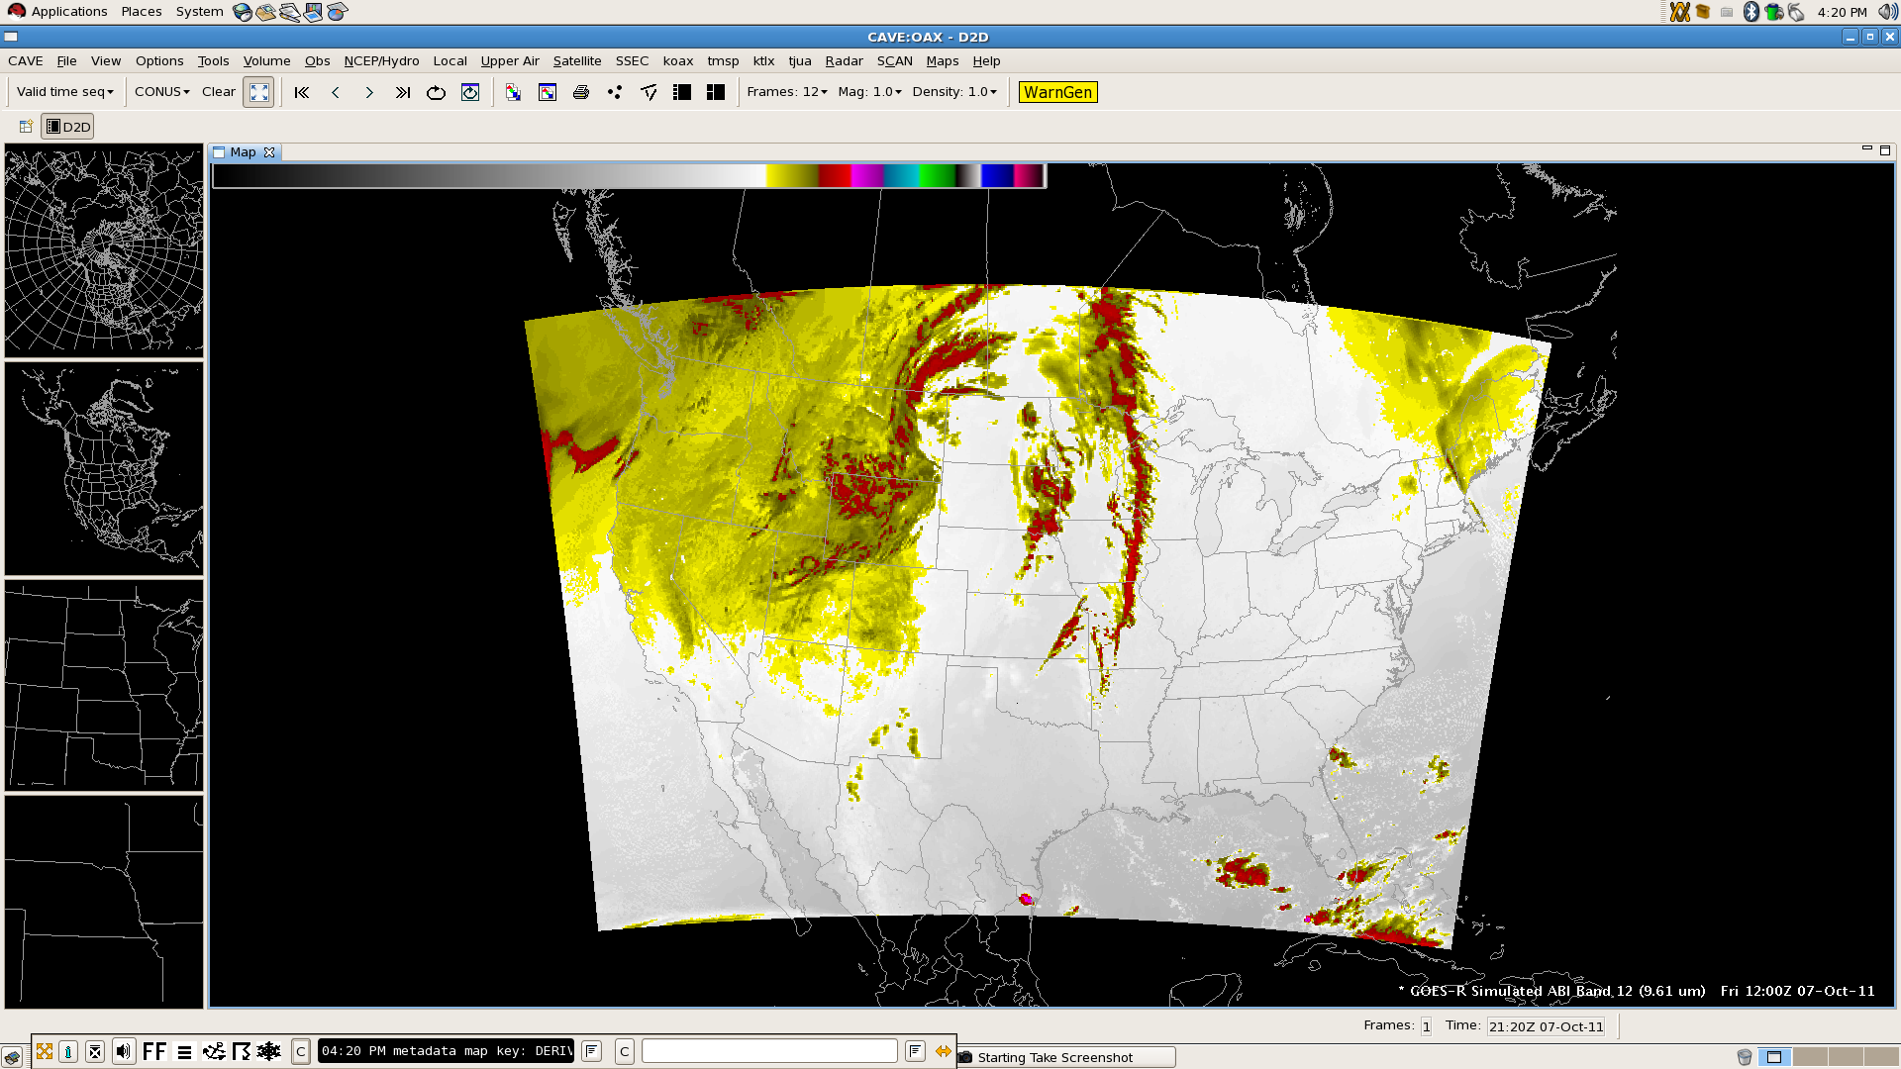
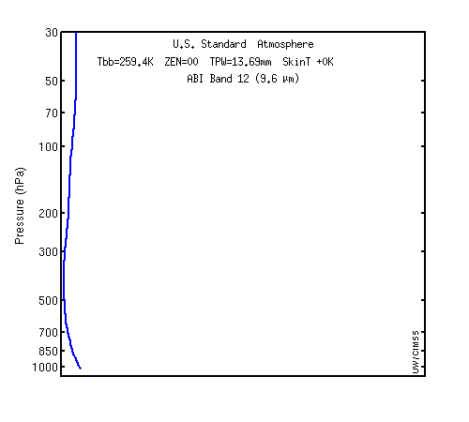
Simulated ABI Band 12 (9.61 µm)
Weighting function for US Standard profile indicates sensitivity to ozone

Slide 11
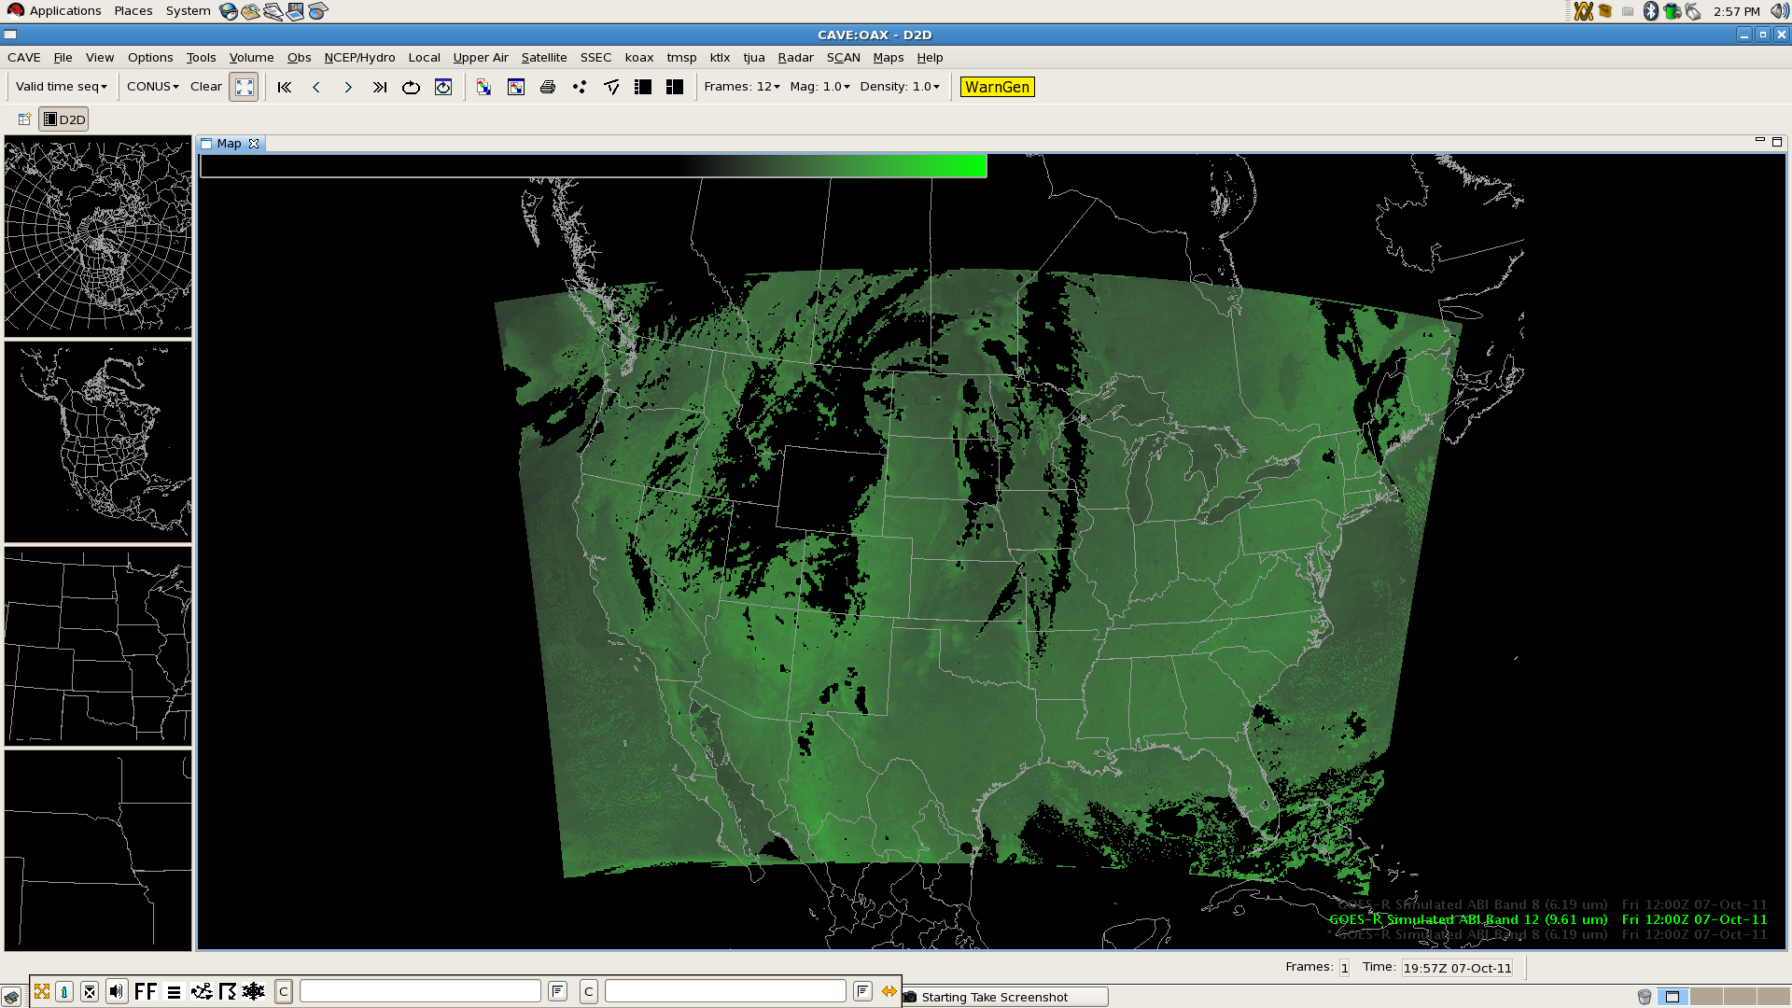
Building an RGB: Band 12 – Band 13
Green with alpha gradient (brighter high ozone concentration indicative of low potential vorticity surfaces)
Notes:
Green 27 to 127

Slide 12
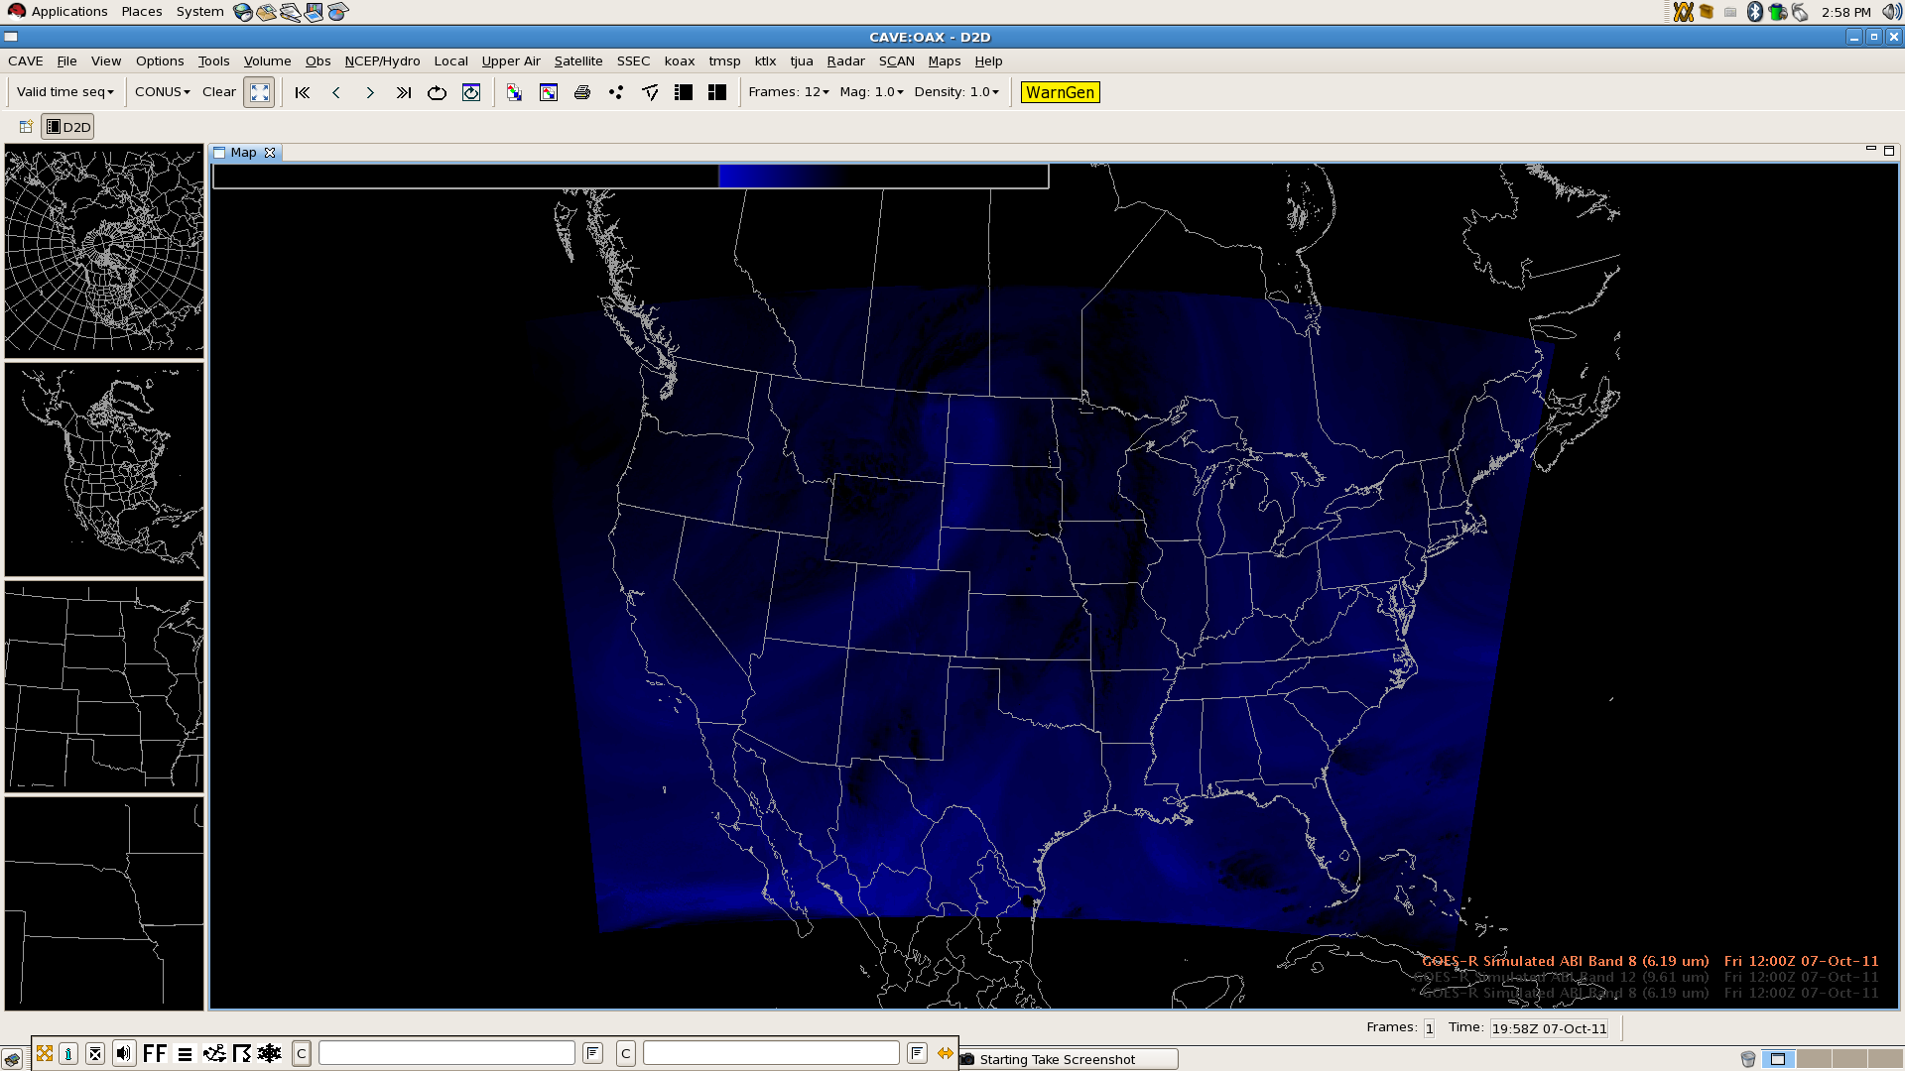
Building an RGB: Band 8 Inverted
Blue with alpha gradient (brighter blues indicate dryer upper tropospheric air, dry slot)
Notes:
Blue 27 to 67

Slide 13
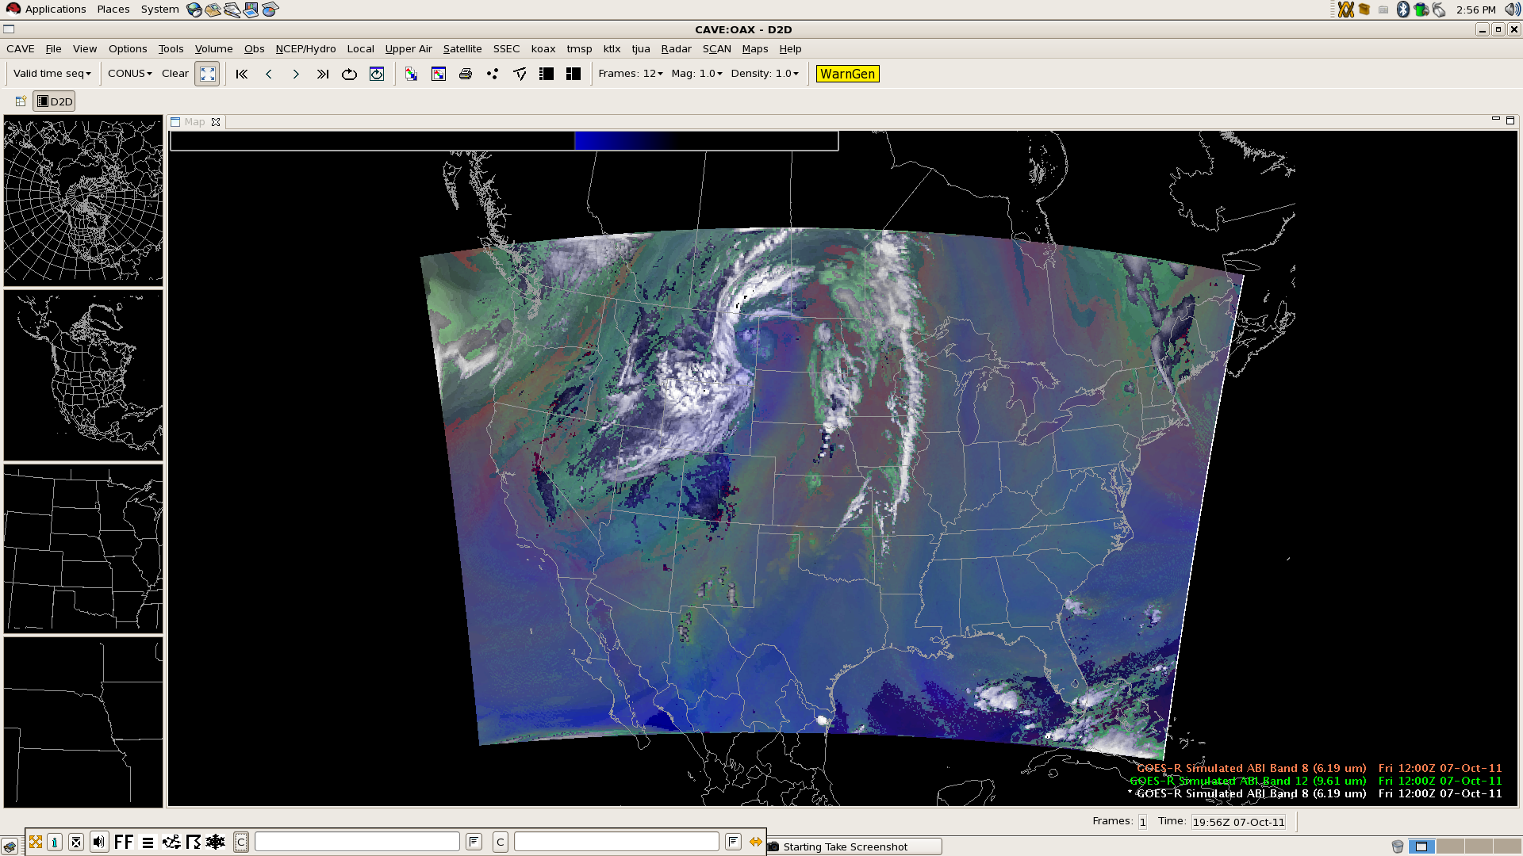
Building an RGB: Composite
Composite shows an amplified weather pattern, synoptic dry slot, and differential tropospheric moisture

Slide 14
Potential AWIPS II Capabilities
User interface for the multi-channel RGB color capability
Implement with GPU Shader Language for quick display time, a strength of AWIPS II
Updated user controls and color scheme selection
New color table widget for developing color tables with more than 256 colors (current AWIPS I transmission format and software limitation)
Product browser capability (Raytheon concept)
Redesign the volume browser?
Expanded, refined capability for derived parameters
Python scripting easy for end users but not necessarily efficient use of resources for complex calculations
User control of image differencing and scaling
Permit operations in value space instead of data storage space

Slide 15
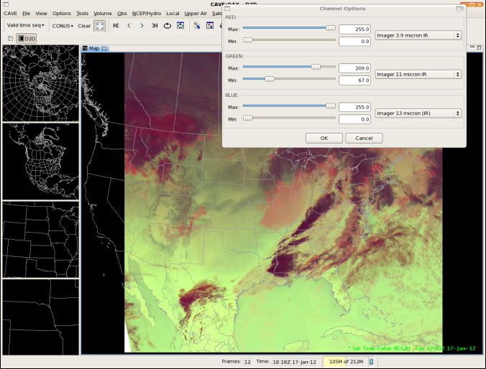
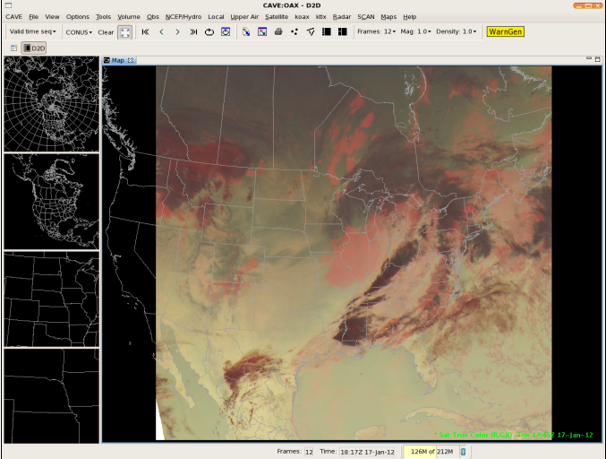
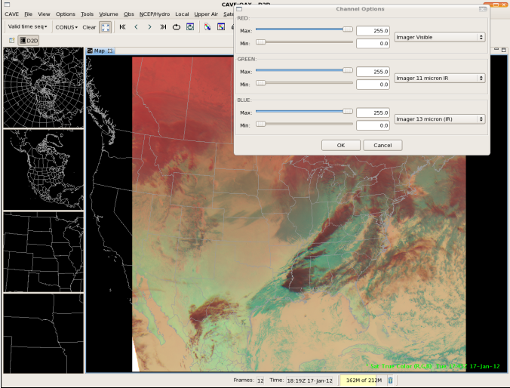
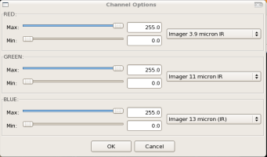
GOES-R and NPP Satellite Imagery New satellite true color visualization plug-in
Slide credit: Frank Griffith

Slide 16
Summary and Recommendations
Multiple ways to input satellite imagery into AWIPS II
Software capabilities currently exist for primitive (but functional) defined-on-display AWIPS II RGBA capability
Exploited and demonstrated at CIMSS
Technical interchange meeting with Raytheon this summer revealed visualization strategy for interactive RGBA composites using graphics card
Advantages and disadvantages of interactive user control should be considered
What do RGBA composites reveal that are not immediately enhanced in individual bands?
Exploit bit depth of satellite imagery in plug-ins
Long-term goal should be unification of satellite components and data store to increase and entice manipulation and interrogation by end users
Contact me: Jordan Gerth, Jordan.Gerth@noaa.gov

