Slide 1
The Evolution and Evaluation of CIMSS’ AWIPS-related efforts since May 2008
Jordan Gerth
In coordination with
Scott Bachmeier
Wayne Feltz
Tim Schmit
and others

Slide 2
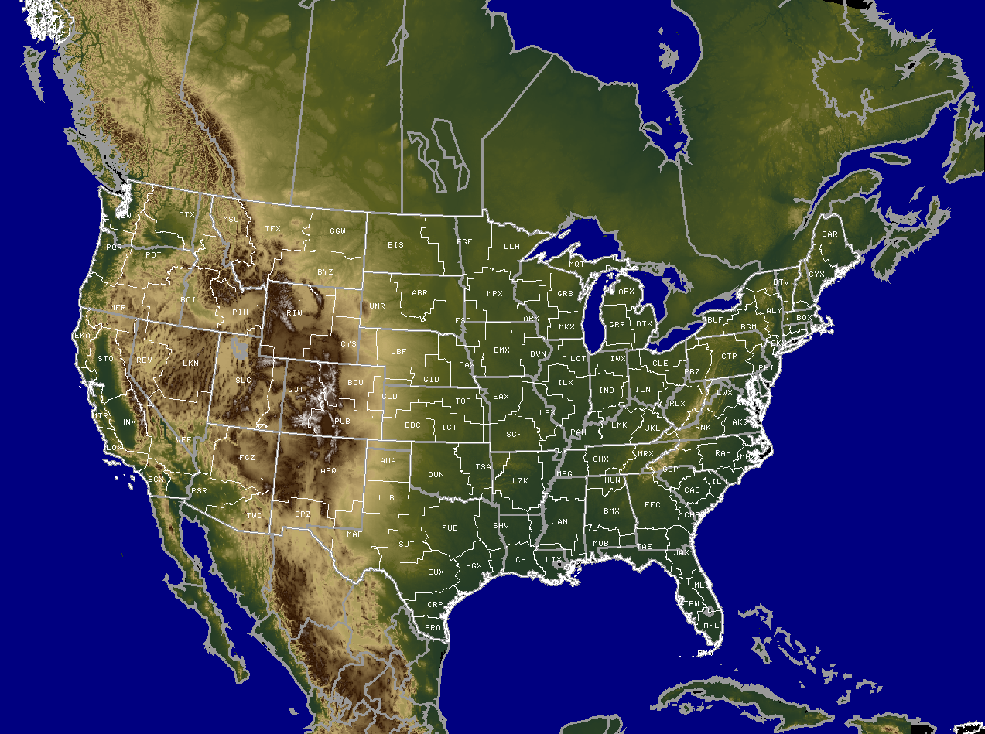
Involved Weather Forecast Offices
Billings, Montana (BYZ) Chicago, Illinois (LOT) Green Bay, Wisconsin (GRB) La Crosse, Wisconsin (ARX) Las Vegas, Nevada (VEF) Marquette, Michigan (MQT) Northern Indiana (IWX) Spokane, Washington (OTX) Wichita, Kansas (ICT)
Aberdeen, South Dakota (ABR) Amarillo, Texas (AMA) Boulder, Colorado (BOU) Dallas/Fort Worth, Texas (FWD) Davenport, Iowa (DVN) Des Moines, Iowa (DMX) Duluth, Minnesota (DLH) El Paso, Texas (EPZ) Glasgow, Montana (GGW) Indianapolis, Indiana (IND) Kansas City, Missouri (EAX) Midland, Texas (MAF) Minneapolis, Minnesota (MPX) Norman, Oklahoma (OUN) Pendleton, Oregon (PDT) Reno, Nevada (REV) Riverton, Wyoming (RIW) Springfield, Missouri (SGF) Tulsa, Oklahoma (TSA) Spaceflight Meteorology Group
33
Kansas City, Missouri (CRH) Fort Worth, Texas (SRH) Salt Lake City, Utah (WRH)
TOTAL
Milwaukee, Wisconsin (MKX)
SMG
in AWIPS
Last updated on Jan 20, 2009
Distribution Node
≥25 MODIS AFDs Issued
≥1 AFD Issued
Receive MODIS Imagery
3
1
9
20

Slide 3
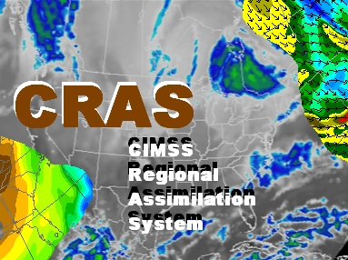
Involved Weather Forecast Offices
Milwaukee, Wisconsin (MKX)
Boulder, Colorado (BOU) Fargo, North Dakota (FGF) Indianapolis, Indiana (IND) Kansas City, Missouri (EAX) La Crosse, Wisconsin (ARX) Nashville, Tennessee (OHX) Rapid City, South Dakota (UNR) Springfield, Missouri (SGF)
18
Bohemia, New York (ERH) Fort Worth, Texas (SRH) Kansas City, Missouri (CRH) Salt Lake City, Utah (WRH)
Aberdeen, South Dakota (ABR) Burlington, Vermont (BTV) Minneapolis, Minnesota (MPX) Northern Indiana (IWX) Riverton, Wyoming (RIW)
TOTAL
in AWIPS
Introduction of GRIB2 fields in August 2008
Last updated on Jan 20, 2009
Distribution Node
≥50 CRAS AFDs Issued
≥1 AFD Issued
Receive CRAS Imagery
4
1
6
7

Slide 4
None so far this May

Slide 6
Meetings with NWS WFO MKX
27 January 2009 at CIMSS with theme “Catering to the satellite needs of operational meteorology”
17 February 2009 at NWS WFO MKX with theme “Building on a collaborative foundation for success in operational satellite meteorology”
Survey conducted to assess presentations and content based on “applicability and pertinence to the field of operational meteorology” (“1”, not applicable; “5”, immediately applicable):
GOES-R Proving Ground and Overview of Simulated ABI Datasets: 4.4
A primer on the use of the current GOES Sounder: 3.4
Using GOES Sounder products to improve regional NWP: 4.4 (CRAS), 4.0 (Nearcasting)
Providing Research Satellite Products to NWS Operations: 4.7
Convective Initiation and Aviation Applications to Forecasting: 4.0
Overall, including organization and subject matter: 4.7

Slide 7
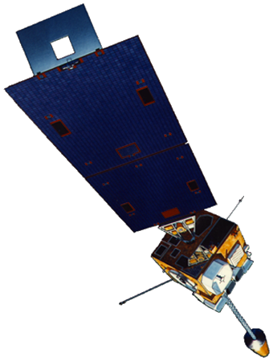
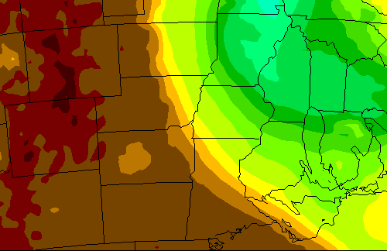
CIMSS Regional Assimilation System
CRAS
The Cooperative Institute for Meteorological Satellite Studies (CIMSS) uses the CIMSS Regional Assimilation System (CRAS) to assess the impact of space-based observations on numerical forecast accuracy.
CRAS is unique in that, since 1996, it’s development was guided by validating forecasts using information from GOES.
Slide credit: Robert Aune, NOAA/NESDIS

Slide 8
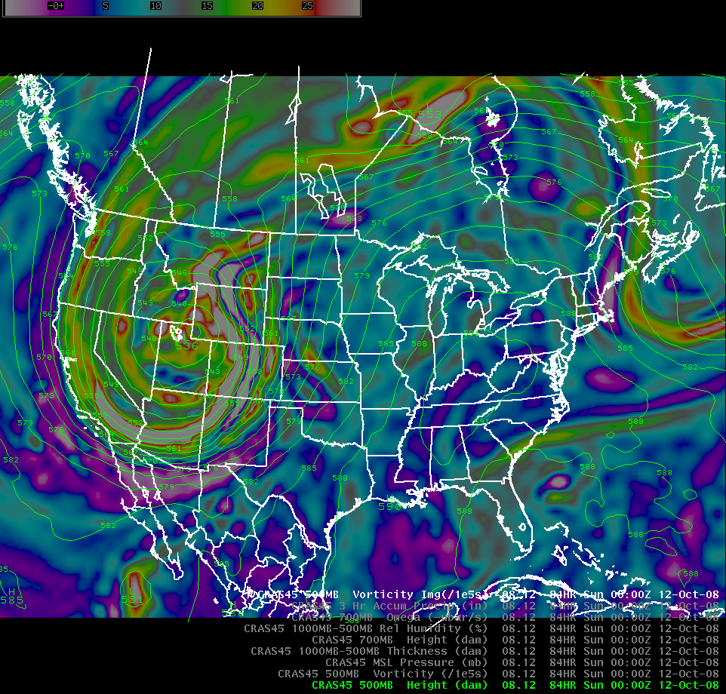

Slide 9
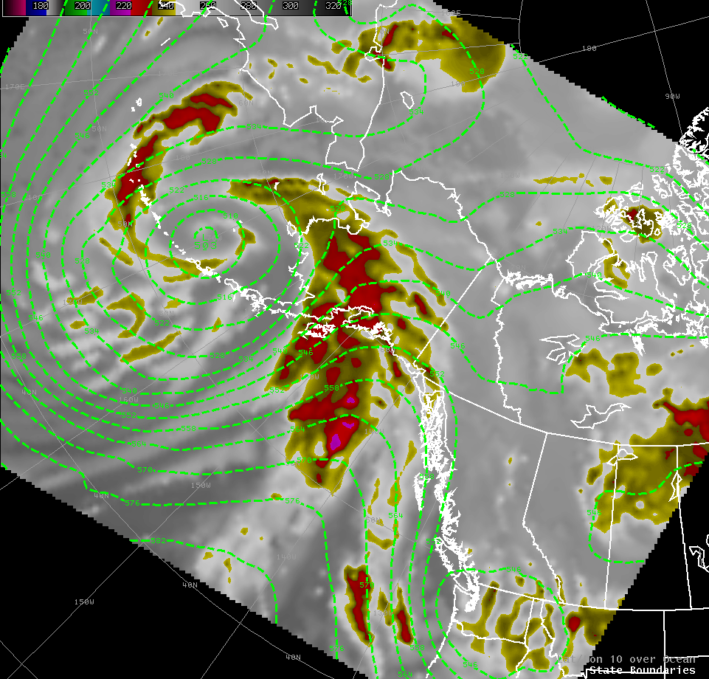

Slide 10
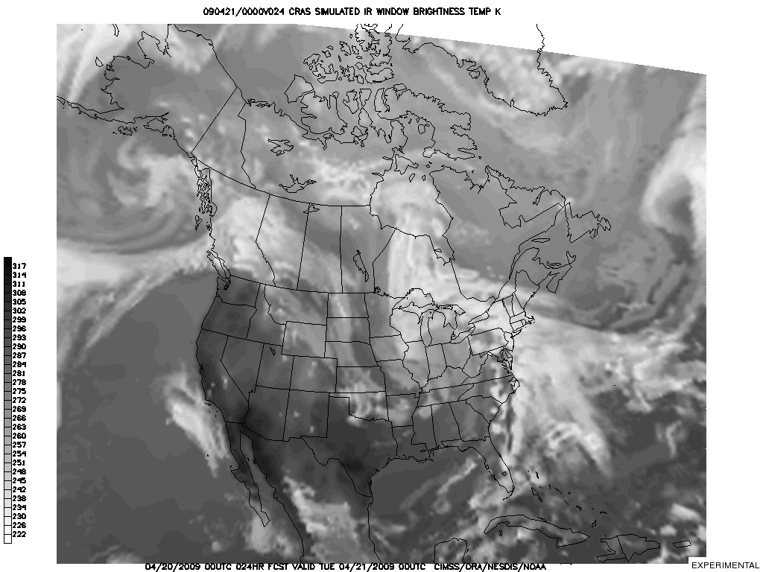
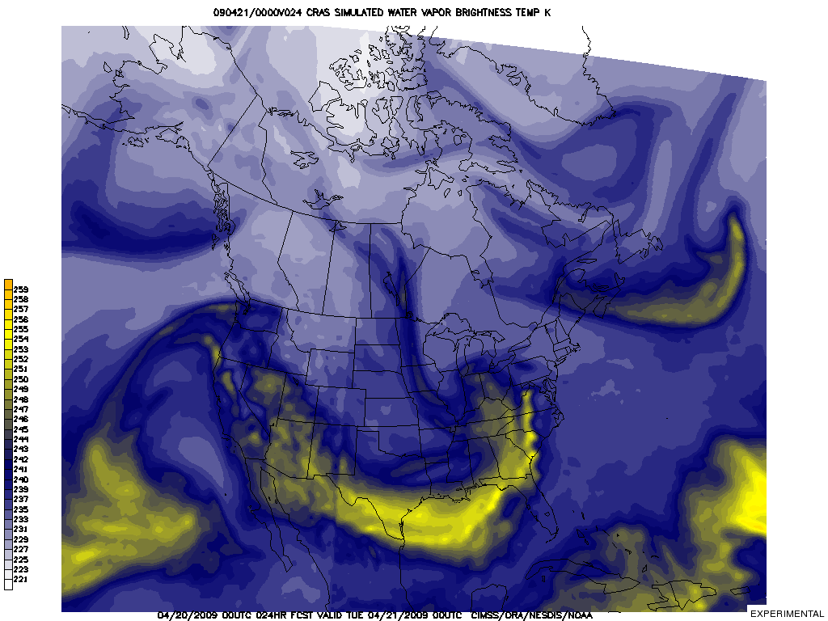
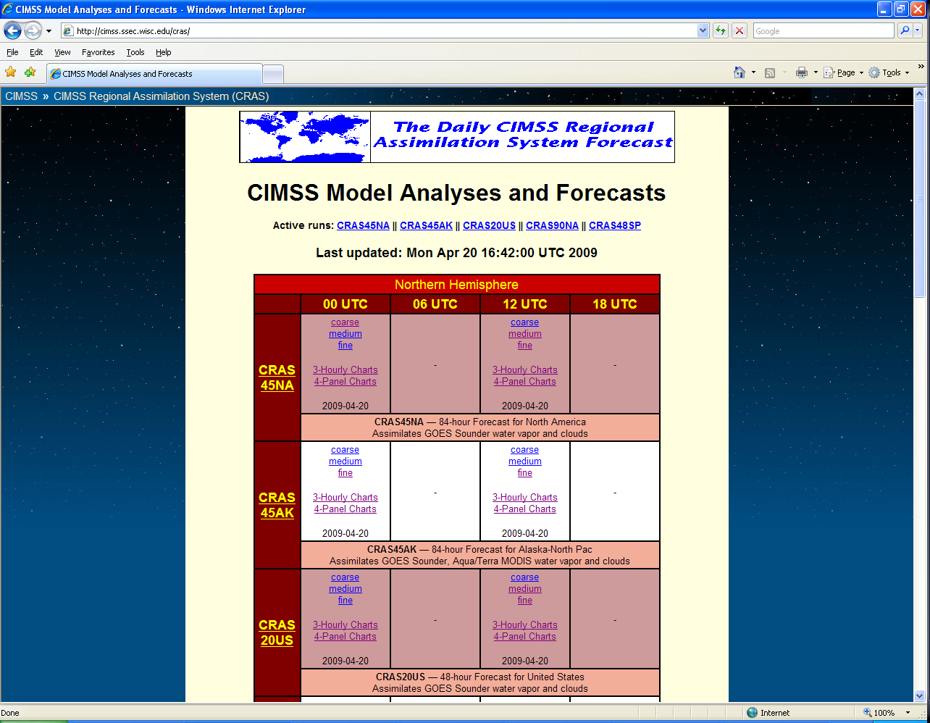
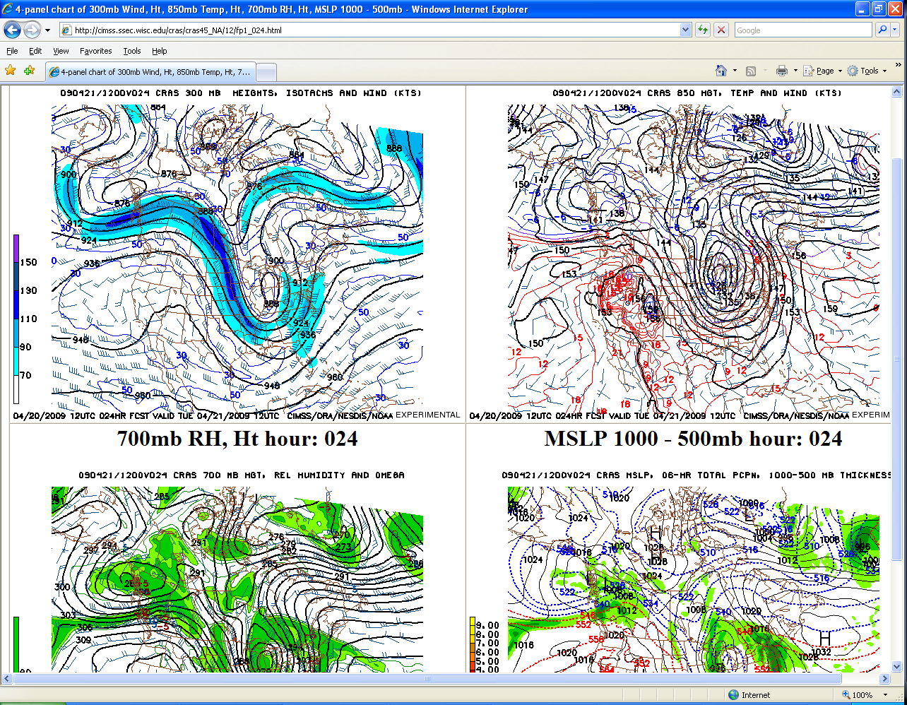
Web Transitioning
http://cimss.ssec.wisc.edu/cras/
NOAA Collaborator: Robert Aune

Slide 11
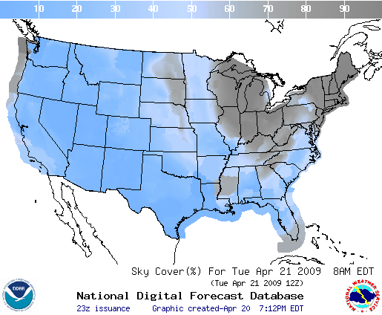
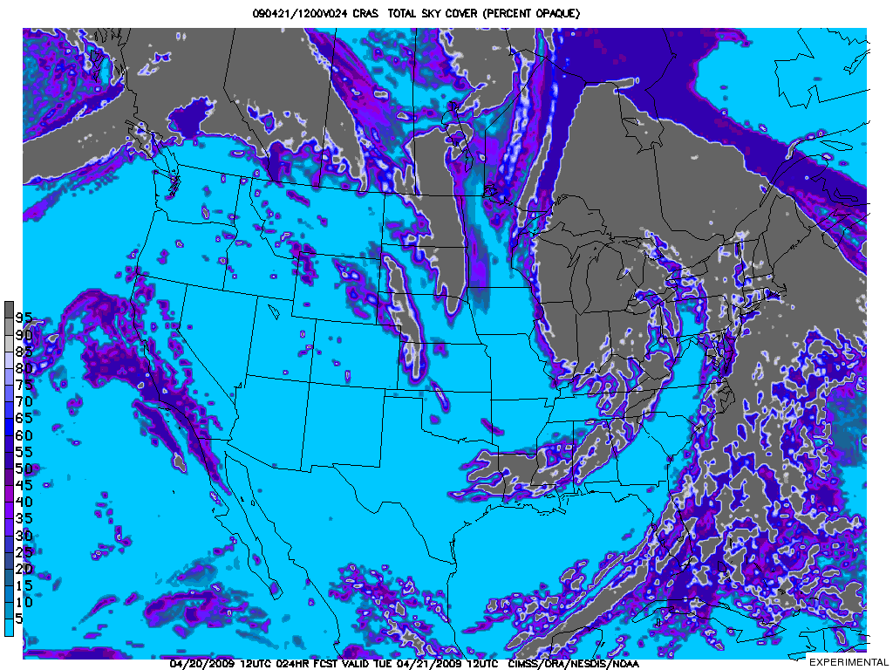
Sky Cover Prediction
Pre-release commentary from National Weather Service Science Operations Officers:
“[The] field really does need something to help with the sky grids.”
“Obviously great potential for (the) NDFD!”

Slide 12
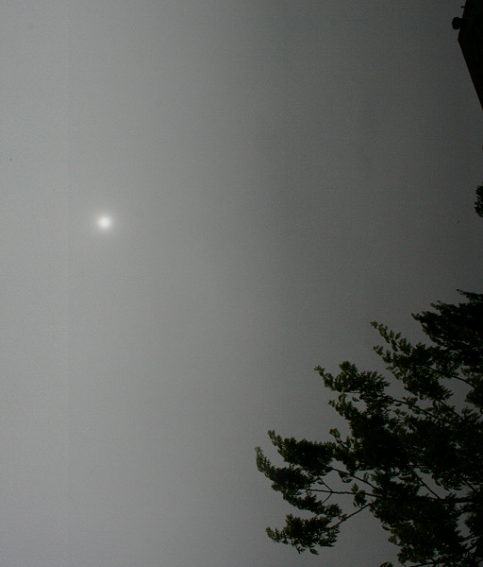
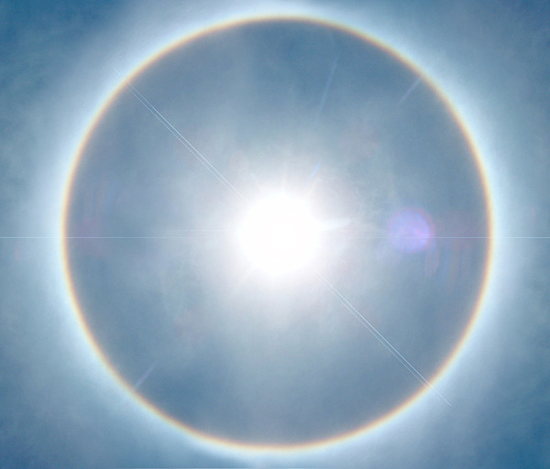
Sky Cover Prediction
The Problem: What is 100% sky cover? Both celestial domes are completely covered with cloud. Do we use an incoming light standard? If so, what do we do at night?
Photos courtesy of National Weather Service Southern Region Headquarters

Slide 13
Transitioning to the WRF
The most recent advances in numerical weather prediction have come with the advent and widespread distribution to the Weather Research and Forecast (WRF) model to both the field and academia. The WRF has two dynamical cores, one with customizable physics, and a 3-dimensional variational (3DVAR) assimilation system. The goal is flexibility.
Concurrently, increases in personal computer capabilities and innovations in parallel processing have led to a realistic ability to run regional simulations on increasingly high-resolution mesoscale spatial and temporal grids with relative ease.
An effort is underway to create initial conditions for the WRF using data from the GOES Sounder in a satellite-focused real-time mesoscale analysis system. WRF domains could then be provided boundary conditions from the CRAS to extend the analysis of satellite data in numerical weather predictions.

Slide 14
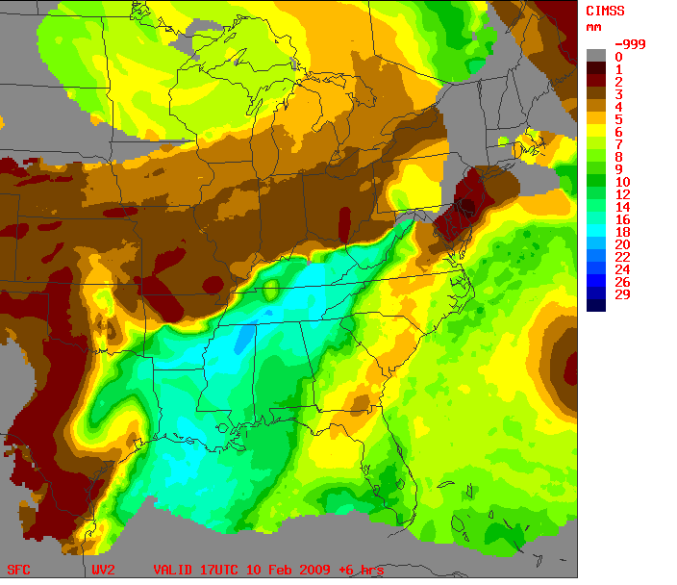
Specific Objective: Expand the benefits of valuable moisture Information contained in GOES Sounder Derived Product Images (DPI)
GOES Sounder products images already are available to forecasters. Products currently available include:
- Total column Precipitable Water (TPW)
- Stability Indices (LI, CAPE)
- 3-layers Precipitable Water (PW) . . .
Build upon GOES’ Strengths:
+ Derived Product Images (DPI) of soundings
speeds comprehension of information
+ Data improves upon model first guess
HOWEVER, some operational realities exist:
- DPIs used primarily as observations
- No predictive component
- 3-layer DPIs not used in current NWP models
- Products often obscured when needed most
- Cloud development/expansion obscures IR observations
Improvement of GOES DPI over NWP guess
Need to add a DPI predictive capability to
close these information gaps
10 Feb 2009, 1700 UTC 900-700 hPa GOES PW 6-Hr nearcast
Slide credit: Robert Aune, NOAA/NESDIS

Slide 15
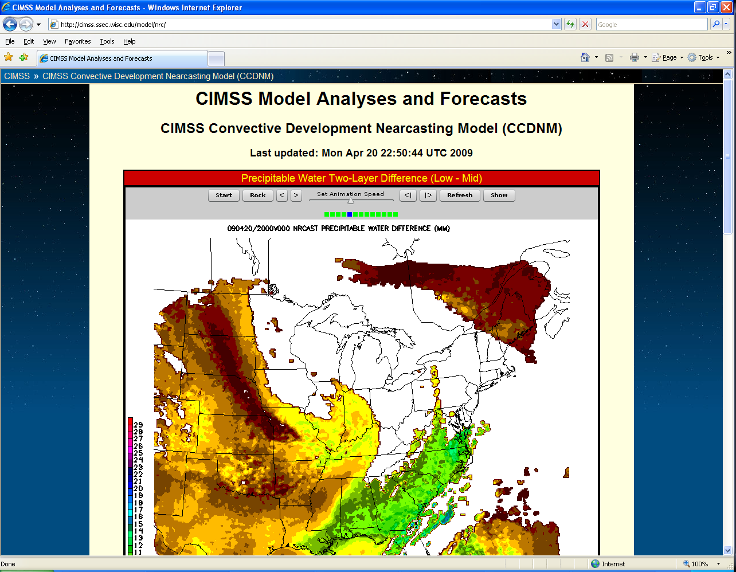
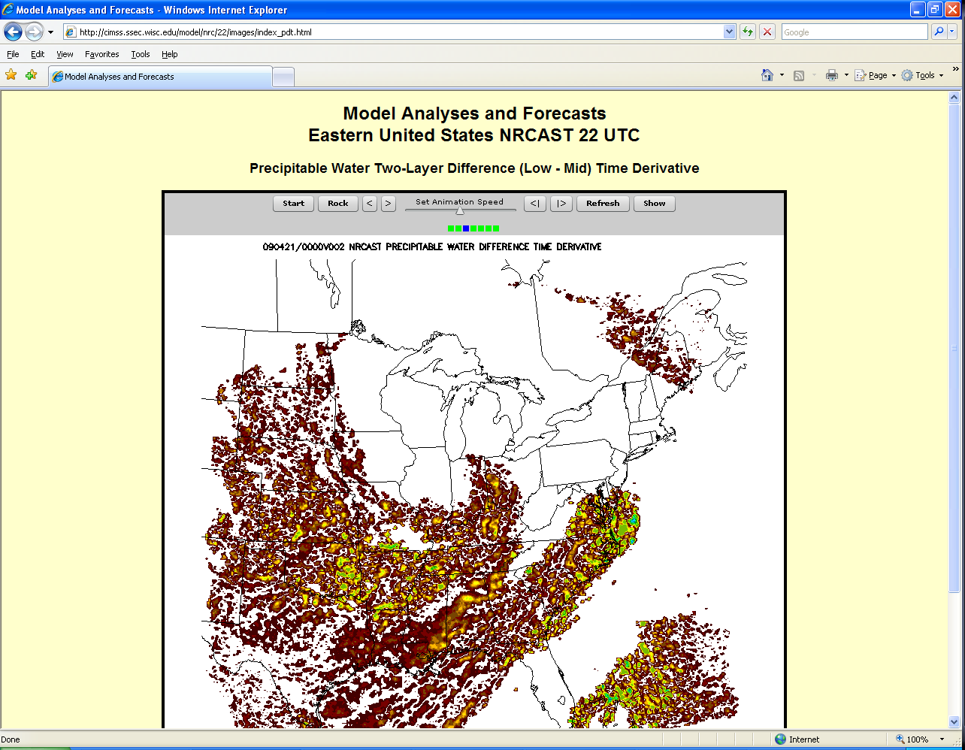
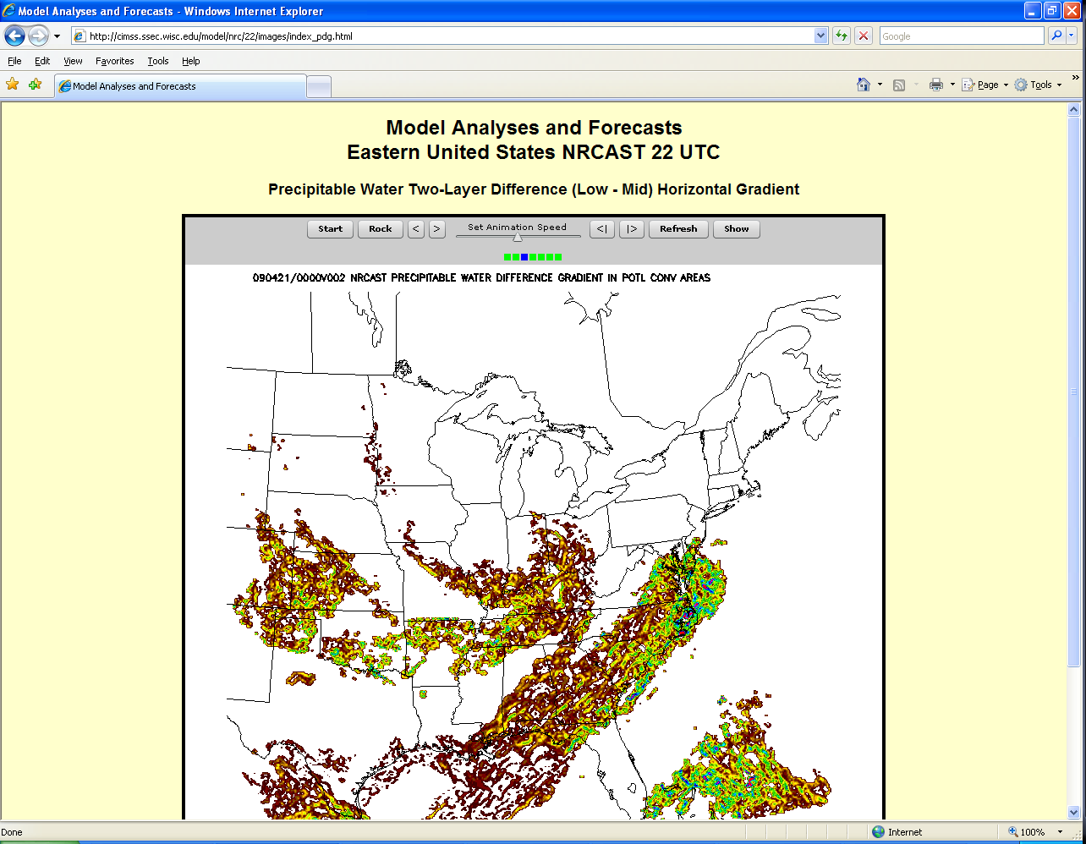
http://cimss.ssec.wisc.edu/model/nrc/
NOAA Collaborator: Robert Aune
CIMSS Collaborator: Ralph Peterson

Slide 16
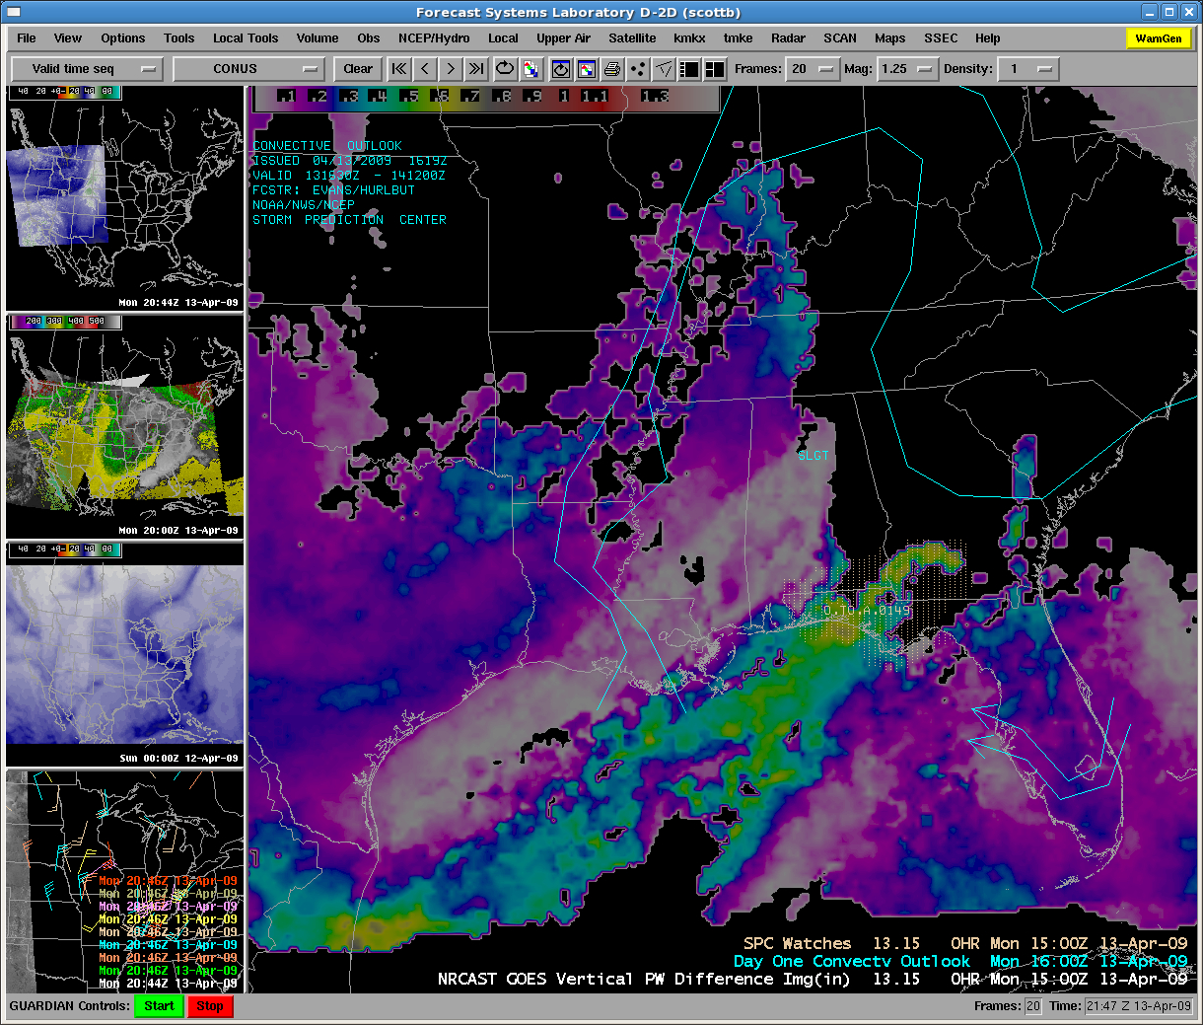

Slide 17
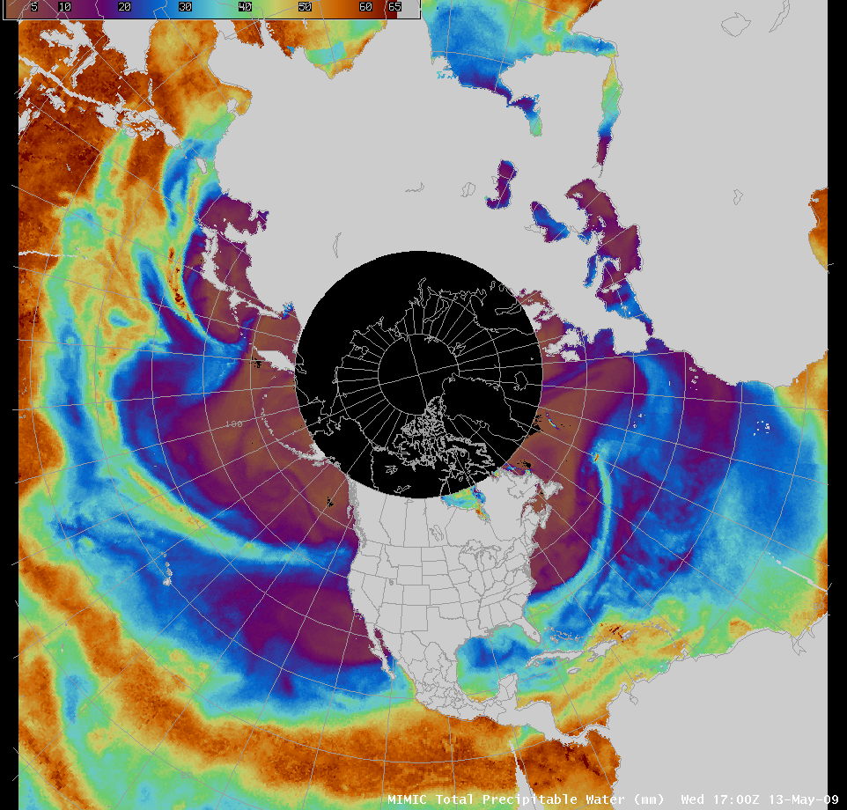

Slide 18
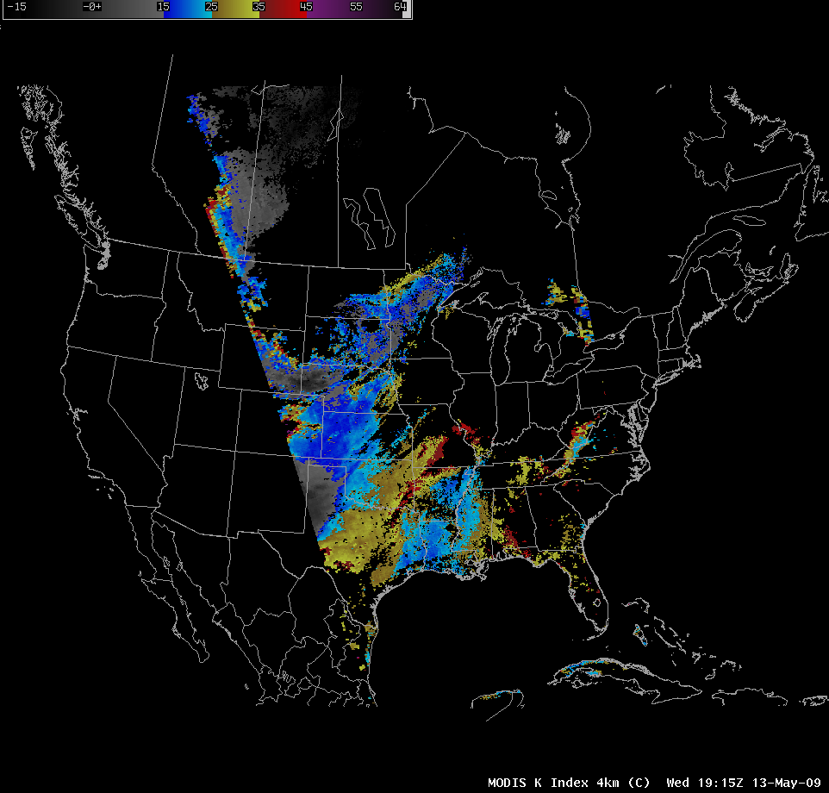

Slide 19
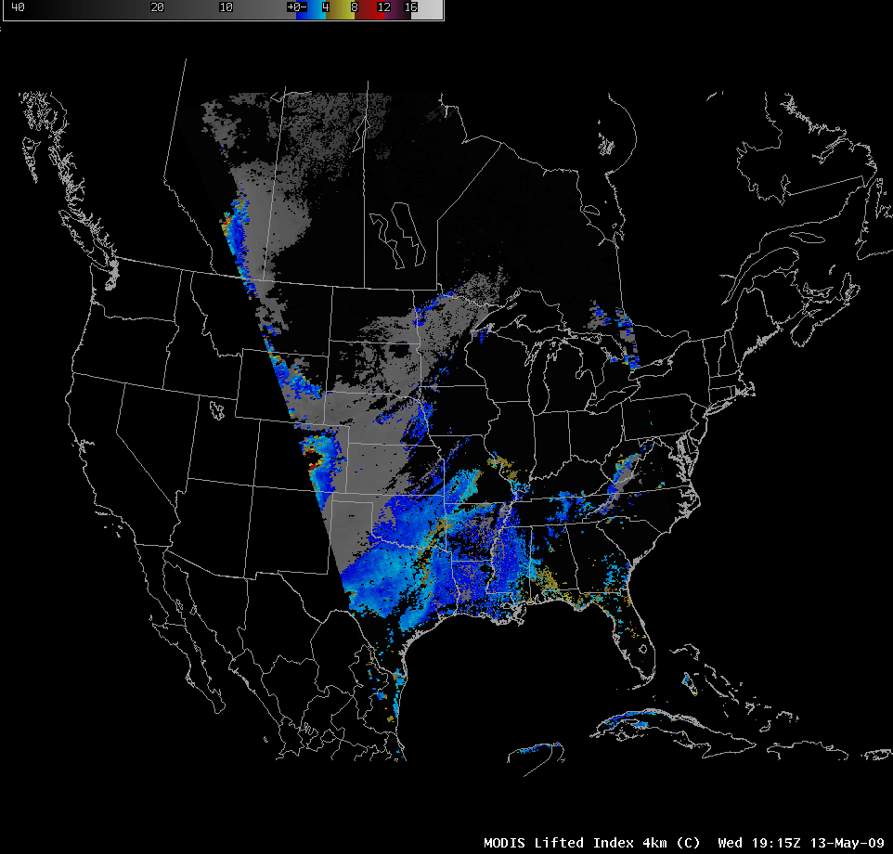

Slide 20
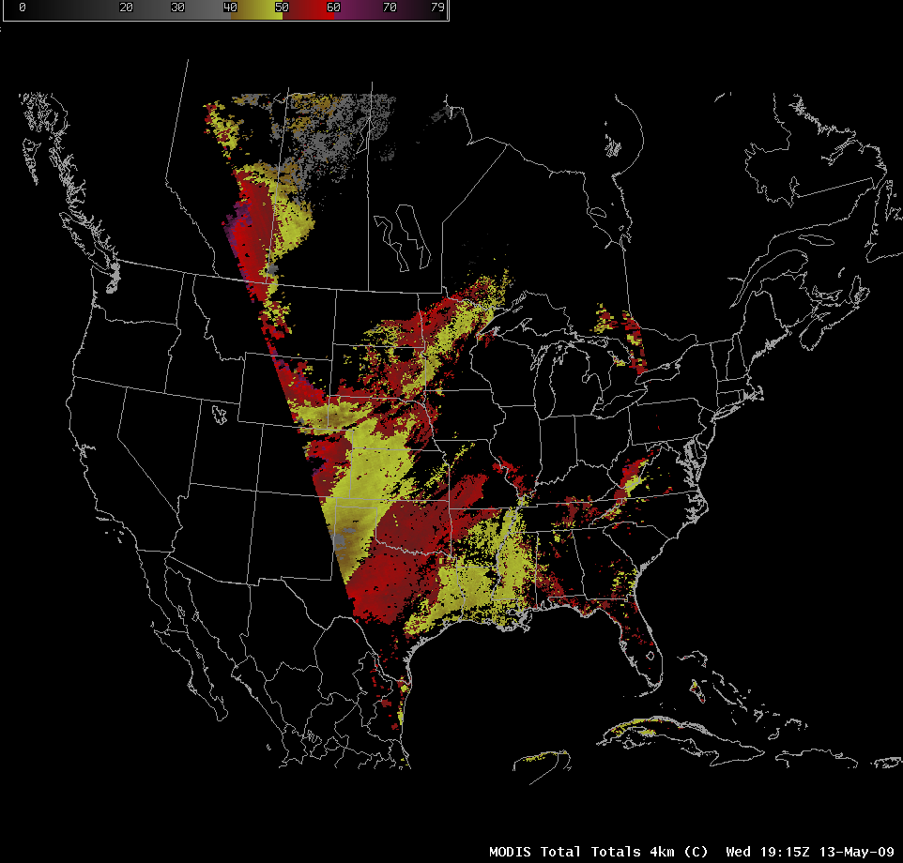

Slide 21
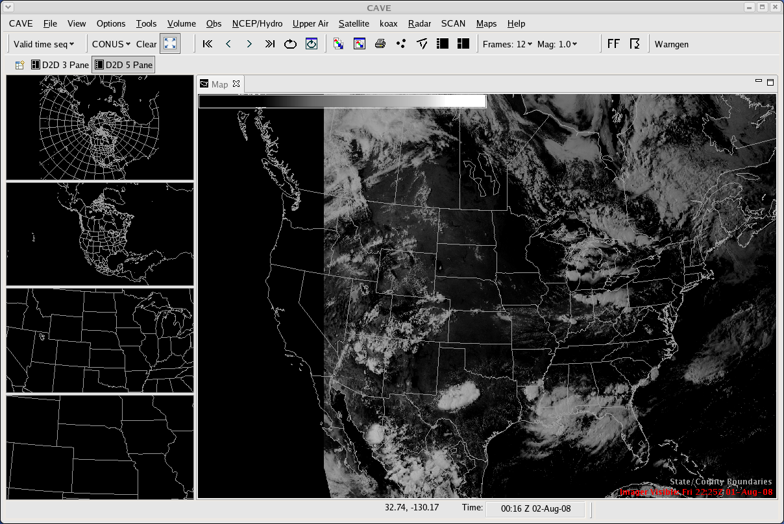
Common AWIPS Visualization Environment (CAVE)

Slide 23
Questions or comments?
jordang@ssec.wisc.edu

