Slide 1
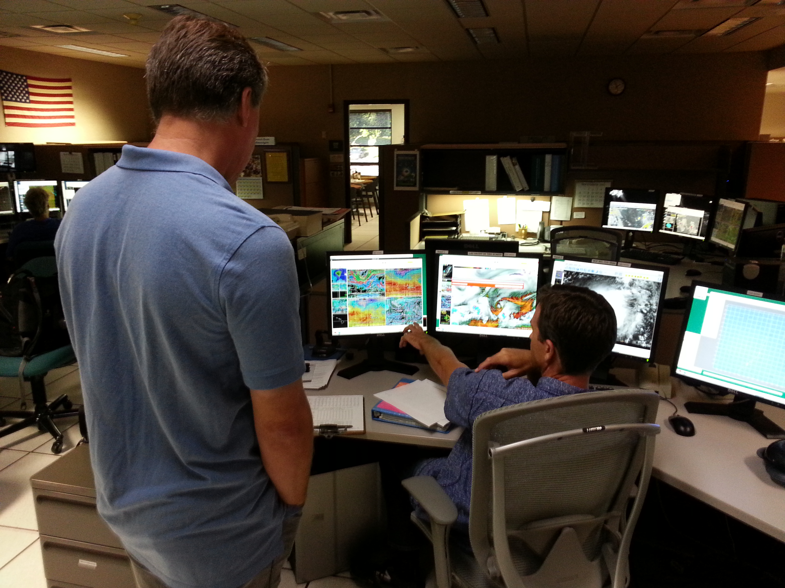
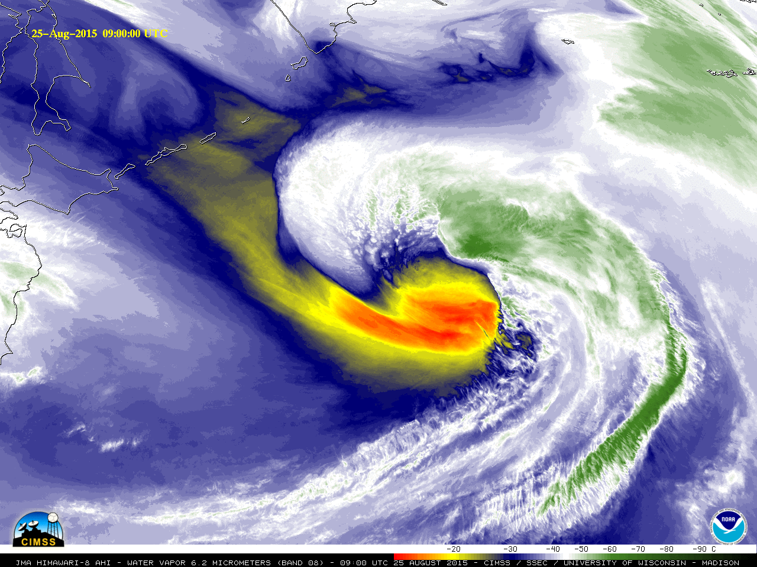
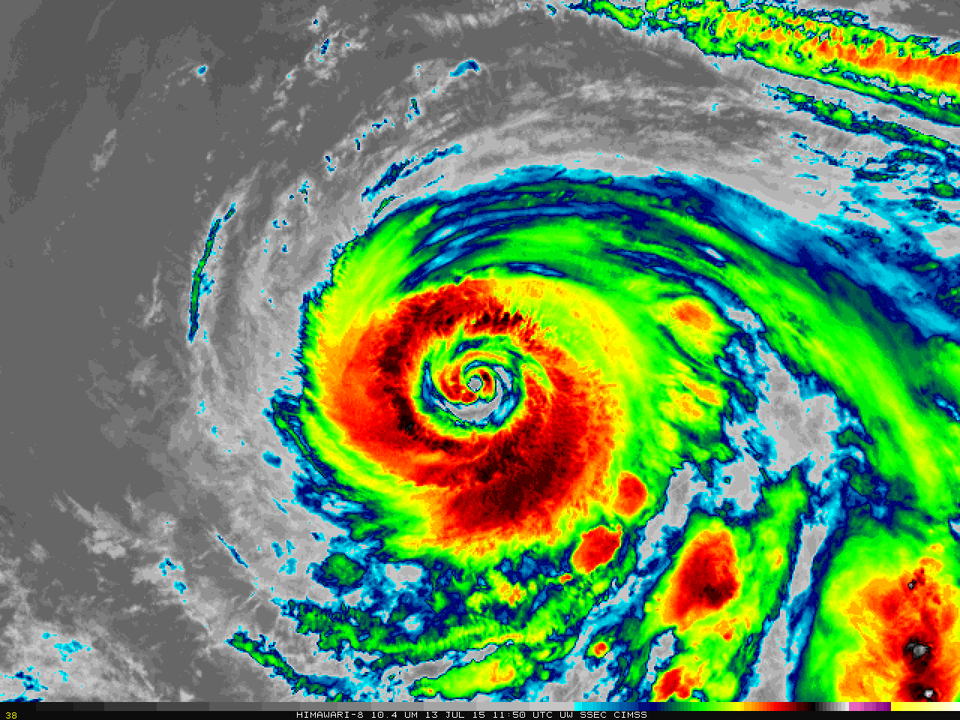
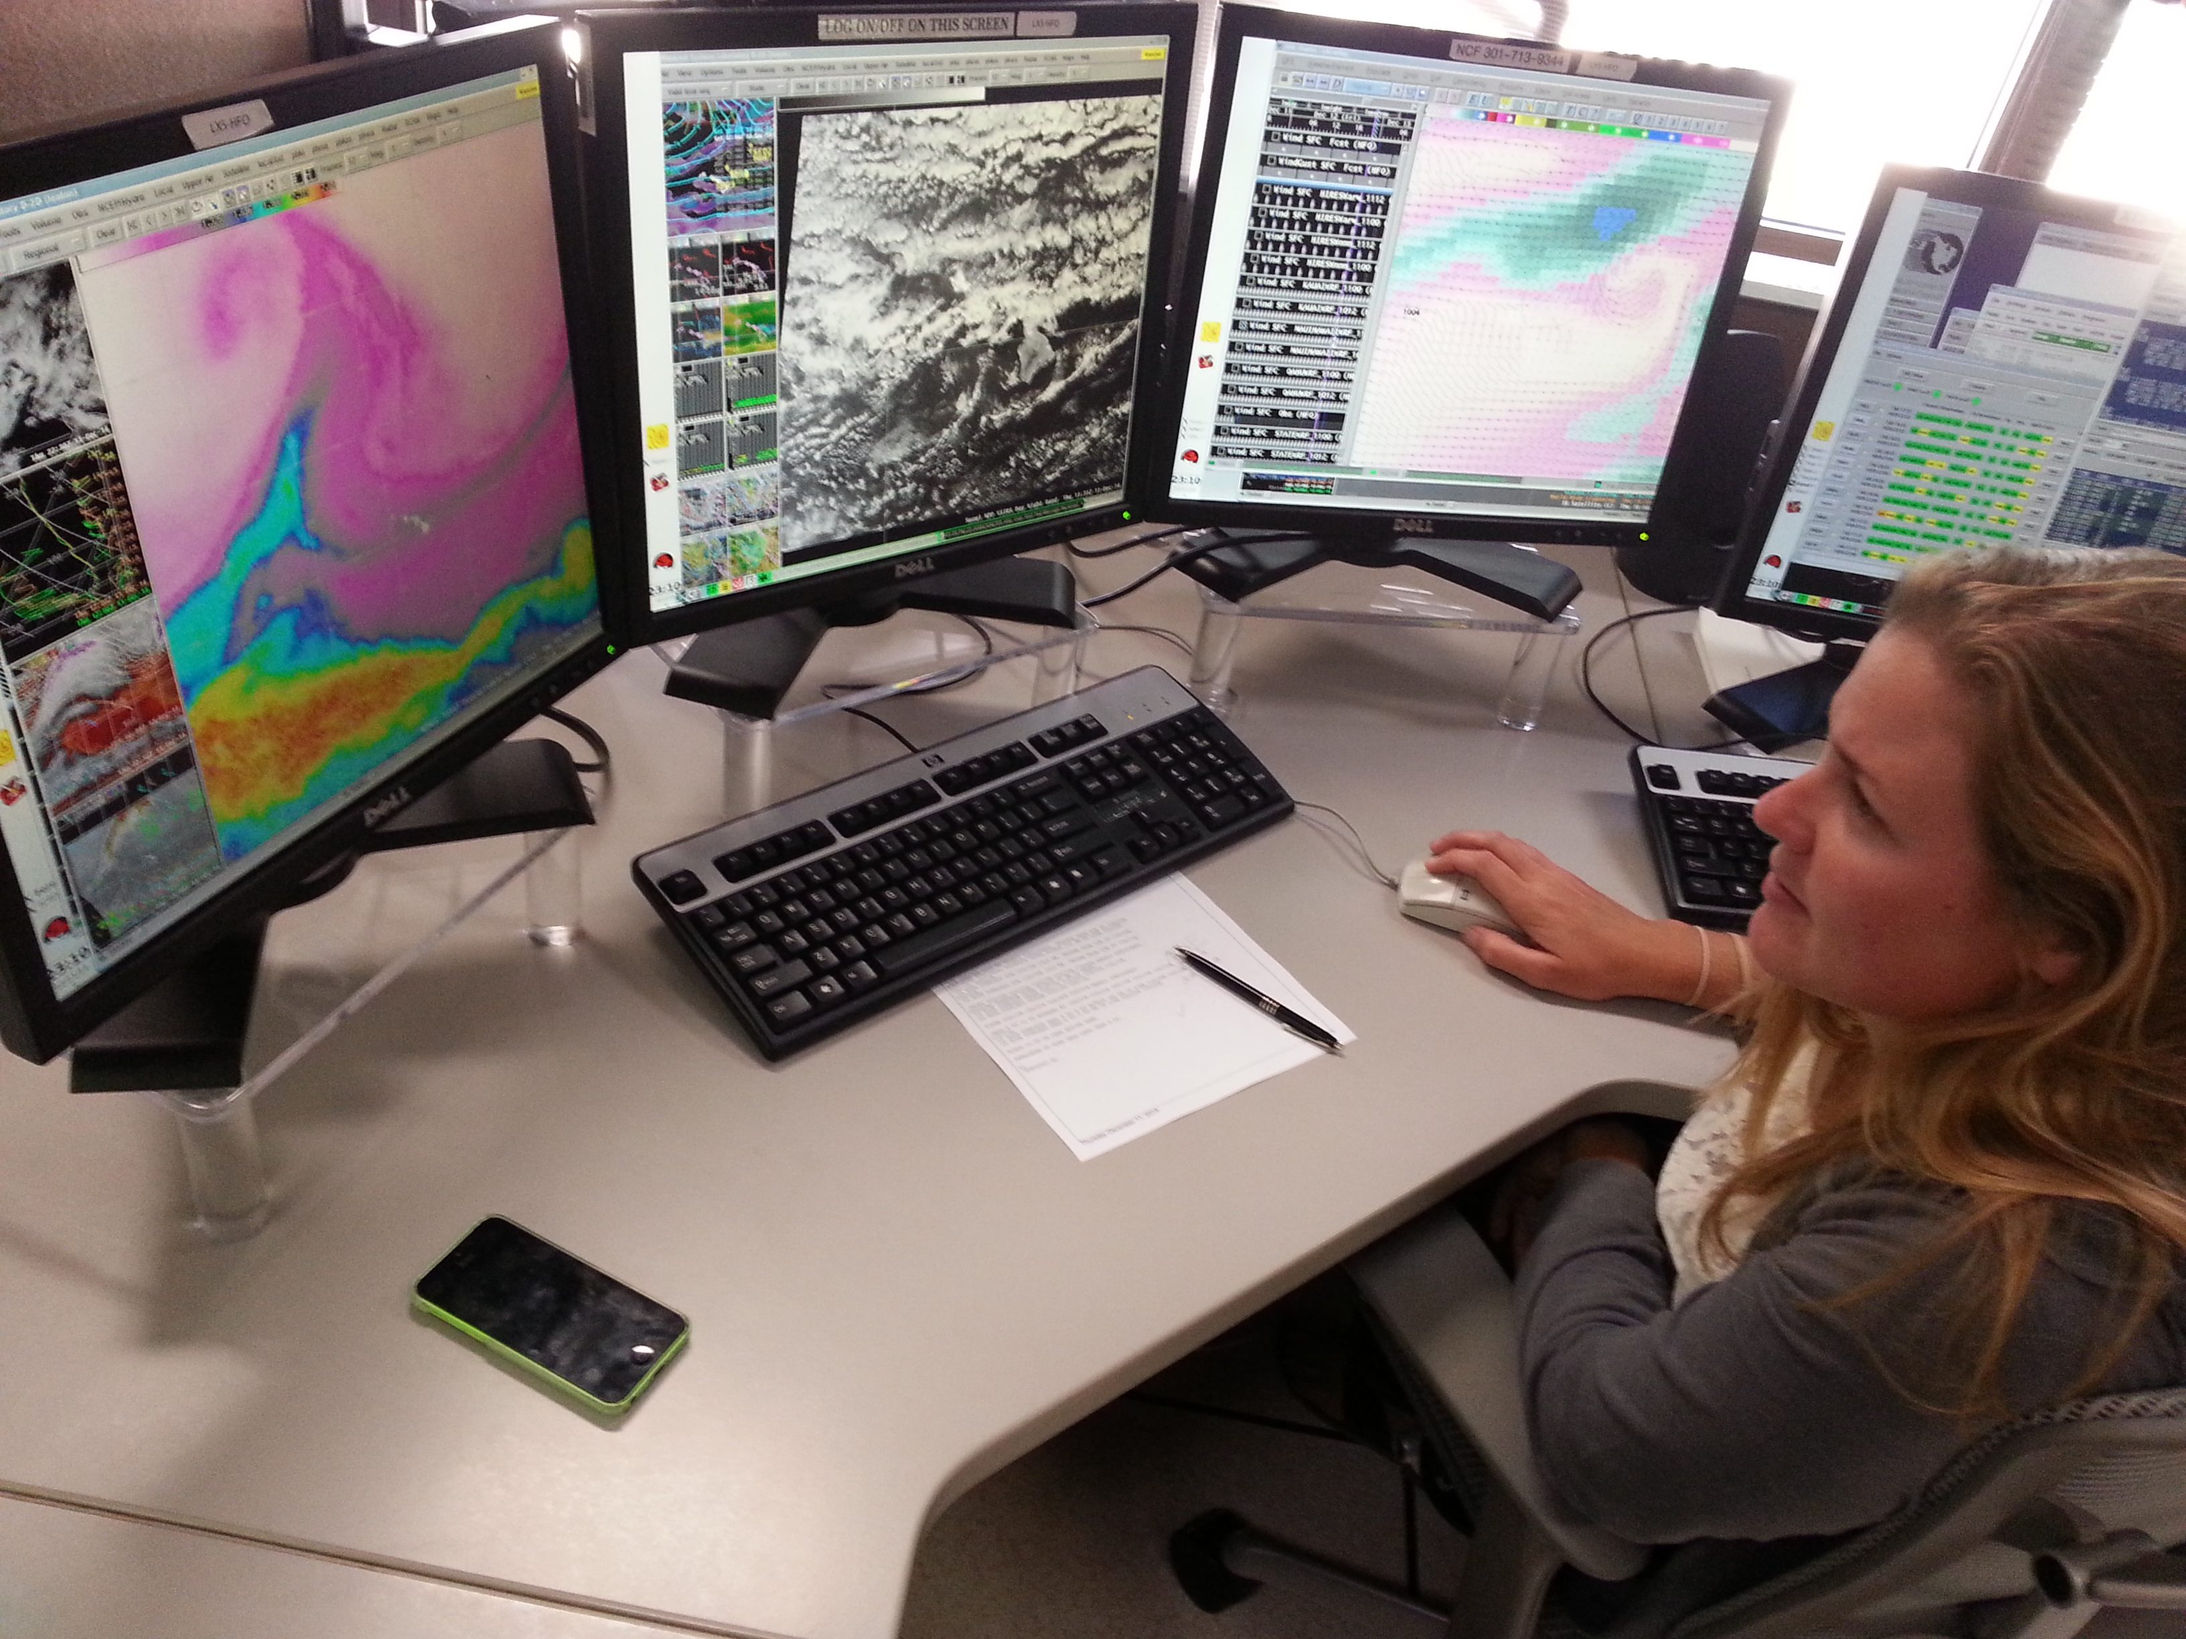
SIFT and Training: You, It, and Your Forecasters
Jordan Gerth
Cooperative Institute for Meteorological Satellite Studies (CIMSS), University of Wisconsin
Kansas City, Missouri
1 March 2016

Slide 2
Why “SIFT”?
SIFT is the Satellite Information Familiarization Tool.
“Whatever may be the limitations which trammel inquiry elsewhere we believe the great state University of Wisconsin should ever encourage that continual and fearless sifting and winnowing by which alone the truth can be found.”
Taken from a 1894 Report of the Board of Regents

Slide 3
SIFT…
Provides an intuitive workspace to display loops of multi-spectral imagery from advanced geostationary imagers quickly, at high resolution, with panning and zooming capabilities.
Runs on three major operating systems.
Requires pre-processed case data.
Only displays satellite imagery (and in the future, derived products).
Can be used as a training aid to sample pixels and compare different spectral bands over regions.

Slide 4
SIFT…
Was built with Python and PyCharm
Numerous open source packages: Numpy, MatPlotLib, SciPy, Numba, PyProj, VisPy, PyOpenGL, NetCDF4, H5Py, Pillow, PyShp, Shapely, Rasterio, GDAL
Supports Mercator projection only (current pre-release)
Reads GeoTIFFs (current pre-release)
Determines reflectance or brightness temperature for all loaded bands with user-dropped point probe
Creates histograms (single band) and density maps (two bands) based on user-defined polygon

Slide 5
SIFT Example

Slide 6
History of SIFT
The idea came during the training workshop in Miami on polar-satellite imagery in February 2015.
SSEC’s training tool for that course, the Hyperspectral-viewer for Development of Research Applications (HYDRA), could not loop imagery.
A decision had to be made whether to further develop HYDRA or create a new tool.
Ultimately, SSEC decided to propose a new tool and have it ready to train Guam in November 2015.
Two developers worked feverously to get it ready.

Slide 7
History of SIFT
SIFT features came from three sources:
Existing capabilities in HYDRA
New capabilities necessary for imagery unique to geostationary satellites
Capabilities that enhance the training and learning experience
These features were specifically proposed to the NWS and ultimately funded for development.
NESDIS has interest in developing and using SIFT for additional purposes, and SIFT may ultimately become the visualization frontend for the Community Satellite Processing Package for Geostationary data (CSPP-Geo).

Slide 8
SIFT vs. WES
SIFT is for use in concert with foundational training and early exposure to imagery as part of satellite-only case studies.
SIFT itself does not provide training. It should help trainers present concepts (as part of lessons) and trainees cement concepts (as part of labs).

Slide 9
SIFT vs. WES
WES is for use in concert with applications training and comparing satellite imagery with other meteorological data as part of an operational workflow.
The envisioned NWS training plan for GOES-R will use both SIFT and WES as trainees transition from foundational lessons to applications.

Slide 10
Present state of SIFT
The current SIFT version is 0.7.2. It is still beta software.
A standalone installer is available for Windows. Instructions are available for Mac and Linux, but not publicly.
The next incremental release, by end of March 2016, will support the creation of Red-Green-Blue (RGB) composites.
Subsequent development subject to funding.

Slide 11
The Future of SIFT
Advanced Baseline Imager (ABI) compatibility
The ability to specify, and display data on, a Lambert Conformal projection, will support users over the contiguous United States.
An improved user interface for selecting multiple bands for multiple times will be implemented in the form of a new window that allows individual band and time range selection within a base data directory, without needing the user to specify individual filenames.

Slide 12
The Future of SIFT
The ability to save and load the state of the workbench will allow users to load a case by selecting one state file, and allowing that file to be easily shared and modified between users.
Supporting baseline satellite products and other data types, such as gridded binary (GRIB) model data, will provide users with an ability to correlate spatial patterns and values of various meteorological datasets and parameters, especially when overlaying satellite imagery.

Slide 13
Bugs and New Features
SSEC has been funded to create a users’ guide.
Please report bugs. Operations and maintenance (O&M) will be funded. STI is envisioning SIFT as the primary tool for “day one” readiness.
Suggestions for new features are appreciated, but current funding structure and timeline makes it unlikely that those capabilities will be incorporated in the near future (before the launch of GOES-R).
There are already dozens of proposed enhancements pending.

Slide 14
Training Kit Computers
Liaisons can request that the training computers with SIFT and case data be shipped to their site.
Sites will be expected to pay for return shipping with insurance back to Madison in most cases.
Requests for additional case data will be honored based on available disk space and the amount of effort to pre-process that imagery.
Nothing else should be installed on the computers.

Slide 15
Examples of SIFT in Action
During the lab exercises, if you find an interesting meteorological example or SIFT use case, please take a screen shot (save to a folder on Desktop), or have a group member capture it with their phone.
Our software developers want to know how users interact with the tool.
We want to build a repository of examples that we may be able to use in subsequent presentations (training or otherwise), or develop into labs.

Slide 16
About Massed Training
Students in massed training are able to quickly develop relevant skills and demonstrate advanced performance.
Dempster, 1990; Glenberg, 1979, 1992
However, these gains are fairly short-term, and skills and knowledge are lost fairly readily.
Ebbinghaus, 1885/1964
Beware of relaxing in the face of short-term excellence instead of long-term competence. Distributed training may be more effective.
Baddeley and Longman, 1978; Simon and Bjork, 2001

Slide 17
Incorporate SIFT into Training
This training workshop is an example of how to incorporate SIFT into massed training. Nationally, efforts are generally focused on producing massed training.
We may need to rely on distributed training to ensure forecasters are retaining what they are learning. Distributed training is about reiterating the same information in different ways over a period of time.
Liaisons are ideal for this at National Centers.
This will be a challenge for sites with no on-site liaisons (NHC, CPHC, TAFB, and some WFOs in the OCONUS).
You can use SIFT to create fact sheets and a case of the day/week/month to reinforce foundational concepts.

Slide 18
Incorporate SIFT into Training
A common question from forecasters is: “Do I need to use all sixteen bands? Some of them look very similar to each other.”
SIFT is a good tool for producing “overconfidence training” (Wilde, 1998) to deal with this question.
Histogram and density maps to show small differences
“Overconfidence training” would put forecasters in a situation where they must assess a case with the five traditional bands, and then, later, compare that assessment to one where they had sixteen bands.
This probably has promise in some areas over others, such as the Dvorak technique.

Slide 19
SIFT Example

Slide 20
Tape Your Training
Making audio or video recordings of your training are beneficial in more ways than one:
Though repurposing, we can bring the liaisons to the field with little additional workload.
We can create a bank of short presentations that are easy to share and access, decreasing the workload for otherwise resource-intensive distributed training.
Unpolished, cell phone videos are very popular today, especially for sharing over social media.
Liaisons can better evaluate and appreciate their skills.
Ward et al., 2003

Slide 21
Summary
SIFT does not provide training itself. It is a way for users to become familiar with the imagery.
SIFT is intended to be easy to use and display imagery quickly. It is not a replacement for the WES.
SIFT can contribute to at least three different training arrangements:
Massed Training
Distributed Training
Overconfidence Training
Your feedback on SIFT and how you might use it is appreciated.

