Slide 1
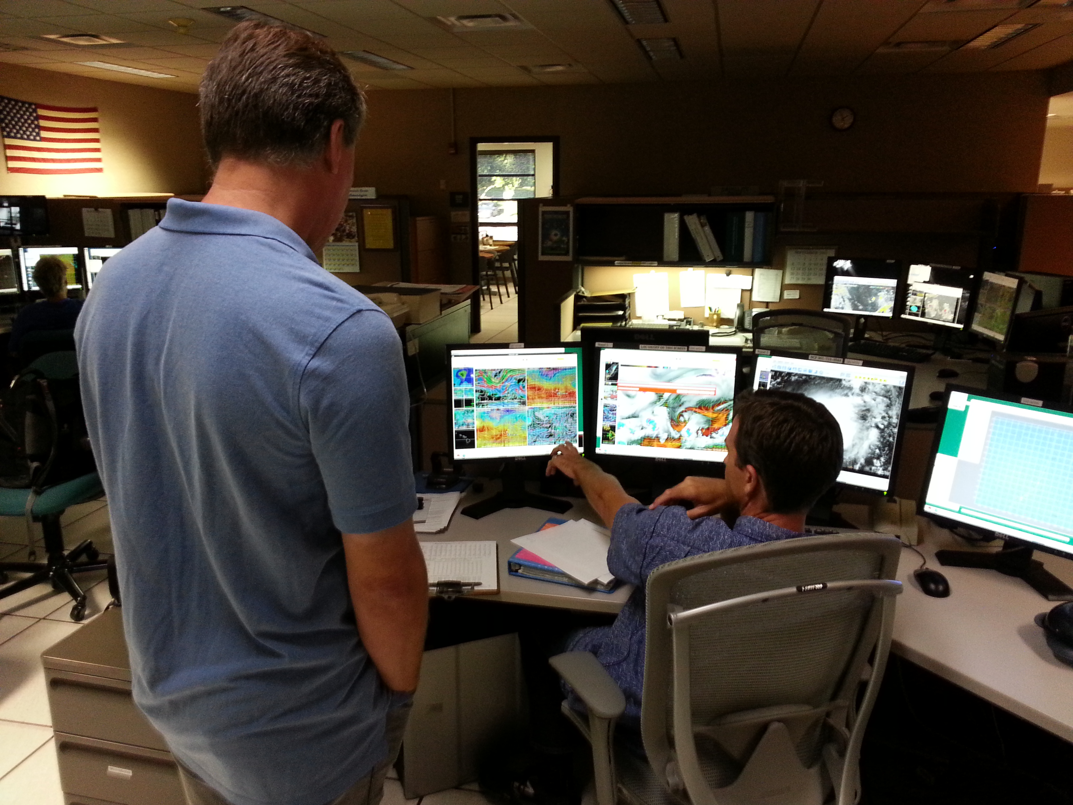
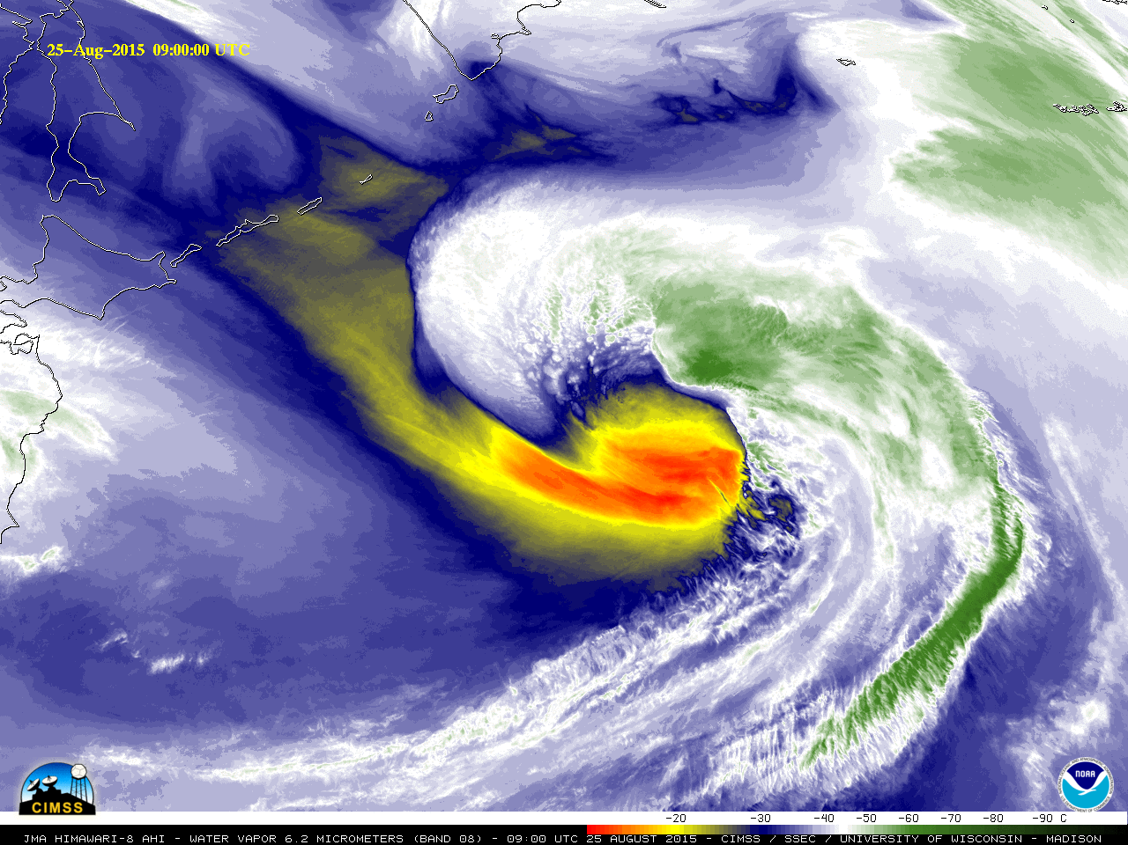
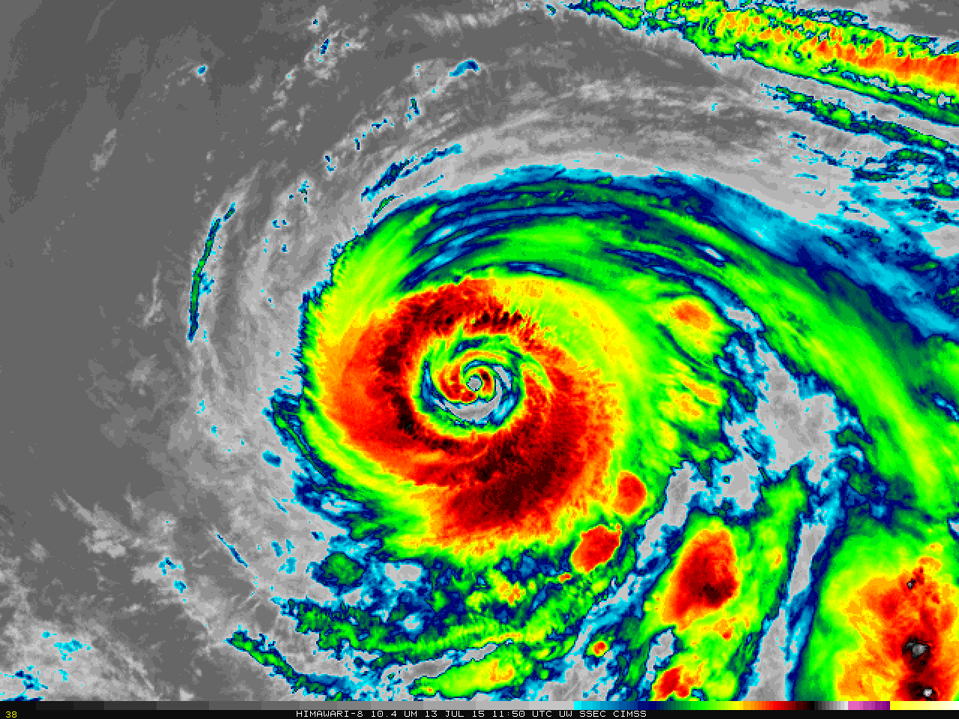
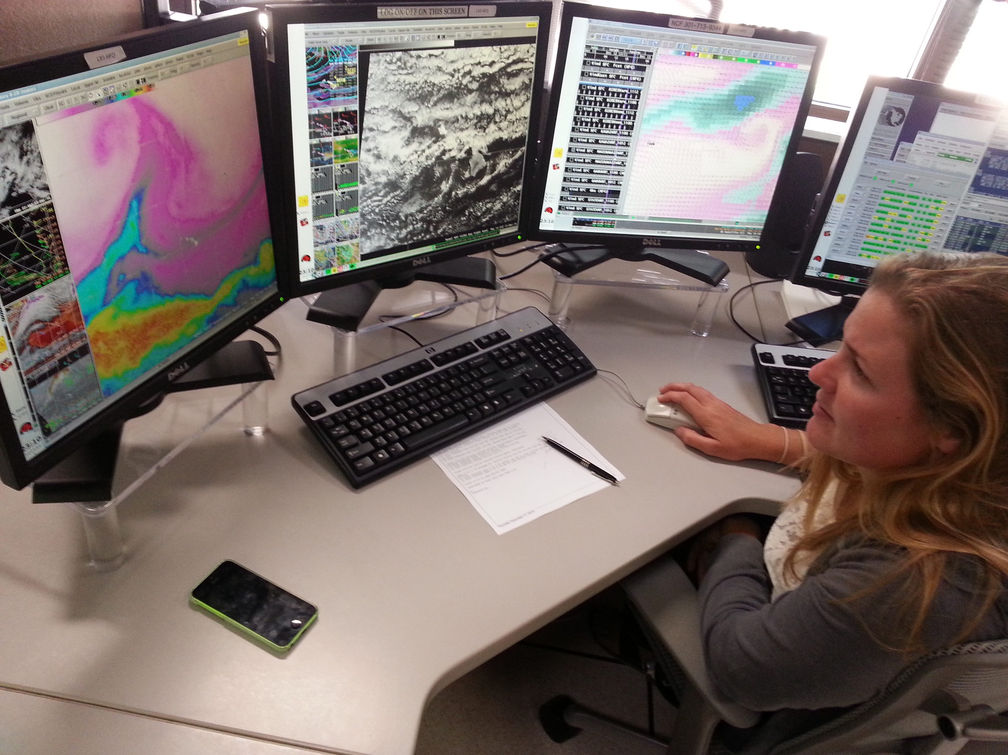
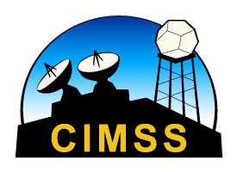
Himawari Training Workshop: Water Vapor Imagery from AHI
Scott Lindstrom
Cooperative Institute for Meteorological Satellite Studies (CIMSS), University of Wisconsin
Honolulu WFO
April 2016

Slide 2
Improvements!
AHI: 3 Water Vapor Channels : 6.2 μm ; 6.9 μm ; 7.3 μm
Current GOES-15 : One water vapor channel
6.5 μm
Past MTSAT-2: One water vapor channel
6.75 μm
AHI: 2-km resolution*
Current GOES-15/MTSAT-2: 4-km resolution*
AHI: 10-minutes for a full disk scan
Current GOES-15/MTSAT-2: ~25 minutes for a full disk scan
* Nominal at sub-satellite point

Slide 3
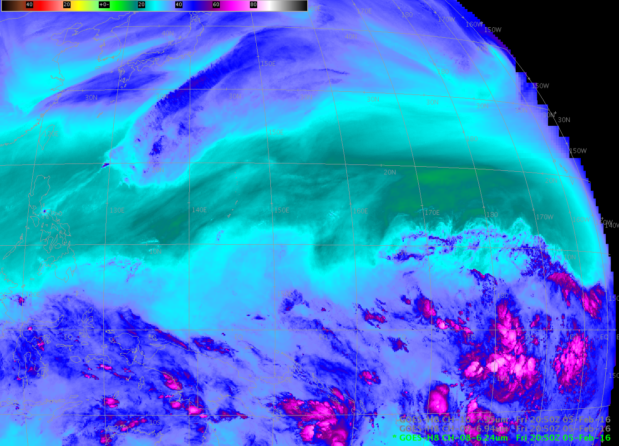
What does 3 Water Vapor channels get you?
6.2 μm
A signature of water vapor
Cirrus clouds show up well, low-level clouds not visible.

Slide 4
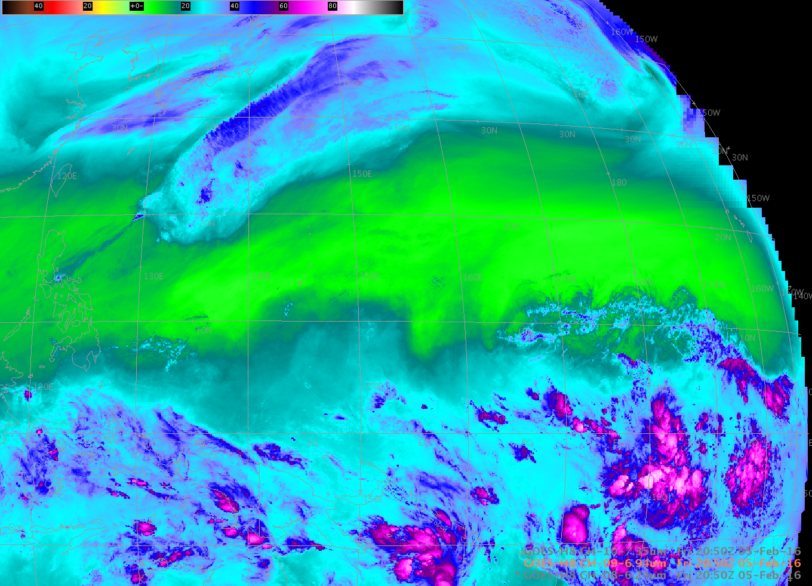
What does 3 Water Vapor channels get you?
6.9 μm
Where did signature of water vapor go?
Absorption of radiation is a function of wavelength. 6.2 μm radiation is absorbed very quickly, 6.9 μm radiation isn’t absorbed so easily. Result: energy from farther down in the atmosphere can be sensed at 7.3 μm vs. 6.9 μm vs. 6.2 μm)

Slide 5
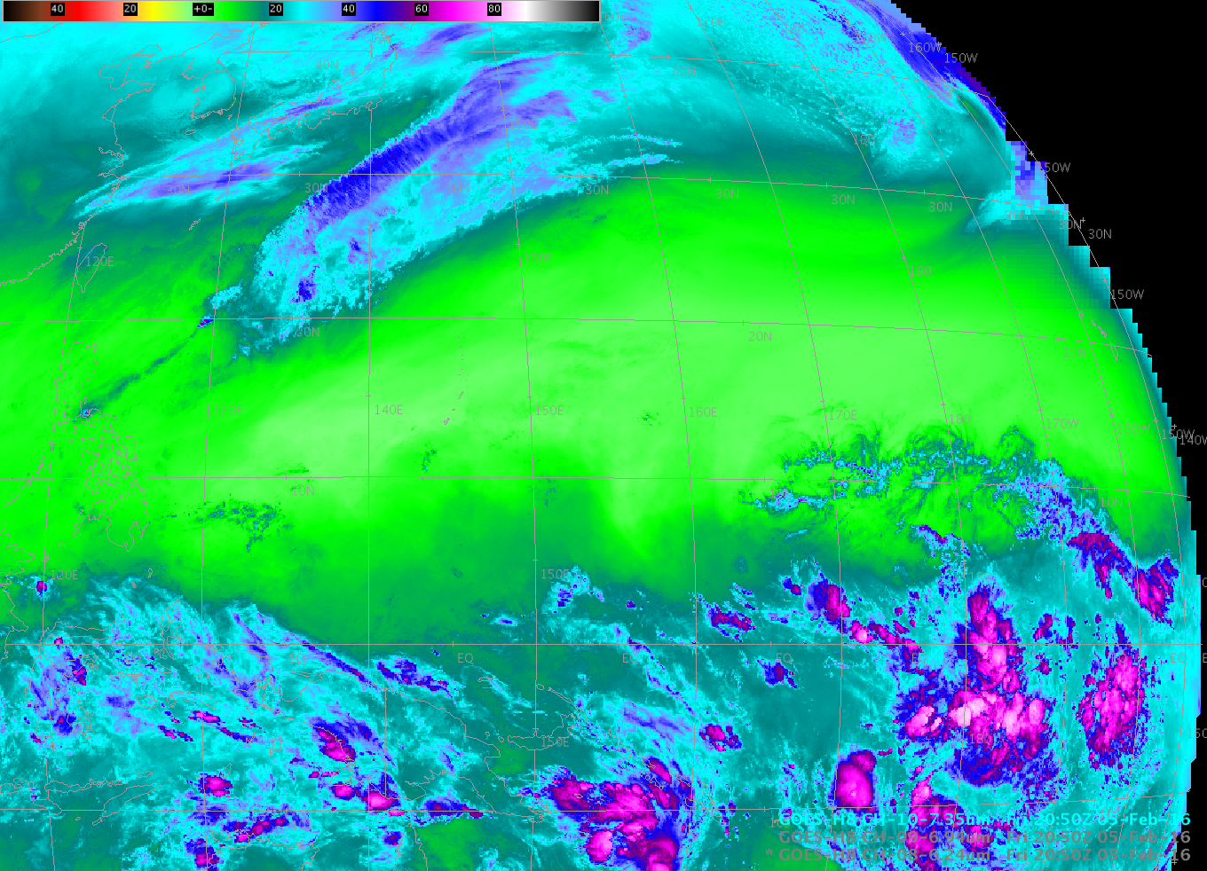
What does 3 Water Vapor channels get you?
7.3 μm
Cirrus clouds not visible, low-level clouds show up well.
Question you should be able to answer: Why the difference in levels between channels?

Slide 6
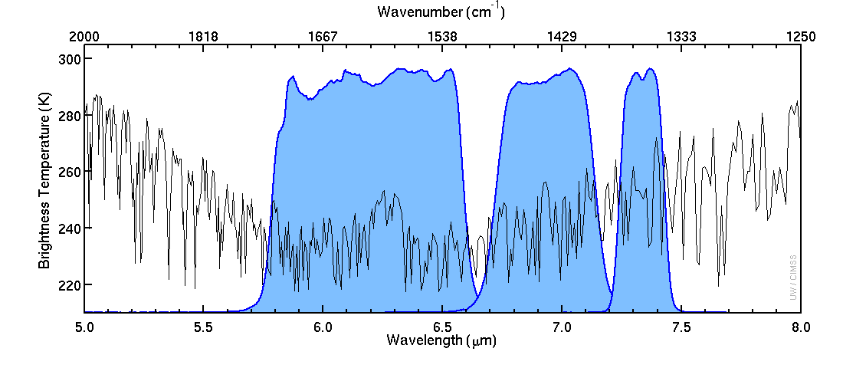
What does 3 Water Vapor channels get you?
Three dimensions (Four, if you animate!)
Water Vapor Imagery shows the top* of a moist layer, and where that top is a function of wavelength: longer wavelengths are detecting energy from farther down into the moist layer
Why? Water Vapor more readily absorbs energy at 6.2 μm vs. 6.9 μm vs. 7.3 μm
So: 6.2 μm energy emitted from, say, 400 mb is more likely to be absorbed than 7.3 μm energy
Temperature Difference
Proportional to absorption
Warmer Temperature:
Less Absorption
6.2 μm
6.9 μm
7.3 μm

Slide 7
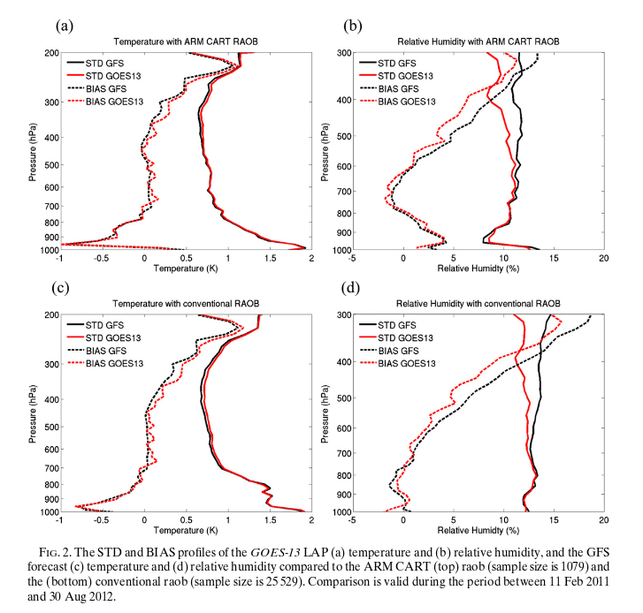
What does 3 Water Vapor channels get you?
Answer: More information about the structure of the atmosphere
Satellite Retrievals do not improve temperature
because temperature is already very accurate
Satellite Retrievals do improve moisture between
700-300 mb – where observations occur
(Think about Water Vapor Weighting Function!)

Slide 8
How do you know from which layer the radiative energy that is sensed by the satellite is originating? The weighting function tells you that information

Slide 9
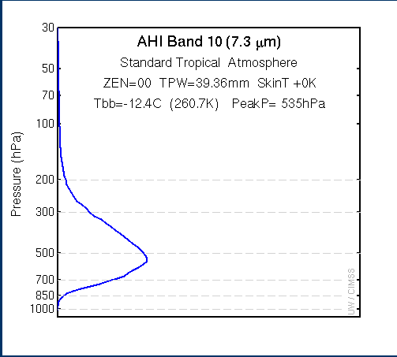
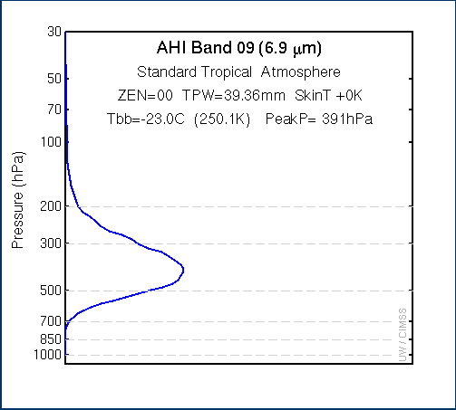
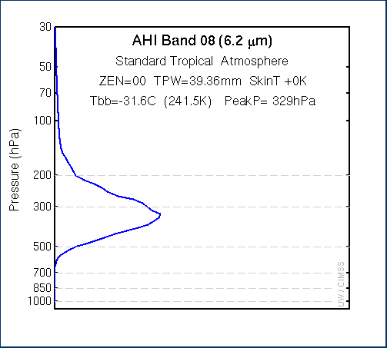
Weighting Functions: Tell you the layer that is emitting the energy
391 mb
329 mb
535 mb
Longer Wavelength has a peak farther down in the atmosphere.
Why? This tells you something about radiative properties of the atmosphere
Graphs above from this site: (Bookmark it!)
http://cimss.ssec.wisc.edu/goes/wf/AHI/

Slide 10
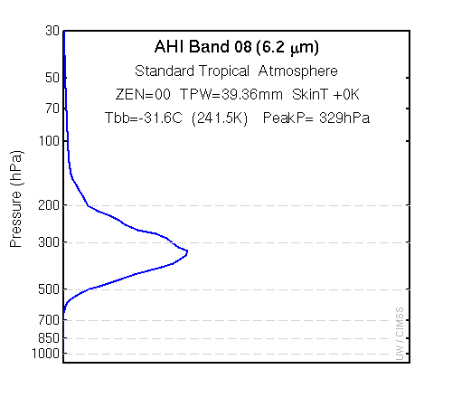
Levels change with wavelength
Because the level changes: the Brightness Temperature Changes too!
Note: This is a Clear Sky Retrieval

Slide 11
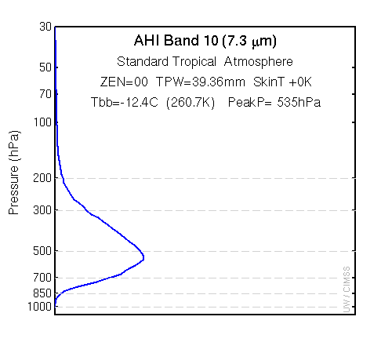
Levels change with wavelength
Because the level changes: the Brightness Temperature Changes too!
Note: This is a Clear Sky Retrieval
(What should a cloudy sky retrieval yield for a weighting function?)

Slide 12
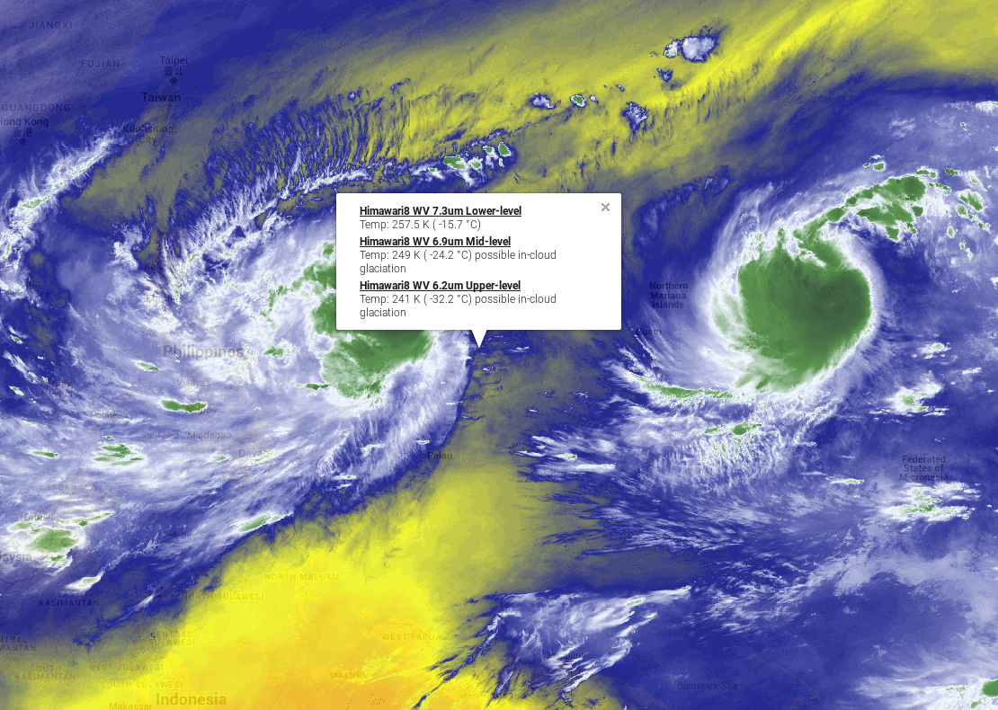

Slide 13
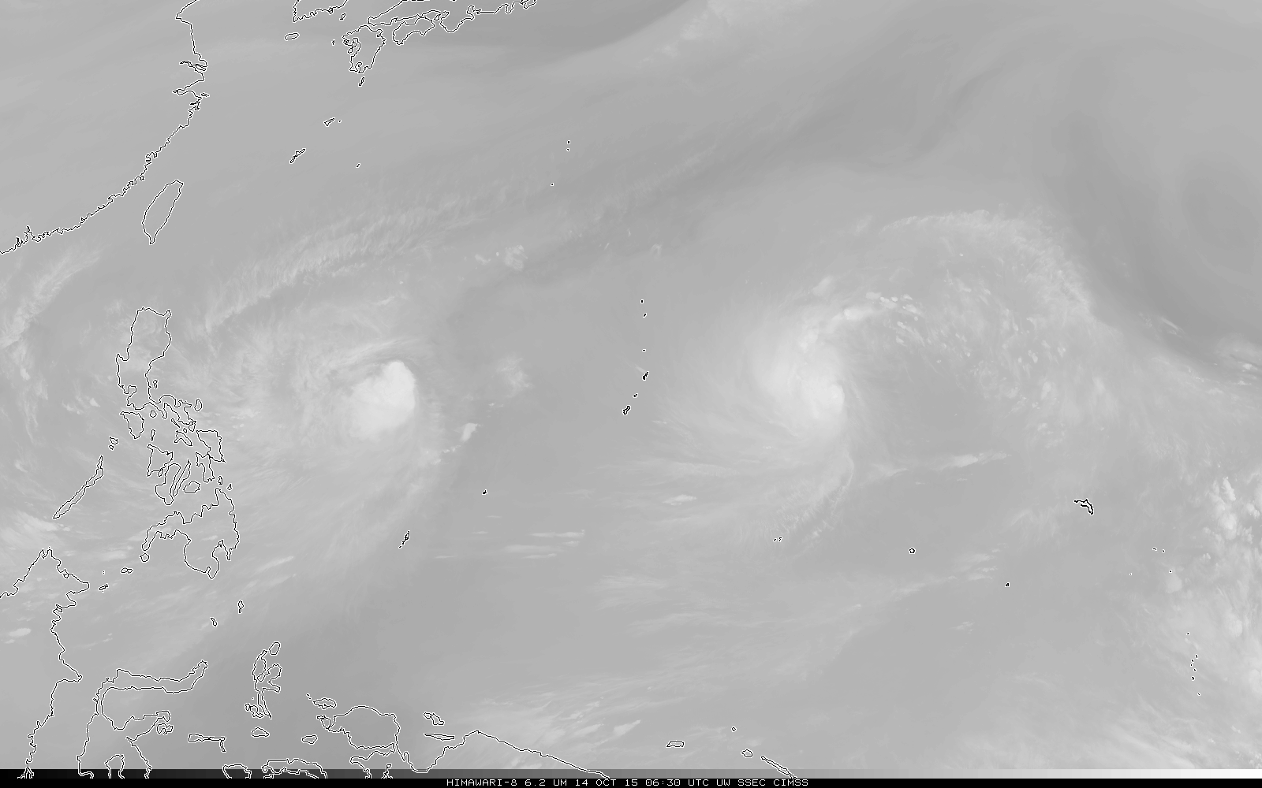
6.2μm – 6.75μm – 6.9μm – 7.3μm --- from coldest to warmest in this greyscale

Slide 14
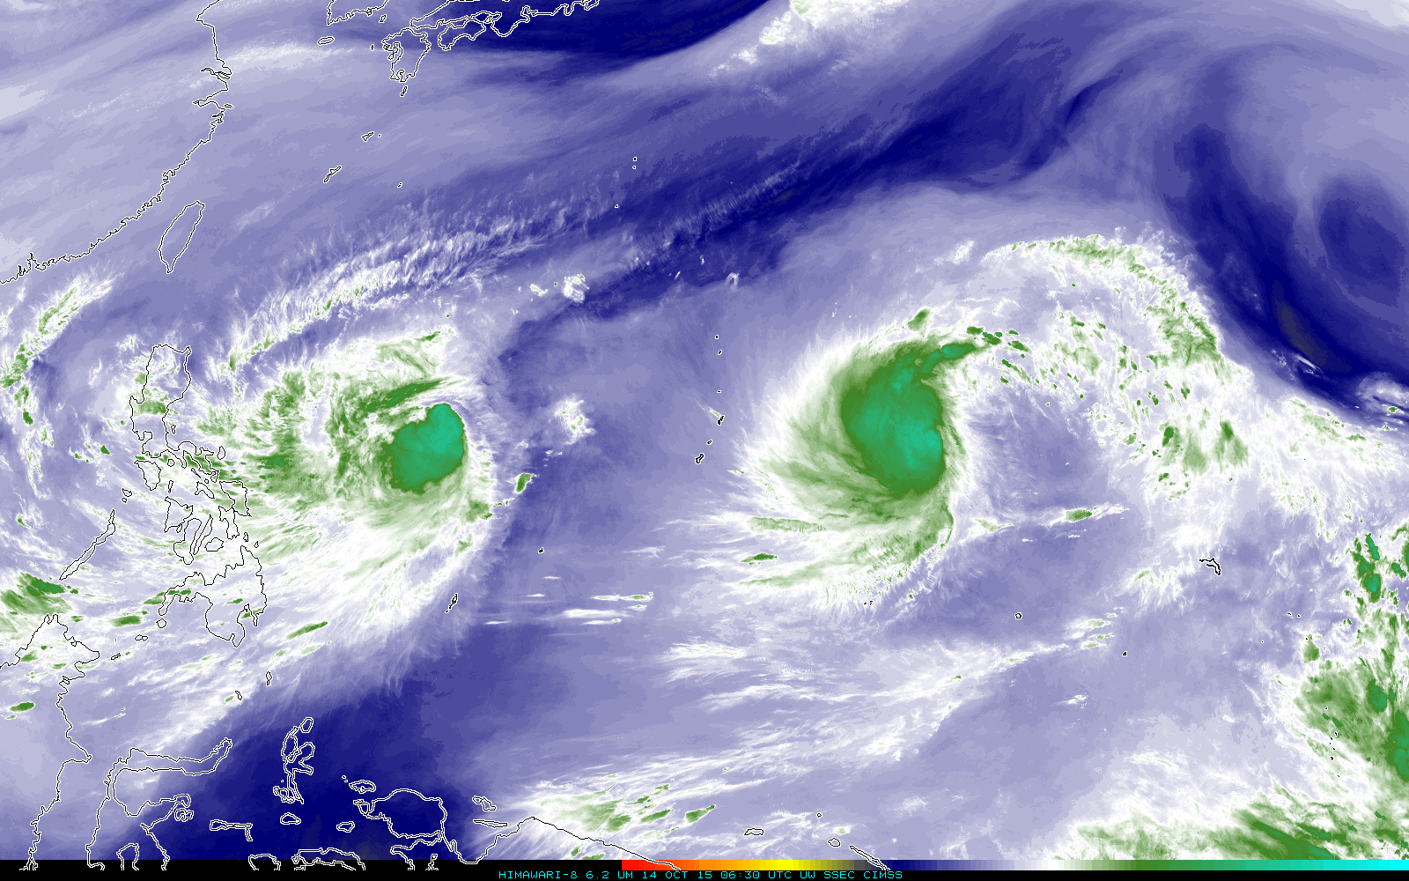
All other things being equal: You see warmer temperatures with longer wavelengths
(because the energy is coming from farther down in the atmosphere)
6.2μm – 6.75μm – 6.9μm – 7.3μm --- from coldest to warmest in this color-enhanced imagery

Slide 15
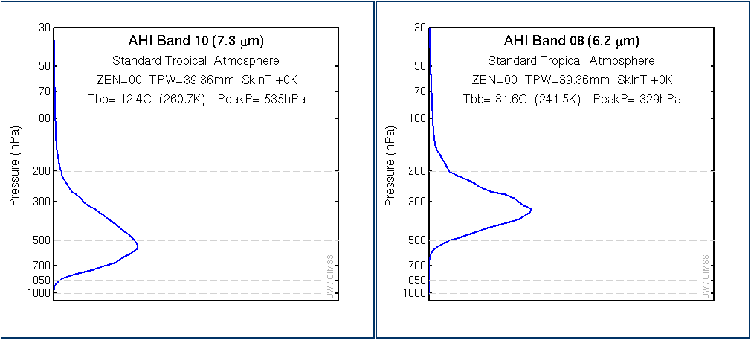
Brightness Temperature (and emitting layer height) changes with Zenith Angle
Zenith Angle ranges between 0º and 70º
Why the change? Path through (cold) upper atmosphere is a function of Zenith Angle
Note the bigger range in Zenith changes at the longer wavelength

Slide 16
Brightness Temperature (and emitting layer height) changes with column moisture Assumption: Evenly mixed water vapor
Column moisture: 100%, 70%, 40%, 10%
A dryer pixel is usually a warmer pixel – because you see farther down into the atmosphere
(But that might happen when the atmosphere is very very cold)

Slide 17
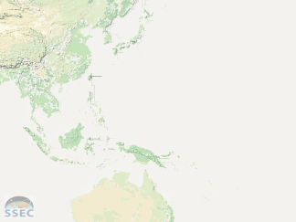
Does the Water Vapor Channel Give you
Information about total Precipitable Water?

Slide 18
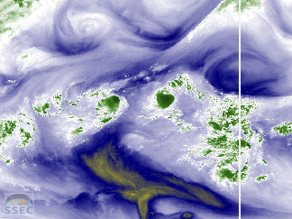
Is this also the distribution of total
Precipitable Water?

Slide 19
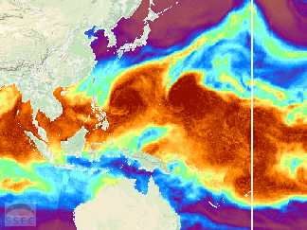
Compare this distribution to the
water vapor distribution

Slide 20
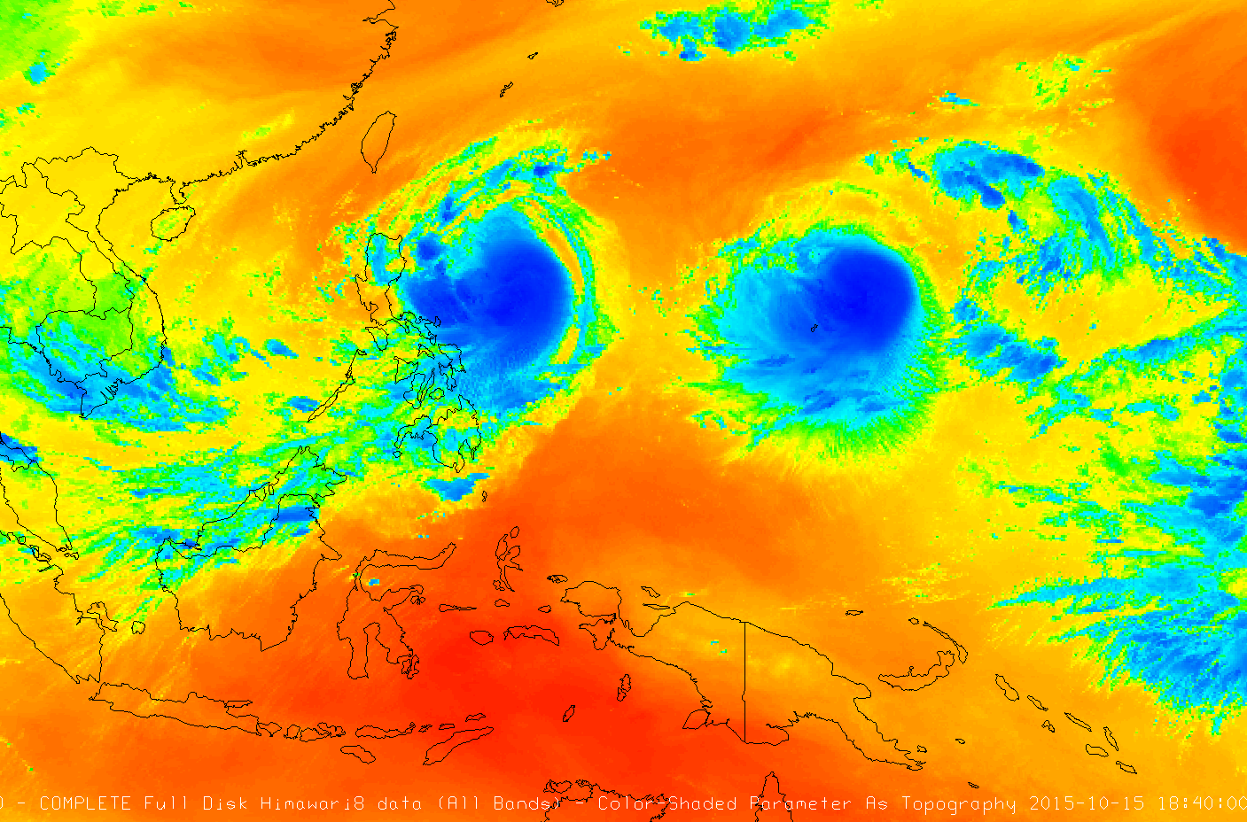
How Many Dimensions do you see?

Slide 21
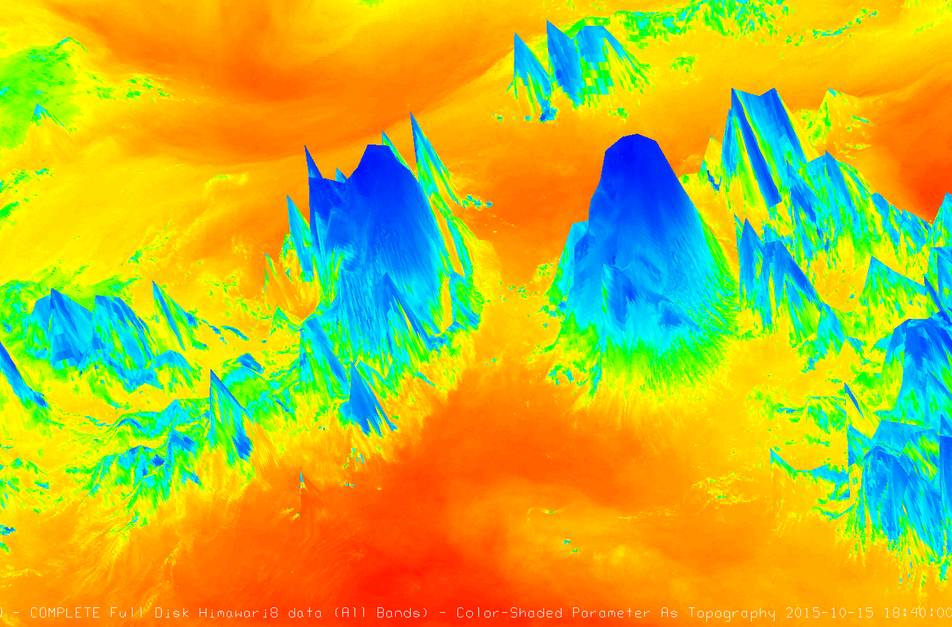
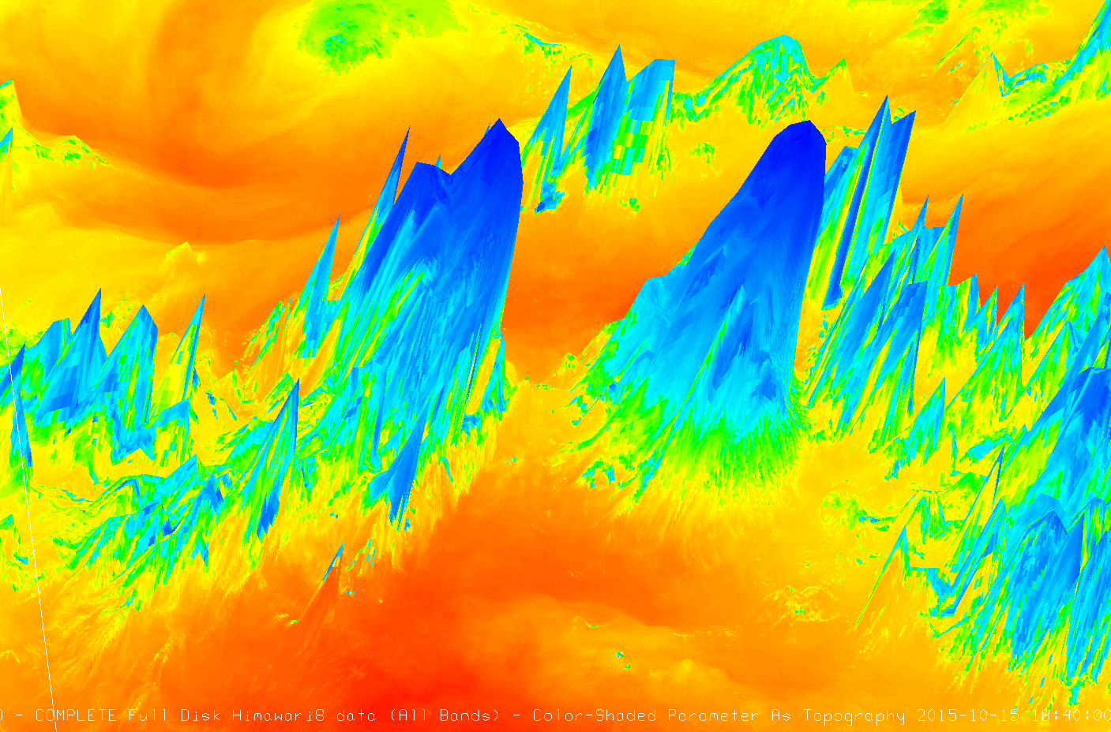
Water Vapor Imagery depicts
a surface! Treat it that way

Slide 22
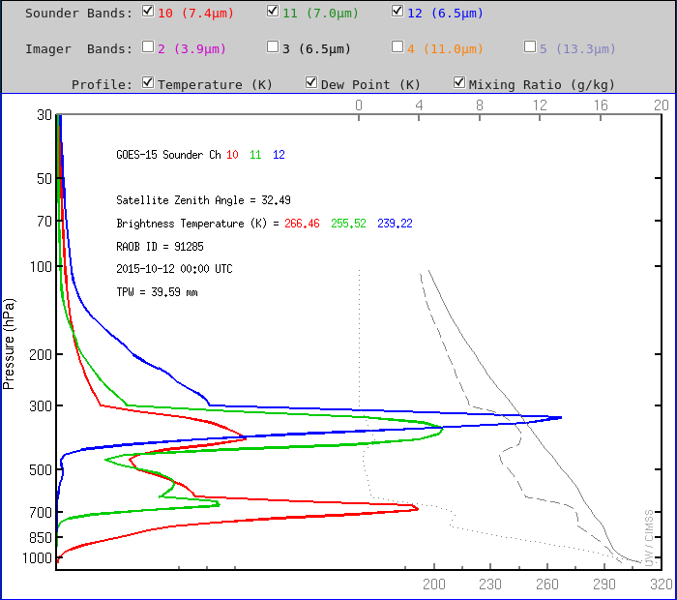
Weighting Functions change by day, depending on the weather

Slide 23
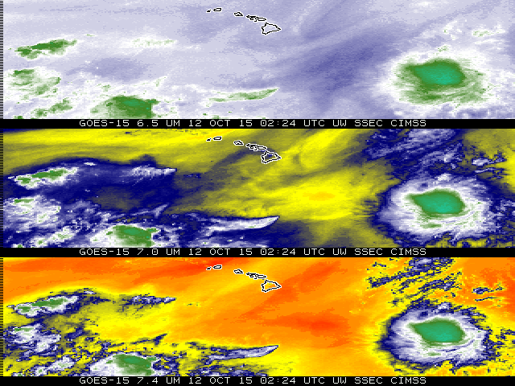

Slide 24
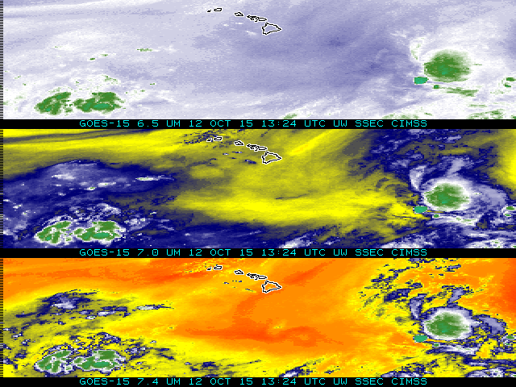
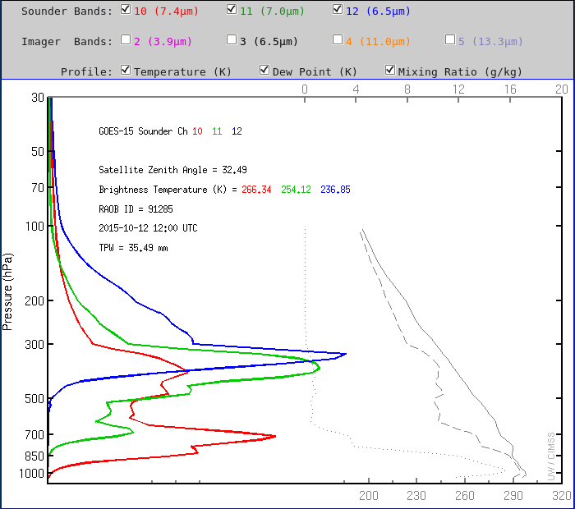

Slide 25
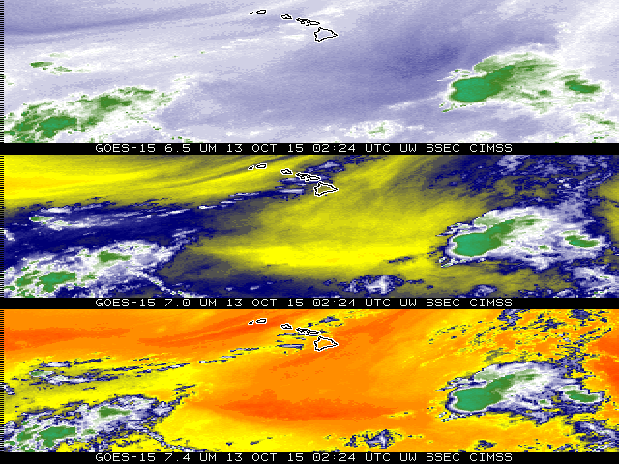
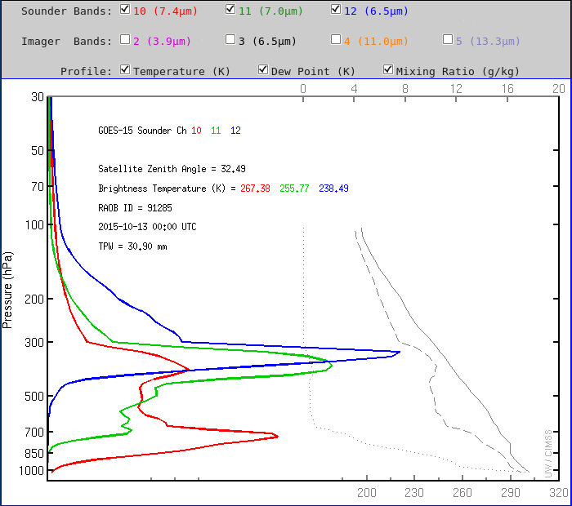

Slide 26
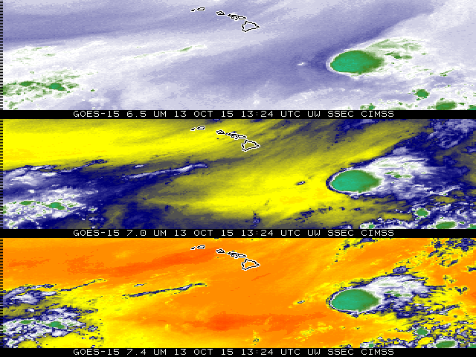
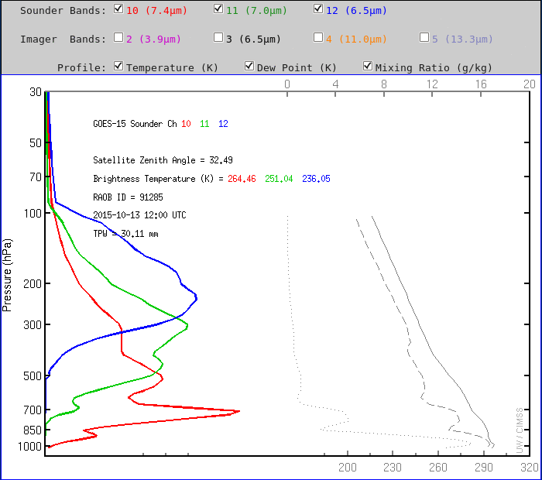

Slide 27
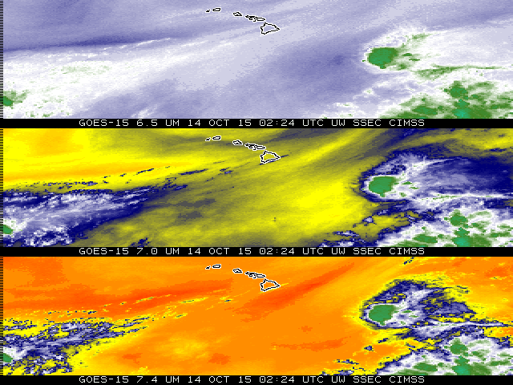
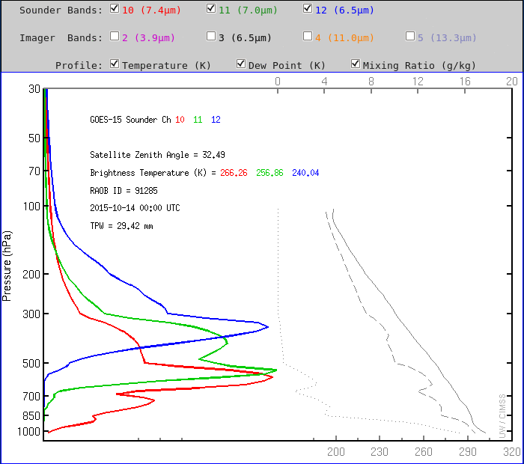

Slide 28
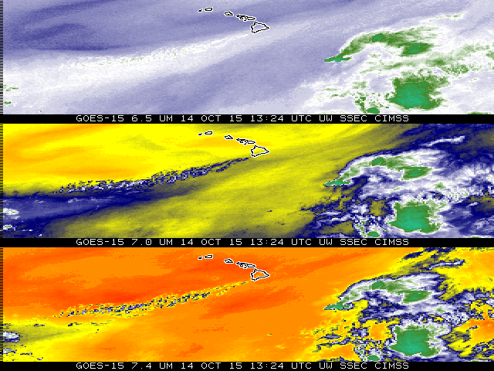
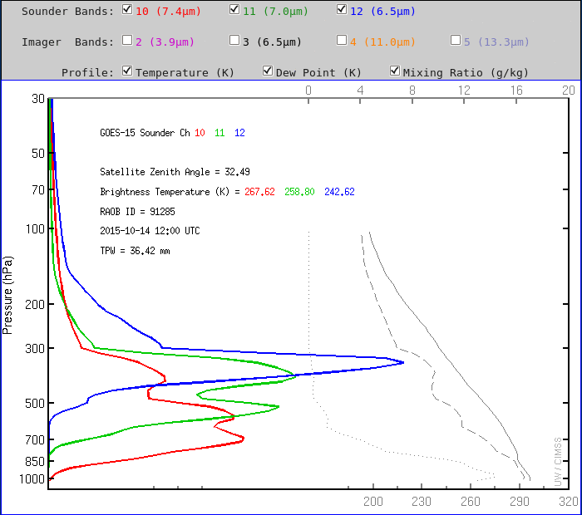

Slide 29
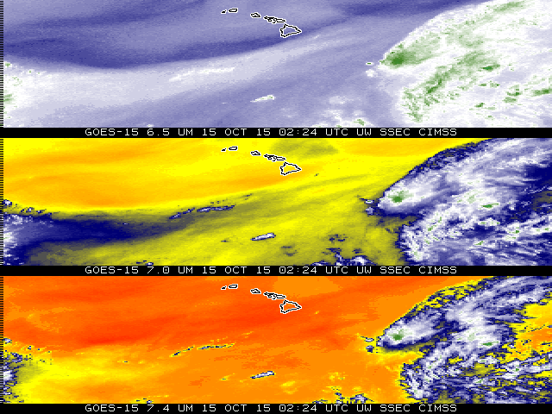
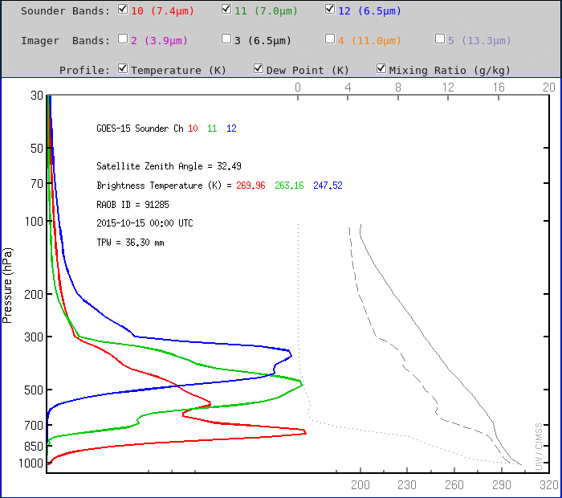

Slide 30
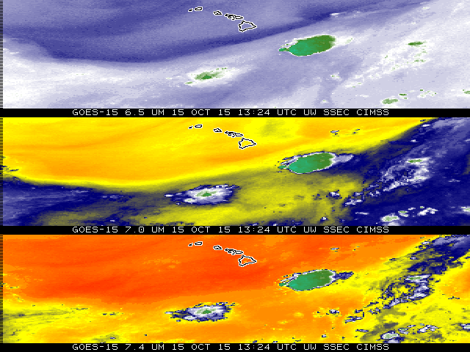
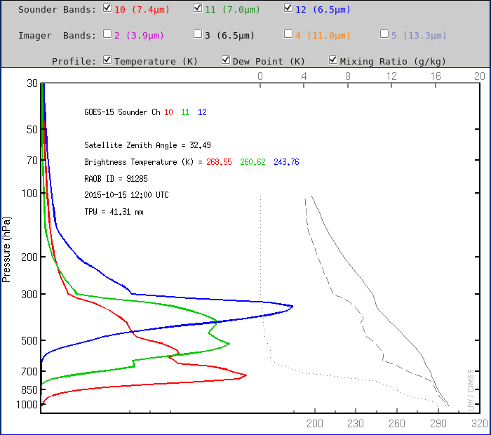

Slide 31
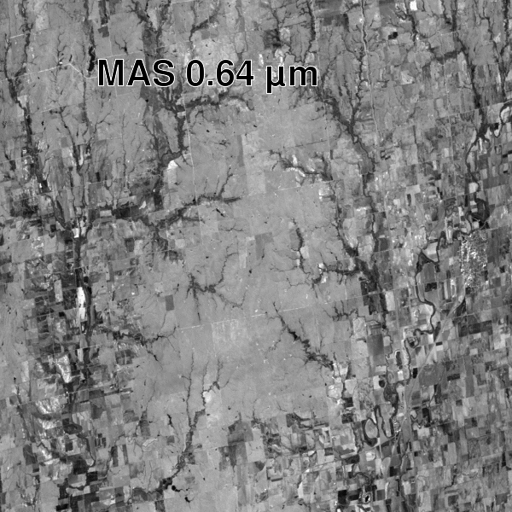
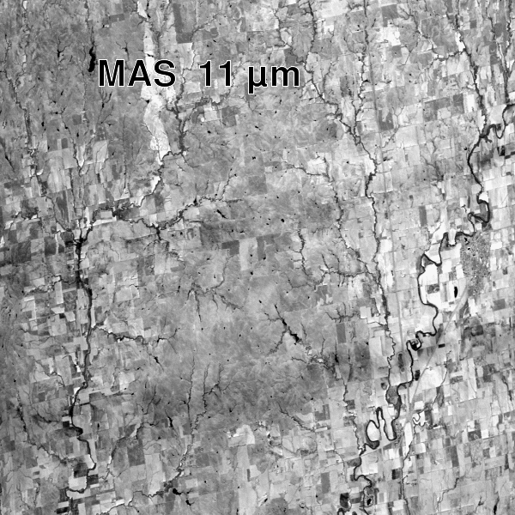
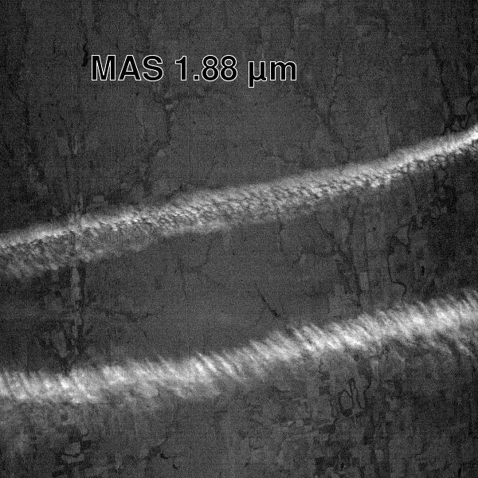
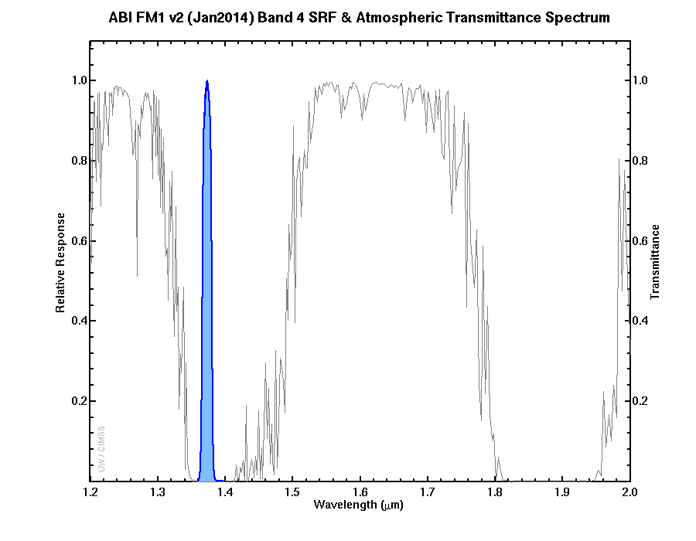
1.88 μm (or 1.38 μm): Band on ABI, and AMI not AHI
(GOES-R)
(Himawari)
(AMI – Korean satellite ~2019)
This is *reflected* radiation

Slide 32
Water Vapor Channels
1.38 μm : Cirrus Channel, detects high cirrus, low dust (in a dry atmosphere)
6.2 μm : Water Vapor Channel, upper levels
6.9 μm : Water Vapor Channel, mid-levels
7.4 μm : Water Vapor Channel, lower levels
A warmer pixel can be warmer or dryer (or both)

Slide 33
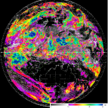
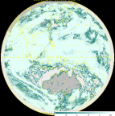
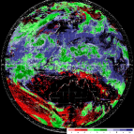
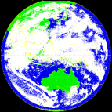
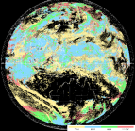
Changes COMS & GEO-KOMPSAT-2A
resolution 6 times upgrade
channel 3times increase
products 3.5 times increase
COMS
Geo-KOMPSAT-2A
COMS
Geo-KOMPSAT-2A
COMS
VIS 1km
IR 4km
Geo-KOMPSAT-2A
VIS 0.5~1km
IR 2km
1
(Black and white)
4
(color image)
Cloud/pre. : 5
Cloud/pre. :19
VIS
Observation frequency 6 times
Aerosol : 5
Aerosol : 16
1hr
2
SW IR
O
Full disk : 1
Full disk : 6
AMV : 3
AMV : 6
4
10
NH : 2
NH : 10
IR
Land sfc. : 3
Land sfc. : 11
…....
KP : every 15min
KP : every 2min
5 channel
16 channel
Total : 16
Total : 52

