Slide 1
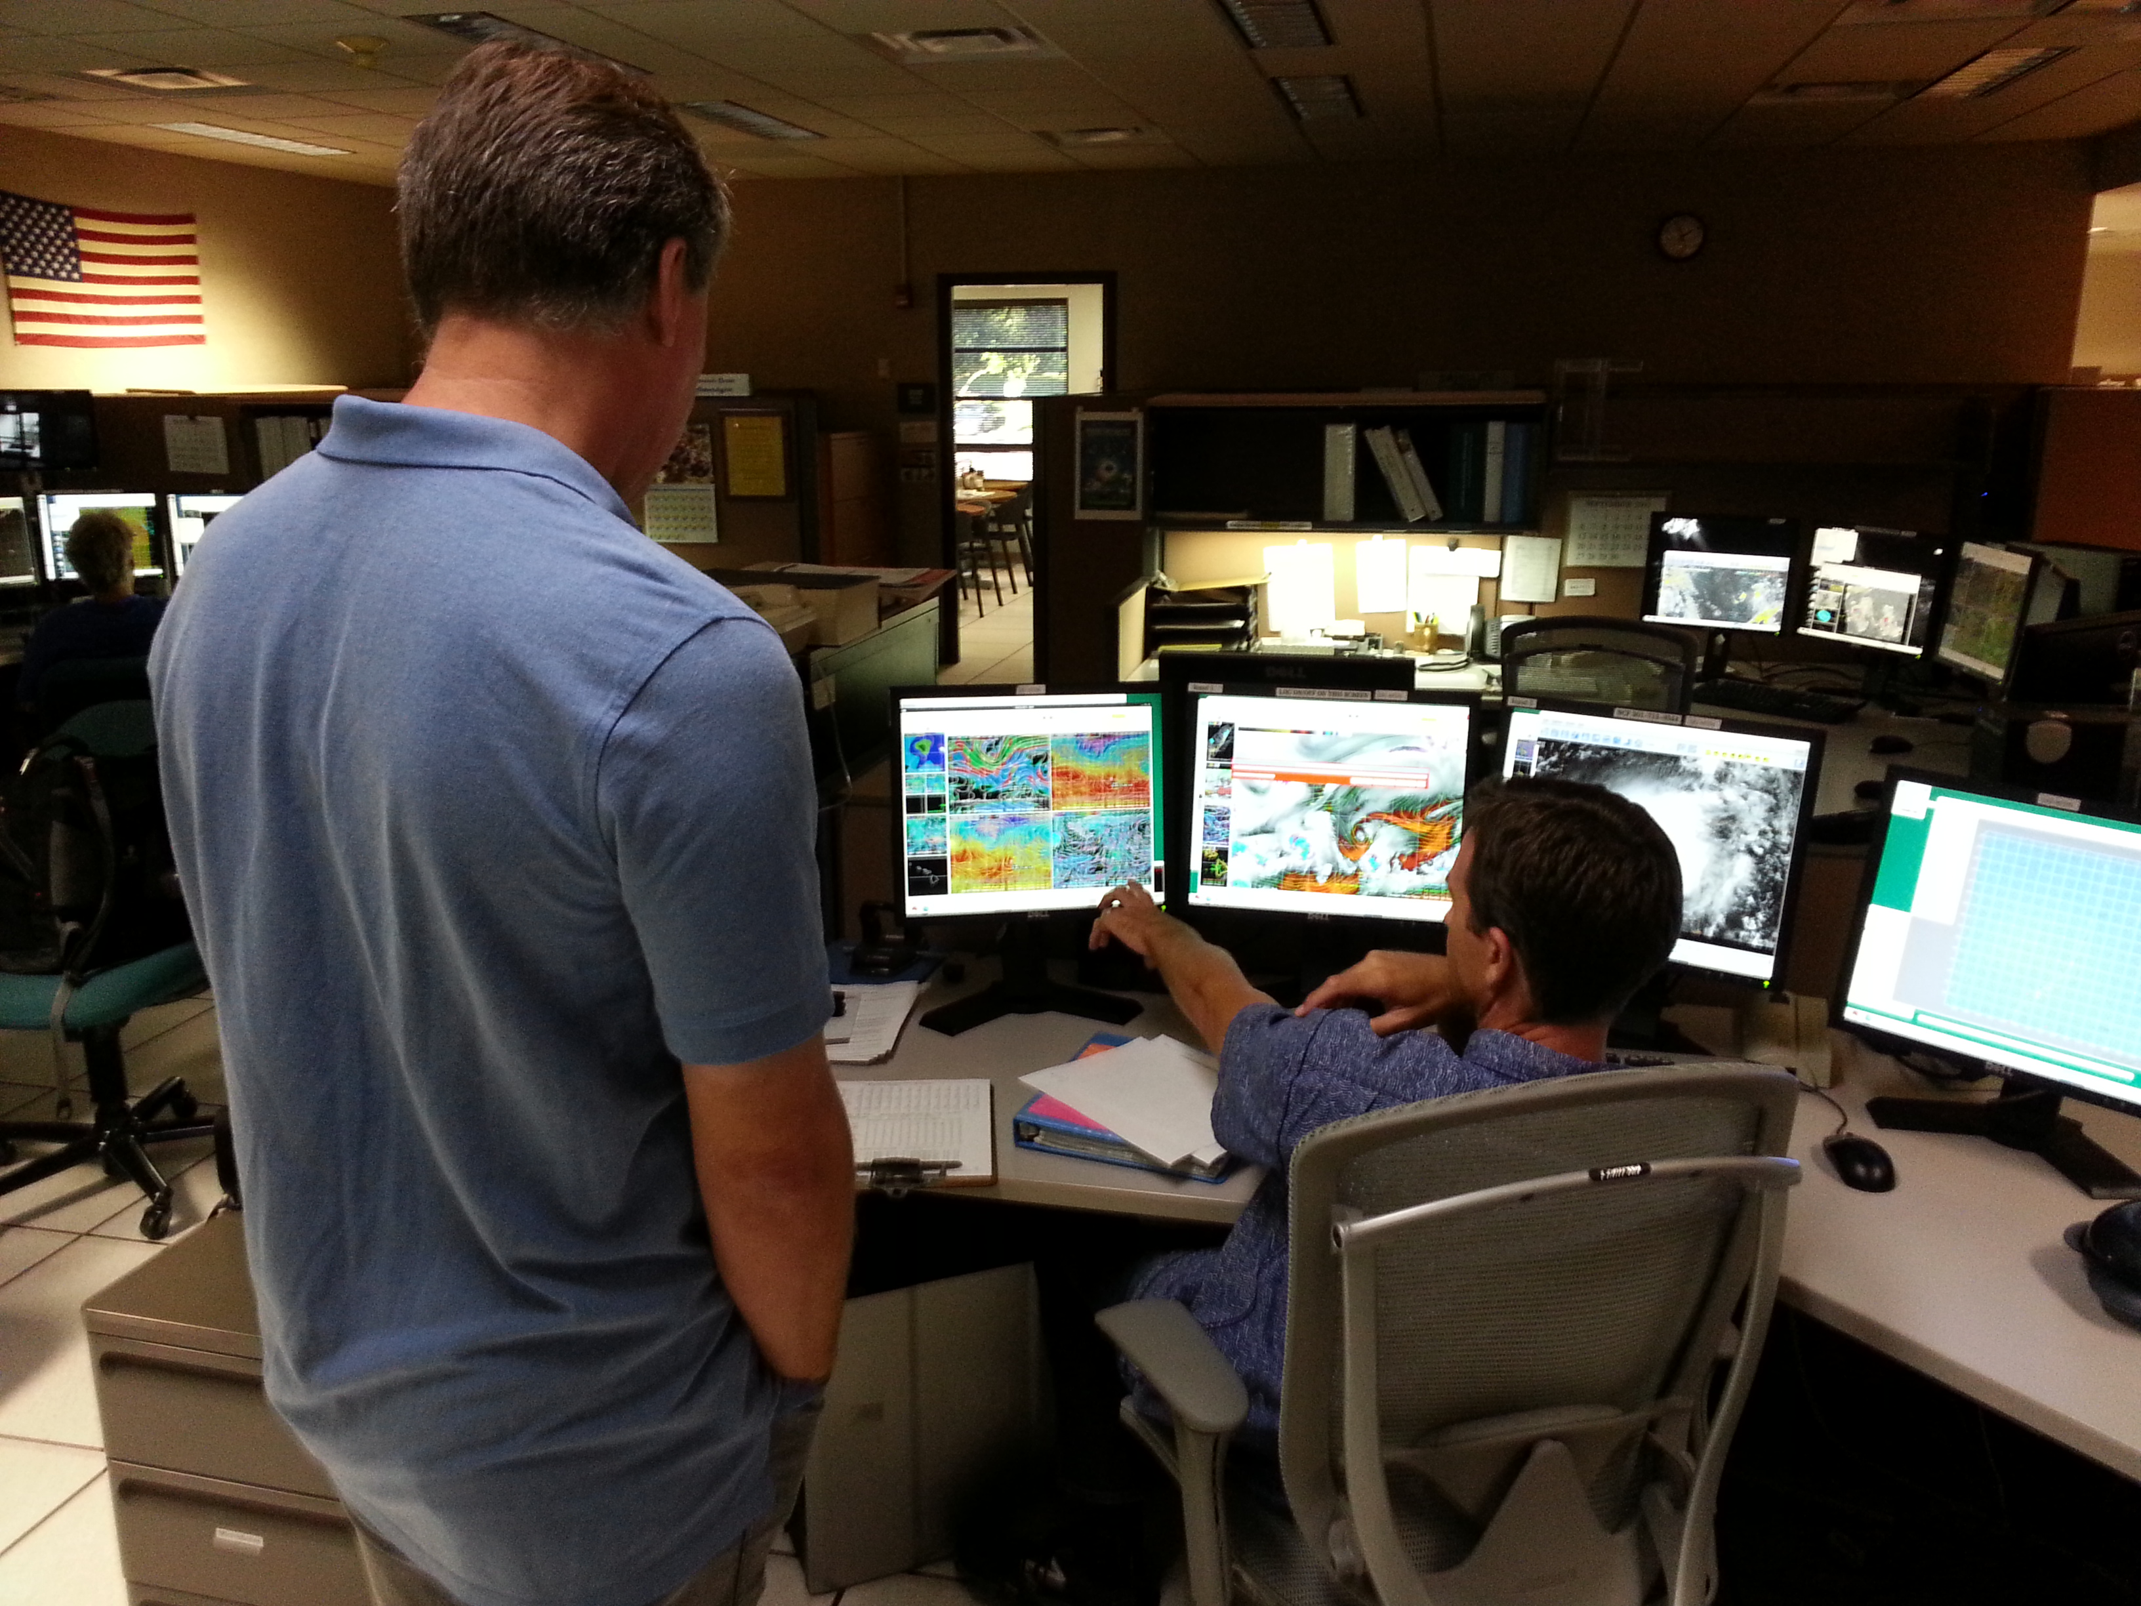
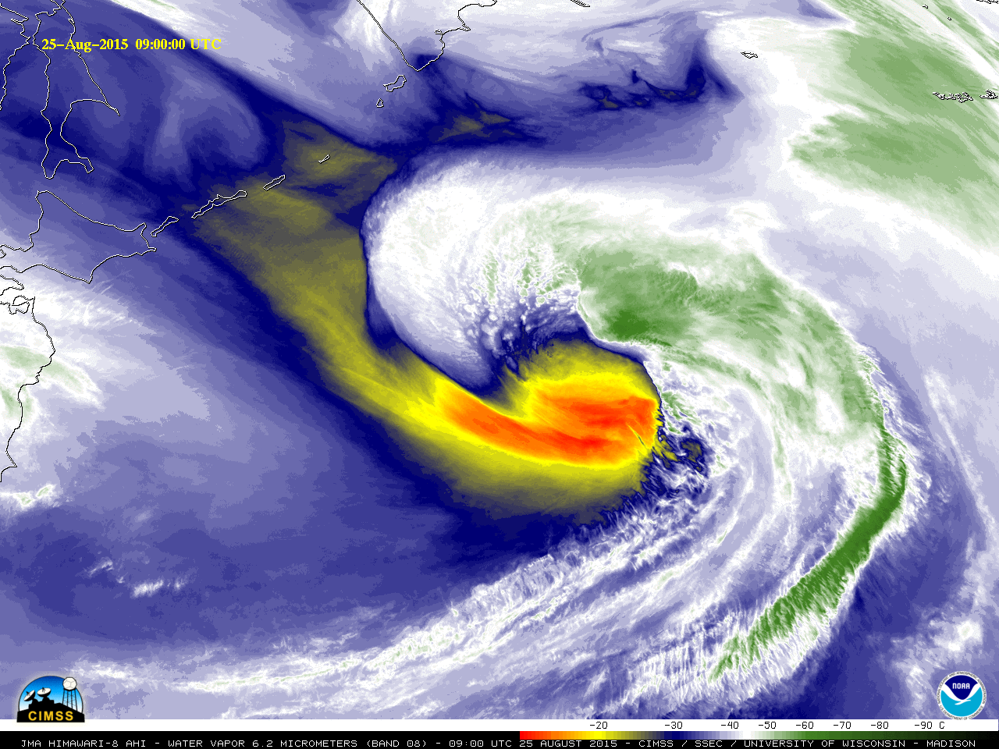
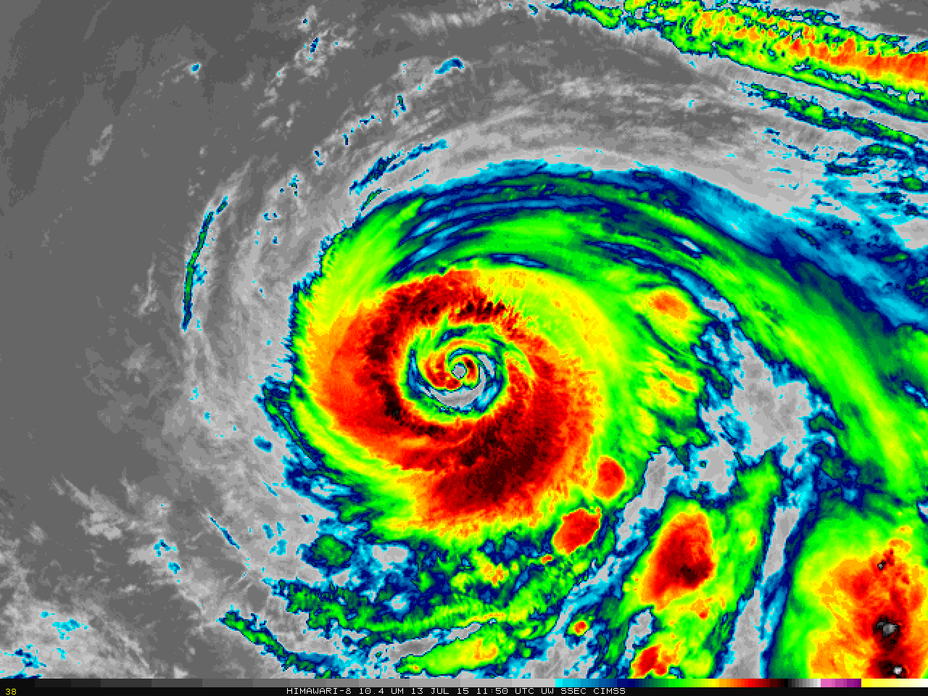
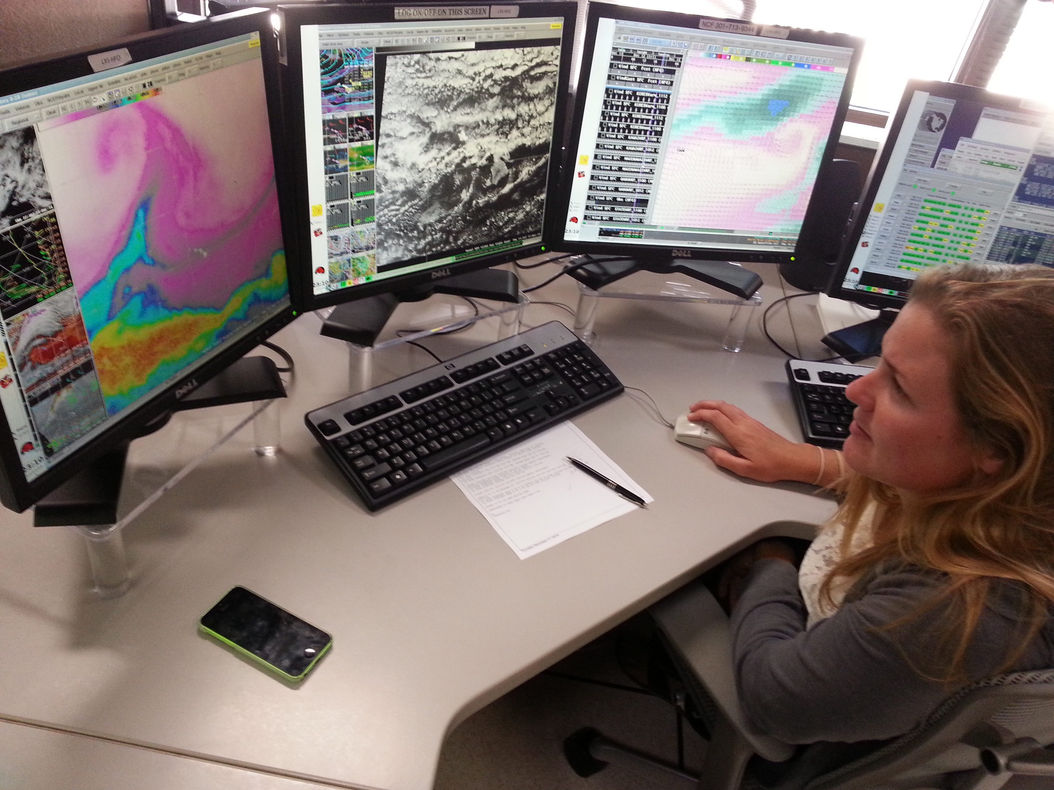
Himawari Training Workshop: AHI Weighting Functions and Red-Green-Blue Composites
Jordan Gerth
Cooperative Institute for Meteorological Satellite Studies (CIMSS), University of Wisconsin
Honolulu, Hawaii
11 and 14 April 2016

Slide 2
Contributors
Tim Schmit
NOAA Advanced Satellite Products Branch
Mat Gunshor
Cooperative Institute for Meteorological Satellite Studies
Paul Menzel
Cooperative Institute for Meteorological Satellite Studies
Others

Slide 3
Two Components
Understand weighting functions and how they can improve your interpretation of satellite imagery as depicting the vertical dimension as a plan view
How to combine multiple spectral bands into a single, composite image
Both components will use web applications
More exploration, less guided
Use SIFT to interrogate imagery closer if needed

Slide 4
AHI Infrared Weighting Functions
Bands 7 through 16, very similar to ABI
Clear-sky

Slide 5
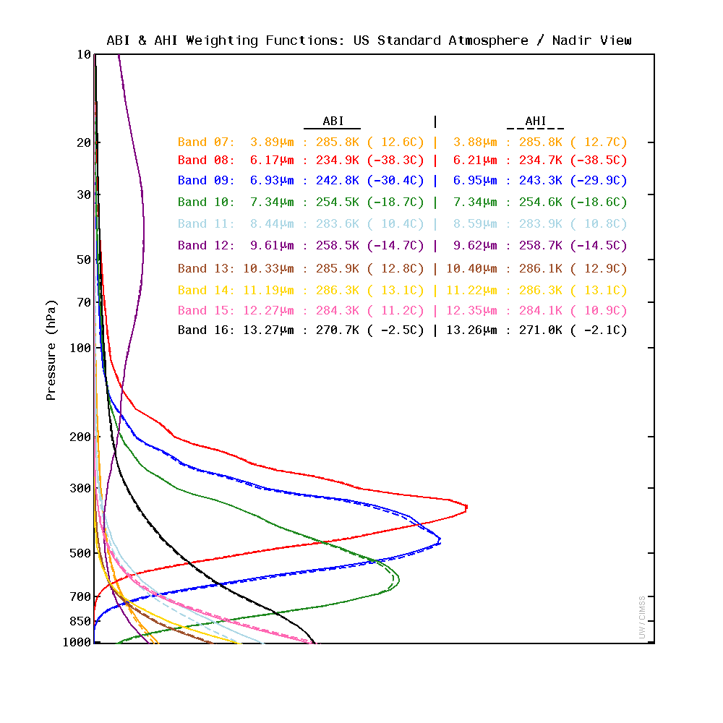
Clear-sky

Slide 6
Weighting Function Considerations
The satellite sees through the atmosphere from the top.
This contrasts to how humans see the atmosphere.
Brightness temperatures are determined by the quantity of the various radiating molecular species in the atmosphere and the temperature of the parent air mass.
Weighting functions are determined from the vertical distribution/concentration of molecular species relative to the wavelength.

Slide 7
Active Molecular Species
Molecular (di-) oxygen (O₂) and nitrogen (N₂) do not absorb and re-emit infrared radiation.
Other molecular species do:
Carbon dioxide (CO₂)
Relatively homogeneous in the troposphere
Water vapor (H₂O)
Favors the lower troposphere
Ozone (O₃)
Stratosphere

Slide 8
Transmittance for Window Bands
z
τ + a + r = 1
z_{N}
close to 1
a close to 0
The molecular species in the
atmosphere are not very active:
most of the photons emitted by the surface make it to the satellite
if a is close to 0 in the atmosphere then ε is close to 0, not much contribution from the atmospheric layers
z₂
z₁
1
τ

Slide 9
Transmittance for Absorption Bands
z
z_{N}
Absorption Band:
τ close to 0
a close to 1
One or more molecular species in the atmosphere is/are very active:
most of the photons emitted by the surface will not make it to the satellite (they will be absorbed)
if a is close to 1 in the atmosphere then ε is close to 1, most of the observed energy comes from one or more of the uppermost atmospheric layers
z₂
z₁
1
τ

Slide 10
Weighting Functions
How the transmittance varies with height
The layer of the atmosphere observed by a given spectral band
Depends on the band; input temperature, moisture, and ozone profiles; skin temperature; surface emissivity; and the zenith (view) angle
Clear-sky fast forward calculations
For simplicity, in this training material, a surface emissivity value of 1 is used for each band

Slide 11
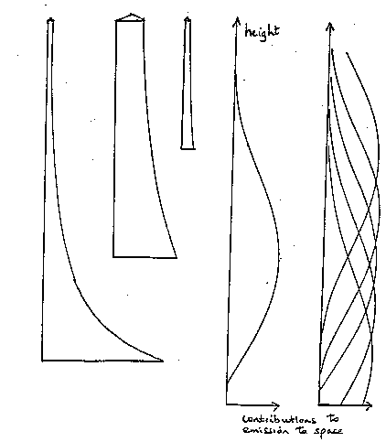
Rsfc R1 R2
top of the atmosphere
τ2 = transmittance of upper layer of atm
τ1= transmittance of lower layer of atm
bb earth surface.
Robs =
Rsfc τ1 τ2 + R1 (1-τ1) τ2 + R2 (1- τ2)

Slide 12
Transmittance vs. Weighting Function
z_{N}
z_{N}
z₂
z₂
z₁
z₁
1
τ
dτ/dz

Slide 13
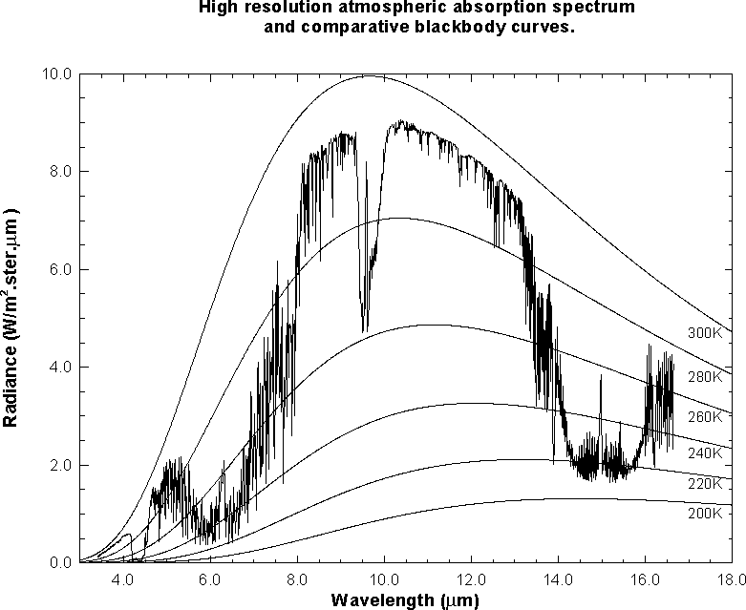
Earth emitted spectra overlaid on Planck function envelopes
O₃
CO₂
H₂O
CO₂
Refer to handout for absorption spectrum relative to spectral response functions

Slide 14
Standard Tropical Profile
Surface Pressure set to 1013 hPa
Without modification the total column ozone for this profile is 283 Dobson Units (DU)
Near-surface temperature and dew point is around 300 K (27° C)

Slide 15
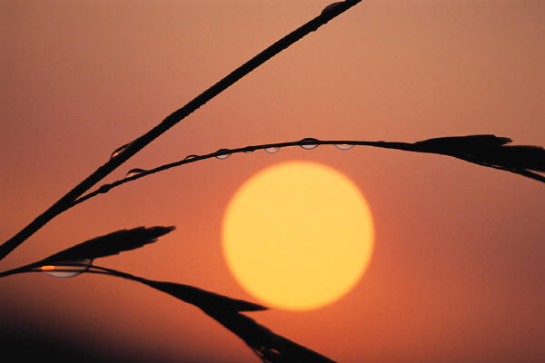
Zenith Angle Matters
The satellite senses through the atmosphere
The path through the atmosphere increases toward the limb of the earth
Changes the weighting function
Changes the brightness temperature
Depends on the band
Parallax increases as zenith angle increases

Slide 16
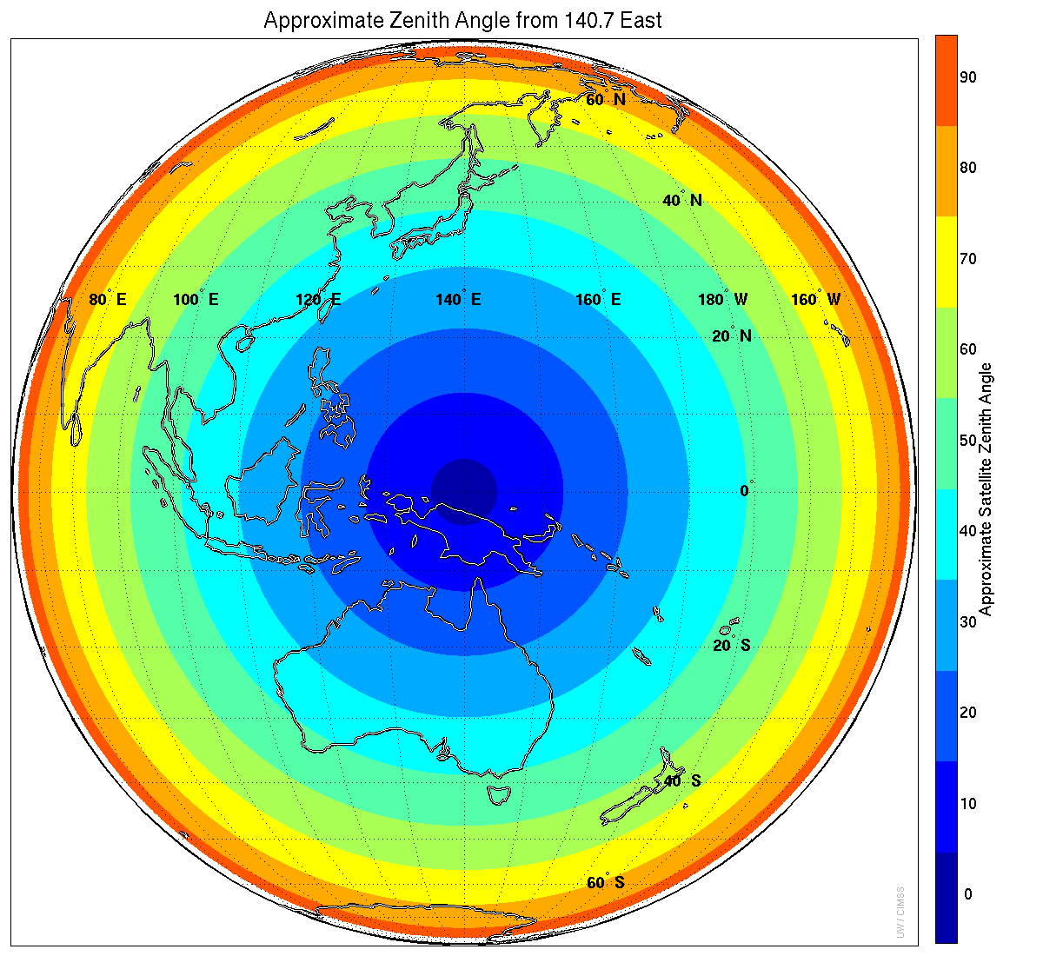
Notes:
Approximate zenith angle, rounded to the nearest 10. So the first, dark blue, ring covers zenith angles from 0 to 4.9 and called “0” on the scale; zenith angles above 5 and below 15 go into the next ring and are labeled as “10”, etc. Himawari-8 operational location.

Slide 17
View Angle Considerations
Depends on the absorptive molecular species in each band

Slide 18
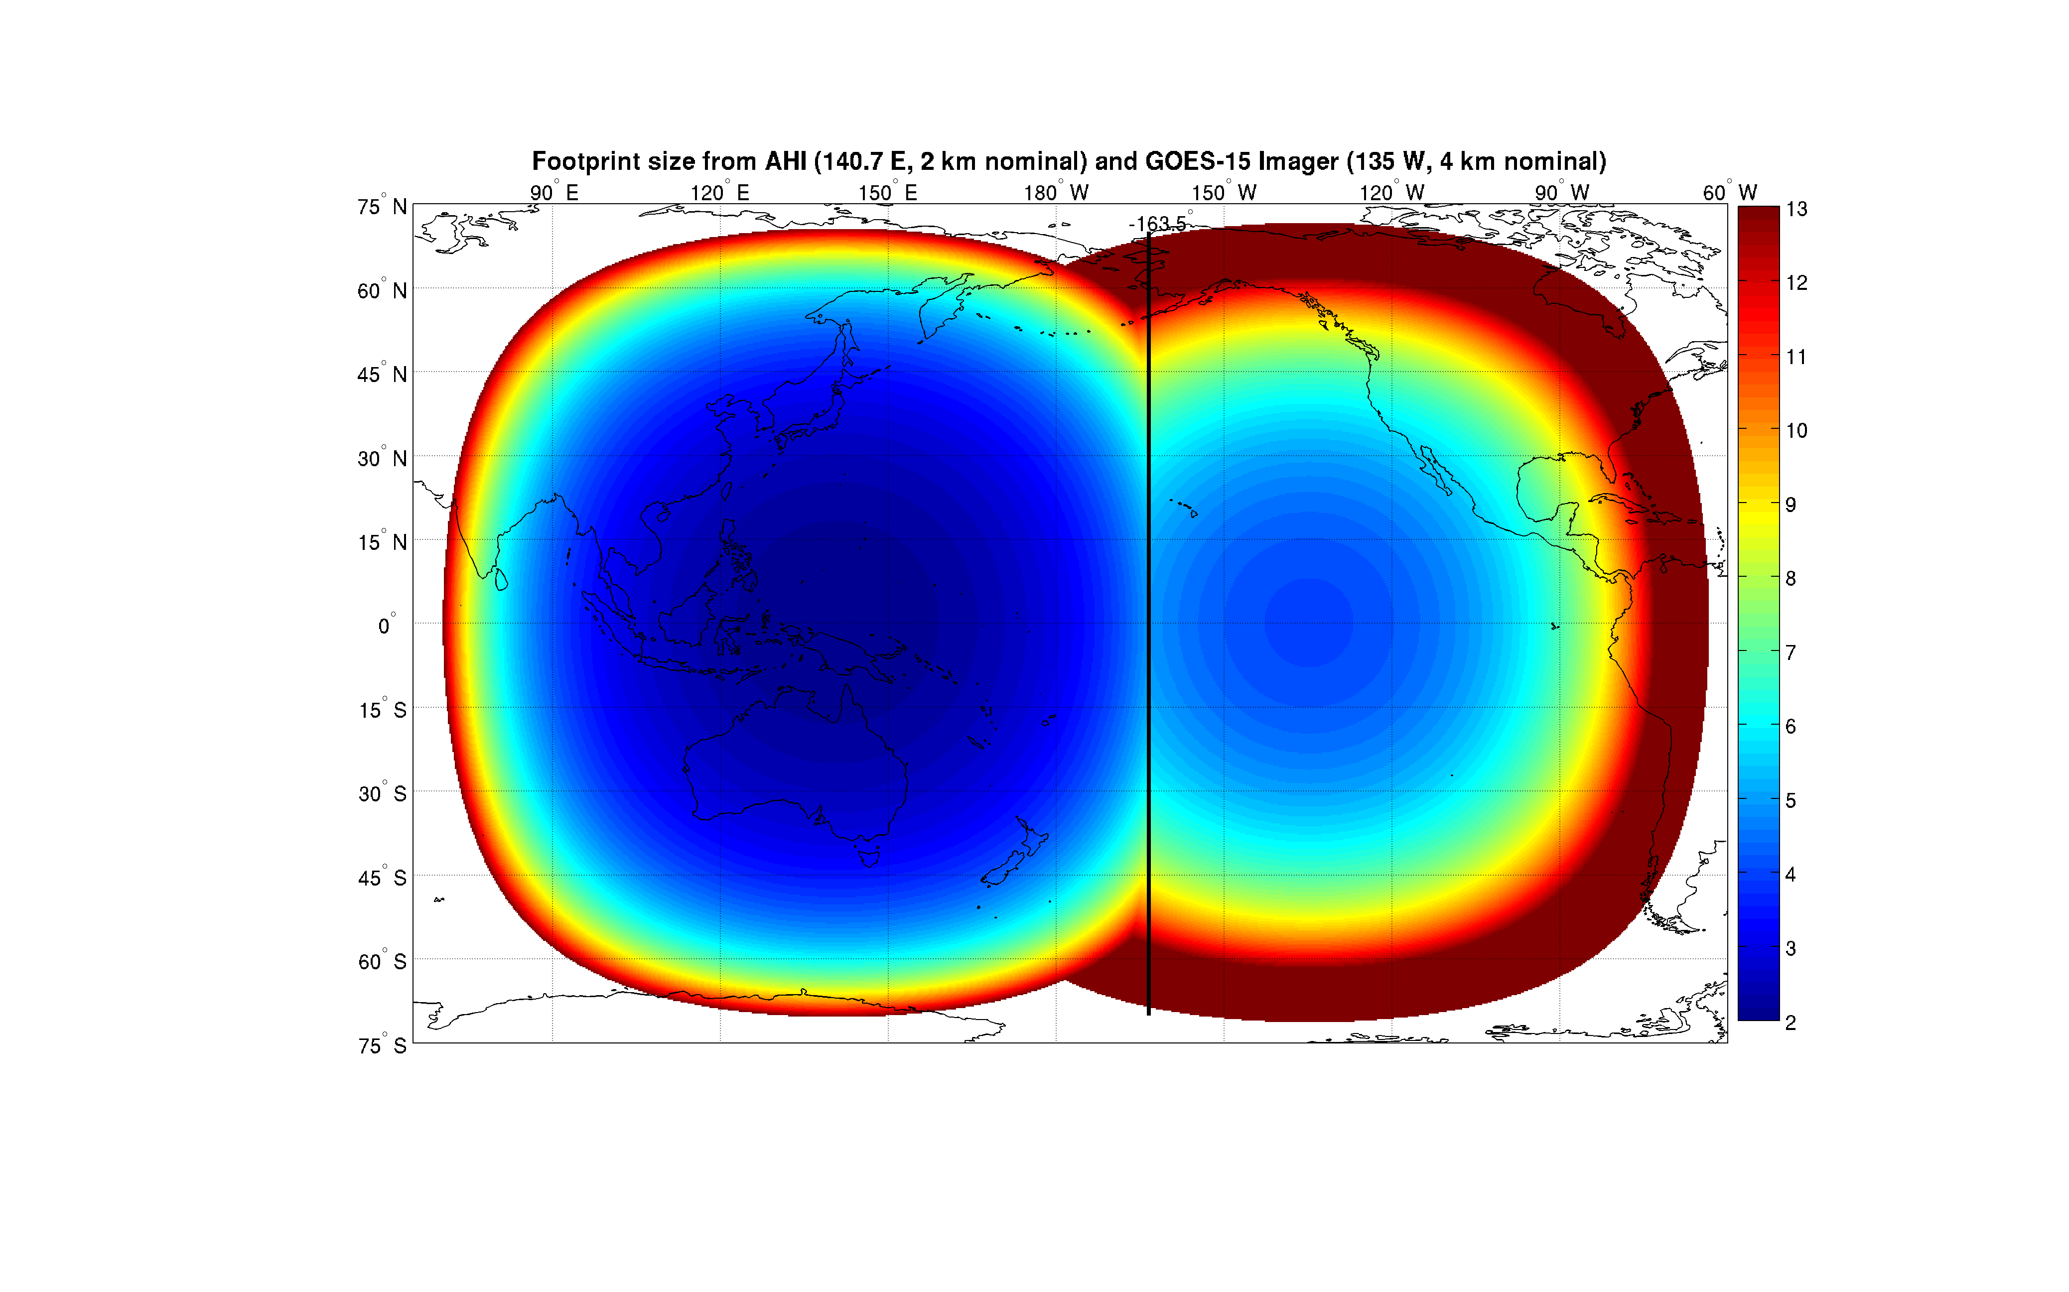
163.5° West

Slide 19
163.5° West Meridian of equal footprint size
The satellite that provides the best zenith angle may not provide the best spatial resolution.
163.5° West is 28.5° from GOES-15, but 55.8° from Himawari-8. The midpoint between GOES-15 and Himawari-8 is 177.2° West.

Slide 20
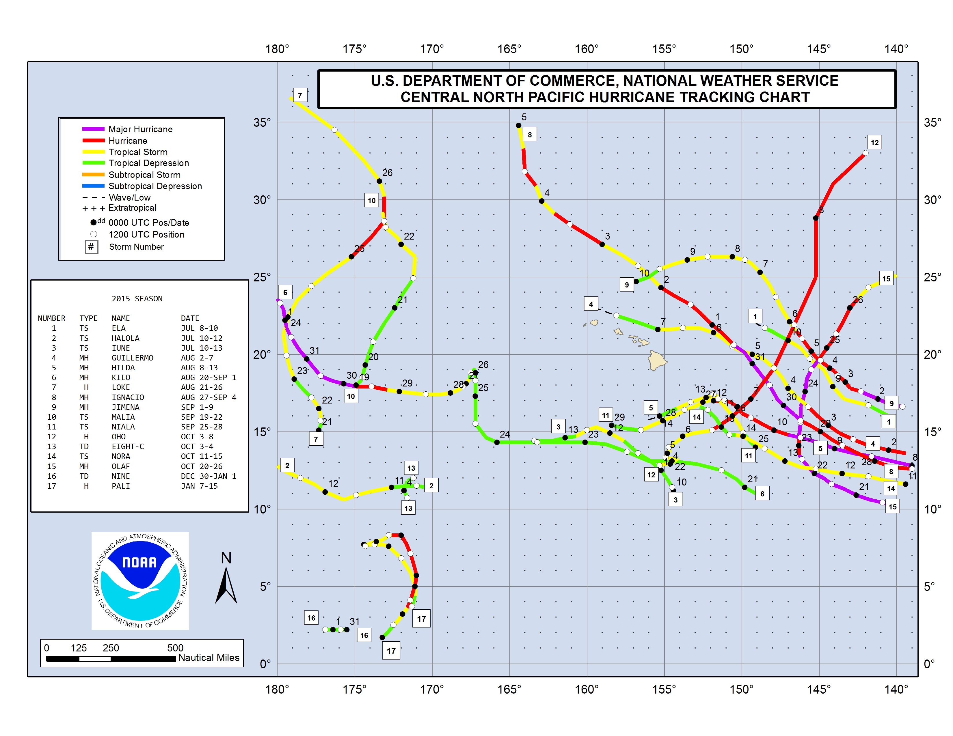
Better view angle from GOES-15;
Better resolution from Himawari-8
H8
G15 G15 G15 G15 G15 G15 G15 G15 G15 G15

Slide 21
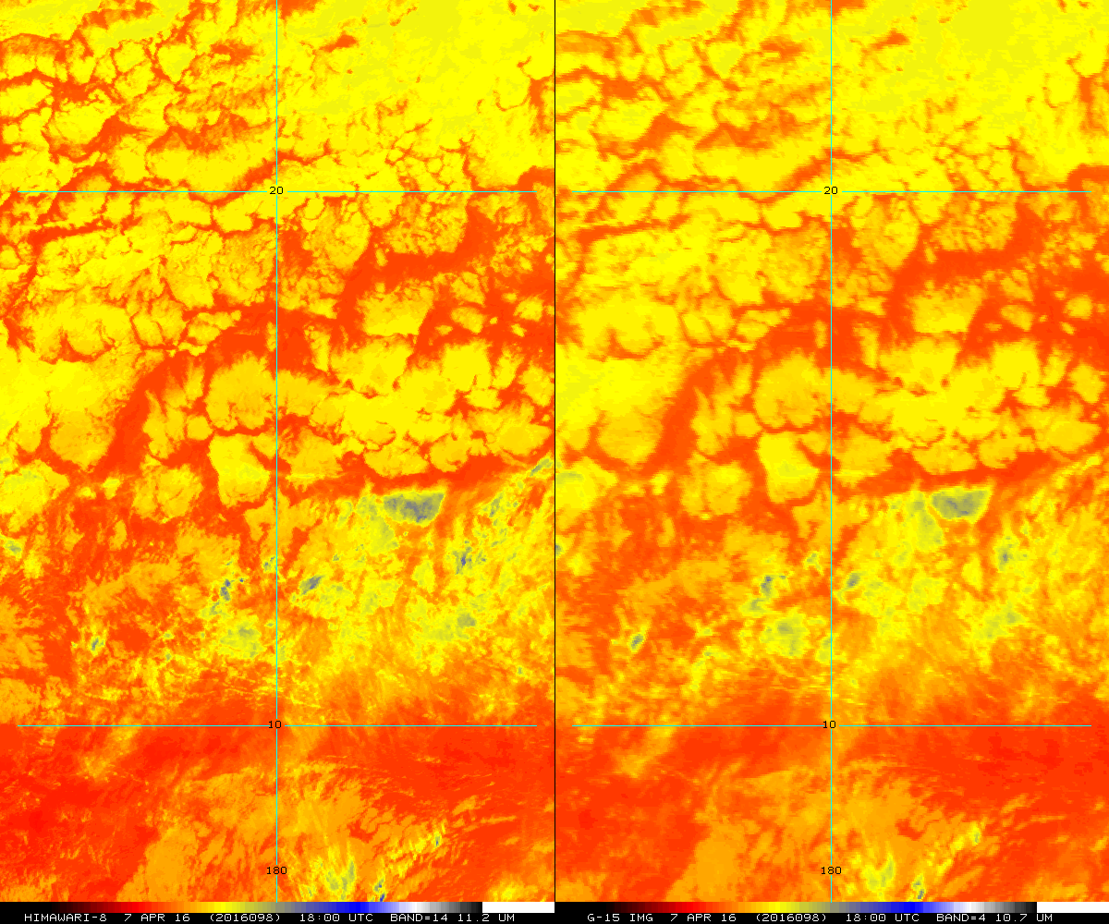
Himawari-8
11.2 μm
GOES-15
10.7 μm
180°
180°
T. Schmit

Slide 22
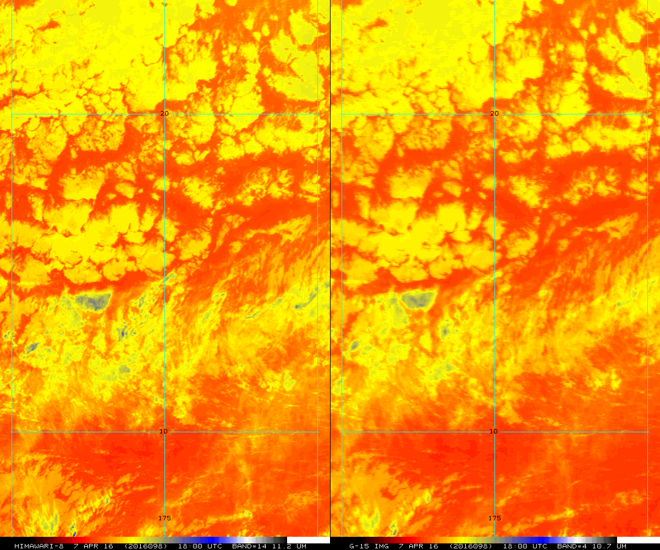
Himawari-8
GOES-15
175° W
175° W
T. Schmit

Slide 23
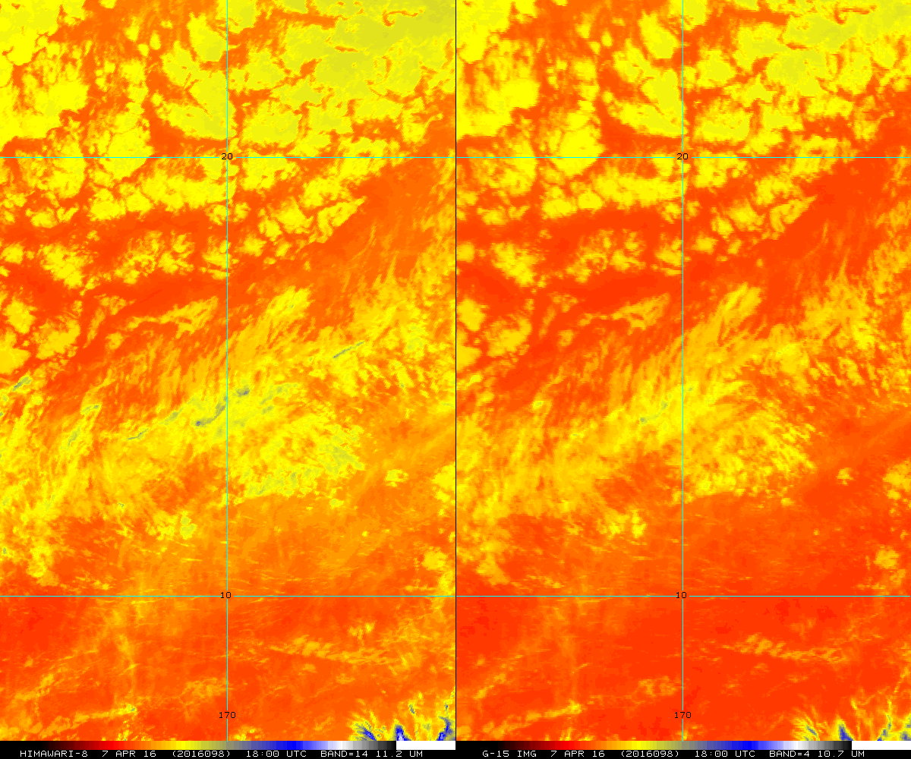
Himawari-8
GOES-15
170° W
170° W
T. Schmit
Notes:
170W
BATCH AHI_GOESWEST_REMAP2.BATCH
PANEL 1 2
PANEL: Done
IMGREMAP HIMAWARI/FD A.9682 TIME=18 DAY=2016098 BAND=14 LATLON=15 170 PRO=MERC RES=2>
Beginning Image Data transfer, bytes= 599680
IMGREMAP: transformations complete ... begin data move
Transferring AREA data outbound, bytes= 1000928
IMGREMAP: Done...
IMGREMAP WESTL/FD A.9681 TIME=18 DAY=2016098 LATLON=15 170 PRO=MERC RES=2 BAND=4 S>
Beginning Image Data transfer, bytes= 335076
IMGREMAP: transformations complete ... begin data move
Transferring AREA data outbound, bytes= 1000928
IMGREMAP: Done...
IMGDISP A.9682 PANEL=1 LATLON=15 170 GRAY=YES
Beginning Image Data transfer, bytes= 600928
IMGDISP: loaded frame 23
IMGDISP: done
IMGDISP A.9681 PANEL=2 LATLON=15 170 GRAY=YES
Beginning Image Data transfer, bytes= 600928
IMGDISP: loaded frame 23
IMGDISP: done
MAP PAN=1
MAP: Completed frame 23
MAP PAN=2
MAP: Completed frame 23
MAP X X LALO INT=10 10 PAN=1 LIN=1 977
MAP: Completed frame 23
MAP X X LALO INT=10 10 PAN=2 LIN=1 977
MAP: Completed frame 23
FRMLABEL PAN=1 "(STYPE) (DAY) ((JDAY)) (HHMM) UTC BAND=(BAND) (WL)
FRMLABEL: Done
FRMLABEL PAN=2 "(STYPE) (DAY) ((JDAY)) (HHMM) UTC BAND=(BAND) (WL)
FRMLABEL: Done
SHOWVG 9681 PAN=1
Done
SHOWVG 9681 PAN=2
Done
SHOWVG 9682 PAN=2
Done
EU REST GA20P
EU: Restoring GA20P.ET to frame(s)= 23
EU: Done
GU MAKE 4 BLACK
GU: Done
GU MAKE 5 BLACK
GU: Done
GU MAKE 7 BLACK
GU: Done
FRMSAVE X AHI_WEST_REMAP_15_170_14_4
Frame saved in /crc1/cimss/tims/gifs/AHI_WEST_REMAP_15_170_14_4.GIF
BATCH: BATCH done /home/tims/mcidas/data/AHI_GOESWEST_REMAP2.BATCH

Slide 24
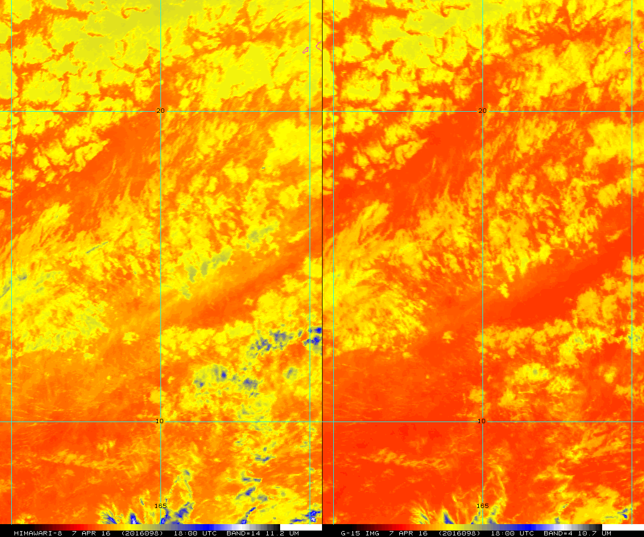
Himawari-8
GOES-15
165° W
165° W
T. Schmit

Slide 25
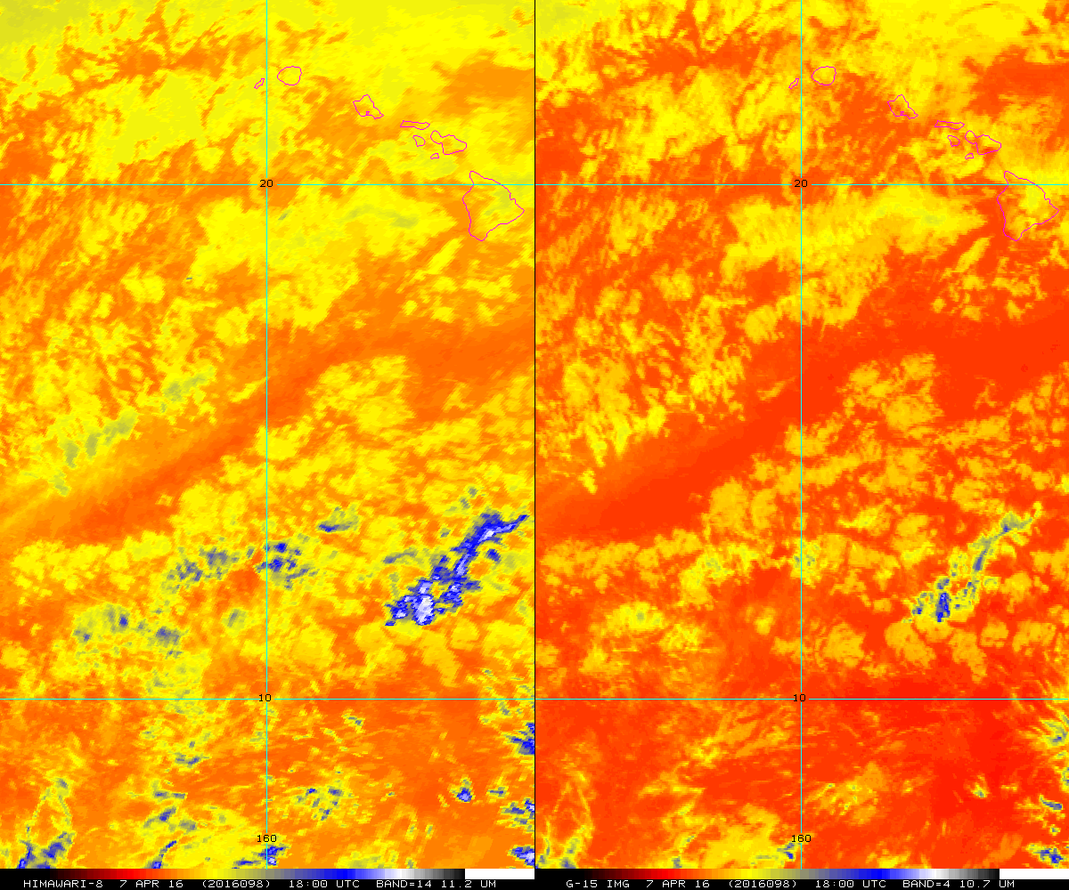
Himawari-8
GOES-15
160° W
160° W
T. Schmit
Notes:
160W
BATCH AHI_GOESWEST_REMAP2.BATCH
PANEL 1 2
PANEL: Done
IMGREMAP HIMAWARI/FD A.9682 TIME=18 DAY=2016098 BAND=14 LATLON=15 160 PRO=MERC RES=2>
Beginning Image Data transfer, bytes= 470752
IMGREMAP: transformations complete ... begin data move
Transferring AREA data outbound, bytes= 1000928
IMGREMAP: Done...
IMGREMAP WESTL/FD A.9681 TIME=18 DAY=2016098 LATLON=15 160 PRO=MERC RES=2 BAND=4 S>
Beginning Image Data transfer, bytes= 368032
IMGREMAP: transformations complete ... begin data move
Transferring AREA data outbound, bytes= 1000928
IMGREMAP: Done...
IMGDISP A.9682 PANEL=1 LATLON=15 160 GRAY=YES
Beginning Image Data transfer, bytes= 600928
IMGDISP: loaded frame 25
IMGDISP: done
IMGDISP A.9681 PANEL=2 LATLON=15 160 GRAY=YES
Beginning Image Data transfer, bytes= 600928
IMGDISP: loaded frame 25
IMGDISP: done
MAP PAN=1
MAP: Completed frame 25
MAP PAN=2
MAP: Completed frame 25
MAP X X LALO INT=10 10 PAN=1 LIN=1 977
MAP: Completed frame 25
MAP X X LALO INT=10 10 PAN=2 LIN=1 977
MAP: Completed frame 25
FRMLABEL PAN=1 "(STYPE) (DAY) ((JDAY)) (HHMM) UTC BAND=(BAND) (WL)
FRMLABEL: Done
FRMLABEL PAN=2 "(STYPE) (DAY) ((JDAY)) (HHMM) UTC BAND=(BAND) (WL)
FRMLABEL: Done
SHOWVG 9681 PAN=1
Done
SHOWVG 9681 PAN=2
Done
SHOWVG 9682 PAN=2
Done
EU REST GA20P
EU: Restoring GA20P.ET to frame(s)= 25
EU: Done
GU MAKE 4 BLACK
GU: Done
GU MAKE 5 BLACK
GU: Done
GU MAKE 7 BLACK
GU: Done
FRMSAVE X AHI_WEST_REMAP_15_160_14_4
Frame saved in /crc1/cimss/tims/gifs/AHI_WEST_REMAP_15_160_14_4.GIF
BATCH: BATCH done /home/tims/mcidas/data/AHI_GOESWEST_REMAP2.BATCH

Slide 26
Dvorak: The “Digital” Printout
Dvorak, Satellite Applications Laboratory, September 1984

Slide 27
ABI Infrared Window Bands
10.7 μm
The spectral response functions are similar for the AHI bands. The red bar is current GOES.

Slide 28
AHI 8.6 μm vs. GOES-15 IR Window
Kilo, 0 UTC 24 August 2015

Slide 29
AHI 10.4 μm vs. GOES-15 IR Window
Kilo, 0 UTC 24 August 2015

Slide 30
AHI 11.2 μm vs. GOES-15 IR Window
Kilo, 0 UTC 24 August 2015

Slide 31
AHI 12.4 μm vs. GOES-15 IR Window
Kilo, 0 UTC 24 August 2015

Slide 32
TS Pali, 8 January 2016
Approximately 7° N, 172° W
GOES-15
10.7 μm
Himawari-8
10.4 μm
S. Bachmeier

Slide 33
Dvorak Considerations
The Dvorak technique was conceived in an era of 8 km resolution infrared window imagery.
Locally warmer and colder (isolated) pixels will be apparent with AHI and ABI given the 2 km resolution.
There are multiple infrared windows on AHI and ABI. The 10.4 μm band is the “cleanest”, and therefore “warmest”.
As zenith angles increase, brightness temperatures will almost always decrease.

Slide 34
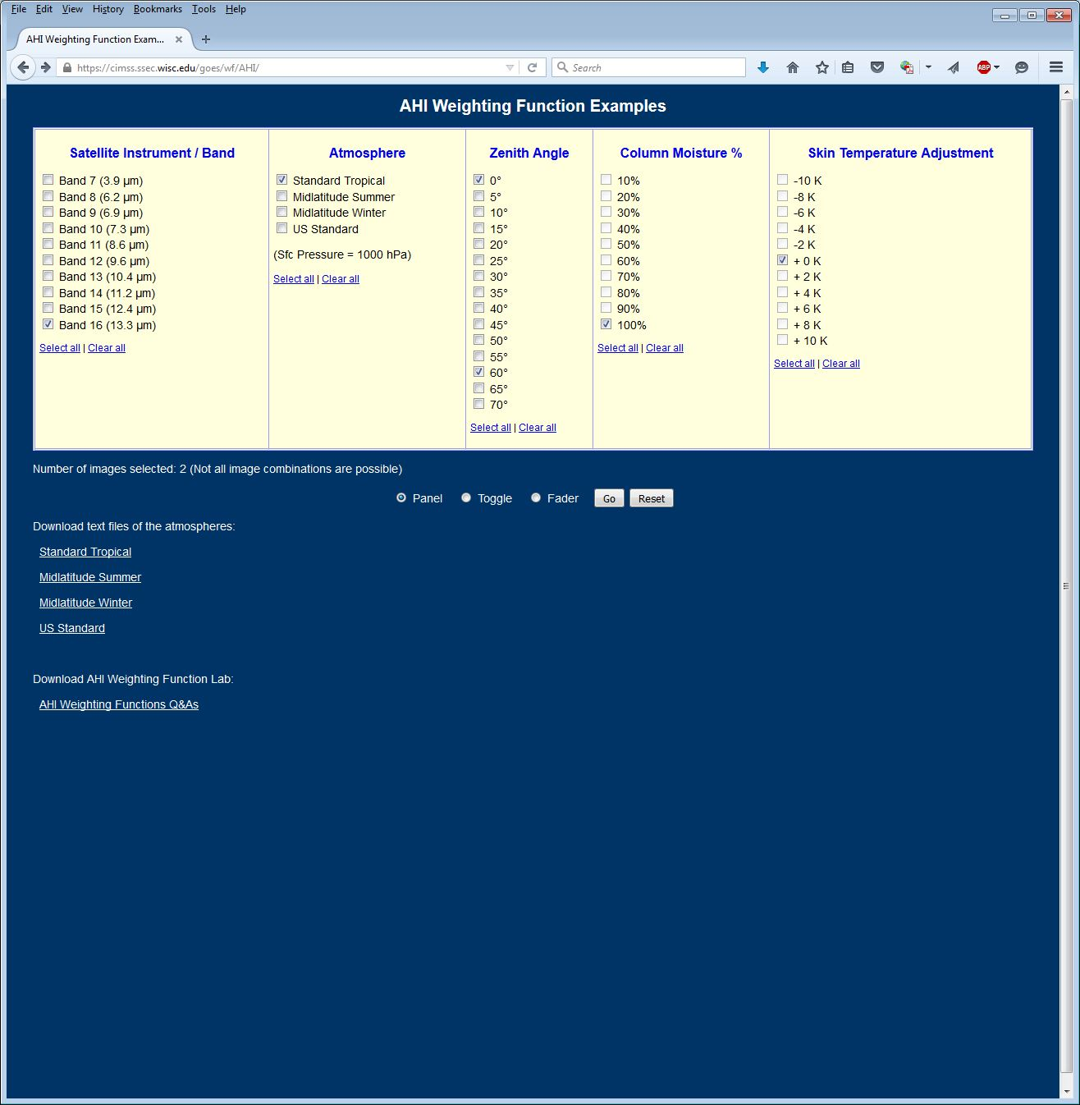
AHI Clear-Sky Weighting Functions

Slide 35
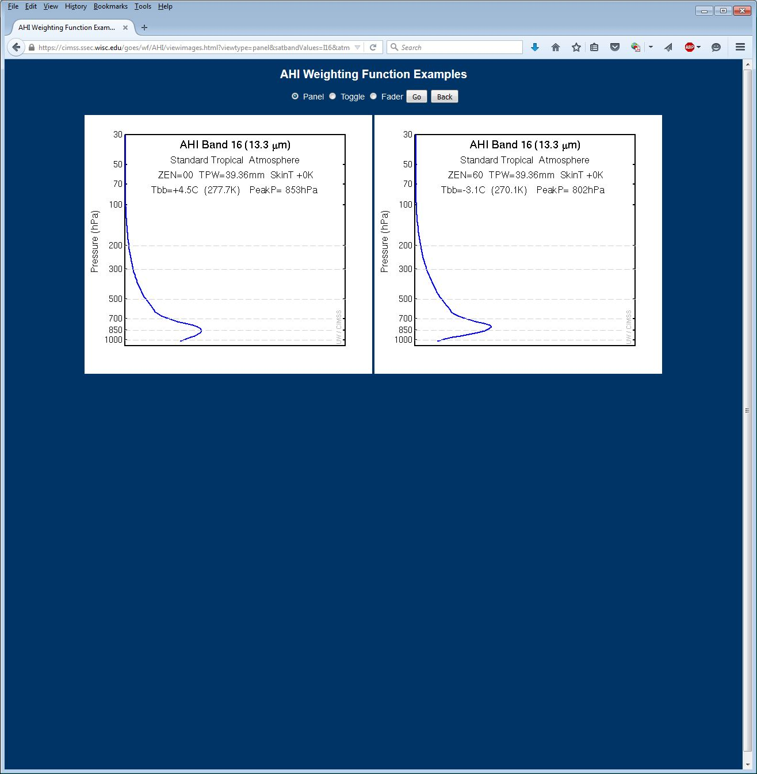
Also online: http://cimss.ssec.wisc.edu/goes/wf/AHI/

Slide 37
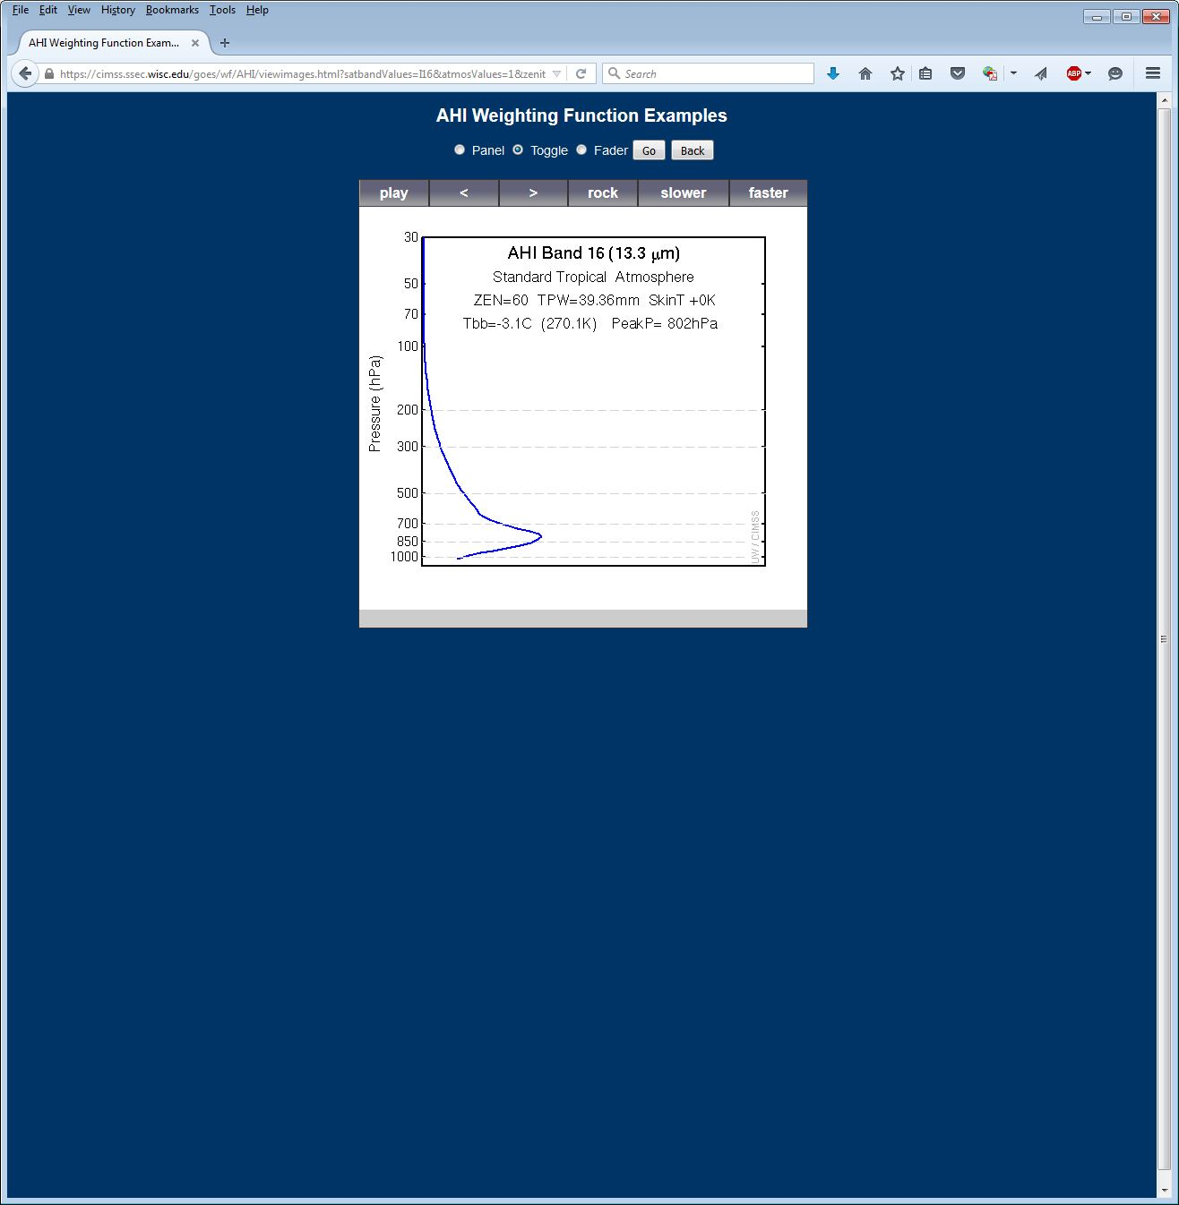

Slide 38
Band 10 BT Dependence on Moisture

Slide 39
BT Difference vs. TPW
Not linear

Slide 40
BT Difference vs. TPW
Not linear

Slide 41
Split Window Difference
“12.4 μm – 10.4 μm”difference compared to 925 hPa GFS dew point field (K)

Slide 42
Band 12 BT Dependence on Moisture

Slide 43
Band 12 BT Dependence on Ozone

Slide 44
Band 12 BT: 1 °C

Slide 45
Surface Temperatures Matter
Unless the surface is completely obscured by an actively emitting molecular species, the brightness temperature is impacted by the temperature of the surface
Changes to temperature of land surfaces readily observable in window bands
Water temperatures can change rapidly as well depending on the sea state
Surface emissivity matters as well, but it is not a major consideration in the infrared.
Surface emissivity is fairly uniform over water.

Slide 46
Band 13 BT: 24 °C

Slide 47
Matching Weighting Function Profiles

Slide 48
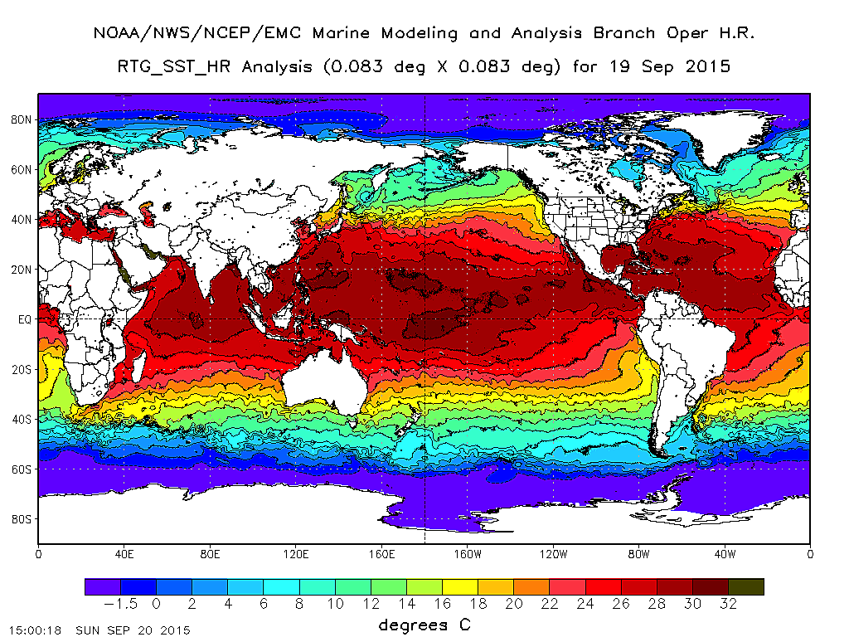

Slide 49
What if our estimate was wrong?
More water vapor
Cooler brightness temperature
Warmer surface temperature
Warmer brightness temperature
It could also be right for the wrong reason!
Check other bands
What is the “cleanest” infrared window band?
How might you use multiple window bands?

Slide 50
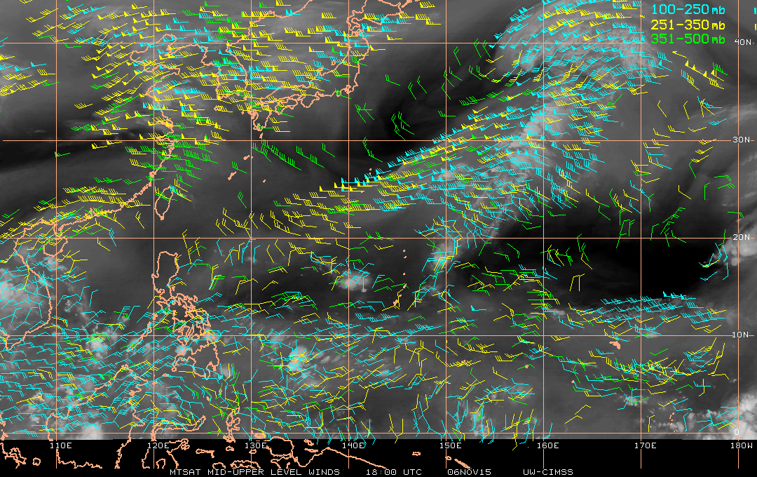
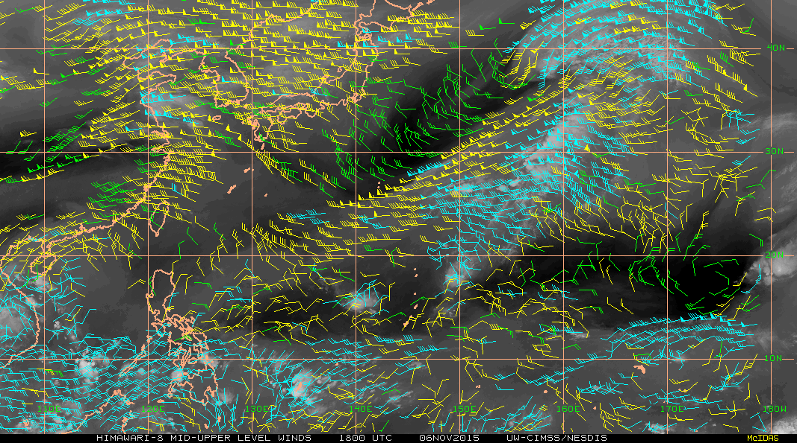
Legend
MTSAT AMVs
Himawari AMVs
Figures from Chris Velden

Slide 51
Red-Green-Blue (RGB) Composites
An introduction to creating RGB composites with AHI
Clear-sky
Green band “boosted” with AHI Band 4 in this animation

Slide 52
Why do we have to “boost” green?
The grass is “greener”
when it is almost yellow.

Slide 53
Red-Green-Blue (RGB) Lexicon
True color image: An image with up to 16,777,216 (24 bits) unique colors
Natural color image: A true color image that depicts the earth from visible red, green, and blue imagery bands, closest to what the human eye would observe, often without atmospheric scattering
False color image: A true color image that depicts the earth with some combination of spectral band imagery, intended to allow a user to easily distinguish one or more atmospheric features

Slide 54
Red-Green-Blue (RGB) Composites
Red-Green-Blue (RGB) composites are a way to visualize multiple bands in one image.
In order to interpret an RGB composite image, you must understand the contribution of the individual bands.
There are practically an infinite number of possible RGBs.
It is possible to display any phenomena in any color.
Don’t be tempted to correlate a feature with a color in your memory.

Slide 55
The Birth of an RGB Composite
Scale a range of values for a single band from 0 to 1
Create a triplet at each pixel, where each of the three bands contributes a value to the triplet
The triplet is in the order of the additive primary colors for display purposes
(Red, Green, Blue)
The triplet (1, 0, 0) is red, (0, 1, 0) is green, (0, 0, 1) is blue, (0, 0, 0) is black, and (1, 1, 1) is white

Slide 56
RGB Color Space as a Cube
Source: https://en.wikipedia.org/wiki/RGB_color_space

Slide 57
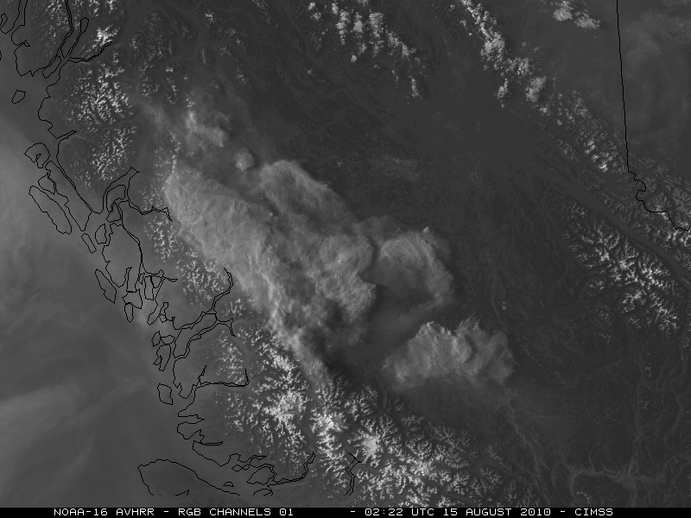
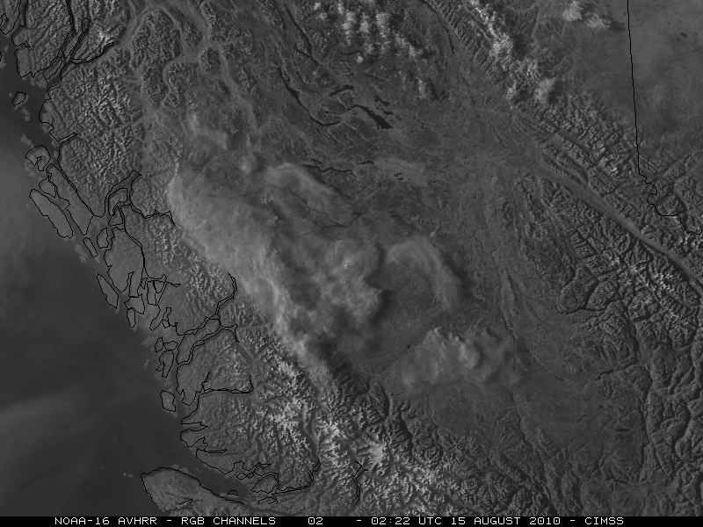
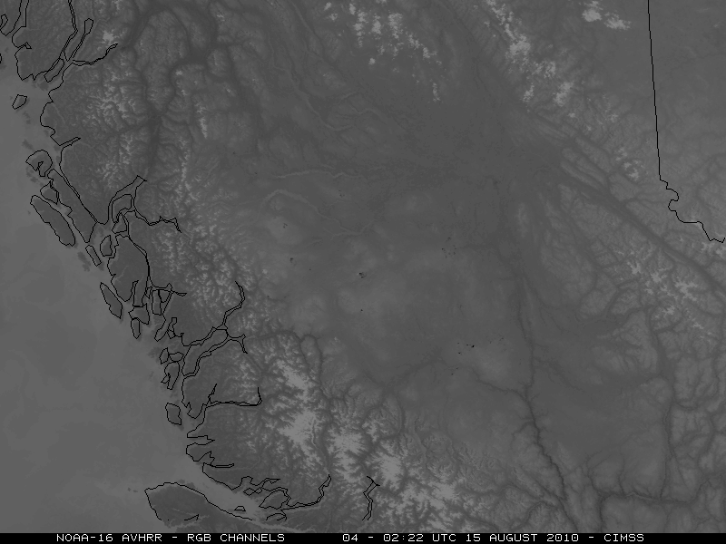
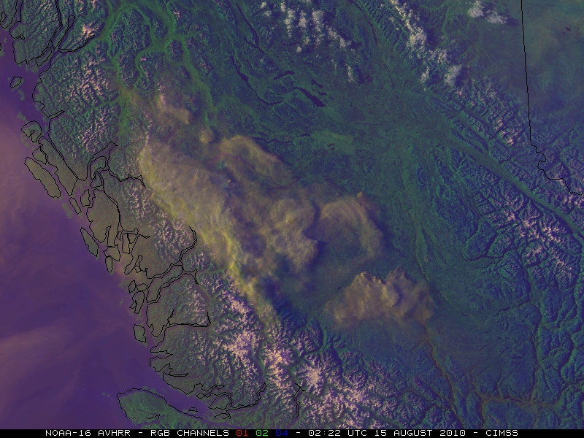
AVHRR example courtesy of Scott Bachmeier, CIMSS
1 2
4 C

Slide 58
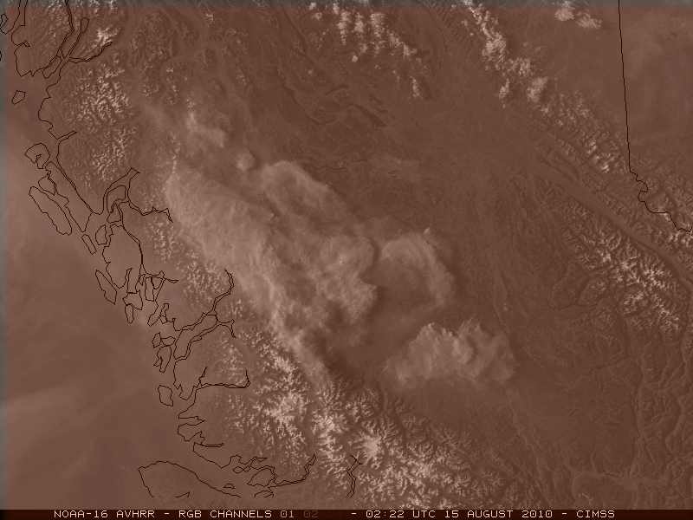
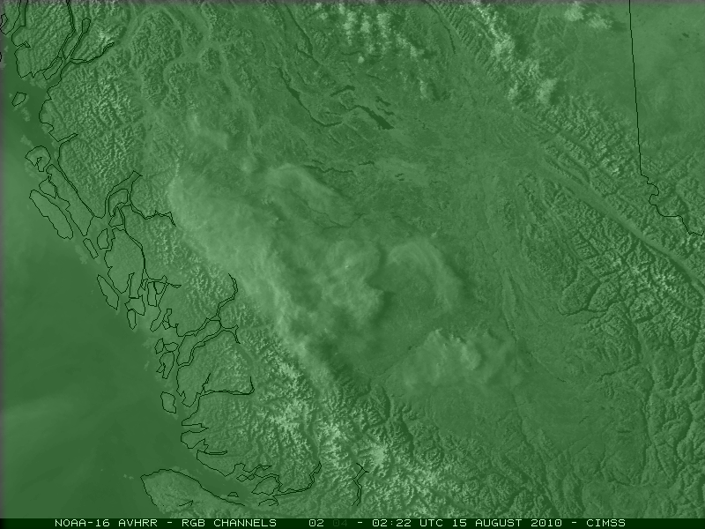
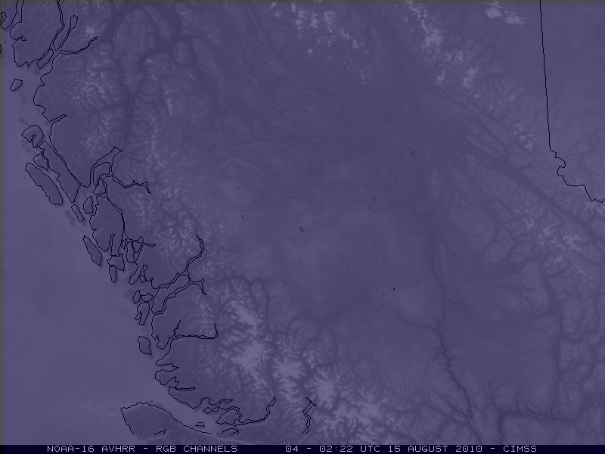
AVHRR example courtesy of Scott Bachmeier, CIMSS
1 2
4 C

Slide 59
“Webapp” Lab Cases from AHI
Guam case from
21 April 2015
This web page is also online: http://cimss.ssec.wisc.edu/goes/webapps/satrgb/overview_ahi.html

Slide 60
Example Case
Objective:
Create an RGB composite using visible and infrared bands that allows for more easily delineating between high cloud and low cloud
Consider physical and radiative properties of clouds:
High clouds are cold, but sometimes optically thin
Low clouds are warm, but usually opaque
Low clouds are obscured by water vapor in deep moisture environments

Slide 61
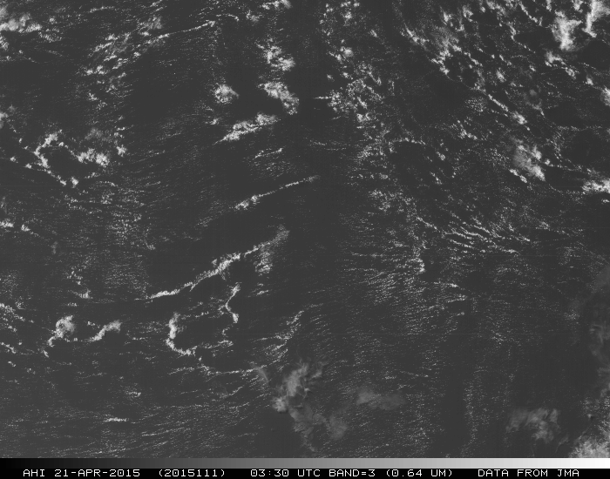
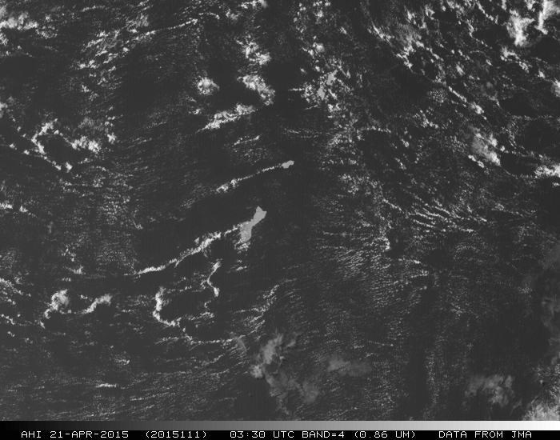
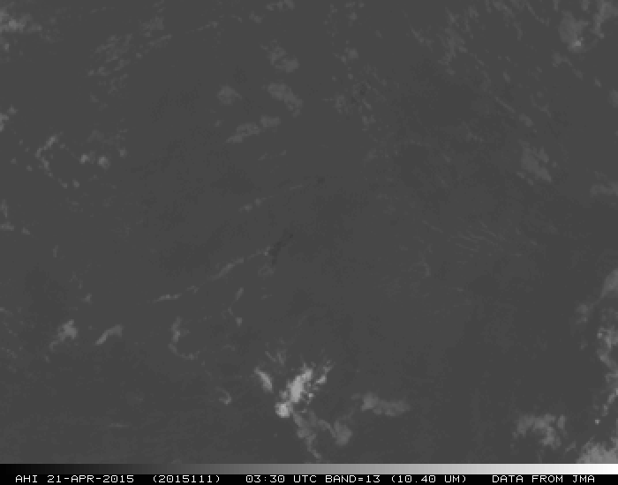
0.64 μm
0.86 μm
10.33 (10.4) μm

Slide 62
Questions
Consider the three bands that contributed to the RGB composite in answering the question below.
0.64 μm, 0.86 μm, and 10.33 μm
Why is Guam colored yellowish green?
Why are cumulus clouds yellow?
Why are high clouds periwinkle?
Why is the ocean navy?
What might look white?

Slide 63
RGB Composite Color Matrix
 | 0.64 μm | 0.86 μm | 10.33 μm | RGB Color
Guam land surface | Notable | Bright | Very warm | Yellowish Green
Cumulus clouds | Bright | Bright | Warm | Yellow
Cirrus clouds | Notable | Notable | Cold | Periwinkle
Ocean | Dark | Dark | Warm | Navy
0.64 μm
0.86 μm
10.33 (10.4) μm

Slide 64
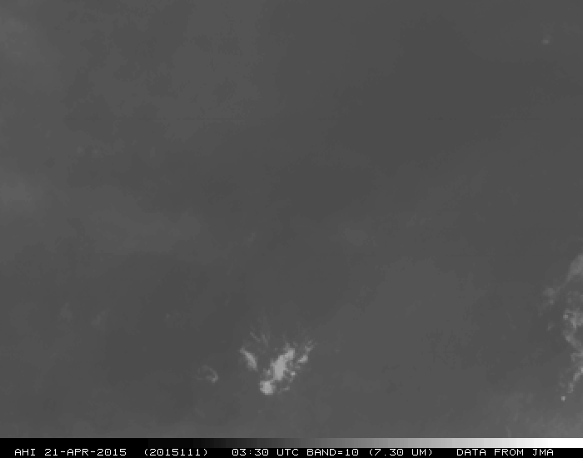
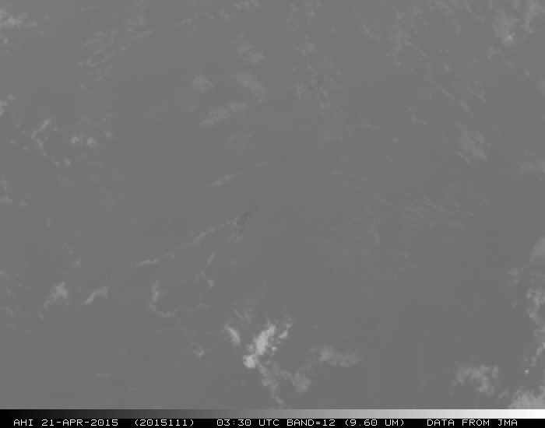
Questions
What if we want to create a composite that makes land surfaces less evident but still makes it easy to discriminate between cumulus clouds and cirrus clouds?
What band(s) do we remove from the composite?
What band(s) do we add to the composite?
Hints:

Slide 65
0.64 μm
7.3 μm
9.6 μm

Slide 66
Critical Takeaways
RGB composites do not show you “more” than the individual bands
When in doubt, review the individual bands
For any three unique bands, there are six ways to combine them into an RGB composite
Some may be more visually appealing than others, but one is not more scientifically valid than the others
Generally, start with lower wavelengths in red and transition to higher wavelengths in blue

Slide 67
RGBs Available in AWIPS II
“Daytime Microphysics”
0.86 μm red, 3.9 μm green, and 10.4 μm blue
“Clouds Convection”
0.86 μm red, 0.86 μm green, and 10.4 μm blue
“Natural Colors” (?)
1.6 μm red, 0.86 μm green, and 0.64 μm blue
“Day Snow-Fog”
0.86 μm red, 1.6 μm green, and 3.9 μm blue
“True Color”
0.64 μm red, 0.51 μm green, and 0.47 μm blue

Slide 68
Other RGB Considerations
Using a band difference in place of a single band for a component of the RGB composite
Air mass RGB
Adjusting the ranges for one or more bands
Exchange the maximum and minimum values (reverse the color gradient)
Adjusting the scaling for one or more bands
Linear
Gamma

Slide 69
RGB Composites Lab
Can you create an RGB composite that…
…improves detection of aerosols and dust?
…highlights volcanic ash?
…helps depict air masses surrounding a tropical cyclone undergoing extratropical transition?
…enhances low-level moisture?
…eases ability to discriminate deep convection from fair weather cirrus?
What other RGB composites might be helpful?

Slide 70
Questions? Comments?
Super Typhoon Maysak as viewed from Himawari-8
Credit: Scott Lindstrom
Ask questions, or send me an e-mail afterwards:
Jordan.Gerth@noaa.gov

